Slide 1
SS-ECHS DATA PRESENTATION
Coding Students for Better Data Collection by Rich McMillan

Slide 2
Agenda
Overview of K-12 Data Collection System
Student Reporting and the District Data Coordinator
Program Service Codes
What Must Be Done

Slide 3
Introduction
Student-level personally-identifiable information data is regularly collected by K-12 school districts, through the use of a statewide data collection system.
This system of data collection is more secure and accurate than the currently used system to collect data using Excel spreadsheets and the GoAnywhere data portal at NYSED

Slide 4
Student Information Repository System (SIRS)
“The New York State Student Information Repository System (SIRS) provides a single source of standardized individual student records for analysis at the local, regional, and State levels to improve student performance and to meet State and federal reporting and accountability requirements:” SIRS (nysed.gov)

Slide 5
LEVEL 2 Reports (L2RPT)
“Level 2 Reports (L2RPT) reflect statewide (Level 2) data in the Student Information Repository System (SIRS):” NYSED :: IRS :: L2RPT Level 2 Report Resources and Information
L2RPT reports are designed to help districts verify a variety of data, including data reported for program assessment and management by NYSED’s OPASS which administers SS-ECHS.
**It is recommended that you contact your District Data Coordinator for additional information regarding the SIRS deadlines and processes for reviewing and certifying the accuracy of these data sets (L2RPT reports). Additional information related to the verification of SIRS data can be found at this location.

Slide 6
Reporting Smart Scholars’ Students in the SIRS Program
To ease some of the reporting requirements on the part of school districts in the future, all Smart Scholars (SS-ECHS) grantees will be required to report program service records to the New York State (NYSED) Student Information Repository System (SIRS) for all students enrolled in a Smart Scholars (SS-ECHS) program.
For Smart Scholars (SS-ECHS), the program service code is 4037, and is collected in the SIRS Program Fact template.
The Department has developed reports for school districts to review their SIRS submitted grant data. The SIRS 602 and 603 reports can be accessed in your district’s Cognos environment. Reach out to your data coordinator for assistance.

Slide 7
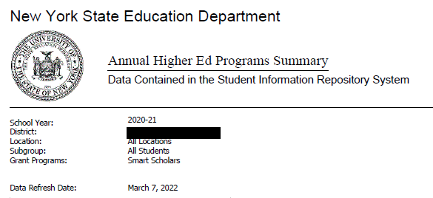
Reviewing Your Data In a COGNOS Environment

Slide 8
Reviewing Your Data In a COGNOS Environment

Slide 9
What must be done?
Currently, not all Smart Scholars’ students are properly coded.
Smart Scholars project directors or data reporters must contact their DDCs to:
Advise of this new need for Smart Scholars’ students to be properly coded; and
Provide a current list of Smart Scholars’ students to DDC for proper coding.

Slide 10
Communicative strategy
DDCs are VERY busy, and they are ESSENTIAL to our data efforts with Smart Scholars, so we must always be considerate of them and careful with the demands placed on them.
ONLY the DDCs can properly code the students in the data systems.
The DDCs likely have no easy way to determine which students are participating in Smart Scholars on their own, so the assistance of the project directors/data reporters is essential for the DDCs to ‘get it right’ and code all program students accurately.

Slide 11
ITS UP TO YOU
Because DDCs are not compensated directly by OPASS at NYSED, we must ask you, our project directors, working contractually for OPASS, to develop, nurture, and maintain good working relationships with the DDCs on your campuses.
It is up to you to provide them accurate and current information to identify your program students, so your DDC can code them properly and in a timely manner.
If a student is not coded, that student will not exist in the data reported to OPASS from the L2 data system.

Slide 12
Thank you for your fantastic efforts on behalf of our student community!
Please contact me, Rich McMillan, with any questions or comments.
Information included in this presentation from the New York State Student Information Repository System (SIRS) Manual, Version 17.12, dated April 1, 2022.

Slide 13
Thank you
Rich McMillan
Richard.McMillan@NYSED.GOV

