Slide 1
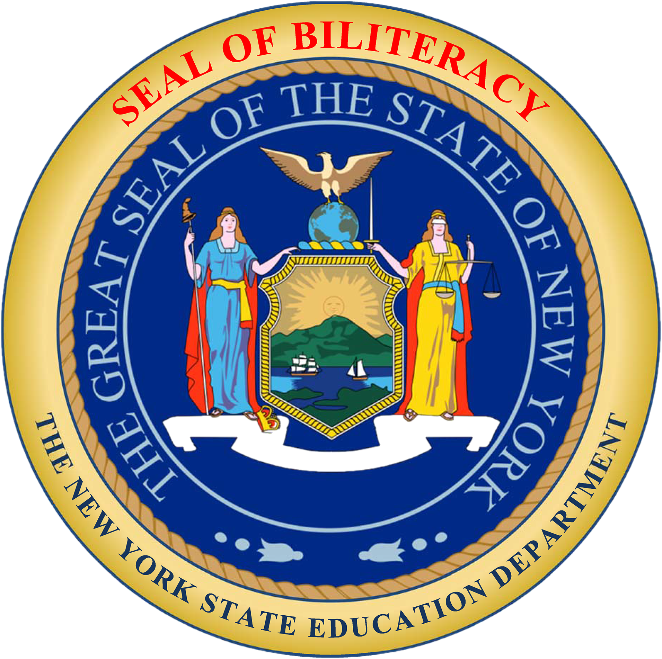
The New York State Seal of Biliteracy (NYSSB)
(School District)
(Date of meeting, Names of Presenters

Slide 2

Who are the members of the SBC?
(List names and titles of each SBC Committee member)

Slide 3
THE NYSSB
The NYSSB is an award given by a school, school district or county office of education that formally recognizes students who have attained a high level of proficiency in two or more world languages (one of which must be English) by high school graduation.
Notes:
The Seal of Biliteracy is an award given by a school, school district or county office of education that formally recognizes students who have attained a high level of proficiency in two or more world languages (one of which must be English) by high school graduation.

Slide 4

THE NYSSB
The NYSSB is awarded by the Commissioner to students who meet the criteria established by the New York State Board of Regents and who attend schools that voluntarily agree to participate in the program.
The NYSSB is affixed to the student’s high school diploma and transcript and must be made available to students at no cost.
Notes:
The NYSSB is awarded by the Commissioner to students who meet the criteria established by the Board of Regents and who attend schools that voluntarily agree to participate in the program.
The NYSSB must be made available to all students who meet the required criteria at no cost to the student.

Slide 5
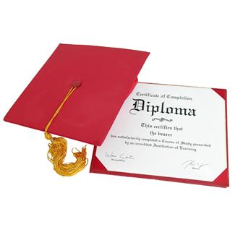
THE NYSSB
The NYSSB is affixed to the student’s diploma and is noted on the student’s official high school transcript and on the graduation program.
Notes:
The NYSSB sticker, provided by NYSED to schools at no charge each year, is affixed to the student’s diploma and is noted on the student’s official high school transcript and on the graduation program.

Slide 6

WHY OFFER THE NYSSB?
The NYSSB acknowledges the importance of being bilingual in today’s global society.
The NYSSB highlights the hard work and achievement of students and encourages them to pursue language study while in school.
The recognition of attaining biliteracy becomes part of the high school transcript and diploma as a statement of accomplishment for future employers and for college admission.
Notes:
So now that we know what the NYSSB is, let’s talk about why New York offers the Seal of Biliteracy.
The NYSSB acknowledges the importance of being bilingual in today’s global society.
The NYSSB highlights the hard work and achievement of students and encourages them to pursue language study while in school.
The recognition of attaining biliteracy becomes part of the high school transcript and diploma as a statement of accomplishment for future employers and for college admission.

Slide 7

WHY OFFER THE NYSSB?
To encourage the study of languages;
To recognize the value of language diversity;
To prepare students with 21st century skills;
To honor the multiple cultures and languages in a community; and
To positively contribute to the district’s accountability score for ESSA.
Notes:
To encourage the study of languages – Having an NYSSB program has the potential to increase enrollment in upper level world language courses as students see the value in continuing their studies of a world language through high school.
To recognize the value of language diversity – there are over 200 languages spoken by students in New York State. Students can earn the NYSSB in any of these languages.
To provide employers with a method of identifying people with language skills – the demand for a bilingual workforce is on the rise in our increasingly globalized society. Students who develop a proficiency in more than one language will be more marketable.
To provide universities with a method to recognize and give credit to applicants for attainment of high-level skills in multiple languages – The NYSSB uses the nationally recognized ACTFL proficiency levels, which makes it easy for colleges across the nation to evaluate students’ applications.
To prepare students with 21st century skills – The communication skills and cultural competence developed by the NYSSB are essential to effectively work with diverse populations.
To honor the multiple cultures and languages in a community – Because students can obtain the NYSSB in any language, it encourages the development of home language skills, honoring the knowledge of our heritage language students.
Students who earn the Seal of Biliteracy positively contribute to the district’s accountability score for ESSA.

Slide 8
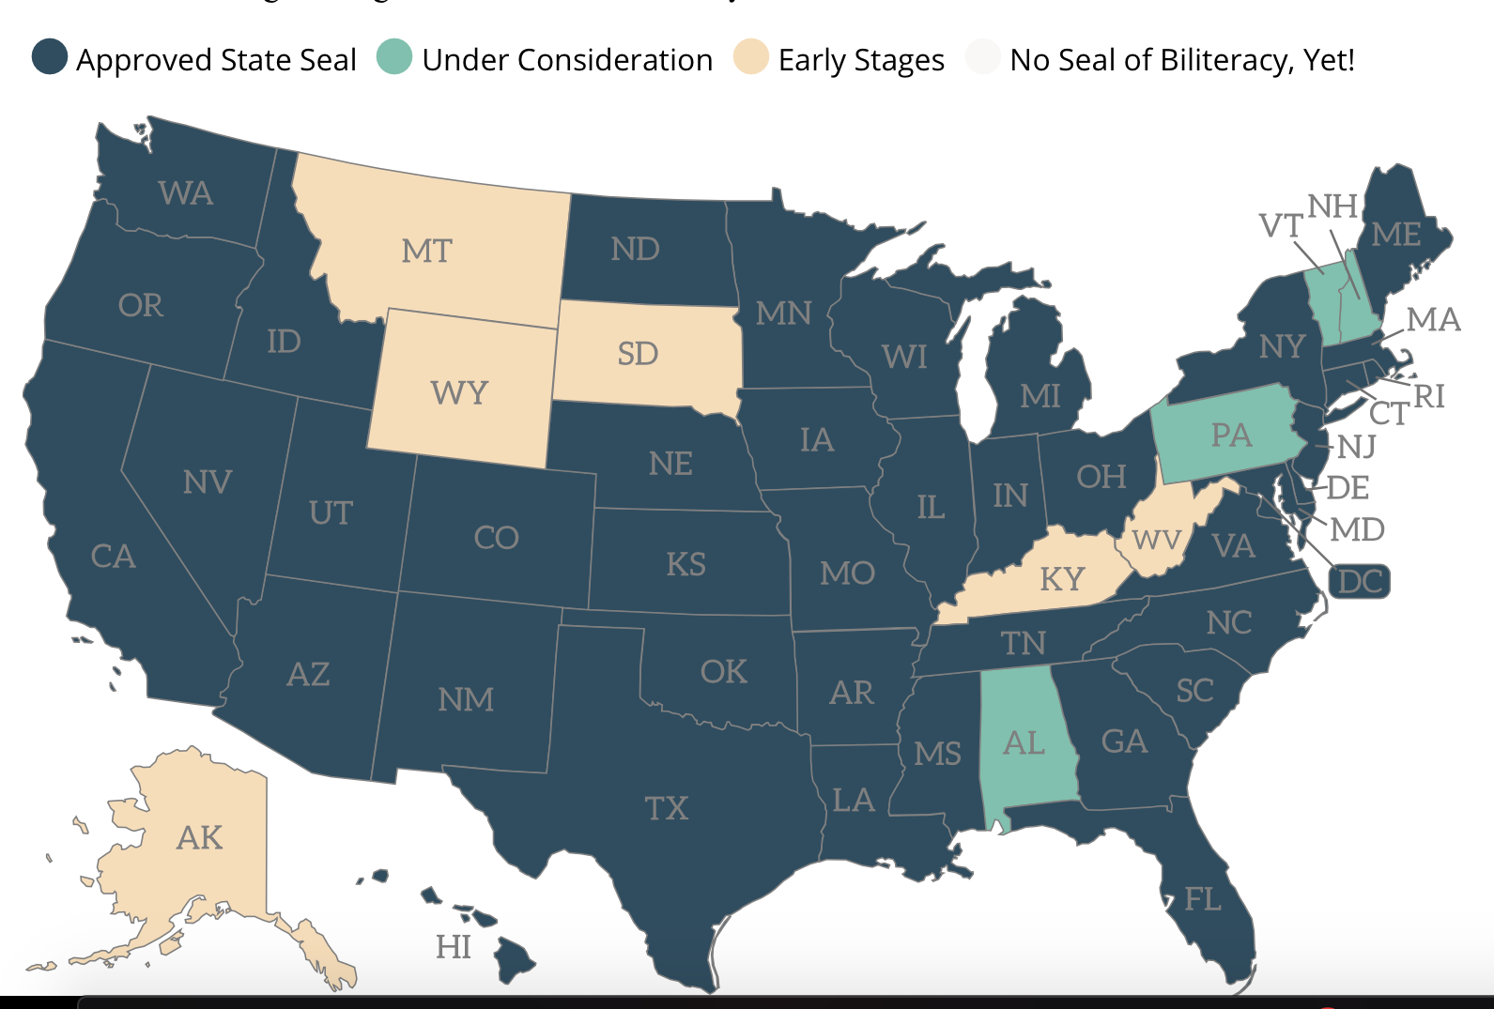
ORIGINS OF THE NYSSB
The Seal of Biliteracy began in California in 2008.
Currently, 40 states plus the District of Columbia offer a State Seal of Biliteracy.
New York was second only to California to adopt this program.
Source: https://sealofbiliteracy.org/
Notes:
40 states plus the District of Columbia currently offer a state-approved Seal of Biliteracy.
California was the first state to establish a Seal of Biliteracy program in 2008, followed by New York in 2012.
More information on Seal of Biliteracy programs in other states can be found on the website sealofbiliteracy.org.

Slide 9

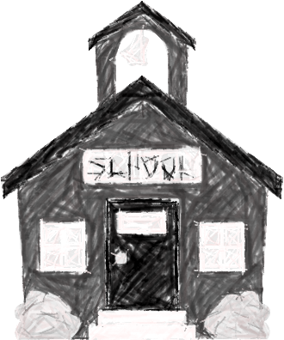
2019-20 NYSSB Statistics
294 schools offered the NYSSB in 2019-20.
That’s one in every five NYS public schools.
Notes:
In 2019-20, there were 294 schools that offered a Seal of Biliteracy program.
This represents 1 in every 5 public high schools in our state.

Slide 10

2019-20 NYSSB Statistics
Growth in the Number of Students Earning the NYSSB
(2015-16 to 2019-20)
Notes:
As with the number of schools offering the NYSSB, we’ve also seen significant growth in the number of students earning the NYSSB each year.
It is important to note that this number increased by more than 500 students from last year despite the COVID-19 related school closures.

Slide 11
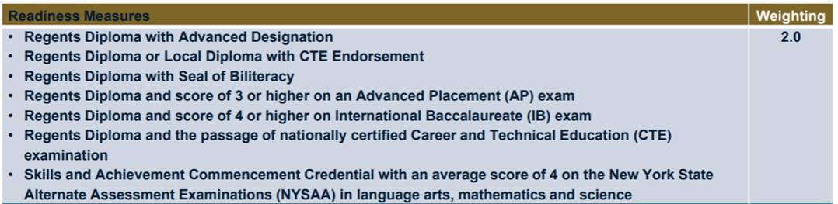
HOW DOES THE Seal benefit our district?
One of the “readiness measures” that are used in the ESSA rating of each school is the number of students who have earned the Seal of Biliteracy.
Notice that this figure has a weighting factor of 2 in the ESSA formula and can significantly increase a school’s score.

Slide 12
Criteria for the nyssb
Complete all requirements for graduating with a NYS Regents diploma
Demonstrate proficiency in English and another language by earning 3 points in each from a choice matrix
Notes:
Let’s now review the criteria for a student to earn the New York State Seal of Biliteracy.
A candidate must complete all requirements for graduating with a NYS Regents diploma and…
…must earn 3 points in English and 3 points in one or more other world languages according the criteria set forth in the Handbook.

Slide 13
Criteria for Demonstrating Proficiency in English | Point Value
1A. Score 80 or higher on the NYS Regents Examination in English Language Arts or ELLs can score 75 or above on two Regents exams other than English, without translation. | 1
1B. ELLs earn an overall score of 290 or above on the NYS English as a Second Language Achievement Test. | 1
1C. Complete all 11th and 12th grade ELA courses with an average of 85 or higher or a comparable score using another scoring system set by the district and approved by the commissioner. | 1
1D. Achieve the following scores on the examinations listed below: - 3 or higher on an Advanced Placement (AP) English Language or English Literature examination. - 80 or higher on all components of the Test of English as a Foreign Language (TOEFL). | 1
1E. Present a culminating project, scholarly essay or portfolio that meets the criteria for speaking, listening, reading, and writing established by the district’s Seal of Biliteracy Committee to a panel of reviewers with at least Intermediate High proficiency in English. | 2
Notes:
Here is the point matrix for English. Students must earn a total of 3 points using any combination of the criteria shown on this page. Each criterion is listed with its corresponding point value.
1A – Students may score 80 or higher on the NYS Regents Examination in English Language Arts; ELLs may also earn a point under this criterion by scoring 75 or above on two Regents Exams other than English without translation.
1B - ELLs may achieve an overall score of 290 or above on the New York State English as a Second Language Achievement Test (NYSESLAT).
1C – Students may complete all 11th and 12th grade ELA courses with an average of 85 or higher.
1D - Students may earn a 3 or higher on an Advanced Placement (AP) English Language or English Literature examination; ELLs may also earn a point under this criterion by scoring an 80 or higher on all components of the Test of English as a Foreign Language (TOEFL).
1E – Students may earn 2 points by presenting a culminating project, scholarly essay or portfolio that meets the criteria for speaking, listening, reading, and writing established by the district’s Seal of Biliteracy Committee to a panel of 2 or more reviewers at the Intermediate High proficiency level or better in English.

Slide 14
Criteria for Demonstrating Proficiency in a World Language | Point Value
2A - Complete a Checkpoint C level World Language course, with a grade of 85 or higher or a comparable score using another scoring system set by the district and approved by the commissioner for both the coursework and final examination (where it exists) consistent with Checkpoint C standards. | 1
2B - Provide transcripts from a school in a foreign country showing at least three years of instruction in the student’s home/native language, with equivalent grade average of B or higher. | 1
2C - For students enrolled in a bilingual education program, complete all required Home Language Arts (HLA) coursework and district HLA exam with an 85 or higher or a comparable score using another scoring system set by the district and approved by the commissioner . | 1
2D - Score at a proficient level on an accredited Checkpoint C World Language assessment (See “Approved Checkpoint C Assessments” on the following slide.) | 1
2E - Present a culminating project, scholarly essay, or portfolio that meets the criteria for speaking, listening, reading, and writing established by the district’s Seal of Biliteracy Committee and that is aligned to the NYS Checkpoint C Learning Standards to a panel of reviewers with at least Intermediate High proficiency in the target language. | 2
Notes:
Here is the point matrix for World Languages. Students must earn a total of 3 points using any combination of the criteria shown on this page. Each criterion is listed with its corresponding point value.
2A – Students may complete a Checkpoint C level World Language course, with a grade of 85 or higher. This Checkpoint C course may be a one-year or a two-year course sequence.
2B – Students may provide transcripts from a school in a foreign country showing at least three years of instruction in the student’s home/native language, with equivalent grade average of B or higher.
2C - Students enrolled in a bilingual education program may complete all required Home Language Arts (HLA) coursework with an 85.
2D – Students may score at a proficient level on an accredited Checkpoint C World Language assessment. We’ll discuss this on the next slide.
2E – Students may present a culminating project, scholarly essay, or portfolio that meets the criteria for speaking, listening, reading, and writing established by the district’s Seal of Biliteracy Committee that is aligned to the NYS Checkpoint C Learning Standards to a panel of 2 or more reviewers at the Intermediate High proficiency level or better in the target language.

Slide 15
General timeline
Fall - Identify eligible students
Fall – Winter - Inform stakeholders (faculty, staff, BOE, students, parents, community) about the Seal.
Winter - Promote the Seal among eligible student cohorts.
Winter – Spring - Monitor student progress towards earning the Seal, including the completion of culminating projects.
Spring - Hold and evaluate student presentations.
Late spring – Celebrate student achievement.

Slide 16

How can the board support this initiative?
Promote the Seal in the community
Serve as mentors to Seal of Biliteracy candidates
Serve as panel reviewers for student presentations
Attend end-of-year Seal celebrations

Slide 17
Questions?

