Slide 1
YEAR 2 FINDINGS FROM THE NYS 21CCLC STATEWIDE EVALUATION
Capturing Innovation,
Building toward Sustainability,
Supporting highly successful
Data Mgmt Practices &
Accountability Systems

Slide 2
PRESENTED BY
Jonathan Tunik, Project Director
Lily Corrigan, Research Associate
Notes:
* The Presentation Handout at your tables includes key highlights from the Year 2 Study
* This Slide deck will be available on the 21CCLC Website on the Resources page
* The complete Statewide Evaluation Report for Year 2 is available on the 21CCLC and NYSED websites.

Slide 3
ITINERARY
Highlight findings in six areas:
NYSED’s Achievement of Statewide Objectives
Technical Assistance Resource Centers (RCs)
Implementation of local 21st CCLC Programs
Annual Evaluation Reports (AERs)
State-Level Data Management System
Support to local Program Evaluators
Focus on findings relevant to program implementers
No open Q & A, BUT…
Write down Qs / Attend either of the Networking Meetings or evening social / Seek us out / Email us
Notes:
We’re going to take you through a brief summary of our findings, which we’ve organized by the six major study areas we are responsible for reporting on each year.
We will touch upon all six, so you can get a sense of the scope of the evaluation. However we will focus more on areas of inquiry that have more direct implications for program implementers. Further details are available on the full report.
Because of the tight schedule this morning, we’re not going to be able to open for questions at the end – but PLEASE write them down and share them with us at a later point. You are welcome to join our networking meetings today, find us between sessions, or as always, you can email us.

Slide 4
Deliverable 1
Evaluation of NYSED’s Achievement of Statewide Objectives
Notes:
Deliverable 1 involves studying the overall program outcomes and impacts at the statewide level.
Specifically what we’re looking at here are:
* Student enrollment & participation, and
* Improvements in participating students’ academic performance and behavior

Slide 5
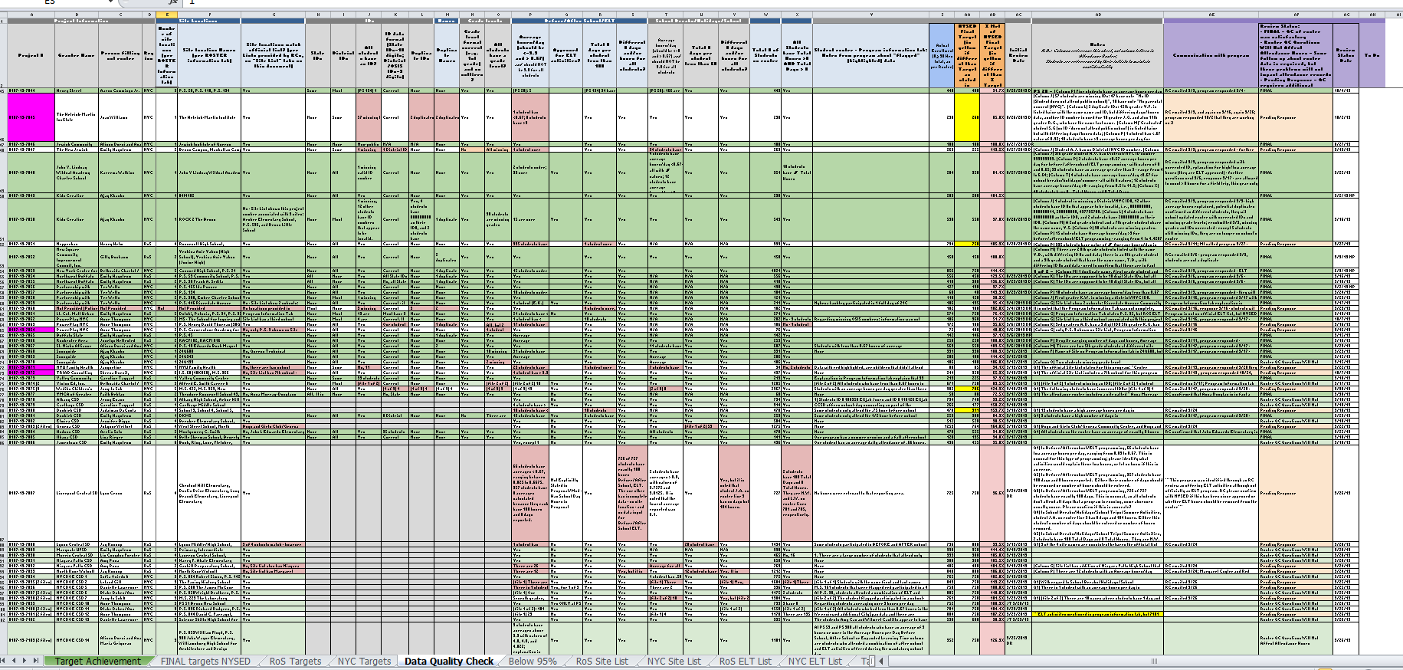
Year 2 Enrollment & Participation
Analysis of Program Attendance Roster Data still in progress…
138 program submissions
Quality control processes applied
Unprecedented level of data quality assurance
Notes:
For the last three months we have been conducting quality assurance reviews of all 138 student attendance rosters from Year 2. MI is very grateful for the support we’ve received during this process, both from our State partners, and from program staff and evaluators who have been so responsive to our questions. It’s so important to get high quality data IN to yield meaningful information and results on the other side.
To date we have completed quality reviews of attendance hours for all but 4 programs – although quality reviews on other roster data are still pending.
As you all know we altered the rosters in Year 2 to better facilitate these reviews. This has helped considerably; in fact, in several cases the size of grant reductions were reduced or eliminated because our quality reviews revealed that some students had initially been omitted from the roster.
We will be asking for feedback on how the template worked during this morning’s “Evaluators’ Track”, to which all are invited.

Slide 6
EARLY FINDINGS
Percent of programs that achieved > 95% of their target
NYC Year 2 = 81% (Year 1 = 38%)
RoS Year 2 = 69% (Year 1 = 36%)
Regular students (> 90 hours)
NYC = 19,784; 65% of combined targets (Y1 = 51%)
RoS = 16,232 ; 64% of combined targets (Y1 = 64%)
New reporting system & accountability standards
► Helps the State accurately measure program dosage & impact
Notes:
Findings from our preliminary analysis of the rosters indicate that there was a much higher percentage of programs that met their target enrollment in Year 2 as compared to Year 1.
In addition, the proportion of so-called “regular attendees”, who attended for at least 90 hours has also improved since Year 1, with NYC programs catching up to RoS.
Once the quality review process is complete, we will move on to analyses looking at enrollment data, alongside APR data and outcome data from the NYState SIRS system.
State data will be matched to participant IDs from the rosters – which is partly why the ID numbers are so important.
Our contract with NYSED includes the necessary confidentiality and non-disclosure assurances – so sensitive data is protected.
Please remember, as per EMSC’s August email, we will be asking for activities to be further disaggregated for Year 3.
This will allow for better quality control, and for more detailed analysis of program impact
By year 4, the new statewide data system should make this whole process easier for everyone. More on that shortly.

Slide 7
DOSAGE RULES!
Maintaining accurate participation records is CRITICAL for measuring the important impacts your programs are having on students
Notes:
An important take-away is that helping us measure program dosage is critical for our assessment of the valuable impacts your programs are having on participants.
Remember that higher dosage results in greater impact, so aim for higher attendance – not just "official" or "regular" attendance – wherever possible.

Slide 8
Deliverable 5
Provide guidance to NYSED on transition to State-Level Data Management System
Notes:
We’re going out of order for a moment because Deliverable 5 is closely related to the state data collection work we’ve being doing for Deliverable 1.
Deliverable 5 entails collaborating with the State and other program stakeholders to design criteria and specifications for the statewide data collection and management system.
The RFP for vendors was released on August 30th, and the State expects to announce the award shortly.
Elizabeth and her team will expand on this in their upcoming presentation.

Slide 9
Deliverable 2
Evaluation of the effectiveness of the Technical Assistance Resource Centers (RCs)
Notes:
Back to sequential order… Deliverable 2 involves studying the effectiveness of the technical support and professional development provided to grantees from the Regional Resource Centers.

Slide 10
High Quality Services & Support
Ongoing TA & Communication
Communication with grantees, assessing needs and providing support services
Collaboration with NYSED & state partners
Conferences & PD Offerings
Collaborative planning of events and opportunities designed to target the learning needs of multiple stakeholders
Formal Monitoring & TA Visits
Structured site visits to check compliance with quality standards and grant regulations, with follow-up support and consulting
Notes:
We found that the resource centers continue to provide consistently high quality services and support to the field across the three major activity categories. These include:
Professional Development opportunities
On-site Site Monitoring and Technical Assistance visits with follow up support, and
Informal, day-to-day communication responding to issues and needs that arise for grantees and state partners

Slide 11
NOTABLE FINDINGS
ATTENDANCE
Representative program attendance at conferences was UP!
CONTENT & DESIGN
Powerful, high priority content delivered in MORE General Sessions to maximize exposure and impact
SATISFACTION
Continued high satisifaction reported by conference attendees
Consistently higher survey response rates...
► Amplify & clarify grantees’ voice & choice
► Facilitate event planning & design
Notes:
To summarize a few notable findings from our evaluation of the Professional Development Conferences…
Program Attendance was very high in both regions, with representation from 94% of funded programs attending conferences.
There were more General Sessions offered, which allowed ALL attendees to receive the same, high priority content.
Conference attendees continued to report high levels of satisfaction with the quality, design, delivery and overall experience at the conferences.
For example, last fall, virtually all respondents to workshop surveys (88% in RoS, 98% in NYC) agreed that they were likely to apply what they had learned in the workshop sessions.
On average, presenters’ skills, attitude and preparedness for content delivery was generally strong.
MI’s recommendations to the RCs, center upon consistent tracking of attendnance at workshops, and the continued joint commitment between the RCs and MI to increase particpation in the conference evaluation surveys.

Slide 12
WHY SURVEYS?
Sharing your feedback is critical for helping the RCs’ continue their tradition of providing targeted, relevant, high quality PD experiences
Notes:
Completing the surveys is such an important part of continuing this dialogue between you, the conference participants, and the RC providers, so that they can continue to offer high quality PD that best meet your needs.

Slide 13
Deliverable 3
Studying the implementation experiences of local 21st CCLC Programs
Notes:
Deliverable 3 involves studying the implementation experiences of local 21st Century Learning Center programs.
MI selects 10 representative programs each year, and conducts exploratory site visits in order to learn about what’s working well for them, and where they may be experiencing challenges.
The purpose of these visits is to look for trends –not to evaluate individual programs; to gain more insights into grantees’ experiences, and to share best practices.

Slide 14
FOCUS AREAS
Student Identification, Recruitment & Enrollment
Attendance & Retention
Academic Linkages
Administrative Coordination
Notes:
We’re going to highlight our findings related to the four major topic areas we explored in our Year 2 visits:
Student Identification, Recruitment & Enrollment
Attendance & Retention (which reflect program dosage)
Academic Linkages to School Day
Administrative Coordination

Slide 15
Student Identification & Recruitment
Use of both open & targeted recruitment strategies
to identify students who would benefit from programming
High school programs use more individualized recruitment strategies
CBOs use branding and leverage name & reputation
to recruit students
Key Recommendations include:
► Collaborate with School-day Staff & use Data
► Balance student PREFERENCE & student NEEDS
Notes:
Across the sample of programs we visited, we found that…
>>>programs generally blended an open enrollment approach with more targeted methods that helped ensure they were serving students in need. Targeted programming was more common in Year 2 than in Year 1.
>>>High school programs, which work with a hard-to-reach age group, tended to use more individualized recruitment strategies aligned to the needs and interests of their populations.
>>>Among Community-based Organizations, brand and name-recognition helped to drive ongoing recruitment efforts.
>>>Key Recommendations include:
* Building student recruitment efforts into the school culture.
* Inviting school administrators and staff to collaborate with after-school directors, to help identify students in need.
* Requesting school data such as school day attendance and academic performance, to inform targeted recruitment and programming.

Slide 16
ATTENDANCE RECOMMENDATIONS
Improve, bolster links with School Day Leaders & Staff
Notes:
Strategies programs used to address attendance challenges involved
Special incentives, such as job certifications for students seeking work
adapting program schedules to fit participant availability, and
>>>Improved communications and connections with school staff, which improved programs’ success at making program adaptations.
Access to data and information about the causes for low attendance can help programs design a targeted plan to address it.

Slide 17
Collaboration with School Day Leaders & Staff
Curriculum Alignment!

Attendance at  meetings
School Day Program
Meeting agendas include links
Afterschool Program
Exchanging student updates
School leaders visit programs
School Day liason/advisor
Shared program guide
Notes:
We also explored the linkage between programs and school day curricula, which requires active collaboration with school day staff. We recognize you don’t always have full control over some of these activities, but where possible, opportunities to strengthen collaboration may include:
>>>Attending each others’ meetings…
>>>…with meeting agendas that address both school day and after school issues
>>>Using templates to exchange information about student academic needs and behavioral/emotional issues
>>>Encouraging school leaders to visit 21C activities
>>>Appoint a school day liaison from within the after school staff, and
>>>Developing a program guide and share with school day staff
>>>However, in some cases even when there was good collaboration, alignment with school day curricula was still lacking.
Some recommendations to help strengthen curriculum alignment include:
Including learning standards and objectives in shared student information
Obtaining guidance from visiting school leaders
Infusing curricular concepts into enrichment activities.

Slide 18
Administrative Coordination
Less staff turnover observed
Staff Handbooks assisted onboarding
Grant/ Program Overview
Sample Lesson Plans
Performance Indicators & Elements from the QSA
Attendance Tracking Procedures
Policies & Procedures
Performance Expectations & Observable “Best Practices” (PAIR)
Orientation Checklist
Notes:
There was much less staff turnover among the programs visited in Year 2 than was seen in the programs visited in Year 1. However, a number of programs still struggled to manage mid-year staff turnover.
Some programs have developed customized 21st CCLC handbooks, which made the process of onboarding new staff easier.
Key contents that could be included in this handbook include things such as…
>>>[read slide entries from animation]
Now I’d like to hand the mic over to Lily Corrigan.

Slide 19
Deliverable 4
Review & assess the quality and completeness of local program-level Annual Evaluation Reports (AERs)
Notes:
Deliverable 4 involves studying a sample of annual reports prepared by local program evaluators, checking for quality and completeness.
The purpose of the AER reviews is:
To help program staff become better informed consumers of evaluation, and
To identify patterns of strengths and challenges
In program implementation
In program evaluation
In communication of findings

Slide 20
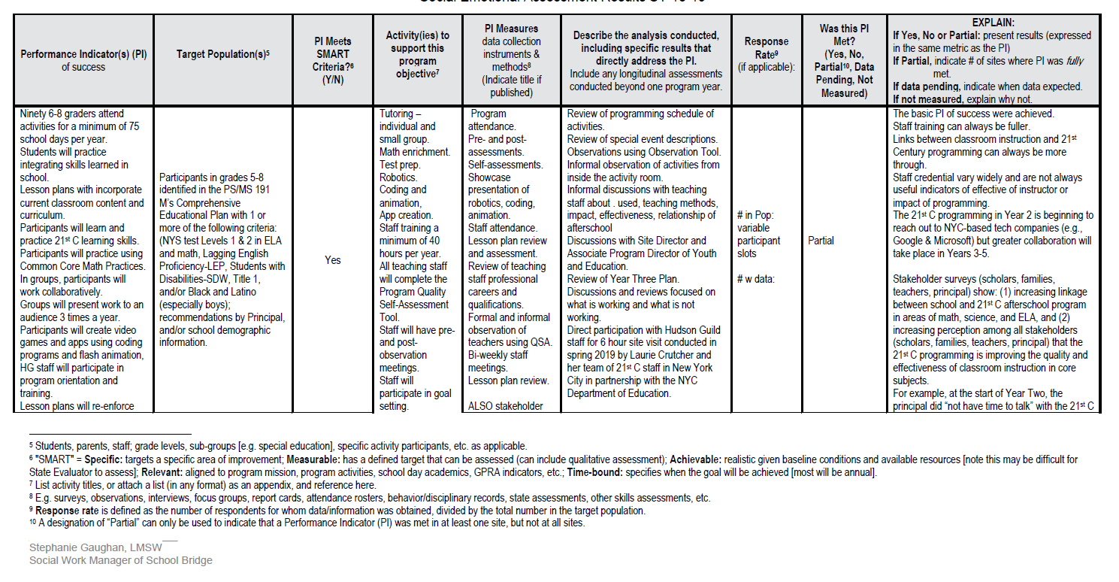
UPDATED AER TEMPLATE
Streamlined Report form to gather info required by State for Analysis
Word doc, tables, instructions
Same data components required by the RFP and Evaluation Manual
Year 2 = pilot, learn, refine
Year 3 = standard use
Notes:
We conducted the first round of AER reviews earlier this year, and presented our findings at the Spring 21C conference. Based on our Year 1 findings, the Program Team identified priorities to be included in a new Annual Evaluation Reporting template, which incorporated feedback from local evaluators and program leaders.
Evaluators used this “pilot” template to develop the Year 2 AERs. MI is just beginning our annual review of a sample of these reports.
This new reporting format includes all the required information specified for the AERs in the RFP and the Evaluation Manual, re-organized into a standardized format.
The purpose of this template was two-fold:
One, to support a more efficient review of the reports; AND
Two, to enable the Statewide Evaluator to collect more uniform data to better support analyses of State level findings.
The new template does not require any additional data collection, as everything requested is already in the grant’s local evaluation requirements. These SAME DATA can be used in the reports prepared for grantees.
Still, the State Program Manager and the Statewide Evaluator do appreciate that this may create an additional layer of work. The State has determined that the Year 2 AERs, submitted this past September, will be considered a pilot, and the Year 2 review will take into account the adjustment to a new reporting structure. We will be soliciting feedback from evaluators this afternoon about their experiences with the new template.

Slide 21
Deliverable 6
Provide support to local Program Evaluators
(Evaluators “Network”)
Notes:
Deliverable 6 involves the State Evaluation Team’s role as a resource for local program evaluators.
We provide support through an Evaluators’ Network, designed to raise awareness of State priorities, increase local evaluators’ access to resources, facilitate inter-program communication and sharing of best practices, and to provide a platform for local evaluators to offer feedback on State-wide policies and procedures.
One of the primary goals of these activities is obtain insights from the local evaluators to help the State drive statewide program improvements.
From the insights gathered from the interactive network of local evaluators, NYSED and state-level program partners can better understand the experiences and needs at the local level. And through suggestions from the field, learn about possible ways to design supportive policies to help address those needs.

Slide 22
SUMMARY OF Y2 ACTIVITIES
Activities & Events
Ongoing Communications
(emails to listserv, calls, web page)
Advisory Group Discussion
Network Meetings
Major Topics Explored
Modifiying Evaluability Process
Review Process for AERs
New AER Template (purpose, form, components, timeline, etc.)
Notes:
Year 2 Activities consisted of…
Continuing our outreach and communications to the field via emails, calls, and postings on the “For Evaluators” web page,
Organizing an advisory group to gather input about a revised Evaluability Process.
And, of course, convening the Network Meetings at the regional conferences.
The Spring Rest of State conference included evaluators from BOTH regions, as well as some program directors. The meeting entailed a broad ranging and spirited discussion about a number of topics revolving around annual local evaluation reporting to the state. Suggestions arising from this discussion resulted in substantial modifications to the AER template.
The Network will be continuing to explore some of these topics in greater depth as we move through Year 3.

Slide 23
JOIN OUR NETWORK!
Meetings at Conferences
Online Forum
Ad Hoc “Workgroups”
Notes:
Join us at our networking events!
They’re full of excellent minds, and we’ve been having some very rich discussions about how to improve data collection, reporting, communication, and a number of other critical issues related to improving local and state level systems and programs.
Today’s sessions are at 11:00 and 2:00 in the Dukes Meeting Room. You are welcome to come with your local evaluator to contribute your perspectives.

Slide 24
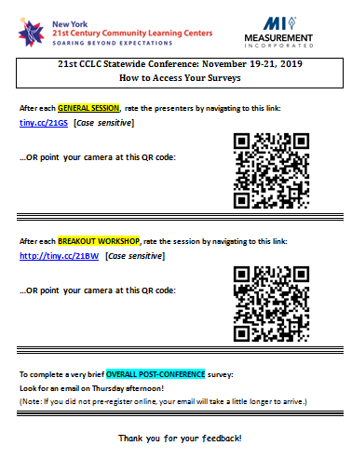
SURVEY REMINDER!
THREE
Separate Surveys
GENERAL SESSIONS
Via QR Code
INDIVIDUAL WORKSHOPS
Via QR Code
OVERALL CONFERENCE
Via Email
General Sessions & Workshops:
Use your phone or tablet device
Scan QR Code/ enter URL
Complete the survey, hit submit
Notes:
Please help us out by completing surveys to rate the general session presentations, workshops and the conference as a whole. They are all brief.
General Session and Workshop surveys are accessed through the QR codes or URLs on the sheet that you picked up with your conference folder
For General Sessions, please open the survey at the end of each session (today and tomorrow morning) and rate each presenter from that session
For the Workshops, open the survey at the end of each workshop.
You will receive the Overall Conference survey in your email on Thursday afternoon.

Slide 25
ATTEND OUR SOCIAL!
Today @ 4:30 PM
Notes:
Stop by our social “mixer” this afternoon. We’ll provide the appetizers.
The “Evaluators’ Social Networking” session is this afternoon at 4:30, location TBA

Slide 26
THANK YOU!
Please email us with questions or comments:
21CEval@measinc.com

Slide 27
PRESENTED BY MEASUREMENT INCORPORATED (MI)
MI’s Team:
Jonathan Tunik, Project Director
Lily Corrigan, Research Associate
Dr. Nina Gottlieb, Senior Field Researcher
Nora Phelan, Research Associate
Dawn Rettig, Research Support Specialist
Bernadette DeVito, Research Support Specialist
With collaboration and contributions from:
Elizabeth Whipple, and the NYSED 21CCLC Program Management Team
Felicia Watson, and the RoS TARC Team
Laurie Crutcher & Elida Martes, and the NYC TARC Team

