Slide 1
An Overview of the Framework-based Regents Examination in Global History and Geography II (Grade 10)
May 2018

Slide 2
Timeline for the Framework-based Regents Examinations in Global History and Geography II (Grade 10)
The Framework-based Regents Examination in
Global History and Geography II (Grade 10) is
based on the NYS K–12 Social Studies Framework; Grade 10 only
first administered in June 2019
the only Global History and Geography Regents Exam available beginning August 2020
Note: Administration of the Transition Exam & the Framework-based exam in Global History and Geography II overlap from June 2019 through June 2020

Slide 3
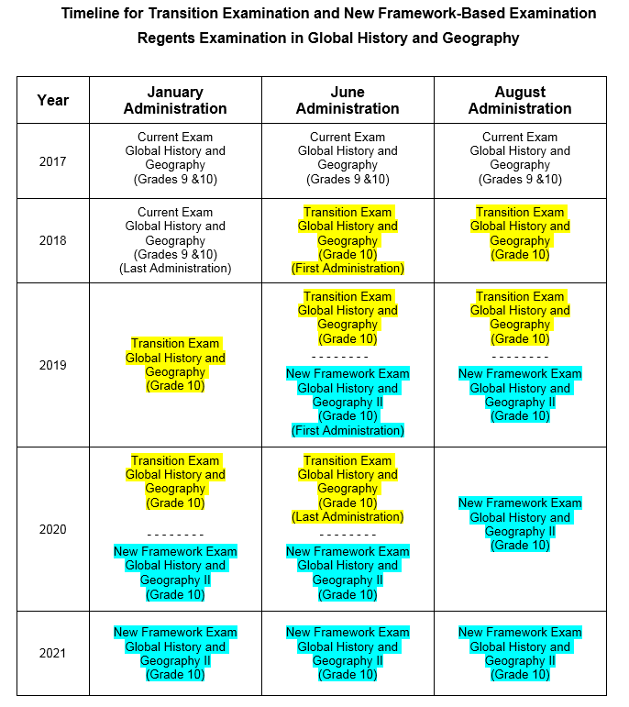

Slide 4
Overlap Period for Exams in Global History and Geography June 2019 to June 2020
For the 2018-19 school year, all schools should provide social studies course instruction for Grade 9 students that is aligned with the new Social Studies Framework.
For the 2018-19 school year, schools should provide instruction for Grade 10 students that aligns with and continues the instruction they received in global history and geography in Grade 9. This instruction may be aligned with the Core Curriculum or with the new Social Studies Framework, dependent upon the instruction the students received in Grade 9.
For the June 2019 administration, schools should administer to Grade 10 students the Regents Exam in Global History and Geography that aligns with the course instruction they received.
If a student takes both the Transition Regents Examination in Global History and Geography – Grade 10 and the new Framework-based Regents Examination in Global History and Geography II (Grade 10), both scores must be recorded on the student’s permanent record.

Slide 5
Framework-based Regents Examination in Global History & Geography II (Grade 10)
The Framework-based Regents Examination in Global History & Geography II (Grade 10) will be based on the content and practices found in the NYS K–12 Social Studies Framework.
The NYS K–12 Social Studies Framework (2014) can be found at
https://www.engageny.org/resource/new-york-state-
k-12-social-studies-framework

Slide 6
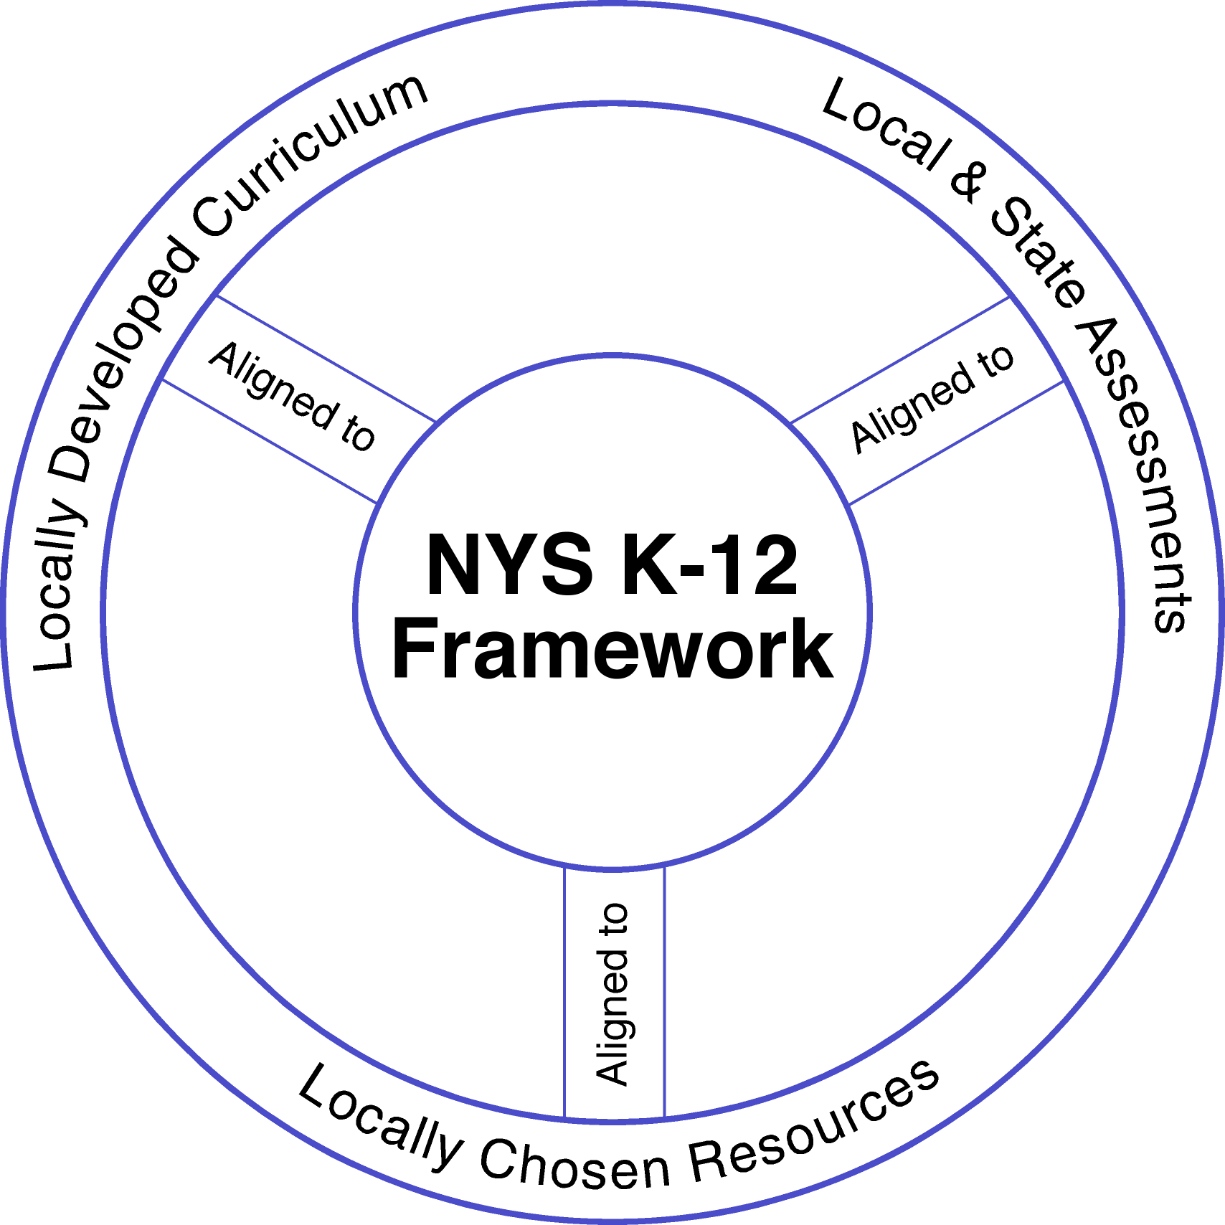
Social Studies Alignment
Notes:
Our work as districts and teachers, in the coming years, is to build CURRICULUM and have it aligned to ASSESSSMENT and the FRAMEWORK
METAPHOR of images: Blueprints are like the Framework (set the course),
Our goal is to build the capacity in our teachers and to prepare students for 2018 when the new Global Regents exam is given.

Slide 7
Social Studies Practices
1. Gathering, Using, and Interpreting Evidence
2. Chronological Reasoning and Causation
3. Comparison and Contextualization
4. Geographic Reasoning
5. Economics and Economic Systems
6. Civic Participation

Slide 8
Evidence-Centered Designed Assessments
What is Evidence-Centered Design (ECD)?
ECD is a systematic process to ensure comparable scores across multiple test forms.
Developing a test with ECD helps to focus on assessing the most valuable aspects of learning (skills and content).

Slide 9
How does ECD work?
Claims – are clear statements about what students should be able to do at the end of the course.
Evidence – is what a student needs to do/say/produce to support acquisition of the claim.
Performance Level Descriptions (PLDs) – are what it means to get a 1, 2, 3, 4, or 5 on the examination.
Test Design – refers to the components that make up the examination.
Task Models – are the structures or shells for collecting evidence for the claims.

Slide 10
Framework-based Global History & Geography II (Grade 10) Test Design
3 Parts
Part 1: 28 Stimulus-Based Multiple-Choice Questions
Part 2: two sets of Stimulus-Based Short-Answer Constructed-Response Questions (CRQs)
1 Cause/Effect Set
1 Similarities/Differences Set OR 1 Turning Point Set
Part 3: one extended Enduring Issues Essay based on a set of five documents

Slide 11
Components and Weighting of Framework-based Global History and Geography II (Grade 10)
Item Types | Number of Questions | Approximate Weighting
Stimulus-Based Multiple-Choice Questions | 28 | 54%
Short-Answer Constructed-Response Questions | 2 sets | 17%
Enduring Issues Essay | 1 | 29%

Slide 12
Framework-based Regents Exam in Global History & Geography II (Grade 10) Test Specification Grid

Slide 13
Links Related to Framework-based Regents Examination in Global History & Geography – Grade 10
Engage NY – Prototypes, Vimeos, and useful documents for Part I, Part II, and Part III https://www.engageny.org/resource/regents-exam-global-history-and-geography-ii
Office of State Assessment Social Studies page – Prototypes, Vimeos, and useful documents for Part I, Part II, and Part III http://www.p12.nysed.gov/assessment/ss/framework-globalhistory.html

Slide 14
Questions or comments
For Assessment: emscassessinfo@nysed.gov

