Slide 1

New York State Identification Test for English Language Learners (NYSITELL)
January 2018

Slide 2
Purpose of the NYSITELL
The NYSITELL is part of the formal identification process for English Language Learners (ELLs)/Multilingual Learners (MLLs) in New York State.
The NYSITELL is given once to assess the English language proficiency level of new entrants whose home or primary language, as indicated in the Home Language Questionnaire (HLQ) and Individual Interview, is other than English.
If a student receives a score of Entering, Emerging, Transitioning, or Expanding on the NYSITELL, then the student is considered to be an ELL/MLL. If a student receives a score of Commanding, the student is not an ELL/MLL.

Slide 3
2018 NYSITELL
The 2018 NYSITELL replaces the 2014 edition, which has been administered through January 31, 2018.
Timeline for implementation of the 2018 NYSITELL:
June 1, 2018: Level I (incoming Kindergarten)
February 1, 2018: Levels II-VIII

Slide 4
General information
The 2018 NYSITELL is aligned to the New York State English as a Second Language Achievement Test (NYSESLAT) and will include similar question types.
8 levels aligned to grade and date of entry
Four modalities:
Speaking, Listening, Reading, and Writing (except Level I, which will be an integrated Listening and Speaking session).

Slide 5
NYSITELL Levels
NYSITELL Level I: Entering Kindergarten Students
Individually Administered
1 booklet: Integrated Speaking and Listening
NYSITELL Levels II – VIII
2 booklets
1 Speaking
1 Integrated Listening, Reading and Writing
Administered in one to two sessions
Schools are not permitted to administer Levels II – VIII from July 1 - July 14

Slide 6
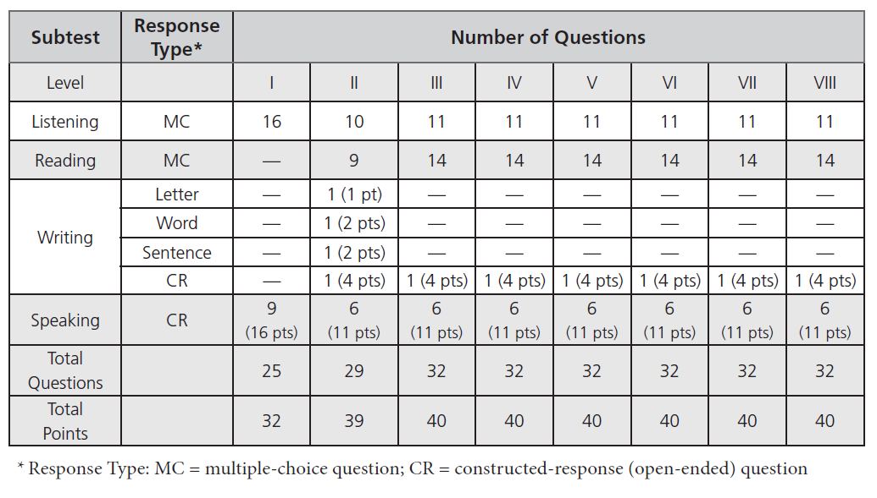
Test Specifications

Slide 7
Test administration: Level I
Consists only of an integrated Listening and Speaking subtest.
Entire test must be individually administered.
Speaking subtest is scored at the time of administration.
Students respond to the Listening multiple-choice questions by pointing to an answer choice.
Student answer choices for Listening and Speaking will be recorded on the Level I score sheet.
Following administration, the student responses are transcribed to the machine-scannable answer sheet.

Slide 8
Test administration: Level II and III
Speaking is individually administered and scored at the time of administration.
Listening, Reading and Writing administered individually or in a group setting.
It is recommended to individually administer entire test at Levels II – III.
Students mark their responses to multiple-choice questions in their test booklets.
Responses must be transcribed by school personnel from the booklet to the student's machine-scannable answer sheet; Make sure that the student information on the test booklet matches the information on the answer sheet before transcribing any information.

Slide 9
Test administration: Level IV - VIII
Speaking is individually administered and scored at the time of administration.
Listening, Reading and Writing can be administered individually or in a group setting.
Students mark their responses on their machine-scannable answer sheets.

Slide 10
Who should administer the NYSITELL
Qualified personnel should be teachers or administrators able to carry out standard examination procedures and should have special training in administering the NYSITELL or NYSESLAT and may include:
New York State certified English to Speakers of Other Languages or Bilingual Education teachers
New York State certified teachers
New York State certified teachers who have been trained in cultural competency, language development, and the needs of English Language Learners (ELLs)/Multilingual Learners (MLLs)

Slide 11
Stopping Rule
A Stopping Rule has been incorporated into the Listening, Reading, and Speaking subtests.
The Directions For Administration provides specific Stopping Rule information for each subtest.
Generally, if a student is unable to answer the first 3 questions, the Stopping Rule can be used.
If a subtest is discontinued for any student, the administrator must mark the appropriate “Tested but unable to answer any questions” circle next to the corresponding subtest

Slide 12
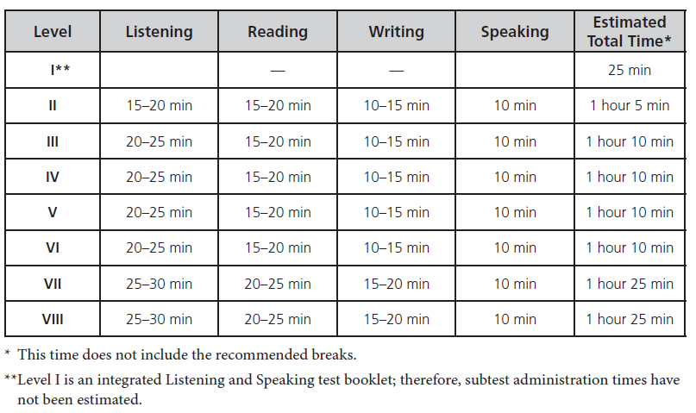
Estimated Administration Times

Slide 13
Test accommodations
In general, students with disabilities must be provided with the testing accommodations specified in their IEPs/504 Plans when taking the NYSITELL.
Accommodations may be provided to students who incur disabilities within 30 days before the assessment, at the principal’s discretion.
ELL/MLL Accommodations permitted on other NYS Assessments are not permitted on this assessment
Consult the 2018 Guide to the NYSITELL for guidance regarding test accommodations.

Slide 14
Scanning (Scoring) the NYSITELL Answer Sheets
District-specific machine-scannable answer sheets provided by the RICs or large-city scanning center must be used
All student responses and scores must be recorded on the machine-scannable answer sheets
Make sure the names match between answer sheets and booklets for those levels requiring transcription
Answer sheets must be submitted to the RICs or large-city scanning centers for scanning and score reporting
Consult the local RIC or large-city scanning centers for information on procuring and processing NYSITELL machine-scannable answer sheets

Slide 15
Thank you
For additional information about the NYSITELL, please visit the Office of State Assessment’s NYSITELL webpage at http://www.p12.nysed.gov/assessment/nysitell/ or email emscassessinfo@nysed.gov
For information regarding the identification of ELL’s please visit http://www.nysed.gov/bilingual-ed/ell-identification-placementhome-language-questionnaire or contact the Office of Bilingual Education and World Languages at OBEWL@nysed.gov

