Slide 1
ECR Informational Rubric: Degree of Response
DR
Degree of Response (ECR)
0
Entering
Lacks development of an opinion or additional information
1
Emerging
Includes basic development of an opinion or additional information
2
Transitioning
Includes limited development of an opinion with a reason and/or additional information
Grade 1
3
Expanding
Includes partial development of an opinion with a reason and additional information
4
Commanding
Includes sufficient development of an opinion with a reason and additional information

Slide 2
ECR Narrative Rubric: Degree of Response
DR
Degree of Response (ECR)
0
Entering
Lacks development of descriptions or events in sequence
1
Emerging
Includes basic development of descriptions or an event
2
Transitioning
Includes limited development of descriptions with details and/or an event
Grade 1
3
Expanding
Includes partial development of descriptions with details and one or more events in sequence
4
Commanding
Includes sufficient development of descriptions with details and two or more events in sequence

Slide 3
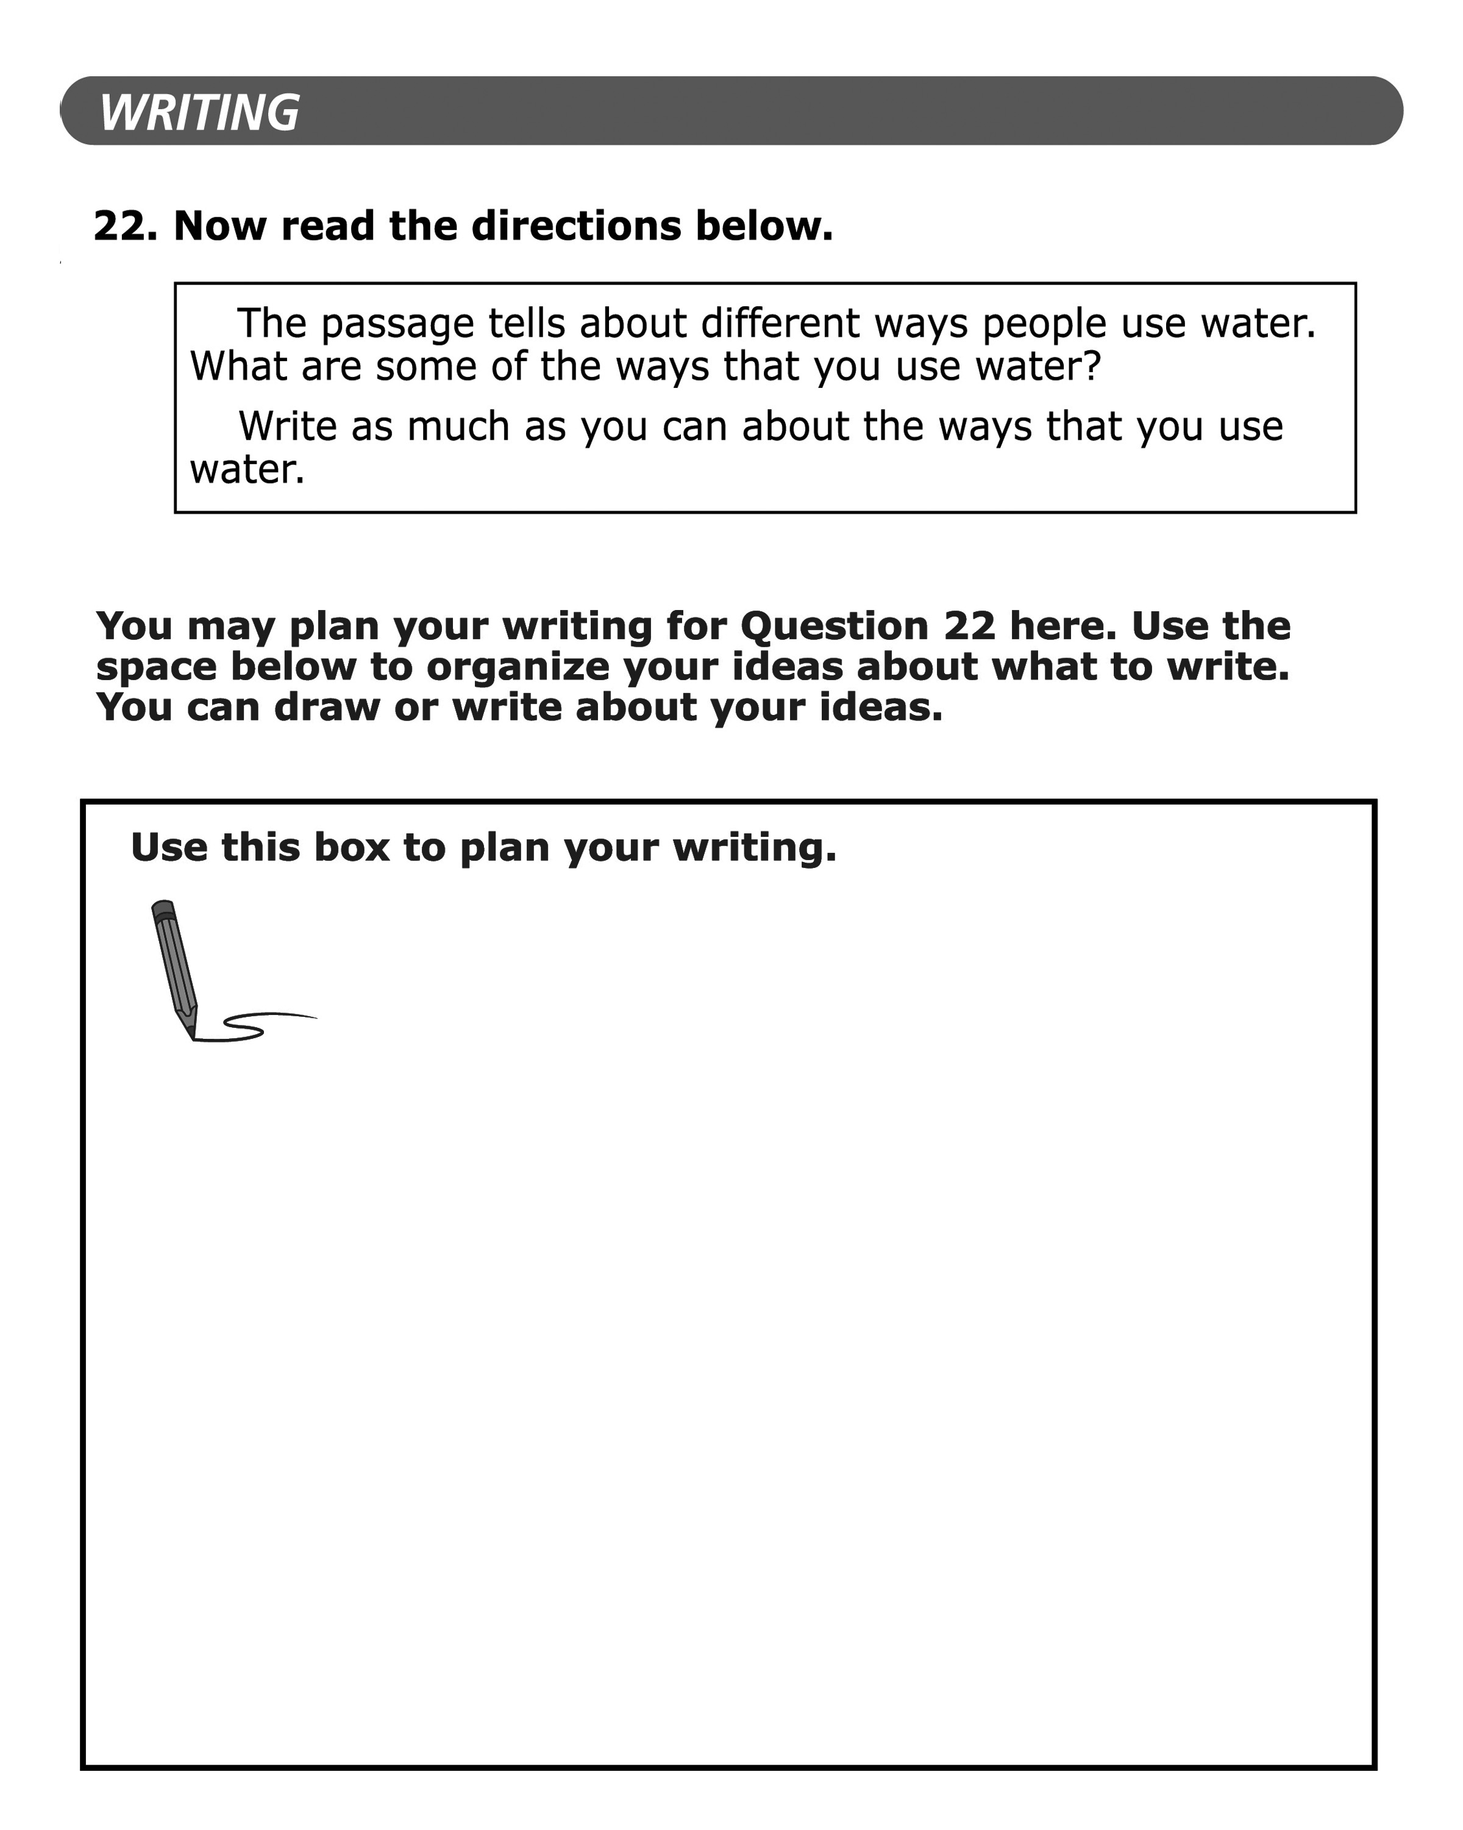
Grade 1: Informational ECR Prompt

Slide 4
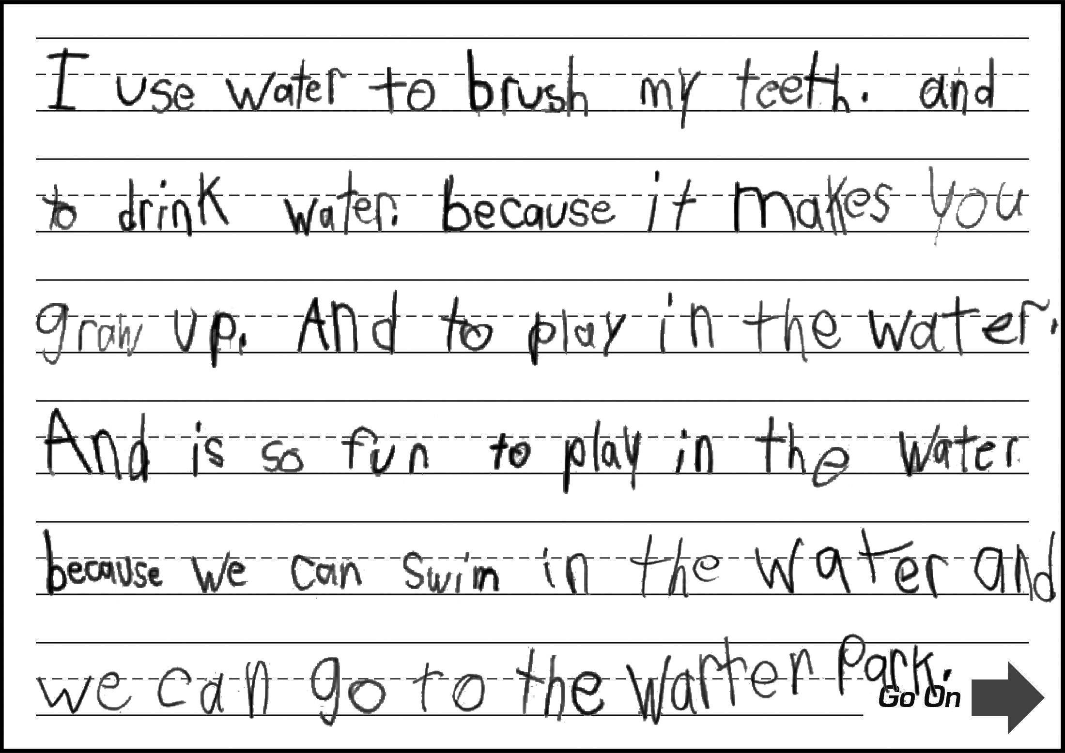
Grade 1: ECR Sample 1
Score:
4
Commanding
CL
Response contains a variety of expanded and complex sentences.
QL
Response contains many grade-level words and phrases (e.g., brush my teeth, grow up, swim, water park).
CR
Response includes words and sentences that sufficiently introduce and complete thoughts, ideas, or both (has an introduction and a clear and organized progression of ideas).
DR
Response includes sufficient development of an opinion with a reason and additional information (lists multiple specific uses for water and elaborates on most ideas with additional details).
M
Response is clear and contains minimal errors;
errors do not obscure meaning.

Slide 5
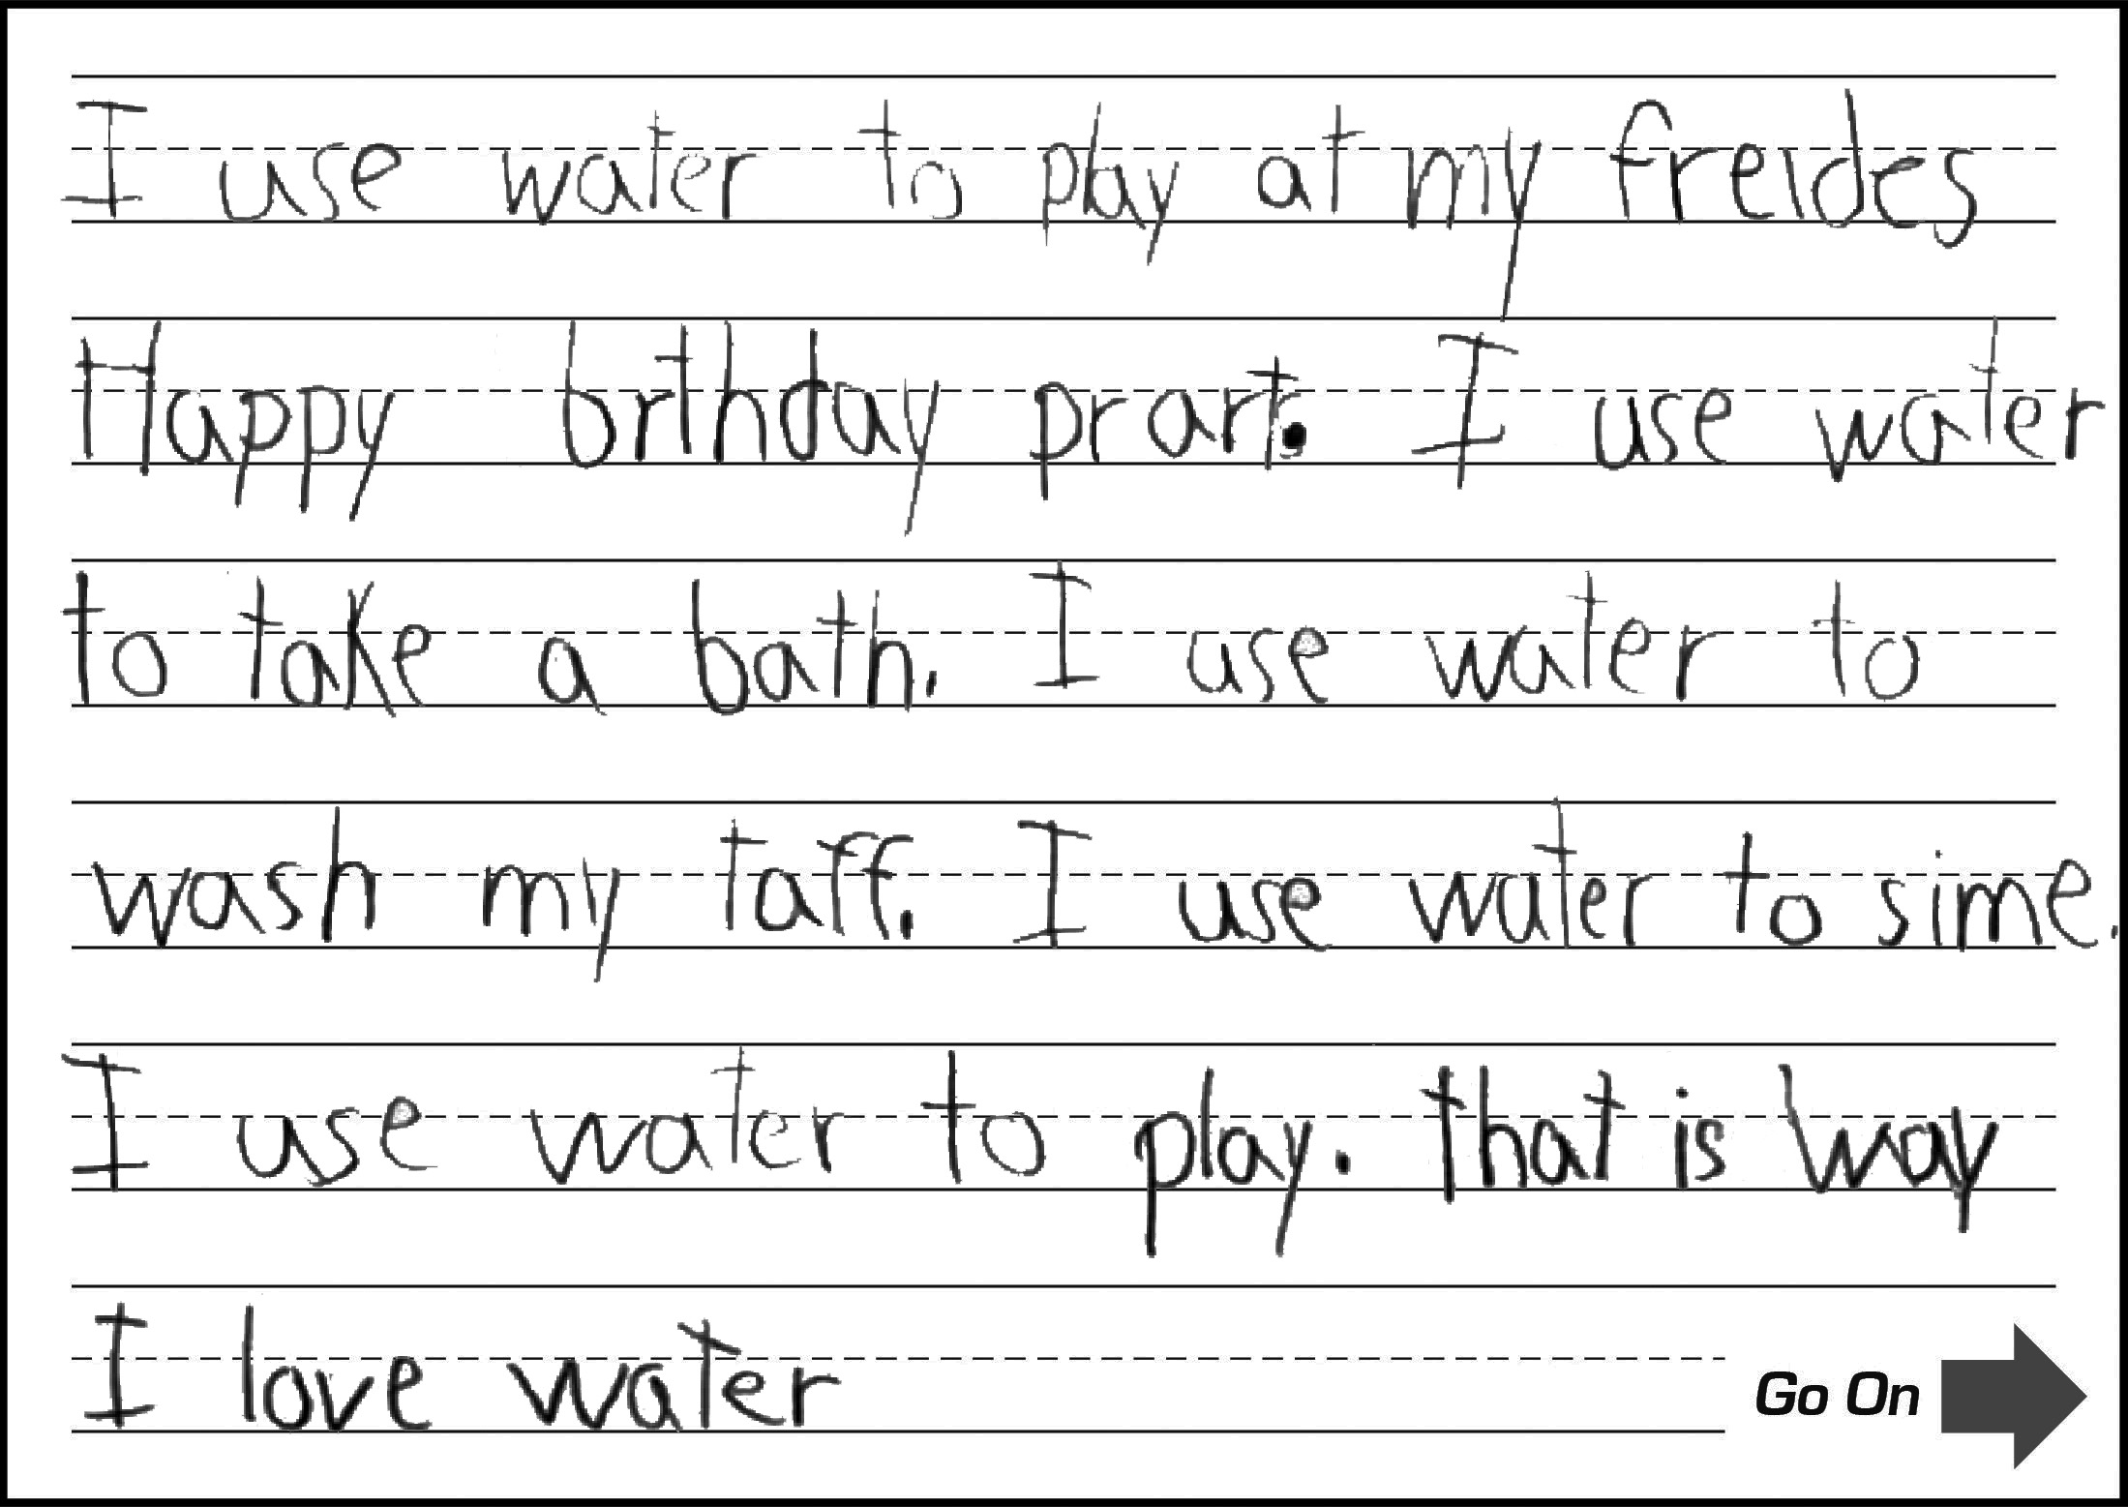
Grade 1: ECR Sample 2
Score:
3
Expanding
CL
Response contains expanded and complex sentences (repetitive structures limit variety of sentence structures).
QL
Response contains some grade-level words and phrases (e.g., happy birthday, take a bath, wash ; errors obscure some language).
CR
Response includes introductory and concluding words and sentences that provide partial organization of thoughts, ideas, or both (has an introduction, conclusion, and some related ideas, but at times ideas are list-like and lack organization).
DR
Response includes partial development of an opinion with a reason and additional information (many ideas are listed, but at times errors obscure development of ideas).
M
Response is mostly clear, but contains some errors that may obscure meaning (e.g., spelling errors: prart for party, taff for teeth, sime for swim).

Slide 6
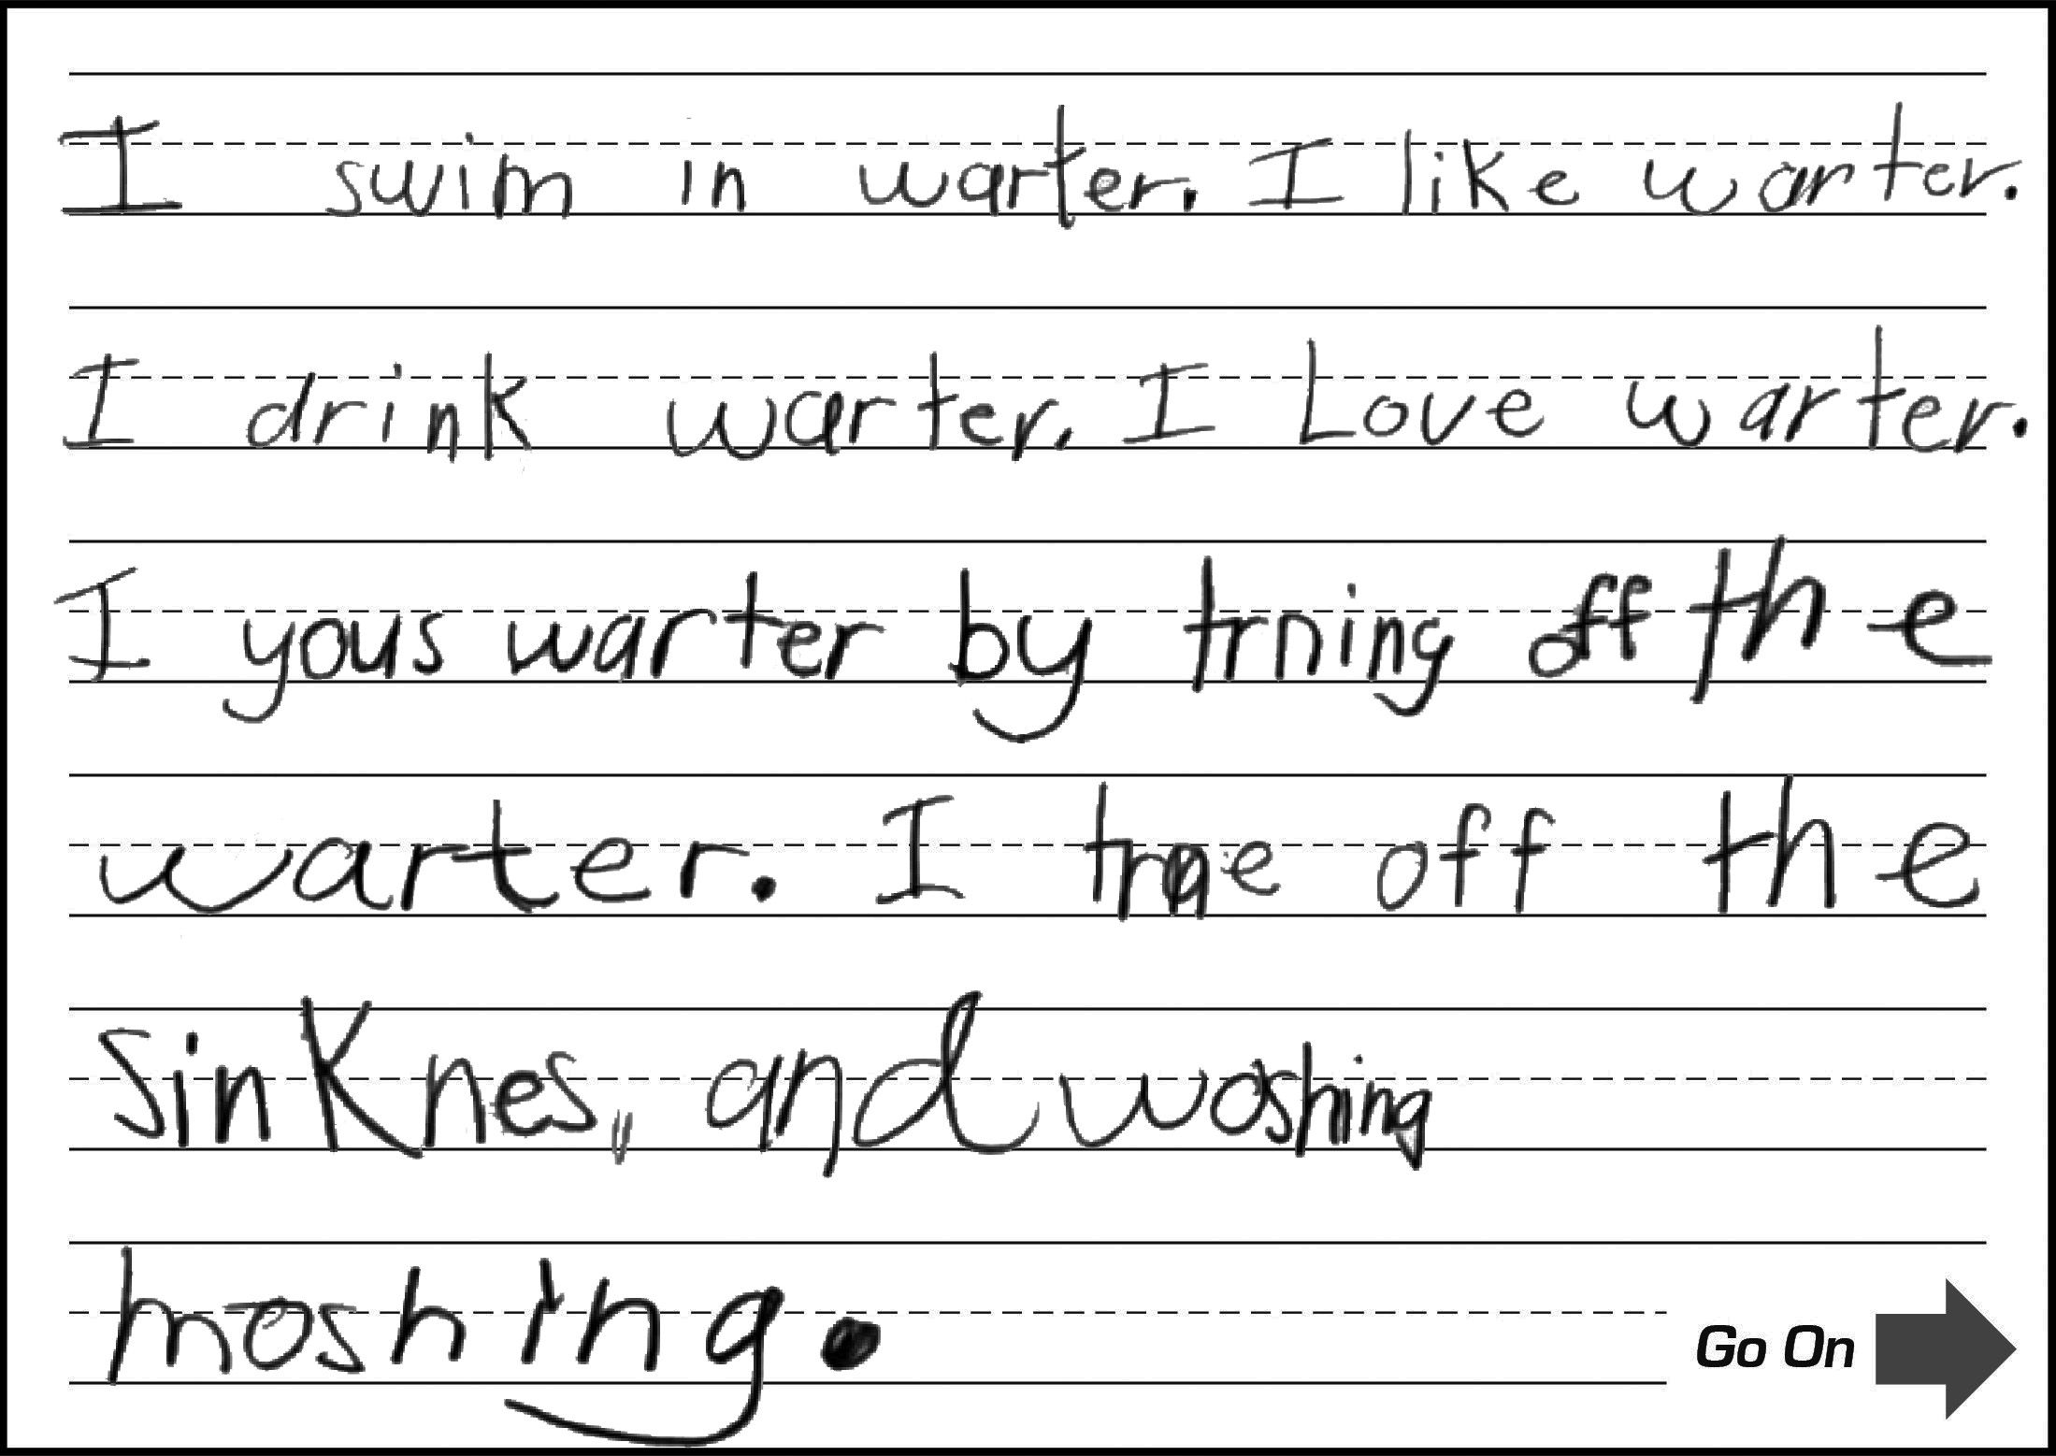
Grade 1: ECR Sample 3
Score:
2
Transitioning
CL
Response contains simple sentences and a few expanded sentences.
QL
Response contains a few grade-level words and phrases (e.g., swim).
CR
Response includes introductory and/or concluding words and sentences that provide limited organization of thoughts, ideas, or both (has multiple ideas about ways to use water, but ideas are repetitive and list-like, with limited organization).
DR
Response includes limited development of an opinion with a reason and/or additional information (several ideas are listed with brief additional information, but ideas are often vague and minimally detailed, and some are repetitive).
M
Response is mostly clear, but contains some errors that may obscure meaning (e.g., spelling errors: sinknes for sink, moshing for machine).

Slide 7
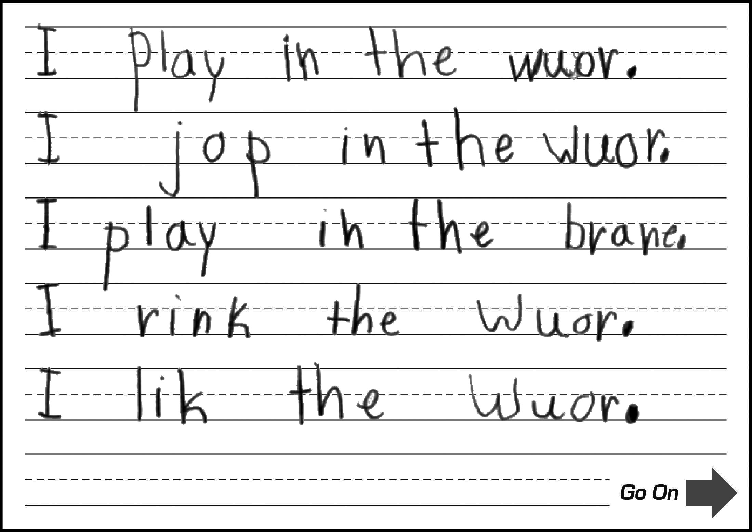
Grade 1: ECR Sample 4
Score:
1
Emerging
CL
Response contains simple sentences and includes at least one expanded sentence (single repeated expanded structure).
QL
Response contains common words and short phrases (errors obscure much of the language in response).
CR
Response includes a basic introduction or completion of a thought or ideas (errors obscure most ideas).
DR
Response includes basic development of an opinion or additional information (errors obscure further development of ideas).
M
Response contains frequent errors that often obscure meaning (frequent impeding spelling errors).

Slide 8
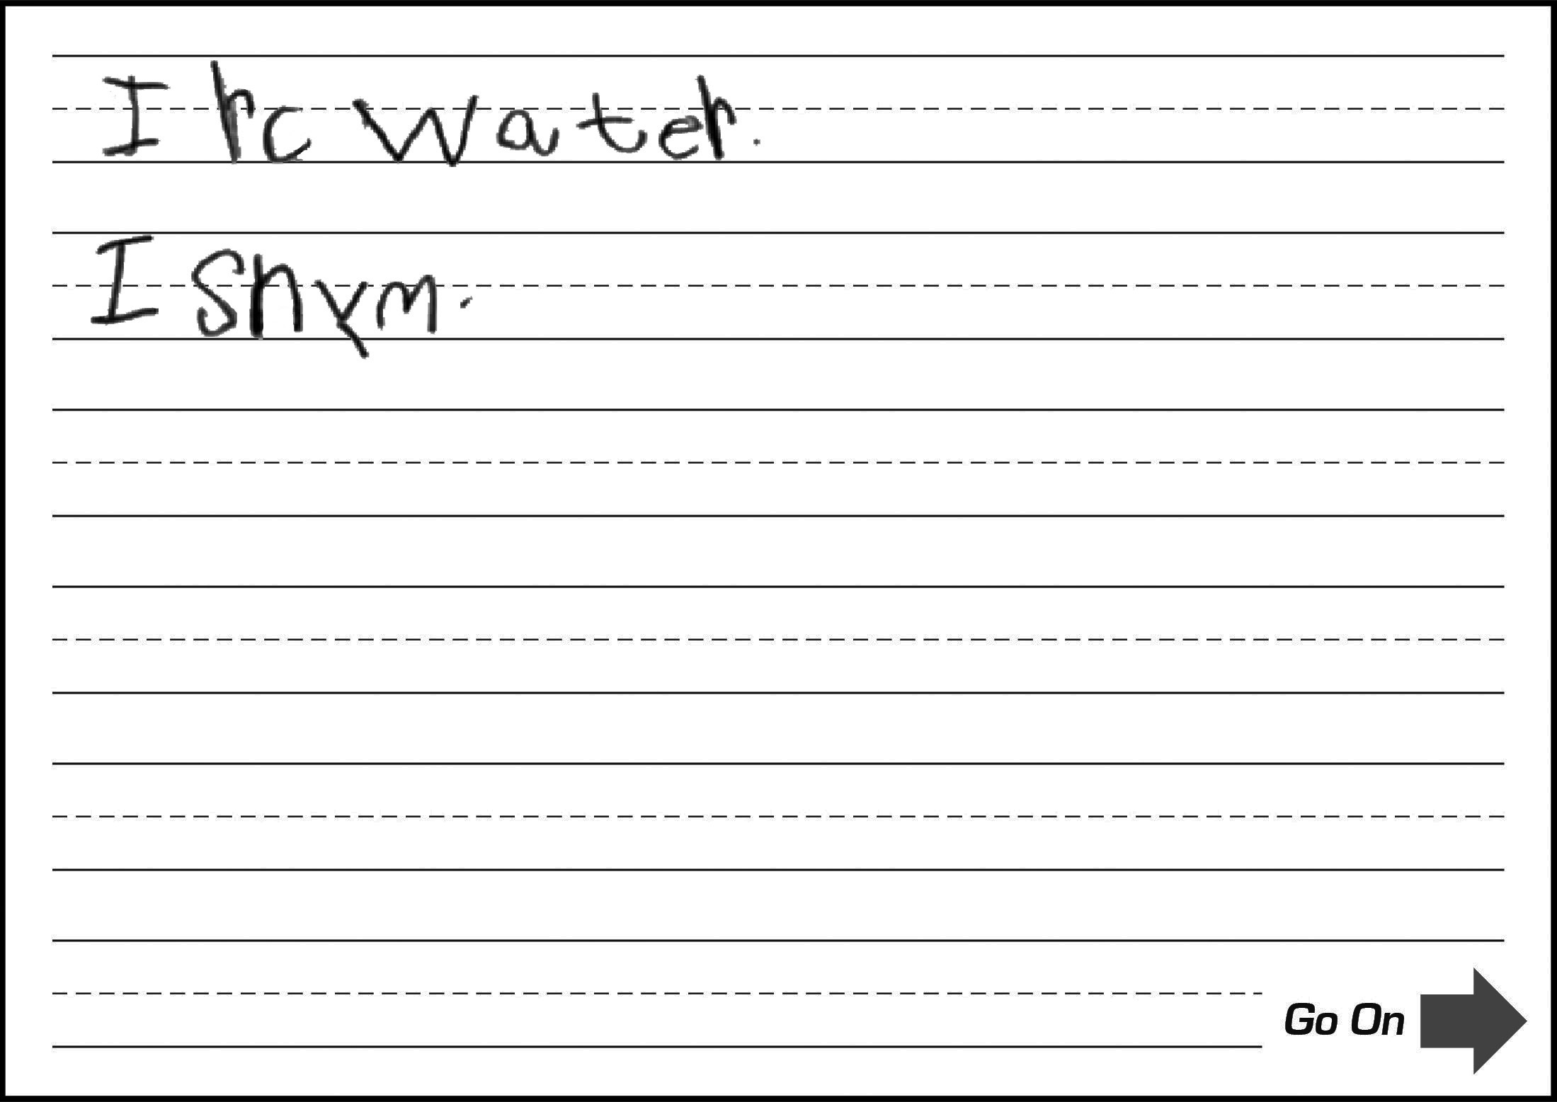
Grade 1: ECR Sample 5
Score:
0
Entering
CL
Response contains few words (errors impede successful development of sentence structure; only single words are comprehensible).
QL
Response contains at most frequently used words.
CR
Response lacks a clear introduction or completion of a thought or an idea due to brevity (majority of response is obscured by errors).
DR
Response lacks development of an opinion or additional information (majority of response is obscured by errors).
M
Response contains numerous errors that totally obscure meaning (no clear, complete thought).

Slide 9
Practice Time

Slide 10
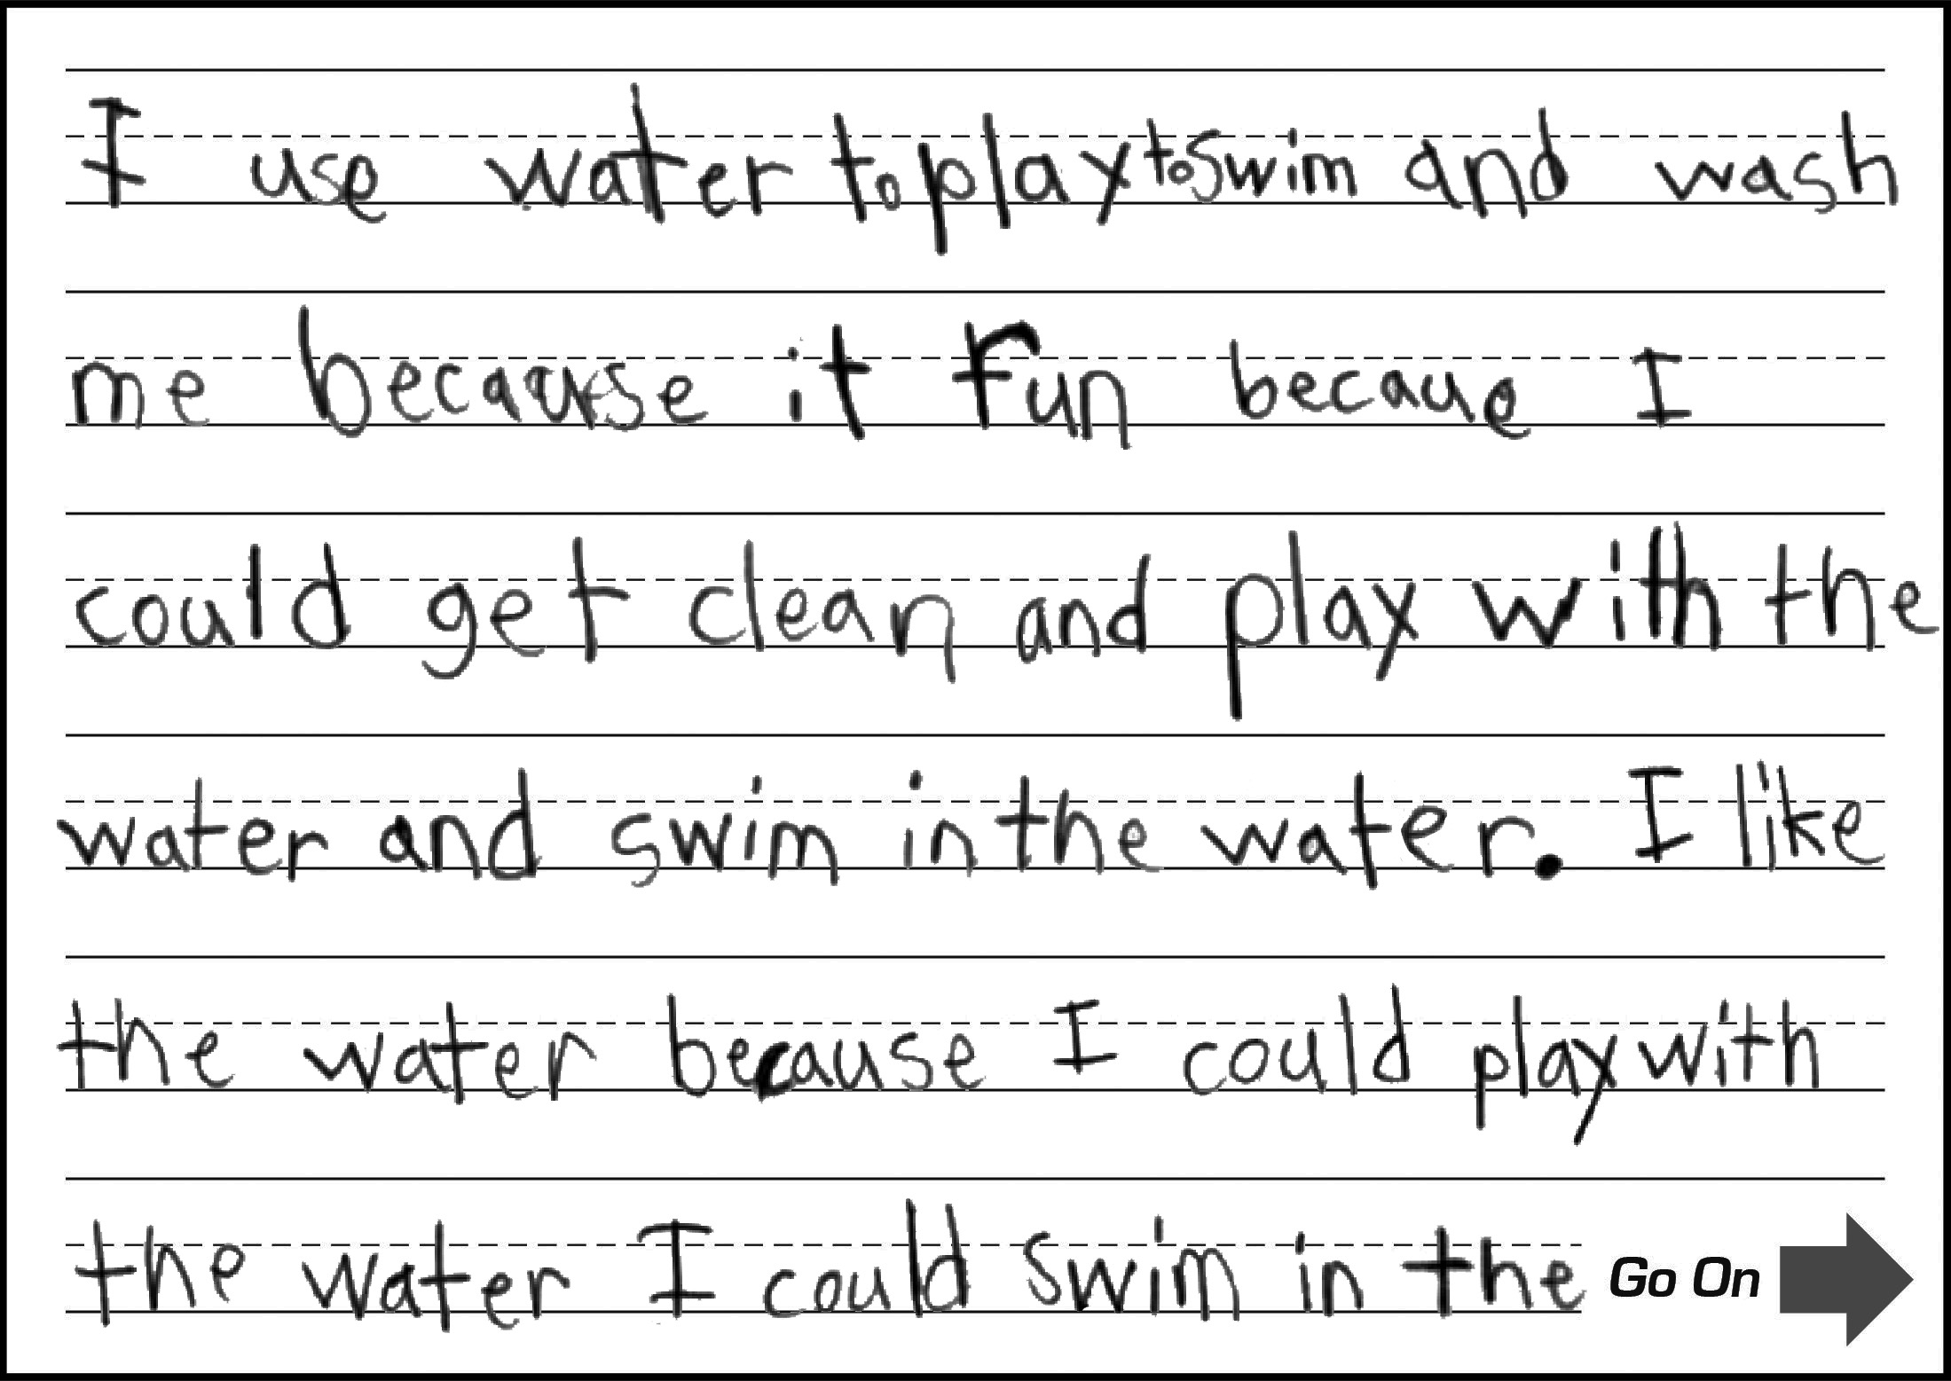
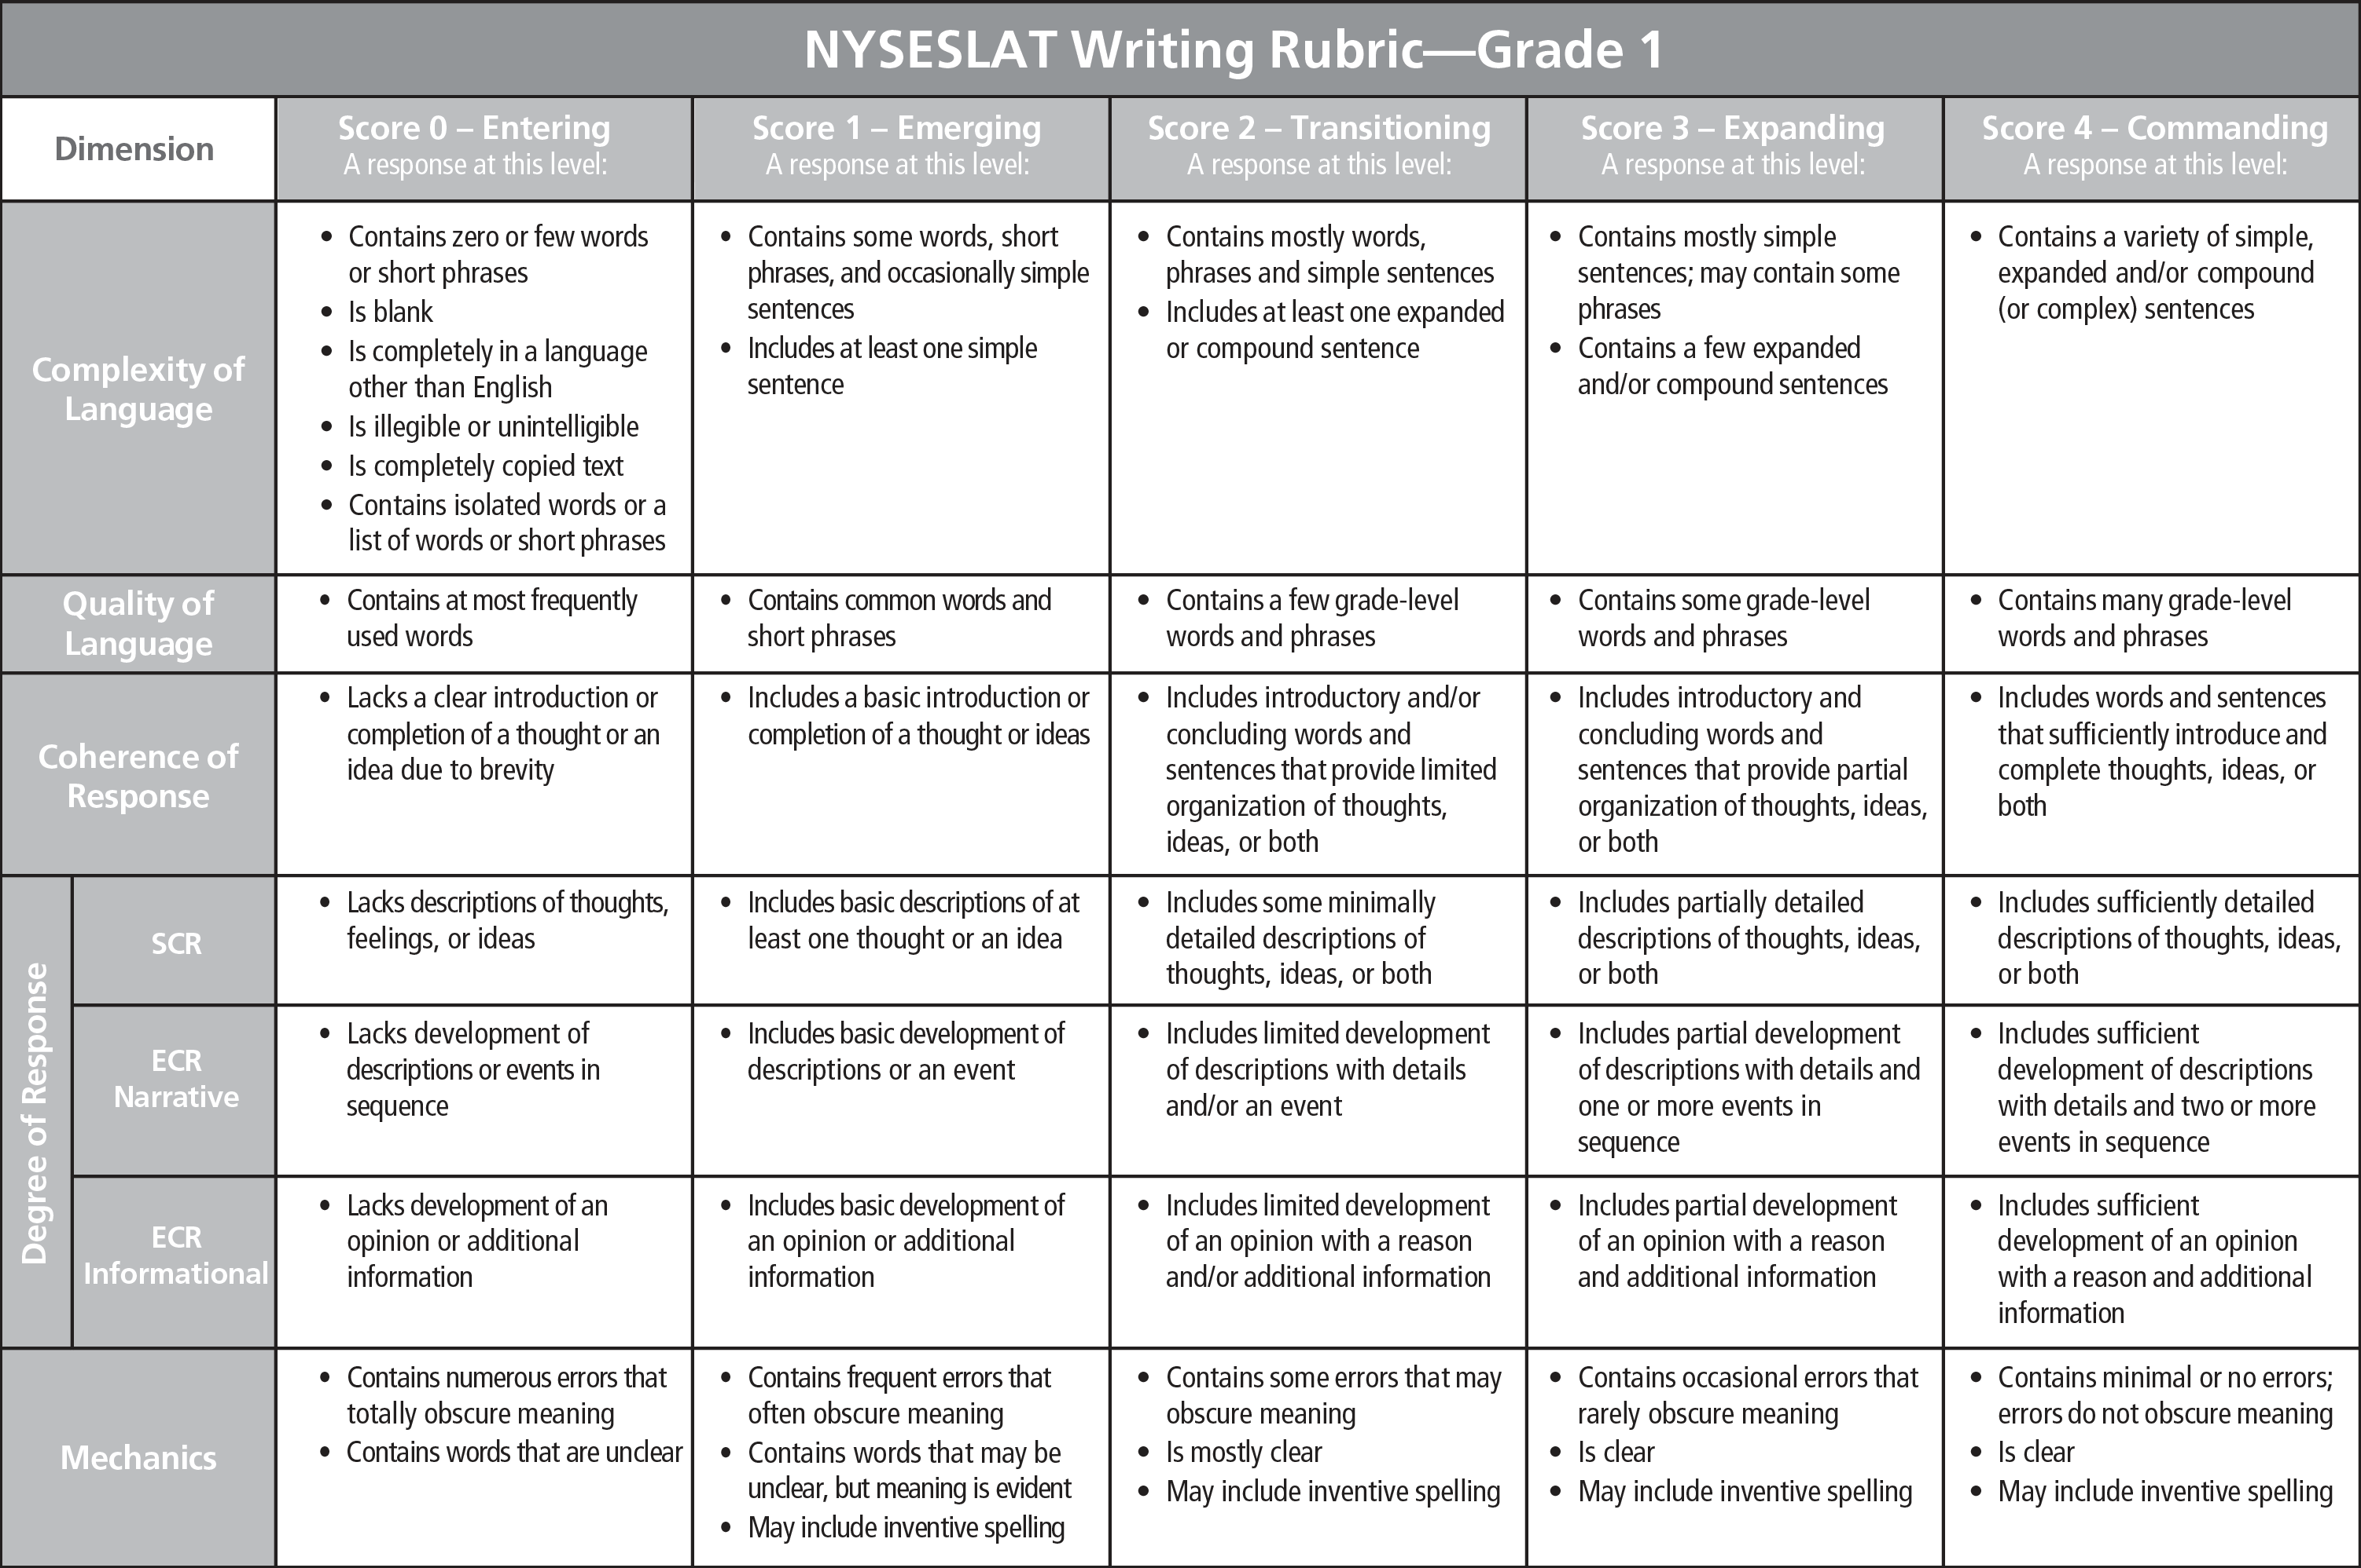
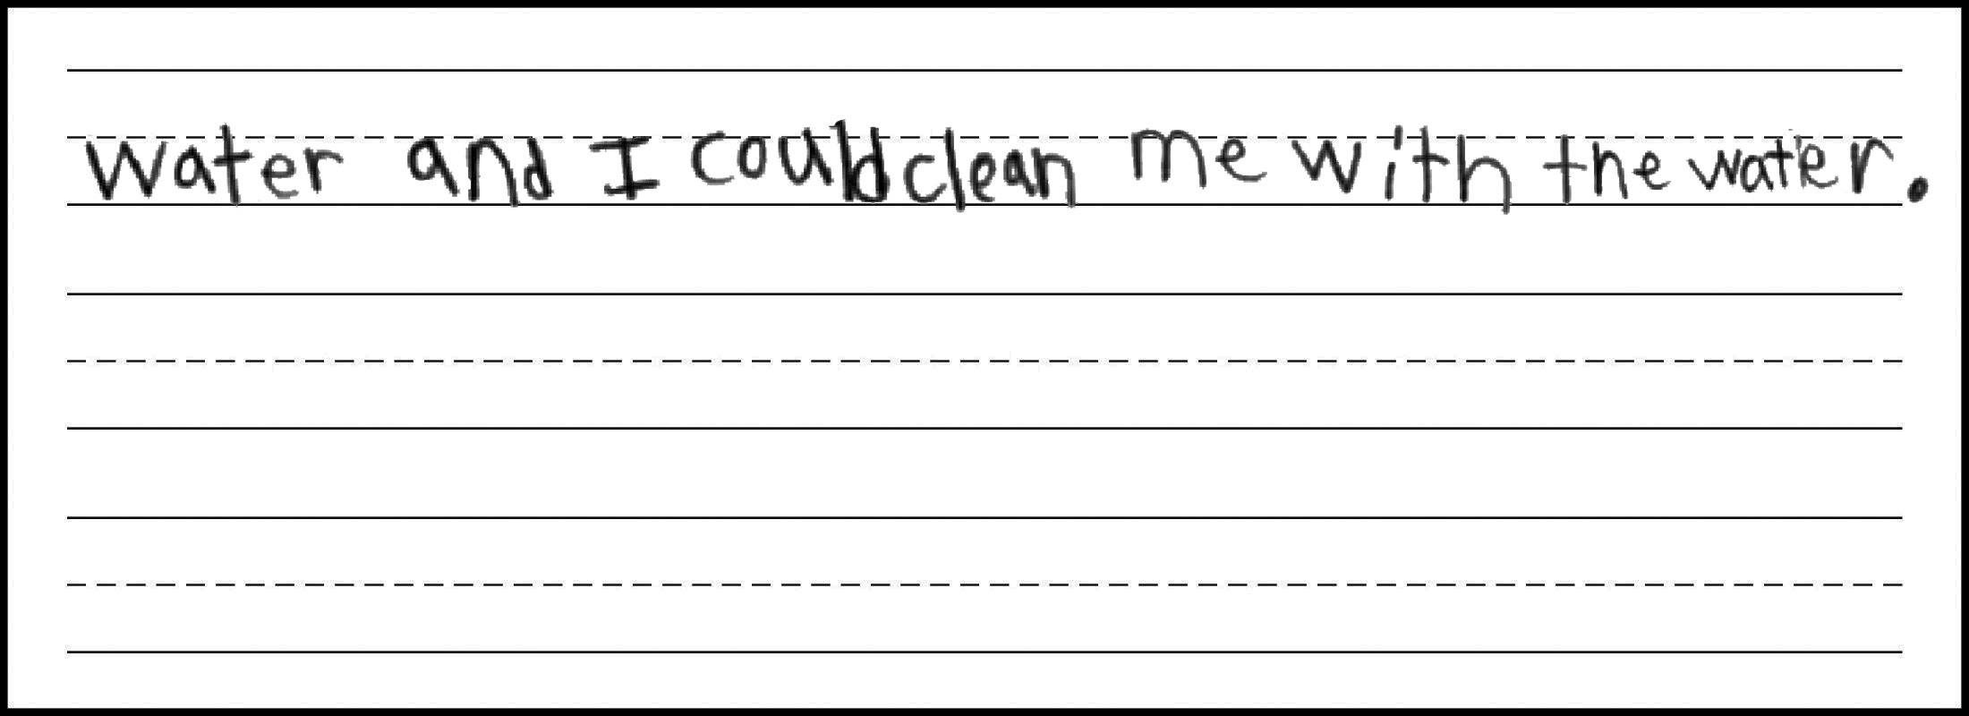
Grade 1: ECR Practice 1

Slide 11
Grade 1: ECR Practice 1
Score:
3
Expanding
CL
Response contains a few expanded, compound, and complex sentences (does not demonstrate a variety of sentences).
QL
Response contains some grade-level words and phrases (e.g., swim, wash me, get clean).
CR
Response includes introductory and concluding words and sentences that provide partial organization of thoughts, ideas, or both (has an introduction and logically connected ideas, but repetitive ideas limit clear sense of organization).
DR
Response includes partial development of an opinion with a reason and additional information (multiple ideas are listed, along with some elaborating details, but ideas are at times repetitive).
M
Response is clear and contains occasional errors that rarely obscure meaning (e.g., sentence structure errors: to play to swim, because it fun ; missing punctuation).

Slide 12
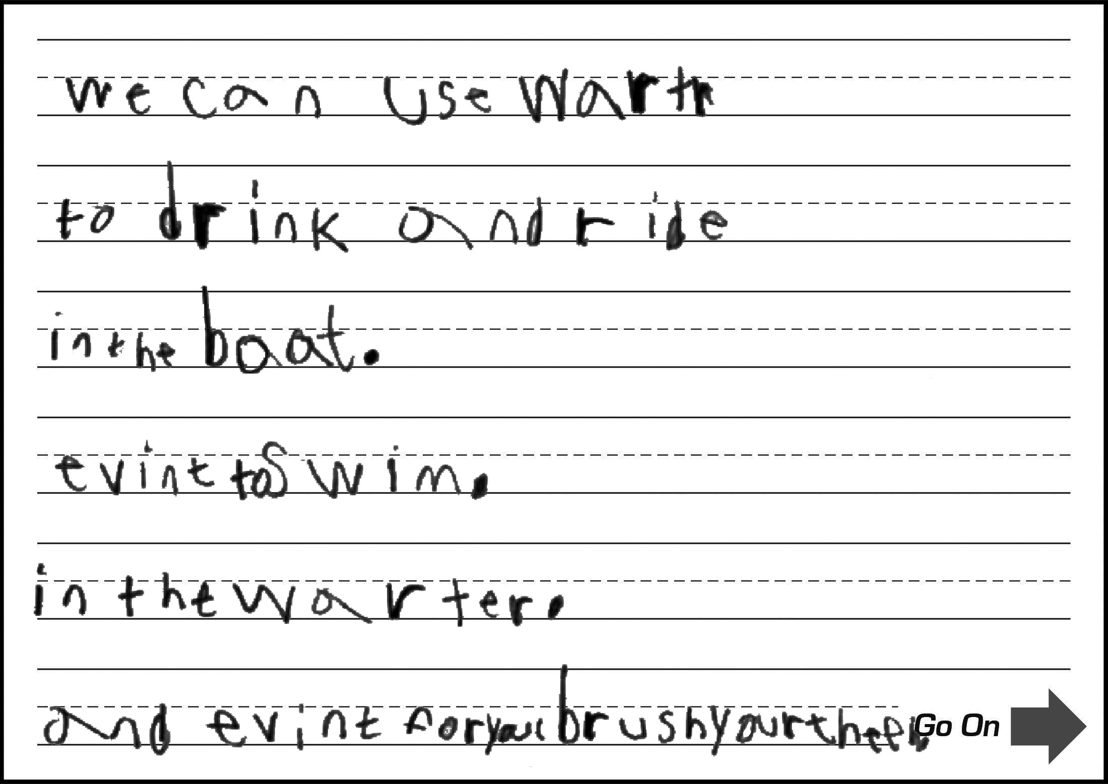
Grade 1: ECR Practice 2

Slide 13
Grade 1: ECR Practice 2
Score:
2
Transitioning
CL
Response contains phrases and includes at least one expanded sentence.
QL
Response contains a few grade-level words and phrases (e.g., ride in the boat).
CR
Response includes introductory and/or concluding words and sentences that provide limited organization of thoughts, ideas, or both (has an introduction and a few related ideas, but ideas lack clear organization).
DR
Response includes limited development of an opinion with a reason and/or additional information (lists several ideas about ways to use water, but they are described briefly with minimal development).
M
Response is mostly clear, but contains some errors that may obscure meaning (e.g., spelling errors: wartr/warter for water, evint for even, theeh for teeth; sentence fragments).

Slide 14
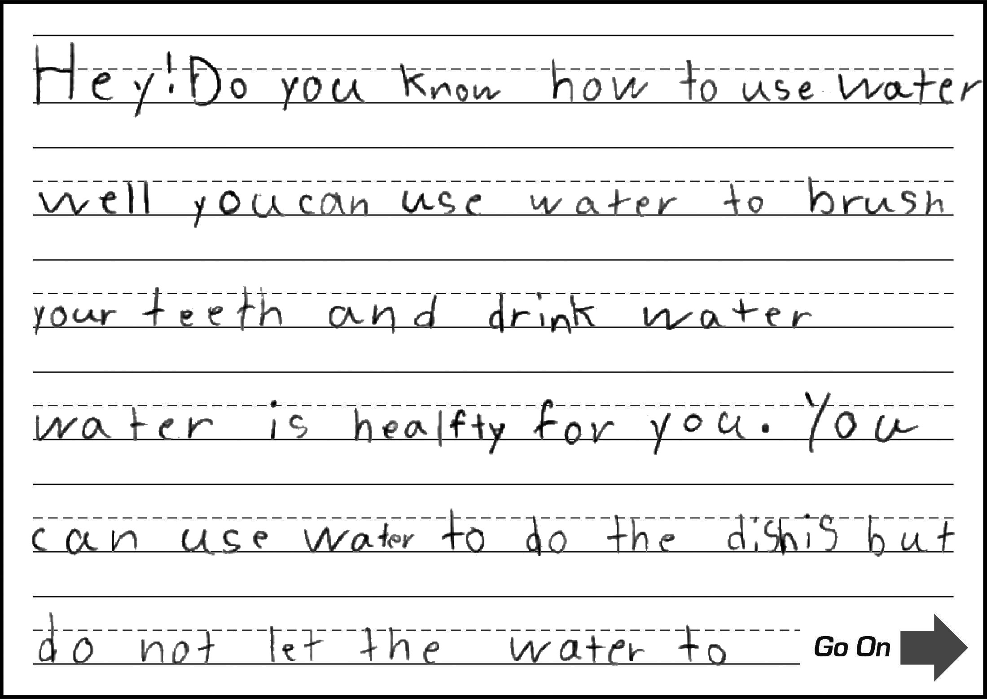
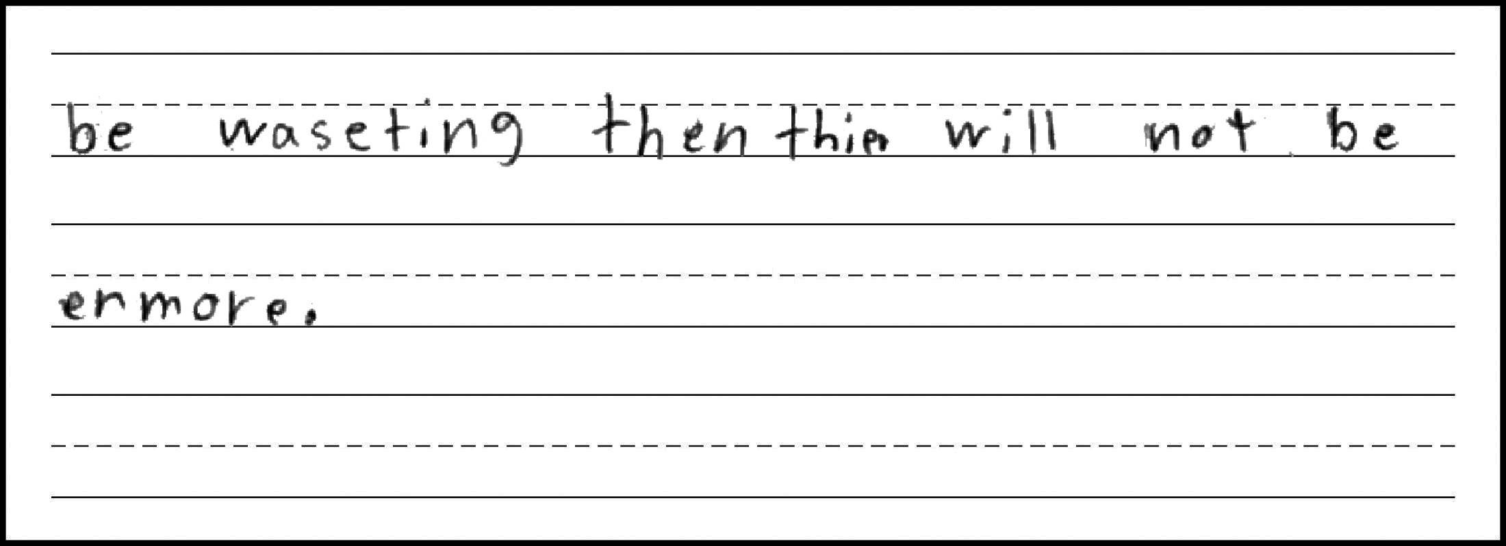
Grade 1: ECR Practice 3

Slide 15
Grade 1: ECR Practice 3
Score:
4
Commanding
CL
Response contains a variety of simple, expanded, compound, and complex sentences.
QL
Response contains many grade-level words and phrases
(e.g., brush your teeth, healthy, do the dishes, wasting).
CR
Response includes words and sentences that sufficiently introduce and complete thoughts, ideas, or both (has an introduction and a connected and cohesive progression of ideas).
DR
Response includes sufficient development of an opinion with a reason and additional information (lists multiple uses for water and elaborates on most with additional details).
M
Response is clear and contains occasional errors that rarely obscure meaning (e.g., punctuation errors).

Slide 16
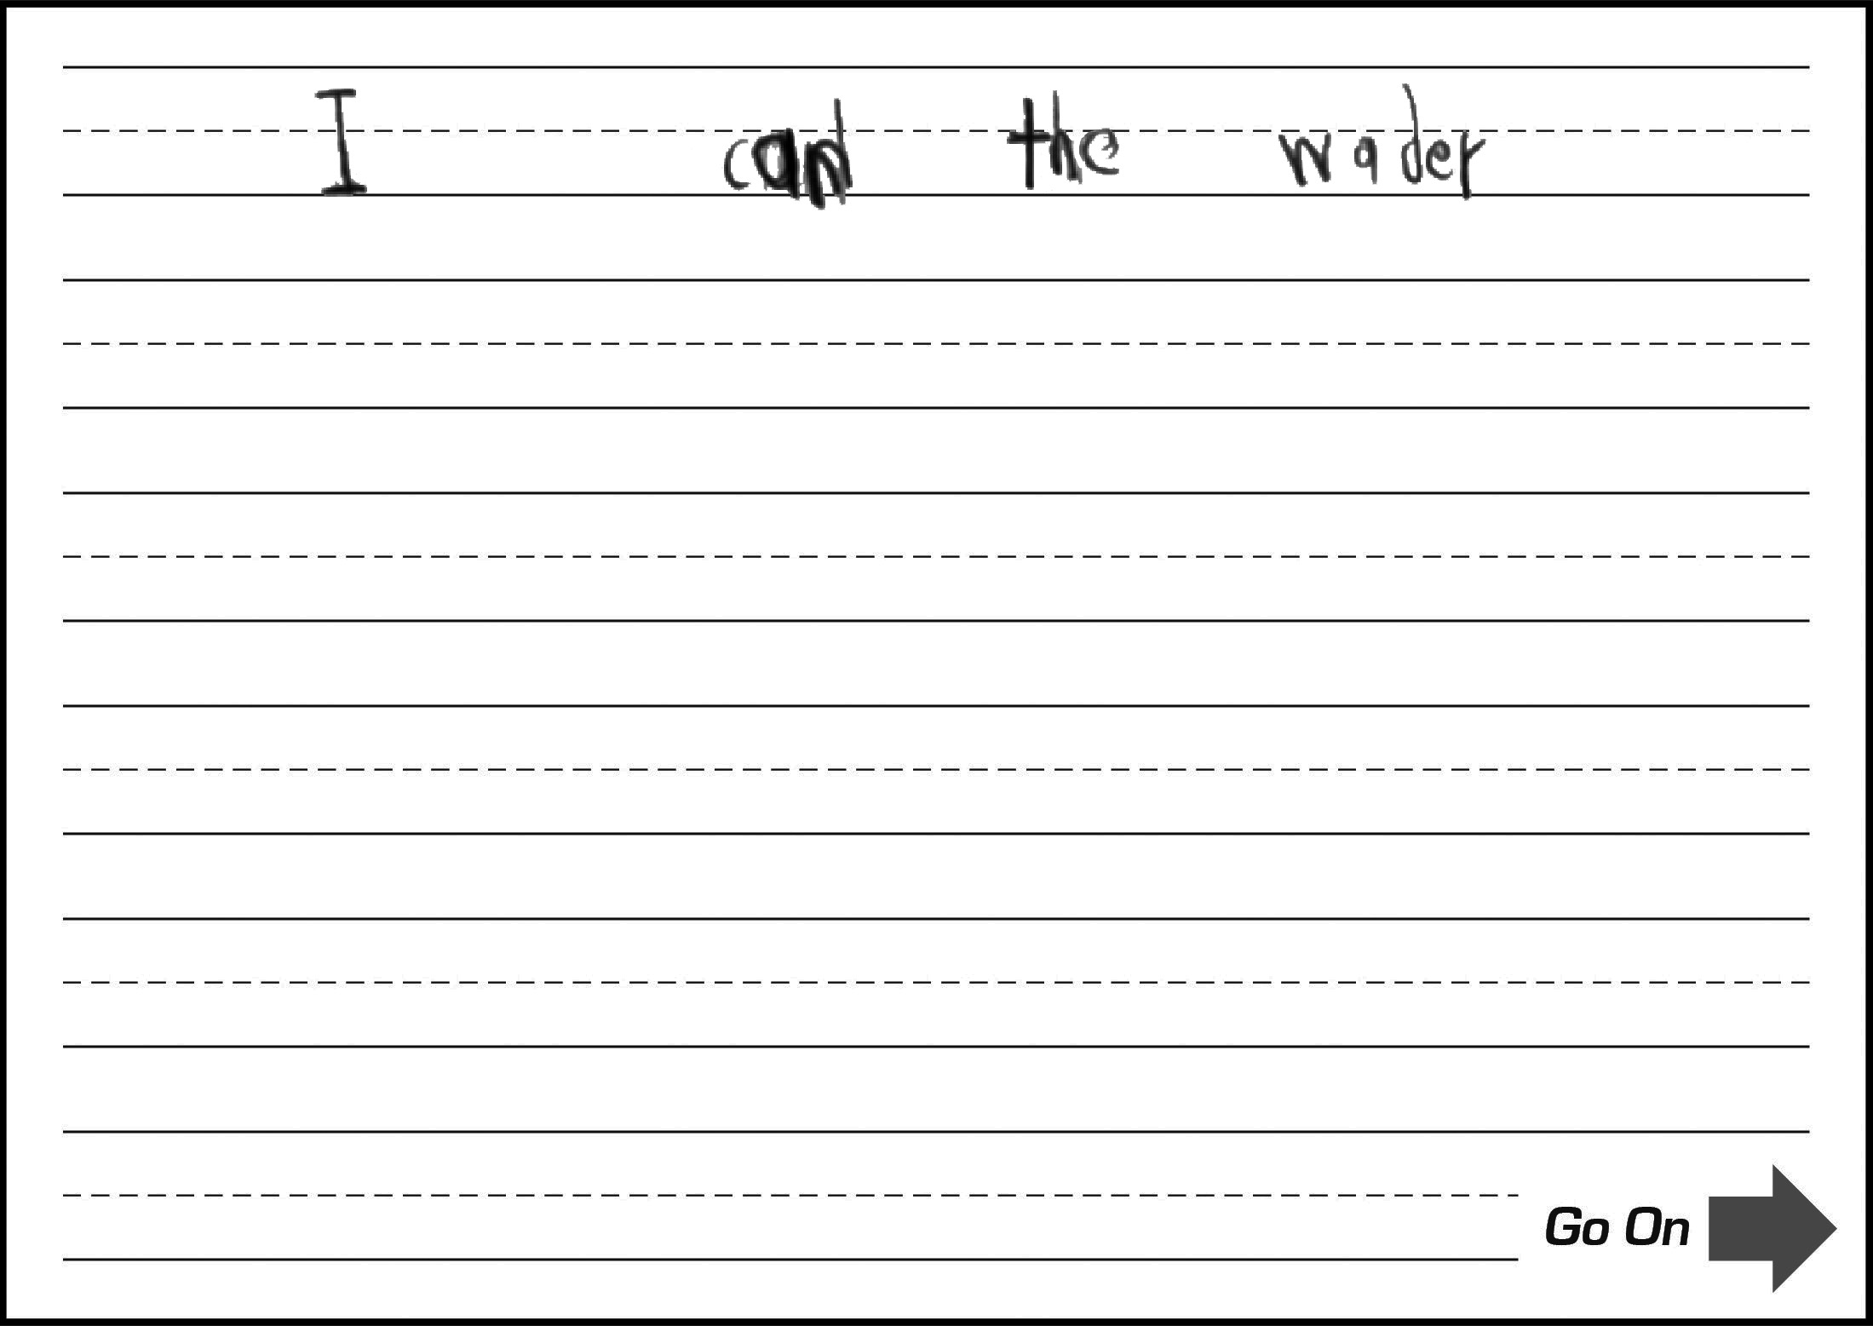
Grade 1: ECR Practice 4

Slide 17
Grade 1: ECR Practice 4
Score:
0
Entering
CL
Response contains few words or short phrases (no complete sentence present).
QL
Response contains at most frequently used words.
CR
Response lacks a clear introduction or completion of a thought or an idea due to brevity (no clear thought expressed).
DR
Response lacks development of an opinion or additional information
(no clear thought expressed).
M
Response contains numerous errors that totally obscure meaning
(no clear thought expressed).

Slide 18
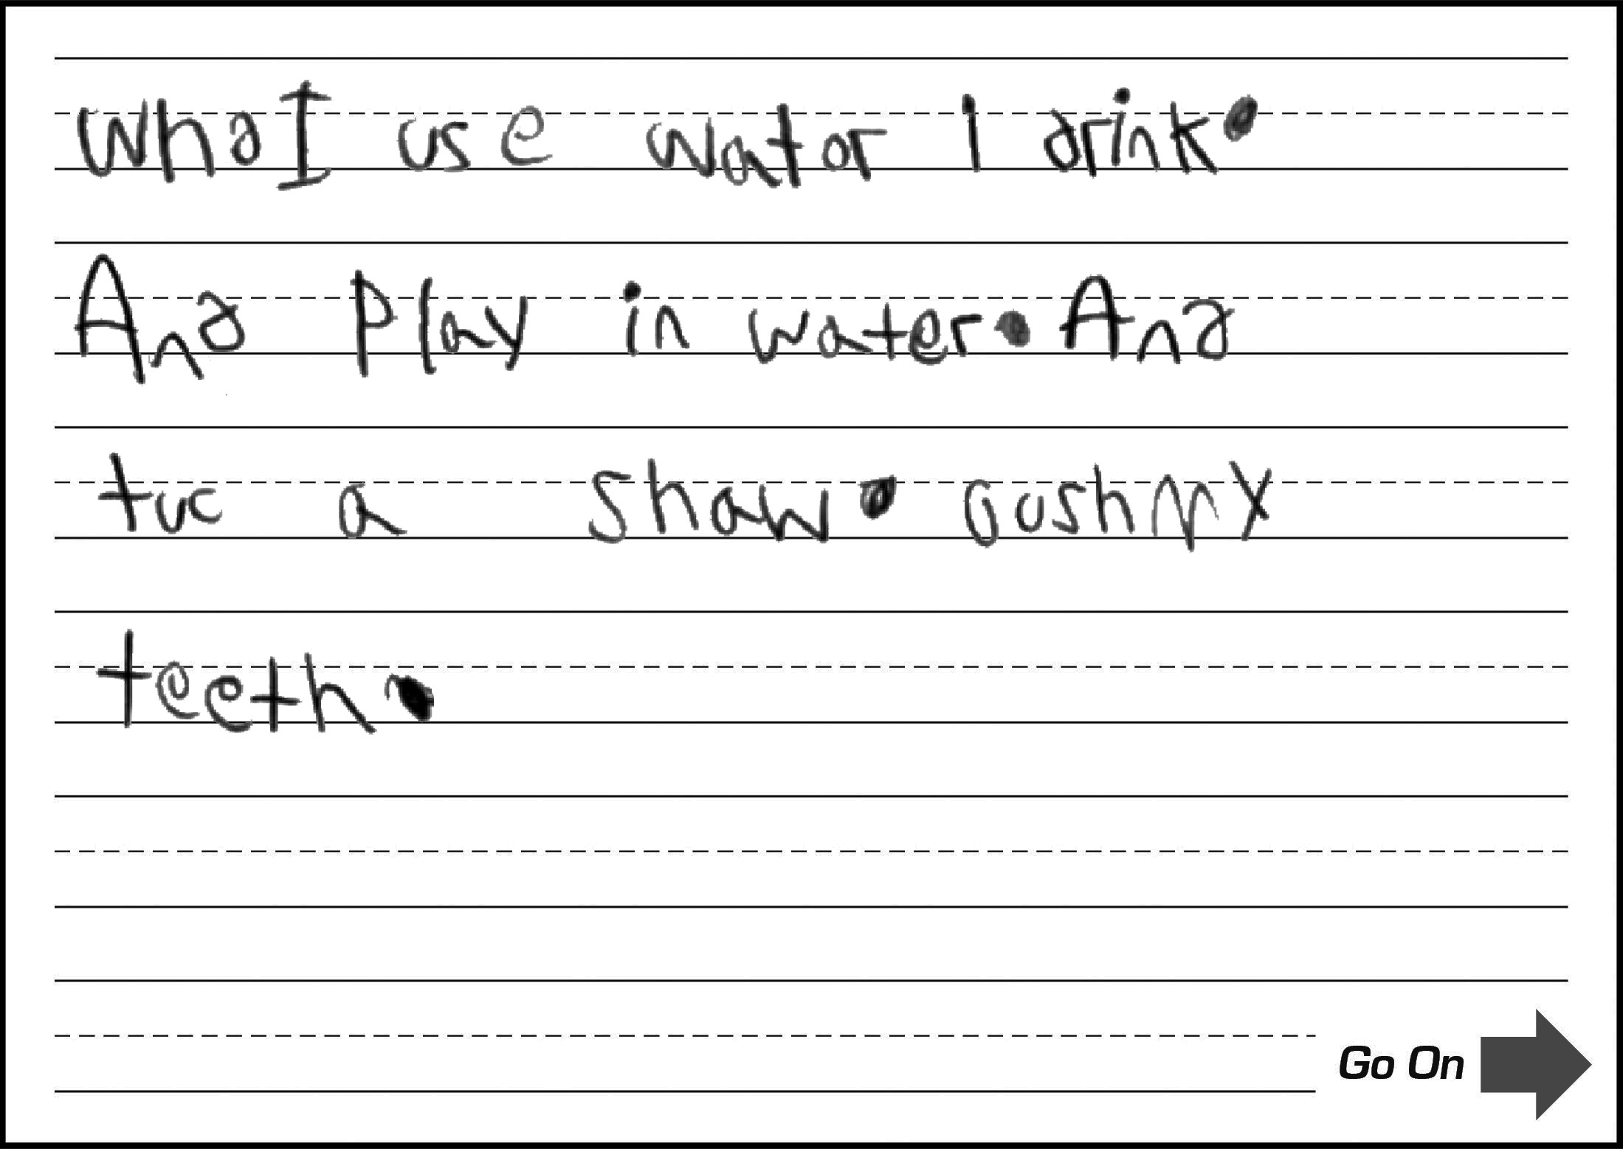
Grade 1: ECR Practice 5

Slide 19
Grade 1: ECR Practice 5
Score:
1
Emerging
CL
Response contains short phrases and includes at least one simple sentence (errors obscure attempts at advanced sentence structure).
QL
Response contains common words and short phrases
(errors often obscure language).
CR
Response includes a basic introduction or completion of a thought or ideas (errors obscure most ideas).
DR
Response includes basic development of an opinion or additional information (errors obscure development of most ideas).
M
Response contains frequent errors that often obscure meaning (frequent grammar and spelling errors).

Slide 20
NYSESLAT Resources
For Information or Assistance
Contact
Questions regarding testing policies, accommodations, security breaches and sensitive student responses
Office of State Assessment
emscassessinfo@nysed.gov 518.474.5902
Questions regarding the provisions of ELL services in Bilingual Education and World Languages programs
Bilingual Education and World Languages programs
obewl@nysed.gov
518.474.8775
718.722.2445
Questions regarding scoring of Speaking and Writing constructed-response questions or shipment of materials
MetriTech, Inc. Customer Service
nyseslat@metritech.com 800.747.4868
For regulatory or training assistance
Regional Bilingual Education Resource Networks
www.nysed.gov/bilingual-ed/regional-supportrberns
Machine-scannable answer sheets and local scanning services
RIC or Large-City Scanning Center
www.p12.nysed.gov/irs/sirs/ric-big5.html
Information about the NYSESLAT and regular updates including training materials and the School Administrator’s Manual (SAM)
NYSESLAT Homepage
www.nysed.gov/state-assessment/new-york-state-english-second-language-achievement-test-nyseslat

