Slide 1
Training for Administering and Scoring Writing

Slide 2
Grade 1 Writing Scoring: Training Overview
Writing Rubric Review
Short Constructed-Response (SCR) Review
Extended Constructed-Response (ECR) Review
Sample Student Responses
Sample Student Responses
Scoring Practice
Scoring Practice

Slide 3
Statewide Scoring Rules for Writing
All of the student responses to the constructed-response questions must be scored by committees of New York State teachers who are specially trained in the scoring of the NYSESLAT.
The Grades 1–12 NYSESLAT is composed of three Listening/Reading/Writing test sessions. Each session contains one constructed-response task. Student responses to the three Writing tasks on the tests must be divided among three scorers, so that no one teacher scores more than one constructed-response task per student.
No teacher who is a student’s English as a New Language, Bilingual Education, or English Language Arts teacher may score any of the constructed-response questions in that student’s test booklets. The principal is responsible for making the final determination as to whether or not a teacher may score specific students’ responses based on this scoring policy.

Slide 4
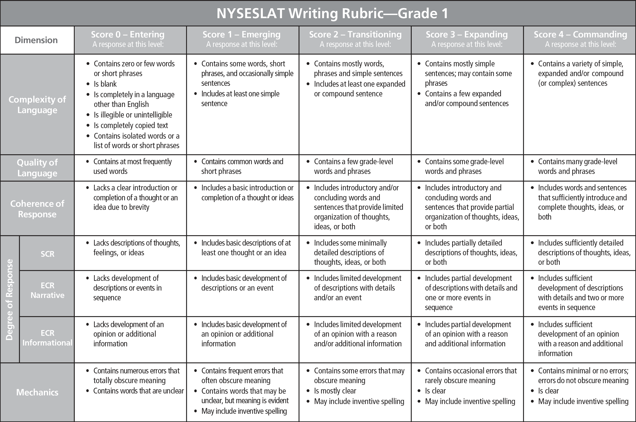
NYSESLAT Writing Rubric Overview

Slide 5
Five Rubric Dimensions
CL
Complexity of Language
I like eating ice cream.
Simple Sentence
I like eating ice cream on a hot day.
Expanded Sentence
I like eating ice cream, and chocolate is my favorite flavor.
Compound Sentence
I like eating ice cream because it tastes delicious.
Complex Sentence

Slide 6
Five Rubric Dimensions
CL
Complexity of Language
0
Entering
Contains zero or few words or short phrases
Is blank
Is completely in a language other than English
Is illegible or unintelligible
Is completely copied text
Contains isolated words or a list of words or short phrases
1
Emerging
Contains some words, short phrases, and occasionally simple sentences
Includes at least one simple sentence
Grade 1
2
Transitioning
Contains mostly words, phrases and simple sentences
Includes at least one expanded or compound sentence
3
Expanding
Contains mostly simple sentences; may contain some phrases
Contains a few expanded and/or compound sentences
4
Commanding
Contains a variety of simple, expanded and/or compound (or complex) sentences

Slide 7
Five Rubric Dimensions
QL
Quality of Language
0
Entering
Contains at most frequently used words
1
Emerging
Contains common words and short phrases
2
Transitioning
Contains a few grade-level words and phrases
Grade 1
3
Expanding
Contains some grade-level words and phrases
4
Commanding
Contains many grade-level words and phrases

Slide 8
Five Rubric Dimensions
CR
Coherence of Response
0
Entering
Lacks a clear introduction or completion of a thought or an idea due to brevity
1
Emerging
Includes a basic introduction or completion of a thought or ideas
2
Transitioning
Includes introductory and/or concluding words and sentences that provide limited organization of thoughts, ideas, or both
Grade 1
3
Expanding
Includes introductory and concluding words and sentences that provide partial organization of thoughts, ideas, or both
4
Commanding
Includes words and sentences that sufficiently introduce and complete thoughts, ideas, or both

Slide 9
Five Rubric Dimensions
DR
Degree of Response (SCR)
0
Entering
Lacks descriptions of thoughts, feelings, or ideas
1
Emerging
Includes basic descriptions of at least one thought or an idea
2
Transitioning
Includes some minimally detailed descriptions of thoughts, ideas, or both
Grade 1
3
Expanding
Includes partially detailed descriptions of thoughts, ideas, or both
4
Commanding
Includes sufficiently detailed descriptions of thoughts, ideas, or both

Slide 10
Five Rubric Dimensions
M
Mechanics
0
Entering
Contains numerous errors that totally obscure meaning
Contains words that are unclear
1
Emerging
Contains frequent errors that often obscure meaning
Contains words that may be unclear, but meaning is evident
May include inventive spelling
2
Transitioning
Contains some errors that may obscure meaning
Is mostly clear
May include inventive spelling
Grade 1
3
Expanding
Contains occasional errors that rarely obscure meaning
Is clear
May include inventive spelling
4
Commanding
Contains minimal or no errors; errors do not obscure meaning
Is clear
May include inventive spelling

Slide 11
Application of the Holistic Writing Rubrics
Become familiar with the Grade 1 rubric
Become familiar with the passage and prompt
Read the response to the prompt
Student responses are evaluated for total, overall performance
Scores are assigned based on the criteria delineated in the rubric
Match evidence from the response to the language of the rubric
Look for what is included in the response, not what is missing
The highest point on a rubric scale does not measure a “perfect” response
On the written tests, factual accuracy and handwriting do not count in scoring

Slide 12
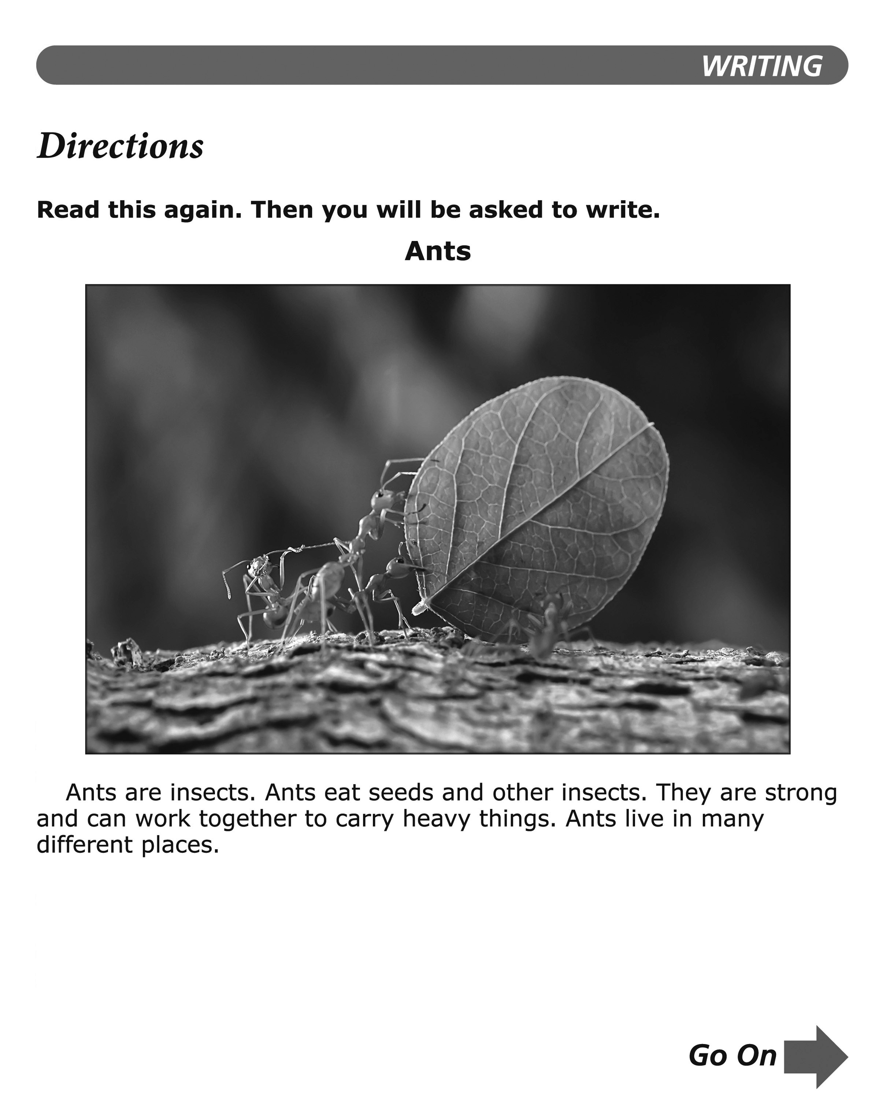
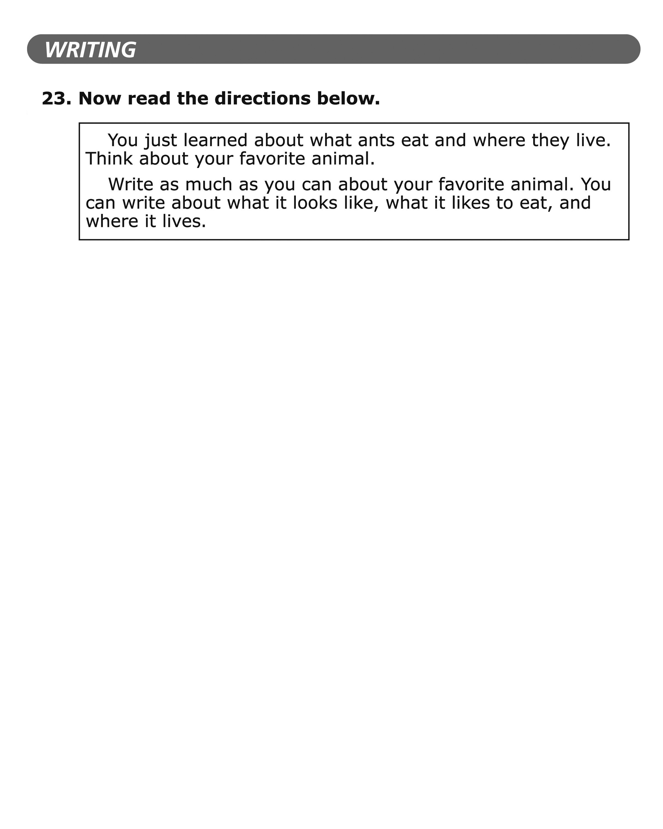
Grade 1: SCR Prompt

Slide 13
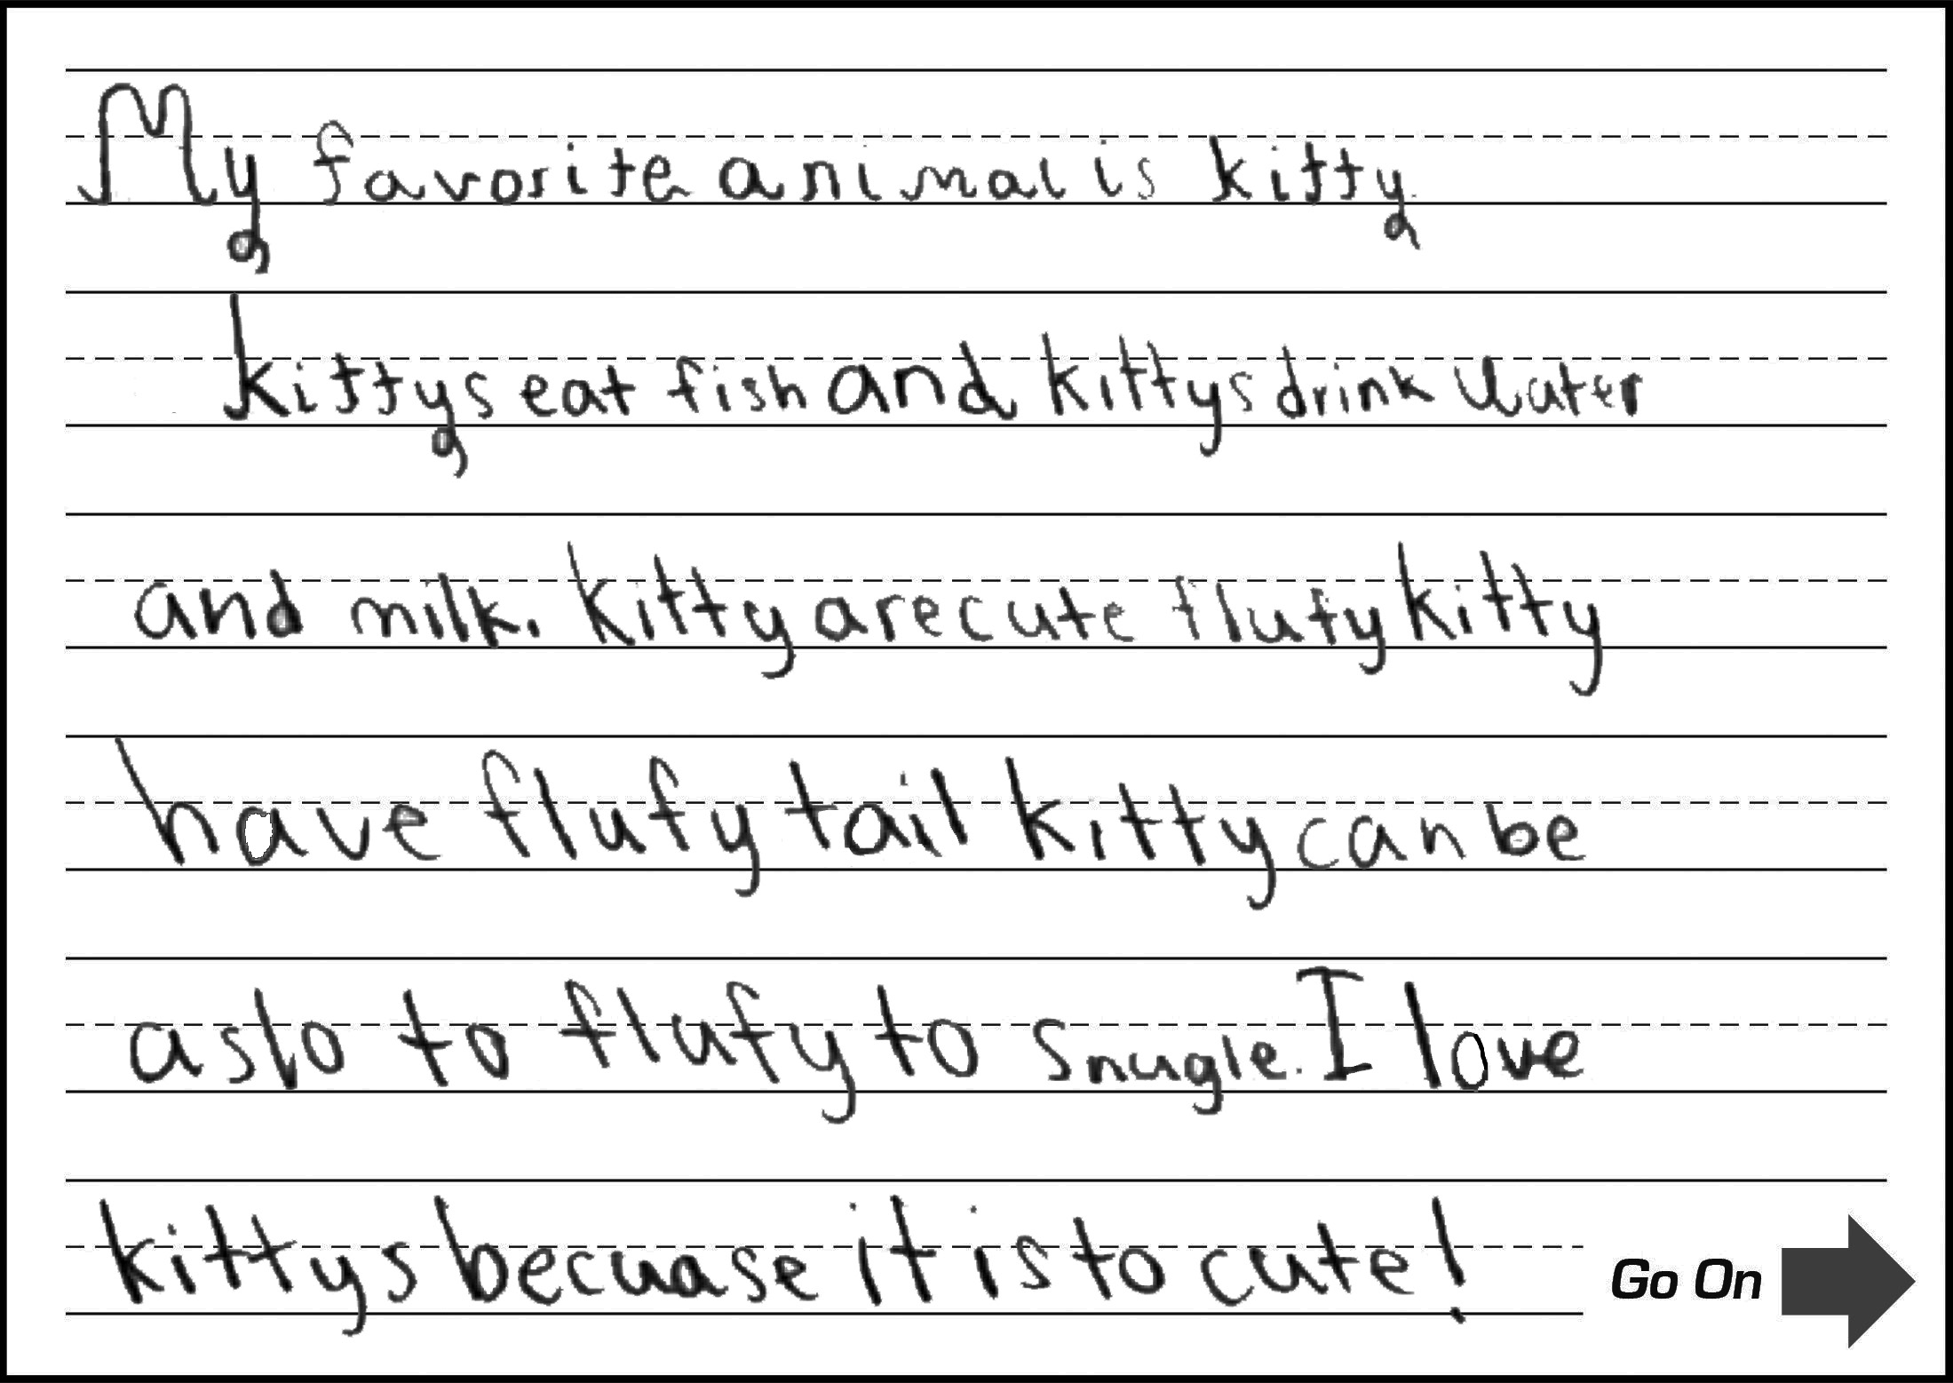
Grade 1: SCR Sample 1
Score:
4
Commanding
CL
Response contains a variety of simple, expanded, compound, and complex sentences.
QL
Response contains many grade-level words and phrases (e.g., fish, milk, cute, fluffy tail, snuggle).
CR
Response includes words and sentences that sufficiently introduce and complete thoughts, ideas, or both (has an introduction, conclusion, and clear and organized progression of ideas).
DR
Response includes sufficiently detailed descriptions of thoughts, ideas, or both (lists many characteristics of cats and elaborates on them with specific details).
M
Response is clear and contains minimal errors; errors do not obscure meaning.

Slide 14
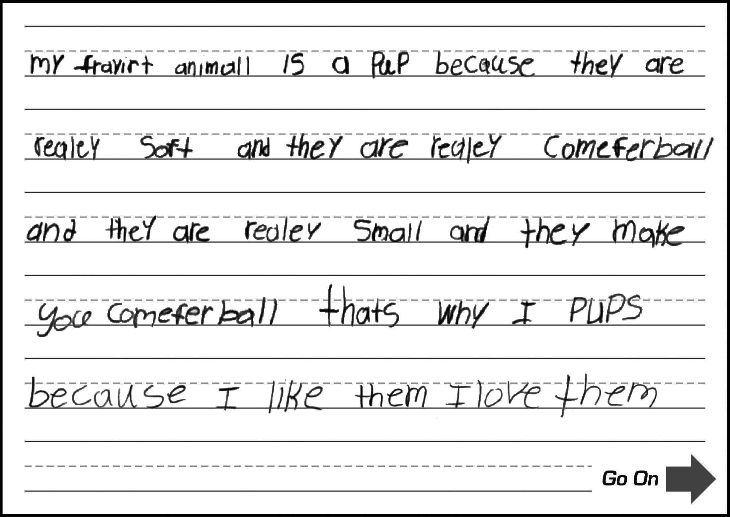
Grade 1: SCR Sample 2
Score:
3
Expanding
CL
Response contains a few compound and complex sentences (does not demonstrate a variety of sentence structures).
QL
Response contains some grade-level words and phrases (e.g., soft, really small, make you comfortable).
CR
Response includes introductory and concluding words and sentences that provide partial organization of thoughts, ideas, or both (has an introduction, related ideas, and conclusion; repetitive language at times hinders organization of ideas).
DR
Response includes partially detailed descriptions of thoughts, ideas, or both (lists multiple specific descriptions, but ideas lack sufficient detail).
M
Response is clear and contains occasional errors that rarely obscure meaning (e.g., spelling errors: fravirt for favorite, comeferball for comfortable; missing words: that's why I pups).

Slide 15
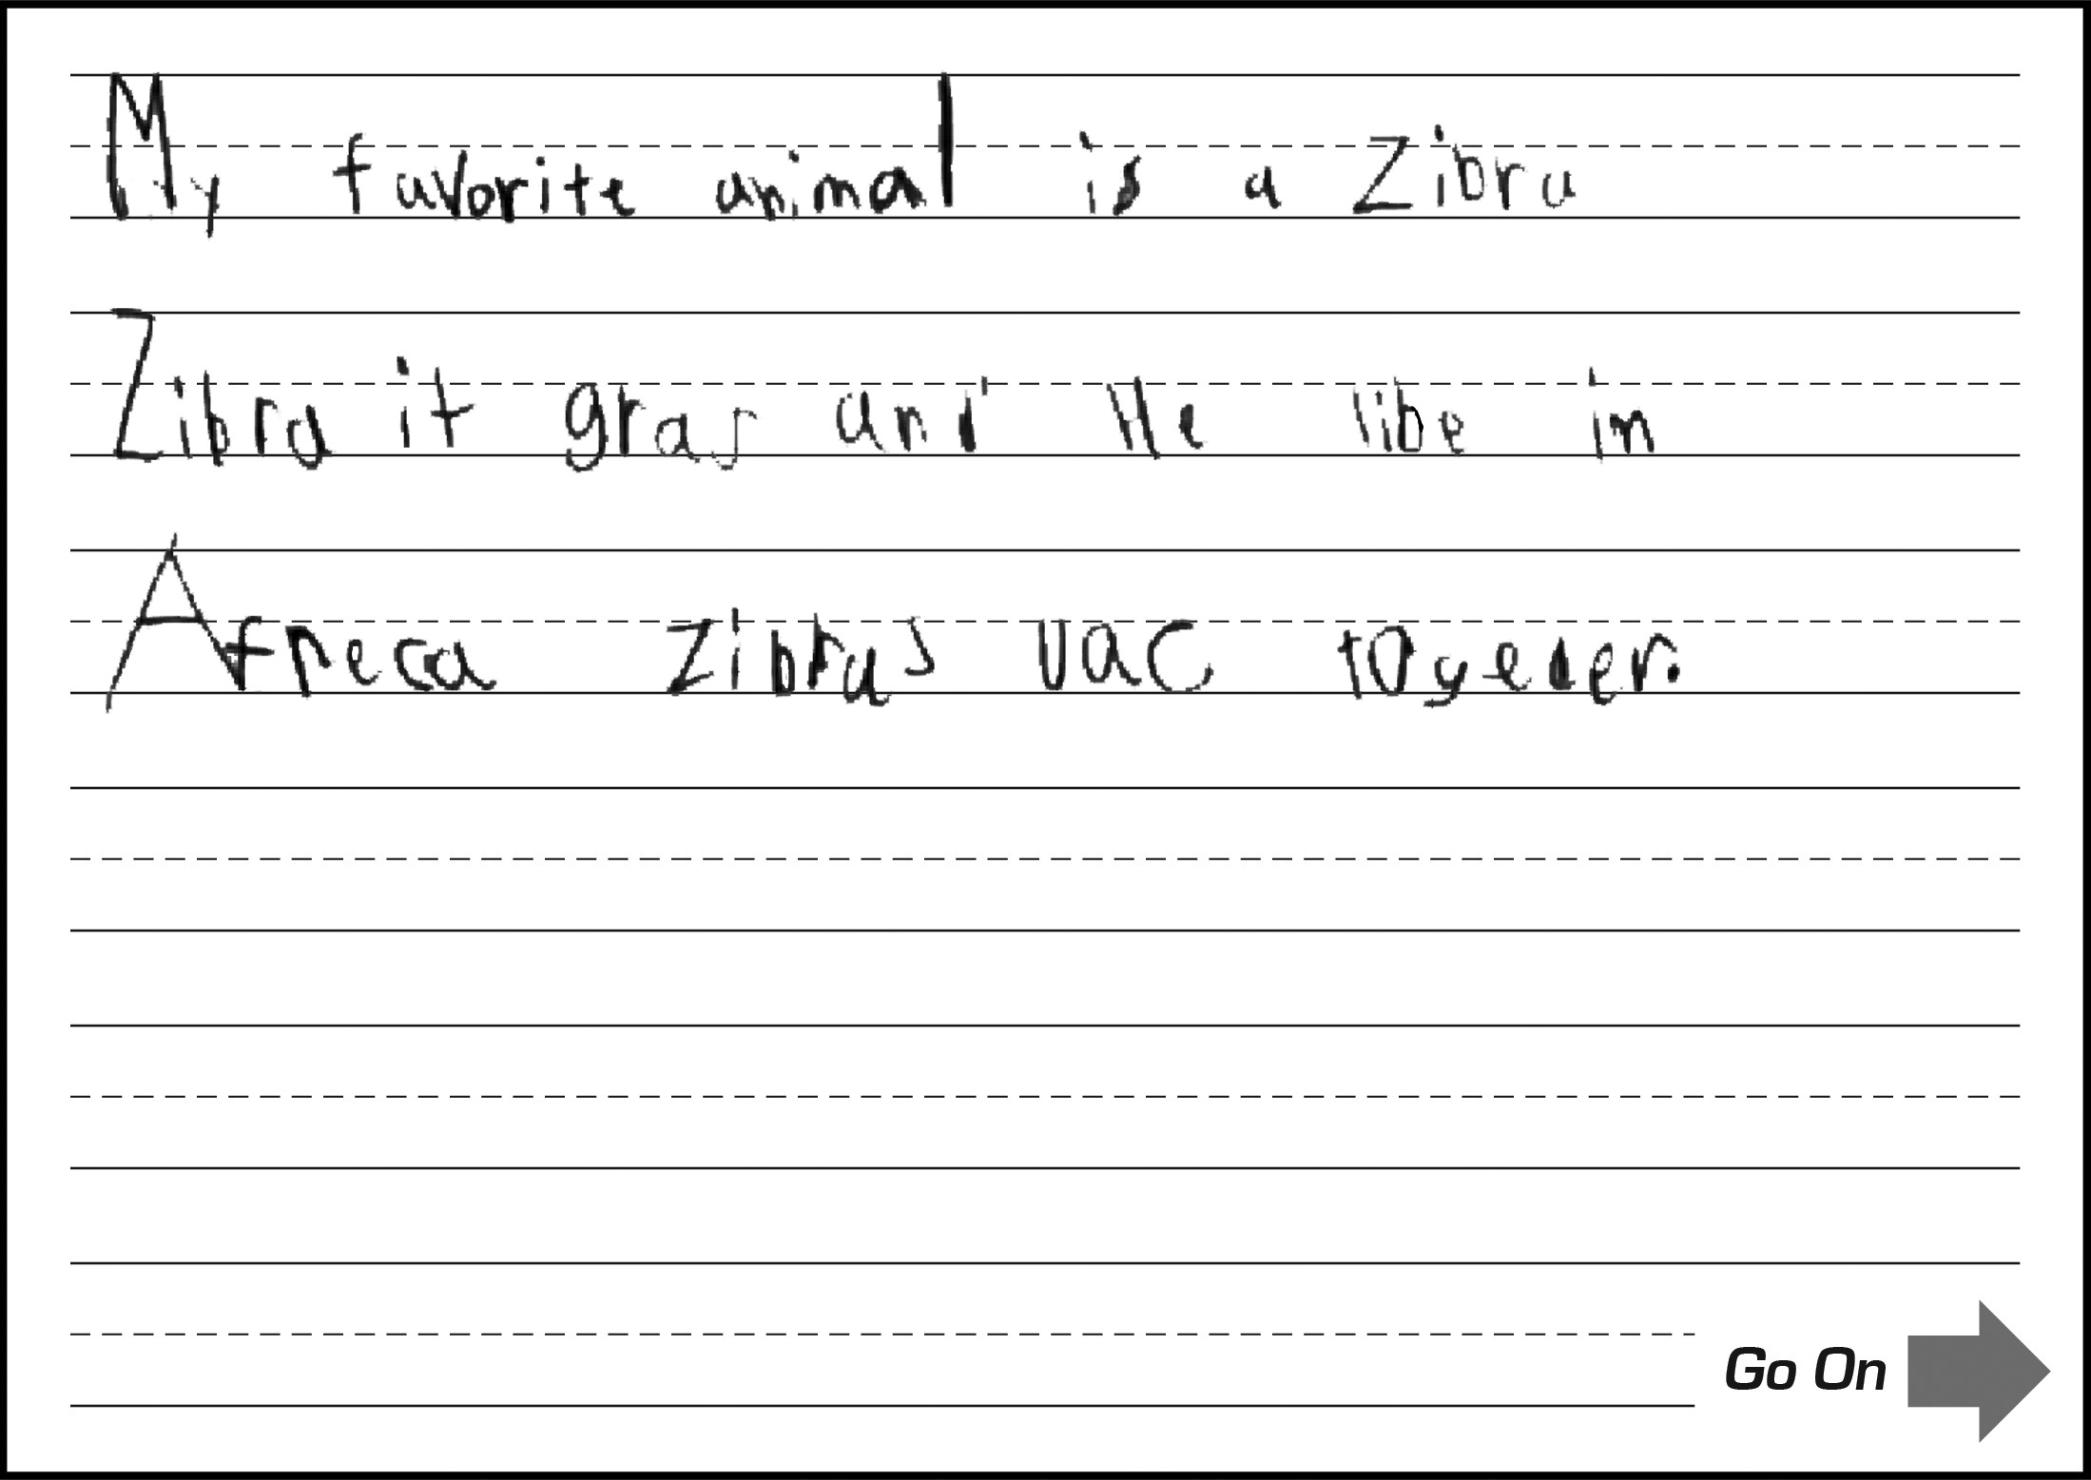
Grade 1: SCR Sample 3
Score:
2
Transitioning
CL
Response contains mostly simple sentences and includes at least one compound sentence.
QL
Response contains a few grade-level words and phrases (e.g., grass).
CR
Response includes introductory and/or concluding words and sentences that provide limited organization of thoughts, ideas, or both (has an introduction and a few related ideas).
DR
Response includes some minimally detailed descriptions of thoughts, ideas, or both (a few brief descriptions with minimal elaboration).
M
Response is mostly clear, but contains some errors that may obscure meaning (e.g., spelling errors: it for eat, libe for life, vac for walk).

Slide 16
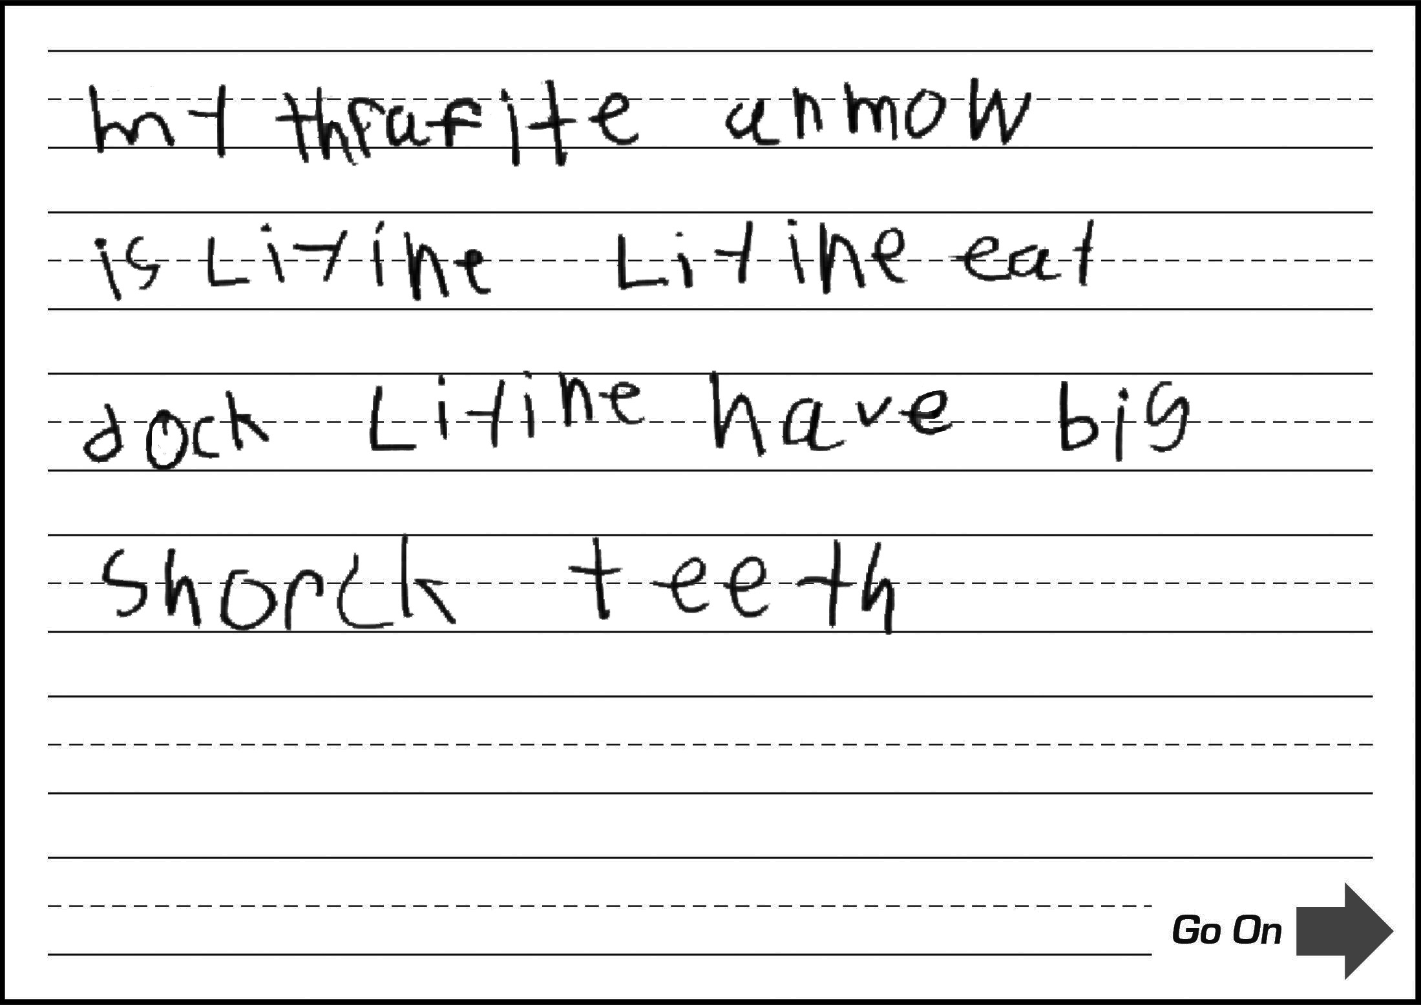
Grade 1: SCR Sample 4
Score:
1
Emerging
CL
Response includes at least one simple sentence.
QL
Response contains a few grade-level words and phrases
(e.g., teeth ; errors often obscure language).
CR
Response includes a basic introduction or completion of a thought or ideas (errors often obscure ideas).
DR
Response includes basic descriptions of at least one thought or an idea (errors often obscure descriptions).
M
Response contains frequent errors that often obscure meaning (frequent impeding spelling errors).

Slide 17
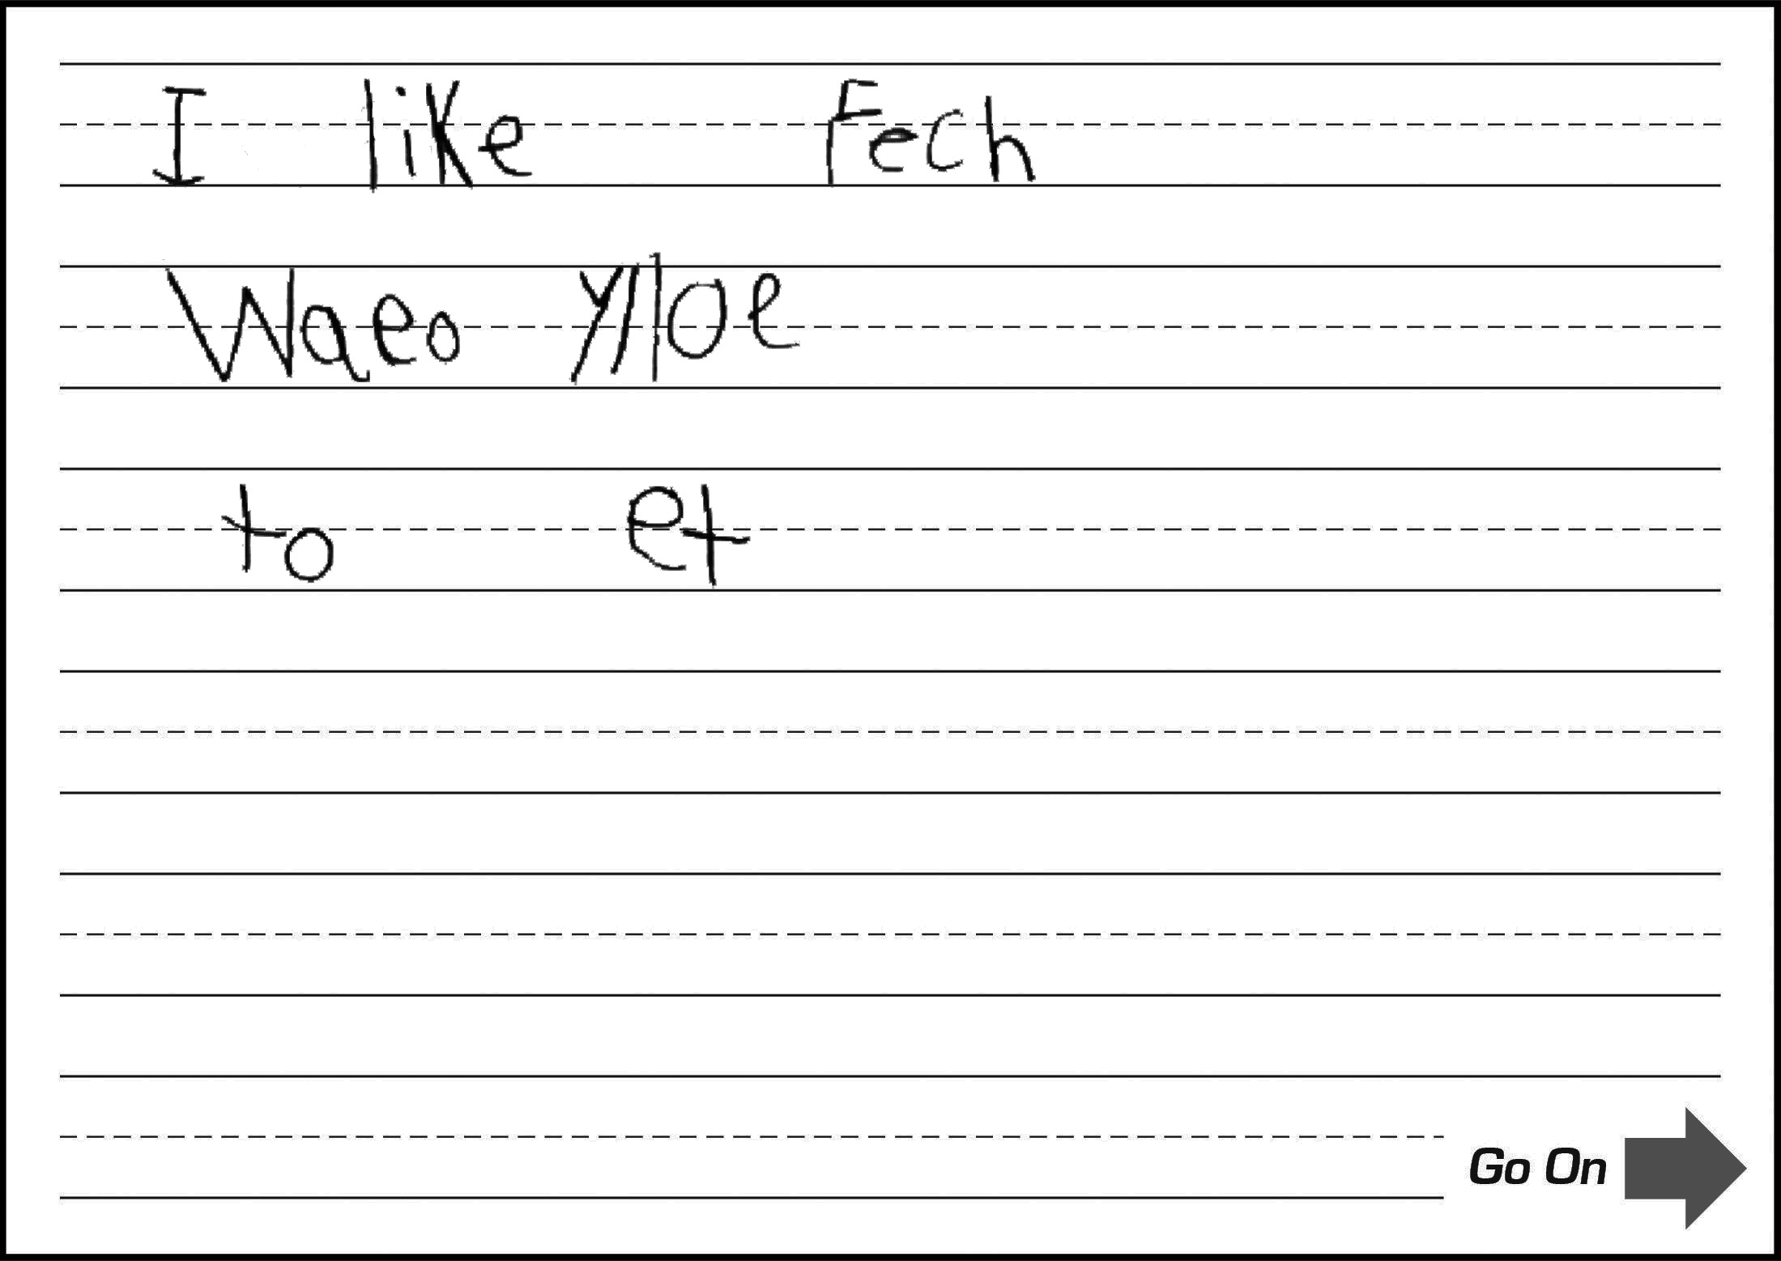
Grade 1: SCR Sample 5
Score:
0
Entering
CL
Response contains few words or short phrases (errors impede successful development of sentence structure; only words and short phrases are comprehensible).
QL
Response contains at most frequently used words (errors obscure most language).
CR
Response lacks a clear introduction or completion of a thought or an idea due to brevity (no clear, complete thought).
DR
Response lacks descriptions of thoughts, feelings, or ideas (no clear, complete thought).
M
Response contains numerous errors that totally obscure meaning (no clear, complete thought).

Slide 18
Practice Time

Slide 19
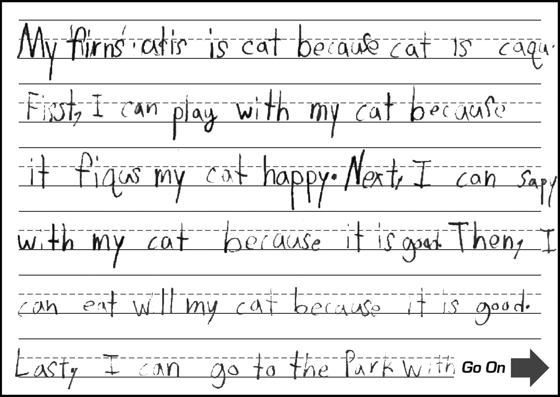
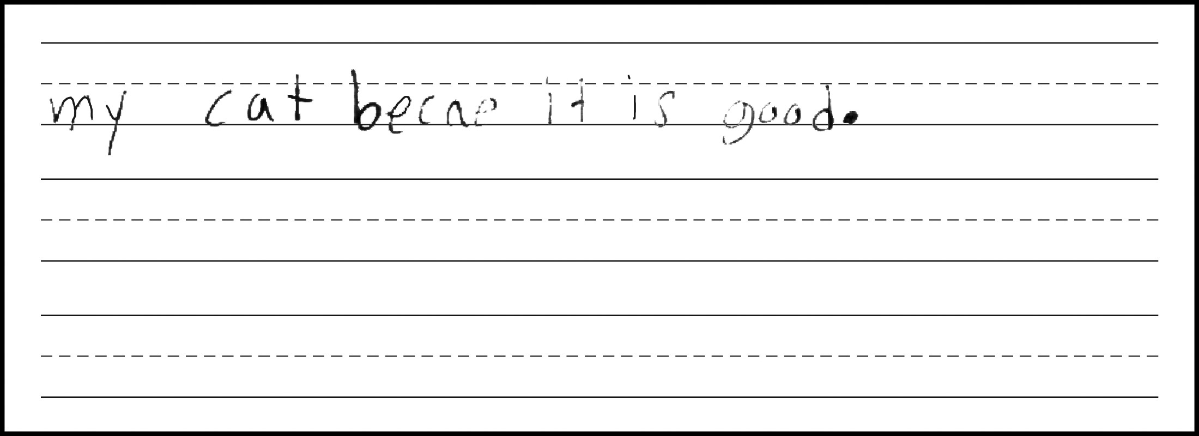
Grade 1: SCR Practice 1

Slide 20
Grade 1: SCR Practice 1
Score:
2
Transitioning
CL
Response includes at least one complex sentence (consists primarily of a single repetitive sentence structure).
QL
Response contains a few grade-level words and phrases (e.g., park ; errors often obscure language).
CR
Response includes introductory and/or concluding words and sentences that provide limited organization of thoughts, ideas, or both (has varied transitions throughout to provide some organization, but impeding errors often obscure ideas and limit the organization and connection of ideas).
DR
Response includes some minimally detailed descriptions of thoughts, ideas, or both (a few descriptions with some repetitive details; errors obscure multiple descriptions).
M
Response contains frequent errors that often obscure meaning (frequent impeding spelling errors).

Slide 21
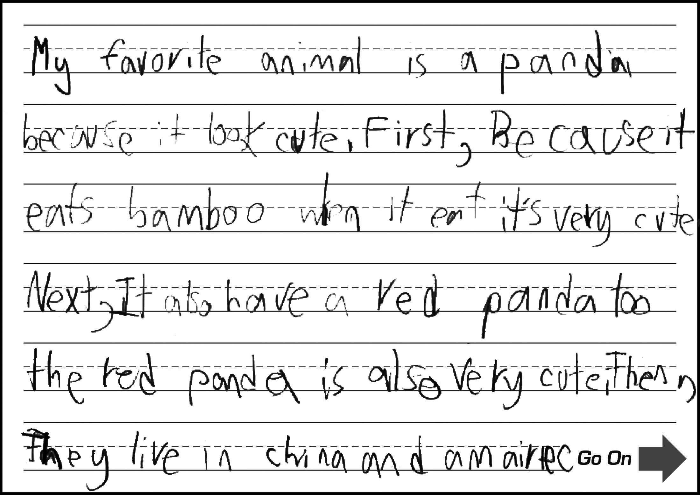
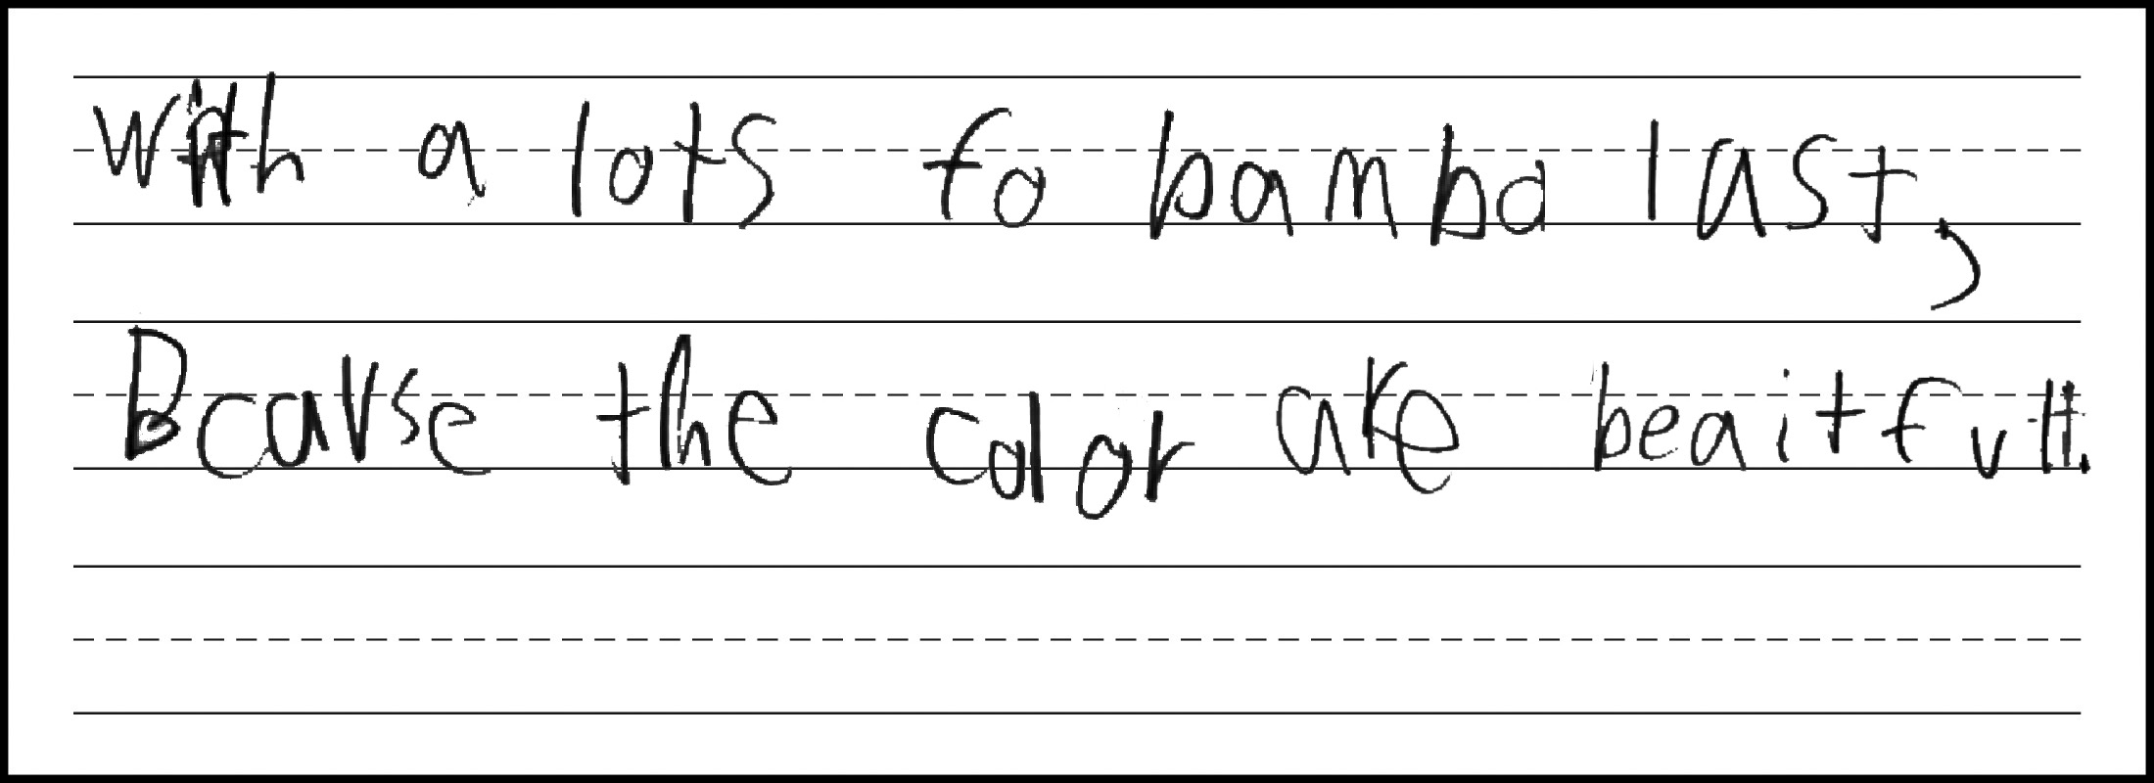
Grade 1: SCR Practice 2

Slide 22
Grade 1: SCR Practice 2
Score:
4
Commanding
CL
Response contains a variety of simple, expanded, and complex sentences.
QL
Response contains many grade-level words and phrases (e.g., look cute, bamboo, red panda, live in China, beautiful).
CR
Response includes words and sentences that sufficiently introduce and complete thoughts, ideas, or both (has an introduction, conclusion, and varied transitions throughout to provide clear organization of ideas).
DR
Response includes sufficiently detailed descriptions of thoughts, ideas, or both (lists many ideas about pandas and provides specific elaborating details).
M
Response contains occasional errors that rarely obscure meaning (e.g. spelling errors: amairiec for America, fo for of, beaitfull for beautiful).

Slide 23
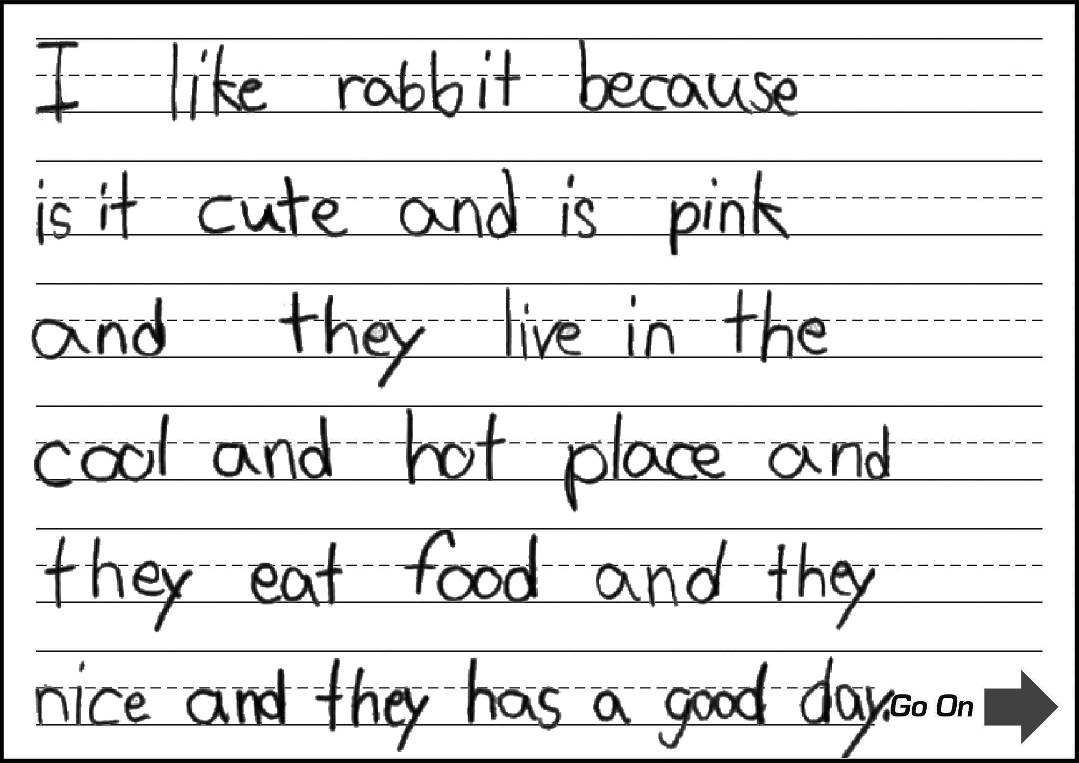
Grade 1: SCR Practice 3

Slide 24
Grade 1: SCR Practice 3
Score:
3
Expanding
CL
Response contains a few expanded, compound, and complex sentences (one long compound sentence with expanded and complex clauses; sentence structures are repetitive and lack variety).
QL
Response contains some grade-level words and phrases (e.g., rabbit, pink, cool and hot).
CR
Response includes introductory and concluding words and sentences that provide partial organization of thoughts, ideas, or both (has an introduction and connected ideas; repetitive "and" transitions at times hinder clear organization of thoughts).
DR
Response includes partially detailed descriptions of thoughts, ideas, or both (lists many ideas about rabbits with a few details, but at times descriptions are brief and general, lacking sufficient detail or elaboration).
M
Response contains occasional errors that rarely obscure meaning (e.g., syntax errors: because is it cute, and they nice).

Slide 25
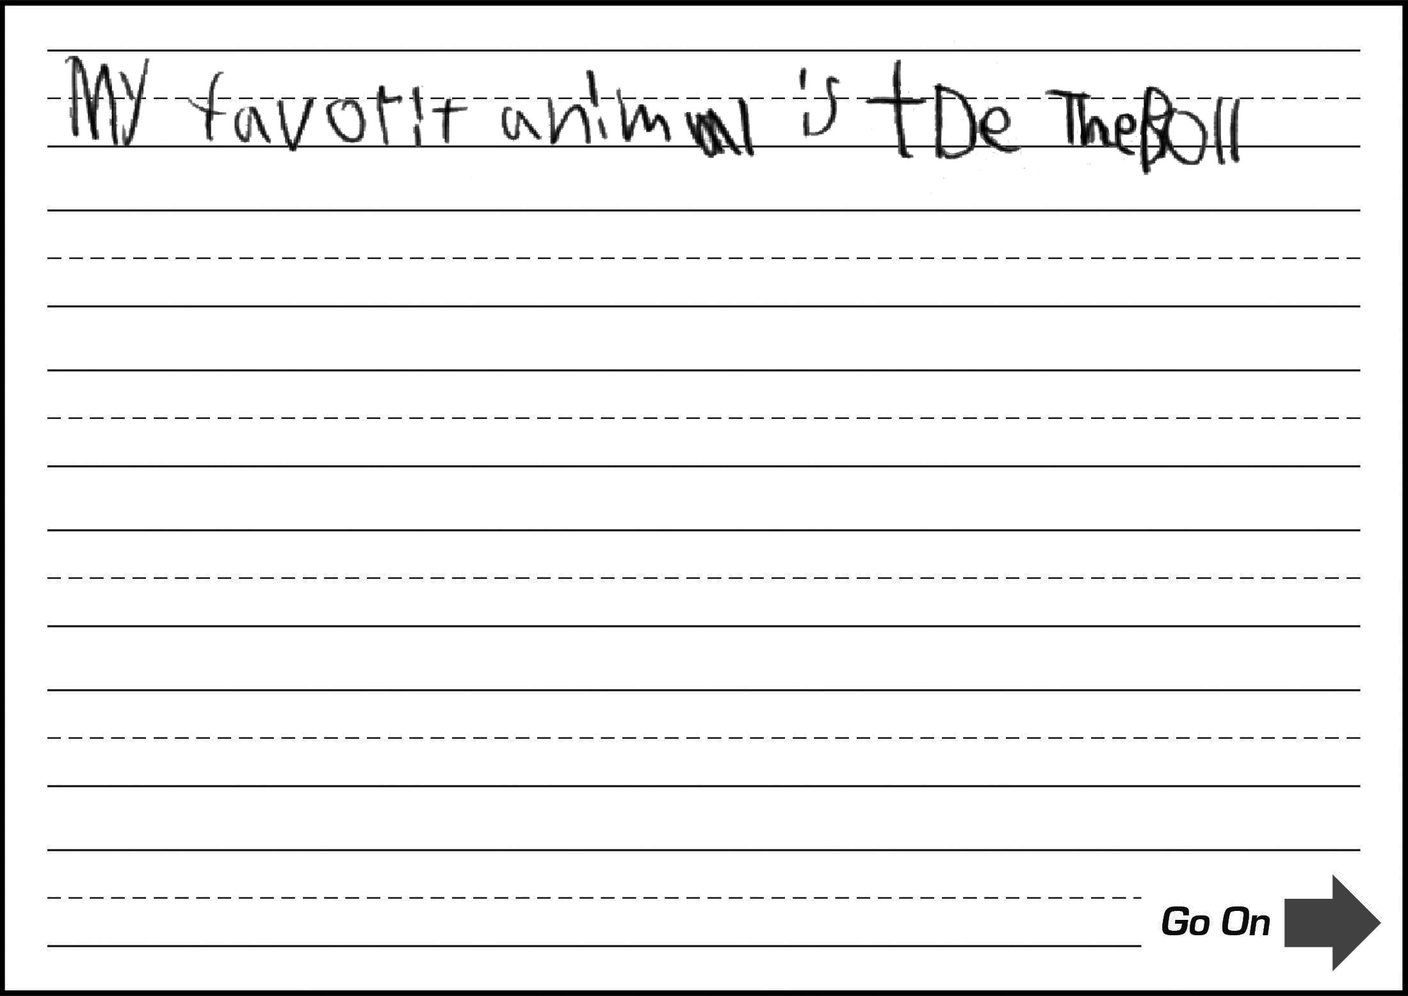
Grade 1: SCR Practice 4

Slide 26
Grade 1: SCR Practice 4
Score:
1
Emerging
CL
Response includes at least one simple sentence.
QL
Response contains common words and short phrases.
CR
Response includes a basic introduction or completion of a thought or ideas (single complete thought).
DR
Response includes basic descriptions of at least one thought or an idea (single complete thought).
M
Response is mostly clear, but contains some errors that may obscure meaning (e.g., spelling errors: tde for ?, boll for bull).

Slide 27
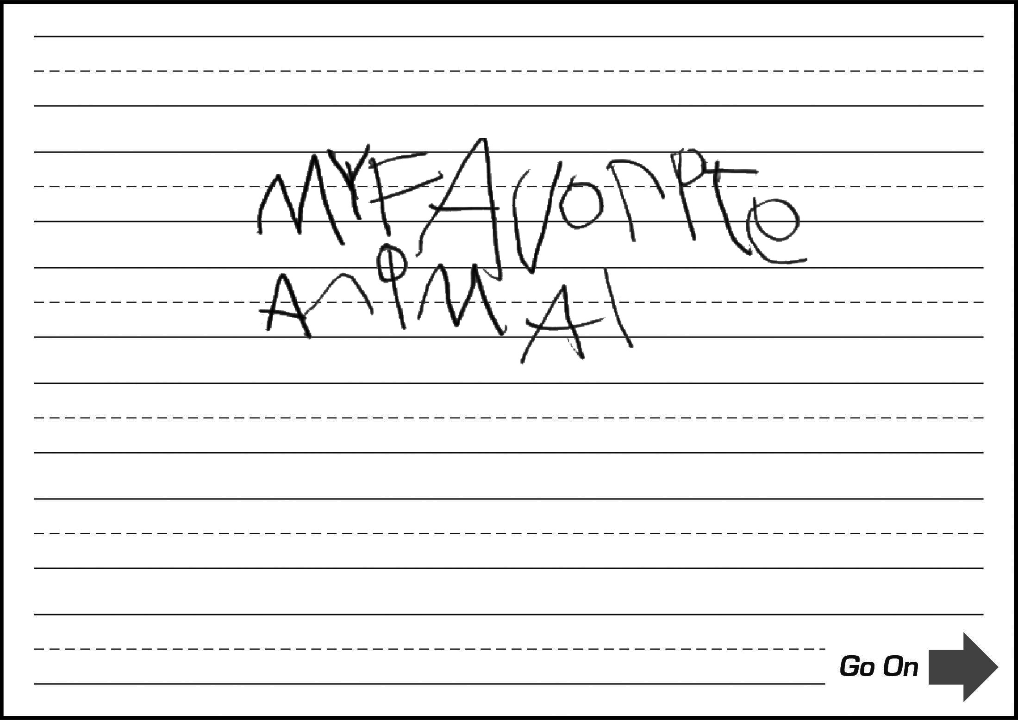
Grade 1: SCR Practice 5

Slide 28
Grade 1: SCR Practice 5
Score:
0
Entering
CL
Response contains few words or short phrases.
QL
Response contains at most frequently used words (majority of language is copied from prompt text).
CR
Response lacks a clear introduction or completion of a thought or an idea due to brevity (incomplete idea).
DR
Response lacks descriptions of thoughts, feelings, or ideas (incomplete idea).
M
Response contains numerous errors that totally obscure meaning (does not express a complete idea).

