Slide 1
Training for Administering and Scoring Speaking

Slide 2
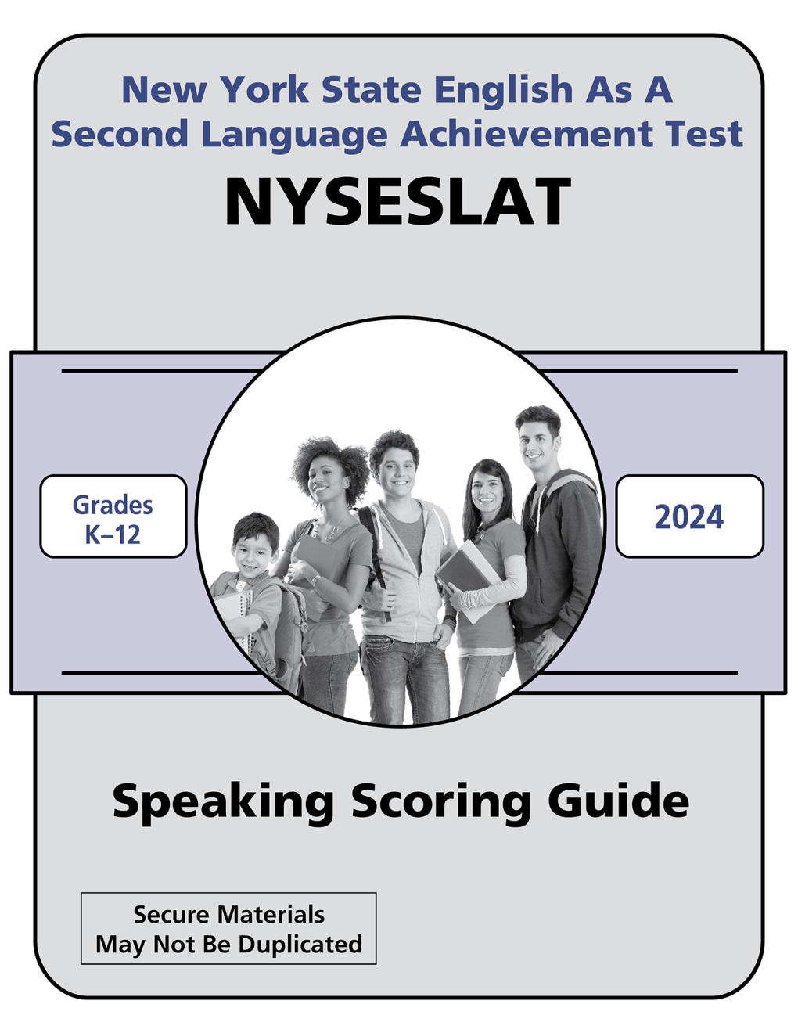
Outcomes for Participants
Understand how to administer the Grade 1 NYSESLAT Speaking test
Gain experience in scoring the Grade 1 NYSESLAT Speaking test

Slide 3
Statewide Scoring Rules for Administering the Speaking
Three options for administering and scoring:
Assign someone other than the student’s teacher to administer and simultaneously score the Speaking test.
Have the student’s teacher administer the Speaking test while a disinterested teacher in the room listens to and simultaneously scores the student’s responses.
Have the student’s teacher administer the Speaking test and record the student’s responses. The audio would subsequently be scored by a disinterested teacher.
Any device used for recording cannot have internet access, or it must have internet access disabled until the test is scored and the recording is removed from the device. Once the recorded student responses are scored, the audio recordings must be destroyed.

Slide 4
Prior to Administering the NYSESLAT Grade 1 Speaking Test
The examiner must be trained in scoring the Speaking test prior to administering the Speaking test.
The examiner must review the rubric, the Speaking Scoring Guide, the test questions, and practice applying the rubric using the Speaking Exemplars.
The examiner must read through the entire DFA along with the Test Booklet before administering the Speaking test.
Make one copy per student of the NYSESLAT Grade 1 Speaking Score Sheet
Practice administering with pointing, page turns, pauses, etc.
The Speaking test should be read slowly, but naturally, and exactly as written in the Directions for Administration (DFA)

Slide 5
NYSESLAT Speaking Test Design
12 Questions*
Theme 1
1. Emerging
2. Transitioning
Skip?
3. Expanding
4. Commanding
Theme 2
5. Emerging
6. Transitioning
Skip?
7. Expanding
8. Commanding
Theme 3
9. Emerging
10. Transitioning
Skip?
11. Expanding
12. Commanding
END
*The Speaking test does not include items targeted to the Entering level. Instead, a score of Entering is determined based on student performance on Emerging-level Speaking questions.

Slide 6
Skipping Rules in Practice
In general, the Skipping Rule applies if the student provides: no response, a response completely in a language other than English, or says only “yes,” “no,” or “I don’t know” to the two previous questions.
Score Point 0
Track 01
Q1: Student says “No.”
[Teacher uses rephrasing.]
Student says “No.”
Q2: Student says “No.”
For any questions that are skipped, write the letter “S” on the Speaking Score Sheet, instead of a score for that question. This is also described on the Score Sheet.

Slide 7
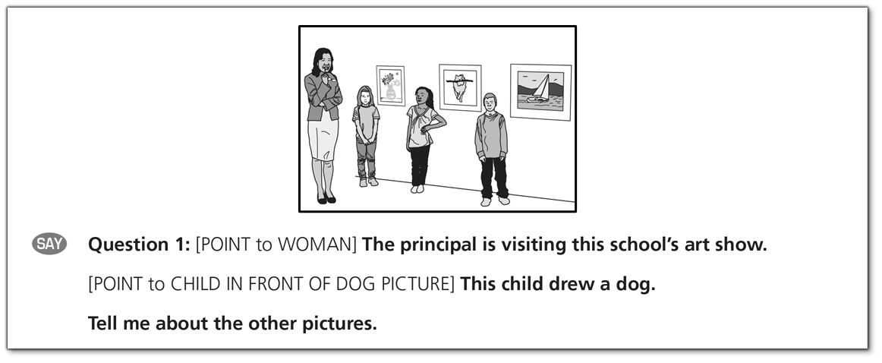
Administering the Grade 1 Speaking Test
Test starts with warm-up and sample questions.
All directions and sample questions may be repeated to students, as necessary.
You may supplement only the directions with your own explanations in English to assist the students with test-taking procedures.
Pointing directions tell the examiner what to point to in the graphics.

Slide 8
Rephrasing Samples
Track 02
Track 03
Track 04
Tell me other things people do in parks.
(Student does not respond)
[Teacher uses rephrasing.]
Many people like to go to parks. They can look at plants. What else can people do in parks?
“Play.”
Tell me what else students can do when they visit the zoo.
“I mean I- no.”
[Teacher uses rephrasing.]
These students visit the zoo. They watch the zookeeper give animals food. What are other things students can do at the zoo?
"I no . . . I don’t know."
Tell me other ways students can make art.
“Umm . . .”
[Teacher uses rephrasing.]
Students make art using different things. She draws with colored pencils. What are other ways students can make art?
“Fun . . . fun."

Slide 9
Scoring the Speaking Test
Review the rubric, the Speaking Scoring Guide, test questions, and practice applying the rubric using the Grade 1 Speaking Exemplars.
Specific instructions for accessing audio exemplars are available at https://nyseslat.metritech.com
Scoring rubric is aligned to each question’s performance level
Two-point (0–1) rubric for Emerging questions
Three-point (0–1–2) rubric for Transitioning, Expanding, and Commanding questions

Slide 10
Application of the Holistic Speaking Rubric
Student responses are evaluated for total, overall performance.
Scores are assigned based on the criteria delineated in the rubric.
Look at all aspects of the rubric.
Response does not have to include all aspects of the rubric to merit a rating at a particular score point.
Conversely, response should include most aspects of the rubric to merit a rating at that score point.
Listen carefully and judge which rubric score best matches all aspects of the response.
Do not penalize students for a response with incorrect content (e.g., New York City is the capital of New York). Rate the language.

Slide 11
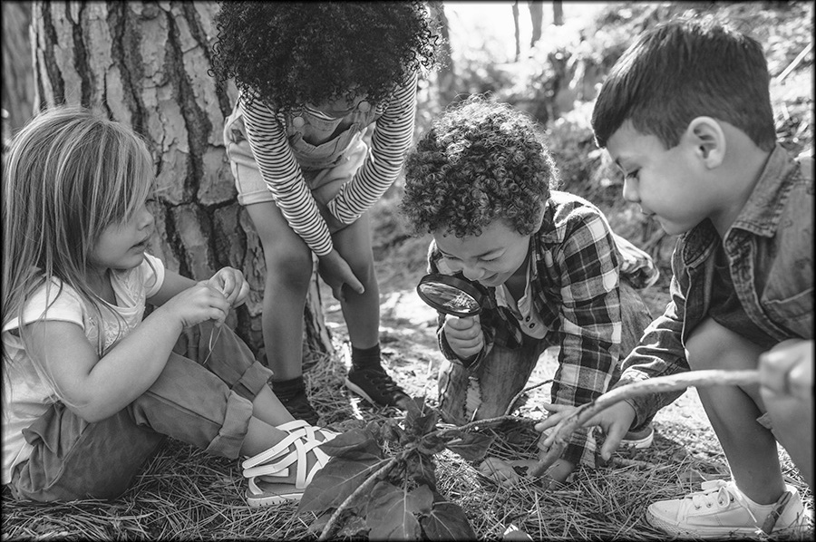
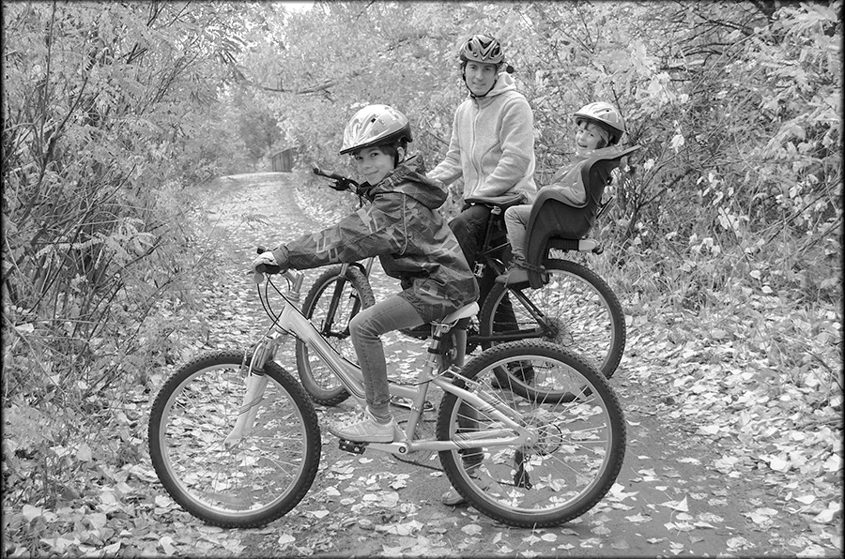
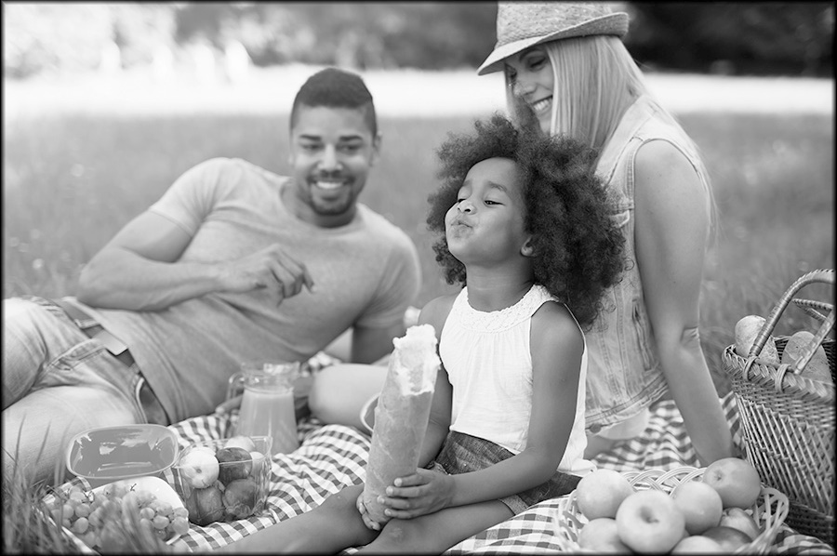
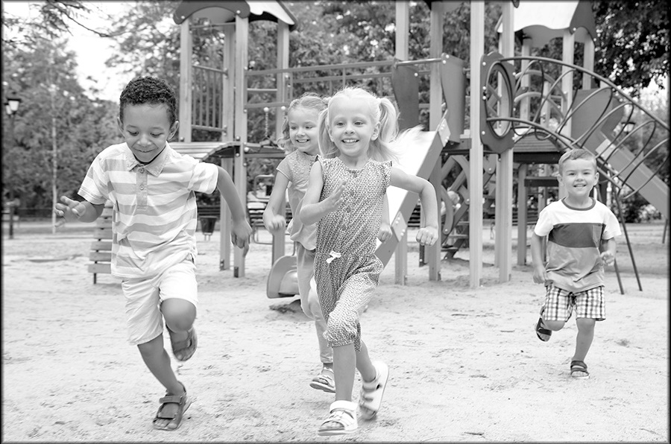
Characteristics of Emerging Level Questions
1.
2.
3.
4.
Always accompanied by a graphic
Examiner gives context
[POINT to EACH PICTURE] Many people like to spend time outside in parks. People can do different things in parks.
Examiner models a sample response
[POINT to PICTURE 1] People can look at plants in the park.
Examiner asks question
Tell me other things people do in parks.
Examiner rephrases if student does not respond
Many people like to go to parks. [POINT to PICTURE 1] They can look at plants. What else can people do in parks?

Slide 12
Emerging Level Rubric
Score 0
Does Not Meet Expectations
Score 1
Meets Expectations
No response
Responds with “yes,” “no,” or “I don’t know”
Responds completely in a language other than English
Uses one word to respond
Does not express a complete thought or idea
Unintelligible
Uses multiple words, short phrases, or sentences to respond
Partially expresses thoughts and ideas
Frequent errors may obscure meaning
N/A

Slide 13
Grade 1 Emerging Samples
1.
2.
3.
4.
Introduction: [POINT to EACH PICTURE] Many people like to spend time outside in parks. People can do different things in parks.
Modeling: [POINT to PICTURE 1] People can look at plants in the park.
Question: Tell me other things people do in parks.
Rephrasing: Many people like to go to parks. [POINT to PICTURE 1] They can look at plants. What else can people do in parks?
Score Point 0
Score Point 1
Track 05
Track 06
“Play.”
“Play with friends . . . do monkey bars . . . mm, riding on bikes . . . going on a slide.”

Slide 14
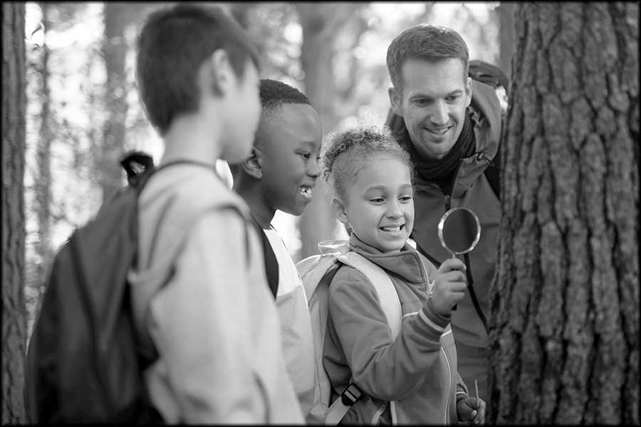
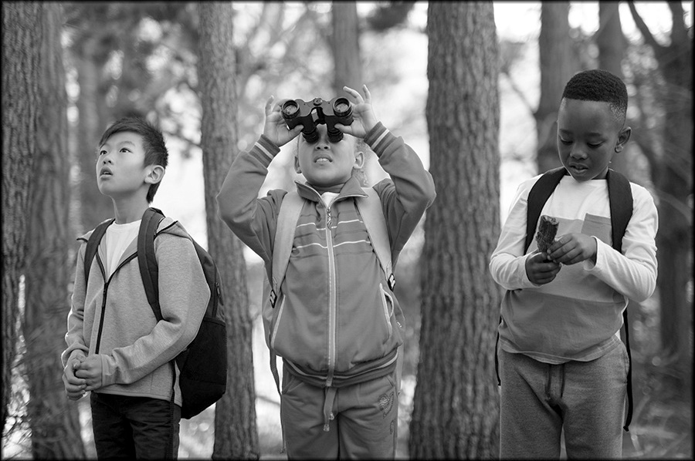
Characteristics of Transitioning Level Questions
1.
2.
Always accompanied by a graphic
Examiner gives context
Some people go to a park to look for animals. [POINT to EACH PICTURE] They walk in the park and look for animals that live there, like insects and birds. People can use tools to look at animals that are near and far away.
Examiner does not model a sample response
Examiner asks question
Tell me about looking for animals.
Examiner does not rephrase if student does not respond
Examiner may use follow-up when more language is needed “Tell me more.”

Slide 15
Transitioning Level Rubric
Score 0
Does Not Meet Expectations
Score 1
Approaches Expectations
Score 2
Meets Expectations
No response
Responds with “yes,” “no,” or “I don’t know”
Responds completely in a language other than English
Uses one word to respond
Does not express a complete thought or idea
Unintelligible
Errors may totally obscure meaning
Uses multiple words to respond
Partially expresses thoughts and ideas
Frequent errors may obscure meaning
Uses connected phrases or a simple sentence to respond
May use multiple sentences
Expresses complete thoughts and ideas relevant to the topic
Occasional errors in words and structures may obscure some meaning

Slide 16
Grade 1 Transitioning Samples
1.
2.
Introduction: Some people go to a park to look for animals. [POINT to EACH PICTURE] They walk in the park and look for animals that live there, like insects and birds. People can use tools to look at animals that are near and far away.
Question: Tell me about looking for animals.
Follow-up: Tell me more.
Score Point 0
Score Point 1
Score Point 2
Track 07
Track 08
Track 09
“Mm . . . “ [examiner prompts for more language] “ . . . Bugs . . . Deers”
“To do the spyglass.” [examiner prompts for more language] “ Telescope.”
“They can look for cats and dogs, any animals.”

Slide 17
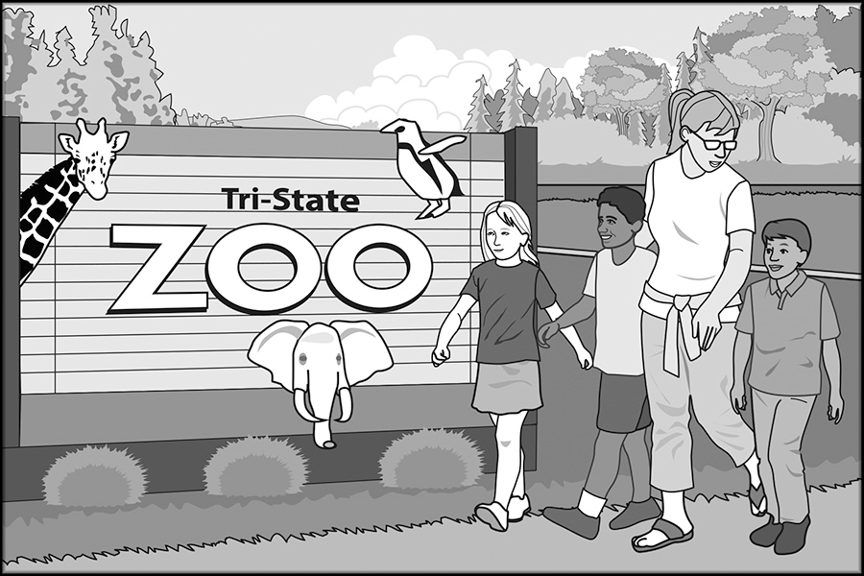
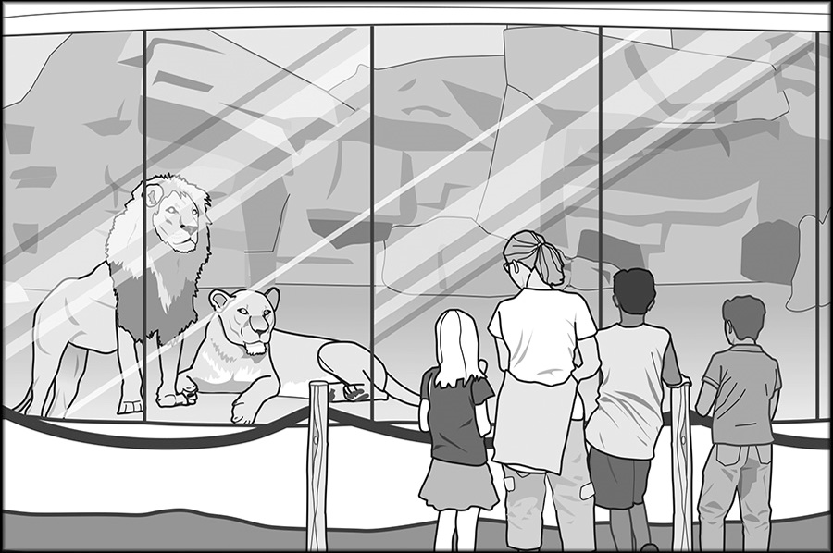
Characteristics of Expanding Level Questions
1.
2.
Accompanied by a graphic
Examiner gives context
[POINT to PICTURE 1] These students are at the zoo with their teacher. [POINT to PICTURE 2] Their teacher tells them about the animals. The students learn what animals eat and what they do. The students love learning about animals at the zoo.
Examiner asks question
Do you like learning about animals?
Examiner does not rephrase if student does not respond
Examiner may use follow-up when more language is needed only if indicated in the DFA
“Why? [OR] Why not?”

Slide 18
Expanding Level Rubric
Score 0
Does Not Meet Expectations
Score 1
Approaches Expectations
Score 2
Meets Expectations
Responds with “yes,” “no,” or “I don’t know”
Uses at most multiple words to respond
Does not express complete thoughts and ideas
Frequent errors may obscure meaning
Uses connected phrases or a simple sentence to respond
Expresses complete thoughts and ideas relevant to the topic
Occasional errors in words and structures may obscure some meaning
Uses connected simple sentences to respond
May use limited expanded sentences
Expresses connected and complete thoughts and ideas relevant to the topic
Infrequent errors in words and structure may obscure some meaning

Slide 19
Grade 1 Expanding Samples
1.
2.
Introduction: [POINT to PICTURE 1] These students are at the zoo with their teacher. [POINT to PICTURE 2] Their teacher tells them about the animals. The students learn what animals eat and what they do. The students love learning about animals at the zoo.
Question: Do you like learning about animals?
Follow-up: Why? [OR] Why Not?
Score Point 0
Score Point 1
Score Point 2
Track 10
Track 11
Track 12
“Yes.” [examiner prompts for more language] “Because interesting.”
“Yes.” [examiner prompts for more language] “Because they are interesting in different ways. Some- some can go water- some can go underwater, some cannot. Some have bigger teeth than the other. And some are different body shapes.”
“Yes because animals are cute.”

Slide 20
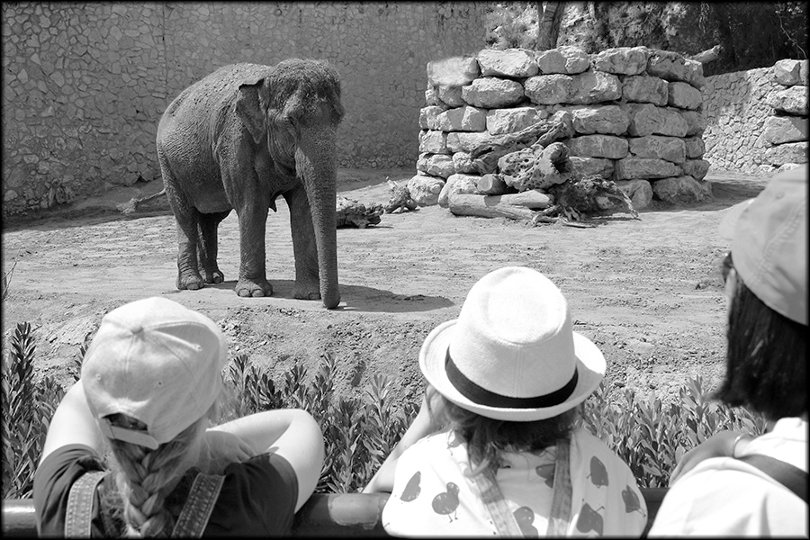
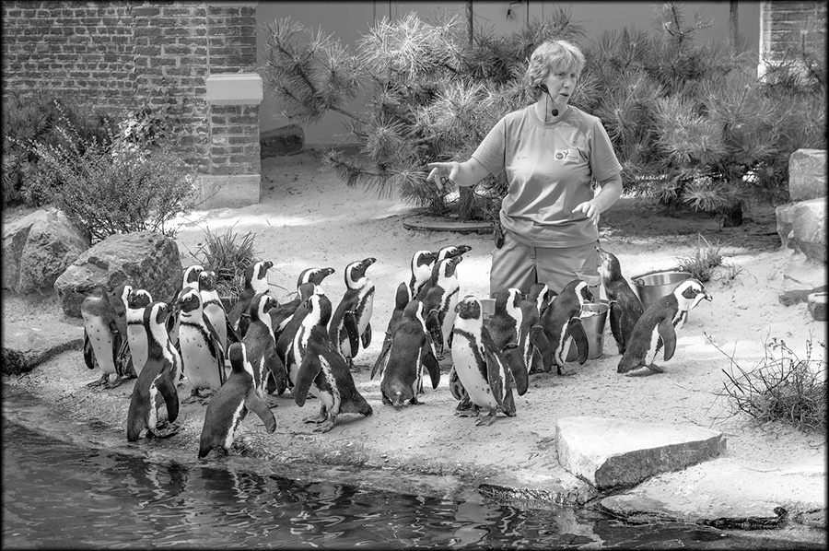
Characteristics of Commanding Level Questions
1.
2.
Accompanied by a graphic
Examiner gives context
These students are visiting the zoo with their class. [POINT to PICTURE 1] They watch the animals. They learn what animals do and what they eat. [POINT to PICTURE 2] The zookeeper teaches them about penguins. She tells them how zookeepers take care of animals. The students ask the zookeeper questions about the animals.
Examiner asks question
Do you think the zoo is a good place to learn about animals?
No modeling or rephrasing
Examiner may use follow-up when more language is needed only if indicated in the DFA
“Why? [OR] Why not?”

Slide 21
Commanding Level Rubric
Score 0
Does Not Meet Expectations
Score 1
Approaches Expectations
Score 2
Meets Expectations
Responds with “yes,” “no,” or “I don’t know”
Uses at most connected phrases or a simple sentence to respond
May express complete thoughts and ideas
Occasional or frequent errors in words and structures may obscure meaning
Uses connected simple sentences to respond
Expresses connected and complete thoughts and ideas relevant to the topic
Infrequent errors in words and structure may obscure some meaning
Uses connected expanded sentences
Generates a fluid response using linking words and phrases to sequence complete thoughts and ideas relevant to the topic
No errors or infrequent errors that do not obscure meaning

Slide 22
Grade 1 Commanding Samples
1.
2.
Introduction: These students are visiting the zoo with their class. [POINT to PICTURE 1] They watch the animals. They learn what animals do and what they eat. [POINT to PICTURE 2] The zookeeper teaches them about penguins. She tells them how zookeepers take care of animals. The students ask the zookeeper questions about the animals.
Question: Do you think the zoo is a good place to learn about animals?
Follow-up: Why? [OR] Why not?
Score Point 0
Score Point 1
Score Point 2
Track 13
Track 14
Track 15
“Yes. They- zookeepers can take care of penguins. And they can take care of- of elephants.”
“Yes it is. Bec- because um when you learn about stuff, you get more smarter, more bigger, and more helpful. Some animals that I like is- is um um penguins. They're my favorite, they're so cute and when you got- when they learn about uh the penguins and stuff, um they'll get smarter and smarter and smarter.”
“Yes because the- the zookeeper knows a lot about animals.”

Slide 23
Special Focus: Questions with Shared Passages
Some pairs of consecutive Expanding and Commanding questions use the same text, printed in the test booklet for each question.
The text is read out loud once for the Expanding question only. The student can read along in the test booklet.
Questions include text with a supportive graphic.

Slide 24
Tips for Scoring Shared-Passage Questions
In some cases, students may read or repeat language directly from the text. It is important to listen for the student’s authentic language.
Sometimes students respond with only language from the text. If they do not create any new language on their own, the response is scored zero.
Some students respond with a combination of their own words and language from the text. Rate the students’ own language.

Slide 25
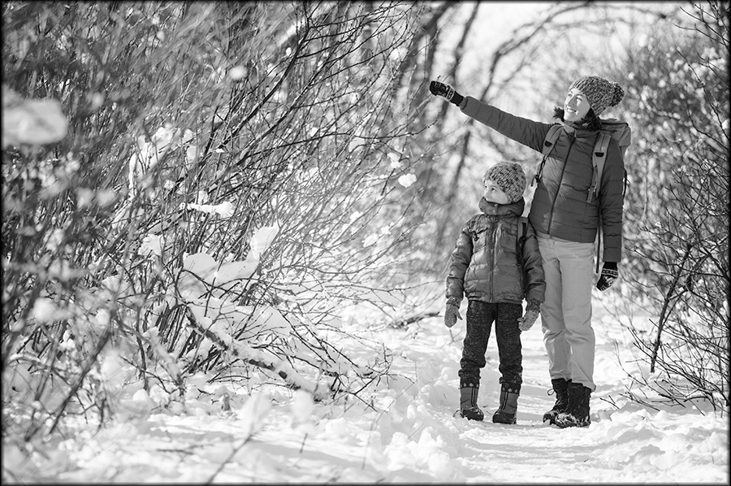
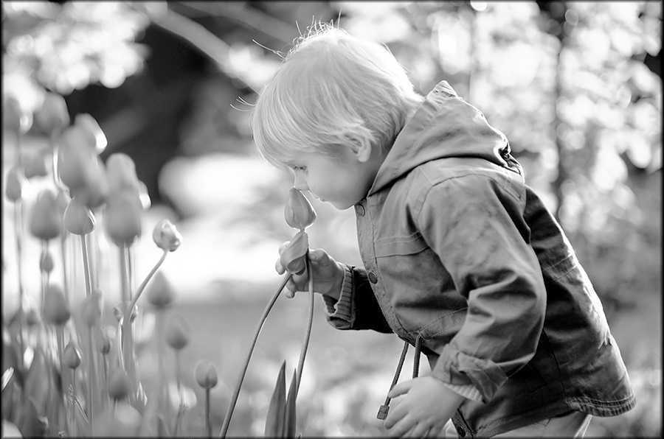
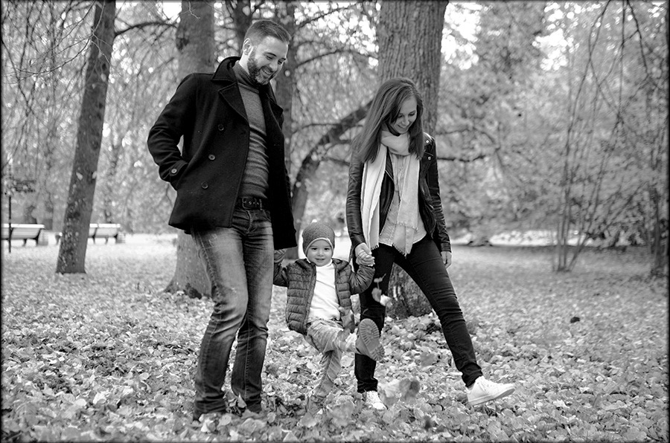
Characteristics of Expanding Level Shared-Passage Questions
1.
2.
3.
4.
Accompanied by a passage and graphic
Examiner gives context
Now let’s talk about parks in different seasons. People can go to parks in New York State all year. In the winter, they can walk through snow. In the spring, they can look at flowers. In the summer, they can walk under trees to stay out of the sun. In the fall, people look at the colorful leaves.
Examiner asks question
In your own words, tell me what people can do in parks in different seasons.
No modeling or rephrasing

Slide 26
Expanding Level Rubric
Score 0
Does Not Meet Expectations
Score 1
Approaches Expectations
Score 2
Meets Expectations
Responds with “yes,” “no,” or “I don’t know”
Uses at most multiple words to respond
Does not express complete thoughts and ideas
Frequent errors may obscure meaning
Uses connected phrases or a simple sentence to respond
Expresses complete thoughts and ideas relevant to the topic
Occasional errors in words and structures may obscure some meaning
Uses connected simple sentences to respond
May use limited expanded sentences
Expresses connected and complete thoughts and ideas relevant to the topic
Infrequent errors in words and structure may obscure some meaning

Slide 27
Expanding Shared-Passage Samples
Introduction: Now let’s talk about parks in different seasons.
Question: In your own words, tell me what people can do in parks in different seasons.
1.
2.
3.
4.
People can go to parks in New York State all year. In the winter, they can walk through snow. In the spring, they can look at flowers. In the summer, they can walk under trees to stay out of the sun. In the fall, people look at the colorful leaves.
Score Point 0
Score Point 1
Score Point 2
Track 16
Track 17
Track 18
“Snow, summer, winter, fall . . . and spring.”
“Play and build a snowman and shovel leaves. I'm done.”
“On the playground in the spring uh they can walk. In the winter they can play in the snow. In the fall they can sit out.”

Slide 28
Characteristics of Commanding Level Shared-Passage Questions
1.
2.
3.
4.
Accompanied by a passage and graphic in the student booklet
Examiner gives context but does not repeat the passage, as explained in the DFA
You just learned about parks in different seasons.
Examiner asks question
What season do you think is best to go to a park?
No modeling or rephrasing
Examiner may use follow-up when more language is needed if indicated in the DFA
“Why?”

Slide 29
Commanding Level Rubric
Score 0
Does Not Meet Expectations
Score 1
Approaches Expectations
Score 2
Meets Expectations
Responds with “yes,” “no,” or “I don’t know”
Uses at most connected phrases or a simple sentence to respond
May express complete thoughts and ideas
Occasional or frequent errors in words and structures may obscure meaning
Uses connected simple sentences to respond
Expresses connected and complete thoughts and ideas relevant to the topic
Infrequent errors in words and structure may obscure some meaning
Uses connected expanded sentences
Generates a fluid response using linking words and phrases to sequence complete thoughts and ideas relevant to the topic
No errors or infrequent errors that do not obscure meaning

Slide 30
Commanding Shared-Passage Samples
Introduction: You just learned about parks in different seasons.
Question: What season do you think is best to go to a park?
Follow-up: Why?
1.
2.
3.
4.
People can go to parks in New York State all year. In the winter, they can walk through snow. In the spring, they can look at flowers. In the summer, they can walk under trees to stay out of the sun. In the fall, people look at the colorful leaves.
Score Point 0
Score Point 1
Score Point 2
Track 19
Track 20
Track 21
“Summer.” [examiner prompts for more language] “Because you can like you can play in the grass.”
“My park favorite is uh snow because we can play in the snow make- we can play with our dads, our moms, our brothers. There's and uh and we can make a snowman.”
“I think the summer is the best season because when the summer is here, you could go to the park and you hear the- you see the sprinklers and you could get wet so you could stay cold and not hot.”

Slide 31
Scoring Recap
NYSESLAT is a language test, not a content test. Students may demonstrate language competence without content accuracy.
Emerging means that student fluency is still emerging. A “yes,” “no,” “I don’t know,” non-English, single word, incomplete thought, or blank response is scored “0.”
Commanding reflects a high level of proficiency with grade-level language. Students can produce a full simple sentence with a complete thought and still be rated “0.”
Rubrics are tailored for the difficulty of specific questions. Remember to adjust your expectations when evaluating responses.

Slide 32
Transitioning Practice
1.
2.
Introduction: Some people go to a park to look for animals. [POINT to EACH PICTURE] They walk in the park and look for animals that live there, like insects and birds. People can use tools to look at animals that are near and far away.
Question: Tell me about looking for animals.
Follow-up: Tell me more.
Practice #1
Practice #2
Practice #3
Track 22
Track 23
Track 24
“Uh, fun.”
[examiner prompts for more language]
“Eh, uh, I don’t know.”
“You can get a magnify because some um . . . what is it called . . . bugs are very small so you have to get a magnify and see what it looks like, just like um like a ladybug.”
“Uh look at [?] birds and rabbits.”

Slide 33
Expanding Practice: Independent Passage
1.
2.
Introduction: [POINT to PICTURE 1] These students are at the zoo with their teacher. [POINT to PICTURE 2] Their teacher tells them about the animals. The students learn what animals eat and what they do. The students love learning about animals at the zoo.
Question: Do you like learning about animals?
Follow-up: Why? [OR] Why not?
Practice #1
Practice #2
Practice #3
Track 25
Track 26
Track 27
“Yeah.” [examiner prompts for more language] “Cause I love animals.”
“Yes.” [examiner prompts for more language] “Lions, giraffes.”
“I like learning about animals because . . . because animals are cool and . . . They . . . sleep . . . And . . . wash their teeth.”

Slide 34
Expanding Practice: Shared Passage
Introduction: Now let’s talk about a trip to a park
Question: In your own words, tell me what these children do at the park.
1.
2.
3.
These children are visiting a park with their class. They walk through the park. They see different plants and animals. They pick some plants to look at and touch. The children have fun and learn a lot.
Practice #1
Practice #2
Practice #3
Track 28
Track 29
Track 30
“He can saw animals and he can go to find dams and you can eh you can saw exists ex- it- in- and you can saw a butterfly or something.”
“They're feeding a squirrel.”
“Uh animal, plant, [?], flowers.”

Slide 35
Commanding Practice: Shared Passage
Introduction: You just learned about a trip to a park
Question: Would you like to visit a park with your class?
Follow-up: Why? [OR] Why not?
1.
2.
3.
These children are visiting a park with their class. They walk through the park. They see different plants and animals. They pick some plants to look at and touch. The children have fun and learn a lot.
Practice #1
Practice #2
Practice #3
Track 31
Track 32
Track 33
“Yes.” [examiner prompts for more language]
“It looks so fun to do some- animals. Look at some trees and look at the pl- at the animals, look at the plants.”
“I would not like to go to the park with my class because they are a little too noisy and they could scare away the birds and- and the squirrels and other bugs. So they are cute bugs but when they leaving animals, I can't see them correctly.”
[examiner prompts for more language]
“Fun . . . because it's fun.”

Slide 36
Commanding Practice: Independent Passage
1.
2.
Introduction: These students are visiting the zoo with their class. [POINT to PICTURE 1] They watch the animals. They learn what animals do and what they eat. [POINT to PICTURE 2] The zookeeper teaches them about penguins. She tells them how zookeepers take care of animals. The students ask the zookeeper questions about the animals.
Question: Do you think the zoo is a good place to learn about animals?
Follow-up: Why? [OR] Why not?
Practice #1
Practice #2
Practice #3
Track 34
Track 35
Track 36
“Yes because zoos animals are very fun.”
“I think the good place to learn about animals is zoo too, because you can learn about animals, you're right, and every time you go to the zoo you can know what they eat really quick.”
“Yes because they like to um because they're good and they're nice and they'll want to play together.”

Slide 37
Transition Slide
Thank You
There will now be a minute break.

