Slide 1

An Introduction and Overview of the Grade 1 NYSESLAT

Slide 2
What is the NYSESLAT?
NYSESLAT annually assesses English language proficiency of NYS English Language Learners (ELLs) in Grades K–12
  Kindergarten and Grades 1, 2, 3–4, 5–6, 7–8, and 9–12
Provides information about the English language development of ELLs
NYSESLAT results help determine the level of English language education services provided to ELLs
Five Performance Levels
  Entering, Emerging, Transitioning, Expanding, and Commanding

Slide 3
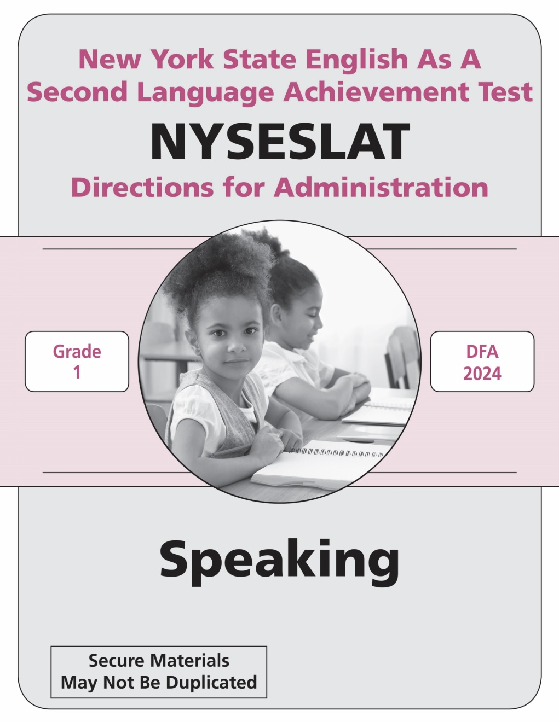
Separating Grade 1 and Grade 2 NYSESLAT
Based on feedback from New York State educators, a new Grade 1 NYSESLAT was developed
The Grade 2 test will remain the same as the prior Grades 1–2 band
Test Samplers are available online at:
https://www.nysed.gov/state-assessment/test-samplers-and-directions-administration

Slide 4
Grade 1 Test Design Specifications
Four test sessions
  One Speaking Session and three Listening/Reading/Writing (L/R/W) Sessions
Uses three answer choices for Listening and Reading multiple-choice questions—A, B, and C
Uses a Grade 1 Writing rubric that reflects the expectations for Grade 1 written responses
Text Complexity: Quantitative and Qualitative
  Passage complexity parallels classroom instructional texts
Passage Length and Word Count

Slide 5
Grade 1 NYSESLAT Test Structure
Session | Number of Questions/Tasks | Total Number of Questions/Tasks | Estimated Testing Time (minutes)
Speaking | 12 Constructed Response | 12 | 15
Listening/Reading/Writing Session 1 | Listening: 8 Multiple-choice Reading: 8 Multiple-choice Writing: 1 Short Constructed Response (SCR) | 17 | 35-55
Listening/Reading/Writing Session 2 | Listening: 8 Multiple-choice Reading: 8 Multiple-choice Writing: 1 (SCR) | 17 | 35-55
Listening/Reading/Writing Session 3 | Listening: 8 Multiple-choice Reading: 11 Multiple-choice Writing: 1 Extended Constructed Response (ECR) | 20 | 35-55

Slide 6
Who May Administer and Score the NYSESLAT
Only qualified personnel should administer the NYSESLAT. Qualified personnel should be certified teachers or administrators able to carry out standard examination procedures and should have special training in administering the NYSESLAT.
  In public and charter schools, the staff administering the NYSESLAT should be
  certified teachers.
  In religious and independent schools, it is highly recommended that the staff administering the NYSESLAT be certified teachers.
A student’s teacher of English as a New Language, Bilingual Education, or English Language Arts may administer but may NOT score their own students’ responses for the Speaking and Writing questions.
The principal is responsible for making the final determination as to whether a teacher may administer or score the NYSESLAT.

Slide 7
Grade 1 NYSESLAT Administration
Speaking is administered individually
Three L/R/W Sessions, each session is group administered
Administer L/R/W sessions in numerical sequence (1, 2, then 3)
Do not break up L/R/W session by modality
The directions are read to the students by the teacher using the script found in the DFA
Except for make-up testing, only one session should be administered per day
Not required to administer sessions on consecutive days
Grade 1 students mark their answers in their test booklet—a teacher or an aide must transcribe the students’ response onto the answer sheet

Slide 8

Operational Scoring Materials
K–12 Speaking Scoring Guide with Audio-Streaming Platform for Accessing Exemplars
K–12 Writing Scoring Guide and Grade 1 Training Set
Prior to scoring the operational NYSESLAT, scorers must train to score the NYSESLAT using the operational scoring materials
Security Reminder: All test materials must be stored in a secure location at all times

Slide 9

NYSESLAT Resources
Details regarding Spring NYSESLAT will be found in:
School Administrator’s Manual (SAM)
Contains general information about administering the NYSESLAT
Speaking and Writing Rubrics
Speaking Score Sheet for Individual Administration
  https://www.nysed.gov/state-assessment/nyseslat-school-administrators-manual
Directions for Administration (DFA)
Contains secure information and instructions for administering each session of the NYSESLAT
Arrives with the Operational Test
Must be returned to MetriTech after scoring and scanning have been completed

Slide 10
Next Training Session–Administering and Scoring the Grade 1 Speaking Test
Speaking Presentation
Speaking Test Design
Speaking Rubric description
Application of the Speaking Rubric to sample items and Grade 1 student spoken responses

