Slide 2
Writing Scoring Training Overview
Writing Rubric Overview
Grades 3–4, 5–6, and 9–12 Short Constructed Response (SCR)
  Sample student responses
Grades 1–2 and 7–8 Extended Constructed Response (ECR)
  Sample student responses
Kindergarten

Slide 3
Writing Rubric Overview
Five dimensions of the rubric in the first column
Five performance levels across the top
Score the response based on the best performance level for the majority of the dimensions
Responses that are completely irrelevant to the prompt can score no higher than a 1
Degree of Response is split into SCR, ECR Narrative, and ECR Informational
Wording comes from Writing Targets of Measurement and Performance Level Descriptions

Slide 4
Five Rubric Dimensions
Complexity of Language (CL)
  Sentence Types:
    Simple: The dog is barking.
    Expanded: The dog is barking in the yard.
    Compound: The dog is barking and it is making noise.
    Complex: The dog is barking because he sees a squirrel.

Slide 5
Five Rubric Dimensions (Continued)
Quality of Language (QL)
  Grade-level vocabulary:
    Tier 1: Basic vocabulary for communicative purposes
      picture, drawing
    Tier 2: General academic vocabulary
      diagram of a cell
      Venn diagram
    Tier 3: Specific content-area vocabulary
      mitochondria (in the cell diagram)
      separation of powers (in a social studies Venn diagram)
Glossary in binder appendix has additional examples

Slide 6
Five Rubric Dimensions (Continued)
Coherence of Response (CR): Level of organization
Degree of Response (DR): Level of Detail
Mechanics (M): Use of English conventions; same across all
grade levels

Slide 7
Application of the Holistic Writing Rubrics
Become familiar with the rubric for the particular grade band
Become familiar with the passage and prompt
Read the response to the prompt
Student responses are evaluated for total, overall performance
Scores are assigned based on the criteria delineated in the rubric
  Match evidence from the response to the language of the rubric
  Look for what is included in the response, not what is missing
The highest point on a rubric scale does not measure a “perfect” response
On the written tests, handwriting does not count
  (binder page 36 for samples and practice)

Slide 8
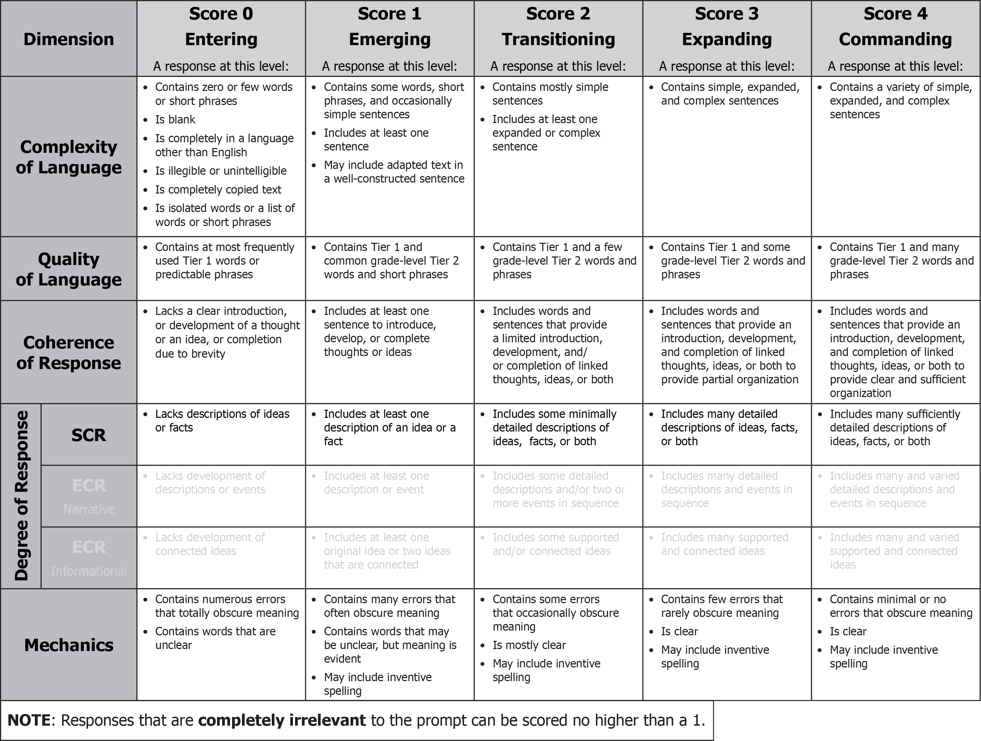
Grades 3–4: SCR Rubric

Slide 9
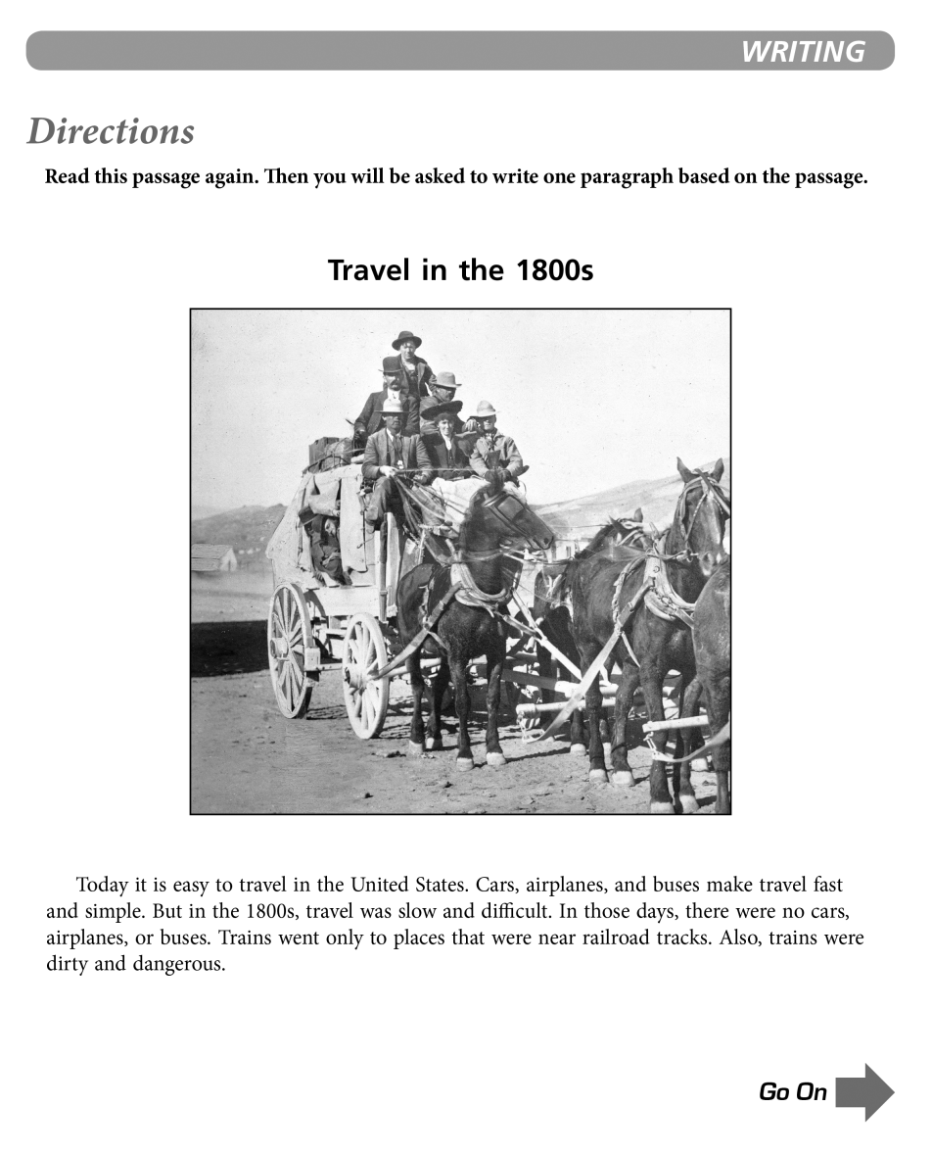
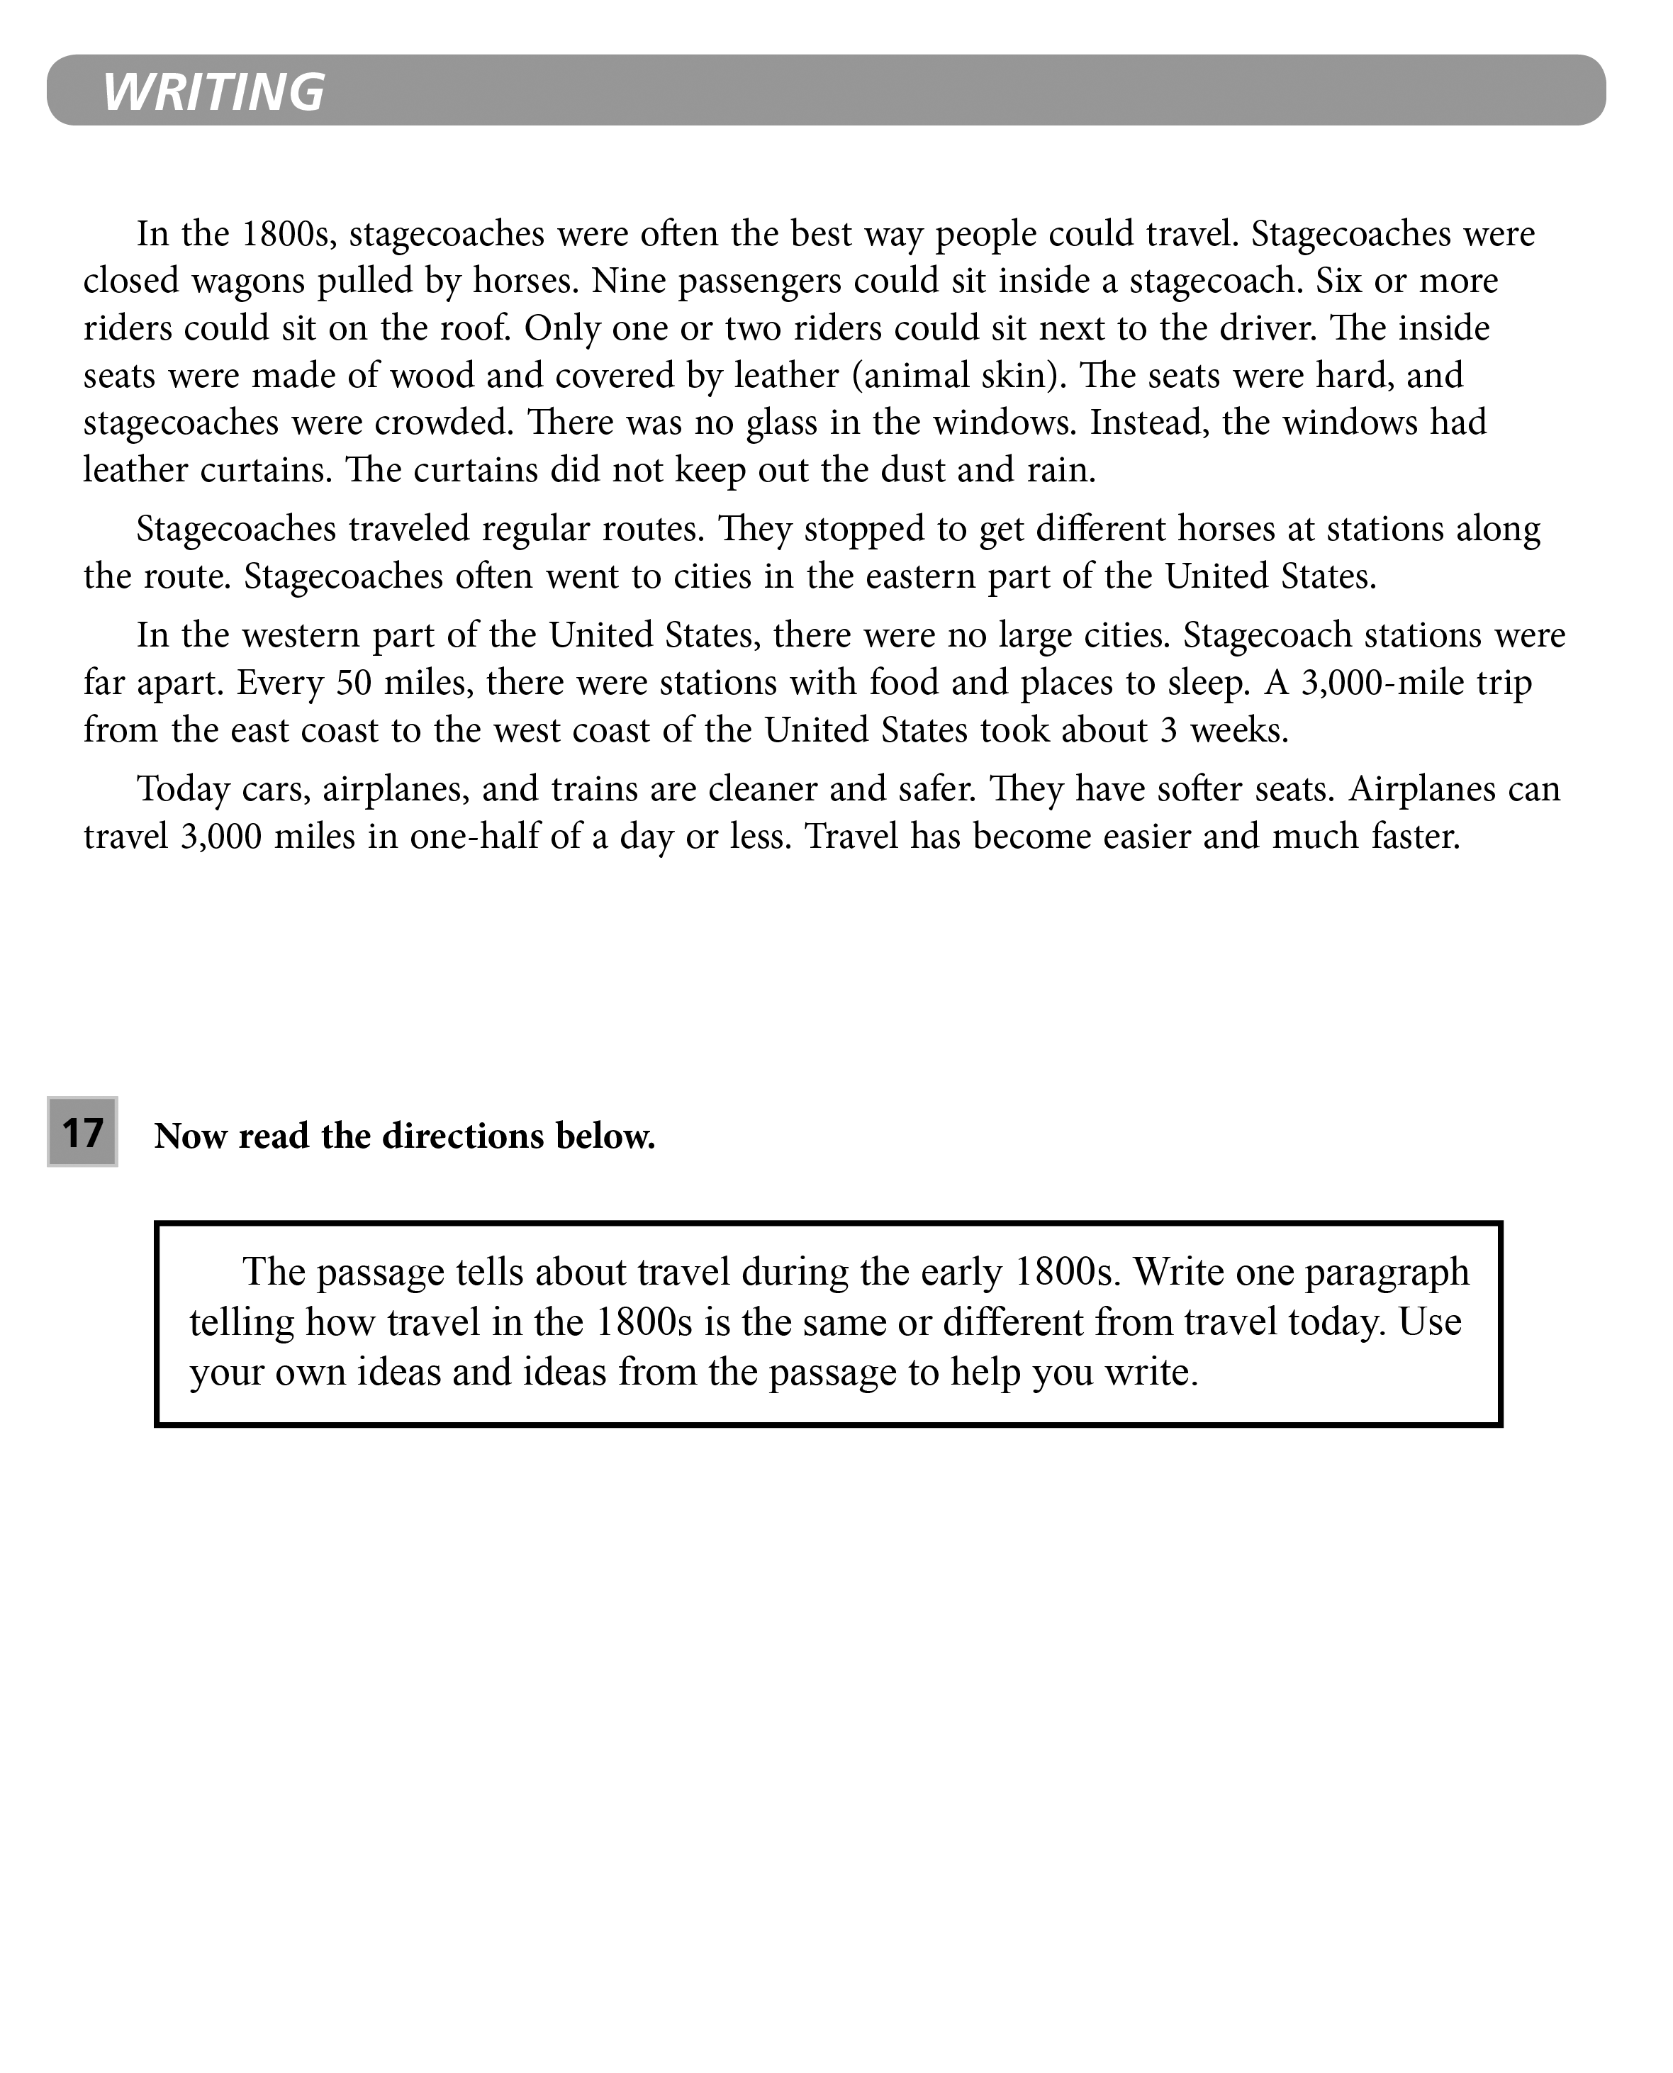
Grades 3–4: SCR Prompt

Slide 10
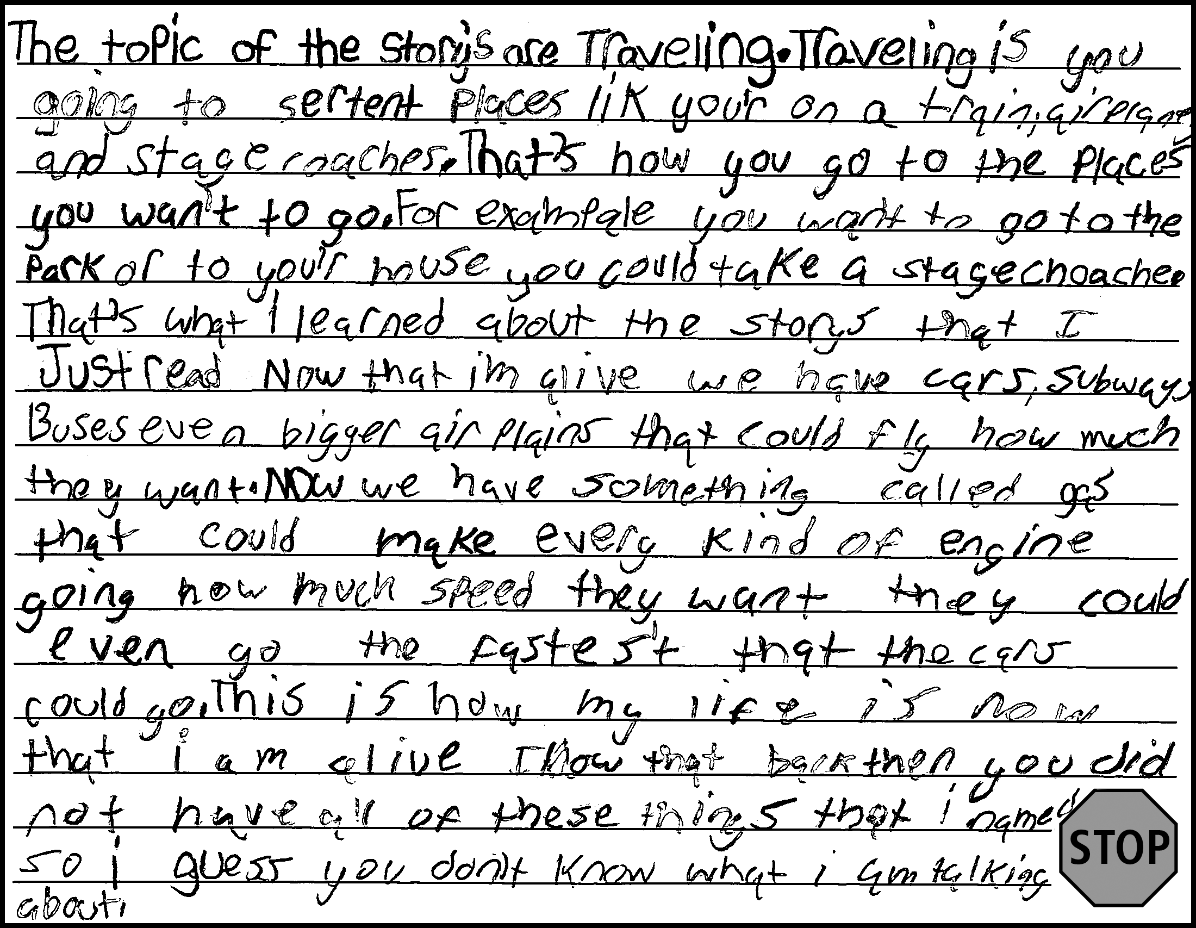
Grades 3–4: SCR Sample 1
Score 4: Commanding
CL
Response contains a variety of expanded and complex sentences.
QL
Response contains many Tier 2 words and phrases (e.g., topic, certain places, stagecoach, now that I’m alive, engine, speed).
CR
Response includes words and sentences that provide an introduction, development, and completion of linked thoughts
and ideas to provide clear and sufficient organization.
DR
Response includes many sufficiently detailed descriptions of ideas and facts.
M
Response is clear and contains few errors that rarely obscure meaning (spelling error: sertent for certain; punctuation errors; some awkward phrases).
*Please see your binder for a full rubric*

Slide 11
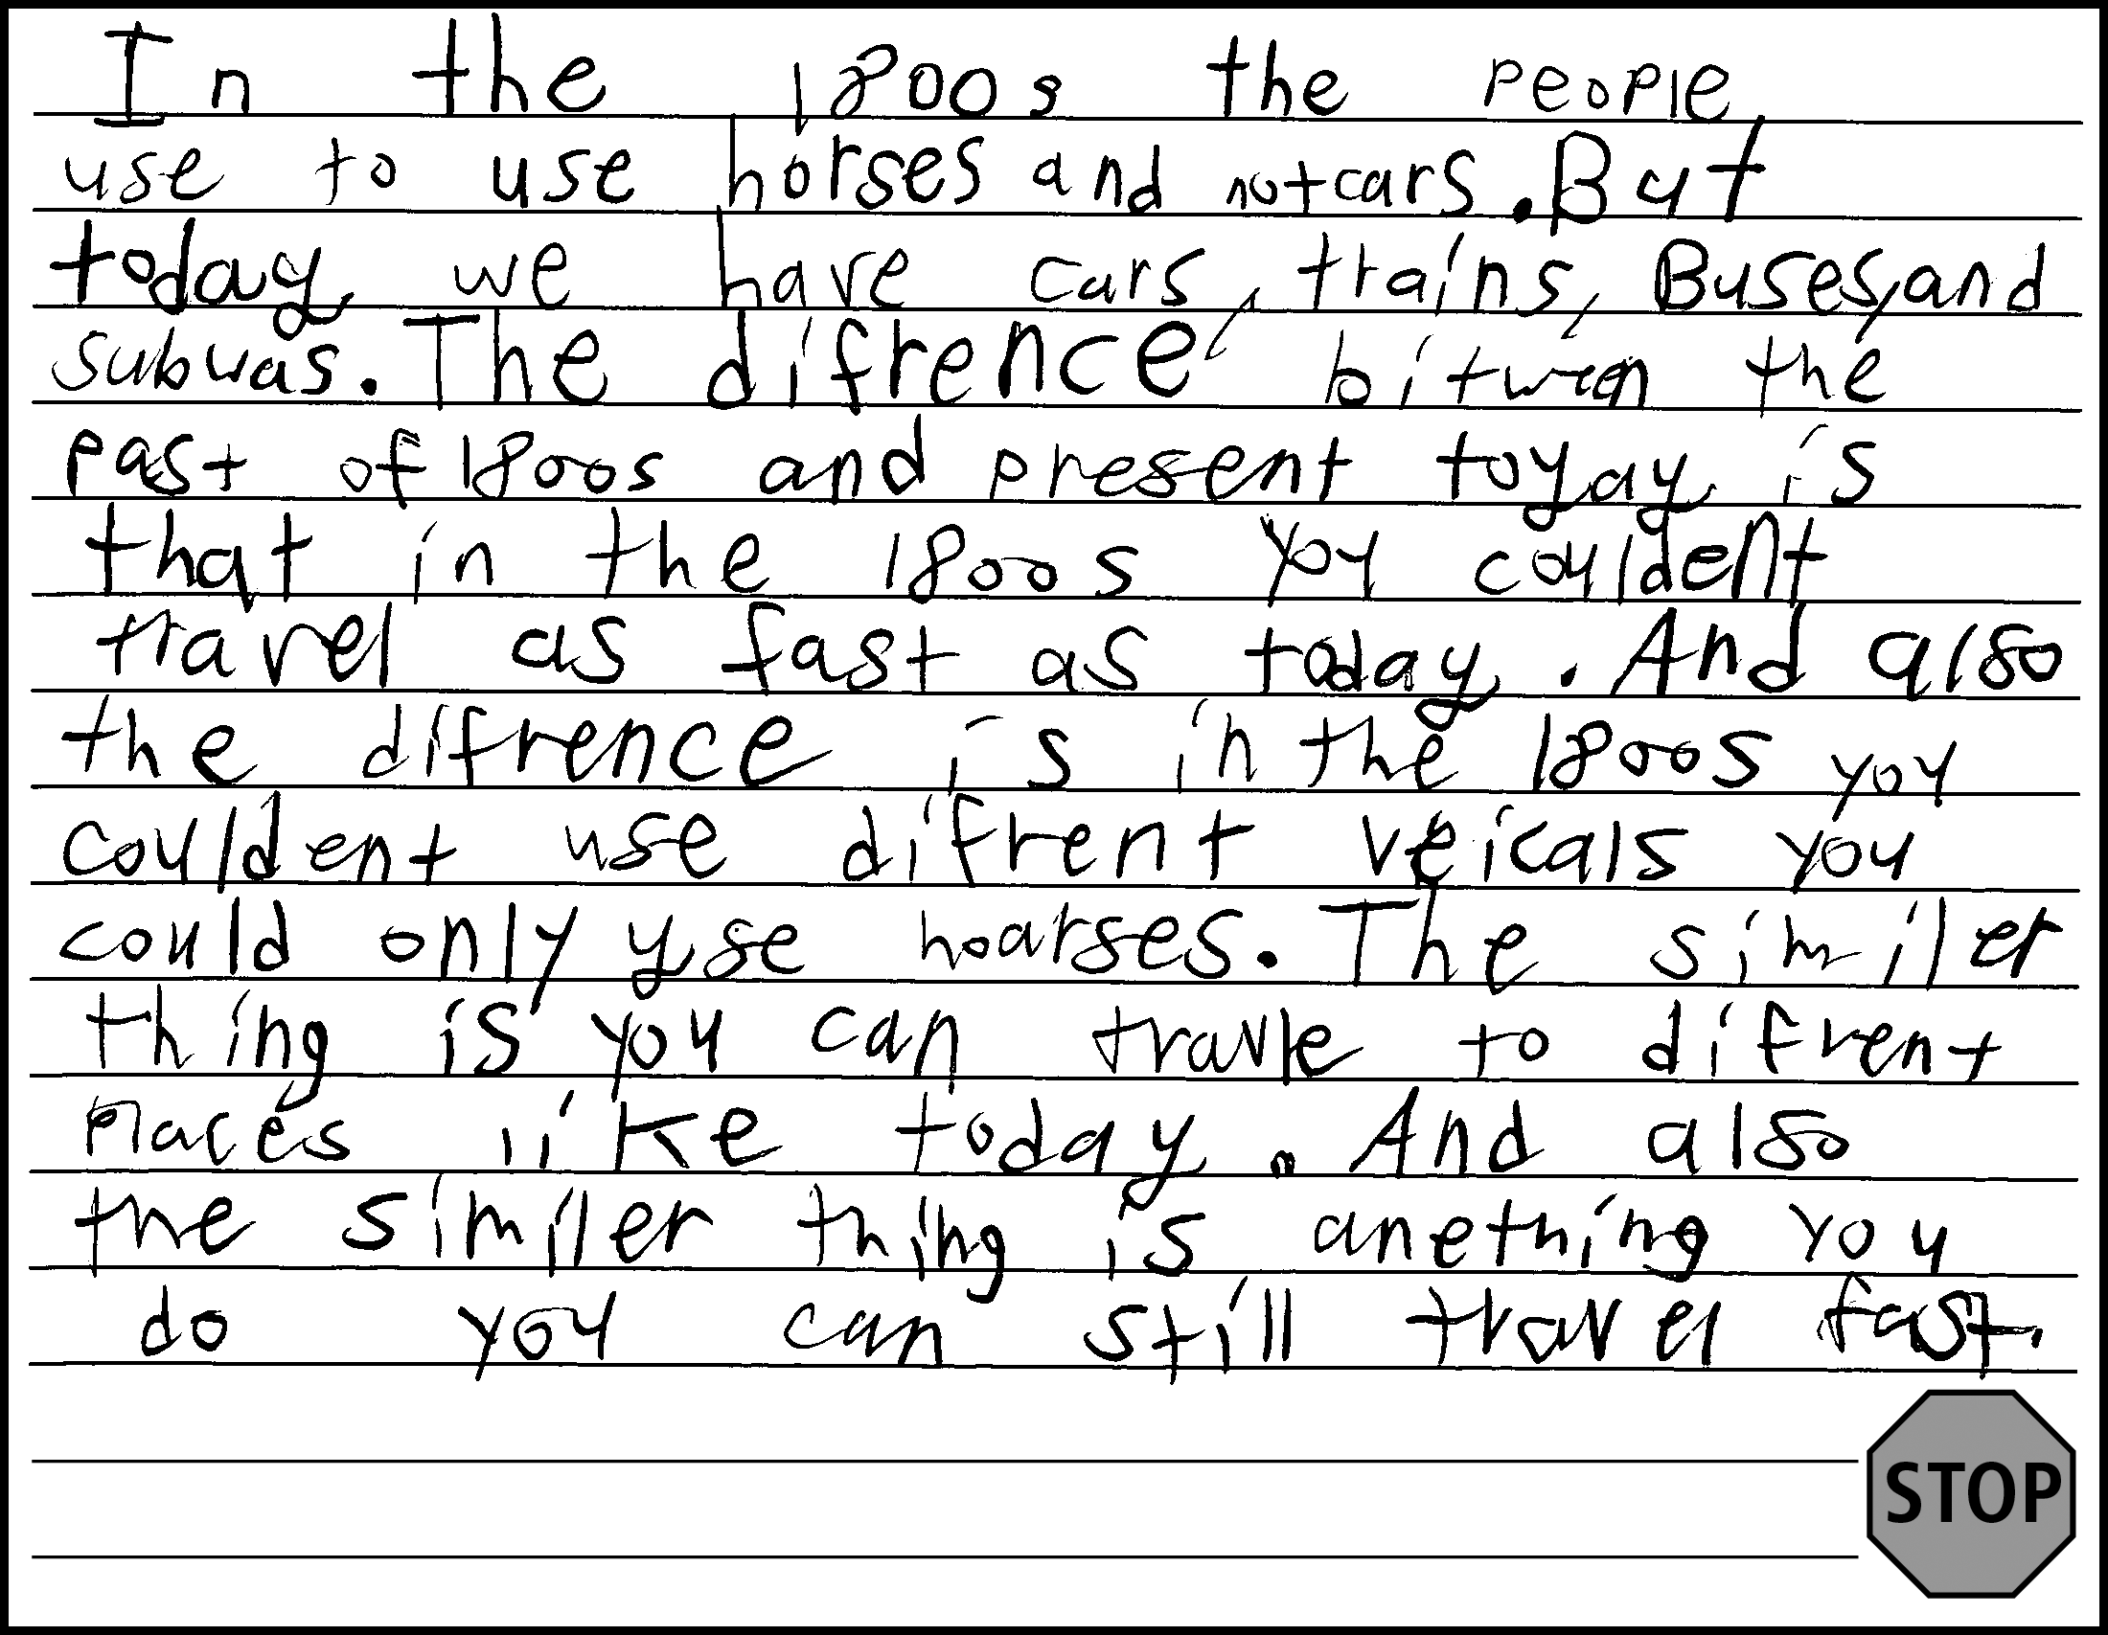
Grades 3–4: SCR Sample 2
Score 3: Expanding
CL
Response contains expanded and complex sentences
(repetitive structures the difference is and the similar thing is limit variety of sentences).
QL
Response contains some Tier 2 words (e.g., vehicles, similar).
CR
Response includes words and sentences that provide an introduction, development, and completion of linked thoughts and ideas to provide partial organization (the first two sentences function as an introduction to the topic; the rest of the response is grouped by similarities and differences, but ideas lack sufficient development).
DR
Response includes many detailed descriptions of ideas and facts (many similarities and differences are provided, but descriptions lack sufficient detail at times).
M
Response is clear and contains few errors that rarely obscure meaning (e.g., spelling error: subwas for subways).
*Please see your binder for a full rubric*

Slide 12
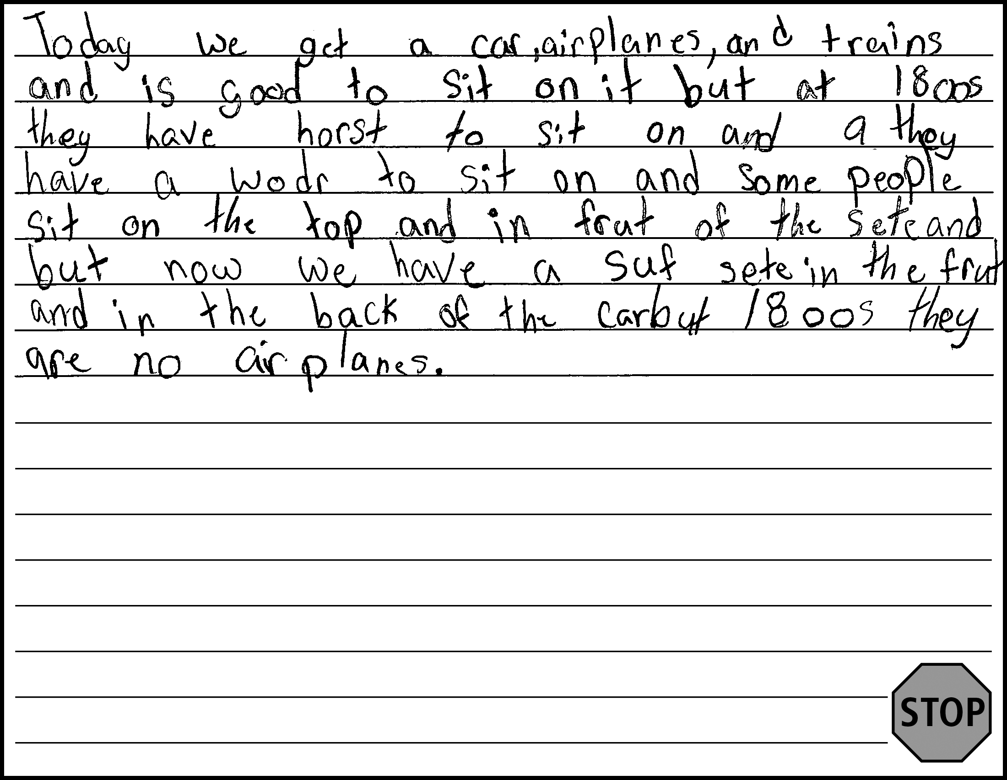
Grades 3–4: SCR Sample 3
Score 2: Transitioning
CL
Response includes at least one expanded sentence.
QL
Response contains at most frequently used Tier 1 words or predictable phrases.
CR
Response includes words and sentences that provide a limited introduction, development, and/or completion of linked thoughts, ideas, or both (ideas are linked and progression is evident, but additional organization and development are impeded by errors).
DR
Includes some minimally detailed descriptions of ideas, facts, or both (additional details obscured by errors).
M
Meaning is evident, but response contains many errors that often obscure meaning (e.g., missing words; spelling errors: horst for horse, wodr for wood, frut for front, suf for soft; usage error: they for there).
*Please see your binder for a full rubric*

Slide 13
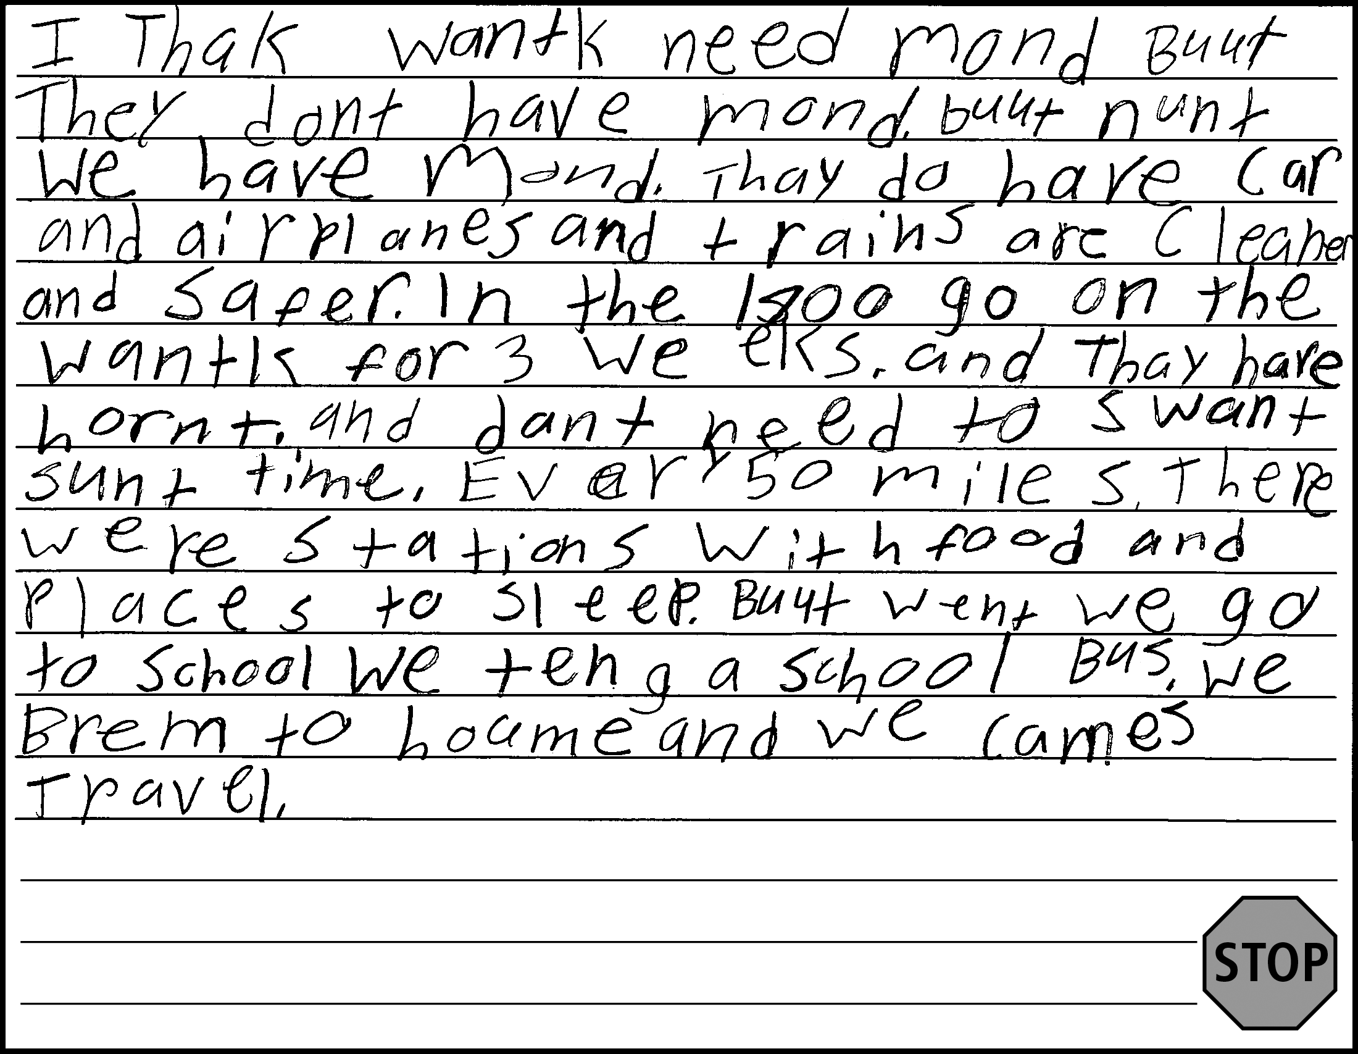
Grades 3–4: SCR Sample 4
Score 1: Emerging
CL
Response includes at least one expanded sentence (errors obscure sentence structures in much of response; some text is copied
from passage).
QL
Response contains at most frequently used Tier 1 words or predictable phrases.
CR
Response includes at least one sentence to introduce, develop, or complete thoughts or ideas (errors obscure organizational elements in much of response).
DR
Response includes at least one description of an idea or a fact (errors obscure details in much of response).
M
Meaning is evident, but response contains many errors that often obscure meaning (spelling errors obscure meaning throughout
the response).
*Please see your binder for a full rubric*

Slide 14
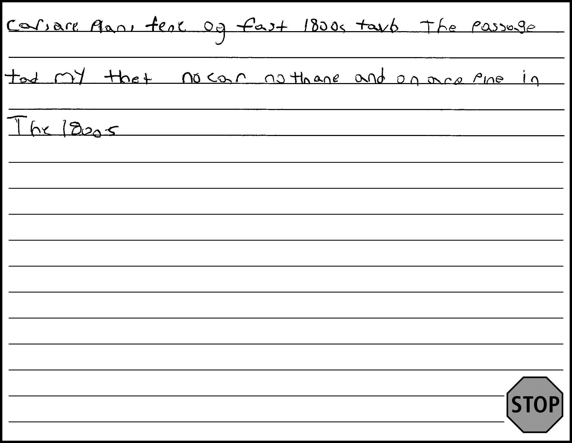
Grades 3–4: SCR Sample 5
Score 0: Entering
CL
Response contains few words or short phrases.
QL
Response contains at most frequently used Tier 1 words or predictable phrases.
CR
Response lacks a clear introduction, or development of a thought or an idea, or completion due to brevity.
DR
Response lacks descriptions of ideas or facts.
M
Response contains numerous errors that totally obscure meaning.
*Please see your binder for a full rubric*

Slide 15
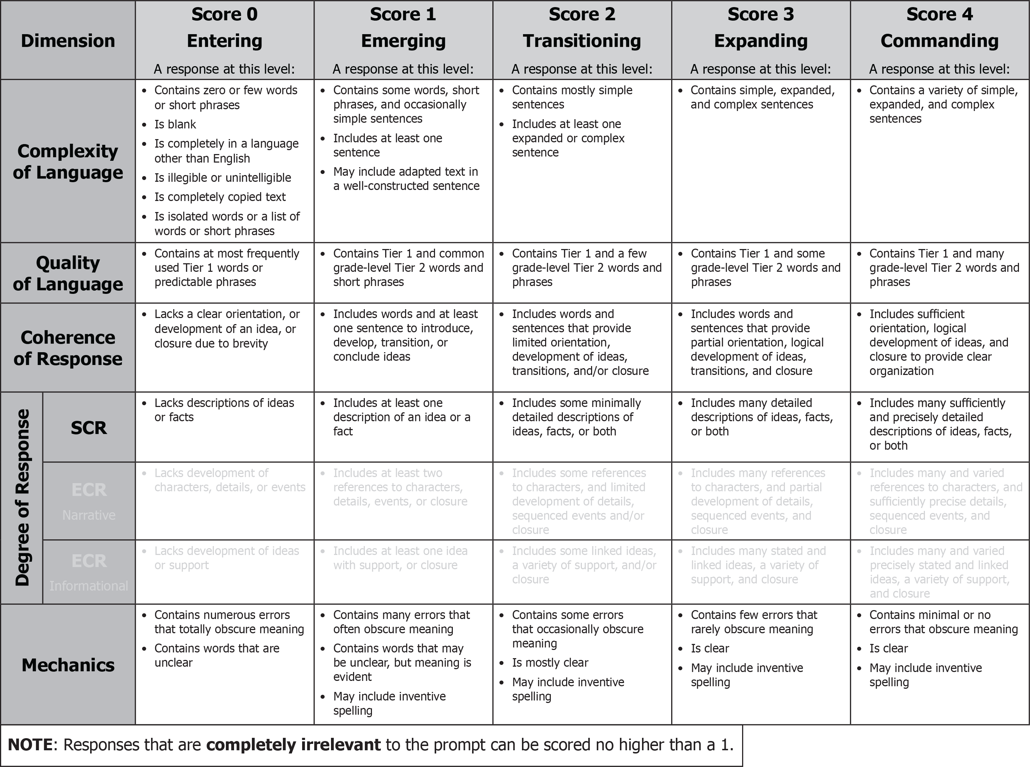
Grades 5–6: SCR Rubric

Slide 16
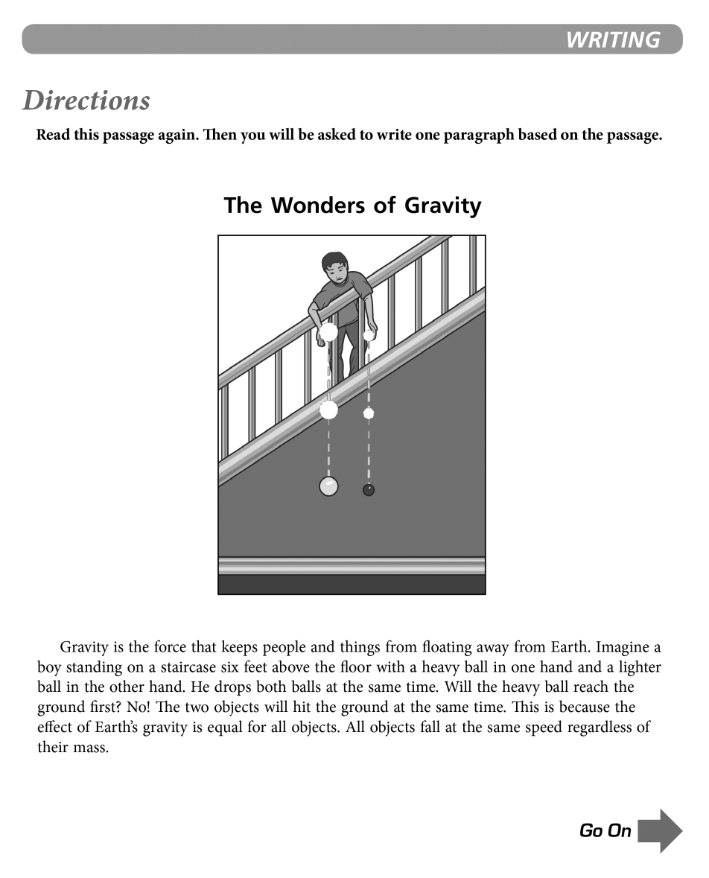
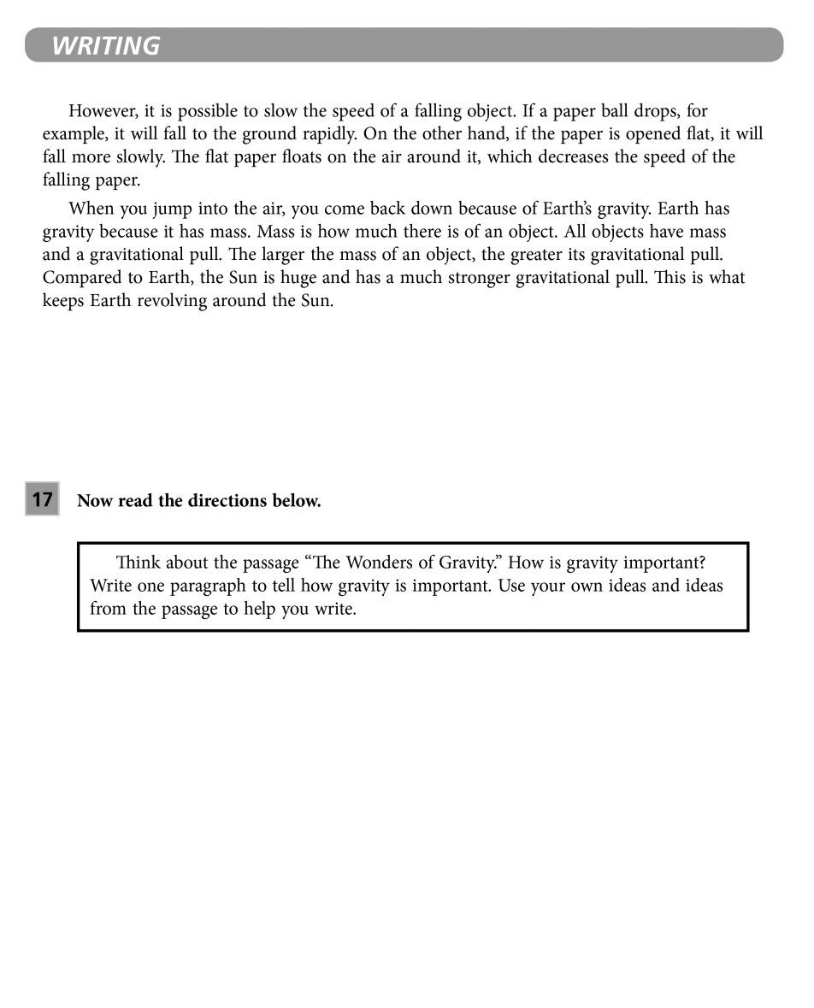
Grades 5–6: SCR Prompt
(binder page 56 for prompt and samples)

Slide 17
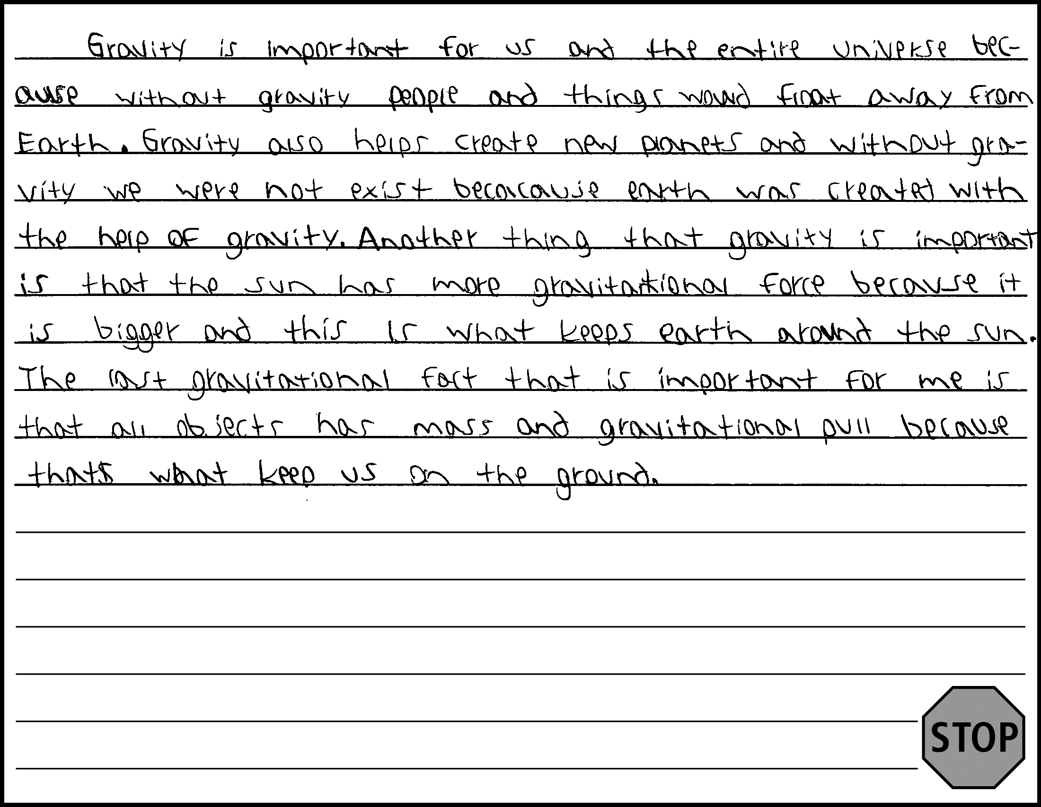
Grades 5–6: SCR Sample 1
Score 4: Commanding
CL
Response contains a variety of expanded and complex sentences.
QL
Response contains many Tier 2 words and phrases (e.g., entire universe, create new planets, exist, gravitational force,
objects, mass)
CR
Response includes words and sentences that provide partial orientation, logical development of ideas, transitions, and closure (has an introduction and organized and connected ideas, but
lacks a clear conclusion, and at times lacks a smooth flow
between ideas).
DR
Response includes many sufficiently and precisely detailed descriptions of ideas, facts, or both.
M
Response is clear and has minimal errors that obscure meaning (e.g., were not exist for would not exist).
*Please see your binder for a full rubric*

Slide 18
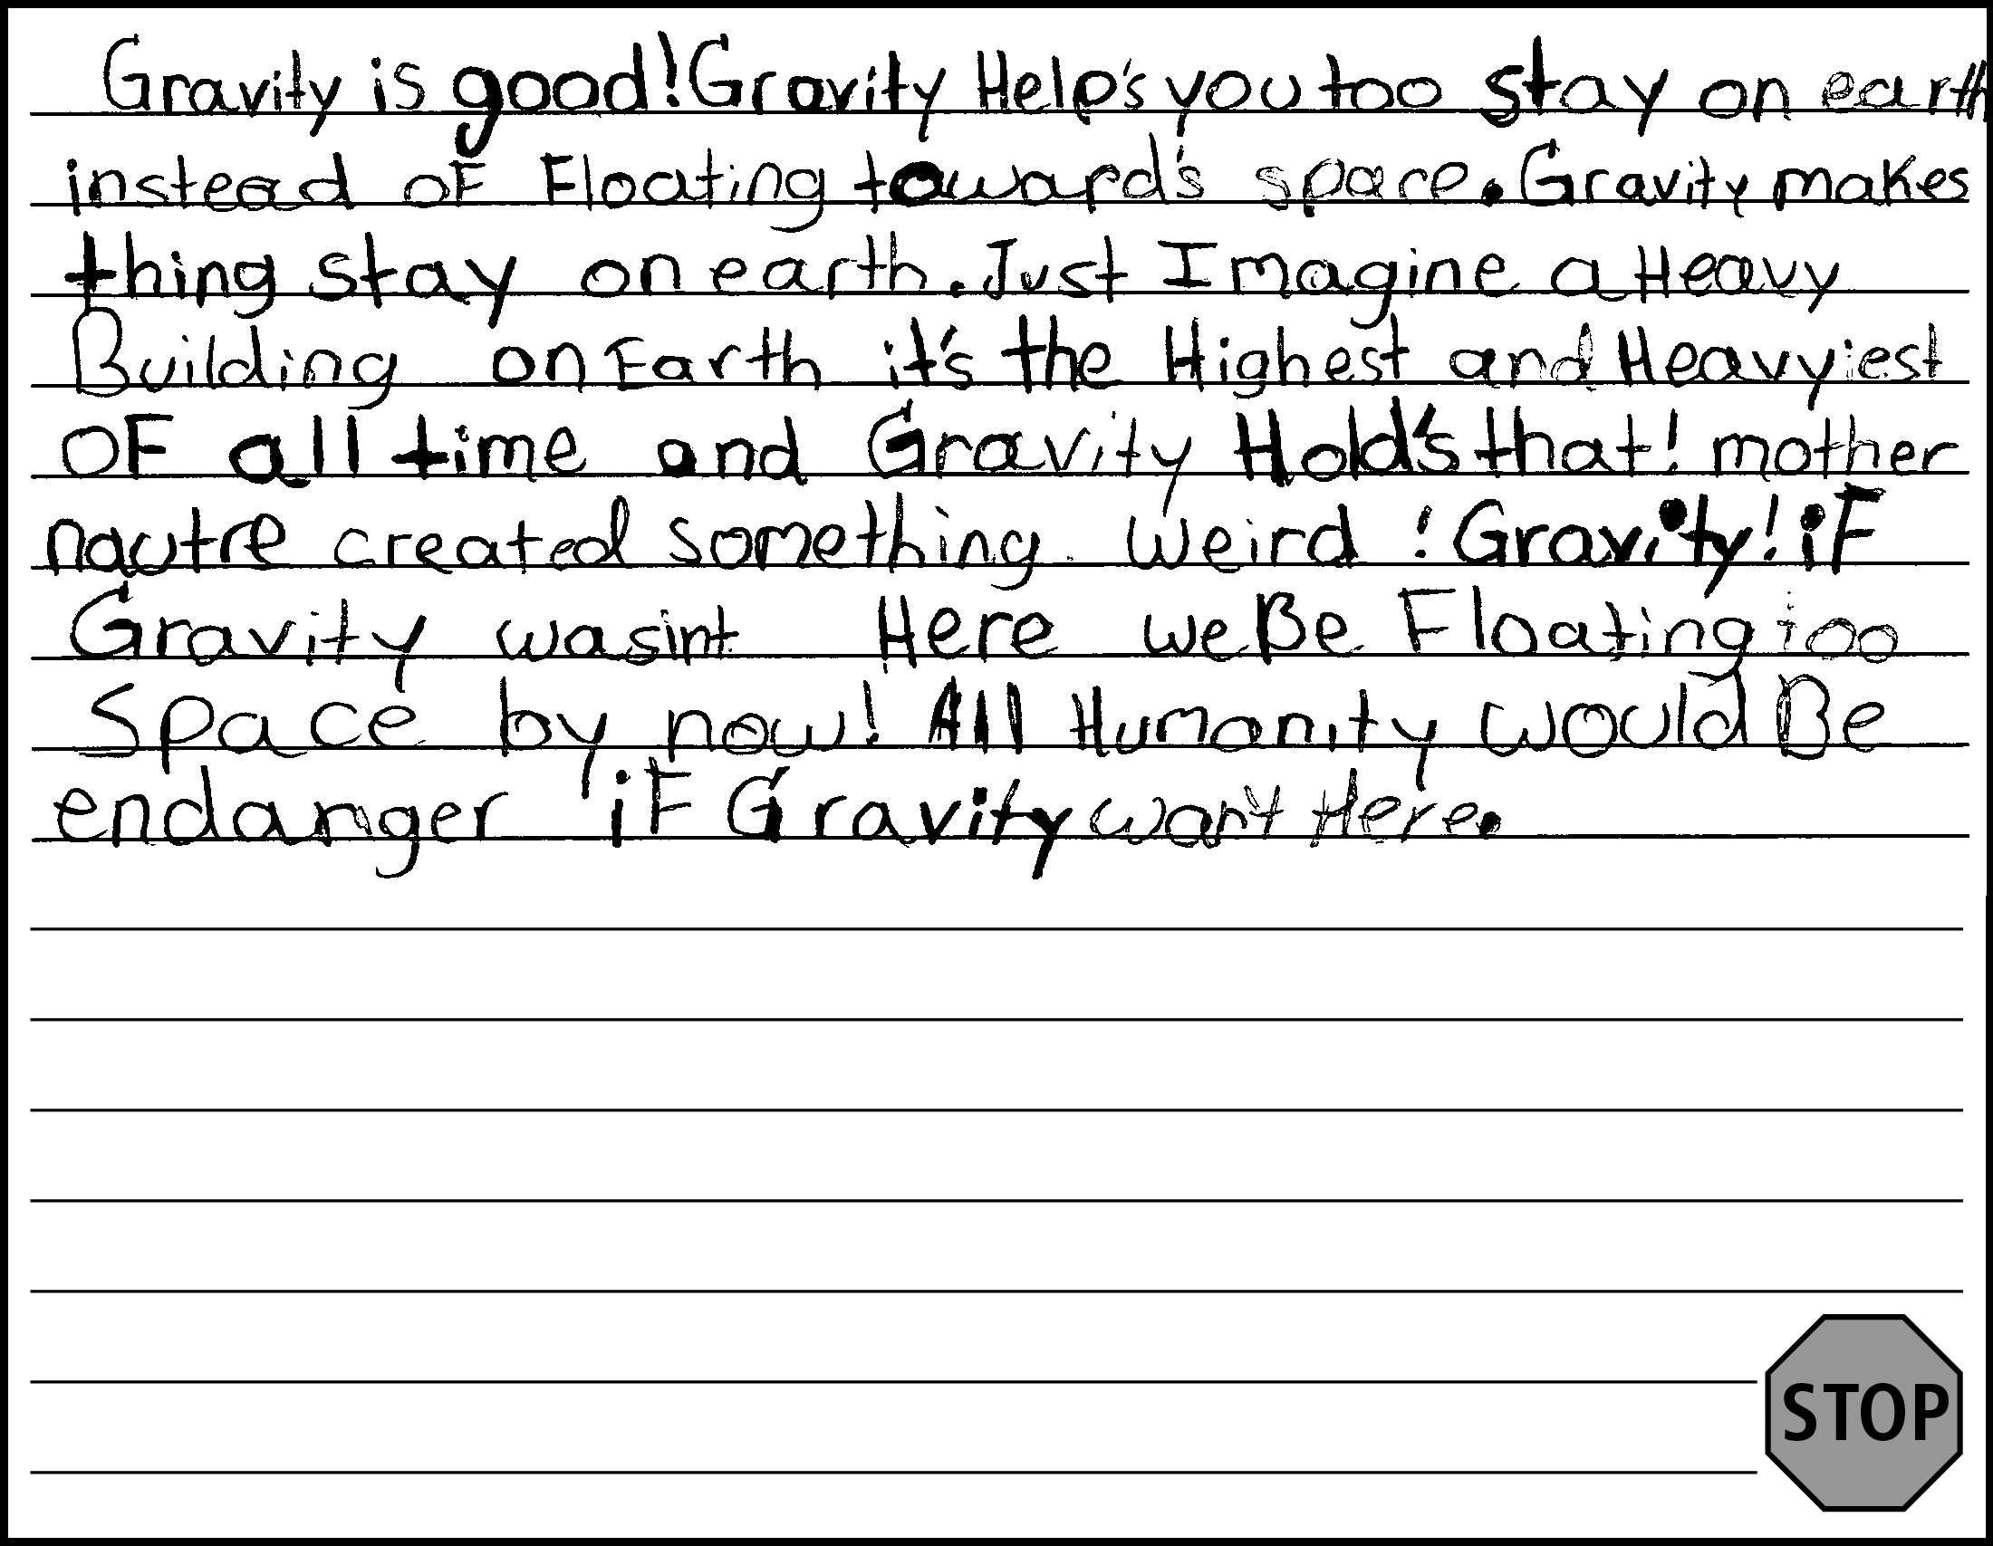
Grades 5–6: SCR Sample 2
Score 3: Expanding
CL
Response contains simple, expanded, and complex sentences (does not demonstrate sufficient command of a variety of sentence structures).
QL
Response contains some Tier 2 words and phrases
(e.g., floating towards space, mother nature, humanity).
CR
Response includes words and sentences that provide limited orientation, development of ideas, transitions, and/or closure
(has an introductory and concluding statement and connected ideas, but ideas are often repetitive and lack a clear and logical progression).
DR
Response includes some detailed descriptions of ideas, facts, or both (many of the details provided repetitively describe the idea that gravity holds objects down).
M
Response is clear and contains few errors that rarely obscure meaning (spelling errors: endanger for endangered, wan’t for weren’t or wasn’t).
*Please see your binder for a full rubric*

Slide 19
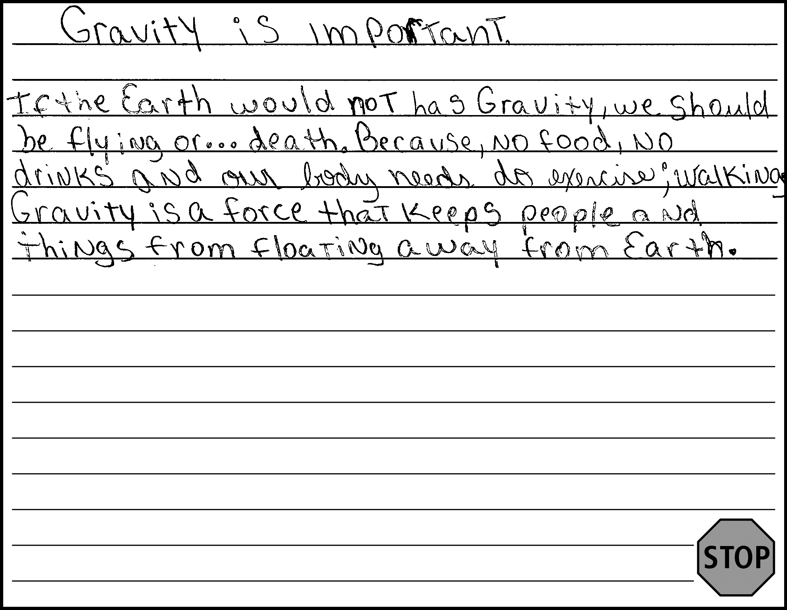
Grades 5–6: SCR Sample 3
Score 2: Transitioning
CL
Response includes at least one expanded or complex sentence (first and last sentences are copied from the passage/prompt).
QL
Response contains a few Tier 2 words and phrases
(e.g., exercise).
CR
Response includes words and sentences that provide limited orientation, development of ideas, transitions, and/or closure (has an introduction, but only one of the following sentences is clearly connected; other original sentence is not connected well enough to create a logical development of ideas).
DR
Response includes some detailed descriptions of ideas, facts, or both (relevant details are occasionally present in the response; Because no food no drinks is not clearly tied to central idea of
the response).
M
Response is mostly clear, but contains some errors that occasionally obscure meaning (word choice errors: has for have, should for would; sentence structure error: Because, no food, no drinks and our body needs do exercise; walking).
*Please see your binder for a full rubric*

Slide 20
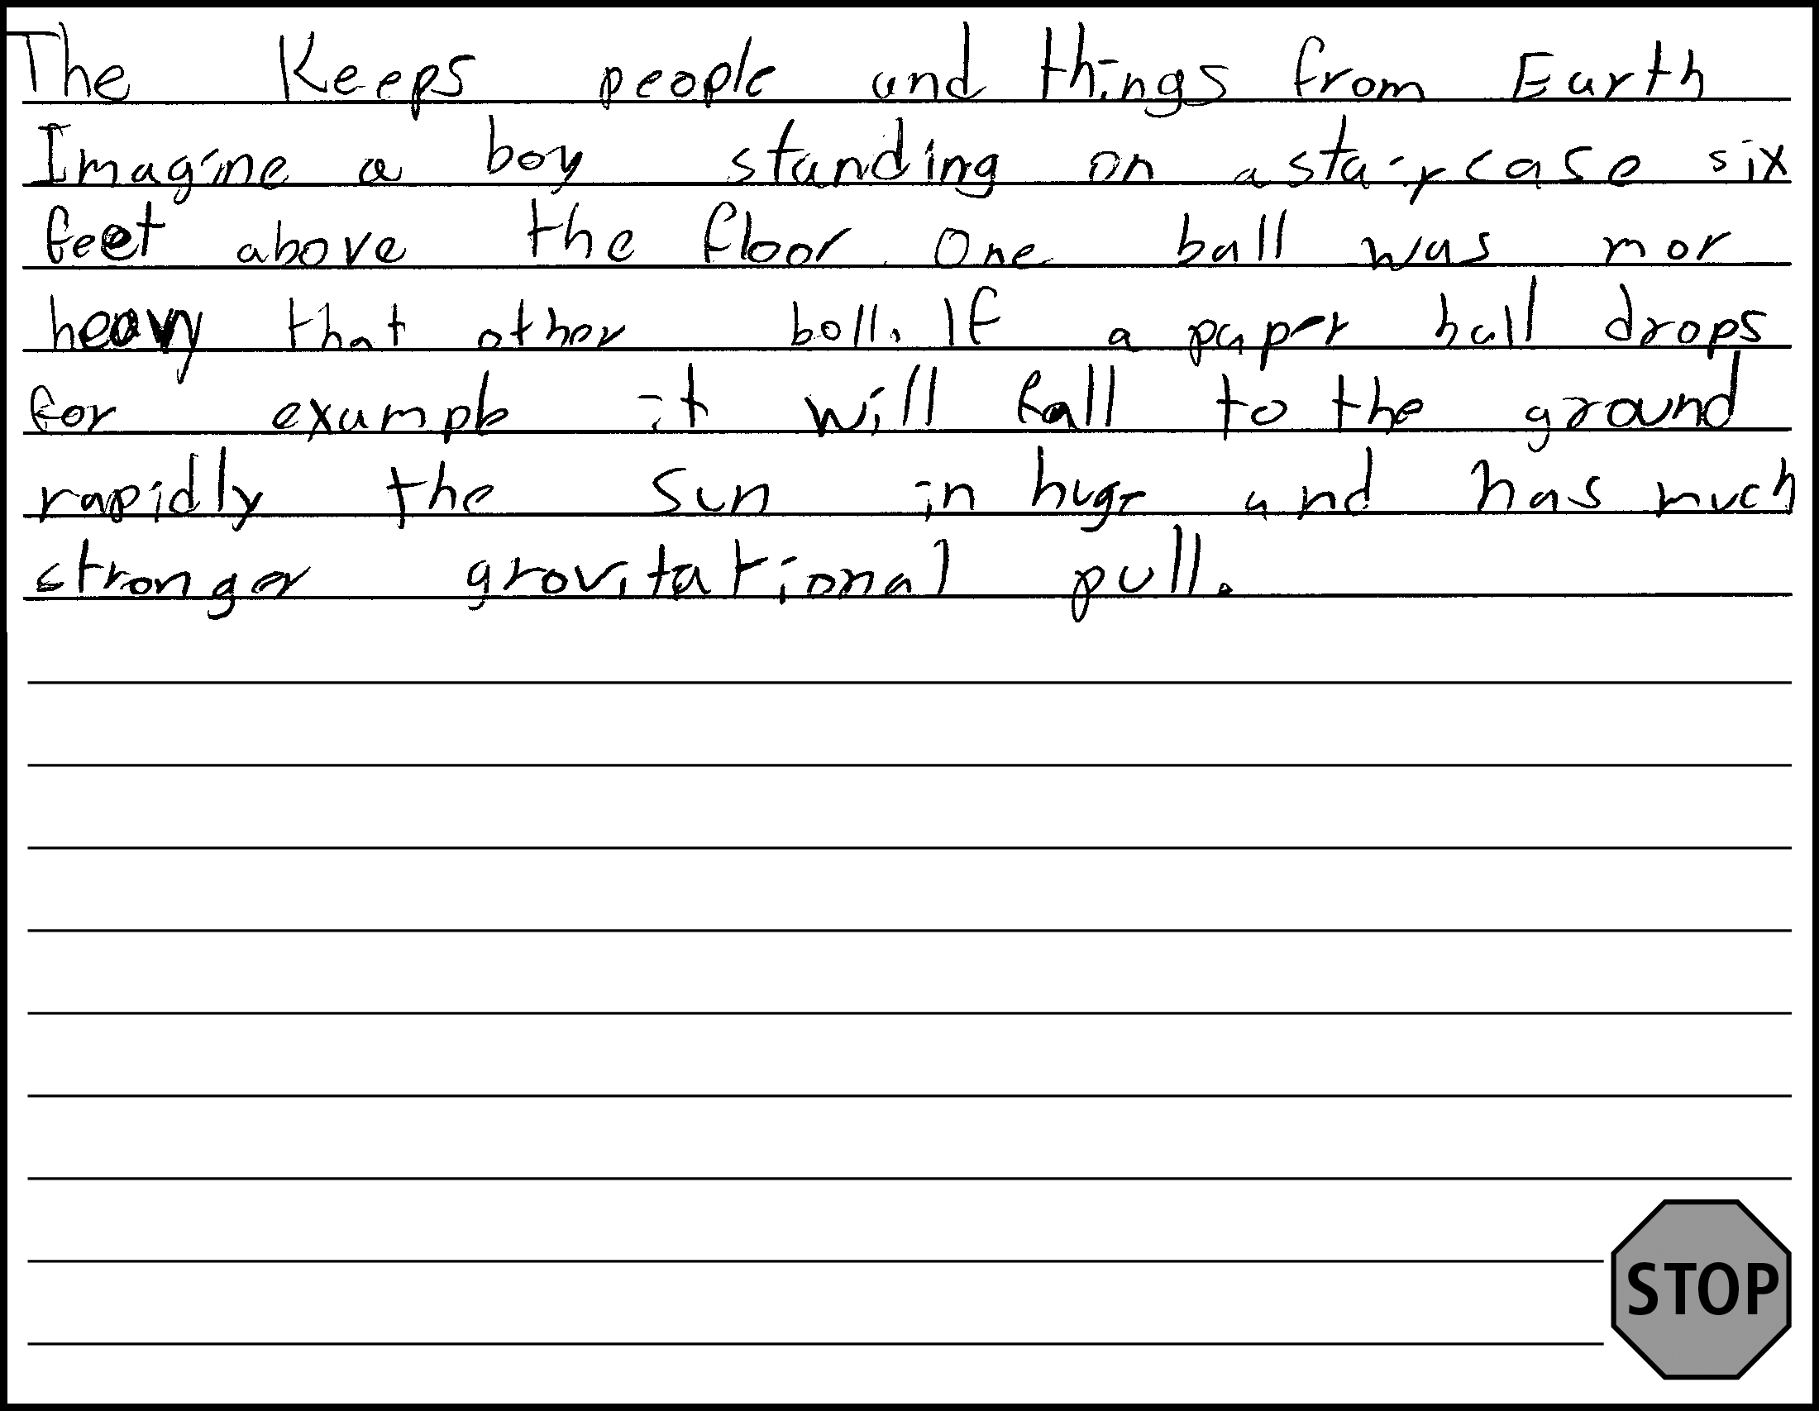
Grades 5–6: SCR Sample 4
Score 1: Emerging
CL
Response includes at least one sentence (majority of response is copied from passage, with one original sentence: One ball was mor heavy that other boll; elements that would make original sentence expanded are obscured by errors).
QL
Response contains Tier 1 and common Tier 2 words and short phrases (more advanced Tier 2 vocabulary is only present in copied text).
CR
Response includes words and at least one sentence to introduce, develop, transition, or conclude ideas (single original sentence).
DR
Response includes at least one description of an idea or a fact (single original sentence compares the two balls).
M
Response is mostly clear, but contains some errors that occasionally obscure meaning (spelling error that for than obscures structure of original sentence).
*Please see your binder for a full rubric*

Slide 21
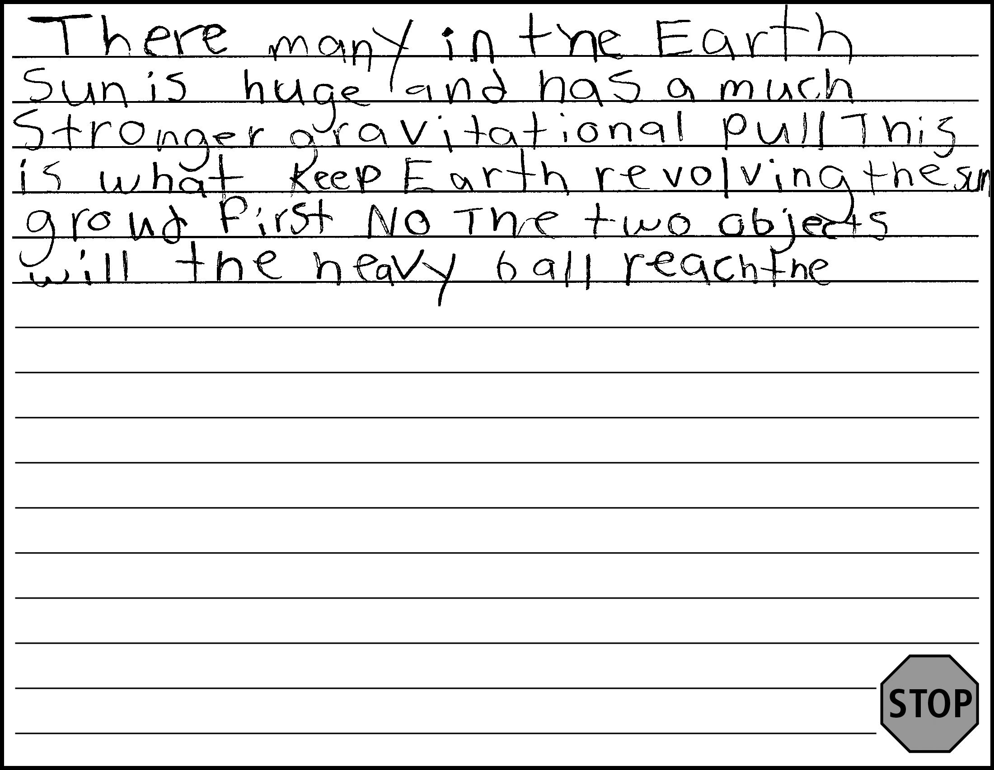
Grades 5–6: SCR Sample 5
Score 0: Entering
CL
Response contains short phrases (most of response is copied from passage; only first line is original).
QL
Response contains at most frequently used Tier 1 words or predictable phrases.
CR
Response lacks a clear orientation, or development of an idea, or closure due to brevity (original text does not clearly express
an idea).
DR
Response lacks descriptions of ideas or facts.
M
Response contains errors that totally obscure meaning (original text does not clearly express an idea).
*Please see your binder for a full rubric*

Slide 22
Additional Practice Items
SCR practice items, including scores and justifications, can be found in the Turnkey materials
Grades 3–4 start on page 46
Grades 5–6 start on page 64
Grades 9–12 start on page 73

Slide 23
2019 NYSESLAT Resources
For Information or Assistance | Contact
Questions regarding testing policies, accommodations, security breaches and sensitive student responses | Office of State Assessment Email: emscassessinfo@nysed.gov Call: 518-474-5902
Questions regarding the provisions of ELL/MLL services in Bilingual Education and English as a New Language programs | Office of Bilingual Education and World Languages Email: obewl@nysed.gov Phone: 518-474-8775 (Albany office) Phone: 718-722-2445 (NYC office)
Questions regarding scoring of Speaking and Writing constructed-response questions or shipment of materials | MetriTech, Inc. Customer Service Email: nyseslat@metritech.com Phone: 800-747-4868 Fax: 217-398-5798

Slide 24
2019 NYSESLAT Resources (Continued)
For Information or Assistance | Contact
For regulatory or training assistance: | Regional Bilingual Education Resource Networks http://www.nysed.gov/bilingual-ed/regional-supportrberns
Machine-scannable answer sheets and local scanning services | RIC or Large-City Scanning Center http://www.p12.nysed.gov/irs/sirs/ric-big5.html
Information about the NYSESLAT and regular updates including the turnkey training materials and School Administrators Manual (SAM) | NYSESLAT Homepage http://www.p12.nysed.gov/assessment/nyseslat

