Slide 2
Speaking Scoring Practice Directions
The Speaking Practice Items are self-paced. These include practice items for all grade bands and item levels.
The Practice Items and scoring materials are found beginning on Page 4 of the Turnkey materials posted on the NYSESLAT web site: http://www.p12.nysed.gov/assessment/nyseslat
Directions for Scoring Practice:
1) Review the Speaking Rubric carefully
  2) Listen to the practice audio file*
  3) Assign a holistic score based on the Rubric for that question
  4) Once you have completed the practice set, you may check your scores using the justification beginning on Page 16 of the Turnkey materials
*Play PowerPoint in presentation/Slide Show mode to hear the audio files

Slide 3
Emerging Rubric Review
No response
Responds with “yes,” “no,” or “I don’t know”
Responds completely in a language other than English
Uses one word to respond
Does not express a complete thought or idea
Unintelligible
Score
0
Uses multiple words, short phrases, or sentences to respond
Partially expresses thoughts and ideas
Frequent errors may obscure meaning
Score
1
N/A
Score
2

Slide 4
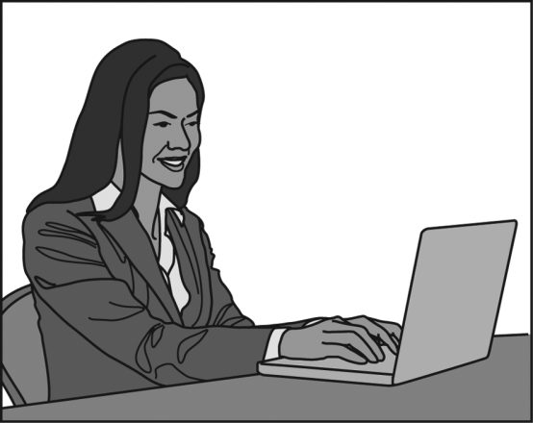
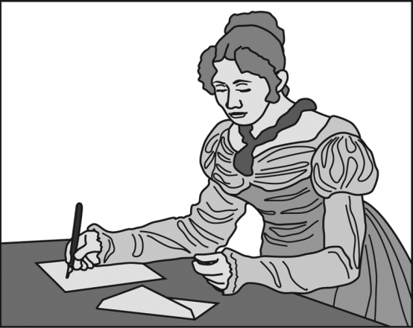
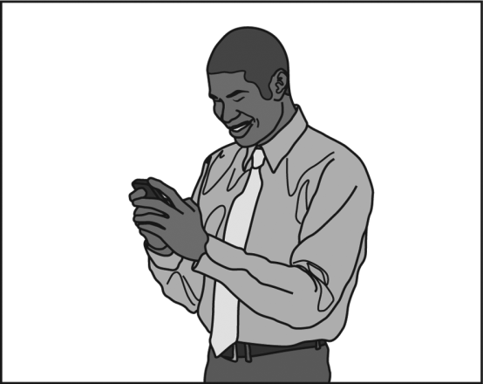


Emerging Practice: Grades 3–4
1.
2.
3.
Context: A long time ago, people wrote letters on paper to communicate. These letters took a long time
to arrive by mail. Today many people use computers to write messages to friends and family. We can send
emails on the computer. We can also send text messages on our phones. These types of messages get to
people much faster than writing and mailing letters.
Modeling: [POINT to PICTURE 1] This woman is writing an e-mail.
Question: [POINT to PICTURES 2 AND 3] Tell me what other people do to communicate.
Rephrasing: [POINT to PICTURE 1] This woman is writing an email. [POINT to PICTURES 2 AND 3]
How do other people write?
Track 44
Track 45
“Call the other people . . . with the phone . . . Write with with with paper . . . and use the computer.”
[No response; rephrasing is read] “Draw.”
Practice #1
Practice #2

Slide 5
Emerging Practice: Grades 7–8
Context: In the summertime, insects do a lot of things outside.
Modeling: [POINT to CATERPILLAR] A caterpillar is crawling in the dirt.
Question: Tell me some things that insects do in the summertime.
Rephrasing: Insects are very active in the summer. [POINT to CATERPILLAR] Here is a caterpillar crawling.
What else is happening in the picture?
“In the summertime, insects such as a worm, they . . . They go on their . . . Ladybugs go on leaves. . . . Mm . . . Bees find honey. Butterflies fly.”
Track 46
Track 47
“I don't know.”
Practice #1
Practice #2

Slide 6
Transitioning Rubric Review
No response
Responds with “yes,” “no,” or “I don’t know
Responds completely in a language other than English
Uses one word to respond
Does not express a complete thought or idea
Unintelligible
Errors may totally obscure meaning
Score
0
Uses multiple words to respond
Partially expresses thoughts and ideas
Frequent errors may obscure meaning
Score
1
Uses connected phrases or a simple sentence to respond
May use multiple sentences
Expresses complete thoughts and ideas relevant to the topic
Occasional errors in words and structures may obscure some meaning
Score
2

Slide 7
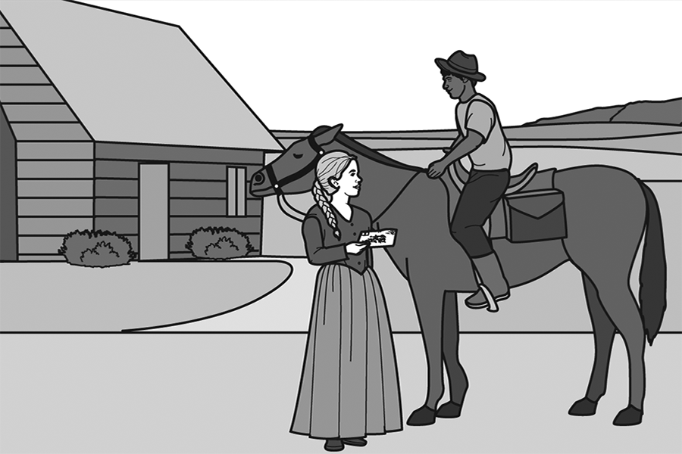
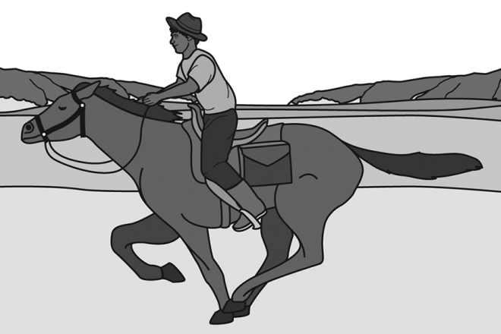
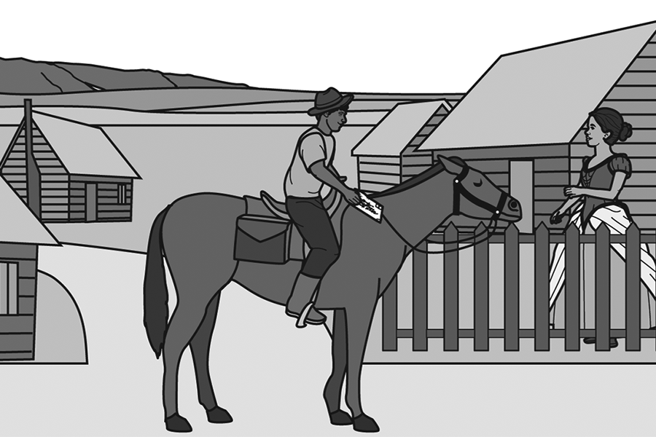
Transitioning Practice: Grades 3–4
1.
2.
3.
Context: In the 1860s, there were no phones or computers to communicate with people who were far away.
People wrote letters to their friends and families, and men rode horses across the United States to deliver
the letters. This service was called the Pony Express.
Question: [POINT to WOMAN IN PICTURE 1] Tell me how this woman’s letter got delivered to her friend.
Track 48
Track 49
Track 50
Practice #1
Practice #2
Practice #3
“Mmm the different people.”
“Mmm… To be- to b- bu- one… mmm… one. [?] Mmm…”
“With uh with with a person. That’s called Pony Express.”

Slide 8
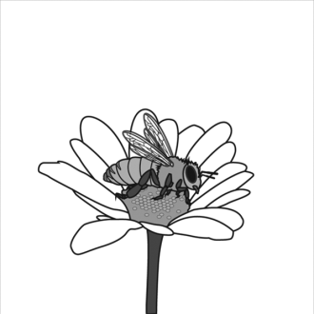
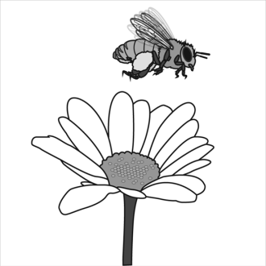
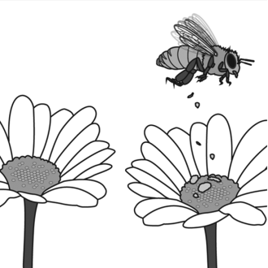
Transitioning Practice: Grades 7–8
1.
2.
3.
Context: Pollination is very important for plants. [POINT to PICTURE 1] In the summertime, honeybees
drink nectar from flowers. [POINT to PICTURE 2] When they do, pollen gets stuck to their bodies.
[POINT to PICTURE 3] They carry it to a different flower where the pollen falls off. By doing this,
honeybees pollinate plants and help them to create seeds.
Question: Tell me how honeybees help plants.
Track 51
Track 52
Track 53
Practice #1
Practice #2
Practice #3
“They . . . They . . .”
“Cause they put more, . . . more plants inside . . . the flowers once they drop it.”
“Um . . . After they drink from the flower, and then something's . . . Um . . . What's stuck on their body.”

Slide 9
Expanding Rubric Review
Responds with “yes,” “no,” or “I don’t know”
Uses at most multiple words to respond
Does not express complete thoughts and ideas
Frequent errors may obscure meaning
Score
0
Uses connected phrases or a simple sentence to respond
Expresses complete thoughts and ideas relevant to the topic
Occasional errors in words and structures may obscure some meaning
Score
1
Uses connected simple sentences to respond
May use limited expanded sentences
Expresses connected and complete thoughts and ideas relevant to the topic
Infrequent errors in words and structure may obscure some meaning
Score
2

Slide 10
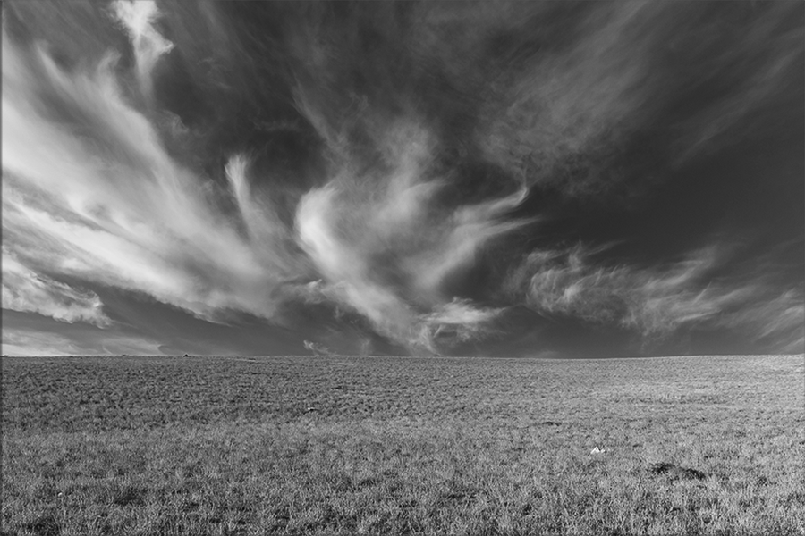
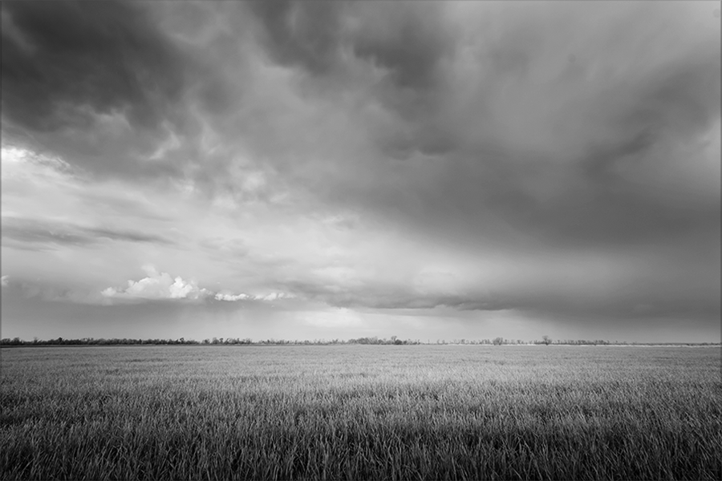
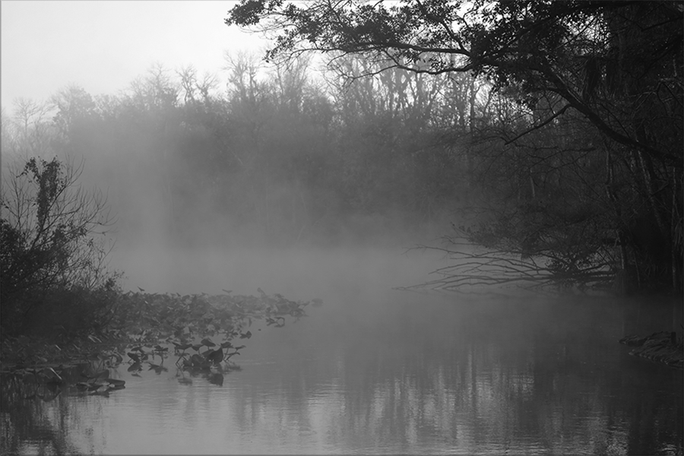
Expanding Practice: Grades 1–2 (Text-Based)
1.
2.
3.
Cirrus
Stratus
Fog
Context: [Now let’s talk about clouds.] There are several different kinds of clouds. One kind of cloud is a
cirrus cloud. These clouds are thin and long and look like white lines on a sunny day. Dark gray clouds in
the sky are called stratus clouds. They cover the sky like a blanket. Other clouds aren’t in the sky at all!
Fog is a special kind of cloud that floats close to the ground. Fog can be dangerous because it makes it
hard for people to see.
Question: Tell me about different kinds of clouds.
Track 54
Track 55
Track 56
Practice #1
Practice #2
Practice #3
“There are rainy . . . rainy clouds, thunder clouds, and snowballs.”
“Different kind of cloud can come on space.”
“They . . . Uh . . . frog clouds can m . . . can make people see weird. Gray cloud is cold. Strings clouds . . . what, white lines on a sunny day. There's different kinds of cloud in the sky.”

Slide 11
Expanding Practice: Grades 3–4 (Text-Based)
Context: [Now let’s talk about the history of writing.] Today many people know how to write. But a long
time ago, only a few people knew how to write. Writing was their job. These people were called scribes.
Scribes often came from rich and powerful families. They wore special clothes to show they were important.
Today, people have found ancient statues of scribes. People have also found their tools, which were
sometimes made of gold.
Question: Tell me about scribes.
Track 57
Track 58
Track 59
Practice #1
Practice #2
Practice #3
“Scribes are the onl- the onl- the only some people used to write. And then only the rich people knew knew how to write. And, and then um uh the gold is there into the write. I think.”
“They’re rich and
powerful families.”
“He no happy.”

Slide 12
Expanding Practice: Grades 7–8 (Text-Based)
Context: [Now let’s talk about honeybees.] Honeybees make honey by collecting
nectar from flowers. They have special “honey stomachs” that turn the nectar into
sugar and remove some of the water from it. They carry the nectar back to the hive
where it is put into cells. Then all the bees flap their wings to dry even more water
out of the nectar. When enough water is evaporated, what is left is the sweet mixture
we call honey. Because honeybees build their hives in hollow spaces, humans can get
bees to live in boxes the humans have built. This is called beekeeping. Beekeepers
help the bees stay alive by providing them with places to live. In addition, the
beekeepers can collect the wax and honey that the bees make. By beekeeping,
humans can help ensure that honey is produced and that there are enough bees to
pollinate nearby crops and plants.
Question: Tell me how honeybees make honey.
Track 60
Track 61
Track 62
Practice #1
Practice #2
Practice #3
“The honey bees make [?] honey by collecting, mm, the [?] from the flower, and they put it into their- their, uh, their home, and then they, uh... and then they turn into sugar, and... [?] then they remove the water. And then it just became honey.”
“Honeybees make honey because the human take a honey.”
“To take some food to the flower.”

Slide 13
Commanding Rubric Review
Responds with “yes,” “no,” or “I don’t know”
Uses at most connected phrases or a simple sentence to respond
May express complete thoughts and ideas
Occasional or frequent errors in words and structures may obscure meaning
Score
0
Uses connected simple sentences to respond
Expresses connected and complete thoughts and ideas relevant to the topic
Infrequent errors in words and structure may obscure some meaning
Score
1
Uses connected expanded sentences
Generates a fluid response using linking words and phrases to sequence
complete thoughts and ideas relevant to the topic
No errors or infrequent errors that do not obscure meaning
Score
2

Slide 14
Commanding Practice: Grades 3–4 (Text-Based)
Context: You just learned about the history of writing. Today many people know how to write. But a long
time ago, only a few people knew how to write. Writing was their job. These people were called scribes.
Scribes often came from rich and powerful families. They wore special clothes to show they were important.
Today, people have found ancient statues of scribes. People have also found their tools, which were
sometimes made of gold.
Question: Tell me why you think scribes were important and respected.
Track 63
Track 64
Track 65
Practice #1
Practice #2
Practice #3
“They were important because they gave people other things.”
“Scribes were important and respected because they were one of the only ones that knew how to write. So they… a lot of people also wanted to write ‘cause also in the past, it was way um harder and different from now these days.”
“Umm… scribes became rich and powerful families… and they they w- they wore special clotheses… and found ancient statues... And people found tools, which sometimes made of gold.”
Notes:
The examiner does not read the text on Commanding level text-based items

Slide 15
Commanding Practice: Grades 5–6 (Text-Based)
Context: You just learned about light pollution. Electric light helps us see at night.
But it also can cause a problem called light pollution. Light pollution refers to the electric
light that shines at night around the world. Because of light pollution, the sky never gets
completely dark in many parts of cities.
Scientists think that light pollution has dangerous effects on people and wildlife. Animals
who hunt at night can become confused by light pollution. Light pollution can also disrupt
our natural sleep patterns. The human body thinks it doesn’t need to sleep because of
the light.
Question: Tell me why light pollution is bad for people and the environment.
Track 66
Track 67
Track 68
Practice #1
Practice #2
Practice #3
“Um . . . Because it can burn your eyes and you cannot see.”
“Light pollution is very . . . um . . . bad or dangerous for the people and the environment because . . . um . . . The light pollution to people . . . um . . .the human body does . . . um . . . Thinks that it doesn't need to sleep because of the light. And for the environment, because animals who hunt at night become really confused by the light pollution.
“Light pollution is bad for people and the environment cause the human body thinks it doesn't need to sleep because of the light.”

Slide 16
Commanding Practice: Grades 7–8 (Text-Based)
Context: You just learned about honeybees. Honeybees make honey by collecting nectar
from flowers. They have special “honey stomachs” that turn the nectar into sugar and remove some
of the water from it. They carry the nectar back to the hive where it is put into cells. Then all the
bees flap their wings to dry even more water out of the nectar. When enough water is evaporated,
what is left is the sweet mixture we call honey. Because honeybees build their hives in hollow
spaces, humans can get bees to live in boxes the humans have built. This is called beekeeping.
Beekeepers help the bees stay alive by providing them with places to live. In addition, the
beekeepers can collect the wax and honey that the bees make. By beekeeping, humans can help
ensure that honey is produced and that there are enough bees to pollinate nearby crops and plants.
Question: Tell me why bees are important for humans and the environment.
Track 69
Track 70
Track 71
Practice #1
Practice #2
Practice #3
“Well, honeybee, they give us honey, so… [?] but it was honey. And um, they can pollinate crops and plants.”
“Mm, I- it helps, um, th- it helps the bees themselves to grow.”
“I think bees are important for the um, the um, bees are important for humans and the environment because it helps humans by providing food, like honey, and it helps the environment by, um, by- for bees to keep on, um, pollinating nearby crops and plants.”
Notes:
In track 69 the examiner adds some of their own words “Let me tell you…”
As you know, the questions are to be read exactly as they are written.

Slide 17
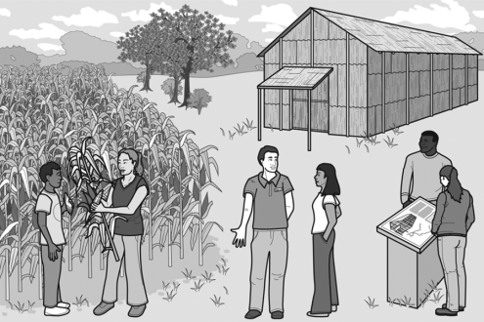
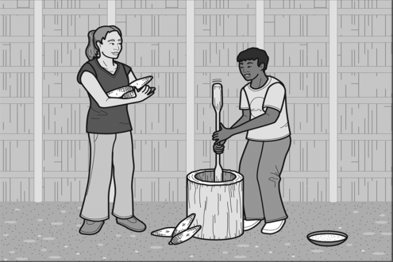
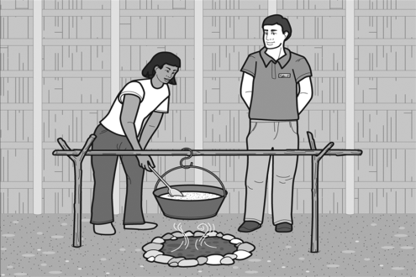
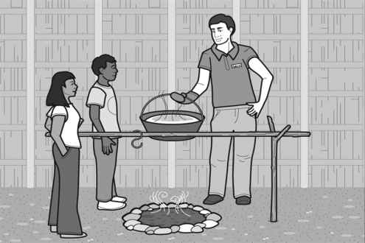
Commanding Practice: Grades 9–12
1.
2.
3.
4.
Context: These students learned a lot by visiting this Native American historical site. Because of all the
things they did and saw, they have a lot of information about the lives of Native Americans that they can
share with other students.
Question: Why do you think it was important for the students to visit a historical site?
Track 72
Track 73
Track 74
Practice #1
Practice #2
Practice #3
“Because they are know how to make or how to produce like corns or to make food.”
“The important reason for the students visiting the historical site is for they can know how their like past um work, and how they cooked meals back in- back in those times.”
“It was im- um it was important for the students to visit the historical site because they have a homework.”
Notes:
After the last practice item, tell participants that the transcriptions, scores, and justifications are in the binder, starting on page 16

Slide 18

Additional Scored Speaking Samples
Scored Speaking Samples – Beginning on Page 22 of the Turnkey materials
  Grade K
  Grade Bands 5-6
  The Transcripts, Scores, and Justifications for these items can be found beginning on Page 30 of the Turnkey materials
Notes:
These Scored Samples are for you to use in training if you need additional samples. The samples start on page 22 in the binder. The transcripts, scores, and justifications for the additional samples are in the binder starting on page 30.

Slide 19
Grade Kindergarten—Emerging Samples
Context: These students are in the art classroom.
Modeling: [POINT to BOY WITH SCISSORS] I see a boy cutting with scissors.
Question: Tell me what students do in art class.
Rephrasing: You can do a lot of things in art class. [POINT to BOY WITH SCISSORS] He is using scissors.
What else is happening in art class?
Score Point 0
Score Point 1
“Mm boy paint... Cut in the- in the paper, and then this boy in make in a triangle, in square and then [?] he’s make in the pink house sunny in [?]”
"Draw?"
Track 22
Track 23

Slide 20
Grade Kindergarten—Transitioning Samples
Context: There are many different projects students can make in art class.
Question: Tell me how the students’ art projects are different.
Score Point 0
Score Point 1
Score Point 2
Track 24
Track 25
Track 26
“Different.”
“Uhh, mm, painting
scissors drawing [?] flower.”
“The girl with a paint um painting a house. Eh... A girl was cuttering with the papers. She draw... a tree. A boy was playing a play dough he are making a fan.”

Slide 21
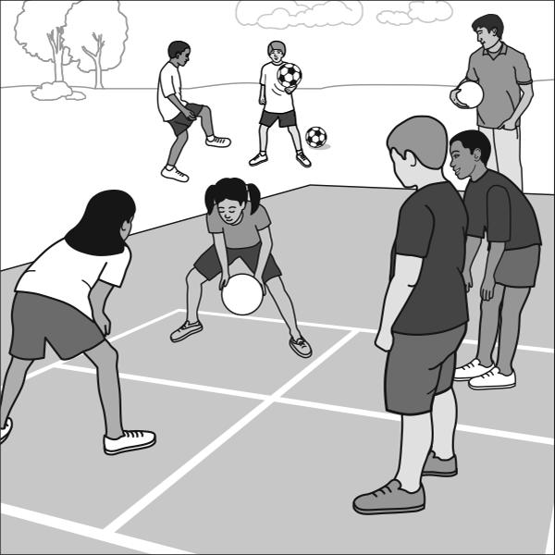
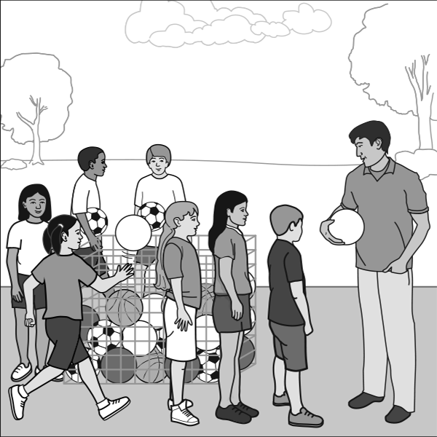
Grade Kindergarten—Expanding Samples
1.
2.
Context: [POINT to PICTURE 1] These students are playing outside.
[POINT to PICTURE 2] Then the teacher calls everyone to line up. It is time to go inside.
Question: Tell me what happens when the teacher says it is time to go inside.
Score Point 0
Score Point 1
Score Point 2
Track 27
Track 28
Track 29
“Go... to... listen.”
“They put the ball
inside the basket."
“They have to put the the the ball away... and after that they have to line up.”

Slide 22
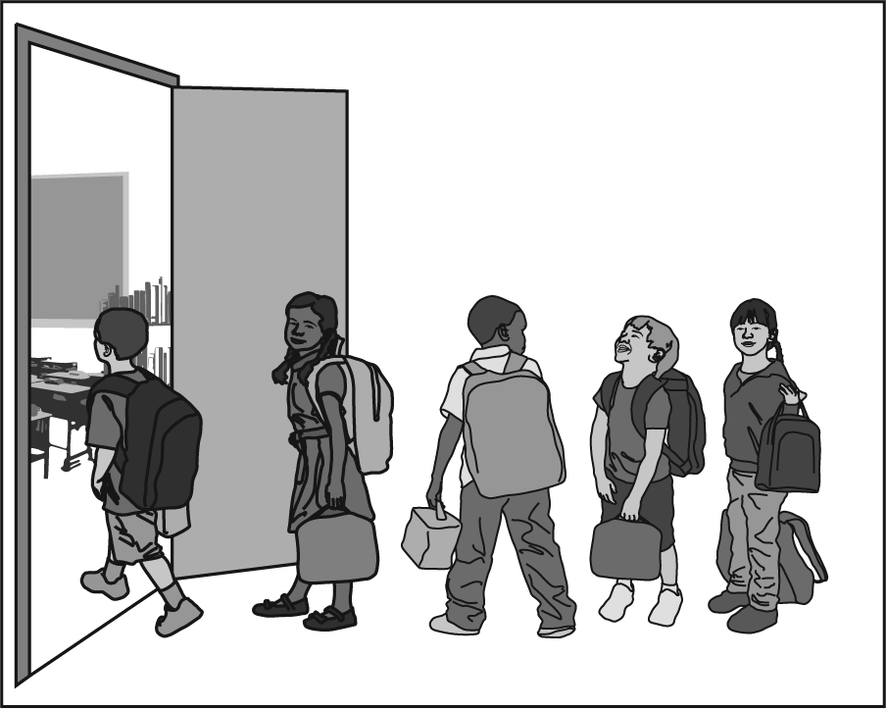
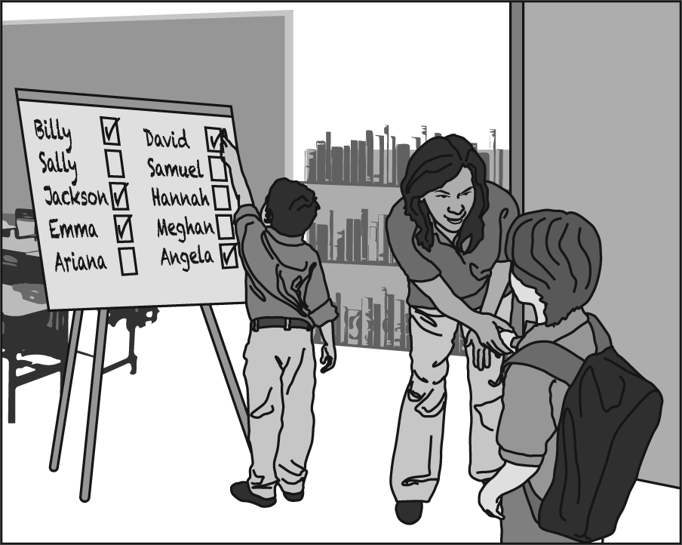
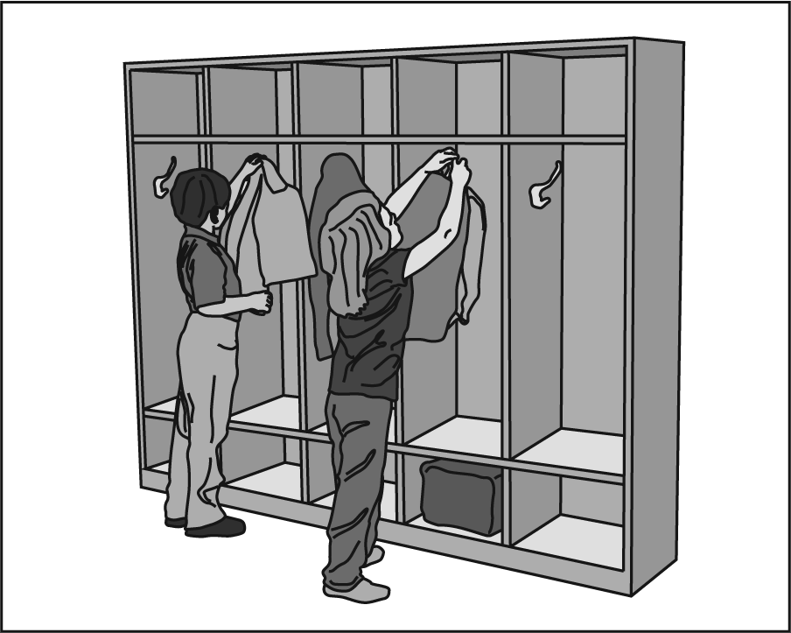
Grade Kindergarten—Commanding Samples
1.
2.
3.
Context: It is morning and these students are walking into their classroom. They have coats and backpacks.
Some students have lunchboxes. There are a lot of things to do to get ready for the day.
Question: How do you get ready for the school day?
Score Point 0
Score Point 1
Score Point 2
Track 30
Track 31
Track 32
“I, I hung up all my stuff.”
“Mmm, mmm, I get ready for school, and then I can unpack my folder and my noteback and my backpack and my and my things to give to give thing to teachers.”
“I put on my jacket and my sweater, and I brush my teeth, I eat snack, and I go to school, and I go inside and take out my homework out and give it to the teacher, and we go like we go sit down on the rug.”

Slide 23

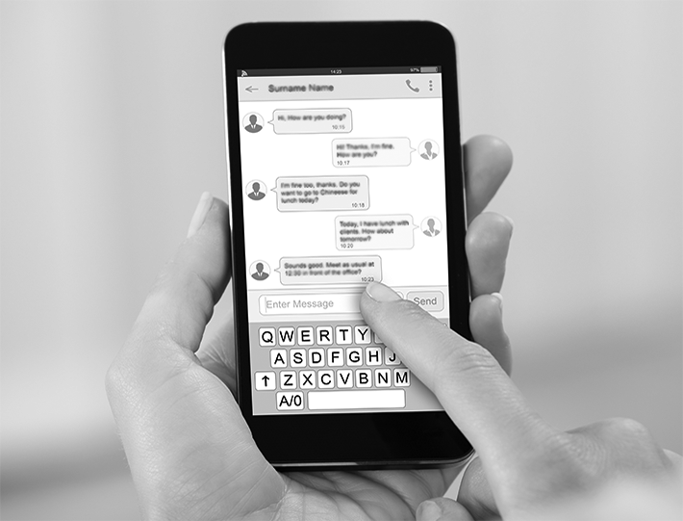

Grades 5–6—Emerging Samples
1.
2.
3.
Context: People write in different ways. Sometimes people write letters, e-mails, or messages to their
friends. [POINT to PICTURE 1] This person is writing with a pen.
Question: Tell me about how people can write.
Rephrasing: You can write in many ways. [POINT to PICTURE 1] You can use a pen. What are
some ways to write?
"No."
[Teacher uses rephrasing.]
"No."
Score Point 0
Score Point 1
“They can write by . . . Uh . . . Uh by the ink.”
Track 33
Track 34

Slide 24
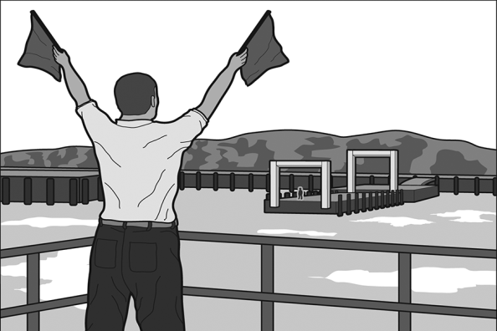
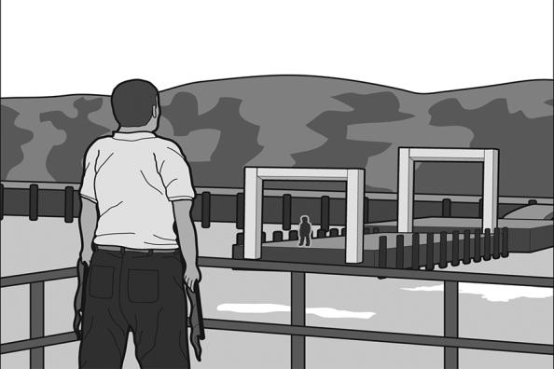
Grades 5–6—Transitioning Samples
1.
2.
Context: People who work on ships need to communicate with people on land. They use flags to help
communicate. In these pictures, the man on the boat used flags to communicate with his co-worker on land.
Question: Tell me why it is important for people on boats to communicate with people on land.
Score Point 0
Score Point 1
Score Point 2
Track 35
Track 36
Track 37
“Hm . . . People on boats to communicate with people on land? . . . I don't know.”
“They cannot lost.”
“It's important for people to communicate in a boat because if the person . . .
Um . . . They waiting for, it's not the person they wanted them to come . . .”

Slide 25
Grades 5–6—Expanding Samples
Context: This person is reading braille by touching dots on a page. People who are visually impaired may
read braille. When they touch the dots, they also feel the different shapes. That way, they know what
the words are.
Question: Tell me how people use braille.
Score Point 0
Score Point 1
Score Point 2
Track 38
Track 39
Track 40
“To read…to read”
“By touching them and they feeling it, um… that’s it.”
“By they using their hands, and like they can’t see because they have blind eyes, like they use it for like computers something like that and to [?]”

Slide 26
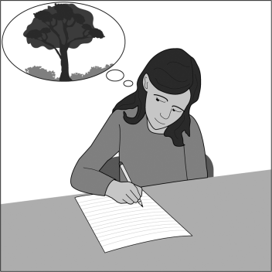
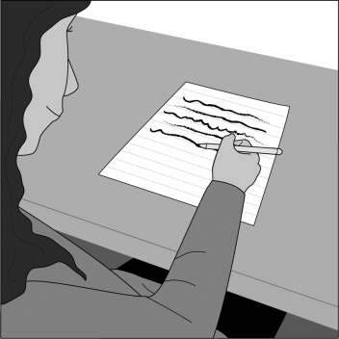
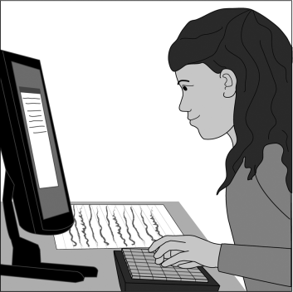
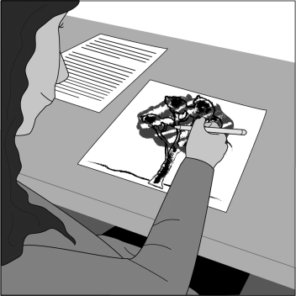
Grades 5–6—Commanding Samples
1.
2.
3.
4.
Context: Marlena used several steps to write her report on the forest. She came up with ideas, did
research, and then she wrote a first draft. Finally, she rewrote the draft and typed the final version to give
to her teacher.
Question: Tell me how following these steps helps her to write a good report.
Score Point 0
Score Point 1
Score Point 2
Track 41
Track 42
Track 43
“mm do she don’t
get confused.”
“Oh, she she she she think and and go to the computer and research about the forest how... wha... what the forest, ah, how to say this word. How how is the forest is and think how to put it um in and think and write write what she saw in the in the switch but eh not like just make uh how to say this uh again just make a, make a review about the forest and put it and write it and that’s it.”
“Um it helps her because she first like make mistakes in the draft, then she, then in the printing, she could like uh correct it.”

Slide 27
2019 NYSESLAT Resources
For Information or Assistance | Contact
Questions regarding testing policies, accommodations, security breaches and sensitive student responses | Office of State Assessment Email: emscassessinfo@nysed.gov Call: 518-474-5902
Questions regarding the provisions of ELL/MLL services in Bilingual Education and English as a New Language programs | Office of Bilingual Education and World Languages Email: obewl@nysed.gov Phone: 518-474-8775 (Albany office) Phone: 718-722-2445 (NYC office)
Questions regarding scoring of Speaking and Writing constructed-response questions or shipment of materials | MetriTech, Inc. Customer Service Email: nyseslat@metritech.com Phone: 800-747-4868 Fax: 217-398-5798

Slide 28
2019 NYSESLAT Resources (Continued)
For Information or Assistance | Contact
For regulatory or training assistance: | Regional Bilingual Education Resource Networks http://www.nysed.gov/bilingual-ed/regional-supportrberns
Machine-scannable answer sheets and local scanning services | RIC or Large-City Scanning Center http://www.p12.nysed.gov/irs/sirs/ric-big5.html
Information about the NYSESLAT and regular updates including the turnkey training materials and School Administrators Manual (SAM) | NYSESLAT Homepage http://www.p12.nysed.gov/assessment/nyseslat

