Slide 1


State Performance Plan (SPP)/
Annual Performance Report (APR)
2020-2025
Individuals with Disabilities Education Act (IDEA)
Indicator 7: Preschool Outcomes
Notes:
In this meeting we will cover target setting and improvement activities relating to State Performance Plan Indicator 7 which measures Preschool Outcomes.

Slide 2
Agenda Slide for Preschool Outcome Presentation
Frequently Used Terms for Preschool Outcomes (Indicator 7)
Indicator 7 Proposed Targets
Next Steps and Closing
Indicator 7 How the Measurement Works
Indicator 7 Data in New York State (Trends and Comparisons)
Indicator 7 Improvement Activities
Notes:
The presentation is organized to present information and collect stakeholder feedback. We will cover:
Terms used throughout the presentation to offer a description of the acronyms and words and phrases that frequently appear.
A detailed description of how the Preschool Outcome Indicator 7 measurement works as part of the State Performance Plan requirements.
A description of how New York State collects data for Indicator 7 and a presentation of recent data trends and comparison analysis.
A summary of existing Improvement Activities and potential new activities that could be taken to improve Preschool Outcomes in New York State.
A walkthrough of our proposed targets for Indicator 7 for the 2020-2025 State Performance Plan period with a description of our rationale/methodology used in determining proposed targets.
And finally Next Steps for how the discussion and dialogue in today’s stakeholder meeting will be used to inform our target setting recommendation and improvement strategies for increasing Preschool Outcomes.

Slide 3
Frequently Used Terms in the Presentation
Term | Description
State Performance Plan or SPP | Evaluates the state’s efforts to implement the requirements and purposes of the IDEA and describes how the state will improve its implementation
Federal Fiscal Year or FFY | Federal Government Fiscal Year (October 1 – September 30)
Annual Performance Report (APR) Reported Data | Data reported to the United States Department of Education Office of Special Education Programs (OSEP) against the state’s targets
Indicator 7 | SPP Indicator 7 measures Preschool Outcomes
Indicator 7A | Indicator 7A measures positive social-emotional skills
Indicator 7B | Indicator 7B measures acquisition and use of knowledge and skills
Indicator 7C | Indicator 7C measures use of appropriate behaviors to meet needs
Baseline | Data starting point to measure improvement over time
Targets | Performance objectives set for SPP measurements
CSE | Committee on Special Education (CSE) responsible for ensuring timely evaluations for school-aged students suspected of having a disability and completing the Child Outcome Rating. ​
CPSE | Committee on Preschool Special Education (CPSE) responsible for ensuring timely evaluations for preschool aged students suspected of having a disability and completing the Child Outcome Rating. ​
Notes:
Today we will use the following language and terms throughout the presentation:
State Performance Plan or SPP is used to describe the plan each state submits to the United States Department of Education containing our efforts to implement the Individuals with Disabilities Education Act.
The term Federal Fiscal Year or FFY is the reporting period for the State Performance Plan Annual Performance Report.
The Annual Performance Report or APR is the data reported by states to the federal Office of Special Education.
Indicator 7 refers to the State Performance Plan indicator that measures Preschool Outcomes
There are three subcomponents to Indicator 7 which are referred to as 7A, 7B, and 7C.
7A reflects the measurement subcomponent for positive social-emotional skills
7B reflects the measurement subcomponent for acquisition and use of knowledge and skills AND
7C reflects the measurement subcomponent for the us of appropriate behaviors to meet needs.
Baseline is a terms that is used in Target Setting which is a starting point for our improvement over time as our targets must ultimately demonstrate improvements over baseline.
Targets are our performance objectives that we establish in our State Performance Plan.
The CSE and the CPSE are terms used for the Committee on Special Education and Committee on Preschool Special Education. For school-aged children the CSE, and for preschool children the CPSE, is responsible for ensuring timely evaluations and for completing the Child Outcome Rating information used for all three outcomes of Indicator 7.

Slide 4
Indicator 7: Preschool Outcomes Measurement
Percent of preschool children aged 3 through 5 with individualized eduction programs (IEPs) who demonstrate improved:
A. Positive social-emotional skills (including social relationships);
B. Acquisition and use of knowledge and skills (including early language/ communication and early literacy); and
C. Use of appropriate behaviors to meet their needs.
For each outcome, Indicator 7 measures both progress and functioning within age expectations:
Progress: of those preschool children who entered the preschool program below age expectations in each outcome, the percent who substantially increased their rate of growth by the time they turned 6 years of age or exited the program.
Functioning within age expectations: the percent of preschool children who were functioning within age expectations in each outcome by the time they turned 6 years of age or exited the program.
Notes:
The Preschool Outcome Indicator 7 measurement considers the percent of preschool children ages 3-5 with demonstrated improvement in: Positive social-emotional skills, Acquisition and use of knowledge and Skills, and Use of appropriate behaviors to meet their needs.
For each of these three outcomes, Indicator 7 measures both Progress and Functioning within Age Expectations.
Progress is measured as: “of those preschool children who entered the preschool program below age expectations in each outcome, the percent who substantially increased their rate of growth by the time they turned 6 years of age or exited the program.”
Functioning within age expectations is measured as: “the percent of preschool children who were functioning within age expectations in each outcome by the time they turned 6 years of age or exited the program.”

Slide 5
Indicator 7: Five Progress Categories
a) Children who did not improve functioning.
b) Children who improved functioning but not sufficient to move nearer to functioning comparable to same aged peers.
c) Children who improved functioning to a level nearer to same aged peers but did not reach it.
d) Children who improved functioning to reach a level comparable to same aged peers.
e) Children who maintained functioning at a level comparable to same aged peers.
Notes:
To measure improvement, Indicator 7 uses 5 Progress Categories that are used to calculate Substantial Increase in Rate of Growth and Functioning within Age Expectations.
The 5 progress categories are:
Children who did not improve functioning
Children who improved functioning but not sufficient to move nearer to functioning comparable to same aged peers
Children who improved functioning to a level nearer to same aged peers but did not reach it
Children who improved functioning to reach a level comparable to same aged peers; and
Children who maintained functioning at a level comparable to same aged peers.
These categories are used to determine if a child is functioning within age expectations or has substantially increased their rate of growth.

Slide 6
Indicator 7 Progress Categories
Functioning within Age Expectations (d+e/a+b+c+d+e)
a) Children who did not improve functioning.
b) Children who improved functioning but not sufficient to move nearer to functioning comparable to same aged peers.
c) Children who improved functioning to a level nearer to same aged peers but did not reach it.
d) Children who improved functioning to reach a level comparable to same aged peers.
e) Children who maintained functioning at a level comparable to same aged peers.
Notes:
The Functioning within Age Expectation component of the measurement uses the progress categories in a formula.
The numerator of the formula is:
Children who improved functioning to reach a level comparable to same aged peers PLUS children who maintained functioning at a level comparable to same aged peers.
This amount is DIVIDED BY the sum of all the progress categories (a through e):
Children who did not improve functioning
Children who improved functioning but not sufficient to move nearer to functioning comparable to same aged peers
Children who improved functioning to a level nearer to same aged peers but did not reach it
Children who improved functioning to reach a level comparable to same aged peers; and
Children who maintained functioning at a level comparable to same aged peers.

Slide 7
Indicator 7 Progress Categories
Substantially Increased Rate of Growth (c+d/a+b+c+d)
a) Children who did not improve functioning.
b) Children who improved functioning but not sufficient to move nearer to functioning comparable to same aged peers.
c) Children who improved functioning to a level nearer to same aged peers but did not reach it.
d) Children who improved functioning to reach a level comparable to same aged peers.
Notes:
The Substantially Increased Rate of Growth measurement uses a numerator of:
Children who improved functioning to a level nearer to same aged peers but did not reach it PLUS Children who improved functioning to reach a level comparable to same aged peers
This amount is DIVIDED BY the sum of a through d:
Children who did not improve functioning
Children who improved functioning but not sufficient to move nearer to functioning comparable to same aged peers
Children who improved functioning to a level nearer to same aged peers but did not reach it; AND
Children who improved functioning to reach a level comparable to same aged peers.

Slide 8
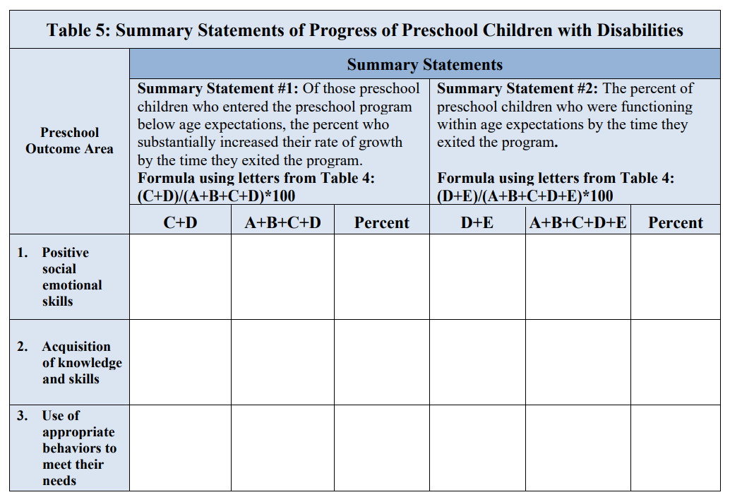
Data Sampling Methodology for Indicator 7
In New York State, data for Indicator 7 is collected on a sample schedule basis:
  NYS has distributed all school districts among six statewide representative samples for the purposes of data reporting for Indicator 7: Preschool Outcomes; the NYC School District is included in the sample each year.
  Most school districts submit data on behalf of all eligible preschool students during the sampling period.
  Large school districts may choose to use the total random sampling methodology to report on a sample of preschool students.
VR15: Preschool Outcomes Report
Notes:
In New York State, Preschool Outcome data is collected from districts on a sample of 1/6th of districts reporting each year with the exception of the New York City Department of Education which reports every year.
Most school districts submit data on behalf of all eligible preschool students for the year they are required to submit data.
Large school districts may instead choose to submit data using a random sampling.

Slide 9
State Performance Plan Indicator 7
How Data is Collected to make Progress Category Determination
Preschool Outcomes Report Process
Entry Assessment
Approved Evaluator completes assessments
Exit Assessment
Approved Evaluator or School District completes assessments
Progress Category
CPSE/CSE completes Preschool Outcomes Report
CPSE completes Child Outcome Summary Form
CPSE/CSE completes Child Outcome Summary Form
Notes:
In order to determine which Progress Category will be reported for Indicator 7 as part of the SPP, an entry and exit assessment is used.
In New York State, the Entry Assessment is performed by the Approved Preschool Evaluator. The Committee on Preschool Special Education uses those assessments to complete a “Child Outcome Summary Form” which serves as the basis for a comparison made at Exit.
The Exit Assessment is performed by an approved preschool evaluator or School District. If the child is being considered for declassification, an approved preschool evaluator will provide the exit assessment information to the CPSE. If a child is referred to the CSE, school district evaluation staff will provide the exit assessment information to the CSE.
The school district Committee on Special Education or the Committee on Preschool Special Education is responsible for using the Child Outcome Summary Form data to complete a Preschool Outcome Report which compares the entry and exit data.

Slide 10
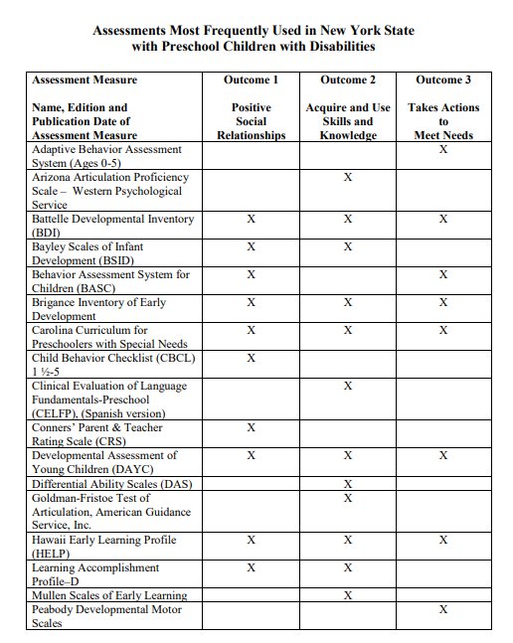
Entry and Exit
Assessments
New York State does not currently prescribe the assessments that must be used for Indicator 7. A list of “Assessments Most Frequently Used in New York State with Preschool Children with Disabilities” is published on the Office of Special Education webpage (see example).
The evaluator must identify:
  the source of information (name of assessment and edition),
  date the assessment was given, and
  a summary of relevant results in each of the three outcome areas.
The evaluator must provide an assurance that their evaluation has sufficient detailed information to identify on a scale of 1-7 the child’s typical functioning in the three outcome areas and, upon exit, information that will determine if the child learned any new skill or behavior since entry into preschool special education.
Notes:
Currently, New York State does not prescribe the assessments that must be used for the entry or exit assessments that serve as the basis for Indicator 7 preschool performance outcomes. We do publish a list of the most frequently used assessments for Preschool Children with Disabilities aligned with the Indicator 7 Outcomes.
The Evaluator performing the entry and/or exit assessments must complete information for the CSE or CPSE to use on the Child Outcome Rating Scale. This information includes supporting evidence identifying:
- the source of information (name of assessment and edition),
- date the assessment was given, and
- a summary of relevant results in each of the three outcome areas.
The Evaluator must also provide an assurance that the Preschool Student Evaluation Summary (from the approved preschool evaluator), or Evaluation Report (from the school district evaluator) has sufficient detailed information for the CPSEs (in the case of declassification) or CSEs (in the case of a referral) to identify on a scale of 1-7 the child’s typical functioning in the three outcome areas and information that will enable them to determine if the child learned any new skill or behavior since entry into preschool special education.

Slide 11
Definitions for Child Outcome Ratings
Category | Rating | Definition
Completely Means: | 7 | Child shows behaviors and skills expected for his or her age in all or almost all everyday situations that are part of the child’s life. Behavior and skills are considered typical for his or her age.
 | 6 | Between Completely and Somewhat
Somewhat Means: | 5 | Child shows behavior and skills expected for his or her age some of the time across situations Behavior and skills are a mix of age appropriate and not appropriate. Behavior and skills might be described as more like those of a slightly younger child. Some behaviors or conditions might be interfering with the child’s capability to achieve age-expected behavior and skills.
 | 4 | Between Somewhat and Emerging
Emerging Means: | 3 | Child does not yet show behaviors and skills expected of a child of his or her age in any situation. Child’s behaviors and skills include immediate foundation skills upon which to build age expected skills. Behaviors and skills might be described as more like those of a younger child. Some behaviors or conditions might be interfering with the child’s capability to achieve age-expected behavior and skills.
 | 2 | Between Emerging and Not Yet
Not yet Means: | 1 | Child does not yet show behaviors and skills expected of a child his or her age in any situation. Child’s skills and behaviors also do not yet include any immediate foundation skills upon which to build age-expected skills. Child’s ways of forming and maintaining social relationships might be described as more like those of a much younger child. Some behaviors or conditions might be seriously interfering with the child’s capability to achieve age-expected behaviors and skills.
Notes:
In New York State, assessment data is used on entry and exit to rate outcomes on a scale of 1-7. The chart above outlines an example of the rating scale with categories of “Completely” to “Not Yet” demonstrating outcomes expected of a child the same age and situation.

Slide 12
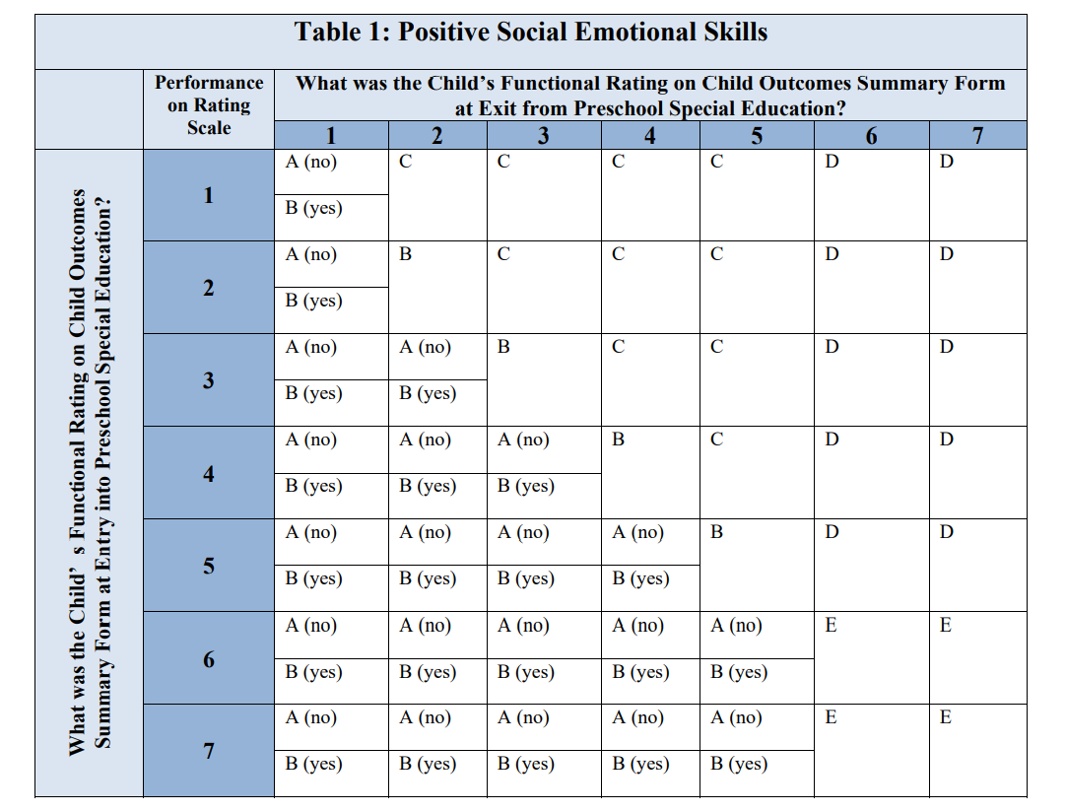
Preschool Outcomes Report
The Child Outcomes Summary results (Performance on Rating Scale) are compared for entry and exit.
The CPSE/CSE must also identify whether the child learned at least one new skill between entry and exit from preschool special education.
These results are then used to determine the progress category for each component:
  Positive Social Emotional Skills
  Acquisition of Knowledge and Skills
  Appropriate Behaviors
Notes:
The rating scale from the Entry Child Outcome Summary and the rating scale from the Exit Child Outcome Summary are compared by the Committee on Special Education or the Committee on Preschool Special Education on the Preschool Outcome Report.
The Committee also must identify whether the child learned at least one new skill between entry and exit which helps inform the outcome report progress category.
Table 1 is the Preschool Outcome Report used to determine progress categories for one of the three Indicator 7 subcomponents: Positive Social Emotional Skills.
The chart has the entry rating scale (1-7) on the vertical line on the left and the exit rating scale (1-7) on the horizontal line at the top. The intersection of those numbers on the chart indicate the Progress Category. The “Yes” the child learned a new skill vs. the “No” the child did not learn a new skill helps to determine the difference between a Progress Category of A or B. A, “No” the child did not learn a new skill would mean the child did not improve functioning; B, “Yes” the child learned a new skill would mean the child improved functioning but not sufficient to move nearer to functioning comparable to same aged peers

Slide 13

Facilitator check for understanding on the SPP measurement or how the data is used to measure results or outcomes.
Virtual Meeting Question
Notes:
During the virtual meetings, we are going to pause and have the facilitator check to ensure the information we presented regarding the measurement was clear and understandable.

Slide 14
Indicator 7: Data Trends and Comparisons
State Performance Plan (SPP)/
Annual Performance Report (APR)
2020-2025
Individuals with Disabilities Education Act (IDEA)
Notes:
We will now consider the Indicator 7 Data Trends and Comparisons in New York State.
We will pause during the presentation so that we can get your feedback on the data. We will specifically discuss what does the data tell us and how should we use the data to inform our target-setting and improvement activities.

Slide 15
Explanation Indicator 7 FFY Data in the Annual Performance Report (APR)
Data years presented will reflect the data NYSED submits to the federal Office of Special Education Programs (OSEP) in the APR which covers the federal fiscal year (FFY) period
2020-21 School Year
The Indicator 7 data sample is
collected on a school year basis
The FFY 2020 APR is
submitted to OSEP
FFY 2020 APR
The 2020-21 School Year Data is
included in the FFY 2020 APR
February 2022
Notes:
The data that we present today will reflect the Annual Performance Report data that NYSED submits to the federal Office of Special Education Programs (or OSEP). The reporting period is based on the federal fiscal year (or FFY). For Indicator 7, school year data is reported in the same year’s APR. For example, the 2020-21 school year sample data is reported in the FFY 2020 APR which is submitted to OSEP in February of 2022.

Slide 16
NYS APR FFY 2019 Indicator 7 Reported Outcomes
Indicator 7 Outcomes | Number of Children | Percentage of Children | Number of Children | Percentage of Children | Number of Children | Percentage of Children
a. Preschool children who did not improve functioning | 30 | 0.55% | 22 | 0.41% | 36 | 0.66%
b. Preschool children who improved functioning but not sufficient to move nearer to functioning comparable to same-aged peers | 551 | 10.15% | 507 | 9.34% | 540 | 9.95%
c. Preschool children who improved functioning to a level nearer to same-aged peers but did not reach it | 2,724 | 50.17% | 2,727 | 50.23% | 2,554 | 47.04%
d. Preschool children who improved functioning to reach a level comparable to same-aged peers | 1,638 | 30.17% | 1,756 | 32.34% | 1,634 | 30.10%
e. Preschool children who maintained functioning at a level comparable to same-aged peers | 486 | 8.95% | 417 | 7.68% | 665 | 12.25%
 | A: Positive Social- Emotional Skills | B: Acquisition and Use of Knowledge and Skills | C: Use of Appropriate Behaviors
Notes:
In our FFY 2019 report (which includes Preschool Outcome data from the 2019-20 school year) data is represented from the school district sample for each progress category in each Indicator 7 subcomponent.
For all subcomponents, the largest numbers were reported for c. preschool children who improved functioning to a level nearer to same-aged peers but did not reach it – which represents approximately half of the data for each subcomponent.
Positive Social-Emotional Skills at 50.17%;
Acquisition and Use of Knowledge and Skills at 50.23%; and
Use of Appropriate Behaviors – 47.04%
The second largest numbers were reported in the progress category d. preschool children who improved functioning to reach a level comparable to same-aged peers.

Slide 17
NYS 7A: Percent of preschool children aged 3 through 5 with IEPs who demonstrate improved positive social-emotional skills:
Increase = Improvement
Increase = Improvement
Notes:
Comparing New York State data over the prior five year period (2015 through 2019)
New York State did not reach any of its performance targets for Indicator 7A (Positive Social-Emotional Skills)
The red dotted line represents the targets during the period and the blue line represents the reported performance from those districts in the reporting cycle.
The values on each line represent the increase or decrease over the prior year.
For Substantially Increased Rate of Growth, performance generally declined during the period.
Functioning within Age Expectations performance also declined during the period.

Slide 18
NYS 7B: Percent of preschool children aged 3 through 5 with IEPs who demonstrate improved acquisition and use of knowledge and skills:
Increase = Improvement
Increase = Improvement
Notes:
As with the data graphs in the last slide:
The red dotted line represents the targets during the period and the yellow line represents the reported performance from those districts in the sampling reporting cycle.
The values on each line represent the increase or decrease over the prior year.
For the Acquisition and Use of Knowledge and Skills subcomponent, reported performance also declined during the period and New York State met only one target.

Slide 19
NYS 7C: Percent of preschool children aged 3 through 5 with IEPs who demonstrate improved use of appropriate behaviors:
Increase = Improvement
Increase = Improvement
Notes:
Looking at the same New York State trend data for the Use of Appropriate Behavior subcomponent, the performance is similar to the other two components:
Performance declined over the period and almost all targets were not met.

Slide 20
State/National Comparisons: APR Results
7A: Percent of preschool children aged 3 through 5 with IEPs who demonstrate improved positive social-emotional skills
Notes:
We compared the New York State trend data to the reported data results of other states of comparable size and demographics and to the 2018 National Mean.
The bar graph illustrates state reported results from the Annual Performance Report from 2014 through 2018 with the 2018 National Mean represented by the dotted red line.
New York State reported higher performance than all other comparison states and higher than the 2018 National Mean of 79% in substantially increasing the rate of growth for Positive Social-Emotional Skills.
However, for the Functioning within Age Expectation progress category, New York State data represents some of the lowest results in the state comparison and below the 2018 National Mean of 55%.

Slide 21
State/National Comparisons: APR Results
7B: Percent of preschool children aged 3 through 5 with IEPs who demonstrate improved acquisition and use of knowledge and skills
Notes:
Looking at the Acquisition and Use of Knowledge and Skills subcomponent, a similar result for 7B is found as with 7A:
New York State is the highest performer for Substantially Increased Rate of Growth and above the 2018 National Mean of 80%
And the lowest performer for Functioning within Age Expectations and below the 2018 National Mean of 49%.

Slide 22
State/National Comparisons: APR Results
7C: Percent of preschool children aged 3 through 5 with IEPs who demonstrate improved use of appropriate behaviors to meet their needs
Notes:
The reported data trend for 7C, Use of Appropriate Behaviors to Meet Needs has similar results:
New York State performs above other results in Rate of Growth (2018 National Mean is 78%)
New York State performs below other results in Functioning within Age Expectations (2018 National Mean is 59%)

Slide 23

1) What did the SPP data tell us?
2) How should we use the data to inform our target-setting and improvement activities?
Virtual Meeting Question
Stakeholder
Discussion
Notes:
In the virtual meetings, we will pause now to have discussion and feedback from stakeholders. We will be asking:
What did the State Performance Plan (or SPP) data tell us?
How should we use the data to inform our target-setting and improvement activities?

Slide 24
Indicator 7: Preschool Outcomes Improvement Strategies
State Performance Plan (SPP)/
Annual Performance Report (APR)
2020-2025
Individuals with Disabilities Education Act (IDEA)
Notes:
We are now going to provide an overview of our existing Improvement Strategies and potential new improvement activities for discussion.

Slide 25

Prekindergarten Early Learning Standards
In 2019, the New York State Education Department updated the Prekindergarten Early Learning Standards.
Approved preschool programs are required to adopt and implement curricula aligned with the New York State Prekindergarten Learning Standards, which ensures continuity with instruction in the early elementary grades; and provides early literacy and emergent reading programs based on developmentally appropriate, effective and evidence-based instructional practices.
Notes:
The New York State Education Department developed and issued updated learning standards for Prekindergarten.
A guiding principle of the Prekindergarten learning standards is that “All children are capable of learning, achieving and making developmental progress.” The Standards are intended for all children regardless of economic, linguistic, and cultural differences or physical, learning, and emotional challenges.
Approved preschool programs serving preschool students with disabilities must implement curricula aligned with these early learning standards which ensures continuity with instruction in early elementary grades and is based on developmentally appropriate, effective and evidence-based practices.

Slide 26

Preschool Development Birth Through Five Renewal (NYSB5-R) Grant
The New York State Education Department Office of Special Education and Office of Early Learning have partnered with the New York State Council on Children and Families on the Preschool Development Birth Through Five Renewal (NYSB5-R) grant from the U.S. Department of Health and Human Services Administration of Children and Families to enhance coordination and more efficiently provide access to high quality, equitable and comprehensive early care and learning environments and services essential for healthy development.
Notes:
Along with the New York State Education Department Office of Early Learning, the Office of Special Education is a partner in the New York State Birth to Five Renewal Grant. This grant is administered by the New York State Council on Children and Families as a leader in cross-collaboration for early care and learning services.
Other collaborating agencies include the NYS Department of Health, NYS Office of Mental Health, NYS Office of Children and Family Services, NYS Education Department, NYS Office of Temporary and Disability Assistance, NYS Governor’s Early Childhood Advisory Council, City University of NY Early Childhood Professional Development Institute, Early Care and Learning Council, and NYS Head Start Collaboration Project.
The intent of the Birth to 5 Renewal grant is to enhance coordination and more efficiently provide access to high quality equitable and comprehensive early learning environments.
Among the activities of the Birth to Five Renewal grant that impact preschool outcomes for preschool students with disabilities are:
Offering Pyramid Model Training and Technical Assistance
Issuing guidance on Blending and Braiding Funds targeted at Early Learning Programs
Sharing Early Childhood Best Practice
Expanding Quality Stars NY
Promoting comprehensive developmental screening of young children to ensure that they are developmentally on track and ready, receiving the appropriate services and supports, and ready for kindergarten.

Slide 27
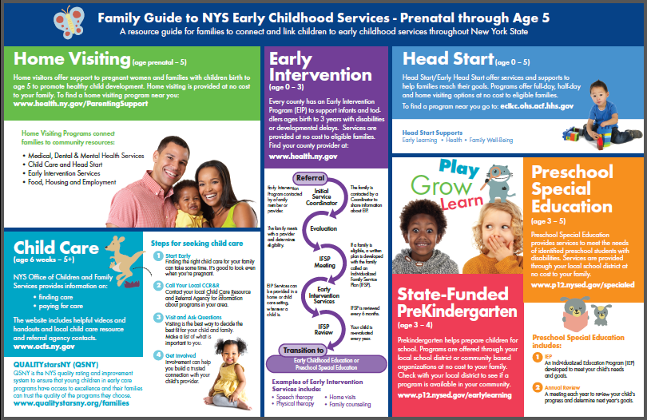
Supporting Families and promoting Parent Voice are key areas of the NYSB5 Grant Project
Notes:
Supporting families with children with disabilities and those who may need additional supports has been identified by the NYSB5 project as a key area to receive technical assistance over the next 18 months to ensure children receive the supports needed whether they qualify for Early Intervention and/or Preschool Special Education Services.
The NYSB5 project is also institutionalizing parent voice and transition support, by forming a Parent Advisory Council and hiring a Family Engagement Coordinator and Early Childhood Transition Coordinator to promote connectedness with families and support successful transitions and knowledge about access to needed services.
Institutionalizing parent voice and transition support, by forming a Parent Advisory Council and hiring a Family Engagement Coordinator and Early Childhood Transition Coordinator to promote connectedness with families and support successful transitions and knowledge about access to needed services during the early years

Slide 28

Office of Special Education Educational Partnership Tiered Support & Professional Development
12 Regional Partnership Centers
14 School-Age Family and Community Engagement Centers
14 Early Childhood Family and Community Engagement Centers
Systems Change Work Providing a Variety of Supports to Educational Organizations in New York State
Regional Learning
Targeted Skills/Support Groups
Support Plans
1
2
3
Notes:
The OSE Educational Partnership is a special education professional development network located in Regional Teams across the State. Regional Teams are comprised of a Regional Partnership Center that has specialists who provide professional development in a range of disciplines including behavior, transition, culturally responsive education, literacy and specially designed instruction, a school aged Family and Community Engagement Center that has specialists with expertise supporting parents and families of school-aged students with disabilities and an early childhood Family and Community Engagement Center that supports parents and families of preschool students with disabilities.
These Regional Teams provide professional development to stakeholders including parents and families as well as schools, including preschools, that serve student with disabilities.
The Regional Teams offer three tiers of support:
Regional Learnings are offered to all educational organizations and/or parents and families of students with disabilities in a region. The training may be offered in-person and/or virtually and there are training topics in all areas of special education.
Targeted Skills Groups are provided to groups of schools that have a similar performance or compliance issue that requires more intensive professional development and targeted assistance.
Support Plans are the most intensive level of support that includes embedded support from one or more specialists from the Regional Team provided directly into the identified schools.
In the next slide, we will take a look at trainings currently offered by the Educational Partnership related to our Indicator.

Slide 29
Educational Partnership Resources
Targeted Professional Development Improvement Strategies
Committee on Preschool Special Education/Committee Special Education Chairperson Training​
Positive Solutions for Families: Pyramid Model​
Positive Behavior Interventions and Supports Tier 1 Team Training​
Positive Behavior Interventions and Supports Tier 2 Team Training
Function Based Thinking in Preschool​
Best Practices in Academic Progress Monitoring​
Classroom Management in a Virtual/Hybrid Setting​
Classroom Management Training​
Early Intervention to Committee on Preschool Special Education for Professionals​
Functional Behavior Assessment/Behavior Intervention Plan Toolkit​
Using the Functional Behavior Assessment/Behavior Intervention Process to Support Students Needing Intensive Interventions​
Specially Designed Instruction Series
Notes:
The OSE Educational Partnership provides several regional learning opportunities that are available to approved preschool programs and to Committees on Preschool Special Education and Committees on Special Education. Among the available trainings to support preschool programs are pyramid model and positive behavior interventions and supports, best practices in progress monitoring, classroom management, and specially designed instruction.
These professional development offerings contain effective practices that are currently available and help influence the effective provision of services and supports to preschool students with disabilities.

Slide 30

Potential Additional Improvement Activities for Consideration
1
2
3
4
Require
Tests/assessments normed for 3 and 5 year olds to ensure greater comparison for children evaluated by CPSE for entry and CSE for exit
Require
Same test/assessment be used at entrance and exit
Report
For the year the school district is to report, report all children and not just a sample of children
Offer
Enhanced training on the Preschool Outcome Report Process
Federal technical assistance is available designed to prepare early childhood special education staff to use the Child Outcomes Summary (COS) process and could be a required activity for districts with lower outcome ratings.
Notes:
For potential new Indicator 7 improvement activities for consideration include:
1) Require that both entry and exit assessments be normed for children aged 3 -5. Currently, a child may be assessed upon entry by an approved evaluator and then upon exit by the CSE who may only have tests normed for 5 year old students which may make the results difficult to compare for progress.
2) Require the same assessment be used for both entry and exit. By using the same assessment tool the comparison of entry and exit results would be easier for reporting scores and measuring growth.
3) Expand existing reporting for large school districts. Reporting all students, rather than a random sample, will provide a more accurate picture of outcomes for students.
4) Offer additional and enhanced training to the field. The reporting process is both difficult to understand and report accurately and consistently. Training on reporting requirements would lead to greater uniformity and understanding. There are some excellent resources available from our federal technical assistance partners on the Child Outcomes Summary process. Utilizing these resources could potentially become a required activity for those districts with lower outcomes ratings.

Slide 31
What activities could be considered, maintained, or strengthened to address improvements in Preschool Outcomes?
Stakeholder Discussion
Notes:
We will now pause the presentation to discuss our improvement activities.
Specifically, we will ask:
What activities could be considered, maintained, or strengthened to address improvement in Preschool Outcomes.
Those not participating in the virtual meetings may submit feedback in our online survey on the SPP/APR webpage.

Slide 32
Indicator 7: Preschool Outcomes Target-Setting
State Performance Plan (SPP)/
Annual Performance Report (APR)
2020-2025
Individuals with Disabilities Education Act (IDEA)
Notes:
We are now going to present our proposed targets for Indicator 7 and the methodology we used for identifying our proposed targets so that we can obtain feedback from stakeholders.

Slide 33
Proposed Targets: Indicator 7A1
Of those children who entered the program below age expectations in positive social-emotional skills, the percent who will substantially increase their rate of growth by the time they turn six years of age or exit the program
Proposed Targets
2020-2025
2015-2019 Average = 89%
Baseline (2008) | 2020 | 2021 | 2022 | 2023 | 2024 | 2025
A1 83.80% | -.25% | +0% | +.25% | +.25% | +.25% | +.25%
change over prior year
Target Setting
Methodology
Considers COVID-19 Impact in Year 1 & 2
Improvement Over Baseline & Aligning with Average Trend Data
Provides Incremental Progress in Years 3-6
  Stakeholder Question: Targets must show improvement over baseline and be rigorous but achievable. Do you feel that the proposed targets are too high, too low, or just right?
Notes:
For Indicator 7A1 (Substantially Increasing Rate of Growth in Positive Social Emotional Skills), we are proposing to improve by one percentage point over the next State Performance Plan period.
The numbers in the circles represent our proposed targets for each year.
To establish the proposed targets, we looked at New York State’s past performance and high performance comparison to other states. We selected an end goal for final year of the SPP (2025); then considered a COVID impact in years 1 and 2 (proposing a .25% decline in Year 1 and then to maintain performance in Year 2); then set a percentage point of .25% to increase each year thereafter.
The 5 year average from the prior SPP period for 7A1 was 89% and we propose to meet this in our 2025 Target.
Our Initial Year proposed Targets consider that Preschool Outcome data declined during the school years impacted by school closures due to COVID-19.
The mid-end year proposed Targets would increase by a quarter percentage point each year.
The proposed targets are intended to be rigorous as New York State has high performance compared to the other comparison states and above the National Mean.
The proposed targets are intended to be achievable as a comparison to our prior State Performance Plan reported data.
We will now pause to have stakeholder discussion on the proposed targets. Targets must show improvement over baseline and be rigorous but achievable. Do you feel the proposed targets are too high, too low, or just right?
Those not participating in the virtual meetings may submit feedback in our online survey on the SPP/APR webpage.

Slide 34
Proposed Targets: Indicator 7A2
The percent of preschool children who were functioning within age expectations in positive social-emotional skills by the time they turned 6 years of age or exited the program
Proposed Targets
2020-2025
2015-2019 Average = 43.9%
Baseline (2008) | 2020 | 2021 | 2022 | 2023 | 2024 | 2025
A2 55.40% | +0.88% | +3.50% | +3.00% | +3.00% | +3.00% | +3.00%
change over prior year
Target Setting
Methodology
Considers COVID-19 Impact in Year 1
Improvement Over Baseline & Increase over Average Trend Data
Provides Incremental Progress in Years 2-6
  Stakeholder Question: Targets must show improvement over baseline and be rigorous but achievable. Do you feel that the proposed targets are too high, too low, or just right?
Notes:
For Indicator 7A2 (Functioning within Age Expectations in Positive Social Emotional Skills), we are proposing to improve by 15.5 percentage points over the next State Performance Plan period.
To establish the proposed targets, we looked at New York State’s past performance and other state comparisons. We also identified that recent performance is lower than our 2008 Baseline. We selected an end goal for final year of the SPP (2025) of achieving our baseline; then considered a COVID impact in year 1 (proposing a modest increase); then set a percentage point of 3%-3.5% increase each year thereafter to reach baseline.
The proposed increase is necessary to demonstrate improvement over the 2008 baseline (because the measurement or data collection did not change the prior baseline is continued).
The numbers in the circles represent our proposed targets for each year.
The 5 year average from the prior SPP period for 7A1 was 43.9% which is significantly below the baseline.
Our Initial Year proposed Target consider that Preschool Outcome data declined during the school years impacted by school closures due to COVID-19.
The mid-end year proposed Targets would increase by approximately 3 percentage point each year.
The proposed targets are intended to be rigorous as the baseline exceeds our prior SPP performance.
The proposed targets are intended to be achievable as we are recommending an end Target close to baseline.
We will now pause to have stakeholder discussion on the proposed targets. Targets must show improvement over baseline and be rigorous but achievable. Do you feel the proposed targets are too high, too low, or just right?
Those not participating in the virtual meetings may submit feedback in our online survey on the SPP/APR webpage.

Slide 35
Proposed Targets: Indicator 7B1
Of those children who entered the program below age expectations in acquisition and use of knowledge and skills, the percent who will substantially increase their rate of growth by the time they turn six years of age or exit the program
Proposed Targets
2020-2025
2015-2019 Average = 89.9%
Baseline (2008) | 2020 | 2021 | 2022 | 2023 | 2024 | 2025
B1 85.30% | -0.45% | 0.00% | +0.25% | +0.25% | +0.25% | +0.25%
change over prior year
Target Setting
Methodology
Considers COVID-19 impact in Year 1 & 2
Improvement Over Baseline & Aligning with Average Trend Data
Provides Incremental Progress in Years 3-6
  Stakeholder Question: Targets must show improvement over baseline and be rigorous but achievable. Do you feel that the proposed targets are too high, too low, or just right?
Notes:
For Indicator 7B1 (Substantially Increasing Rate of Growth in Acquisition and Use of Knowledge and Skills), we are proposing to improve by one percentage point over the next State Performance Plan period.
The numbers in the circles represent our proposed targets for each year.
To establish the proposed targets, we looked at New York State’s past performance and high performance comparison to other states. We selected an end goal for final year of the SPP (2025); then considered a COVID impact in years 1 and 2 (proposing a .45% decline in Year 1 and then to maintain performance in Year 2); then set a percentage point of .25% to increase each year thereafter.
The 5 year average from the prior SPP period for 7B1 was 89.9% and we propose to meet this in our 2025 Target.
Our Initial Year proposed Targets consider that Preschool Outcome data declined during the school years impacted by school closures due to COVID-19.
The mid-end year proposed Targets would increase by a quarter percentage point each year.
The proposed targets are intended to be rigorous as New York State has high performance compared to the other comparison states and above the National Mean.
The proposed targets are intended to be achievable as a comparison to our prior State Performance Plan reported data.
We will now pause to have stakeholder discussion on the proposed targets. Targets must show improvement over baseline and be rigorous but achievable. Do you feel the proposed targets are too high, too low, or just right?
Those not participating in the virtual meetings may submit feedback in our online survey on the SPP/APR webpage.

Slide 36
Proposed Targets: Indicator 7B2
The percent of preschool children who were functioning within age expectations in acquisition and use of knowledge and skills by the time they turned 6 years of age or exited the program.
Proposed Targets
2020-2025
5-Year Prior Average = 43.9%
Baseline (2008) | 2020 | 2021 | 2022 | 2023 | 2024 | 2025
B2 55.30% | +0.97% | +2.50% | +2.50% | +2.50% | +3.50% | +3.50%
change over prior year
Target Setting
Methodology
Considers COVID-19 impact in Year 1
Improvement Over Baseline & Increase over Average Trend Data
Provides Incremental and Accelerated Progress in Years 2-6
  Stakeholder Question: Targets must show improvement over baseline and be rigorous but achievable. Do you feel that the proposed targets are too high, too low, or just right?
Notes:
For Indicator 7B2 (Functioning within Age Expectations in Acquisition and Use of Knowledge and Skills), we are proposing to improve by 12.5 percentage points over the next State Performance Plan period.
To establish the proposed targets, we looked at New York State’s past performance and other state comparisons. We also identified that recent performance is lower than our 2008 Baseline. We selected an end goal for final year of the SPP (2025) of achieving our baseline; then considered a COVID impact in year 1 (proposing a modest increase); then set a percentage point increase of 2.5 to 3.5 each year thereafter to reach baseline.
The proposed increase is necessary to demonstrate improvement over the 2008 baseline (because the measurement or data collection did not change the prior baseline is continued).
The numbers in the circles represent our proposed targets for each year.
The 5 year average from the prior SPP period for 7B2 was 43.9% which is significantly below the 2008 baseline.
Our Initial Year proposed Target consider that Preschool Outcome data declined during the school years impacted by school closures due to COVID-19.
The mid-end year proposed Targets would increase by approximately 2.5 percentage points in Years 2,3, and 4 and by 3.5 percentage points in 2024 and 2025.
The proposed targets are intended to be rigorous as the baseline exceeds our prior SPP performance.
The proposed targets are intended to be achievable as we are recommending an end Target close to baseline.
We will now pause to have stakeholder discussion on the proposed targets. Targets must show improvement over baseline and be rigorous but achievable. Do you feel the proposed targets are too high, too low, or just right?
Those not participating in the virtual meetings may submit feedback in our online survey on the SPP/APR webpage.

Slide 37
Proposed Targets: Indicator 7C1
Of those children who entered the program below age expectations in use of appropriate behaviors, the percent who will substantially increase their rate of growth by the time they turn six years of age or exit the program
Proposed Targets
2020-2025
2015-2019 Average = 88.4%
Baseline (2008) | 2020 | 2021 | 2022 | 2023 | 2024 | 2025
C1 82.80% | -0.91% | 0.00% | +0.25% | +0.25% | +0.25% | +0.25%
change over prior year
Target Setting
Methodology
Considers COVID-19 impact in Year 1 & 2
Improvement Over Baseline & Aligning with Average Trend Data
Provides Incremental Progress in Years 3-6
  Stakeholder Question: Targets must show improvement over baseline and be rigorous but achievable. Do you feel that the proposed targets are too high, too low, or just right?
Notes:
For Indicator 7C1 (Substantially Increasing Rate of Growth in Use of Appropriate Behaviors), we are proposing to improve by one percentage point over the next State Performance Plan period.
The numbers in the circles represent our proposed targets for each year.
To establish the proposed targets, we looked at New York State’s past performance and high performance comparison to other states. We selected an end goal for final year of the SPP (2025); then considered a COVID impact in years 1 and 2 (proposing a .91% decline in Year 1 and then to maintain performance in Year 2); then set a percentage point of .25% to increase each year thereafter.
The 5 year average from the prior SPP period for 7C1 was 88.4% and we propose to approximate this in our 2025 Target.
Our Initial Year proposed Targets consider that Preschool Outcome data declined during the school years impacted by school closures due to COVID-19.
The mid-end year proposed Targets would increase by a quarter percentage point each year.
The proposed targets are intended to be rigorous as New York State has high performance compared to the other comparison states and above the National Mean.
The proposed targets are intended to be achievable as a comparison to our prior State Performance Plan reported data.
We will now pause to have stakeholder discussion on the proposed targets. Targets must show improvement over baseline and be rigorous but achievable. Do you feel the proposed targets are too high, too low, or just right?
Those not participating in the virtual meetings may submit feedback in our online survey on the SPP/APR webpage.

Slide 38
Proposed Targets: Indicator 7C2
The percent of preschool children who were functioning within age expectations in use of appropriate behaviors by the time they turned 6 years of age or exited the program.
Proposed Targets
2020-2025
2015-2019 Average = 48.8%
Baseline (2008) | 2020 | 2021 | 2022 | 2023 | 2024 | 2025
C2 63.20% | +0.65% | +6.00% | +3.60% | +3.65% | +3.65% | +3.60%
change over prior year
Target Setting
Methodology
Considers COVID-19 impact in Year 1
Improvement Over Baseline & Increase over Average Trend Data
Provides Incremental Progress in Years 2-6
  Stakeholder Question: Targets must show improvement over baseline and be rigorous but achievable. Do you feel that the proposed targets are too high, too low, or just right?
Notes:
For Indicator 7C2 (Functioning within Age Expectations in Use of Appropriate Behaviors), we are proposing to improve by 20.5 percentage points over the next State Performance Plan period.
To establish the proposed targets, we looked at New York State’s past performance and other state comparisons. We also identified that recent performance is lower than our 2008 Baseline. We selected an end goal for final year of the SPP (2025) of achieving our baseline; then considered a COVID impact in year 1 (proposing a modest increase); then set a large increase in Year 2 in order to have a set a percentage point of 3.6-3.65 increase each year thereafter to reach baseline.
The proposed increase is necessary to demonstrate improvement over the 2008 baseline (because the measurement or data collection did not change the prior baseline is continued).
The numbers in the circles represent our proposed targets for each year.
The 5 year average from the prior SPP period for 7C2 was 48.8% which is significantly below the baseline.
Our Initial Year proposed Target consider that Preschool Outcome data declined during the school years impacted by school closures due to COVID-19.
The mid-end year proposed Targets would increase by 6 percentage points in year 2 and then by approximately 3.60-3.65 percentage point each year thereafter.
The proposed targets are intended to be rigorous as the baseline exceeds our prior SPP performance.
The proposed targets are intended to be achievable as we are recommending an end Target close to baseline.
We will now pause to have stakeholder discussion on the proposed targets. Targets must show improvement over baseline and be rigorous but achievable. Do you feel the proposed targets are too high, too low, or just right?
Those not participating in the virtual meetings may submit feedback in our online survey on the SPP/APR webpage.

Slide 39
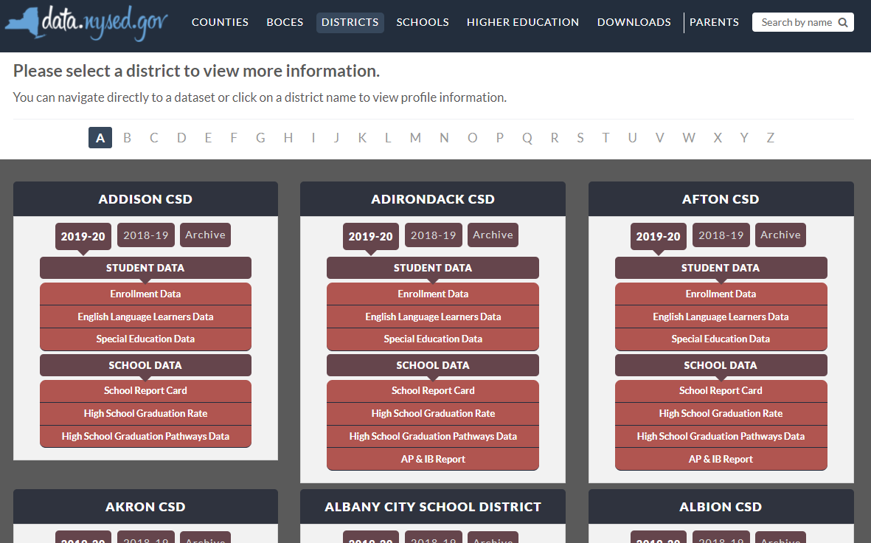

New York State School District SPP Data
Additional information on SPP Indicator data may be found in school district “Special Education Data” reports available at data.nysed.gov
Notes:
For additional information on how the SPP Indicator data impacts your school district, please visit data.nysed.gov.
In the “Districts” category on this webpage, you can view the Special Education Data reports under each school district. These reports are published annually for each individual school district and outline the district’s performance on the SPP Indicators. For Indicator 7, data will be available for those districts required to report in the applicable sample year.

Slide 40

Share Your Voice in our Online Survey
Each SPP Indicator has an online survey to collect input on NYS’s target-setting and/or improvement activities
The online surveys are intended to collect feedback from interested stakeholders. They are available for those who are not attending a virtual meeting or for those who have additional information to share beyond the virtual meetings
Please visit the SPP/APR webpage to submit your survey
Notes:
We greatly appreciate your feedback and ask that you visit our SPP/APR webpage (link provided in the slide).
We will use the survey information to collect input from those who have not attended a virtual meeting or for those who have additional information to share.
Each individual SPP Indicator will have its own survey and we encourage you to access all surveys that are of interest to you so that we can achieve our objective of meaningful stakeholder engagement. It is important to us to ensure that voices from diverse backgrounds are included in conversations about our students and we value multiple perspectives and viewpoints to inform our efforts.

Slide 41





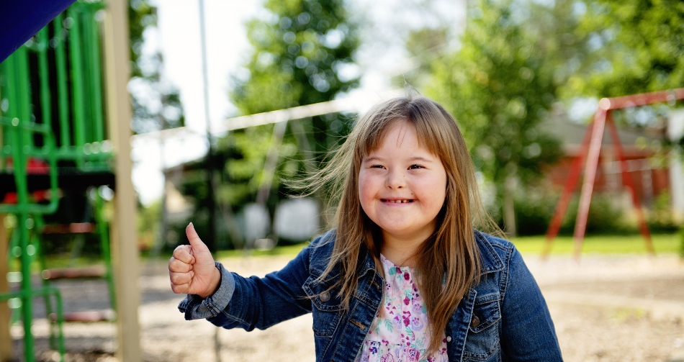
THANK YOU for your contribution
Your Voice is Important to New York State’s Efforts to Improve Outcomes for our Students with Disabilities
Notes:
Thank you for your participation and contribution today. We greatly value your voice and input on our efforts to improve outcomes for students with disabilities in New York State.

