Slide 1

State Performance Plan (SPP)/
Annual Performance Report (APR)
2020-2025
Individuals with Disabilities Education Act (IDEA)
Indicator 6 – Preschool Least Restrictive Environment
Notes:
Today’s presentation will discuss State Performance Plan Indicator 6 which measures education in the Least Restrictive Environment for Preschool Students with Disabilities.

Slide 2
Agenda Preschool Least Restrictive Environment
Frequently Used Terms for Preschool Least Restrictive Environment
Indicator 6 Improvement Activities
Next Steps and Closing
Indicator 6 How the Measurement Works
Indicator 6 Data in New York State (Trends and Comparisons)
Indicator 6 Proposed Target Setting
Notes:
Today we will first review the Frequently Used Terms that will be used throughout the presentation to describe the indicator and the data collected to measure outcomes.
We will then provide a description of how Indicator 6 Preschool Least Restrictive Environment Measurement Works and illustrate data treads and comparisons in New York State.
Next we will provide an overview of existing activities and potential new activities aimed at improving preschool least restrictive environment outcomes.
We will then offer our proposed State Performance Plan targets for the 2020 through 2025 Annual Performance Reports to the federal government.
Finally, we will offer next steps for how to continue the discussion and obtain additional information and resources.

Slide 3
Frequently Used Terms in the Presentation
Term | Description
State Performance Plan or SPP | Evaluates the state’s efforts to implement the requirements and purposes of the IDEA and describes how the state will improve its implementation
Federal Fiscal Year or FFY | Federal Government Fiscal Year (October 1 – September 30)
Indicator 6 | SPP Indicator 6 measures Preschool Least Restrictive Environment
Indicator 6A | Indicator 6A measures preschool services in a regular early childhood program
Indicator 6B | Indicator 6B measures preschool services in a separate special education class, separate school or residential facility.
Indicator 6C | Indicator 6C measures preschool services in the home setting
Baseline | Data starting point to measure improvement overtime
Targets | Performance Objectives set for SPP Measurements
Annual Performance Report (APR) Reported Data | Data reported to the United States Department of Education Office of Special Education Programs (OSEP) against the state’s targets
Data Equated to New Measurement | Submitted Data recalculated using the components of a new measurement
Notes:
Today we will use the term State Performance Plan or SPP to identify the plan used by the federal Department of Education to evaluate state’s efforts to implement the requirements and purposes of the Individuals with Disabilities Education Act (also referred to at the IDEA).
The term Federal Fiscal Year or FFY is the reporting period of time used for the Annual Performance Report which runs from October 1st through September 30th.
Indicator 6 is the SPP Indicator that measures Preschool Least Restrictive Environment.
6A is a subcomponent of the Indicator 6 measurement which captures majority of services in a regular early childhood program; subcomponent 6B captures services in a separate class, separate school or residential facility; and subcomponent 6C captures services in the home.
We will use the term “Baseline” as a starting point in our New York State results used to measure our improvement over time. Targets reflect our desired annual outcomes for our measurement results and are required as part of our SPP in order to set performance objectives.
The Annual Performance Report or APR is data that is reported annually to the United States Department of Education Office of Special Education Programs. It contains our actual reported performance against our SPP Targets.
Finally, because our Indicator 6 measurement has changed, meaning prior to 2020 we measured progress in a different manner than we will for 2020 through 2025, some of the data we use in the presentation will be equated data. Equated data is our New York State historical data that we have “recalculated” to the best of our ability to apply the standards of the new measurement. We will use the terms “equated data” or “equated to new measurement” when this occurs in our presentation of data.

Slide 4
Least Restrictive Environment
A preschool child with a disability is entitled to all the rights and protections guaranteed under Part B of the IDEA, including the right to be educated in the least restrictive environment (LRE).
Notes:
The IDEA Part B includes the right for a preschool child with a disability to be educated in the least restrictive environment.

Slide 5

Part B LRE requirements
Part B LRE requirements state a strong preference for educating children with disabilities in regular classes alongside their peers without disabilities.
Notes:
Least restrictive environment (also referred to as “LRE”) includes a strong preference for educating children with disabilities in regular classes alongside their peers without disabilities and requires the consideration of whether supplementary aids and services would enable the child to receive education in the regular early childhood program prior to placement outside of that setting.

Slide 6
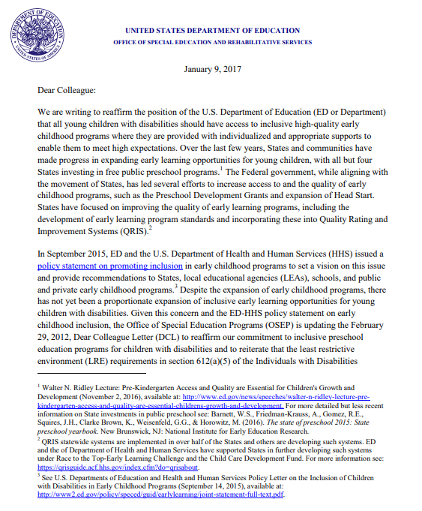
USDE Guidance on LRE
The United States Department of Education January 2017 Guidance Dear Colleague Letter (DCL) related to Preschool Least Restrictive Environments (LRE) (PDF) is an effective resource to highlight the importance of preschool inclusion and outline the IDEA preschool least restrictive environment requirements.
Notes:
The United States Department of Education has issued guidance on preschool LRE to reaffirm their position that all young children with disabilities should have access to inclusive high-quality early childhood programs where they are provided with individualized and appropriate supports to enable them to meet high expectations.

Slide 7

Policy Statement on Inclusion of Children with Disabilities in Early Childhood Programs: U.S. Departments of Education and Health and Human Services
"Inclusion in early childhood programs refers to including children with disabilities in early childhood programs, together with their peers without disabilities; holding high expectations and intentionally promoting participation in all learning and social activities, facilitated by individualized accommodations; and using evidence-based services and supports to foster their development (cognitive, language, communication, physical, behavioral, and social-emotional), friendships with peers, and sense of belonging. This applies to all young children with disabilities, from those with the mildest disabilities, to those with the most significant disabilities.“ U.S. Departments of Health and Human Services and Education, Policy Statement on Inclusion of Children with Disabilities in Early Childhood Programs (2015)
Notes:
In alignment with federal preschool LRE guidance, the U.S. Department of Education and U.S. Department of Health and Human Services issued a joint statement on the inclusion of children with disabilities in early childhood programs.
The policy statement reads in part:
"Inclusion in early childhood programs refers to including children with disabilities in early childhood programs, together with their peers without disabilities; holding high expectations and intentionally promoting participation in all learning and social activities, facilitated by individualized accommodations; and using evidence-based services and supports to foster their development (cognitive, language, communication, physical, behavioral, and social-emotional), friendships with peers, and sense of belonging. This applies to all young children with disabilities, from those with the mildest disabilities, to those with the most significant disabilities.“

Slide 8
Indicator 6 – Preschool LRE FFY 2013-19 Measurement
Targets are established by the State with Stakeholder Input
Percent of children aged 3 through 5 with individualized education programs (IEPs) attending a:
A. Regular early childhood program and receiving the majority of special education and related services in the regular early childhood program.
B. Separate special education class, separate school or residential facility.
For data collection purposes, a Regular Early Childhood Program is a program that includes a majority (at least 50 percent) of children who do not have IEPs and that may include, but is not limited to:
Head Start;
Kindergartens;
Preschool classes offered to an eligible pre-kindergarten population by the public school system;
Private kindergartens or preschools;
Group child development centers or child care.
Improvement = Increase over Baseline
Improvement = Decrease over Baseline
Notes:
State’s preschool LRE performance is measured by SPP Indicator 6.
From 2013 through 2019, the Preschool LRE Indicator 6 measurement considered the Percent of children aged 3 through 5 with IEPs attending a:
Regular early childhood program and receiving the majority of special education and related services in the regular early childhood program (where improvement is measured as an increase in the percentage, or in other words, improvement occurs when more preschool students with disabilities receive a majority of their services in a regular early childhood environment); and
Separate special education class, separate school or residential facility (where improvement occurred with a decrease in the percentage or fewer preschool students with disabilities receiving services in a separate class, school or facility).
When reporting data in the SPP, a regular early childhood environment is one were at least 50% of the children attending the class do not have individualized education programs (or IEPs). Typically these are preschool programs, licensed childcare programs, Head Start, or public school district PreK programs (such as Universal Prekindergarten or UPK).
It is important to consider that Indicator 6A and Indicator 6B do not add up to 100%. Meaning, not all children receive a majority of their services in a regular early childhood environment or attend a separate class setting. For example, a child may attend a regular early childhood program but not receive a majority of their services there. While most children are represented in the reported data for Indicator 6A or 6B, not all are. For example, the 2020 data reflects 39% of preschool students with disabilities met 6A criteria; 30% met 6B criteria;11% were receiving home services and 20% did not fall into the other categories.

Slide 9
Indicator 6 – Preschool LRE FFY 2020-25 Measurement
Targets are established by the State with Stakeholder Input
Percent of children with individualized education programs (IEPs) aged 3, 4, and aged 5 who are enrolled in a preschool program attending a:
A. Regular early childhood program and receiving the majority of special education and related services in the regular early childhood program.
B. Separate special education class, separate school or residential facility.
C. Receiving special education and related services in the home.
New Measurement: States must report only those five-year-old children with disabilities who are enrolled in preschool programs in this indicator.
New Measurement Component: Home Environment. “Home” is the “unduplicated total who received the majority of their special education and related services in the principal residence of the child's family or caregivers, and who attended neither a Regular Early Childhood Program nor a Special Education Program provided in a separate class, separate school, or residential facility.
Improvement = Increase over Baseline
Improvement = Decrease over Baseline
States may choose to set one target that is inclusive of children ages 3, 4, and 5, or set individual targets for each age.
Improvement = Decrease over Baseline
Notes:
For the SPP 2020 through 2025, the Indicator 6 measurement has changed.
The first change is that, Indicator 6 now includes only those children aged 5 who are enrolled in preschool program. Previously all 5 year old children were included in Indicator 6 but starting in 2020, states are required to identify if a child with a disability aged 5 attends a preschool program or a kindergarten program. If the child age 5 attends a preschool program, they are reported in Indicator 6; if the child age 5 attends a school-age kindergarten program, then they are reported as part of School-Age LRE (which is Indicator 5).
The second change is that Indicator 6 now also includes a new subcomponent to measure special education and related services provided in the home. For this subcomponent, home means the unduplicated total of children who receive the majority of their special education and related services in the principal residence of the child’s family or caregiver and who attend neither a regular early childhood program nor a separate class, school, or facility program. The United States Department of Education Office of Special Education Programs (also known as OSEP) has communicated that the final target for Indicator 6C (receiving special education services in the home) should decrease from the baseline established in FFY 2020 because OSEP expects that most children would attend a regular early childhood program and receive the majority of special education and related services in the regular early childhood program. Therefore, it is expected that the targets for the “home” category should decrease over time.
The last new component of the Indicator 6 measurement for 2020 through 2025 is that States may choose to set one target that is inclusive of children ages 3, 4, and 5, or set individual targets for each age. This means states could have up to 9 separate targets for Indicator 6.

Slide 10

Data Collection Methodology for Indicator 6
Data is collected for all children in New York State who meet the age requirements.
Sampling is not allowed.
Preschool environment data is reported annually as a “snapshot” or “point in time” as of the first Wednesday in October (BEDs Day).
Code | Preschool Least Restrictive Environment Code Description
PS04 | Separate Class
PS05 | Separate School
PS06 | Residential Facility
PS07 | Home
PS08 | Service Provider Location or some other location that is not in any other code
PS09 | Attending a regular early childhood program for 10 or more hours a week and receiving the majority of hours of special education and related services in the regular early childhood program
PS10 | Attending a regular early childhood program for 10 or more hours a week and receiving the majority of hours of special education and related services in some other location
PS11 | Attending a regular early childhood program for less than 10 hours a week and receiving the majority of hours of special education and related services in the regular early childhood program
PS12 | Attending a regular early childhood program for less than 10 hours a week and receiving the majority of hours of special education and related services in some other location
Notes:
Indicator 6 data is collected annually for all children who meet the age requirements (there is no data sampling allowed for this indicator).
Data reflecting preschool students’ Primary Service Code and Least Restrictive Environment Code is collected annually via the Student Information Repository System (SIRS) and verified by school districts. The reported data is a “snapshot” or “point in time” reflecting students’ educational environment as of the first Wednesday in October (BEDs Day).
Due to the timing of the “snapshot” being in October, the reported data does not reflect all preschool students with disabilities entering the program during the school year. Many preschool students with disabilities first become eligible after October; for example, January is a month when many children enter into preschool special education services due to the transition from early intervention.

Slide 11

Facilitator check for understanding on the SPP measurement for Indicator 6 and how the data is used to measure results or outcomes in LRE.
Notes:
We are going to pause to check to ensure the information we presented regarding the measurement was clear and understandable.

Slide 12
Indicator 6 New York State Data
New York State Data Trends and Comparisons
Notes:
We are going to present data from Indicator 6 that will illustrate trends and compare New York State data to other states and national mean.
Following our data presentation we will pause for stakeholder feedback to discuss as a group:
what does the data tell us?
what is your reaction to the data? and
how should the data inform Indicator 6 targets and improvement strategies?

Slide 13
Explanation Indicator 6 FFY Data in the Annual Performance Report (APR)
Data years presented will reflect the data NYSED submits to the federal Office of Special Education Programs (OSEP) in the APR which covers the federal fiscal year (FFY) period
October 2020
The Indicator 6 data sample is
collected on a “point in time” basis
The FFY 2020 APR is
submitted to OSEP
FFY 2020 APR
The October 2020 Preschool LRE Data is included in the FFY 2020 APR
February 2022
Notes:
The data that we present today will reflect the Annual Performance Report data that NYSED submits to the federal Office of Special Education Programs (or OSEP). The reporting period is based on the federal fiscal year (or FFY). For Indicator 6, preschool least restrictive environment or preschool LRE data is reported in the same year’s APR. For example, the October 2020 preschool LRE data is reported in the FFY 2020 APR which is submitted to OSEP in February of 2022.

Slide 14
New York State SPP 2013-19 Targets and Actuals
Indicator 6A: Regular Early Childhood Program
Increase = Improvement
Difference | +.02 | -.31 | -1.56 | -1.59 | -3.44 | -6.94 | -7.80
Notes:
We will now consider New York State’s past performance in Indicator 6 based on the actual reported data in our Annual Performance Report (or APR).
The graph and chart contains New York State historical data reported in each year’s APR from 2013 through 2019 for the Percent of children aged 3 through 5 with IEPs attending a regular early childhood program and receiving the majority of special education and related services in the regular early childhood program. For Indicator 6A, the greater the percent the better the improvement for this outcome. In other words, more children receiving a majority of their services in a regular early childhood environment demonstrates improvement.
The red dotted line illustrates the New York State Indicator 6A Targets during the period and the blue solid line reflects the New York State actual reported data results. Each year on the line graph is marked with the percentage point increase or decrease from the prior year. For example, from 2013 to 2014, the New York State target increased by +0.6 percentage points and the reported data increased by +0.27 percentage points.
The chart below the line graph provides the reported percent values for each year with the difference between the New York State Target and Actual Reported Data in the bottom row labeled “difference.” A positive symbol is used where results performed better than the target and a negative symbol is used where results performed worse than the target.
The data reflects that while New York State Indicator 6A Targets increased by approximately 7 percentage points, the actual reported data performed relatively flat (the average reported data was approximately 42.9% for the period). This resulted in a -7.8 percentage point difference between New York State Targets and actual data reported in 2019.

Slide 15
7-PAK States Results Comparison
Indicator 6A: Regular Early Childhood Program
Increase = Improvement
Notes:
The bar graph demonstrates performance for New York, California, Florida, Pennsylvania, Illinois, Texas, and Ohio in Indicator 6A (majority of services in a regular early childhood program) for the years 2015 through 2018.
These states are referred to as the 7-PAK States. 7-PAK States is a consortium of the seven largest states that the National Association of State Directors of Special Education, Inc. determined to have both similar demographics (e.g., general population, diversity, significant rural and inter-city populations) and issues in the delivery of special education programs to its students with disabilities.
As a reminder, for Indicator 6A, the greater the percentage, the better the outcome.
The red dotted line reflects the 2018 National Mean for Indicator 6A performance at 50%. The bar graph values above the dotted line performed better than the 2018 National Mean and the bar graph values below the red dotted line performed worse.
New York State ranks in the middle for Indicator 6A performance compared to other states and below the 2018 National Mean.

Slide 16
New York State SPP 2013-19 Targets and Actuals
Indicator 6B: Separate Class, School or Facility
Decrease = Improvement
Difference | 0 | -.65 | -2.86 | -2.68 | -3.46 | -5.28 | -5.25
Notes:
For the percent of children aged 3 through 5 with IEPs attending a separate class, school or facility, the New York State reported APR data from 2013 through 2019 is reflected on the graph and chart. For Indicator 6B, the lower the percent (or fewer preschool students with disabilities in a separate class, school, or facility) demonstrates improvement on this measurement.
The red dotted line illustrates the New York State Indicator 6B Targets and the blue solid line reflects the New York State actual reported results. Each year on the line graph is marked with the percentage point increase or decrease from the prior year to show change from year to year. For example, from 2013 to 2014 the New York State 6B target decreased by 1.77 percentage points and the reported results decreased by 1.12 percentage points.
The chart below the line graph contains the reported percent values for each year with the difference between the New York State Target and Actual Reported Data in the bottom row labeled “difference.” A negative symbol is used to demonstrate where reported data performed worse than the target.
The data reflects that while New York State Indicator 6B Targets decreased by approximately 5.75 percentage points, the actual reported data performed relatively flat (on average approximately 23%) which resulted in the reported results being 5.25 percentage point worse than the New York State Target in 2019.

Slide 17
7-PAK States Results Comparison
Indicator 6B: Separate Class Setting
Decrease = Improvement
Notes:
The above bar graph demonstrates performance for the 7-PAK States in Indicator 6B (preschool separate class, setting, facility) for the years 2015 through 2018. As a reminder, for Indicator 6B, the lower the percentage, the better the outcome on this measurement.
The red dotted line reflects the 2018 National Mean for Indicator 6B performance at 20%. Bar graph values below the dotted line performed better than the 2018 National Mean and the bar graph values above the red dotted line performed worse.
New York State ranks in the middle for performance in Indicator 6B compared to other states but worse than the 2018 National Mean.

Slide 18
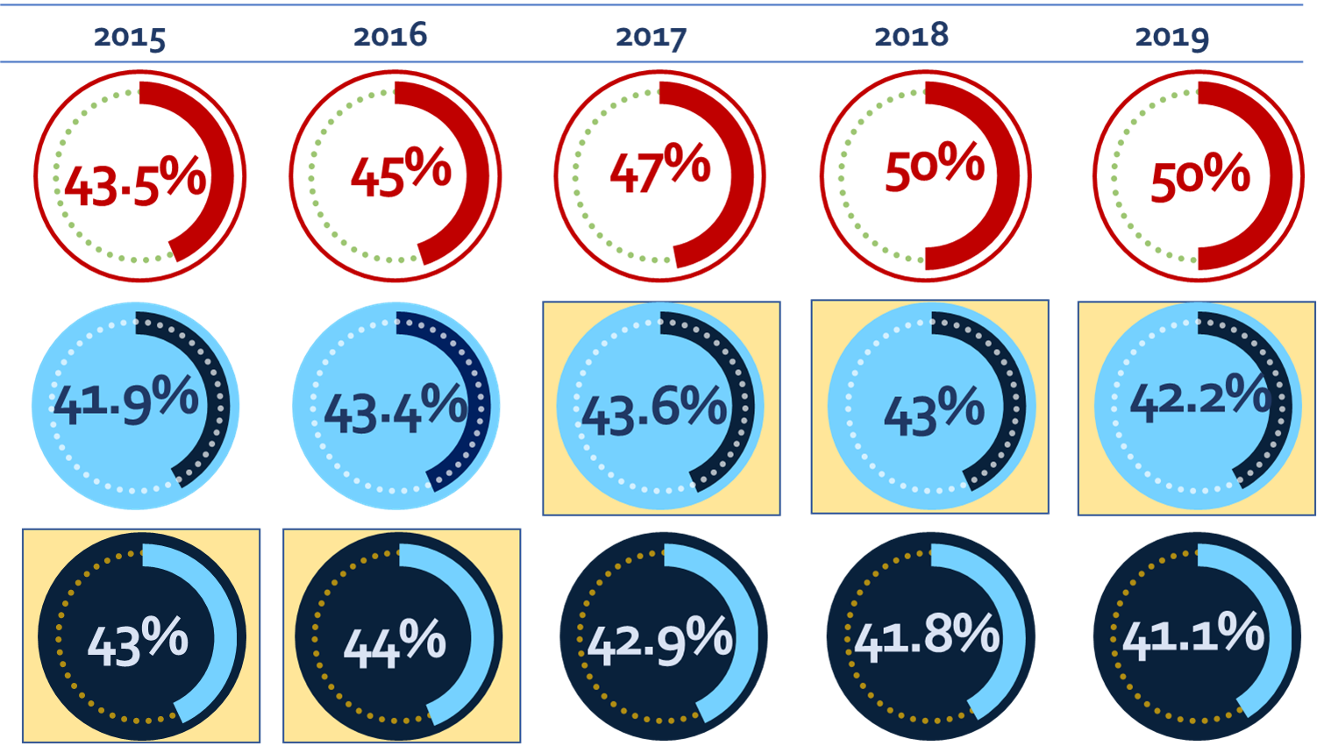
6A Regular Early Childhood Program: Old vs New Measurement
Increase = Improvement
Target
Old Measurement (includes 5-year-olds in Kindergarten)
New Measurement (excludes 5-year-olds in Kindergarten)
Notes:
In 2020, the Indicator 6 measurement changed. Previously, all children ages 3-5 were included in the Indicator 6 measurement but in 2020, 5 year olds in kindergarten are now included in the school-age LRE measurement (Indicator 5) instead.
In order to compare the impact of the new Indicator 6 measurement, we recalculated the historic data equated to the new measurement standards. In other words, to see the impact we considered the historic reported data but removed children aged 5 attending kindergarten to equate this data to the new standards for 2020.
The chart compares the old measurement and new measurement against the applicable year’s target.
For example, in 2019, the New York State target for preschool children with disabilities receiving a majority of services in a regular early childhood environment was 50%. The reported data (using the old measurement) was 42.2% but when the 5 year olds in kindergarten were removed to equate the data to the new measurement, New York State performed worse at 41.1%. The data demonstrates that the new measurement reflected better performance in 2015 and 2016; but the old measurement, with all 5 year olds (including those 5 year old children in kindergarten) performed better in 2017, 2018 and 2019.

Slide 19
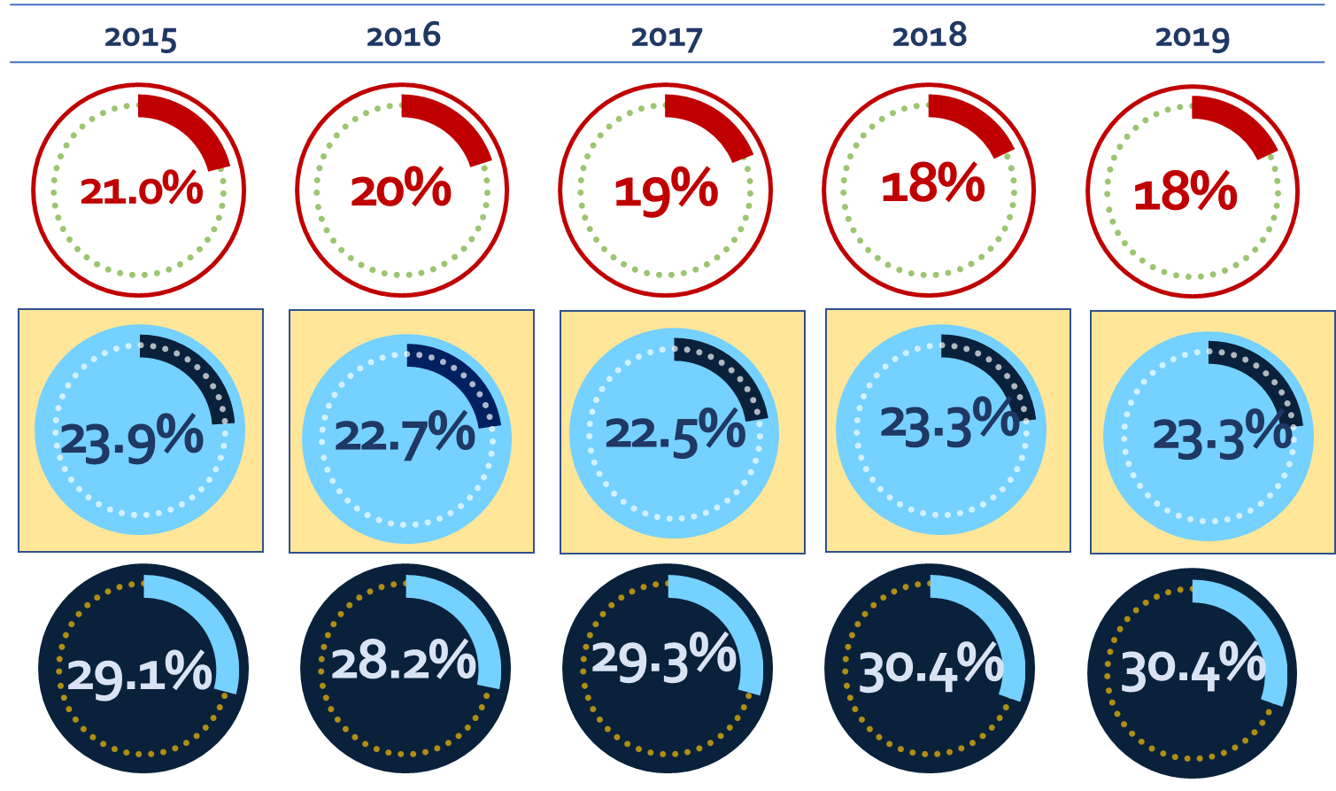
6B Separate Class Setting: Old vs New Measurement
Target
Old Measurement (includes 5-year-olds in Kindergarten)
New Measurement (excludes 5-year-olds in Kindergarten)
Decrease = Improvement
Notes:
When comparing 6B, preschool separate class, school, or facility data under the old data measurement and the new equated data measurement, the old measurement which included 5 year old in kindergarten performed significantly better in all years 2015 through 2019. As a reminder, the lower the percent the greater the improvement in Indicator 6B. Therefore, in New York State including 5 year olds in kindergarten improved Indicator 6B results and removing them in the new measurement reduces New York State’s performance in Indicator 6B.
For example, the New York State target for Indicator 6B in 2019 was no more that 18% of preschool students with disabilities in a separate class, school, or facility; with 5 year olds in kindergarten included in the reported data, New York State performed at 23.3% Once these kindergarten children were not counted toward the measurement, the percent of preschool children attending a separate class, school, or facility increased to 30.4%.

Slide 20

Past Trend and State/National Comparison Data
1) What did the Indicator 6 Statewide SPP data tell us?
2) How should we use the data to inform our target-setting and improvement activities?
Stakeholder
Discussion
Notes:
During the virtual meetings, we will pause to have discussion and feedback from stakeholders on the Indicator 6 Statewide data. We will be asking: What did the State Performance Plan data tell us? And how should we use the data to inform our target-setting and improvement activities?

Slide 21
Indicator 6 Disaggregated Data in NYS
Consideration of data by Race & Ethnicity, School District Needs Resource Capacity and County Region
Notes:
We will now consider disaggregated data for Indicator 6 to consider preschool least restrictive environment data by race & ethnicity, school district needs resource capacity, and region by New York State county.
Similar to the stakeholder feedback on the statewide data, we will also be asking virtual meeting participants :
what does the data tell us?
what is your reaction to the data? and
How should the data inform Indicator 6 targets and improvement strategies?

Slide 22
Indicator 6A: Regular Class Setting
Student Data by Race and Ethnicity (FFY 2019)
Increase = Improvement
6A: Regular Class 50% Target
Did Not Meet Target
Met Target
2019 Data Equated to the New 2020 Measurement with FFY 2019 Target
Notes:
The bar graph illustrates Indicator 6A data (receiving a majority of services in a regular early childhood program) by race and ethnicity.
The data is from October 2019 (we choose this point in time because it is pre-COVID). The 2019 data is equated to the new Indicator 6 measurement so that only those 5 year old children attending a preschool program are included in the data.
The New York State 2019 target of 50% is reflected as the red dotted vertical line. Bar graph values to the right of the line met target and bar graph values to the left of the line did not.
Each bar on the graph represents a student cohort by race or ethnicity and each student count belonging to that cohort is also labeled. The highest percent receiving a majority of services in a regular early childhood program is reflected at 57.1% by the Native Hawaiian Other Pacific Islander cohort which has a student count of 28. The lowest percentage of 24.2% is reflected by the American Indian or Alaska Native cohort with a student count of 74. The only other cohort with less than 1,000 students was the Multiracial cohort at 47.7% with a student count of 833.
The other cohorts reflect approximately a 10 percentage point range from 35.1% (for the Hispanic or Latino cohort) to 44.9% (for the White cohort).
Indicator 6 Race and Ethnicity data is made available to each district in its annual Verification Report where each school district is required to review its data to verify the report accurately represents the LRE data for all preschool children with disabilities for whom the district has CPSE responsibility and who were receiving special education services on the October snapshot date. The Verification Report specifically directs each district to also verify that all students’ race/ethnicity information is accurate. Therefore, this information can be used as an identifier for how school district decision-making results in equity in opportunities for preschool children with disabilities and we will discuss this further in our improvement strategy conversation.

Slide 23
Indicator 6A: Regular Class Setting
Needs/Resource Capacity FFY 2019
Increase = Improvement
6A: Regular Class 50% Target
Notes:
Next we considered disaggregate data by school district need/resource capacity. Again, we used FFY 2019 data from October of 2019 (pre-COVID impact).
The need/resource capacity index is a measure of a school district's ability to meet the needs of its students with local resources. Districts are evaluated based on an estimated poverty percentage (which considers free-and-reduced-price-lunch and poverty factors) and a Combined Wealth Ratio (which is a ratio of district wealth per pupil to State average wealth per pupil). New York City represents the New York City Department of Education, and the Large City represents the Big 4 school districts of Buffalo, Rochester, Syracuse, and Yonkers. Low Needs districts have more local resources and High Need districts have fewer local resources.
Rural High Need Districts have fewer than 50 students per square mile; or fewer than 100 students per square mile and an enrollment of less than 2,500.
For Indicator 6A (majority of services in a regular early childhood setting), the reported results range from the lowest performance of 33.2% for urban/suburban high needs and highest performance of 45.8% for the New York City Department of Education. No district category met the New York State 2019 Target.

Slide 24
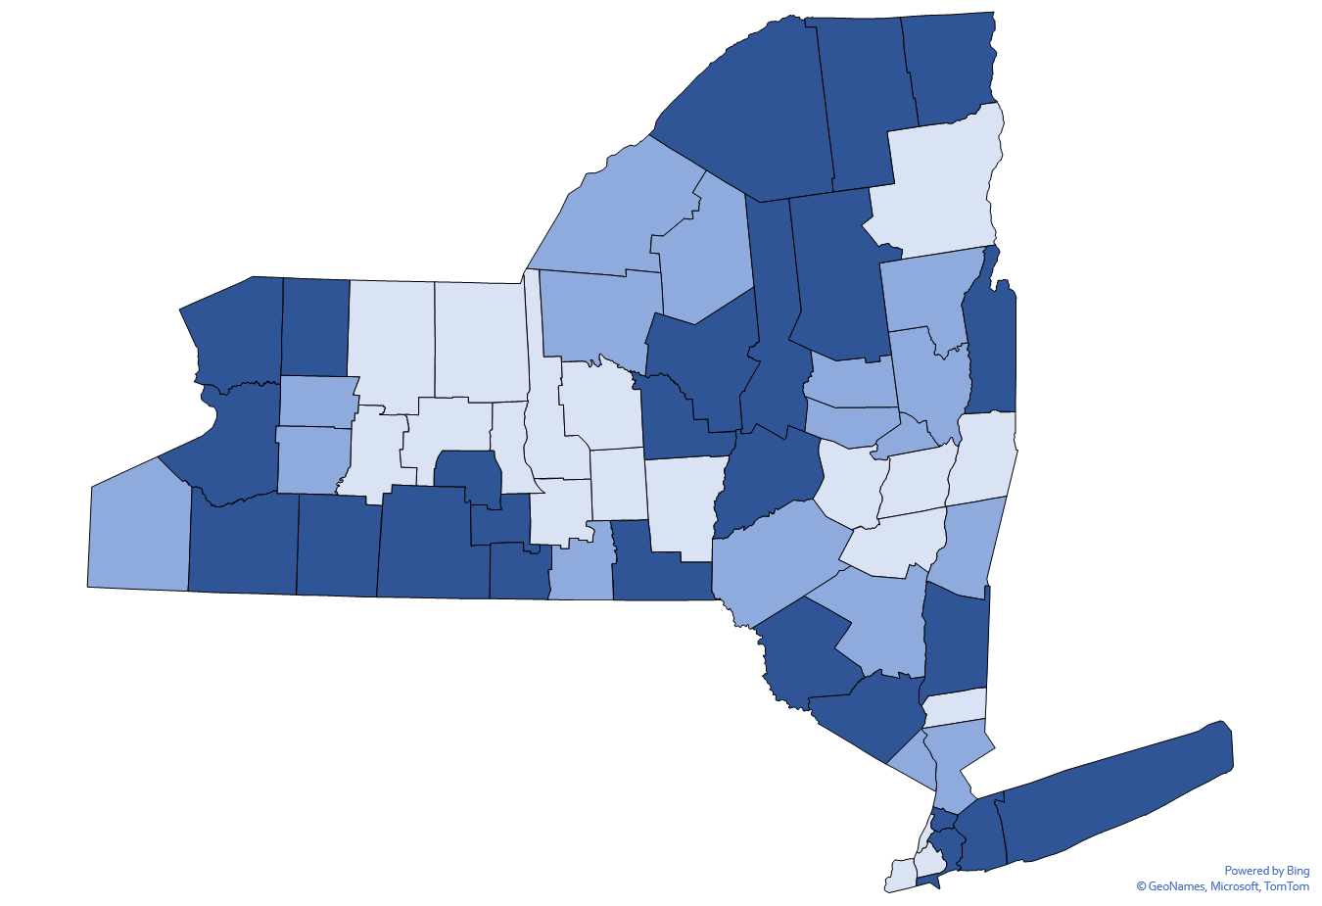
Regional 6A Data
Majority of services in a regular early childhood program
County Level Data | Minimum Value | Maximum Value
Met Target | 50.0% | 100.0%
Did not Meet Target (Within 25%) | 37.5% | 49.9%
Did not Meet Target (Over 25%) | 0.0% | 37.4%
Notes:
When looking at Indicator 6 data on a regional County level, there is a variety in performance. For Indicator 6A, the light blue Counties reflect where the school districts on aggregate met the 2019 Target of 50% or more preschool students with disabilities receiving a majority of services in a regular early childhood program.
Medium blue Counties did not meet the 50% Target but were within 25% of the Target - meaning those school districts in aggregate had between 37.5% and 49.9% of its preschool students with disabilities receiving a majority of services in a regular early childhood program.
School districts in dark blue Counties on aggregate did not meet the 2019 target and were more than 25% from the target (they had less than 37.5% of their preschool students with disabilities receiving a majority of services in a regular early childhood program). Creating new early childhood program capacity or expanding inclusion in existing early learning settings needs to be greater priority in these regions in order to meet Indicator 6A Targets.

Slide 25
6A Disaggregate Data
1) What did the Indicator 6A disaggregate SPP data tell us?
2) How should we use the data to inform our target-setting and improvement activities?
Stakeholder
Discussion
Notes:
During the virtual meetings, we will pause to have discussion and feedback from stakeholders on the Indicator 6 disaggregate data. We will be asking: What did the State Performance Plan data tell us? And how should we use the data to inform our target-setting and improvement activities?

Slide 26
Indicator 6B: Separate Class Setting
Student Data by Race and Ethnicity (FFY 2019)
6B: Separate Class 18 % Target
Decrease = Improvement
No Cohort Met Target
2019 Data Equated to the New 2020 Measurement with FFY 2019 Target
Notes:
For Indicator 6B, the lower the percentage the greater the improvement. The 2019 Indicator 6B target is reflected by the red dotted line at 18%. In 2019, no student cohort met the New York State target of less than 18% of preschool students with disabilities placed in a separate class, school, or facility.
The Indicator 6B by race and ethnicity demonstrates that preschool students who are Hispanic or Latino (at 42.1%), Black or African American (at 44.9%), Asian (at 41.5%), or American Indian or Alaska Native (at 47.7%) are significantly more likely to be placed in a preschool separate class, school, or facility compared to the White student cohort (at 20.3%).

Slide 27
Indicator 6B: Separate Class Setting
Needs/Resource Capacity (FFY 2019)
Decrease = Improvement
6B: Separate Class 18 % Target
Notes:
For Indicator 6B (preschool separate class, school, or facility), rural high needs districts performed the best at 10.4% with the New York City Department of Education performing the lowest with 45.8% of its preschool students with disabilities placed in a separate special class. Because New York City’s performance greatly impacts New York State results (as it represents a little less than half of the student cohort) its significantly lower performance in Indicator 6B skews the statewide data as all other district categories perform measurably better in Indicator 6B (although not meeting the 18% target with the exception of rural high needs districts).

Slide 28
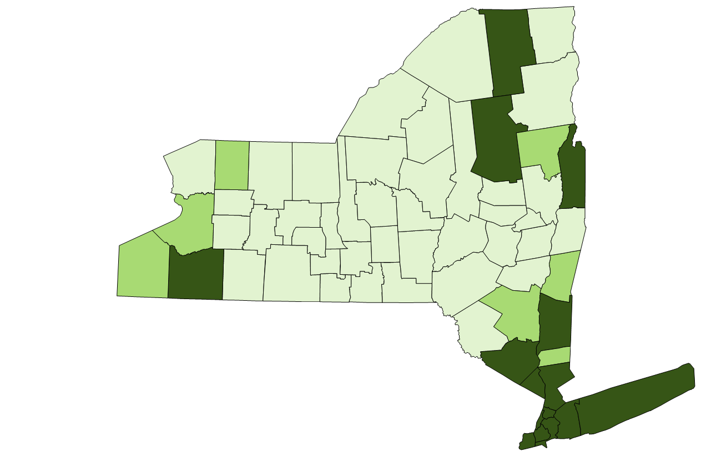
Regional 6B Data
Separate special education class, separate school or residential facility
County Level Data | Minimum Value | Maximum Value
Met Target | 0% | 18%
Did not Meet Target (Within 25%) | 18.1% | 22.5%
Did not Meet Target (Over 25%) | 22.6% | 100.0%
Notes:
School District aggregate data by County for Indicator 6B also demonstrates regional disparities in the percent of preschool students with disabilities attending a separate class, school, or facility.
The light green Counties are those where school district data in aggregate met the New York State 2019 target of 18% or less for separate preschool class, school, or facility placements.
The medium green shade reflects aggregate school district data where the 18% target was not met but reported performance was within 25% of the target. In other words, the school districts in the medium green Counites had aggregate data demonstrating the percent of preschool students with disabilities placed in a separate class, school, or facility was between 18.1% and 22.5%.
The dark green shade on the map reflects those Counties where over 22.5% of preschool students with disabilities are placed in a separate class, school, or facility based on aggregate data from the districts. Expanding inclusion in new and existing early learning settings needs to be greater priority in these regions in order to meet Indicator 6B Targets.

Slide 29
6B Disaggregate Data
1) What did the Indicator 6B disaggregate SPP data tell us?
2) How should we use the data to inform our target-setting and improvement activities?
Stakeholder
Discussion
Notes:
During the virtual meetings, we will pause to have discussion and feedback from stakeholders on the Indicator 6 disaggregate data. We will be asking: What did the State Performance Plan data tell us? And how should we use the data to inform our target-setting and improvement activities?

Slide 30
Indicator 6C: Home Setting
Student Data by Race and Ethnicity (FFY 2019)
Decrease = Improvement
2019 Data Equated to the New 2020 Measurement
Notes:
While Indicator 6C (home setting) is a new subcomponent to Indicator 6, the race and ethnicity data can still be evaluated.
The 2019 preschool LRE data equated to the new Indicator 6 measurement illustrates that the White student cohort is most likely to receive services in the home (at 10.1%) and Black or African American cohort are least likely to receive services in the home (at 3.9%).
As a reminder, for purposes of target setting, OSEP has directed that the percent of home services should decrease over time to demonstrate improvement in this measurement.

Slide 31
Indicator 6C: Home Setting
Needs/Resource Capacity FFY 2019
Decrease = Improvement
Notes:
For Indicator 6C (services in the home) the range in data based on district need/resource capacity is quite substantial with the New York City Department of Education performing the highest per the measurement (at 1.2% of students receiving home services) and rural high needs performing the lowest at 19.4%. This could reflect fewer early childhood center-based program opportunities that are currently available in rural areas.

Slide 32

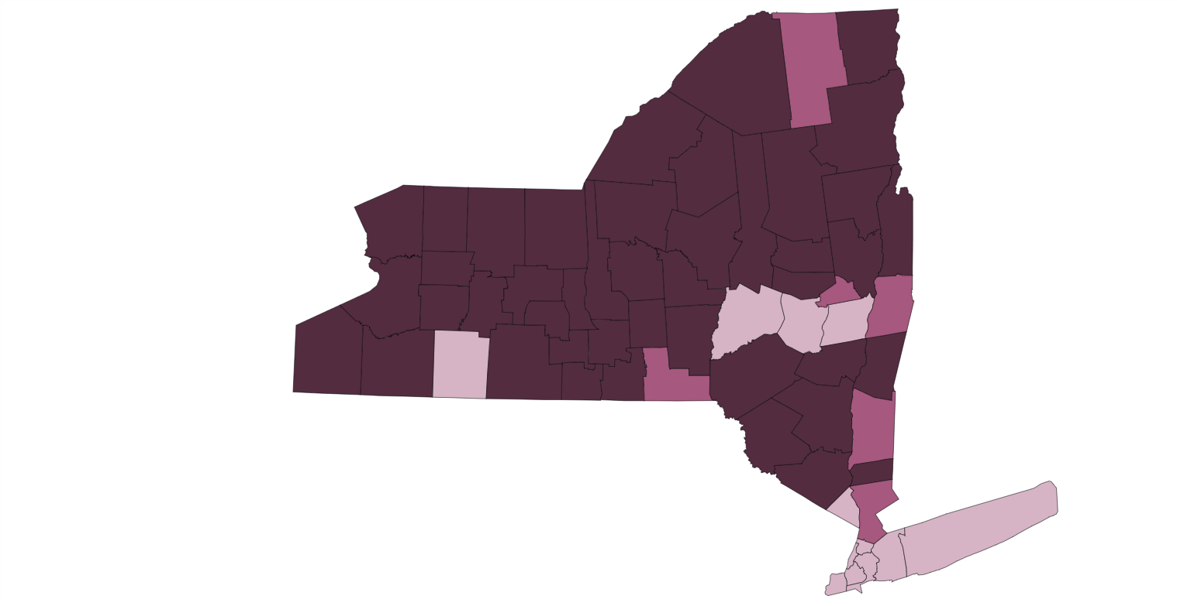
2020 Regional 6C Data
Receiving special education and related services in the home
11.3% aggregate statewide average performance in 2020
County Level Data | Minimum Value | Maximum Value
Met Baseline | 0% | 11.30%
Did Not Meet Baseline (Within 25%) | 11.31% | 14.07%
Did Not Meet Baseline (Over 25%) | 14.08% | 100%
Notes:
For Indicator 6C, there was not a 2019 New York State target because this Indicator 6 subcomponent is new for 2020. To do a regional comparison, we used 2020 reported data which provides an aggregate statewide performance number of 11.3% for preschool students with disabilities receiving services in the home.
The 2020 data will be impacted by COVID-19. During the COVID-19 pandemic, home services increased statewide by 3.5 percentage points in 2020 compared to a prior five-year average from 2015-2019. Several Counites saw a decrease in home services in 2020 compared to its prior five-year district aggregate average. Most New York State Counties saw an increase and in these Counties the increase was on average 5.5 percentage points.
The regional data for Indicator 6C (services in the home setting) illustrates that most County level data exceeds the 2020 Baseline of 11.3% by over 25% - these Counties are reflected in the dark purple and have over 14.08% of preschool students receiving home services. Those Counties which exceeded the 2020 baseline but within 25% of the baseline are reflected in medium purple and the pale pink shade represents those Counties where school districts in aggregate met the baseline of 11.3% or fewer preschool students with disabilities receiving services in the home.

Slide 33
6C Disaggregate Data
1) What did the Indicator 6C disaggregate SPP data tell us?
2) How should we use the data to inform our target-setting and improvement activities?
Stakeholder
Discussion
Notes:
During the virtual meetings, we will pause to have discussion and feedback from stakeholders on the Indicator 6 disaggregate data. We will be asking: What did the State Performance Plan data tell us? And how should we use the data to inform our target-setting and improvement activities?

Slide 34
Indicator 6 – Improvement Strategies
State Performance Plan (SPP)/
Annual Performance Report (APR)
2020-2025
Individuals with Disabilities Education Act (IDEA)
Notes:
Our presentation will now consider the existing and potential new strategies aimed at improving least restrictive environment outcomes for preschool students with disabilities.

Slide 35

Inclusive Programs and Activities is a Priority Area
Providing high quality inclusive programs and activities is one of seven core principles and practices supported by research for all students with disabilities as part of New York State’s Blueprint for Improved Results for Students with Disabilities
Notes:
The Office of Special Education considers Least Restrictive Environment to be a priority area in New York State. This is reflected in the Office of Special Education Blueprint for Improved Results for Students with Disabilities where providing high quality inclusive programs and activities is one of seven core principles and practices supported by research to improve outcomes for all students with disabilities. Research has consistently demonstrated that the inclusion of students with disabilities in general education classrooms results in favorable outcomes.
As stated in the in the federal policy statement on inclusion of children with disabilities in early childhood programs, “inclusion in early childhood programs can set a trajectory for inclusion across the life course, making it critical that we include individuals with disabilities in all facets of society from birth.” Sharing this policy objective, the Office of Special Education is committed to ensuring preschool students with disabilities are included in programs that deliver high quality early childhood education to all children.

Slide 36
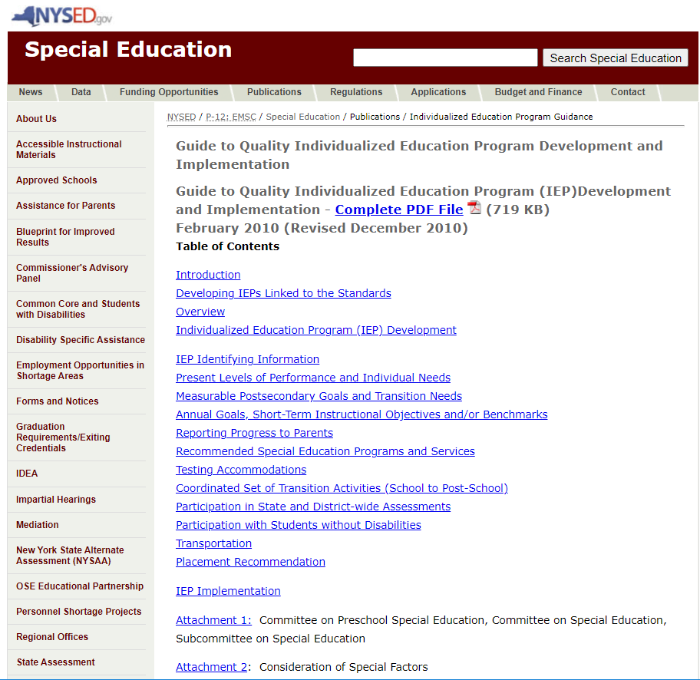
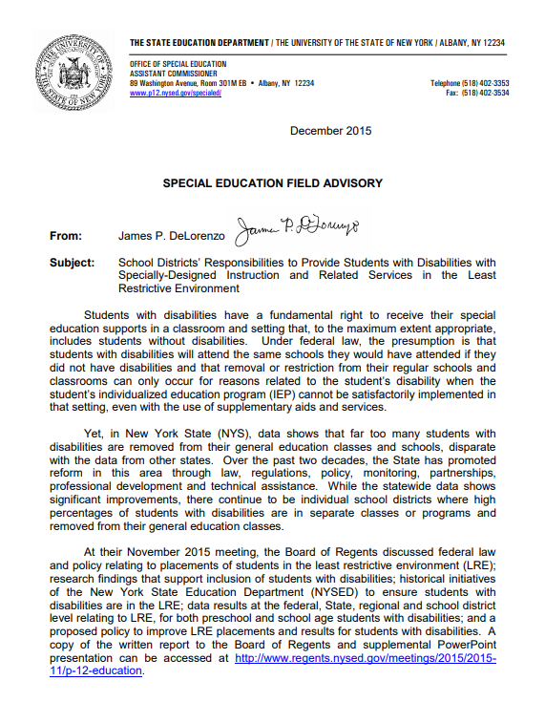
LRE Guidance from the Office of Special Education
The Office of Special Education published guidance on Individualized Education Program (IEP) development and School District Responsibilities to Provide Students with Disabilities with Specially-Designed Instruction and Related Services in the Least Restrictive Environment (LRE)
Notes:
Field memos issued by the Office of Special Education in 2010 and 2015 regarding quality IEP development and implementation and school district responsibilities for providing students with services in the least restrictive environment remain a good point of reference for parents, committees on preschool special education, and program providers to ensure preschool least restrictive environment requirements are being met.

Slide 37
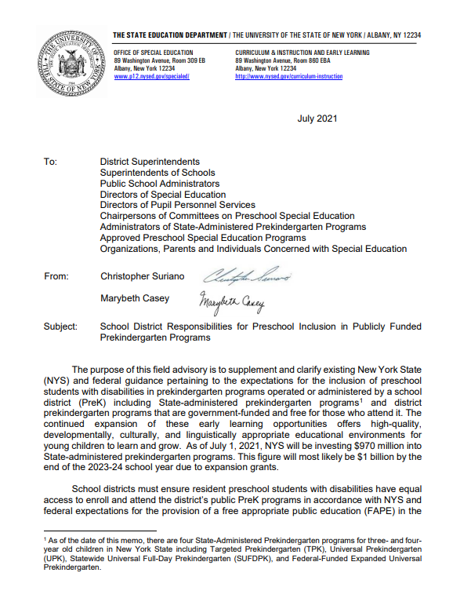
Promoting Preschool Inclusion in PreK Programs
Joint guidance was issued in July 2021 titled “School District Responsibilities for Preschool Inclusion in Publicly Funded Prekindergarten (PreK) Programs.”
This guidance outlines that publicly funded PreK programs must be leveraged to meet preschool least restrictive environment responsibilities and ensure meaningful preschool inclusion.
NYSED plans to support school districts in implementing blended funding and dual enrollment models in publicly funded PreK programs by issuing future guidance based on questions from the field. Questions may be submitted to SPECED@nysed.gov
Notes:
In July of 2021, the NYSED Office of Special Education and Office of Early Learning issued a joint memo titled School District Responsibilities for Preschool Inclusion in Publicly Funded Prekindergarten Programs.
This guidance contains federal and New York State expectations that school districts ensure resident preschool students with disabilities have equal access to enroll and attend the district’s public PreK programs in accordance with the provision of a free and appropriate public education (FAPE) in the least restrictive environment.
It is important for School Districts to recognize and plan to leverage their publicly funded Prekindergarten programs as valuable opportunities to satisfy preschool inclusion requirements.
There is a short Questions and Answers component of the guidance based on some existing conversations with school districts planning to blend funding and utilize dual enrollment. We are collecting additional questions for future guidance to assist school districts in their dual enrollment implementation to achieve preschool inclusion in their publicly funded programs.

Slide 38
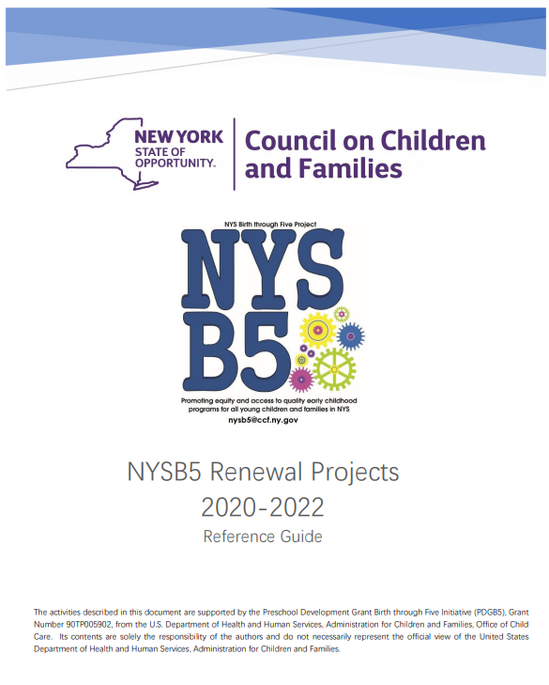
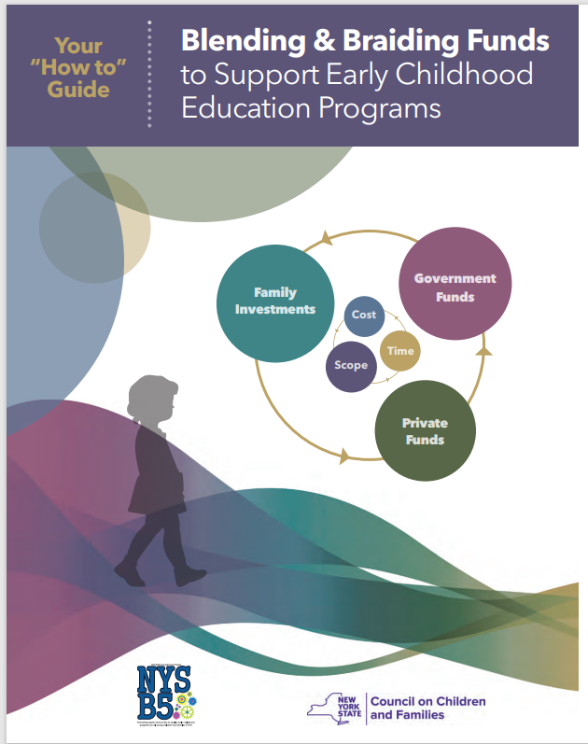

Early Childhood Cross-System Collaboration
Partnership with the New York State Council on Children and Families on the New York State Birth – Five Renewal Grant to enhance coordination and more efficiently provide access to high quality, equitable and comprehensive early care and learning environments and services essential for healthy development.
“How to Guide for Blending and Braiding Funds” was issued to assist early childhood program providers in navigating reimbursement options including integrated general and special education services.
OSE participation in the Early Childhood Advisory Council (ECAC) which provides strategic direction and advice to the State of New York on early childhood issues.
Notes:
The Office of Special Education has cross-system partnerships with state and local agencies to promote high-quality early learning opportunities through the Birth to 5 grant from the U.S. Department of Health and Human Services Administration of Children and Families. This three year grant runs from 2020-2022 for a total of $40.2 million and is intended to enhance coordination and more efficiently provide access to high quality, equitable and comprehensive early care and learning environments for children.
As part of this grant effort, a “How to Guide for Blending and Braiding Funds” was created to assist program providers in identifying how to access and leverage various funding streams to support early childhood learning environments, including inclusive preschool programs for students with and without disabilities. The Guide has been reformatted as a Train the Trainer, with training dates to be posted later this year.
This work is supported by the New York State Early Childhood Advisory Council which is comprised of experts in education, health care, child welfare and mental health. The Office of Special Education is invited to participate in meetings and provide feedback and input on the Early Childhood Advisory Council strategic plan.

Slide 39

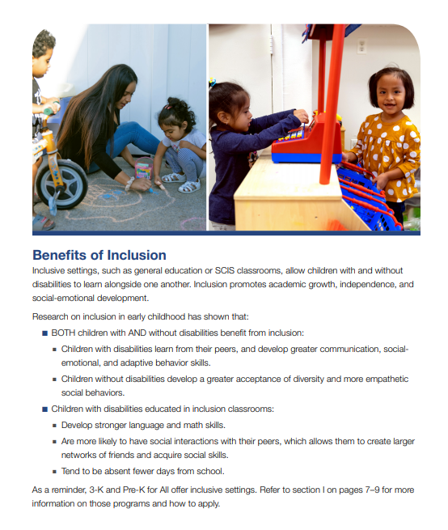
NYCDOE Preschool Inclusion Efforts
The New York City Department of Education (NYCDOE) is implementing a comprehensive plan to promote preschool inclusion.
As part of the NYCDOE inclusion plan, more preschool students with disabilities will receive the majority of their services in a regular early childhood classroom and the number of preschool students receiving services in a special class program will be reduced.
Notes:
As previously described in the presentation, the New York City Department of Education has a higher rate of special class placements compared to the rest of the state. For our target-setting purpose, NYSED is expecting that New York City Department of Education’s investment in preschool inclusion will have a significant impact on New York State’s Indicator 6 performance.
Specifically, the New York City Department of Education is implementing a comprehensive plan to promote preschool inclusion and reduce the number of preschool students with disabilities placed in a separate class, school, or facility in the district. The Office of Special Education is partnering in this work by providing technical assistance, review of district materials and policies, and monitoring the district’s improvement activities to ensure the New York City Department of Education’s goals and objectives are achieved to come into alignment with New York State preschool least restrictive environment performance targets.

Slide 40

Office of Special Education Educational Partnership Tiered Support & Professional Development
12 Regional Partnership Centers
14 School-Age Family and Community Engagement Centers
14 Early Childhood Family and Community Engagement Centers
Systems Change Work Providing a Variety of Supports to Educational Organizations in New York State
Regional Learning
Targeted Skills/Support Groups
Support Plans
1
2
3
Notes:
The OSE Educational Partnership is a special education professional development network located in Regional Teams across the State. Regional Teams are comprised of a Regional Partnership Center that has specialists who provide professional development in a range of disciplines including behavior, transition, culturally responsive education, literacy and specially designed instruction, a school-aged and an early childhood Family and Community Engagement Center to support parents and families.
These Regional Teams offer three tiers of support:
Regional Learnings offered to all educational organizations and/or parents and families of students with disabilities in a region.
Targeted Skills Groups provided to groups of schools that have a similar performance or compliance issue that requires more targeted assistance.
Support Plans are the most intensive level of support that includes embedded support from one or more specialists from the Regional Team provided directly into the identified schools.

Slide 41
Educational Partnership Resources
Targeted Professional Development Improvement Strategies
Educational Partnership Trainings impacting Preschool LRE include, but are not limited to:
Classroom Management Training
CPSE/CSE Chairperson Training
Creating the Individualized Education Program
Functional Behavioral Assessment (FBA)/Behavioral Intervention Plan (BIP) Toolkit
Using the FBA/BIP Process to Support Students Needing Intensive Interventions
Function Based Thinking in Preschool
Introduction to the Behavior Pathways
Specially Designed Instruction Series
Positive Behavior Interventions and Supports Tier 1 & Tier 2 Team Training
Positive Solutions for Families: Pyramid Model
Preschool Special Education Process
Using the Competing Behavior Pathway to Identify Interventions
Notes:
The Educational Partnership has developed a variety regional learning opportunities aimed at addressing issues that may lead to a preschool student being placed in a more restrictive setting. By providing this training to school districts and providers, committees on preschool special education are better equipped to develop individualized education programs to support children with a variety of program and service needs in inclusive early childhood settings.

Slide 42
Potential New Improvement Strategies#1-#3
1
2
3
Amend New York State law to deem school districts approved to provide preschool Special Education Itinerant Services (SEIS) and Special Class in an Integrated Setting (SCIS) program services without separate NYSED approval.
Require districts to review their Indicator 6 data in aggregate and also by race and ethnicity. For districts not meeting Indicator 6 targets, or if a disparity is found in the race and ethnicity data, districts would be required to complete a Local District Preschool Inclusion Self-Assessment.
Create a targeted monitoring activity to review and document Committee on Preschool Special Education decision-making processes pertaining to preschool inclusion. Include documentation that the parent was informed of their child’s rights to receive services in the least restrictive environment.
Notes:
We would like to discuss some improvement strategies that are not currently in place but may be considered as potential new activities to improve preschool LRE outcomes.
First, just as the New York State law was amended to deem school districts to be approved as preschool evaluators, one recommendation would be to amend the law to also deem school districts as approved providers of Special Education Itinerant Services and Special Class in an Integrated Setting programs without having to apply to NYSED for authorization.
A second option would be to require a district to complete a self-assessment following its review that the district preschool LRE data does not meet Indicator 6 targets. For districts that do not meet the Indicator 6 targets in aggregate, or if the district identifies a disparity in its data based on race & ethnicity, a self-assessment could identify areas the district could address to increase inclusive preschool opportunities.
For a third proposed improvement strategy, a targeted monitoring activity could be implemented for districts not meeting the Indicator 6 target for three consecutive years. This would require the CPSE to document its LRE decision-making process at the IEP meeting and document how parents were informed of their child’s right to receive preschool special education services in the least restrictive environment.

Slide 43
Potential New Improvement Strategies #4-#7
4
5
6
7
Streamline the existing regional need process to identify need for SEIS and SCIS programs in counties based on districts' Indicator 6 data.
Streamline the existing regional need process to identify need based on a school district’s endorsement of an inclusive PreK program for dually enrolled resident students.
Issue a moratorium on special class expansions where least restrictive environment targets are not being met.
Supplement existing guidance with additional information for blending and braiding district PreK and county preschool special education funding.
Notes:
​A fourth potential recommendation would be to streamline the regional need process for inclusive preschool programs. For example, providers seeking to apply for Special Education Itinerant Services or Special Class in an Integrated Setting program services in counties that did not meet Indicator 6 targets could use district’s aggregate performance data as the regional need justification for the program. ​
​
Additionally, as a fifth potential improvement activity, if a district wants to operate an inclusive state administered PreK program, the district’s endorsement of this objective could serve as the regional need justification without the requirement to provide specific student identified need. ​
​
A sixth potential improvement activity could be to issue a moratorium on creating additional preschool special classes where preschool least restrictive environment targets are not met.
A seventh item for consideration would be for the Office of Special Education to develop additional guidance for how to blend and braid available funding for preschool special education and public PreK programs in order to increase the inclusive opportunities in the district’s PreK programs. ​
​

Slide 44
Potential New Improvement Strategies #8-#9
8
9
Amend regulation to expand the preschool continuum in New York State to include more flexible models for preschool special education delivery in the regular early childhood program environment.
Create a parent resource to describe the benefits of preschool inclusion and outline their child's right to receive preschool special education programs and related services in the least restrictive environment.
Notes:
An eighth potential activity would be for the Office of Special Education to amend New York State regulations to expand the preschool continuum to include additional program models that allow for more flexibility in preschool special education service delivery within regular early childhood programs. ​
​
Finally, a ninth potential improvement activity would be to create parent resources outlining the benefits of preschool inclusion and their child's right to receive preschool special education and related services in the least restrictive environment.

Slide 45
What activities could be considered, maintained, or strengthened to address improvements in preschool least restrictive environment?
Stakeholder Question
Notes:
We will now pause the presentation to ask what activities could be considered, maintained, or strengthened to address improvement in preschool least restrictive environments?

Slide 46
Indicator 6 – Preschool Least Restrictive Environment Target Setting
State Performance Plan (SPP)/
Annual Performance Report (APR)
2020-2025
Individuals with Disabilities Education Act (IDEA)
Notes:
Indicator 6, Preschool Least Restrictive Environments, requires each state to establish targets for performance. We will now provide an overview of the Office of Special Education’s proposed targets for Indicator 6 and request stakeholder feedback on each target.

Slide 47
Target Setting Recommendation for Indicator 6
Inclusive Targets vs. Individual Targets
Notes:
First, we will present a target-setting recommendation for Indicator 6 Inclusive Targets.

Slide 48
NYSED is Recommending One Target Inclusive of Children Ages 3, 4, and 5 for Indicator 6
States may choose to set one target that is inclusive of children ages 3, 4, and 5, or set individual targets for each age.
NYSED proposes to NOT establish individual targets due to the small sample size for Age 5. NYSED recommends Indicator 6 targets inclusive of children ages 3, 4, and 5.
Setting Type | Age 5 Student Count 2015-16 | % 2015-16 | Age 5 Student Count 2016-17 | % 2016-17 | Age 5 Student Count 2017-18 | % 2017-18 | Age 5 Student Count 2018-19 | % 2018-19 | Age 5 Student Count 2019-20 | % 2019-20
A. Regular early childhood program | <=5 | 12.1 | <=5 | 17.2 | <=5 | 14.3 | <=5 | 22.2 | <=5 | 41.7
B. Separate class, school or residential facility | <=5 | 9.1 | <=5 | 17.2 | <=5 | 14.3 | <=5 | 11.1 | <=5 | 8.3
C. Receiving special education and related services in the home | <=5 | 0% | <=5 | 3.4 | <=5 | 0% | <=5 | 0% | <=5 | 0%
Notes:
The new Indicator 6 measurement allows states to establish one target including all preschool children ages 3, 4, and 5 or states may set individual targets for each age.
Historically, inclusive targets have been established for Indicator 6 and we are proposing to continue this by proposing to not establish individual targets by age and instead establish inclusive targets. Our rationale is that the age 5 cohort is extremely small and therefore data is very inconsistent from year to year. For example, for the 2015-16 school year through the 2019-20 school year, New York State had less than 5 children in its cohort of children aged 5 attending a preschool program for all Indicator 6 subcomponents. As a result, the percent values from year to year varied greatly. This would make target setting and improvement activities difficult for the age 5 cohort. Inclusive targets would still apply to the age 5 children as part of the larger Indicator 6 cohort.

Slide 49
Do you agree with NYSED’s recommendation to set Indicator 6 targets inclusive of children ages 3, 4, and 5?
Stakeholder Question
Notes:
We’d like to get stakeholder feedback on our recommendation that Indicator 6 targets be inclusive of all children ages 3, 4, and 5 and not establish separate targets for each age.

Slide 50
Baseline and 2020-2025 Proposed Targets
Target Setting Recommendation for Indicator 6
Notes:
We will now present our baseline and 2020-2025 target-setting recommendation for Indicator 6 and request stakeholder feedback.

Slide 51
New Baseline for Indicator 6: Preschool LRE
A. Receiving a majority of services in a regular early childhood program
2020 Reported Data Serves as New FFY 2020-25 Baseline
B. Separate special education class, separate school or residential facility
2020 Reported Data Serves as New FFY 2020-25 Baseline
29.8%
C. Receiving special education and related services in the home
2020 Reported Data Serves as New FFY 2020-25 Baseline
11.3%
New Baseline is 2.7 percentage points lower than old baseline
New Baseline is 3 percentage points worse than old baseline
New Measurement
39.5%
Notes:
Because the Indicator 6 measurement changed in 2020 to add the new 6C services in the home subcomponent, and to include only those children age 5 who attend a preschool program, New York State will establish a new baseline for our SPP targets.
A baseline is a starting point used to evaluate improvement over the SPP period. Each 2025 target must demonstrate improvement over the applicable baseline.
The new baseline for Indicator 6A, 6B, and 6C is the data that was reported for these subcomponents by school districts in October 2020.
For Indicator 6A (majority of services in a regular early childhood environment) the 2020 baseline is 39.5% . This is 2.7 percentage points lower than the prior New York State baseline of 42.20% from 2011 demonstrating that New York State’s performance on Indicator 6A has decreased from the last SPP baseline.
For Indicator 6B (separate class, school, or facility) the 2020 baseline is 29.8% which is 3 percentage points higher than the New York State 2011 baseline of 26.80% - demonstrating that New York State’s performance on Indicator 6B has decreased from the last SPP baseline.
Indicator 6C is a new subcomponent of the measurement and the 2020 baseline is 11.3%

Slide 52
Proposed Targets: Indicator 6A
Percent of children with IEPs aged 3, 4, and aged 5 who are enrolled in a preschool program attending a regular early childhood program and receiving the majority of special education and related services in the regular early childhood program.
Increase = Improvement
2015-2019 Five Year Equated Average = 42.57%
Baseline 2020 | 2021 | 2022 | 2023 | 2024 | 2025
39.5% | +2 | +2 | +2 | +2.5 | +2
Student Impact | 4299 additional students in a regular program (2020 baseline vs 2025 proposed target)
Target Setting
Methodology
Recognition that preschool LRE is a priority area
Improvement Over Baseline & Increase over Average Past Trend Data
Consideration of Student Impact associated with each proposed Target
  Stakeholder Question: Targets must show improvement over baseline and be rigorous but achievable. Do you feel that the proposed targets are too high, too low, or just right?
Notes:
The Office of Special Education proposed targets for Indicator 6A (majority of services in the regular early childhood program environment) are reflected in the circles on the line graph. 2020 would start with the baseline of 39.5% and we propose to increase over baseline by 10.5 percentage points by 2025 with a proposed target of 50% (a 2 percentage point increase in each year except 2024 where we propose a 2.5 percentage point increase).
Our rationale and methodology used to establish the proposed targets includes:
Recognition that Preschool LRE is as priority area and therefore we expect additional attention to improvement will have a meaningful impact on Indicator 6 results;
Our proposed targets demonstrate improvement over baseline and improvement over the prior 5-Year performance average of 42.57%;
Identifying the statewide student impact that 4299 additional preschool students with disabilities would be educated in a regular early childhood program if 2025 targets are met. With the expansion of school district PreK programs and the implementation of the New York City Department of Education preschool inclusion plan, this number should be achievable.
We will now pause to have stakeholder discussion on the proposed preschool LRE targets for majority of services in a regular early childhood environment. Targets must show improvement over baseline and be rigorous but achievable. Do you feel the proposed targets are too high, too low, or just right?

Slide 53
Proposed Targets: Indicator 6B
Percent of children with IEPs aged 3, 4, and aged 5 who are enrolled in a preschool program attending separate special education class, separate school or residential facility
Decrease = Improvement
2015-2019 Five Year Equated Average = 29.5%
Baseline 2020 | 2021 | 2022 | 2023 | 2024 | 2025
29.8% | -1.8 | -4 | -1 | -1 | -2
Student Impact | 3995 fewer preschool students in a separate class (2020 baseline vs 2025 proposed target)
Target Setting
Methodology
Recognition that Preschool LRE is a Priority Area
Improvement Over Baseline & Increase over Average Past Trend Data
Consideration of Student Impact associated with each Proposed Target
  Stakeholder Question: Targets must show improvement over baseline and be rigorous but achievable. Do you feel that the proposed targets are too high, too low, or just right?
Notes:
For Indicator 6B the Office of Special Education proposed State Performance Plan targets are reflected in the circles on the line graph.
2020 would start with the baseline of 29.8% and we propose to decrease below baseline by 9.8 percentage points by 2025 with a proposed target of 20% (a 1.8 percentage point decrease in 2021, 4 point decrease in 2022, a 1 point decrease in 2023 and 2024, and a 2 percentage point decrease in 2025).
Our rationale and methodology used to establish the proposed targets includes:
Recognition that Preschool LRE is as priority area and we expect the expansion of district PreK programs to have a meaningful impact;
Our proposed targets demonstrate improvement over baseline and improvement over the prior 5-Year performance average of 29.5%;
Identifying the statewide student impact that 3995 fewer preschool students with disabilities would be educated in a separate class, school, or facility if 2025 targets are met.
We will now pause to have stakeholder discussion on the proposed targets. Targets must show improvement over baseline and be rigorous but achievable. Do you feel the proposed targets are too high, too low, or just right?

Slide 54
Proposed Targets: Indicator 6C
Percent of children with individualized education programs (IEPs) aged 3, 4, and aged 5 receiving special education and related services in the home
Decrease = Improvement
2015-2019 Five Year Equated Average = 8.17%
Baseline 2020 | 2021 | 2022 | 2023 | 2024 | 2025
11.3% | -0.30 | -.50 | -.50 | -.50 | -0.50
Student Impact | 922 fewer students would receive home services (2020 baseline vs 2025 proposed target)
Target Setting
Methodology
Recognition that preschool LRE is a priority area
Improvement Over Baseline & Consideration of COVID-19 impact
Consideration of Student Impact associated with each proposed Target
  Stakeholder Question: Targets must show improvement over baseline and be rigorous but achievable. Do you feel that the proposed targets are too high, too low, or just right?
Notes:
For Indicator 6C (services in the home) the Office of Special Education proposed targets are reflected in the circles on the line graph.
2020 Indicator 6C would start with the baseline of 11.3% and we propose to decrease below baseline by 2.3 percentage points by 2025 with a proposed target of 9% (a 0.3 percentage point decrease in 2021, a 0.5 percentage point decrease in all subsequent years).
Our rationale and methodology used to establish the proposed targets includes:
Recognition that Preschool LRE is as priority area and therefore we expect additional attention to improvement will have a meaningful impact on Indicator 6 results;
Our proposed targets demonstrate improvement over baseline;
Our proposed targets recognize that during COVID-19, preschool home-based services increased in most Counties and adjustment to pre-COVID levels may take some time before our results align with our prior 5 year average of 8.17%;
Identifying the statewide student impact that 922 fewer preschool students with disabilities would be educated at home if 2025 targets are met. If home services in 2025 align with pre-COVID-19 pandemic levels, this proposed target should be met.
We will now pause to have stakeholder discussion on the proposed preschool LRE targets for Indicator 6C services in the home setting. Targets must show improvement over baseline and be rigorous but achievable. Do you feel the proposed targets are too high, too low, or just right?

Slide 55
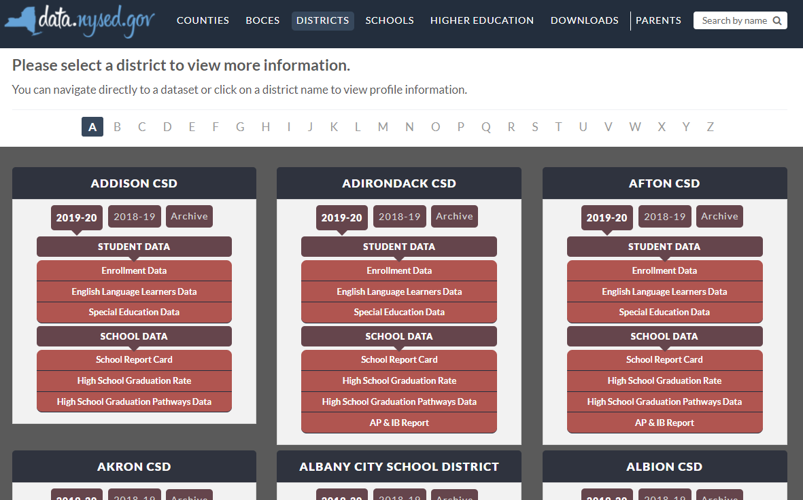

New York State School District SPP Data
Additional information on SPP Indicator data may be found in school district “Special Education Data” reports available at data.nysed.gov
Notes:
For additional information on how the SPP Indicator data impacts your school district, please visit data.nysed.gov.
In the “Districts” category on this webpage, you can view the Special Education Data reports under each school district. These reports are published annually for each individual school district and outline the district’s performance on the SPP Indicators.

Slide 56

Share Your Voice in our Online Survey
Each SPP Indicator has an online survey to collect input on NYS’s target-setting and/or improvement activities
The online surveys are intended to collect feedback from interested stakeholders. They are available for those who are not attending a virtual meeting or for those who have additional information to share beyond the virtual meetings
Please visit the SPP/APR webpage to submit your survey http://www.nysed.gov/special-education/ffy-2020-2025-spp-apr
Notes:
We greatly appreciate your feedback and ask that you visit our SPP/APR webpage (link provided in the slide).
We will use the survey information to collect input from those who have not attended a virtual meeting or for those who have additional information to share.
Each individual SPP Indicator will have its own survey and we encourage you to access all surveys that are of interest to you so that we can achieve our objective of meaningful stakeholder engagement. It is important to us to ensure that voices from diverse backgrounds are included in conversations about our students and we value multiple perspectives and viewpoints to inform our efforts.

Slide 57






THANK YOU for your contribution
Your Voice is Important to New York State’s Efforts to Improve Outcomes for our Students with Disabilities
Notes:
Thank you for your participation and contribution today. We greatly value your voice and input on our efforts to improve outcomes for students with disabilities in New York State.

