Slide 1
State Performance Plan (SPP) 2/ Annual Performance Report (APR) 2020-2025
Individuals with Disabilities Education Act (IDEA)
General Overall Presentation – 2021; Indicator 2: Dropout Rate – 2021
Notes:
Welcome to the State Performance Plan (SPP) 2/Annual Performance Report (APR) 2020-2025 presentation.

Slide 2
Dropout Rate
AGENDA
ABOUT
INDICATOR 2
COMING
CHANGES
MEASURING
TRENDS
IMPROVEMENT STRATEGIES
STATE OF
THE STATE
COLLABORATION
Notes:
In this presentation we will be discussing the State Performance Plan (SPP) Indicator 2, Dropout Rate, the percent of students with Individualized Education Programs (IEPs) who drop out of high school.
As we advance through the slides, we will review measurement of the dropout rate, present trend and comparative data, and propose new State targets for dropout and consider improvement strategies.
The agenda is a roadmap for collaboration, providing opportunities to pose questions and determine future direction.

Slide 3
Frequently Used Terms in the Presentation
Term | Description
State Performance Plan or SPP | A six-year plan that the US Department of Education requires states to develop to improve its implementation of the IDEA
SPP Indicator | One of 17 measures that makes up a state’s six-year plan
Compliance Indicators | Focus on whether a specific requirement of IDEA was met. Targets are set at 0 or 100 percent
Results Indicators | Focus on student and family outcomes. Targets vary and are determined by each State
Annual Performance Report (APR) | A progress update under the SPP, prepared each year by NYSED and submitted to OSEP
Federal Fiscal Year or FFY | Federal Government Fiscal Year (October 1 – September 30)
SPP Indicator 2 | An SPP Indicator that measures the percent of youth with individual education programs (IEPs) dropping out of high school
Baseline | Data starting point to measure improvement over time
Targets | Performance Objectives set for SPP Measurements
Notes:
This slide is a list of key terms and definitions that appear in the presentation.
Let’s take a moment for you to familiarize yourselves with these terms.

Slide 4
The Gravity of Dropping Out: Fast Facts
The number of students with disabilities dropping out for the 2018-19 school year was 68,711 nationally and 6,408 in New York State. (U.S. Department of Education EDFacts Data Warehouse)
Two thirds of all entry level jobs and 80% of all “good jobs” that provide a wage that can support a family require some type of training post high school (Carnevale et al 2018).
A high school dropout will earn approximately $170,000- $200,000 less than a high school graduate over his/her lifetime. And almost a million dollars less than a college graduate (U.S. Census Bureau, American Community Survey, 2006-2008)
Students may begin to consider dropping out as early as the late elementary school grades (National Research Council, 2011)
The number of boys (SWD) dropping out of school was almost twice that of the number of girls in New York State for the 2019-20 school year. (https://data.nysed.gov)
Notes:
In this slide, there are some fast facts about dropping out. Between the 2008-09 school year and 2017-18 school year, the percentage of students with disabilities dropping out decreased from 22.4% to 16% nationally as indicated in the 2020 Annual Report to Congress.
While the downward trend in the national dropout data is encouraging, it is worthwhile to note that as of the 2017-18 school year, this represented 68,711 students with disabilities dropping out.
Students who do not complete high school face economic and social challenges throughout their lifetimes as they are more likely to be unemployed, earn lower wages, have poor health and have involvement with the criminal justice system. Students may consider dropping out as early as elementary school, with boys being at greater risk for dropping out.
What you will see today in many of the slides presented is data driven, but it is also human driven as these numbers represent the struggles of real children.

Slide 5
Indicator 2 Measurement
Percent of youth with Individualized Education Programs (IEPs) dropping out of high school.
Data for this indicator are “lag” data.
The goal for this results indicator is a reduction in the total number of dropouts.
Notes:
Indicator 2 measures the dropout rate. As a results indicator, Indicator 2 focuses on student and family outcomes with targets determined by each state.
The reporting year for the data corresponds to the federal fiscal year (FFY), which begins on October 1st and ends September 30th. The data reported for the FFY APR are considered lag data because it is the data from the school year before the federal fiscal year in question. The next slide illustrates an example of this process.

Slide 6
Explanation of Indicator 2 FFY Data in the Annual Performance Report (APR)
Data years presented will reflect the data NYSED submits to the federal Office of Special Education Programs (OSEP) in the APR which covers the federal fiscal year (FFY) period
2019-2020 School Year
Indicator 2 school year data
The FFY 2020 APR is
submitted to OSEP
FFY 2020 APR
The 2019-20 School Year Data is
included in the FFY 2020 APR
February 2022
Notes:
For example, for Indicator 2, for the FFY 2020 APR, we submit dropout data from the 2019-20 school year and compare those results to a state determined target.

Slide 7
Data Collection
Dropout rate data for NYS are:
Collected annually for all students with IEPs
Reported in the subsequent annual report
Not sampled
Notes:
The New York State Student Information Repository System (SIRS) is the statewide mechanism for electronic collection of student data. Local Education Agencies (LEAs), including public school districts, charter schools, Religious and independent (nonpublic) schools, BOCES, the New York State School for the Deaf and the New York State School for the Blind, must use this system to report certain data, including dropout data, to NYSED.
The State must report dropout information for all its students with disabilities, not just a sample of students.

Slide 8
Dropout Rate: Leaver/Exiter
The Leaver/Exiter dropout rate is the percent of youth with IEPs (ages 14-21), who exited special education due to dropping out, in a single year.
New York State will begin using this calculation for FFY 2020.
This is based on the data used for reporting under IDEA.
$\left(\frac{\begin{aligned}Number of youth with IEPs \\ \left(ages 14−21\right) who exited special \\ education due to dropping out \end{aligned}}{\begin{aligned}Number of all youth with (IEPs) \\ \left(ages 14−21\right)who exited high school\end{aligned}}\right)$ $×100$
Notes:
Beginning with FFY 2020, Indicator 2 measures the number of students with disabilities who dropped out of high school in a single year. The number of students with disabilities who dropped out in a single year is divided by the total number of students with disabilities who exited special education due to dropping out, graduating with a regular high school diploma, receiving a certificate or reaching maximum age, in a single year. Prior to FFY 2020, we reported drop out data based on a cohort of all students with disabilities who entered grade 9 together and of those students, who dropped out during the next four years of high school.
In summary, the new methodology looks at students with disabilities in a single year, rather than the prior methodology that looked at a group of students with disabilities over a span of four years. The new methodology for drop out is not directly comparable to the prior methodology. This is because the new methodology looks at a single year of data rather than data over four years.
The new methodology results in higher dropout rates because the number of students included in the denominator is smaller. The rationale for OSEP to change to this methodology is that it offers a single, standard measure that allows comparison of dropout rates across all states. The prior methodology was not consistent across states.
The denominator in the new methodology includes youth with disabilities who graduated with a regular high school diploma, received a certificate, reached maximum age, or dropped out.
This calculation is based on data used for reporting to the U.S. Department of Education under Section 618 of the Individuals with Disabilities Education Act (IDEA).

Slide 9
Facilitator check for understanding:
Are there any questions on the
SPP measurement or how the
data are used to measure results?
Notes:
Are there any questions on the SPP measurement or how the data are used to measure results?

Slide 10
What Does This Change Look Like?
$\left(\begin{aligned}\begin{aligned}No. of youth with IEPs who exited \\ special education due to dropping out \\ ____________________________________________________________ \\ Total no. of high school students \end{aligned} \\ with IEPs by cohort\end{aligned}\right)$ X 100
$\left(\begin{aligned}No. of youth with IEPs ages \left(14−21\right) who exited special \\ education due to dropping out \\ __________________________________________________________________ \\ No. of all youth with IEPs (ages 14−21) \\ who left high school\end{aligned}\right)$ X 100
Notes:
The blue line in the prior year’s calculation chart shows the targets for dropout for the 2015 through 2018 school years. It is important to remember that these targets were set using the prior methodology that will not be used in the future.
Actual performance of students with disabilities (red line) in the prior year’s calculation chart shows that we exceeded the targets for the 2015 through 2018 school years.
The new calculation chart represents what data for school years 2015 through 2018 looks like when using the new calculation. You can see that the new calculation results in higher percentages for the dropout rate (green line).
The new methodology results in higher dropout rates. Under the new methodology, the numerator is larger because it includes any student who dropped out in the year rather than only the students in the cohort of students who entered grade 9 together. The single year numerator may include students who are older or younger than the students in a particular cohort. In addition, the denominator is smaller because it only includes students exiting high school for specific reasons in a single year. The cohort methodology includes all students with disabilities who entered grade 9 together.
The new methodology for drop out is not directly comparable to the prior methodology.
Note: improvement in dropout rate results in a lower percentage. In other words, a lower dropout rate is better.

Slide 11
Drop Out Rates by Subgroup Students With Disabilities Exiting Special Education 2019-20 SY
Notes:
This slide shows data for students with disabilities in the 2019-20 school year by subgroup, using the new methodology of students with disabilities who exited special education in a single year.
The blue bar shows the dropout rate for the subgroup. This is the number of students in the subgroup who dropped out as a percentage of all students in the subgroup who exited high school in the 2019-20 school year.
The dropout rates for these subgroups are of concern. As we move forward to seek stakeholder input on improvement activities, keep this data in mind so the activities may be designed to improve the performance for these groups.
Please note that data for all subgroups is not shown. Subgroups with dropout rates less than 2% are not displayed.

Slide 12
Data Questions
What questions do you have about the data?
What did the SPP data tell us?
How should we use the data to inform our target-setting and improvement activities?
Notes:
What questions do you have about the data?
What did the SPP data tell us? How should we use the data to inform our target-setting and improvement activities?

Slide 13
Office of Special Education Educational Partnership Tiered Support & Professional Development
12 Regional Partnership Centers
14 School-Age Family and Community Engagement Centers
14 Early Childhood Family and Community Engagement Centers
Systems Change Work Providing a Variety of Supports to Educational Organizations in New York State
Regional Learning
Targeted Skills/Support Groups
Support Plans
1
2
3
Notes:
Now we’re going talk about improvement activities that NYSED utilizes to decrease our drop out rates for students with disabilities.
The OSE Educational Partnership is a special education professional development network located in Regional Teams across the State. Regional Teams are comprised of a Regional Partnership Center that has specialists who provide professional development in a range of disciplines including behavior, transition, culturally responsive education, literacy and specially designed instruction, a school aged Family and Community Engagement Center that has specialists with expertise supporting parents and families of school-aged students with disabilities and an early childhood Family and Community Engagement Center that supports parents and families of preschool students with disabilities.
These Regional Teams provide professional development to stakeholders including parents and families as well as schools, including preschools, that serve students with disabilities.
The Regional Teams offer three tiers of support:
Regional Learnings are offered to all educational organizations and/or parents and families of students with disabilities in a region. The training may be offered in-person and/or virtually and there are training topics in all areas of special education.
Targeted Skills Groups are provided to groups of schools that have a similar performance or compliance issue that requires more intensive professional development and targeted assistance.
Support Plans are the most intensive level of support that includes embedded support from one or more specialists from the Regional Team provided directly into the identified schools.
In the next slide, we will take a look at trainings currently offered by the Educational Partnership related to our Indicator.

Slide 14
Improvement Activities – OSE Educational Partnership
Available Professional Development and Trainings:
CDOS Module 2: Learning Standards Self Determination Training
CDOS Module 3: Work-Based Learning Student-Directed IEPs for Professionals
Diploma and Credential Options Standards Based IEPs
Transition Assessment Training Creating the IEP
Transition in the IEP NYSAA 1% TSG Foundational Content
Transition for Families Specially Designed Instruction
Family Engagement: Communication & Culture Next Steps in SDI
What Does It Mean to Be Culturally Responsive Best Practices in Academic Progress Monitoring
Fundamentals in Equity:
Exploring Equity and Cultural Responsiveness
Developing Behavior Systems that Work
Parent and Family Engagement within the FBA
& BIP Process
Notes:
Here is a list of professional development and trainings currently offered by the Educational Partnership that are related to our Indicator, including transition, diploma and credential options, and career development and occupational studies, or CDOS.

Slide 15
Improvement Activities – SEQA
NYSED’s Special Education Quality Assurance (SEQA) Regional Offices conduct Coordinated Intervention District Reviews on secondary transition
Transition self-reviews are required for all of NYS
SEQA’s New York City Regional Office conducts a collaborative transition review with the New York City Department of Education (NYCDOE)
NYSED also requires identified school districts to adopt evidence-based practices, all of which have the potential outcomes for students with disabilities. Some of these, such as Early Warning Intervention and Monitoring Systems and aligning coursework to secure post-secondary success, directly linked to dropout prevention and improved graduation rate and other ongoing work supported by OSE and SEQA.
Notes:
For the IDEA Determination Districts, SEQA Regional Associates may conduct a Coordinated Intervention District (CID) Review. The CID review helps ensure that school districts are developing quality IEPs with respect to secondary transition, parents are provided with written information explaining graduation requirements; and informing parents that once their child graduates with a regular diploma they are no longer eligible for a free and appropriate public education (FAPE).
NYSED requires school districts to conduct self-reviews of the regulatory requirements regarding transition planning in the IEP; schools independently apply their understanding of the transition requirements during review of students’ IEPs.
In NYC, schools participate in a collaborative transition review with SEQA Regional Associates; schools and district leaders have an opportunity to engage in discussion regarding the standard for transition requirements in the IEP; schools apply the standard of the transition requirements by correction of the IEPs determined not to have met the regulatory standard.
Evidence-based practices such as Early Warning Intervention and Monitoring Systems and aligning coursework to secure post-secondary success for students with disabilities support improved graduation rates.
These monitoring and improvement activities are designed to ensure students with disabilities, their families and school communities can engage in meaningful discussions about the pathway options available to achieve a diploma or credential. Through this process, factors that place a student at risk for dropping out may be identified and addressed.

Slide 16
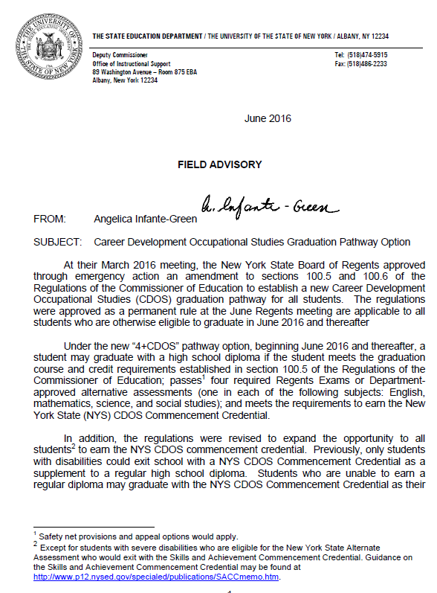
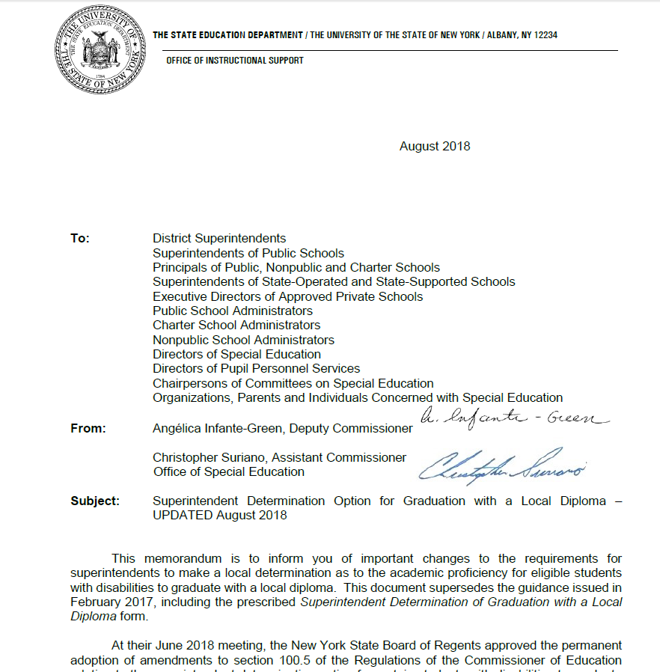
Improvement Activities - OSE
Office of Special Education (OSE) establishes regulatory standards and diploma options for students with disabilities
Safety Net options established for students with disabilities
Superintendent Determination Option introduced
Notes:
The policies from the OSE establish the regulatory standards and diploma options available to students with disabilities.
Students with disabilities have safety net options available to meet testing requirements for a local High School diploma.
There are four safety net options available for students with disabilities to graduate with a local High School diploma.
The Superintendent Determination Option allows a superintendent (or the principal/head of school of a registered nonpublic school or charter school, as applicable) to make a local determination that a student with a disability has otherwise met the standards for graduation with a local high school diploma when such student has not been successful, because of their disability, at demonstrating proficiency on one or more of the Regents examinations required for graduation.
The Career Development Occupational Studies (CDOS) Graduation Pathway Option was developed based on extensive research that connects work experiences and learning.

Slide 17
Improvement Activities: Pathways to Graduation
In the “4+1” pathway assessments option, students must take and pass four required Regents Exams or Department-approved alternative assessments (one each in English language arts, mathematics, science, and social studies) and complete a comparably rigorous pathway to meet the fifth assessment requirement for graduation.
Multiple pathways approved in 2015 and 2016 are in areas of student interest such as the Arts, World Languages, Humanities, Career and Technical Education (CTE), Career Development and Occupational Studies (CDOS) and Science, Technology, Engineering and Mathematics (STEM).
In addition, the Board of Regents approved the Civic Readiness Pathway as a pilot project to be implemented in selected schools as of September 2021.
http://www.nysed.gov/common/nysed/files/programs/curriculum-instruction/multiplepathwayshandout.pdf
Notes:
Since 2015, multiple pathways to a diploma have been created. The Board of Regents approved a pilot project for the Civic Readiness Pathway to be implemented in select schools beginning in September 2021. It will join the existing 4+1 pathways to a diploma, in the areas of student interest listed above, which allow students to replace one Regents examination with content area requirements; in this case, civic knowledge and participation.
Additional information about the pathways to graduation is accessible via the link in the slide.

Slide 18
Proposed Improvement Activities
Conduct a SEQA Review focusing on implementation of the coordinated set of transition activities/services on students’ Individualized Education Programs (IEPs)
Conduct educational workshops for families on topics such as diploma and credential options, transition, etc.
Conduct additional outreach to parent groups (e.g., monthly informational zoom meetings or newsletters on these and other topics)
Notes:
This slide shows some additional improvement activities that NYSED is recommending to improve the dropout rate for students with disabilities. We look forward to your feedback on these and any others you may suggest.

Slide 19
The Dropout ABCs
The process of dropping out may begin as early as the elementary school grades with challenges deepening in ensuing school years
Research based guidance from national and State resources indicate that key warning signs linked with dropping out are:
A: Attendance
B: Behavior problems and suspension
C: Course grades
Notes:
When students drop out of school it is life changing, but this process occurs over many years, beginning in some cases with challenges in elementary school and deepening through middle and high school.
We would like to share with you the key areas research has identified as warning signs for dropping out: Attendance, Behavior, and Course grades (ABCs of dropping out). Examples of these challenges are:
Daily attendance of 90% or less
Three or more days of suspension and/or repeated behavior problems
Failing course grades in English, Math or both
We invite you to consider everything we have shared and join us in discussion around additional improvement strategies designed to support students in remaining in school.

Slide 20
Improvement Activity Questions
What activities could be considered, maintained, or strengthened to address improvements in this area?
Notes:
What activities could be considered, maintained, or strengthened to address improvements in this area?

Slide 21
Moving Forward: Setting Targets
Step 1 New Baseline
Selection
Step 3 Consider Methodology for Target Setting
Step 4 Propose New Targets
Step 5 Obtain Stakeholder Input
Step 2 Analyze Data
New targets are needed.
Targets must be rigorous and achievable
Final targets must be higher vs. baseline
Notes:
To establish new targets, we need to select a new baseline, analyze data from past years, choose a method for establishing targets and obtain input on the targets we propose.
It’s important to remember that the new targets must be rigorous but also must be achievable.

Slide 22
Proposed Targets: Indicator 2
Decrease = Improvement
2015 – 2019 Average Drop Out Rate Using the New Calculation was 20.15%
SY 2018-19 (Baseline) | SY 2019-20 | SY 2020-21 | SY 2021-22 | SY 2022-23 | SY 2023-24 | SY 2024-25
19.37% | 0 | 0 | 0 | -0.37 | -0.5 | -0.5
Target Setting Methodology
Considers COVID-19 Impact in Years 1 -3
Improvement Compared to Baseline & Prior Four-Year Average (20.15%)
Provides Steady Progress in Years 4, 5, and 6
Notes:
This slide shows the targets NYSED is proposing to use for the FFY 2020-25 SPP/APR.
Looking back to the baseline of 19.37% for 2018-19, the last school year pre-COVID-19, and anticipating some slippage due to the challenges of COVID-19, NYSED is proposing to set the same baseline of 19.37% for the 2021-22 school year, and then setting incremental targets for improvement in the remaining years of the six-year cycle.
Because the impact of COVID-19 is unpredictable, we are holding the baseline for three consecutive years.

Slide 23
Targets must show improvement over baseline and be rigorous but achievable. Do you feel the proposed targets are too high, too low, or just right?
Notes:
Targets must show improvement over baseline and be rigorous but achievable. Do you feel that the proposed targets are too high, too low, or just right?

Slide 24
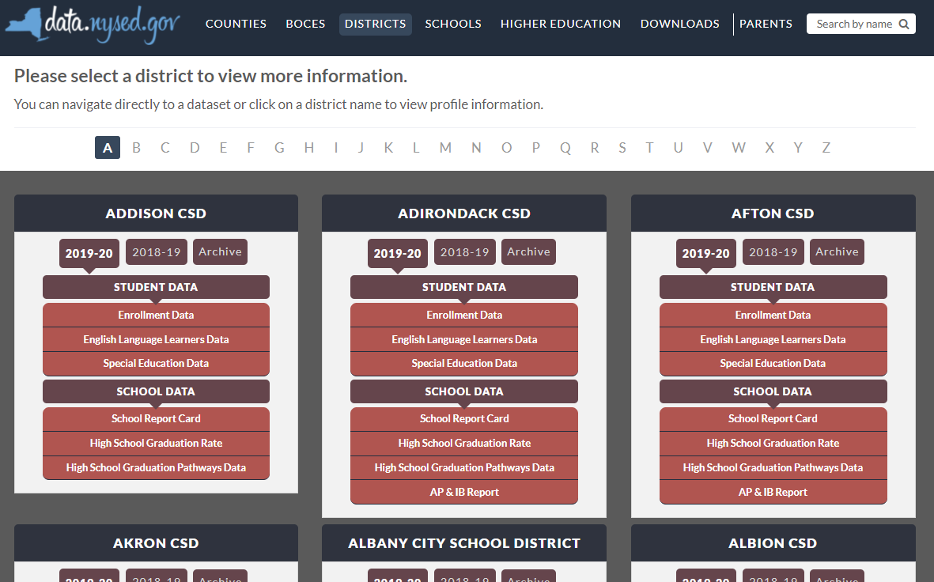
New York State School District SPP Data
Additional information on SPP Indicator data may be found in school district “Special Education Data” reports available at data.nysed.gov
Notes:
For additional information on how the SPP Indicator data impact your school district, please visit data.nysed.gov.
In the “Districts” category on this webpage, you can view the Special Education Data reports under each school district. These reports are published annually for each individual school district and outline the district’s performance on the SPP Indicators.

Slide 25
Share Your Voice in our Online Survey
Each SPP Indicator has an online survey to collect input on NYS’s target-setting and/or improvement activities
The online surveys are intended to collect feedback from interested stakeholders. They are available for those who are not attending a virtual meeting or for those who have additional information to share beyond the virtual meetings
Please visit the SPP/APR webpage to submit your survey
Notes:
We greatly appreciate your feedback and ask that you visit our SPP/APR webpage (link provided in the slide).
We will use the survey information to collect input from those who have not attended a virtual meeting or for those who have additional information to share.
Each individual SPP Indicator will have its own survey and we encourage you to access all surveys that are of interest to you so that we can achieve our objective of meaningful stakeholder engagement. It is important to us to ensure that voices from diverse backgrounds are included in conversations about our students and we value multiple perspectives and viewpoints to inform our efforts.

Slide 26
References
Carnevale, Anthony P, Jeff Strohl, Neil Ridley, and Artem Gulish. Three Educational Pathways to Good Jobs: High School, Middle Skills, and Bachelor’s Degree. Washington, DC: Georgetown University Center on Education and the Workforce, 2018. cewgeorgetown@georgetown.edu.
National Research Council. 2011. High School Dropout, Graduation, and Completion Rates: Better Data, Better Measures, Better Decisions. Washington, DC: The National Academies Press. https://doi.org/10.17226/13035
Rumberger, R., Addis, H., Allensworth, E., Balfanz, R., Bruch, J., Dillon, E., Duardo, D., Dynarski, M., Furgeson, J., Jayanthi, M., Newman-Gonchar, R., Place, K., & Tuttle, C. (2017) Preventing dropout in secondary schools (NCEE 2017-4028). Washington, DC: National Center for Education Evaluation and Regional Assistance (NCEE), Institute of Education Sciences, U.S. Department of Education. https;//whatworks.ed.gov
United States Census Bureau. Accessed July 28, 2021, https://www2.census.gov/library/publications/2011/acs/acs-14.pdf
Notes:
This slide and the next list all the sources cited for the Indicator 2 presentation.

Slide 27
References (continued)
U.S. Department of Education EDFacts Data Warehouse (EDW), “IDEA Part B Exiting” 2018-19. Data Extracted as of May 27, 2020 from file specification 009.
U.S. Department of Education, EDFacts Data Warehouse (EDW), OMB #1850-0925: IDEA Part B Exiting Collection, 2009-10 and 2017-18.
Rumberger, R., Addis, H., Allensworth, E., Balfanz, R., Bruch, J., Dillon, E., Duardo, D., Dynarski, M., Furgeson, J., Jayanthi, M., Newman-Gonchar, R., Place, K., & Tuttle, C. (2017) Preventing dropout in secondary schools (NCEE 2017-4028). Washington, DC: National Center for Education Evaluation and Regional Assistance (NCEE), Institute of Education Sciences, U.S. Department of Education. https://whatworks.ed.gov
Notes:
This slide is a continuation of the references.

Slide 28
THANK YOU for your contribution
Your Voice is Important to New York State’s Efforts to Improve Outcomes for our Students with Disabilities
Notes:
Thank you for your participation and contribution today. We greatly value your voice and input on our efforts to improve outcomes for students with disabilities in New York State.

