Slide 1

State Performance Plan (SPP)/
Annual Performance Report (APR)
2020-2025
Individuals with Disabilities Education Act (IDEA)
Indicator 17: State Systemic Improvement Plan (SSIP)
Notes:
This presentation will provide information on State Performance Plan Indicator 17 to assist stakeholders in providing feedback on proposed targets and improvement activities.

Slide 2
Agenda
Understanding the State Systemic Improvement Plan (Indicator 17)
Indicator 17 Proposed Targets
Indicator 17 SSIP Data
Indicator 17 Improvement Activities
Notes:
In this meeting, we will cover target setting and improvement activities relating to Indicator 17 of the State Performance Plan, which I will refer to as ‘SPP’ moving forward. This Indicator is also known as the State Systemic Improvement Plan or ‘SSIP’.
By the end of this session, participants will:
gain an understanding of what the SSIP is;
understand the progress on this indicator made to date;
learn about the existing improvement activities and propose potential new activities to improve outcomes for students with learning disabilities in New York State; and
assist in proposing targets for this indicator for the SPP annual performance plan cycle for the years 2020 to 2025.

Slide 3
Frequently Used Terms in the Presentation
Term | Description
Annual Performance Report (APR) Reporting Data | Data reported to the United States Department of Education Office of Special Education Programs (OSEP) against the State’s targets.
Baseline | Data starting point to measure improvement over time.
Evidence-Based Practices (EBP) | Effective instructional strategies supported by evidence and research that are proven to improve student achievement.
Indicator 17 or State Systemic Improvement Plan (SSIP) | Indicator 17 (SSIP) is part of OSEP's Results-Driven Accountability (RDA) initiative to improve results for children with disabilities by improving educational services, including special education and related services.
Multi-Tiered System of Support (MTSS) | MTSS is a model many schools use to provide targeted support to struggling students.
State Identified Measureable Result (SiMR) | The measurement goal of the State Systemic Improvement Plan (SSIP) that has the potential to improve outcomes for children with disabilities.
State Performance Plan (SPP) | Evaluates the state’s efforts to implement the requirements and purposes of the IDEA and describes how the state will improve implementation.
Targets | Performance objectives set for SPP measurements.
Transformation Zone | A slice of the State education system that represents a cross-section of schools selected to pilot the implementation of MTSS.
Notes:
To prepare you for our session, please take a minute to review the terms on this slide as they are used throughout the presentation.

Slide 4
What is Indicator 17
State Systemic Improvement Plan (SSIP)?
Notes:
(Speaker reads slide)

Slide 5
State Systemic Improvement Plan (SSIP)
SSIP = State Systemic Improvement Plan
Federal requirement for all states
To improve outcomes for students with disabilities
By creating a plan to implement evidence-based practices
Notes:
Indicator 17, the SSIP, is a requirement of the United States Department of Education’s Office of Special Education Programs (OSEP). It is a multi-year, achievable plan, developed with stakeholder input, that is designed to increase the capability of school districts to implement, scale up, and sustain quality instructional practices. The goal is to improve outcomes for students with disabilities. SSIP progress is reported annually to the United States Department of Education through the New York State Education Department’s Annual Performance Report.
The SSIP focuses on our need to improve literacy, behavior, and social-emotional outcomes of students with learning disabilities in grades three through five, by implementing the evidence-based framework, referred to as a Multi-Tiered System of Supports or ‘MTSS’.

Slide 6
SSIP Focus
State Identified Measurable Result (SIMR):
For students classified as students with learning disabilities in SSIP Pilot Schools (grades 3-5), increase the percent of students scoring at proficiency levels 2 and above on the grades 3-5 English Language Arts (ELA) State Assessment.
Notes:
To determine New York State’s focus and State Identified Measurable Result , or ‘SiMR’, stakeholders previously examined trends in performance data across multiple years and determined that students with learning disabilities were one of the lowest performing groups amongst all students with disabilities.
The data also indicated that student performance on the New York State English Language Arts assessment drops significantly between grades three and five. It was determined that the drop in performance was due to a shifting of expected skill levels of students from that of learning to read, to using reading to learn.
This information led New York State to develop a SiMR that targeted the performance of students with learning disabilities in grades three through five. As we discuss our work on this indicator, including our improvement strategies, please keep in mind that this SiMR, or overall goal, is remaining the same as we move forward into the next six years of our cycle.

Slide 7
Improvement Activities
Notes:
Once the SiMR was determined, improvement activities and strategies were selected to address the causes of low performance and help districts to improve literacy achievement for students with disabilities.

Slide 8
SSIP – Improvement Strategies
    Organizational Capacity Building
    Program and Resource Development
    Professional Development, Technical Assistance and Coaching
    Needs Assessment, Improvement Planning and Monitoring
    State Education and District Partnership and Community Engagement
Notes:
The SSIP focused on five specific improvement strategies that were designed to help achieve the SiMR and build capacity to implement, scale up and sustain evidence-based practices.
Strategy I focused on developing regional, district and school-based teams to increase organizational capacity, collaboration, and responsiveness within the district and school.
Strategy II involved defining the MTSS model, and selecting and developing tools, resources and guidance documents that were accessible to all program leaders, trainers, and practitioners.
Strategy III focused on creating a model of professional development, technical assistance and coaching that was targeted and comprehensive.
Strategy IV involved developing data driven instruction and decision making, with a focus on every student.
Strategy V focused on creating plans, processes, and resources to engage families and communities in the SSIP project.

Slide 9
What is MTSS?
A Framework for:
  Instructional delivery
  Interventions that are matched to student need
  Data-driven decision-making
  Continuous examination and improvement process
So that every child receives what they need
when they need it
Notes:
MTSS was used to ensure high quality instruction was being provided to the schools participating in the SSIP project.
MTSS is a framework for school improvement that focuses on systems level change from classroom, to school and district to provide all students, including students with disabilities, with multiple levels of high-quality instruction. This support is matched to student needs and is progress monitored frequently to make instructional decisions and to ensure effectiveness.

Slide 10



MTSS is Like an Ice Cream Sundae
Tier 2
Tier 1
Tier 3
This Photo by Unknown Author is licensed under CC BY-NC
Notes:
The implementation of MTSS includes a variety of evidence-based instruction, supports and assessment practices, so that all students receive the appropriate level of support they need when they need it. As the levels or Tiers increase, so does the intensity of support. Higher tiers of support don’t replace core instruction; but supplement it.
To better understand the tiers, think of an ice cream sundae.
The ice cream is the universal support or Tier 1. It is the high-quality core instruction that all students receive. A strong foundation at Tier 1 limits the number of students needing support at Tiers 2 and 3.
The hot fudge over the top represents Tier 2. Tier 2 is for students who are not making adequate gains from core instruction alone. Struggling students are provided supplemental instruction matching their individual needs.
The whipped cream, nuts, and cherry represent Tier 3. This is the additional intensified supports beyond Tier 1 and Tier 2 that may be needed by a small number of students. Not every student will need the same intensified supports.
If a student is not making progress at Tier 3, a special education evaluation is usually the next step.
Just like the toppings on a sundae, interventions and supports for students are layered on, as and when needed, to ensure success.

Slide 11
What MTSS Is Not
MTSS is not:
  a curriculum or program;
  just a process for struggling students;
  synonymous with Academic Intervention Services (AIS); or
  just a set of forms, steps, or procedures to follow.
Notes:
[Presenter read slide.]

Slide 12

SSIP Transformation Zone
Long Island
Lower Hudson Valley
NYC
Transformation
Zone
Current State
Notes:
The SSIP can be thought of as a small-scale school improvement project. The State decided to select a manageable, yet large enough, cross-section of districts to participate in the SSIP initiative. A cohort of 14 schools from 10 districts within 3 regions of the State participated in the SSIP to test proposed activities aimed at improving literacy achievement for students in grades 3 through 5 with learning disabilities. These districts became the SSIP Transformation Zone.
The work within the Transformation Zone was designed not only to improve literacy achievement in these schools, but to develop replicable strategies which would be used to scale up the project by adding more schools.

Slide 13
The Office of Special Education’s Educational Partnership
12 Regional Partnership Centers
14 School-Age Family and Community Engagement Centers
14 Early Childhood Family and Community Engagement Centers
Systems Change Work Providing a Variety of Supports to Educational Organizations in New York State
Regional Learning
Targeted Skills/Support Groups
Support Plans
1
2
3
Notes:
To support MTSS implementation within the transformation zone, the Office of Special Education (OSE) deployed resources from the Office of Special Education or ‘OSE’ Educational Partnership to provide targeted intensive and embedded professional development and coaching. Each participating school in the SSIP received a Support Plan provided by the OSE Educational Partnership.
The OSE Educational Partnership is a special education professional development network comprised of Regional Teams across the State. Regional Teams include a Regional Partnership Center that has specialists who provide professional development in a range of disciplines including behavior, transition, culturally responsive education, literacy and specially designed instruction, a School Aged Family and Community Engagement Center that has specialists with expertise supporting parents and families of school-aged students with disabilities and an Early Childhood Family and Community Engagement Center that supports parents and families of preschool students with disabilities.
These Regional Teams provide professional development to stakeholders including parents and families as well as schools, including preschools, that serve student with disabilities.
The Regional Teams offer three tiers of support:
Regional Learnings are offered to all educational organizations and/or parents and families of students with disabilities in a region. The training may be offered in-person and/or virtually and there are training topics in all areas of special education.
Targeted Skills Groups are provided to groups of schools that have a similar performance or compliance issue that requires more intensive professional development and targeted assistance.
Support Plans are the most intensive level of support that includes embedded support from one or more specialists from the Regional Team provided directly to the identified schools.

Slide 14

Facilitator check for understanding on the SSIP
Notes:
We are going to pause to ensure the information we presented regarding the SSIP was clear and understandable.

Slide 15
Proficiency of Students with Learning Disabilities in Grades 3-5
Percentage of Students Scoring at or Above Grade Level
 | 2015-16 | 2016-17 | 2017-18 | 2018-19
Long Island | 20% Baseline | 27% | 35% | 27%
Lower Hudson | 20% Baseline | 28% | 21% | 26%
NYC | 20% Baseline | 24% | 38% | 39%
Tran. Zone | 20% Baseline | 26% | 34% | 34%
State | 20% Baseline | 32% | 41% | 40%
Notes:
We will now consider New York State’s past performance for Indicator 17 based on the actual reported data in our Annual Performance Reports. This chart contains historical SiMR data from 2015 through 2020 for students with learning disabilities in grades 3 through 5 who scored 2 or higher on the New York State English Language Arts assessment.
The chart on the left shows the percent of students with learning disabilities in grades 3 through 5 scoring at or above grade level on the English Language Arts assessment in each of the individual regions within the Transformation Zone for each year of the SSIP. It also shows for comparison, the Transformation Zone as a whole compared to all students with learning disabilities in grades 3-5 across the State.
The chart on the right shows the progress for the entire Transformation Zone schools, regardless of region, as compared to the State results. The black line shows the targets for each school year of the SSIP. The other colored lines show you the progress within the transformation zone as compared to students with learning disabilities in grades three through five statewide.​
A target of 42% was set for 2019-2020, but due to COVID-19, State assessments were not administered.
Please take three minutes to look at the data and identify patterns, trends, conclusions and/or any questions you may have.
​

Slide 16

What did the SSIP data tell us?
Stakeholder
Feedback
Notes:
We will now pause and ask you to consider the following:
What did the SSIP data tell you?
How should the data be used to inform target-setting and improvement activities?

Slide 17
SSIP Improvement Activities

Slide 18

Proposed Improvement Activities
Improvement Activities are:
activities that will result in improved results for students with disabilities
infrastructure changes - how system changes support achievement of the SiMR, sustainability, and scale-up
identified evidence-based instructional practices that when carried out with fidelity are having the desired effects
Notes:
As mentioned earlier, improvement activities are: (Presenter Read Bullets on Slide).
Based on the learnings from previous years of the SSIP, new improvement ideas have been proposed to build capacity to implement, scale up and sustain evidence-based practices.

Slide 19
State Personnel Development Grant (SPDG)
The SPDG program is a competitive funding opportunity provided by the United States Department of Education (USDE).
Grants are awarded to state educational agencies to help them reform and improve their systems for personnel preparation and professional development of individuals providing early intervention, educational, and transition services to improve results for children with disabilities.
NYSED was awarded the SPDG in October 2020.
Notes:
As indicated on the previous slide, one of our improvement activities is changes to our infrastructure which includes scale up of the MTSS framework. One way we are doing this is through the State Personnel Development Grant or ‘SPDG’.
The SPDG is a competitive grant awarded to state education agencies by the United States Department of Education.
The purpose of these grants are to help state education agencies to improve their systems for the preparation and professional development of individuals providing early intervention, educational, and transition services to children with disabilities
New York State was awarded the SPDG in October of 2020. The primary goal of New York State’s SPDG award is to improve results for students, particularly students with disabilities, by establishing a Statewide, evidence-based, multi-tiered system of supports that integrates academics, behavior, social-emotional learning, and culturally responsive education through effective structures and practices at the State, district, and school levels.

Slide 20
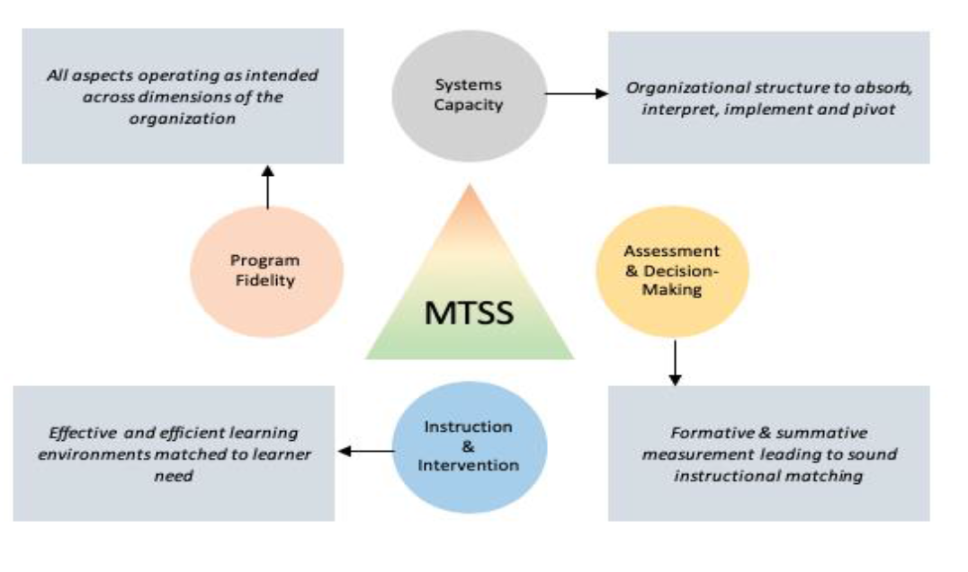
NYSED’s MTSS-I Framework
MTSS-I
Notes:
The previous SSIP MTSS model laid the groundwork for an enhanced, Statewide integrated framework for MTSS. It is currently under development and will be utilized with schools participating in the SPDG project. This Statewide model, MTSS-I, integrates academics, behavior, cultural responsiveness, and other supports and includes many elements from the SSIP MTSS model.
MTSS-I includes 4 core components. These are the essential pieces of practice and/or key ingredients that must be in place to get the expected outcomes.
Systems capacity refers to the ability of a district and school to implement and sustain the MTSS-I framework.
Assessment and Decision Making is the systematic process of collecting and interpreting information to make instructional decisions for students and to ensure effectiveness of instructional practices.
Instruction and intervention includes programs, practices, and materials which are drawn from evidence-based findings and outlined in research shown to be effective in improving student outcomes.
And finally, program fidelity refers to the degree to which an intervention or program is implemented as originally developed.

Slide 21
Why MTSS-I?
Provides specific types of support for all individuals who interact with students in the form of PD, technical assistance, and instructional coaching;
Outlines clearly defined roles and responsibilities for all individuals who interact with students;
Provides a coherent system for continuous improvement; and
Ensures that a common understanding or language exists when discussing implementation and expected outcomes.
Notes:
(Presenter read slide first)
When MTSS-I is implemented with fidelity, the focus is on the system to ensure that all students get what they need to be successful learners. The MTSS-I framework enables the alignment of systems necessary to help schools and districts integrate priorities and organize resources.

Slide 22
MTSS-I CENTER
NYSED is using its SPDG award to create an MTSS-I Center to:
develop MTSS-I materials, in collaboration with NYSED and the OSE Educational Partnership, that will be available on our website for all schools;
provide coaching to approximately 50 school districts across the State in MTSS-I;
provide coaching to OSE Education Partnership professional development specialists to increase Statewide capacity to support districts in the implementation of MTSS-I; and
collaborate with colleges and universities to increase the integration of MTSS-I in teacher preparatory curricula.
Notes:
[Presenter Read Slide]
NYSED will utilize the MTSS-I Center to promote MTSS-I across the State and provide coaching to approximately 50 school districts, with these school districts becoming the schools that will be participating in the SSIP. In short, NYSED is merging its SPDG plan with the SSIP. The next slide will provide more information regarding the support that each school participating in the SPDG’s MTSS-I Center and the SSIP will receive.

Slide 23
Support Provided to Each District That Receives an MTSS-I Grant
Each district will be provided three years of direct support to each designated school. Direct support will include:
Site visits will occur within individual schools, with the frequency determined based on needs.
Additionally, MTSS-I coaches will be available via e-mail, phone and/or virtually to each school for ongoing technical assistance across the life of the project.
In year 1, each district will be provided with 5 professional development days.
In year 2, each district will be provided with 5½ professional development days.
In year 3, each district will be provided with 6 professional development days.
Notes:
[Presenter Read Slide]
Districts that meet certain criteria, specifically districts that previously participated in the Transformation Zone or other Response to Intervention initiatives and/or have a high level of poverty, have been selected to participate in the SPDG and will be offered the opportunity to do so. There will be four cohorts of districts that will participate over four years of the project. This expansion will scale up the number of districts and schools who are receiving embedded professional development from 14 schools representing 10 districts to approximately 200 schools representing 50 districts.
The first cohort will include 10 districts;
The second cohort will include 10 districts;
The third cohort will include 15 districts; and
The fourth cohort will include 15 districts.
Each district will be asked to invite up to three schools to participate in the project.
The districts currently involved in the current SSIP Transformation Zone will be invited to participate in the first cohort of the SPDG project.

Slide 24
Facilitator check for understanding on the improvement activities
Notes:
We are going to pause to check to ensure the information we presented was clear and understandable.

Slide 25
What improvement activities should be considered, maintained, or strengthened to address the SIMR and to improve outcomes for students with learning disabilities?
Stakeholder
Feedback
Notes:
We would like to get your thoughts on the proposed improvement activities.
What improvement activities should be considered, maintained, or strengthened to address the SiMR and to improve outcomes for students with learning disabilities?

Slide 26
Indicator 17 Target Setting
Notes:
OSEP requires that states set annual targets for Indicator 17. A target is a future numerical value or percentage point goal that the state sets to show progress toward its SiMR. As we discussed earlier in the presentation, the SiMR is the percent of students classified as students with learning disabilities in the SSIP Pilot Schools (grades 3-5) scoring at proficiency levels 2 and above on the grades 3-5 ELA State Assessment.

Slide 27

Target Setting
Targets must be:
Measureable and rigorous
Based on analysis of current and trend data
Show improvement over baseline
Set with the advice of stakeholders
Notes:
The US Department of Education requires that [Presenter Read Slide]
First, we will share the targets and progress from the first five years of the SSIP, and then we will discuss targets for the next five years.

Slide 28
Proposed Targets for 2020-2025
School Year | Targets | Actual | School Year | Proposed Targets
2015-16 | 20% | Baseline | 2020-21 | 35% New Baseline
2016-17 | 24% | 26% | 2021-22 | 36%
2017-18 | 32% | 34% | 2022-23 | 37%
2018-19 | 42% | 34% | 2023-24 | 38%
2019-20 | 42% | N/A | 2024-25 | 39%
 |  |  | 2025-26 | 40%
Notes:
For the next six years of our SPP, we have established a new baseline beginning in FFY 2020. It was established based on the actual 2018-2019 English Language Arts state assessment results for students with learning disabilities in grades 3 through 5 in the new cohort of districts invited to participate in the SPDG project. The proposed targets are modest based on the most recent research on the COVID-19 learning loss.
When proposing targets for the following years, NYSED reviewed previous years’ progress on the SiMR. Although the data trended upward or remained the same during the first four years of the SSIP, it is possible that this trend may not continue due to the significant impact of COVID-19 on learning. Recent research states that students made gains during the 2020-21 school year at a lower rate compared to pre-pandemic trends, especially between winter and spring.
(Source: https://www.nwea.org/content/uploads/2021/07/Learning-during-COVID-19-Reading-and-math-achievement-in-the-2020-2021-school-year.research-brief-1.pdf).

Slide 29
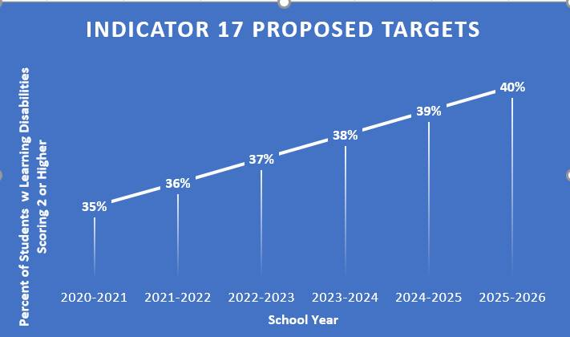
Graph of Proposed Targets for 2020-2025
Notes:
Based on the considerations of COVID-19’s impact on learning loss as well as the anticipated length of time for schools to demonstrate progress in utilizing evidence-based practices through an MTSS-I framework, proposed targets, as illustrated on the graph on the screen, are designed to show modest growth over the next five years.

Slide 30
Consider Proposed Targets
Stakeholder
Feedback
Notes:
We will now pause to discuss the proposed targets.

Slide 31
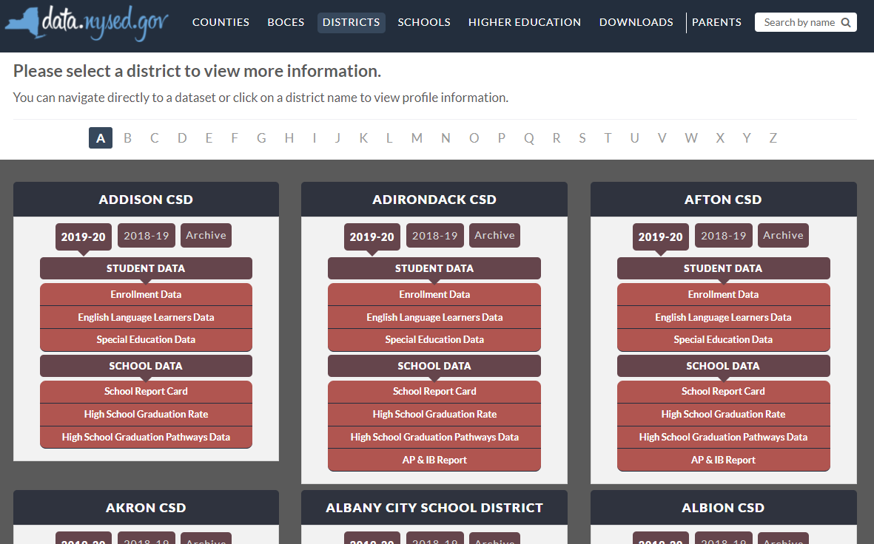

New York State School District SPP Data
Additional information on SPP Indicator data may be found in school district “Special Education Data” reports available at data.nysed.gov
Notes:
For additional information on how the SPP Indicator data impacts your school district, please visit data.nysed.gov.
In the “Districts” category on this webpage, you can view the Special Education Data reports under each school district. These reports are published annually for each individual school district and outline the district’s performance on the SPP Indicators.

Slide 32

Share Your Voice in our Online Survey
Each SPP Indicator has an online survey to collect input on NYS’s target-setting and/or improvement activities
The online surveys are intended to collect feedback from interested stakeholders. They are available for those who are not attending a virtual meeting or for those who have additional information to share beyond the virtual meetings
Please visit the SPP/APR webpage to submit your survey
Notes:
We greatly appreciate your feedback and ask that you visit our SPP/APR webpage (link provided in the slide).
We will use the survey information to collect input from those who have not attended a virtual meeting or for those who have additional information to share.
Each individual SPP Indicator will have its own survey and we encourage you to access all surveys that are of interest to you so that we can achieve our objective of meaningful stakeholder engagement. It is important to us to ensure that voices from diverse backgrounds are included in conversations about our students and we value multiple perspectives and viewpoints to inform our efforts.

Slide 33






THANK YOU for your contribution
Your Voice is Important to New York State’s Efforts to Improve Outcomes for our Students with Disabilities
Notes:
Thank you for your participation and contribution today. We greatly value your voice and input on our efforts to improve outcomes for students with disabilities in New York State.

