Slide 1
Welcome to the SPP/APR
Indicator 13: Secondary Transition
Notes:
Welcome to the State Performance Plan (SPP) 13/Annual Performance Report (APR) 2020-2025 presentation.

Slide 2
Agenda
Introduction
Improvement Activities
Measurement
Data Collection
Data Trends
Notes:
As we advance through the slides, we will review the measurement of secondary transition, present trends and comparative data, and consider improvement strategies. The agenda is a road map for collaboration, providing opportunities to pose questions and determine future direction. ​

Slide 3
Frequently Used Terms
Term | Description
State Performance Plan (SPP) | Evaluates the state’s efforts to implement the requirements and purposes of the Individuals with Disabilities Education Act (IDEA) and describes how the state will improve its implementation.
Annual Performance Report (APR) | The IDEA requires each state to develop a state performance plan/annual performance report (SPP/APR) that evaluates the state’s efforts to implement the requirements and purposes of the IDEA and describes how the state will improve its implementation.
Federal Fiscal Year (FFY) | October 1 – September 30.
SPP Indicator 13 | Measures the percent of youth aged 15 and above with an IEP that includes appropriate measurable postsecondary goals that are annually updated and based upon an age-appropriate transition assessment, transition services, including courses of study, that will reasonably enable the student to meet those postsecondary goals, and annual IEP goals related to the student's transition services needs. There also must be evidence that the student was invited to the IEP Team meeting where transition services are to be discussed and evidence that, if appropriate, a representative of any participating agency if appropriate, a representative of any participating agency that is likely to be responsible for providing or paying for transition services, including, if appropriate, pre-employment transition services, was invited to the IEP Team meeting with the prior consent of the parent or student who has reached the age of majority.
Notes:
These are frequently used terms and definitions that will be referenced throughout the presentation. Please take a moment to familiarize yourself with these terms:
​State Performance Plan (SPP);
Annual Performance Report (APR);
Federal Fiscal Year (FFY); and
SPP Indicator 13.

Slide 4
Frequently Used Terms (1 out of 2)
Term | Description
Transition Services | A coordinated set of activities for a student with a disability, designed within a results-oriented process, that is focused on improving the academic and functional achievement of the student with a disability to facilitate the student's movement from school to post-school activities, including, but not limited to, postsecondary education, vocational education, integrated employment (including supported employment), continuing and adult education, adult services, independent living, or community participation. The coordinated set of activities must be based on the student’s strengths, preferences and interests, and shall include needed activities in the following areas: (1) instruction; (2) related services; (3) community experiences; (4) the development of employment and other post-school adult living objectives; and (5) when appropriate, acquisition of daily living skills and provision of a functional vocational evaluation.
7-Pak Consortium | New York, California, Florida, Pennsylvania, Illinois, Texas, and Ohio are known as the 7-Pak States. The term 7-Pak States refers to a consortium of the seven largest states that the National Association of State Directors of Special Education, Inc. determined to have both similar demographics (e.g., general population, diversity, significant rural and inner-city populations) and issues in the delivery of special education programs to its students with disabilities.
“states” | The term “states” is inclusive of the 50 states, eight territories or associated states, the Bureau of Indian Education and the District of Columbia.
Notes:
These are additional frequently used terms that will be referenced throughout the presentation. Please take a moment to familiarize yourself with these terms:
​Transition Services
7-Pak Consortium
“states”

Slide 5
Frequently Used Terms (2 out of 2)
Term | Description
Measurable Postsecondary Goals | Identifies the student’s long-term goals for living, working and learning as an adult; acknowledges the student's needs, preferences and interests and should be expressed in terms of the student's aspirations for the future.
Transition Assessment | Assessments related to training, education, employment, and, where appropriate, independent living skills for the purpose of determining a student’s appropriate measurable postsecondary goals for secondary transition.
Coordinated Set of Activities | Based on the individual student’s needs, taking into account the student’s strengths, preferences and interests, and including: instruction; related services; community experiences; the development of employment and other post-school adult living objectives; and when appropriate, acquisition of daily living skills and provision of a functional vocational evaluation.
Courses of Study | A multi-year description of coursework from the student's current to anticipated exit year that is designed to help achieve the student's desired post-school goals.
Participating Agency | A State or local agency, other than the public agency responsible for a student’s education, which is financially and legally responsible for providing transition services to the student.
Notes:
This is the final list of frequently used terms that will be referenced throughout the presentation. Please take a moment to familiarize yourself with these terms:
Measurable Postsecondary Goals;;
Transition Assessment;
Coordinated Set of Activities;
Courses of Study; and
Participating Agency.
​

Slide 6
Participants will...
Gain a deeper understanding of SPP/APR Indicator 13.
Gain a deeper understanding of current information and trend data as well as state and national comparisons regarding New York State's progress towards meeting the required 100% compliance.
Discuss strategies to improve performance on Indicator 13.​
Notes:
Participants in today's presentation will:
Gain a deeper understanding of SPP/APR Indicator 13;
Gain a deeper understanding of current information and trend data as well as state and national comparisons regarding New York State's progress towards meeting the required 100% compliance; and
Discuss strategies to improve performance on SPP Indicator 13.

Slide 7
Participants will gain a deeper understanding of Indicator 13.
Notes:
In order to gain a deeper understanding, we will now discuss what Indicator 13 measures, including federal and State requirements related to the development of transition plans.
As we move through this part of the presentation, consider what questions you may have regarding how data are collected and used to measure compliance.

Slide 8
Understanding SPP Indicator 13 Regulations Federal
States are required to report data on the “percent of youth with IEPs aged 16 and above with an IEP that includes appropriate measurable postsecondary goals that are annually updated and based upon an age-appropriate transition assessment, transition services, including courses of study, that will reasonably enable the student to meet those postsecondary goals, and annual IEP goals related to the student’s transition service needs.”
“There also must be evidence that the student was invited to the IEP Team meeting where transition services are to be discussed and evidence that, if appropriate, a representative of any participating agency was invited to the IEP Team meeting with the prior consent of the parent or student who has reached the age of majority.” (20 U.S.C. 1416(a)(3)(B)).
Notes:
This slide describes the federal regulations pertaining to Indicator 13. It references the age at which secondary transition should begin. It also references the components that would facilitate a successful transition experience for students.​
​
“States are required to report data on the percent of youth with IEPs aged 16 and above with an IEP that includes appropriate measurable postsecondary goals that are annually updated and based upon an age-appropriate transition assessment, transition services, including courses of study, that will reasonably enable the student to meet those postsecondary goals, and annual IEP goals related to the student’s transition service needs.” ​
​“There also must be evidence that the student was invited to the IEP Team meeting where transition services are to be discussed and evidence that, if appropriate, a representative of any participating agency was invited to the IEP Team meeting with the prior consent of the parent or student who has reached the age of majority.”

Slide 9
Comparison of Federal and State Regulations
Federal | State
If a State’s policies and procedures provide that public agencies must meet these requirements at an age younger than 16, the State may, but is not required to, choose to include youth beginning at that younger age in its data for this indicator. If a State chooses to do this, it must state this clearly in its SPP/APR and ensure that its baseline data are based on youth beginning at that younger age. | New York State (NYS) law requires transition planning on a student’s IEP beginning with the IEP in effect when the student turns age 15. The New York State baseline data are based on youth beginning at age 15.
Notes:
New York State has taken advantage of the federal option to apply the regulation to younger students and make it more rigorous. While federal regulations require transition planning to begin with the first IEP to be in effect at age 16, New York State law and regulation require transition planning on a student’s IEP beginning with the IEP in effect when the student turns age 15.
As previously noted in the Federal regulation, the IEP Team is responsible for the development of the transition plan in the IEP. In New York State, the Committee on Special Education (CSE), which is synonymous with the term IEP Team, is responsible for the development of the IEP including the transition plan.

Slide 10
Understanding the Regulations
The Regulations of the Commissioner of Education Part 200 Students with Disabilities requires Indicator 13 to monitor the following requirements:
Measurable annual goals, including academic and functional goals;
Appropriate measurable postsecondary goals based upon age-appropriate transition assessments;
A statement of the transition services needs of the student that focuses on the student's courses of study;
Needed activities to facilitate the student's movement from school to post-school activities; and
Participation of the student in transition planning, and to the extent appropriate and with parental consent or consent of a student 18 years of age or older, the school district invites a representative of any participating agency that is likely to be responsible for providing or paying for transition services.
Notes:
Indicator 13 includes the following requirements from the Regulations of the Commissioner of Education Part 200 Students with Disabilities. ​It is important to understand all the elements of the transition plan as outlined in the Regulations of the Commissioner. These regulations govern New York State special education administration and require monitoring of the following requirements:
Measurable annual goals, including academic and functional goals;
Appropriate measurable postsecondary goals based upon age-appropriate transition assessments; ​
A statement of the transition services needs of the student that focuses on the student’s courses of study;​
Activities to facilitate the student's movement from school to post-school activities;​ and
Participation of the student in transition planning and, with parental consent or consent of a student 18 years of age or older, the school district invites a representative of any participating agency responsible for providing or paying for transition services.
​

Slide 11
Data Collection
New York State has divided all school districts into six statewide representative samples. Each group reports once every six years. ​However, New York City reports every year.
The data for this Indicator are collected by conducting the Secondary Transition Self-Review for Students with Disabilities. This is a focused self-review of the content of each selected school district’s sample of IEPs with respect to transition planning and services. Samples from local educational agencies (LEAs) must be representative, considering such variables as disability categories, age, race, gender, and family income.​
New York City is the only school district whose review is a joint review by the New York State Education Department and the New York City Department of Education. ​
Notes:
We will now explain how data are collected for Indicator 13.
New York State has divided all school districts into six statewide representative samples. Each group reports once every six years. However, New York City reports every year.
The data for this indicator are collected by conducting the Secondary Transition Self-Review for Students with Disabilities. This is a focused self-review of the content of the school district’s IEPs with respect to transition planning and services. The review focuses on requirements in the following areas:​
​
Participation of the student in transition planning; ​
Postsecondary goals; ​
Present levels of performance and transition needs; ​
Annual goals; and ​
Transition activities. ​
​
​

Slide 12
Sampling Methodology
Federal Indicator Number | Eligible Population of Students from Which a Random Sample Must be Selected | Minimum Number of Students in the Sample | Method for Selecting Students | Required Documentation
13 | All students with disabilities ages 15-21 who are provided special education services in district-operated programs or under contract with other service providers | All students up to 30 eligible students. NYC samples 100 students | Random selection using a random number table | Documentation period is seven years. Maintain list of all eligible students, copy of Random Number Table used, beginning random number for selecting students, and list of all students who were selected and their number
Notes:
This is the sampling methodology in which New York State engages. As previously discussed, in preparation for the Secondary Transition Self-Review, the sample selected must be representative of the district to include various categories such as disability categories, age, gender, race and family income.
In the rest of the state, all districts must randomly sample a minimum of 30 eligible students. However, districts with less than 30 eligible students must include all eligible students in their sample. In New York City, the sample is a minimum of 100 eligible students. This can be attributed to the size of New York City school districts. ​

Slide 13
Measurement of Data
# of youth aged 15 and above with an IEP that is fully compliant with SPP 13 citations
Percent =
X 100
# of youth with an IEP age 15 and above
Notes:
We will now discuss how data are measured.
To determine New York State's performance on Indicator 13, we measure the percent of students with IEPs aged 15 and above with an IEP that includes:
appropriate measurable postsecondary goals that are annually updated and based upon an age-appropriate transition assessment;
transition services, including courses of study, that will reasonably enable the student to meet those postsecondary goals; and annual IEP goals related to the student’s transition services needs;
there also must be evidence that the student was invited to the IEP team meeting where transition services are to be discussed; and
if appropriate, a representative of any participating agency was invited to the IEP team meeting with the prior consent of the parent or student who has reached the age of majority.
Thus, the number of compliant IEPs is then divided by the total number of students aged 15 and above with an IEP, times 100; resulting in the determination of the performance on SPP Indicator 13.

Slide 14
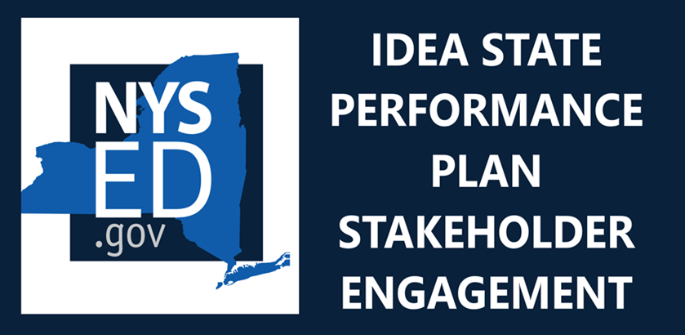
Facilitator check for understanding
Facilitator Check for understanding on the SPP measurement or how the data are used to measure results or outcomes.
Notes:
We will now pause for your feedback.
Stakeholder feedback is essential. Your responses to the question on this slide and other questions posed through the course of the presentation are important.
At this point, what questions do you have regarding how data are collected and used to measure compliance?

Slide 15
Facilitator check for understanding #2
While New York City reports SPP Indicator 13 data annually, other districts in New York State are assigned to one of six groups that report once every six years. What would you think are the advantages of districts reporting more frequently*? *(i.e., once a year or once every three years)
Notes:
While New York City reports SPP Indicator 13 data annually, other districts in New York State are assigned to one of six groups that report once every six years.
What would you think are the advantages of districts reporting more frequently*?
*(for example, once a year or once every three years)

Slide 16
Participants will understand current information and trend data.
Notes:
Our second goal is to understand current information and trend data. As we move through this part of the presentation, consider what aspects of the data appear interesting and whether the data suggest any opportunities for improvement.

Slide 17
Understand current New York State information and trend data
Baseline 2009
67.20%
FFY | 2014 | 2015 | 2016 | 2017 | 2018 | 2019
Target = | 100% | 100% | 100% | 100% | 100% | 100%
Data | 78.29% | 76.50% | 90.23% | 88.05% | 92.51% | 88.10%
100%
90%
80%
70%
60%
50%
Notes:
This chart shows New York State's trend data for Indicator 13 over the past six years. The graph under the chart shows the trend data for each year. The red line indicates the target and the blue line indicates New York State’s performance.​
For Indicator 13 the target must always equal 100% compliance. This is a federal requirement. ​
In 2009 New York State established a baseline of 67.20% of students 15 years old and older whose IEP was compliant with the Indicator 13 requirements.
​
New York State has always exceeded the baseline set in 2009.
​
In 2016 and 2018 New York State achieved greater than 90% compliance, with 90.23% and 92.51%, respectively.​
Most recently, in 2019 New York State reported 88.10% compliance.
​

Slide 18
Understand current New York State information and trend data for noncompliant districts
Decrease = Improvement
Notes:
This slide displays the areas that have been identified as noncompliant during data collection for the FFYs 2017-18 through 2019-20.
​
Every year, approximately 105 school districts report on SPP Indicator 13.​
Over time, the rate of compliance has varied but not reached 100% in any of the areas measured.
Our goal is to have 100% compliance.
During the 2019-20 school year, the area of measurable postsecondary goals displays the most noncompliance, while the other areas display lesser but similar levels of noncompliance. This means that the number of districts identified as noncompliant in the area of measurable postsecondary goals is the highest, while the other areas are almost the same.
​

Slide 19
New York State and National Trends for SPP 13 7-Pak Consortium Indicator 13 Results
 | 2014 | 2015 | 2016 | 2017 | 2018
NY Results | 78.29% | 76.50% | 90.23% | 88.05% | 92.51%
OH Results | 99.26% | 99.34% | 99.27% | 99.96% | 99.90%
IL Results | 93.73% | 93.07% | 97.50% | 98.63% | 99.17%
PA Results | 81.19% | 83.07% | 84.32% | 82.18% | 80.18%
FL Results | 88.77% | 90.55% | 90.38% | 94.84% | 90.40%
CA Results | 93.49% | 99.41% | 99.59% | 99.79% | 99.78%
TX Results | 99.74% | 99.84% | 99.58% | 99.79% | 99.52%
Notes:
We will now compare New York State’s trend data to the reported data results of other states of comparable size and demographics.​
​
New York, California, Florida, Pennsylvania, Illinois, Texas, and Ohio are known as the 7-Pak Consortium. This term refers to a consortium of the seven largest states that the National Association of State Directors of Special Education determined to have both similar demographics, such as general population, diversity, significant rural and inner-city populations, and issues in the delivery of special education programs to its students with disabilities. ​
​
In this slide, on the left is a graph of Indicator 13 results for the 7-Pak Consortium, with New York State on the far left of the graph. The graph describes each state’s performance data from FFYs 2014 through 2018.
On the right is a chart of the performance data that the graph is based upon. In this chart, the New York State performance data is in bold in the top row. ​
Based on the data, in 2014 and 2015 New York State was ranked as the least compliant of all the states in the 7-Pak Consortium. In 2016 and 2017 it was the sixth and in 2018 it was the fifth least compliant.

Slide 20
Results by 7-Pak Consortium and National Mean
2018 National Mean = 89%
Notes:
In this chart, we compare the 2018 national mean of 89%, as represented by the horizontal dashed black line, to the performance of the states in the 7-Pak Consortium. As indicated on the graph, in 2018 New York State’s performance of 92.5% exceeded the national mean of 89%. ​
​

Slide 21
Notes:
Now we have an opportunity for you to provide input on the information we shared about the data.
What do you see in the data that is interesting?
Do the data suggest any opportunities for improvement?

Slide 22
Discuss strategies to improve performance on Indicator 13.
Notes:
Our next goal is to discuss strategies to improve performance on Indicator 13.

Slide 23
Current Improvement Strategies (1 of 2)
NYSED has taken the following actions to ensure that IEPs include required transition components:​
The New York State Education Department has seven branches, each under the direction of the Commissioner of Education. Two of these branches are Adult Career and Continuing Education Services-Vocational Rehabilitation (ACCES-VR) and P-12 Instructional Support, which includes the Office of Special Education (OSE). These branches have programs which benefit students’ secondary transition and post-school outcomes.
A Joint Agreement for the Coordination of Transition Services between ACCES-VR and the Office of Special Education was signed by representatives of ACCES and P-12 Instructional Support on April 21, 2020. Through the agreement, which defines their relationship and their respective roles and responsibility to students with disabilities, the provision of transition services and pre-employment transition services for students with disabilities forms the basis for which the Joint Agreement was made.
ACCES-VR is one agency that may be invited to participate in the development of the transition plan during the IEP meeting, with appropriate consent.​
OSE’s Youth Advisory Panel advises NYSED on ways to improve the quality of special education services and student outcomes.
Notes:
We will now discuss the New York State Education Department’s actions to ensure that IEPs include the required transition components:​
​
The New York State Education Department has seven branches, each under the direction of the Commissioner of Education. Two of these branches are Adult Career and Continuing Education Services-Vocational Rehabilitation (ACCES-VR) and P-12 Instructional Support, which includes the Office of Special Education (OSE). These branches have programs which benefit students’ secondary transition and post-school outcomes.
A Joint Agreement for the Coordination of Transition Services between ACCES-VR and the Office of Special Education was signed by representatives of ACCES and P-12 Instructional Support on April 21, 2020. Through the agreement, which defines their relationship and their respective roles and responsibility to students with disabilities, the provision of transition services and pre-employment transition services for students with disabilities forms the basis for which the Joint Agreement was made.
ACCES-VR is one agency that may be invited to participate in the development of the transition plan during the IEP meeting, with appropriate consent.​
OSE’s Youth Advisory Panel advises NYSED on ways to improve the quality of special education services and student outcomes.
​

Slide 24
Current Improvement Strategies (2 of 2)
NYSED has taken the following additional actions to ensure that IEPs include required transition components:​
SEQA provides technical assistance to districts to improve the quality of transition plans in the IEP.
SEQA monitors the development of transition plans to identify noncompliance and ensure that any noncompliance is corrected.
NYSED’s State-mandated IEP form was developed to ensure school districts are appropriately documenting transition requirements on students’ IEPs.​
Notes:
NYSED has taken the following additional actions to ensure that IEPs include the required transition components:​
​
Special Education Quality Assurance (SEQA) Regional Offices across the State provide technical assistance to districts to improve the quality of transition plans in the IEP.
SEQA monitors the development of transition plans to identify noncompliance and ensure that any noncompliance is corrected.
NYSED’s State-mandated IEP form was developed to ensure school districts are appropriately documenting transition requirements on students’ IEPs.​

Slide 25
Office of Special Education Educational Partnership Tiered Support & Professional Development
12 Regional Partnership Centers
14 School-Age Family and Community Engagement Centers
14 Early Childhood Family and Community Engagement Centers
Systems Change Work Providing a Variety of Supports to Educational Organizations in New York State
Regional Learning
Targeted Skills/Support Groups
Support Plans
1
2
3
Notes:
The OSE Educational Partnership is a special education professional development network located in Regional Teams across the State. Regional Teams are comprised of a Regional Partnership Center that has specialists who provide professional development in a range of disciplines including behavior, transition, culturally responsive education, literacy and specially designed instruction; a school-aged Family and Community Engagement Center that has specialists with expertise supporting parents and families of school-aged students with disabilities; and an early childhood Family and Community Engagement Center that supports parents and families of preschool students with disabilities.
These Regional Teams provide professional development to stakeholders including parents and families as well as schools, including preschools, that serve student with disabilities.
The Regional Teams offer three tiers of support:
Regional Learnings are offered to all educational organizations and/or parents and families of students with disabilities in a region. The training may be offered in-person and/or virtually and there are training topics in all areas of special education.
Targeted Skills Groups are provided to groups of schools that have a similar performance or compliance issue that requires more intensive professional development and targeted assistance.
Support Plans are the most intensive level of support that includes embedded support from one or more specialists from the Regional Team provided directly into the identified schools.
In the next slide, we will take a look at trainings currently offered by the Educational Partnership related to Indicator 13.

Slide 26
OSE Educational Partnership Available Professional Development and Trainings
Improvement Activities
What Does it Mean to Be Culturally Responsive
Virtual Overview of the Indicator 13 Self-Review Process
Agency 101 (formerly Navigating Adult Services)*
TAP for Transition Webinar—A Walkthrough of Work-Based Learning (WBL) Part 1: Train the Trainer
Transition Assessment Training
TAP for Transition Webinar—Student-Directed IEP for Professionals and Families: Train the Trainer
CDOS Module 1-3: Work-Based Learning
Diploma and Credential Options*
Self-Determination Training
Notes:
Since its inception, the Office of Special Education Educational Partnership has provided various trainings to educational organizations and families to prepare students for postsecondary life. This slide includes a sample of many offered trainings. Those that are marked with an asterisk have been translated into Spanish.
Some of the currently available trainings include:
TAP for Transition Webinar-Student Directed IEP for Professionals and Families;
Transition Assessment Training; and
Virtual Overview of the Indicator 13 Self-Review Process.

Slide 27
What Improvement Is Needed?
Given your perspective, what needs to be improved in the following areas to develop more thorough and effective transition plans in IEPs?​ Annual Goals​ Postsecondary Goals​ Courses of Study Coordinated Set of Transition Activities​
What do you see in the data that is interesting? Do the data suggest any opportunities for improvement?
Notes:
Now we have an opportunity for you to provide input on the information we shared about our current improvement strategies.
The previous three slides discussed various improvement activities in which New York State participates. Therefore, given your perspective, consider the areas of the IEP listed below, and identify what needs to be improved to develop more thorough and effective transition plans in IEPs. ​
​
Annual Goals: Goals and objectives that are consistent with the student’s needs and abilities to be followed during the period in which the IEP will be in effect.
Postsecondary Goals: These identify the student’s long-term goals for living, working and learning as an adult.
Coordinated Set of Transition Activities: These activities must be based on the individual student’s needs, taking into account the student’s strengths, preferences and interests.
Courses of Study: a multi-year description of coursework from the student's current to anticipated exit year that is designed to help achieve the student's desired post-school goals.

Slide 28
What Improvement is Needed #2?
Given your perspective, what needs to be improved in the following areas to develop more thorough and effective transition plans in IEPs?​ Given your perspective, what needs to be improved in student participation and agency participation to develop more thorough and effective transition plans?
What do you see in the data that is interesting? Do the data suggest any opportunities for improvement?
Notes:
Again, this is an invitation to provide input. Consider the items that are indicated below and identify the areas in which both can be improved. ​
​
Student participation: The student is required to be invited to the meeting that is held to consider the postsecondary goals for the student and transition services needed to assist the student in reaching those goals. If the student does not attend, the district must take steps to ensure that the student's preferences and interests are considered.
Agency participation: This refers to a State or local agency, other than the public agency responsible for a student’s education, which is financially and legally responsible for providing transition services to the student.

Slide 29
Question: Data
What do you see in the data that is interesting? Do the data suggest any opportunities for improvement?
Notes:
Now we have an opportunity for you to provide input on the information we shared about the data.
What do you see in the data that is interesting?
Do the data suggest any opportunities for improvement?

Slide 30
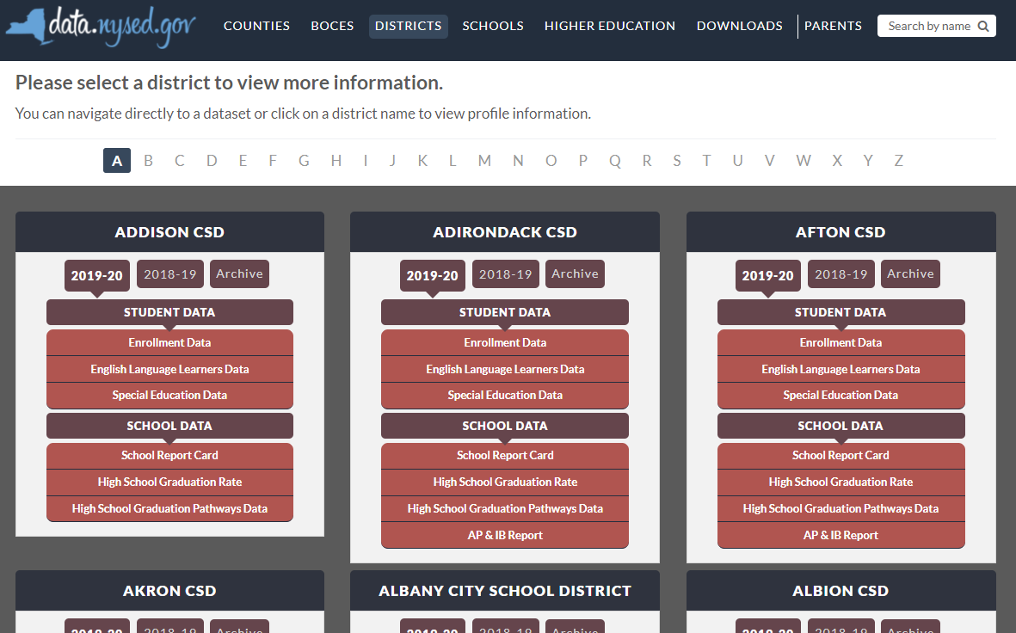
New York State School District SPP Data
Additional information on SPP Indicator data may be found in school district “Special Education Data” reports available at data.nysed.gov
Notes:
For additional information on how the SPP Indicator data impacts your school district, please visit data.nysed.gov.
In the “Districts” category on this webpage, you can view the Special Education Data reports under each school district. These reports are published annually for each individual school district and outline the district’s performance on the SPP Indicators.

Slide 31
Share Your Voice in our Online Survey
Each SPP Indicator has an online survey to collect input on NYS’s target-setting and/or improvement activities
The online surveys are intended to collect feedback from interested stakeholders. They are available for those who are not attending a virtual meeting or for those who have additional information to share beyond the virtual meetings
Please visit the SPP/APR webpage to submit your survey
Notes:
We greatly appreciate your feedback and ask that you visit our SPP/APR webpage (link provided in the slide).
We will use the survey information to collect input from those who have not attended a virtual meeting or for those who have additional information to share.
Each individual SPP Indicator will have its own survey and we encourage you to access all surveys that are of interest to you so that we can achieve our objective of meaningful stakeholder engagement. It is important to us to ensure that voices from diverse backgrounds are included in conversations about our students and we value multiple perspectives and viewpoints to inform our efforts.

Slide 32
THANK YOU for your contribution
Your Voice is Important to New York State’s Efforts to Improve Outcomes for our Students with Disabilities
Notes:
Thank you for your participation and contribution today. We greatly value your voice and input on our efforts to improve outcomes for students with disabilities in New York State.

