Slide 1






State Performance
Plan (SPP) 1/
Annual Performance Report (APR)
2020-2025
Individuals with Disabilities Education Act (IDEA)
General Overall Presentation – 2021; Indicator 1: Graduation Rate – 2021
Notes:
Welcome to the State Performance Plan (SPP) 1/Annual Performance Report (APR) 2020-2025 presentation.

Slide 2







Graduation Rate
AGENDA
ABOUT
INDICATOR 1
COMING
CHANGES
MEASURING
TRENDS
IMPROVEMENT STRATEGIES
STATE OF
THE STATE
COLLABORATION
Notes:
In this presentation, we will be discussing the State Performance Plan (SPP) Indicator 1, Graduation Rate, the percent of students with Individualized Education Programs (IEPs) who exit high school with a regular high school diploma.
As we advance through the slides, we will review measurement of the graduation rate, present trend and comparative data, and propose new State targets for graduation and consider improvement strategies.
The agenda is a roadmap for collaboration, providing opportunities to pose questions and determine future direction.

Slide 3
Frequently Used Terms in the Presentation
Term | Description
State Performance Plan or SPP | A six-year plan that the US Department of Education requires states to develop to improve its implementation of the IDEA
SPP Indicator | One of 17 measures that makes up a state’s six-year plan
Compliance Indicators | Focus on whether a specific requirement of IDEA was met. Targets are set at 0 or 100 percent
Results Indicators | Focus on student and family outcomes. Targets vary and are determined by each State
Annual Performance Report (APR) | A progress update under the SPP, prepared each year by NYSED and submitted to OSEP
Federal Fiscal Year or FFY | Federal Government Fiscal Year (October 1 – September 30)
SPP Indicator 1 | An SPP Indicator that measures the percent of youth with individual education programs (IEPs) graduating from high school with a regular diploma
Baseline | Data starting point to measure improvement over time
Targets | Performance Objectives set for SPP Measurements
Notes:
This slide is a list of key terms and definitions that appear in the presentation.
Let’s take a moment for you to familiarize yourselves with these terms.

Slide 4
Indicator 1 Measurement
Percent of youth with Individualized Education Programs (IEPs) graduating from high school with a regular diploma.
Data for this indicator are “lag” data.
The goal for this results indicator is an increase in the total number of graduates.
Notes:
Indicator 1, which measures the graduation rate, is a results indicator focusing on student outcomes with targets determined by each state.
The reporting year for the data corresponds to the federal fiscal year (FFY), which begins on October 1st and ends September 30th. The data reported for the FFY APR are considered lag data because it is the data from the school year before the federal fiscal year in question. The next slide illustrates an example of this process.

Slide 5
Explanation of Indicator 1 FFY Data in the Annual Performance Report (APR)
Data years presented will reflect the data NYSED submits to the federal Office of Special Education Programs (OSEP) in the APR which covers the federal fiscal year (FFY) period
2019-2020 School Year
The Indicator 1 school year data
The FFY 2020 APR is
submitted to OSEP
FFY 2020 APR
The 2019-20 School Year Data are
included in the FFY 2020 APR
February 2022
Notes:
For example, for Indicator 1, for the FFY 2020 APR, we submit graduation data from the 2019-20 school year and compare those results to a state determined target.

Slide 6
Data Collection
Graduation rate data for NYS are:
Collected annually for all students with IEPs
Reported in the subsequent annual report
Not sampled
Example:
SY 2020-21 Graduation Data Collected
SY 2020-21
Graduation Data Reported: 2022 APR
2022 APR Report
Shared with USDE
February 2023
2021
2022
2023
Notes:
This slide shows how we collect and report the data.
The New York State Student Information Repository System (SIRS) is the statewide mechanism for electronic collection of student data. Local Education Agencies (LEAs), including public school districts, charter schools, Religious and independent (nonpublic) schools, BOCES, the New York State School for the Deaf and the New York State School for the Blind, must use this system to report certain data, including graduation data, to NYSED.
The State must report graduation information for all its students with disabilities, not just a sample of students.

Slide 7

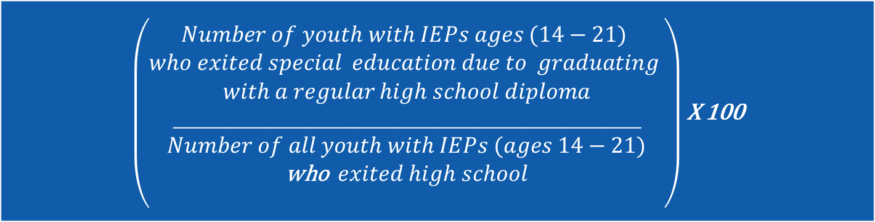
Graduation Rate: New Calculation
The new measurement is the percent of youth with IEPs exiting from high school with a regular high school diploma.
The new calculation will be used beginning FFY 2020.
This is based on the data used for reporting under IDEA.
$\left(\begin{aligned}\# \\ \#\#\#\#\#Number of youth with IEPs ages (14−21) \\ who exited special education due to graduating \\ with a regular high school diploma \\ _______________________________________________________ \\ Number of all youth with IEPs (ages 14−21) \\ \text{who} exited high school \\ \end{aligned}\right)$ X 100
Notes:
Beginning with FFY 2020, Indicator 1 measures the number of students with disabilities who graduated from high school in a single year. The number of students with disabilities who graduated in a single year is divided by the total number of students with disabilities who exited special education due to graduating with a regular high school diploma, receiving a certificate, dropping out or reaching maximum age, in a single year. Prior to FFY 2020, we reported graduation data based on a cohort of all students with disabilities who entered grade 9 together and of those students, the ones who graduated during the next four years of high school.
The new methodology for graduation is not directly comparable to the prior methodology because the new methodology looks at students who exited special education in a single year of data rather than looking at a group of students and their outcomes over a four-year time span. The rationale for OSEP to change to this methodology is that it offers a single, standard measure that allows comparison of graduation rates across all states. The prior methodology was not consistent across states.
The new methodology results in higher graduation rates. Under the new methodology, the numerator is larger because it includes any student who graduated in the year rather than only the students in the cohort of students who entered grade 9 together. The single year numerator may include students who are older or younger than the students in a particular cohort. In addition, the denominator is smaller because it only includes students exiting high school for specific reasons in a single year. The cohort methodology includes all students with disabilities who entered grade 9 together.
This calculation is based on data used for reporting to the U.S. Department of Education under section 618 of the Individuals with Disabilities Education Act (IDEA).

Slide 8




Facilitator check for understanding:
Are there any questions on the SPP measurement or how the data are used to measure results ?
Notes:
Are there any questions on the SPP measurement or how the data are used to measure results?

Slide 9

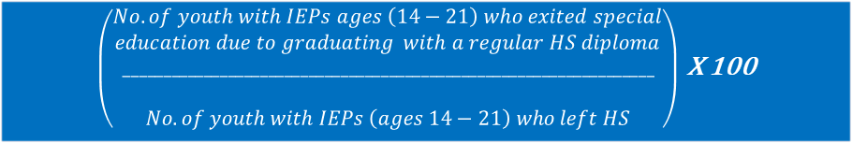
What Does This Change Look Like?
$\left(\begin{aligned}\begin{aligned}No. of youth with IEPs in the current year^{′}s \\ adjusted cohort graduating with a regular diploma \\ ____________________________________________________________ \\ No. of youth with IEPs in the current year^{′}s\end{aligned} \\ adusted cohort eligible to graduate\end{aligned}\right)$ X 100
$\left(\begin{aligned}No. of youth with IEPs ages \left(14−21\right) who exited special \\ education due to graduating with a regular HS diploma \\ __________________________________________________________________ \\ \\ No. of youth with IEPs \left(ages 14−21\right) who left HS\end{aligned}\right)$ X 100
Notes:
The blue line in the prior year’s calculation chart shows the targets for graduation for the 2015 through 2018 school years. It is important to remember that these targets were set using the prior methodology that will not be used in the future.
Actual performance of students with disabilities (red line) in the prior year’s calculation chart shows that we did not meet the targets for the 2015 through 2018 school years.
The new calculation chart represents what data for school years 2015 through 2018 looks like when using the new calculation. You can see that the new calculation results in higher percentages for the graduation rate (green line).
The new methodology results in higher graduation rates. Under the new methodology, the numerator is larger because it includes any student who graduated in the year rather than only the students in the cohort of students who entered grade 9 together. The single year numerator may include students who are older or younger than the students in a particular cohort. In addition, the denominator is smaller because it only includes students exiting high school for specific reasons in a single year. The cohort methodology includes all students with disabilities who entered grade 9 together.
The new methodology for graduation is not directly comparable to the prior methodology.

Slide 10
Graduation Rates by Subgroup
Students With Disabilities Exiting Special Education
2019-20 SY
Notes:
This slide shows data for students with disabilities in the 2019-20 school year by subgroup, using the new methodology of students with disabilities who exited special education in a single year.
The green bar shows the graduation rate for the subgroup. This is the number of students in the subgroup who graduated as a percentage of all students in the subgroup who exited high school in the 2019-20 school year.
The graduation rates for these subgroups are of concern. As we move forward to seek stakeholder input on improvement activities, keep this data in mind so the activities may be designed to improve the performance for these groups.
Please note that data for all subgroups are not shown. Subgroups with graduation rates greater than 80% are not displayed.
The source for the data presented above is the 2019-20 EDFacts FS009 Data File.

Slide 11
Data Questions
What questions do you have about the data?
What did the SPP data tell us?
How should we use the data to inform our target-setting and improvement activities?
Notes:
What questions do you have about the data?
What did the SPP data tell us? How should we use the data to inform our target-setting and improvement activities?

Slide 12

Office of Special Education Educational Partnership Tiered Support & Professional Development
12 Regional Partnership Centers
14 School-Age Family and Community Engagement Centers
14 Early Childhood Family and Community Engagement Centers
Systems Change Work Providing a Variety of Supports to Educational Organizations in New York State
Regional Learning
Targeted Skills/Support Groups
Support Plans
1
2
3
Notes:
The OSE Educational Partnership is a special education professional development network located in Regional Teams across the State. Regional Teams are comprised of a Regional Partnership Center that has specialists who provide professional development in a range of disciplines including behavior, transition, culturally responsive education, literacy and specially designed instruction, a school aged Family and Community Engagement Center that has specialists with expertise supporting parents and families of school-aged students with disabilities and an early childhood Family and Community Engagement Center that supports parents and families of preschool students with disabilities.
These Regional Teams provide professional development to stakeholders including parents and families as well as schools, including preschools, that serve student with disabilities.
The Regional Teams offer three tiers of support:
Regional Learnings are offered to all educational organizations and/or parents and families of students with disabilities in a region. The training may be offered in-person and/or virtually and there are training topics in all areas of special education.
Targeted Skills Groups are provided to groups of schools that have a similar performance or compliance issue that requires more intensive professional development and targeted assistance.
Support Plans are the most intensive level of support that includes embedded support from one or more specialists from the Regional Team provided directly into the identified schools.
In the next slide, we will take a look at trainings currently offered by the Educational Partnership related to our Indicator.

Slide 13
Improvement Activities – OSE Educational Partnership
Available Professional Development and Trainings
CDOS Module 2: Learning Standards Self Determination Training
CDOS Module 3: Work-Based Learning Student-Directed IEPs for Professionals
Diploma and Credential Options Standards Based IEPs
Transition Assessment Training Creating the IEP
Transition in the IEP NYSAA 1% TSG Foundational Content
Transition for Families Specially Designed Instruction
Family Engagement: Communication & Culture Next Steps in SDI
What Does It Mean to Be Culturally Responsive Best Practices in Academic Progress Monitoring
Fundamentals in Equity:
Exploring Equity and Cultural Responsiveness
Notes:
Here is a list of trainings currently offered by the Educational Partnership that are related to our Indicator, including transition, diploma and credential options, and career development and occupational studies, or CDOS.

Slide 14

Improvement Activities – SEQA
NYSED’s Special Education Quality Assurance (SEQA) Regional Offices conduct Coordinated Intervention District Reviews on secondary transition
Transition self-reviews are required for all of NYS
SEQA’s New York City Regional Office conducts a collaborative transition review with the New York City Department of Education (NYCDOE)
NYSED also requires identified school districts to adopt evidence-based practices, all of which have the potential outcomes for students with disabilities. Some of these, such as Early Warning Intervention and Monitoring Systems and aligning coursework to secure post-secondary success, directly linked to dropout prevention and improved graduation rate and other ongoing work supported by OSE and SEQA.
Notes:
For the IDEA (Individuals with Disabilities Education Act) Determination Districts, SEQA Regional Associates may conduct a Coordinated Intervention District (CID) Review. The CID review helps ensure that school districts are developing quality IEPs with respect to secondary transition, parents are provided with written information explaining graduation requirements; and informing parents that once their child graduates with a regular diploma they are no longer eligible for a free and appropriate public education (FAPE).
NYSED requires school districts to conduct self-reviews of the regulatory requirements regarding transition planning in the IEP; schools independently apply their understanding of the transition requirements during review of students’ IEPs.
In NYC, schools and district leaders participate in a collaborative transition review with SEQA Regional Associates; schools have an opportunity to engage in discussion regarding the standard for transition requirements in the Individualized Education Program (IEP); schools apply the standard of the transition requirements by correction of the IEPs determined not to have met the regulatory standard.
Evidence-based practices such as Early Warning Intervention and Monitoring Systems and aligning coursework to secure post-secondary success for students with disabilities support improved graduation rates.
These monitoring and improvement activities are designed to ensure students with disabilities, their families and school communities are informed of the requirements and pathway options available to achieve a high school diploma.

Slide 15
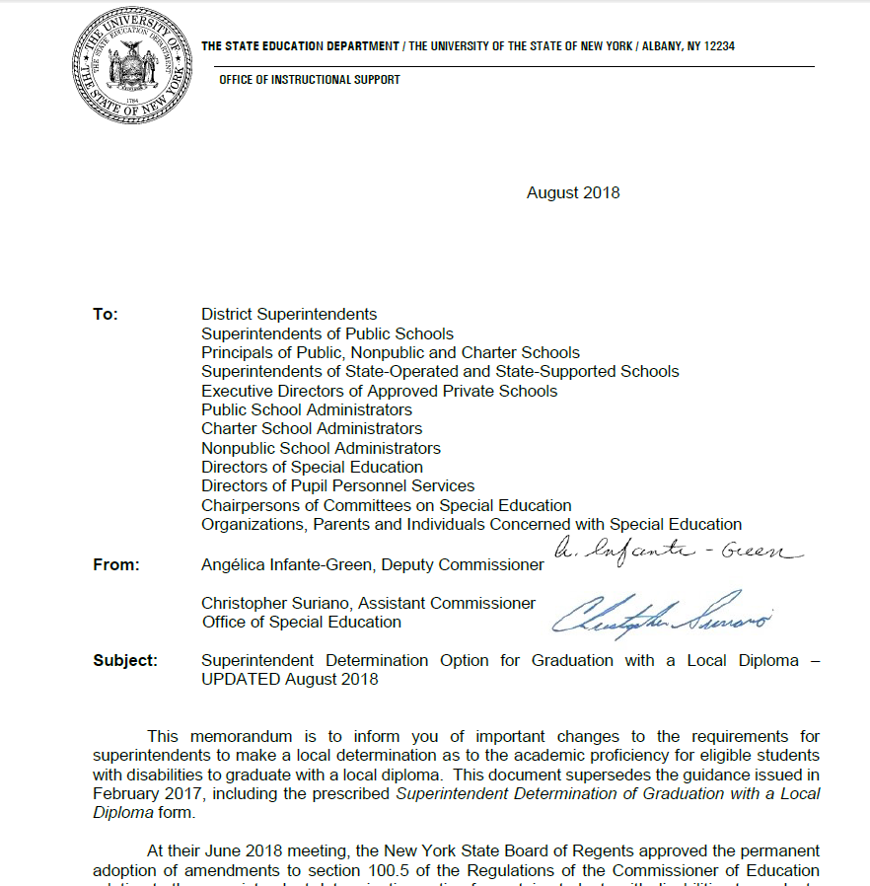
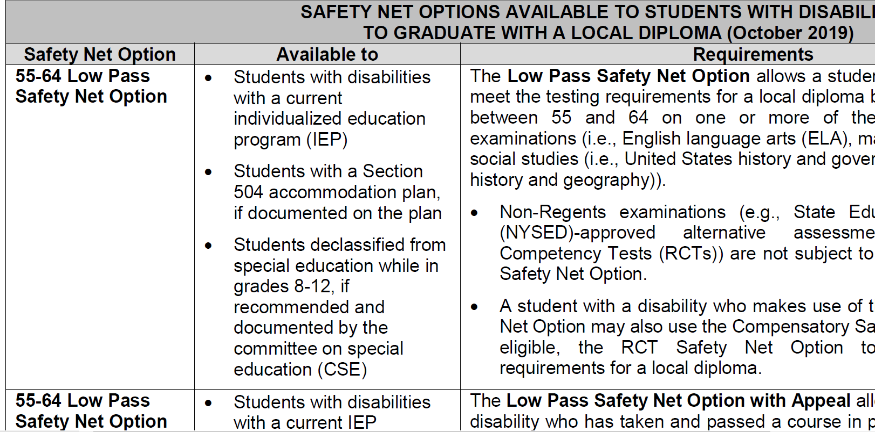
Improvement Activities - OSE
Office of Special Education (OSE) establishes regulatory standards and diploma options for students with disabilities
Safety Net options established for students with disabilities
Superintendent Determination Option introduced
Notes:
The policies from the Office of Special Education (OSE) establish the regulatory standards and diploma options available to students with disabilities.
Students with disabilities have safety net options available to meet testing requirements for a local high school diploma.
There are four safety net options available to students with disabilities to graduate with a local high school diploma.
The Superintendent Determination Option allows a superintendent (or the principal/head of school of a registered nonpublic school or charter school, as applicable) to make a local determination that a student with a disability has otherwise met the standards for graduation with a local high school diploma when such student has not been successful, because of their disability, at demonstrating proficiency on one or more of the Regents examinations required for graduation.
Additional information about the safety net options and Superintendent Determination Option are accessible via the links in the slide.

Slide 16
Improvement Activities:
Pathways to Graduation
In the “4+1” pathway assessments option, students must take and pass four required Regents Exams or Department-approved alternative assessments (one each in English language arts, mathematics, science, and social studies) and complete a comparably rigorous pathway to meet the fifth assessment requirement for graduation.
Multiple pathways approved in 2015 and 2016 are in areas of student interest such as the Arts, World Languages, Humanities, Career and Technical Education (CTE), Career Development and Occupational Studies (CDOS) and Science, Technology, Engineering and Mathematics (STEM).
In addition, the Board of Regents approved the Civic Readiness Pathway as a pilot project to be implemented in selected schools as of September 2021.
http://www.nysed.gov/common/nysed/files/programs/curriculum-instruction/multiplepathwayshandout.pdf
Notes:
Since 2015, multiple pathways to a diploma have been created. The Board of Regents approved a pilot project for the Civic Readiness Pathway to be implemented in select schools beginning in September 2021. It will join the existing 4+1 pathways to a diploma, in the areas of student interest listed above, which allow students to replace one Regents examination with content area requirements; in this case, civic knowledge and participation.
Additional information about the pathways to graduation is accessible via the link in the slide.

Slide 17
Proposed Improvement Activities
Conduct a SEQA Review focusing on implementation of the coordinated set of transition activities/services on students’ Individualized Education Programs (IEPs)
Conduct educational workshops for families on topics such as diploma and credential options, transition, etc.
Conduct additional outreach to parent groups (e.g., monthly informational zoom meetings or newsletters on these and other topics)
Notes:
This slide shows some additional improvement activities that NYSED is recommending to improve the graduation rate for students with disabilities. We look forward to your feedback on these and any others you may suggest.

Slide 18
Improvement Activity Questions
What activities could be considered, maintained, or strengthened to address improvements in this area?
Notes:
What activities could be considered, maintained, or strengthened to address improvements in this area?

Slide 19
Setting Targets
Step 1
New Baseline
Selection
Step 3
Consider Methodology for Target Setting
Step 4
Propose New Targets
Step 5
Obtain Stakeholder Input
Step 2
Analyze Data
New targets are needed
Targets must be rigorous and achievable
Final targets must be higher vs. baseline
Notes:
To establish new targets, we need to select a new baseline, analyze data from past years, choose a method for target setting and obtain input on the targets we propose.

Slide 20
Proposed Targets: Indicator 1
SY 2015 – 2018 Average Performance 68%
SY 2018-19 (Baseline) | SY 2019-20 | SY 2020-21 | SY 2021-22 | SY 2022-23 | SY 2023-24 | SY 2024-25
69.33% | +0.67 | +1 | +1 | +1 | +1 | +1
Target Setting Methodology
Exceeding Prior Performance (2015 – 2018) by +7 percentage points
Improvement Over Baseline
Provides Steady Progress
Notes:
This slide shows the targets NYSED is proposing to use for the 2020-25 SPP/APR.
Due to the unpredictability of the impact of COVID-19, NYSED is proposing to base targets on pre-COVID performance, taking into consideration the application of the new measurement.
NYSED is proposing to set a baseline of 69.33% and then set incremental targets for improvement each year of the six-year cycle. The proposed targets increase by 0.67% the first year and then 1% each of the remaining years.

Slide 21
Targets must show improvement over baseline and be rigorous but achievable.
Do you feel the proposed targets are too high, too low, or just right?
Notes:
Targets must show improvement over baseline and be rigorous but achievable. Do you feel that the proposed targets are too high, too low, or just right?

Slide 22
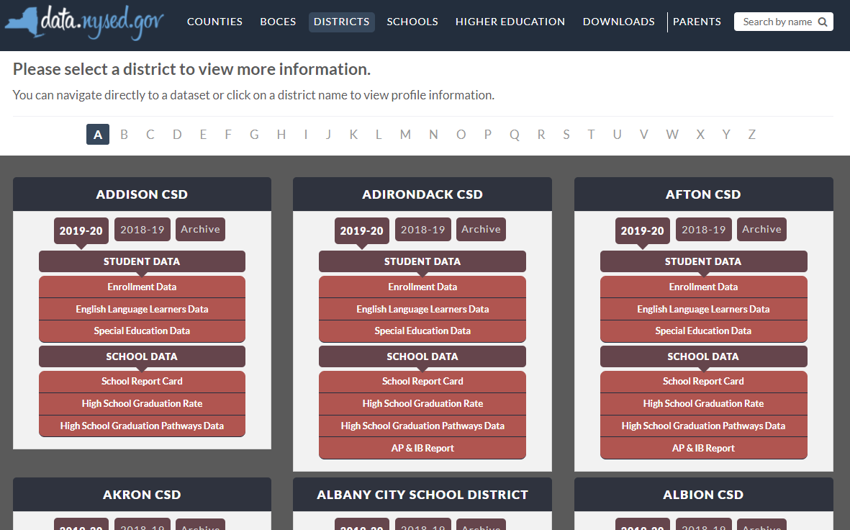

New York State School District SPP Data
Additional information on SPP Indicator data may be found in school district “Special Education Data” reports available at data.nysed.gov
Notes:
For additional information on how the SPP Indicator data impact your school district, please visit data.nysed.gov.
In the “Districts” category on this webpage, you can view the Special Education Data reports under each school district. These reports are published annually for each individual school district and outline the district’s performance on the SPP Indicators.

Slide 23

Share Your Voice in our Online Survey
Each SPP Indicator has an online survey to collect input on NYS’s target-setting and/or improvement activities
The online surveys are intended to collect feedback from interested stakeholders. They are available for those who are not attending a virtual meeting or for those who have additional information to share beyond the virtual meetings
Please visit the SPP/APR webpage to submit your survey
Notes:
We greatly appreciate your feedback and ask that you visit our SPP/APR webpage (link provided in the slide).
We will use the survey information to collect input from those who have not attended a virtual meeting or for those who have additional information to share.
Each individual SPP Indicator will have its own survey and we encourage you to access all surveys that are of interest to you so that we can achieve our objective of meaningful stakeholder engagement. It is important to us to ensure that voices from diverse backgrounds are included in conversations about our students and we value multiple perspectives and viewpoints to inform our efforts.

Slide 24






THANK YOU for your contribution
Your Voice is Important to New York State’s Efforts to Improve Outcomes for our Students with Disabilities
Notes:
Thank you for your participation and contribution today. We greatly value your voice and input on our efforts to improve outcomes for students with disabilities in New York State.

