Slide 1
List of Sections
1. Introduction
2. The Getting Started Worksheet
3. Multi-Year MOE Summary Worksheet—Historical Data
4. 15-16 Amounts Worksheet
5. 15-16 MOE Worksheet
6. 15-16 Exc & Adj Worksheet: Exception (a)
7. 15-16 Exc & Adj Worksheet: Exception (b)
8. 15-16 Exc & Adj Worksheet: Exception (c) and Exception (d)
9. 15-16 Exc & Adj Worksheet: Exception (e)
10. 15-16 Exc & Adj Worksheet: MOE Adjustment
11. 14-15 Exc & Adj Worksheet
12. Return to 15-16 MOE Worksheet
13. Multi-Year MOE Summary Worksheet—Current Year Data
14. Conclusion
Notes:
This presentation consists of fourteen sections.
The sections build on each other to walk a user through completion of the calculator from beginning to end.
We’ll start with entering some basic set-up information and historical data, then entering data for 2015–16 that will show whether your LEA meets MOE without exceptions and adjustments. We’ll then work through each of the exceptions and adjustments, and return to the 15-16 calculations to see how these affect the LEA’s MOE amounts and determinations. We’ll end up looking at a multi-year summary of LEA MOE information.

Slide 2
Introduction
What is Local Educational Agency Maintenance of Effort?
The local maintenance of effort (MOE) requirement obligates any local educational agency (LEA) receiving IDEA Part B funds to budget and spend at least the same amount of local — or state and local — funds for the education of children with disabilities on a year-to-year basis (see textbox for regulatory language). The required MOE levels for budgeting and spending are referred to, respectively, as the “eligibility standard” and the “compliance standard.”

Slide 3
Introduction
Eligibility Standard - 34 CFR §300.203(a)(1)
For purposes of establishing the LEA's eligibility for an award for a fiscal year, the SEA must determine that the LEA budgets, for the education of children with disabilities, at least the same amount, from at least one of the following sources, as the LEA spent for that purpose from the same source for the most recent fiscal year for which information is available: (i) Local funds only; (ii) The combination of State and local funds;(iii) Local funds only on a per capita basis; or (iv) The combination of State and local funds on a per capita basis.
The past method that NYS Education Department (NYSED) required LEAs to comply with the Eligibility Standard in our IDEA LEA application was not in compliance. To comply with the Eligibility Standard, beginning with the 2017-18 IDEA application, LEAs will be required to complete the LEA MOE calculator described later in this presentation.
Notes:
Pages 5 & 6 of last years application is the method that LEAs were required to complete to meet the Eligibility Standard for LEA MOE.
Click link below to review last years IDEA grant application:
http://www.p12.nysed.gov/specialed/finance/2016-17-idea-application.html

Slide 4
Introduction
Compliance Standard - 34 CFR §300.203(b)(2)
An LEA meets the compliance standard if it does not reduce the level of expenditures for the education of children with disabilities made by the LEA from at least one of the following sources below the level of those expenditures from the same source for the preceding fiscal year, except as provided in §§ 300.204 and 300.205: (i) Local funds only; (ii) The combination of State and local funds; (iii) Local funds only on a per capita basis; or (iv) The combination of State and local funds on a per capita basis.
NYSED has never required LEAs to meet the Compliance Standard. Due to this fact, NYSED is not in compliance with the State Educational Agencies general supervisory responsibilities in 34 CFR 300.149.
To address this non-compliance, LEAs will be required to complete the Compliance Standard component of the LEA MOE Calculator for the 2013-14, 2014-15, and 2015-16 school year. Details on how to complete the Calculator will be described later in the presentation.

Slide 5
Introduction
Allowable exceptions to MOE - 34 CFR §300.204
An LEA may reduce its MOE obligation for budgeting or expenditures if there is an allowable exception. Allowable exceptions are those due to a) voluntary or for-cause departure of special education staff, b) decrease in enrollment of IDEA-eligible children, c) termination of an exceptionally costly program for a particular child, under certain circumstances, d) termination of costly expenditures for long-term purchases, and e) assumption of cost by its SEA’s high-cost fund.
An LEA may reduce its budget for the education of children with disabilities if it anticipates an allowable exception in the coming school year, such as the expected retirement of a staff member. However, by reducing its budget in anticipation of an allowable exception later in the year, an LEA puts itself at risk of budgeting less than it will ultimately need to meet MOE, should the expected exception not occur.
These allowable exceptions to MOE are described later in this presentation because they are part of The Calculator.

Slide 6
Introduction
Adjustments to local fiscal efforts in certain fiscal years - 34 CFR 300.205
An LEA may reduce its MOE obligation by up to 50 percent of any increase over the preceding year in its IDEA Part B Section 611 allocation . That is, if an LEA receives more IDEA Section 611 funds than it received for the previous fiscal year, it may reduce its state and/or local contributions by up to 50 percent of the amount of the increase. To adjust its MOE obligation in this manner, an LEA must ensure that it provides FAPE for children with disabilities; NYSED must determine that the LEA “meets requirements” of the IDEA Part B; NYSED must not have taken action against the LEA under IDEA Section 616; and the LEA must not have been identified as having significant disproportionality based on race or ethnicity with respect to identification of children as children with disabilities, including identification as children with particular impairments, placement in particular educational settings, or the incidence, duration, and type of disciplinary actions.
LEAs are also permitted to voluntarily use up to 15 percent of IDEA Part B Sections 611 and 619 funds to provide coordinated early intervening services (CEIS). These are services provided to children who are not currently identified as needing special education or related services, but who need additional academic or behavioral support to succeed in general education. If an LEA chooses to take advantage of both provisions — using funds for CEIS and reducing its MOE obligation by up to 50 percent of its IDEA Section 611 funding increase — the combined total of Part B funds used under both provisions cannot exceed the lesser of the maximum dollar amounts available for either CEIS (15 percent of Sections 611 and 619 funds) or MOE reduction (50 percent of the increase in Section 611 funds). Please see CIFR’s guide on CEIS (http://cifr.wested.org/resources/ceis/) for more information.
These allowable adjustments to MOE are described later in this presentation because they are part of The Calculator.

Slide 7
Using
The Local Educational Agency (LEA)
Maintenance of Effort (MOE) Calculator
Notes:
NOTE: Use this version of this section if you want your LEAs to use an SEA-approved method for calculating exception (b) and manually enter those calculations.

Slide 8

Purpose of the LEA MOE Calculator
The purpose of the LEA MOE Calculator is to help state educational agencies (SEAs) and LEAs to:
Document local, or state and local, fiscal effort in an LEA for the education of children with disabilities.
Determine whether that effort meets the IDEA’s LEA MOE requirements (34 CFR §300.203).
Notes:
Under the IDEA LEA MOE requirement, each LEA is required to budget and expend at least the same amount of funds for the education of children with disabilities as it spent in the previous year. LEAs must meet an eligibility standard — by budgeting at least the same amount as in the previous year — and a compliance standard — by expending at least the same amount as in the previous year.
IDEA permits LEAs to meet each standard by any of four methods: total local funds, total state and local funds, local funds per capita, or state and local funds per capita.
CIFR developed the LEA MOE Calculator to assist LEAs in meeting that requirement by providing a tool to:
Document amounts of fiscal effort in an LEA for the education of children with disabilities using local funds only or the combination of State and local funds, and
Determine whether that effort met the IDEA’s LEA MOE requirements.

Slide 9
Getting Started Worksheet
TAB 3 of the Calculator
Please provide information for questions 1-7:
LEA Name (Insert District Name)
LEA ID (Agency CODE)
Start of State Fiscal Year (month and day) (07/01)
End of State Fiscal Year (month and day) (6/30)
Are you able to separately account for the budgeting and expenditures of local funds and state funds from 2013-14 to the present year. There is a drop down box in cell B6. Answer should be YES
Would you like the spreadsheet to calculate Exceptions (b) (decrease in child count) for you? There is a drop down box in cell b7. Answer is Yes
Does your state have a high cost funds operated by SEA under 300.704(c)? Answer is NO for all years

Slide 10
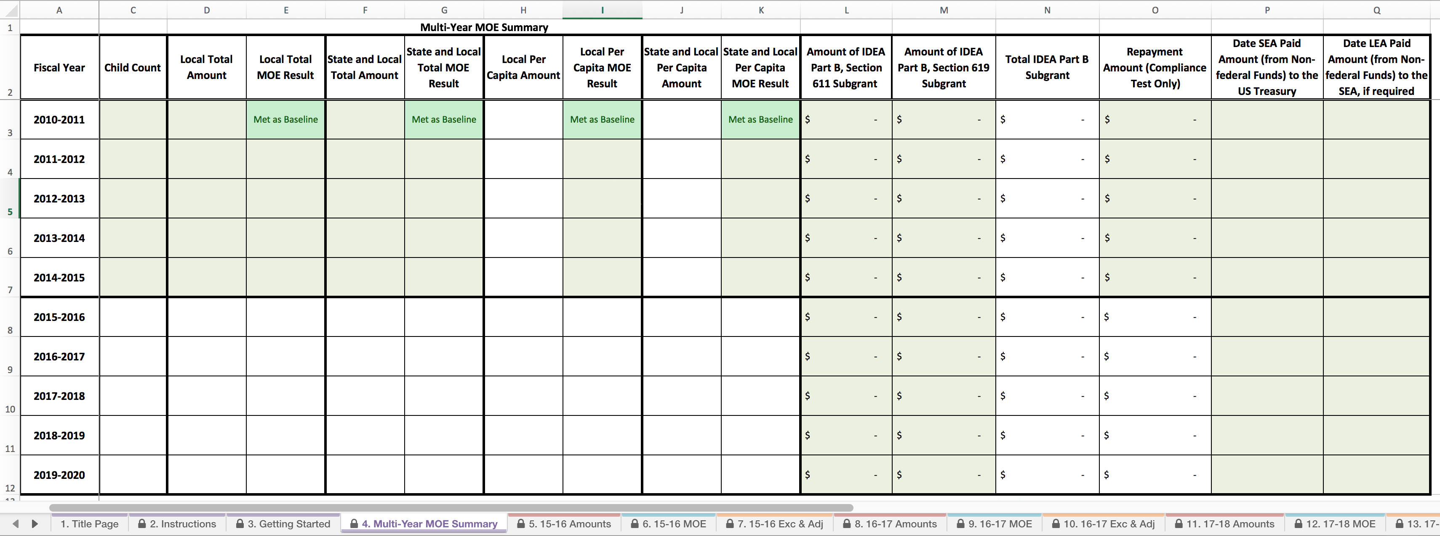
Multi-Year MOE Summary Worksheet
Tab 4 of the Calculator
This sheet is a summary of the LEA’s fiscal efforts from FYs 2010–11 through 2019–20.
LEAs must enter information for only school years 2013-14 and 2014-15 on this worksheet.
DO NOT delete any
Rows on this
Worksheet. Leave
Years 2010-2013
Blank.

Slide 11
Multi-Year MOE Summary Worksheet
Tab 4 of the Calculator
Notes:
In the green cells of the Multi-Year MOE Summary Worksheet, you will enter summary historical MOE data for your LEA. We will show you how.
COMPLETE THIS SUMMARY FOR YEARS 2013-14 and 2014-15 AND ALL METHODS. Do not delete any columns or rows from this worksheet.

Slide 12

Enter Child Counts
Tab 4 of the Calculator
1000
990
1050
1100
1070
Notes:
NYSED has determined the baseline year is 2013-14. DO NOT include any information in Cells C3 to C5.
In Cells C6 to C7, please enter your child counts for the years listed in column A.
The data is also posted on http://www.p12.nysed.gov/sedcar/state.htm under school -age student reports - By Enrollment, Classification Rate and School District.
Districts certify their Student with Disabilities count (those receiving services in the first Wednesday in October) during January. Districts certify online the VR 1-6 & VR 8 report, which are certified through the SED Business Portal.

Slide 13
Enter Expenditure Amounts
Tab 4 of the Calculator
1000
$
500,000.00
$
1,000,000.00
$
500.00
$
1,000.00
990
$
500,000.00
$
1,050,000.00
$
505.05
$
1,060.61
1050
$
500,000.00
$
950,000.00
$
476.19
$
904.76
1100
$
500,000.00
$
900,000.00
$
454.55
$
818.18
1070
$
500,000.00
$
850,000.00
$
467.29
$
794.39
Notes:
In Cells D6 and D7, please enter the amounts of fiscal effort for special education and related services in your LEA using local funds only.
In Cells F6 and F7, please enter the amounts of fiscal effort for special education and related services in your LEA using the combination of State and local funds.
DO NOT enter information for Fiscal Years 2010-11, 2011-12, or 2012-13.

Slide 14
Note Per Capita Amounts
Tab 4 of the Calculator
1000
$
500,000.00
$
1,000,000.00
$
500.00
$
1,000.00
990
$
500,000.00
$
1,050,000.00
$
505.05
$
1,060.61
1050
$
500,000.00
$
950,000.00
$
476.19
$
904.76
1100
$
500,000.00
$
900,000.00
$
454.55
$
818.18
1070
$
500,000.00
$
850,000.00
$
467.29
$
794.39
Notes:
In Cells H6 to H7, the Calculator will show local per capita amounts based on the child count and local amounts YOU have entered.
In Cells J6 to J7, the Calculator will show state and local per capita amounts based on the child count and local amounts YOU have entered.

Slide 15
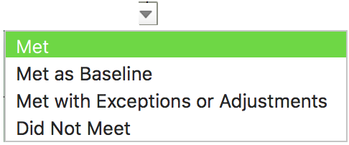
Select MOE Compliance Results
Tab 4 of the Calculator
1000
$
500,000.00
$
1,000,000.00
$
500.00
$
1,000.00
990
Met
Met
Met
Met
$
500,000.00
$
1,050,000.00
$
505.05
$
1,060.61
Met
Met with
Exceptions or
Adjustments
Did Not Meet
Did Not Meet
1050
$
500,000.00
$
950,000.00
$
476.19
$
904.76
1100
Met
Did Not Meet
$
454.55
Did Not Meet
$
818.18
Did Not Meet
$
500,000.00
$
900,000.00
Met
Did Not Meet
Did Not Meet
Did Not Meet
1070
$
500,000.00
$
850,000.00
$
467.29
$
794.39
Notes:
For each of these historical years, and for each method, please choose the correct MOE result from the drop-down menu.
2013-14 – For each method where information is included, the MOE result is Met as Baseline

Slide 16


Auto-calculated data
V1.0. DRAFT ONLY
1000
$
500,000.00
$
1,000,000.00
$
500.00
$
1,000.00
990
Met
Met
Met
Met
$
500,000.00
$
1,050,000.00
$
505.05
$
1,060.61
Met
Met with
Exceptions or
Adjustments
Did Not Meet
Did Not Meet
1050
$
500,000.00
$
950,000.00
$
476.19
$
904.76
FYs 2015–16 through 2019–20 will be auto-calculated based on data entered later.
1100
Met
Did Not Meet
$
454.55
Did Not Meet
$
818.18
Did Not Meet
$
500,000.00
$
900,000.00
Met
Did Not Meet
Did Not Meet
Did Not Meet
$
500,000.00
$
850,000.00
$
467.29
Did Not Meet
$
794.39
1070
500,000.00
$
1,000.00
1000
$
$
1,000,000.00
$
500.00
990
Met
Met
Met
Met
$
500,000.00
$
1,050,000.00
$
505.05
$
1,060.61
Met
Met with
Exceptions or
Adjustments
Did Not Meet
Did Not Meet
1050
$
500,000.00
$
950,000.00
$
476.19
$
904.76
1100
Met
Did Not Meet
$
454.55
Met
$
818.18
Did Not Meet
$
500,000.00
$
900,000.00
Met
Did Not Meet
Met
Did Not Meet
1070
$
500,000.00
$
850,000.00
$
467.29
$
794.39
Notes:
Fiscal Years 2015–16 through 2019–20 will be auto-calculated based on data entered later.

Slide 17
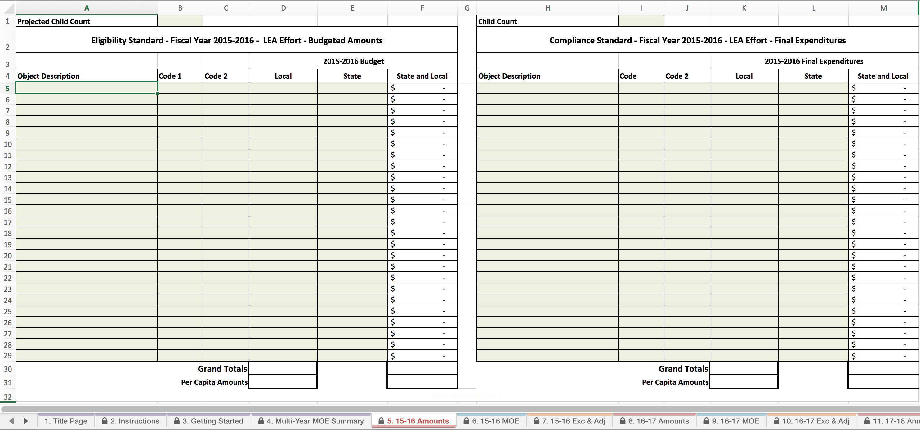
15-16 Amounts Worksheet
Tab 5 of the Calculator
This sheet is for recording the LEA’s fiscal effort.
For 2015–16 Compliance, LEAs will enter final expenditure data in the table on the right.
Notes:
The Amounts tab is for recording your LEA’s effort. Since we are working on the compliance standard for 2015–16, we will enter expenditure data.

Slide 18
15-16 Amounts Worksheet
Tab 5 of the Calculator
Notes:
We are doing the Compliance Standard for 2015-16

Slide 19
Entering Child Count Data
Tab 5 of the Calculator
1072
Notes:
Start by entering the child count for 2015–16.
The data is also posted on http://www.p12.nysed.gov/sedcar/state.htm under school -age student reports - By Enrollment, Classification Rate and School District.

Slide 20
Entering Expenditure Data
Tab 5 of the Calculator
1072
Special Ed Personnel-Salaries
1010
$
400,000.00
$
200,000.00
600,000.00
Special Ed Personnel-Benefits
1020
$
50,000.00
$
50,000.00
100,000.00
Transportation
4201
$
20,000.00
$
10,000.00
30,000.00
Special Education Materials
5200
$
50,000.00
$
20,000.00
70,000.00
General Special Education
5999
$
80,000.00
$
45,000.00
125,000.00
$
600,000.00
$
925,000.00
$
559.70
$
862.87
Notes:
The headers for the first three columns (Object Description, Code 1, and Code 2) are editable. LEAs can edit these columns to meet your LEAs need.
Use the blank rows to enter your LEA’s local and state expenditures. Use one row for each item. The spreadsheet will calculate a state and local total for you.

Slide 21
Grand Totals for 15-16
Tab 5 of the Calculator
1072
Special Ed Personnel-Salaries
1010
$
400,000.00
$
200,000.00
600,000.00
Special Ed Personnel-Benefits
1020
$
50,000.00
$
50,000.00
100,000.00
Transportation
4201
$
20,000.00
$
10,000.00
30,000.00
Special Education Materials
5200
$
50,000.00
$
20,000.00
70,000.00
General Special Education
5999
$
80,000.00
$
45,000.00
125,000.00
$
600,000.00
$
925,000.00
$
559.70
$
862.87
Notes:
The spreadsheet will calculate grand totals for local only and state and local expenditures.

Slide 22
Per Capita Amounts for 15-16
Tab 5 of the Calculator
1072
Special Ed Personnel-Salaries
1010
$
400,000.00
$
200,000.00
600,000.00
Special Ed Personnel-Benefits
1020
$
50,000.00
$
50,000.00
100,000.00
Transportation
4201
$
20,000.00
$
10,000.00
30,000.00
Special Education Materials
5200
$
50,000.00
$
20,000.00
70,000.00
General Special Education
5999
$
80,000.00
$
45,000.00
125,000.00
$
600,000.00
$
925,000.00
$
559.70
$
862.87
Notes:
The spreadsheet will calculate a per capita amount for local only and state and local expenditures, using the child count you entered above.

Slide 23
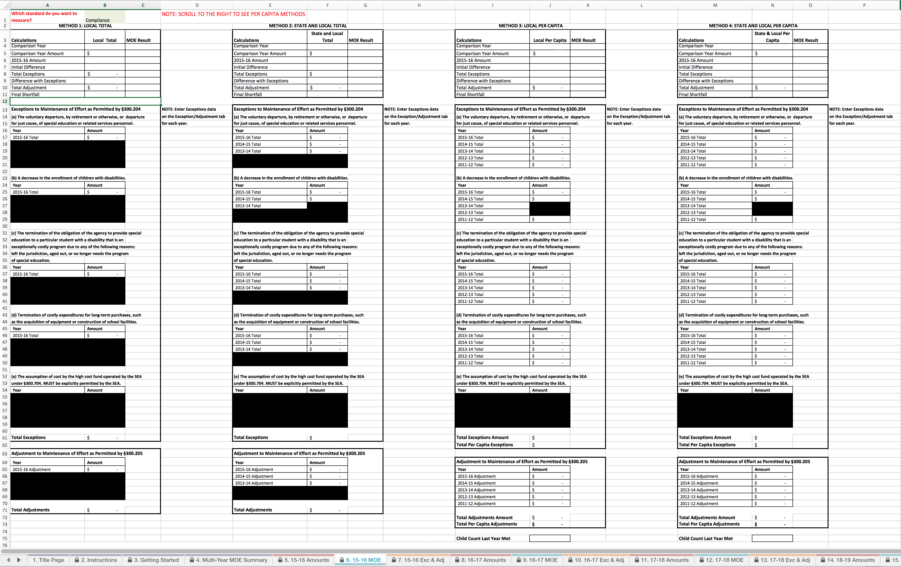
15-16 MOE Worksheet
Tab 6 of the Calculator
This worksheet uses data entered on other sheets to calculate whether the eligibility and compliance standards have been met.
In our sample so far, we have entered the final expenditures amounts, but not the exceptions or adjustments.
Notes:
The 15-16 MOE Worksheet draws on information entered so far on the Getting Started Worksheet and 15-16 Amounts Worksheet to determine whether your LEA has met MOE without exceptions or adjustments.

Slide 24
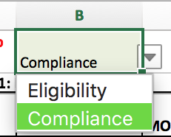
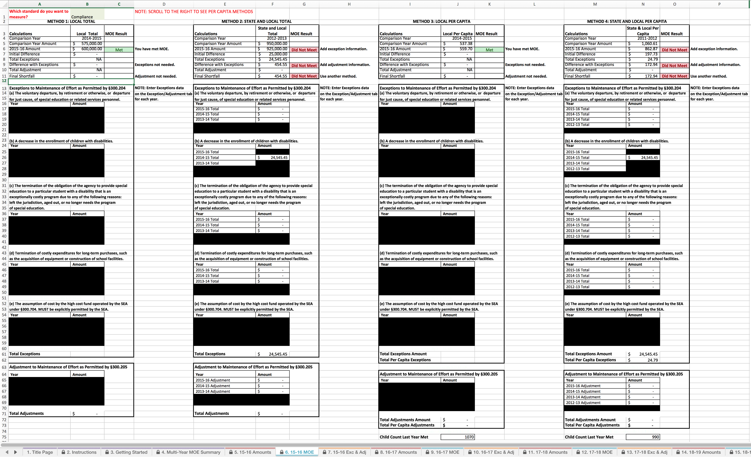
15-16 MOE Worksheet
Tab 6 of the Calculator
Notes:
First, select whether the Compliance or Eligibility standard is being measured. We are working on the Compliance standard for 2015–16, so please be sure “Compliance” is selected here.

Slide 25
15-16 MOE Worksheet
Tab 6 of the Calculator
Notes:
This worksheet calculates MOE for all four methods, although your LEA does not need to meet MOE by all four methods.

Slide 26
15-16 MOE Worksheet – Method 1: Local Total
Notes:
Let’s look at the Local Total method in the sample.

Slide 27
15-16 MOE Worksheet – Method 1: Local Total
Notes:
First, the Calculator determines the Comparison Year for each method, determined by the most recent year in which the LEA met the MOE compliance standard for that method. This information is obtained from the Multi-Year MOE Summary worksheet.

Slide 28
15-16 MOE Worksheet – Method 1: Local Total
Notes:
The Calculator also determines the Comparison Year Amount, which is the amount needed to meet MOE by this method.

Slide 29
15-16 MOE Worksheet – Method 1: Local Total
Notes:
The Calculator pulls in your LEA’s Local Total amount from the data you entered on the 15-16 Amounts Worksheet. The Calculator compares the 15-16 amount with the Comparison Year amount to determine if your LEA has met MOE. In this sample, the LEA has met MOE.

Slide 30
15-16 MOE Worksheet – Method 1: Local Total
Notes:
The LEA in this sample has met MOE without needing exceptions or adjustments.

Slide 31
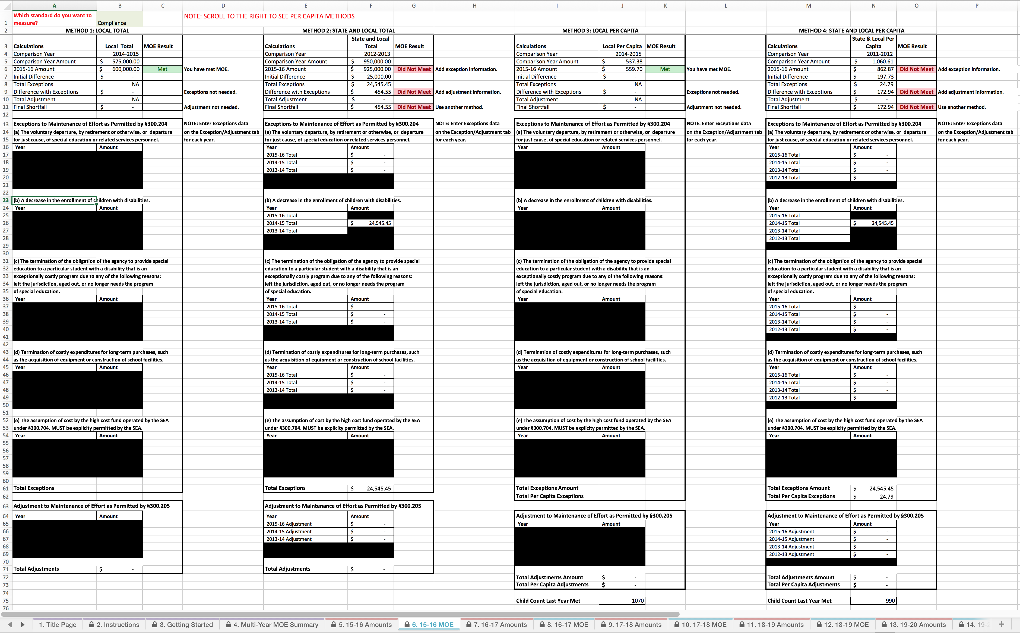
15-16 MOE Worksheet – Method 1: Local Total
V1.0. DRAFT ONLY

Slide 32
15-16 MOE Worksheet – Method 2: State and Local Total
Notes:
Let’s look at the State and Local Total Method in the sample and see how things may be different for different methods.
Note that the Comparison Year is different for the State and Local Total Method.

Slide 33
15-16 MOE Worksheet – Method 2: State and Local Total
Notes:
The Comparison Year Amount is also different for this method. Remember that the Comparison Year Amount is the amount the LEA spent in the last year they met MOE by this method.

Slide 34
15-16 MOE Worksheet – Method 2: State and Local Total
Notes:
Note that in the sample, the LEA did not meet MOE using the State and Local Total Method.

Slide 35
15-16 MOE Worksheet – Method 2: State and Local Total
Notes:
No exceptions or adjustment data have been entered so far. They were not needed for the Local Total Method, but they are needed for the LEA to meet MOE by the State and Local Total Method.
It is a good idea to enter exceptions and adjustment data in case the LEA decides to switch in the future to the State and Local Total Method.

Slide 36
15-16 MOE Worksheet – Method 2: State and Local Total
Notes:
No exceptions or adjustment data have been entered so far. They were not needed for the Local Total Method, but they are needed for the LEA to meet MOE by the State and Local Total Method.
It is a good idea to enter exceptions and adjustment data in case the LEA decides to switch in the future to the State and Local Total Method.

Slide 37
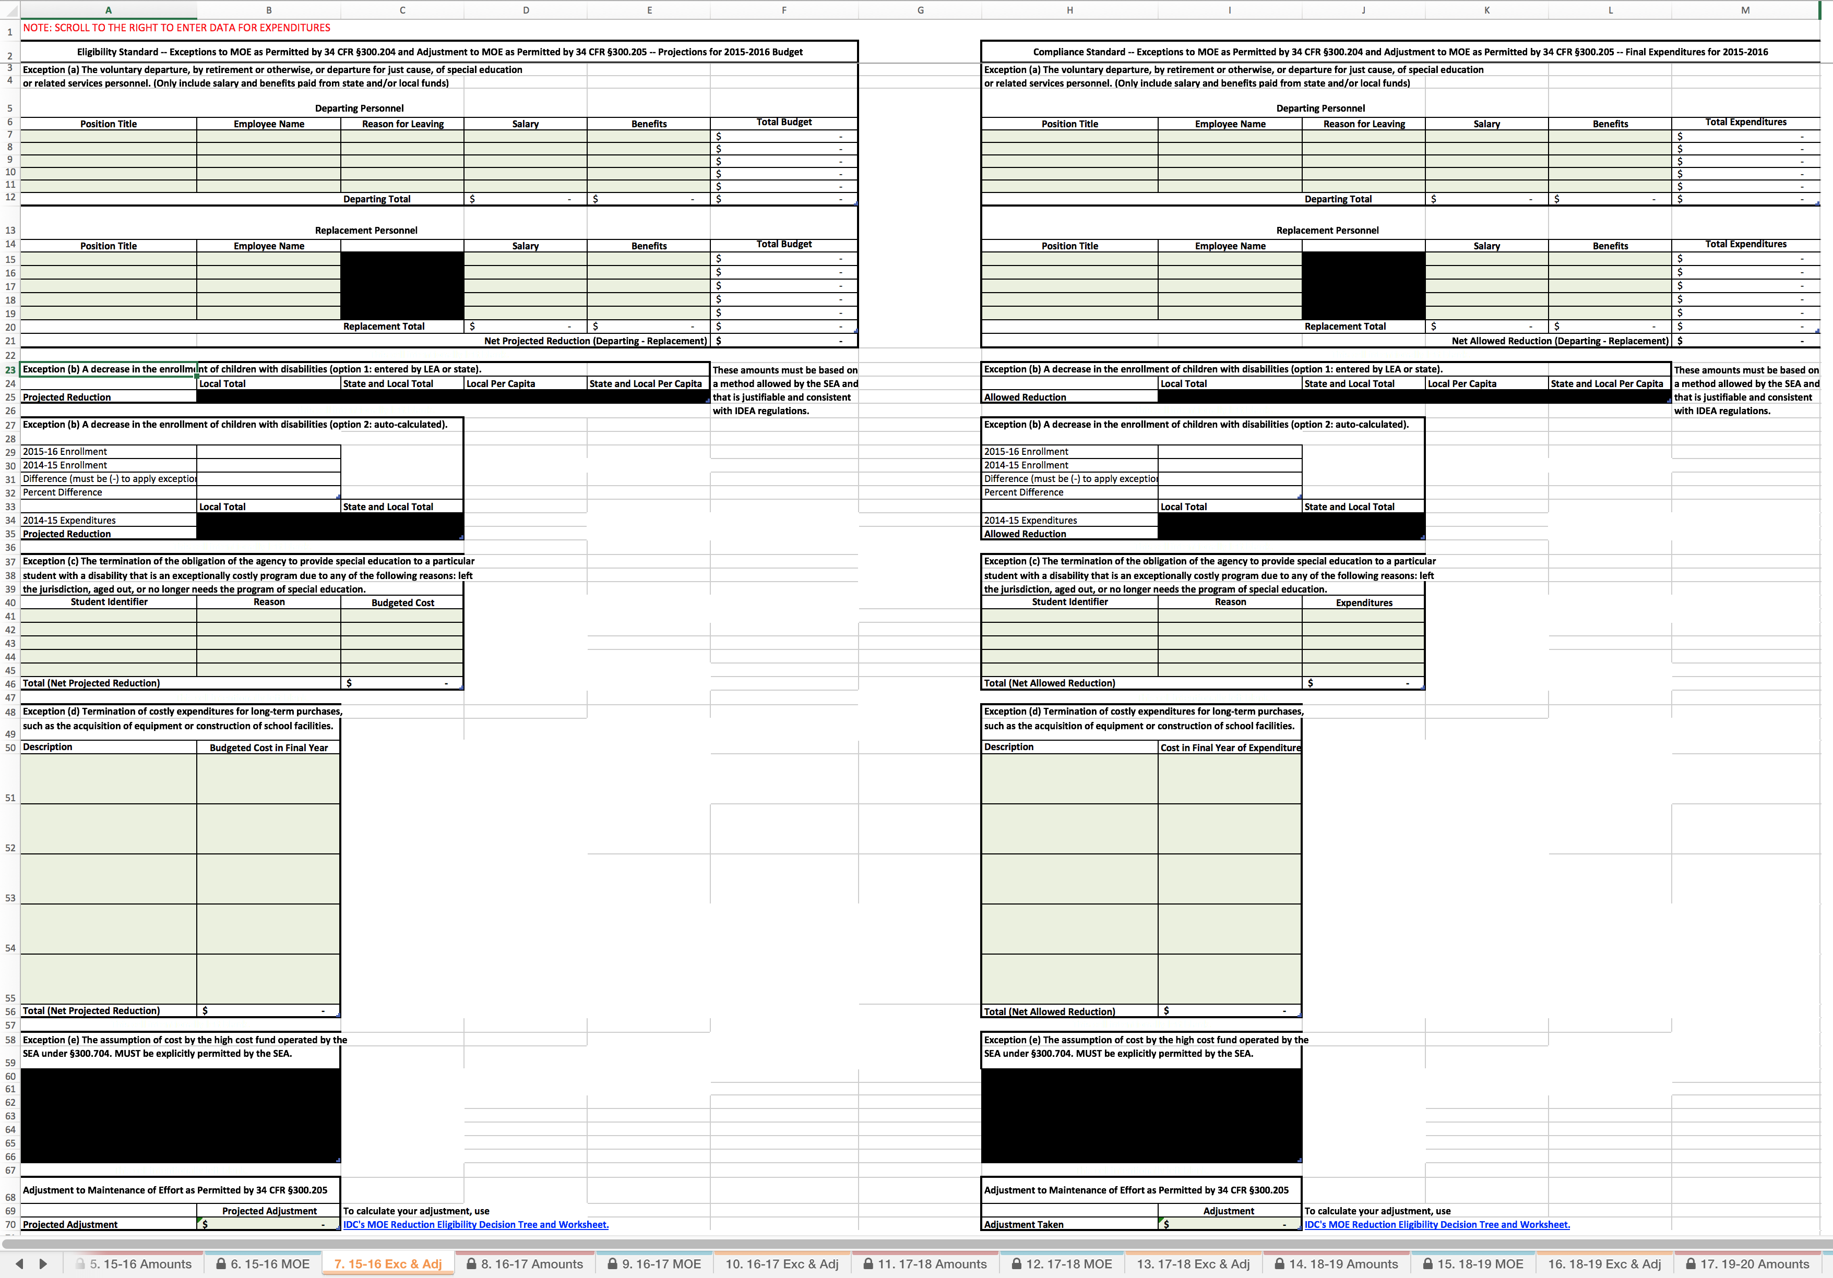
15-16 Exc & Adj Worksheet
Tab 7 of the Calculator
The Exc & Adj worksheet provides a place for an LEA to document the five exceptions permitted under 34 CFR §300.204 and the MOE adjustment permitted under 34 CFR §300.205.
Notes:
When reporting MOE, your LEA should enter information on any relevant qualifying MOE exceptions and adjustments in the Exceptions & Adjustments worksheets, which will auto-populate the MOE worksheet we just reviewed.

Slide 38
15-16 Exc & Adj Worksheet
Tab 7 of the Calculator
Exception (a): Voluntary departure
Exception (b): Decrease in enrollment
Exception (c): Exceptionally costly program
Exception (d): Long-term purchases
Exception (e): SEA high cost fund
Notes:
The Exceptions & Adjustment worksheets provide a place for you to document each of the five exceptions and the MOE adjustment permitted under the IDEA regulations.
This information will help if you did not meet MOE based on final expenditures. You might meet MOE based on the exceptions and/or adjustment.
Even if you meet MOE by one or more methods, you should consider entering all exceptions and adjustment data, since this information may be helpful for future years if your LEA needs to switch methods.
The 15-16 Exc & Adj Worksheet has two sets of data tables: the one to the left is for the eligibility (budget) standard and the one to the right is for the compliance (expenditure) standard. Since we are working on the compliance standard for 2015–16, we will use the tables on the right.

Slide 39
Exception (a)
An LEA may reduce the level of expenditures by the LEA under Part B of the Act below the level of those expenditures for the preceding fiscal year if the reduction is attributable to …
(a) the voluntary departure, by retirement or otherwise, or departure for just cause, of special education or related services personnel.
34 CFR §300.204(a)
Notes:
Exception (a) may be used to reduce the required MOE amount based on the voluntary departure, by retirement or otherwise, or departure for just cause, of special education or related services personnel. We’ll show you how to use the Calculator for this exception.

Slide 40
Exception (a)

Slide 41
Exception (a): Departing Personnel
Senior Special Education Teacher
John Smith
Retirement
$
60,000.00
$
10,000.00
70,000.00
60,000.00
10,000.00
70,000.00
Notes:
First, enter information about all departing personnel, including amounts of Salary and Benefits paid from local, or state and local, funds.

Slide 42
Exception (a): Replacement Personnel
Senior Special Education Teacher
John Smith
Retirement
$
60,000.00
$
10,000.00
70,000.00
60,000.00
10,000.00
70,000.00
Junior Special Education Teacher
Judy Jones
$
40,000.00
$
8,000.00
48,000.00
40,000.00
8,000.00
48,000.00
22,000.00
Notes:
Next, enter the same information about the replacement personnel. The Calculator will calculate the difference.

Slide 43
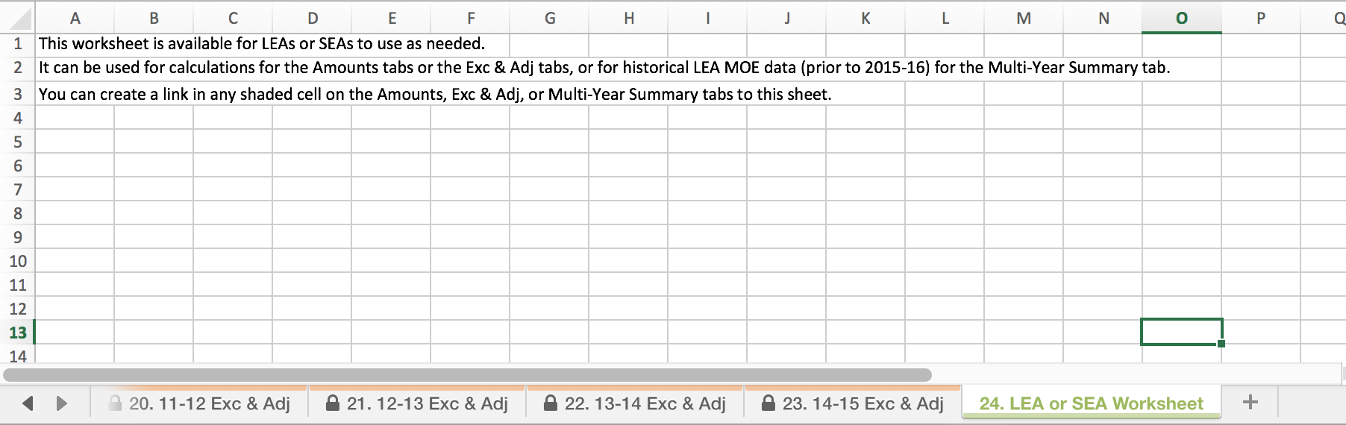
Exception (a): Additional Information
Notes:
If this is not sufficient space to list all personnel, you can include a summary on the Exc & Adj Worksheet and provide detailed information on the LEA or SEA worksheet, Tab 24 (the final tab in the Calculator). Be sure that the summary includes the complete dollar amounts, because the Calculator is not designed to read data from the LEA or SEA worksheet. That tab is provided for your convenience only.

Slide 44
Exception (b)
V1.0. DRAFT ONLY
Exception (a): Voluntary departure
Exception (b): Decrease in enrollment
Exception (c): Exceptionally costly program
Exception (d): Long-term purchases
Exception (e): SEA high cost fund
Notes:
[NOTE: Use this version of this section if you want your LEAs to use the Calculator to automatically calculate exception (b), using an OSEP-approved method. If you want your LEAs to use an SEA-approved method for calculating exception (b) and manually enter those calculations, use Section 7b instead.]

Slide 45
Exception (b)
V1.0. DRAFT ONLY
An LEA may reduce the level of expenditures by the LEA under Part B of the Act below the level of those expenditures for the preceding fiscal year if the reduction is attributable to …
(b) A decrease in the enrollment of children with disabilities.
34 CFR §300.204(b)
Notes:
Exception (b) may be used by LEAs that have a decrease in the enrollment of children with disabilities.

Slide 46
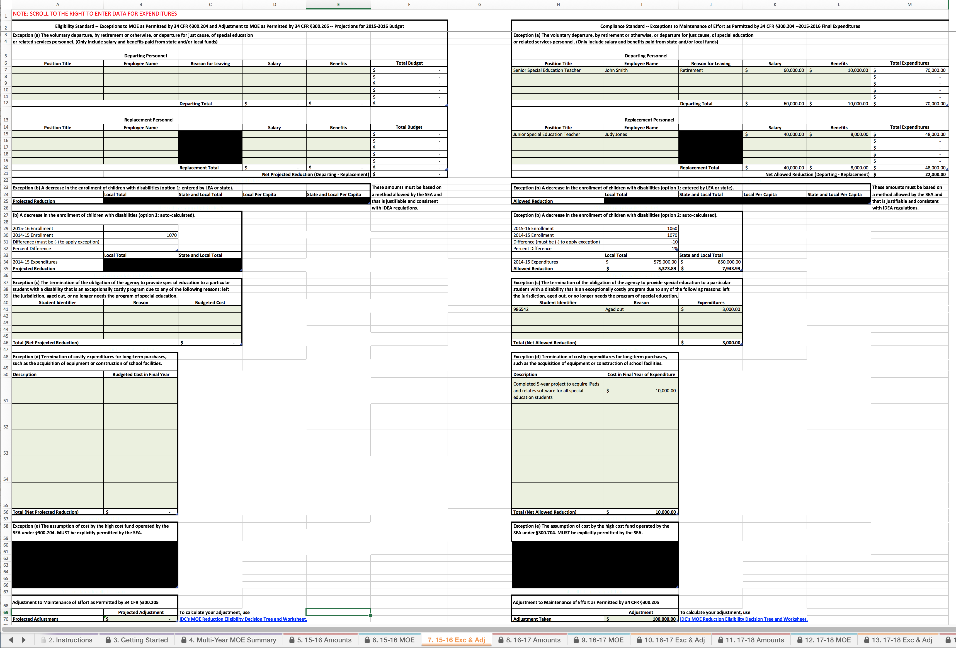
Exception (b) when there is a decrease in enrollment
V1.0. DRAFT ONLY
Notes:
The Calculator will automatically calculate the reduction your LEA may take for a decrease in enrollment. No data entry is needed.

Slide 47
Exception (b) when there is a decrease in enrollment
V1.0. DRAFT ONLY
Notes:
The Exc & Adj tab pulls from the child count you entered for 2015-16 on the 15-16 Amounts Worksheet.
It also pulls the child count you entered for 2014-15 on the Multi-Year Summary Worksheet.
The Calculator determines whether there was a decrease. If there is a decrease, it calculates the percentage difference between years.

Slide 48
Exception (b) when there is a decrease in enrollment
V1.0. DRAFT ONLY
Notes:
The Calculator pulls the 2014-15 Local Total and State and Local Total amounts from the Multi-Year Summary Worksheet and then uses the percentage difference in enrollment to determine the reduction amount.

Slide 49
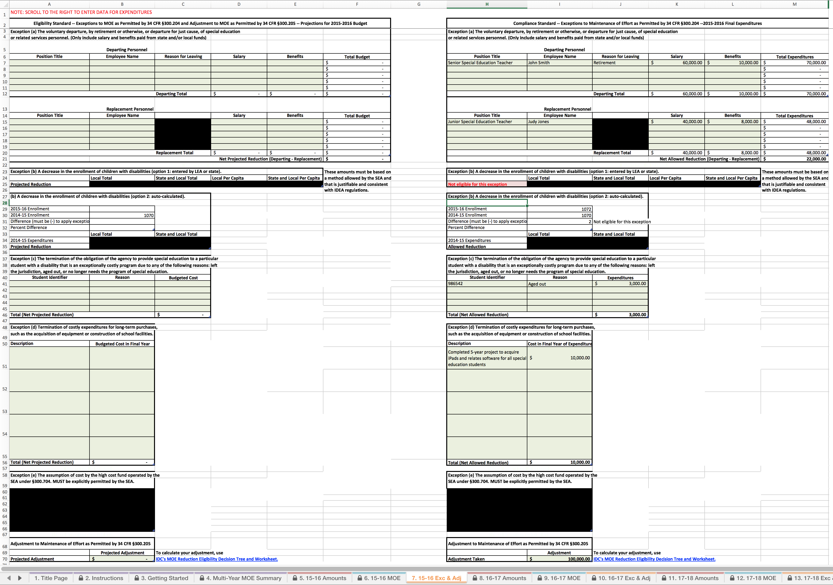
Exception (b) when there is no decrease in enrollment
V1.0. DRAFT ONLY
Notes:
Let’s see what happens if there is not a decrease in enrollment, but an increase.

Slide 50
Exception (b) when there is no decrease in enrollment
V1.0. DRAFT ONLY
Notes:
The Calculator still determines the change between 2014-15 and 2015-16, but now it notes that the LEA is “Not eligible for this exception.”

Slide 51
Exception (b) when there is no decrease in enrollment
V1.0. DRAFT ONLY
Notes:
The cells in this table are blacked out because the LEA is not eligible for Exception (b).

Slide 52
Exception (c)
V1.0. DRAFT ONLY
Exception (a): Voluntary departure
Exception (b): Decrease in enrollment
Exception (c): Exceptionally costly program
Exception (d): Long-term purchases
Exception (e): SEA high cost fund

Slide 53
Exception (c)
V1.0. DRAFT ONLY
An LEA may reduce the level of expenditures by the LEA under Part B of the Act below the level of those expenditures for the preceding fiscal year if the reduction is attributable to …
(c) the termination of the obligation of the agency, consistent with this part, to provide a program of special education to a particular child with a disability that is an exceptionally costly program, as determined by the SEA, because the child: (1) Has left the jurisdiction of the agency; (2) Has reached the age at which the obligation of the agency to provide FAPE to the child has terminated; or (3) No longer needs the program of special education.
34 CFR §300.204(c)
Notes:
Exception (c) is used to reduce the required MOE amount when an LEA is no longer obligated to provide a costly program for a particular child with a disability because the child: (1) Has left the jurisdiction of the agency; (2) Has reached the age at which the obligation of the agency to provide FAPE to the child has terminated; or (3) No longer needs the program of special education.

Slide 54
Exception (c)
V1.0. DRAFT ONLY
Notes:
You should work closely with us to determine whether a program for a particular child qualifies as costly.
[GIVE MORE DETAILED INSTRUCTIONS HERE ABOUT HOW TO MAKE THIS DETERMINATION.]

Slide 55
Exception (c): Exceptionally Costly Program
V1.0. DRAFT ONLY
986542
Aged Out
$
3,000.00
3,000.00
Notes:
For each student in a costly program that was terminated, enter a Student Identifier. Then use the dropdown menu to select the Reason for the termination of the obligation of the agency to provide special education. Finally, enter all expenditures from state and local funds for that child’s program.

Slide 56
Exception (d)
V1.0. DRAFT ONLY
Exception (a): Voluntary departure
Exception (b): Decrease in enrollment
Exception (c): Exceptionally costly program
Exception (d): Long-term purchases
Exception (e): SEA high cost fund

Slide 57
Exception (d)
V1.0. DRAFT ONLY
An LEA may reduce the level of expenditures by the LEA under Part B of the Act below the level of those expenditures for the preceding fiscal year if the reduction is attributable to …
(d) the termination of costly expenditures for long-term purchases, such as the acquisition of equipment or the construction of school facilities.
34 CFR §300.204(d)
Notes:
Exception (d) may be used when the LEA terminates costly expenditures for long-term purchases, such as the acquisition of equipment or the construction of school facilities.

Slide 58
Exception (d)
V1.0. DRAFT ONLY
Notes:
You should work closely with us to determine which expenditures may qualify for this exception.
[GIVE MORE DETAILED INSTRUCTIONS HERE ABOUT HOW TO MAKE THIS DETERMINATION.]

Slide 59
Exception (d): Long-term Purchases
V1.0. DRAFT ONLY

Slide 60
Exception (d): Long-term Purchases
V1.0. DRAFT ONLY
Completed 5-year project to acquire iPads and related software for all special education students
$
10,000.00
10,000.00
Notes:
Enter a description of each costly expenditure for a long-term purchase that has terminated, and provide all expenditures from state and local funds in the final year of purchase.

Slide 61
Adjustment to MOE
Adjustment to Maintenance of Effort– for any fiscal year for which the [IDEA Part B] allocation received by an LEA under §300.705 exceeds the amount the LEA received for the previous fiscal year, the LEA may reduce the level of expenditures otherwise required by §300.203(b) by not more than 50 percent of the amount of that excess.
34 CFR §300.205
Notes:
[NOTE: You can remove this section if none of your LEAs received an increase in their Federal Part B allocation.]

Slide 62
Eligibility for an Adjustment to MOE
https://ideadata.org/resource-library/56995073150ba000628b45df/
Notes:
To be eligible for the MOE adjustment, the LEA must meet several conditions including having a “meets requirements” determination. The amount of the adjustment also depends on if the LEA is implementing coordinated early intervening services. Details on the eligibility for an adjustment and how to calculate the amount available are contained in the IDEA Data Center’s MOE Reduction Eligibility Decision Tree and Worksheet. A link to that tool is shown here and is also included in the Calculator instructions.

Slide 63
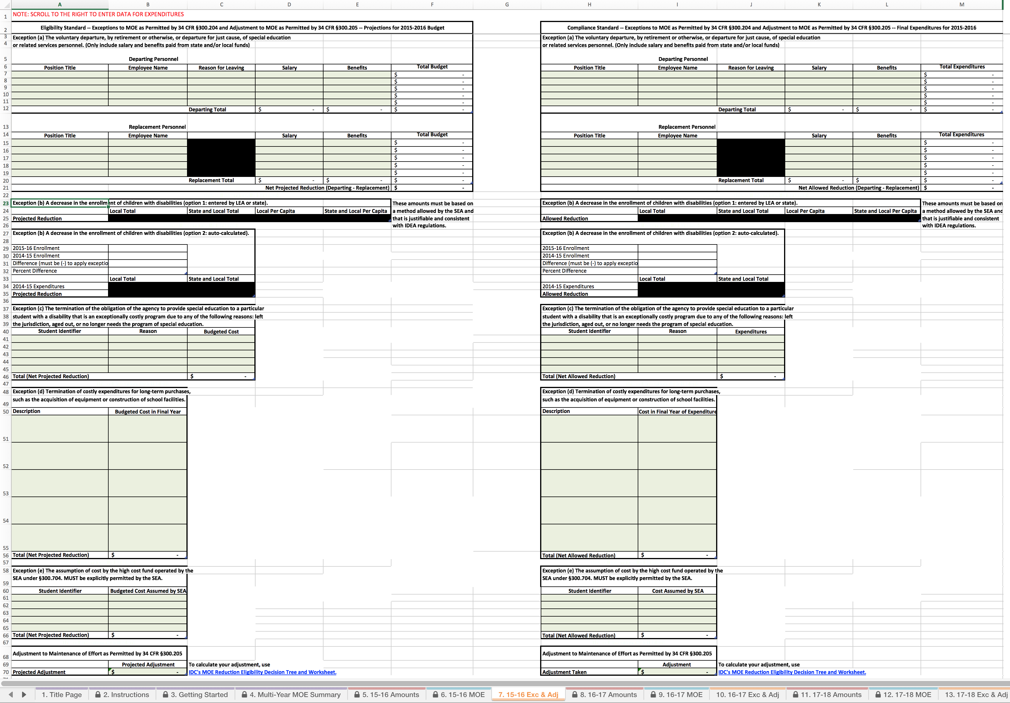
Adjustment to MOE
V1.0. DRAFT ONLY

Slide 64
Adjustment to MOE
V1.0. DRAFT ONLY
100,000.00
Notes:
When you have determined the amount of the available adjustment, enter the amount, up to the total available adjustment, taken in row 70. For this example, we indicate an adjustment of $100,000.
OR
When the SEA has provided you with the amount of the available adjustment, enter the amount, up to the total available adjustment, taken in row 70. For this example, we indicate an adjustment of $100,000.

Slide 65
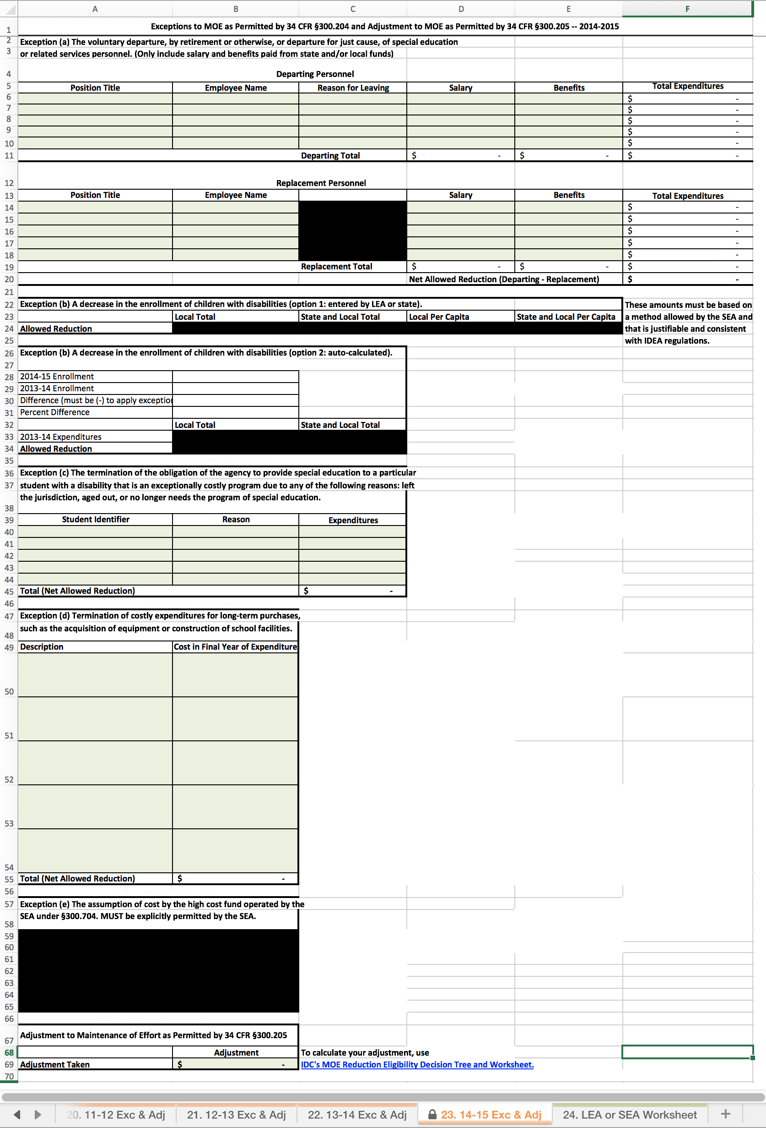
14-15 Exc & Adj Worksheet
Tab 23 of the Calculator
For years prior to 2015–16, users should enter final expenditure data only.
Notes:
Let’s look at the Exc & Adj Worksheet for 2014-15. It looks different from the worksheet for 2015-16, because it only includes one set of data tables; there are no tables for entry of budget data. Users should enter final expenditure data only.

Slide 66
14-15 Exc & Adj Worksheet
Tab 23 of the Calculator
V1.0. DRAFT ONLY
Notes:
You should enter data based on final expenditures for each exception or adjustment you want to apply from 2014–15 or earlier years. Since these are historical data, you can summarize and only include total amounts.

Slide 67
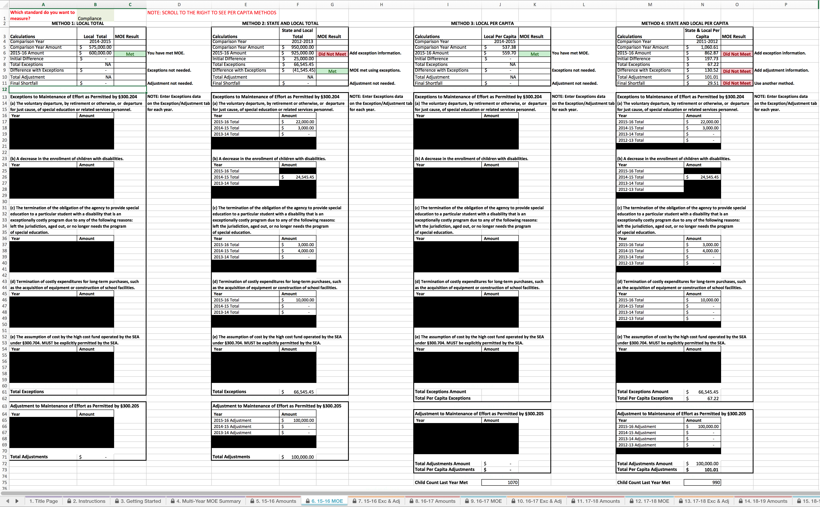
15-16 MOE Worksheet
The MOE worksheet uses the data entered on the Exc & Adj worksheets to calculate a final MOE result for each method.
Notes:
Let’s see what has happened to the 15-16 MOE tab now that we have entered some data for exceptions and adjustments.

Slide 68
15-16 MOE Worksheet
Notes:
You can see that new data are entered in the tables for exceptions and adjustments.

Slide 69
15-16 MOE Worksheet – Method 2: State and Local Total
Notes:
We’ll look at how this has changed the results for the State and Local Total method.

Slide 70
15-16 MOE Worksheet – Method 2: State and Local Total
Notes:
The comparison year is still the same. Remember, it is the year the LEA last met MOE using the State and Local Total method.

Slide 71
15-16 MOE Worksheet – Method 2: State and Local Total
Notes:
The comparison year amount is still the same.

Slide 72
15-16 MOE Worksheet – Method 2: State and Local Total
Notes:
This shows that the LEA did not meet MOE just with expenditures. They need to include exceptions to meet MOE.

Slide 73
15-16 MOE Worksheet – Method 2: State and Local Total
Notes:
The LEA had an initial difference of $25,000, but they had exceptions of more than $66,000.

Slide 74
15-16 MOE Worksheet – Method 2: State and Local Total
Notes:
This means that the LEA has now met MOE using exceptions.

Slide 75
15-16 MOE Worksheet – Method 2: State and Local Total
Notes:
The LEA does not need the adjustment to meet MOE, so the adjustment is not shown.

Slide 76
15-16 MOE Worksheet – Method 2: State and Local Total
Notes:
You can see how the Calculator has pulled in data from the Exc & Adj worksheets.

Slide 77
15-16 MOE Worksheet – Method 4: State and Local Per Capita
Notes:
Let’s look at how the exception and adjustment information has changed the results for the State and Local Per Capita method.

Slide 78
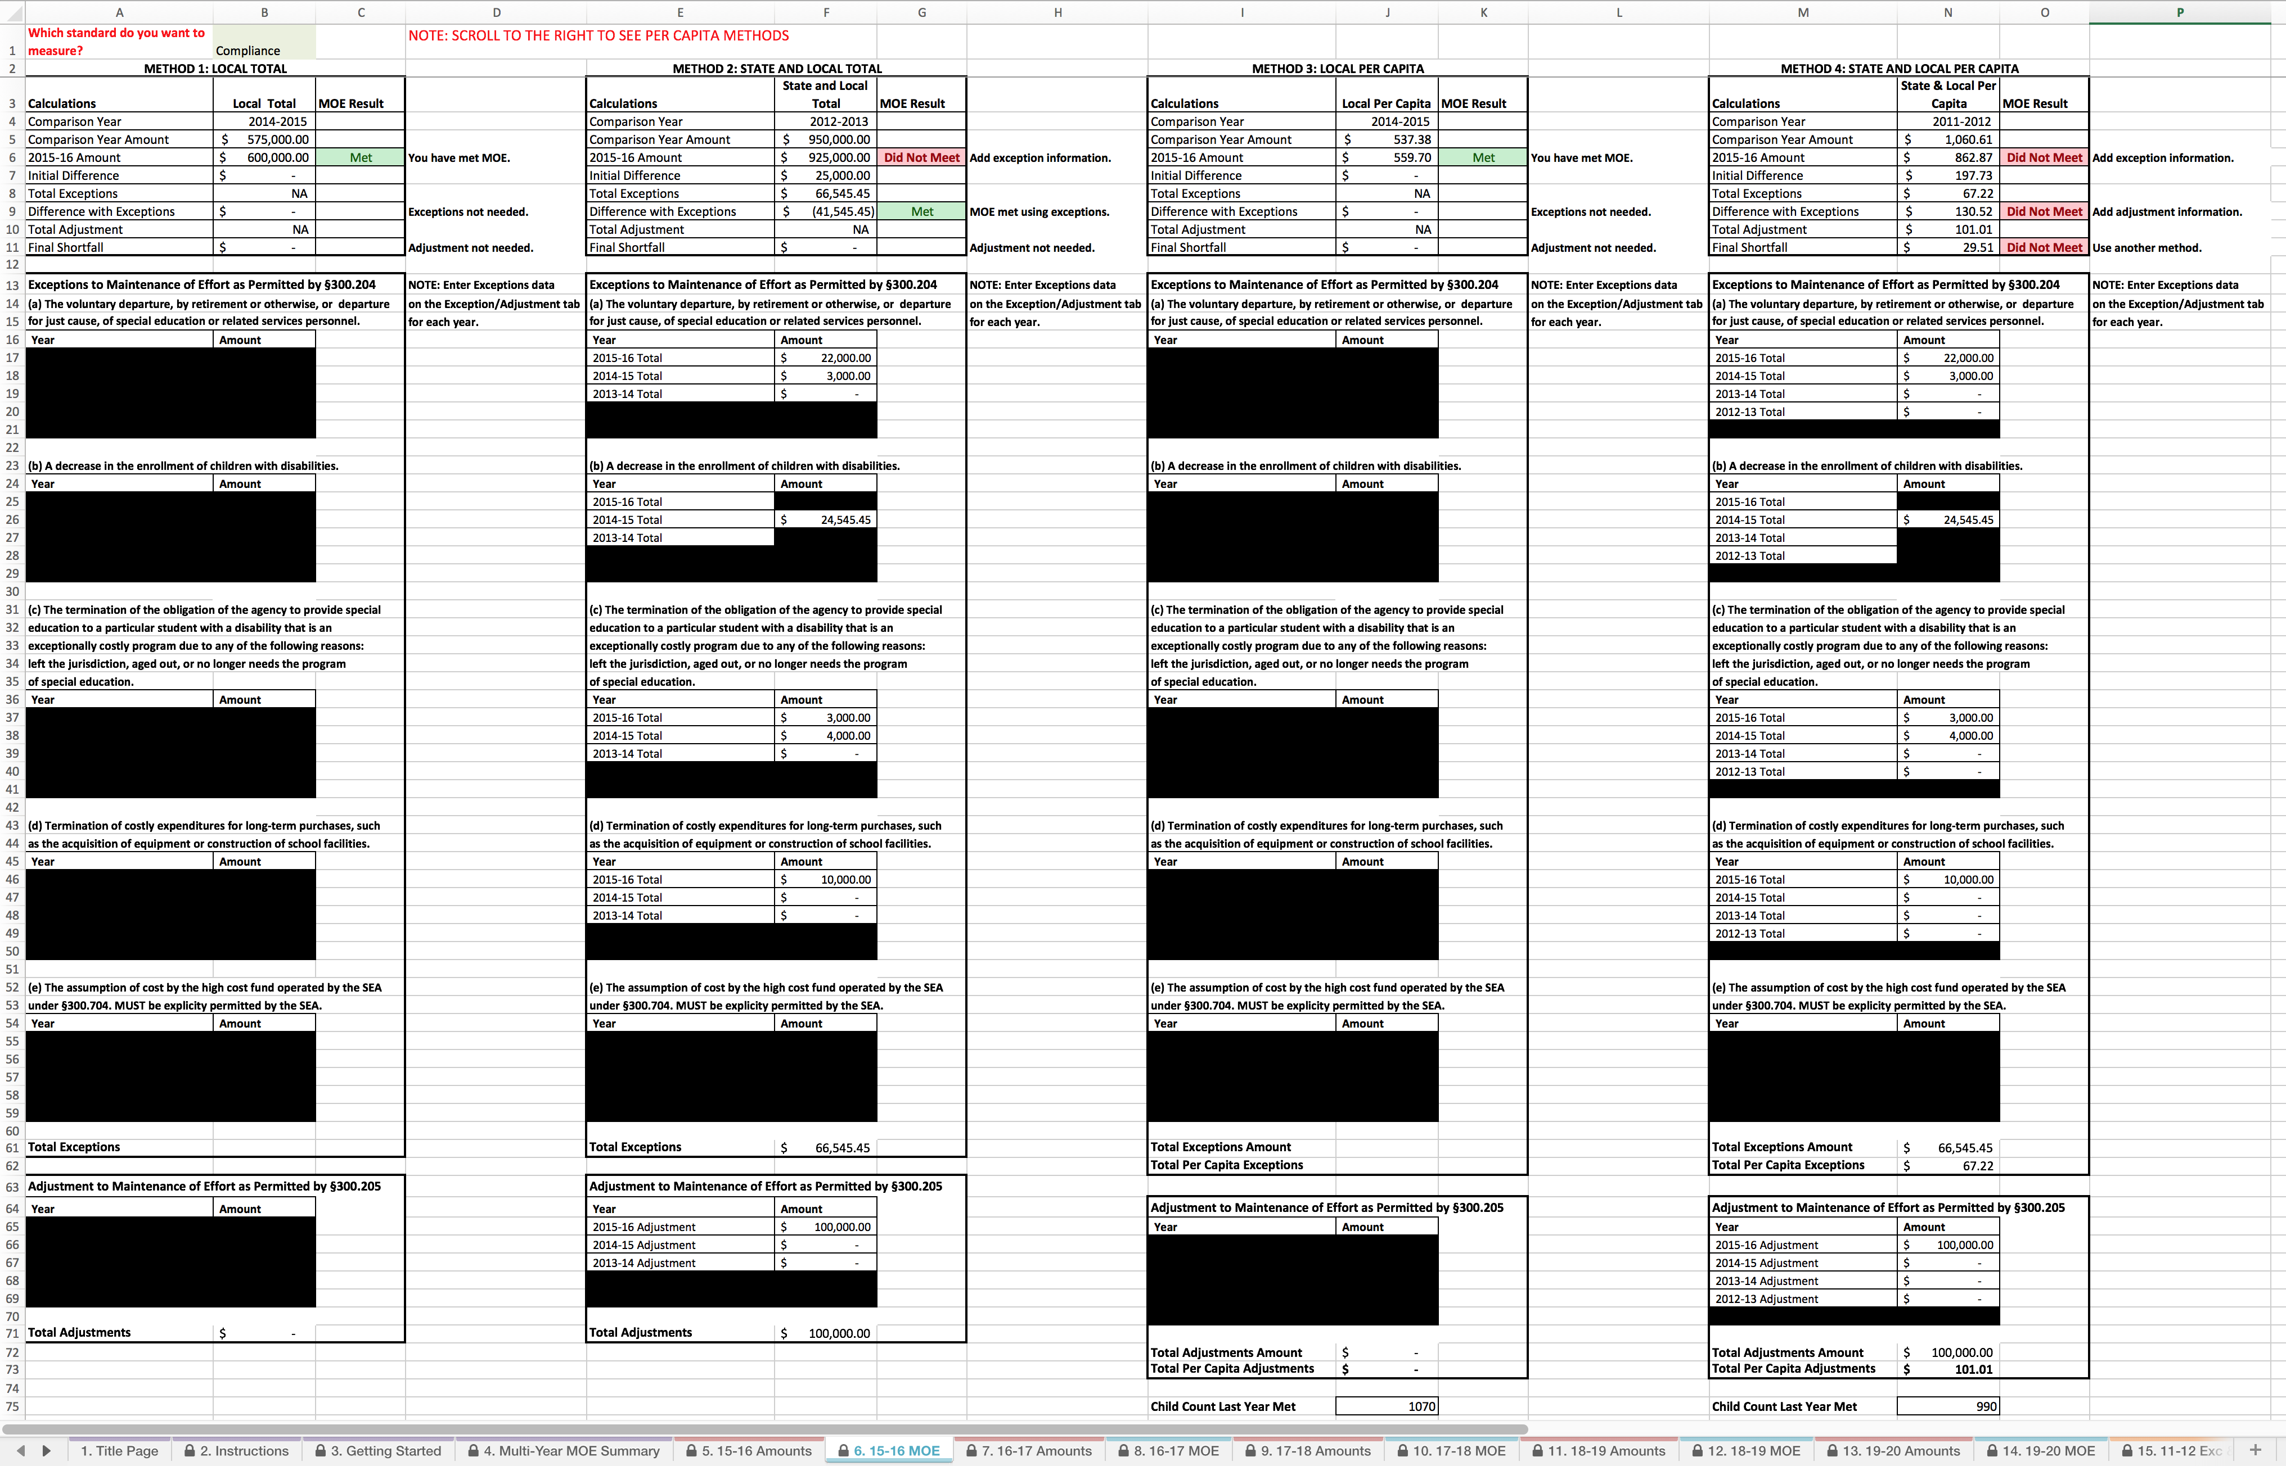
15-16 MOE Worksheet – Method 4: State and Local Per Capita
Notes:
Again, the comparison year is the same as before. This is the last year the LEA met MOE using the State and Local Per Capita method.

Slide 79
15-16 MOE Worksheet – Method 4: State and Local Per Capita
Notes:
The comparison year amount is also the same as it was before.

Slide 80
15-16 MOE Worksheet – Method 4: State and Local Per Capita
Notes:
The LEA did not meet MOE with just expenditures, but needs to add exceptions and/or adjustments.

Slide 81
15-16 MOE Worksheet – Method 4: State and Local Per Capita
Notes:
The LEA had an initial difference of $197.73 and total exceptions of $67.22.

Slide 82
15-16 MOE Worksheet – Method 4: State and Local Per Capita
Notes:
The exceptions were not enough for the LEA to meet MOE. The LEA should consider taking the adjustment to meet MOE using this method.

Slide 83
15-16 MOE Worksheet – Method 4: State and Local Per Capita
Notes:
The exceptions and adjustment combined were not enough for the LEA to meet MOE. The LEA does not meet MOE by the State and Local Per Capita method.

Slide 84
15-16 MOE Worksheet – Method 4: State and Local Per Capita
V1.0. DRAFT ONLY
Notes:
You can see how the Calculator has pulled in data from the Exc & Adj worksheets.

Slide 85
15-16 MOE Worksheet – Method 4: State and Local Per Capita
V1.0. DRAFT ONLY
Notes:
The Calculator provides a total Exceptions amount and calculates a per capita amount.

Slide 86
15-16 MOE Worksheet – Method 4: State and Local Per Capita
V1.0. DRAFT ONLY
Notes:
The Calculator has pulled in the adjustment information from the Exc & Adj worksheets.

Slide 87
15-16 MOE Worksheet – Method 4: State and Local Per Capita
V1.0. DRAFT ONLY
Notes:
The child count used to determine the per capita exceptions and adjustments is the child count from the last year the LEA met MOE using this method.

Slide 88
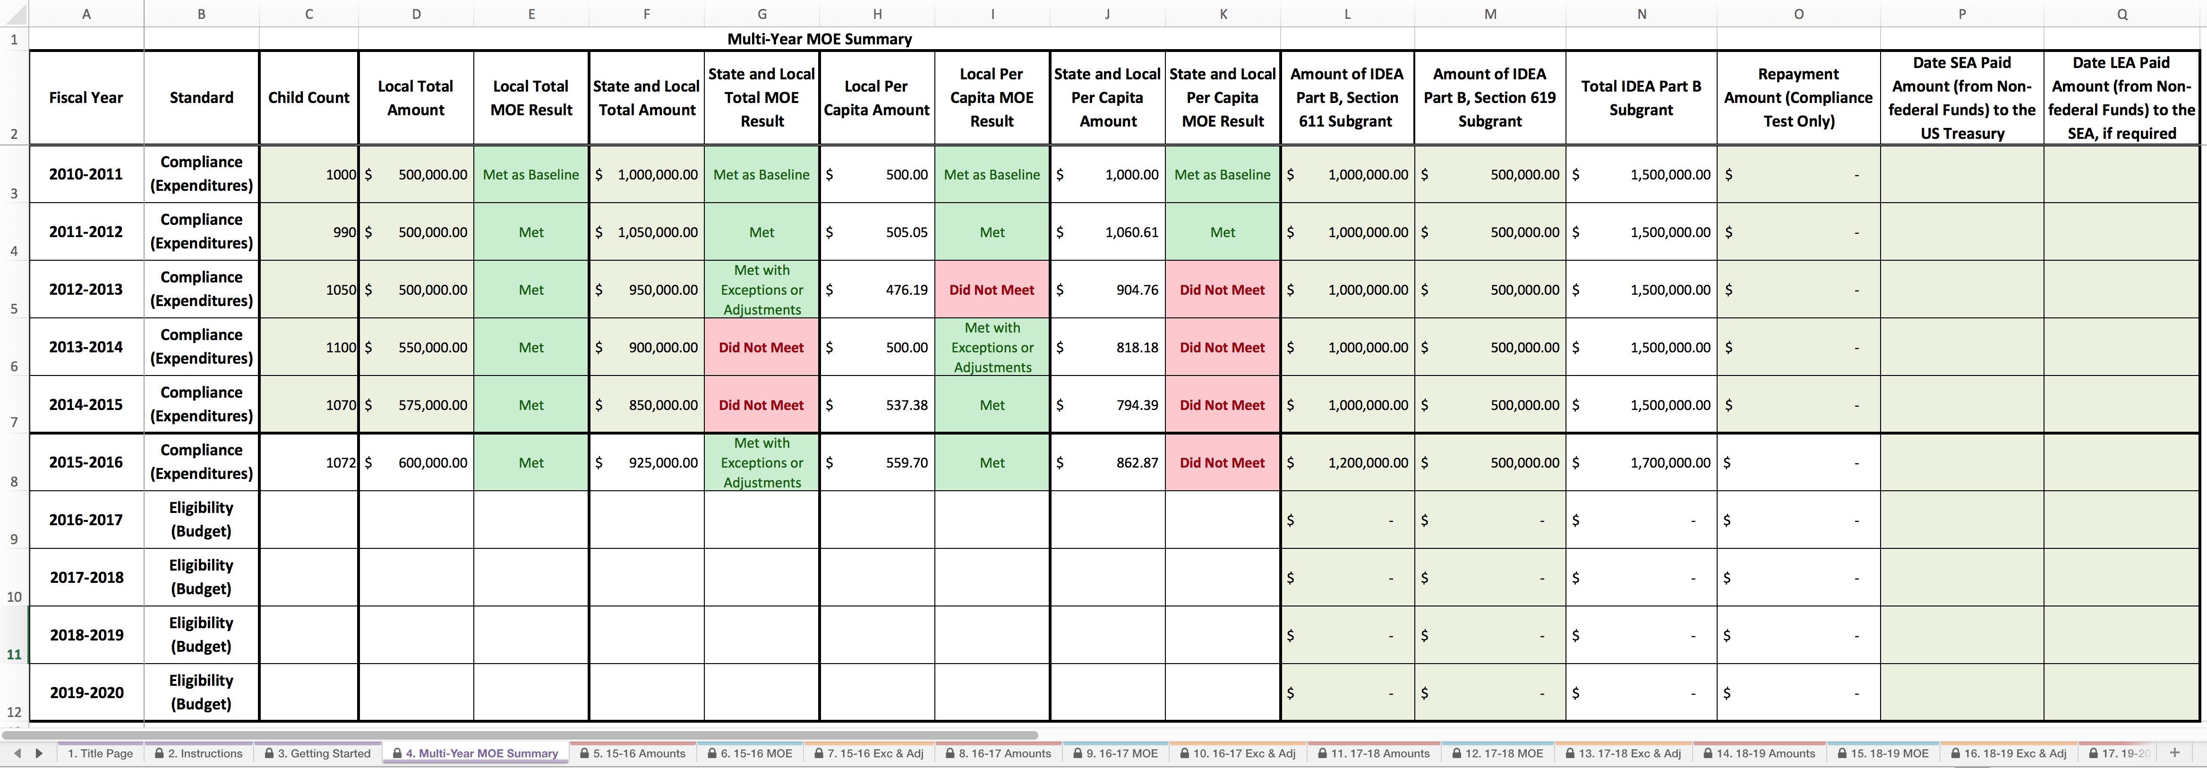
Multi-Year MOE Summary Worksheet, After Data Entry
The worksheet:
Displays the final MOE amounts and results as calculated on the MOE worksheet.
Includes columns for the new data elements, including repayment amount.
Notes:
Now we can return to the Multi-Year MOE Summary Worksheet to see how the data we have entered elsewhere is represented.

Slide 89
Multi-Year MOE Summary Worksheet, After Data Entry
Notes:
The Calculator presents the final amounts and results for each method.

Slide 90
New Data Elements
Notes:
This is a good time for you to enter your 2015–16 subgrant information. This information is needed to calculate the required repayment amount in case you do not meet MOE by any method. Enter these data in Columns L and M.

Slide 91
Repayment Amount
Notes:
No repayment is required because MOE was met using three methods – any one method would have sufficed.

Slide 92
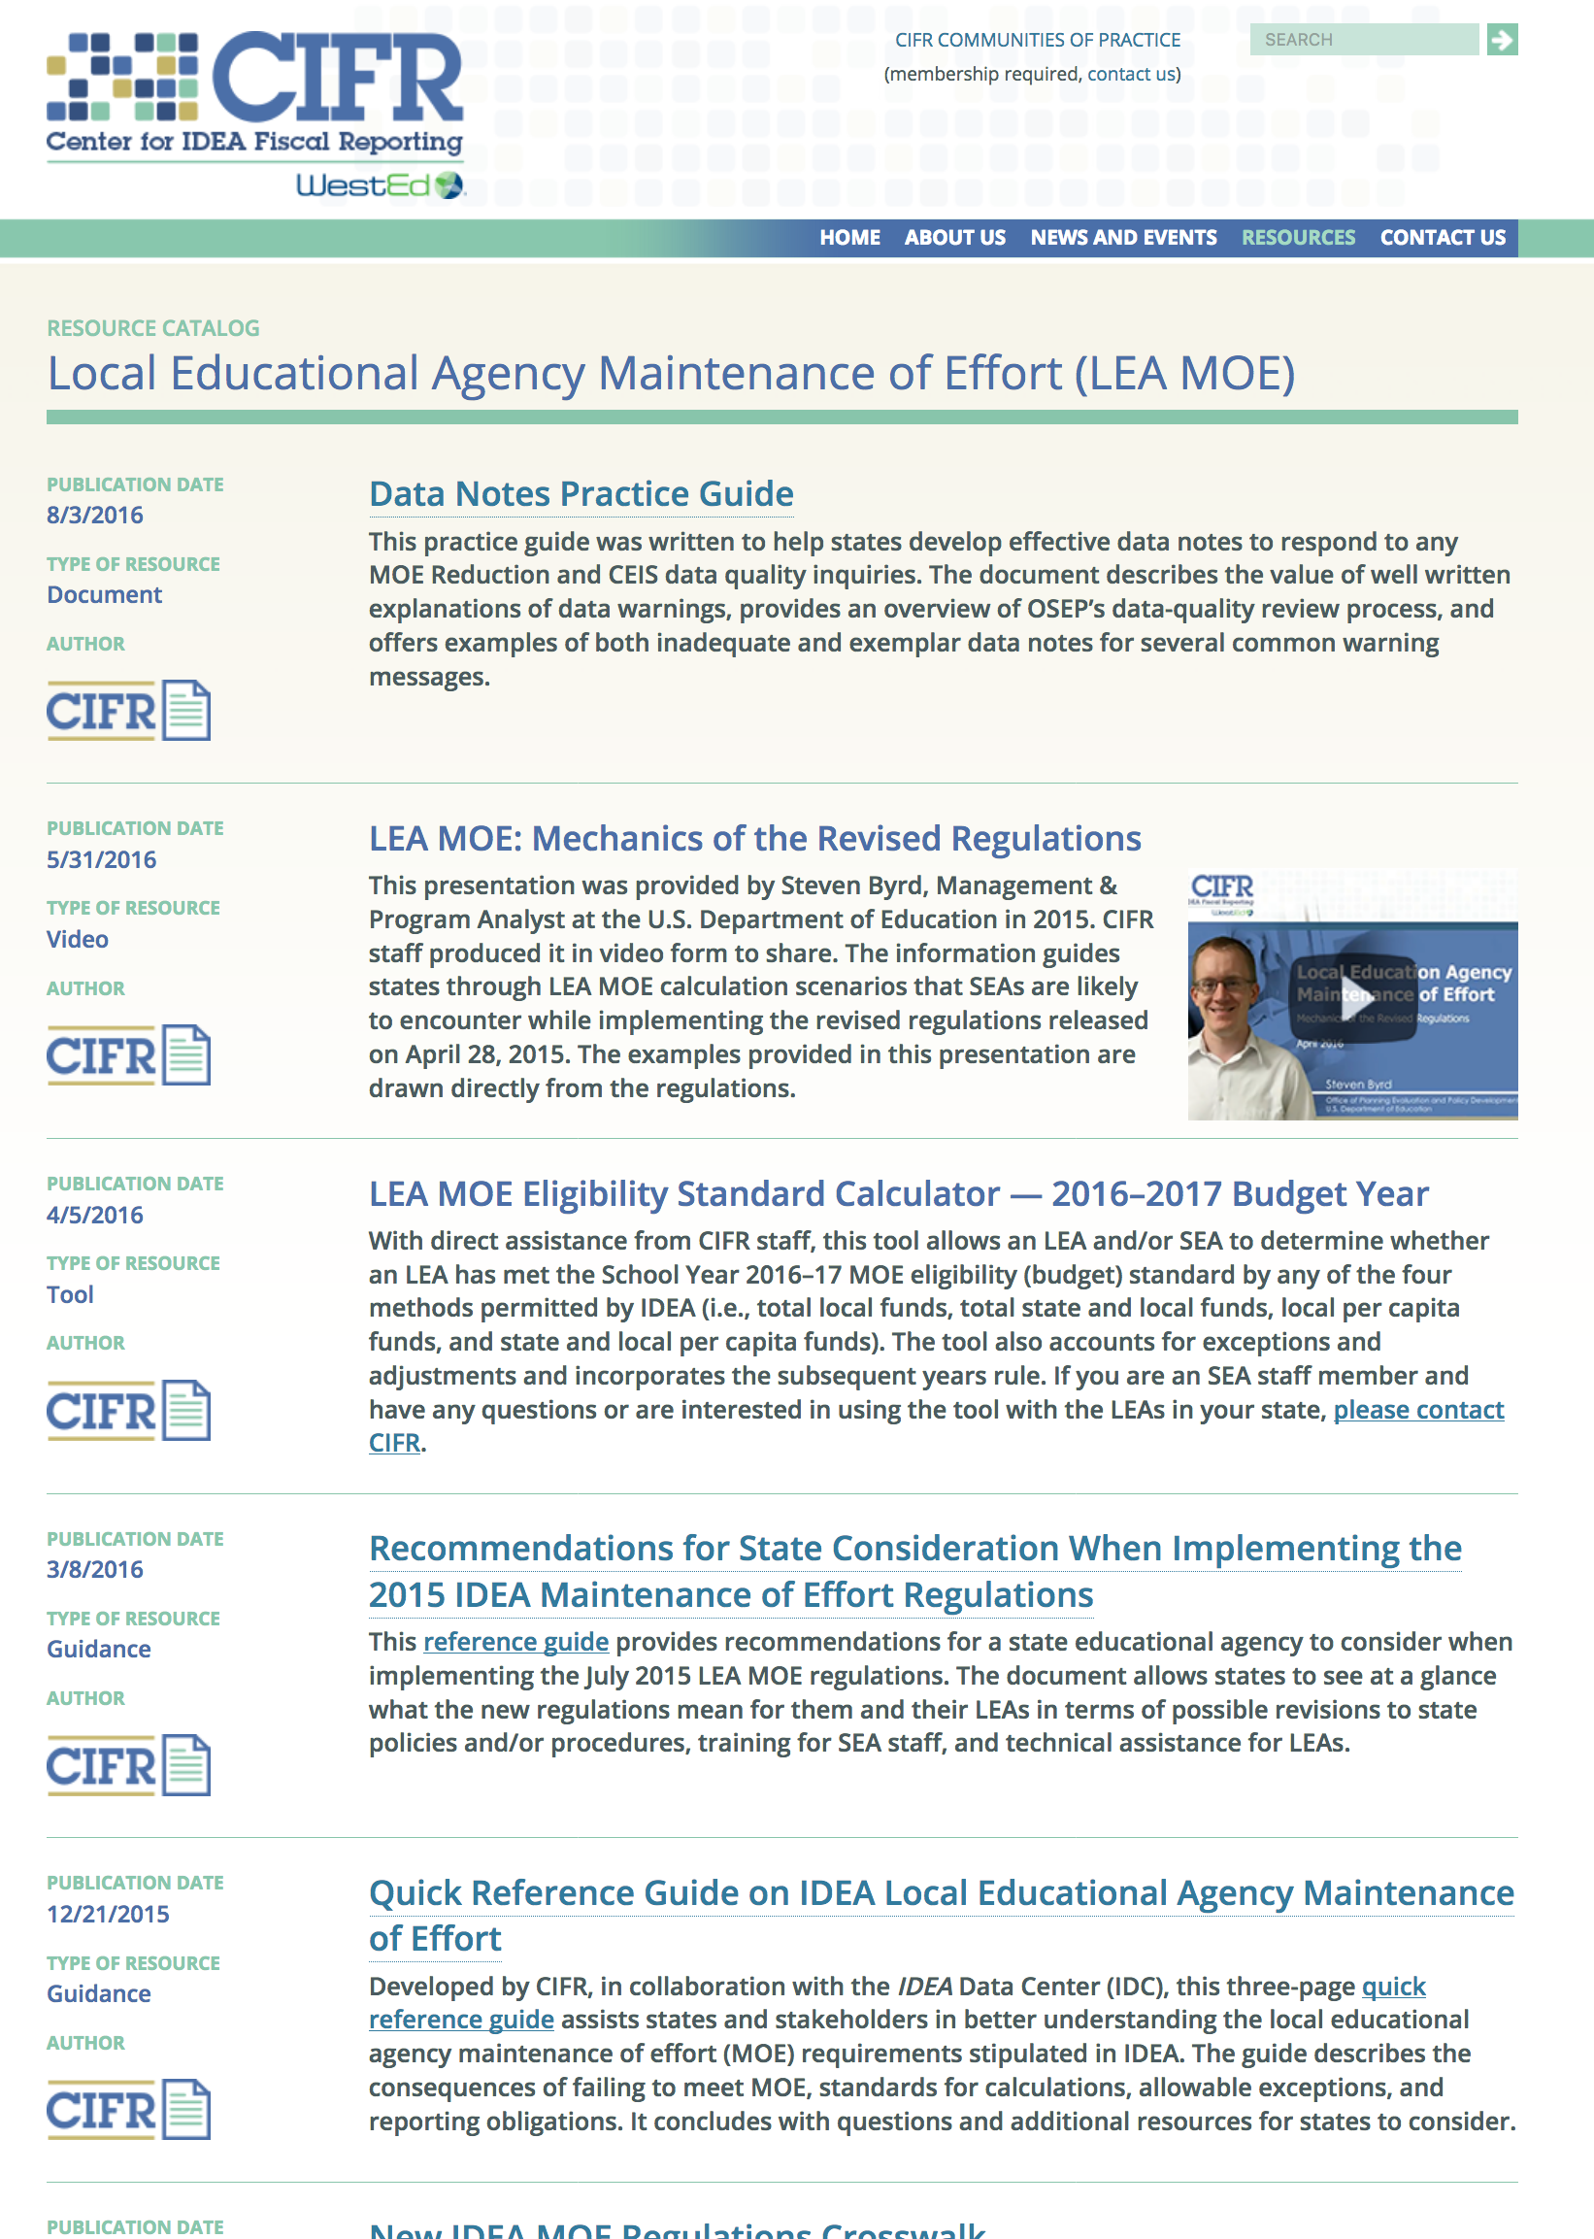
Other CIFR Resources on LEA MOE
Did you find this useful? Check out CIFR’s other LEA MOE resources.
http://cifr.wested.org/resources/lea-moe
Notes:
In addition to the LEA MOE Calculator, CIFR and its partners have many other resources available on LEA MOE. These resources include:
A quick reference guide on LEA MOE,
A data notes practice guide,
A freed up funds calculator, and
A video presentation on the mechanics of the LEA MOE calculation based on the 2015 revised regulations.

