Slide 1

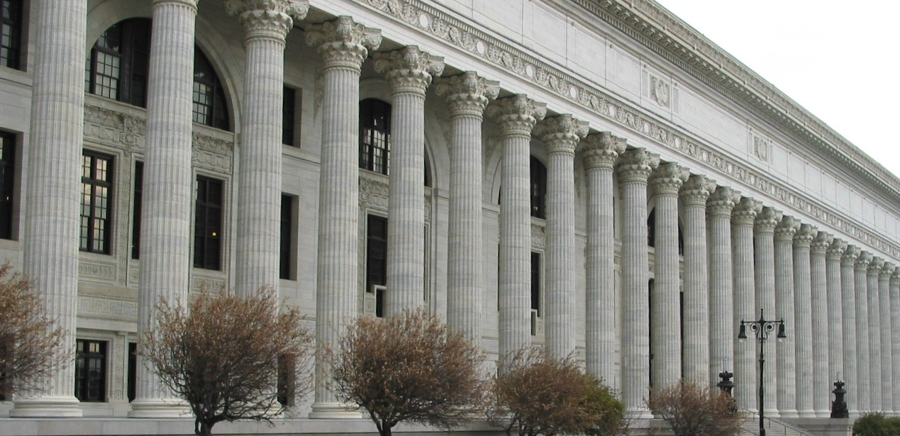
2023-2028 Mentor Teacher Internship Program (MTIP)
Information
April 2023

Slide 2
PURPOSE OF GRANT
The NYS Mentor Teacher Internship Program was established in 1986 by amendment to Education Law 3033, Chapter 436. The New York State Legislature provides funding for the development and implementation of State-supported mentor teacher internship programs in local school districts and through boards of cooperative educational services (BOCES).
These programs enable experienced teachers (mentors) in a district or BOCES to provide guidance and support to beginning teachers (interns) in their first and/or second year of teaching. It is anticipated that the induction provided will engage teachers in a productive and satisfying teaching and learning experience. Induction should be designed to enhance teachers’ skills and increase the likelihood of their remaining in the teaching profession

Slide 3
Essential Components of the MTIP
The essential components of mentor teacher internship projects, pursuant to Section 3033 of the Education Law, Part 85 of the Regulations of the Commissioner of Education and are consistent with the New York State Mentoring Standards (see Appendix 1) and include, but are not limited to:
Program focus on the mentor/intern relationship which develops throughout the project year, as the mentor guides the new teacher to self-assessment, professional confidence, and independence
Joint development by school administration and local teachers' bargaining agent:
Release time for interns and mentors
Selection of mentors and interns
Training for mentors and interns
Activities and role of the mentors
Activities and role of the interns
Role of building principals
Program evaluation
Program management

Slide 4
Summary of Statutory Requirements
To be eligible for an award, all school districts and BOCES submitting applications for this RFP must include in the description of the district internship plan how the needs of the interns for training and support will be assessed, the training, and how the mentors will guide and support their interns.
The internship plan is developed and negotiated with local teacher bargaining units in accordance with Article XIV of the Civil Service Law.
A list of teachers to serve as mentors must be developed by a selection committee consisting of a majority of classroom teachers chosen by the certified or recognized teacher bargaining unit.
Interns and mentors must be released from at least 10 percent of their instructional duties to participate in the program

Slide 5
Summary of Statutory Requirements Continued
Mentors must exhibit superior pedagogical skills, superior subject matter skills, excellent teaching abilities, and interpersonal relationship qualities. They must also demonstrate a willingness to participate in the program.
The superintendent or district superintendent is responsible for assigning mentor teachers and first or second year teachers to work together.
Mentor designations
  Part-time mentors: Part-time mentors' duties are to be reduced by at least 10 percent for each intern served. Persons designated as part-time mentors shall carry at least a 60 percent classroom instruction assignment.
  Full-time mentors: Persons designated as full-time mentors must spend 100 percent of their time in mentor service.
Full-time mentor restriction: Teachers serving as full-time mentors may do so for only two school years within any consecutive five school years. It is recommended that each mentor designated as full-time should serve no fewer than five interns and no more than ten interns during the project year.

Slide 6

Expenditures to be Supported by Grant Funds
Local districts and BOCES participating in the program are eligible for reimbursement for release-time costs, coordination, fringe benefits, training costs, supplies and materials, evaluation, in-state travel, and indirect costs. For indirect costs, use your rate approved by NYSED.
Equipment and remodeling costs are not allowable expenditures under this grant program. Applicants will need to submit with their application a completed Form FS-10 for the one-year period July 1, 2023- June 30, 2024. The FS-10 and fiscal guidance are located at http://www.oms.nysed.gov/cafe

Slide 7
Entities’ Responsibility
Projects must operate under the jurisdiction of the local board of education or other appropriate governing body and are subject to at least the same degree of accountability as all other expenditures of the local agency.
The local board of education or other appropriate governing body is responsible for the proper disbursement of, and accounting for, project funds.
Written agency policy concerning wages, mileage and travel allowances, overtime compensation, or fringe benefits, as well as State rules pertaining to competitive bidding, safety regulations, and inventory control must be followed.
Supporting or source documents are required for all grant-related transactions entered into the local agency's recordkeeping system.
Source documents that authorize the disbursement of grant funds consist of purchase orders, contracts, time and effort records, delivery receipts, vendor invoices, travel documentation and payment documents, including check stubs.

Slide 8
Entities’ Responsibilities
Supporting documentation for grants and grant contracts must be kept for at least six years after the last payment was made unless otherwise specified by program requirements.
Additionally, audit or litigation will "freeze the clock" for records retention purposes until the issue is resolved. All records and documentation must be available for inspection by State Education Department officials or its representatives.
For additional information about grants, please refer to the Fiscal Guidelines for Federal and State Aided Grants
NYSED Grants Finance

Slide 9
Definitions
Intern
A full-time teacher with no greater than a 90 percent classroom instructional assignment, employed by a public school district or a BOCES having an approved internship plan, in his/her first or second year of service in a specific certificate title, holding a valid Initial, or Provisional, certificate.
Mentor
A teacher holding a Professional or Permanent certificate in the same certificate title or area as Intern*, having demonstrated his or her mastery of pedagogical and subject matter skills, given evidence of superior teaching abilities and interpersonal relationship qualities, and indicated willingness to participate as a mentor.

Slide 10

District Professional Development Plans and
Multi-District Cooperation
The planning and design of the proposed internship should be undertaken in the context of the district’s Continuing Teacher and Leader Education (CTLE).
A single school district or BOCES may not submit a grant proposal on behalf of other districts. Applicants may, however, describe in the proposal the coordination, networking, training, and other activities that will be jointly engaged in with other districts.

Slide 11

Support by Institution of Higher Education
Districts may enter into a Memorandum of Agreement with an Institution of Higher Education (IHE) that will offer continued support to the Intern whom the IHE recommended for certification and the District hired.
(Attachment 3)

Slide 12
Proposal Review
Each eligible proposal will be reviewed by at least two reviewers. Each reviewer will score the proposal according to the indicated point criteria in the Proposal Narrative and the Budget using the Proposal Evaluation Rubric. If individual scores are more than 15 points apart, another reviewer will score the application. The two scores closest in numeric value will be averaged to calculate the final average score of the application. If the third reviewer’s score is equal to the average of the two original scores, the third reviewer’s score will become the final score.
Proposals will be ranked in order of final average score from highest to lowest. In the event of tie scores, proposals with the highest score on the Proposal Narrative will be ranked higher.
Proposals that receive a final average score of 75 (60%) or more (not including bonus points) will be considered for funding. Applicants will be funded in rank order until the funds are exhausted. In the event there are insufficient funds to fund the next ranked applicant in full, the next ranked applicant will be given the opportunity to operate a smaller program using the remaining funds.

Slide 13

Funding Methodology
Total funding for this grant for 2023-2028 is $10 million. Annual funding is expected to be $2 million, subject to the appropriation and availability of funds.
Funding Set–asides: Given the unique needs for teacher support and retention in the largest school districts in our state, portions of the anticipated total statewide allocation for funding have been reserved for such districts, should they apply and qualify for funding under the NYS Mentor Teacher Internship Program. This results in a tiered approach to apportionment of anticipated funding dollars, as illustrated in the next slide.

Slide 14
Funding Methodology
The $2 million first year funding will be apportioned in the following manner:
Tier 1: The New York City Department of Education may submit a funding request for up to $1,016,000 (or 50.8% of the total statewide allocation of $2 million) and funding up to that amount will be awarded, provided NYC DOE submits a qualifying application.
Tier 2: City school districts with populations of 100,000 or more may each submit a funding request for up to $65,000 [total requests by this cohort not to exceed $260,000 or 13% of the total statewide allocation] and funding up to such amount will be awarded, provided a qualifying application is submitted. This includes the city school districts of Buffalo, Rochester, Syracuse and Yonkers.

Slide 15
Funding Methodology
Tier 3: $724,000 is available funding in year 1. Determination of grant awards for all districts/BOCES will be based on the anticipated number of new teachers to be served multiplied by 10% of the median NYS teacher salary ($8,540). Districts or BOCES may apply for funding to support up to six qualifying new teachers. See Funding request form for guidance on calculating grant award request. Applications will be ranked and funded based on scoring of the application, highest to lowest.
If any funds allocated to Tiers 1 or 2 remain after making awards to all eligible awardees in Tiers 1 or 2, those funds will be allocated to Tier 3 until the funds remaining are insufficient to fund the next ranked application in full. The next ranked applicant with a passing score of 75 points will be given the opportunity to operate a reduced program with the remaining funds.

Slide 16

Multi-year Funding Cycle
Successful proposals will be eligible for funding on a multi-year basis. Grant awards will remain at the previous year level per new teacher for each of the subsequent four years, with Year 1 of the funding cycle starting on July 1, 2023 and ending on June 30, 2024. Thereafter, based on a statutory and regulatory review each new project year, along with off-site (program and fiscal reports) and on-site monitoring, annual funding, contingent upon approval in the State Budget, will continue on a level consistent with Year 1 of the five-year funding cycle, based on the number of interns to be supported. In the event of any statutory or regulatory noncompliance, funding will be reviewed for reduction or it may be totally rescinded.

Slide 17
Multi Year Funding Cycle
If there is a decrease in the total statewide allocation for the Program in Year 2, 3, 4, or 5 of the cycle, the percentage of decrease will be applied to each district funding level from the previous year’s funding.
If there is an increase in the total statewide allocation for the Program in Year 2, 3, 4 or 5 of the cycle, the increased dollars will be reserved for proposals from eligible districts which received a passing score and did not receive an award or participate in Year 1 or prior year in the cycle. Funding will continue for the remaining years of the five-year cycle, contingent upon the State Budget.

Slide 18

Payment Schedule
An initial payment of 25 percent of grant funds will be made upon approval of the Proposed Budget (FS-10) by the Program Office and the Grants Finance Office and approval of the grant procurement record by the Office of the State Comptroller (OSC). Thereafter, up to 90 percent of grant funds will be distributed throughout the project through submission of a Request for Funds (FS-25). Final payments will be released upon submission of a Final Expenditure Report (FS-10-F). This report (FS-10-F) must be submitted directly to the Grants Finance Office by July 31 of each grant year.

Slide 19

Required Reports
At a minimum, funded projects will file a mid-year project report from July through December, describing and outlining the rationale for activities and expenditures to date, presenting information about the nature and numbers of participating mentors and interns, and providing descriptions of any substantial revisions to the original project proposal by February 15 of each grant year. Such information shall be submitted in a form prescribed by the Department. Other reporting may be required if reviews of the program deem they are warranted.

Slide 20
Required Reports
In addition to filing the final expenditure report as prescribed in the Payment Schedule section, funded projects shall file with the Department, on or before July 31 of each grant year, an Annual Program Report including an FS-10F and shall include:
the names of the Interns who successfully completed the Mentor Teacher Internship Program,
the areas of certification/certificate titles for Mentors and Interns,
the certificate area and number of years of teaching experience of the Mentors,
a description of the teaching assignments of each Mentor and Intern,
a description of the Mentor training,
how the funding was used, types of activities conducted, and
evidence of results, and other evaluation and descriptive information as the Commissioner may require.

Slide 21

Submission Requirements
An electronic version of the complete application in Microsoft Word (.doc) or portable document format (.pdf) must be sent to MTIP@nysed.gov by no later than 5:00 Eastern time on May 10, 2023.
Applicants must also mail in one original and two copies of the signed FS-10 budget. This must be postmarked by the application due date of May 10, 2023.
The FS-10 budget should be mailed to:
New York State Education Department
Mentor Teacher Internship Program (MTIP)
89 Washington Avenue, Room 975 EBA
Albany, NY 12234

Slide 22


MTIP Questions and Answers
All questions must be submitted via E-mail to;
MTIP@nysed.gov by April 7, 2023
A complete list of Questions and Answers will be posted to:
MTIP no later than April 21, 2023

