Slide 1

Mandated Services Aid (MSA)/Comprehensive Attendance Policy (CAP)
Online System
User Guide
2024-2025
Office of Religious and Independent School Support (ORISS)

Slide 2
School Year 2024-25
The MSA-CAP Guidance documents highlighting the MSA-CAP process are available on the Office of Religious and Independent School Support (ORISS) Forms and Guidance Documents web page
www.nysed.gov/nonpublic-schools/mandated-services-aidcomprehensive-attendance-policy-msa-cap

Slide 3
Presentation Overview
MSA-CAP Overview & Summary of Mandates- slide 7
Comprehensive Attendance Policy (CAP)-slide 17
MSA-CAP General Information- slide 21
Entering a claim/Using the MSA-CAP portal- slide 31
Recordkeeping- slide 93
Save/Print Claim as PDF-slide 97
What’s New- slide 4

Slide 4


Field Testing 2024-2025
During the 2024-25 school year, the following field tests were administered:
Elementary & Intermediate exams for Grades 3- 8 for Math and English Language Arts (Mandate 2 EIA)
Regents Examinations (Mandate 4 RE)
    Algebra I & Algebra II
    Biology (new exam for 2025)
    Chemistry
    Earth Space (new exam 2025)
    English
    Geometry
    Global History II
    Physics
    U.S. History
Grade 5 Science (Mandate 11) and Grade 8 Science (Mandate 14)
  K-12 NYSESLAT (Mandate 18)

Slide 5
Learning Standards UPDATE
Next Generation Learning Standards (NGLS) and NYS P-12 Science Learning Standards have begun to roll out alongside the phase out of Common Core exams for Regents Examinations in Mathematics, Science and English Language Arts.
Exam Title | First Administration of New Exam | Last Administration of Current Exam
Algebra I | June 2024 | January 2024
Geometry | June 2025 | January 2025
Earth & Space Sciences* | June 2025 | June 2026
Life Science: Biology | June 2025 | June 2026
Algebra II | June 2026 | January 2026
Chemistry* | June 2026 | June 2027
Physics* | June 2026 | June 2027
English Language Arts | June 2026 | January 2026
Questions about the learning standards should be directed to the Office of Standards and Instruction at emscurric@nysed.gov

Slide 6

exams 2024-2025
  The following exams were given in 2024-2025:
    3-8 ELA (Mandate 2)
    3-8 Math (Mandate 2)
    August 2024, January 2025, June 2025 Regents exams (Mandate 4)
    Grade 5 Science Test (Mandate 11)
    Grade 8 Science Test (Mandate 14)
    K-12 NYSESLAT/NYSITELL (Mandate 18)

Slide 7

Mandate 13 -nys Scholarships for Academic Excellence Application (sae) will now accept electronic applications only
The Office of Postsecondary Access, Support, and Success (OPASS) is pleased to announce the release of the 2025 Scholarships for Academic Excellence (SAE).
For the first time, SAE scholarship nominations will be accepted through NYSED Business Portal only. This new online process discontinues the paper form and will increase the efficiency and management of this vital scholarship program for the students receiving the award.
For more information, please visit the SAE website and review the SAE Cover Letter, FAQ, and Bulletin.
  Any questions about SAE should be sent directly via email to scholar@nysed.gov.
  Please note: Eligibility for reimbursement of Mandate 13 will require adherence to all guidelines and requirements of the SAE award including electronic submission through the business portal via SED Monitoring by the February deadline.

Slide 8
Mandate 18 –wida Assessments in 2027
English Language Learner (ELL) assessments (NYSESLAT and NYSITELL) will transition to WIDA beginning in Spring 2027.
At the October 2025 Board of Regents meeting, New York State Education Department staff announced that New York will be joining the WIDA Consortium, a group dedicated to the research, design, and implementation of a high-quality, culturally and linguistically appropriate system to support ELLs in K-12 contexts.
The current assessments (NYSESLAT and NYSITELL) will continue to be administered in the 2025-26 School Year. WIDA assessments will roll out beginning in Spring 2027.
NYSED will provide more information about the implementation of WIDA assessments. New York educators are encouraged to sign up for the “WIDA in New York” email newsletter to receive up-to-date information and resources.

Slide 9
Mandated Services Aid (MSA) overview
Mandated Services Aid (MSA) is a New York State funded reimbursement program for religious and independent schools to receive reimbursement for state mandates they have met in the prior school year (July 1 to June 30).
The reimbursement request, or claim, must be submitted via our online system on or before April 1st annually.
A full listing of the individual mandates and a brief explanation of each follows this introduction.
The NYS Comptroller has the authority to audit the records of private firms and non-profit organizations that receive funding for accuracy and compliance with State law.
To assist NYSED in the timely review of MSA-CAP claims placed on hold, schools will be prompted to upload documentation directly to the MSA-CAP system. Claims will remain on hold until all documents are provided and reviewed for approval by ORISS staff.

Slide 10
SUMMARY OF MANDATES
Mandate 1: Pupil Attendance Report (PAR): Attendance must be recorded once daily, summarized periodically, and maintained on file by the school. PAR applies to Kindergarten through 12th grade students only.
Mandate 2: Elementary and Intermediate Assessment in English Language Arts and Math (EIA): Grades 3 through 8 Math and English Language Arts (ELA) tests must be administered and reported to the New York State Education Department’s Office of Information and Reporting Services (IRS) through a contract with a Regional Information Center (RIC) for scanning and reporting in the Student Information Repository System (SIRS).

Slide 11
SUMMARY OF MANDATES
Mandate 3: Basic Educational Data System (BEDS) Reporting of Enrollment. Religious and independent schools must file annual BEDS Report with NYSED by the established deadline to be eligible for MSA reimbursement. Please include only those teachers that participated in Pupil Attendance Reporting (PAR) in your claim. Do not include Pre-K teachers.
Mandate 4: Regents Examinations (RE): Regents exams must be administered, scored, the results interpreted, and reported in level 0 of Student Information Repository System (SIRS) and schools must contract for data collection, scanning, and reporting services with a RIC or outside provider to be eligible for MSA reimbursement.

Slide 12
SUMMARY OF MANDATES
Mandate 6: Calculator Expense (CE): Costs of four function or scientific calculators will be reimbursed at the flat rate of $15 per calculator. Reimbursement for the costs of graphing calculators will be at the flat rate of $110 per calculator. Pupils administered an Algebra I, Algebra II, or Geometry Regents Exam must be provided the use of a graphing calculator without symbol manipulation.
Mandate 7: Registration of High School (RHS). (ONLY APPLICABLE ONCE): The high school registration program involves the submission of an Application for Religious and independent Secondary School Registration, review of data concerning student achievement, and a visit from the religious and independent schools.

Slide 13
SUMMARY OF MANDATES
Mandate 8: State School Immunization Program (SSIP): Only applicable to New York City, Rochester, and Buffalo). Complete and return the New York State Annual School Immunization Survey Summary Form by the required deadline. New York City schools must send the form to the NYC Health Department & Mental Hygiene Immunization Program; all other eligible schools must send the form to the NYS Department of Health Immunization Program.
Mandate 9: Documentation of Integration of Required Instruction in 7th and 8th Grade (DIRI): The requirements for technology education, home and career skills, and library and information skills may be met by the integration of the State Learning Standards of such subjects into other courses in accordance with the criteria found in Section 100.4(2) of the Commissioner’s Regulations.

Slide 14
SUMMARY OF MANDATES
Mandate 10: Graduation Reporting for Non-public Schools (HSGR) (grade 12 only): Religious and independent schools eligible to award a local or Regents diploma, Career Development & Occupational Studies (CDOS) Commencement Credential, or Skills & Achievement Commencement Credential must work with a RIC or third-party scoring center to report their 12th-grade graduates through the New York State Education Department’s (NYSED) Student Information Repository System (SIRS).
Mandate 11: Grade Five Science Test (GFST): Grade Five Elementary-Level Science Tests (formerly administered in Grade four). Exams must be reported to NYSED’s Student Information Repository System (SIRS) through a contract with a Regional Information Center (RIC) for scanning and reporting.
REMINDER: Only administered exams are eligible to claim. Documentation will be requested for exams claimed in excess of the # reported on-file.

Slide 15
SUMMARY OF MANDATES
Mandate 12: Expenditure for Travel Costs to Examination Storage Sites (TSS):Pick up for secure examinations being stored at a neutral site. (Note: All examinations included in the mandates are secure examinations.)
Mandate 13: New York State Scholarships for Academic Excellence Application (SAE): Scholarships for Academic Excellence opportunities must be published and made available to all students each school year. SAE Submissions will only be accepted through the NYSED Business Portal beginning in 2025; documentation will be requested for this mandate if no electronic applications are on file for your school.

Slide 16
SUMMARY OF MANDATES
Mandate 14: Grade Eight Science Test (GEST): Grade Eight Science Test must be administered and reported to the Student Information Repository System (SIRS) through a contract with a Regional Information Center (RIC) for scanning and reporting.
Mandate 17: Pesticide Neighbor Notification (PNN): School Pesticide Neighbor Notification Law requires all non-public schools to notify parents and interested parties prior to pesticide applications in instructional and administrative buildings and grounds, as well as playgrounds and athletic fields.

Slide 17
SUMMARY OF MANDATES
Mandate 18: New York State English as a Second Language Achievement Test (NYSESLAT): The NYSESLAT is designed specifically for limited English proficient (LEP) students to determine proficiency in the English language. NYSESLAT test must be administered according to the rules, regulations and guidelines issued by the New York State Education Department. Student answer sheets must be sent to the RIC or large city scoring Center for scoring by the required deadline. An ELL exam change is scheduled for 2027.
Mandate 19: RIC and Scoring Center:
All NYSED exams, including Elementary & Intermediate exams for Grades 3-8, Science exams, NYSESLAT, and Regent’s exams require scanning, scoring and reporting of data through a contract with an outside vendor or the local Regional Information Center (RIC). A receipt for expenses may be requested.
(Note: If your tests are graded by a Scoring Center, no printing costs may be claimed.)
NYSITELL New York State Identification Test for English Language Learners (NYSITELL): Assess the English Language proficiency of new entrants whose home language is a language other than English. NYSITELL must be administered in accordance with the rules, regulations and guidelines issued by the New York State Education Department. Student answer sheets must be sent to the RIC or large city Scoring Center for scoring and reporting to the Department.

Slide 18
Comprehensive Attendance Policy (CAP)

Slide 19
Comprehensive Attendance Policy (CAP)
CAP was promulgated by the Board of Regents for all schools in June 2002. The attendance policy must encompass the nine points outlined in Commissioner’s Regulations 104.(i), All religious and independent schools must have such a policy on file and may be asked to produce the policy during a site visit or claim review.
The purpose of the policy shall be to ensure the maintenance of an adequate record verifying the attendance of all children at instruction in accordance with Education Law sections 3205 and 3210 and establish a mechanism by which the patterns of pupil absence can be examined to develop effective intervention strategies to improve school attendance.

Slide 20
Nine elements to be included in
CAP
1. A statement of the objectives to be accomplished;
2. A description of the specific strategies to accomplish each objective;
3. A determination of which pupil absences, tardiness and early departures will be excused, and which will not be excused and an illustrative list of excused and unexcused pupil absences and tardiness;
4. A description of the coding system used to identify the reason for a pupil’s absence, tardiness or early departure recorded in the register of attendance;
5. A description of the school’s policy regarding pupil attendance and a pupil’s ability to receive course credit;
6. A description of the incentives to be employed to encourage pupil attendance and any disciplinary sanctions to be used to discourage unexcused pupil absences, tardiness and early departures;

Slide 21
CAP elements (continued)
7. A description of the notice to be provided to the parents of a pupil who is absent, tardy or leaves school early without an acceptable excuse;
8. A description of the process to develop specific intervention strategies to be employed by teachers and other school employees to address identified patterns of unexcused pupil absence, tardiness or early departure;
9. Identification of the person(s) designated in each school building who will be responsible for reviewing pupil attendance records and initiating appropriate action to address unexcused pupil absence, tardiness and early departure consistent with the comprehensive attendance policy.

Slide 22
The CAP reimbursement amount is generated using the average hourly rates reported for staff in Mandate 1 Pupil Attendance Reporting (PAR) and the enrollment reported for a given school year.
The formula used to calculate CAP reimbursement is as follows:
Teachers K-6 expenses = ([Teachers hourly salaries] x [K-6 enrollment]) x (0.17)
Administrative K-6 expenses = ([Administrative hourly salaries] x [K-6 enrollment]) x (.125)
Support staff K-6 expenses = ([Support staff hourly salaries] x [K-6 enrollment]) x (.125)
Teachers 7-12 expenses = ([Teachers hourly salaries] x [7-12 enrollment]) x (4.13)
Administrative 7-12 expenses = ([Administrative hourly salaries] x [7-12 enrollment]) x (.35)
Support staff 7-12 expenses = ([Support staff hourly salaries] x [7-12 enrollment]) x (.50)
CALCULATING CAP

Slide 23
MSA-CAP General Information

Slide 24
School Year 2024-2025
MSA-CAP Claims
Per state law, the 24-25 claims must be received by April 1, 2026. No Amendments will be accepted after May 31, 2026.
An e-mail message will be sent to school administrators when the MSA-CAP online system is ready to enter claims. Please make sure all contacts for your school are up to date in SEDREF
Email datasupport@nysed.gov to update SEDREF contacts

Slide 25
Payee Information
If your school does not have an OSC vendor ID, you will need to complete and submit a Payee Information form and substitute W-9 to obtain one before applying for MSA-CAP aid.
Office of State Comptroller (OSC) Vendor ID and Substitute W-9 forms are on the ORISS website at the link below.
https://www.nysed.gov/nonpublic-schools/osc-vendor-information-nysed-payments

Slide 26
Electronic Payments
“Electronic Payments” are the Office of the State Comptroller’s program to maximize efficiency in making State payments to local governments, school districts, vendors, contractors, not-for-profits, payroll deduction agents and other eligible payees.
Payments will be sent to the payees from the Office of the State Comptroller (OSC) utilizing the payee’s chosen method of payment. The OSC listed Automated Clearing House (ACH) as the preferred payment method and is now requiring vendors currently enrolled in ACH to be paid utilizing the ACH payment method only.
Vendors not enrolled in the ACH system are highly encouraged to enroll.
For more information about this fast and convenient way to receive your nonpublic school aid, go to Office of the State Comptroller

Slide 27
MSA-CAP Online System Data entry details
The MSA-CAP Online System will be auto-populated in your claim with the pre-reported data that has been submitted to the Office of Information Reporting Services (IRS).
If the data showing is incorrect, the user has the option of entering different data; If the tolerance level is exceeded, the claim will be set to a “hold” or “post review” status. The claim can still be submitted and will then await review by ORISS staff. Please prepare to upload data to the file requests triggered in red at the bottom of your claim.
Prior to submitting the claim, please double-check that you have entered the correct data and that you have the supporting documentation. Many schools have had to refund money because of entry errors and lack of documentation. Please review data carefully before submitting your claim.
The buttons for mandates 7, High School Registration, and 8, SSIP, will be disabled for some schools. You will not be able to enter claim data for that mandate. If a school has been previously reimbursed for mandate 7, it cannot receive reimbursement again. For SSIP (mandate 8), a school must be in New York City, Rochester or Buffalo to qualify for reimbursement.

Slide 28
MSA-CAP Online System details (continued)
Claims can be amended after the payment is made and claim is “closed” before the deadline on May 31, 2026.
Do not use commas when entering salaries and benefits
(do not use any special characters).
You must select “standard workday” or “actual hours are varied” for PAR for the mandate to calculate. If “standard workday” is selected, you must enter the # of hours in the workday.
Please click on the <Save Form>button after completing entry for each mandate. There is no limit on the number of times you can save; your claim will not be final until “Submitted”.
Explanations are required for significant annual increases in total and average hourly compensation, staffing levels, hours worked, and enrollment. The system will request an explanation and provide a white box in your claim.
You must report items to Student Information Repository System (SIRS) for applicable mandates to be eligible for reimbursement.
Schools with claims on hold should upload all documents directly to the MSA system file request, which will appear in red at the bottom of the claim.

Slide 29
MSA-CAP Online System - Statuses
Auto Approved
Hold – Program Reviewer may request further clarification or documentation before approval is granted.
Withdrawn-Claims inactive in the MSA-CAP for 6 months will be withdrawn with the option to do an amendment.
Post Review Pending/Post Review- Claims have been paid but remain on hold for review. Program Reviewer may request further clarification or documentation before approval is granted.
Approved-Payment has been/ will be issued in 7-10 business days.
Overpayment- ALL subsequent Mandated Services Aid or Comprehensive Attendance Policy payments will be held until the overpayment has been remitted.
Paid/Closed

Slide 30
Examples of Approved Claim Explanations
Be clear, concise and specific in explanations. For example:
  There was a small increase of $1.22 over last year’s teachers’ average hourly wage, which significantly increases the reimbursement due to the 5,000 teacher parameter hours for PAR.
  A nearby school closed so we picked up 25 students and had to add a new grade 4 class increasing our enrollment. Added two teachers; one for the 4th grade class and ½ day kindergarten.
  We began offering more Regents exams which meant we had to add more proctors which increased the average hourly rate $8.00. It also increased the total combined hours for the exams.
  Our administrator retired. We had to increase the salary to find a qualified replacement.

Slide 31
Common MSA-CAP Mistakes
Not multiplying the number of days in the work year or the number of hours in the workday to arrive at the total hours of work for all assigned tasks (line 2 in the calculation of the hourly rate) if you have full time staff.
Using salaries for staff that did not perform the services for the mandate.
Including stipends in the staff salaries or parsonage in fringe benefits.
Including pre-school students in the BEDS enrollment.
Using different # of teachers for PAR and BEDS
Not entering an explanation for increases when triggered
Forgetting to certify before submitting your claim
Uploading multiple documents to the one data request

Slide 32
Common MSA-CAP Mistakes
(continued)
Not including Regents Exams for August, January and June in the Secondary Examination Report.
Not reporting data as directed in the guidelines.
Using W-2’s for staff gross salaries; claim should be by school year, not calendar year, and requires payroll company documents and/or signed contracts.
Not paying attention to exam data discrepancies.
Not having documentation to support the claim.
Entering the same data as the year prior instead of preparing correct claim year information
Entering data for the current school year or different year than the claim year
Providing receipts for a different year than the services claimed.

Slide 33

Using the MSA-CAP Online System

Slide 34
MSA-CAP
Getting Started
Please review all of the updated Guidance Documents before completing this year’s application in the MSA-CAP portal.
In addition to other information, the Guidelines describe requirements for each mandate, such as record-keeping, and provide important information about calculating hourly rates and expenditures.
Call or email the ORISS office if you have questions; we are here to help!
msa-cap-oriss@nysed.gov
518-474-3936

Slide 35
Prior to Completing the MSA-CAP Online claim
Assemble testing records, BEDS Enrollment, attendance, exam invoices, calculator receipts, RIC/BOCES data and any other documentation for mandates your school will be claiming.
Gather employee records from your payroll company showing the payroll company name or logo for all staff claimed or signed staff contracts if payroll is completed in-house. Prepare a summary document to correlate which staff are claimed for each individual mandate and show fringe benefit breakdowns and totals.
Gather staff contracts for the staff claimed if a payroll company is not used by your school.

Slide 36

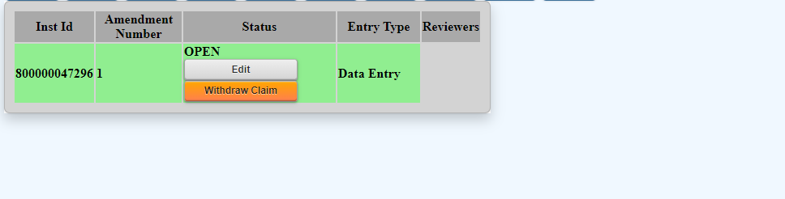
Starting a New MSA-CAP Claim
To open a new claim, go to the MSA-CAP application on the NYSED Business Portal http://portal.nysed.gov/ and next to “Create”, click on the button marked “2025-New”.
Once the screen reloads, use your cursor to hover over “2025” - the new claim should be on the screen and marked as “OPEN”.
To begin working on your new, “Open” claim, click “Edit”.

Slide 37
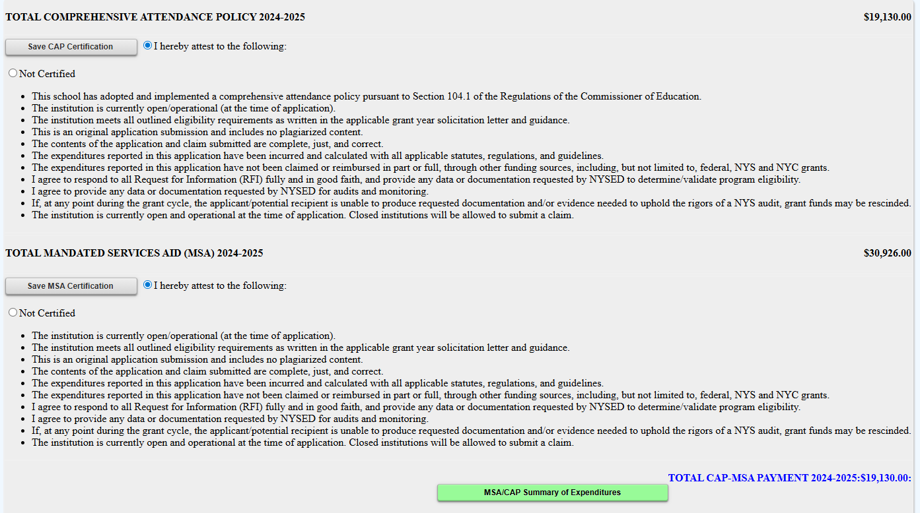
Starting a New MSA-CAP Claim
CAP certification will appear first. You will not be able to certify CAP until you have
  Attested to the items required for certification
  entered (and saved) salary and benefits information for Mandate 1.
Click on MSA-CAP Summary of Expenditures to open your whole claim and begin working on individual mandates.

Slide 38
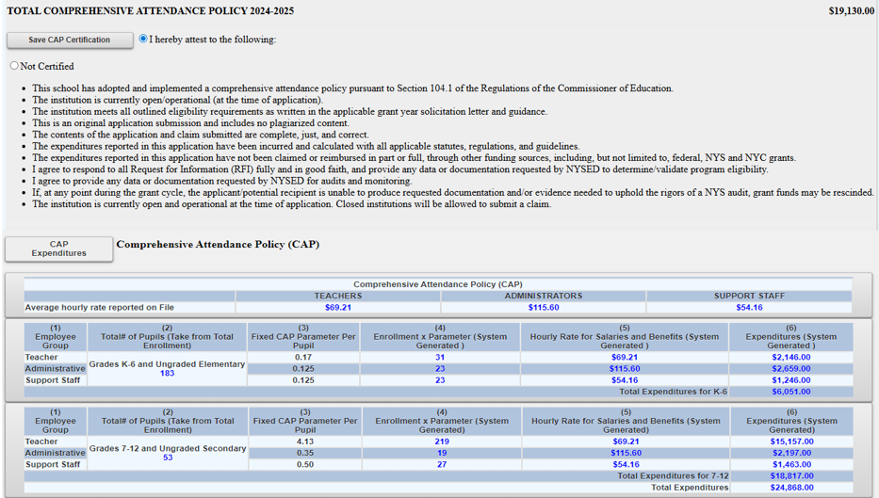
Comprehensive Attendance Policy (CAP) Certification
* You will not be able to CERTIFY and save CAP until AFTER ENTERING DATA FOR MANDATE 1*

Slide 39
BEDS Enrollment Screen

Slide 40

Entering the MSA-CAP Claim
BEDS Enrollment
Click on the “BEDS Enrollment” button and the BEDS Enrollment Screen will expand.
Enrollment data is displayed and populated in the data entry field. Drop down defaults to BEDS on File; change to Opening or Closing if you are entering different values.
Click on the <Save Form>button at the top of the screen.
Note: When selecting either Opening or Closing enrollment, if the enrollment varies from the reported BEDS data, a clear and detailed explanation of the variance must be provided. A box will appear on the screen with an orange note stating, “Enrollment claimed exceeds the tolerance level.” The claim cannot be submitted until the explanation is entered in the box provided. An explanation for any year-to-year increase in enrollment should also be provided in the MSA-CAP Workbook if submitting your claim via email.
A box will appear on the screen for entry of the explanation. The claim cannot be submitted until data entered in the explanation box.

Slide 41
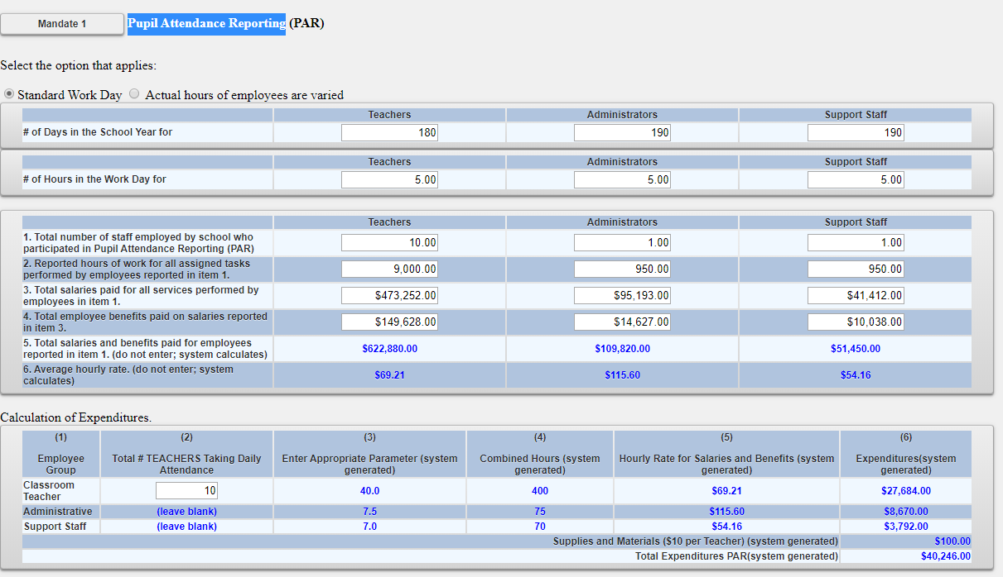
Mandate 1: PAR Screen

Slide 42
Entering the MSA-CAP Claim
Pupil Attendance Reporting (PAR)
Click on the button for “standard workday” or “actual hours of employees are varied”.
If “standard workday ” is selected, enter the # of days in the school year and # of hours in the workday for teachers, administrators and support staff.
The # of days in the school year and at least one entry for # of hours in the workday are required fields.

Slide 43
Completing mandate 1
You need to know how many employees provided the service—line 1.
Enter the total (annual) hours the employees worked—line 2.
Enter the total (annual) salaries for the employees—line 3.
Enter the total (annual) employee benefits—line 4.

Slide 44
Completing mandate 1
(continued)
The system calculates the total (annual) salaries and benefits-line 5.
The system calculates the Average Hourly Rate-line 6.
*Total should always be the ANNUAL total; the system pro-rates mandate totals based on ANNUAL reported totals.

Slide 45
Mandate 1: Pupil Attendance Reporting (PAR)
Calculation of Hourly Rate
& Calculation of Expenditures
Enter data for line 1. Use the “tab” key to move to the next data entry field.
Continue entering data for lines 2-4. When you get to the end of line 4, tab again. If you enter a comma in the number, you will receive an error message after you click on the <Save Form> button.
Enter the total # of teachers taking daily attendance.
Click on the <Save Form> button.
The system calculates the information for lines 5-6 for the calculation of hourly rates and columns 3, 4, 5 & 6 for the calculation of expenditures.
Note: If the PAR total exceeds last year’s amount significantly, an explanation will be requested.
A box will appear on the screen for entry of the explanation. The claim cannot be submitted until data is entered in the explanation box.

Slide 46
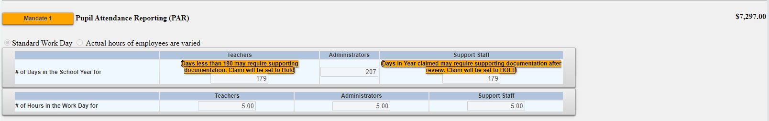
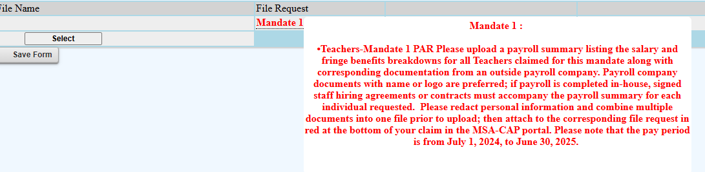
Mandate 1: CALENDAR REQUEST
Your claim may be set to Hold if you enter fewer than 180 days in the school year for Teachers or 190 for Administrators/Support Staff.
This will trigger an orange hold message and a request for a school year calendar (example on slide to follow) for Mandate 1 will appear at the bottom of the claim screen in red. A system triggered email request will follow with a request for document upload sent to the Administrator on file.

Slide 47
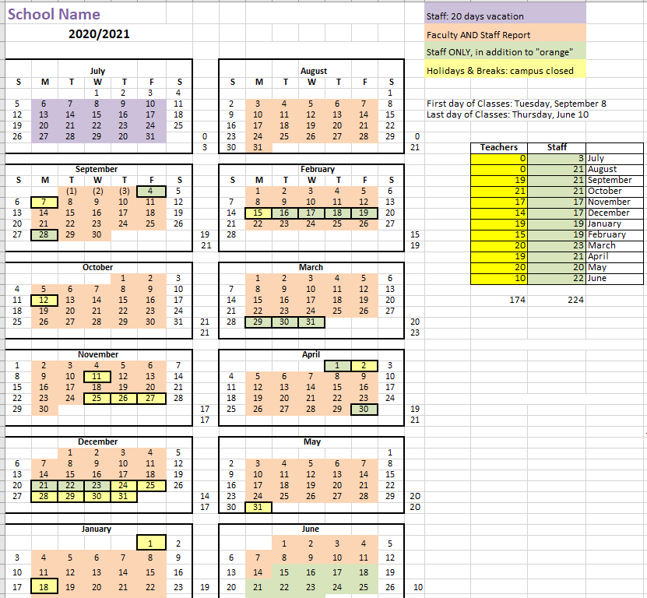
Mandate 1: SAMPLE CALENDAR EXAMPLE
*Please include totals for Teachers and other staff

Slide 48
If your school does not use a payroll company, staff contracts or hiring agreements will be requested for each staff claimed.
Payroll documentation must include:
A redacted payroll company document with the company logo.
Totals matching the amounts claimed
A summary document which:
  specifies the role of each individual (Administrator, Teacher, Support Staff)
  shows a breakdown of fringe benefits for each individual.
  calculates a total for gross salary and benefits for each staff claimed.
Mandate 1: SAMPLE PAYROLL EXAMPLES documents

Slide 49
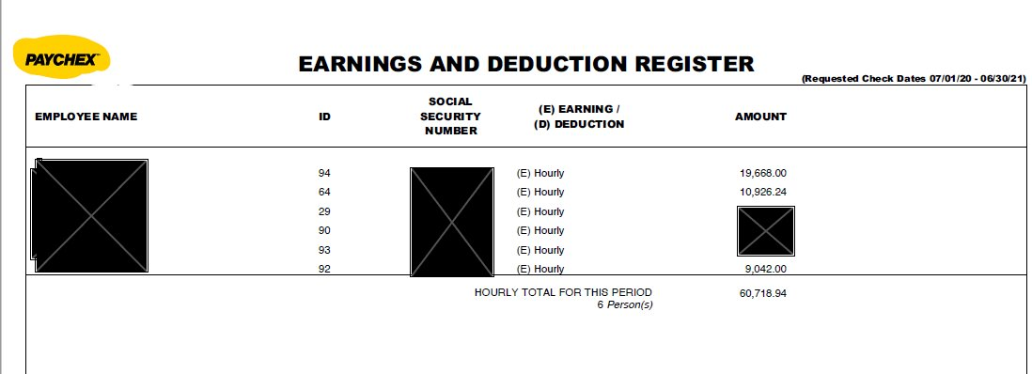
Mandate 1: SAMPLE PAYROLL EXAMPLE- payroll company document (redacted, with logo)

Slide 50
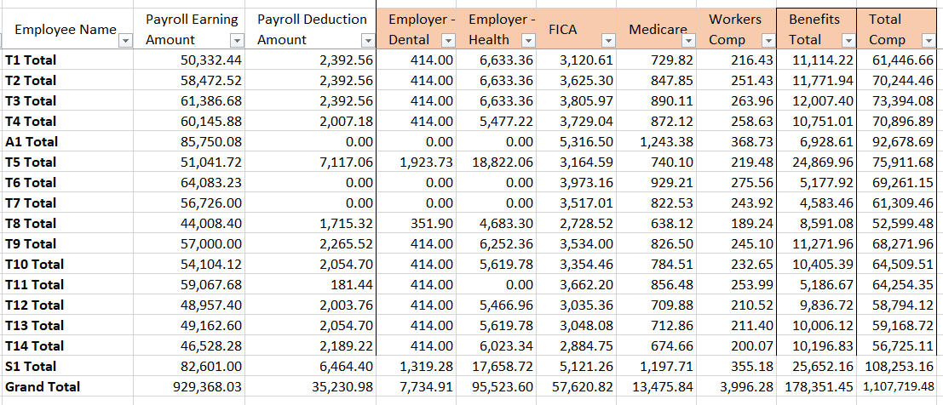
Mandate 1: SAMPLE PAYROLL summary

Slide 51
Mandate 2: Elementary and Intermediate Assessment in English Language Arts and Math (EIA)
Calculations of Hourly Rate, Combined Hours, & Expenditures
Calculation of Hourly Rate
Enter data for line 1. Use the “tab” key to move to the next data entry field.
Continue entering data for lines 2-4. When you get to the end of line 4, tab again.
If you enter a comma in the number or if you enter a character instead of a number in any of the fields, you will receive an error message saying “not a valid number” after you click on the <Save Form> button. A caution sign will appear next to the field that caused the problem.
*Documentation must be maintained for all expenditures.*

Slide 52
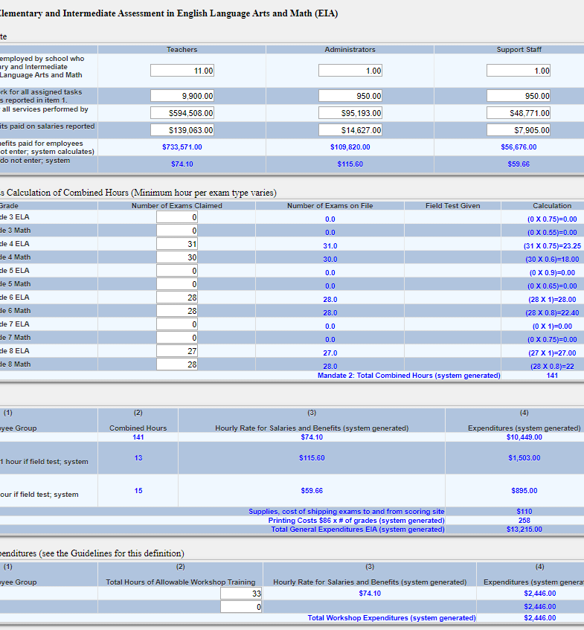
Mandate 2:
EIA Screen

Slide 53
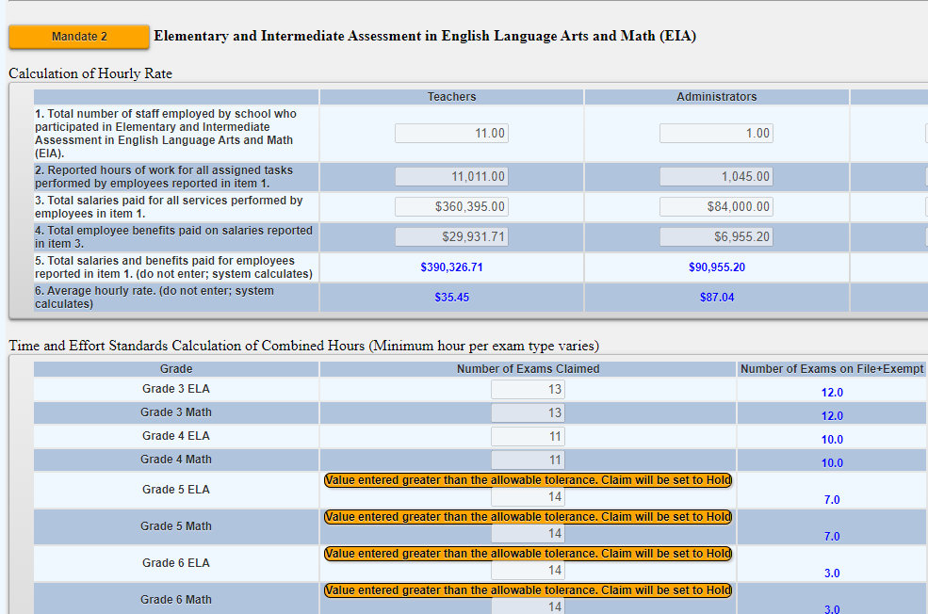
Mandate 2: EIA HOLD
Your claim may trigger a hold if the number of exams does not match the exams on file. You may still claim the number of exams entered but will be asked to provide documentation.

Slide 54
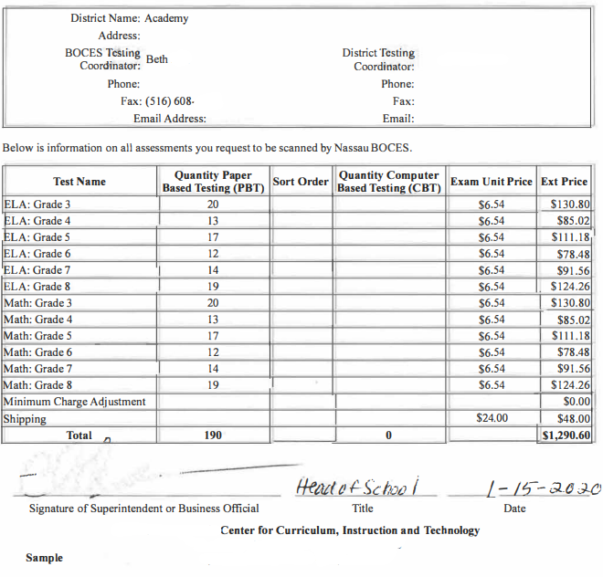
Mandate 2:
EIA SAMPLE DOCUMENT

Slide 55
Mandate 2: (EIA)
Calculations of Hourly Rate, Combined Hours, & Expenditurescontinued
Exam Expenditures
Enter the number of tests administered (compare to number of tests showing as on file).
Teacher Workshop Expenditures
Enter the total hours of allowable workshop training.
Enter the dollar amount of the workshop fee.
The system generates the calculations of Total Expenditures and Total Workshop Expenditures and populates the “MSA/CAP Summary of Expenditures” Screen.
*Documentation must be maintained for all these expenditures.*

Slide 56
Mandate 3: Basic Educational Data System Reporting (BEDS) Enrollment
Click on the <Mandate 3> button.
Enter data for line 1. Use the “tab” key to move to the next data entry field.
Continue entering data for lines 2-4.
Enter the total # of teachers taking daily attendance in the calculation of expenditure area.
Click on the <Save Form>button.
The system generates the information for lines 5 and 6 and completes the fields for Calculation of Expenditures and populates the “MSA/CAP Summary of Expenditures” Screen.
*Documentation must be maintained for all these expenditures.*

Slide 57
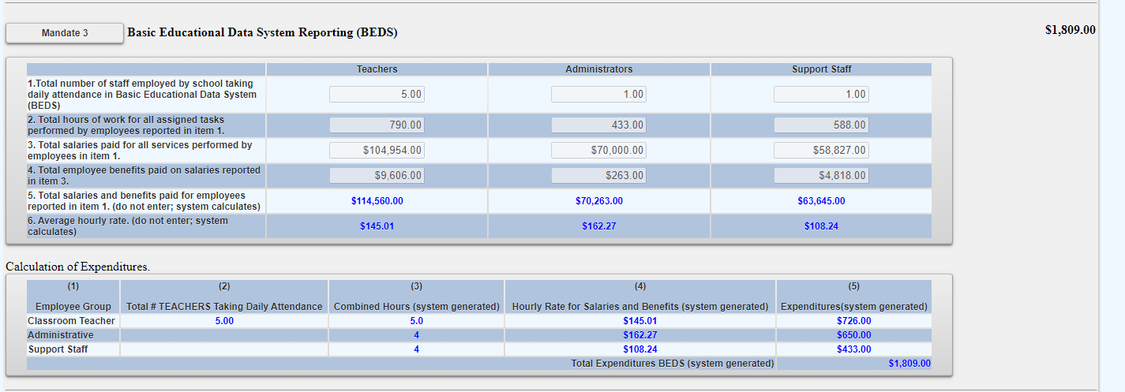
Mandate 3: BEDS Reporting
Screen

Slide 58
Mandate 4: Regents Examinations
Calculation of Hourly Rate
Click on the <Mandate 4> button.
Enter data for line 1. Use the “tab” key to move to the next data entry field.
Continue entering data for lines 2-4.
The system generates the information for lines 5 and 6 and completes the fields for Calculation of Expenditures.
*Documentation must be maintained for all these expenditures.*

Slide 59

Mandate 4: Regents Examinations (continued)
Calculation of Combined Hours
The system shows the number of Regents exams that were reported to the Office of Information Reporting Services (SIRS).
Enter the number of exams that were administered. Use the “tab” key to move to the next field.
You must make an entry for each exam you want to receive reimbursement for.
When you have completed entering the exam data, click the <Save Form> button at the top and bottom of the claim. The system then generates the Total General Expenditures.
  *Documentation must be maintained for all these expenditures.*

Slide 60
Mandate 4: Regents Exams (continued)
Teacher Workshop Expenditures
Under Section B enter the total hours of allowable workshop training.
Enter the dollar amount of the workshop fee.
The system generates the Total Expenditures,
Test Kits
Under Section C, enter the total number students taking Regents Earth Science and the number of Earth Science Test Kits purchased during the school year.
The system generates the calculations of the Total Expenditures and Total Workshop/Test Kits Expenditures and populates the “MSA/CAP Summary of Expenditures” Screen.
*Documentation must be maintained for all these expenditures.*

Slide 61
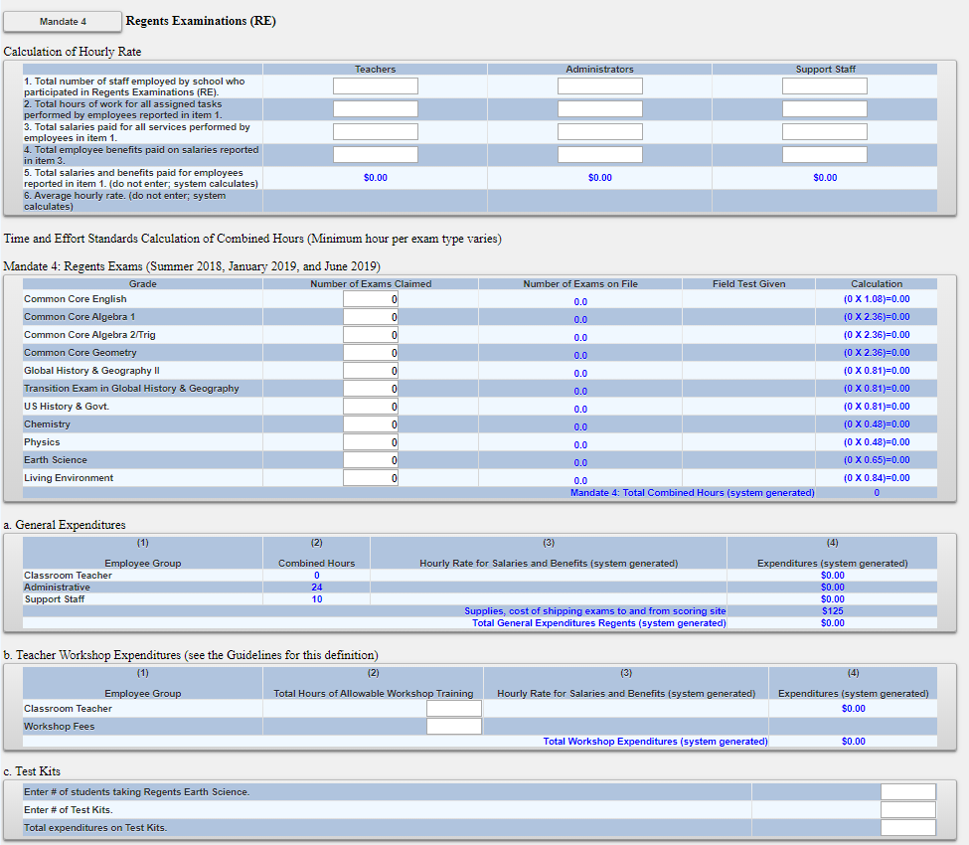
Mandate 4:Regents Exam Screen

Slide 62
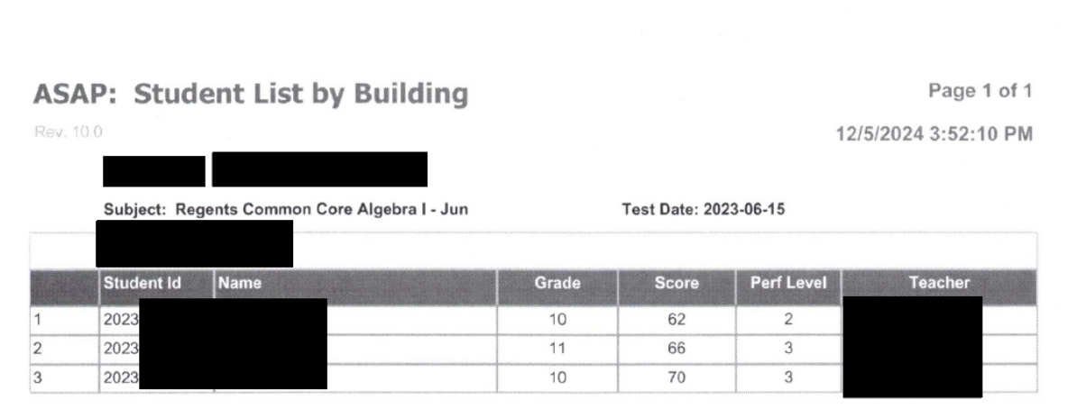
Mandate 4: Regents Exam
Sample Document

Slide 63

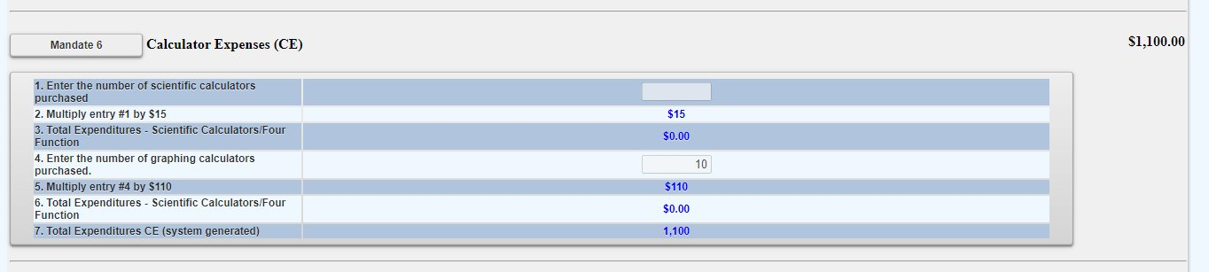
Mandate 6: Calculator Expenses
Enter the number of scientific calculators that were purchased.
Use the “tab” key to move to the next data entry field.
Enter the number of graphing calculators that were purchased.
Click on the <Save Form> button.
The system generates the calculations of Total Expenditures and populates the “MSA/CAP Summary of Expenditures” screen.
*Documentation must be maintained for all these expenditures in the form of a receipt*

Slide 64
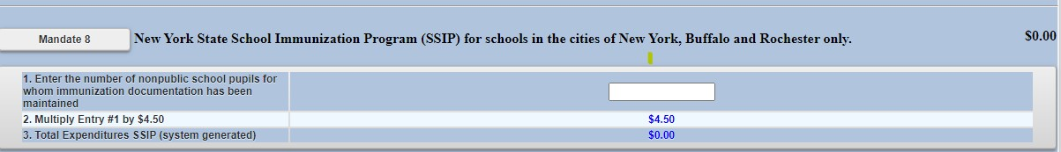
Mandate 8: New York State School Immunization Program (SSIP)
Only Grade K-12 students in non-public schools in New York City, Buffalo or Rochester that filed their immunization data with NYSDOH are eligible for Mandate 8. The Mandate 8 button will be disabled for the other non-public schools.
Enter the number of non-public school pupils for whom immunization documentation has been maintained.
The system generates the calculations of Total Expenditures for SSIP and populates the “MSA/CAP Summary of Expenditures” screen.
Mandate 8 rate increase – The SSIP, State School Immunization Program, rate has been set at $4.62 for 2024-2025.

Slide 65
Mandate 9: Documentation of Integration of Required Instruction in 7th and 8th Grade
(DIRI)
Calculation of Hourly Rate
Click on the <Mandate 9> button.
Enter data for line 1. Use the “tab” key to move to the next data entry field.
Continue entering data for lines 2-4.
Calculation of Expenditures
Use the “tab” key to move to the combined hours field.
Enter Total # of 7th & 8th grade teachers that participated in the mandate.
Click on the <Save Form> button.
The system generates the calculations of Total General Expenditures for DIRI and populates the “MSA/CAP Summary of Expenditures” screen.
*Documentation must be maintained for all these expenditures.*

Slide 66
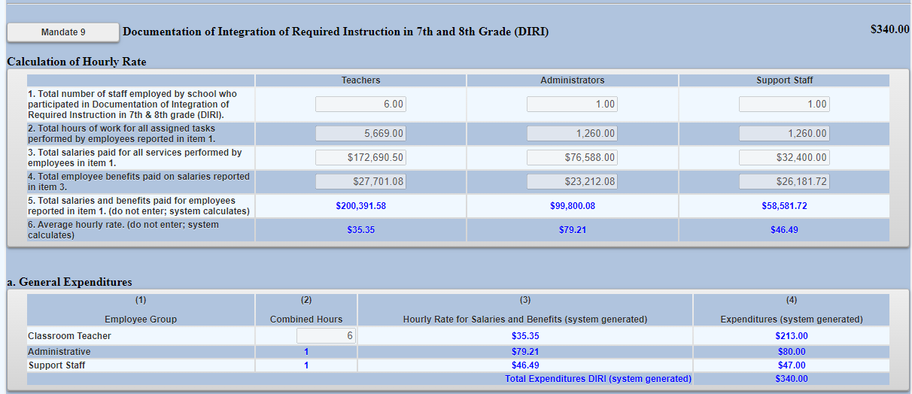
Mandate 9: DIRI Screen

Slide 67
Mandate 10:
High School Graduation Report (HSGR)
Calculation of Hourly Rate
Click on the <Mandate 10> button.
Enter data for line 1. Use the “tab” key to move to the next data entry field.
Continue entering data for lines 2-4.
Calculation of Expenditures
Use the “tab” key to move to the next field.
Enter the number of graduation candidates. Please note that if the # entered does not match the # on-file, documentation will be requested.
Click on the <save> button.
The system generates the calculations of Total General Expenditures for HSGR and populates the “MSA/CAP Summary of Expenditures” screen.

Slide 68
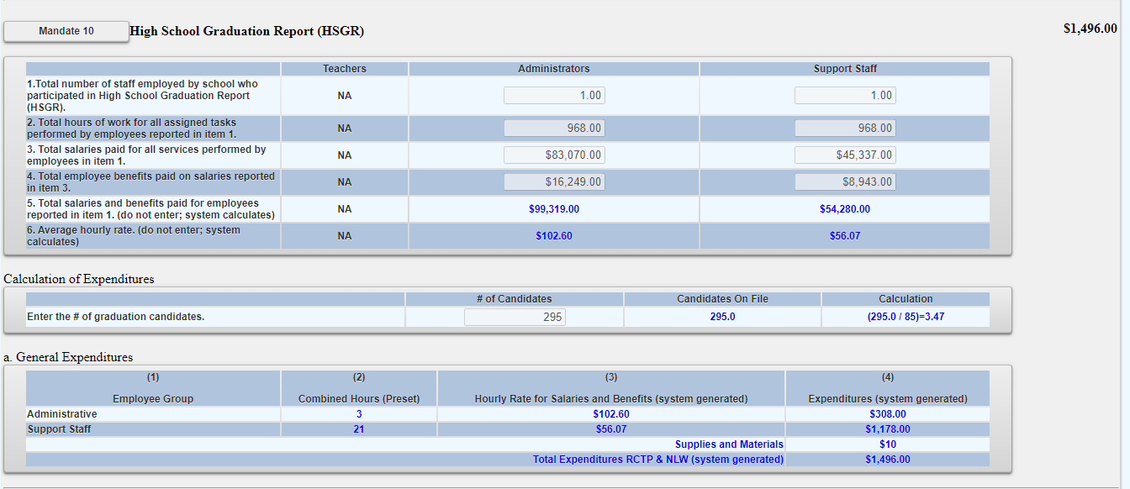
Mandate 10: (HSGR) screen

Slide 69
Mandate 11: Grade Five Science Test (GFST)
Calculation of Hourly Rate
Enter data for line 1. Use the “tab” key to move to the next data entry field.
Continue entering data for lines 2-4. Do not use commas. When you get to the end of line 4, tab again.
If you enter a comma in the number or if you enter a character instead of a number in any of the fields, you will receive an error message saying “not a valid number” after you click on the “save” button. A caution sign will appear next to the field that caused the problem.
Enter number of tests administered, regardless of amount shown as on file. You may be asked for documentation if amount differs.
*Documentation must be maintained for all these expenditures.*

Slide 70
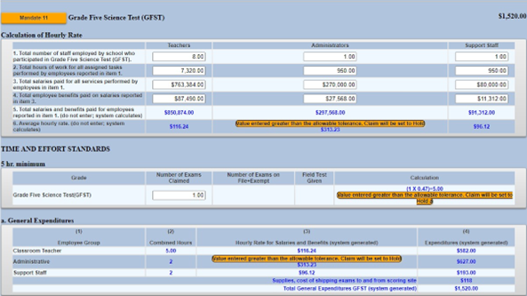
Mandate 11: Grade Five Science Test Screen

Slide 71
Mandate 11: GFST – Teacher Workshop Expenditures & Test Kits
Teacher Workshop Expenditures
Enter the total hours of allowable workshop training (the time that the teacher is out of the classroom). Use the “tab” key to move to the next field.
Enter the dollar amount of workshop fees. Use the “tab” key to move to the next field.
Test Kits
Enter number of students taking Grade Five Science Test
Enter number of test kits purchased (Note: each kit serves 30 pupils)
Click on the <Save Form> button.
The system generates the calculations of Total Expenditures and Total Workshop/Test Kits Expenditures and populates the “MSA/CAP Summary of Expenditures” Screen.
*Documentation must be maintained for all these expenditures.*

Slide 72
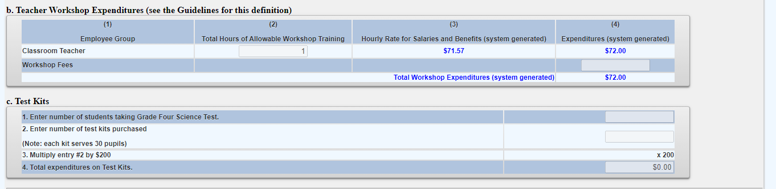
Mandate 11: GFST – Teacher Workshop Expenditures & Test Kits Screen

Slide 73
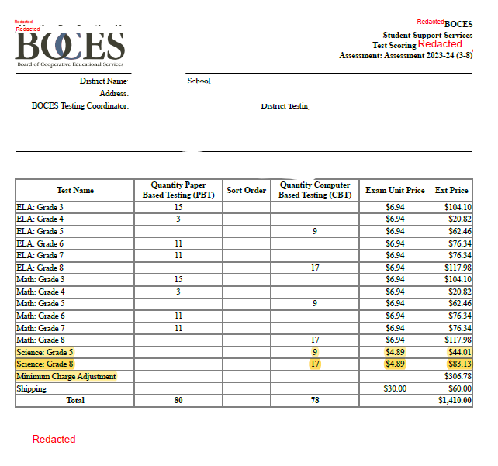
Mandate 11: Grade Five Science
Sample Document Example

Slide 74
Mandate 12: Travel to Storage Sites
(TSS)
TSS Expenditures
Enter total number of staff employed by school who participated in TSS.
Enter total hours of work for all assigned tasks performed by employees reported in line 1.
Enter total salaries paid for all services performed by employees in line 1.
Enter total employee benefits paid on salaries in line 3.
Enter total salaries and benefits paid for employees reported in line 1. ( system automatically calculates)
Average hourly rate is automatically calculated by system.
Click on the <Save Form> button.
The system generates the calculations of Total Expenditures and Total Workshop Expenditures and populates the “MSA-CAP Summary of Expenditures” Screen.
*Documentation must be maintained for all these expenditures.*

Slide 75
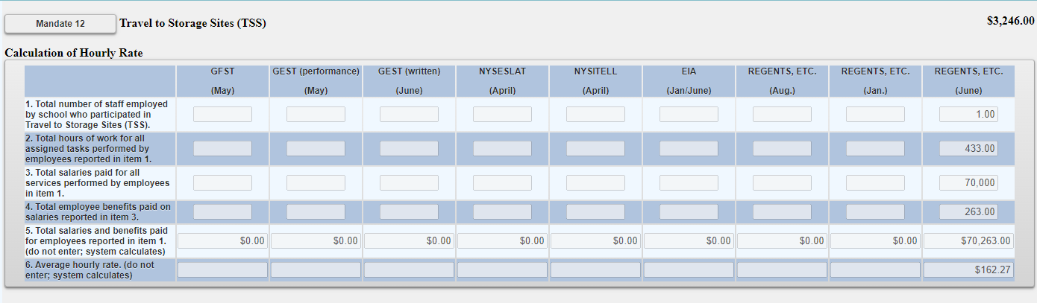
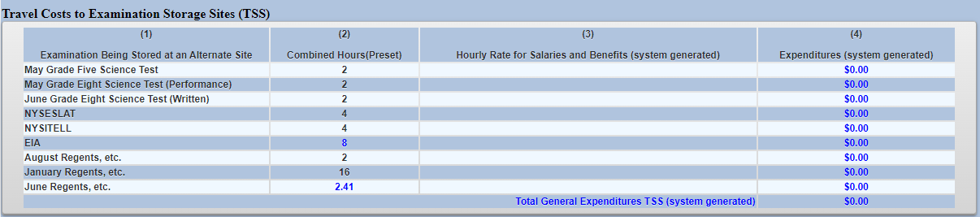
Mandate 12: Travel to Storage Sites (TSS) Screen

Slide 76
Mandate 13: Scholarship for Academic Excellence Application (SAE)
SAE Expenditures
Enter total number of staff employed by school who participated in the SAE.
Enter total hours of work for all assigned tasks performed by employees reported in line 1.
Enter total salaries paid for all services performed by employees in line 1.
Enter total employee benefits paid on salaries in line 3.
Enter total salaries and benefits paid for employees reported in line 1. ( system automatically calculates)
Average hourly rate is automatically calculated by system.
Click on the <Save Form> button.
The system generates the calculations of Total Expenditures and Total Workshop Expenditures and populates the “MSA-CAP Summary of Expenditures” Screen.
*Documentation must be maintained for all these expenditures.*

Slide 77
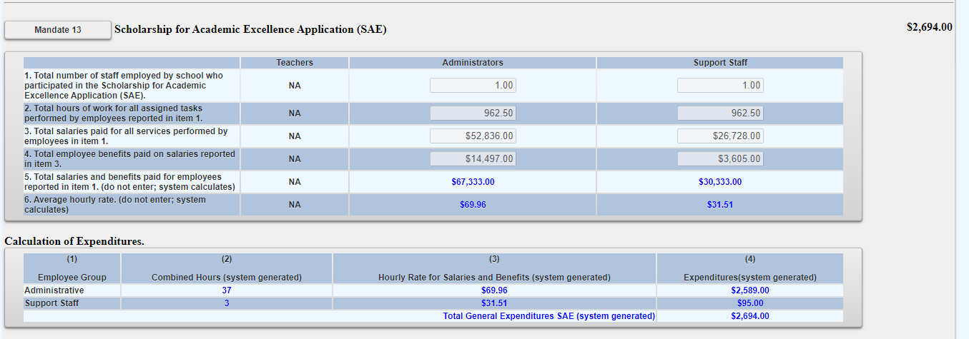
Mandate 13: Scholarship for Academic Excellence Application (SAE) Screen

Slide 78
Mandate 14: Grade Eight Science Test (GEST)
GEST Expenditures
Enter total number of staff employed by school who participated in Grade Eight Science Test (GEST).
Enter total hours of work for all assigned tasks performed by employees reported in line 1.
Enter total salaries paid for all services performed by employees in line 1.
Enter total employee benefits paid on salaries in line 3.
Enter total salaries and benefits paid for employees reported in line 1. ( system automatically calculates)
Average hourly rate is automatically calculated by system.
Enter number of tests administered, regardless of amount shown as on file. You may be asked for documentation if amount differs.
Click on the <Save Form> button.
The system generates the calculations of Total Expenditures and Total Workshop Expenditures and populates the “MSA-CAP Summary of Expenditures” Screen.

Slide 79
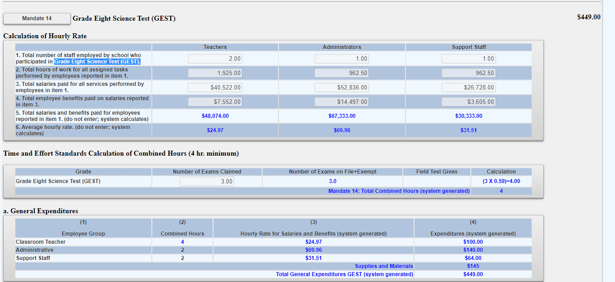
Mandate 14: Grade Eight Science Test (GEST) Screen

Slide 80
Mandate 14: Grade Eight Science Test (GEST) Sample Document Example

Slide 81
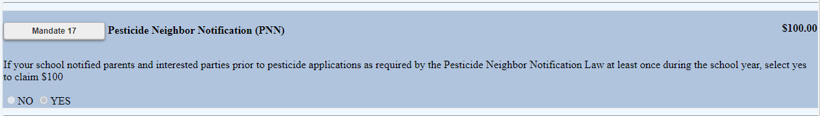
Mandate 17: Pesticide Neighbor Notification (PNN)
The School Pesticide Neighbor Notification Law requires all Non-public schools to notify parents and interested parties prior to pesticide applications in instructional and administrative buildings and grounds, as well as playgrounds and athletic fields.
Click yes to claim if your school notified parents and interested parties prior to pesticide applications as required by the Pesticide Neighbor Notification Law.
The system will automatically award $100 for this mandate if claimed.

Slide 82
Mandate 18: New York State English as a Second Language Achievement Test (NYSESLAT) and New York State Identification Test for English Language Learners(NYSITELL)
NYSESLAT/NYSITELL Expenditures
Enter total number of staff employed by school who participated in NYSESLAT/NYSITELL.
Enter total hours of work for all assigned tasks performed by employees reported in line 1.
Enter total salaries paid for all services performed by employees in line 1.
Enter total employee benefits paid on salaries in line 3.
*Documentation must be maintained for all these expenditures.*

Slide 83
Mandate 18: New York State English as a Second Language Achievement Test (NYSESLAT) and New York State Identification Test for English Language Learners(NYSITELL)
NYSESLAT/NYSITELL Expenditures
Enter total salaries and benefits paid for employees reported in line 1. ( system automatically calculates)
Average hourly rate is automatically calculated by system.
Enter number of tests administered, regardless of amount shown as on file. You may be asked for documentation if amount differs.
Click on the <Save Form> button.
The system generates the calculations of Total Expenditures and Total Workshop Expenditures and populates the “MSA-CAP Summary of Expenditures” Screen.

Slide 84
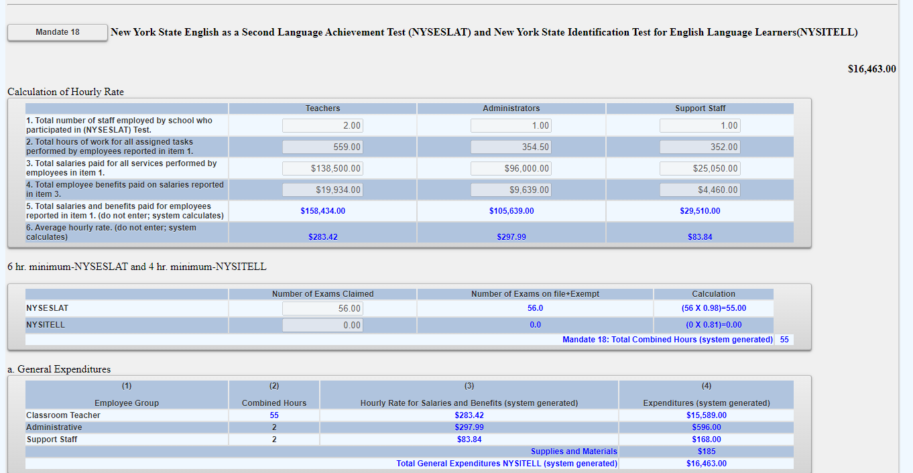
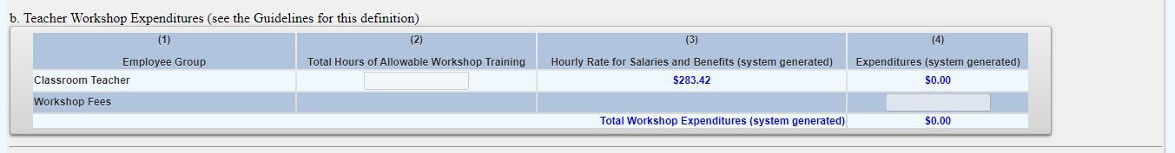
Mandate 18: New York State English as a Second Language Achievement Test (NYSESLAT) and New York State Identification Test for English Language Learners(NYSITELL) Screen

Slide 85
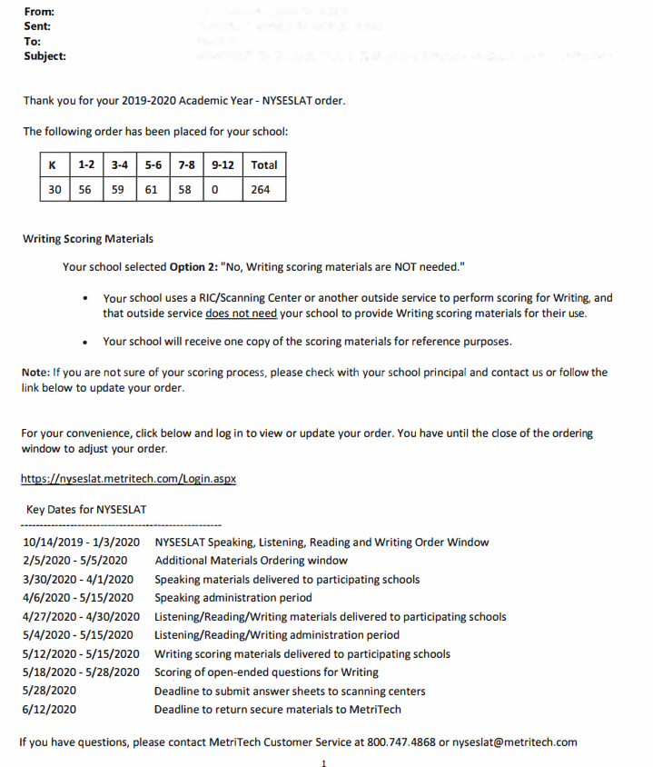
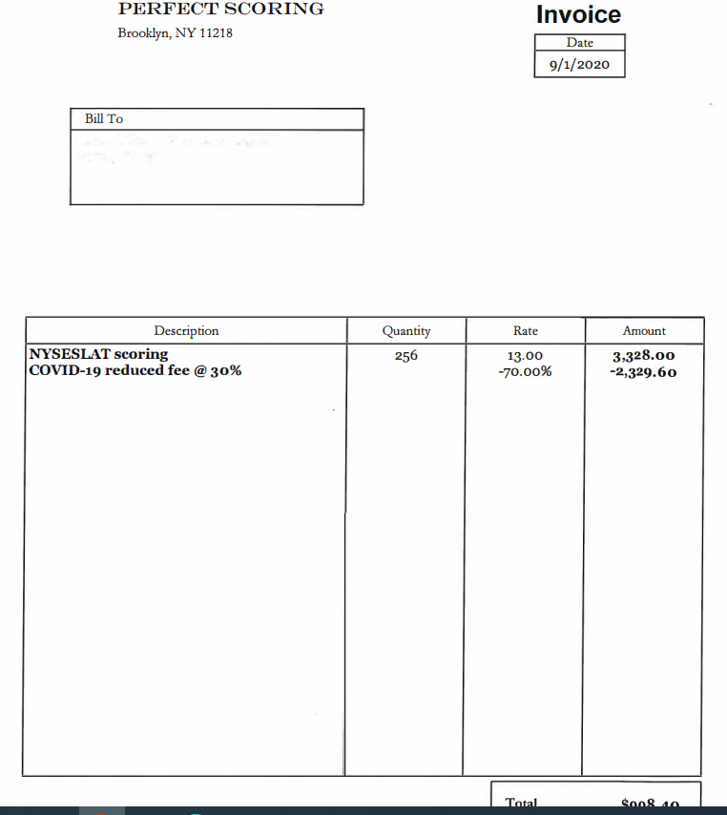
Mandate 18: NYSESLAT & NYSITELL Test
Sample Document Examples

Slide 86
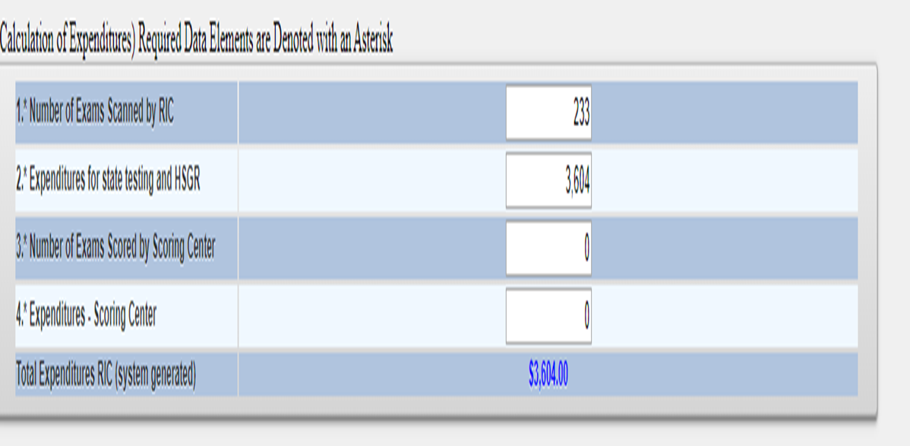
Mandate 19-RIC & Scoring Center Expenditures
An entry must be made in each field. If you only have the total expenditures for the scanning and scoring, enter zeroes in the other fields. If you leave the fields blank, a warning message will appear at the top of the screen.
The 3rd through 8th grade tests may be scored by Regional Scoring Centers. (Note: If your tests are graded by a Scoring Center, no printing costs are separately reimbursed under Mandate 2, EIA.)
Round to the nearest dollar amount when entering expenditure amounts.

Slide 87
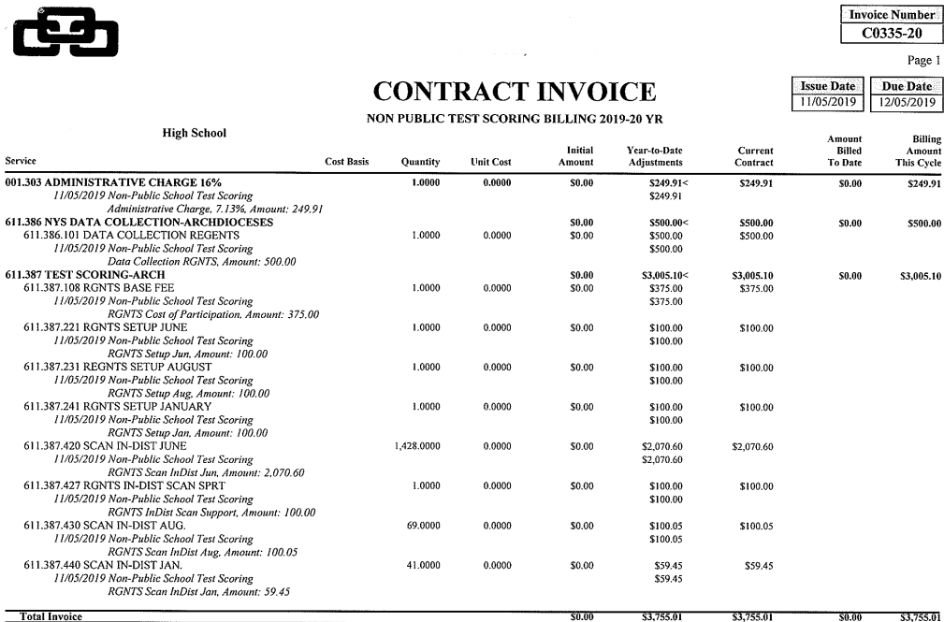
Mandate 19-Sample Document Example

Slide 88
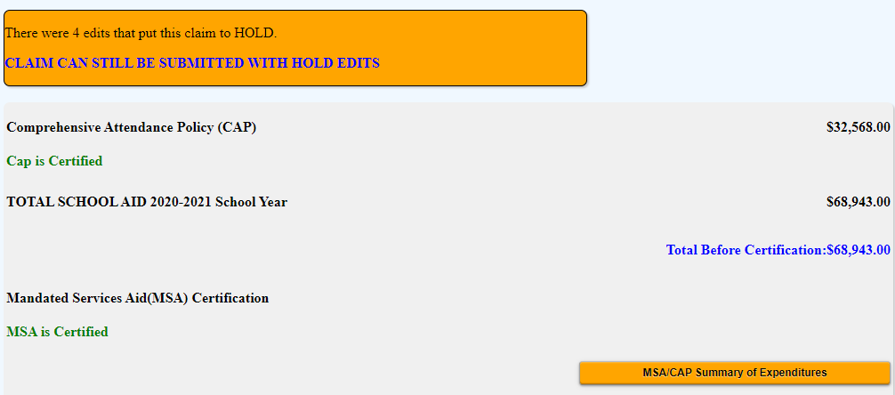
Hold Messages
Expanding the “MSA-CAP Summary of Expenditures” button will show details including reason/s for the claim being placed in hold status.

Slide 89
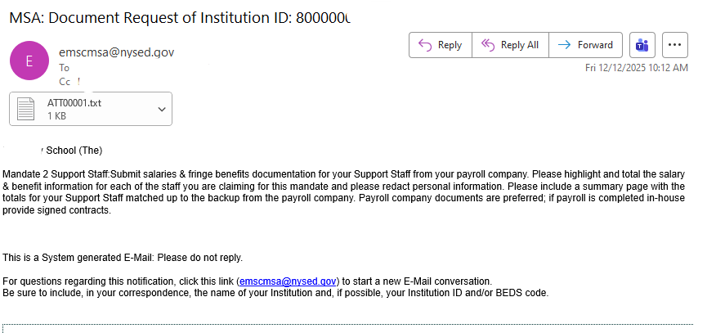
HOLD CLAIMS: UPLOAD DOCUMENT REQUEST
The claims in hold status will be reviewed by MSA-CAP staff who will send a request to schools to provide supporting document/s.
School will also receive a system triggered e-mail request (shown below).
Schools will be able to access their claims in the MSA-CAP system to upload requested document/s directly to the file request, which will appear in red at the bottom of the claim.

Slide 90
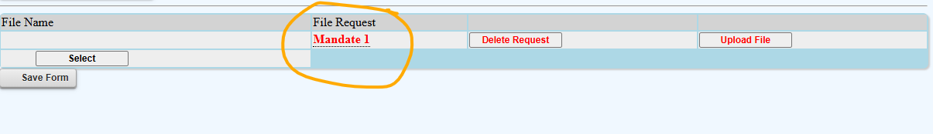
UPLOADING DOCUMENT REQUEST FILES (continued)
Scroll down to the File Request at the bottom of your claim screen
Select the File to attach for upload
Please note that pending file requests are displayed in red. Completed uploads will change from red to black/blue when uploaded.
Please upload the file to the corresponding request.
The system will not allow multiple files; please combine into one document prior to upload or contract ORISS to request additional spots.
Hover over the Mandate listed under File Request and more information will appear.

Slide 91
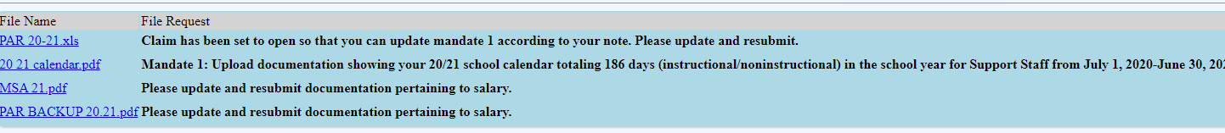
UPLOAD DOCUMENT REQUEST (continued)
After the file is uploaded, there will be a link that both the schools and the reviewer can view and download.
Claims that were successfully uploaded will have the file name displayed in blue and the file request will change from red to black.

Slide 92
Submit and Certify
Non-public schools have the option to assign an MSA CFO to submit and certify their MSA-CAP claim. Currently, most non-public schools only have the CEO in that role. If schools would like to add an MSA-CAP CFO to submit and certify their claim, please email datasupport@nysed.gov.
If your non-public school does not have a CFO, the submit and certify roles automatically defaults to the CEO. Once the MSA-CAP CFO is added to SEDREF, please contact our office and we will entitle the MSA-CFO to the MSA-CAP NYSED Business portal online system.
Additional staff must be entitled by the school CEO to enter data using SEDDAS.

Slide 93
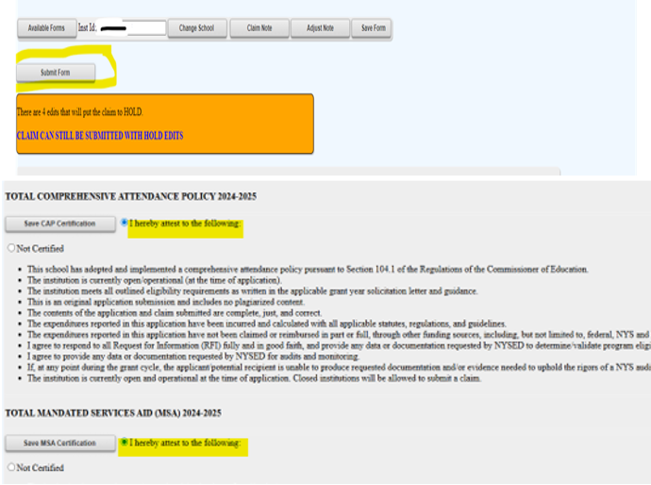
Submitting the MSA Claim
Read the certification statements and click the “I hereby attest" CAP Certification and MSA Certification” bullets.
Click on the <Submit Form> button at the top of the claim.
Once submitted, the system returns you to the “home” screen and displays the status of the claim.
You will also receive a system message with your claim submission status.

Slide 94
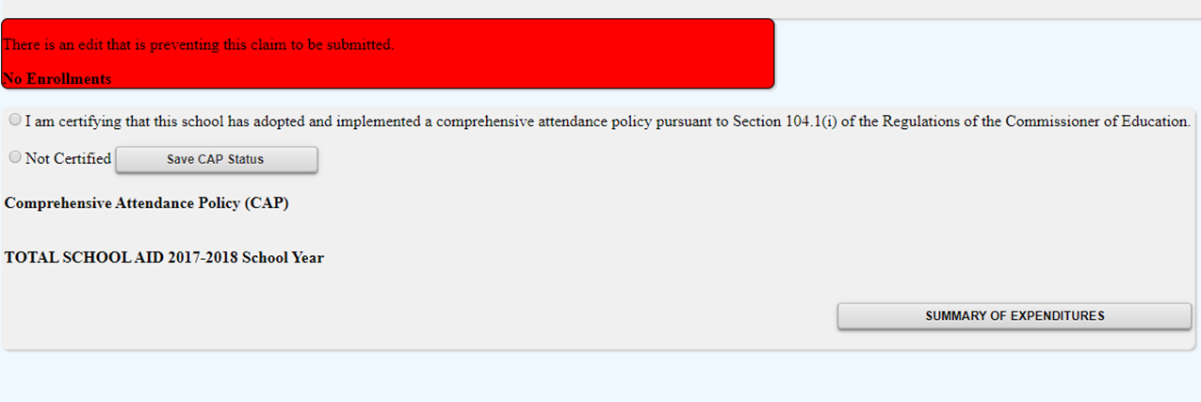
Submitting Claims: Warning Messages
*Expanding the Summary of Expenditures button will show the user the issues preventing submission of the claim.

Slide 95

Record-keeping
It is very important that accurate documentation be kept by every school that claims mandated services. Even if your MSA-CAP claim forms are completed by an independent contractor or diocesan office, the school is responsible for maintaining complete records.
Documentation must be maintained for a minimum of 7 years. Records must be available for inspection, monitoring and/or audit by the New York State Education Department and the Office of the State Comptroller.
It is recommended that each school creates and maintains a mandated services documentation file for each school year that a claim is submitted.

Slide 96
Recordkeeping (continued)
The following list identifies documentation that we recommend schools keep on file or otherwise have readily available:
  Payroll company records, for only those employees providing the mandated service, including allowable fringe benefits. If you use a payroll service, you will need to put copies of the applicable payroll records in the mandated services aid documentation file. If you do not use a payroll company, copied of signed contracts will be requested.
  Salary agreements and/or contracts for those employees providing mandated services.
  Time distribution records. You are required to maintain documentation to show that the employee actually provided services such as taking attendance or proctoring exams.

Slide 97
Recordkeeping (continued)
  Student enrollment records, class schedules or Attendance rosters.
  Invoices/cancelled checks or credit card receipts/statements for purchases made to perform mandated services.
  Any documentation that supports the information and calculations used to prepare any claim for nonpublic school aid.
  Schools must maintain inventory records for calculators and science test kits. Calculators are not a consumable product. The inventory control procedure should include a replenishment cycle to replace aging and broken calculators. Calculators may not be given permanently to students. Only scientific and graphing calculators are reimbursable.
  Documentation of calculator purchase must be retained for monitoring and/or audit.

Slide 98
Recordkeeping (continued)
Documentation of the hours that form the basis for a standard workday must be maintained by the school.
Information gathering per Comptroller’s Audit.
Documentation must be maintained to show the basis of the calculation for the average hourly rates.
Schools must maintain inventory records of the science test kits and earth science test kits.
Evidence of number of students who graduated from high school such as student transcripts.
Records of student scores on State examinations such as the Individual Student Score Reports, Nonpublic Secondary Examination Report, Comprehensive Information Report.
Failure to maintain adequate supporting documentation may result in a disallowance or partial disallowance.
NOTE: This is not an all-inclusive list

Slide 99
HOW TO VIEW/SAVE/PRINT CLAIM AS PDF

Slide 100
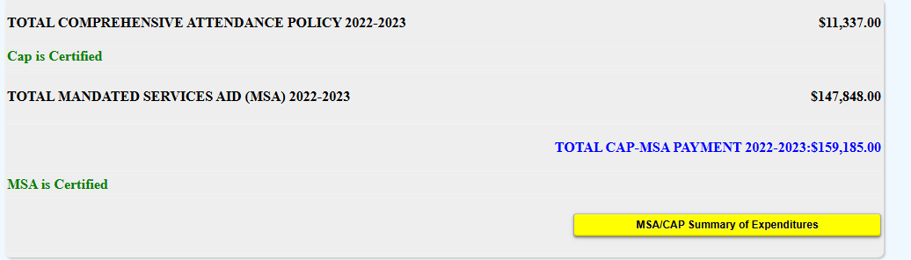
Select the MSA-CAP Summary of Expenditures button to expand and open the other mandates/

Slide 101

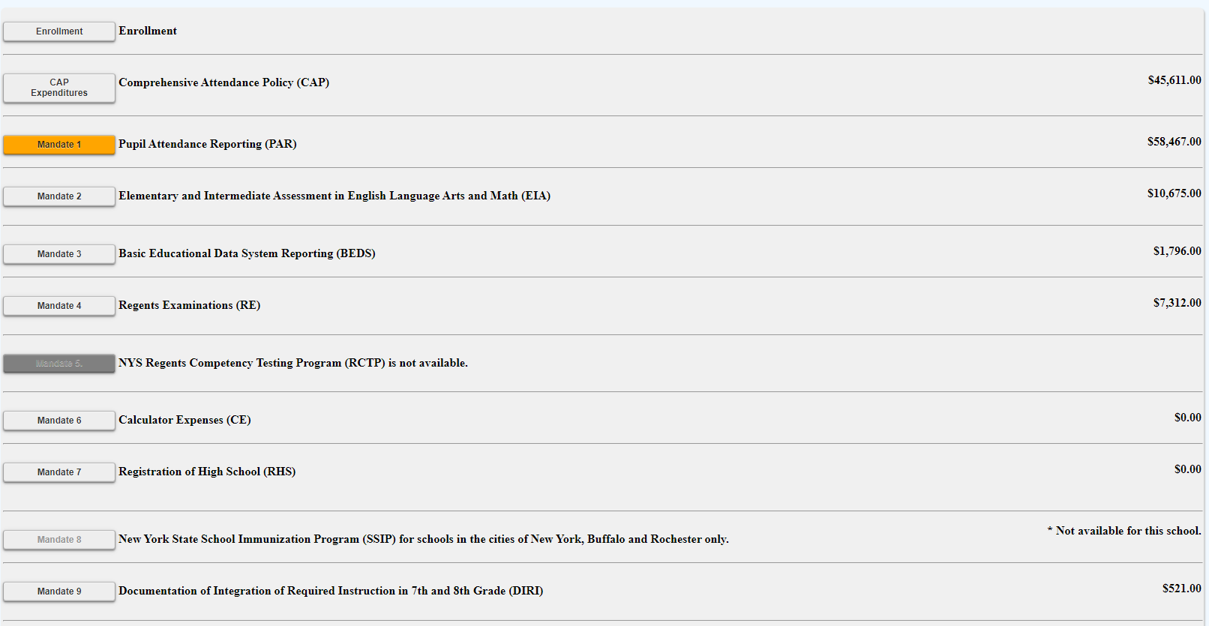
Select each mandate to expand and view detailed explanation of each mandate.

Slide 102
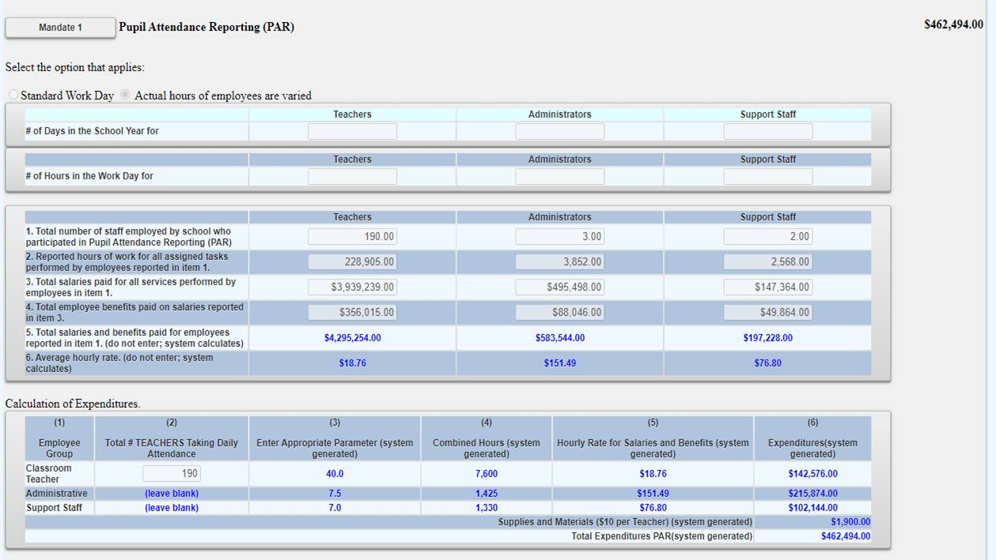
Sample of expanded mandate

Slide 103
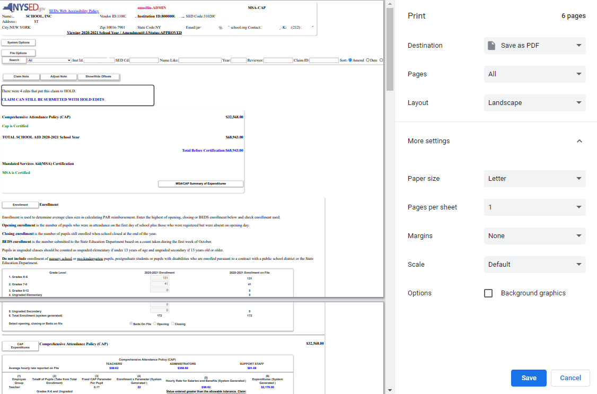
Select print feature and print or save document as PDF and print. You may need to decrease the document size to ensure the entire claim is visible on their screen before printing.

Slide 104

For additional assistance with msa-cap email: msa-cap-oriss@nysed.gov

