Slide 1

MSA-CAP Online System
User Guide
2023-2024
Office of Religious and Independent School Support (ORISS)

Slide 2
School Year 2023-24
The MSA-CAP Guidance documents highlighting the MSA-CAP process are available on the ORISS Forms and Guidance Documents web page
www.nysed.gov/nonpublic-schools/mandated-services-aidcomprehensive-attendance-policy-msa-cap

Slide 3
Presentation Overview
MSA-CAP Overview & Summary of Mandates- slide 7
Comprehensive Attendance Policy (CAP)-slide 16
MSA-CAP General Information- slide 25
MSA-CAP System Access- slide 22
Entering a claim/Using the MSA-CAP portal- slide 32
Recordkeeping- slide 93
Save/Print Claim as PDF-slide 97
What’s New- slide 4

Slide 4


Field Testing 2023-2024
During the 2023-24 school year, field tests were administered for the following MSA related exams:
    NYSESLAT (Mandate 18)
    Grades 3-8 ELA and Math Elementary and Intermediate exams (Mandate 2)
    Regents’ exams in Algebra I & II , English, Geometry, Global History II, Biology, Chemistry, and Earth Space

Slide 5

exams 2023-2024
  Mandate 11: Grade 4 Science Test (GFST) will now be administered as Grade 5 science test and this change will continue in the future.
The following exams were given in 2023-2024:
    3-8 ELA (Mandate 2)
    3-8 Math (Mandate 2)
    August 2023, January 2024, June 2024 Regents (Mandate 4)
    Grade 5 Science Test (Mandate 11)
    Grade 8 Science Test (Mandate 14)
    K-12 NYSESLAT/NYSITELL (Mandate 18)

Slide 6

Mandate 13 (sae)- change ahead for 2025-26 submissions
Mandate 13: New York State Scholarships for Academic Excellence Application (SAE):
For the first time, beginning next year for 2025-26, the SAE scholarship nominations will be accepted only through SED Monitoring.
This new online process discontinues the paper form and will increase the efficiency and management of this vital scholarship program for the students receiving the award. Any questions on SAE, its survey, or submission may be sent via email to scholar@nysed.gov.
The deadline for submission is February 28, 2025. Claims for Mandate 13 will only be accepted for submissions made through SED Monitoring.
The 2023-24 MSA-CAP claim year guidelines for Mandate 13 will not change.

Slide 7
Mandated Services Aid (MSA) overview
Mandated Services Aid (MSA) is a New York State funded reimbursement program for nonpublic schools. The schools receive reimbursement for the state mandates they have met in the prior school year (July 1 to June 30).
The reimbursement request, or claim, must be processed via our online system or submitted by email on or before April 1st annually.
To assist NYSED in the timely review of MSA-CAP claims placed on hold, schools must provide an explanation for any year-to-year changes in total and average hourly compensation, staffing levels, hours worked, tests administered, enrollment, etc., both in the MSA-CAP system and in the MSA-CAP workbook.
A full listing of the mandates and a brief explanation of each follows this introduction.
The NYS Comptroller has the authority to audit the records of private firms and non-profit organizations that receive funding from public programs such as Nonpublic School Aid for accuracy and compliance with State law.

Slide 8
SUMMARY OF MANDATES
Mandate 1: Pupil Attendance Report (PAR): Attendance must be recorded once daily, summarized periodically, and maintained on file by the school. PAR applies to grades Kindergarten through 12th grade only.
Mandate 2: Elementary and Intermediate Assessment in English Language Arts and Math (EIA): Grades 3 through 8 Math and English Language Arts (ELA) tests must be administered and reported to the New York State Education Department’s Office of Information and Reporting Services (IRS) through a contract with a Regional Information Center (RIC) for scanning and reporting in the Student Repository System (SIRS).

Slide 9
SUMMARY OF MANDATES
Mandate 3: Basic Educational Data System (BEDS) Reporting of Enrollment. Non-public schools must filed BEDS Reports with NYSED by the established deadline in order to receive MSA-CAP reimbursement. Include only those teachers that participated in Pupil Attendance Reporting (PAR). Do not include Pre-K teachers in your claim.
Mandate 4: Regents Examinations (RE): Regents exams must be administered, scored, the results interpreted, and reported in level 0 of SIRS. Non-public schools that administer any of the Regents Examinations must contract for data collection, scanning, and reporting services with a RIC.

Slide 10
SUMMARY OF MANDATES
Mandate 6: Calculator Expense (CE): Costs of four function or scientific calculators will be reimbursed at the flat rate of $15 per calculator. Reimbursement for the costs of graphing calculators will be at the flat rate of $110 per calculator. Pupils administered an Algebra I, Algebra II, or Geometry Regents Exam must be provided the use of a graphing calculator without symbol manipulation.
Mandate 7: Registration of High School (RHS). (ONLY APPLICABLE ONCE): The high school registration program involves the submission of an Application for Non-public Secondary School Registration, review of data concerning student achievement, and a visit from the Non-public School Office.

Slide 11
SUMMARY OF MANDATES
Mandate 8: State School Immunization Program (SSIP): Only applicable to New York City, Rochester, and Buffalo). Complete and return the New York State Annual School Immunization Survey Summary Form by the required deadline. New York City schools must send the form to the NYC Health Department & Mental Hygiene Immunization Program; all other eligible schools must send the form to the NYS Department of Health Immunization Program.
Mandate 9: Documentation of Integration of Required Instruction in 7th and 8th Grade (DIRI): The requirements for technology education, home and career skills, and library and information skills may be met by the integration of the State Learning Standards of such subjects into other courses in accordance with the criteria found in Section 100.4(2) of the Commissioner’s Regulations.

Slide 12
SUMMARY OF MANDATES
Mandate 10: Graduation Report for Non-public Schools (HSGR) grade 12 only: Non-public schools are responsible for reporting all graduates by the end of August annually by filing with SIRS or RIC (this includes a local or Regents diploma, Career Development & Occupational Studies Commencement Credentials or Skills & Achievement Commencement Credentials).
Mandate 11: Grade Five Science Test (GFST): Grade Five Elementary-Level Science Tests began in Spring 2024. The tests must be administered and reported to the SIRS through a contract with a Regional Information Center (RIC) for scanning and reporting.

Slide 13
SUMMARY OF MANDATES
Mandate 12: Expenditure for Travel Costs to Examination Storage Sites (TSS):Pick up for secure examinations being stored at a neutral site. (Note: All examinations included in the mandates are secure examinations.)
Mandate 13: New York State Scholarships for Academic Excellence Application (SAE): Submission of the Scholarships for Academic Excellence Nomination Summary Form, listing the nominee(s) and the individual student application forms. Scholarships for Academic Excellence must be published and made available to students at the beginning of the school year.

Slide 14
SUMMARY OF MANDATES
Mandate 14: Grade Eight Science Test (GEST): Grade Eight Science Test must be administered and reported to the SIRS through a contract with a Regional Information Center (RIC) for scanning and reporting.
Mandate 17: Pesticide Neighbor Notification (PNN): School Pesticide Neighbor Notification Law requires all non-public schools to notify parents and interested parties prior to pesticide applications in instructional and administrative buildings and grounds, as well as playgrounds and athletic fields.

Slide 15
SUMMARY OF MANDATES
Mandate 18: New York State English as a Second Language Achievement Test (NYSESLAT): The NYSESLAT is designed specifically for limited English proficient (LEP) students to determine proficiency in the English language. NYSESLAT test must be administered according to the rules, regulations and guidelines issued by the New York State Education Department. Student answer sheets must be sent to the RIC or large city scoring Center for scoring by the required deadline of May 31, 2023.
Mandate 19: RIC and Scoring Center: The 3rd through 8th grade tests may be scored by Regional Scoring Centers. (Note: If your tests are graded by a Scoring Center, no printing costs are separately reimbursed under Mandate 2, EIA.) All elementary exams, NYSESLAT, NYSITELL and Regents exams require scanning and that the student data be recorded and maintained by a Regional Information Center (RIC).
NYSITELL New York State Identification Test for English Language Learners (NYSITELL): Assess the English Language proficiency of new entrants whose home language is a language other than English. NYSITELL must be administered in accordance with the rules, regulations and guidelines issued by the New York State Education Department. Student answer sheets must be sent to the RIC or large city Scoring Center for scoring and reporting to the Department.

Slide 16
Comprehensive Attendance Policy (CAP)

Slide 17
Comprehensive Attendance Policy (CAP)
CAP was promulgated by the Board of Regents for all schools in June 2002. The attendance policy must encompass the nine points outlined in Commissioner’s Regulations 104.(i), All non-public schools must have such a policy on file and may be asked to produce the policy during a site visit or claim review.
The purpose of the policy shall be to ensure the maintenance of an adequate record verifying the attendance of all children at instruction in accordance with Education Law sections 3205 and 3210 and establish a mechanism by which the patterns of pupil absence can be examined to develop effective intervention strategies to improve school attendance.

Slide 18
Nine elements to be included in the
CAP
1. A statement of the objectives to be accomplished;
2. A description of the specific strategies to accomplish each objective;
3. A determination of which pupil absences, tardiness and early departures will be excused, and which will not be excused and an illustrative list of excused and unexcused pupil absences and tardiness;
4. A description of the coding system used to identify the reason for a pupil’s absence, tardiness or early departure recorded in the register of attendance;
5. A description of the school’s policy regarding pupil attendance and a pupil’s ability to receive course credit;
6. A description of the incentives to be employed to encourage pupil attendance and any disciplinary sanctions to be used to discourage unexcused pupil absences, tardiness and early departures;

Slide 19
CAP elements (continued)
7. A description of the notice to be provided to the parents of a pupil who is absent, tardy or leaves school early without an acceptable excuse;
8. A description of the process to develop specific intervention strategies to be employed by teachers and other school employees to address identified patterns of unexcused pupil absence, tardiness or early departure;
9. Identification of the person(s) designated in each school building who will be responsible for reviewing pupil attendance records and initiating appropriate action to address unexcused pupil absence, tardiness and early departure consistent with the comprehensive attendance policy.

Slide 20
CALCULATING CAP
The reimbursement amount is generated using the average hourly rates reported for staff in Mandate 1 Pupil Attendance Reporting (PAR) and the enrollment reported for a given school year.
The formula used to calculate CAP reimbursement is as follows:
Teachers K-6 expenses = ([Teachers hourly salaries] x [K-6 enrollment]) x (0.17)
Administrative K-6 expenses = ([Administrative hourly salaries] x [K-6 enrollment]) x (.125)
Support staff K-6 expenses = ([Support staff hourly salaries] x [K-6 enrollment]) x (.125)
Teachers 7-12 expenses = ([Teachers hourly salaries] x [7-12 enrollment]) x (4.13)
Administrative 7-12 expenses = ([Administrative hourly salaries] x [7-12 enrollment]) x (.35)
Support staff 7-12 expenses = ([Support staff hourly salaries] x [7-12 enrollment]) x (.50)

Slide 21
MSA-CAP General Information

Slide 22
School Year 2023-2024
MSA-CAP Claims
Per state law, the 23-24 claims must be received by April 1, 2025. No Amendments will be accepted after May 31, 2025.
An e-mail message will be sent to school administrators when the MSA-CAP online system is ready to enter claims. Please make sure all contacts for your school are up to date in SEDREF
Email datasupport@nysed.gov to update SEDREF contacts

Slide 23
Payee Information
If your school does not have a vendor ID, you will need to complete and submit a Payee Information form and substitute W-9 to obtain one before applying for MSA-CAP aid.
OSC Vendor ID and Substitute W-9 forms are on the ORISS website.
nysed.gov/nonpublic-schools

Slide 24
Electronic Payments
“Electronic Payments” are the Office of the State Comptroller’s program to maximize efficiency in making State payments to local governments, school districts, vendors, contractors, not-for-profits, payroll deduction agents and other eligible payees.
Payments will be sent to the payees from the Office of the State Comptroller (OSC) utilizing the payee’s chosen method of payment. The OSC listed Automated Clearing House (ACH) as the preferred payment method and is now requiring vendors currently enrolled in ACH to be paid utilizing the ACH payment method only.
Vendors not enrolled in the ACH system are highly encouraged to enroll.
For more information about this fast and convenient way to receive your nonpublic school aid, go to Office of the State Comptroller

Slide 25
MSA-CAP Online System Data entry details
The MSA-CAP Online System will be auto-populated in your claim with the pre-reported data that has been submitted to the State Office of Information Reporting Services (SIRS).
If the data showing is incorrect, the user has the option of entering different data; If the tolerance level is exceeded, the claim will be set to a “hold” or “post review” status. The claim can still be submitted and will then await review by ORISS staff. Please prepare to upload data to the file requests triggered in red at the bottom of your claim.
Prior to submitting the claim, please double-check that you have entered the correct data and that you have the supporting documentation. Many schools have had to refund the state money because of entry errors and lack of documentation. Please review data carefully before submitting your claim.
The buttons for mandates 7, High School Registration, and 8, SSIP, will be disabled for some schools. You will not be able to enter claim data for that mandate. If a school has been previously reimbursed for mandate 7, it cannot receive reimbursement again. For SSIP (mandate 8), a school must be located in New York City, Rochester or Buffalo to qualify for reimbursement.

Slide 26
MSA-CAP Online System details (continued)
Claims can be amended after the payment is made and claim is “closed” before the deadline on May 31, 2025.
Do not use commas when entering salaries and benefits
(do not use any special characters).
You must select “standard workday” or “actual hours are varied” for PAR for the mandate to calculate. If “standard workday” is selected, you must enter the # of hours in the workday.
Please click on the <Save Form>button after completing entry for each mandate. There is no limit on the number of times you can save, your claim will not be final until click “Submitted”.
Explanations are required for significant annual increases in total and average hourly compensation, staffing levels, hours worked, and enrollment.
You must report graduates to SIRS in order to claim for High School Graduation Report, Mandate 10.
Schools with claims on hold can upload documents directly to the MSA system file request, which will appear in red at the bottom of the claim.

Slide 27
MSA-CAP Online System - Statuses
Auto Approved
Hold – Program Reviewer may request further clarification or documentation before approval is granted.
Withdrawn-Claims inactive in the MSA-CAP for 6 months will be withdrawn with the option to do an amendment.
Post Review Pending/Post Review- Program Reviewer may request further clarification or documentation before approval is granted.
Approved-Payment will be received in 7-10 business days.
Overpayment- ALL subsequent Mandated Services Aid or Comprehensive Attendance Policy (CAP) payments will be held until the overpayment has been remitted.
Paid/Closed

Slide 28
Examples of Approved Claim Explanations
Be clear, concise and specific- for example:
  There was a small increase of $1.22 over last year’s teachers’ average hourly wage, which significantly increases the reimbursement due to the 5,000 teacher parameter hours for PAR.
  A nearby school closed so we picked up 25 students and had to add a new grade 4 class increasing our enrollment. Added two teachers; one for the 4th grade class and ½ day kindergarten.
  We began offering more Regents exams which meant we had to add more proctors which increased the average hourly rate $8.00. It also increased the total combined hours for the exams.
  Our administrator retired. We had to increase the salary to find a qualified replacement.

Slide 29
Common MSA-CAP Mistakes
Not multiplying the number of days in the work year or the number of hours in the workday to arrive at the total hours of work for all assigned tasks (line 2 in the calculation of the hourly rate) if you have full time staff
Using salaries for staff that did not perform the services for the mandate.
Including stipends in the staff salaries or parsonage in fringe benefits
Including pre-school students in the BEDS enrollment.
Using different # of teachers for PAR and BEDS
Not entering an explanation for increases in PAR, BEDS and/or Total Aid
Forgetting to certify before submitting your claim
Uploading multiple documents to the one data request

Slide 30
Common MSA-CAP Mistakes
(continued)
Not including Regents Exams for August, January and June in the Secondary Examination Report.
Not reporting data as directed in the guidelines.
Using W-2’s for staff gross salaries; claim should be by school year, not calendar year, and requires payroll company documents and/or signed contracts.
Not paying attention to exam data discrepancies.
Not having documentation to support the claim.
Entering the same data as the year prior instead of preparing correct claim year information
Entering data for the current school year or different year than the claim year
Providing receipts for a different year than the services claimed.

Slide 31

Using the MSA-CAP Online System

Slide 32
MSA-CAP
Getting Started
Please read the Guidelines for the 2023-24 school year before completing the MSA-CAP forms.
In addition to other information, the Guidelines describe requirements for each mandate, such as record-keeping, and provide important information about calculating hourly rates and expenditures.
Call or email the ORISS office if you have questions; we are here to help!
msa-cap-oriss@nysed.gov
518-474-3936

Slide 33
Prior to Completing the MSA-CAP Online claim
Assemble testing records, BEDS Enrollment, attendance, exam invoices, calculator receipts, RIC/BOCES data and any other documentation for mandates your school will be claiming.
Gather employee records from your payroll company showing gross salary, hours worked and allowable fringe benefits. Prepare a summary document to correlate which staff are claimed for each individual mandate.
Gather staff contracts for the staff claimed if a payroll company is not used by your school.

Slide 34
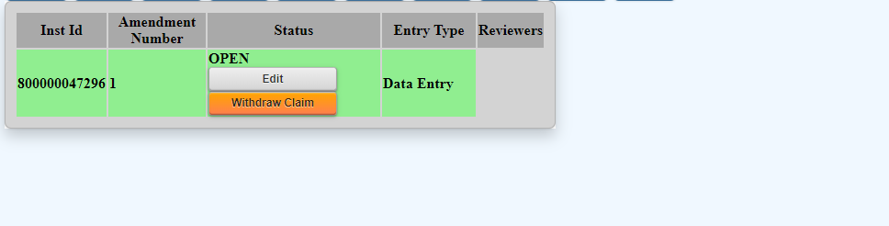
Starting a New MSA-CAP Claim
To open a new 2023-2024 claim, go to the MSA-CAP application on the NYSED Business Portal http://portal.nysed.gov/ and, next to “Create”, click on the button marked “2024-New”.
When you hover over “2024” once the screen reloads, the new claim should be on the screen and marked as “OPEN”.
To begin working on your new, “Open” claim, click “Edit”.

Slide 35
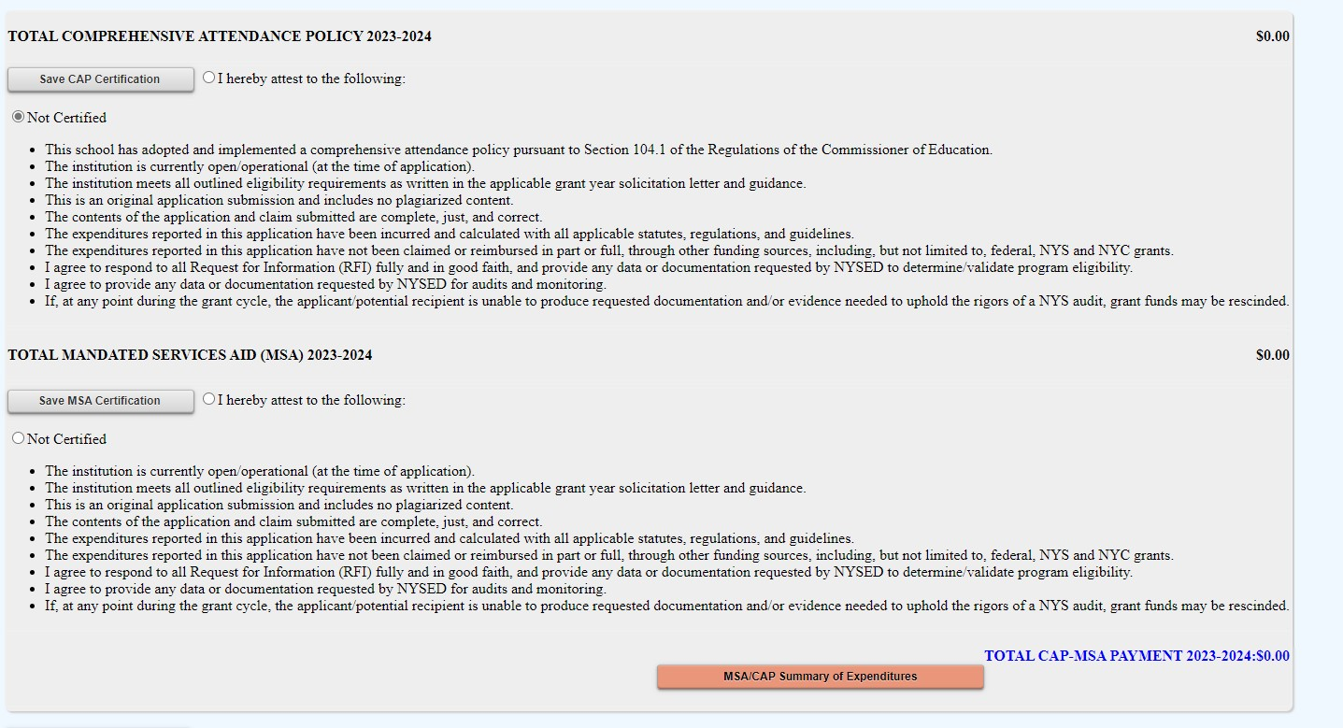
Starting a New MSA-CAP Claim
CAP certification will appear first. You will not be able to certify CAP until you have entered (and saved) salary and benefits information for Mandate 1.
Click on MSA-CAP Summary of Expenditures to open your whole claim and begin working on individual mandates.

Slide 36
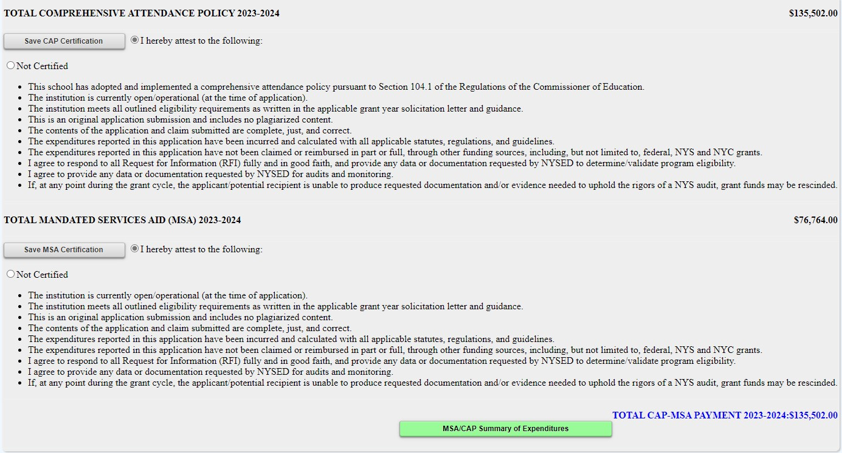
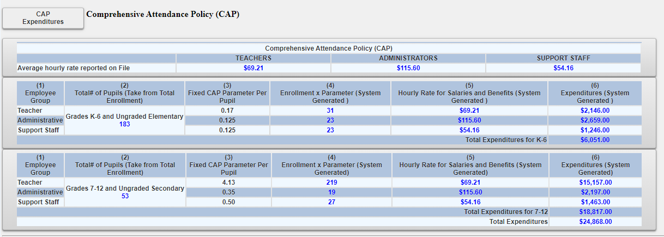
Comprehensive Attendance Policy (CAP) Certification
* You will CERTIFY CAP AFTER ENTERING DATA FOR MANDATE 1*

Slide 37
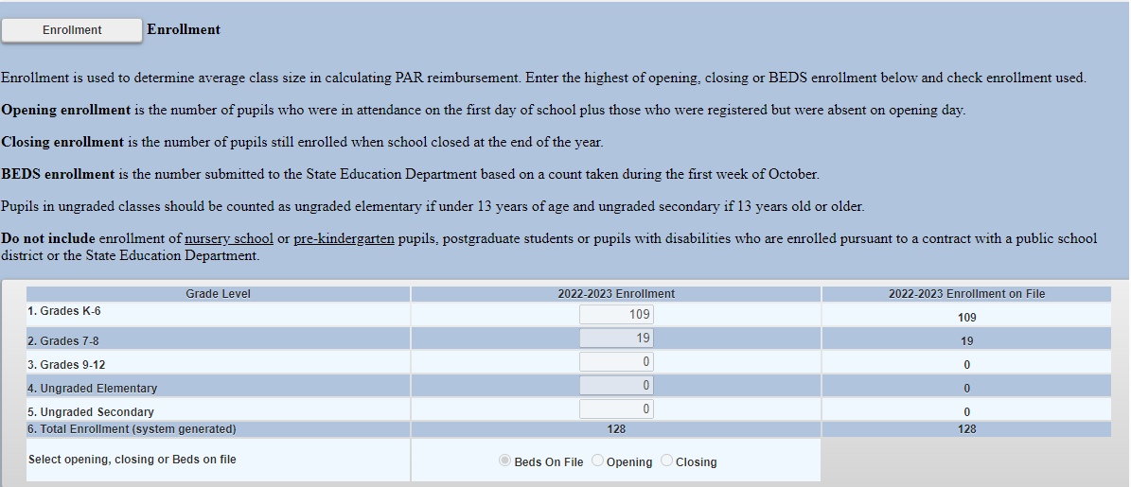
BEDS Enrollment Screen

Slide 38
Entering the MSA-CAP Claim
BEDS Enrollment
Click on the “Enrollment” button.
The BEDS Enrollment Screen will be displayed.
Enrollment data is displayed and populated in the data entry field. Drop down defaults to BEDS on File; change to Opening or Closing if you are entering different values.
Click on the <Save Form>button at the top of the screen.
Note: When selecting either Opening or Closing enrollment, if the enrollment varies from the reported BEDS data, a clear and detailed explanation of the variance must be provided. A box will appear on the screen with an orange note stating, “Enrollment claimed exceeds the tolerance level.” The claim cannot be submitted until the explanation is entered in the box provided. An explanation for any year-to-year increase in enrollment should also be provided in the MSA-CAP Workbook if submitting your claim via email.
A box will appear on the screen for entry of the explanation. The claim cannot be submitted until something is entered in the explanation box.

Slide 39
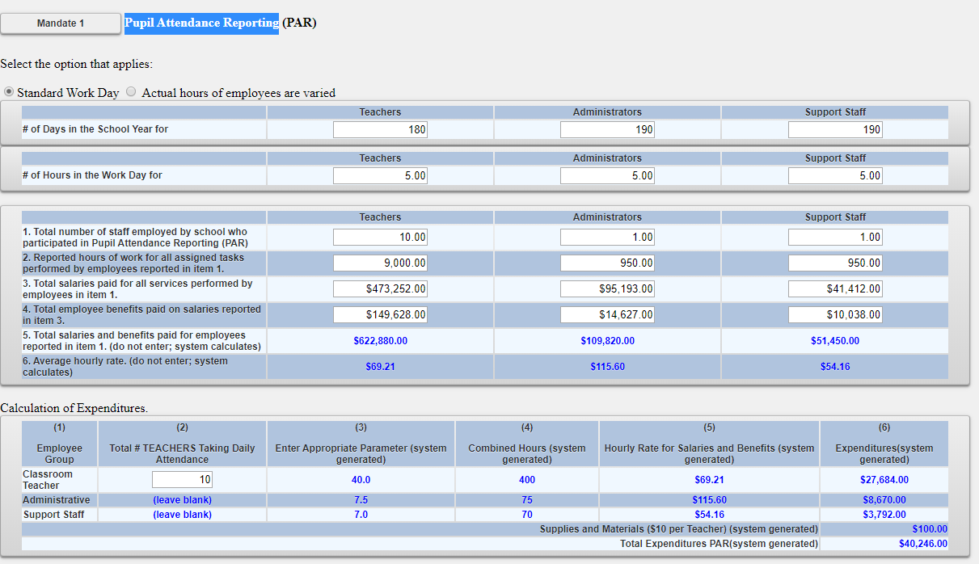
Mandate 1: PAR Screen

Slide 40
Entering the MSA-CAP Claim
Pupil Attendance Reporting (PAR)
Click on the button for “standard workday” or “actual hours of employees are varied”.
If “standard workday ” is selected, enter the # of days in the school year and # of hours in the workday for teachers, administrators and support staff.
The # of days in the school year and at least one entry for # of hours in the workday are required fields.

Slide 41
Completing mandate 1
You need to know how many employees provided the service—line 1.
Enter the total (annual) hours the employees worked—line 2.
Enter the total (annual) salaries for the employees—line 3.
Enter the total (annual) employee benefits—line 4.

Slide 42
Completing mandate 1
(continued)
The system calculates the total (annual) salaries and benefits-line 5.
The system calculates the Average Hourly Rate-line 6.
*Total should always be the ANNUAL total, NOT the total for the individual mandate. The system pro-rates mandate totals based on ANNUAL reported totals.

Slide 43
Mandate 1: Pupil Attendance Reporting (PAR)
Calculation of Hourly Rate
& Calculation of Expenditures
Enter data for line 1. Use the “tab” key to move to the next data entry field.
Continue entering data for lines 2-4. When you get to the end of line 4, tab again. If you enter a comma in the number, you will receive an error message after you click on the <Save Form> button.
Enter the total # of teachers taking daily attendance.
Click on the <Save Form> button.
The system calculates the information for lines 5-6 for the calculation of hourly rates and columns 3, 4, 5 & 6 for the calculation of expenditures.
Note: If the PAR total exceeds last year’s amount significantly, an explanation will be requested.
A box will appear on the screen for entry of the explanation. The claim cannot be submitted until data is entered in the explanation box.

Slide 44
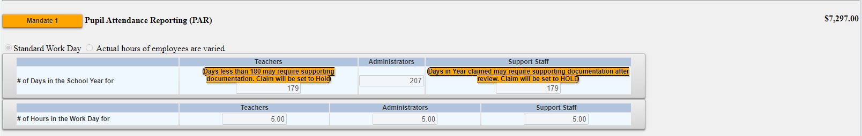
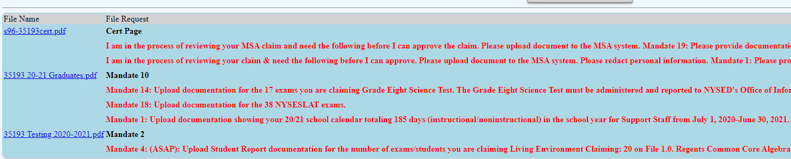
Mandate 1: DOCUMENT REQUESTS
Your claim may be set to Hold if you enter fewer than 180 days in the school year for Teachers or 190 for Administrators/Support Staff.
This will trigger a document upload request at the bottom of the claim screen in red and an email will be sent to the Administrator on file.

Slide 45
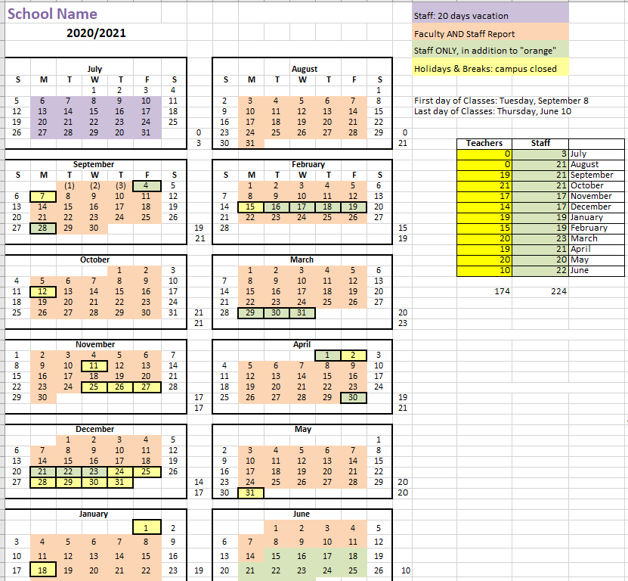
Mandate 1: SAMPLE CALENDAR EXAMPLE
*Please include totals for Teachers and other staff

Slide 46
If your school does not use a payroll company, staff contracts or hiring agreements will be requested for each staff claimed.
Payroll documentation must include:
A redacted payroll company document with the company logo.
Totals matching the amounts claimed
A summary document which:
  specifies the role of each individual (Administrator, Teacher, Support Staff)
  shows a breakdown of fringe benefits for each individual.
  calculates a total for gross salary and benefits for each staff claimed.
Mandate 1: SAMPLE PAYROLL EXAMPLES documents

Slide 47
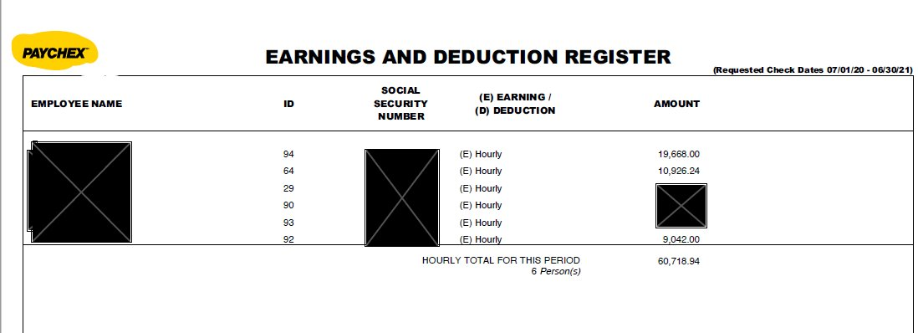
Mandate 1: SAMPLE PAYROLL EXAMPLE- payroll company document (redacted, with logo)

Slide 48
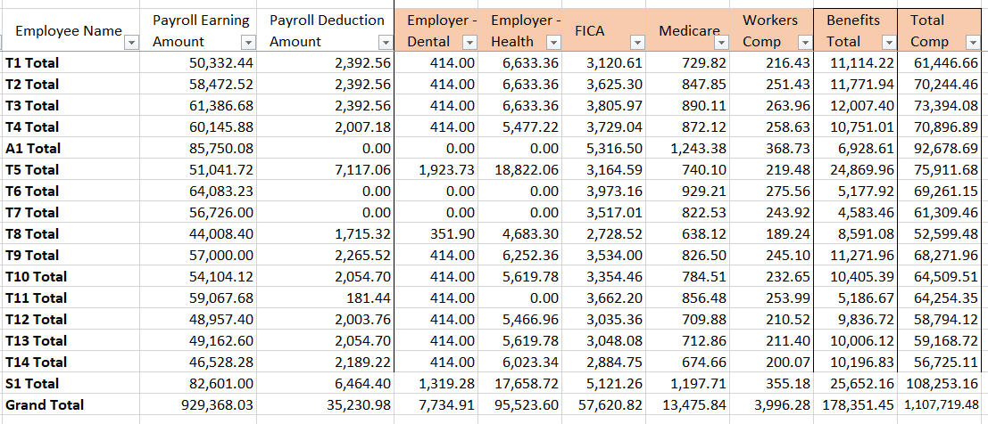
Mandate 1: SAMPLE PAYROLL summary

Slide 49
Mandate 2: Elementary and Intermediate Assessment in English Language Arts (EIA) and Math
Calculations of Hourly Rate, Combined Hours, & Expenditures
Calculation of Hourly Rate
Enter data for line 1. Use the “tab” key to move to the next data entry field.
Continue entering data for lines 2-4. When you get to the end of line 4, tab again.
If you enter a comma in the number or if you enter a character instead of a number in any of the fields, you will receive an error message saying “not a valid number” after you click on the <Save Form> button. A caution sign will appear next to the field that caused the problem.
*Documentation must be maintained for all expenditures.*

Slide 50
Mandate 2: (EIA)
Calculations of Hourly Rate, Combined Hours, & Expenditurescontinued
Exam Expenditures
Enter the number of tests administered (compare to number of tests showing as on file).
Teacher Workshop Expenditures
Enter the total hours of allowable workshop training.
Enter the dollar amount of the workshop fee.
The system generates the calculations of Total Expenditures and Total Workshop Expenditures and populates the “MSA/CAP Summary of Expenditures” Screen.
*Documentation must be maintained for all these expenditures.*

Slide 51
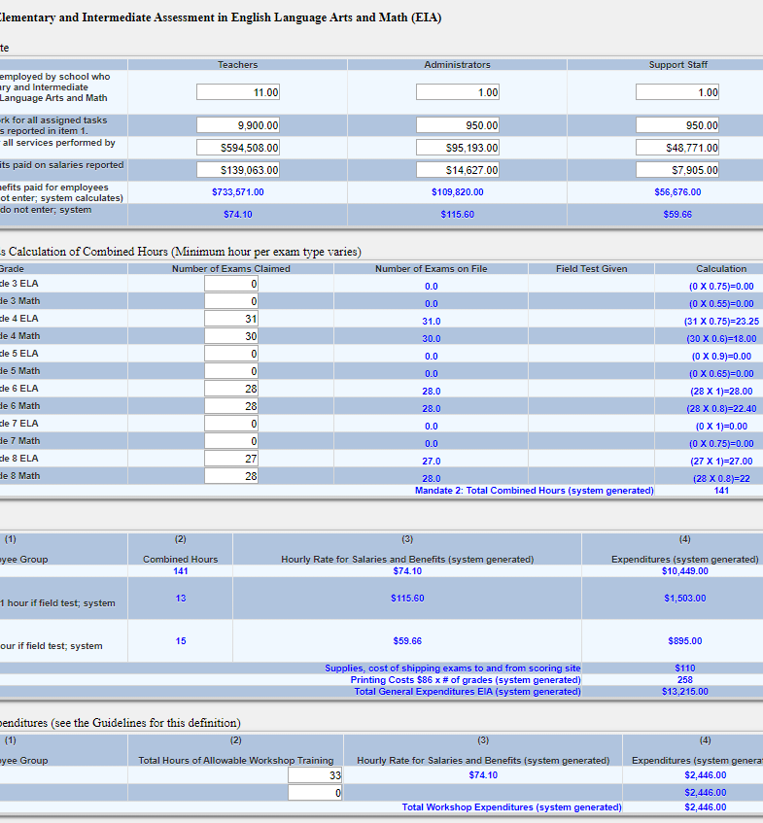
Mandate 2:
EIA Screen

Slide 52
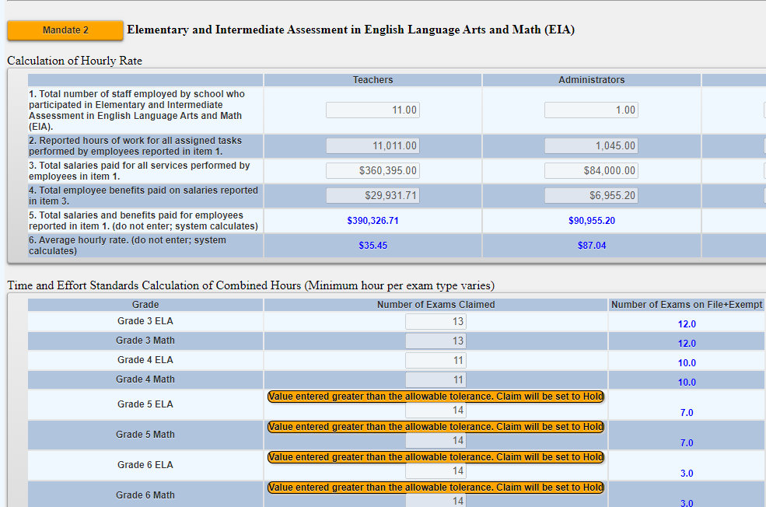
Mandate 2: EIA HOLD
Your claim may trigger a hold if the number of exams does not match the exams on file. You may still claim the number of exams entered but will be asked to provide documentation.

Slide 53
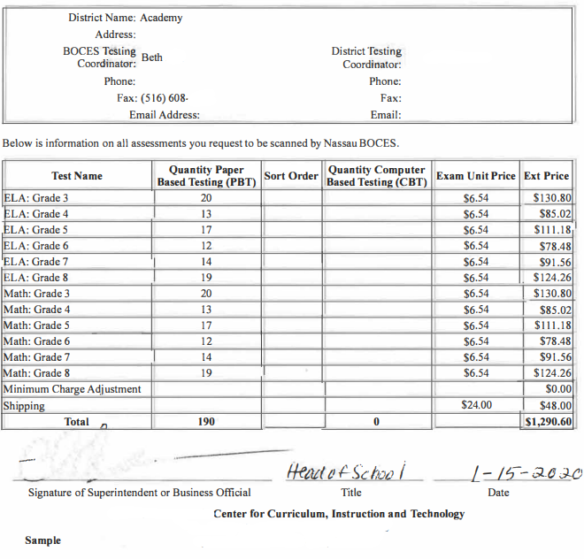
Mandate 2:
EIA SAMPLE DOCUMENT

Slide 54
Mandate 3: Basic Educational Data System Reporting (BEDS) Enrollment
Click on the <Mandate 3> button.
Enter data for line 1. Use the “tab” key to move to the next data entry field.
Continue entering data for lines 2-4.
Enter the total # of teachers taking daily attendance in the calculation of expenditure area.
Click on the <Save Form>button.
The system generates the information for lines 5 and 6 and completes the fields for Calculation of Expenditures and populates the “MSA/CAP Summary of Expenditures” Screen.
*Documentation must be maintained for all these expenditures.*

Slide 55
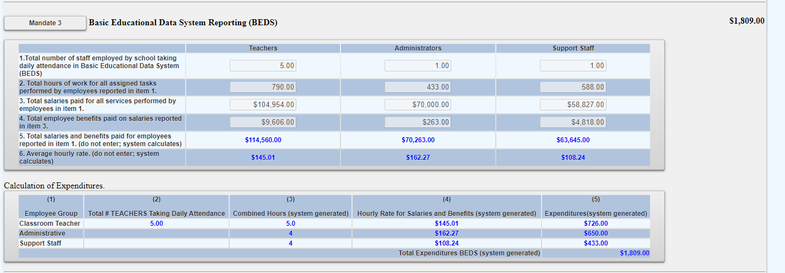
Mandate 3: BEDS Reporting
Screen

Slide 56
Mandate 4: Regents Examinations
Calculation of Hourly Rate
Click on the <Mandate 4> button.
Enter data for line 1. Use the “tab” key to move to the next data entry field.
Continue entering data for lines 2-4.
The system generates the information for lines 5 and 6 and completes the fields for Calculation of Expenditures.
*Documentation must be maintained for all these expenditures.*

Slide 57

Mandate 4: Regents Examinations (continued)
Calculation of Combined Hours
The system shows the number of Regents exams that were reported to the Office of Information Reporting Services.
Enter the number of exams that were administered. Use the “tab” key to move to the next field.
You must make an entry for each exam you want to receive reimbursement for.
When you have completed entering the exam data, click the <Save Form> button. The system generates the Total General Expenditures.
  *Documentation must be maintained for all these expenditures.*

Slide 58
Mandate 4: Regents Exams (continued)
Teacher Workshop Expenditures
Under Section B enter the total hours of allowable workshop training.
Enter the dollar amount of the workshop fee.
The system generates the Total Expenditures,
Test Kits
Under Section C, enter the total number students taking Regents Earth Science and the number of Earth Science Test Kits purchased during the 2022-2023 school year.
The system generates the calculations of the Total Expenditures and Total Workshop/Test Kits Expenditures and populates the “MSA/CAP Summary of Expenditures” Screen.
*Documentation must be maintained for all these expenditures.*

Slide 59
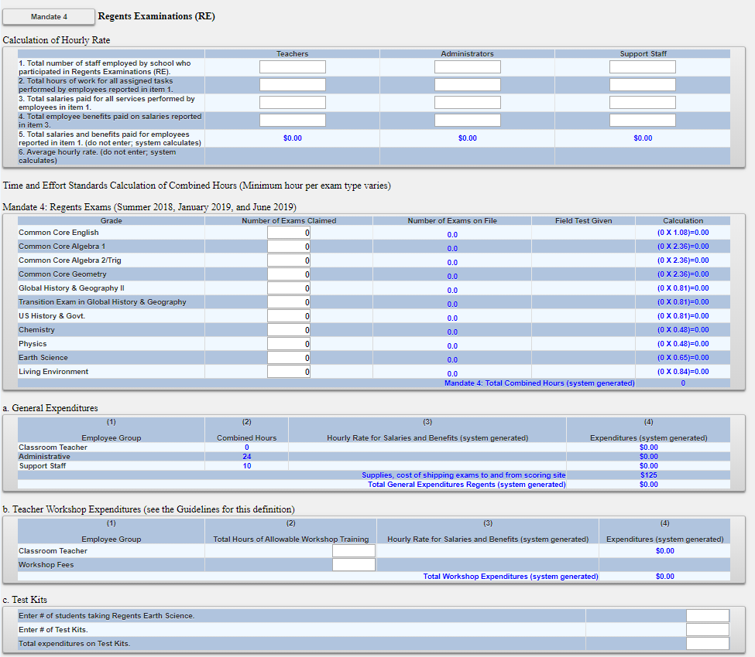
Mandate 4:Regents Exam Screen

Slide 60
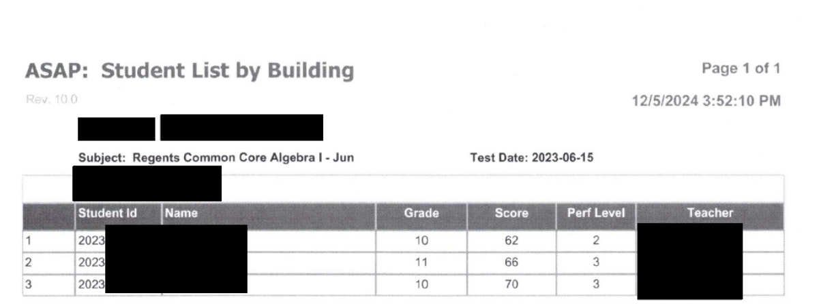
Mandate 4: Regents Exam
Sample Document

Slide 61

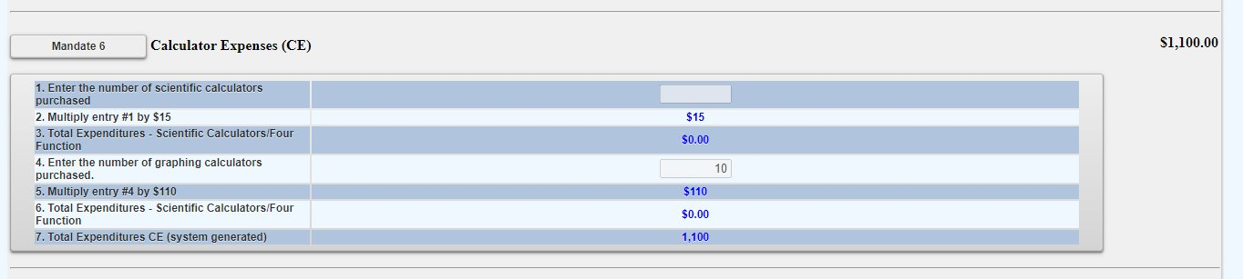
Mandate 6: Calculator Expenses
Enter the number of scientific calculators that were purchased.
Use the “tab” key to move to the next data entry field.
Enter the number of graphing calculators that were purchased.
Click on the <Save Form> button.
The system generates the calculations of Total Expenditures and populates the “MSA/CAP Summary of Expenditures” screen.
*Documentation must be maintained for all these expenditures in the form of a receipt*

Slide 62
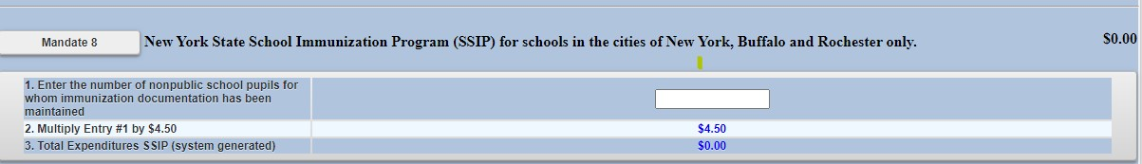
Mandate 8: New York State School Immunization Program (SSIP)
Only Grade K-12 students in non-public schools in New York City, Buffalo or Rochester that filed their immunization data with NYSDOH are eligible for Mandate 8. The Mandate 8 button will be disabled for the other non-public schools.
Enter the number of non-public school pupils for whom immunization documentation has been maintained.
The system generates the calculations of Total Expenditures for SSIP and populates the “MSA/CAP Summary of Expenditures” screen.

Slide 63
Mandate 9: Documentation of Integration of Required Instruction in 7th and 8th Grade
(DIRI)
Calculation of Hourly Rate
Click on the <Mandate 9> button.
Enter data for line 1. Use the “tab” key to move to the next data entry field.
Continue entering data for lines 2-4.
Calculation of Expenditures
Use the “tab” key to move to the combined hours field.
Enter Total # of 7th & 8th grade teachers that participated in the mandate.
Click on the <Save Form> button.
The system generates the calculations of Total General Expenditures for DIRI and populates the “MSA/CAP Summary of Expenditures” screen.
*Documentation must be maintained for all these expenditures.*

Slide 64
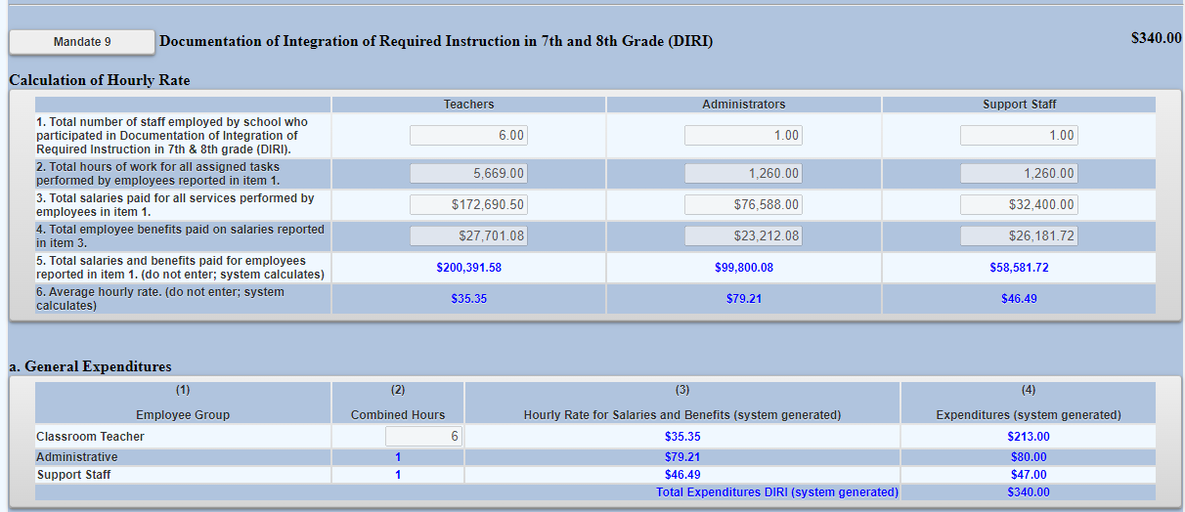
Mandate 9: DIRI Screen

Slide 65
Mandate 10:
High School Graduation Report (HSGR)
Calculation of Hourly Rate
Click on the <Mandate 10> button.
Enter data for line 1. Use the “tab” key to move to the next data entry field.
Continue entering data for lines 2-4.
Calculation of Expenditures
Use the “tab” key to move to the next field.
Enter the number of graduation candidates.
Click on the <save> button.
The system generates the calculations of Total General Expenditures for HSGR and populates the “MSA/CAP Summary of Expenditures” screen.
*Documentation must be maintained for all these expenditures.*

Slide 66
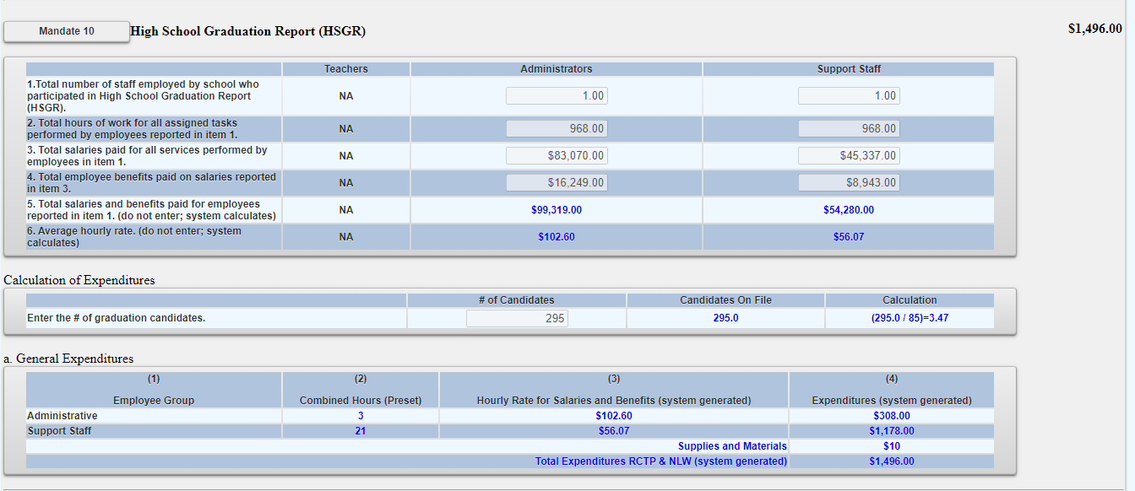
Mandate 10: (HSGR) screen

Slide 67
Mandate 11: Grade Five Science Test (GFST)
Calculation of Hourly Rate
Enter data for line 1. Use the “tab” key to move to the next data entry field.
Continue entering data for lines 2-4. Do not use commas. When you get to the end of line 4, tab again.
If you enter a comma in the number or if you enter a character instead of a number in any of the fields, you will receive an error message saying “not a valid number” after you click on the “save” button. A caution sign will appear next to the field that caused the problem.
Enter number of tests administered, regardless of amount shown as on file. You may be asked for documentation if amount differs.
*Documentation must be maintained for all these expenditures.*

Slide 68
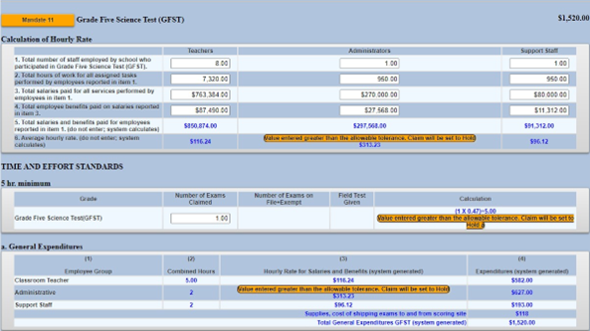
Mandate 11: Grade Five Science Test Screen

Slide 69
Mandate 11: GFST – Teacher Workshop Expenditures & Test Kits
Teacher Workshop Expenditures
Enter the total hours of allowable workshop training (the time that the teacher is out of the classroom). Use the “tab” key to move to the next field.
Enter the dollar amount of workshop fees. Use the “tab” key to move to the next field.
Test Kits
Enter number of students taking Grade Five Science Test
Enter number of test kits purchased (Note: each kit serves 30 pupils)
Click on the <Save Form> button.
The system generates the calculations of Total Expenditures and Total Workshop/Test Kits Expenditures and populates the “MSA/CAP Summary of Expenditures” Screen.
*Documentation must be maintained for all these expenditures.*

Slide 70
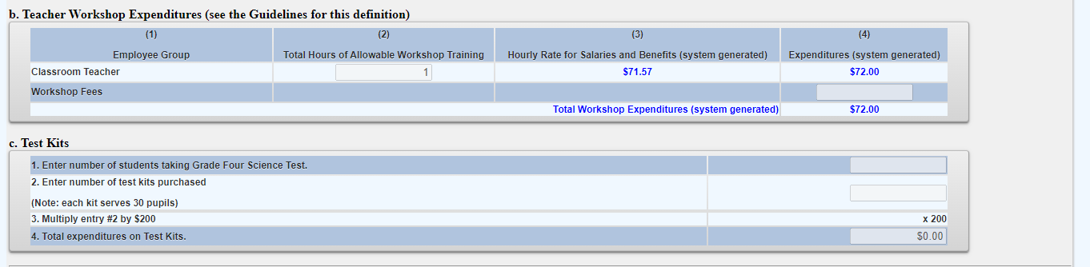
Mandate 11: GFST – Teacher Workshop Expenditures & Test Kits Screen

Slide 71
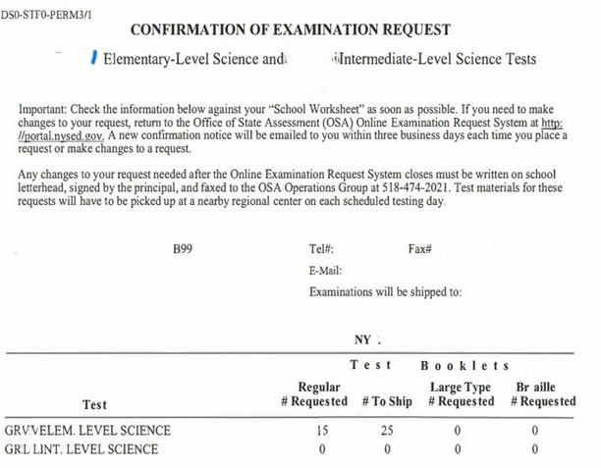
Mandate 11: Grade Five Science
Sample Document Example

Slide 72
Mandate 12: Travel to Storage Sites
(TSS)
TSS Expenditures
Enter total number of staff employed by school who participated in TSS.
Enter total hours of work for all assigned tasks performed by employees reported in line 1.
Enter total salaries paid for all services performed by employees in line 1.
Enter total employee benefits paid on salaries in line 3.
Enter total salaries and benefits paid for employees reported in line 1. ( system automatically calculates)
Average hourly rate is automatically calculated by system.
Click on the <Save Form> button.
The system generates the calculations of Total Expenditures and Total Workshop Expenditures and populates the “MSA/CAP Summary of Expenditures” Screen.
*Documentation must be maintained for all these expenditures.*

Slide 73
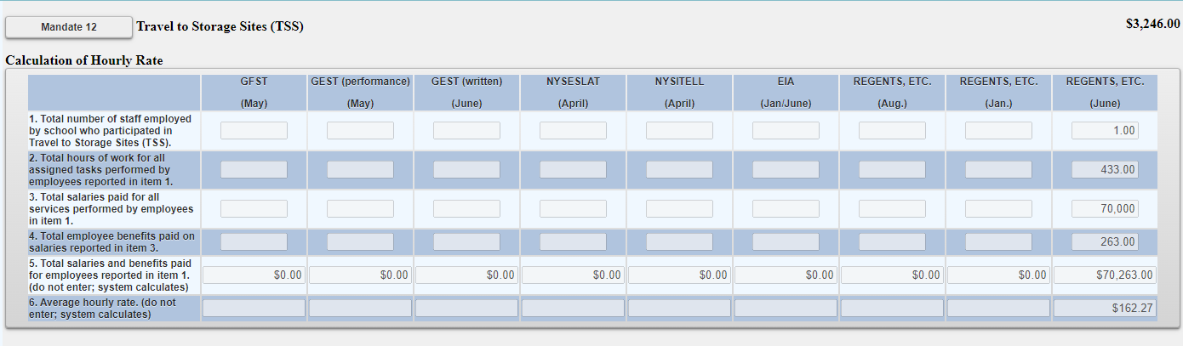
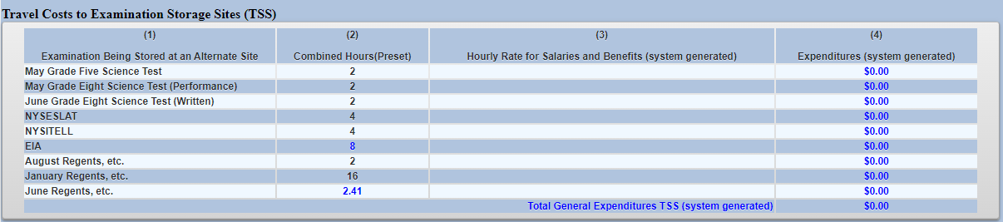
Mandate 12: Travel to Storage Sites (TSS) Screen

Slide 74
Mandate 13: Scholarship for Academic Excellence Application (SAE)
SAE Expenditures
Enter total number of staff employed by school who participated in the SAE.
Enter total hours of work for all assigned tasks performed by employees reported in line 1.
Enter total salaries paid for all services performed by employees in line 1.
Enter total employee benefits paid on salaries in line 3.
Enter total salaries and benefits paid for employees reported in line 1. ( system automatically calculates)
Average hourly rate is automatically calculated by system.
Click on the <Save Form> button.
The system generates the calculations of Total Expenditures and Total Workshop Expenditures and populates the “MSA/CAP Summary of Expenditures” Screen.
*Documentation must be maintained for all these expenditures.*

Slide 75
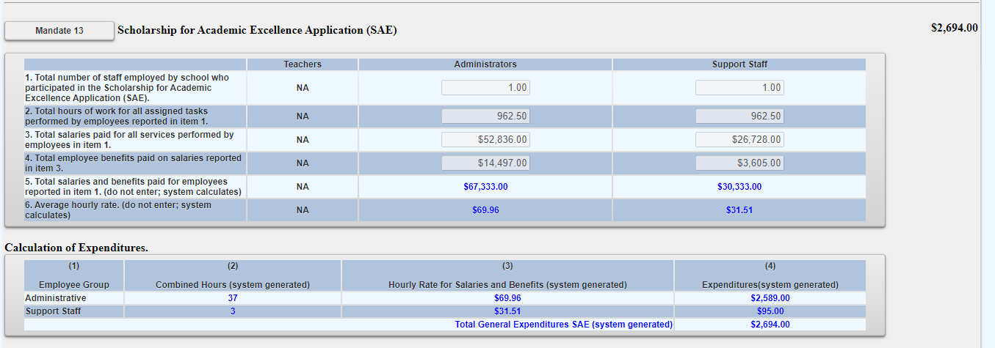
Mandate 13: Scholarship for Academic Excellence Application (SAE) Screen

Slide 76
Mandate 14: Grade Eight Science Test (GEST)
GEST Expenditures
Enter total number of staff employed by school who participated in Grade Eight Science Test (GEST).
Enter total hours of work for all assigned tasks performed by employees reported in line 1.
Enter total salaries paid for all services performed by employees in line 1.
Enter total employee benefits paid on salaries in line 3.
Enter total salaries and benefits paid for employees reported in line 1. ( system automatically calculates)
Average hourly rate is automatically calculated by system.
Enter number of tests administered, regardless of amount shown as on file. You may be asked for documentation if amount differs.
Click on the <Save Form> button.
The system generates the calculations of Total Expenditures and Total Workshop Expenditures and populates the “MSA/CAP Summary of Expenditures” Screen.

Slide 77
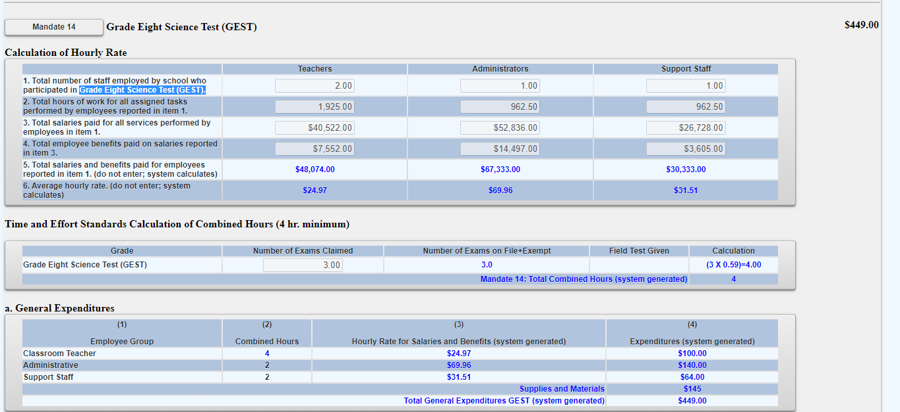
Mandate 14: Grade Eight Science Test (GEST) Screen

Slide 78
Mandate 14: Grade Eight Science Test (GEST) Sample Document Example

Slide 79
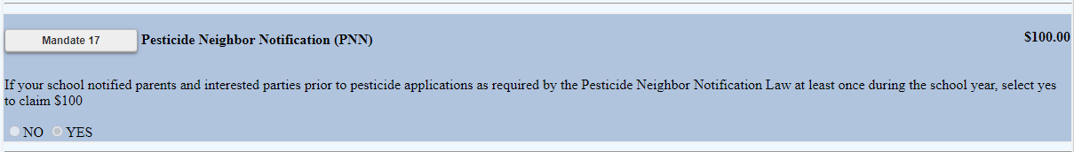
Mandate 17: Pesticide Neighbor Notification (PNN)
The School Pesticide Neighbor Notification Law requires all Non-public schools to notify parents and interested parties prior to pesticide applications in instructional and administrative buildings and grounds, as well as playgrounds and athletic fields.
Click yes to claim if your school notified parents and interested parties prior to pesticide applications as required by the Pesticide Neighbor Notification Law.
The system will automatically award $100 for this mandate if claimed.

Slide 80
Mandate 18: New York State English as a Second Language Achievement Test (NYSESLAT) and New York State Identification Test for English Language Learners(NYSITELL)
NYSESLAT/NYSITELL Expenditures
Enter total number of staff employed by school who participated in NYSESLAT/NYSITELL.
Enter total hours of work for all assigned tasks performed by employees reported in line 1.
Enter total salaries paid for all services performed by employees in line 1.
Enter total employee benefits paid on salaries in line 3.
*Documentation must be maintained for all these expenditures.*

Slide 81
Mandate 18: New York State English as a Second Language Achievement Test (NYSESLAT) and New York State Identification Test for English Language Learners(NYSITELL)
NYSESLAT/NYSITELL Expenditures
Enter total salaries and benefits paid for employees reported in line 1. ( system automatically calculates)
Average hourly rate is automatically calculated by system.
Enter number of tests administered, regardless of amount shown as on file. You may be asked for documentation if amount differs.
Click on the <Save Form> button.
The system generates the calculations of Total Expenditures and Total Workshop Expenditures and populates the “MSA/CAP Summary of Expenditures” Screen.

Slide 82
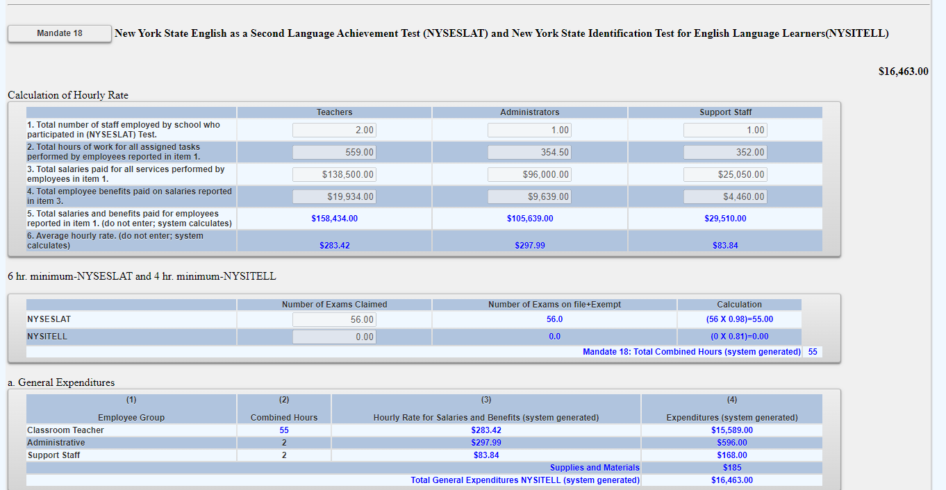
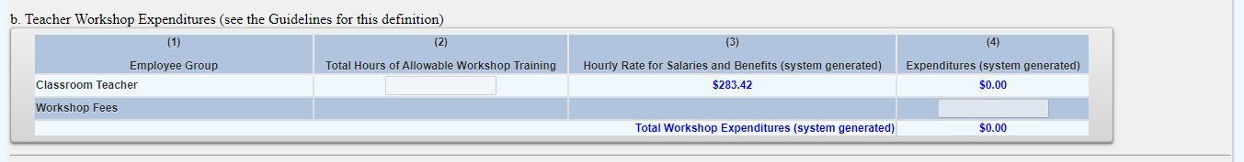
Mandate 18: New York State English as a Second Language Achievement Test (NYSESLAT) and New York State Identification Test for English Language Learners(NYSITELL) Screen

Slide 83
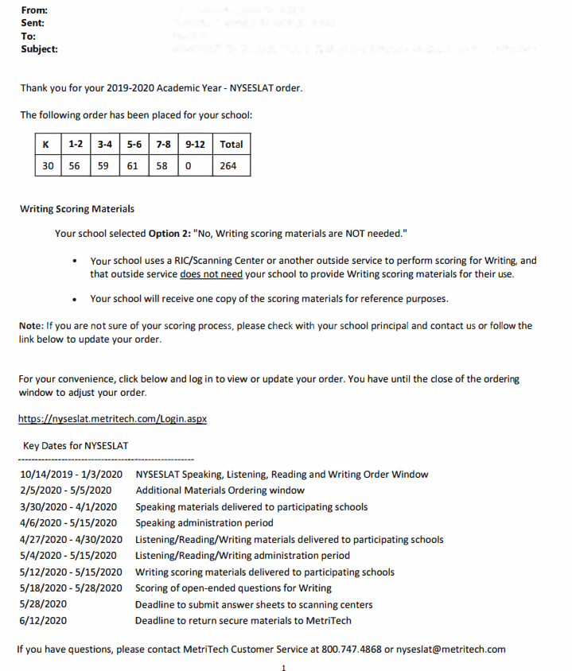
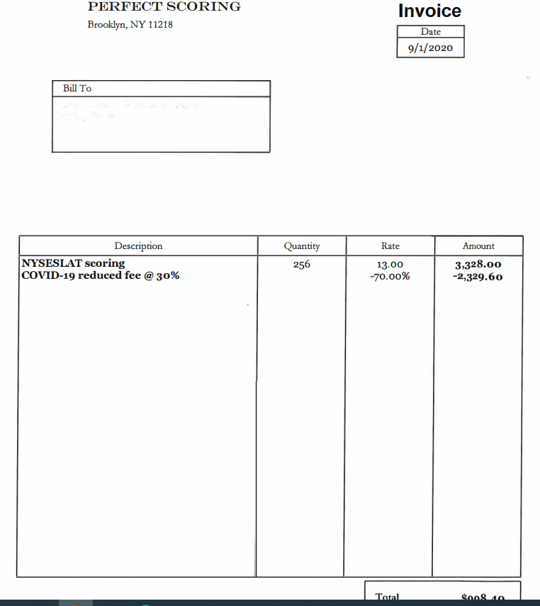
Mandate 18: NYSESLAT & NYSITELL Test
Sample Document Examples

Slide 84
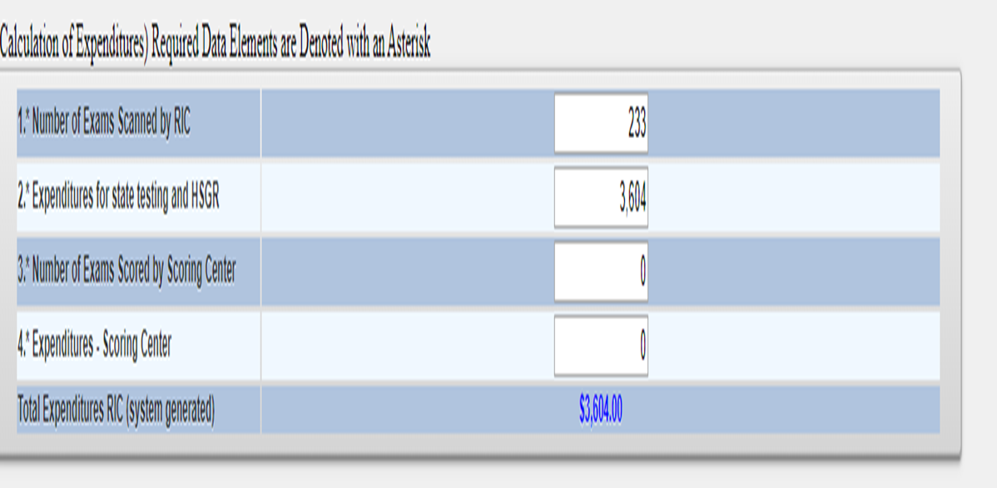
Mandate 19-RIC & Scoring Center Expenditures
An entry must be made in each field. If you only have the total expenditures for the scanning and scoring, enter zeroes in the other fields. If you leave the fields blank, a warning message will appear at the top of the screen.
The 3rd through 8th grade tests may be scored by Regional Scoring Centers. (Note: If your tests are graded by a Scoring Center, no printing costs are separately reimbursed under Mandate 2, EIA.)
Round to the nearest dollar amount when entering expenditure amounts.

Slide 85
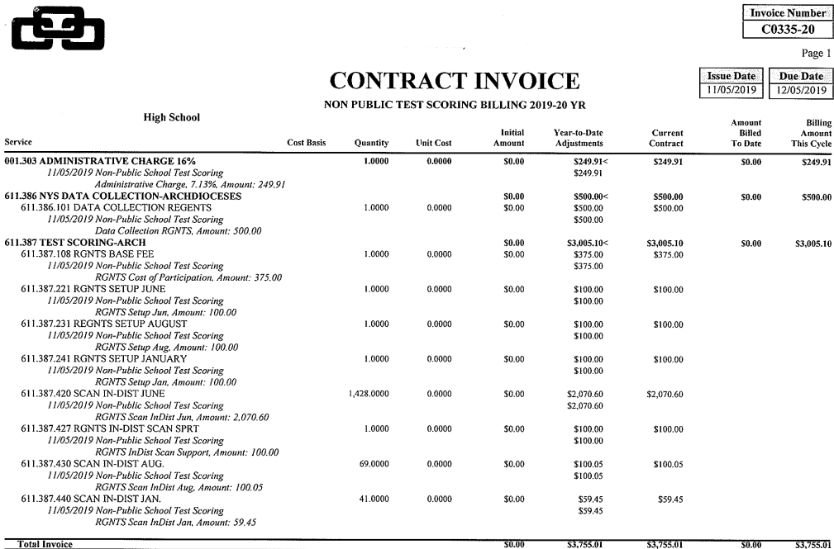
Mandate 19-Sample Document Example

Slide 86
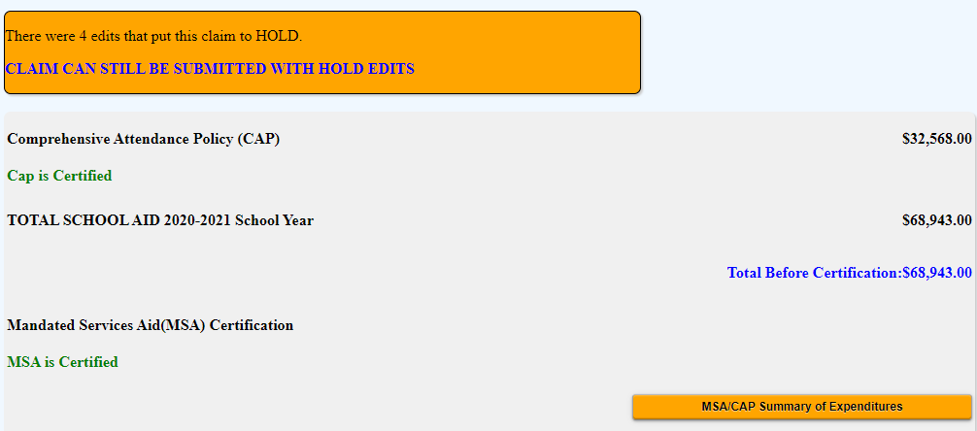
Hold Messages
Expanding the “MSA/CAP Summary of Expenditures” button will show details including reason/s for the claim being placed in hold status.

Slide 87
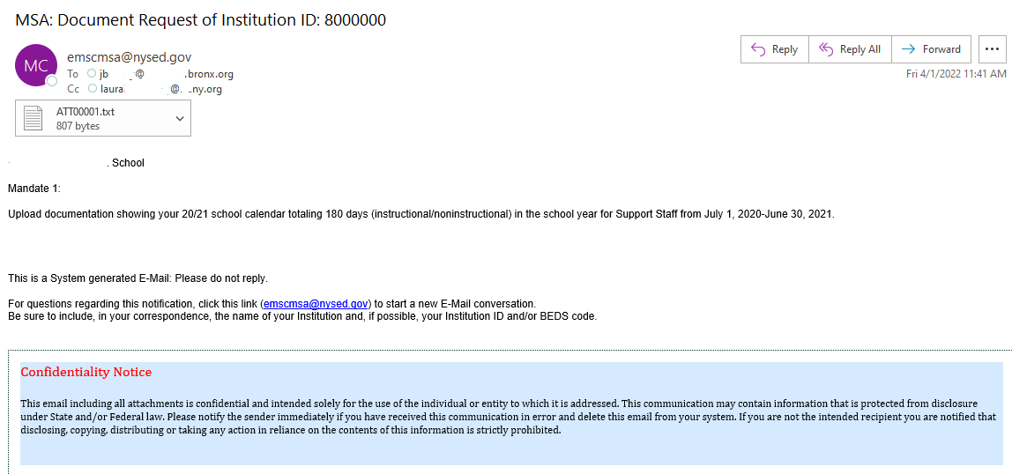
HOLD CLAIMS: UPLOAD DOCUMENT REQUEST
The claims in hold status will be reviewed by MSA-CAP staff who will send a request to schools to provide supporting document/s.
School will also receive a system triggered e-mail request. The document request text will be in the e-mail.
Schools will be able to access their claims in the MSA-CAP system to upload requested document/s.

Slide 88
UPLOADING DOCUMENT REQUEST FILES (continued)
Scroll down to the File Request at the bottom of your claim screen
Select the File to attach for upload
Scroll all the way to the right of your screen to the Upload File button.
Please note that file requests that are still pending are displayed in red.
Please upload the file to the corresponding request.
The system will not allow multiple file, either combine into one document prior to upload or contract ORISS to request additional spots.

Slide 89
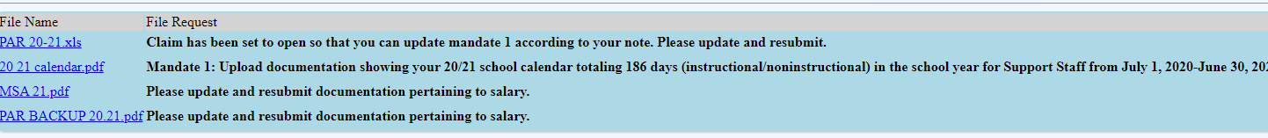
UPLOAD DOCUMENT REQUEST (continued)
After the file is uploaded, there will be a link that both the schools and the reviewer can view and download.
Claims that were successfully uploaded will have the file name displayed in blue and the file request wording will change from red to black.

Slide 90
Submit and Certify
Non-public schools have the option to assign an MSA CFO to submit and certify their MSA-CAP claim. Currently, most non-public schools only have the CEO in that role. If schools would like to add an MSA-CAP CFO to submit and certify their claim, please email datasupport@nysed.gov.
If your non-public school does not have a CFO, the submit and certify roles automatically defaults to the CEO. Once the MSA-CAP CFO is added to SEDREF, please contact our office and we will entitle the MSA-CFO to the MSA-CAP NYSED Business portal online system.
Additional staff can be entitled by the CEO to enter data only.

Slide 91
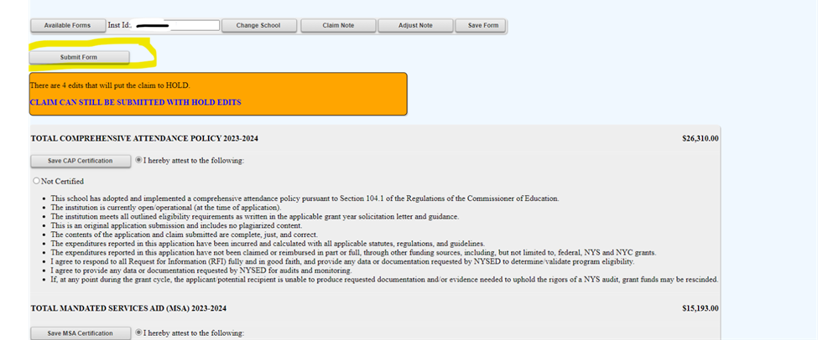
Submitting the MSA Claim
When all errors have been corrected, the certification buttons will appear at the top of the MSA-CAP Summary of Expenditures screen.
Read the certification statements and click the “I hereby attest" CAP Certification and MSA Certification” bullets.
Click on the <Submit Form> button.
The system returns you to the “home” screen and displays the status of the claim.

Slide 92
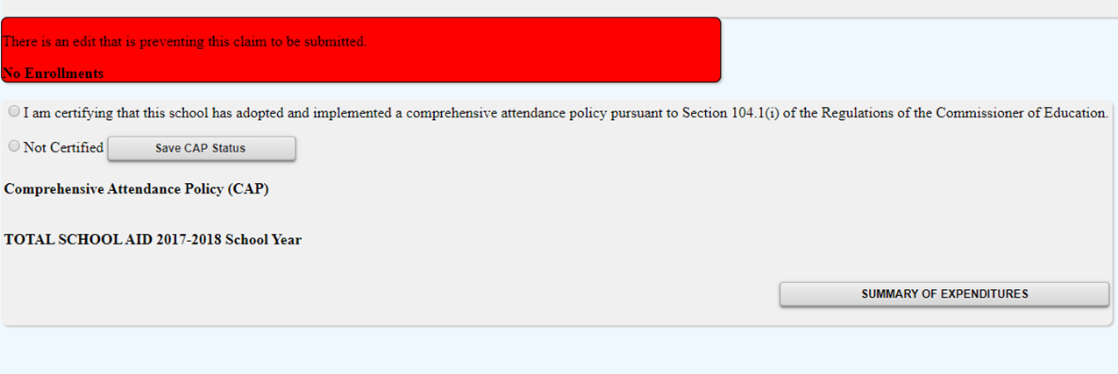
Submitting Claims: Warning Messages
Expanding the Summary of Expenditures button will show the user the issues preventing submission of the claim.

Slide 93

Record-keeping
It is very important that accurate documentation be kept by every school that claims mandated services. Even if your MSA-CAP claim forms are completed by an independent contractor or diocesan office, the school is responsible for maintaining complete records.
Documentation must be maintained for a minimum of 7 years. Records must be available for inspection, monitoring and/or audit by the New York State Education Department and the Office of the State Comptroller.
It is recommended that each school creates and maintains a mandated services documentation file for each school year that a claim is submitted.

Slide 94
Recordkeeping (continued)
The following list identifies documentation that we recommend schools keep on file or otherwise have readily available:
  Payroll records, for only those employees providing the mandated service, including allowable fringe benefits. If you use a payroll service, you will need to put copies of the applicable payroll records in the mandated services aid documentation file. If you do not use a payroll company, copied of contracts will be requested.
  Salary agreements and/or contracts for those employees providing mandated services.
  Time distribution records. You are required to maintain documentation to show that the employee actually provided services such as taking attendance or proctoring exams.

Slide 95
Recordkeeping (continued)
  Student enrollment records, class schedules or Attendance rosters.
  Invoices/cancelled checks or credit card receipts/statements for purchases made to perform mandated services.
  Any documentation that supports the information and calculations used to prepare any claim for nonpublic school aid.
  Schools must maintain inventory records for calculators and science test kits. Calculators are not a consumable product. The inventory control procedure should include a replenishment cycle to replace aging and broken calculators. Calculators may not be given permanently to students. Only scientific and graphing calculators are reimbursable.
  Documentation of calculator purchase must be retained for monitoring and/or audit.

Slide 96
Recordkeeping (continued)
Documentation of the hours that form the basis for a standard workday must be maintained by the school.
Information gathering per Comptroller’s Audit.
Documentation must be maintained to show the basis of the calculation for the average hourly rates.
Schools must maintain inventory records of the science test kits and earth science test kits.
Evidence of number of students who graduated from high school such as student transcripts.
Records of student scores on State examinations such as the Individual Student Score Reports, Nonpublic Secondary Examination Report, Comprehensive Information Report.
Failure to maintain adequate supporting documentation may result in a disallowance or partial disallowance.
NOTE: This is not an all-inclusive list

Slide 97
HOW TO VIEW/SAVE/PRINT CLAIM AS PDF

Slide 98
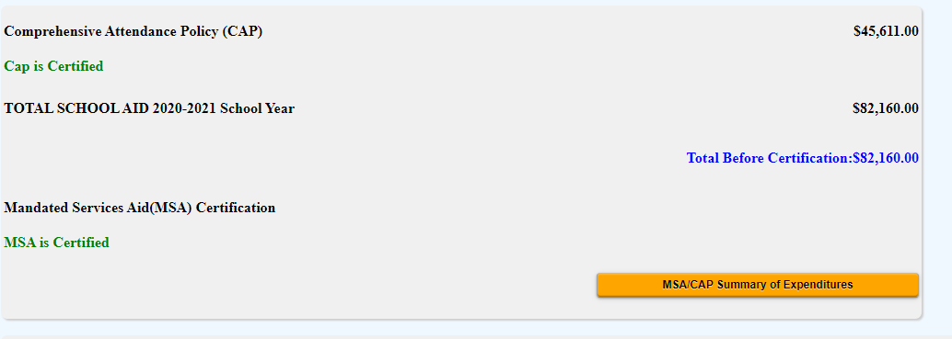
Select the MSA/CAP Summary of Expenditures button to expand and open the other mandates/

Slide 99

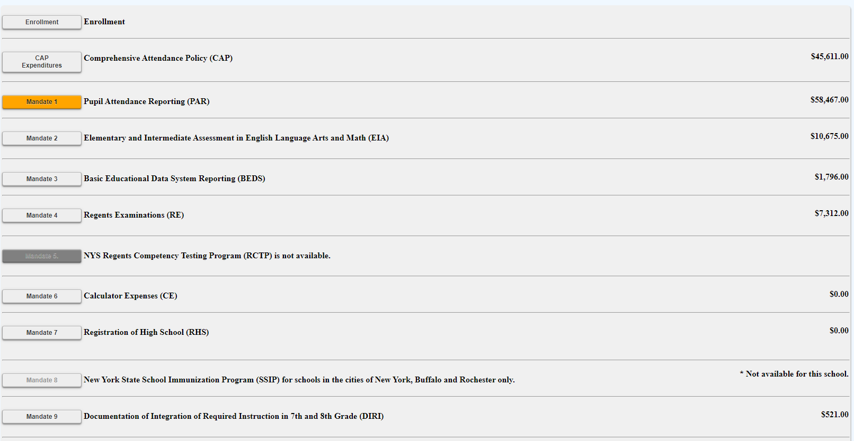
Select each mandate to expand and view detailed explanation of each mandate.

Slide 100
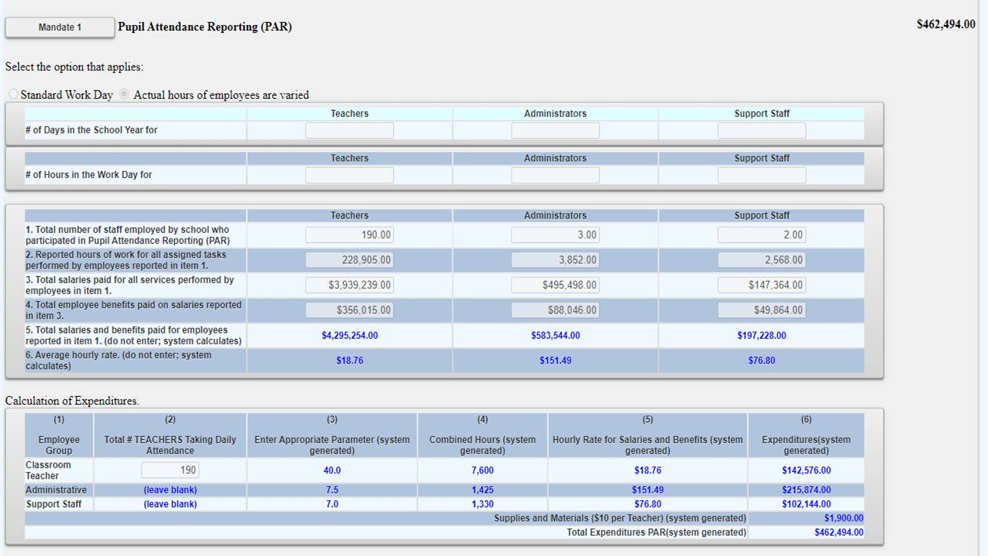
Sample of expanded mandate

Slide 101
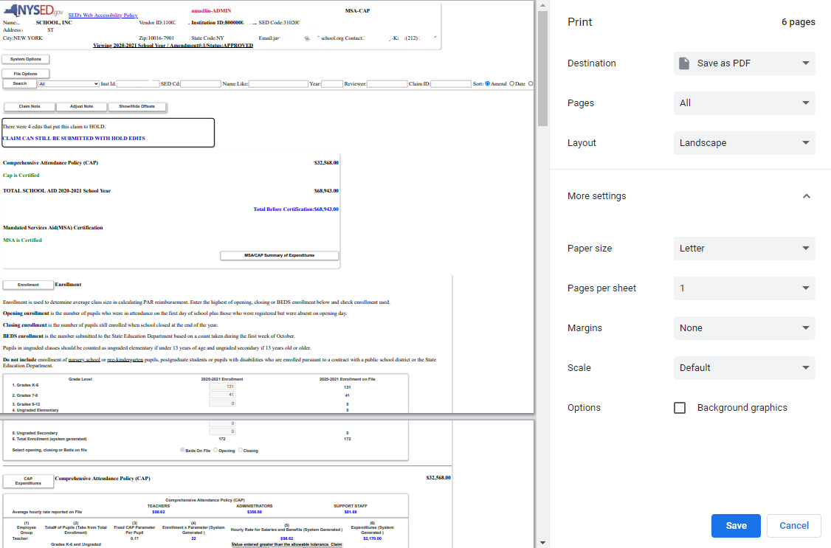
Select print feature and print or save document as PDF and print. You may need to decrease the document size to ensure the entire claim is visible on their screen before printing.

Slide 102

For additional assistance with msa-cap email: msa-cap-oriss@nysed.gov

