Slide 1
Nonpublic School Aid Mandated Services Aid (MSA) & Comprehensive Attendance Policy (CAP)
Guidance for Preparing the 2021-22 Claim
& Utilizing the MSA Online System
New York State Education Department
MSA-CAP Office

Slide 2
Presentation Overview
What’s New
MSA-CAP Overview
Comprehensive Attendance Policy (CAP)
MSA-CAP General Information
MSA-CAP Online System-General Information
Using MSA-CAP Online System
Recordkeeping
Save/Print Claim as PDF
*Documentation must be maintained for all these expenditures.*

Slide 3
What’s New

Slide 4
Changes to the MSA-CAP Forms/Online System
School Year 2021-22
The MSA-CAP Guidance document highlighting the MSA-CAP processes is available on the Non-public Schools MSA-CAP page @ MSA-CAP Forms
Please refer to the Special COVID-19 document for guidance pertaining to calculating the Average Hourly Rates [(Annual Gross Salary + Fringe Benefits)/ Total Annual Hours Worked] Claiming Parameters, and Hold-Harmless for Regents Exam Cancellations.

Slide 5
Changes to the MSA-CAP Forms/Online System (continued)
School Year 2021-22
During the 2021-22 school year, field tests were administered for the following MSA related exams:
Grades 3 through 8 Math and English Language Arts (Mandate 2)
Regents Examinations (Mandate 4)
Grade 8 Science (Mandate 14)
K-12 NYSESLAT (Mandate 18)

Slide 6
Changes to the MSA-CAP Forms/Online System (continued) School Year 2021-22
The following exams were given in 2021-22:
3-8 ELA (Mandate 2)
3-8 Math (Mandate 2)
June 2022 Regents (Mandate 4)
4 & 8 Science (Mandates 11 and 14)
K-12 NYSESLAT/NYSITELL (Mandate 18)
The following Regents exams were granted exemption status in 2021-22:
August 2021 Regents (Mandate 4)
January 2022 Regents (Mandate 4)
June 2022 Regents US History and Government Framework (Mandate 4)

Slide 7
Changes to the MSA-CAP Forms/Online System (continued)
School Year 2021-22
The following Regents exam was not administered in 2021-22:
Regents US History and Government Framework (Mandate 4)
Mandate 8 –The SSIP, State School Immunization Program, rate has been set at $3.85. The new appropriation limits participation in this program to New York City, Rochester, and Buffalo schools that have immunization records on file with the New York State Department of Health.

Slide 8
MSA/CAP OVERVIEW

Slide 9
Mandated Services Aid (MSA)
Mandated Services Aid (MSA) is a New York State funded reimbursement program for nonpublic schools. The schools receive reimbursement for the state mandates that they have met in the prior school year (July 1 to June 30). In order to receive reimbursement, the school must have met the requirements of the mandate and have documentation to support it. The reimbursement request, or claim, must be processed via our online system. A full listing of the mandates and a brief explanation of each one follows this introduction.
Many of the mandates are met by reporting information in a timely fashion to the Department itself. For example, the Basic Educational Data Systems (BEDS) report, which is due every October, has a twofold purpose for nonpublic schools: it fulfills the requirement of mandate number three and enables a school’s claim to be entered into the processing system for Mandated Services. Other mandates, such as Pupil Attendance Reporting (PAR) rely on the school providing the state information relative to the time and effort attributed to complying with the regulation.

Slide 10
MSA (continued)
Reimbursement of mandated services to nonpublic schools may be made for the actual costs related to complying with certain State mandates, if eligibility requirements are met. To be eligible for reimbursement, the school must:
Provide instruction in all required subjects according to §3204 of the Education Law.
Require pupils to attend full-time instruction according to §3205 of the Education Law.
No students for which the school receives direct tuition payments from the state or local government may be included in the MSA calculations (e.g., tuition payments for a disabled student).
Be a not-for-profit institution.

Slide 11
MSA (continued)
Expenses incurred in fulfilling mandates are reimbursable. These include, but are not limited to the following activities:
BEDS forms
Pupil attendance records
Elementary school tests
Regents Exams
Regents Scholarship applications
Registration of high schools
Graduation reports
Documentation of incorporation of home and career skills, technology education and library and information skills into other courses
Comprehensive School Improvement Plan (for schools identified by the Commissioner as having to develop a Plan)

Slide 12
SUMMARY OF MANDATES
Pupil Attendance Report (PAR): Attendance must be recorded once daily, summarized periodically, and maintained on file by the school. PAR applies to grades Kindergarten through 12th grade only.
Elementary and Intermediate Assessment in English Language Arts and Math (EIA): Grades 3 through 8 Math and English Language Arts (ELA) tests must be administered and reported to the New York State Education Department’s Office of Information and Reporting Services through a contract with a Regional Information Center (RIC) for scanning and reporting in the Student Repository System (SIRS).
Mandate 3: Basic Educational Data System Reporting (BEDS) Enrollment. BEDS Report of Non-public schools must be filed with NYSED by the established deadline in order to receive MSA-CAP services reimbursement. Include only those teachers that participated in Pupil Attendance Reporting (PAR). Do not include Pre-K teachers in your claim.
Mandate 4: Regents Examinations (RE): Regents exams must be administered, scored, the results interpreted, and reported in level 0 of SIRS. Non-public schools that administer any of the Regents Examinations must contract for data collection, scanning, and reporting services with a RIC.
*Documentation must be maintained for all these expenditures.*

Slide 13
SUMMARY OF MANDATES (continued)
Calculator Expense (CE): Costs of four function or scientific calculators used in the administration of certain math and science tests will be reimbursed at the flat rate of $15 per calculator. These tests include Grade 6, 7 and 8 Math, Living Environment, Chemistry, Earth Science and Physics.
Reimbursement for the costs of graphing calculators will be at the flat rate up to $110 per calculator. Pupils administered an Algebra I, Algebra II, or Geometry Regents Exam must be provided the use of a graphing calculator without symbol manipulation.
Registration of High School (RHS). (ONLY APPLICABLE ONCE): The high school registration program involves the submission of an Application for Non-public Secondary School Registration, review of data concerning student achievement, and a visit from the Non-public School Office.
State School Immunization Program (SSIP): Only applicable to New York City, Rochester, and Buffalo). Complete and return the New York State Annual School Immunization Survey Summary Form by the required deadline. New York City schools must send the form to the NYC Health Department & Mental Hygiene Immunization Program; all other eligible schools must send the form to the NYS Department of Health Immunization Program.
Documentation of Integration of Required Instruction in 7th and 8th Grade (DIRI): The requirements for technology education, home and career skills, and library and information skills may be met by the integration of the State learning standards of such subjects into other courses in accordance with the criteria found in Section 100.4(2) of the Commissioner’s Regulations.

Slide 14
SUMMARY OF MANDATES (continued)
Graduation Report for Non-public Schools (HSGR) grade 12 only: Non-public schools are now responsible for reporting all students who were awarded a local or Regents diploma, Career Development & Occupational Studies Commencement Credentials or Skills & Achievement Commencement Credential in SIRS. Graduation Reporting must now be completed with your local RIC and filed by the end of August annually
Grade Four Science Test (GFST): Grade Four Elementary-Level Science Test must be administered and reported to the SIRS through a contract with a Regional Information Center (RIC) for scanning and reporting.
Expenditure for Travel Costs to Examination Storage Sites (TSS):Pick up for secure examinations being stored at a neutral site. (Note: All examinations included in the mandates are secure examinations.)
New York State Scholarships for Academic Excellence Application (SAE): Submission of the Scholarships for Academic Excellence Nomination Summary Form, listing the nominee(s) and the individual student application forms. Scholarships for Academic Excellence must be published and made available to students at the beginning of the school year.

Slide 15
SUMMARY OF MANDATES (continued)
Grade Eight Science Test (GEST): Grade Eight Science Test must be administered and reported to the SIRS through a contract with a Regional Information Center (RIC) for scanning and reporting.
Pesticide Neighbor Notification (PNN): School Pesticide Neighbor Notification Law requires all non-public schools to notify parents and interested parties prior to pesticide applications in instructional and administrative buildings and grounds, as well as playgrounds and athletic fields.
New York State English as a Second Language Achievement Test (NYSESLAT): The NYSESLAT is designed specifically for limited English proficient (LEP) students to determine proficiency in the English language. NYSESLAT test must be administered according to the rules, regulations and guidelines issued by the New York State Education Department. Student answer sheets must be sent to the RIC or large city scoring Center for scoring by the required deadline of May 28, 2022.
NYSITELL New York State Identification Test for English Language Learners (NYSITELL): Assess the English Language proficiency of new entrants whose home language is a language other than English. NYSITELL must be administered in accordance with the rules, regulations and guidelines issued by the New York State Education Department. Student answer sheets must be sent to the RIC or large city Scoring Center for scoring and reporting to the Department.
RIC and Scoring Center: The 3rd through 8th grade tests may be scored by Regional Scoring Centers. (Note: If your tests are graded by a Scoring Center, no printing costs are separately reimbursed under Mandate 2, EIA.) All elementary exams, NYSESLAT, NYSITELL and Regents exams require scanning and that the student data be recorded and maintained by a Regional Information Center (RIC).

Slide 16
SUMMARY OF MANDATES (continued)
Grade Eight Science Test (GEST): Grade Eight Science Test must be administered and reported to the SIRS through a contract with a Regional Information Center (RIC) for scanning and reporting.
Pesticide Neighbor Notification (PNN): School Pesticide Neighbor Notification Law requires all non-public schools to notify parents and interested parties prior to pesticide applications in instructional and administrative buildings and grounds, as well as playgrounds and athletic fields.
New York State English as a Second Language Achievement Test (NYSESLAT): NYSESLAT test must be administered according to the rules, regulations and guidelines issued by the New York State Education Department. Student answer sheets must be sent to the RIC or large city scoring Center for scoring by the required deadline of May 28, 2022.
NYSITELL New York State Identification Test for English Language Learners (NYSITELL): Assess the English Language proficiency of new entrants whose home language is a language other than English. NYSITELL must be administered in accordance with the rules, regulations and guidelines issued by the New York State Education Department. Student answer sheets must be sent to the RIC or large city Scoring Center for scoring and reporting to the Department.
RIC and Scoring Center: The 3rd through 8th grade tests may be scored by Regional Scoring Centers. (Note: If your tests are graded by a Scoring Center, no printing costs are separately reimbursed under Mandate 2, EIA.) All elementary exams, NYSESLAT, NYSITELL and Regents exams require scanning and that the student data be recorded and maintained by a Regional Information Center (RIC).

Slide 17
Comprehensive Attendance Policy (CAP)

Slide 18
Comprehensive Attendance Policy (CAP)
CAP was promulgated by the Board of Regents for all schools in June 2002. The attendance policy must encompass the nine points outlined in Commissioner’s Regulations 104.(i), All non-public schools must have such a policy on file and may be asked to produce the policy during a site visit or claim review.
The purpose of the policy shall be to ensure the maintenance of an adequate record verifying the attendance of all children at instruction in accordance with Education Law sections 3205 and 3210 and establish a mechanism by which the patterns of pupil absence can be examined to develop effective intervention strategies to improve school attendance.

Slide 19
CAP (continued)
Nine elements to be included in the CAP
1. A statement of the objectives to be accomplished;
2. A description of the specific strategies to accomplish each objective;
3. A determination of which pupil absences, tardiness and early departures will be excused, and which will not be excused and an illustrative list of excused and unexcused pupil absences and tardiness;
4. A description of the coding system used to identify the reason for a pupil’s absence, tardiness or early departure recorded in the register of attendance;
5. A description of the school’s policy regarding pupil attendance and a pupil’s ability to receive course credit;
6. A description of the incentives to be employed to encourage pupil attendance and any disciplinary sanctions to be used to discourage unexcused pupil absences, tardiness and early departures;

Slide 20
CAP (continued)
7. A description of the notice to be provided to the parents of a pupil who is absent, tardy or leaves school early without an acceptable excuse;
8. A description of the process to develop specific intervention strategies to be employed by teachers and other school employees to address identified patterns of unexcused pupil absence, tardiness or early departure;
9. Identification of the person(s) designated in each school building who will be responsible for reviewing pupil attendance records and initiating appropriate action to address unexcused pupil absence, tardiness and early departure consistent with the comprehensive attendance policy.

Slide 21
CAP (continued)
The reimbursement amount is generated using the average hourly rates reported for staff in Mandate 1 Pupil Attendance Reporting (PAR) and the enrollment reported for a given school year.
The formula used to calculate CAP reimbursement is as follows:
Teachers K-6 expenses = ([Teachers hourly salaries] x [K-6 enrollment]) x (0.17)
Administrative K-6 expenses = ([Administrative hourly salaries] x [K-6 enrollment]) x (.125)
Support staff K-6 expenses = ([Support staff hourly salaries] x [K-6 enrollment]) x (.125)
Teachers 7-12 expenses = ([Teachers hourly salaries] x [7-12 enrollment]) x (4.13)
Administrative 7-12 expenses = ([Administrative hourly salaries] x [7-12 enrollment]) x (.35)
Support staff 7-12 expenses = ([Support staff hourly salaries] x [7-12 enrollment]) x (.50)

Slide 22
MSA-CAP General Information

Slide 23
School Year 2021-22 MSA-CAP Claims
Per state law, the 21-22 claims must be received by April 1, 2023. No Amendments will be accepted after May 31, 2023.
An e-mail message will be sent to school administrators when the MSA-CAP online system is ready to enter claims.

Slide 24
Contact Information
MSA-CAP Office
518- 474-3936
MSA-CAP Office Email
The MSA-CAP Web-based System is accessible via the Department’s web portal (NYSED Business Portal)
NYSED Business Portal Username & Password Help: 518-473-8832
MSA-CAP: MSA-CAP Website
Information and Reporting Services: IRS Website
518-474-7965
Office of State Assessment: Assessment Website
518-486-5765

Slide 25
Check SEDREF
The Department’s authoritative source for institutional information
To see your institution’s information, go to https://portal.nysed.gov/pls/sedrefpublic/SED.sed_inst_qry_vw$.startup
Update contact information and BEDS data: datasupport@nysed.gov

Slide 26
Electronic Payments
“Electronic Payments” are the Office of the State Comptroller’s program to maximize efficiency in making State payments to local governments, school districts, vendors, contractors, not-for-profits, payroll deduction agents and other eligible payees.
Payments will be sent to the payees from the Office of the State Comptroller (OSC) utilizing the payee chosen method of payment. The Office of the State Comptrollers Guide to Financial Operations listed Automated Clearing House (ACH) as the preferred payment method and is now requiring vendors currently enrolled in ACH to be paid utilizing the ACH payment method only.
Vendors not enrolled in the ACH system are highly encouraged to enroll.
For more information about this fast and convenient way to receive your nonpublic school aid, go to Office of the State Comptroller

Slide 27
Payee Information
If any Payee Information is missing or inaccurate, you will need to complete and submit a Payee Information form. Payee Website
Vendor changes other than Payee Information Vendor Changes Website

Slide 28
Payee Information Screen
The payee information screen includes the Chief Executive Officer’s or Chief Financial Officer’s e-mail address. It is very important that this address be up-to-date because all communications regarding the MSA-CAP claim will be sent to that e-mail address. User will get error message if no email address is on file. To update e-mail address, please contact DATA SUPPORT

Slide 29
MSA-CAP ONLINE SYSTEM GENERAL INFORMATION

Slide 30
MSA-CAP Online System
The MSA-CAP Online System links to information that has been submitted to the Office of Information Reporting Services. BEDS data, elementary and secondary examination data, and Regents examination data will be displayed for the applicable mandates. Applicable data entry field is also populated with the same value.
The MSA user has the option of entering the same populated data or something different for applicable mandates. If the tolerance level that we established is exceeded, a warning message will appear at the top of the screen. The claim will be set to a “hold” or “post review” status.
When you complete entering data for a mandate, the Section I – Summary expenditure data will automatically be populated.
Warning signs appear next to the problem field for the mandate and on the Section I – Summary expenditure screen.
If you see a warning message & sign, prior to submitting the claim, please double-check that you have entered the correct data and that you have the supporting documentation.
Many schools had to refund the State money because of entry errors and lack of documentation.
The buttons for mandates 7, High School Registration, and 8, SSIP, will be disabled for some schools. You will not be able to enter claim data for that mandate. If a school has been previously reimbursed for mandate 7, it cannot receive reimbursement again. For SSIP (mandate 8), a school must be located in New York City, Rochester or Buffalo.

Slide 31
MSA-CAP Online System (continued)
The school administrator will receive an e-mail message when the claim is “auto approved”, set to “hold” “paid” “post review” and “overpayment”.
Claims can be amended after the payment is made “closed”.
Do not use commas when entering salaries and benefits Not a valid number Mandate 1. (do not use any special characters)
You must select “standard workday” or “actual hours are varied”.
If “standard workday” is selected, you must enter the # of hours in the workday.
You must click on the <Save Form>button after completing entry for each mandate.
Explanations are required when PAR exceeds last year’s PAR by 25%, when BEDS enrollment exceeds what was submitted on the BEDS Report by 20% and the Total Aid Expenditure exceeds the previous year by 25%.
You must enter the number of graduation candidates for High School Graduation Report, Mandate 10.
Schools with claims on hold can now upload documents to the MSA system.

Slide 32
MSA-CAP Online System - Statuses
Auto Approved
Hold – Program Reviewer may request further clarification or documentation before approval is granted
Withdrawn-Claims inactive in the MSA-CAP for 6 months will be withdrawn with the option to do an amendment.
Post Review Pending/Post Review- Program Reviewer may request further clarification or documentation before approval is granted.
Approve-Payment will be received in 7-10 business days
Overpayment- ALL subsequent Mandated Services Aid or Comprehensive Attendance Policy (CAP) payments will be held until the overpayment has been remitted
Paid/Closed

Slide 33
Examples of Approved Claim Explanations
Be clear, concise and specific
Enrollment increased by 17 students. Last year 12 teachers took attendance; this year we had 11 teachers taking attendance. This changed the time and effort standard from 20 to 30 which increased the Pupil Attendance Reporting (PAR) expenditure.
The increase in PAR is due to the fact that there was a new administrator hired two years ago who had a graduated salary increase. This meant that the average hourly wage for the administrator increased significantly. In addition, there was a small increase of $1.22 over last year’s teachers’ average hourly wage. Despite the fact that it is a minimal increase, it significantly increases the reimbursement due to the fact that there are 5,000 teacher parameter hours for PAR.
A nearby school closed so we picked up 25 students and had to add a new grade 4 class. Added two teachers; one for the 4th grade class and ½ day kindergarten.
We began offering more Regents exams which meant we had to add more proctors which increased the average hourly rate $8.00. It also increased the total combined hours for the exams.
Our administrator retired. We had to increase the salary 25% in order to find a replacement.

Slide 34
Common MSA-CAP Mistakes
Not multiplying the number of days in the work year X the number of hours in the workday to arrive at the total hours of work for all assigned tasks (line 2 in the calculation of the hourly rate) if you have full time staff.
Using salaries for staff that did not perform the services for the mandate.
Including stipends in the staff salaries.
Including substitute teachers.
Including pre-school students in the BEDS enrollment.
Using different # of teachers for PAR and BEDS.
Not entering an explanation for the increase in PAR, BEDS and/or Total Aid.
Including students from another school in the count of tests administered. If you reported 8th graders in your Oct. BEDS Report, you are sent a Secondary School Examination Report in June.
Not including Regents Exams for August, January and June in the Secondary Examination Report.
Using W-2’s for staff gross salaries; school year not calendar year.
Not paying attention to exam data discrepancies.
Not having documentation to support the claim.

Slide 35
Using MSA-CAP Online System

Slide 36
MSA-CAP- Getting Started
Please read the accompanying Guidelines for the 2021-22 school year before completing the MSA-CAP forms.
In addition to other information, the Guidelines describe requirements for each mandate and recordkeeping, and provide important information about calculating hourly rates and expenditures.
Call or email the MSA-CAP office if you have questions; we are here to help!

Slide 37
Completing the MSA-CAP Online (continued)
Assemble testing records, the Graduation and Dropout Report, BEDS Report, attendance records, invoices for test kits, teacher workshop fees, calculators, scoring center costs, etc. and any other documentation that supports the mandated services aid claim for each mandate.
Gather employee records showing gross salary, hours worked and allowable fringe benefits.

Slide 38
Completing the MSA-CAP Online (continued)
You need to know how many employees provided the service—line 1.
Enter the total hours the employees worked—line 2.
Enter the total salaries for the employees—line 3.
Enter the total employee benefits—line 4.
The system calculates the total salaries and benefits-line 5.
The system calculates the Average Hourly Rate-line 6.

Slide 39
Entering the MSA-CAP Claim
After you click on the <All the information is correct> button, the following information will appear:
School year <2021-22 button>
Institution ID
Beds Code
Claim Number – includes year and inst. ID
Amendment Number
Claim Status
Received date
Entry Type
<Edit>, <Print>, and <Withdraw Claim> buttons

Slide 40
Starting a New MSA-CAP Claim
To open a new 2021-2022 claim, go to the MSA-CAP application on the NYSED Business Portal http://portal.nysed.gov/ and, next to “Create”, click on the button marked “2022-New”. When you hover over “2022” once the screen reloads, the new claim should be on the screen and marked as “OPEN”. School year <2021-22 button>
To begin working on your new, “Open” claim, click “Edit”.

Slide 41
Starting a New MSA-CAP Claim
CAP certification will appear first. You will not be able to certify CAP until you have entered (and saved) salary and benefits information for Mandate 1.

Slide 42
Entering the MSA-CAP Claim BEDS Enrollment
Click on the “Enrollment” button.
The BEDS Enrollment Screen will be displayed.
Enrollment data is displayed and populated in the data entry field. Drop down defaults to BEDS on File; change to Opening or Closing if you are entering different values.
Click on the <Save Form>button at the top of the screen.
Note: If the BEDS enrollment figure you entered exceeds what was submitted on the BEDS Report by 20%, an explanation will be required.
A box will appear on the screen for entry of the explanation. The claim cannot be submitted until something is entered in the explanation box.

Slide 43
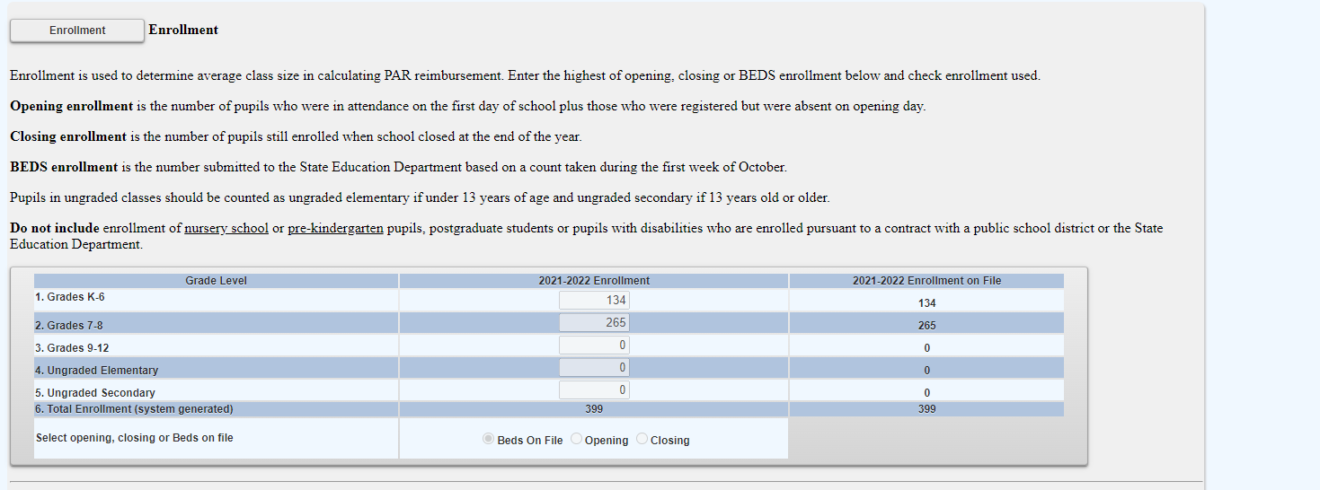
BEDS Enrollment Screen

Slide 44
Entering the MSA-CAP Claim Pupil Attendance Reporting (PAR)
Click on the button for “standard workday” or “actual hours of employees are varied”.
If “standard workday ” is selected, enter the # of days in the school year and # of hours in the workday for teachers, administrators and support staff.
The # of days in the school year and at least one entry for # of hours in the workday are required fields.

Slide 45
Mandate 1: Pupil Attendance Reporting (PAR) Calculation of Hourly Rate & Calculation of Expenditures
Enter data for line 1. Use the “tab” key to move to the next data entry field.
Continue entering data for lines 2-4. When you get to the end of line 4, tab again. If you enter a comma in the number, you will receive an error message after you click on the <Save Form> button.
Enter the total # of teachers taking daily attendance.
Click on the <Save Form> button.
The system calculates the information for lines 5-6 for the calculation of hourly rates and columns 3, 4, 5 & 6 for the calculation of expenditures.
Note: If the PAR total exceeds last year’s PAR by a 25%, an explanation will be required. A warning message will appear at the top of the screen.
A box will appear on the screen for entry of the explanation. The claim cannot be submitted until data is entered in the explanation box.

Slide 46
Mandate 1: PAR Screen

Slide 47
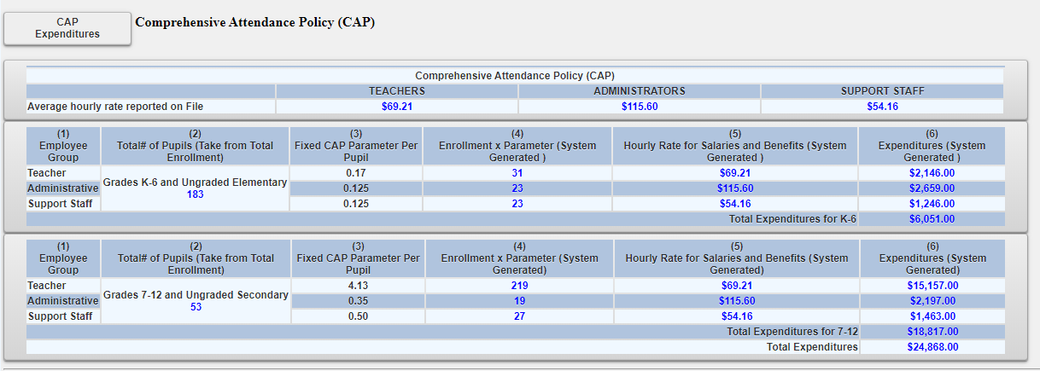
Comprehensive Attendance Policy (CAP) Certification * CERTIFY CAP AFTER ENTERING DATA FOR MANDATE 1*

Slide 48
Mandate 1: DOCUMENT REQUESTS
You claim may be set to Hold if you enter fewer than 180 days in the school year for Teachers or 190 for Administrators/Support Staff.
This will trigger a document upload request at the bottom of the claim screen and an email will be sent to the Administrator on file for a school calendar.

Slide 49
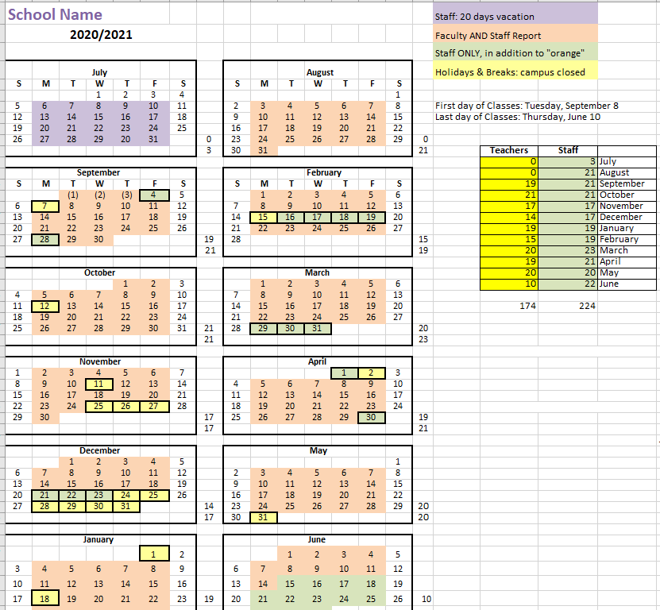
Mandate 1: SAMPLE CALENDAR EXAMPLE *Please include totals for Teachers and other staff

Slide 50
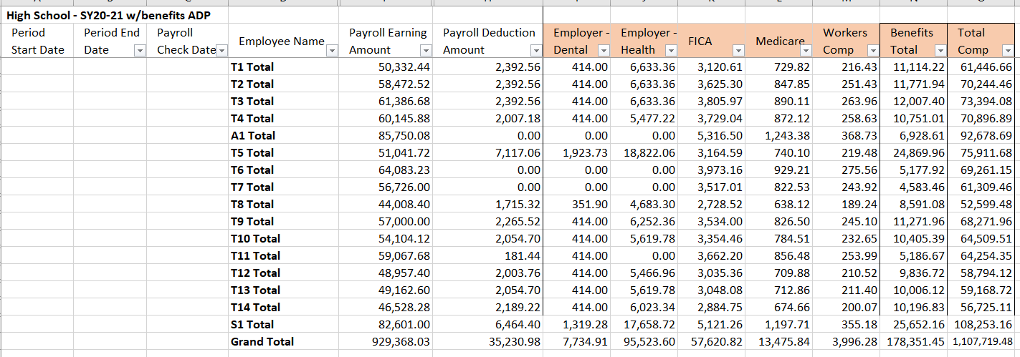
Mandate 1: SAMPLE PAYROLL EXAMPLE
Payroll records for those employees providing the mandated service, showing gross salary, and all payroll deductions including a breakdown of fringe benefits including sources of data (company names), must be maintained and made accessible upon request.
Payroll company documents are preferred; if payroll is completed in-house, please provide payroll (w/ benefit breakdowns) on school letterhead, accompanied by staff hiring agreements or contracts.
Please redact identifying information from documents.

Slide 51
Mandate 2: Elementary and Intermediate Assessment in English Language Arts and Math (EIA) Calculations of Hourly Rate, Combined Hours, & Expenditures
Calculation of Hourly Rate
Enter data for line 1. Use the “tab” key to move to the next data entry field.
Continue entering data for lines 2-4. When you get to the end of line 4, tab again.
If you enter a comma in the number or if you enter a character instead of a number in any of the fields, you will receive an error message saying “not a valid number” after you click on the <Save Form> button. A caution sign will appear next to the field that caused the problem.
*Documentation must be maintained for all these expenditures.*

Slide 52
Mandate 2: Elementary and Intermediate Assessment in English Language Arts and Math (EIA) Calculations of Hourly Rate, Combined Hours, & Expenditures(continued)
Exam Expenditures
Enter the number of tests administered (compare to number of tests showing as on file).
Teacher Workshop Expenditures
Enter the total hours of allowable workshop training.
Enter the dollar amount of the workshop fee.
The system generates the calculations of Total Expenditures and Total Workshop Expenditures and populates the “MSA/CAP Summary of Expenditures” Screen.
*Documentation must be maintained for all these expenditures.*

Slide 53
Mandate 2: EIA Screen

Slide 54
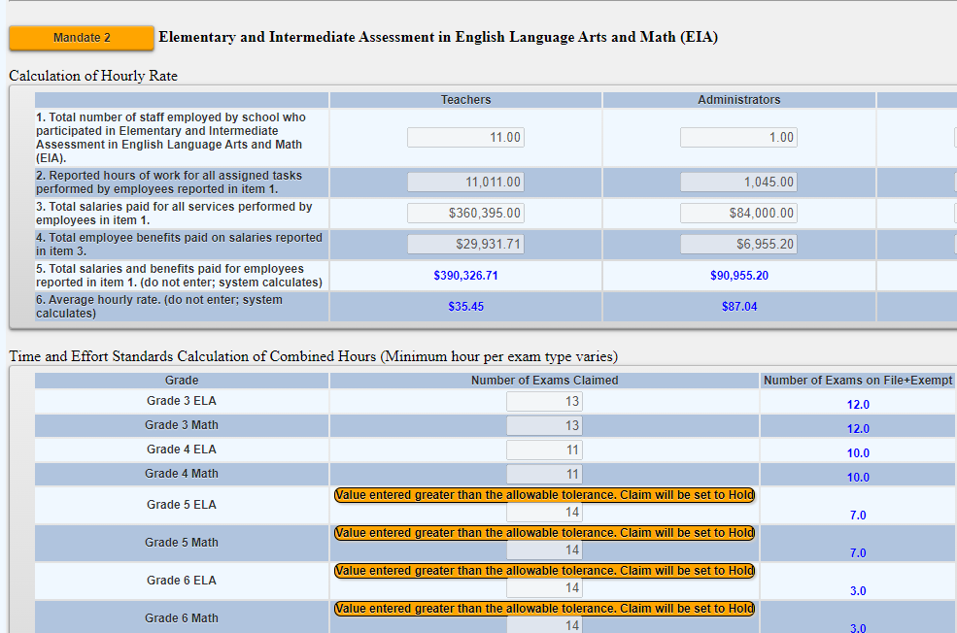
Mandate 2: EIA HOLD
Your claim may trigger a hold if the number of exams does not match the exams on file. You may still claim the number of exams entered but will be asked to provide documentation.

Slide 55
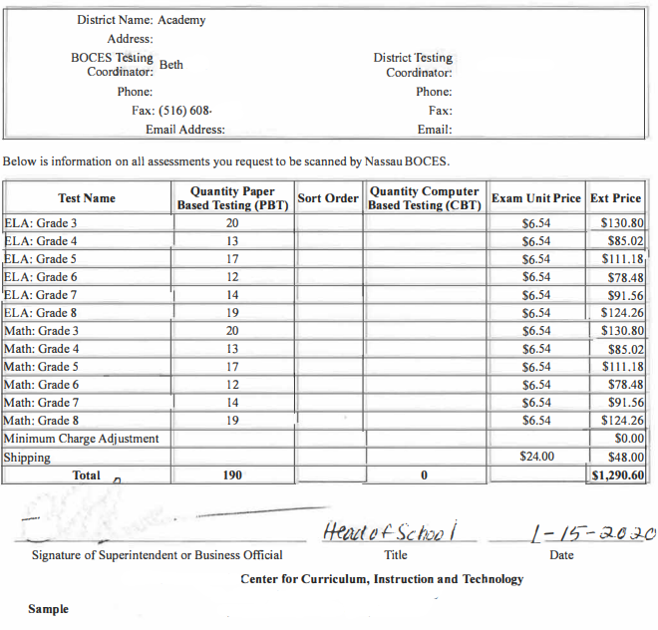
Mandate 2: EIA SAMPLE DOCUMENT

Slide 56
Mandate 3: Basic Educational Data System Reporting (BEDS) Enrollment
Click on the <Mandate 3> button.
Enter data for line 1. Use the “tab” key to move to the next data entry field.
Continue entering data for lines 2-4.
Enter the total # of teachers taking daily attendance in the calculation of expenditure area.
Click on the <Save Form>button.
The system generates the information for lines 5 and 6 and completes the fields for Calculation of Expenditures and populates the “MSA/CAP Summary of Expenditures” Screen.
*Documentation must be maintained for all these expenditures.*

Slide 57
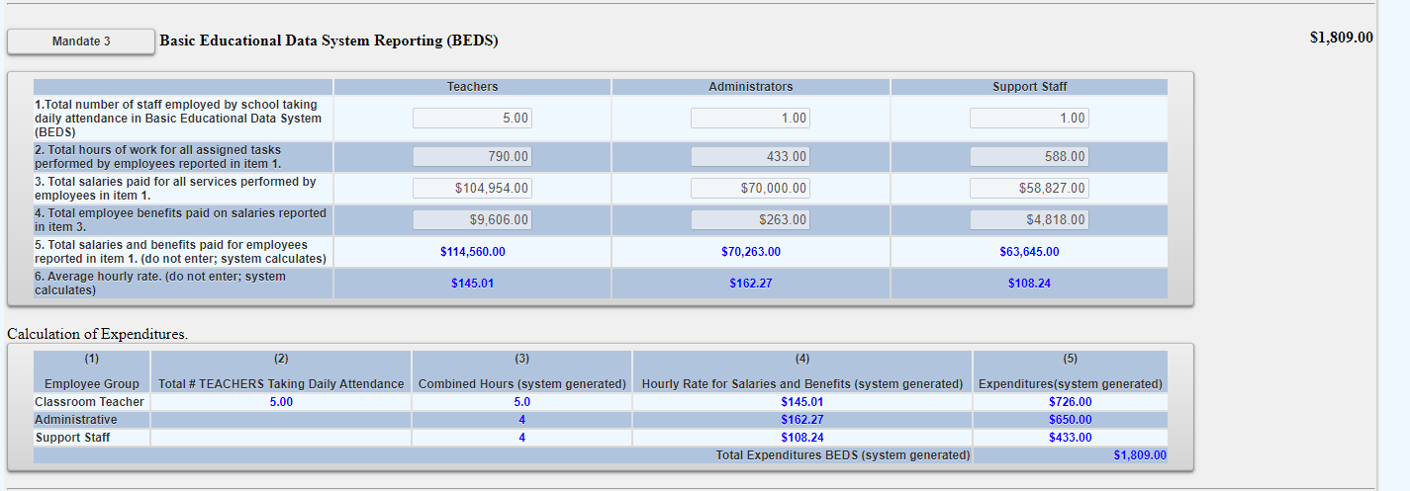
Mandate 3: BEDS Enrollment Screen

Slide 58
Mandate 4: Regents Examinations
Calculation of Hourly Rate
Click on the <Mandate 4> button.
Enter data for line 1. Use the “tab” key to move to the next data entry field.
Continue entering data for lines 2-4.
The system generates the information for lines 5 and 6 and completes the fields for Calculation of Expenditures.
*Documentation must be maintained for all these expenditures.*

Slide 59
Mandate 4: Regents Examinations (continued)
Calculation of Combined Hours
The system shows the number of Regents exams that were reported to the Office of Information Reporting Services.
Enter the number of exams that were administered. Use the “tab” key to move to the next field.
You must make an entry for each exam you want to receive reimbursement for.
When you have completed entering the exam data, click the <Save Form> button. The system generates the Total General Expenditures.
*Documentation must be maintained for all these expenditures.*

Slide 60
Mandate 4: Regents Exams (continued)
Teacher Workshop Expenditures
Under Section B enter the total hours of allowable workshop training.
Enter the dollar amount of the workshop fee.
The system generates the Total Expenditures,
Test Kits
Under Section C, enter the total number students taking Regents Earth Science and the number of Earth Science Test Kits purchased during the 2021-2022 school year.
The system generates the calculations of the Total Expenditures and Total Workshop/Test Kits Expenditures and populates the “MSA/CAP Summary of Expenditures” Screen.
*Documentation must be maintained for all these expenditures.*

Slide 61
Mandate 4:Regents Exam Screen

Slide 62
Mandate 4:Regents Exam Sample Document Example

Slide 63
Mandate 6: Calculator Expenses
Enter the number of scientific calculators that were purchased.
Use the “tab” key to move to the next data entry field.
Enter the number of graphing calculators that were purchased.
Click on the <Save Form> button.
The system generates the calculations of Total Expenditures and populates the “MSA/CAP Summary of Expenditures” screen.
*Documentation must be maintained for all these expenditures.*

Slide 64
Mandate 6: Calculator Screen

Slide 65
Mandate 8: New York State School Immunization Program (SSIP)
Only Grade K-12 students non-public schools in New York City, Buffalo or Rochester that filed their immunization data with NYSDOH are eligible for Mandate 8. The Mandate 8 button will be disabled for the other non-public schools.
Enter the number of non-public school pupils for whom immunization documentation has been maintained.
The system generates the calculations of Total Expenditures for SSIP and populates the “MSA/CAP Summary of Expenditures” screen.

Slide 66
Mandate 9: Documentation of Integration of Required Instruction in 7th and 8th Grade (DIRI)
Calculation of Hourly Rate
Click on the <Mandate 9> button.
Enter data for line 1. Use the “tab” key to move to the next data entry field.
Continue entering data for lines 2-4.
Calculation of Expenditures
Use the “tab” key to move to the combined hours field.
Enter Total # of 7th & 8th grade teachers that participated in the mandate.
Click on the <Save Form> button.
The system generates the calculations of Total General Expenditures for DIRI and populates the “MSA/CAP Summary of Expenditures” screen.
*Documentation must be maintained for all these expenditures.*

Slide 67
Mandate 9:DIRI Screen

Slide 68
Mandate 10: High School Graduation Report (HSGR)
Calculation of Hourly Rate
Click on the <Mandate 10> button.
Enter data for line 1. Use the “tab” key to move to the next data entry field.
Continue entering data for lines 2-4.
Calculation of Expenditures
Use the “tab” key to move to the next field.
Enter the number of graduation candidates.
Click on the <save> button.
The system generates the calculations of Total General Expenditures for HSGR and populates the “MSA/CAP Summary of Expenditures” screen.
*Documentation must be maintained for all these expenditures.*

Slide 69
Mandate 10: HSGR SCREEN

Slide 70
Mandate 11: Grade Four Science Test (GFST)
Calculation of Hourly Rate
Enter data for line 1. Use the “tab” key to move to the next data entry field.
Continue entering data for lines 2-4. Do not use commas. When you get to the end of line 4, tab again.
If you enter a comma in the number or if you enter a character instead of a number in any of the fields, you will receive an error message saying “not a valid number” after you click on the “save” button. A caution sign will appear next to the field that caused the problem.
*Documentation must be maintained for all these expenditures.*

Slide 71
Mandate 11: Grade Four Science Test Screen

Slide 72
Mandate 11: GFST – Teacher Workshop Expenditures & Test Kits
Teacher Workshop Expenditures
Enter the total hours of allowable workshop training (the time that the teacher is out of the classroom). Use the “tab” key to move to the next field.
Enter the dollar amount of workshop fees. Use the “tab” key to move to the next field.
Test Kits
Enter number of students taking Grade Four Science Test
Enter number of test kits purchased (Note: each kit serves 30 pupils)
Click on the <Save Form> button.
The system generates the calculations of Total Expenditures and Total Workshop/Test Kits Expenditures and populates the “MSA/CAP Summary of Expenditures” Screen.
*Documentation must be maintained for all these expenditures.*

Slide 73
Mandate 11: GFST – Teacher Workshop Expenditures & Test Kits Screen

Slide 74
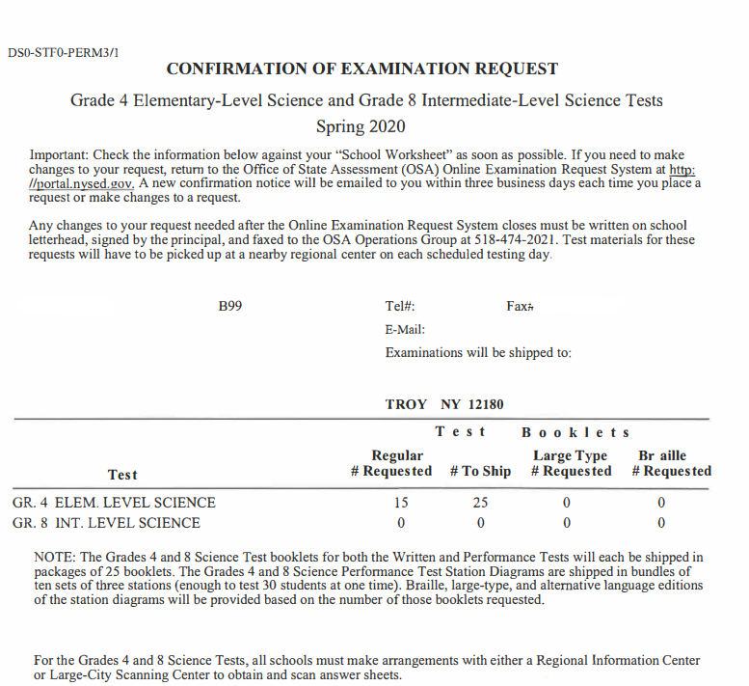
Mandate 11: Grade Four Science Sample Document Example

Slide 75
Mandate 12: Travel to Storage Sites (TSS)
TSS Expenditures
Enter total number of staff employed by school who participated in TSS.
Enter total hours of work for all assigned tasks performed by employees reported in line 1.
Enter total salaries paid for all services performed by employees in line 1.
Enter total employee benefits paid on salaries in line 3.
Enter total salaries and benefits paid for employees reported in line 1. ( system automatically calculates)
Average hourly rate is automatically calculated by system.
Click on the <Save Form> button.
The system generates the calculations of Total Expenditures and Total Workshop Expenditures and populates the “MSA/CAP Summary of Expenditures” Screen.
*Documentation must be maintained for all these expenditures.*

Slide 76
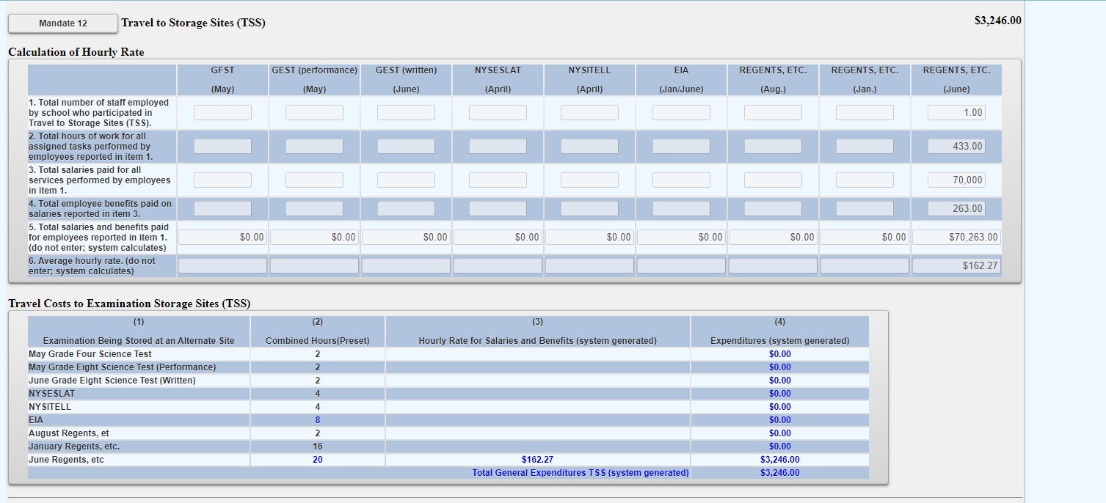
Mandate 12: Travel to Storage Sites (TSS) Screen

Slide 77
Mandate 13: Scholarship for Academic Excellence Application (SAE)
SAE Expenditures
Enter total number of staff employed by school who participated in the SAE.
Enter total hours of work for all assigned tasks performed by employees reported in line 1.
Enter total salaries paid for all services performed by employees in line 1.
Enter total employee benefits paid on salaries in line 3.
Enter total salaries and benefits paid for employees reported in line 1. ( system automatically calculates)
Average hourly rate is automatically calculated by system.
Click on the <Save Form> button.
The system generates the calculations of Total Expenditures and Total Workshop Expenditures and populates the “MSA/CAP Summary of Expenditures” Screen.
*Documentation must be maintained for all these expenditures.*

Slide 78
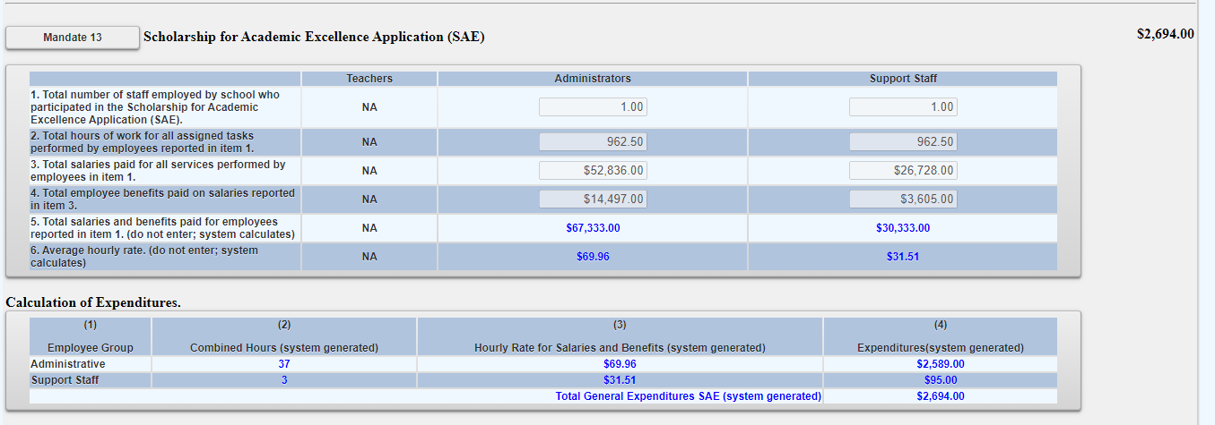
Mandate 13: Scholarship for Academic Excellence Application (SAE) Screen

Slide 79
Mandate 14: Grade Eight Science Test (GEST)
GEST Expenditures
Enter total number of staff employed by school who participated in Grade Eight Science Test (GEST).
Enter total hours of work for all assigned tasks performed by employees reported in line 1.
Enter total salaries paid for all services performed by employees in line 1.
Enter total employee benefits paid on salaries in line 3.
Enter total salaries and benefits paid for employees reported in line 1. ( system automatically calculates)
Average hourly rate is automatically calculated by system.
Click on the <Save Form> button.
The system generates the calculations of Total Expenditures and Total Workshop Expenditures and populates the “MSA/CAP Summary of Expenditures” Screen.
*Documentation must be maintained for all these expenditures.*

Slide 80
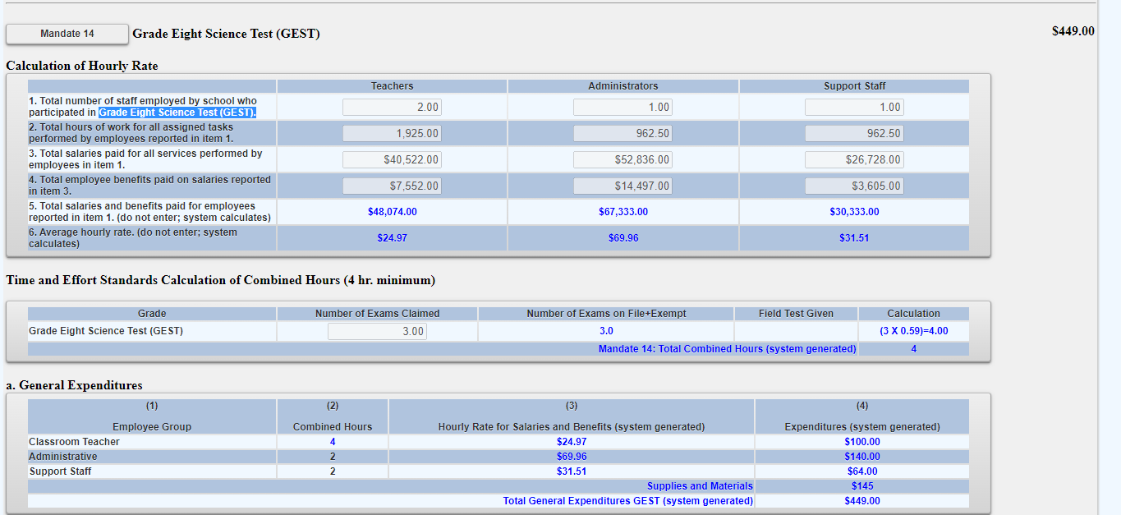
Mandate 14: Grade Eight Science Test (GEST) Screen

Slide 81
Mandate 14: Grade Eight Science Test (GEST) Sample Document Example

Slide 82
Mandate 17: Pesticide Neighbor Notification (PNN)
The School Pesticide Neighbor Notification Law requires all Non-public schools to notify parents and interested parties prior to pesticide applications in instructional and administrative buildings and grounds, as well as playgrounds and athletic fields.
Click yes to claim if your school notified parents and interested parties prior to pesticide applications as required by the Pesticide Neighbor Notification Law.
The system will automatically award $100 for this mandate if claimed.

Slide 83
Mandate 18: New York State English as a Second Language Achievement Test (NYSESLAT) and New York State Identification Test for English Language Learners(NYSITELL)
NYSESLAT/NYSITELL Expenditures
Enter total number of staff employed by school who participated in NYSESLAT/NYSITELL.
Enter total hours of work for all assigned tasks performed by employees reported in line 1.
Enter total salaries paid for all services performed by employees in line 1.
Enter total employee benefits paid on salaries in line 3.
Enter total salaries and benefits paid for employees reported in line 1. ( system automatically calculates)
Average hourly rate is automatically calculated by system.
Click on the <Save Form> button.
The system generates the calculations of Total Expenditures and Total Workshop Expenditures and populates the “MSA/CAP Summary of Expenditures” Screen.
*Documentation must be maintained for all these expenditures.*

Slide 84
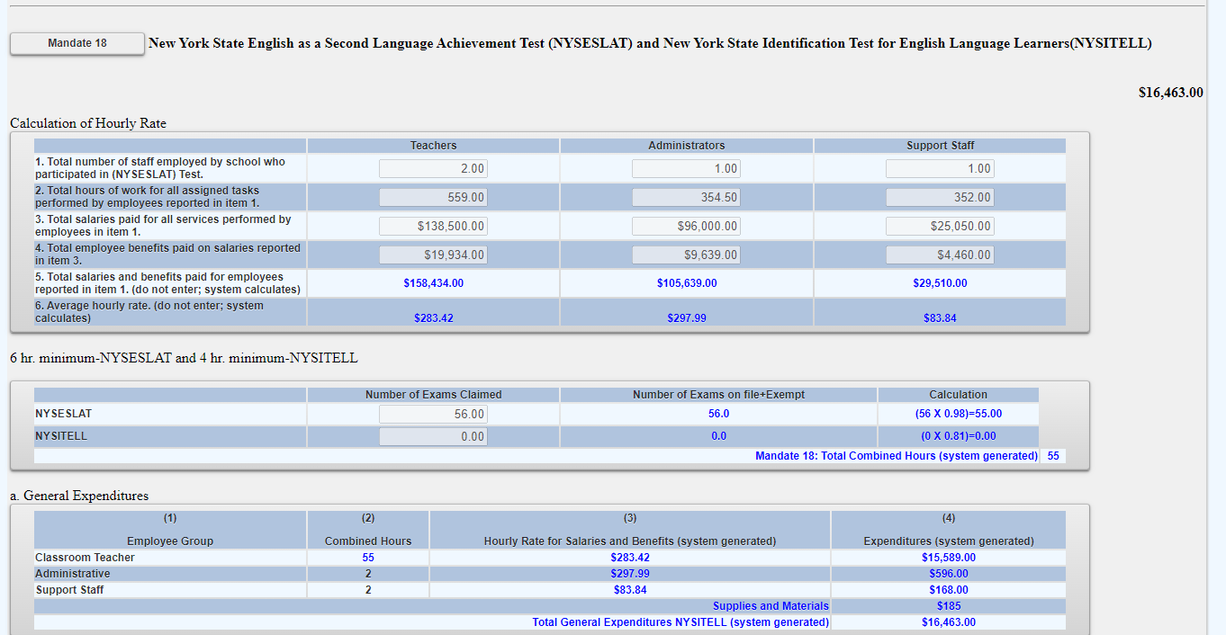
Mandate 18: New York State English as a Second Language Achievement Test (NYSESLAT) and New York State Identification Test for English Language Learners(NYSITELL) Screen

Slide 85
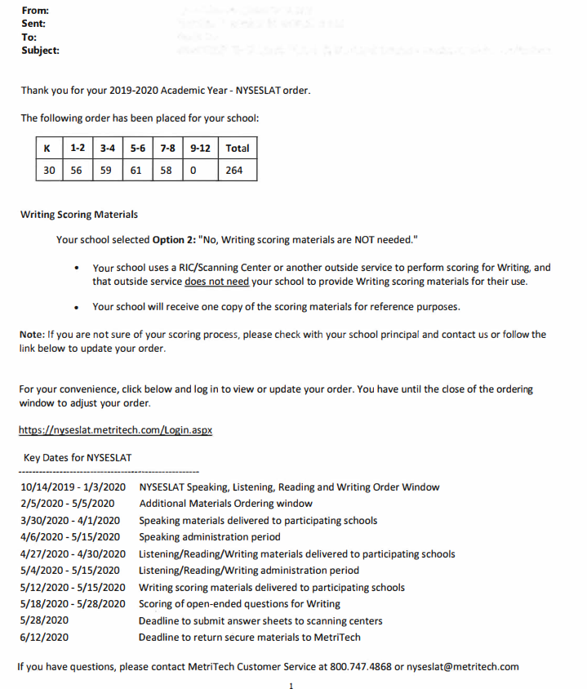
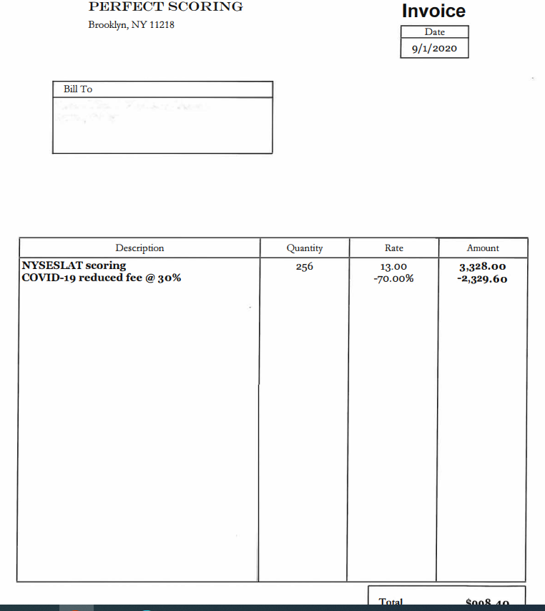
Mandate 18: NYSESLAT & NYSITELL Test Sample Document Examples

Slide 86
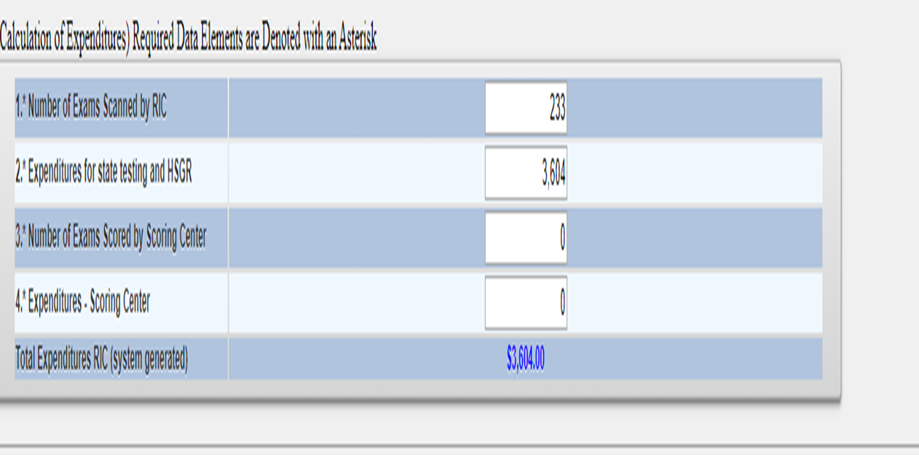
Mandate 19-RIC & Scoring Center Expenditures
An entry must be made in each field. If you only have the total expenditures for the scanning and scoring, enter zeroes in the other fields. If you leave the fields blank, a warning message will appear at the top of the screen.
The 3rd through 8th grade tests may be scored by Regional Scoring Centers. (Note: If your tests are graded by a Scoring Center, no printing costs are separately reimbursed under Mandate 2, EIA.)
Round to the nearest dollar amount when entering expenditure amounts.

Slide 87
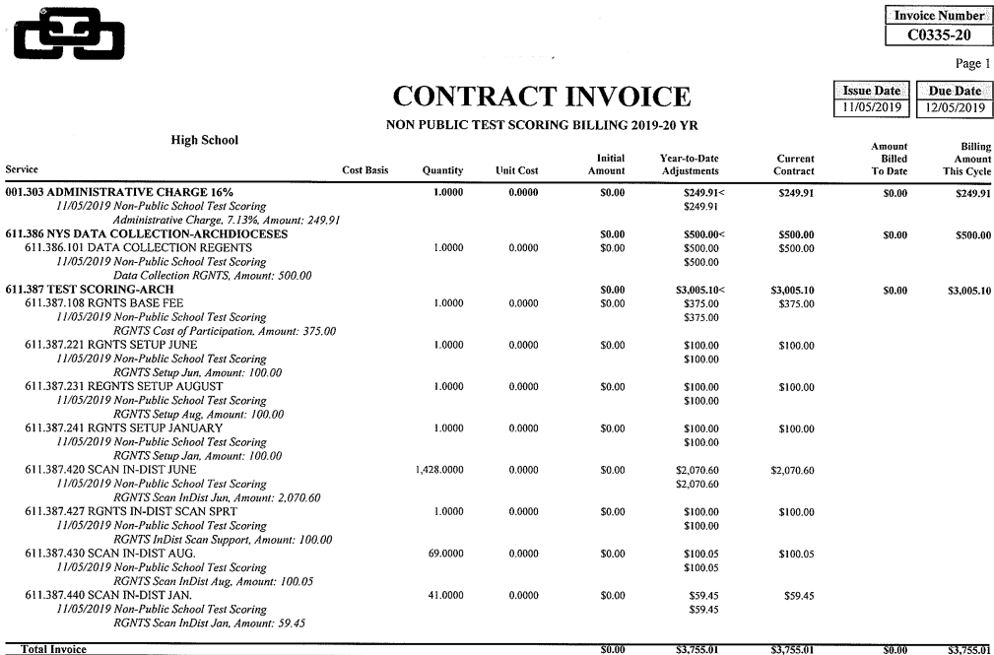
Mandate 19-Sample Document Example

Slide 88
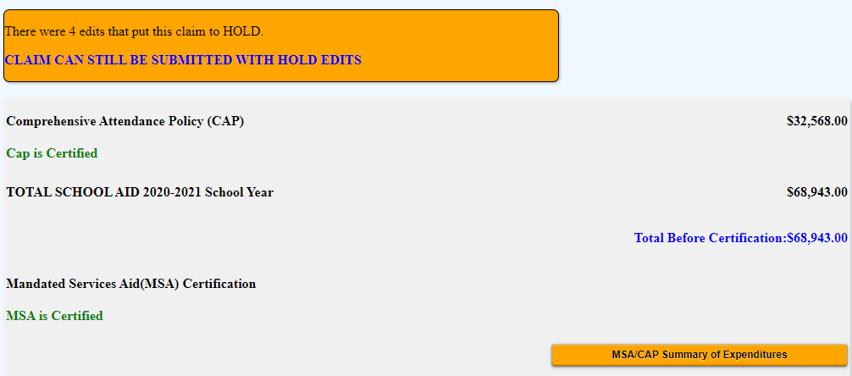
Hold Messages
Expanding “MSA/CAP Summary of Expenditures” will show the user the reasons for the claim being in hold status.

Slide 89
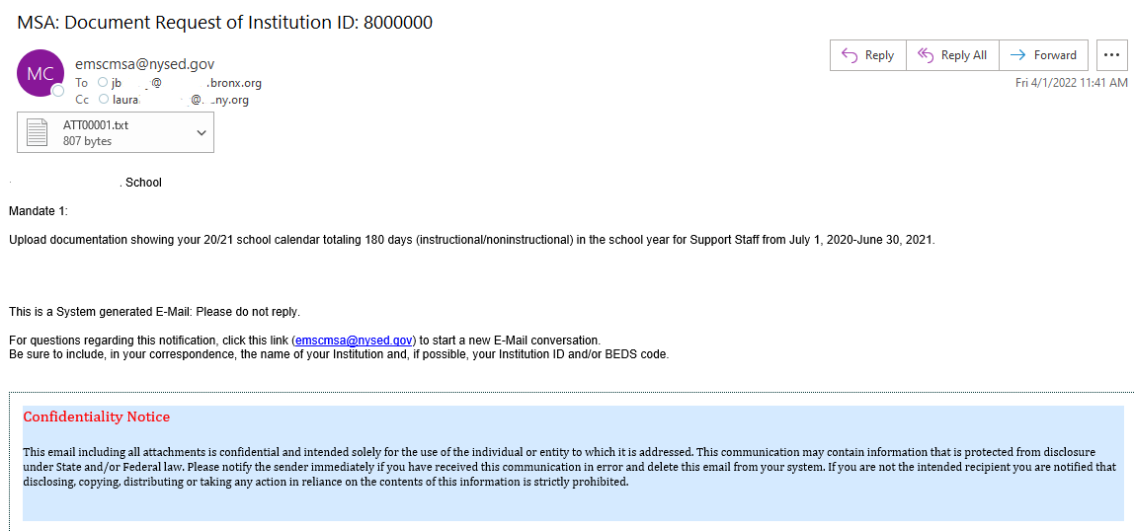
HOLD CLAIMS: UPLOAD DOCUMENT REQUEST
Schools with claims on hold can upload documents to the MSA-CAP system. The claims in hold status will be reviewed and the reviewer will send a request to schools to provide documentation. The schools will be able to access their claims in the MSA-CAP system and upload requested document/s.
School will receive an e-mail for the request. The document request text will be in the e-mail.

Slide 90
HOLD CLAIMS: UPLOAD DOCUMENT REQUEST (continued)
Select the File
Choose File
Select the Upload File button by scrolling all the way to the right of your screen.
Please note that file requests that are still pending are displayed in red.

Slide 91
HOLD CLAIMS: UPLOAD DOCUMENT REQUEST (continued)
After the file is uploaded, there will be a link that both the schools and the reviewer can view and download.
Claims that were successfully uploaded will have the file name displayed in blue and file request wording in black.

Slide 92
Submit and Certify
Non-public schools have the option to assign an MSA CFO to submit and certify their MSA-CAP claim. Currently, most non-public schools only have the CEO in that role. If schools would like to add an MSA-CAP CFO to submit and certify their claim, please email datasupport@nysed.gov.
If your non-public school does not have a CFO, the submit and certify roles automatically defaults to the CEO. Once the MSA-CAP CFO is added to SEDREF, please contact our office and we will entitle the MSA-CFO to the MSA-CAP NYSED Business portal online system.

Slide 93
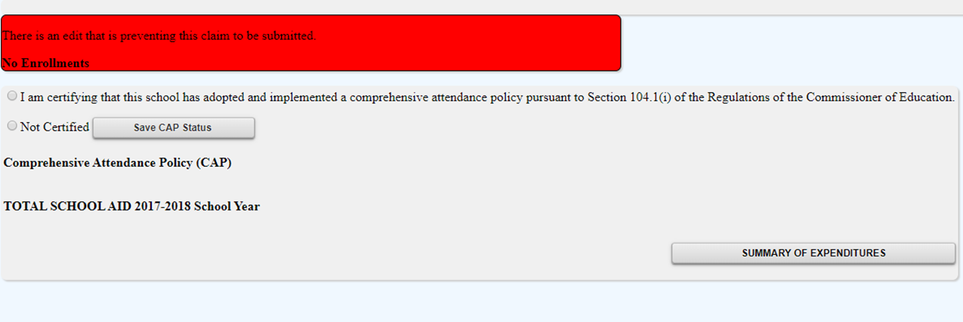
Submitting Claims: Warning Messages
Expanding summary of expenditures will show the user the warnings associated with the claim.

Slide 94
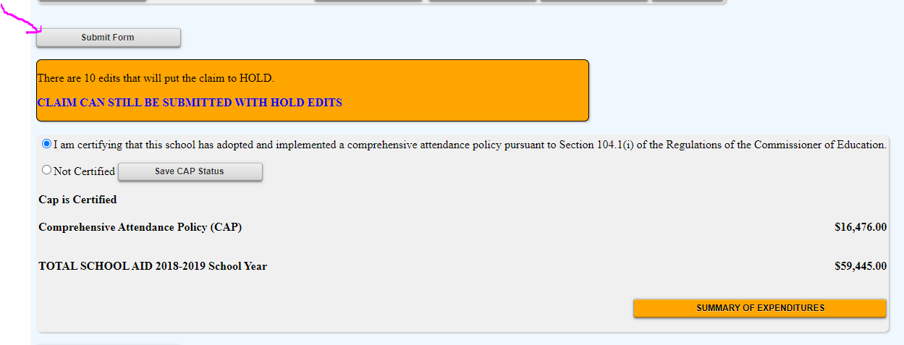
Submitting the MSA Claim
When all errors have been corrected, the certification buttons will appear at the top of the MSA-CAP Summary of Expenditures screen.
Read the certification statement and click the “save CAP Certification and save MSA Certification” button.
Click on the <Submit Form> button.
The system returns you to the “home” screen and displays the status of the claim.

Slide 95
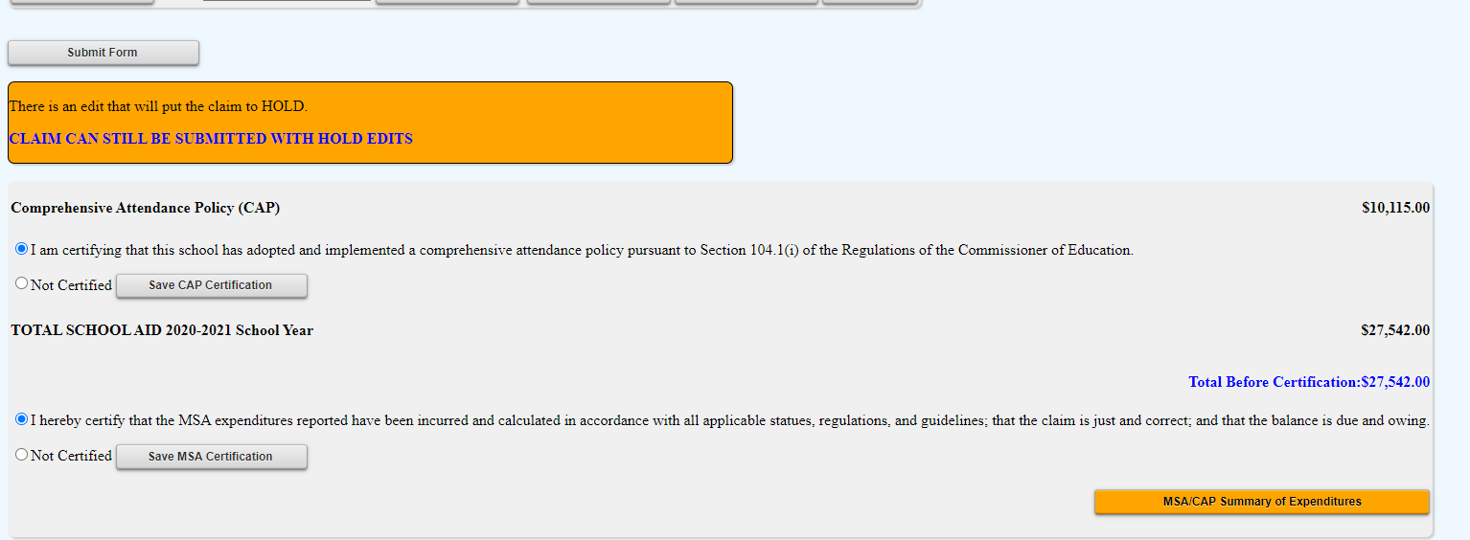
Submitting the MSA Claim
When all errors have been corrected, the certification buttons will appear at the top of the MSA-CAP Summary of Expenditures screen.
Read the certification statement and click the “save CAP Certification and save MSA Certification” button.
Click on the <Submit Form> button.
The system returns you to the “home” screen and displays the status of the claim.

Slide 96
MSA Screen Submitting the MSA Claim

Slide 97
Recordkeeping

Slide 98
Recordkeeping
It is very important that accurate documentation be kept by every school that claims mandated services. Even if your mandated services forms are completed by an independent contractor or diocesan office, the school is responsible for maintaining complete records.
Documentation must be maintained for a minimum of 7 years. Records must be available for inspection, monitoring and/or audit by the New York State Education Department and the Office of the State Comptroller.
It is recommended that each school creates and maintains a mandated services documentation file for each school year that a claim is submitted. The following list identifies types of records/ documentation that would be recommended to include in the file or otherwise have readily available:

Slide 99
Recordkeeping (continued)
Payroll records, for only those employees providing the mandated service, including allowable fringe benefits. If you use a payroll service, you will need to put copies of the applicable payroll records in the mandated services aid documentation file.
Salary agreements and/or contracts for those employees providing mandated services.
Time distribution records. You are required to maintain documentation to show that the employee actually provided services such as taking attendance or proctoring exams.

Slide 100
Recordkeeping (continued)
Student enrollment records, class schedules or Attendance rosters.
Invoices/cancelled checks or credit card receipts/statements for purchases made to perform mandated services.
Any documentation that supports the information and calculations used to prepare any claim for nonpublic school aid.
Schools must maintain inventory records for calculators and science test kits. Calculators are not a consumable product. The inventory control procedure should include a replenishment cycle to replace aging and broken calculators. Calculators may not be given permanently to students.
Documentation of calculator purchase must be retained for monitoring and/or audit.

Slide 101
Recordkeeping (continued)
Documentation of the hours that form the basis for a standard workday must be maintained by the school.
Information gathering per Comptroller’s Audit.
Documentation must be maintained to show the basis of the calculation for the average hourly rates.
Schools must maintain inventory records of the science test kits and earth science test kits.
Evidence of number of students who graduated from high school such as student transcripts.
Records of student scores on State examinations such as the Individual Student Score Reports, Nonpublic Secondary Examination Report, Comprehensive Information Report.
Failure to maintain adequate supporting documentation may result in a disallowance or partial disallowance.
NOTE: This is not an all-inclusive list

Slide 102
SAVE/PRINT CLAIM AS PDF

Slide 103
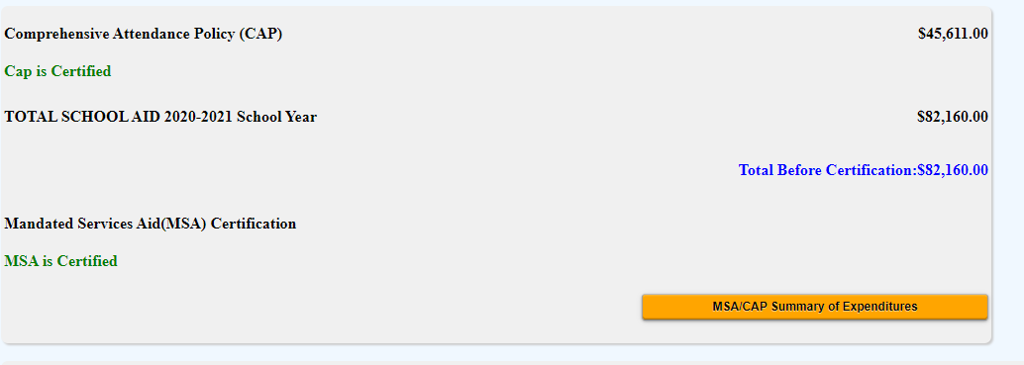
Select MSA/CAP Summary of Expenditures at the top of the MSA/CAP claim form.

Slide 104
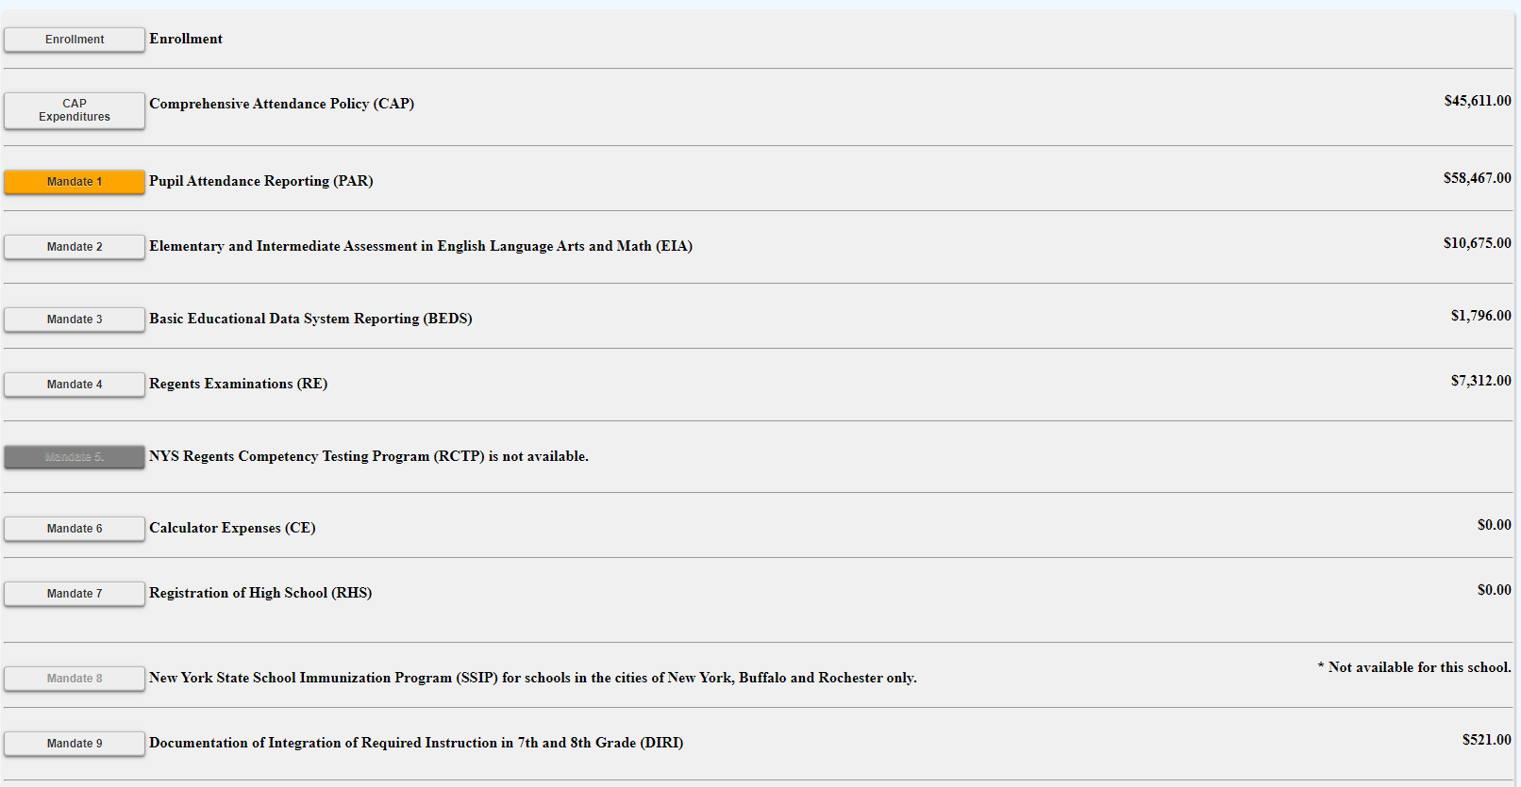
Select each mandate to expand and view detailed explanation of each mandate.

Slide 105
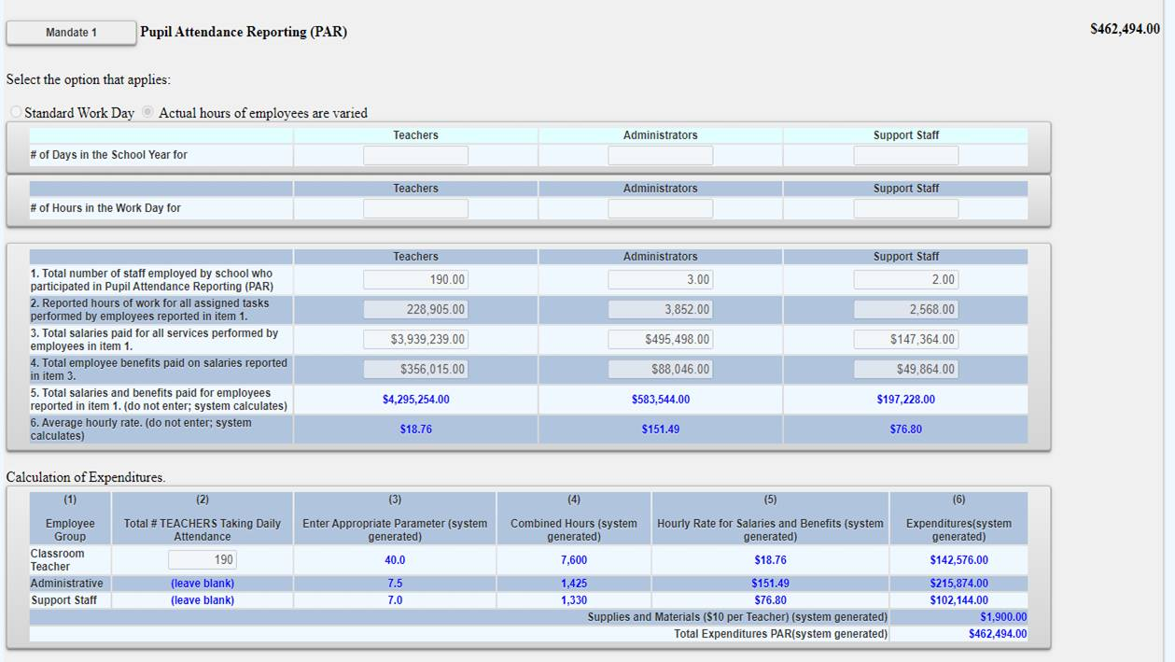
Sample of expanded mandate.

Slide 106
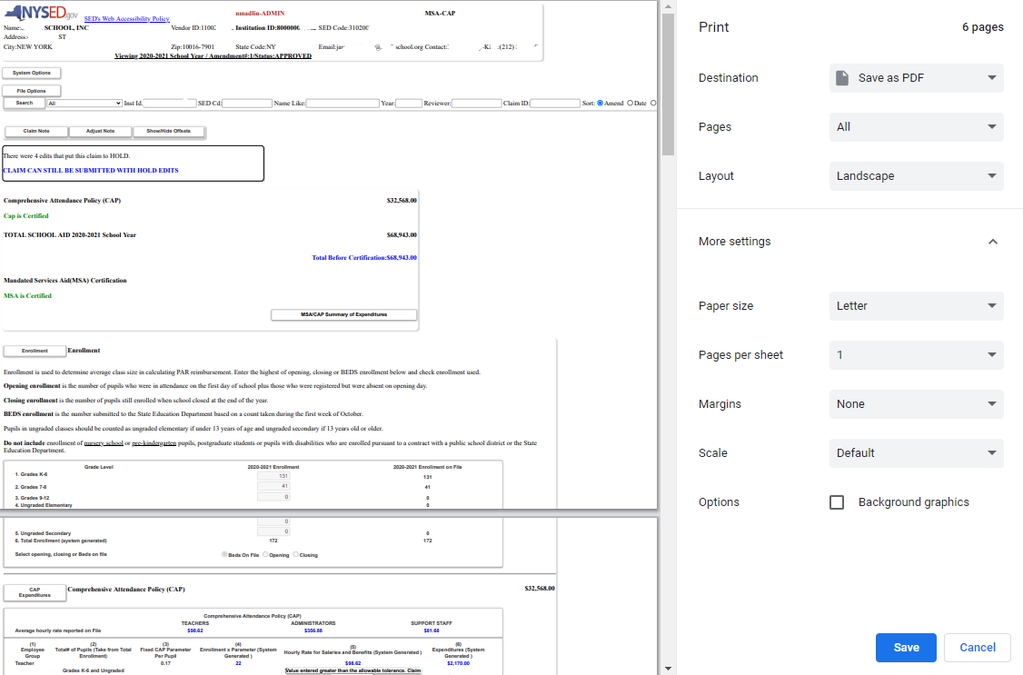
Select print feature and print or save document as PDF and print. You may need to decrease the document size to ensure the entire claim is visible on their screen before printing.

