Slide 1
New York State Fire Safety Inspection Reporting for Religious and Independent Schools 2021
New York State Education Department
State Office of Religious and Independent Schools

Slide 2
Key Legal Citations: 8 NYCRR 155.8 Regulation of the Commissioner of Education and Education Law 807-a
All school buildings containing classrooms, dormitory, laboratory, physical education, dining or recreational facilities for students use must be inspected annually for compliance
Notes:
All buildings that contain classrooms, dormitories, labs, PE, dining or recreational facilities for student use MUST be inspected annually for compliance with Education law 807-a

Slide 3
Who Needs to Submit the Fire Safety Report to the State Office of Religious and Independent Schools (SORIS)?
All Religious and Independent Schools that have 25 or more students enrolled and are located outside of NYC, Buffalo, Rochester, Syracuse, and Yonkers
All Religious and Independent Schools that are located in NYC, Buffalo, Rochester, Syracuse, and Yonkers OR have less than 25 students enrolled must follow the local jurisdiction code enforcement authority and their requirements for annual safety inspections for nonpublic schools.
Notes:
Submission of Reports:
All schools located outside of the BIG 5 who have 25 students or more MUST submit an annual Fire Inspection
Who does not have to Submit?
Any school who is located in the Big 5 – regardless of enrollment
Any school who has under 25 students enrolled

Slide 4
New Process
Religious and Independent Schools that are required to submit their Annual Fire Inspection Reports can now do so electronically via the NYSED Application Business Portal.
Notes:
We will still accept paper reports for those that cannot access the portal.

Slide 5
New Process Steps
After the annual fire inspection has been completed, the religious and independent school leader will enter the fire inspection information for each building into the
secure portal.
Notes:
After the inspection has been completed by the appropriate official, the school will need to log in and complete the process online.

Slide 6
New Process Steps
Log into the NYSED Application Business Portal
https://portal.nysed.gov/abp
NOTE:
Each Religious and Independent school must enter their own building data into the secure portal.

Slide 7
Your school building will Appear.
Select “Enter Report”
Notes:
Once you click on Facilities Planning – Fire Report you will select SEDREF Buildings, and your school will appear. Select “Enter Report”.

Slide 8
Online Sections
Inspection Date
Part I : General Information and Fire/Life Safety History (Q1-8)
Part II: Conformance Codes
Part III: NonPublic School Certifications
Once all sections have been completed, click “Save and Review”
Notes:
All sections must be completed in order to submit report.

Slide 9
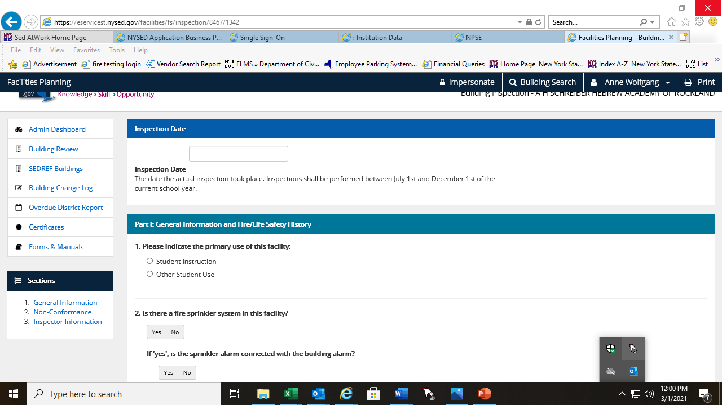
Inspection Section 1: General Info & Fire/Life Safety History
Notes:
Questions begin – at this time enter all information pertaining to your fire inspection.

Slide 10
Inspection Section 2: Nonconformance Information
Notes:
How to complete Section 2
1. If the school building does NOT have a Nonconformance, this section will be left blank.
2. Enter any Nonconformance information exactly as shown on your completed fire safety report.
3. If the school had a nonconformances that have been corrected, please enter the correction date as part o the process (see next slide)

Slide 11
Nonconformance Correction
Notes:
If the school had a nonconformances that have been corrected, please enter the correction date as part of the process.

Slide 12
Inspection Verification & Certification
Notes:
When there are non-conformances, we ask that the school submit a revised copy of the FSR with the completion dates. Otherwise, it will remain in Pending Status.
Enter information as per your competed Inspector’s fire safety report (circled information).

Slide 13
Inspection Section 3: Inspector & Building Administrator Information
Notes:
Please complete Section III A with your inspection method.
Please compete Section III B with your inspector’s information.

Slide 14
Updated Fire Report Manual http://www.p12.nysed.gov/nonpub/fire_safety_report.html
Notes:
The complete Manual for Non-Public School Facility Fire and Building Safety Inspections can be found at the link provided.

Slide 15
Online Fire Report System – FAQ NYS Education Law 807-a
Q. Which religious and nonpublic schools are required to submit a fire safety report (FSR) with NYSED?
A. All schools are required to have an annual fire safety inspection completed;
the requirement to submit the FSR does not apply to religious and independent schools in the cities of NYC (five boroughs), Buffalo, Rochester, Syracuse, and Yonkers and for any school outside of these areas that have enrollment under 25 students
Q. When are the annual FSR required to be submitted to NYSED?
A. The annual FSR are required to be completed by between July 1 and December 1, annually and submit to NYSED by December 16, annually.

Slide 16
Online Fire Report System – FAQ
Q. What changes are taking place with the annual fire inspection process itself?
None. The new reporting system should have no impact on the actual fire inspection process. NYSED has updated and streamlined the paper form (to be retained at the local level ONLY), but the inspection process (aka – the NYS code items SED is requesting on the report) has not changed.
Q. The fire inspection report includes a field for the name and license # for the code enforcement official, but his/her signature is no longer part of the official submission package to SED. Why has that changed?
The school leader will legally certify the data’s accuracy via the secure SED business portal. This is the same portal used for many other sensitive SED processes.

Slide 17
Online Fire Report System – FAQ
Q. Who is the Fire Code and Building Code enforcement authority for nonpublic school facilities?
The local building official and/or fire marshal where the nonpublic school facility is located is the authority having jurisdiction for code enforcement for non public school facilities.
Q. If non-conformances were reported for the nonpublic school FSR, is the school required to remediate the reported non-conformances?
Yes, the items found to be non-conformant are violations of the current building code, fire code and property maintenance code. The non-conformances must be corrected.
Q. Is it permissible to mail in the paper copy of the fire inspection report instead of using the on-line system?
Yes. However, it is encouraged to use the new on-line system. It is now “live” beginning with fire reports that are due by December 16,2021.

Slide 18
Online Fire Report System – FAQ
Q. How can my nonpublic school obtain a copy of the updated paper fire inspection report (to be used and retained at the local level only) and the updated fire inspection manual?
They can be found on SORIS website at: http://www.p12.nysed.gov/nonpub/fire_safety_report.html
Q. How can the Director of School Facilities obtain a password for the on-line fire report system?
The school leader is the only person in the district with the secure password. The school leader is legally responsible for certifying the building verification process and the accuracy of the annual fire inspections.

Slide 19
Online Fire Report System – FAQ
Q. Can school staff input data in the on-line system without certifying the data?
Yes. School staff, with permission of the school leader, may enter the fire inspection data – however only the school leader is permitted to legally certify the data’s accuracy.
Q. The school leader at my school has designated me as the person to go through the new system enter fire safety inspection data. What does the school leader need to do in order for this to happen?
The school leader is the only person at the school with the secure password. Therefore if they want you to perform the data entry, they first need to “entitle” (aka delegate) access to the “Religious and Independent School-Fire Safety” system through the SED Delegated Account System (SEDDAS). Instructions are available at: www.p12.nysed.gov/seddas/seddashome.html. Questions on this specific step should be directed to the SEDDAS Help Desk at: seddas@nysed.gov

Slide 20
On-Line Fire Report System – FAQ
Q. What is SEDREF?
The State Education Department Reference File (SEDREF) is the central system that maintains vital information for school districts, nonpublic, charter schools, and BOCES. Additional guidance on SEDREF is available at: www.oms.nysed.gov/sedref/ home.html.
Q. Our school is housed in multiple building. We have separate BEDS numbers for the K-8 and the 9-12 buildings. Does this mean that our K-12 school requires two separate Fire Safety Reports – one for the K-8 and the other for the 9-12?
Yes. Each school building is required to have a Fire Safety Report.

Slide 21
Thank You!
NYS Education Department
State Office of Religious and Independent Schools
SORIS@NYSED.gov

