Slide 1
Lesson 5: Impact of Revolution on Six Nations
Slides for Guided Notes

Slide 2
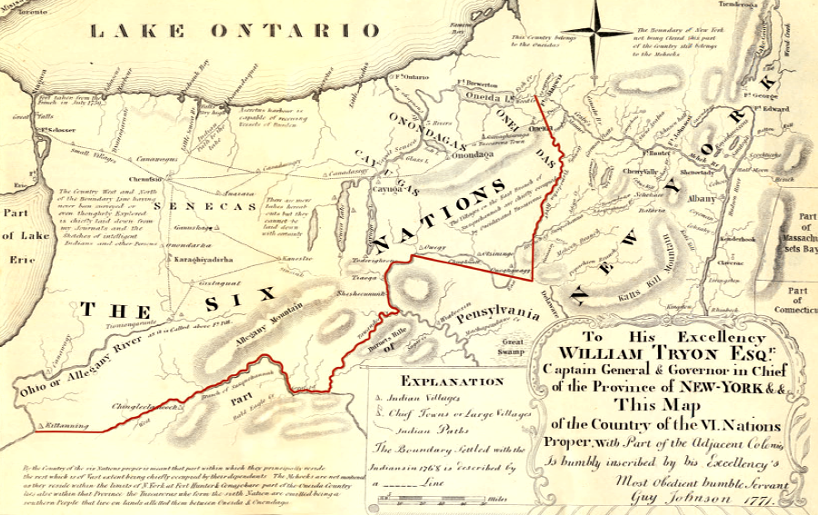
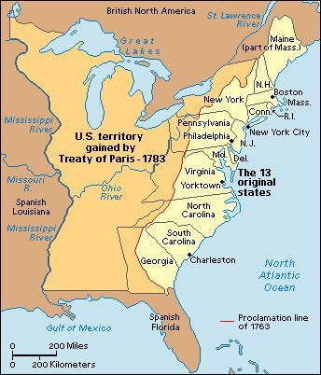
Revolutionary War Impact:
The Six Nations were not included in the Treaty of Paris because it was negotiated solely between Great Britain and the United States
They tried to keep influence and control over their land by maintaining trade with the British.
Their land acted as a buffer between British forts and the U.S. frontier.
Before the Revolution, the Six Nations leased land while retaining hunting and food rights.

Slide 3
Revolutionary War Impact:
After the Revolution, the U.S. claimed to fully own rights to Indian land.
  Native land ownership was a barrier to U.S. westward expansion.
  Native boundaries were hard to define due to traditional, non-surveyed markers.

Slide 4
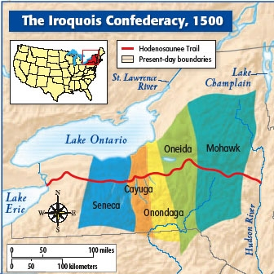
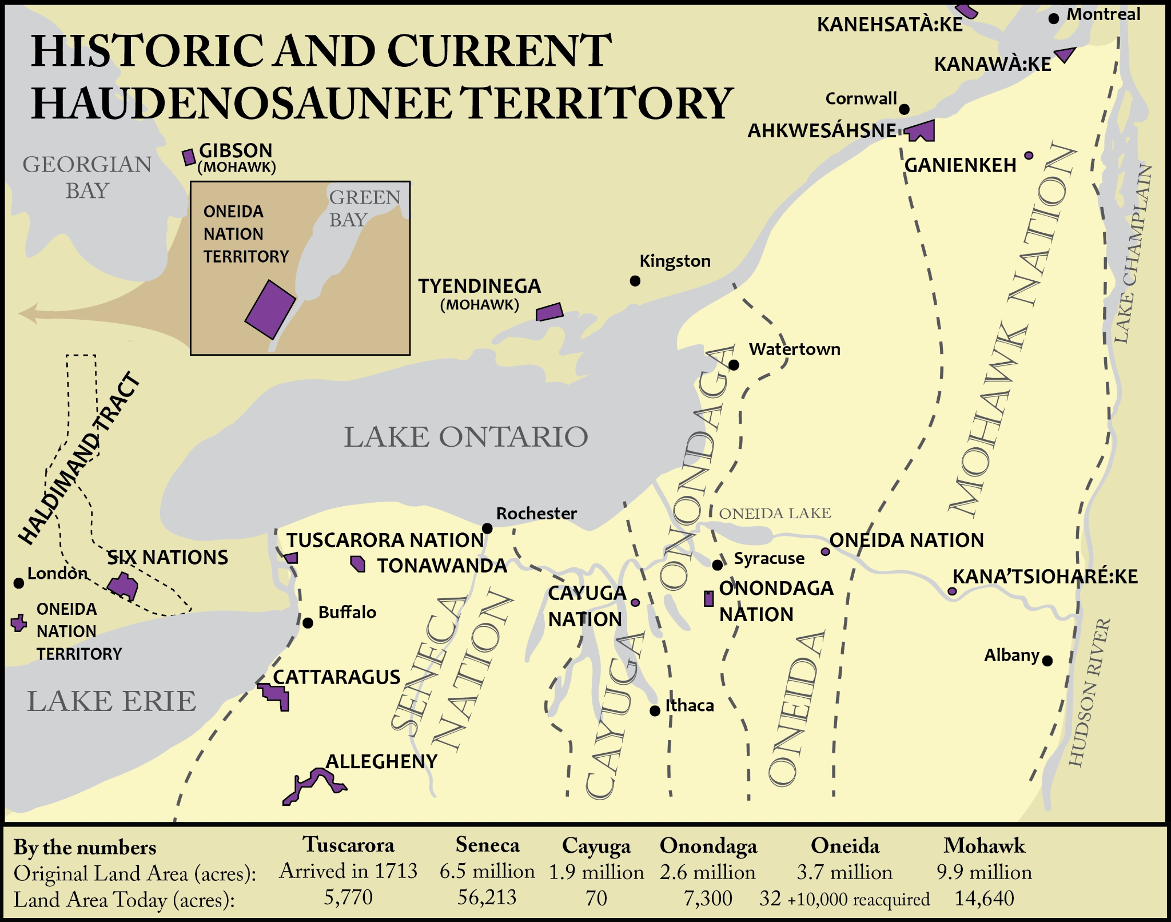

Slide 5
Lesson 6: Six Nations Postwar
Slides for Guided Notes

Slide 6
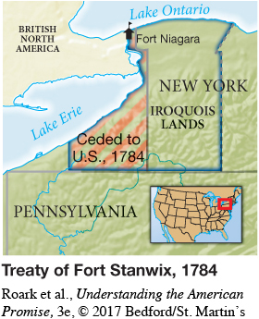
Treaty of Fort Stanwix (1784)
Why the Treaty Was Needed:
The 1783 Treaty of Paris ended the war but didn’t include Native nations.
Tensions:
New York State tried to make its own land deals—Six Nations rejected this.
  U.S. officials refused to negotiate with a united Haudenosaunee front.
Treated the Mohawk, Onondaga, Cayuga, and Seneca as defeated enemies.
  Joseph Brant (Mohawk) delivered the rejection and left the treaty grounds.

Slide 7
Treaty of Fort Stanwix (1784)
Terms of the Treaty:
Six Nations ceded large land claims
U.S. created the first Indian reservation in U.S. history.
Promised to protect Six Nations land—but did not keep this promise.
Took Native hostages until all POWs were returned.
The treaty was signed by the U.S. in 1785, but never approved by the Six Nations.

Slide 8
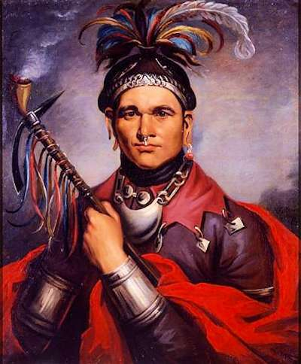
Who was Cornplanter?
Cornplanter was a Seneca chief and respected diplomat.
  Seneca mother & European father
Fought on the side of the British, like most of the Seneca.
After the war, he chose peace, working to protect Seneca lands through diplomacy instead of violence.
Helped negotiate the Treaty of Fort Stanwix (1784) but grew frustrated with broken promises.
📝 Why did he write to George Washington in 1790?
To speak out against the continued loss of Haudenosaunee land despite promises made in earlier treaties.
He warned that treaties weren’t being honored, and his people were suffering.
The letter shows how Native leaders tried to use American systems (like writing to the President) to fight for justice.

