Slide 1




2026-2030 Sign Language Interpreting Services
Getting Ready to Propose: Instructional Video

Slide 2

Presenters
Assistant Commissioner
Linda Schramm
Director of Operations
Lauren Newell
Service Delivery Team
Malgorzata Zegarska-Sanders
Sheena Bassett
Brenda Rotolo

Slide 3

Announcements
RFP Questions & Answers
🌐 This Recorded Session is posted on the ACCES Procurement website https://www.acces.nysed.gov/procurement
❓ Have questions? Submit them using the online question form https://nysedcau.highq.com/nysedcau/renderSmartForm.action?formId=c2735f64-7a7b-491c-be2a-bffafe815ad4
🗓️ Deadline to submit questions: February 6, 2026
📬 Responses will be posted by: February 13, 2026

Slide 4

Agenda
ACCES-VR Overview
Highlights of SLI RFP
Method of Award
RFP Application Process

Slide 5

ACCES-VR Overview
Mission:
ACCES-VR assists individuals with disabilities to achieve and maintain employment and to support independent living through training, education, rehabilitation, and career development.
Vision:
All individuals with disabilities who want to work will have the opportunity to achieve employment and independence.

Slide 6
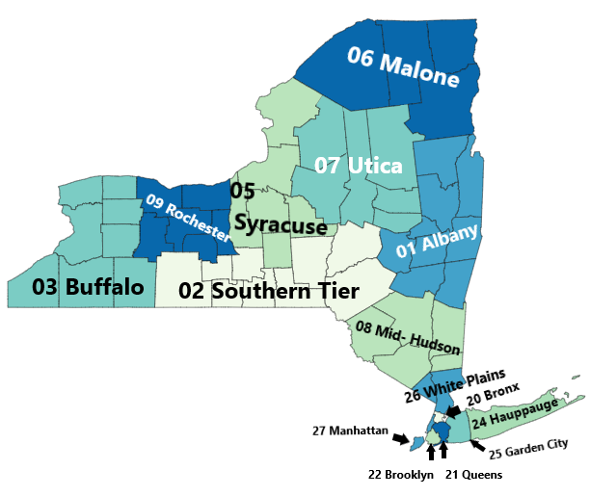
ACCES-VR overview part 2
Adult Career and Continuing Education Services (ACCES) is part of the New York State Education Department (NYSED)
ACCES consists of four offices:
Adult Education Programs & Policy (AEPP)
High School Equivalency (HSE)
The Bureau of Proprietary School Supervision (BPSS)
The Vocational Rehabilitation Program (ACCES-VR)
ACCES-VR has 15 district offices and 10 satellite offices throughout NYS.

Slide 7

An overview of ACCES VR continued
State Vocational Rehabilitation Agencies like ACCES-VR receive funding through the Federal Education Department’s Rehabilitation Services Administration (RSA)
To implement our Mission and Vision, ACCES-VR contracts with vendors to deliver services including:
Post-Secondary Education
Colleges
BPSS Schools
Vehicle Modifications
Psychological Services
Core Rehabilitation Services
Sign Language Interpreting

Slide 8

Introduction to Sign Language Interpretation Services

Slide 9

Key Points in the RFP
No Restrictions – Can apply to serve 1 or many District Office(s)
Virtual and Onsite Service Delivery – No requirement to provide both
Mandatory Requirement
Agency Supervisors:
Must be Certified with 2 years' experience post certification
Timeliness of billing
Payment requests must be submitted through the ACCES-VR vendor portal by the 15th day of the month, for services performed during the previous month.
Contract Term
June 1, 2026 - September 30, 2030

Slide 10


Interpreting Rates 2026 -2027 Base Services
Pre-Certified Interpreting – On Site
Rate: $78.52 per hour
Minimum: Two-hour minimum for on-site services, with payment made in 15-minute increments thereafter.
Documentation: A completed timesheet verifying the provision of services, signed by the interpreter and the customer or, when applicable, ACCES-VR staff.
Video Remote Interpreting
Rate: $78.52 per hour
Minimum: One-hour minimum for VRI services, with payment made in 15-minute increments thereafter
Documentation: Documentation verifying that services were provided, such as a completed timesheet signed by the interpreter and supported by appropriate confirmation from the customer or ACCES-VR staff (e.g., email confirmation, session log, or other agreed-upon documentation).

Slide 11


Interpreting Rates 2026-2027 Service Add-Ons
Certified Interpreter Differential
Rate: $13.10 per hour
Payment made in 15-minute increments
Documentation: Requirements follow the base service provided.
Regional Differential
Rate: $16.92 per hour
Only available for on-site, not VRI
Payment made in 15-minute increments
Documentation: Requirements follow the base service provided.

Slide 12


Interpreting Rates 2026-2027 Service Add-Ons cont.
Short Notice and Special Circumstances (Evening, Weekend, Holiday, Short Notice)
Rate: $13.10 per hour
Payment made in 15-minute increments
Documentation: Requirements follow the base service provided.
Cancellation Fee
Rate: $78.52 per hour
Payment made in 15-minute increments
Documentation: Requirements follow the base service provided.

Slide 13


Interpreting Rates 2026-2027
Complex Interpreting
Rate: $5.00 per hour
Payment made in 15-minute increments
Documentation: Requirements follow the base service provided.
Interpreter Travel
Rate: $78.52 per hour
Portal-to-portal basis when the assigned location requires more than 35 miles of one-way travel from the interpreter’s point of origin. Only travel exceeding 35 miles one way is eligible for reimbursement .
Documentation: supporting documentation of shortest route mileage as determined by a web mapping service (e.g., Google Maps, Bing Maps).

Slide 14
Travel Chart
One-Way Travel Mileage | Reimbursement Rate | Amount
35 miles or less | Not eligible | $0.00
36 – 50 miles | 0.50 of hourly rate | $39.26
51+ miles | 1.0 of hourly rate | $78.52
A Travel distance = 42 miles one-way​
This falls within the 36–50 mile bracket​
Reimbursable at 0.50 of the hourly rate​
Interpreter is paid $39.26 for travel one way, $78.52​ round trip.
​
​

Slide 15

Performance Monitoring
Submission of Quarterly Progress Reports
Regularly distribute Customer Satisfaction Surveys
Interpreter certification audits
Key Performance Indicators Include:
Vendor-initiated cancellations
Interpreter no-shows
Unfilled assignments
Timely submission of Quarterly Progress Reports and billing
Submission of Customer Satisfaction Surveys
Review of staff qualifications

Slide 16

Evaluation of Bids Proposal Submission:
All eligible proposals must be received by the deadline.
Ensure all components of the application are addressed.
Submit the required number of copies, completed forms, assurances, and original signatures.
Evaluation Process:
An evaluation committee will review all proposals based solely on RFP requirements.
Reviewers will not assume prior knowledge of the bidder or their current programs.
Include clear descriptions of qualifications and capacity to deliver required services.

Slide 17
Method of Award
Funding Overview
Total anticipated funding: $20 million (entire contract period)
Each Region is allocated a portion of the funding based on anticipated customer and staff needs within that Region
The funding allocated to each Region is further divided into two allocations based on anticipated customer and staff needs for these services:
On-site Interpreting
Video Remote Interpreting (VRI)
Contract Value Calculation
Bidders receive a portion of the funding allocated to a service in a Region based on each bidder's portion of the total vendor capacity to provide that service in that Region.
Example: If a bidder has 10% of total on-site hours capacity in a Region, they receive 10% of on-site funding for that Region.
Initial contract value is the combined total of allocations across all selected Regions and services.

Slide 18
Estimated Contract Value
Estimated Contract Values
Initial contract values are estimates and may change based on actual utilization.
Services are paid for only when authorized and provided.
There is no guarantee that a vendor will receive the full estimated award amount.
NYSED Right to Adjust Contract Values
NYSED may increase a vendor’s contract value under the following conditions:
Upon recommendation from the District Office (DO)
With approval from the Central Office
Reasons for Adjustment
Increased or decreased overall utilization of interpreter services in the Region
Vendor’s demonstrated capacity to provide services
Geographic need for services within the Region
Ability to match interpreters to customer or staff needs
Review of vendor performance
Customer's informed choice

Slide 19

Bidder Application Process

Slide 20

SLI Application Process
Online application process
Must be submitted no later than March 6, 2026.
Proposals received after the due date will be deemed as non-responsive and will not get an award.
Do not wait until the last minute to submit your application to avoid technical difficulties.
NYSED will send an automatic email confirmation upon receipt.

Slide 21
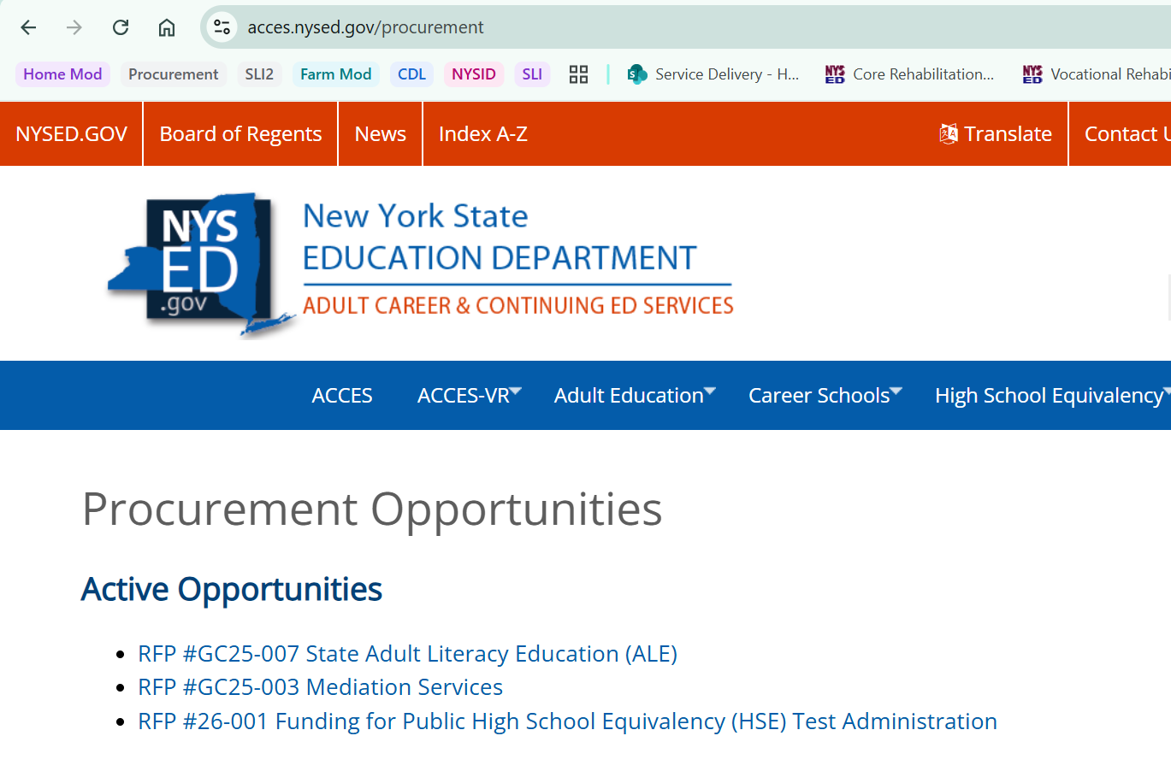
How to Access the Application Online https://www.acces.nysed.gov/procurement

Slide 22
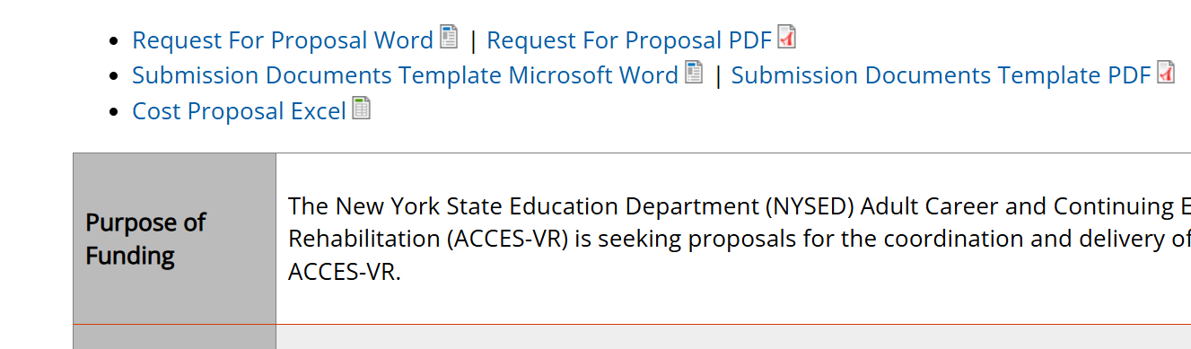
How to Access the Application Online https://www.acces.nysed.gov/procurement

Slide 23
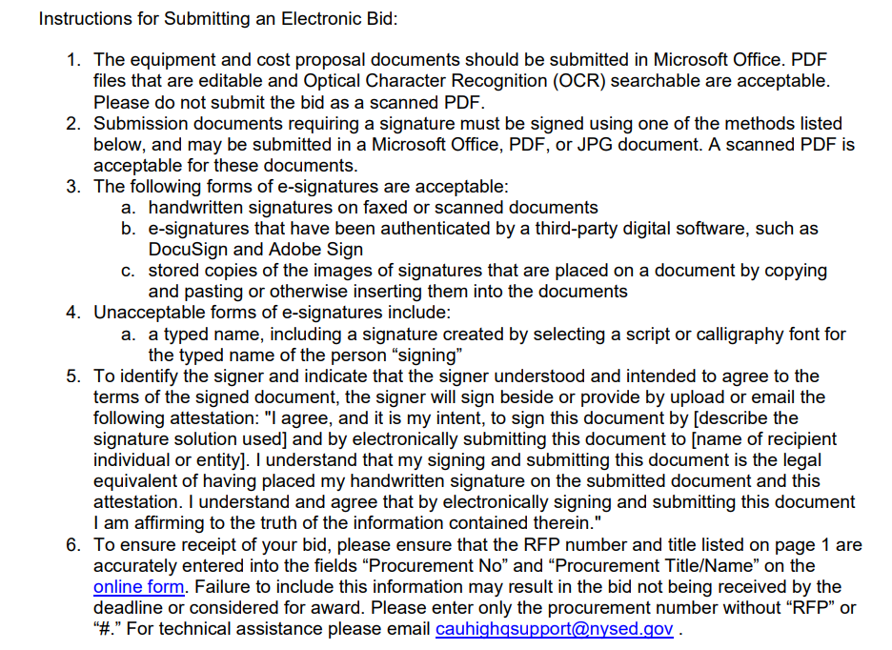
How to Access the Application Online Access the link to the application within the RFP
Look for the “Instructions for Submitting an Electronic Bid” within the RFP. Here you will find a link to the Application Form.

Slide 24

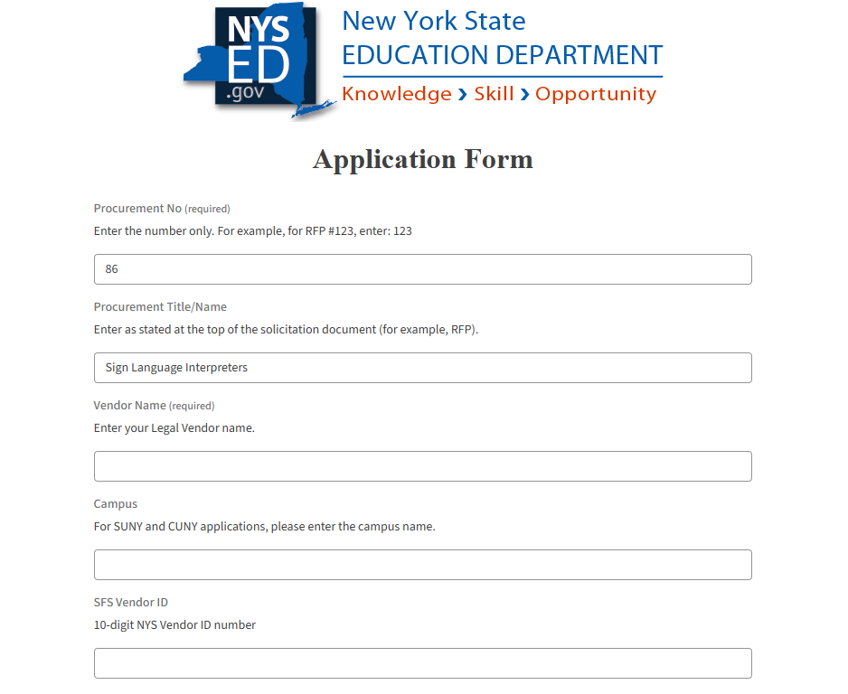
NYSED HighQ Application
Ensure you enter the correct RFP # (86) and Procurement Title (Sign Language Interpreters)

Slide 25
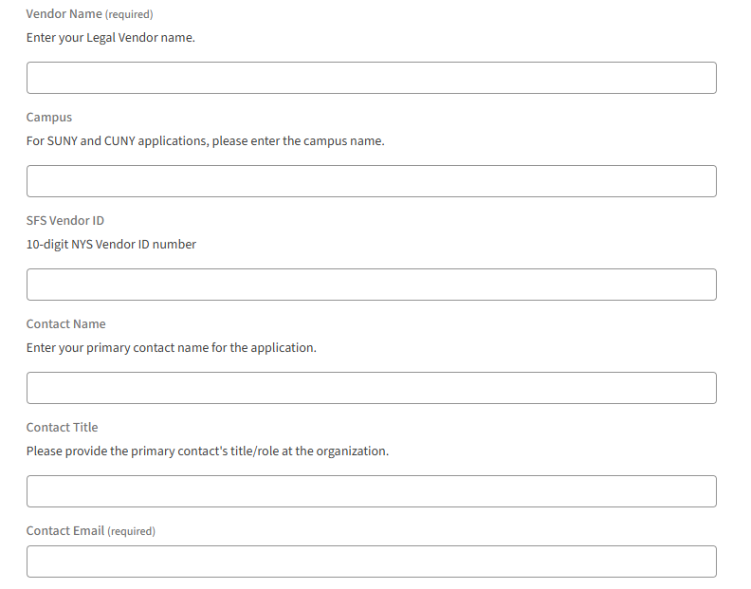
NYSED HighQ Application
Include;
Your Organizations legal name
SFS Vendor ID 10-digit NYS Vendor number
*Note: The NYS Vendor ID is not your Taxpayer ID or EIN. If you don’t have a NYS Vendor ID submit a W-9 with your proposal
Contact information

Slide 26
How to Access the Application Online https://www.acces.nysed.gov/procurement
The link to the application is embedded with the Request for Proposal.

Slide 27
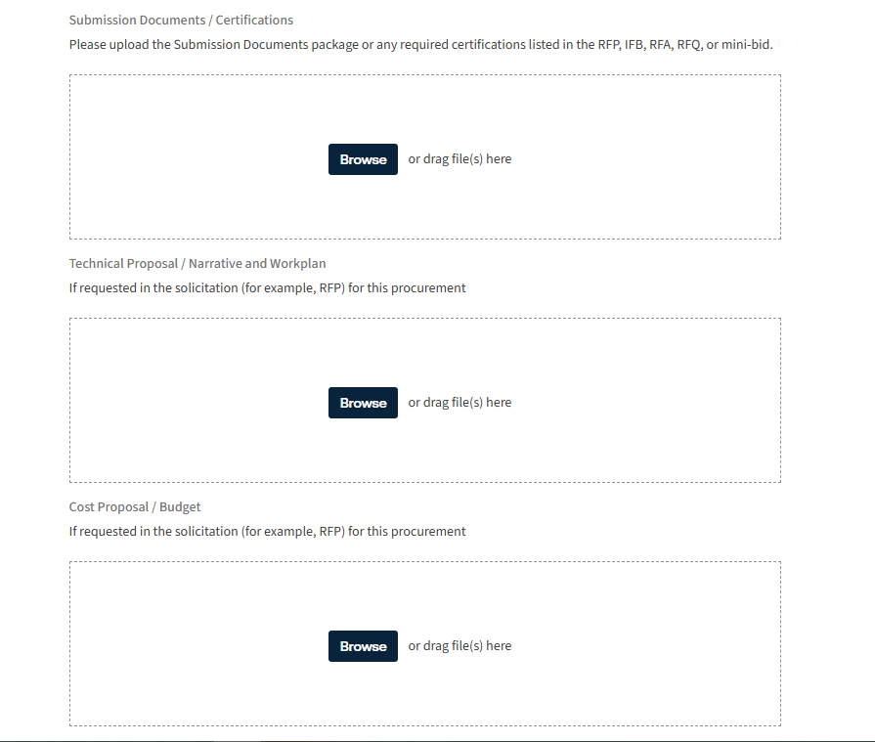
NYSED HighQ Application – Upload Boxes
Submission Documents Include;
Submission Documents
Checklist, Mandatory Certifications with Signatures
Technical Proposal
Mandatory Requirement Certification, Staff Roster, Supervisor certifications
Cost Proposal – N/A Do not need to upload anything in this section
X – Not Applicable

Slide 28
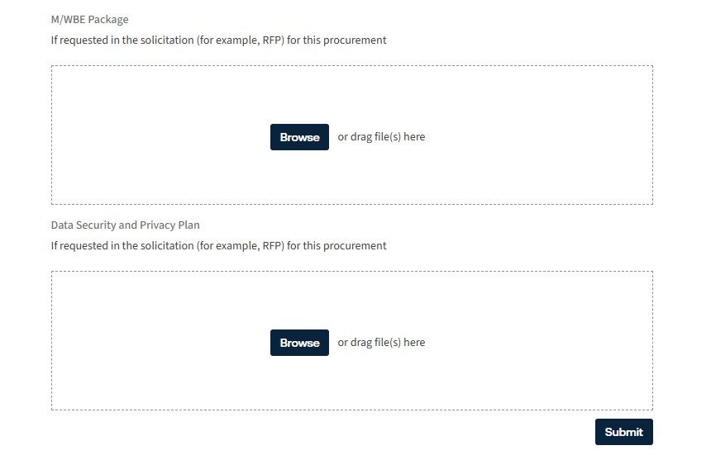
NYSED HighQ Application – Upload Boxes cont.
Submission Documents Include;
M/WBE Package – N/A do not need to upload anything in this section
Data Security and Privacy Plan - N/A do not need to upload anything in this section
SUBMIT
X – Not Applicable
X – Not Applicable

Slide 29
Sign Language Interpreters RFP Application Timeline
Questions must be submitted via the online form by 2/6/2026
A Questions and Answers Summary will be posted to NYSED’s Procurement website by 2/13/2026
Bids must be submitted electronically by 3/6/2026

Slide 30


Thank you for attending
“When you help someone, you help everyone.”
-May Parker

