Slide 1
Final Submission Forms Workbook
Guidance
NYSED - Office of Facilities Planning

Slide 2
Welcome
The Final Submission Forms Workbook is a collection of required forms necessary for the approval of final plans and specifications for projects.
This powerpoint presentation has been created to aid in the completion of these forms in accordance to the standards of the New York State Education Department, Office of Facilities Planning.

Slide 3
Table of Contents Guide
Each PowerPoint slide is numbered to assist in quickly locating the required section.
Each project requirement fulfills a different and necessary role in the review of a project.

Slide 4
Table of Contents
Submission Documents ..……………………………………………………………………………………………………………………… pg. 5
Submission Documents Districtwide and Submission Documents Demolition …………….…….………….………. pg. 6
155.5 Contract Documents Checklist …………………………………………...………………………………………………….….. pg. 7
FP-CL: Checklist for Application for Building Permit …..…….………………………………..………….……………...…….. pg. 8-9
FP-F: Applicaton for Examination and Approval of Final Plans and Specifications ...……………………….……. pg. 10-11
FP-EEB: Evaluation of Existing Building ..…………………………………………………………………………………………….. pg. 12
FP-SC: Scope of Proposed Project ……………..………………………………………………………................………………… pg. 13
Project Details …………………………………………………………………..………………………………………..…………….………. pg. 14
FP-OPRHP-MOU: SHPO Review Exemption .….………………………………………....…………………………...….………. pg. 15
SHPO Cover Form (used to obtain a SHPO Determination Letter) …..…………………………………………..…..…. pg. 16
FP-SGIS: State Smart Growth Public Infrastructure Impact Statement …………………………........................ pg. 17-18
FP-CCC: Code Compliance Checklist ……………………….………………….……………………………………………….……… pg. 19-20
FP-SSI: Statement of Special Inspection …………..…………………………..……………………….…………………………… pg. 21-22
FP-CFP: Certification of Final Building Plans .…..…………………………………..…………….………………………..…….. pg. 23-25
FP-AP: Application for Apportionment ……………………………………………………………………………….………………. pg. 26-27
Important Webpages: OFP and Related Offices …………………………....................................................…….. pg. 28
Facilities Planning and Related Contacts …………..…………………….…………………………………………………..…….. pg. 29

Slide 5
Submission Document
The first Submission Document worksheet provides guidance on forms necessary for successful project submission and review.
REMEMBER:
Keep all forms in order according to the Submission Document.
Forms that extend beyond a single page must be stapled together.

Slide 6
Submission Document Guidance: Districtwide and Demolition
Submission Documents have been developed for successful project submission and review of districtwide and demolition projects.
Districtwide Projects:
Consult with your project manager before submitting districtwide projects as there are limited scope items that are permissible. Examples of projects which should not be submitted as a districtwide project:
  Projects with additions, roofs, windows, etc. which are building specific.
Demolition Projects:
If the building has a unique SED building number assigned, a separate demolition project is required.
If the building does not have a unique SED building number, discuss with Project Manager on best course of action.

Slide 7
155.5 Contract Documents Checklist
Confirm that the Uniform Safety Standards for School Construction and Maintenance statements are included in the Spec Book.
In rare cases, these may be included on the drawings.

Slide 8
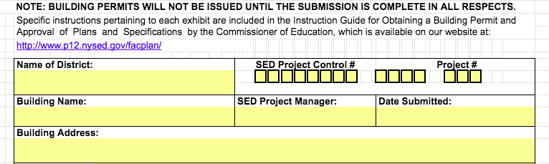
FP-CL Checklist for Application for Building Permit
Ensure that the District Name, Building Name, and Building Address are accurate.
Project Number, Project Manager Name, and Date Submitted are required.
Information entered on this form transfers to the other workbook forms.

Slide 9
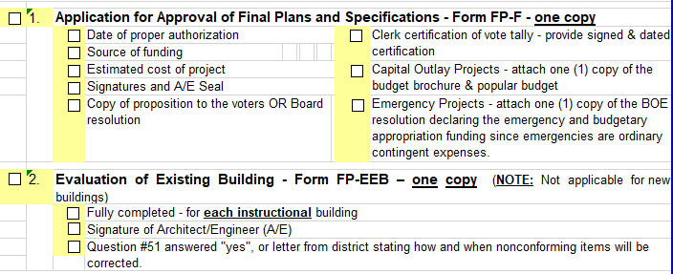
FP-CL Checklist - continued
The Checklist is a tool to confirm that the essential items for successful project submission are presented for review. Many topics include special instructions.
To promote complete project submissions, we recommend that checkboxes be selected as requirements are finalized rather than prepopulating.
There is a required certification at the bottom of the page.

Slide 10
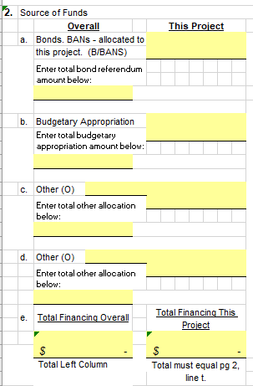
FP-F Applicaton for Examination and Approval of Final Plans and Specifications
Source of funds.
Overall:
This column must be completed.
Information comes from the proposition, budget brochure, or Board of Education resolutions.
For “Other” categories, include funding source and total allocation. For example: Smart Bond, EXCEL, EPC, Legislative Grant.
Voter approved Transfers to Capital are considered Budgetary Appropriations.
This Project:
In this column, enter the estimated project funding.

Slide 11
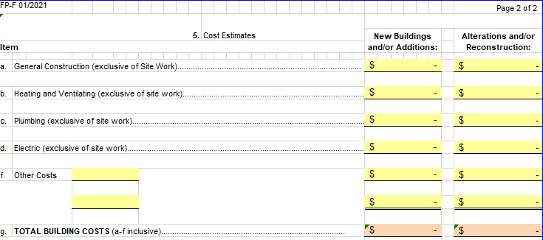
FP-F Final Plans Approval - continued
Page 2:
Correctly enter costs in appropriate categories and in applicable columns.
Report “Swing Space” and “Other” costs in 5k: General Admin. Costs.
Report Sitework on line 5n.
Furniture and equipment must be reported on line 5p.

Slide 12
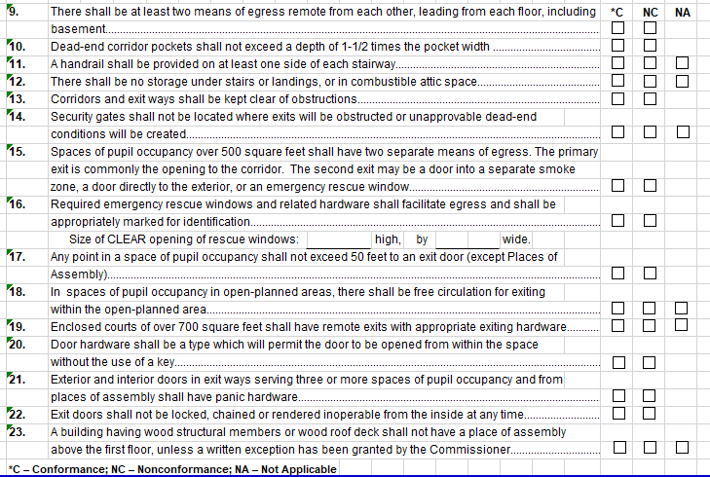
FP-EEB Evaluation of Existing Building
Legend:
C: Conformance.
NC: Nonconformance.
NA: Not applicable.
REMINDER:
Q 9-47: Only one selection is allowed per question.
Form will be rejected when there are missing or multiple entries.
Q 16: Provide the size of CLEAR opening of rescue windows.
If any items are checked as NC and are not corrected in this project, provide a written explanation and select “no” for Q #51.

Slide 13

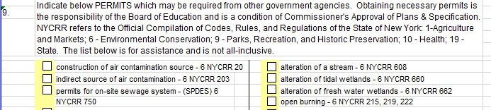
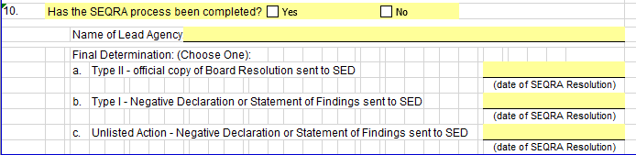
FP-SC Scope of Proposed Project
Questions 7 and 8 each must have at least one appropriate selection.
Complete question 9 if permits are required.
SEQRA info is provided in question 10. Including the name of the lead agency and date of the resolution on the corresponding SEQRA type line. Confirm SEQRA Date matches the date on the SEQRA Resolution.
#11g must not include a statement such as “including but not limited to…”. If included, form will be rejected.

Slide 14
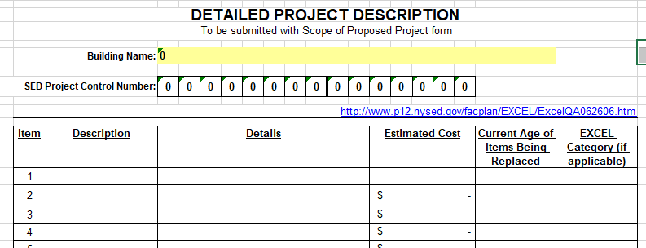
Project Details Form - REQUIRED
This form is now required for all project submissions.
Provide separate lines for major portions of the work (i.e., classroom alteration, auditorium stage removal, etc.).
Also provide separate lines for items with a 15-year minimum life expectancy (see list at right) to assist in confirming aid allowances. Items replaced prematurely may have disallowances applied.
Provide the estimated cost and current age of major scope items.
If the project involves EXCEL funding, categories may be found in question 9 in: http://www.p12.nysed.gov/facplan/EXCEL/ExcelQA062606.htm
Items that must be broken out to check life expectancy:
  Roofs, boilers, tracks, fields, furniture, equipment, site work, deteriorated building elements (auditorium seating, auditorium proscenium curtains, bleacher installations (interior), cabinetry/casework, chalk/tackboard installations, locker installations (gym type/corridor type), sun/light control (curtains, drapes, blinds)) should be separated out.

Slide 15
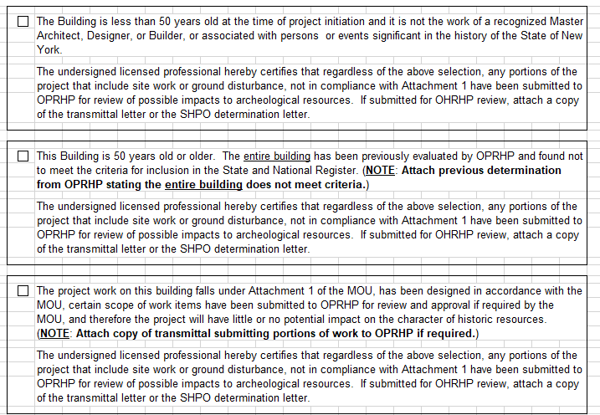

FP-OPRHP-MOU SHPO Review Exemptions
Only use the 1st option if “the building is less than 50 years old”.
New buildings require a SHPO Determination Letter as there are typically new ground disturbances.
If the second option is selected, please provide backup documentation for this determination such as a screen shot of the CRIS site indicating the building’s name, address, and determination status as “not eligible”.
If the project falls under attachment 1 of the MOU, use this option. The Memorandum of Understanding is found at: http://www.p12.nysed.gov/facplan/documents/MOU-StateEducationDepartment-SchoolConstructionandLibraryGrantAgreement-SED-11-6-2017.pdf
If the project requires a SHPO determination letter, the FP-OPRHP-MOU is not required.

Slide 16
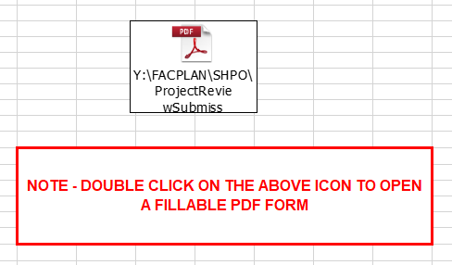
SHPO Cover Form – to obtain SHPO Determination Letter
When a project requires a State Historic Preservation Office (SHPO) Determination Letter, use the hyperlink on this page to submit the project to NYS Office of Parks, Recreation, and Historic Preservation.
Once the SHPO review is completed, they will issue a Determination Letter. Include this in the project submission.
Confirm that the SED Project Number is provided to NYS OPRHP as it is required on the SHPO Determination Letter for the project.
Refer to Memorandum of Understanding to access when a SHPO Determination Letter is required.
http://www.p12.nysed.gov/facplan/documents/MOU-StateEducationDepartment-SchoolConstructionandLibraryGrantAgreement-SED-11-6-2017.pdf

Slide 17
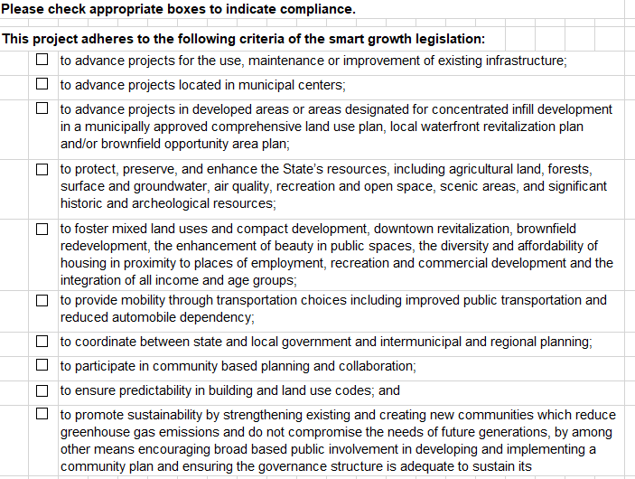
FP-SGIS Smart Growth Statement
If the project adheres to the Smart Growth Public Infrastructure Policy Act, Environmental Conservation Law (Article 6 § 1-11), select at least one of these options.

Slide 18
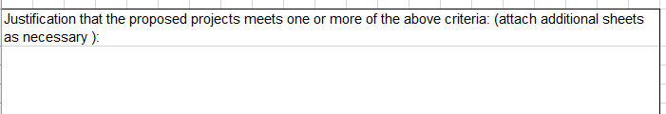
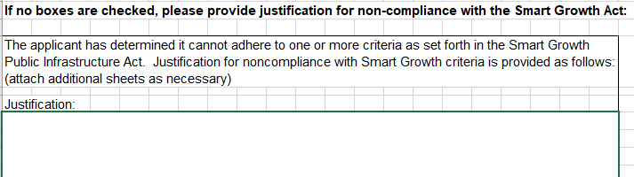
FP-SGIS Smart Growth Statement - continued
If the project adheres to the Smart Growth Legislation, a justification must be included in the first box.
If the project does not adhere to the Smart Growth Legislation, a justification for non-compliance must be included in the second box.

Slide 19
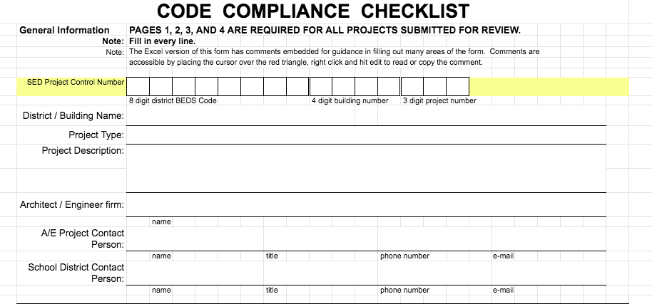
FP- CCC Code Compliance Checklist
Remember to complete:
Project Type
Project Description

Slide 20
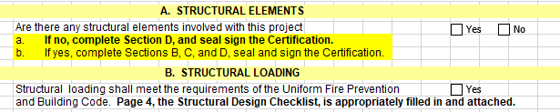
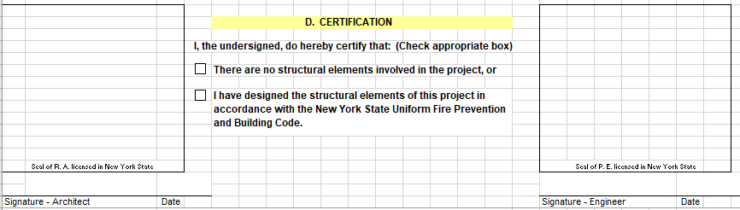
FP-CCC Code Compliance Checklist - continued
Carefully follow the instructions found in Question A.
Question A must have a Yes or No response.
If the response to question A is No, complete question D.
If the responses to question A is Yes, complete questions B, C, and D as well as the certification on Page 4.
In question C:
  If boxes are selected indicating engineer responsibility, the form must have the signature, date, and seal of an engineer.
  If boxes are selected indicating architect responsibility, the form must have the signature, date, and seal of an architect.
  If boxes are checked indicating both architect and engineer responsibility, the form must have the signature, date, and seal of both an architect and engineer.

Slide 21
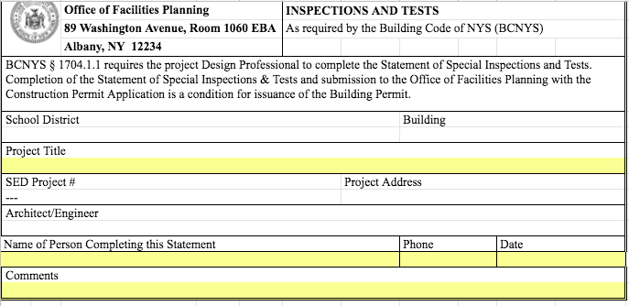
FP-SSI Statement of Special Inspection
SSI is required for new projects and projects with additions.
SED Project # is required.
Add Comments, as applicable.

Slide 22
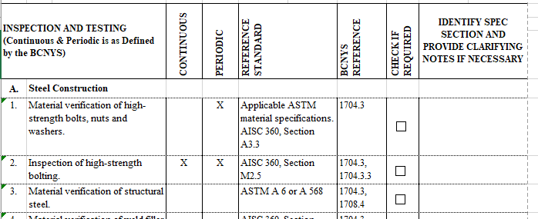
FP-SSI Statement of Special Inspection - continued
Select checkboxes, as applicable, in the Check If Required column.
If a selection is made, identify the spec section and provide additional information as necessary in the column on the right.

Slide 23
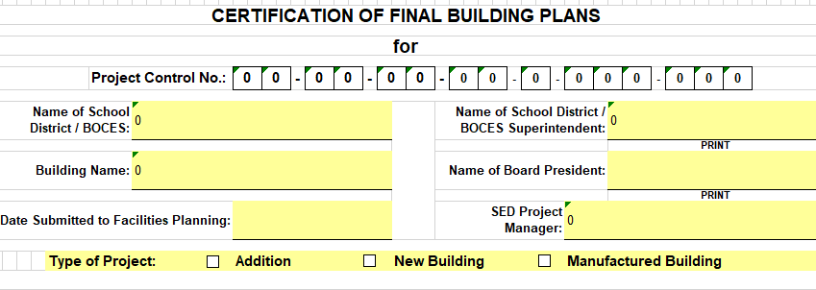
FP-CFP Certification of Final Building Plans
This form is only required for a new building or addition project.

Slide 24
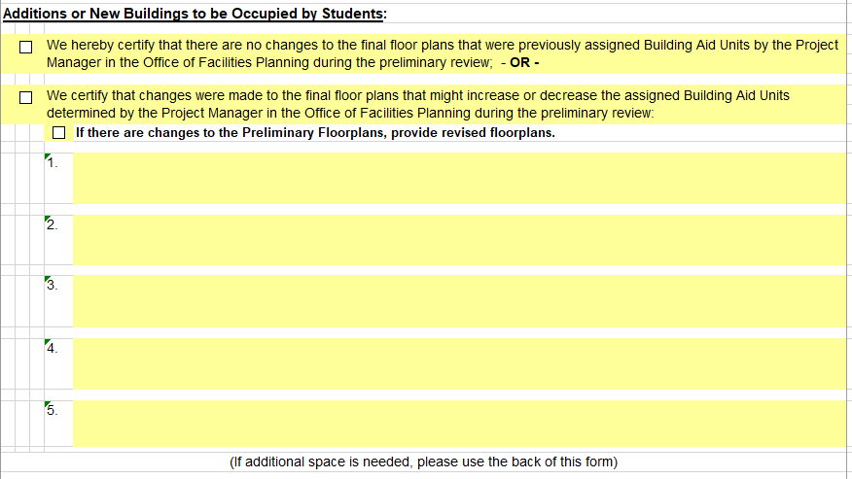
FP-CFP Certification of Final Building Plans - continued
Advise whether the Final project has changes to floorplans from those submitted in the Preliminary Submission.
Any changes to the floorplans must be described in 1 through 5.
Revised floorplans must be provided to the Project Manager. Please attach them to this form.
Certify whether the students will be using the addition.

Slide 25
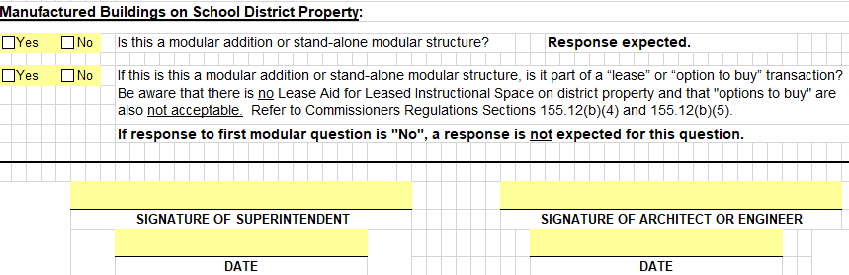
FP-CFP Certification of Final Building Plans - continued
Properly complete the Manufactured Buildings section.
If the response to the first question in No, a response to the second question is not required.
If the response to the first question is Yes, a response is required for the second question.
Remember to certify (sign) the form.

Slide 26
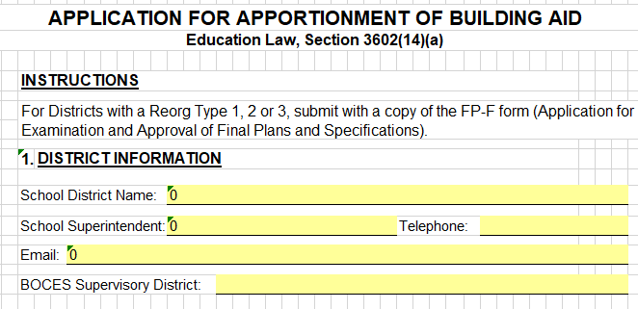
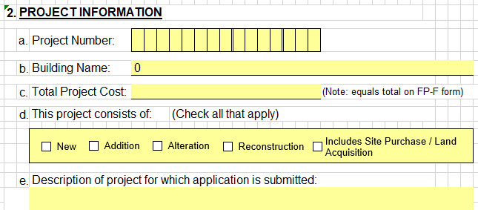
FP-AP Application for Apportionment
This form is required for districts with a Reorg Type 1, 2, or 3.
The Reorg List may be found at:
  http://www.p12.nysed.gov/facplan/documents/Reorg.Districts.pdf
Include the Project Information.

Slide 27

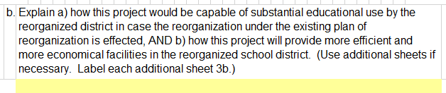
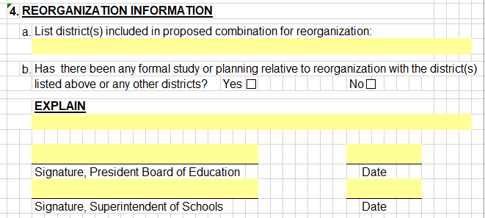
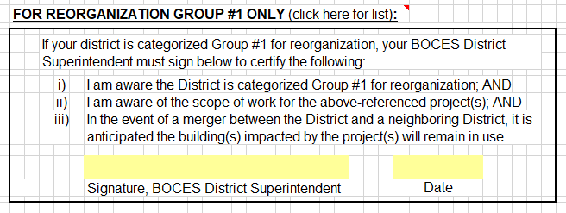
FP-AP Application for Apportionment - continued
Confirm that either questions 3 a and/or 3 b is completed and all three parts of question 4 (a, b, and explanation) are completed.
If the district is a Reorg Type 1, the BOCES Superintendent certification is required.

Slide 28
Important Webpages – OFP and Related Offices
Staff Directory | http://www.p12.nysed.gov/facplan/StaffDirectory.html
Project Mgr. List by District | http://www.p12.nysed.gov/facplan/documents/PMbyDistrict_001.htm
OFP Forms | http://www.p12.nysed.gov/facplan/SubInfo.htm
Project Review Status | http://www.p12.nysed.gov/facplan/status.html
Project Approval Status | http://www.p12.nysed.gov/facplan/articles/Projects.htm
Third Party Reviews | http://www.p12.nysed.gov/facplan/ThirdPartyVendorReview.html
Change Order Status | http://www.p12.nysed.gov/facplan/CHANGOR1.HTM
State Aid: SA-139, SA-4, etc. | https://stateaid.nysed.gov/build/
Fire Safety Report (scroll to bottom of page) | http://www.p12.nysed.gov/facplan/FireSafety/fire_safety_report_homepage.html
Smart Bond SSIP | http://p1232.nysed.gov/mgtserv/smart_schools/ApprovedSSIPs.htm
Smart Bond Allocations | http://www.p12.nysed.gov/mgtserv/smart_schools/docs/SmartSchoolsAllocation.pdf

Slide 29
Facilities Planning and Related Contacts
Letters Of Intent | Anthony Ghent | 518-486-2049 | anthony.ghent@nysed.gov
Building Permits | Anthony Ghent | 518-486-2049 | anthony.ghent@nysed.gov
Code questions | OFP Arch. or Eng. | 518-474-3906 | emscfp@nysed.gov
Final Cost Reports | Wendy Clark | 518-474-2380 | wendy.clark@nysed.gov
Smart Bond Office |  | 518-474-5928 | Smartschools@nysed.gov
Building Aid | Louise Gallerie | 518-473-9889 | louise.gallerie@nysed.gov
Prescreening | Please be patient. | Wait 2 weeks for contact or Rev #. | If submitting electronically, remember to send email to emscfp@nysed.gov
Change orders | Please be patient. | Being processed as quickly as possible. | On Final Cost Report, may need to enter PENDING on the applicable line.
Bon Fires | Fire Safety | 518-486-2053 | firesafety@nysed.gov
Pesticides | OFP Architect | 518-474-3906 | emscfp@nysed.gov
Temperature | OFP Architect | 518-474-3906 | emscfp@nysed.gov
Graduation Tents | Fire Safety | 518-486-2053 | firesafety@nysed.gov

