Slide 1


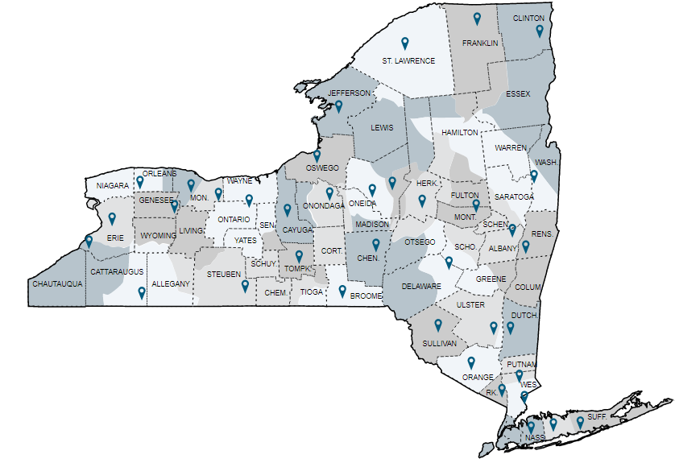

New York State Science Education Ecosystem Network
-Working document-
PBS Learning Media
Identified National Government Assets
Pins mark the locations and link to websites for local TV stations.
STEM Partnerships
STEM Ecosystems
Collaborations offering an array of learning opportunities. Designed pathways enable young people to become engaged, knowledgeable and skilled in the STEM disciplines.
New York State STEM Hubs interconnect business, higher education, community organizations
Math Science Partnership (MSP) Programs
Title II, Part B of the Elementary and Secondary Education Act (ESEA) legislation authorizes the MSP competitive grant program aimed at improving the achievement of students in mathematics and science through partnerships that enhance the teaching of elementary and secondary teachers of mathematics and science (P-12).
New York State Education Department/Science Education Steering Committee
Webpage and most up to date information for the New York State P-12 Science Learning Standards
National Assets
New York State Museum
Pin locations are approximations.

Slide 2
Identified National Assets from U.S. Government Sources
National Aeronautics and Space Administration (NASA)
National Institute of Health (NIH)
National Oceanic and Atmospheric Administration(NOAA)
National Science Foundation (NSF)
  STEM Teaching Tools
Smithsonian
United States Department of Agriculture(USDA)
United States Department of Education
United States Department of Energy
U.S. Environmental Protection Agency Education Resources (EPA)

