Slide 1
New York Culturally Responsive-Sustaining Education Framework
General Session
Notes:
As participants arrive, welcome them to the session.
“Welcome to the professional development session on the New York Culturally Responsive-Sustaining (CR-S) Education Framework.”
Note: Allow 20 minutes for welcome and introductions.

Slide 2
Introductions
Name
Title
Organization
Name
Title
Organization
Notes:
Please introduce yourself!
Share: “After we review the agenda and objectives, we will do more introductions.”

Slide 3
Welcome
Notes:
Share: “We will begin by sharing the agenda and engaging in an activity.”

Slide 4

Agenda
Welcome
Introduction to Culturally Responsive-Sustaining (CR-S) Education
Overview of the New York Culturally Responsive-Sustaining Education Framework
Closing and Next Steps
Notes:
Share the agenda: “After the welcome activities, the session continues with a brief introduction to what culturally responsive-sustaining education is, and then we will explore what the New York Culturally Responsive-Sustaining Education Framework offers.
We will close by sharing resources and suggesting next steps.”

Slide 5

Objectives
Develop our understandings of the who, what, why, and where of the New York CR-S Education Framework
Who is involved in the CR-S Education Framework
Who benefits from it?
What are the principles of the CR-S Education Framework?
Why the CR-S Education Framework?
How can CR-S can support students?
Where can I find out more?
Where do I go next?
Notes:
Share the objectives: “We will be working on developing our understanding of the who, what, why, and where of the New York Culturally Responsive-Sustaining (CR-S) Education Framework.
Who is involved in it and who benefits from it,
what are the guiding principles,
why now and how does it support students, and
where can I find out more and where do I go next.”

Slide 6
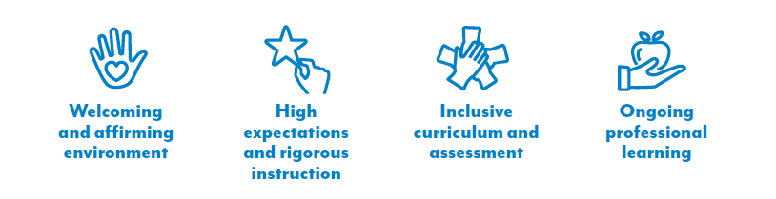
Building Community
We will use the principles of the New York CR-S Education Framework to guide our learning today:
Notes:
Share how we will build community: “In order to build our understanding of the New York CR-S Education Framework and the strategies, we need to work as a learning community.
We will follow the principles of the the CR-S Education Framework in our work.
The principles are
creating a welcoming and affirming environment,
establishing high expectations and following rigorous instruction,
providing inclusive curriculum and assessment, and
refining our strategies with ongoing professional learning.
The principles are designed to guide the implementation of policies and facilitate ideal learning environments for everyone involved.”

Slide 7
Getting Ready
Complete the following sentence:
During this session on the New York CR-S Education Framework,
I hope to learn about . . .
Notes:
Share: “Please complete the following sentence about this session on the New York CR-S Education Framework.
During this session on the New York CR-S Education Framework, I hope to learn about . . .
Reflect privately. We will not share these at this time.”

Slide 8
Any questions about the session agenda or objectives?
Notes:
Ask participants if they have any questions on the session agenda or objectives.
Note that you can answer questions during the session, also designate a whiteboard or other place to post questions.

Slide 9

Getting Ready: Introductions
Please record your responses to the following prompts. Be prepared to share your responses with a partner or in a small group.
What is your full name?
Do you know who chose it or why it was chosen for you?
Is there any family or ethnic significance to your name?
Notes:
Please refer to the Introductions handout and prompt participants to complete the activity.
Share: “Please record your responses to the following prompts. We will have about two minutes to work independently.”
If any participant is not comfortable participating, participants can listen to others and join the full group activity following the partner work.

Slide 10
Introductions: Partner/Group Work
Please share your responses with a partner or in a small group.
What is your full name?
Do you know who chose it or why it was chosen for you?
Is there any family or ethnic significance to your name?
Notes:
Share: “Please share your responses with a partner or in a small group.
You will have three minutes to discuss. Within that time, make sure that each person has an opportunity to share.”

Slide 11
Introductions: Full Group Discussion
What did you learn about others?
How did it feel to share about your culture, identity, and history?
Notes:
Lead a debrief of the activity: Give enough wait time for participants to think about both questions and then ask for volunteers.
“What did you learn about others? How did it feel to share about your culture, identity, and history?”
Prompt participants to share: Encourage them to be specific about how the activity supported their feelings of belongingness. There are five minutes scheduled for this discussion.

Slide 12
Introductions: Debrief
Purpose of this activity:
  Bring every participant’s voice into the room
  Highlight and affirm the variety of cultures, identities, and histories that we bring to this work
  Establish a learning environment that values sharing and discussion
How is this activity an example of engaging in CR-S education?
Which principles does it reference?
Notes:
Share the purpose of this activity: “This activity allowed us the opportunity to bring all participants’ voices into the room, highlight and affirm our diversity, and establish our learning environment.
We shared the four principles of the New York Culturally Responsive-Sustaining Education Framework.”
Prompt participants: “Would anyone like to share how this activity is an example of engaging in CR-S education? Or which principle it references?”
Share how this activity is an example of creating a welcoming and affirming environment, being inclusive of others, and encouraging ongoing professional learning. Encourage participants to share other ideas as well. Most importantly, it is an example of doing culturally responsive-sustaining education.

Slide 13
Introduction to Culturally Responsive-Sustaining Education
What
Why
Notes:
Share: “Now we will discuss the what and why of culturally responsive-sustaining education.”
Note: Allow 15 minutes for this topic.

Slide 14
Defining Culturally
Responsive-Sustaining Education
Culturally responsive-sustaining education
is grounded in a cultural view of learning and human development in which multiple expressions of diversity — race, social class, gender, language, sexual orientation, nationality, religion, ability — are recognized and regarded as assets for teaching and learning.
Notes:
Share: “First, what is culturally responsive-sustaining education?
CR-S takes a cultural view of learning and human development in which multiple expressions of diversity are recognized and regarded as assets for teaching and learning.
The school community is representative of many cultures, and therefore schools need to be intentional about the relationship between culture and schools.
Our students’ cultures can be positioned as strengths and as the foundation of empowering, rigorous, and innovative learning.”

Slide 15

What is culture?
Culture includes multiple components of one’s identity, including but not limited to:
Culture transcends practices such as cuisines, art, music, and celebrations to include ways of thinking, values, and forms of expression.
race
economic status
nationality
religion
gender
language
sexual orientation
ability
Notes:
Share: “To discuss culturally responsive-sustaining education, let’s pause and define culture.
The New York State Education Department defines culture as the multiple components of one’s identity, including but not limited to race, economic background, nationality, religion, gender, language, sexual orientation, and ability.
Culture transcends practices such as cuisines, art, music, and celebrations to also include ways of thinking, values, and forms of expression.
Schools then become a meeting point for cultures, containing children and adults who bring with them multiple facets of their identity, along with unique experiences and perspectives.”
Prompt participants: “Is there anything new, interesting, or surprising about this definition of culture? Is there anything that you would like to add to this definition?”

Slide 16

Our students’ cultures can be positioned as strengths and as the foundation of empowering, rigorous, and innovative learning.
Representing students’ cultures and making learning meaningful supports the students’ sense of belonging, motivation, success, and achievement.
Notes:
Share: “Students’ cultures should be positioned as strengths in order to support their success. Learning is rooted in the lives and experiences of people and cultivated through activities that people find meaningful. It is critical that schools seek to highlight the strengths of culture. Representing students’ culture and making learning meaningful supports their sense of belonging, motivation, success, and achievement.”

Slide 17
Students gain when culturally responsive-sustaining education guides our education system
Students are motivated and prepared for rigorous and independent learning
Students feel connected to the school community
Teaching and learning are rooted in the lives and experiences of people and cultivated through meaningful activities
Students experience academic success
Students are socio-politically conscious and socio-culturally responsive
Notes:
Share: “Through implementing classroom practice aligned with culturally responsive-sustaining education students experience academic success.
From these experiences:
Students feel connected to the school community.
Students are prepared for rigor and independent learning as they understand themselves as contributing members of the school and classroom community.
They demonstrate an ability to use critical reasoning, take academic risks, and leverage a growth mindset to learn from mistakes. Students are self-motivated, setting and revising academic personal goals to drive their own learning and growth.
Students also acknowledge the limitations of their own perspectives. They have empathy for others while they appreciate and respect others’ differences.
They build and maintain strong relationships, including those along lines of difference, in their class and school communities. All layers of the environment in which students learn (classroom, school, family, and community) affirm and value the various aspects of students’ cultural identities (i.e., race, ethnicity, age, gender, sexual orientation, ability, religion, socioeconomic background).
They bring a critical lens to the world as they study historical and contemporary conditions of inequity and learn from marginalized voices.
Students learn about power and privilege in the context of various communities and are empowered as agents of positive social change.”

Slide 18

Culturally Responsive-Sustaining Education in Practice
Culturally responsive-sustaining education
is about teaching
each and every student
in front of you.
Notes:
Begin a conversation about what culturally responsive-sustaining education looks like.
Share: “Culturally responsive-sustaining education is about teaching each and every student in front of you. This requires getting to know students and developing meaningful relationships with them, engaging in the students’ communities, and welcoming home and youth culture into the classroom as areas ripe for discussion. The Introductions activity exemplifies culturally responsive-sustaining education by getting to know each other and welcoming home culture into the session.
Prompt participants to share with a partner what culturally responsive-sustaining education looks like in practice.
Encourage partner sharing and remind participants to situate their ideas in classrooms and schools, being specific as they can. Remind participants that our opening activity was an example of bringing ourselves into the learning environment, highlighting our individual differences, and supporting our learning community.
Note that this topic may be new to some participants and make sure to reference that the Framework Briefs and the CR-E Education Framework provide additional guidance.

Slide 19

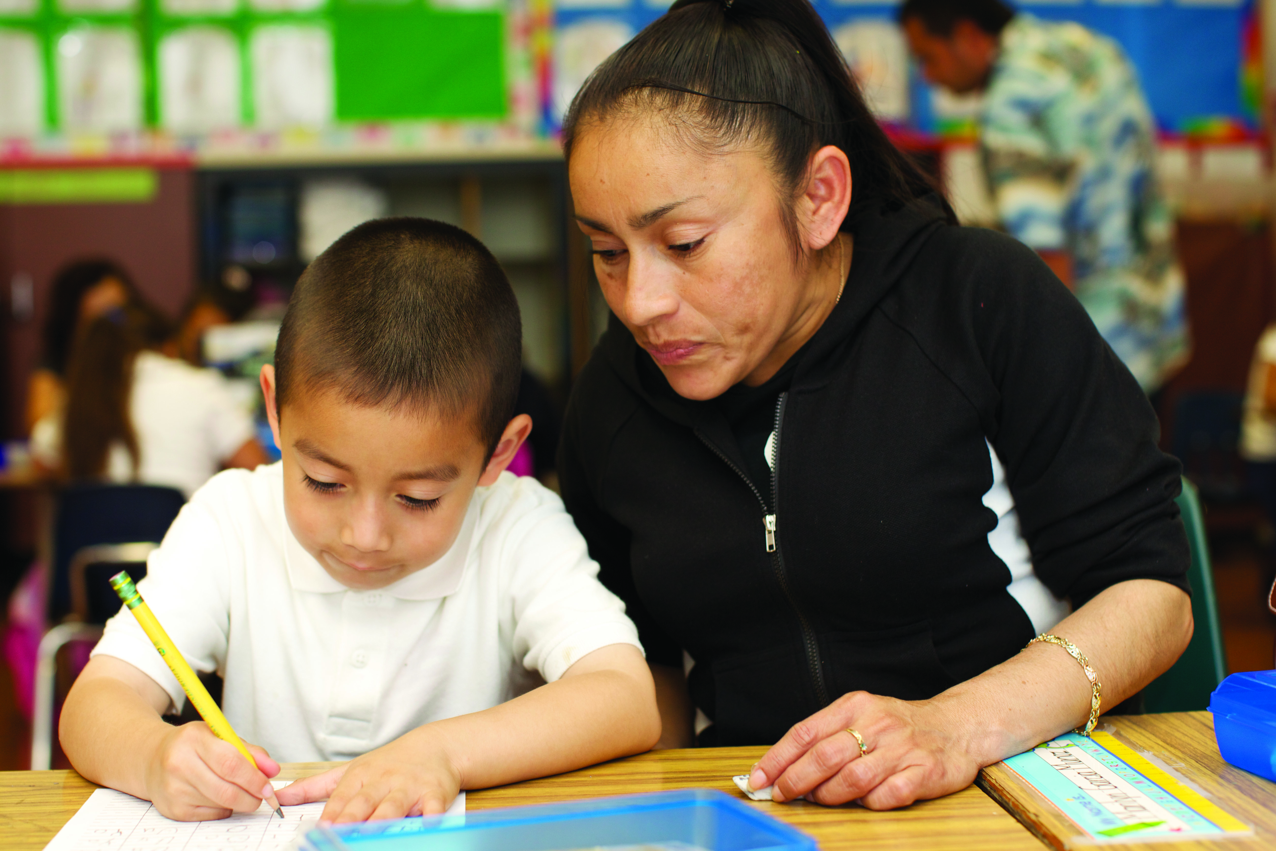
Culturally responsive-sustaining education improves our community
Provides opportunities for learning about and collaborating with stakeholders to prioritize community needs.
Promotes trust and respect between schools and communities, recognizing shared responsibilities.
Reflect on how you see culturally responsive-sustaining education improving our community.
Notes:
Share: “How does culturally responsive-sustaining education improve our community?
Implementing culturally responsive sustaining education:
Provides opportunities for learning about and collaborating with stakeholders to prioritize and plan for the needs of our local community.
Promotes a relationship of trust and respect between schools and communities, recognizing that student achievement and school improvement are shared responsibilities.”
Prompt participants to reflect on how they see culturally responsive-sustaining education as improving our community.

Slide 20
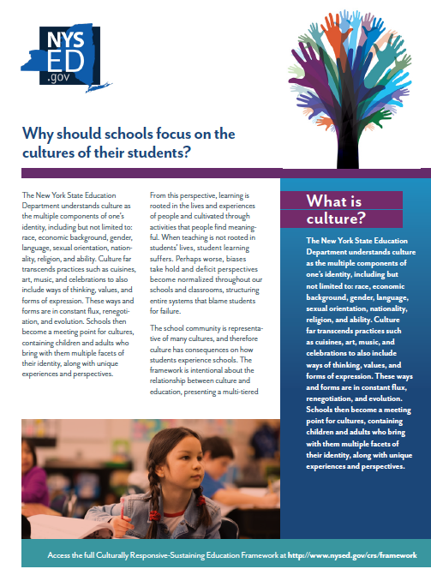
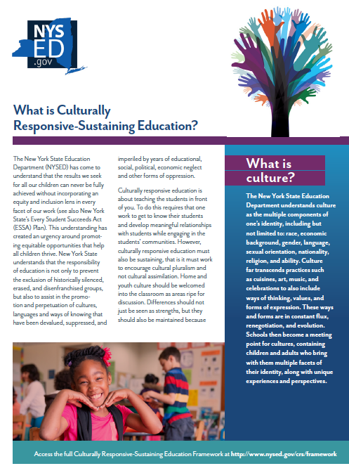
Why: Learn more!
The Framework Briefs detail responses to:
  What is culturally responsive-sustaining education?
  What is the New York Culturally Responsive-Sustaining Education Framework?
  What do students gain when culturally responsive-sustaining education guides our education system?
  Why should schools focus on the cultures of their students?
  How does implementing the New York Culturally Responsive-Sustaining Education Framework improve the school community as a whole?
Notes:
Share: “The Framework Briefs share critical information from the CR-S Education Framework in a shorter format, where each brief is one to two pages long.
Please take an opportunity to learn more about culturally responsive-sustaining education through the Framework Briefs.
The Framework Briefs detail responses to:
What is culturally responsive-sustaining education?
What is the New York Culturally Responsive-Sustaining Education Framework?
What do students gain when culturally responsive-sustaining education guides our education system?
Why should schools focus on the cultures of their students?
How does implementing the New York Culturally Responsive-Sustaining Education Framework improve the school community as a whole?”

Slide 21
Overview of the New York Culturally Responsive-Sustaining Education Framework
Why
Who
What
Notes:
Share: “Now we will discuss the why of the New York Culturally Responsive-Sustaining Education Framework itself, who is involved, and what it looks like in practice.”
Note: Allow 20 minutes for this session.

Slide 22
Why the Culturally Responsive-Sustaining Education Framework
“The student success that we seek for all our children can never be fully achieved without incorporating an equity and inclusion lens in every facet of our work.”
(NYSED, 2018, page 6)
Notes:
Share: “First, why the New York Culturally Responsive-Sustaining Education Framework? It is a response to understanding that ‘the student success that we seek for all our children can never be fully achieved without incorporating an equity and inclusion lens in every facet of our work.’ This means that NY State has committed to multiple efforts in this area, from a new Diversity Equity and Inclusion statement to additional workplace training.
“Understanding the importance of incorporating an equity and inclusion lens into our work has created an urgency around promoting equitable opportunities that help all children thrive. The responsibility of education is not only to prevent the exclusion of historically silenced, erased, and disenfranchised groups but also to assist in the promotion and perpetuation of cultures, languages, and ways of knowing that have been devalued, suppressed, and imperiled by years of educational, social, political, and economic neglect and other forms of oppression.”

Slide 23

Culturally Responsive-Sustaining Education Framework
Supports your continued implementation of effective and equitable policies and practices
Focuses on establishing learning environments that support all students and their learning
Notes:
Share: “The Culturally Responsive-Sustaining Education Framework helps education stakeholders implement policies and practices that educate all students effectively and equitably while focusing on establishing learning environments that
affirm cultural identities and foster positive academic outcomes,
develop students’ abilities to connect across lines of difference,
elevate historically marginalized voices, and
cultivate critical thinking and empower students as agents of social change.
The Framework lays out these ideas and then provides principles and strategies for all education stakeholders.”

Slide 24
Principles of CR-S Education Framework
Notes:
Share: “The following principles support the implementation of policies and facilitate ideal learning environments for students.
There are four principles in the Framework:
Welcoming and affirming environment,
High expectations and rigorous instruction,
Inclusive curriculum and assessment, and
Ongoing professional learning.”

Slide 25
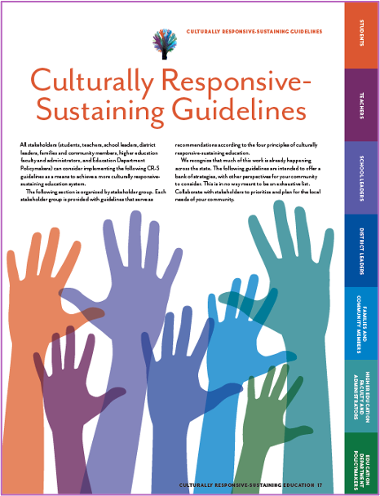
Who is involved?
All stakeholders must work together to create the conditions under which our vision of education can flourish.
Students
Teachers
District leaders
Family and community members
Education department policy makers
School leaders
Higher education faculty and administration
Notes:
Share: “Who is involved in this work? All stakeholders must work together to create the conditions under which our vision of education can flourish.
NYSED recognizes that for CR-S education to thrive, the impetus cannot be placed solely on students, teachers, and school leaders.
Stakeholders include students, teachers, school leaders, district leaders, families and community members, higher education faculty and administrators, and education department policymakers.”

Slide 26
Every stakeholder has a role
Every stakeholder can implement strategies aligned with each principle.
Strategies by stakeholder and principle:
Students
pp. 18–23
Teachers
pp. 24–29
District leaders
pp. 30–35
Family and community members
pp. 36–39
Education department policy makers
pp. 40–43
School leaders
pp. 44–49
Higher education faculty and administration
pp. 50–53
Notes:
Share: “All education stakeholders have a role in the implementation of culturally responsive-sustaining education. The Framework lays out strategies organized by principle and stakeholder group.”

Slide 27

Example Strategies in the CR-S Education Framework
Engage in classroom management strategies
that avoid assigning blame or guilt to students
based on perceptions about their cultures, differences, or home lives.
Teachers
Conduct periodic review of school policies
(i.e., dress code, discipline code, conduct code),
by collaborating with parents, teachers, and community members to incorporate research-based best practices such as restorative justice, positive behavior interventions, and supports.
District Leaders
Family and Community Members
Partner with teachers and school leaders to inform them of, and assist with, school community needs.
Notes:
Share: “There are four principles in the Framework, and we are going to dive deep into selected strategies related to creating a welcoming and affirming environment.
These strategies are in the CR-S Education framework, and we chose them to have a conversation about them and what they involve.
We selected complex strategies to discuss; we did not choose them because they are any more important than other strategies, but we wanted the set of strategies to show variety and highlight the complexity of the strategies.”
Prompt participants to read the strategies listed.

Slide 28
Think and Discuss:
Why is each strategy important?
Engage in classroom management strategies
that avoid assigning blame or guilt to students
based on perceptions about their cultures, differences, or home lives.
Teachers
Conduct periodic review of school policies
(i.e., dress code, discipline code, conduct code),
by collaborating with parents, teachers, and community members to incorporate research-based best practices such as restorative justice, positive behavior interventions, and supports.
District Leaders
Family and Community Members
Partner with teachers and school leaders to inform them of, and assist with, school community needs.
Notes:
Prompt participants to consider: “Why is each strategy important to students and their success? Reflect independently and then we will share in the full group.”
Provide three minutes for individual reflection and then five minutes for discussion. Make sure to acknowledge that the strategies are complex; they include multiple steps, spur different interactions with students and the community, and require personal reflection and planning.
Remind participants to be specific about the steps that they would take to implement the strategy in their school contexts. Note that differences will arise in implementation, but the specificity is important. Seek to discuss all four sample strategies, if possible.
Support notes:
Consider sharing that a teacher engaging classroom management strategies that celebrate students and establish and maintain relationships, rather than using punitive management strategies, builds students’ confidence in sharing their ideas and feeling more comfortable in their learning environment.
Reviewing school policies in coordination with the community and other educators highlights the differences in understanding policies and identifies more conducive policies to support all students.
Partnerships with teachers, school leaders, and other educational stakeholders creates understanding, builds relationships, and supports community problem-solving.
Ask participants to share their ideas about why each strategy is important and share any other feedback.
Take up to 10 minutes for sharing, if time allows.

Slide 29
Think and Discuss:
What ideas do you have about implementation?
Engage in classroom management strategies
that avoid assigning blame or guilt to students
based on perceptions about their cultures, differences, or home lives.
Teachers
Conduct periodic review of school policies
(i.e., dress code, discipline code, conduct code),
by collaborating with parents, teachers, and community members to incorporate research-based best practices such as restorative justice, positive behavior interventions, and supports.
District Leaders
Family and Community Members
Partner with teachers and school leaders to inform them of, and assist with, school community needs.
Notes:
Prompt participants: “Now, choose one of these strategies and think about how you could implement this strategy authentically. Reflect independently and then share any ideas about how to implement this strategy with a partner.”
Provide one minute for individual reflection and five minutes for group discussion. Encourage to ask questions and be specific about the steps they would take to implement the strategy (if they have ideas), but also recognize that participants may not have ideas about how to implement a strategy yet, and that is understandable.
Notice that while the strategies listed are complex, they do not define specific instructional steps and may be challenging to implement,
differences will arise in implementation, but the specificity is important and may come with time and more learning.
Remind individuals the critical importance of self-reflection to authentically implement the strategies of culturally responsive-sustaining education.
Prompt for questions before moving to the closing.

Slide 30
Closing and Next Steps
Who
Where
Notes:
Share: “As we move to the end of the session, we will share resources and explain how you can continue your learning.”
Note: Allow 5 minutes for closing and next steps.

Slide 31
Learn more!
New York Culturally Responsive-Sustaining Education:
http://nysed.gov/crs
Culturally Responsive-Sustaining Education Framework
Framework Briefs
Culturally Responsive-Sustaining Education Roadmap
Notes:
Share: “More information on the Framework is available at these sites. Please review the Roadmap and the briefs. Your involvement is critical!
The Framework Briefs share critical information from the CR-S Education Framework in a shorter format; each brief is one to two pages long.
The Framework Briefs detail responses to:
What is culturally responsive-sustaining education?
What is the New York Culturally Responsive-Sustaining Education Framework?
What do students gain when culturally responsive-sustaining education guides our education system?
Why should schools focus on the cultures of their students?
How does implementing the New York Culturally Responsive-Sustaining Education Framework improve the school community as a whole?”

Slide 32
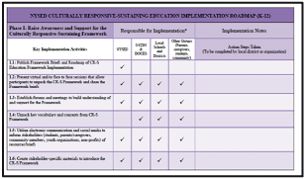
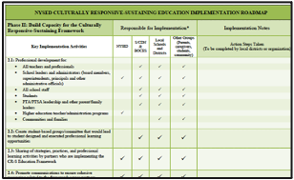
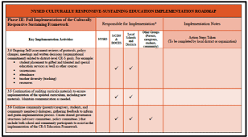
Culturally Responsive-Sustaining (CR-S) Education Roadmap
Phase I: Raise awareness of and support for the CR-S Education Framework
Phase II: Build capacity for the CR-S Education Framework
Phase III: Full implementation of the CR-S Education Framework
Notes:
Share: “The Roadmap has three phases: raising awareness of and support for the Framework, building capacity for the Framework, and fully implementing the Framework. The published Roadmap details key implementation activities and provides a template for detailed notes and next steps.”

Slide 33
Reflecting on the Session
Record your reflections:
What are three points about culturally responsive-sustaining education that you want to remember?
What are two next steps that you are going to take with the New York CR-S Education Framework?
What is one lingering question that you have?
Notes:
Share: “Please reflect on the session.
What are three points that you want to remember as related to your role as a school or district leader?
What are two next steps that you are going to take with the strategies you reviewed or with the CR-S Education Framework?
What is one lingering question that you have?
Record your reflections.”
Prompt participants to share with a partner or in the full group, depending on group size.

Slide 34

Assess Your Learning and Share Feedback
Please complete the survey to help us understand how we have supported your awareness of the New York Culturally Responsive-Sustaining Education Framework!
Your feedback helps us continue to improve our work and meet your needs.
Thank you for sharing your learning with us!
Notes:
Share: “Please complete the survey to assess your understanding of the concepts presented here, as well as providing us with valuable feedback.”
Your feedback helps us to continue to improve our work to meet your needs. Thank you for sharing your learning with us.

Slide 35

Questions?
Notes:
Prompt for questions.

Slide 36
Thank you!
@
[List name and email contact]
NY Culturally Responsive-Sustaining Education:
http://www.nysed.gov/crs
Notes:
Share: “Thank you for coming!”
In closing, share your contact information and present the NY Culturally Responsive-Sustaining Education website.

Slide 37
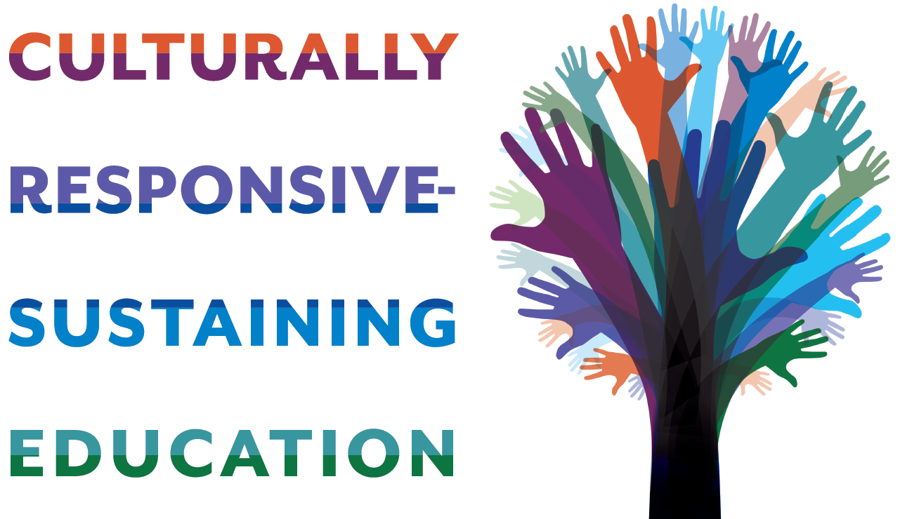
CR-S Education

