Slide 1
Vocabulary Development for English Language Learners/Multilingual Language Learners

Slide 2
Welcome!
This is the second presentation in a series of 3 sponsored by the New York State Education Department Office of Bilingual Education and World Languages (OBEWL).
The goal is to support teachers in scaffolding English language Arts instruction for English language learners/Multilingual language learners (ELLs/MLLs).
This presentation focuses on vocabulary development
The other two presentations focus on:
#1 building background knowledge
#3 supporting comprehension during close reading.

Slide 3
Welcome!
Examples of lessons that use these strategies can be found in the English Language Arts Resource Guide on the EngageNY website:
https://www.engageny.org/resource/scaffolding-instruction-english-language-learners-resource-guides-english-language-arts-and

Slide 4
Welcome!
Ideally, you will view this presentation as part of a school-based professional learning community (PLC).
This in an interactive presentation that includes several activities and partner talks.
When you see the following image, pause the webinar and complete the activity or partner talk as a small group or with a partner.

Slide 5
Partner Talk
Familiarize yourself with other members of your group.
Share with each other the following information:
What grade(s) do you teach?
Approximately how many ELLs/MLLs do you serve?
What are the English proficiency levels of the ELLs/MLLs that you provide services to?
Notes:
Trainer may want to add specific questions that pertain specifically to attendees and their schools/students.

Slide 6
Overview of Presentation
Introduction to vocabulary development
Exemplar lesson
Vocabulary selection
Intensive vocabulary instruction
Embedded vocabulary instruction
Teaching word learning strategies

Slide 7
Introduction to Vocabulary Development

Slide 8
Anchor Standards
Craft and Structure
Standard 4: Interpret words and phrases as they are used in a text, including determining technical, connotative, and figurative meanings, and analyze how specific word choices shape meaning or tone.
Vocabulary Acquisition and Use
Standard 4: Determine or clarify the meaning of unknown and multiple-meaning words and phrases by using context clues, analyzing meaningful word parts, and consulting general and specialized reference materials, as appropriate.
Standard 5: Demonstrate understanding of figurative language, word relationships and nuances in word meanings.
Standard 6: Acquire and accurately use general academic and content-specific words and phrases sufficient for reading, writing, speaking, and listening; demonstrate independence in gathering and applying vocabulary knowledge when considering a word or phrase important to comprehension or expression.
Source: http://www.nysed.gov/common/nysed/files/nys-next-generation-ela-standards.pdf

Slide 9
What the Research Says
“[Use] engaging informational texts as a platform for intensive vocabulary instruction; [choose] a small set of academic vocabulary words for in-depth instruction; [teach] vocabulary in depth using multiple modalities (writing, listening, and speaking);” and teach students word learning strategies to help them independently figure out the meanings of words” (Baker et al., 2014, p. 6).
Our goal in this webinar is to provide actionable methods for enacting this research in your classroom.

Slide 10
Vocabulary Acquisition Throughout the Lesson
Lesson Component | Vocabulary Acquisition
Enhance background knowledge | Teach vocabulary related to background.
Pre-teach vocabulary | Pre-teach words and phrases that are central to understanding the text.
Engage in close reading | Use ESOL techniques. Students apply word learning strategies. Students use glossaries to look up new words.
Guided practice | Students identify words they still don’t know.
Develop language | Teach vocabulary strategies related to language standards and word learning strategies.

Slide 11
Exemplar Lesson
The Value of Sports in People’s Lives

Slide 12
It’s Not Just a Game!
TEXT
Whether you run a race, bounce a basketball, or hurl a baseball home, you do it because it’s fun. Some scientists claim play is a natural instinct—just like sleep. That might explain why sports are likely to be as old as humanity.
Some claim sports began as a form of survival. Prehistoric man ran, jumped, and climbed for his life. Hunters separated themselves by skill, and competition flourished. Wall paintings dating from 1850 BC that depict wrestling, dancing, and acrobatics were discovered in an Egyptian tomb at Bani Hasan. The ancient Greeks revolutionized sports by holding the world’s first Olympic games at Olympia in 776 BC. But it wasn’t until the early nineteenth century that sports as we know them came into play. (Pardon the pun!) Modern sports such as cricket, golf, and horse racing began in England and spread to the United States, Western Europe, and the rest of the world. These sports were the models for the games we play today, including baseball and football.
All organized sports, from swimming to ice hockey, are considered serious play. There are rules to obey, skills and positions to learn, and strategies to carry out. But Peter Smith, a psychology professor at Goldsmiths, University of London, and author of Understanding Children’s Worlds: Children and Play (Wiley, 2009), says, “Sport-like play is usually enjoyable, and done for its own sake.”
MODEL
PRACTICE
Notes:
Make sure participants have an opportunity to read the text.

Slide 13
Vocabulary Selection
Which words should we teach?

Slide 14
Vocabulary Selection
Frequency
Use tools like Corpus of Contemporary American English (COCA): https://corpus.byu.edu/coca/ and http://clevercloudedu.com/4kwcce/img/4KW_Source_List.pdf
Importance to Text
Select words that will be critical for answering text-dependent questions.
Conceptual Complexity
Select words to pre-teach that are not easily imageable, that are abstract, and/or that have a high degree of relatedness.

Slide 15
Vocabulary Selection
Frequency
ELLs/MLLs’ reading comprehension is compromised because they don’t know common English words that English proficient students are likely to have acquired.
The 100 most frequent English words account for about 50 percent of words that readers encounter in text.
The 1,000 most frequent English words account for about 70 percent of words that readers encounter in text.
The 4,000 most frequent English words account for about 80 percent of words that readers encounter in text.
Source: Graves, M. F., & Sales, G. C. (2009). The first 4,000 words.
Seward, Inc.: Minneapolis, MN.

Slide 16
Vocabulary Selection
First 4,000 Words
First Quartile | Second Quartile | Third Quartile | Fourth Quartile
Whether you run a race, bounce a basketball, or hurl a baseball home, you do it because it’s fun. Some scientists claim play is a natural instinct—just like sleep. That might explain why sports are likely to be as old as humanity.
Some claim sports began as a form of survival. Prehistoric man ran, jumped, and climbed for his life. Hunters separated themselves by skill, and competition flourished. Wall paintings dating from 1850 BC that depict wrestling, dancing, and acrobatics were discovered in an Egyptian tomb at Bani Hasan.
Notes:
The First 4,000 Words: The words were selected from the most frequent word forms in The Educator’s Word Frequency Guide (Zeno et al., 1995) which overlaps with 4,000 word families of Hiebert’s Word Zones™ corpus (2005). The texts they are drawn from are K–14.

Slide 17
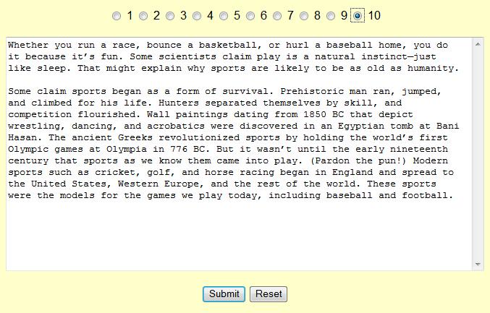
Vocabulary Selection
Academic Word List Highlighter
Accessible at: http://www.nottingham.ac.uk/~alzsh3/acvocab/awlhighlighter.htm

Slide 18
Vocabulary Selection
Highlighted Results

Slide 19
Partner Talk
What, if anything, surprised you about the words returned (or not returned) by the Academic Word List Highlighter?

Slide 20
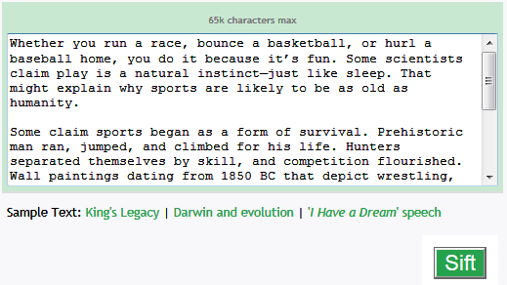
Vocabulary Selection
Word Sift
Accessible at: http://www.wordsift.com/
Notes:
WordSift was developed under a grant from the Council of Great City Schools to Kenji Hakuta. It was developed with the help and inspiration of middle school science teachers at the San Francisco Unified School District through a collaboration supported by the Strategic Education Research Partnership (SERP).
This is a potential tool for indicating which words are important within the text, because they are the words that the author uses frequently. Use this resources to find out more about these words (General Services List, AWL, Marzano, etc.)
These slides are based only on the first three paragraphs of the text, not the whole excerpt. For presentations where people have laptops, they could try it out with the rest of the excerpt.

Slide 21
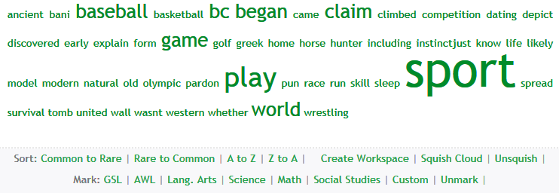
Vocabulary Selection
Word Sift: Default Results
Accessible at: http://www.wordsift.com/
Notes:
Word Sift displays the most frequent words in this text (note: not necessarily the most frequent words found across texts), excluding function words. The words in the display are alphabetically ordered by default, and their relative frequency in the text is indicated by their size. Singular and plural nouns are counted together. Other options for sorting are also available on the website.

Slide 22
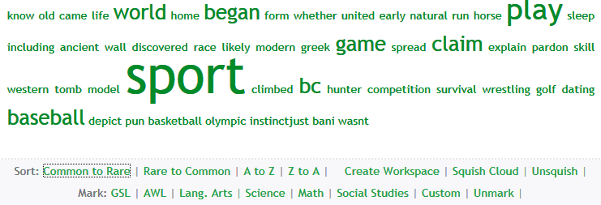
Vocabulary Selection
Word Sift: Common to Rare Words
Accessible at: http://www.wordsift.com/
Notes:
If you choose the “Common to Rare” sort feature, the words will be listed in order of frequency in the Project Gutenberg list. Project Gutenberg is a digital archive of over 42,000 texts that are in the public domain. In this example, “great”, “come”, and “long” are the most frequent words in the Project Gutenberg list. Words’ relative frequency in the text you uploaded is still indicated by their size. Note that the “Common to Rare” sorting feature ONLY applies to the most common words in your text, not to all of the words in your text.

Slide 23
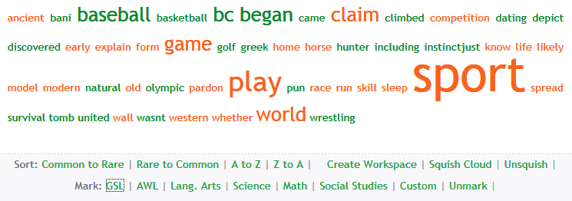
Vocabulary Selection
Word Sift: General Service List
Accessible at: http://www.wordsift.com/
Notes:
If you choose the “GSL” feature, words that appear in the General Service List will be marked red. The General Service List was developed by Michael West in the 1950’s to represent the 2,000 most common words appearing in the English language. In this example, “afternoon”, “against”, and “base” are some of the words in the General Service list. Words’ relative frequency in the text you uploaded is still indicated by their size. Note that the “GSL” feature ONLY applies to the most common words in your text, not to all of the words in your text.

Slide 24
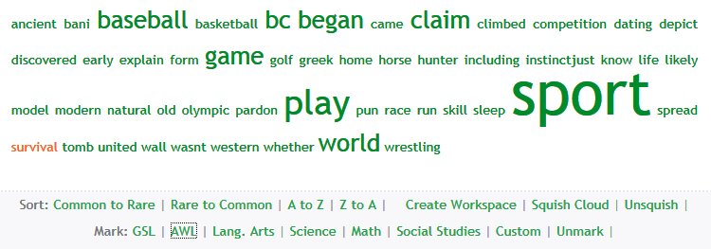
Vocabulary Selection
Word Sift: Academic Word List
Accessible at: http://www.wordsift.com/
Notes:
If you choose the “AWL” feature, words that appear in the Academic Word List will be marked red. In this example, “assemble” and “despite” are the words in the AWL. Words’ relative frequency in the text you uploaded is still indicated by their size. Note that the “AWL” feature ONLY applies to the most common words in your text, not to all of the words in your text.

Slide 25
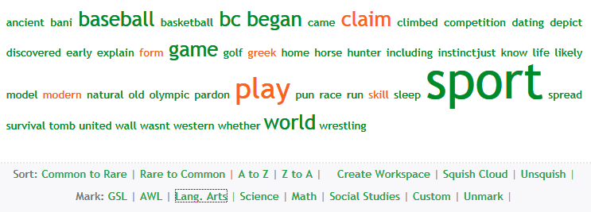
Vocabulary Selection
Word Sift: Content Area Words (Language Arts)
Accessible at: http://www.wordsift.com/
Notes:
If you choose one of the content area features, words that are common in that subject will be marked red. In this example, Social Studies words are marked. The list of common words in the content areas was developed from Marzano (2004). Then several teachers with content specialization went through the list to delete and add items, consulting their own glossaries and wealth of teaching experience. Words’ relative frequency in the text you uploaded is still indicated by their size. Note that the content area features ONLY apply to the most common words in your text, not to all of the words in your text.

Slide 26
Vocabulary Selection
Visual Thesaurus
Accessible at: http://www.wordsift.com/
Notes:
The WordSift site also includes the visual thesaurus, which provides a visual representation of word’s relatedness to other terms.

Slide 27
Activity 1b: Vocabulary Selection
Return to Activity 1 in your handout on page 3.
Click on the hyperlink for Activity 1b or type http://www.wordsift.com into an internet browser.
Copy the text excerpt in your handout and paste it into the text box. Select “Sift.”
Try out the different “Sort” and “Mark” options.

Slide 28
Partner Talk
What was the result of trying different “Sort” and “Mark” options?
How did the Word Sift results differ from the Academic Word List Highlighter results?
How might you use these tools to select vocabulary for a lesson you deliver to ELLs/MLLs?
Notes:
Have participants review notes from previous day.

Slide 29
Vocabulary Selection
Importance to Text
To be successful readers, ELLs/MLLs need to know words that are frequent across multiple texts (see previous slides).
ELLs/MLLs also need to know the meanings of words and phrases that are crucial to understanding the text at hand (as indexed by the text-dependent questions).
Text | Text-Dependent Question | Key Vocabulary
Whether you run a race, bounce a basketball, or hurl a baseball home, you do it because it’s fun. Some scientists claim play is a natural instinct—just like sleep. That might explain why sports are likely to be as old as humanity. | Why may sports be “as old as humanity”? | natural instinct, humanity

Slide 30
Vocabulary Selection
Conceptual Complexity
Words that are conceptually complex are more difficult to acquire.
Conceptually complex words may require more intensive instruction.
Conceptual complexity
Imageability
Concreteness
Relatedness

Slide 31
Vocabulary Selection
Imageability
A word is easily imageable if little effort is required to form an image of it in your mind.
If you wanted to draw a picture of the word, how much context would be required? A word that could be drawn without context is easily imageable.
Easily imageable words: dinosaur, pencil, rain
Somewhat imageable words: prevent, abandoned
Not imageable words: spirit, promise, merely

Slide 32
Vocabulary Selection
Concreteness
A word is concrete (tangible) if its referent can be easily perceived through the senses.
How easily can you feel, smell, see, hear, or taste a referent of the word?
Very concrete words: eggs, throne, pencil, run
Somewhat abstract words: expensive, peered
Very abstract words: era, indeed

Slide 33
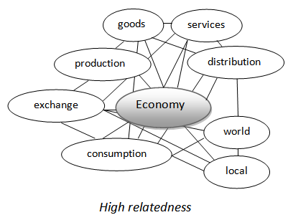
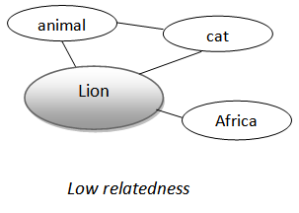
Vocabulary Selection
Relatedness
The degree to which understanding the word requires an understanding of related concepts is relatedness.
Words that have dense networks of other related concepts have high relatedness.

Slide 34
Activity 2: Vocabulary Selection
Turn to Activity 2 on page 4 of your handout.
Rate each of the listed words on their conceptual complexity.
Share your results with a partner or small group. Discuss any differences and reconcile your results.
Easy
Hard
Imageability
High
(5)
Low
(1)
Concreteness
Low
Relatedness
High

Slide 35
Example 1: Vocabulary Selection
 | Imageability | Concreteness | Relatedness | Difficulty
instinct | 1 | 1 | 5 | hard
sleep | 5 | 4 | 1 | easy
humanity | 2 | 2 | 4 | hard
jumped | 5 | 5 | 1 | easy
rules | 4 | 3 | 3 | middle

Slide 36
Other Considerations
First-Language Knowledge
There is transfer from the first to the second language in word knowledge. If a student understands a concept in his or her first language, it is only the second language label that needs to be acquired.
Students whose first language shares cognates with English have even more of an advantage. They also have the label.
One-third to one-half of words in English share cognate status with Spanish.

Slide 37
Partner Talk
What is different about developing vocabulary in ELLs/MLLs?
What are several things to consider in selecting vocabulary for ELLs/MLLs?
Notes:
Q1: ELLs/MLLs may not know the most frequently used English words, so word frequency should be considered.
Q2 It is important to consider word frequency as well as importance to understanding the text in selecting words to teach. Words that are more abstract will be harder for students to acquire so they require more direct instruction. There is a lot of transfer between first and second language vocabulary knowledge.

Slide 38
Vocabulary Instruction
How do we teach the words we selected?

Slide 39
Vocabulary Instruction
Teacher-directed instruction
More intensive instruction for abstract words (extended instruction)
Use an illustration and synonym to explain a word’s meaning.
Provide a definition. Make sure it is the one used in the target text.
Provide the home language definition and cognate status.
Repeat the sentence from the text that uses the word.
Invite students to talk about the word.
Less intensive instruction for concrete words (embedded instruction)
Define the word in situ.
Use gestures to demonstrate the word.
Show the word in illustrations from the text.
Provide examples using concepts that are familiar to students
Student-directed learning
Glossaries
Word learning strategies

Slide 40
Vocabulary Instruction
Teacher-Directed Extended Instruction
Students see:
The teacher says:
Let’s talk about the word survival.
Picture. Look at the picture. This woman needs a fire for survival in the cold.
Explanation. Survival means being able to live through very hard or dangerous times.
Survival in Spanish is supervivencia. Survival and supervivencia have the same root (-viv-), so they look a little similar.
Partner talk. Tell your partner what you would need for survival if you were lost.
Text connection. In the text, it says that sports started as a form of survival for early humans.
Context: Some claim sports began as a form of survival.

Slide 41
Activity 3: Vocabulary Instruction
Open your handout to Activity 3 on page 6.
Select one of the following words from the text excerpt for extended instruction:
strategy
psychology
Use the template in your handout to create a word card. Try to find an image online that illustrates the word.
Compare your card with someone who did the same word.
Show your card to someone else who did the other word.
Take time for discussion with each partner.

Slide 42
Example 1: Vocabulary Instruction
Students see:
The teacher says:
Let’s talk about the word strategy.
Picture. Look at the picture. The coach is telling the team about a strategy to win the game.
Explanation. Strategy means a plan or method for reaching a goal.
Strategy in Spanish is estrategia. Strategy and estrategia are cognates. They look and sound similar.
Partner talk. Tell your partner a goal you have and your strategy to reach it.
Text connection. In the text, it says that sports are serious because they require skills and strategies to do well.
Context: There are rules to obey, skills and positions to learn, and strategies to carry out.

Slide 43
Example 2: Vocabulary Instruction
Students see:
The teacher says:
Let’s talk about the word psychology.
Picture. Look at the picture. The woman is a psychologist. She is trying to understand how children learn new things.
Explanation. Psychology is a subject you can study. It helps us understand how people think, learn, and act.
Psychology in Spanish is psicología. Psychology and psicología are cognates. They look and sound similar.
Partner talk. If you studied psychology, what would you want to understand about people? Tell your partner.
Text connection. In the text, a psychology professor talks about why sports are important.
Context: Peter Smith, a psychology professor, says, “Sport-like play is usually enjoyable, and done for its own sake.”

Slide 44
Partner Talk
What are the challenges in preparing for extended vocabulary instruction?
What are some benefits of extended vocabulary instruction for ELLs/MLLs?
How will you use this strategy in your classroom?

Slide 45
Vocabulary Instruction
Teacher-Directed Embedded Instruction
Word | ESOL Technique
skill | Define and provide an example “A skill is something you practice so you can do it well, like dancing or reading.” A skill I have is teaching. Another skill is cooking.
obey | Define in situ “Obeying rules means that you follow the rules.”
exercise | Define and show a picture or make a gesture to illustrate exercise “Exercise is an activity that improves the health of the mind or body.”

Slide 46
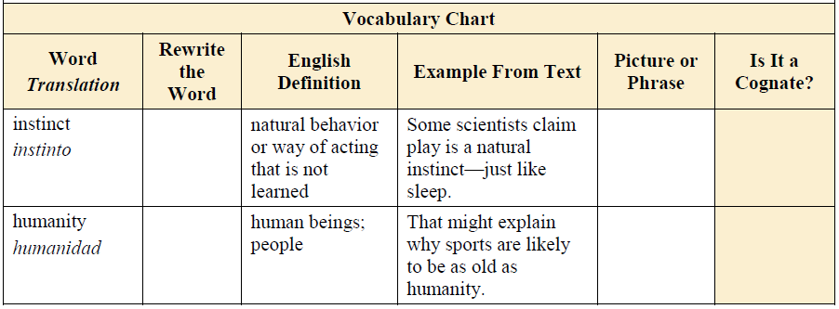
Vocabulary Instruction
Glossary Use
Notes:
All words appear in the glossary, whether teacher or student directed. Glossaries are listed as a student-directed learning technique because the glossary is an important resource for students to find and review word meanings.

Slide 47
Teaching Word Learning Strategies
It is not feasible to directly teach students all of the words they need to know to be successful readers.
It is important to teach students word learning strategies so that they can learn words on their own:
Context clues
Reference materials (e.g., online dictionaries, bilingual dictionaries)
Cognates (for languages that share cognates with English)
Morphology (e.g., using prefixes and suffixes to determine word meanings)

Slide 48
Teaching Word Learning Strategies: Context Clues

Slide 49
Teaching Word Learning Strategies: Reference Materials
Online:
English: wordsmyth.net
Spanish: Spanish.dictionary.com
Smartphone apps:
English: Dictionary! (Android & iPhone)
Free Spanish–English Dictionary + (iPhone)

Slide 50
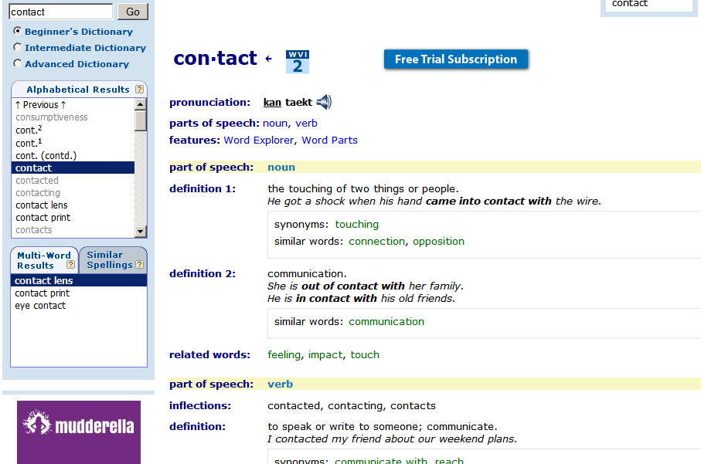
Demonstrate and explain:
Where to enter the word and dictionary levels
Pronunciation key
Parts of speech
Definitions
Example use
Synonyms
WordSmyth.net

Slide 51
Partner Talk
What are your key takeaways regarding the following:
Vocabulary selection?
Extended vocabulary instruction?
Embedded vocabulary instruction?
Teaching word learning strategies?
What questions do you still have?
How do you plan to get these questions answered?

Slide 52
Reference
Baker, S., Lesaux, N. Jayanthi, M., Dimino, J. Proctor, C. P., Morris, & J. Newman-Gonchar, R. (2014). Teaching academic content and literacy to English learners in elementary and middle school (NCEE 2014-4012). Washington, DC: U.S. Department of Education, Institute for Education Sciences, National Center for Education Evaluation and Regional Assistance.

Slide 53
http://www.nysed.gov/program-offices/office-bilingual-education-and-world-languages-obewl

