Slide 1

Understanding Our Final Determinations Data
[Insert Local Logo Here]

Slide 2
Overview
Section 1 | Reviewing the Accountability System
Section 2 | Unpacking our Data
Section 3 | Planning Next Steps

Slide 3
Notes for Facilitator
There may be notes in the “Notes” section of each slide for further guidance specific to that slide.
When applicable, Student Information Repository System (SIRS) Reports with relevant data have been referenced.
For more information about the accountability system in the 2025-26 school year, please explore these resources:
NYSED and District Accountability Resources and Data webpage: https://www.nysed.gov/accountability/school-and-district-accountability-resources-and-data
NYSED SIRS Guidance: https://www.nysed.gov/information-reporting-services/student-information-repository-system-sirs-guidance
NYSED Continuous Improvement webpage: https://www.nysed.gov/accountability/continuous-improvement
New York State Public Data Reporting: https://data.nysed.gov/

Slide 4
SECTION 1
Reviewing the Accountability System
Why is accountability important?
What are the accountability support models?
What are the accountability indicators?
How is a subgroup identified?
How can an identified subgroup exit?

Slide 5



The Importance of Accountability
The mission of New York State is to ensure that every child has access to the highest quality educational opportunities, services, and supports so that they can reach their fullest potential.
Positive Learning Environments
Well-Rounded Development
Preparation for the Future
Notes:
Please visit these resources for an overview of the Reimagine accountability system beginning in the 2025-26 school year:
Reimagine Overview webinar: https://vimeo.com/1084762340
Reimagine Overview fact sheet: https://www.nysed.gov/sites/default/files/programs/accountability/rebuild-to-reimagine-phase-fact-sheet.pdf

Slide 6



Support Models and Identifications
Identifying Schools for Support Models Ensures that:
Multiple measures are used to provide a full picture of student achievement
Progress is tracked over time
Data are provided to guide inquiry about student learning
Notes:
Facilitators are encouraged to speak about the possibilities for continuous improvement when looking into support model identifications and accountability level determinations. Regardless of support model, school and districts can engage with the accountability data for targeted goal setting.

Slide 7
Support Models and Identifications
Schools and Subgroups
Schools, Subgroups, and Districts
Districts
Comprehensive Support and Improvement (CSI)
Additional Targeted Support and Improvement (ATSI)
Targeted Support and Improvement (TSI)
Local Support and Improvement
(LSI)
Target District
Identified every three years
(i.e., 2025-2026, 2028-2029 SYs)
Identified annually
(i.e., 2025-2026, 2026-2027, 2027-2028 SYs)

Slide 8



Continuum of Supports
ATSI
TSI
LSI: PTSI
LSI
CSI
CSI-
Receivership
State, District, or Local Level Support
Progress Monitoring
Improvement Planning

Slide 9
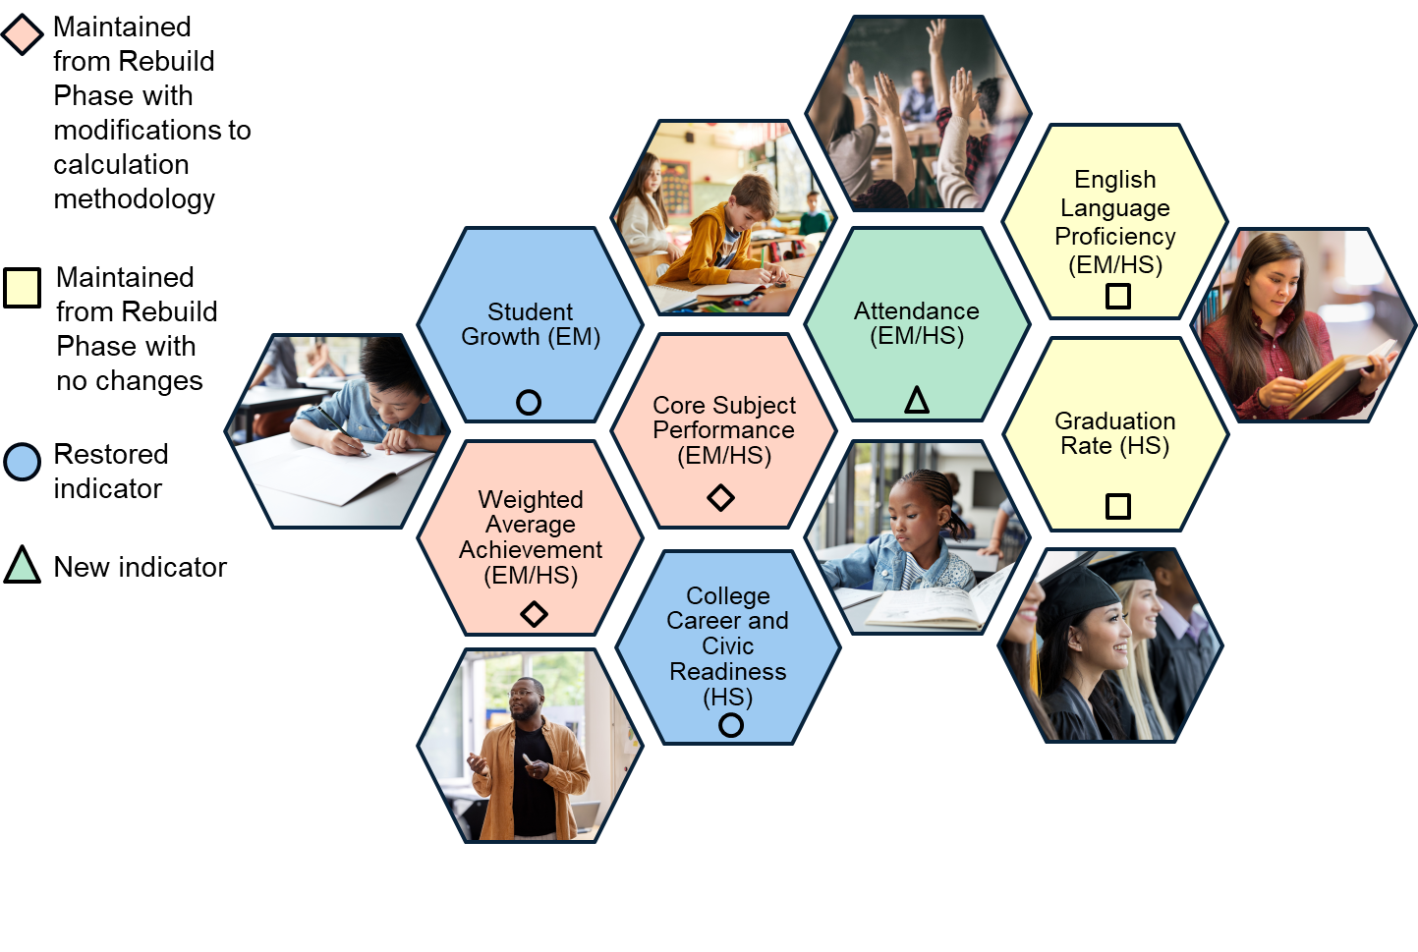
Reimagine Phase Accountability Indicators

Slide 10
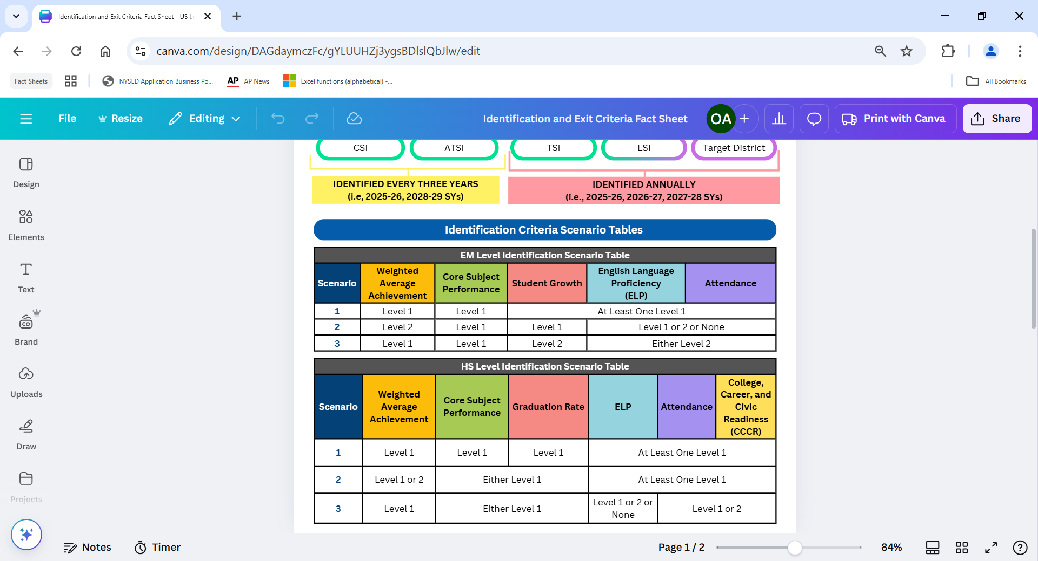
Identification Criteria: Scenario Tables
At the EM and HS levels, the All Students group and accountability subgroups are identified for support models based on their accountability indicator levels and the scenarios listed in the tables here (applying only Scenarios 1 and 2 for the 2025-26, 2026-27 and 2027-28 school years):
Notes:
Identification and Exit Criteria Resources:
Webinar: https://vimeo.com/1086416361
Identification and Exit Criteria Fact Sheet: https://www.nysed.gov/sites/default/files/programs/accountability/0625_reimagine-fact-sheet_identification-and-exit-criteria.pdf

Slide 11



Exit Criteria: Eligibility
Schools and/or subgroups identified for CSI, ATSI, or TSI can exit their support models and transition to LSI in the second school year after initial identification or any school year thereafter.
Yr 2 or
any school year thereafter
Yr 1
Identified school or subgroup
Not eligible to exit
Met exit criteria
Exits support model
Notes:
Prior to the 2025-26 school year, a school or identified subgroup was required to not meet identification criteria and make annual progress for two consecutive years to exit the CSI, ATSI, or TSI support model and transition to the LSI support model.
Starting in the 2025-26 school year, schools and/or subgroups identified for CSI, ATSI, or TSI can exit their support model and transition to the LSI support model in the second school year after initial identification or any school year thereafter if they meet their support model’s exit criteria.
This modification provides additional time for identified schools and subgroups to implement their improvement strategies to meet the exit criteria.
Schools identified for Potential TSI (still in the LSI support model) or districts identified as a Target District are eligible to exit in any school year after identification.
Identification and Exit Criteria Resources:
Webinar: https://vimeo.com/1086416361
Identification and Exit Criteria Fact Sheet: https://www.nysed.gov/sites/default/files/programs/accountability/0625_reimagine-fact-sheet_identification-and-exit-criteria.pdf

Slide 12
Data Resources Crosswalk
Excel File & Report Guide
Accountability indicator level data
Use: Identify strengths and areas of need
SIRS Reports
Subgroup and student-level data by indicator
Use: Highlight subgroup and student-specific results
NYSED School Report Card
Publicly available accountability data
Use: Generate data reports for collaborative analysis
Local Data
NYSED Resources
School/District assessments
Use: Compare with state data to analyze programmatic needs
Fact sheets, webinars, and resource documents about the accountability system
Use: Build capacity for more robust continuous improvement planning
The following is a list of data resources and how they are useful:

Slide 13
SECTION 2
Unpacking Our Data
What are our accountability support models for the 2025-26 school year?
What are our elementary/middle and high school data?
What does the data show us?

Slide 14
Our District and School Support Models
ELEMENTARY/MIDDLE LEVEL
District Level Support Model:
 | School Name​ | Support Model​ | Identified Subgroups
School Level | ​ | ​
 | ​ | ​
Notes:
Duplicate slide as needed.

Slide 15
Our District and School Support Models
HIGH SCHOOL LEVEL
District Level Support Model:
 | School Name​ | Support Model​ | Grad Rate <67%? (Y/N) | Identified Subgroups
School Level | ​ | ​
 | ​ | ​
Notes:
Duplicate slide as needed.

Slide 16
Elementary/Middle (EM) School Level
Accountability Indicator Calculations

Slide 17
Sample Title Here
What Do Our EM Data Say?
School Name:
Accountability Subgroup​​ | Weighted​​ Average Achievement Level | Core Subject Performance​​ Level | Student Growth Level | English Language Proficiency (ELP) Level​​ | Attendance Level
​All​ Students | ​​ | ​​ | ​ | ​​ | ​​
​Asian​ | ​​ | ​​ | ​ | ​​ | ​​
​Black​ | ​​ | ​​ | ​ | ​​ | ​​
​Economically Disadvantaged | ​​ | ​​ | ​ | ​​ | ​​
​English Language Learners | ​​ | ​​ | ​ | ​​ | ​​
​Hispanic​ | ​​ | ​​ | ​ | ​​ | ​​
​Multiracial​ | ​​ | ​​ | ​ | ​​ | ​​
Native American​ | ​ | ​ | ​ | ​ | ​
Students With Disabilities | ​ | ​ | ​ | ​ | ​
White​ | ​ | ​ | ​ | ​ | ​
17
Notes:
Duplicate slide for each identified EM school as needed.
Look through your EM tab on the Excel data file and enter a Level 1, 2, 3, or 4 for the All Students group and accountability subgroup for each of the accountability indicators.

Slide 18
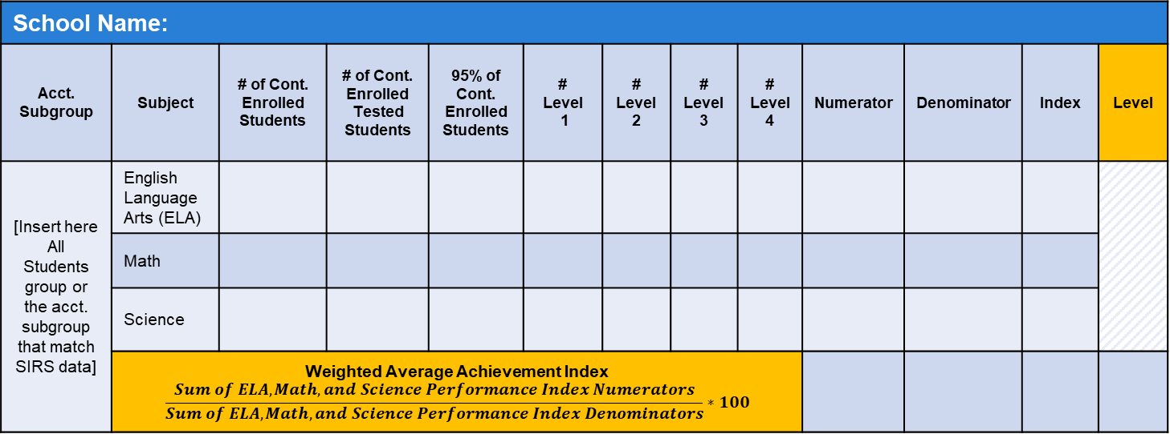
Sample Title Here
Weighted Average Achievement Data
School Name:
Acct. Subgroup | Subject | # of Cont. Enrolled Students | # of Cont. Enrolled Tested Students | 95% of Cont. Enrolled Students | # Level 1 | # Level 2 | # Level 3 | # Level 4 | Numerator | Denominator | Index | Level
[Insert here All Students group or the acct. subgroup that match SIRS data] | English Language Arts (ELA)
 | Math
 | Science
 | Weighted Average Achievement Index $$\frac{Sum of ELA, Math, and Science Performance Index Numerators}{Sum of ELA, Math, and Science Performance Index Denominators}∗100$$
Note: “acct.” refers to “accountability” and “cont.” refers to “continuously”
18
Notes:
Duplicate slide for each identified EM school as needed.
See SIRS 106 Report for EM Level Weighted Average Achievement/Core Subject Performance data for the All Students group and accountability subgroups.
Weighted Average Achievement/Core Subject Performance Calculation Review:
Webinar: https://vimeo.com/1091201951
Weighted Average Achievement and Core Subject Performance (EM) fact sheet: https://www.nysed.gov/sites/default/files/programs/accountability/0625_reimagine-fact-sheet_em-weighted-and-core.pdf
Weighted Average Achievement (EM) fact sheet: https://www.nysed.gov/sites/default/files/programs/accountability/em-weighted-fact-sheet.pdf

Slide 19
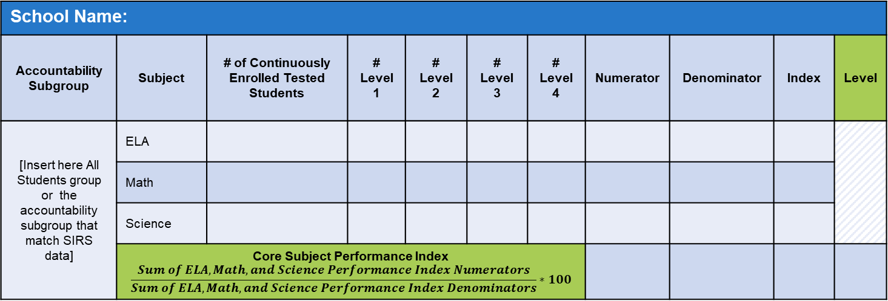
Sample Title Here
Core Subject Performance Data
School Name:
Accountability Subgroup | Subject | # of Continuously Enrolled Tested Students | # Level 1 | # Level 2 | # Level 3 | # Level 4 | Numerator | Denominator | Index | Level
[Insert here All Students group or the accountability subgroup that match SIRS data] | ELA
 | Math
 | Science
 | Core Subject Performance Index $$\frac{Sum of ELA, Math, and Science Performance Index Numerators}{Sum of ELA, Math, and Science Performance Index Denominators}∗100$$
19
Notes:
Duplicate slide for each identified EM school as needed.
See SIRS 106 Report for EM Level Weighted Average Achievement/Core Subject Performance data for the All Students group and accountability subgroups.
Weighted Average Achievement/Core Subject Performance Calculation Review:
Webinar: https://vimeo.com/1091201951
Weighted Average Achievement and Core Subject Performance (EM) fact sheet: https://www.nysed.gov/sites/default/files/programs/accountability/0625_reimagine-fact-sheet_em-weighted-and-core.pdf
Core Subject Performance (EM) fact sheet: https://www.nysed.gov/sites/default/files/programs/accountability/0625_reimagine-fact-sheet_em-core.pdf

Slide 20
Sample Title Here
Student Growth Data
School Name:
Accountability Subgroup | Subject | Student Growth Percentile | Growth Level
[Insert here All Students group or the accountability subgroup that match SIRS data] | ELA
 | Math
 | ELA/Math Combined
20
Notes:
Duplicate slide for each identified EM school as needed.
See SIRS 112 Report for EM Level Student Growth data for the All Students group and accountability subgroups.
Student Growth Calculation Review:
Webinar: https://vimeo.com/1090576338
Student Growth fact sheet: https://www.nysed.gov/sites/default/files/programs/accountability/student-growth-fact-sheet.pdf

Slide 21
Sample Title Here
ELP Data
Our Local Data
Calculations using Local Data
School Name:
Student [Insert Student Data Below] | Individual Probability of Making Progress | Made Progress? | Years Identified as ELL
#
#
#
 | Formula | Calculation using Local Data
Benchmark | (Sum of Individual Probabilities) ÷ # of Enrolled ELLs
Progress Rate | (Sum of Students who Made Progress) ÷ # of Enrolled ELLs
Success Ratio | Progress Rate ÷ Benchmark
ELP Level
21
Notes:
Duplicate slide for each identified EM school as needed.
See SIRS 113 Report for EM Level ELP data for the All Students group and accountability subgroups.
ELP Calculation Review:
Webinar: https://vimeo.com/1095634771
ELP fact sheet: https://www.nysed.gov/sites/default/files/programs/accountability/elp-fact-sheet.pdf

Slide 22
Sample Title Here
Attendance Data
School Name:
Accountability Subgroup | # of Students Meeting Enrollment Criteria | # Level 1 | # Level 2 | # Level 3 | # Level 4 | Attendance Index | Attendance Level
[Insert here All Students group or the accountability subgroup that match SIRS data]
22
Notes:
Duplicate slide for each identified EM school as needed.
See SIRS 116, 370, 371, and 375 Reports for EM Level Attendance data for the All Students group and accountability subgroups.
Attendance Calculation Review:
Webinar: https://vimeo.com/1087184699
Attendance fact sheet: https://www.nysed.gov/sites/default/files/programs/accountability/0625_reimagine-fact-sheet_attendance.pdf

Slide 23
High School (HS) Level
Accountability Indicator Calculations

Slide 24
Sample Title Here
What Do Our HS Data Say?
School Name:
Accountability Subgroup | Weighted Average Achievement Level​​ | Core Subject Performance Level​​ | Grad Rate Level​ | ELP​​ Level | Attendance Level​​ | College, Career, and Civic Readiness (CCCR) Level
​All​ Students | ​​ | ​​ | ​ | ​​ | ​​
​Asian​ | ​​ | ​​ | ​ | ​​ | ​​
​Black​ | ​​ | ​​ | ​ | ​​ | ​​
​Economically Disadvantaged | ​​ | ​​ | ​ | ​​ | ​​
​English Language Learners | ​​ | ​​ | ​ | ​​ | ​​
​Hispanic​ | ​​ | ​​ | ​ | ​​ | ​​
​Multiracial​ | ​​ | ​​ | ​ | ​​ | ​​
Native American​ | ​ | ​ | ​ | ​ | ​
Students with Disabilities | ​ | ​ | ​ | ​ | ​
White​ | ​ | ​ | ​ | ​ | ​
24
Notes:
Duplicate slide for each identified EM school as needed.
Look through your HS tab on the Excel data file and enter a Level 1, 2, 3, or 4 for the All Students group and accountability subgroup for each of the accountability indicators.

Slide 25
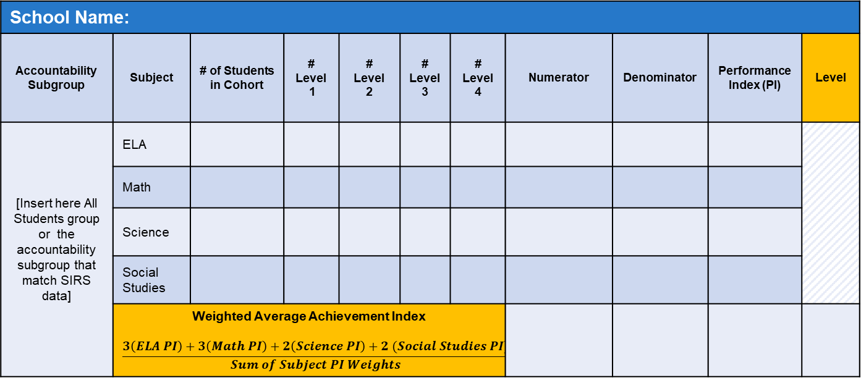
Sample Title Here
Weighted Average Achievement Data
School Name:
Accountability Subgroup | Subject | # of Students in Cohort | # Level 1 | # Level 2 | # Level 3 | # Level 4 | Numerator | Denominator | Performance Index (PI) | Level
[Insert here All Students group or the accountability subgroup that match SIRS data] | ELA
 | Math
 | Science
 | Social Studies
 | Weighted Average Achievement Index $$\frac{3\left(ELA PI\right)+3\left(Math PI\right)+2\left(Science PI\right)+2 (Social Studies PI)}{Sum of Subject PI Weights}$$
25
Notes:
Duplicate slide for each identified HS school as needed.
See SIRS 114 Report for HS Level Weighted Average Achievement/Core Subject Performance data for the All Students group and accountability subgroups.
Weighted Average Achievement/Core Subject Performance (HS) Calculation Review:
Webinar: https://vimeo.com/1091302457
Weighted Average Achievement and Core Subject Performance (HS) fact sheet: https://www.nysed.gov/sites/default/files/programs/accountability/hs-weighted-fact-sheet.pdf
Weighted Average Achievement (HS) fact sheet: https://www.nysed.gov/sites/default/files/programs/accountability/hs-weighted-fact-sheet.pdf

Slide 26
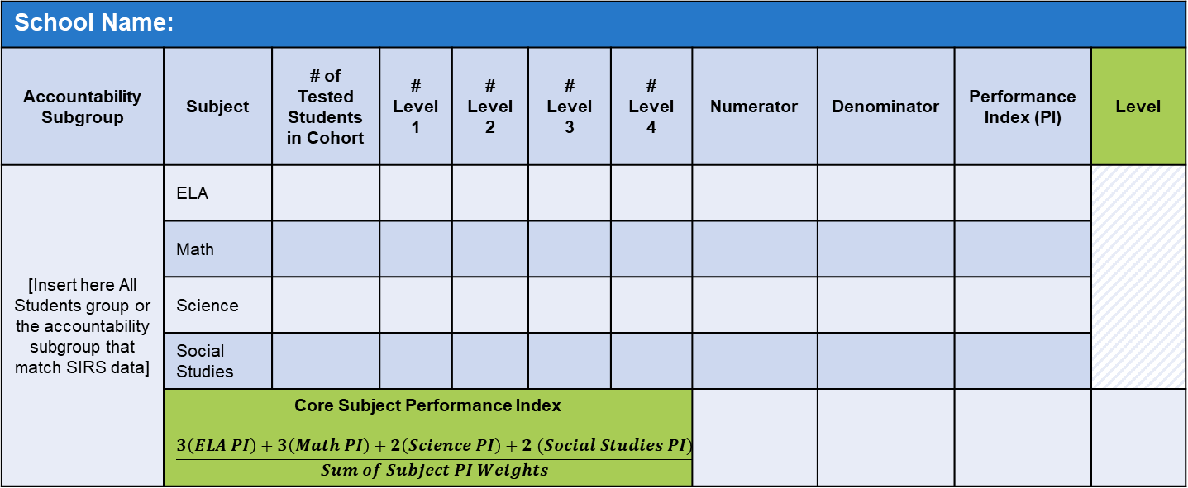
Sample Title Here
Core Subject Performance Data
School Name:
Accountability Subgroup | Subject | # of Tested Students in Cohort | # Level 1 | # Level 2 | # Level 3 | # Level 4 | Numerator | Denominator | Performance Index (PI) | Level
[Insert here All Students group or the accountability subgroup that match SIRS data] | ELA
 | Math
 | Science
 | Social Studies
 | Core Subject Performance Index $$\frac{3\left(ELA PI\right)+3\left(Math PI\right)+2\left(Science PI\right)+2 (Social Studies PI)}{Sum of Subject PI Weights}$$
26
Notes:
Duplicate slide for each identified HS school as needed.
See SIRS 114 Report for HS Level Weighted Average Achievement/Core Subject Performance data for the All Students group and accountability subgroups.
Weighted Average Achievement/Core Subject Performance (HS) Calculation Review:
Webinar: https://vimeo.com/1091302457
Weighted Average Achievement and Core Subject Performance (HS) fact sheet: https://www.nysed.gov/sites/default/files/programs/accountability/hs-weighted-fact-sheet.pdf
Core Subject Performance (HS) fact sheet: https://www.nysed.gov/sites/default/files/programs/accountability/0625_reimagine-fact-sheet_hs-core.pdf

Slide 27
Sample Title Here
Graduation Rate Data
School Name:
Accountability Subgroup | 4-year Graduation Rate | 5-year Graduation Rate | 6-year Graduation Rate | Unweighted Average Graduation Rate | Graduation Rate Level
[Insert here All Students group or the accountability subgroup that match SIRS data]
27
Notes:
Duplicate slide for each identified HS school as needed.
See SIRS 105 Report for HS Level Graduation Rate data for the All Students group and accountability subgroups.
Graduation Rate Calculation Review:
Webinar: https://vimeo.com/1091299095?share=copy#t=0
Graduation Rate fact sheet: https://www.nysed.gov/sites/default/files/programs/accountability/graduation-rate-fact-sheet.pdf

Slide 28
Sample Title Here
ELP Data
Our Local Data
Calculations using Local Data
School Name:
Student [Insert Student Data Below] | Individual Probability of Making Progress | Made Progress? | Years Identified as ELL
#
#
#
 | Formula | Calculation using Local Data
Benchmark | (Sum of Individual Probabilities) ÷ # of Enrolled ELLs
Progress Rate | (Sum of Students who Made Progress) ÷ # of Enrolled ELLs
Success Ratio | Progress Rate ÷ Benchmark
ELP Level
28
Notes:
Duplicate slide for each identified HS school as needed.
See SIRS 113 Report for HS Level ELP data for the All Students group and accountability subgroups.
ELP Calculation Review:
Webinar: https://vimeo.com/1095634771
ELP fact sheet: https://www.nysed.gov/sites/default/files/programs/accountability/elp-fact-sheet.pdf

Slide 29
Sample Title Here
Attendance Data
School Name:
Accountability Subgroup | # of Students Meeting Enrollment Criteria | # Level 1 | # Level 2 | # Level 3 | # Level 4 | Attendance Index | Attendance Level
[Insert here All Students group or the accountability subgroup that match SIRS data]
29
Notes:
Duplicate slide for each identified HS school as needed.
See SIRS 116, 370, 371, and 375 Reports for HS Level Attendance data for the All Students group and accountability subgroups.
Attendance Calculation Review:
Webinar: https://vimeo.com/1087184699
Attendance fact sheet: https://www.nysed.gov/sites/default/files/programs/accountability/0625_reimagine-fact-sheet_attendance.pdf

Slide 30
Sample Title Here
CCCR Data
School Name:
Accountability Subgroup | Readiness Measure* | Weight | # of Students | Numerator | Denominator | Index | Level
[Insert here All Students group or the accountability subgroup that match SIRS data] | Regents Diploma with Advanced Designation | 2
 | Annual Regents Diploma with Seal of Biliteracy
 | Regents Diploma with CDOS Credential | 1.5
 | Regents Diploma and High School Credit through AP Course
 | Local Diploma | 1
 | Regents Diploma
 | High School Equivalency Diploma earned in one of previous two reporting years | 0.5
 | No High School Diploma or High School Equivalency Diploma | 0
 | CCCR
*Note: Include applicable Readiness Measures with appropriate weights to the table. See CCCR Fact Sheet for the full list of Readiness Measures.
*
30
Notes:
Duplicate slide for each identified HS school as needed.
See SIRS 108 Report for HS Level CCCR data for the All Students group and accountability subgroups.
CCCR Calculation Review:
Webinar: https://vimeo.com/1090205941
CCCR fact sheet: https://www.nysed.gov/sites/default/files/programs/accountability/cccr-fact-sheet.pdf

Slide 31
SECTION 3
Planning Next Steps
Support Model Identification Recommendations
Accountability Level Recommendations
Notes:
The following section serves as recommendations and considerations to be woven into continuous improvement efforts.

Slide 32



Putting it All Together
Explore all data resources to find and understand trends
Utilize data for goal setting
Zoom in on areas of concern to ensure proper support
Notes:
Additional points to consider:
Look at your schools’ and districts’ data in combination with accountability indicator cut points and the statewide Measures of Interim Progress (MIPs) and Long-Term Goals (LTGs). These cut points, MIPs, and LTGs can be excellent reference points when trying to figure out where to direct interventions and resources and when setting targets and goals.
For each indicator, which students have the highest level of need? Can you identify patterns in performance by indicator? By subgroup?
Looking at your local data, are there curricular and programmatic changes you could make that may benefit your students?
Use all provided data resources in your improvement planning to develop actionable steps you can take to best support your school and district communities.

Slide 33
Support Model Identification Recommendations
If our school and/or subgroup is identified for…

Slide 34
Any Support Model (including LSI Support Model)
The following recommendation(s) should be considered for continuous improvement planning:
Examine how the school’s All Students group and subgroups are performing in relation to the indicator cut points
Compare ELA and math subject PIs for the Core Subject Performance indicator to identify any significant variation between the subjects
Click here for Accountability Indicator Level Cut Points

Slide 35
LSI:PTSI-1 (under the LSI Support Model)
The following recommendation(s) should be considered for continuous improvement planning:
Conduct a comprehensive root cause analysis to understand the underlying factors contributing to subgroup identification
Collect and analyze all relevant data associated with the identified subgroup
Develop and implement targeted strategies aimed at improving achievement in identified areas

Slide 36
LSI:PTSI-2 (under the LSI Support Model)
The following recommendation(s) should be considered for continuous improvement planning:
Compare current year data with prior year results to identify persistent areas of concern
Monitor progress closely, keeping in mind that if the subgroup meets the identification criteria again based on this year’s data, it will be formally identified for TSI
Develop and implement targeted strategies aimed at improving achievement in identified areas

Slide 37
CSI, ATSI, TSI, or LSI:PTSI
The following recommendation(s) should be considered for continuous improvement planning:
For the English Language Learner (ELL) Subgroup
For the Students with Disabilities (SWD) Subgroup
Multilingual Learner (ML) and ELL Program Quality Review and Reflective Protocol Toolkit: This toolkit strengthens the school quality review process for Multilingual Learner and ELL programs and services
Regional Bilingual Education Resource Network (RBERN): The purpose of the RBERNs is to establish regionally-based resources to provide a coordinated system of high-quality technical assistance, training, information dissemination, and professional development to districts/school to improve their instructional programs and practices for ELLs
The NYSED Educational Partnership is a coordinated and cohesive network of support focused on enhancing services and supports for students with disabilities from early childhood and school-age education to engagement in post-school opportunities
The Educational Partnership’s mission is to support and empower educational organizations, families, and communities to improve equity, access, opportunities, and outcomes for all students with disabilities in New York State

Slide 38
Accountability Level Recommendations
If the All Students group or subgroup(s) receive the following accountability level…

Slide 39
Level 1 for Weighted Average Achievement and Level 2 for Core Subject Performance
The following recommendation(s) should be considered for continuous improvement planning:
Recognize that the Level 1 results fall within the bottom 10% statewide, signaling the need for targeted strategies within an improvement plan
Use Student Information Repository System (SIRS) 106 and 114 reports to examine participation rates, as low participation may be influencing overall performance
Identify and implement strategies to increase participation in statewide assessments
Analyze student-level results compared to the Weighted Average Achievement and Core Subject Performance indicator cut points to inform goal setting and progress monitoring
Click here for Accountability Indicator Level Cut Points

Slide 40
Level 3 or 4 for Weighted Average Achievement and Core Subject Performance and Level 1 for Graduation Rate
The following recommendation(s) should be considered for continuous improvement planning:
Analyze barriers preventing students from graduating on time
Consider support and programmatic modifications to boost graduation rates
As schools can be identified for CSI if the All Students group has a 4-year Graduation Rate lower than 67% and 5-year and 6-year Graduation Rates not at or above 67%, review SIRS 105 report to examine which students are graduating in each cohort

Slide 41
Level 1 for Weighted Average Achievement and Core Subject Performance and Level 3 or 4 for Graduation Rate
The following recommendation(s) should be considered for continuous improvement planning:
Recognize that this combination of results aligns with Scenario 2 for identification, indicating performance concerns that require targeted improvement efforts
Review student-level results in relation to the Weighted Average Achievement and Core Subject Performance indicator cut points to guide analysis, identify gaps, and set measurable goals
Examine local curriculum and grading policies to ensure they are fully aligned with the New York State Learning Standards and support consistent expectations for student learning
Click here for Accountability Indicator Level Cut Points

Slide 42
Level 1 or 2 for Attendance
The following recommendation(s) should be considered for continuous improvement planning:
Recognize that earning a Level 1 on Attendance is one of the criteria that may contribute to identification
Use SIRS 113 report to review student-level attendance patterns in relation to the indicator cut points to inform analysis and goal setting
Develop targeted interventions for students whose attendance places them near the Level 1/Level 2 threshold
Examine the effectiveness of current programs in meeting students’ holistic needs, particularly supports related to mental health, family engagement, and wraparound services
Click here for Accountability Indicator Level Cut Points

Slide 43
Level 1 or 2 for ELP
The following recommendation(s) should be considered for continuous improvement planning:
Recognize that earning a Level 1 on the ELP indicator is one of the criteria that may contribute to identification
Analyze trends and needs across all ELP performance levels to determine programmatic strengths and gaps
Use student-level data from the SIRS 113 report to identify specific areas of need and the expected growth required to demonstrate annual progress in the upcoming school year

Slide 44
Level 1 for CCCR
The following recommendation(s) should be considered for continuous improvement planning:
Recognize that earning a Level 1 on the CCCR indicator is one of the criteria that may contribute to identification
Examine barriers that limit students’ access to or completion of CCCR-aligned credentials
Identify and maximize opportunities such as coursework, programs, and pathways that support students in earning credentials
Verify the accuracy of the SIRS 108 report data, including ensuring that students assigned a weight of “0” are reported correctly and that students who have dropped out but have earned a High School Equivalency diploma have contributed positively to the CCCR Index

Slide 45
Level 1 for Student Growth
Recognize that earning a Level 1 for Student Growth falls within Scenario 2 for potential identification
Use SIRS 112 report data to understand the narrative that the growth results tell about student learning
Clarify how the ELA and math Growth Indices differ and what each reveals about student trajectories
Compare growth rates across subgroups and grade levels, analyzing root causes for any discrepancies
Identify student growth data that were unexpected or concerning (“red flags”) and investigate underlying factors
For students who demonstrated low growth last year and are still enrolled this year, examine current growth patterns and reflect on support needed to accelerate progress
The following recommendation(s) should be considered for continuous improvement planning:

Slide 46


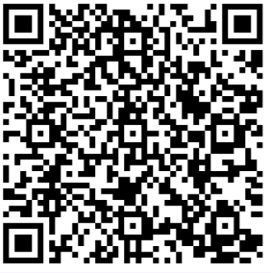
Additional Resources
School and District Accountability Resources and Data
https://www.nysed.gov/accountability/school-and-district-accountability-resources-and-data
Fact sheets
Webinars
Links to additional resources (MIPs, LTGs, cut points)
Continuous Improvement
https://www.nysed.gov/accountability/continuous-improvement
Additional resources and supports for identified schools and districts
Accountability SIRS Report Information
https://www.nysed.gov/information-reporting-services/level-2-reporting-l2rpt-system-resources-and-information
SIRS report guides
Questions about the New York State ESSA accountability system can be emailed to the Office of Accountability at accountinfo@nysed.gov.

