Slide 1
Selecting Demonstrable Improvement Indicators
April 10, 2019
Ira Schwartz
Associate Commissioner, Office of Accountability
Andrew Morozov
Associate, Education Research
Office of Accountability
Jeffrey Fletcher
Education Specialist
Office of Accountability

Slide 2
Goals for Today’s Webinar
Provide brief overview of Demonstrable Improvement (DI) Process, including methodological updates.
Review Level 1 and Level 2 DI Indicators.
Explain how to use the DI spreadsheet to select DI Indicators.
Clarify next steps and how to request assistance.
Answer questions.

Slide 3
Questions
You may ask questions during this presentation by:
Typing them in the chat box of this webinar, or
Emailing them to accountinfo@nysed.gov.
Note:
We will make a recording of this webinar available at: http://www.p12.nysed.gov/accountability/de/SchoolReceivership.html

Slide 4
Additional Resources:
Today’s presentation will focus on selection of Demonstrable Improvement indicators, using the Excel template emailed on April 3, 2019: DI_indicator_selection_worksheet_2019_[district].xlsx
“Data Dictionary for 2018-19 to 2020-21” available at: http://www.p12.nysed.gov/accountability/de/SchoolReceivership.html
For background on School Receivership, see presentation “Demonstrable Improvement for Schools in Receivership” available at: http://www.p12.nysed.gov/accountability/de/SchoolReceivership.html

Slide 5
1. Demonstrable Improvement Process Overview

Slide 6
Demonstrable Improvement Process
What is Demonstrable Improvement?
For schools operating under Superintendent Receivership:
Demonstrable Improvement (DI) is the process used to determine whether an Independent Receiver shall be appointed to a school in Superintendent Receivership.
Struggling Schools must annually make DI after a two-year period, and annually thereafter, or they will be placed in Independent Receivership.
All schools newly identified for Superintendent Receivership have been designated as Struggling.
No newly identified schools are designated as Persistently Struggling.
Schools that make Demonstrable Improvement continue under Superintendent Receivership.

Slide 7
Demonstrable Improvement Process
Demonstrable Improvement Indicators
One or more indicators have been established for each Metric specified in legislation.
The State Education Department selects and assigns some of the school indicators, called Level 1 indicators.
Level 1 indicators will be based primarily on where the school’s performance needs the most improvement.
The Superintendent Receiver in consultation with the Community Engagement Team selects additional indicators, called Level 2 indicators.
A Superintendent Receiver may also propose Local indicators (as additional Level 1 or Level 2 indicators) for approval by the Commissioner.
Note: Avoid selecting or proposing indicators that measure the same performance as another indicator, as well as indicators that only apply to a small proportion of a school’s students.

Slide 8
Demonstrable Improvement Process
Making Demonstrable Improvement
For each indicator, a school can make progress by achieving a school specific annual Progress Target.
In deciding whether Demonstrable Improvement has been made, the Commissioner shall consider:
Performance on DI indicators relative to annual Progress Targets.
Number of years schools have been identified.
Superintendent’s successful use of Receivership Powers to implement the school’s Plan.

Slide 9
Demonstrable Improvement Process
Making Demonstrable Improvement
The result of the process shall be an evidence-based judgment that:
The school made Demonstrable Improvement;
The school did not make Demonstrable Improvement, unless there are shown to be extenuating or extraordinary circumstances; or
In addition to school’s performance on the DI indicators, the Commissioner shall review the totality of the school's record to make a determination as to whether or not the school made Demonstrable Improvement.

Slide 10
Demonstrable Improvement Process
Removal from Superintendent Receivership
Making Demonstrable Improvement does not remove a school from Superintendent Receivership.
Removal from Receivership occurs at the end of the school year in which a school under Superintendent Receivership is removed from Comprehensive Support and Improvement (CSI) status.

Slide 11
DI Methodology Updates
Guiding Principles
Beginning with the 2018-19 school year, NYSED revised the DI methodology to:
Align DI indicators with ESSA indicators;
Update and streamline the annual Progress Targets; and
Differentiate Progress Targets for schools continuing in Receivership vs. newly identified Receivership schools.
DI Determinations based on the updated methodology will first be made using 2019-20 school year results.

Slide 12
DI Methodology Updates
For each indicator, a school can make progress by achieving a school specific annual Progress Target.
Progress Targets are based on closing the gap between the 2017-18 result for the school (“school baseline”) and the 2017-18 state median result (“state baseline”).*
Progress Targets increase over the three-year period.
Progress Targets are differentiated for
Cohort 1 schools - schools that are continuing in Receivership vs.
Cohort 2 schools - newly identified Receivership schools.
*To ensure that targets remain achievable, a maximum target increment limit is
applied if the school baseline is too far from the state baseline.

Slide 13
DI Methodology Updates
Example: Year 1 Progress Target = 1/12th of the gap between the 2017-18 school and state baselines.
Level 1 Indicator Targets (expressed as gap fractions)
Year | Cohorts 1 & 2
2018-19 | 1/12
2019-20 | 2/12 = 1/6
2020-21 | 3/12 = 1/4
Level 2 Indicator Targets
Year | Cohort 1 | Cohort 2
2018-19 | 1/8 | 1/12
2019-20 | 2/8 = 1/4 | 2/12 = 1/6
2020-21 | 3/8 | 3/12 = 1/4

Slide 14
DI Methodology: Computing the DI Index
A school makes progress on an indicator if it meets or exceeds the annual Progress Target for that indicator. No partial or extra credit.
DI Index is a weighted average of Level 1 and Level 2 indicators.
Level 1 indicators are weighted at 50% of the DI Index and Level 2 indicators are weighted at 50% of the DI Index, regardless of the number of Level 1 and Level 2 indicators.
Each indicator within Level 1 and Level 2 shall be weighted equally (except indicators listed on Slide 21 for Cohort 1 Schools only).
DI Index ranges from 0% to 100%, with cutpoints as follows:
>= 67% | Preliminarily Determination: Made DI
>= 40% & < 67% | Commissioner’s Decision
< 40% | Preliminarily Determination: Did Not Make DI

Slide 15
Questions?

Slide 16
2. Demonstrable Improvement Indicators

Slide 17
DI Indicators: Requirements
Level 1 Indicators:
Indicators that are mostly performance-based (e.g., ELA/Math Performance Indices, student growth, and graduation rate).
Based on results for the “All Students” group (not subgroups).
Assigned by SED when the school baseline is below the state baseline (2017-18 statewide median) for the indicator.
Schools are assigned a minimum of 5 Level 1 Indicators (7 for schools serving Middle and High School grades).
Schools are assigned all Level 1 indicators where their baseline is below the state baseline.*
If a school falls below the state baseline on a Level 1 indicator based on 2018-19 results, then that indicator will be assigned to the school as an additional Level 1 indicator for the 2019-20 and 2020-21 school years.
*The indicator is not assigned if there is too little room for growth over 3 years.

Slide 18
DI Indicators: Requirements
Level 2 Indicators:
Mostly based on results for accountability subgroups (e.g., Students with Disabilities, racial/ethnic groups).
Available for selection if the school baseline is below the state baseline.*
Schools must select a minimum of 5 Level 2 Indicators (7 for schools serving Middle and High School grades).
Schools can select up to a maximum of 10 Level 2 Indicators.
Local Indicators:
May be proposed by districts as Level 1 or Level 2 indicators.
Note: Cohort 1 schools must resubmit all Local indicators to the Department for approval.
*The indicator is not available if there is too little room for growth over 3 years.

Slide 19
DI Indicators: Level 1
Elementary & Middle Schools
School Safety
3-8 ELA All Students MGP²
3-8 Math All Students MGP²
Student Suspension Rate (Out of School)
Chronic Absenteeism
ELA Core Subject Performance Index¹
Math Core Subject Performance Index¹
Science Core Subject Performance Index¹
ELA Weighted Academic Achievement Index¹
Math Weighted Academic Achievement Index¹
Science Weighted Average Performance Index¹
ELP Success Ratio
High Schools
School Safety
2016 Total Cohort (11th Graders) Passing ELA Regents*
2017 Total Cohort (10th Graders) Passing Math Regents*
ELA Performance Index
Math Performance Index
Science Performance Index
Social Studies Performance Index
Student Suspension Rate (Out of School)
Chronic Absenteeism
College, Career, & Civic Readiness (CCCR) Index
2015 Total Cohort 4-Year Grad Rate - All Students*
2014 Total Cohort 5-Year Grad Rate - All Students*
2013 Total Cohort 6-Year Grad Rate - All Students*
ELP Success Ratio
¹ Core Subject PI and Weighted Academic Achievement Index calculations use the same formula in the numerator. For the denominator, the Weighted Academic Achievement Index uses the greater of: (1) # of continuously enrolled students who are tested, or (2) 95% of continuously enrolled students. The Core Subject Performance Index denominator is the # of continuously enrolled students who are tested. A school will be assigned either the Core Subject or the Weighted Academic Achievement Indicator for a subject, not both (see Indicator Availability status “Core vs. Weighted Override” on the Excel template).
² Baseline MGP is based on 3-year weighted average (2015-16, 2016-17, 2017-18).
*Cohorts listed are for 2018-19 school year results.

Slide 20
DI Indicators: Level 2
Indicator Name
Student Attendance
3-8 ELA MGP†
3-8 Math MGP†
3-8 ELA Level 2 and above Gap with non-similarly classified Students†
3-8 Math Level 2 and above Gap with non-similarly classified Students†
HS ELA Level 2 and above Gap with non-similarly classified Students†
HS Math Level 2 and above Gap with non-similarly classified Students†
2018 Total Cohort (9th Graders) with 5 or more credits*
2017 Total Cohort (10th Graders) with 5 or more credits*
2016 Total Cohort (11th Graders) with 5 or more credits*
2015 Total Cohort 4-Year Grad Rate† *
2014 Total Cohort 5-Year Grad Rate† *
2013 Total Cohort 6-Year Grad Rate† *
Drop Out Rate
Teacher Turnover
Teacher Attendance
HS Student Promotion Rate (promoted from grades 9,10 & 11)
3-8 ELA Core Subject Performance Index†
3-8 Math Core Subject Performance Index†
3-8 ELA Weighted Average Performance Index†
3-8 Math Weighted Average Performance Index†
HS ELA Performance Index†
HS Math Performance Index†
Science Performance Index†
Social Studies Performance Index†
College, Career, & Civic Readiness (CCCR) Index†
†These Level 2 indicators are based on the accountability subgroups. *Cohorts listed are for 2018-19 school year results.

Slide 21
DI Indicators: Level 2
Indicators #2, #6, #7, #8, and #94 are focused on organizational and school process changes.
For Cohort 1 Schools:
These indicators are weighted at 1% of the Level 2 component of the DI Index.
These indicators do not count towards the minimum of 5 (or 7) Level 2 indicators. They do count toward the maximum of 10 Level 2 indicators.
For Cohort 2 Schools, these indicators are weighted and counted like all other Level 2 indicators.
For both cohorts, only one DTSDE Tenet can be selected (indicators #6, #7, and #8).
Indicator Code | Indicator Name
2 | Plan for and implement quality Community School Model
6 | Family and Community Engagement (DTSDE Tenet 6)
7 | Teacher Practices and Decisions (DTSDE Tenet 4)
8 | Curriculum Development and Support (DTSDE Tenet 3)
94 | Providing 200 Hours of quality Extended Day Learning Time (ELT)

Slide 22
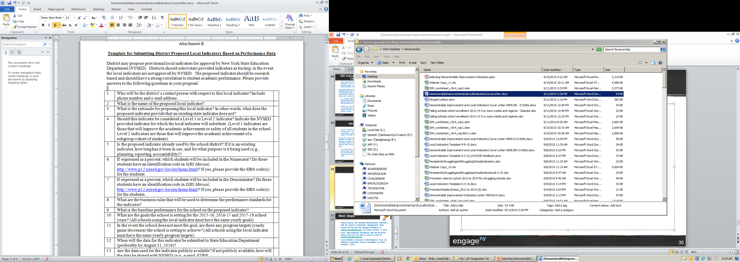
Local Indicators
The April 3, 2019 Letter includes a template that districts can use to propose Local Indicators for Department approval (see Appendix B).

Slide 23
Questions?

Slide 24
3. Selecting Demonstrable Improvement Indicators

Slide 25
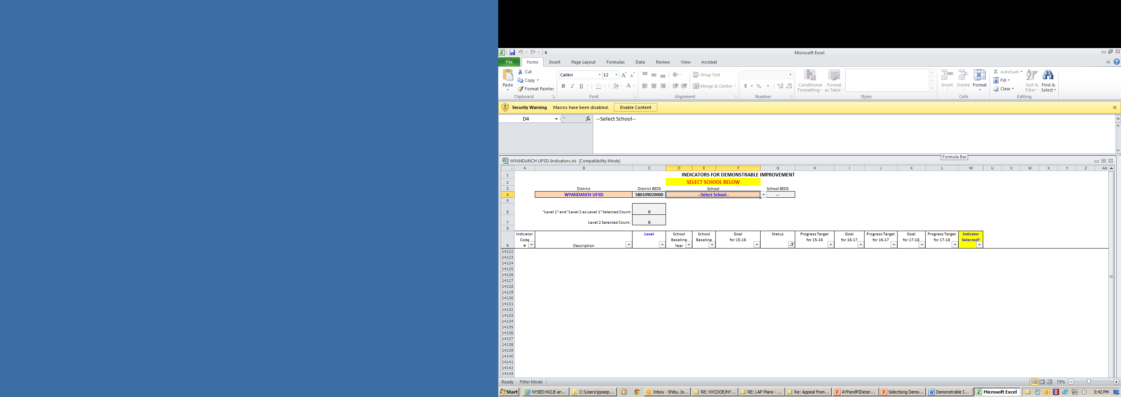
Opening the Excel Template
SED has emailed each Superintendent/EPO a Microsoft Excel file with the list of Demonstrable Improvement indicators available for selection.
If the file opens with a notification “Security Warning: Macros have been disabled. Enable Content”, click “Enable Content”. A macro is a set of instructions that are programmed into the spreadsheet to automate tasks.

Slide 26
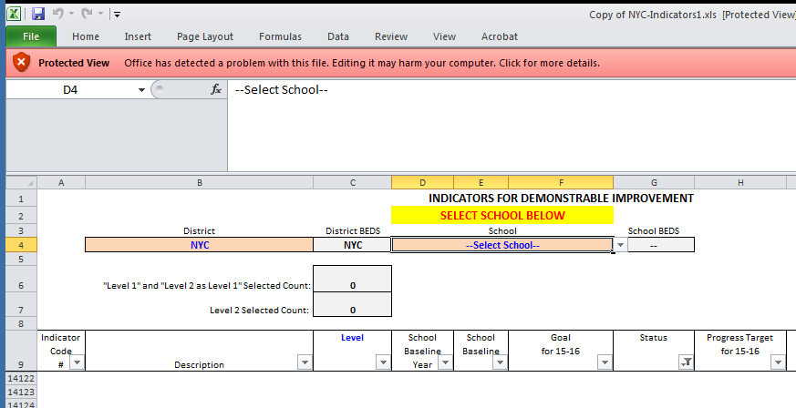
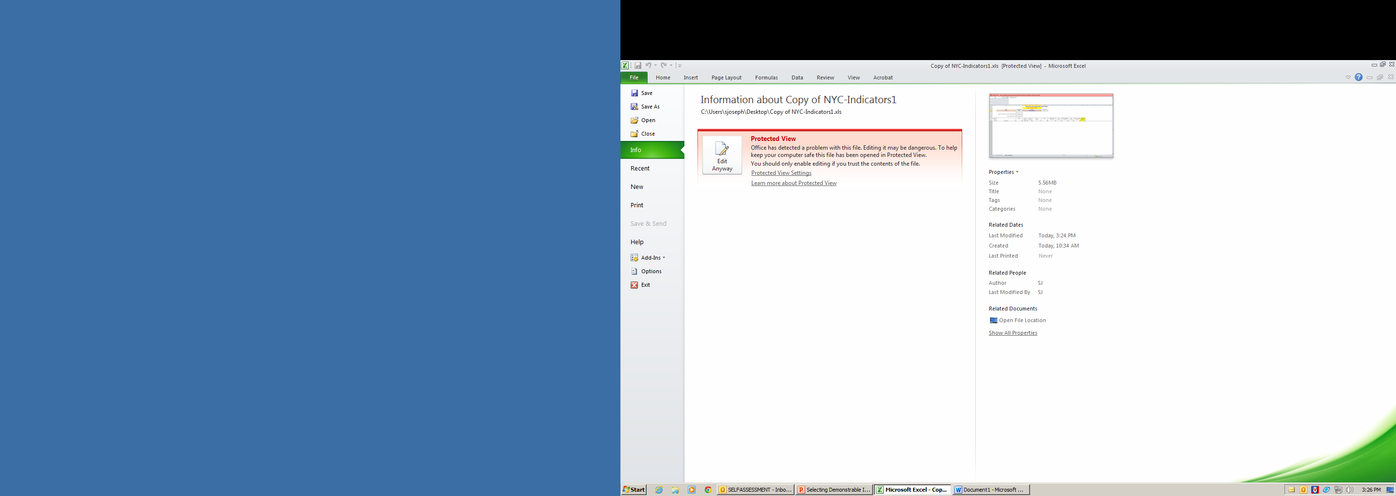
Opening the Excel Template
If the file opens with a notification “Protected View Office has detected a problem with this file. Editing it may harm your computer. Click for more details”, click on the message and select the option “Edit Anyway”.

Slide 27
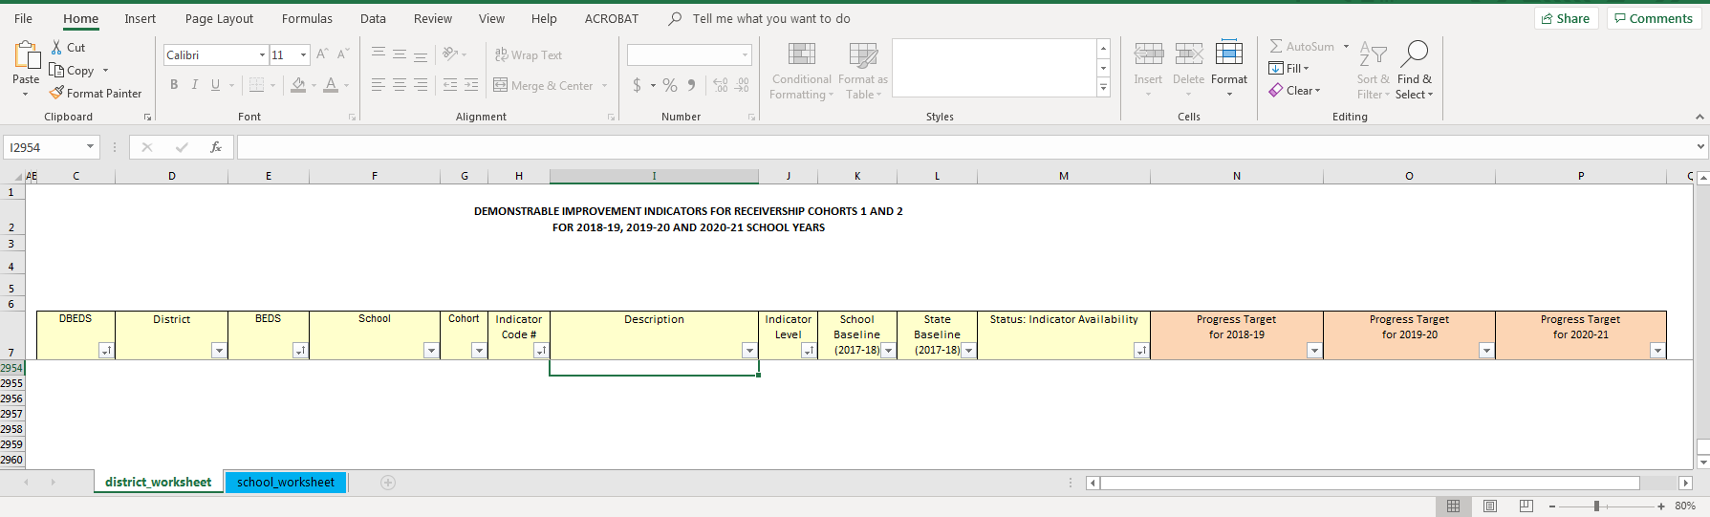
Navigating the Excel Template
The file has two tabs:
district_worksheet
school_worksheet
Please review the “district_worksheet” first.

Slide 28
District Worksheet
The "district_worksheet" includes the following indicator information for all Receivership Schools in the district:
Descriptions of all indicators, including applicable levels and indicator #'s.
School baseline performance on indicators.
State baseline (state median) in 2017-18 to which the School baseline is compared.
"Status: Indicator Eligibility" which provides information on the selection of the indicators (for Level 1 Indicators) or eligibility for potential selection of the indicator (for Level 2 Indicators).
If applicable, Progress Targets for 2018-19, 2019-20, and 2020-21.

Slide 29
District Worksheet
"Status: Indicator Eligibility" labels:
Level 1 Indicators
Does not Meet State Baseline / Selected by SED – Selected by the Department
Meets State Baseline / Not Selected by SED
Proximity to State Baseline Override / Not Selected by SED
Core vs. Weighted Override / Not Selected by SED
TBD¹
NA / No Baseline Available
Level 2 Indicators
Available for Selection
Does not meet State Baseline / Available for Selection
Meets State Baseline / Not Available for Selection
Proximity to State Baseline Override / Not Available for Selection
Core vs. Weighted Override / Not Available for Selection
TBD¹
NA / No Baseline Available
schools can select
¹ TBD indicators include Student Attendance (#3) and Student Suspension Rate (#4). Baselines and targets for these indicators are pending.

Slide 30
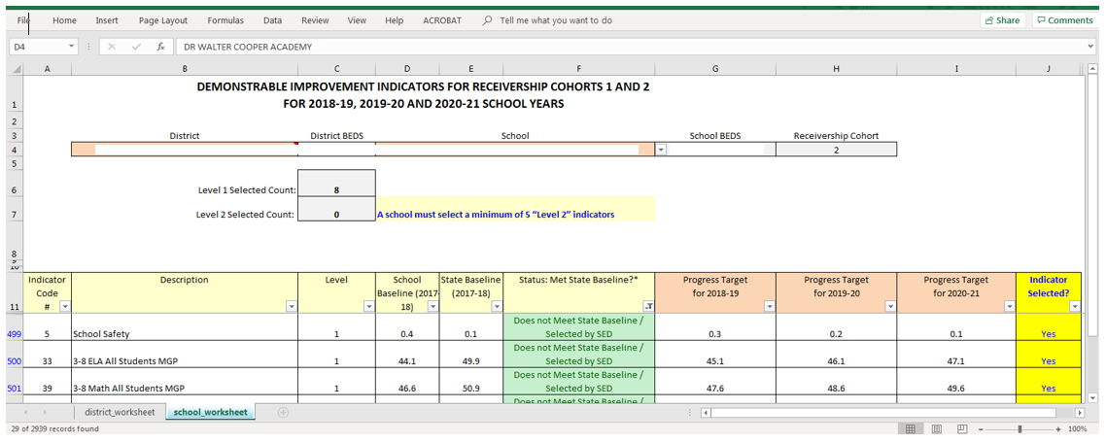
School Worksheet: Select School
Use “school_worksheet” to select the DI indicators for each school in the district:
Select the school from the “School” dropdown list.
The template will display all available indicators for the school:
Level 1 Indicators selected by SED.
Level 2 Indicators available for selection by the school.

Slide 31
School Worksheet: Layout
Progress Targets for
2018-19, 2019-20, 2020-21

Slide 32
School Worksheet: Layout
Indicator selection status

Slide 33
School Worksheet: Layout
Guidance related to rules for selecting indicators:

Slide 34
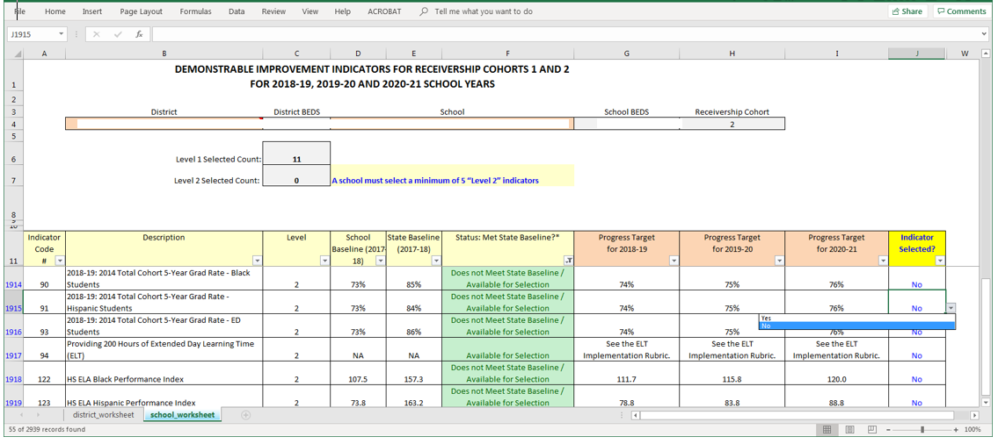
School Worksheet: Level 2 Indicators
Selecting Level 2 Indicators

Slide 35
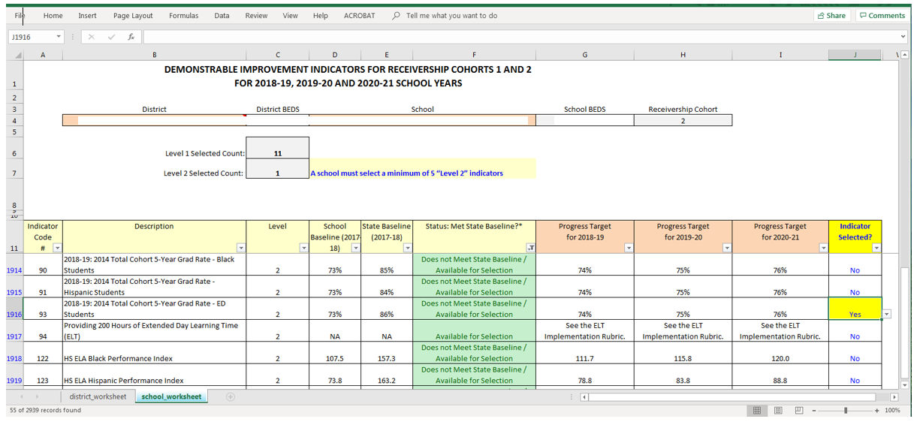
School Worksheet: Level 2 Indicators
Count of selected Level 2 Indicators
Level 2 Indicator selected

Slide 36
School Worksheet: Level 2 Indicators
Key Considerations:
Schools must select a minimum of 5 (or 7) Level 2 Indicators.
School can select a maximum of 10 Level 2 Indicators.
For Cohort 1 schools, Indicators #2, #6, #7, #8, and #94 do not count towards the minimum. They do count toward the maximum of 10 Level 2 indicators (see Slide 21).
Also, for Cohort 1 schools these indicators are weighted at 1% of the Level 2 component of the DI Index.
Only 1 DTSDE Tenet (Indicators #6, #7, and #8) can be selected by either cohort (see Slide 21).

Slide 37
School Worksheet: Level 2 Indicators
Key Considerations: Avoid selecting Level 2 indicators that:
Only focus on one type of indicator (e.g., only Performance Index) or indicators for the same subject (e.g. only ELA).
Only focus on one subgroup (e.g., only ELLs, or only Black or Hispanic students).
Only apply to a small percentage of the school’s students.

Slide 38
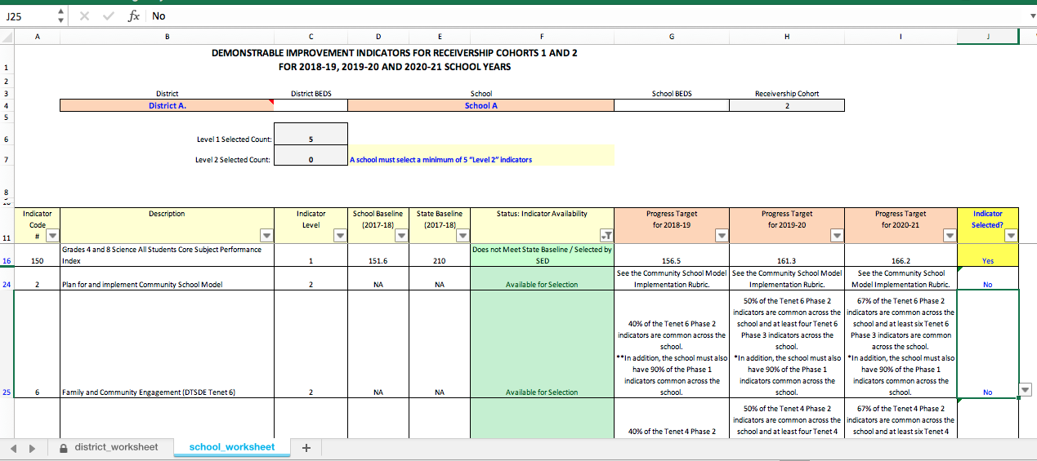
School Worksheet: Example School A
School A is a Cohort 2 school.
Guidance on minimum count of Level 2 Indicators

Slide 39
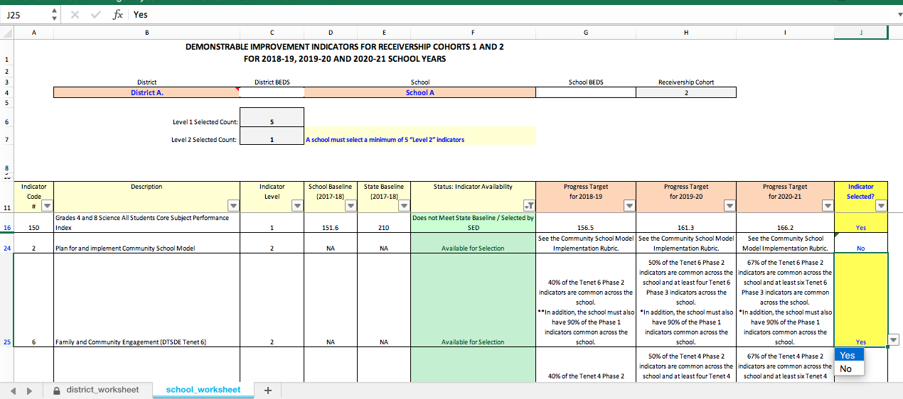
School Worksheet: Example School A
Count reflects the number of Indicators selected
Indicator selected

Slide 40
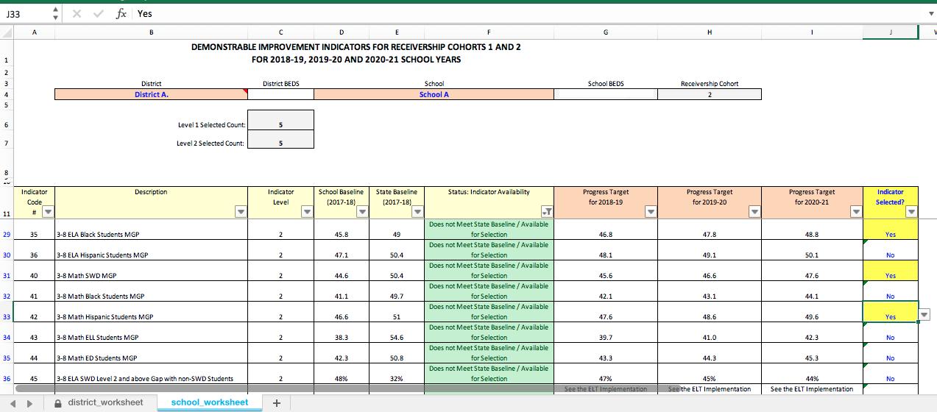
School Worksheet: Example School A
Minimum 5 Level 2 Indicators selected
Message disappears when minimum # of Level 2 Indicators is reached

Slide 41
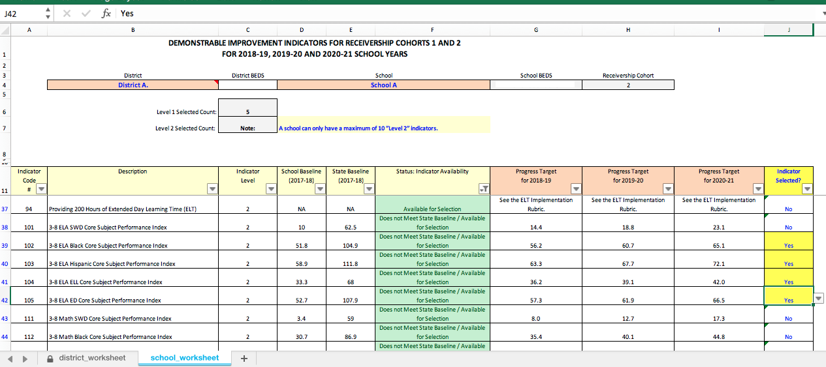
School Worksheet: Example School A
More than 10 Level 2 Indicators selected
Warning on exceeding the maximum # of Level 2 Indicators

Slide 42
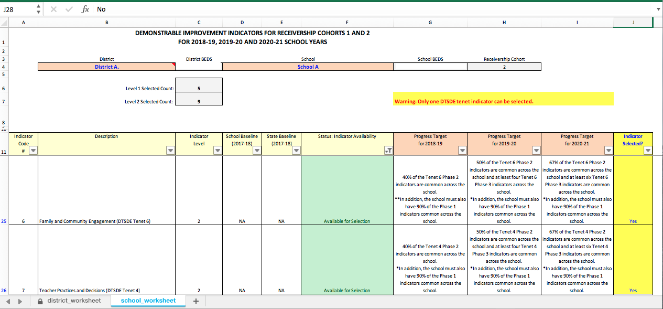
School Worksheet: Example School A
Warning if more than 1 DTSDE Tenet selected
Two DTSDE Tenets selected (maximum is 1).

Slide 43
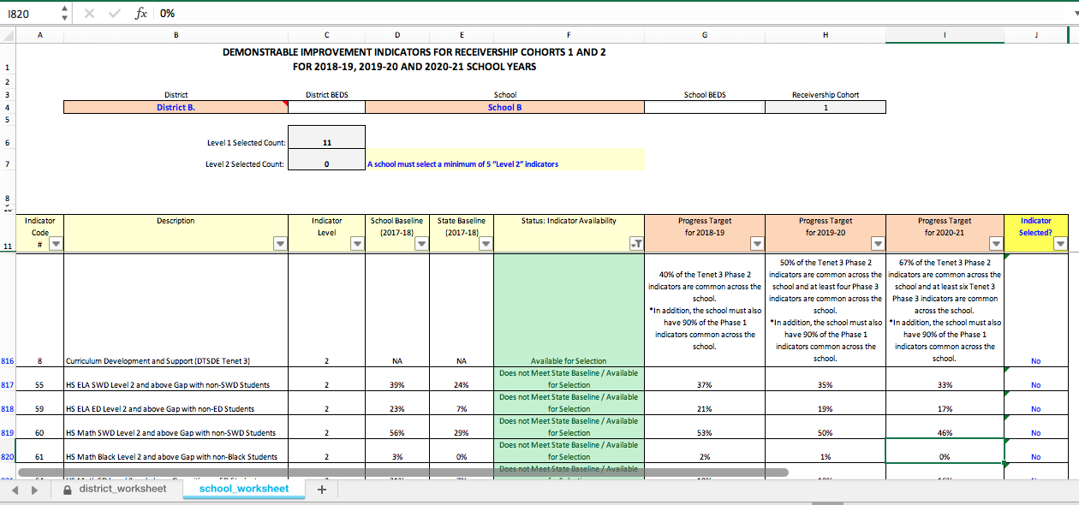
School Worksheet: Example School B
School B is a Cohort 1 school.
Similar selection rules for Cohort 1 and Cohort 2 schools.
Two differences: see following slides

Slide 44
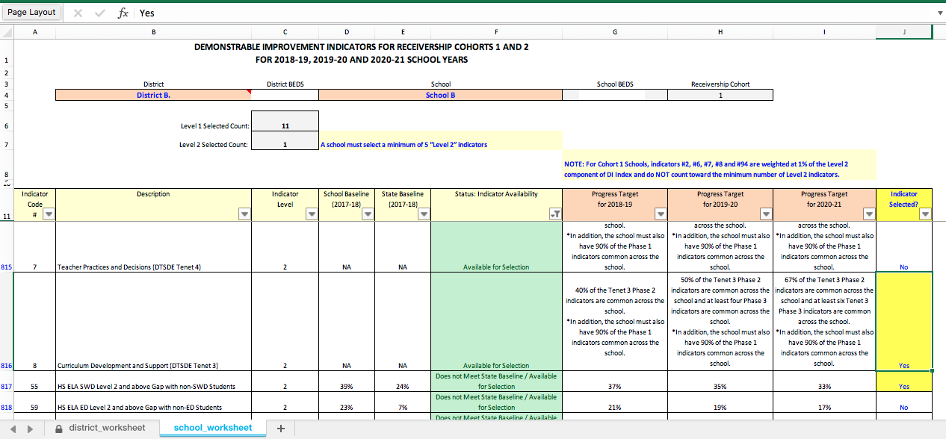
School Worksheet: Example School B
Cohort 1 Difference #1: How Indicators #2, #6, #7, #8, and #94 are weighted.
Message appears if Indicators #2, #6, #7, #8, or #94 selected
Indicator #2, #6, #7, #8, or #94 selected

Slide 45
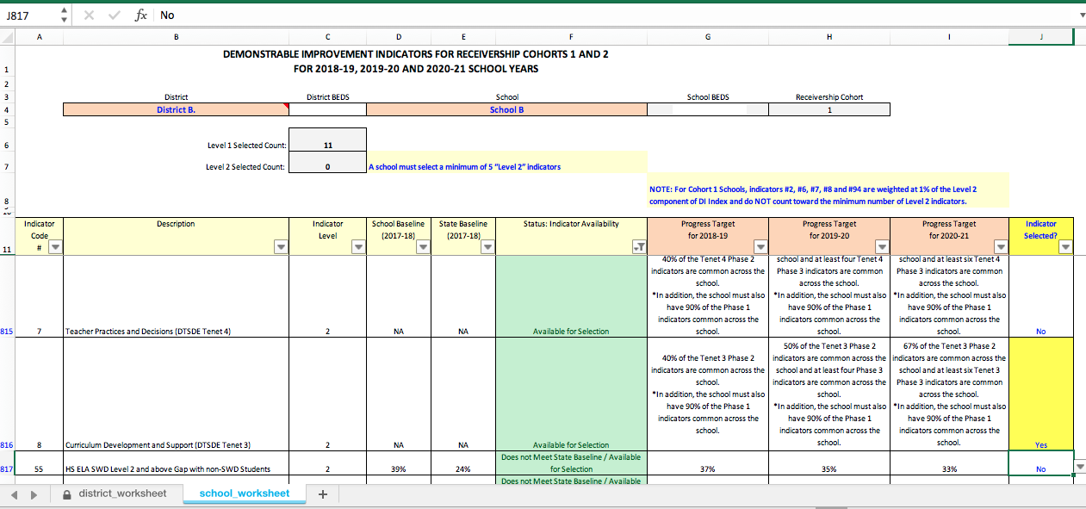
School Worksheet: Example School B
Cohort 1 Difference #2: How Indicators #2, #6, #7, #8, and #94 are counted.
For Cohort 1 schools Indicators #2, #6, #7, #8, and #94 do not count towards the minimum, but do count towards the maximum.
Indicator #8 Selected

Slide 46
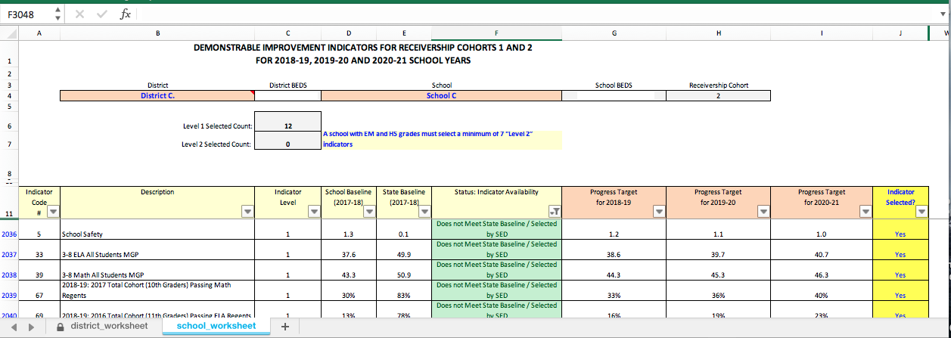
School Worksheet: Example School C
Schools serving both middle and high school grades require a minimum of 7 Level 2 Indicators.
All other selection rules apply.
Message providing guidance on minimum required selection of 7 Level 2 Indicators

Slide 47

School Worksheet: Notifications Glossary
Issue: More than 1 DTSDE Tenet selected (Indicators #6, #7, and #8).
Solution: Deselect one (or more) DTSDE Indicators.
&
Issue: Insufficient number of Level 2 Indicators selected.
Solution: Select additional Level 2 Indicators (except Indicators #2, #6, #7, #8, and #94 for Cohort 1 schools).
Issue: Maximum number of 10 Level 2 Indicators exceeded.
Solution: Deselect Level 2 Indicators to have no more than 10 indicators selected.
Issue: A reminder to Cohort 1 schools about the 1% weighting
for Indicators #2, #6, #7, #8, and #94.

Slide 48
School Worksheet: Provide to SED
After all indicators are selected:
Save the completed Excel template.
Print the list of selected indicators for each school and retain for your records.
Email the Excel template to accountinfo@nysed.gov by May 8, 2019.
Include the Template for Submitting District Proposed Local Indicators, if any (see Attachment B in April 3, 2019 letter).
Note:
Baselines and targets for indicators Student Attendance (#3) and Student Suspension Rate (#4) will be communicated later under separate cover.
Schools should not select these indicators until these indicators are confirmed as eligible (i.e., data are available and the school baseline does not exceed the state baseline).

Slide 49
Next Steps
Review the steps outlined in the April 3, 2019 letter and this presentation.
Consult the “Data Dictionary for 2018-19 to 2020-21” for additional details on DI Indicators.
Discuss the selected DI Indicators with the school’s Community Engagement Team.
For technical assistance with the Excel file, e-mail: accountinfo@nysed.gov.
Submit the Excel template with the selected indicators to accountinfo@nysed.gov by May 8th, 2019.
Submit local Indicator proposal(s) to accountinfo@nysed.gov by May 8th, 2019.
A recording of this webinar will be available at: http://www.p12.nysed.gov/accountability/de/SchoolReceivership.html

Slide 50
Questions?

Slide 51
Appendix

Slide 52
Target Setting: Overrides
Indicator Eligibility Overrides:
Proximity to State Baseline: The indicator is not available if there is too little room for growth over the 3 years.
Example: School A’s baseline for All Students 4-year graduation rate is 87% and the state baseline is 89% (gap = 2%). There is not enough room for at least 1% increase per year over 3 years. The indicator is not available.
Core Subject Performance Index vs. Weighted Academic Achievement Index¹: These indicators measure similar outcomes for each subject. Only the indicator with the larger gap between the school and the state baselines is available. Schools are assigned either the Core Subject or the Weighted Average Indicator for a subject, not both.
Example: School A’s baseline ELA All Students Core Subject PI is 58.5 and the state baseline is 128.5 (gap = 70 points). The school’s baseline ELA All Students Weighted Achievement Index is 48.5 and the state baseline is 108.5 (gap = 60 points). The Core Subject PI indicator is available and the Weighted Achievement Index indicator is not available.
¹ Core Subject PI and Weighted Academic Achievement Index calculations use the same formula in the numerator. For the denominator, the Weighted Academic Achievement Index uses the greater of: (1) # of continuously enrolled students who are tested, or (2) 95% of continuously enrolled students. The Core Subject Performance Index denominator is the # of continuously enrolled students who are tested.

Slide 53
Target Setting: Overrides
Progress Target Overrides:
Minimum Target Limit: If the gap closing formula produces a target increment that is less than the smallest acceptable increment, a minimum target increment limit is applied.
Example: School A’s baseline All Students 4-year graduation rate is 83% and the state baseline is 89% (gap = 6%). The Year 1 target increment is 1/12th of the gap, or .5%. This is less than the minimum acceptable target increment of 1%. Therefore a 1% target increment is used instead (Year 1 target = 83% + 1%). The same minimum limits are used for Year 2 and Year 3 target increments.
Maximum Target Limit: If the school baseline is too far from the state baseline, the gap closing formula can produce unrealistic targets. To ensure that targets remain achievable, a maximum target increment limit is applied.
Example: School A’s baseline Grades 4 and 8 Science All Students Core Subject PI is 70 and the state baseline is 210 (gap = 140 points). The Year 1 target increment is 1/12th of the gap, or 11.7 points. This is larger than the maximum Year 1 target increment limit of 5 points. Therefore a 5 point increment is used instead (Year 1 target = 70 + 5).

