Slide 1
Principal Preparation Project Advisory Team (Phase 2)
January 17, 2018

Slide 2
Agenda Item #1
Welcome by the Chairs
Suzanne Rosenblith
Reginald Landeau, Jr.
Gladys Cruz
Introductions

Slide 3
Agenda Item #2
Getting Oriented to the project and the day’s work
Reimbursement
Travel and schedule meeting time(s)
Lunch
Email addresses (OK to share within the Team?)
Affinity exercise
Take one post-it
15 words or less
What is the single biggest hurdle to achieving results we desire?
Post-its collected

Slide 4
Agenda Item #3
Key to our success
Turn to neighbors and consider the next slide
Discuss whether your views differ and why
Be ready to reflect on the “take-away” and implications for our work

Slide 5
People are poor because they make bad decisions. People make bad decisions because they are poor.
WHICH IS MORE LIKELY TRUE?

Slide 6
WHAT IS THE POSSIBLE TAKE-AWAY?

Slide 7
Possibly it is this . . .
NYU professor Kwame Anthony Appiah puts it this way.
We must hold 2 ideas in our head at the same time. We are all alike. We are all different.
Viewpoints may differ. The challenge is to see beyond differences to identify what we all believe in and value.

Slide 8
Agenda Item #4
What can the psychology of scarcity teach us about the challenge that the Commissioner has given us?

Slide 9
Poverty (& chicken or the egg) is from Sendhil Mullainathan
A behavioral economist, Mullainathan focuses on choice.
USAFA uses something in pilot training (Gen. Alan Klayton)
“Obstacles don’t define the path. Our response does.”
Mullainathan explores other phenomena (runway crashes)

Slide 10
THE PSYCHOLOGY OF SCARCITY

Slide 11
What happens when plane landings go awry . . . And what the implications are for our work

Slide 12
In WWII, the U.S. was plagued with unexplained bomber crashes. Often missions ended tragically and at the last possible moment. These involved landings on friendly home airfields located abroad. Inexplicably, pilots retracted the landing gear on touch-down.

Slide 13
The question is, why?
Was it carelessness?
. . . training?
. . . stress?
. . . fatigue?
. . . distractions?

Slide 14
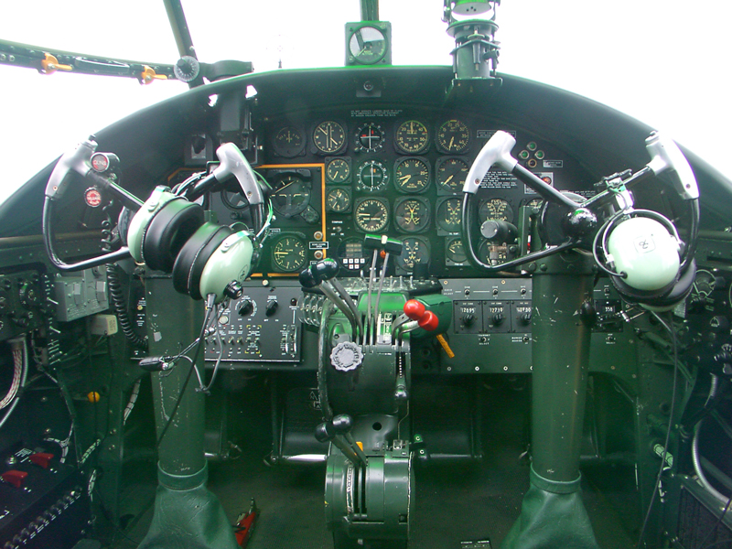

Slide 15
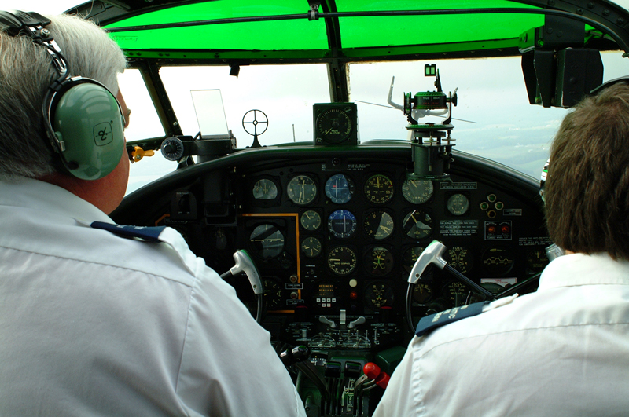

Slide 16
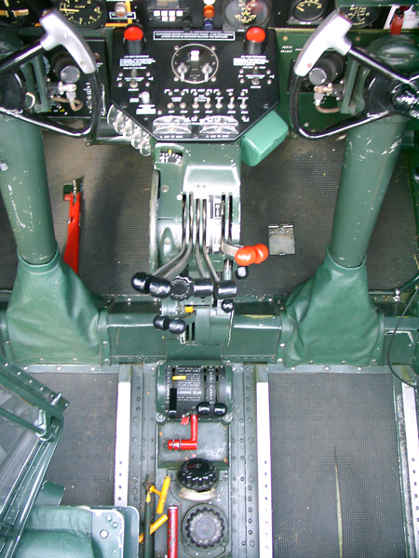

Slide 17
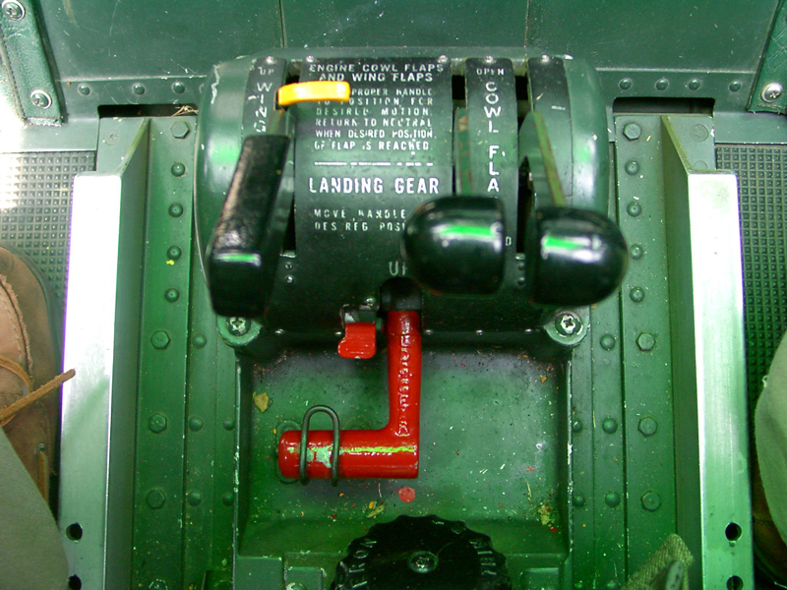

Slide 18
Ruling out other possibilities, officials finally surmised . . .
While stress and lack of sleep can alter cognitive function,
. . . the accident source may be linked to cockpit design.
With the source understood, solution was easy.
Small design tweaks reduced error that leads to tragedy

Slide 19
WHAT IS THE POSSIBLE TAKE-AWAY?

Slide 20
Possibly it is this . . .
To improve things we have tools at our disposal
But be cautious when deciding which tool to use
A hammer can help build a cathedral or tear it down
Focus on the wrong thing can hinder more than help

Slide 21
Or maybe it is this . . .
Avoid obvious solutions that focus on the wrong thing
Especially if solutions blame those we’re trying to help
Remember, people don’t fail; systems do

Slide 22
Or even possibly this . . .
The “choice architecture” matters.
How choices are presented affects decision-making.
The goal is simple.
Change choices without reducing freedom to choose.
Make small changes that yield big improvement.

Slide 23
Source:
S. Mullainathan and E. Shafir, Scarcity: The New Science of Having Less and How it Defines our Lives, 2013, p. 167-169
Sendhil Mullainathan
MacArthur Fellowship recipient
Professor of Behavioral Economics

Slide 24
Agenda Item #5: Logic Model
Objective:
Understand why we exist, what we do, and how we do it
Pitfall:
Looking for answers in all the wrong places
Three types of “wins”
An assist from Charlie Baum (Starting Point)
Data by Source display
What is the goal?
How do we know what we know about this topic?
Insight that surfaced
Three vignettes (page 53)
Toward a logic model

Slide 25
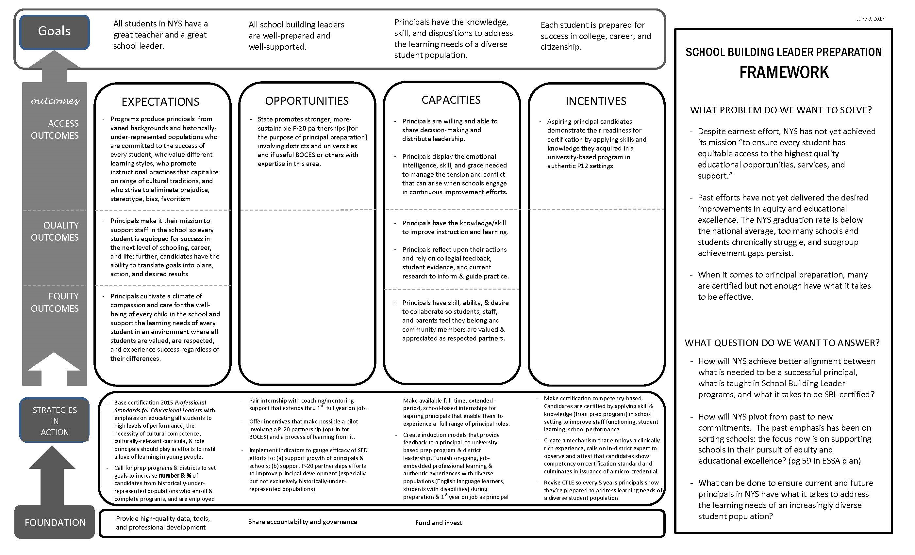
A Logic Model: Review the “placemat”

Slide 26
Agenda Item #6: How do we achieve consensus
At a trial’s outset, the judge wants to seat a jury.
The burden of proof is “beyond a reasonable doubt.”
Thus it matters whether jurors agree to be reasonable.
This is where the judge learns who stays and who goes.
But what does it mean to be reasonable?

Slide 27
Imagine we wanted to describe the ideal learning environment

Slide 28
Ideal learning environment
Didactic
Self-directed
Structured
Self-paced
Prescribed paced
Unstructured
“Other”-directed
Experiential

Slide 29
Ideal learning environment
Didactic
Self-directed
Structured
Self-paced
Prescribed paced
Unstructured
“Other”-directed
Experiential

Slide 30
Ideal learning environment
Didactic
Self-directed
Structured
Self-paced
Prescribed paced
Unstructured
“Other”-directed
Experiential

Slide 31
Ideal learning environment
Didactic
Self-directed
Structured
Self-paced
Prescribed paced
Unstructured
“Other”-directed
Experiential

Slide 32
Do I agree to be reasonable?

Slide 33
Do I agree to subordinate my self-interest so we can achieve together what no one of can achieve alone? (the aim here is find what you can live with and support, not what you view as ideal)

Slide 34
How will we achieve consensus?
Fist to Five (page 52)

Slide 35
Agenda Item #7: Why we’re here; what we do
Objective
Understand the mission, boundaries, and questions that animate our work
Daphne Koller
Four Phases of the Project
Work-Streams
Goal, Success Criteria, Charge, and Deliverables
Folder contents
Web site http://www/nysed.gov/schools/principal-project-advisory-team
Three thoughts from the 11-stop listening tour (page 37)

Slide 36
2 things matter; one is prominence, the other is resonance. For implementation to succeed we need both. I’ll explain. The Quality Review is very prominent (that’s good). But it does not resonate with those in the field (that’s bad). Prominence means it has a place of importance. It doesn’t sit on the shelf. The trick is to make it prominent without contaminating it because it is tied to something that doesn’t really lead to growth and improvement. So, the challenge for the state and us is to work together to make sure the Professional Standards for Educational Leaders resonate and are prominent . . . in a healthy way.

Slide 37
I think we need standards, not standardization. If we standardize around one approach a handful of people will fall through the cracks. The exact form of the (district-university) partnership will reflect the kind of community being served. What we need is standards but enough flexibility in the system that we’re responsive to the local community’s needs.

Slide 38
I want to return to standards and standardization. I ask us to think about and commit to making sure we keep a clear focus on one thing. That is equity. Through the transition, will or how will these standards and/or standardization impact equity? It is easy to say implementation matters. What really matters today is that equity is advanced.

Slide 39
Review our process to reach consensus
Fist to Five
The goal is to something that every member can live with and support.
When co-chairs call a question, members show hands to show support.
Those who hold up 3, 4, or 5 fingers support the option
2 fingers means “I cannot live with it ‘as is’”
1 finger means “A larger reservation prevents me from supporting it”
Showing a fist means “I cannot support it, as a matter of conscience.”
Note: Options that are forwarded enjoy consensus support. For these, every Team member shows 3, 4, or 5 fingers. Those who show a fist, 1, or 2 fingers will be asked, “What would it take to make this something you can live with and support?”

Slide 40
Agenda Item #8: How do we what we do?
Operating agreements
Approved minutes reflect official account of our work and our meetings.
Jointly support what we help create.
Consensus recommendations move forward.
Reach consensus using an established process.
Our meetings are held in public but they are not meetings of the public.
“No stripes”, members and their contributions are valued equally.
OK to miss 1 meeting (we support decisions made in our absence).
Fist to Five

Slide 41
Agenda Item #9: Housekeeping
How do we avoid “mission creep?”
Lock in agreements, record in minutes, post prominently.
Cross each bridge once (avoid revisiting decided issues).
Use “Parking Lot” to trap promising ideas beyond our charge
Avoid trying to cure world hunger
Fist to Five

Slide 42
Agenda Item #10: Working lunch
Stretch, gather lunch, and visit
Be ready to start in about 30 min.
When the video ends, we’ll re-convene

Slide 43
Agenda Item #11: Consensus-building
Take out a single Post-it. Write the letter that best reflects your answer to the following:
You’re elected to Congress. At the newcomer orientation, the facilitator asks you to respond to a one question. When comes to deciding on an issue, to whom or what will you be loyal?
Those from your district who voted for you
All those from your district who voted, including those who did and did not vote for you
Not just those who voted but everyone in your district with a pulse (even children)
Your own conscience
All of humanity
The planet
Future generations
Something else (name it)
Collect Post-its.
Members turn to neighbors and compare notes (try to reach as much consensus as you can; be ready to report out)
As a whole group, see how many and which threesomes could reach agreement
In whole group, respond to
What if anything surprised you?
If you weren’t surprised, why not?
Be ready to reflect on the “take-away”

Slide 44
More consensus-building
Take out a single blank piece of paper.
Draw a large pentagon (flat base, peak pointed upward).
Place each of the following at one of the vertices. Places a word so its location corresponds to its importance relative to the others.
- Truth-telling
- Respect for property
- Equity
- Justice
- Respect for life
Turn to your two neighbors and compare notes (try to reach as much consensus as you can; be ready to report out)
Be ready to name a “take-away” & implications for our work

Slide 45
Agenda Item #12: Where do we start?
Return to Affinity Exercise from opening. Each member used 15 words to describe biggest hurdle to achieving results we desire.
Display how results distribute conceptually.
Refer to member responses to online MonkeySurvey (page 10)
This richness of ideas reflect the range of opinion in our team.
The question is, Where do we begin? How do we sort it out?
How do we make sense of it in a way that leads to high ground?
Distribute MonkeySurvey responses that have been classified
Describe who Bob Terry was, what he did, and the framework.

Slide 46
Agenda Item #13: Ladder on the right wall?
Work on your own
Review 2 areas (principal supervisors & competency based)
Categorize entries using mission/power/structure/resource
Turn to neighbors to form a group of three. Compare notes. Try to reach as much agreement as you can.
Each group of three joins with another group of three. Compare notes. Reach as much agreement as possible
Place on chart paper the entries for each of the two areas that are a related to mission.
Be ready to report out

Slide 47
Agenda Item #14: Moving into small groups
Form 5 small work groups, each focused on aspect of our charge
Distribute reading material for each small group
Identify the most obvious/important policy implications (in the form of a question)
As an example, for competency-based it may be:
How will we know changes that are made improve performance of individuals, institutions, and system?
How will comparability of judgments across person, institution, and year be achieved?
How do we stay legal (IHEs must be accredited) while transitioning to a different set of requirements?
How will we support growth of ppl & institutions yet make defensible judgments re quality & adequacy?
Within existing resources how can incentives be used to multiple impact and accelerate improvement?
How do we decide which changes we propose are uniformly expected across NY and which will be flexible?
Record questions on chart paper
Discuss (a) options for next steps; (b) help you want from your Phase 2 teammates; (c) how you want to proceed at the next meeting.
Be ready to report out to the whole group

Slide 48
Agenda Item #15: Reconvene as whole group
Each group report out

Slide 49
Agenda Item #16: Evaluate the meeting

Slide 50
Next Meeting Reminder and Adjourn
Schedule for future meetings
Jan. 31, 2017
Feb. 28, 2017
Mar. 21, 2017
ADJOURN

