Slide 1
Ossining Leadership Pipeline
Presentation to Principal Project Advisory Team
January 25, 2017

Slide 2
About us…
Ray Sanchez, Superintendent
FSLA graduate
EdD
UCEA recognition
Nancy de la Cruz-Arroyo, Supervisor of Early Childhood & Funded Programs

Slide 3
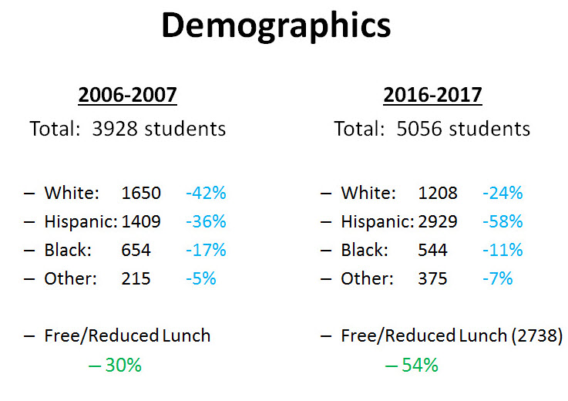
About the Ossining Union Free School District

Slide 4
About the Ossining Union Free School District
Educationally
Princeton Plan
Early Literacy/Family Literacy Program
Full-Day Pre-Kindergarten
Dual Language Programs
Science Scholars
Full-Service School Model
Secondary/Post-Secondary partnerships

Slide 5
Building blocks for educational leadership
Cultivating teacher leadership
District-based leadership development
Sustained professional development
Strengthening Teacher & Leader Effectiveness Grants
FSLA as formal leadership preparation
Promoting promising candidates
Creating leadership opportunities as part of preparation
Action Collaborative Network

Slide 6
STLE Effective Practices Career ladder pathway models for teachers and leaders
Clearly define and align professional development expectations for teacher and principal leaders.
Develop and implement a refined human resources management process to ensure high quality teacher and principal leaders.
Build supportive communities of leaders and provide opportunities to develop and share expertise, thereby building capacity and extending the influence of the most effective educators throughout the district
Partner with local IHEs dedicated to building teacher and principal leaders

Slide 7
About Future School Leaders Academy
Support structures
Advisement
Cohort
Internship
Two years, 600 hours
Building and district levels
Course Content
30 credits
Standards-based, thematic
Conference group
Integrates theory and practice
Districts, BOCES, Bank Street College partnership
Superintendent nominated candidates
Shared tuition costs
Advisory board structure
Standards-based
Application and assessments
Applied assignments and projects
District case study and action research project
Portfolio of standards-based accomplishments

Slide 8
FSLA track record
Cohort years 3 | Number of candidates prepared | Number ever advanced into certified leadership positions | Current school and district leaders
1999-2005 | 5 | 4 | 3
2005-2007 | 0 |  | +1
2007-2009 | 1 | 0
2009-2011 | 0
2011-2013 | 2 | 2 | 1
2013-2015 | 3 | 3 | 3
2015-2017 | 3 (on track to graduate)
2017-2019 | 3 (nominated)

Slide 9
Ossining school and district leaders
Role | Total number | Number FSLA prepared
Assistant principals and other certified building level leaders (not principal) | 7 | 2
Principals | 6 | 3
Central district supervisors and assistant superintendents |  | 2
Superintendent | 1 | 1
Total |  | 8

Slide 10
Scenario: 2015-2016 School Year
Scenario 1 | Scenario 2
3 Administrative Vacancies | 2 Administrative Vacancies
Principal | Director of Technology
2 Assistant Principals | Elementary Principal
All filled by District FSLA candidates | All filled by FSLA candidates (1- district supported, 1- out-of-District)

Slide 11
How FSLA program benefits Ossining
Two-year program with a strong student-centered approach to school improvement and leadership that complements the district’s approach
Strong equity focus that prepares candidates to investigate learning opportunity disparities and explore solutions through action research
Two-year concurrent internship experience, that enables candidates to apply coursework to field work experiences in their schools
Draws on local district experiences and priorities and state policy developments in curriculum and field work planning, through the advisory committee continuous improvement process

Slide 12
How Ossining benefits FSLA
Advisory committee input
Superintendent teaches in the program (Supervision and Professional Development)
Makes district initiatives available as learning experiences for conference group seminars
Partner in grant pursuits
TLQP
STLE

Slide 13
Role of TLQP funding in supporting Ossining Leadership development pipeline
Three three-year grants (federal Title II-a funding) in partnership with Bank Street College, PNW BOCES and three other districts
Provides tuition support for 2-3 candidates per cohort, over two years (almost 60% of the total tuition costs)
Provides release time funds for 2-3 candidates per cohort, over two years (equivalent to .2 FTE per year)
Provides experts for leadership development institutes that address regional equity priorities

