Slide 1
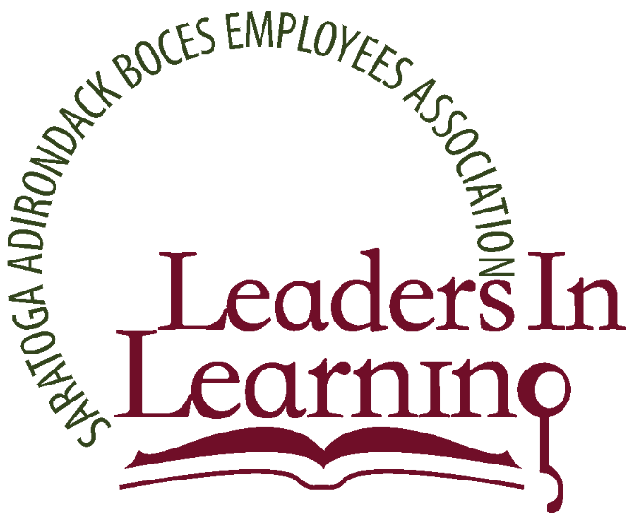
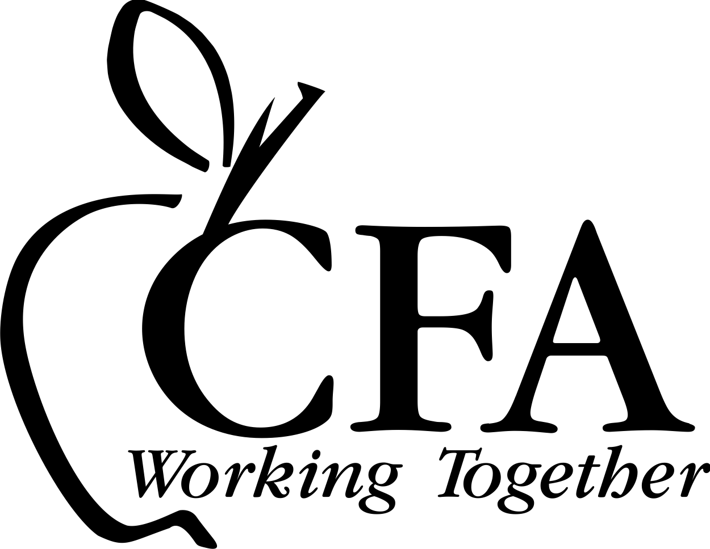
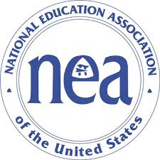
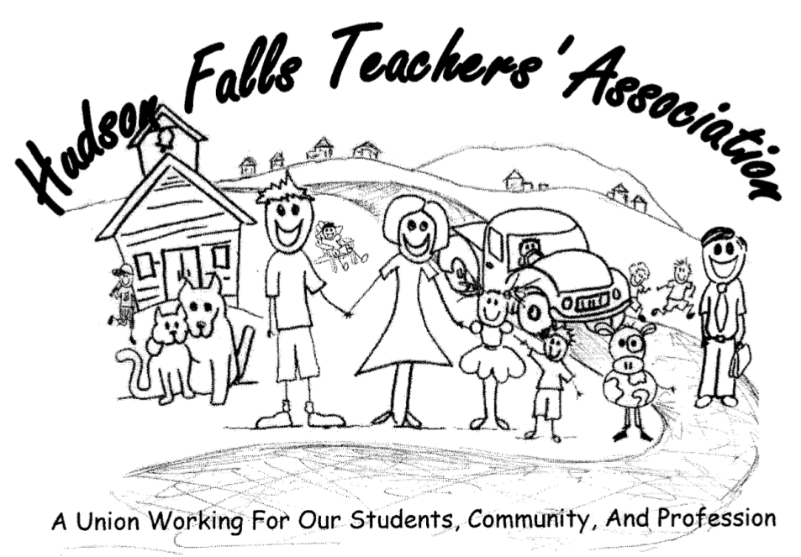
Cambridge Faculty Association,
Hudson Falls Teachers Association, and
Southern Adirondack Board of Cooperative Educational Services (BOCES) Education Association
in Partnership with:
SUNY Plattsburgh @ Queensbury, the Cambridge Central School District, Hudson Falls Central School District, and WSWHE BOCES
The Classroom Academy: A Residency Model for Teacher Preparation
This program is made possible through funding by an NEA Center for Great Public Schools grant.
Award: November 2016

Slide 2
In the next decade,
conservative estimates say the U.S. will hire more than 1.5 million new teachers in our schools.
-Jenny DeMonte, PhD.
“A Million New Teachers are Coming, Will They be Ready to Teach?”
Ed. Policy Center at American Institutes for Research, 2015.

Slide 3
The Importance of Partnership
Teacher
Preparation
Notes:
Cambridge Faculty Association
Hudson Falls Teachers Association
Southern Adirondack BOCES Education Association
Cambridge Central School District, Hudson Falls Central School District, WSWHE BOCES
SUNY Plattsburgh @ Queensbury
New York State United Teachers (NYSUT)
National Board Council of New York (NBCNY)
New York State Education Department
Greater Capital Region Teacher Center
Capital Area School Development Association
National Board for Professional Teaching Standards
Adelphi University
National Education Association Center for Great Public Schools

Slide 4
Notes:
We started with a Planning Grant and brought all these partners together to identify the problem and develop a change idea.

Slide 5
Current student teacher model
This also, limits retake opportunities for the edTPA (an assessment portfolio)
Most colleges in NYS require two, eight week student teaching placements.
The problem with this model is it does not allow our teacher candidates to fully address the 7 NYS Teaching Standards or honor the complexity of teaching.
Knowledge of Students and Student Learning Knowledge of Content and Instructional Planning
Instructional Practice
Learning Environment
Assessment for Student Learning
Professional Responsibilities and Collaboration
Professional Growth
Notes:
Add retention statistics

Slide 6
Previously under the STLE grants,
Cambridge co-wrote and piloted a waiver with SUNY Plattsburgh to place teacher candidates in one, 16 week placement.
This new program builds on that learning & positive feedback from teacher candidates.
Notes:
We discovered our candidates felt they were way ahead of their peers when preparing for the edTPA because they had the opportunity to know their students, plan accordingly, and not lose valuable time transitioning to a new class, teacher, and system.

Slide 7
Teaching is a complex act. Danielson (1996) estimates that a teacher makes more than 3,000 nontrivial decisions every day. No list can capture the extraordinary subtlety involved in making instant decisions about which student to call on, how to frame an impromptu question, or how to respond to an interruption. The late Madeline Hunter compared teaching to surgery, “where you think fast on your feet and do the best you can with the information you have. You must be very skilled, very knowledgeable, and exquisitely well trained, because neither the teacher nor the surgeon can say, ‘Everybody sit still until I figure out what in the heck we're gonna do next’” (Goldberg, 1990, p. 43).
Goldberg, Mark F. “Ch 26 The Qualities of Great Teachers”. Keeping Good Teachers, Editor: Marge Scherer.
Notes:
Honors the complexity of teaching
statistics

Slide 8
The Problem
We are Trying to Solve

Slide 9
Positively impact student experience and performance by:
Increasing the number of clinically-rich hours teacher candidates will spend in classrooms in three partner districts, under the attendance of a high quality master/attending teacher, from 16 weeks to 40 weeks in 2017-18, and 80 weeks in 2018-19 with an increase of 100% of participating regions and schools in 2019-2020.

Slide 10
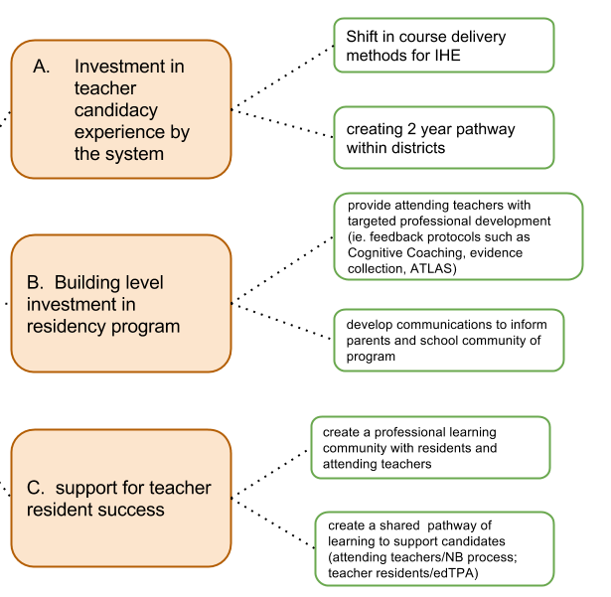
Identifying the “How”

Slide 11
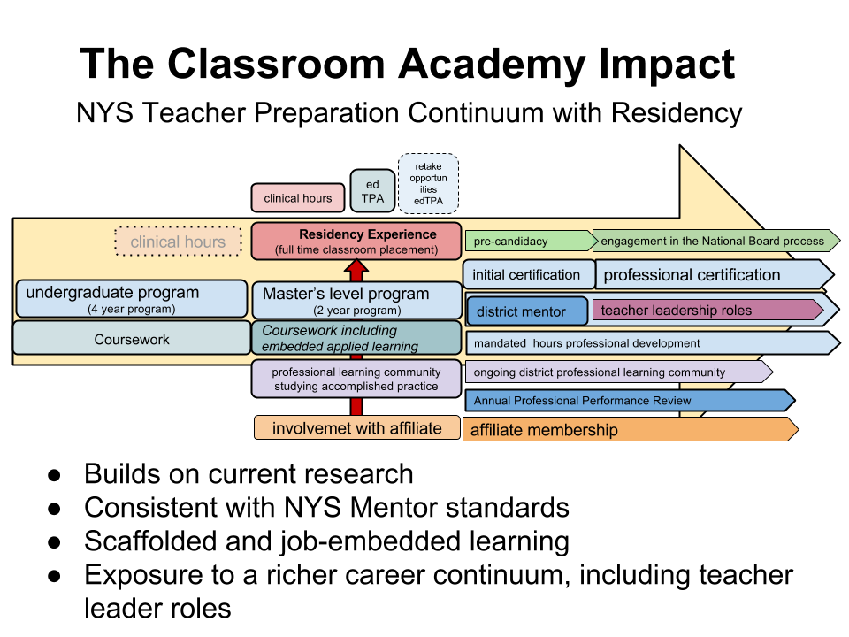
DRAFT
DRAFT
DRAFT

Slide 12
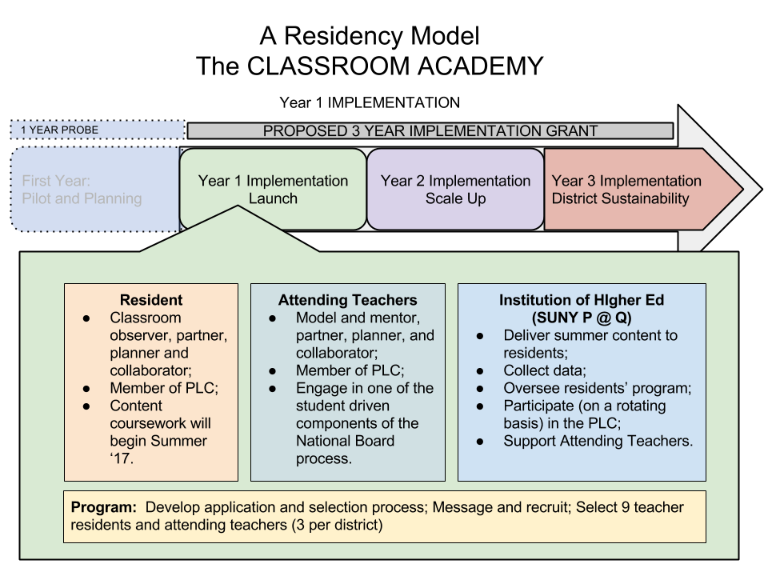

Slide 13
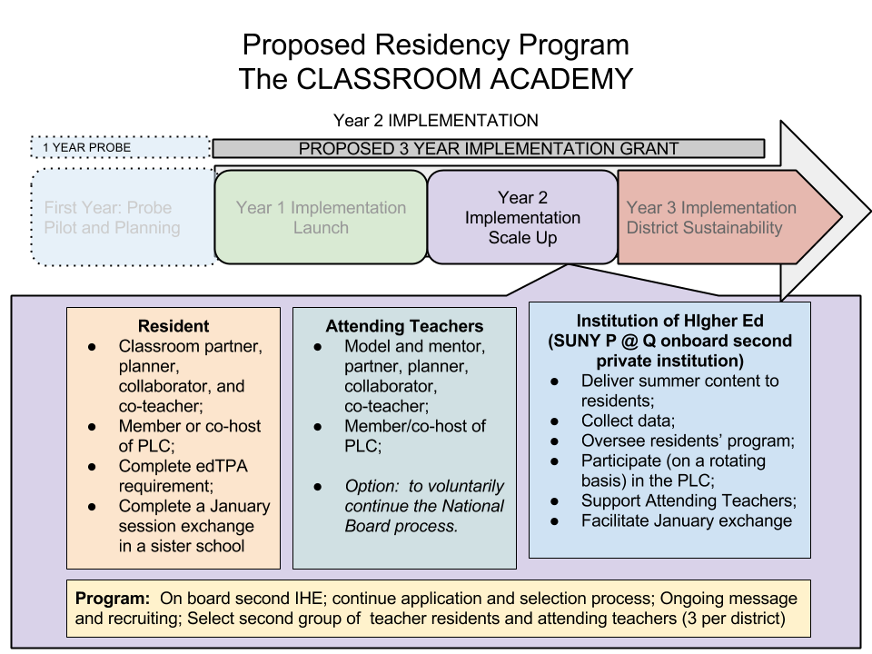

Slide 14
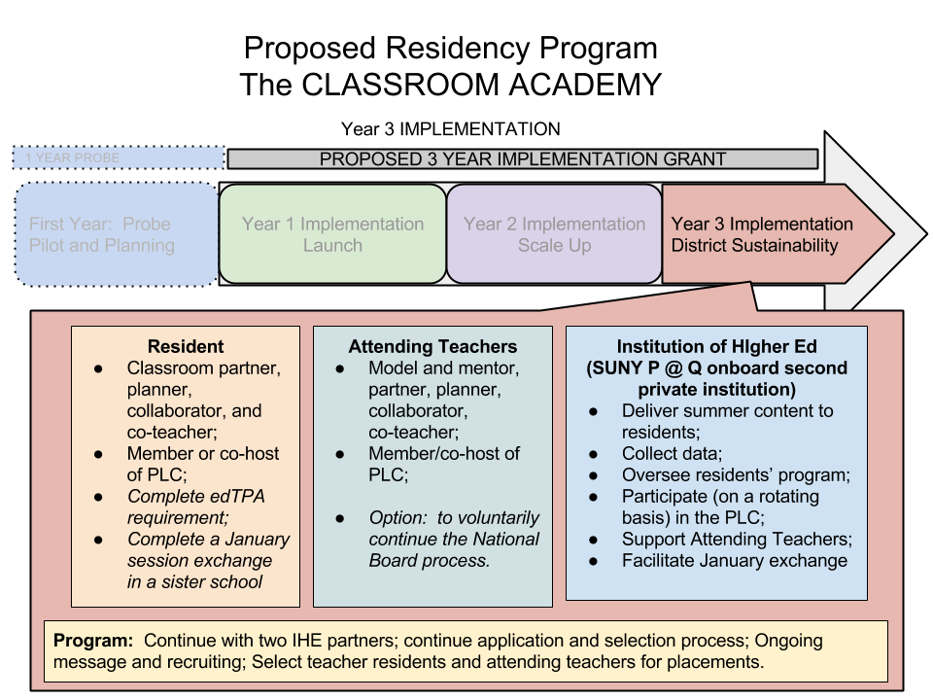

Slide 15
SUSTAINABILITY
The Clinically Rich models developed, by IHEs, under RTTT, disappeared with the funding.
So to build in sustainability, without grant funding, we have worked with our BOCES partner to submit a Contract for Shared Services on the P-12 side. This CoSer will allow districts to develop a revenue stream through the BOCES reimbursement model to provide a revenue stream to
continue the program.

Slide 16
ELEVATING
THE PROFESSION
through partnership and innovation.

