Slide 1
Principal Project Advisory Team
May 1, 2017

Slide 2
Agenda Item #1: Welcome & Objectives
Meeting objectives
Understand what has happened since we last met
Recognize feedback we received from focus groups and surveys occurring March 3 - April 10
Consider Deans’ view of Professional Standards for Educational Leaders (online survey)
Decide whether to approve additional beliefs based on “Fab 5” revisions
Review online survey results showing Adv Tm reaction to breakout group recommendations
Compare March 22 draft of breakout group recommendations to consolidated May 1 draft
Decide if discrepancies exist between March 22 draft and May 1 draft; if so reconcile them
Use “Fist to Five” to identify how many/which recommendations enjoy consensus support
Understand plans in place to gather stakeholder feedback (May 2 – May 15)
Confirm (or adjust as needed) process to reach consensus recommendations May 31, 2017
Either accept “as is” or make needed change to the minutes from meeting #5 (Mar 22, 2017)

Slide 3
Our Aim for Today Agenda Item #2: Identify recommendations that have the potential to enhance principal preparation

Slide 4
Setting the tone
On March 22, emphasis began to shift from “me” to “we”
That continues today
We take another step
We merge breakout group recommendations into 1 draft

Slide 5
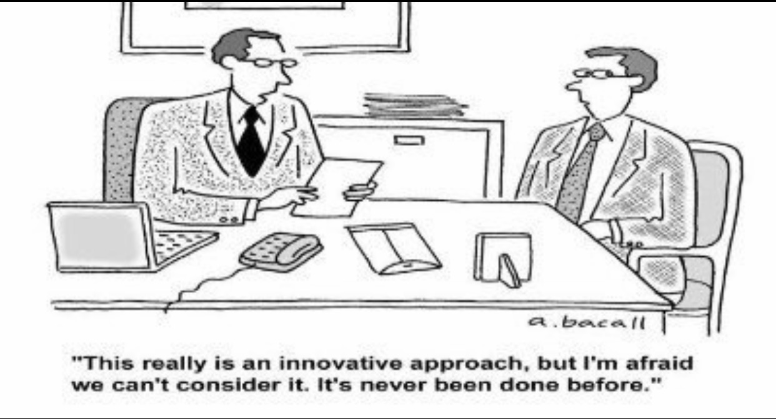

Slide 6
Keys to today
Be open-minded
But not so open-minded that our brains fall out
Seek to understand before advocating
Live up to agreements we made to ourselves 8 months ago

Slide 7
More specifically . . .
On Sept. 22, 2016 we all considered were invited to answer a single question:
“To achieve more than anyone can alone do we each agree to be reasonable?”
Each of us agreed.
As a team, we approved norms.
Forward recommendations that we reach by consensus
Show we’re reasonable by accepting and supporting proposals we can live with and not just those that are ideal (i.e., be flexible in our thinking)
If initially -- as a matter of conscience -- we can’t support a proposal, we agree to state what would make it something we do support

Slide 8
Agenda Item #3: What Happened Since we Last Met
What has happened since we last met
NYSED is expected to invite public comment on NYS draft ESSA plan (next week)
High-concept paper submitted on our behalf is included in draft ESSA plan for NYS
The last of 22 focus groups occurred in the Bronx, Queensbury, and Yonkers
235 individuals responded to a paper and pencil survey conducted Mar-April, 2017
Ed School deans completed a survey related to Prof’l Standards for Educ’l Leaders
Alignment studies done gauging whether SBL exam covers content/skills from PSELs
Metropolitan Council for Educational Administration Programs provided input
Advisory Team member Michelle Young has indicated that NELP recommendations (related to standards for programs to prepare school building leaders) will be sent to CAEP this summer and should be ready for use January 2018
Presentation is due to be made on this topic to NYS Board of Regents May 8, 2017

Slide 9
Housekeeping
Accept “as is” or suggest needed changes to:
Minutes from fifth Advisory Team meeting (Mar. 22)
Agreements reached & Transcription of Notes (Mar. 22)

Slide 10
Agenda Item 4: Graphs Showing Belief Statements
Seven beliefs have been approved by consensus
Purpose
Instruction
Shared Decision-Making and Shared Leadership
Continuous Improvement & Change Management
Equity
Value Diversity
Collaborative Partnership
Five beliefs are still under consideration
Innovation
Reflective Practice
Shared Responsibility for Feedback
Skillful Practice Under Authentic Conditions
Program Admission
Figure 1 shows level of agreement with a statement, “These are an important foundation for principal certification.” (235 respondents)
Figure 2 shows level of agreement with a statement, “I support these in concept.” (235 respondents)

Slide 11
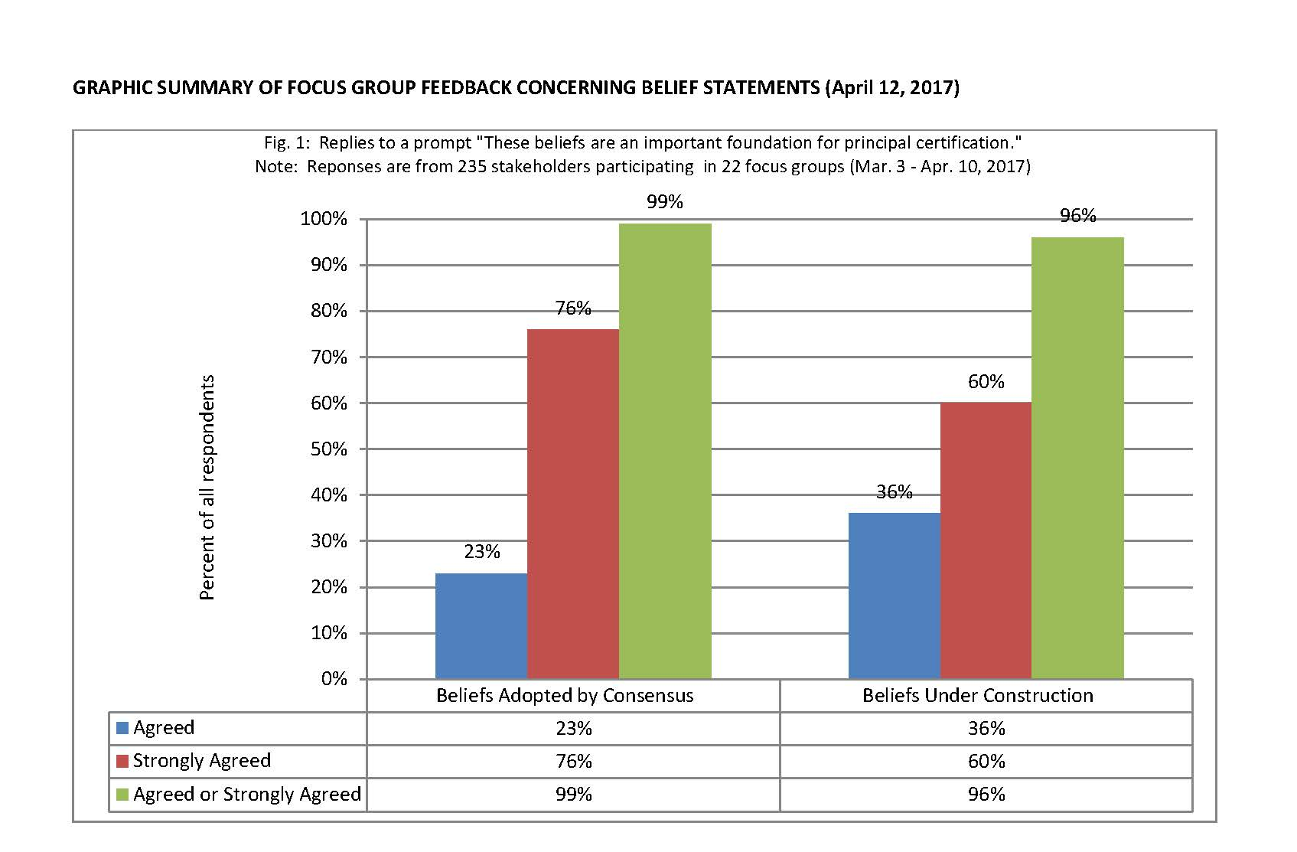

Slide 12
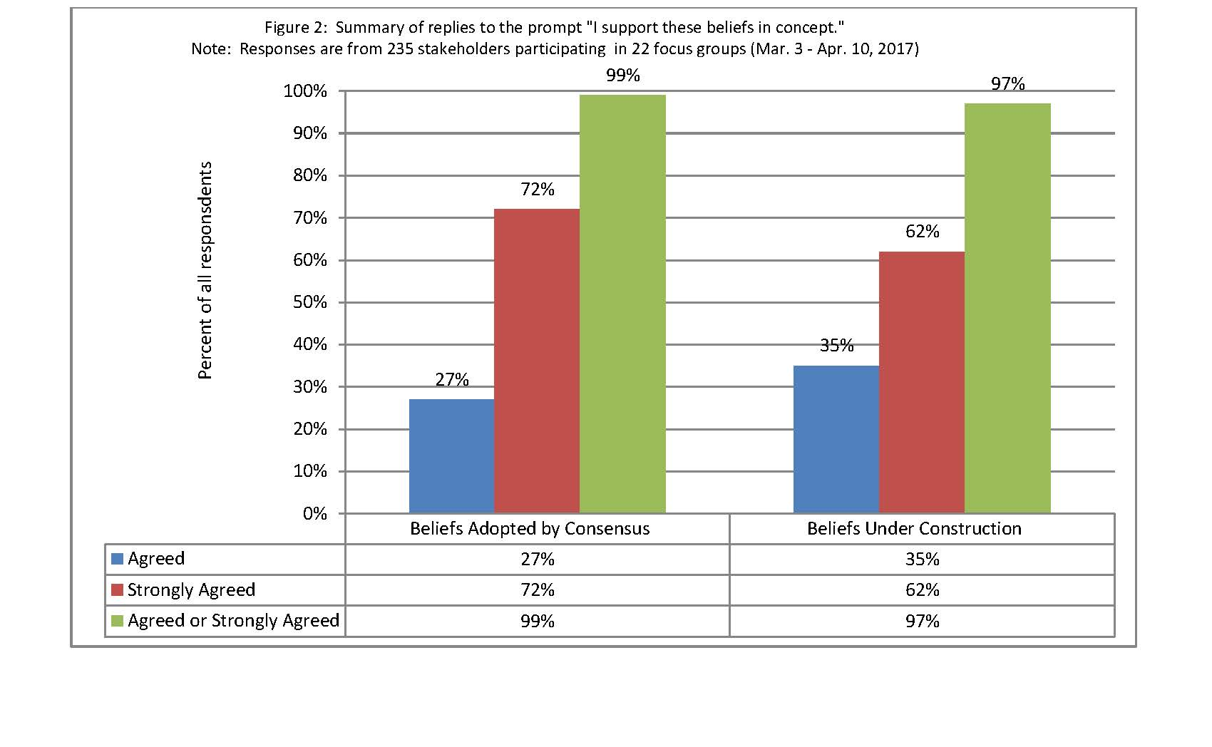

Slide 13
Agenda Item 4: Graphs concerning Recommendations
Graphs 3-13 show level of support for draft recommendations (235 respondents)
For each draft recommendation, three questions were posed
Of what importance is this recommendation?
Of what value is this to the initial certification of principals?
Which best describes your support for this recommendation?
Choices available to the respondents included:
None
Little
Moderate
Great

Slide 14
Agenda Item 5: Fab 5 Delivers on Belief Statements
Shout out to the Fab 5
John Blowers (P12-Higher Ed Partnership)
Lynn Lisy-Macan (Authentic Experiences & the Internship)
Grace Barrett (Professional Learning and Ongoing Support)
Kathleen Feeley (Diversity)
Larry Woodbridge (Standards)
A brief word about the process (Kathleen Feeley)

Slide 15
Review our process to reach consensus
Fist to Five
The goal is to something that every member can live with and support.
When co-chairs call a question, members show hands to show support.
Those who hold up 3, 4, or 5 fingers support the option
2 fingers means “I cannot live with it ‘as is’”
1 finger means “A larger reservation prevents me from supporting it”
Showing a fist means “I cannot support it, as a matter of conscience.”
Note: Options that are forwarded enjoy consensus support. For these, every Team member shows 3, 4, or 5 fingers. Those who show a fist, 1, or 2 fingers will be asked, “What would it take to make this something you can live with and support?”

Slide 16
Call the question on revised beliefs
Team members indicate level of support for each belief

Slide 17
Agenda Item 6: Gauging Reaction of Advisory Team Colleagues to Breakout Team Recommendations
Turn to the last item in your folder
Authentic Experiences (96% Agree or Strongly Agree)
Standards (91% Agree or Strongly Agree)
Diversity (91% Agree or Strongly Agree)
P12-Higher Education Partnership (87% Agree or Strongly Agree)
Prof’l Learning/Ongoing Support (78% Agree or Strongly Agree)

Slide 18
Agenda Item 7: Discrepancy Check
Compare March 22 draft to May 1 merged draft
Re-arrange your chairs so you can confer as a breakout group
Compare 2 documents (note big discrepancies on chart paper)
Decide if adjustment needed (if so, record it on chart paper)
Be ready to report out

Slide 19
Agenda Item 8: Closing in on Recommendations
Reform as a whole group
Fist to Five
Whole group discussion

Slide 20
Agenda Item 9: Process going forward
Unless the Advisory Team reaches a different understanding today, then on May 31, 2017, we move point by point through recommendations and use Fist to Five to identify those embraced by consensus
We move ahead with those recommendations agreed upon by consensus of those participating on May 31, 2017
We forward recommendations verbatim
Explanatory language will be added to describe the process used

Slide 21
Next Meeting Reminder & Adjourn
Schedule for final meeting (11:30 am - 2:30 pm)
May 31, 2017 (approve entire set of recommendations)
ADJOURN

