Slide 1
Principal Project Advisory Team
January 25, 2017

Slide 2
Agenda Item #1: Greetings/Introductions
Meeting objectives
  Reach consensus on belief statements
  Identify efforts to create nat’l standards for programs that prepare building leaders
  Learn what is working well nationally and in NYS related to educator preparation
  Refine the recommendations that are emerging in our five breakout group areas
Those participating via WebEx are in a group titled “Professional Learning and Support”
What has happened since we last met
  Advisory Team completed online Monkey-Survey on beliefs (Jan. 10 - 18)
  Subgroup of the ESSA Think Tank approved our “High-Concept Paper” (Jan. 17)
  US DoE forgoes to issue new rules on “supplement vs supplant” (Jan. 18)
  US DoE places 60-day hold on regulations related to ESSA accountability (Jan. 20)
  Survey of Regents underway on 2015 Prof’l Standards for Educ’l Leaders (til Feb. 10)

Slide 3
Contents of Your Packet

Slide 4
Packet Item #2: Mann Gulch and “Escape Fire”
1-min video tells how an out-of-control forest fire led to a tragic loss
1-min follow up video describes the implications for health care
The clips set the tone for brainstorming session later in the meeting

Slide 5
Packet Item #4: Nov. 30th Attendance, Minutes, Notes
Accept “as is” or suggest needed changes to:
Minutes from third Advisory Team meeting (Nov 30)
Agreements reached & Transcription of Notes (Nov 30)

Slide 6
Packet Item #5: Organization of Breakout Groups
Revised to:
Identifies current membership in each breakout group
Reflects the language of current belief statements
Shows beliefs that are approved and those under construction

Slide 7
Packet Item #6: Timeline for Principal-ship Policies
Contains
Top 3 Rows: Nat’l activity related to certification & accreditation
Bottom 3 Rows: Activity within NYS related to the topic

Slide 8
Packet Item #7: Excerpts from the Literature
Selections that correspond to work underway in breakout groups

Slide 9
Packet Item #8: Graphs Showing Belief Statements
Two beliefs have been approved by consensus
Value Diversity: Effective principal prep programs recruit and produce aspiring leaders from varied backgrounds and historically-under-represented populations who are committed to the success of every student, who value different learning styles, who promote instructional practices that capitalize on a range of cultural traditions, and who strive to eliminate prejudice, stereotype, bias, and favoritism
Continuous Improvement: Well-prepared school building leader candidates display the emotional intelligence, skill, and grace needed to manage tension and conflict that can arise when schools engage in continuous improvement efforts
Four earned widespread support (>90% agreed/strongly agreed)
Instruction
Purpose
Equity
Shared Decision-Making and Shared Leadership

Slide 10
Aim today
Focus on beliefs enjoying the greatest support
“Call the question” on which we can accept
Strive in future meetings to bring back revised language for remaining six beliefs (for consideration)
Continue until we find we have a set that is fully supported beliefs

Slide 11
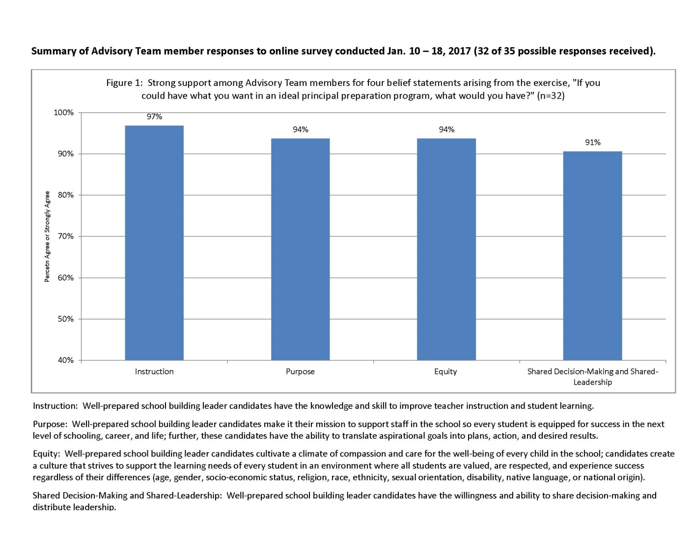

Slide 12
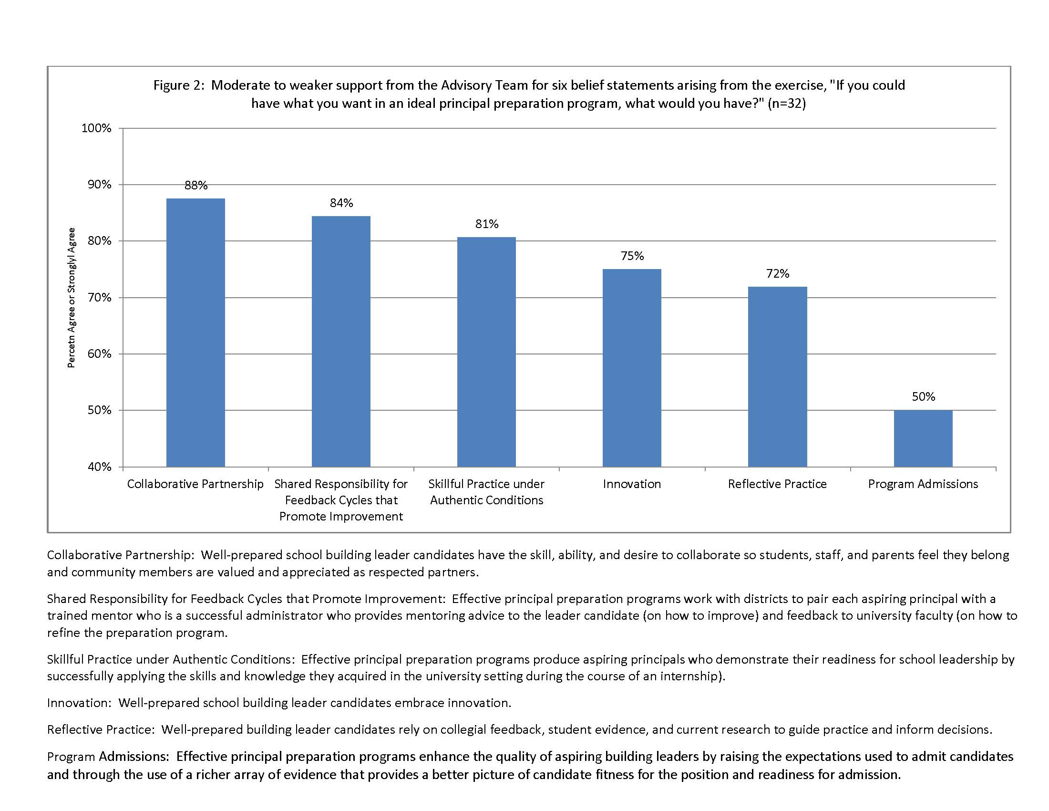

Slide 13
Agenda Item #2: Old Business
Review the Bidding
We started by asking one question about principal prep
“If you could have what you want, what would you have?”
Themes that emerged were framed as belief statements
Our aim is to identify where we have consensus on beliefs.
So it helps to approach each statement with one thought.
“Can I live with (and support) the revised language?”
Turn to your neighbors within your breakout group.
Consider if you can agree today to accept these four beliefs “as is”
Be ready to use “Fist to Five” to show your support

Slide 14
Review our process to reach consensus
Fist to Five
  The goal is to something that every member can live with and support.
  When co-chairs call a question, members show hands to show support.
  Those who hold up 3, 4, or 5 fingers support the option
  2 fingers means “I cannot live with it ‘as is’”
  1 finger means “A larger reservation prevents me from supporting it”
  Showing a fist means “I cannot support it, as a matter of conscience.”
Note: Options that are forwarded enjoy consensus support. For these, every Team member shows 3, 4, or 5 fingers. Those who show a fist, 1, or 2 fingers will be asked, “What would it take to make this something you can live with and support?”

Slide 15
Packet Item #9: Table Comparing States on PSELs
According to this limited survey, thus far 6 states have modified their leadership standards to conform with the 2015 Professional Standards for Educational Leaders.
In addition to NYS, another 12 states plan to undertake the kind of review we are currently conducting (this includes Iowa).

Slide 16
Packet Item #10: High Concept Paper
This document captures several of the ideas we are considering.
It has received approval from a sub-group of the ESSA Think Tank and will be considered by the full Think Tank later this week.
If embraced by the Think Tank, the paper will make its way to the NYS Board of Regents.

Slide 17
Agenda Item #3: Update on Nat’l Efforts
Welcome Michelle Young
Advisory Team member
Executive Director, University Council for Educational Administration

Slide 18
Agenda Item #4: Expanding the universe of possibility. . .
You have 3 minutes for this part of the brainstorming activity
Take a post-it
Work silently and on your own
Answer the question,
What is the boldest possible way to improve school leader preparation?
Record as many possible “bold ways” as you can (one idea per post-it)
Turn to your neighbors and compare notes
Be ready to report out on at least one bold way

Slide 19
Agenda Item #5: Learn What Works
Welcome each of our presenters
15 minutes per presentation (includes any Q&A)

Slide 20
Agenda Item #6: Breakout Group Meetings
Convene in breakout groups
Record any consensus findings
Group leader be ready to report out (60 sec summary)

Slide 21
Next Meeting Reminder & Adjourn
Schedule for future meetings (11:30 am - 2:30 pm)
  Feb. 22, 2017 (each breakout group presents draft recommendations to whole group for feedback)
  Mar. 22, 2017 (finalize draft recommendations)
  Apr. 12, 2017
  May 31, 2017
ADJOURN

