Slide 1

P-TECH Summary Data Request
Cohort 1, Classes 1 and 2
Cohort 2, Class 1

Slide 2

Summary Data Query Using Online Forms
Separate Forms for:
Cohort 1, Class 1,
Cohort 1, Class 2,
and
Cohort 2, Class 1

Slide 3

Summary Data is Sought from Cohort 1 and Cohort 2 projects
The data request focuses upon student outcomes.
Thus, only three classes are under study—Cohort 1, Classes 1 and 2, and Cohort 2, Class 1.
Outcome measures’ data sought are graduation/completion counts and college credits earned.
Also, annual enrollment counts and institution data is needed.

Slide 4


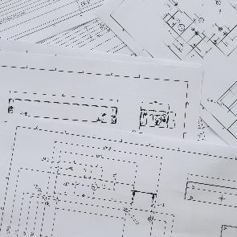



Collection Method – Microsoft Forms
Summary data contains no student PII so collection is easier.
Microsoft Forms
You will be provided a link to the online form(s) for your project to complete.
Microsoft Forms is an online data collection tool.
Data entered is immediately available for compilation.
GoAnywhere is not used for this data collection effort.
Numbers or text responses are easily entered into the form(s).

Slide 5
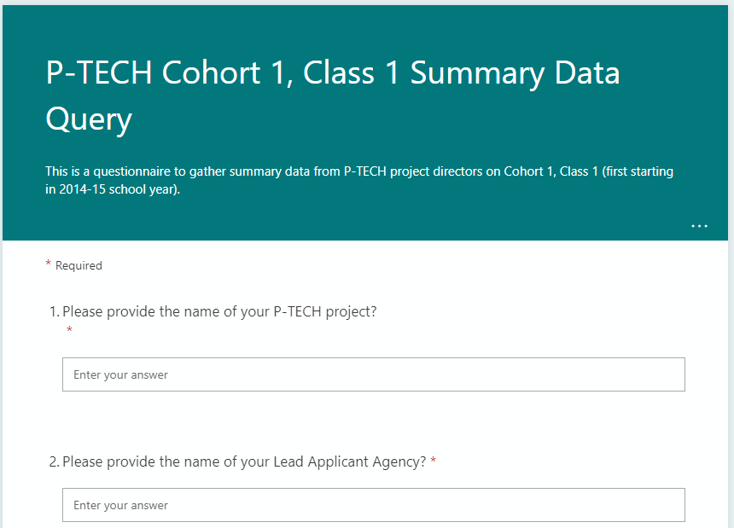
Examples of Microsoft Forms

Slide 6
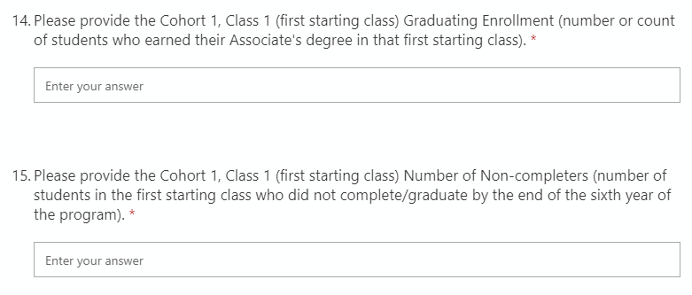
Graduation and Non-completers

Slide 7
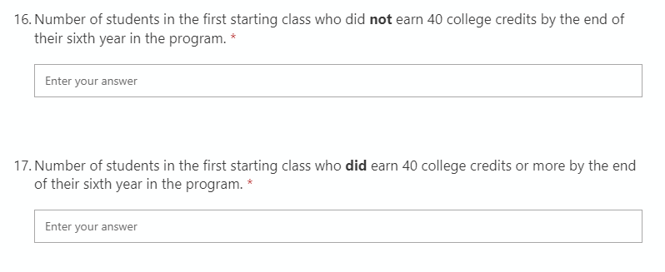
College Credits

Slide 8
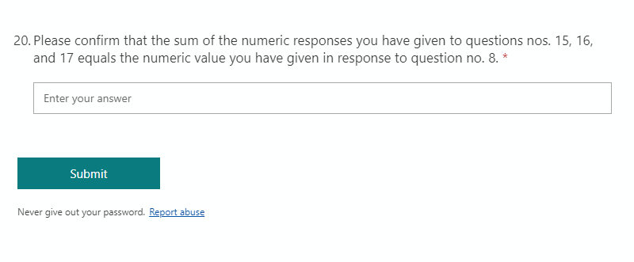
Complete and Submit Form
Once you have completed the form, press the ‘Submit’ button at the bottom of the form.

Slide 9

Please contact us with any questions or issues. ~~~~~~~~~~~~~~ Richard.McMillan@NYSED.GOV Thank You
Theme by Jens Martensson

