Slide 1
ESSA Virtual
Grants Training
July 30, 2025

Slide 2
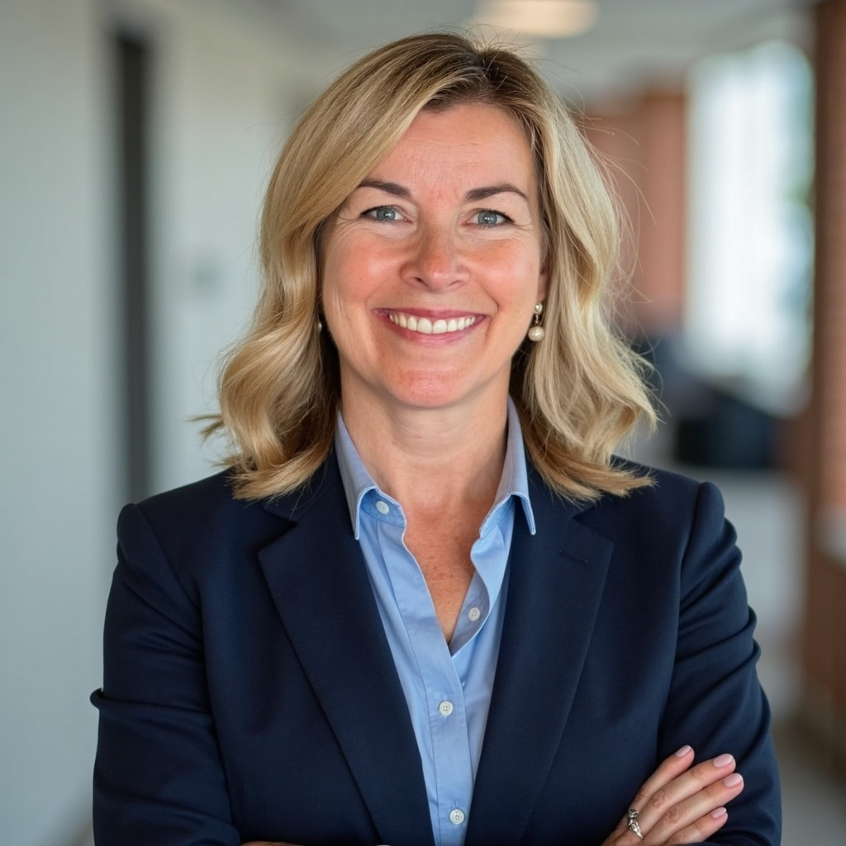
Donna Watson
Troy City School District
Deputy Superintendent
Former Director of Curriculum and Pupil Personnel Services for the Schodack Central School District
Former Curriculum Coordinator and High School English Language Arts Teacher for the Watervliet City School District
Consolidated Grant application writer and collaborator for 32 years with three different school districts
Member of the New York State Education Department’s Committee of Practitioners
Submission of successful competitive grant applications including NYS PTech, 21st Century Community Learning Centers, Expanded Prekindergarten, McKinney Vento, Learning Technology, Empire State After School Program, Smart Scholars, School Improvement, Student Mental Health Grant and Mentor Teacher Internship Program (MTIP)
Lead District Administrator for Instruction
Ph.D. SUNY Albany
CAS, MS, MA and BA from SUNY Albany - All Educational Administration and Policy Studies
Mom of four children (18 years old, 24 years old, 25 years old and 28 years old) and one dog (8 years old)

Slide 3
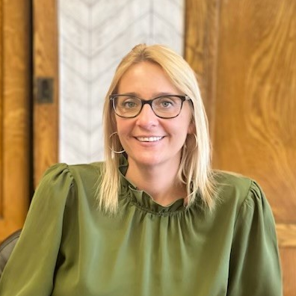
Juli Currey
Troy City School District
Director of Grants, Academic Programs and Accountability
Former Troy City School District, School #12 elementary teacher
Consolidated Grant application writer and collaborator for 13 years with the Troy City School District
Title I Coordinator
Prekindergarten program administrator
Submission of successful competitive grant applications including NYS PTech, 21st Century Community Learning Centers, Expanded Prekindergarten, McKinney Vento, Learning Technology, Empire State After School Program, Smart Scholars, School Improvement, Student Mental Health Grant and Mentor Teacher Internship Program (MTIP)
Manage and monitor all state and federal grant programs and budgets
Graduated from the College of Saint Rose
  Bachelor of Science in Childhood Education
  Master of Science in Education
  Master of Science in Educational Leadership
  Certificate of Advanced Study, School District Business Leadership
Mother of three children (11 years old, 8 years old and 6 years old)

Slide 4

Consolidated Grants:
Top Ten Lessons Learned!

Slide 5
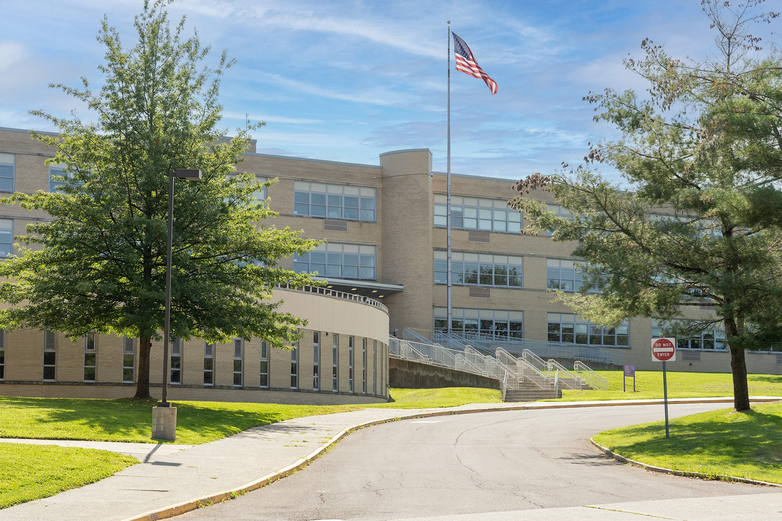
About the Troy CSD
3,470 Students, 700 Employees
High Need Small City School District in Upstate New York
5 Neighborhood Elementary Schools, 1 Middle School, 1 High School, 1 Alternative School & 1 Pre K-School
ESSA Target District, Two Elementary Schools Identified as Targeted Support and Improvement (TSI) Based on Sub-Group Performance

Slide 6

District Mission Statement
The Troy City School District will provide a strong educational and social foundation to graduate ALL students college and career ready.

Slide 7


#10: Understand Requirements of Titles!
Title I A - Improving Basic Programs Operated by LEAs
  Set Asides for Homeless and Parent Engagement
Title I D - Neglected and Delinquent
Title II A - Supporting Effective Instruction
Title III - ELL
Title III - Immigrant Students
Title IV - Student Support and Academic Enrichment
Title V - Rural and Low-Income Schools
Link to More Information - https://www.nysed.gov/essa/schools/consolidated-application

Slide 8
#9: Keep Prior Years & Feedback!
Starting Point in Troy
  Previous Consolidated Grant Application
  Previous DCIP Planning Document & DCIP Template
  Feedback from NYSED - See E-mail from DCIP that includes the “DCIP Review Form” - Look to “General Observations” and “Notes and Feedback” Specific to Each Priority
  Previous SCEPs Can Also Be Helpful
  Highlighting Activity Is Helpful - Green, Yellow, Red

Slide 9
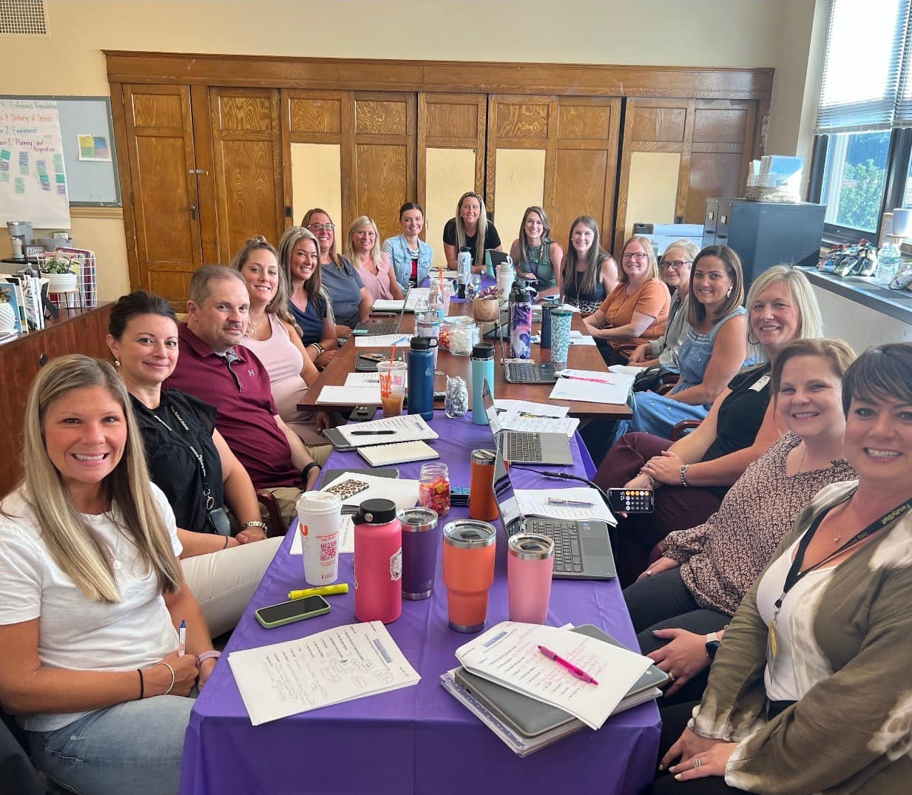
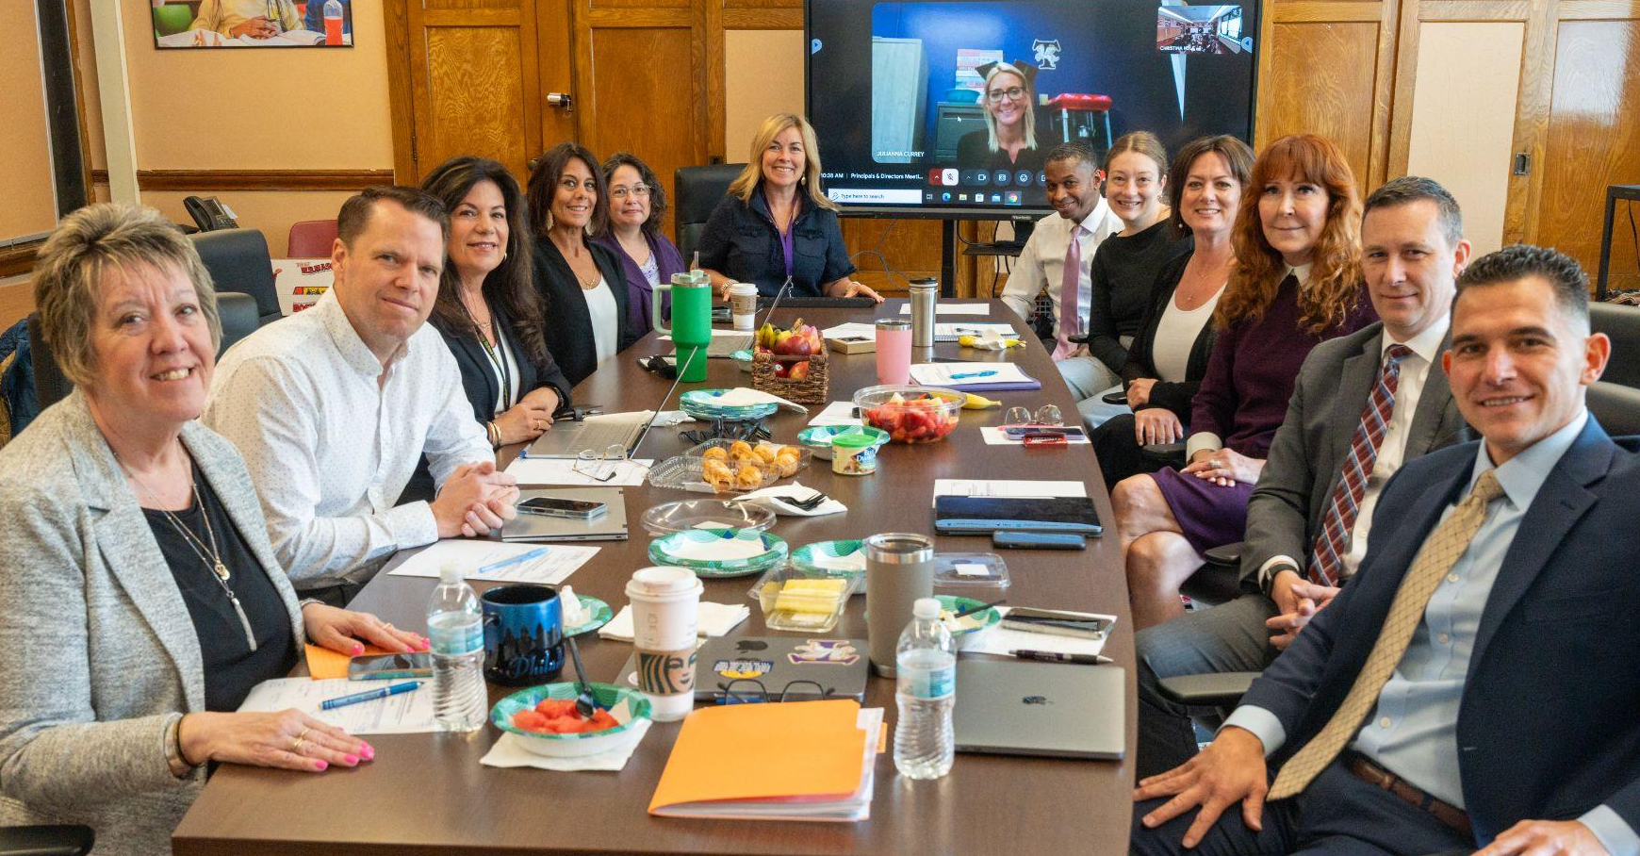
#8: Collaborate Early & Often!
Engage All Stakeholders Early in the Process, Scheduled Meetings and Plan for DCIP on the Calendar (DLT, BLT)
Ongoing Monitoring and Evaluation of the DCIP and SCEPs
Documentation of Meetings and Plans
Consultation and Collaboration Form
Reach Out to Your Non-public Partners Early
Connection and Collaboration with In-district, Non-public School Partners

Slide 10
#7: Know Your Resources!
Consolidated Application Toolkit (NYSED) - Office of ESSA Funded Programs Website Offers Step by Step Guidance and Contact Information for Every Program Office - Call Them!
NYS Grants Finance Website - www.oms.nysed.gov/cafe/ - Includes Instructions for FS-10s, Amendments & the Final Expenditure Report
NYSED Webinars and Recorded Trainings, SED Monitoring Checklists & Quality Control Tools
Regional Bilingual Education Resource Networks (RBERNs)
BOCES Support Services
District Colleagues and Mentors in Other Districts
Phone Your Friends in Troy!!!!

Slide 11
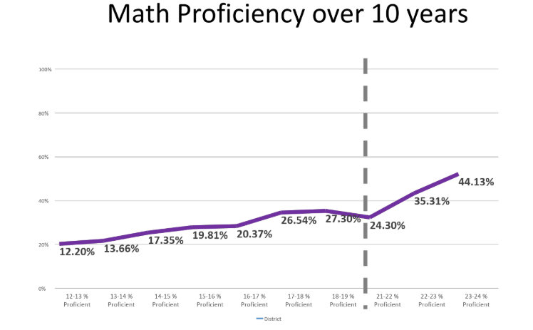
#6: Maintain Up to Date Data!
Always Data-based Decisions!
Review the Survey Data
Utilize the Data to Drive the Plan (Green, Yellow, Red)
Data will Provide Justification for Utilization of Funds
Celebrate Your Growth and Build On It
Continue Funding Strategies, Programs and Practices that Have an Impact

Slide 12
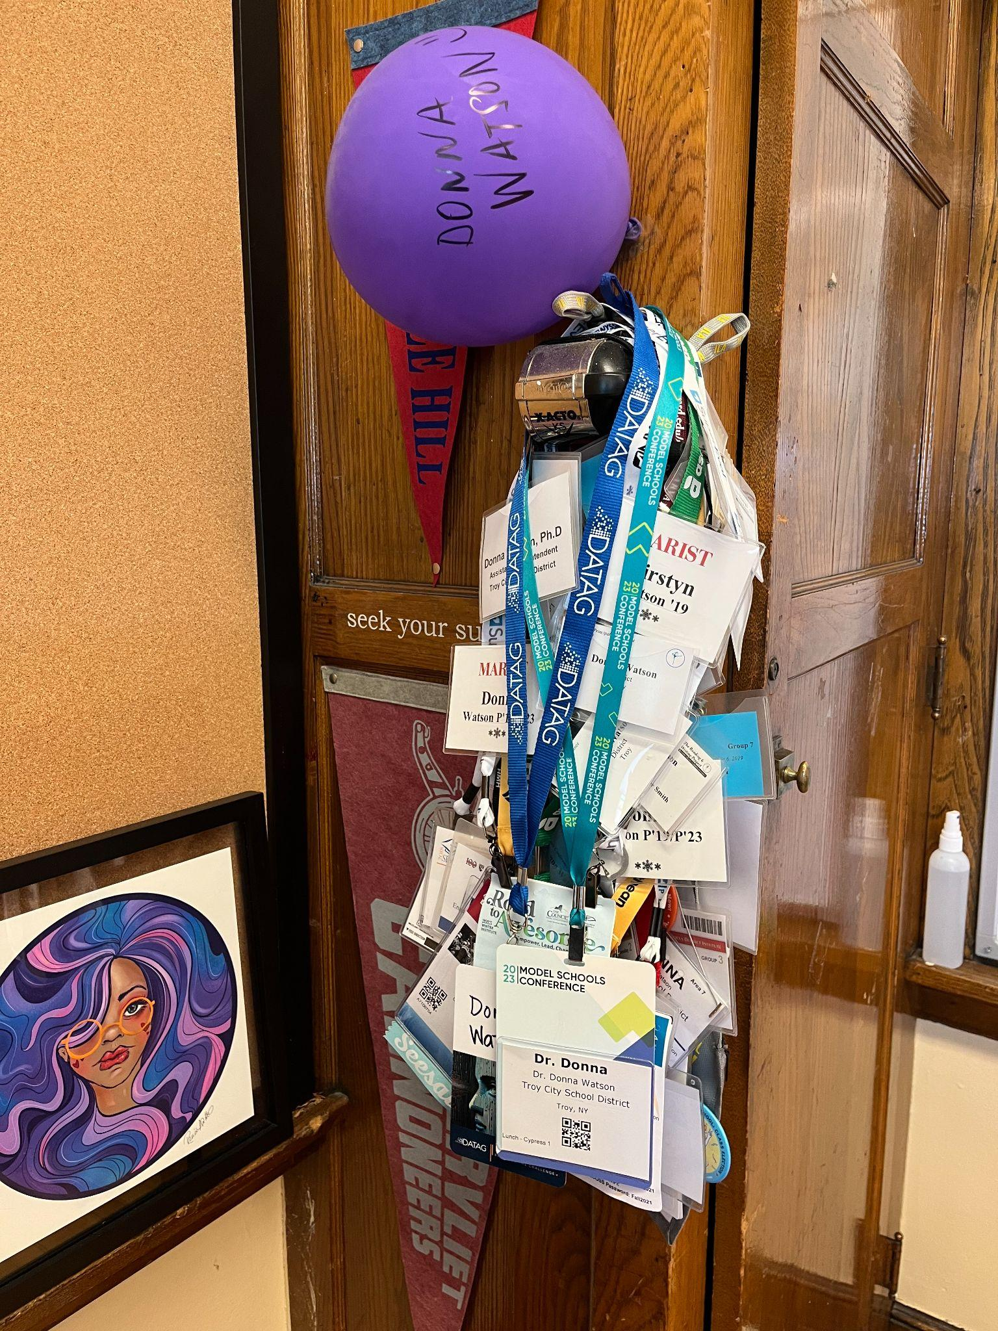
#5: NYSED Webinars!
Sessions Like Those You Are Attending This Week!
Start with the “Quick Bites FS-10 and Budget Narrative Sessions”
NYSED “ESSA Office Webinars & Videos Page” Under 2025-2026
Check the “Monitoring Review Webinars” for Compliance Best Practices
You Tube Videos and Chat GPT on NYSED-related Topics

Slide 13

#4: Capture All Unspent Funds!
Understand Allowable Expenses
Carryover Limits (Title I 15% of allocation, Title ID, IIA, III, IV, V 100% of allocation)
Monitor the Budget
Collaborate with Stakeholders and Work as a Team
Submit Amendments!

Slide 14
#3: Amend, Amend, Amend!
Remember to Progress Monitor Your DCIP
Programmatic Changes or Shifts in Priorities (i.e. Shifting from After-school Tutoring to More Mental Health Support)
Staff Turnover or Hiring Delays (i.e. A Planned Staff Position Took Longer to Fill, etc.)
Cost Increases or Reductions for Planned Expenses
New Opportunities or Needs Identified Mid-Year (i.e. a Professional Development Opportunity You Just Learned About, etc.)
Capturing Those Unused Funds - Don’t Leave One Penny on the Table
Changes or Updated Guidance from SED

Slide 15
#2: FS-10s Are Your Friend!
FS-10s Are a Guide for the Use of Funds, Keeping You Organized and Aligned to District Priorities
Capture Those Carryover Funds
Details Matter!
Progress Monitor That Budget - FS-10s Make the Final Expenditure Report Much Easier to Complete
Understand the Benefits and Indirect Costs
FS-10s Are Your “Accountability Partner”

Slide 16
#1: Fund the Plan, Don’t Plan the Fund
Start with a Sound Plan, Then Allocate the Resources to Support That Plan
Process in Troy
  All Schools Create School Comprehensive Education Plans (SCEPs) based on the Current and Demonstrated Needs of Students & Families Now
  District Leadership Team (DLT) Reviews Input from 10 Committees (PDP, Literacy, SEDL, Equity, Family Engagement, Attendance, Instructional Coaches, Technology, MTSS, & PBIS Committees) - Goals and Strategies
  DLT Reviews Survey Data - Students, Families, Faculty & Staff
  DLT Reviews Student Outcome Data - (MMI, Attendance, Behavior, etc.)
  DLT Completes the DCIP Planning Document and DCIP Template
  Then, Consolidated Grant is Completed and Funding Allocated

Slide 17
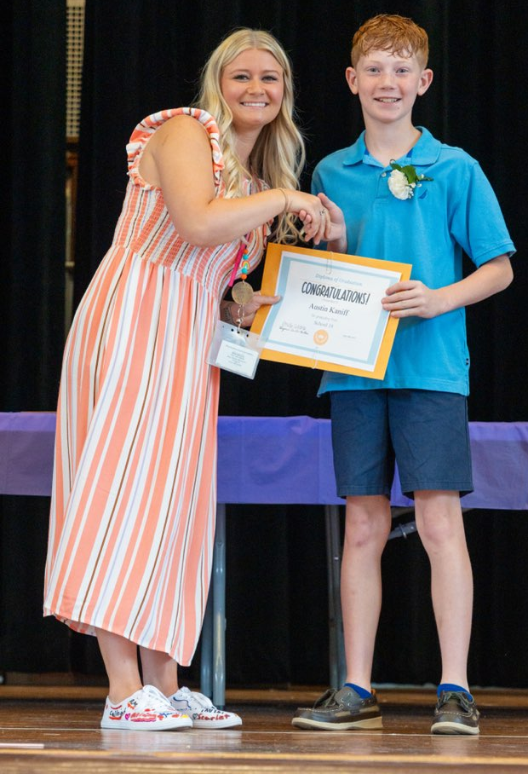
You Are Trusted to Lead This Important Work!

Slide 18
Thank You!!!!

Slide 19
Troy CSD Contact Information
Have Questions?
Please Reach Out!
Juli Currey - curreyj@troycsd.org
Donna Watson - watsond@troycsd.org

