Slide 1

Equitable Services to Non-Public Schools
Letter of Intent:
Engage Partners
Affirmation of Consultation:
Roadmap for services
Ongoing Consultation:
Delivery & Evaluation of Services
July 29-30, 2025
NYSED ESSA Virtual Training
Notes:
Welcome to the presentation on Equitable Services to Non-Public Schools. This presentation is part of NYSED’s 2025 ESSA Virtual Training.

Slide 2
Agenda
Letter of Intent:
Engage Partners
Affirmation of Consultation:
Roadmap for services
Ongoing Consultation:
Delivery & Evaluation of Services
Purpose of Equitable Services
Initial Consultation
Calculation of Shares
Affirmation of Consultation
Consolidated Application
Ongoing Consultation
Notes:
Today we’ll follow the consultation process all the way through from initial contact with potential non-public school partners to evaluation of the program. We will spend a lot of time on the Consolidated Application requirements.

Slide 3

Purpose of Equitable Services
Driven by Student Needs
Notes:
Non-profit, private schools are entitled to services to promote the achievement of eligible students.
Driven by student need, these services may be substantially different than what is provided at the public school.
It also means that the process must be focused on what is best for the students, not the private school.

Slide 4


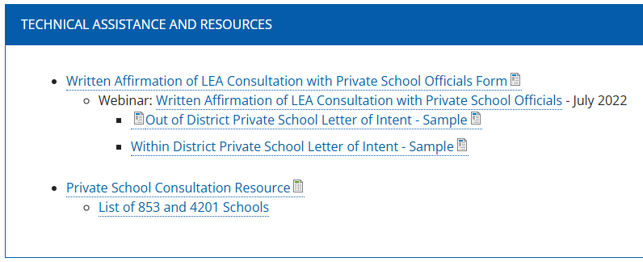


Initial Consultation Letter of Intent
https://www.nysed.gov/essa/equitable-services-nonpublic-schools
NYSED’s records only
include Non-public
schools with BEDS codes.
Start Early – April or May
Use the NYSED Consultation Resource
Work with the registrar, guidance counselors, and local CBOs to identify all non-public partners
Notes:
NYSED provides several resources on our Equitable Services page. Here you will find:
The Letters of Intent templates and the Written Affirmation of Consultation form
The private School consultation resource and the list of 853 and 4201 schools
Something important o note is that NYSED’s records only include non-public schools with BEDS codes. There may be unregistered private schools that the LEA is also required to consult with. The LEA should work with their registrar, guidance counselors, and local community-based organizations to identify all potential non-public school partners.

Slide 5

Must Do’s Initial Consultation
Intent to Participate: Which private schools agree to be involved?
Is Transferability being considered? How will this impact the available services?
How will the non-public school verify the number of private school students used to calculated the proportional share?
Are any parties interested in pooling?
Order the steps for successful planning.
Verify the number of students generating funds
Calculate Per Pupil Amounts
Data-drive discussions: student needs, eligibility for services
Set benchmarks for measuring success
Schedule meetings for ongoing consultation
As the program is developed, discuss:
What are the needs of the eligible private school students? What data has been used to identify those needs?
What services might address those needs?
How will the LEA ensure that services are effective?
Notes:
There are several must-do items an LEA must complete when initiating consultation with non-public schools.
LEAs must determine the Intent to Participate: Which private schools are agreeing to be involved?
Is Transferability being considered? If so, how will this impact the available services?
How will the non-public school verify the number of private school students used to calculate the proportional share?
And are any parties interested in pooling of resources?
As the program is developed, you’ll continue to discuss the needs of eligible private school students and the data that’s been used to identify those needs. You’ll determine what services might address them and finally how the LEA will ensure that these services are effective.
You may consider the following order of operations for successful planning. Beginning first with verifying the number of students who will generate funds and calculating the per pupil amounts. Moving on to Data-Driven discussions of student needs and eligibility for services, setting benchmarks for measuring success and finally scheduling meetings for ongoing consultation.
Please note that this order is not prescribed. An LEA may need to adjust this order of steps when circumstances demand, such as when allocations from USDE are delayed.

Slide 6
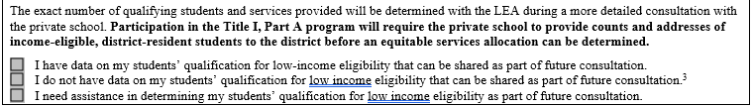

How to count Title I eligible students
The same measure of poverty used at the public school
Comparable poverty data from a survey
Verify residence
Grade level and age of each child
Household income
Comparable poverty data from a different source
Proportionality
An Equated Measure
https://oese.ed.gov/files/2023/05/Title-I-ES-guidance-revised-5-2023.pdf
Notes:
For those non-publics that do not have FRPL data, they may
use comparable poverty data from a survey that verifies the residence, grade level, and household income of each student
comparable data from a different source
proportionality
or an equated measure.
The LEA and non-public school must agree to use this measure and communicate effectively to ensure that eligibility is firmly established.
For additional insight on this process, please see USDE’s Title I Part A Guidance on Equitable Services. Pages 20 to 22 explain these methods in detail.

Slide 7


LEAs may dictate all terms of the Equitable Services program.
True or False
Developing an Equitable Services program is a collaborative process that keeps students’ needs in focus. This requires consistent and clear communication from all parties.
True
False
Notes:
Is it true or false that LEAs may dictate all terms of the equitable services program? The answer is false. Developing an Equitable Services program is a collaborative process that keeps students’ needs in focus. This requires consistent and clear communication from all parties.

Slide 8

Generating Proportional Shares:
Which students are counted?
New York CSD (K-12)
Title I School Wide Program
Allocations for all Titles I, II, and IV
Total # students: 400
Total # Title I-eligible: 250
Title I: $100,000
Title II: $50,000
Title IV: $20,000
Proportional Shares are determined by a student’s household income and residence
Proportional shares are determined by the total number of students attending a Private School physically located within the LEA’s catchment area.
Notes:
So how do non-public schools generate proportional shares?
It’s important to note that academic need is not a consideration when counting the number of students who generate a per pupil share of funds.
Title 1 proportional shares are calculated based on students’ household incomes and residences.
Title 2 and 4 proportional shares are calculated based on the total number of students enrolled at a private school that is physically located with the LEA’s catchment area.

Slide 9
Example of 1 LEA with 2 private schools
New York CSD (K-12)
Title I School Wide Program
Allocations for all Titles I, II, and IV
St. Alison’s School
West Campus
(K-12)
St. Alison’s School East Campus
(K-12)
New York CSD’s Attendance Boundary
Total # students: 400
Total # Title I-eligible: 250
Title I: $100,000
Title II: $50,000
Title IV: $20,000
Total # students: 100
Total # Title I-eligible students: 3
Total # students: 100
Total # Title I-eligible students: 3
3 students are generating Title I funds
ALL 100 students are eligible for Title II or IV services
3 students are generating Title I funds
0 students are eligible for Title II or IV services
Notes:
Let’s work through a scenario wherein we have a single, small, relatively low-income public school serving two private schools. Both private schools are part of the Saint Alison’s school network. Both private schools have about 100 total students, about 3 of whom would be eligible for Title 1 services. The West campus is within the New York CSD’s attendance boundary. The East campus is not. Because of this St. Alison’s school West Campus is eligible to receive servies under Title 1, Title 2, and Title 4. St Alison’s school East Campus is eligible only for Title 1 services. In the West campus, we see that all 100 students in attendance are eligible for these Title 2 and 4 services. That’s because Title 2 and 4 services are available to any students who are enrolled within the LEA’s attendance boundary.

Slide 10
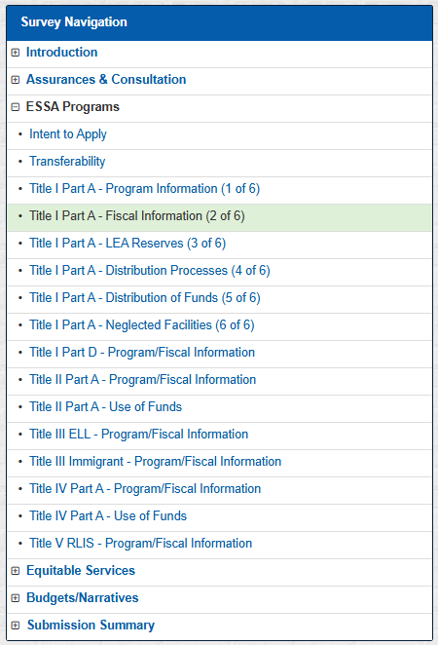
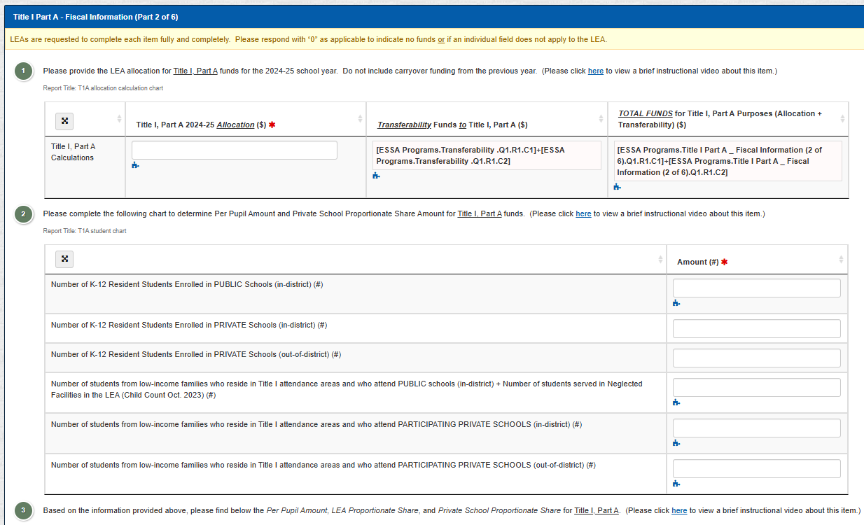
Private School Students are counted if:
Reside within the LEA’s Title I Attendance Area
From a low-income family
Notes:
The Consolidated Application is equipped to calculate per pupil amounts and proportional shares once the student data from private school consultation is entered into the relevant section.
For Title 1 shares, you will enter the total number of private school students who are eligible for services on the page for Title 1 Part A – Fiscal Information (2 of 6)
These are students who reside within one of the LEA’s Title 1 attendance area AND live in a low-income household.
Non-public schools are not required to provide evidence of their methods, however the non-public school and LEA officials should agree upon the method to be used. The non-public school should have evidence available in case it is requested by an auditor evaluating the program.

Slide 11
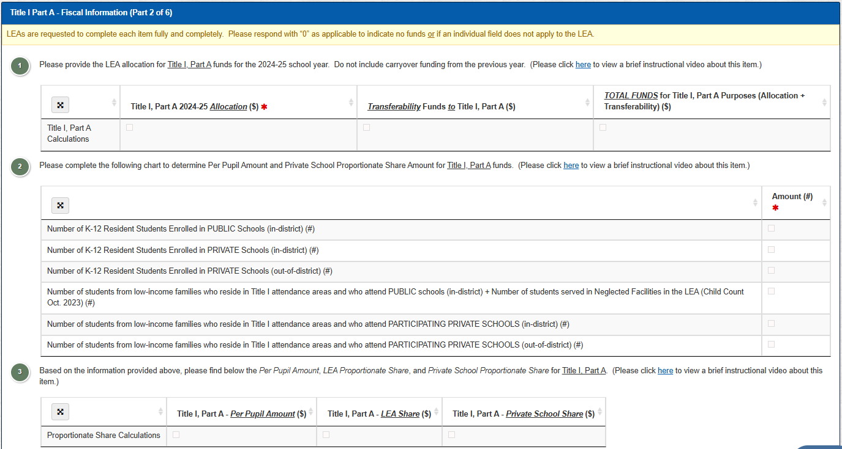
Example of Consolidated Application Title 1 Part A – Fiscal Information 2 of 6
These values will be entered automatically from the Transferability section.
$100,000
$0
$100,000
Enter this data based on initial conversations with participating non-public schools
400
25
5
250
3
3
100,000
256
= $390.625
/student
$390.63
$97,656.25
$2,343.75
Notes:
In question 2, we’ve entered our demographic data showing the total number of students enrolled in the public school as well as at both in-district and out-of-district private schools and the number of students from low-income families residing in Title 1 attendance areas who are enrolled at both public and private schools.
Next, we enter the LEA’s Title 1 allocation. Information from the transferability section will be entered automatically. Using the low-income student counts, the ConApp will calculate the per-pupil amount for Title 1 and the public and non-public shares.
You can use this information to finish the consultation with your non-public schools.

Slide 12
Only students from low-income families can receive Title I Equitable Services.
True or False
To be eligible for Equitable Services under Title I, students must:
Reside in a Title I Attendance Area
Be at-risk of failing to meet rigorous academic standards.
True
False
Notes:
Is it true or false that only students from low-income families can receive Title 1 equitable services? This is FALSE. To be eligible for equitable services under Title 1, students must: Reside in a Title I attendance area AND Be at-risk of failing to meet rigorous academic standards.
This means that one private school student may generate the proportional share by virtue of their residence and household income, but the services that share provides can be offered to any student who resides in the LEA’s title I attendance area AND is at-risk of academic failure.

Slide 13
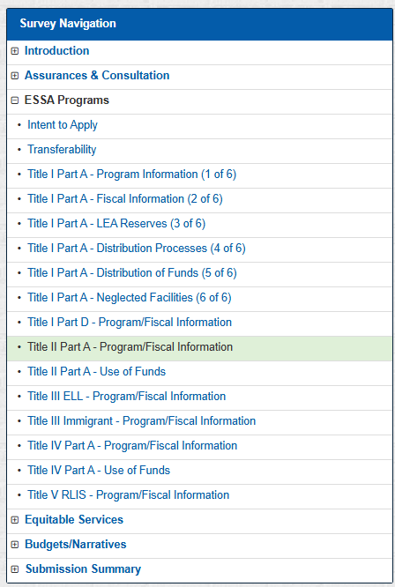
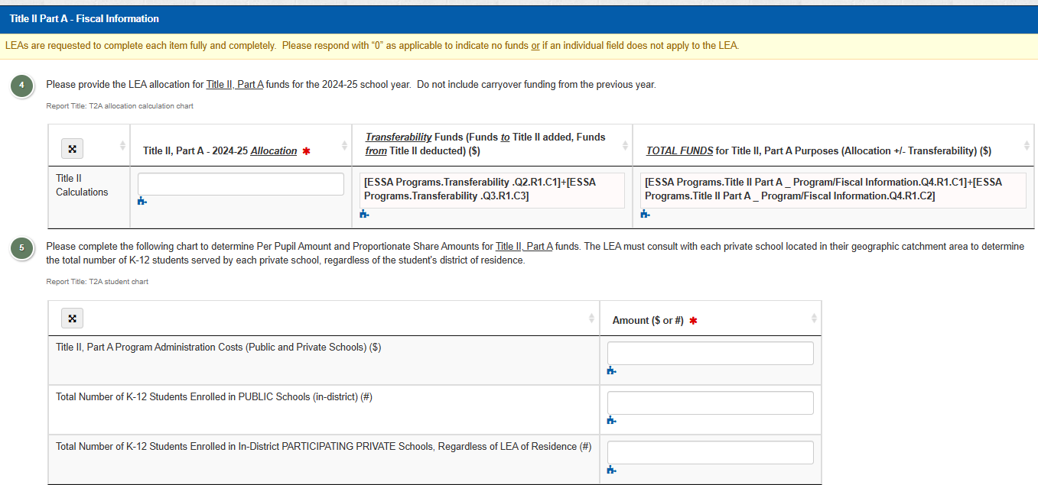
Private School Students are counted if:
they attend a private school within the LEA’s attendance catchment area
regardless of their residence or income level
Notes:
Title 2 allocation and demographics will be entered on the page Title 2 Part A – Program and Fiscal Information.

Slide 14
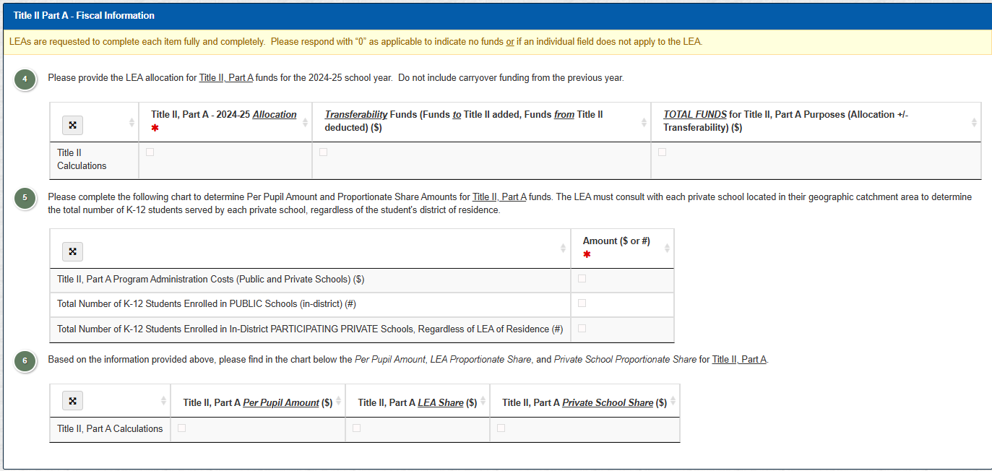
Example of Consolidated Application Title 2 Part A Fiscal Information
These values will be entered automatically from the Transferability section.
$50,000
$0
$50,000
Must be discussed during consultation
$1,350
400
100
$50,000
-$1,350
$48,650 available for services
$97.30
$38,920
$9,730
Notes:
When completing the Title 2 Part A Fiscal Information page, the LEA will need to enter information gathered during initial consultation. You’ll first enter the allocation, and
the values for transferability will be automatically filled in.
LEAs have the option to reserve administration costs “off the top”, but this must be discussed with the non-public school first because it decreases the amount available for services.
Examples of administrative costs could include indirect cost or partial salary for a clerk or secretary to prepare and maintain documents or schedules.
The amount available after the administrative reserve will be used to automatically calculate the per pupil amount and the LEA and non-public school shares.

Slide 15
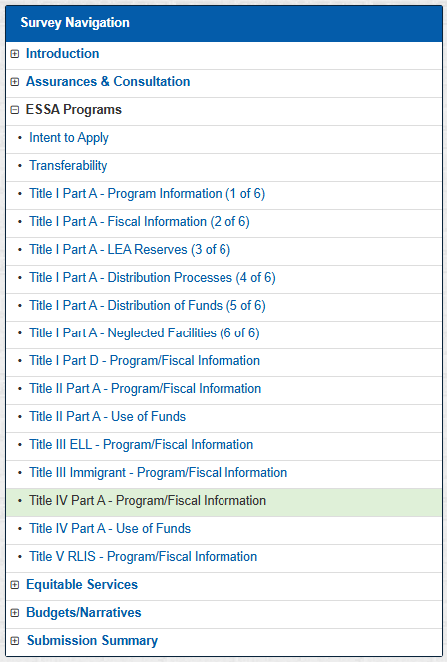
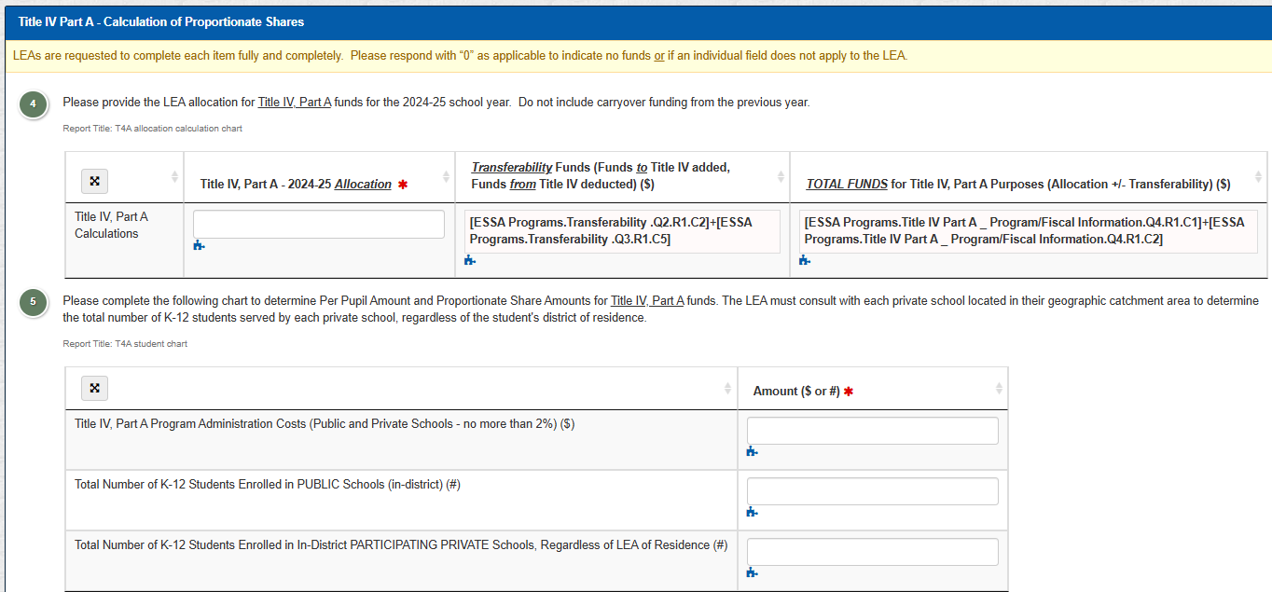
Private School Students are counted if:
they attend a private school within the LEA’s attendance catchment area
regardless of their residence or income level
Notes:
You’ll notice that the page Title 4 Part A – Program/Fiscal Information is identical to the page for Title 2.

Slide 16
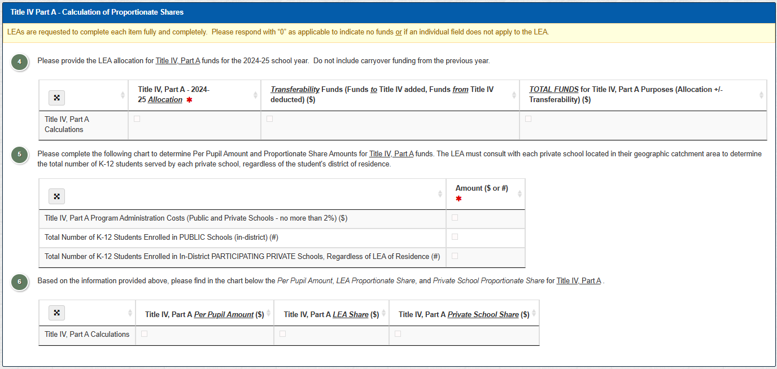
Example of Consolidated Application Title 4 Part A – Calculation of Proportionate Shares
These values will be entered automatically from the Transferability section.
$20,000
$0
$20,000
Must be discussed during consultation
$400
400
100
$20,000
-$400__
$19,600 available
$39.20
$15,680
$3,920
Notes:
First we enter our Title 4 allocation of $20,000. The transferability values will fill in. And again we have the option to reserve administrative costs up to 2% off the top. This reduces the total amount available for services.
The final allocation after the administrative reserve is removed is used to calculate the Title 4 per pupil amount and the LEA and private school shares.

Slide 17
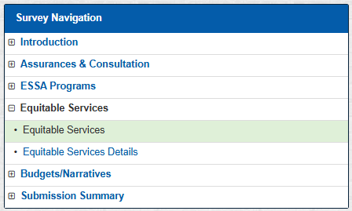

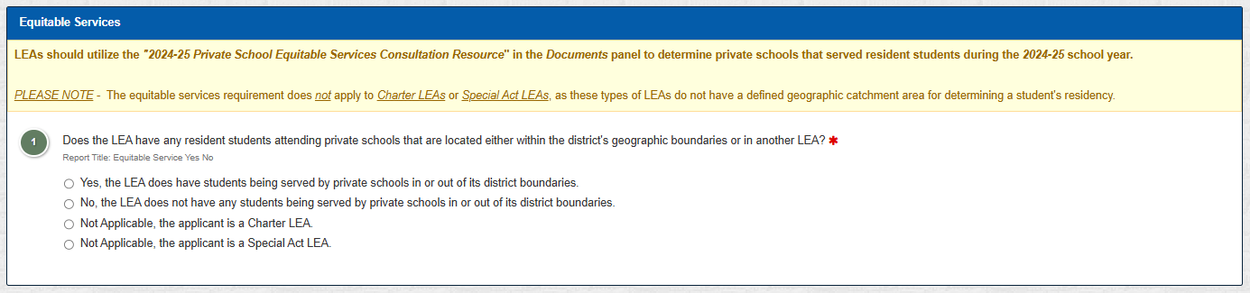
Consolidate Application Equitable Services Question 1
But our non-public schools always decline...
You must contact every private school every year!
Notes:
Every LEA must answer the first question on the Equitable Services page.
You may already have an idea of which non-public schools will participate, but if there are any non-public schools that serve any school-age children residing in the district, you must select yes. The statute governing equitable services does not include an exceptions for perennially-declining non-public schools, but it does include language insisting that public schools contact all potentially-eligible, non-profit private schools every year.

Slide 18
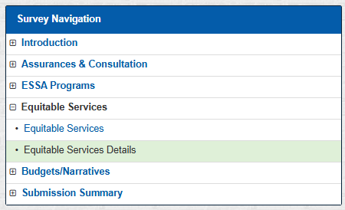
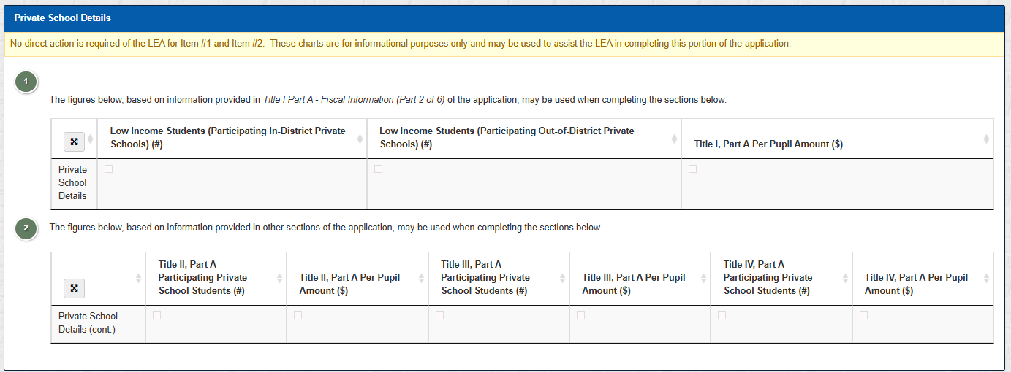
Example of Consolidated Application Equitable Services Details, Question 1 and 2
These values will automatically fill using data from:
Title I Part A – Fiscal Information (2 of 6)
Title II Part A – Program/Fiscal Information
Title III ELL – Program/Fiscal Information
Title IV Part A – Program/Fiscal Information
3
3
$390.63
100
$97.30
0
$0
100
$39.20
Notes:
Clicking yes on the Equitable Services page will open the Equitable Services Details page.
This is the final place where your equitable services information will be entered and where you will upload your consultation forms.
All of the data entered on the previous pages will be automatically filled into the Equitable Services Details page, Questions 1 and 2.
The per pupil amount is needed to plan the scope of services and complete section 4 of the Written Affirmation of Consultation form.

Slide 19
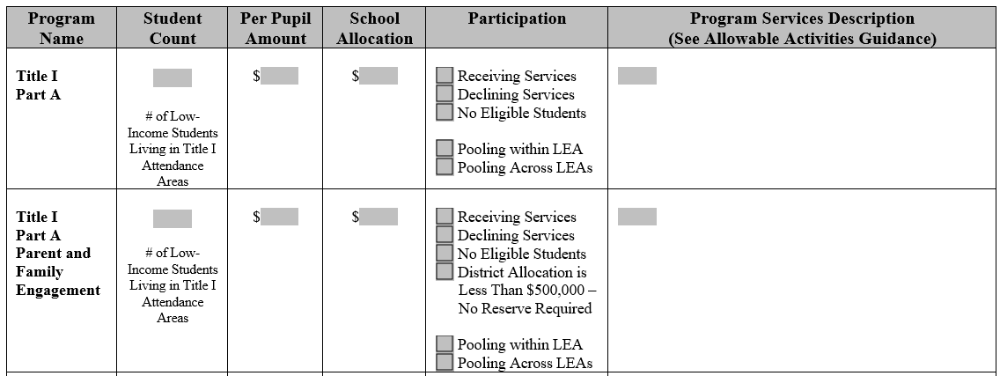
Example of Written Affirmation of Consultation form, Section 4 for Title 1
Section 4: What services will be provided?
X
Eligible students will receive tutoring in math and ELA after school for a total of one hour per week. Tutoring will be provided by a SAS teacher under contract with NYCSD at a rate of $40/hr.
3
390.63
1,171.88
What if the Title I allocation is >$500,000?
NPS can choose to “roll” funds into Title I Part A services, waiving this requirement
NPS can choose to engage Title I parents through means such as an event with Title I pull-out sessions or a Title I stakeholder meeting.
N/A
X
The LEA must never reimburse the non-public school.
Notes:
Using the Per Pupil Amount calculated by the ConApp, you can return to the non-public school with their proportional share and collaborate to develop the equitable services program.
The final pages of the Affirmation of Consultation form should provide all of the information necessary to complete the FS-10.
In our example, we’re providing tutoring in Math and ELA to eligible students under Title 1. This is going to be provided by a St. Alison’s School teacher who is under contract with New York CSD at a rate of $40 per hour.
In our example, we did not have a parent & family engagement requirement. But what if we did?
A non-public school can choose to decline the parent & family engagement requirement, instead adding those funds to their academic services. A non-public school may also choose to engage Title 1 parents. Often this will be in the form of an open house or parent/family event that includes a special Title 1 component, such as a pull-out session or stakeholder meeting.
Regardless of what services are provided, the LEA may never reimburse a non-public school. Consistent ongoing consultation will allow non-public school partners to communicate their evolving academic and family engagement needs throughout the school year, allowing adequate time for planning and pre-ordering of supplies.

Slide 20
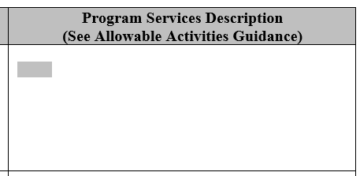
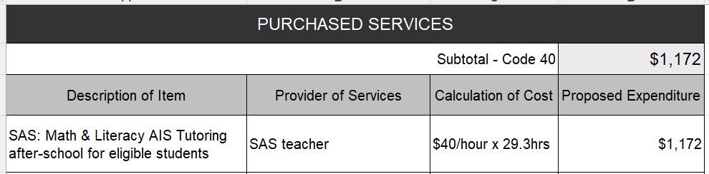
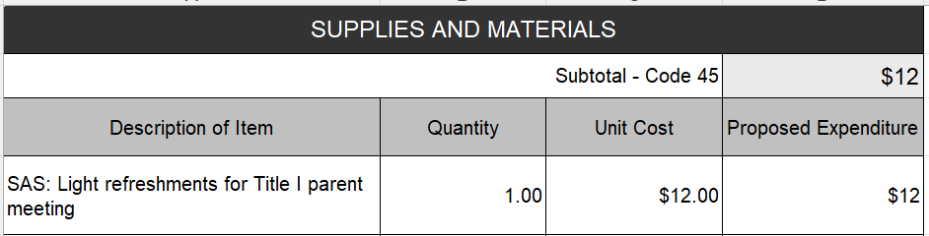
Program Description → Title I FS-10
Eligible students will receive tutoring in math and ELA after school for a total of one hour per week. Tutoring will be provided after school and during school breaks by a SAS teacher under contract with NYCSD at a rate of $40/hr.
Notes:
For our tutoring service, we have identified that this is for a non-public school. We’ve identified our vendor, a St. Alison’s School teacher, and we’ve included the hourly rate and the total for this line item.

Slide 21

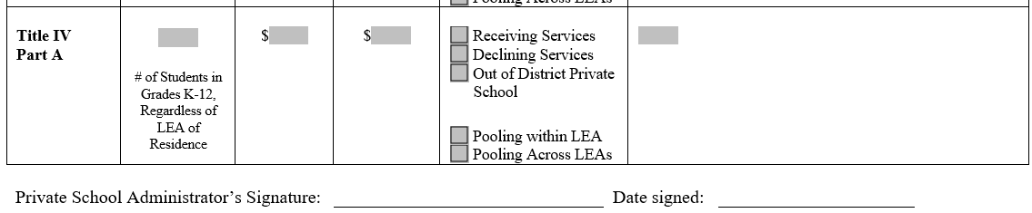
Example of Written Affirmation of Consultation form, Section4 for Titles 1 and 4
Braiding funds into a single, coherent Equitable Services Program is best practice and maximizes impacts on student learning.
100
X
Up to $9,730 of contract for PD and Coaching services from Teacher’s College for math and literacy teachers.
Why is this group of services an example of braiding funds?
AIS instruction
Instructional Coaching
Technology Coaching
97.30
9,730
100
X
Instructional technology coaching with NYCSD employee outside of contract time for up to 98 hours @ $40/hour.
39.20
3,920
Notes:
This non-public school had identified a need to improve their instructional services for math and literacy and is requesting the use of Title 2 funds to do so. They are also requesting coaching in instructional technology out of Title 4. This is a good example of braiding funds because students are receiving AIS instruction, and teachers are learning how to deliver that instruction more effectively.

Slide 22
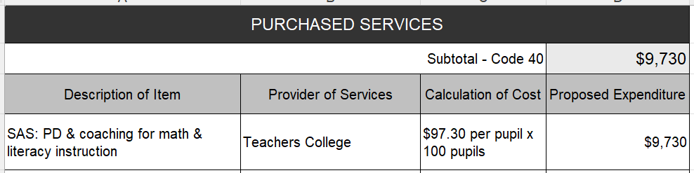
Program Description → Title II FS-10
Purchase Orders
Contracts
Records of teacher participation
Evaluations of teacher progress
What record-keeping does this LEA need to be mindful of?
Up to $9,730 of contract for PD and Coaching services from Teacher’s College for math and literacy teachers.
Notes:
Once again, we’re going to use the information in our Written Affirmation of Consultation Form to develop the FS-10. We have identified that this is for a non-public school
the service the vendor, the cost calculation based on the per pupil amount, and finally
the line item amount.
You cannot provide this level of detail for the administrative reserve in the FS-10,
so please identify the portion of indirect costs that are part of equitable services in the budget narrative.
Record-keeping is a very important part of this process. In this case, the LEA will need to keep records of purchase order, contracts with appropriate language, records of teacher participation, and an evaluation of teachers’ progress.

Slide 23
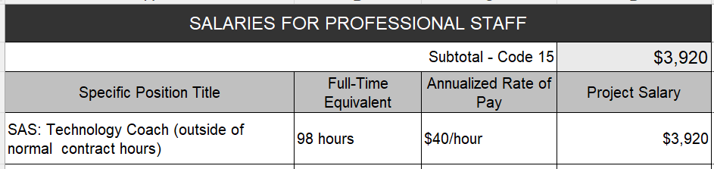
Program Description → Title IV FS-10
What record-keeping does this LEA need to be mindful of?
Purchase Orders
Contracts
Records of teacher participation
Evaluations of teacher progress
AND
Timesheet for Tech Coach
Instructional technology coaching with NYCSD employee outside of contract time for up to 98 hours @ $40/hour.
Notes:
Our Title 4 Equitable Services program involves coaching from one of the LEA’s employees, so we can put their stipend and hourly rate in Code 15.
This tech coach may also have a salary from the same funding source. As long as coaching hours occur outside of the tech coach’s normal contractual hours with the LEA, there is no problem with paying both a salary and a stipend to the same person from the same funding source.
That said, there is some record keeping this LEA needs to be very mindful of. In addition to the record-keeping required for Title 2, the LEA should maintain a timesheet for their tech coach demonstrating that these activities are taking place outside of their normal contractual obligations.

Slide 24
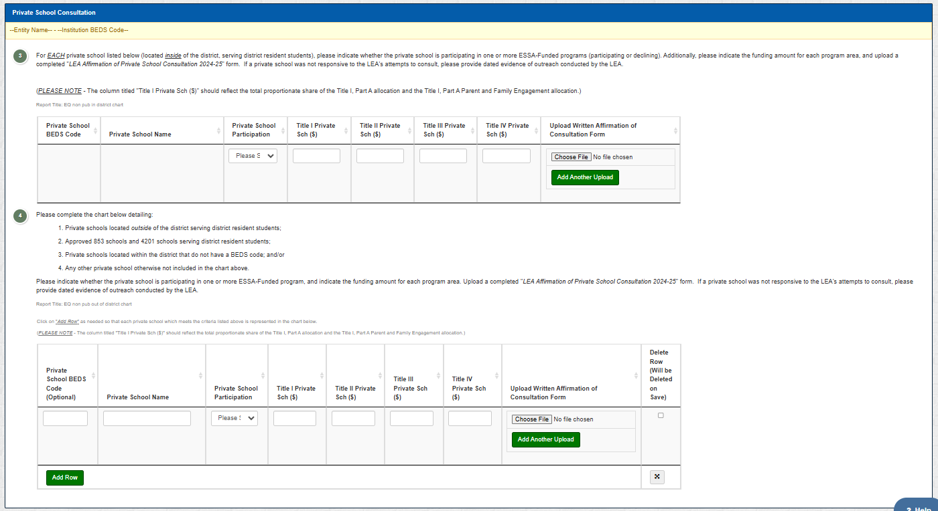
Notes:
In questions 3 & 4 of the Equitable Services Details page, you will upload the completed Affirmation of Consultation forms for each non-public school that you consulted with AND evidence of either declination or non-responsiveness for non-participating non-public schools.

Slide 25
NYSED Support
Thank You for Your Continued Collaboration!
Equitable Services forms and guidance can be found on our website at http://www.nysed.gov/equitable-services-nonpublic-schools
Please contact the ESSA-Funded Programs Office at (518) 473-0295 or via email at conappta@nysed.gov if you have any questions or concerns regarding the ESSA-Funded Programs.
Please visit our ConApp web-site at: http://www.nysed.gov/essa/schools/consolidated-application
Notes:
Thank you for viewing the Equitable Services presentation from NYSED’s 2025 ESSA virtual training.
For additional guidance on equitable services and the required Written Affirmation of Consultation Forms, please visit our equitable services webpage at nysed.gov/equitable-services-nonpublic-schools
If you have additional questions or questions specific to your application, please contact the ESSA-Funded Programs Office at (518) 473-0295 or via email at conappta@nysed.gov

