Slide 2
Kindergarten Writing Training
Kindergarten Writing: Four Constructed-Response Types
Letter Writing (0–1 score point scale)
Sample student responses
Word Writing (0–2 score point scale)
Sample student responses
Sentence Writing (0–2 score point scale)
Sample student responses
SCR: Write a Story (0–4 score point scale)
Sample student responses

Slide 3
Application of the Holistic Writing Rubrics
Become familiar with the rubric for the particular grade band
Become familiar with the prompt (or passage and prompt)
Read the response to the prompt
Student responses are evaluated for total, overall performance
Scores are assigned based on the criteria delineated in the rubric
Match evidence from the response to the language of the rubric
Look for what is included in the response, not what is missing
The highest point on a rubric scale does not measure a “perfect” response
On the written tests, handwriting does not count

Slide 4
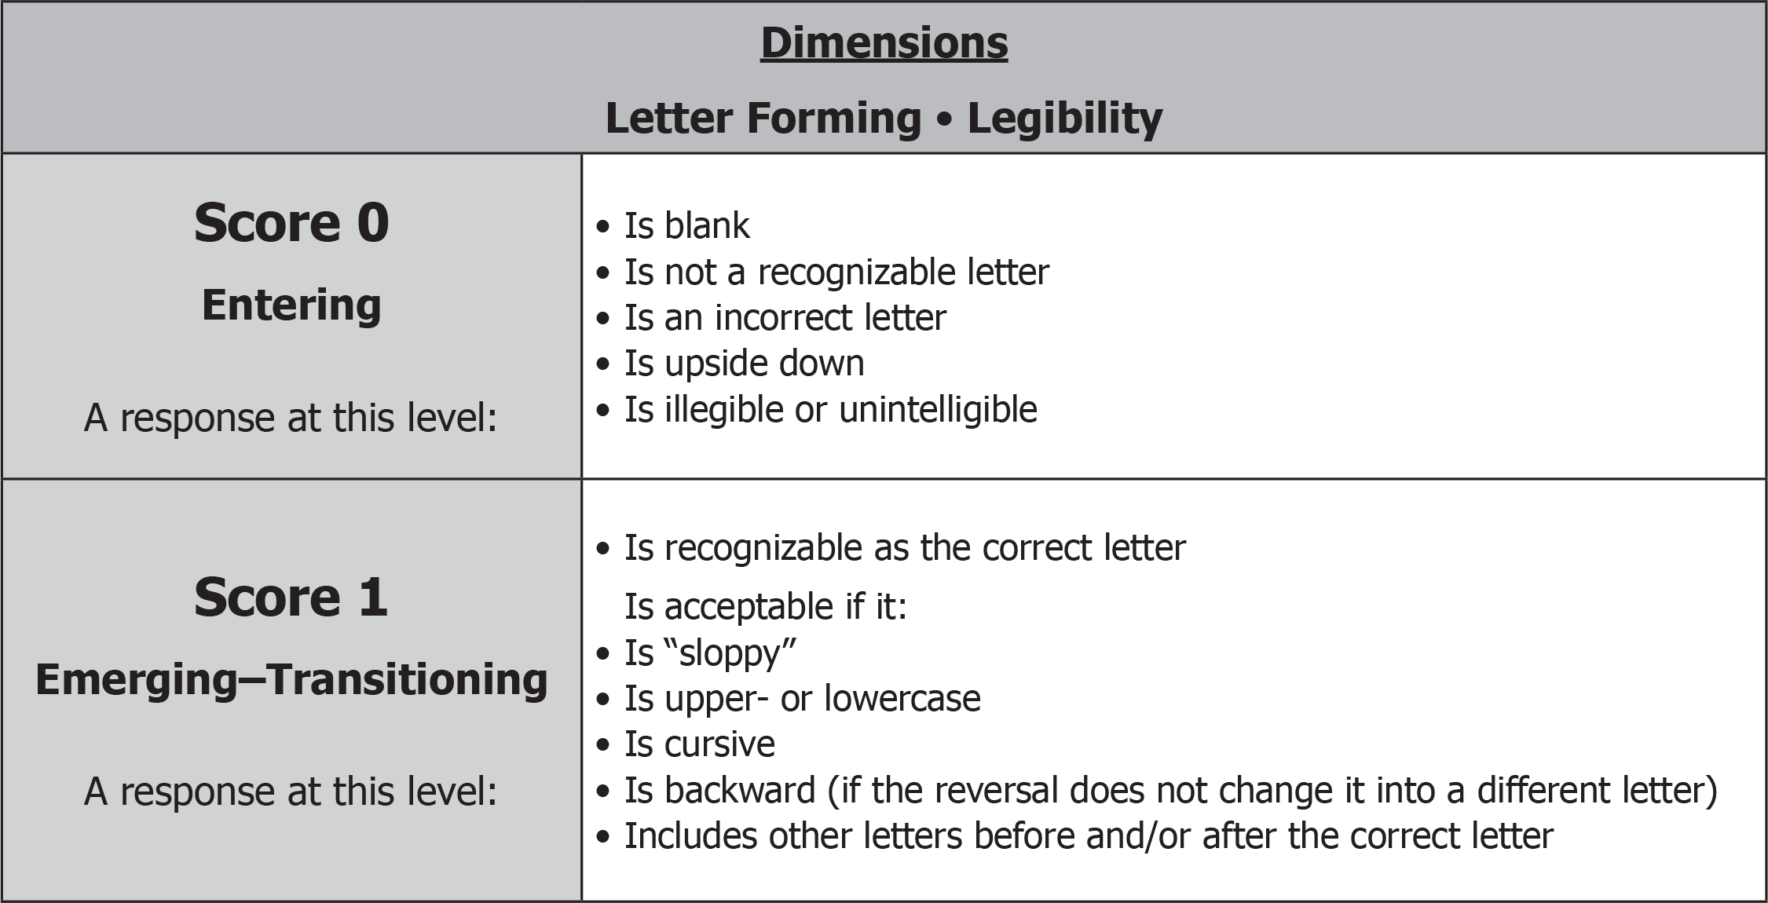
Grade K: Letter Writing Rubric and Prompt
(binder page 130 for prompt and samples)

Slide 5
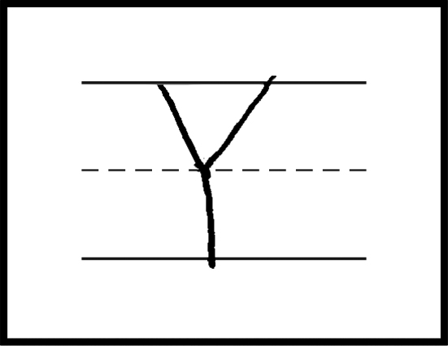
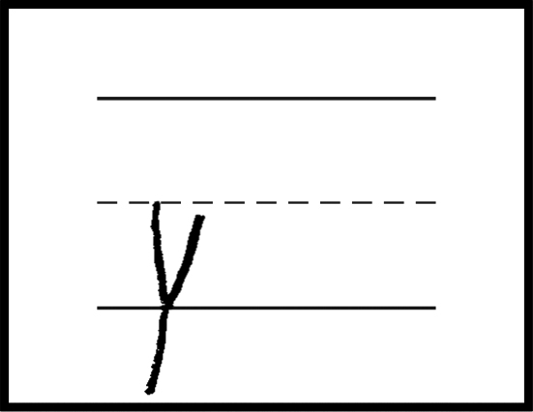
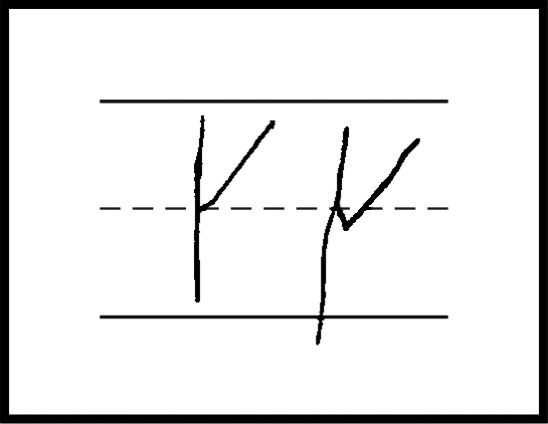
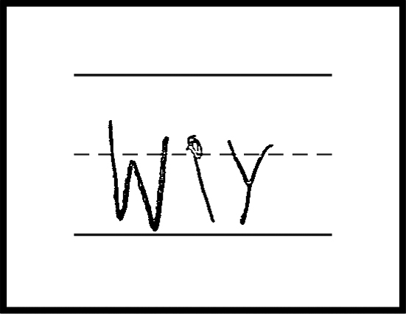
Grade K: Letter Writing Samples
1
2
Score: 1 (Emerging-Transitioning)
Score: 1 (Emerging-Transitioning)
Response is recognizable as the correct letter. Response is uppercase.
Response is recognizable as the correct letter. Response is lowercase.
3
4
Score: 1 (Emerging-Transitioning)
Score: 1 (Emerging-Transitioning)
Response is recognizable as the correct letter.
Response includes other letters before or after the correct letter.
Response is backward (reversal does not change it into a different letter).
Response is recognizable as the correct letter. Response includes other letters before the correct letter.
*Please see your binder for a full rubric*

Slide 6
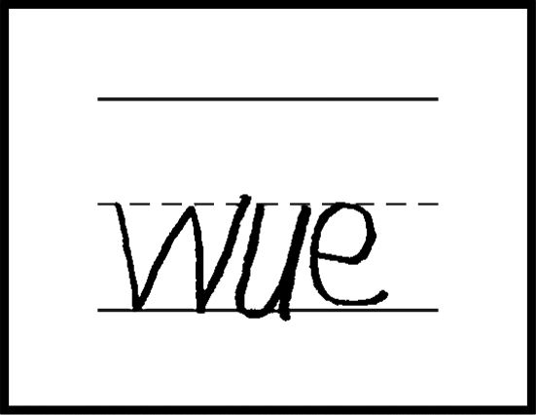
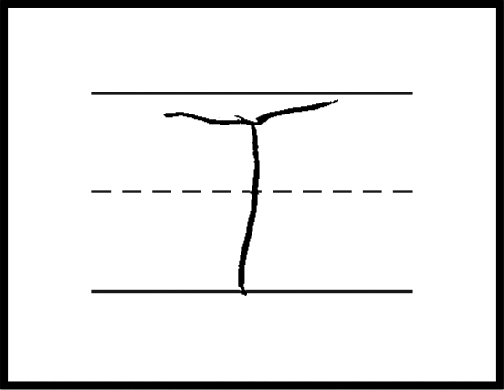
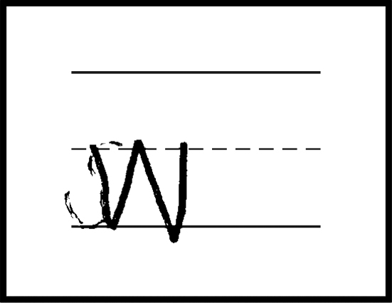
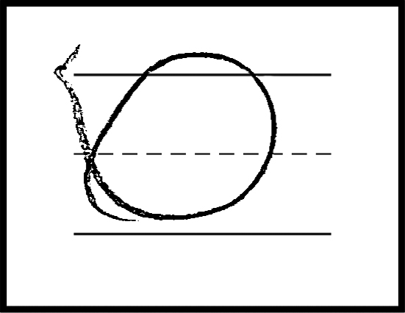
Grade K: Letter Writing Samples
5
6
Score: 0 (Entering)
Score: 0 (Entering)
Response is incorrect letters..
Response is an incorrect letter.
7
8
Score: 0 (Entering)
Score: 0 (Entering)
Response is an incorrect letter.
Response is not a recognizable letter.
*Please see your binder for a full rubric*

Slide 7
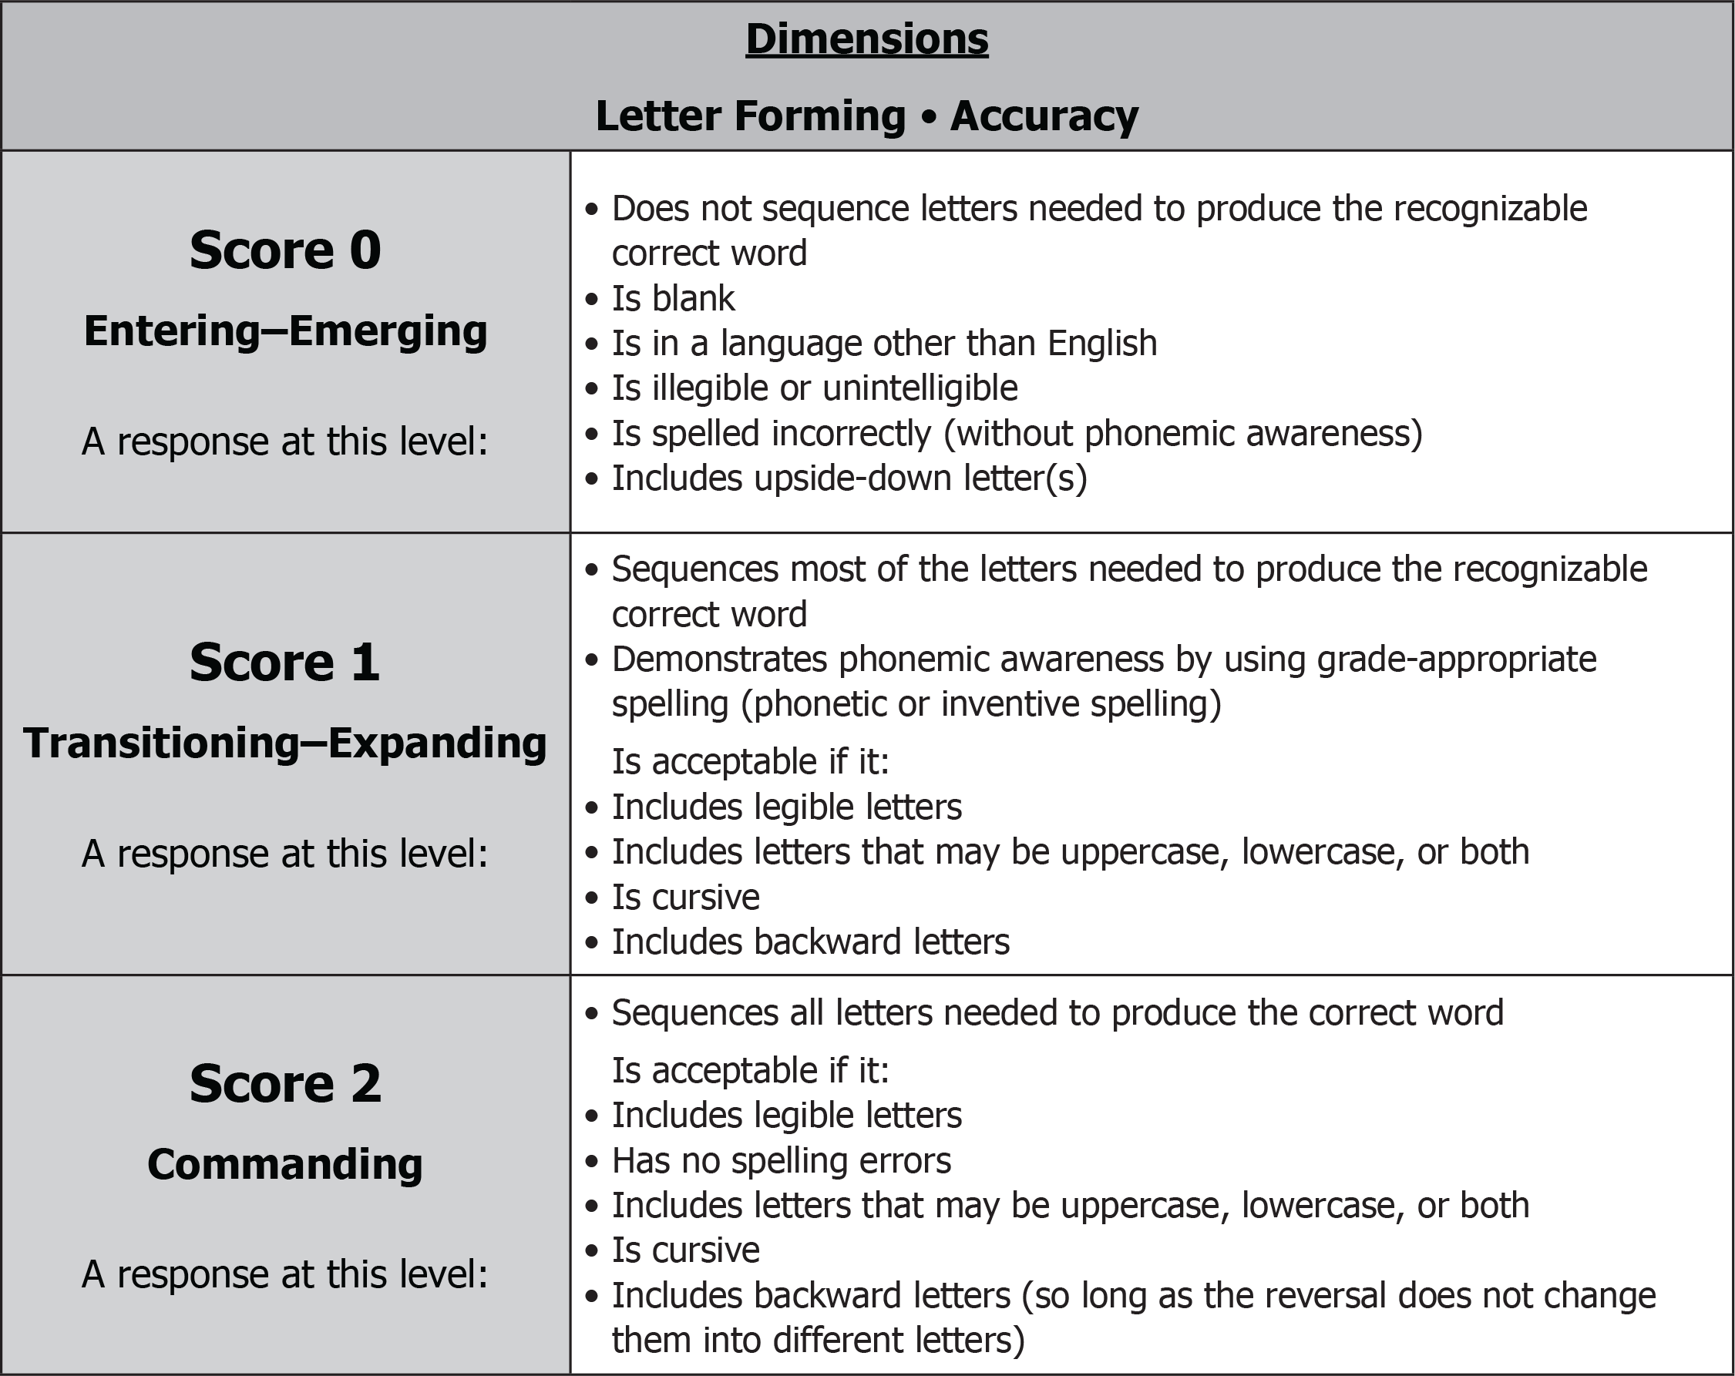
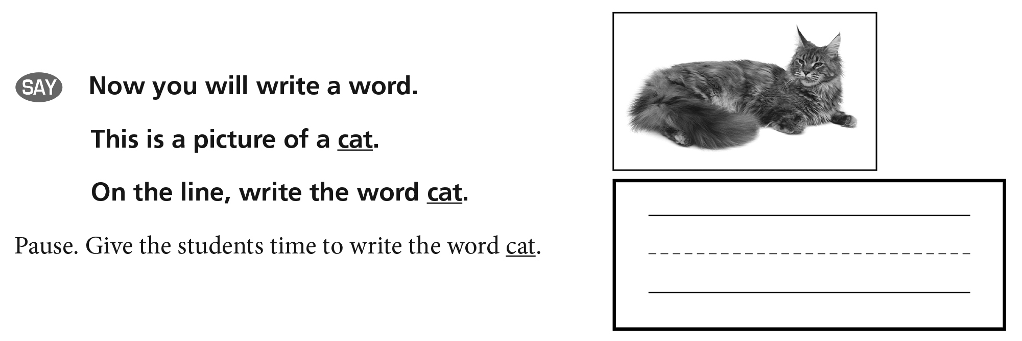
Grade K: Word Writing Rubric and Prompt
(binder page 137 for prompt and samples)

Slide 8
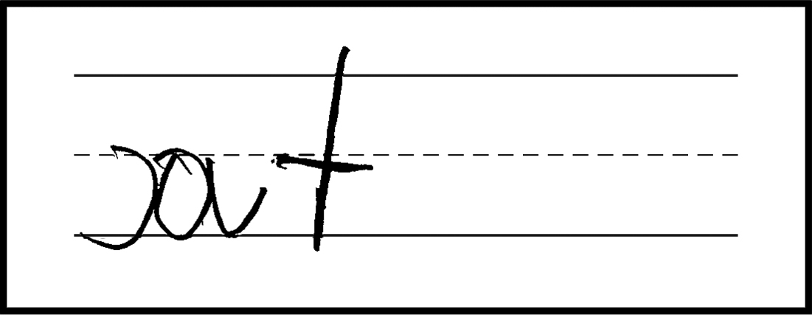
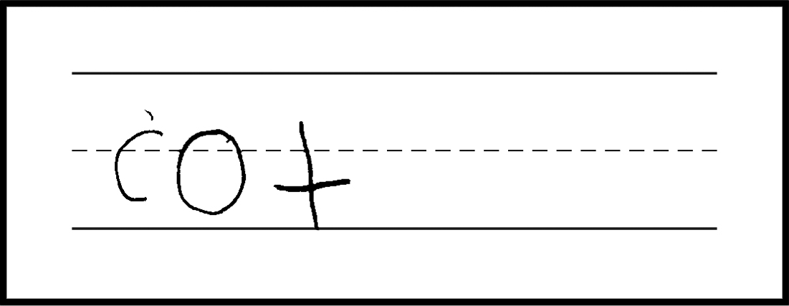
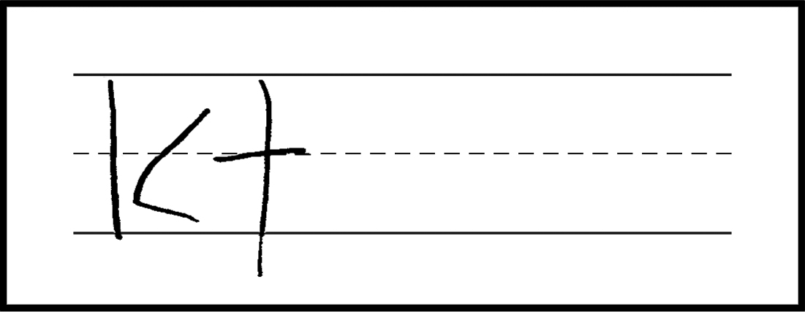
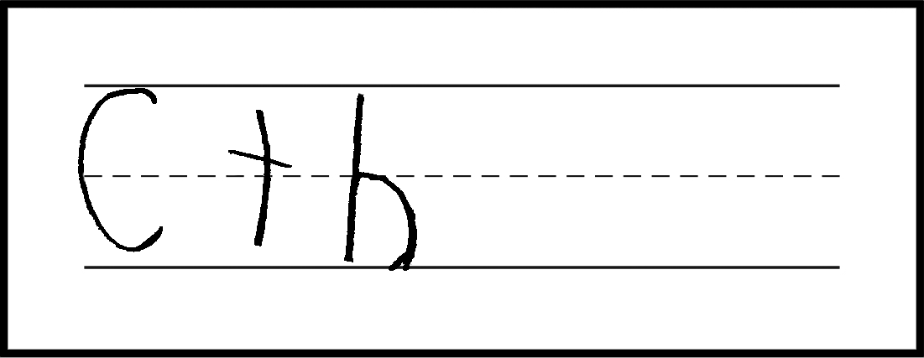
Grade K: Word Writing Samples—cat
1
2
3
Score: 2 (Commanding)
Score: 1 (Transitioning-Expanding)
Score: 1 (Transitioning-Expanding)
Response sequences all letters needed to produce the correct word. Response includes a backward letter (reversal does not change it into a different letter).
Response sequences most of the letters needed to produce the recognizable correct word (contains the correct initial and terminal phonemes and letters, with an incorrect vowel).
Response demonstrates phonemic awareness by using grade-appropriate spelling.
Response sequences most of the letters needed to produce the recognizable correct word (contains the correct initial phoneme with the rest of the letters correctly produced and sequenced).
Response demonstrates phonemic awareness by using grade-appropriate spelling.
Response includes letters that may be both uppercase and lowercase.
4
5
6
Score: 1 (Transitioning-Expanding)
Score: 0 (Entering-Emerging)
Score: 0 (Entering-Emerging)
Response sequences most of the letters needed to produce the recognizable correct word (contains the correct initial and terminal phonemes and letters, with a missing middle phoneme and letter).
Response demonstrates phonemic awareness by using grade-appropriate spelling.
Response does not sequence letters needed to produce the recognizable correct word (while the student demonstrates some phonemic awareness of the initial and terminal phonemes, the response does not produce and sequence most of the correct letters in the correct order).
Response does not sequence letters needed to produce the recognizable correct word.
Response is spelled incorrectly.
*Please see your binder for a full rubric*

Slide 9
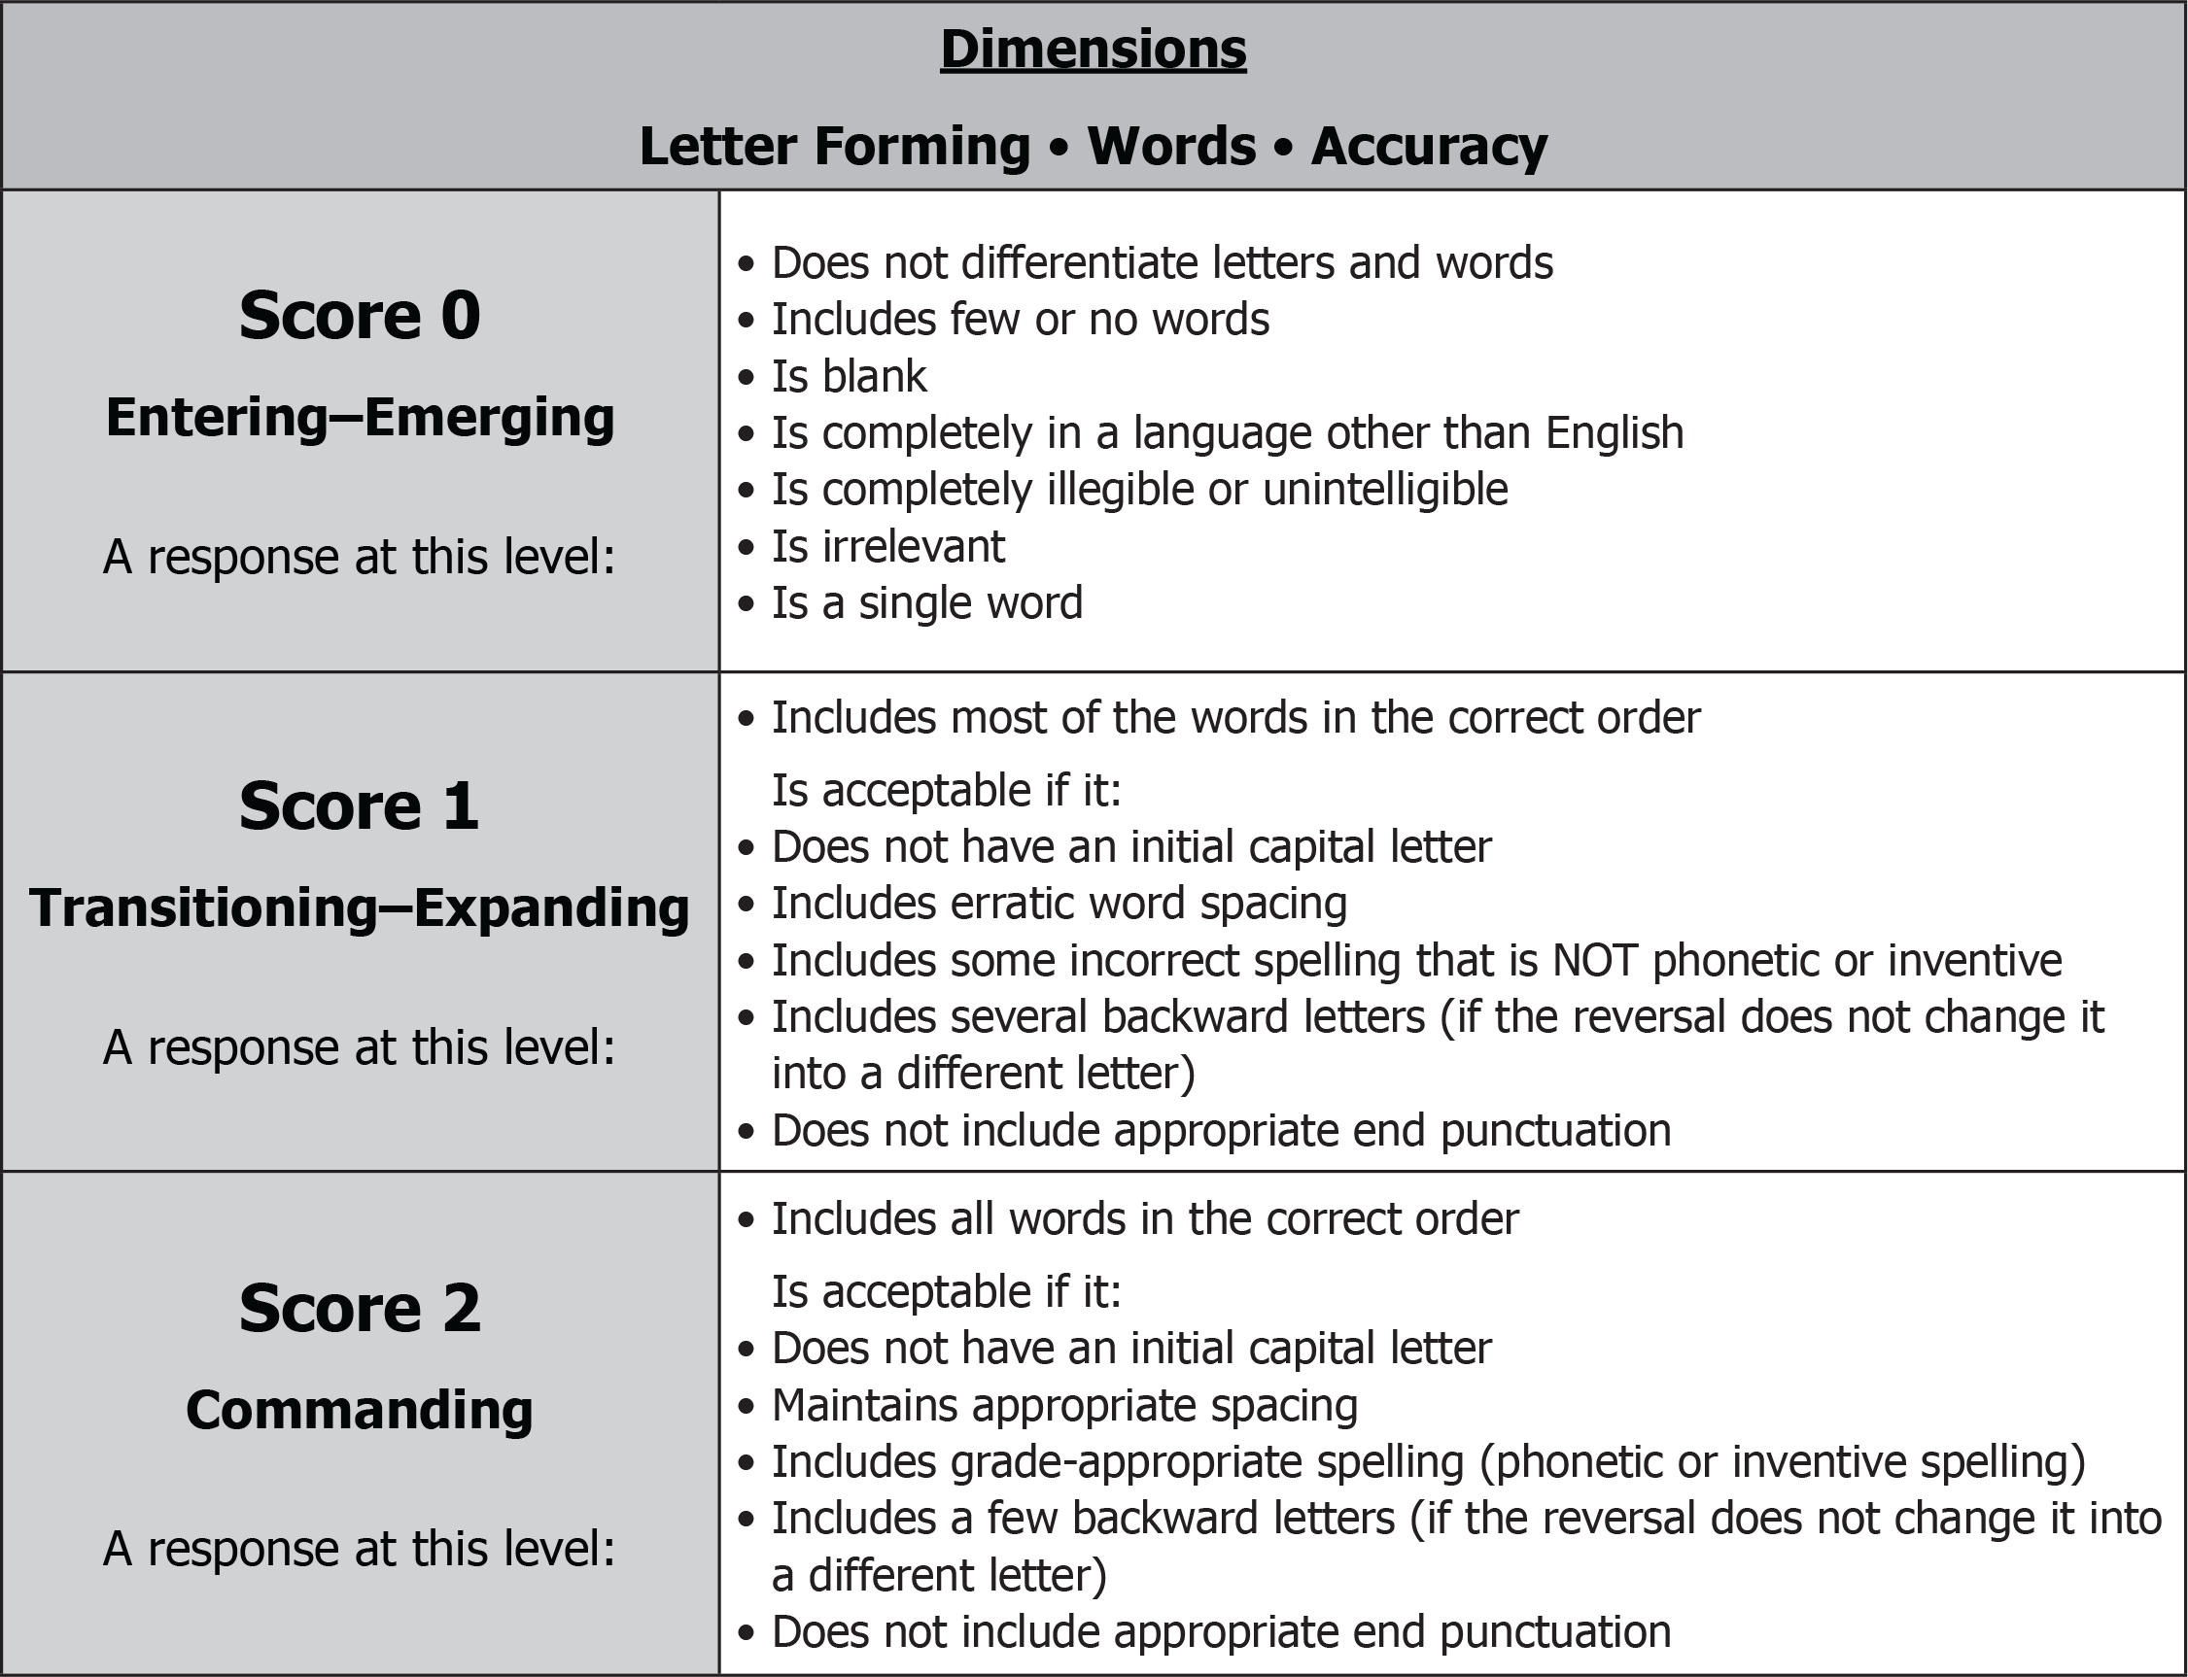
Grade K: Sentence Writing Rubric and Prompt
(binder page 143 for prompt and samples)

Slide 10
Grade K: Sentence Writing Samples
1
2
Score: 2 (Commanding)
Score: 2 (Commanding)
Response includes all words in the correct order.
Response includes grade-appropriate spelling (phonetic or inventive spelling).
Response does not include appropriate end punctuation.
Response includes all words in the correct order.
Response does not have an initial capital letter.
Response includes grade-appropriate spelling (phonetic or inventive spelling).
Response does not include appropriate end punctuation.
3
4
Score: 2 (Commanding)
Score: 1 (Transitioning-Expanding)
Response includes all words in the correct order.
Response includes most of the words in the correct order (initial and terminal words).
Response does not have an initial capital letter.
Response does not include appropriate end punctuation.

Slide 11
Grade K: Sentence Writing Samples
5
6
Score: 1 (Transitioning-Expanding)
Score: 1 (Transitioning-Expanding)
Response includes most of the words in the correct order (initial and terminal words).
Response does not have an initial capital letter.
Response includes some incorrect spelling that is not phonetic or inventive.
Response includes most of the words in the correct order.
Response does not have an initial capital letter.
Response includes some incorrect spelling that is not phonetic or inventive (letter reversal turns a p into a q).
Response does not include appropriate end punctuation.
7
8
Score: 1 (Transitioning-Expanding)
Score: 0 (Entering-Emerging)
Response includes most of the words in the correct order.
Response includes some incorrect spelling that is not phonetic or inventive (wiol is unacceptable for will).
Response does not include appropriate end punctuation.
Response is irrelevant.
Response is a single word.
*Please see your binder for a full rubric*

Slide 12
Write A Story Writing Rubric
Dimensions of the rubric in the first column
Performance levels across the top
Score the response based on the best performance level for the majority of the dimensions
Responses that are completely irrelevant to the prompt can score no higher than a 1
Wording comes from Writing Targets of Measurement and Performance Level Descriptions

Slide 13
Write A Story Writing Rubric (Continued)
Complexity of Language/Quality of Language (C/QL)
Sentence Types:
Simple: The dog is barking.
Expanded: The dog is barking in the yard.
Compound: The dog is barking and it is making noise.
Complex: The dog is barking because he sees a squirrel.
Coherence of Response (CR): To provide descriptions and events to write a story or write about a topic
Mechanics (M): Use of English conventions; same across all grade levels

Slide 14
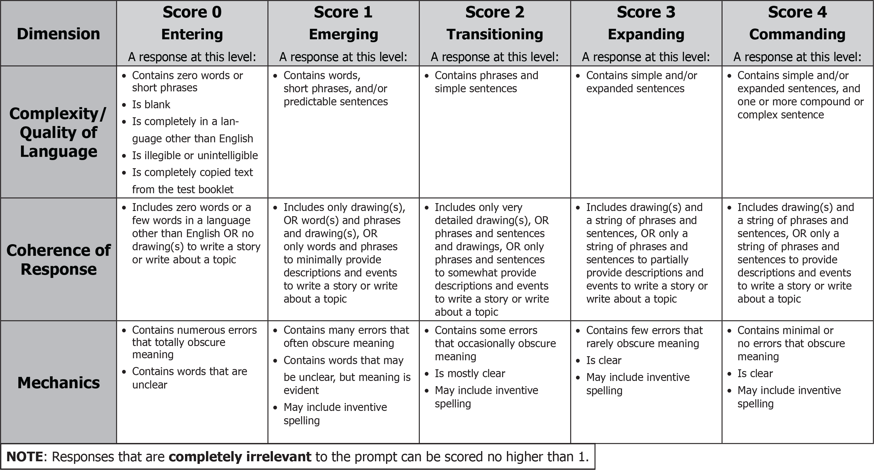
Grade K: SCR Writing Rubric

Slide 15
Grade K: SCR Prompt
(binder page 150 for prompt and samples)

Slide 16
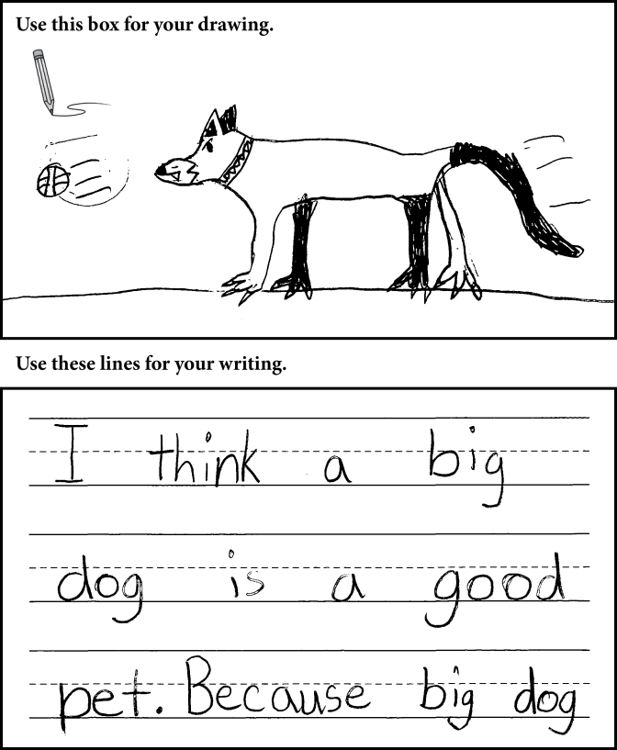
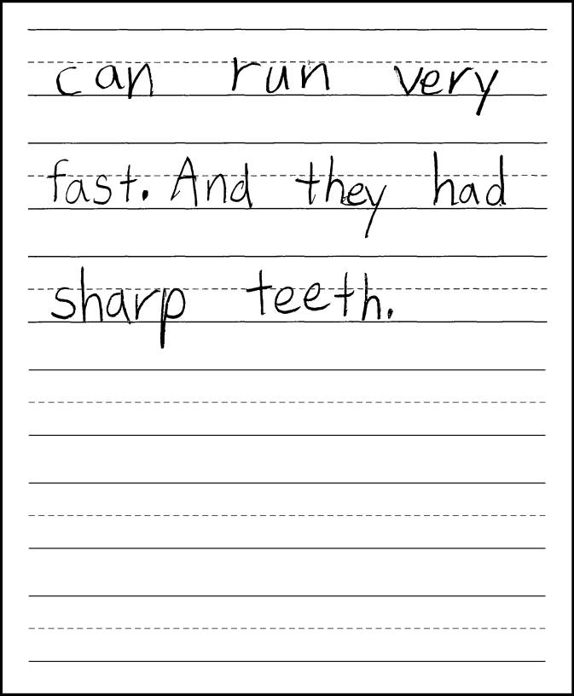
Grade K: SCR Sample 1
Score 4: Commanding
C/QL
Response contains complex and simple sentences.
CR
Response includes a drawing and sentences to provide descriptions and events to write about a topic.
M
Response is clear and contains minimal errors that obscure meaning (punctuation error).

Slide 17
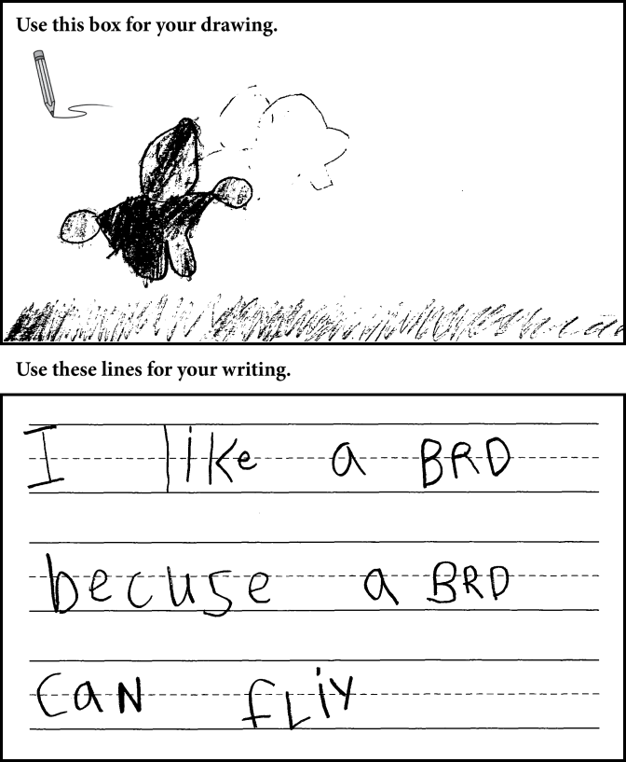
Grade K: SCR Sample 2
Score 3: Expanding
C/QL
Response contains a complex sentence.
CR
Response includes a drawing and a sentence to somewhat provide descriptions and events.
M
Response is clear and contains few errors that rarely obscure meaning (spelling error: brd for bird).

Slide 18
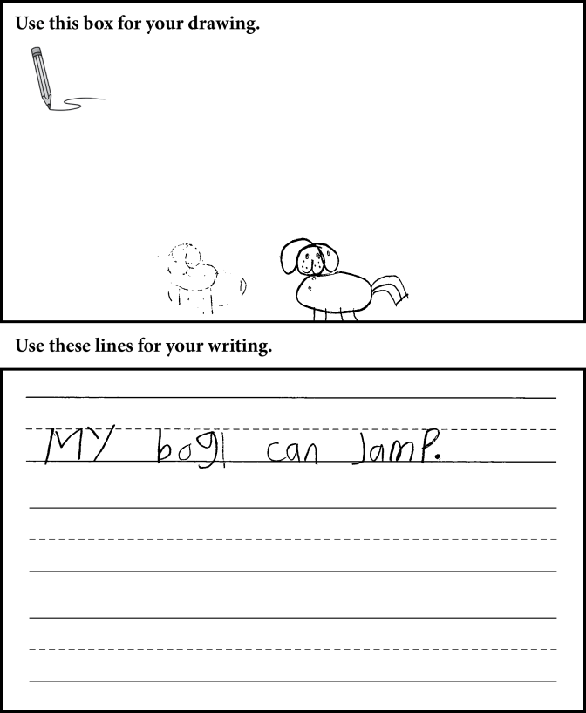
Grade K: SCR Sample 3
Score 2: Transitioning
C/QL
Response contains a simple sentence.
CR
Response includes a drawing and a sentence to somewhat provide descriptions
and events to write about a topic.
M
Response is mostly clear, but contains some errors that occasionally obscure meaning (spelling errors in a brief response: bog for dog, jamp for jump).

Slide 19
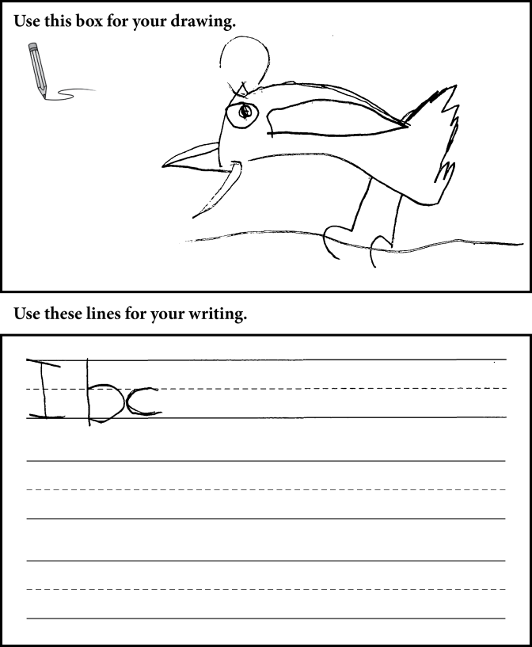
Grade K: SCR Sample 4
Score 1: Emerging
C/QL
Response is unintelligible.
CR
Response includes a drawing to minimally provide descriptions and events (see note below).
M
Response contains numerous errors that totally obscure meaning (text is a string of letters).
Note: If a response contains no text or incomprehensible text, but includes a drawing related to the prompt, the response will be scored as a holistic 1 (or a holistic 2, on the rare occasion that a drawing is very detailed).

Slide 20
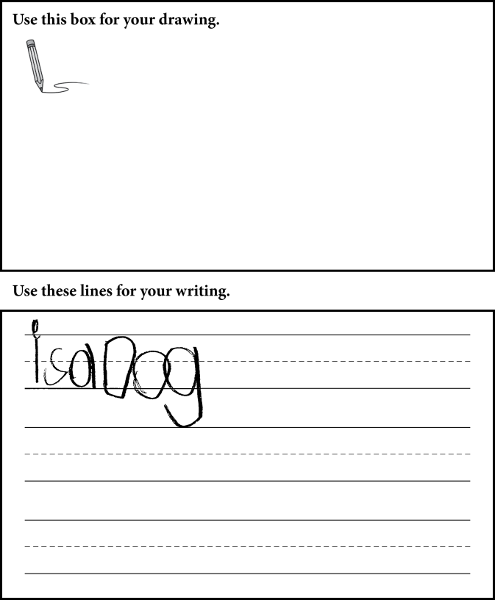
Grade K: SCR Sample 5
Score 1: Emerging
C/QL
Response contains words and a short phrase.
CR
Response includes only words and phrases to minimally provide descriptions.
M
Response contains errors that often obscure meaning (unsuccessful attempted sentence).

Slide 21
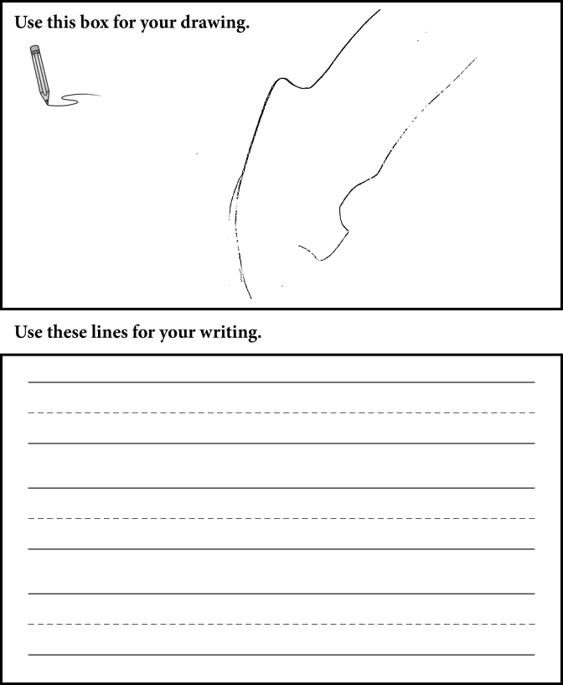
Grade K: SCR Sample 6
Score 0: Entering
C/QL
Response contains zero words or short phrases.
CR
Response includes zero words and no drawings to write about a topic (drawing is not recognizable as being related to the prompt).
M
Response contains zero words written in response to the prompt.

Slide 22
Additional Practice Items
Kindergarten practice items, including scores and justifications, can be found in the Turnkey materials
Letter Writing starts on page 133
Word Writing starts on page 139
Sentence Writing Starts on page 145
Write a Story SCR starts on page 161

Slide 23
2019 NYSESLAT Resources
For Information or Assistance | Contact
Questions regarding testing policies, accommodations, security breaches and sensitive student responses | Office of State Assessment Email: emscassessinfo@nysed.gov Call: 518-474-5902
Questions regarding the provisions of ELL/MLL services in Bilingual Education and English as a New Language programs | Office of Bilingual Education and World Languages Email: obewl@nysed.gov Phone: 518-474-8775 (Albany office) Phone: 718-722-2445 (NYC office)
Questions regarding scoring of Speaking and Writing constructed-response questions or shipment of materials | MetriTech, Inc. Customer Service Email: nyseslat@metritech.com Phone: 800-747-4868 Fax: 217-398-5798

Slide 24
2019 NYSESLAT Resources (Continued)
For Information or Assistance | Contact
For regulatory or training assistance: | Regional Bilingual Education Resource Networks http://www.nysed.gov/bilingual-ed/regional-supportrberns
Machine-scannable answer sheets and local scanning services | RIC or Large-City Scanning Center http://www.p12.nysed.gov/irs/sirs/ric-big5.html
Information about the NYSESLAT and regular updates including the turnkey training materials and School Administrators Manual (SAM) | NYSESLAT Homepage http://www.p12.nysed.gov/assessment/nyseslat

