Slide 2
Extended Constructed Response (ECR)
Extended Constructed-Response Training
  Grades 1–2 and 7–8
  Sample student responses
ECR Task Type
  Two-or-more-paragraph response
  Narrative: Characters, sequenced events, details
  Informational: Ideas, claims, evidence

Slide 3
Writing Rubric Overview
Five dimensions of the rubric in the first column
Five performance levels across the top
Score the response based on the best performance level for the majority of the dimensions
Responses that are completely irrelevant to the prompt can score no higher than a 1
Degree of Response is split into SCR, ECR Narrative, and ECR Informational
Wording comes from Writing Targets of Measurement and Performance Level Descriptions

Slide 4
Five Rubric Dimensions
Complexity of Language (CL)
  Sentence Types:
    Simple: The dog is barking.
    Expanded: The dog is barking in the yard.
    Compound: The dog is barking and it is making noise.
    Complex: The dog is barking because he sees a squirrel.

Slide 5
Five Rubric Dimensions (Continued)
Quality of Language (QL)
  Grade-level vocabulary:
    Tier 1: Basic vocabulary for communicative purposes
      picture, drawing
    Tier 2: General academic vocabulary
      diagram of a cell
      Venn diagram
    Tier 3: Specific content-area vocabulary
      mitochondria (in the cell diagram)
      separation of powers (in a social studies Venn diagram)
Glossary in binder appendix has additional examples

Slide 6
Five Rubric Dimensions (Continued)
Coherence of Response (CR): Level of organization
Degree of Response (DR): Level of Detail
Mechanics (M): Use of English conventions; same across all
grade levels

Slide 7
Application of the Holistic Writing Rubrics
Become familiar with the rubric for the particular grade band
Become familiar with the passage and prompt
Read the response to the prompt
Student responses are evaluated for total, overall performance
Scores are assigned based on the criteria delineated in the rubric
  Match evidence from the response to the language of the rubric
  Look for what is included in the response, not what is missing
The highest point on a rubric scale does not measure a “perfect” response
On the written tests, handwriting does not count
  (binder page 86 for samples and practice)

Slide 8
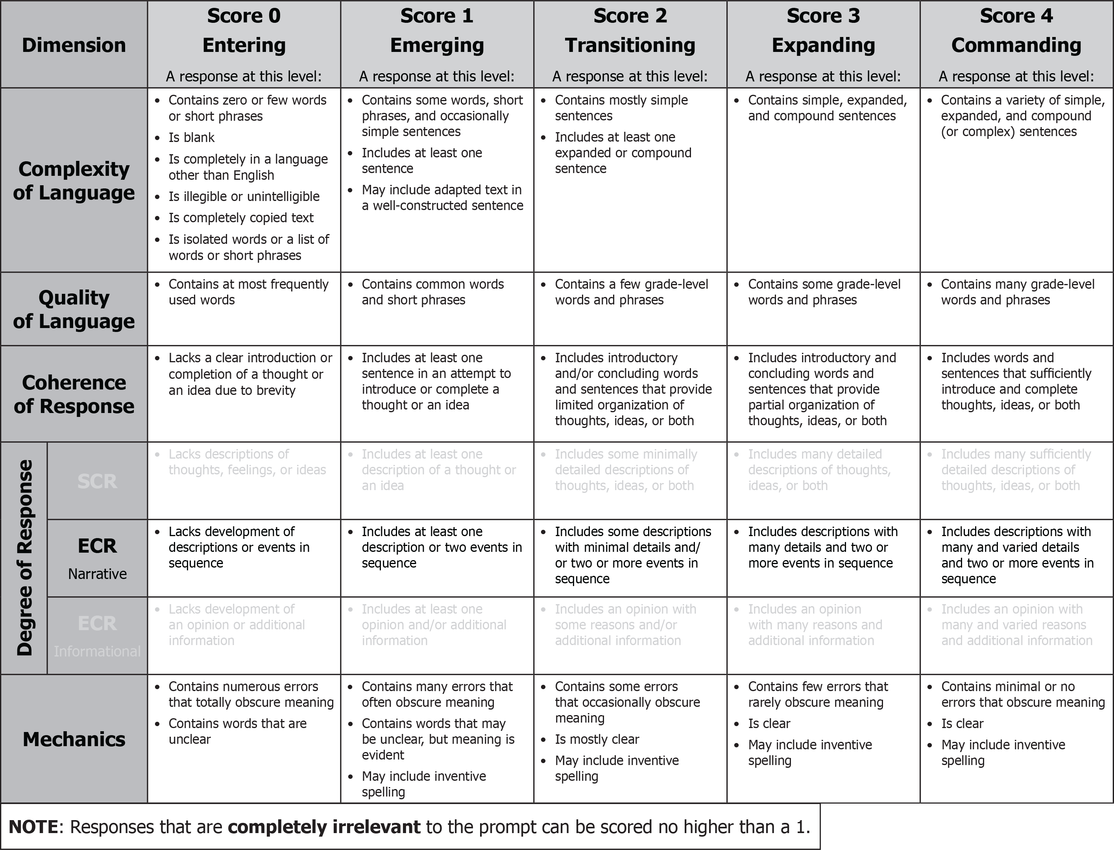
Grades 1–2: ECR Rubric (Narrative)

Slide 9
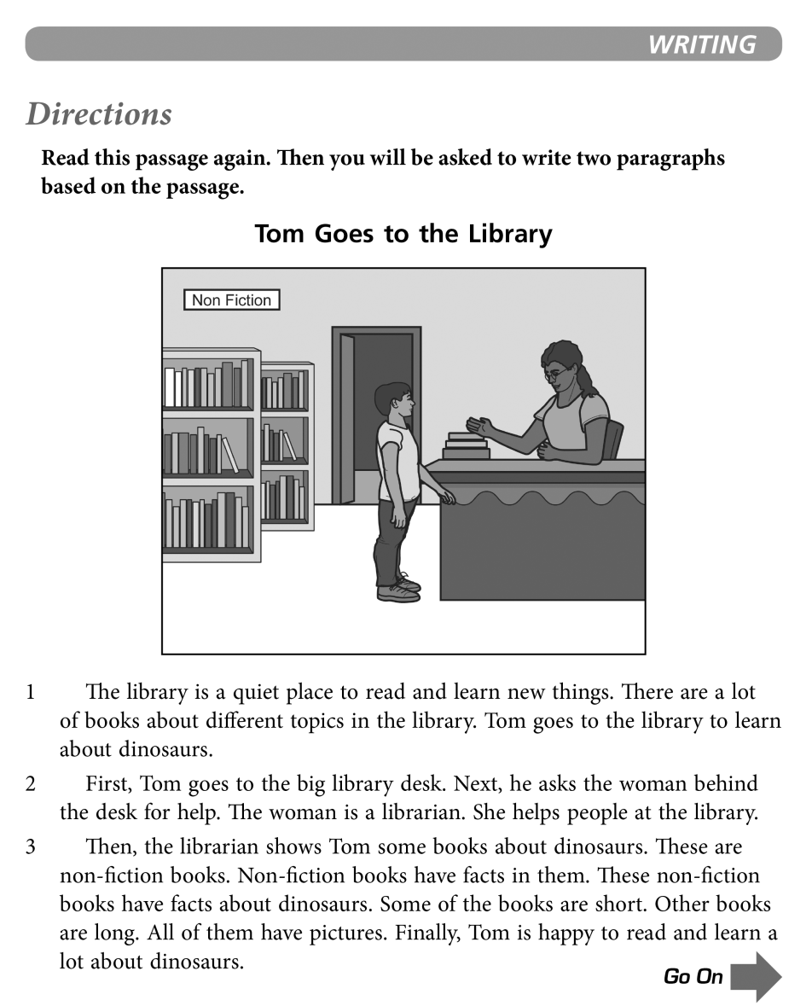
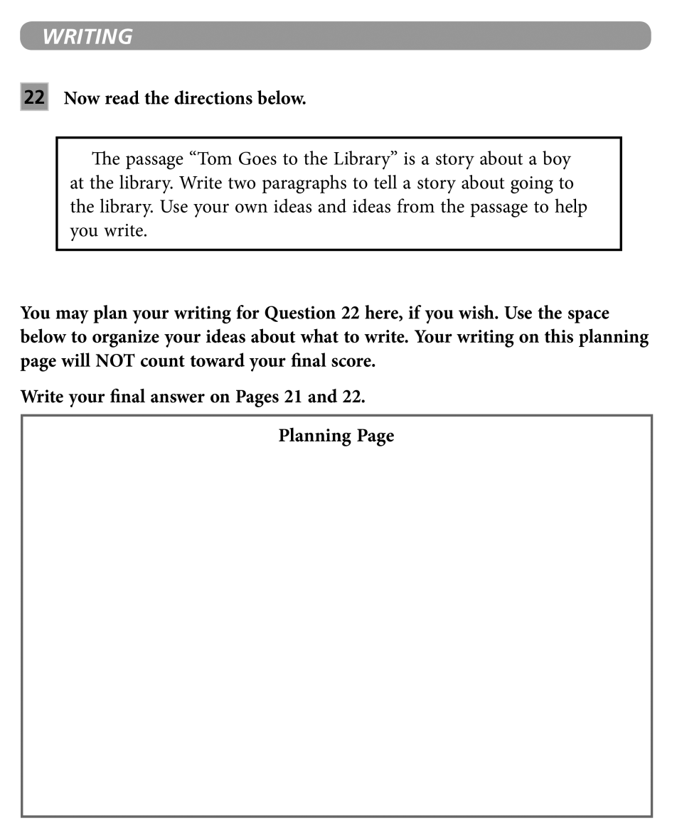
Grades 1–2: ECR Prompt

Slide 10
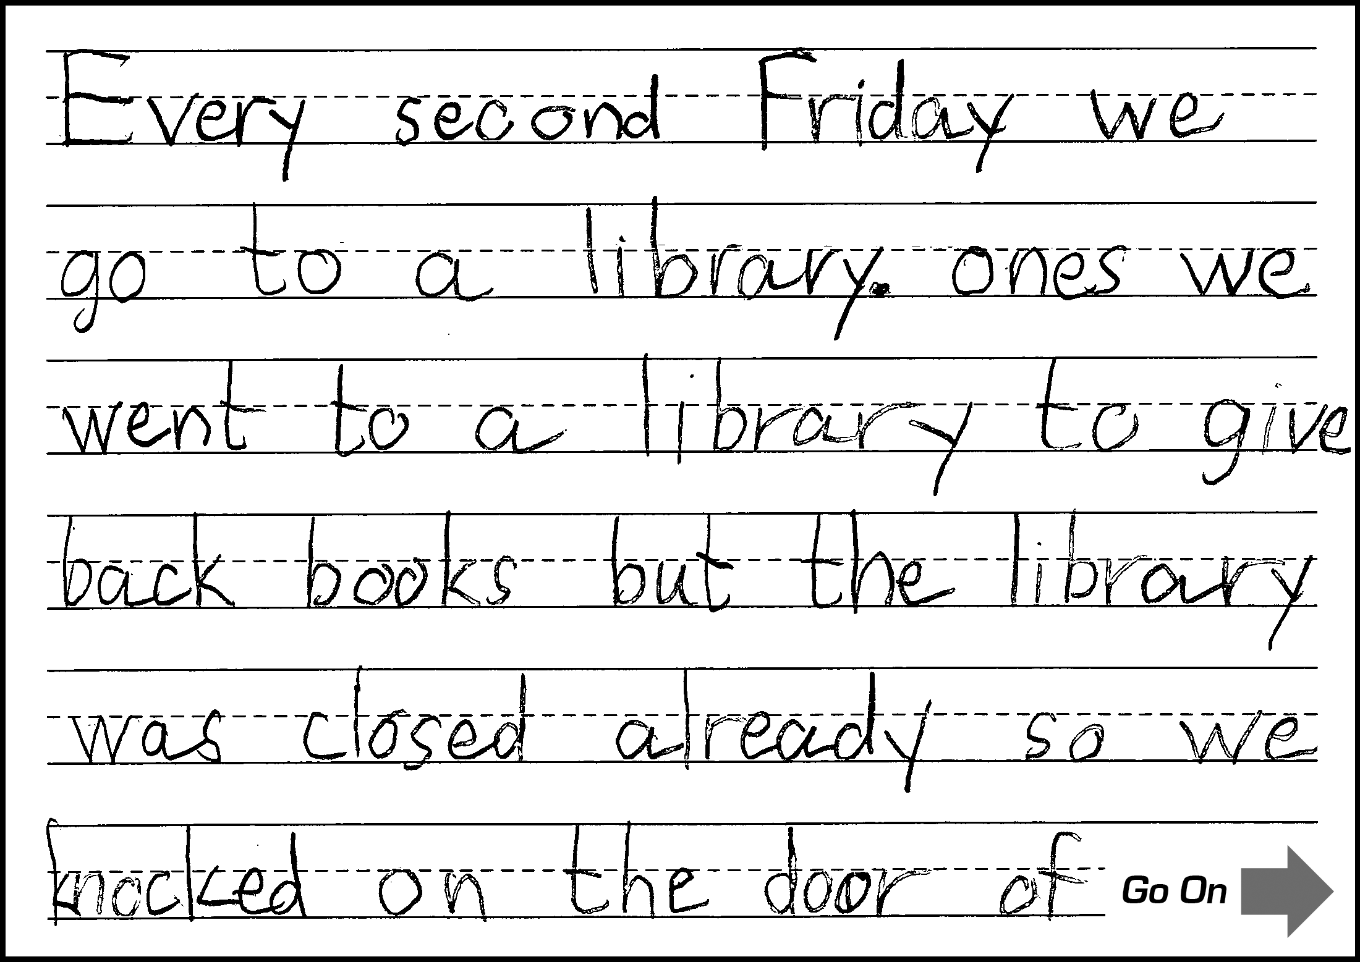
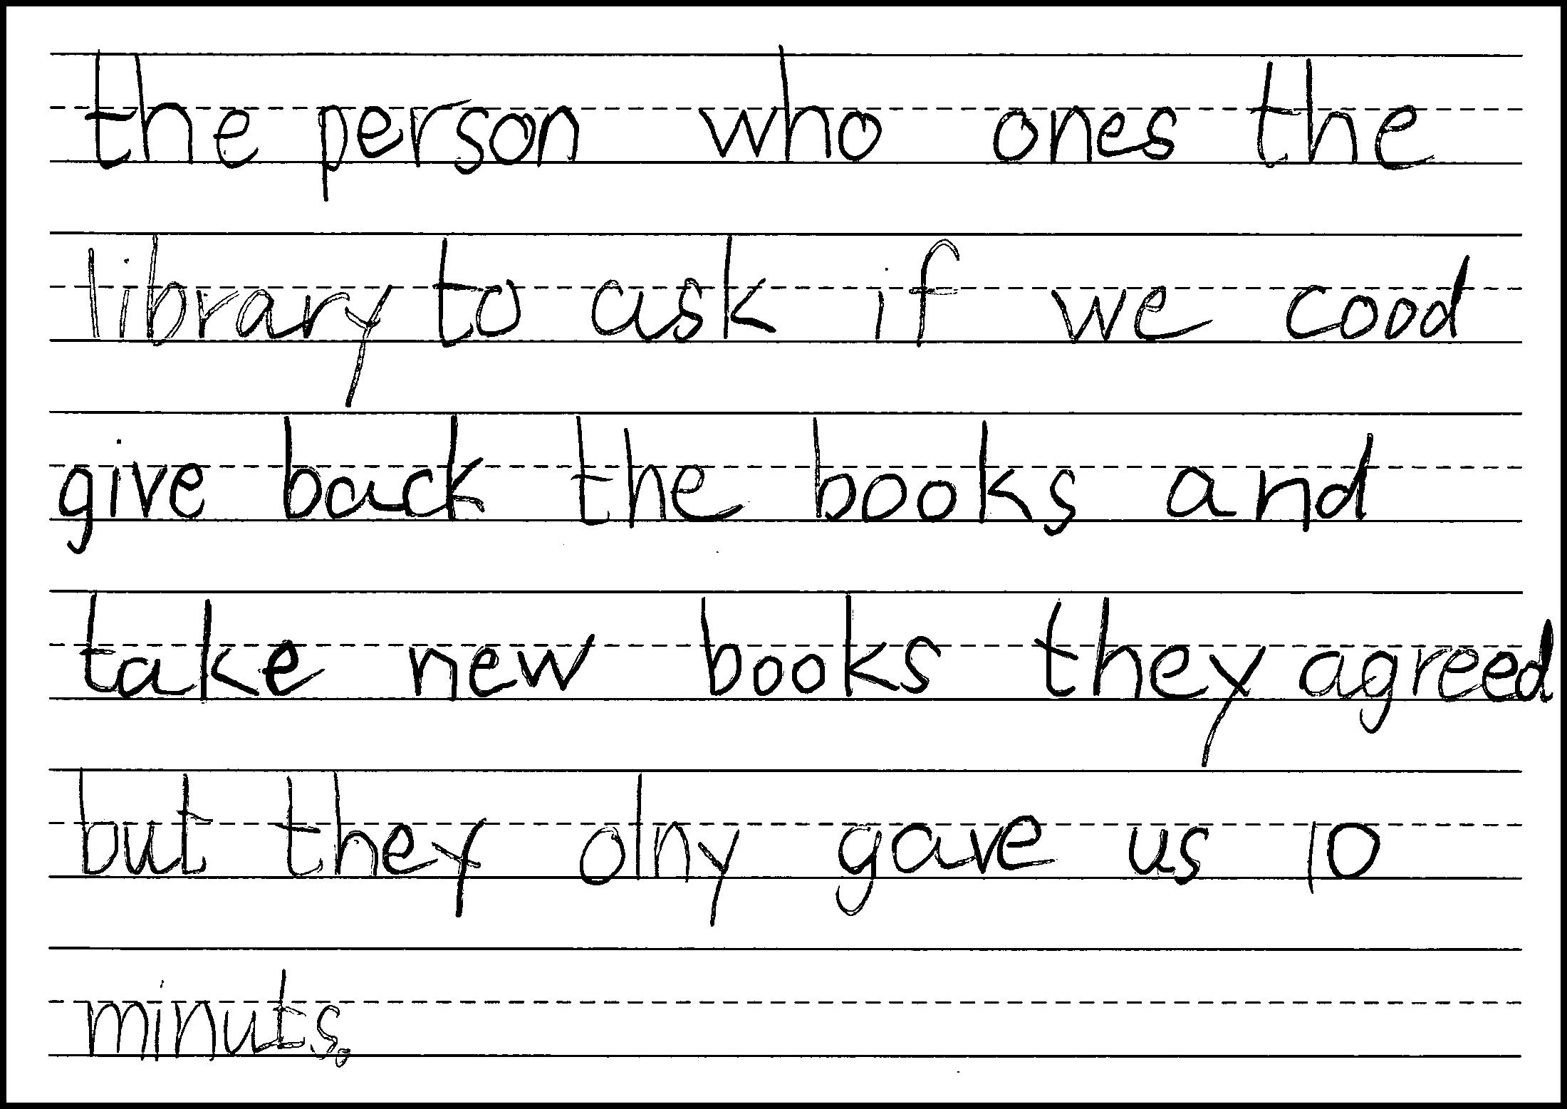
Grades 1–2: ECR Sample 1
Score 4: Commanding
CL
Response contains a variety of expanded, compound, and
complex sentences.
QL
Response contains some grade-level words and phrases
(e.g., every second Friday, agreed, gave us 10 minutes).
CR
Response includes words and sentences that sufficiently introduce and complete thoughts, ideas, or both.
DR
Response includes descriptions with many and varied details and two or more events in sequence.
M
Response is clear and contains minimal errors that
obscure meaning.
*Please see your binder for a full rubric*

Slide 11
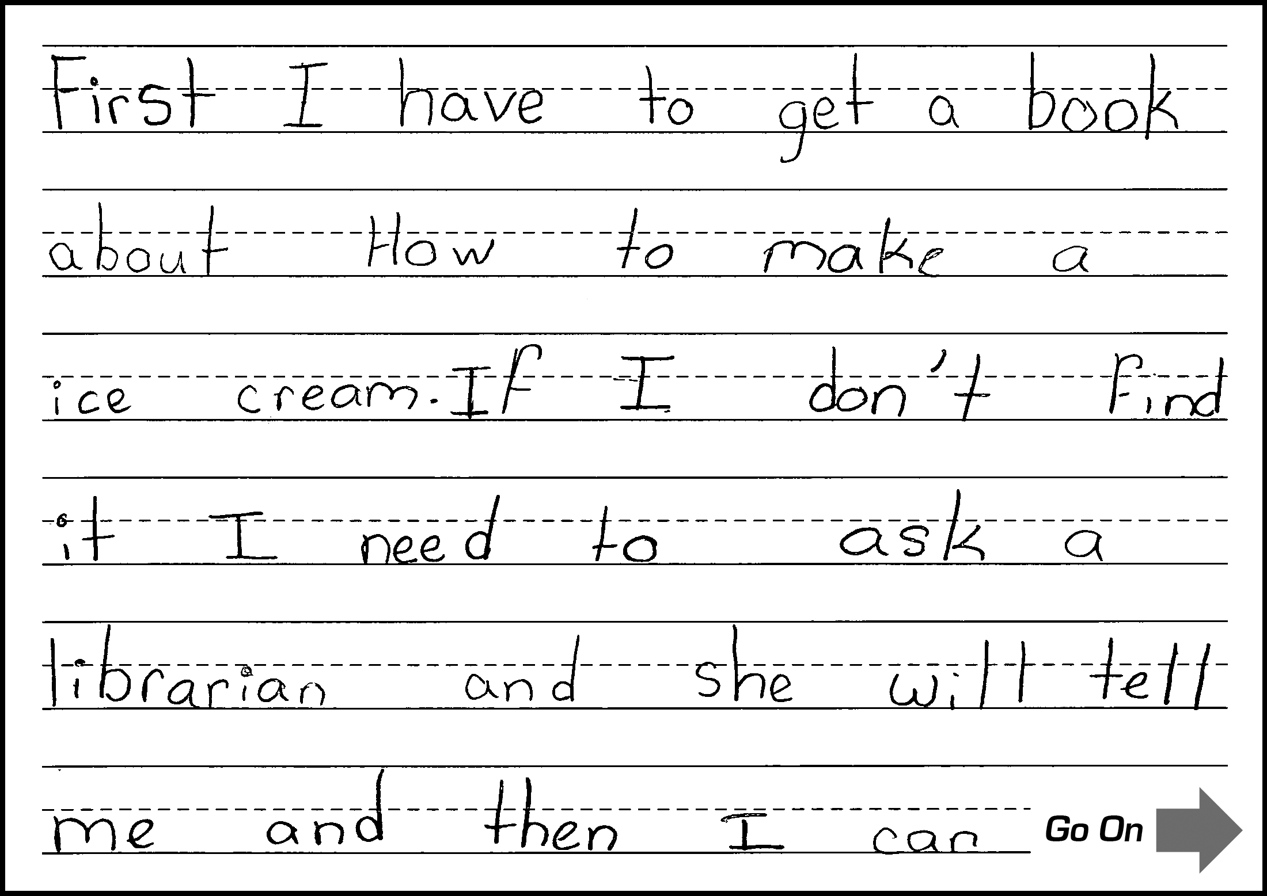
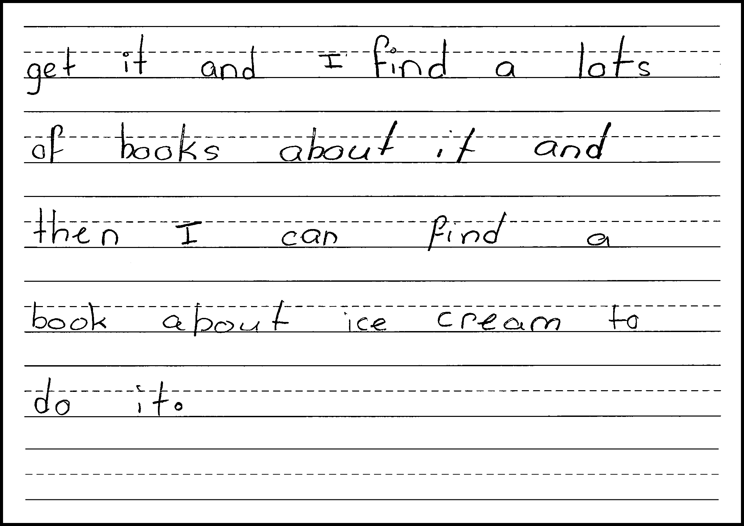
Grades 1–2: ECR Sample 2
Score 3: Expanding
CL
Response contains simple, expanded, compound, and complex sentences (repetitive and structure limits variety of sentences).
QL
Response contains a few grade-level words and phrases
(e.g., librarian).
CR
Response includes introductory and concluding words and sentences that provide partial organization of thoughts, ideas, or both (has an introduction and connected ideas, but the smooth progression of ideas is at times impeded by the repetitive use of the conjunction and).
DR
Response includes descriptions with many details and two or more events in sequence (repetitive description of getting/finding a book limits variety of details).
M
Response is clear and contains no errors that obscure meaning.
*Please see your binder for a full rubric*

Slide 12
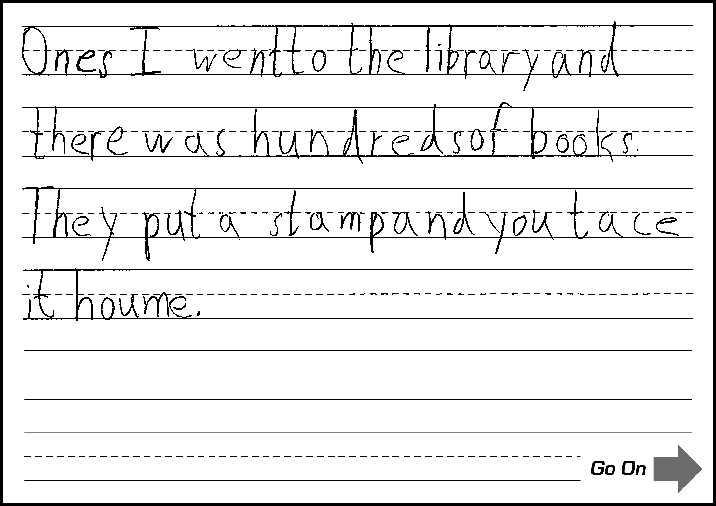
Grades 1–2: ECR Sample 3
Score 2: Transitioning
CL
Response contains compound sentences.
QL
Response contains a few grade-level words and phrases
(e.g., hundreds, stamp).
CR
Response includes introductory and/or concluding words and sentences that provide limited organization of thoughts, ideas,
or both (has an introduction and a very brief body of
connected ideas).
DR
Response includes some descriptions with minimal detail and/or two or more events in sequence (some details in a brief response).
M
Response is clear and contains few errors that rarely obscure meaning (spelling errors: ones for once).
*Please see your binder for a full rubric*

Slide 13
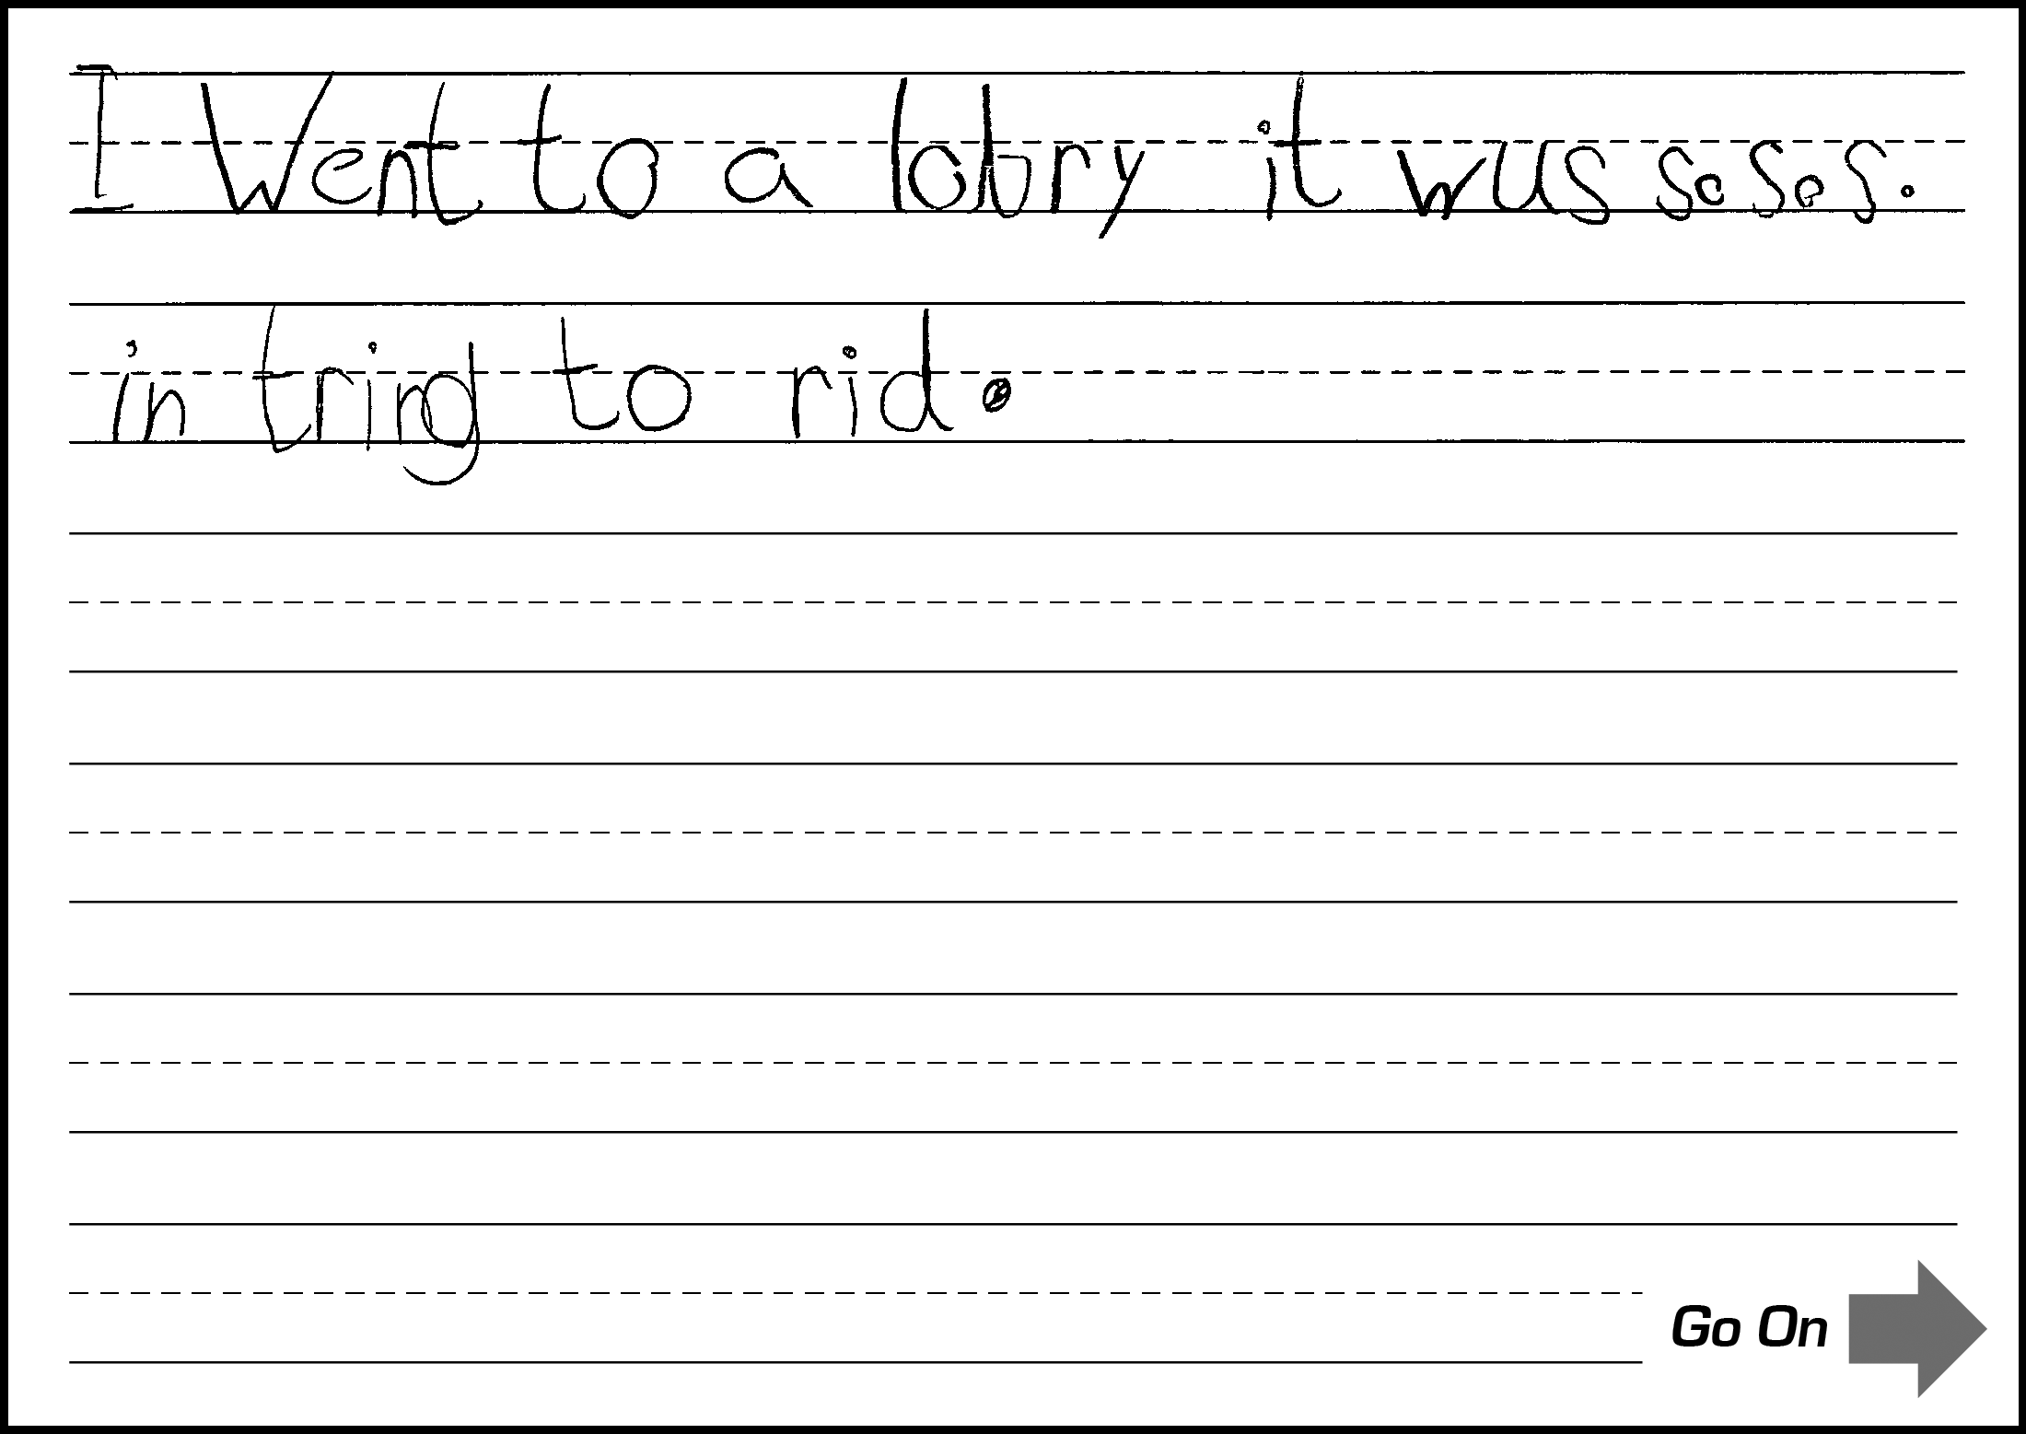
Grades 1–2: ECR Sample 4
Score 1: Emerging
CL
Response includes at least one expanded sentence (the first sentence is expanded and the attempt at a second expanded sentence is impeded by errors).
QL
Response contains common words and short phrases.
CR
Response includes at least one sentence in an attempt to introduce or complete a thought or an idea.
DR
Response includes at least one description or two events
in sequence.
M
Meaning is evident, but response contains many errors that often obscure meaning (spelling errors obscure most of the response).
*Please see your binder for a full rubric*

Slide 14
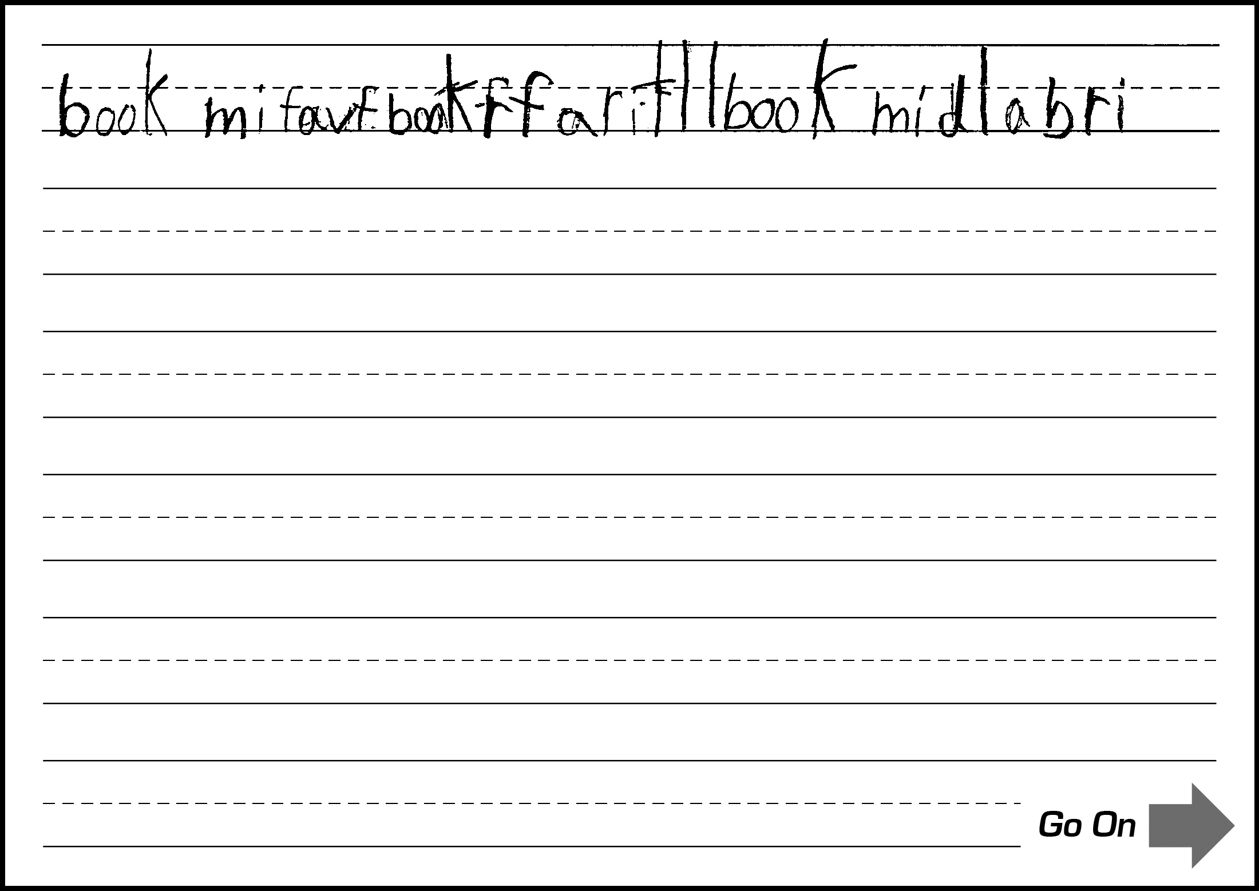
Grades 1–2: ECR Sample 5
Score 0: Entering
CL
Response contains few words and short phrases (any sentence structure present is obscured by errors).
QL
Response contains at most frequently used words
(most words are obscured by errors).
CR
Response lacks a clear introduction or completion of a thought
or an idea due to brevity (errors obscure meaning in most
of response).
DR
Response lacks development of descriptions or events
in sequence.
M
Response contains numerous errors that totally obscure meaning.
*Please see your binder for a full rubric*

Slide 15
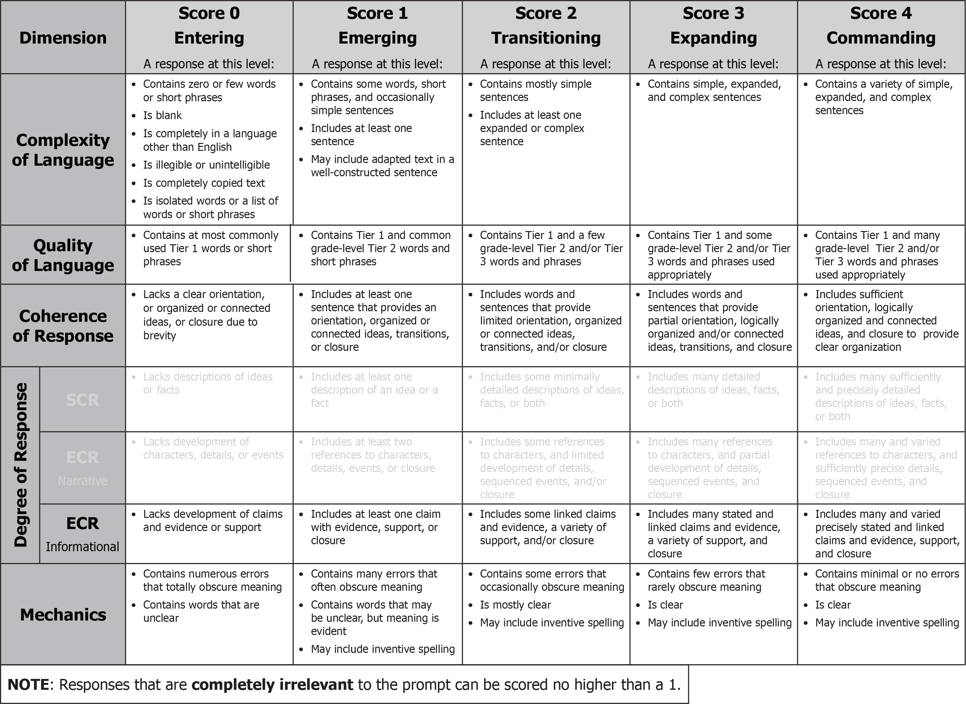
Grades 7–8: ECR Rubric (Informational)

Slide 16
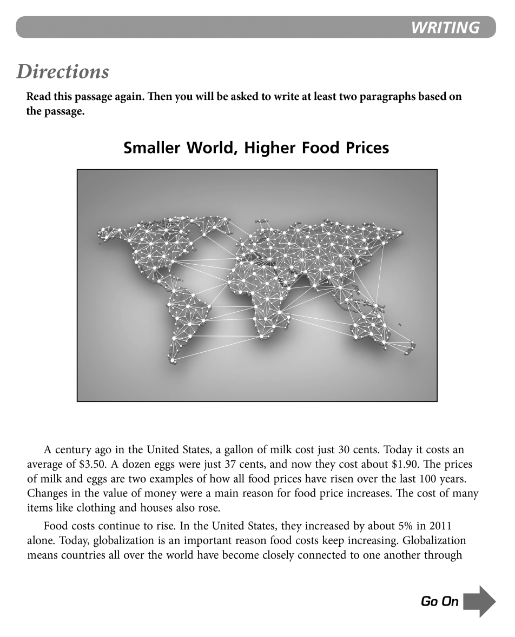
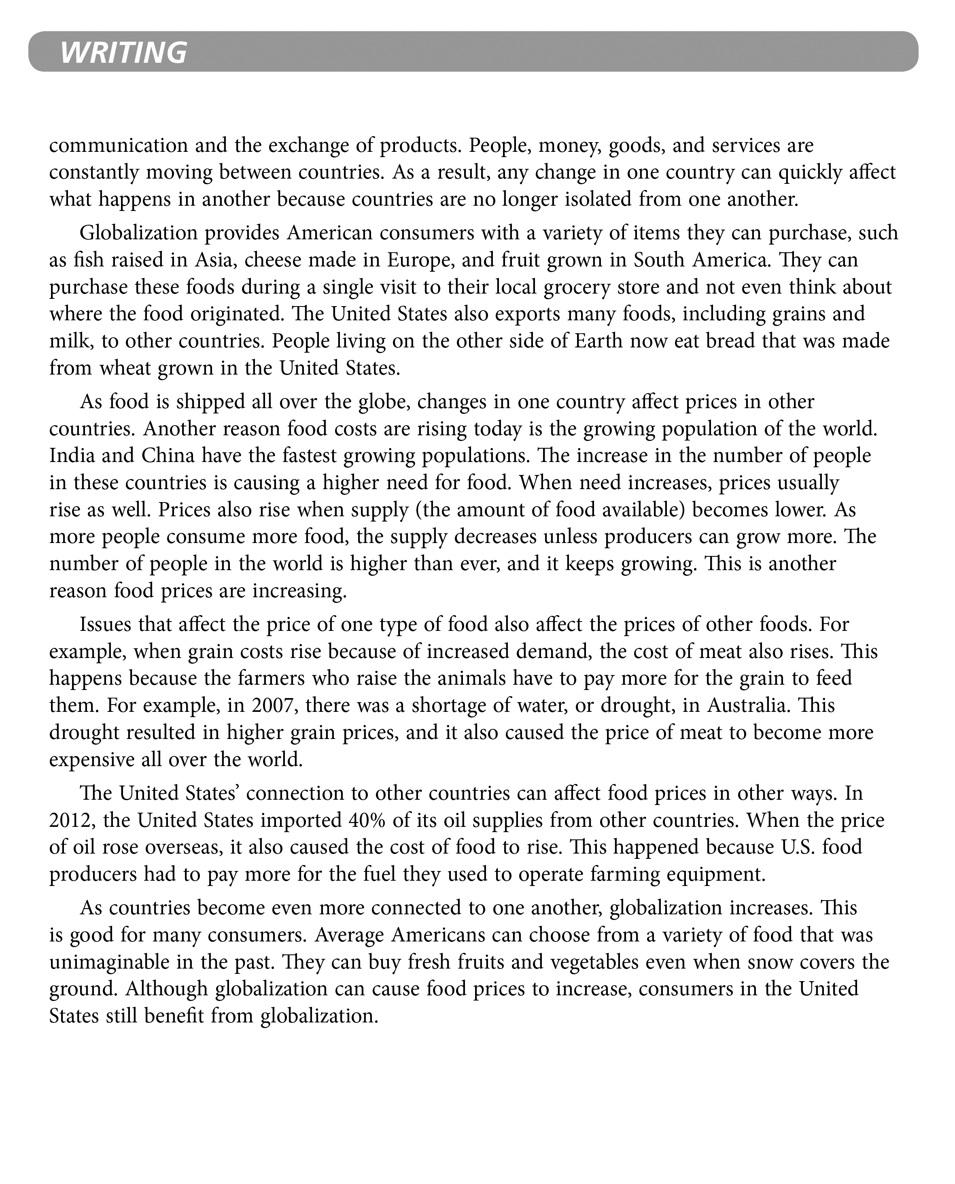
Grades 7–8: ECR Prompt
(binder page 108 for prompt and samples)

Slide 17
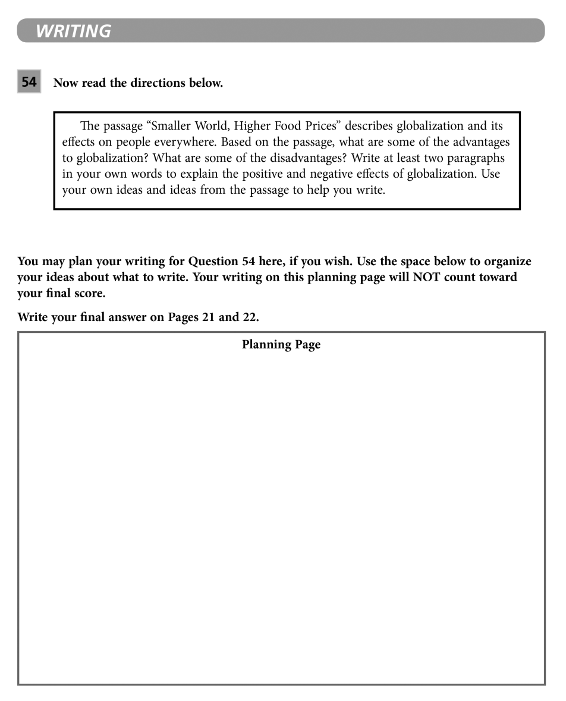
Grades 7–8: ECR Prompt (Continued)

Slide 18
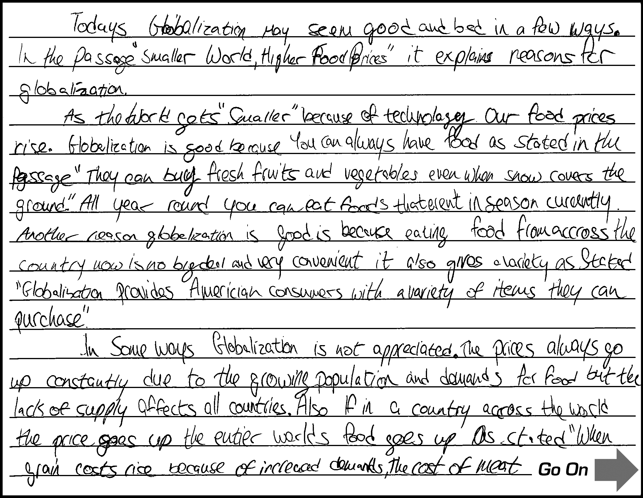
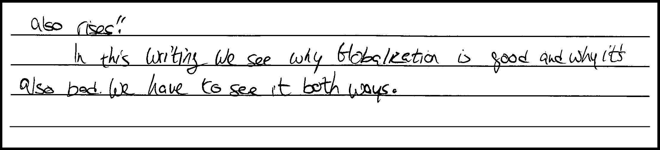
Grades 7–8: ECR Sample 1
Score 4: Commanding
CL
Response contains a variety of simple, expanded, and
complex sentences.
QL
Response contains many Tier 2 and/or Tier 3 words and phrases used appropriately (e.g., technology, in season, convenient, growing population and demands for food, lack of supply).
CR
Response includes sufficient orientation, logically organized and connected ideas, and closure to provide clear organization.
DR
Response includes many and varied precisely stated and linked claims and evidence, support, and closure.
M
Response is clear and contains minimal errors that obscure meaning (e.g., spelling errors: eren’t for aren’t).
*Please see your binder for a full rubric*

Slide 19
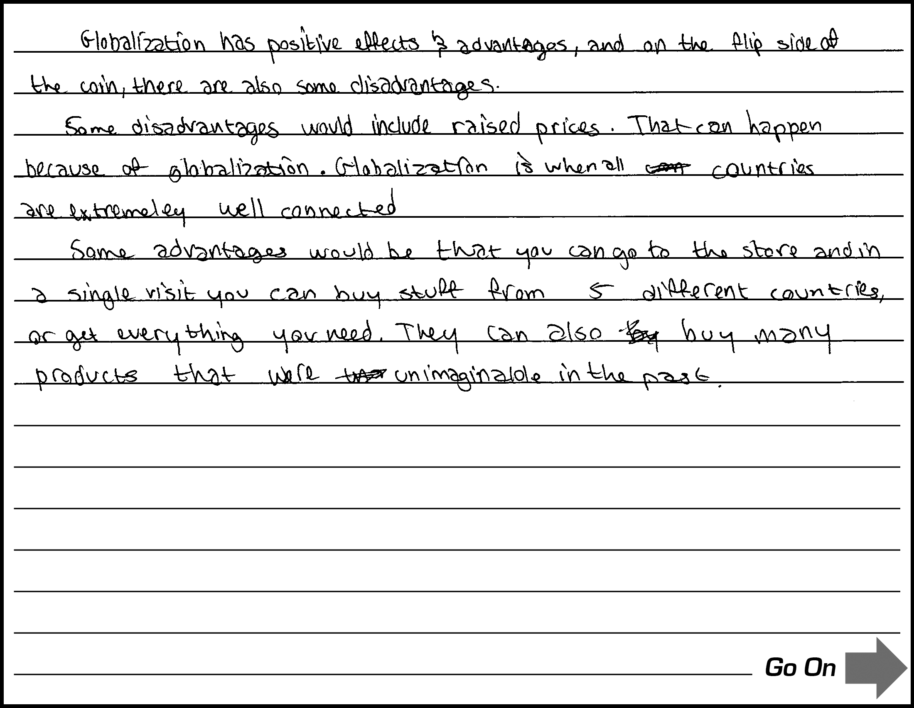
Grades 7–8: ECR Sample 2
Score 3: Expanding
CL
Response contains expanded and complex sentences.
QL
Response contains many Tier 2 and/or Tier 3 words and phrases used appropriately (e.g., flip side of the coin, extremely well connected, in a single visit, unimaginable in the past).
CR
Response includes words and sentences that provide partial orientation, logically organized and/or connected ideas, transitions, and closure (has an introduction and connected ideas, but response lacks closure and at times lacks a smooth and clear progression of ideas).
DR
Response includes many stated and linked claims and evidence, support, and closure (some supported claims are present, but they lack sufficient elaboration).
M
Response is clear and contains no errors that obscure meaning.
*Please see your binder for a full rubric*

Slide 20
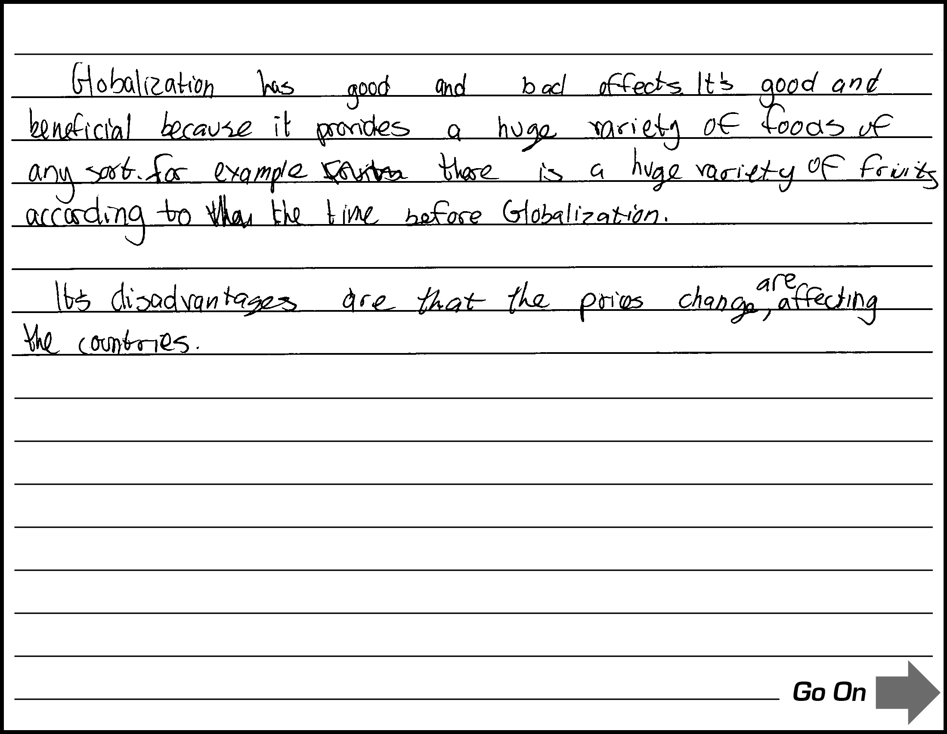
Grades 7–8: ECR Sample 3
Score 2: Transitioning
CL
Response contains expanded and complex sentences.
QL
Response contains a few Tier 2 and/or Tier 3 words and phrases (e.g., beneficial, variety of foods).
CR
Response includes words and sentences that provide limited orientation, organized or connected ideas, transitions, and/or closure (has an introductory statement, a very brief body of connected ideas, and an abrupt ending).
DR
Response includes some linked claims and evidence (brief response with few claims and minimal support).
M
Response is clear and contains few errors that rarely obscure meaning (awkward phrases: there is a huge variety of fruits according to the time before Globalization, the prices change are affecting the countries).
*Please see your binder for a full rubric*

Slide 21
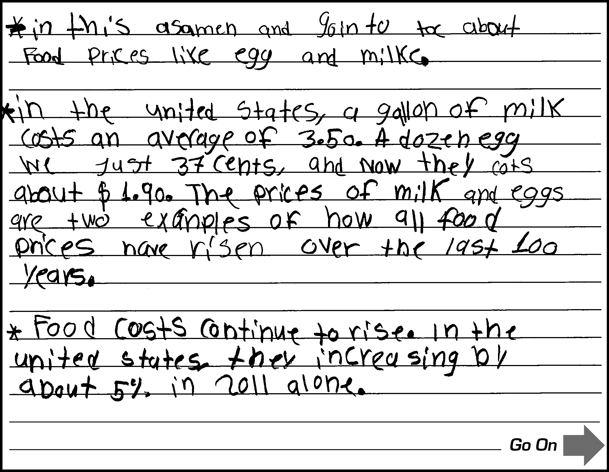
Grades 7–8: ECR Sample 4
Score 1: Emerging
CL
Response includes at least one expanded sentence (the first sentence is original while the following two paragraphs are completely copied from the passage).
QL
Response contains Tier 1 and common Tier 2 words and phrases.
CR
Response includes at least one sentence that provides an orientation (has an introductory statement that provides an orientation, but the rest of the response is copied from
the passage).
DR
Response lacks development of claims and evidence or support (support is found only in copied text).
M
Meaning is evident, but response contains many errors that often obscure meaning (original sentence is impeded by spelling and word choice errors: In this asamen and goin to toc about food prices like egg and milke for In this assignment I’m going to talk about food prices like eggs and milk).
*Please see your binder for a full rubric*

Slide 22
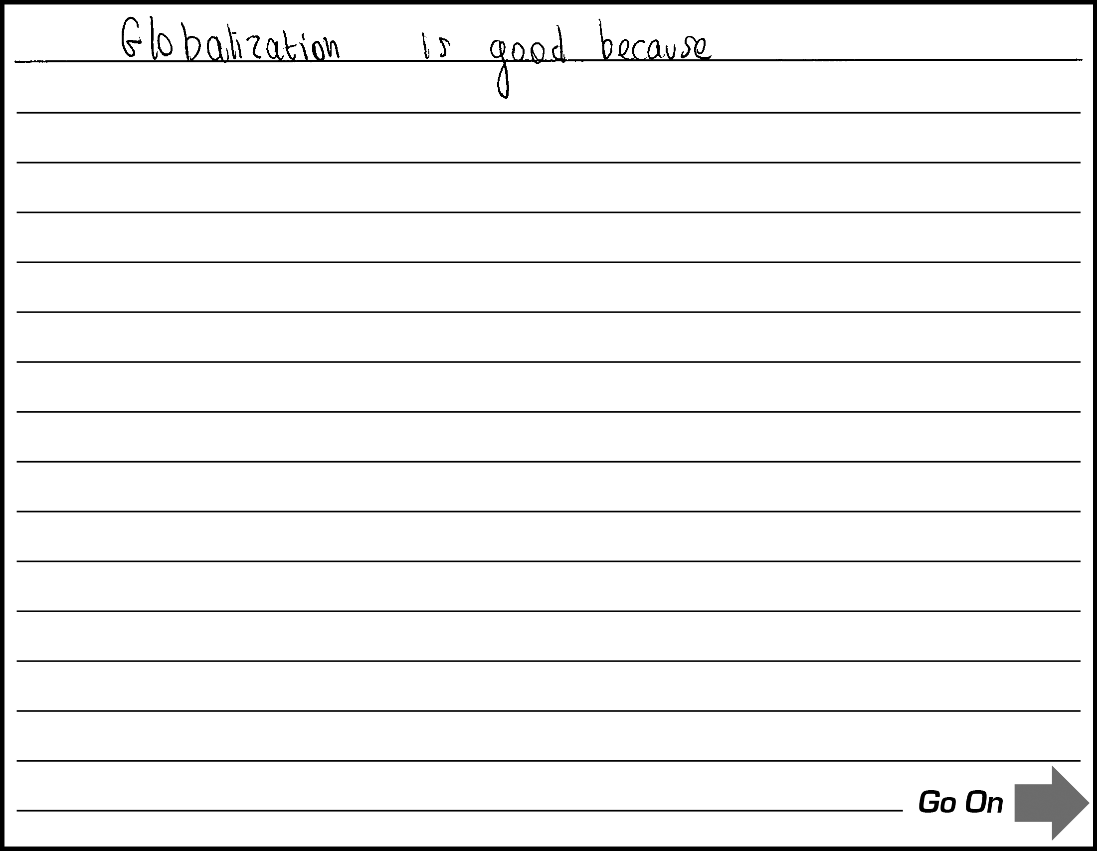
Grades 7–8: ECR Sample 5
Score 0: Entering
CL
Response includes at least one sentence (has a complete independent clause that expresses a complete thought).
QL
Response contains at most commonly used Tier 1 words or short phrases (the usage of globalization does not clearly demonstrate knowledge of its meaning).
CR
Response lacks a clear orientation, or organized or connected ideas, or closure due to brevity.
DR
Response lacks development of claims and evidence or support (has a claim, but no support or evidence is provided).
M
Response is clear but lacks sufficient original language to
rate Mechanics.
*Please see your binder for a full rubric*

Slide 23
Additional Practice Items
ECR practice items, including scores and justifications, can be found in the Turnkey materials
Grades 1–2 start on page 99
Grades 7–8 start on page 119

Slide 24
2019 NYSESLAT Resources
For Information or Assistance | Contact
Questions regarding testing policies, accommodations, security breaches and sensitive student responses | Office of State Assessment Email: emscassessinfo@nysed.gov Call: 518-474-5902
Questions regarding the provisions of ELL/MLL services in Bilingual Education and English as a New Language programs | Office of Bilingual Education and World Languages Email: obewl@nysed.gov Phone: 518-474-8775 (Albany office) Phone: 718-722-2445 (NYC office)
Questions regarding scoring of Speaking and Writing constructed-response questions or shipment of materials | MetriTech, Inc. Customer Service Email: nyseslat@metritech.com Phone: 800-747-4868 Fax: 217-398-5798

Slide 25
2019 NYSESLAT Resources (Continued)
For Information or Assistance | Contact
For regulatory or training assistance: | Regional Bilingual Education Resource Networks http://www.nysed.gov/bilingual-ed/regional-supportrberns
Machine-scannable answer sheets and local scanning services | RIC or Large-City Scanning Center http://www.p12.nysed.gov/irs/sirs/ric-big5.html
Information about the NYSESLAT and regular updates including the turnkey training materials and School Administrators Manual (SAM) | NYSESLAT Homepage http://www.p12.nysed.gov/assessment/nyseslat

