Slide 2
Outcomes for Participants
Understand how to administer the NYSESLAT Speaking test
Gain experience in scoring the NYSESLAT Speaking test
Develop skills in providing local training in NYSESLAT administration and scoring

Slide 3
Speaking Test Format
12 Items*
Theme 1 | 1 | Emerging
 | 2 | Transitioning
 | 3 | Expanding
 | 4 | Commanding
Theme 2 | 5 | Emerging
 | 6 | Transitioning
 | 7 | Expanding
 | 8 | Commanding
Theme 3 | 9 | Emerging
 | 10 | Transitioning
 | 11 | Expanding
 | 12 | Commanding
*The Speaking test does not include items targeted to the Entering level. Instead, a score of Entering is determined based on student performance on Emerging-level Speaking questions.

Slide 4

Rubric
Scoring rubric is aligned to item level
Two-point rubric for Emerging items
Three-point rubric for Transitioning, Expanding, and
Commanding items

Slide 5
Educator Review
NYS teachers reviewed and provided extensive feedback on all field test items.
Examples of how recent educator feedback has shaped the Speaking test:
  Page number in the Directions for Administration (DFA) is given for examiner if Skipping Rule is used
  Changes to pointing directions to facilitate administration
  Updated warm-up questions
  Test question numbers in the DFA are now next to the prompt rather than the introduction to the question

Slide 6
Administration—Tips
Test starts with warm-up and sample questions
Provides an opportunity for the examiner to remind students to respond in English using their own words and to speak loudly enough so the examiner can hear
Allows the examiner to practice working with the student so that the scored portion goes smoothly
Script provides modeling and rephrasing support at the
Emerging level

Slide 7
Administration—Tips (Continued)
Remember to read slowly, but naturally, and exactly as written in the Directions for Administration
  Read over the whole DFA and Test Booklet before administration
  Practice administering with pointing, page turns, etc.
  Remind your colleagues to do the same

Slide 8
Administration—Tips (Continued)
Wait a minimum of 5 seconds for response
  After every question before going on to the next question
  Offer rephrasing after 5 seconds only if it is an Emerging question and the DFA includes rephrasing
  Move on to the next question 5 seconds after rephrasing so that the student is at ease
  The examiner can provide additional wait time if it appears that the student is still thinking about how to answer.

Slide 9
Skipping Rules
Follow the Skipping Rule in the DFA instructions precisely. In general, the Skipping Rule applies if the student provides:
  no response
  only “yes,” “no,” or “I don’t know” to the two previous questions
  a response completely in a language other than English
If the student gives no response to previous items, Skipping Rule applies to items:
  3 and 4
  7 and 8
  11 and 12
For questions where the skipping rule is allowed, the text is marked with a [SKIPPING RULE] bracket.

Slide 10


Skipping Rules in Practice
Theme 1 | Emerging
 | Transitioning
 | Skip?
 | Expanding
 | Commanding
Theme 2 | Emerging
 | Transitioning
 | Skip?
 | Expanding
 | Commanding
Theme 3 | Emerging
 | Transitioning
 | Skip?
 | Expanding
 | Commanding
END
For any items that are skipped, write the letter “S” on the Speaking Score Sheet, instead of a score for that item. This is also described on the Score Sheet.
Score Point 0
Track 01
Q1: Student says “No.”
[Teacher uses rephrasing.]
Student says “No.”
Q2: Student says “No.”

Slide 11
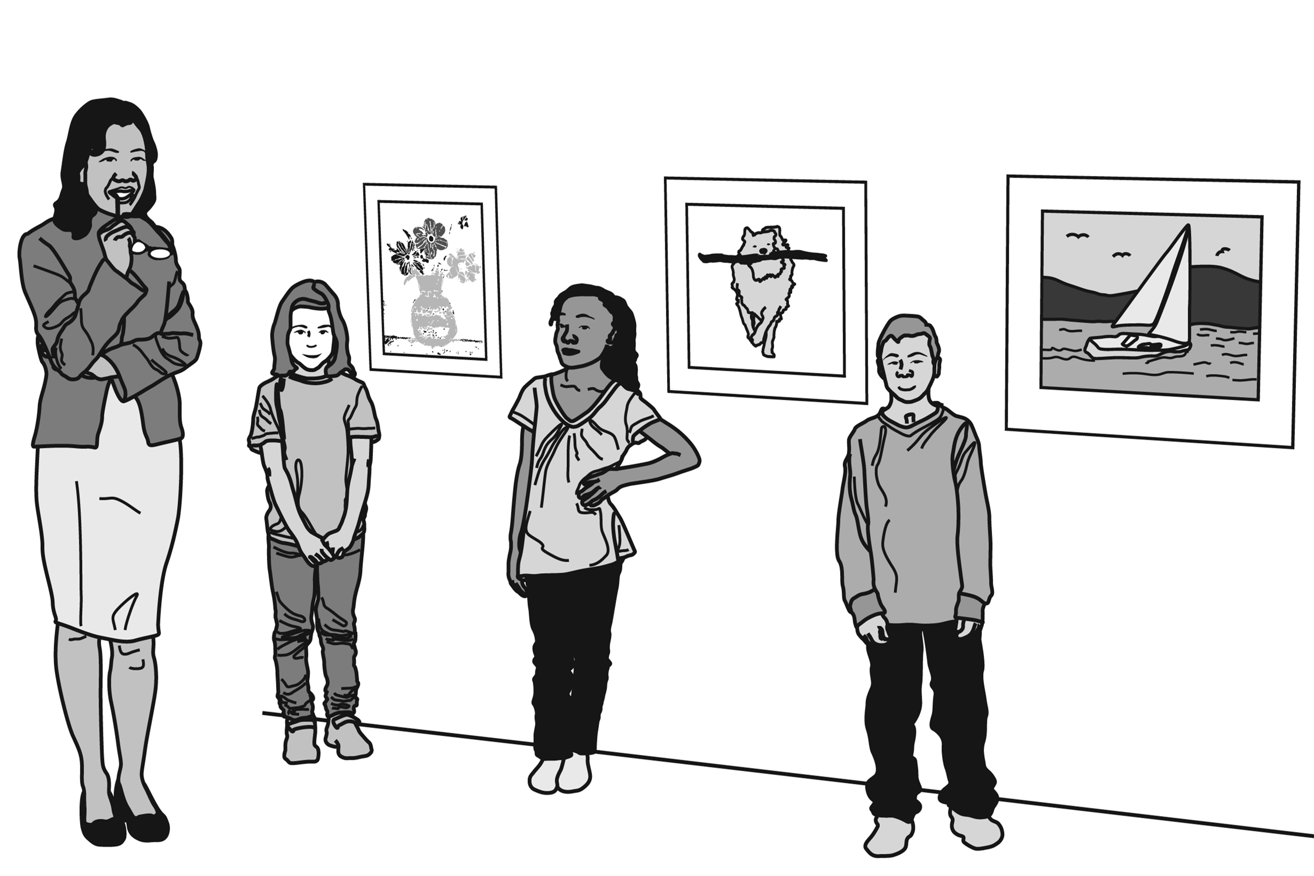

Pointing
Pointing directions are provided for Speaking questions. These pointing directions should be used as scripted.
Practice pointing when reading through the DFA.
Pointing directions are usually at the beginning of a sentence or a clause, however, the placement of directions can vary.

Slide 12
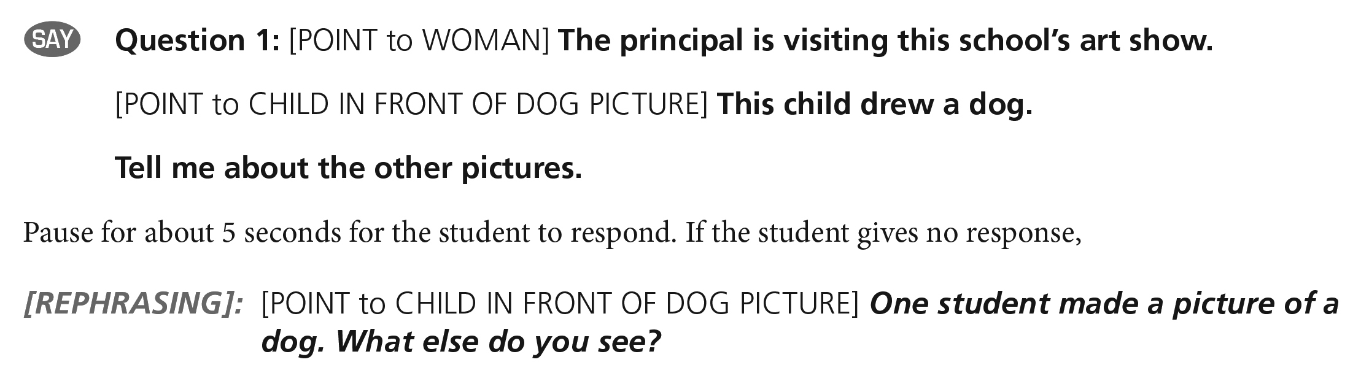
Rephrasing (Emerging Level Only)
  Rephrasing text is provided to use when a student:
    does not respond to the question,
    does not respond to the question in English, or
    does not understand the question.
  Rephrasing may only be used once per question and must be read as written.
  In the specific questions where it appears, rephrasing text is marked with a [REPHRASING] bracket, and the text to be read out loud to the examinee is printed in bold italic text.

Slide 13
Rephrasing Samples
Track 02
Track 03
Track 04
“Racing? Um… I don’t understand.”
Note: Teacher should have used rephrasing, but did not.
Tell me ways to do
research at the library.
(Student does not respond)
[Teacher uses rephrasing.]
Gregory uses different things to do research. He can use books. What can Gregory use at the library?
"Information"
Tell me ways to do
research at the library.
“mm…can you repeat please?”
[Teacher uses rephrasing.]
Gregory uses different things to do research. He can use books. What can Gregory use at the library?
“I don’t know."

Slide 14
Modeling
In the DFA, all Emerging items include a model of the expected response.
The purpose of modeling is to provide students with an example of what their response should sound like.
The Modeling text is NOT printed in the student test booklet.
Please emphasize in your local training that Modeling provides additional support to students.
This is Modeling text

Slide 15
Repetition
Scenario | Response
Student does not understand initial directions (before the test items are presented). | All directions and sample questions may be repeated to students as necessary. You may supplement only the directions with your own explanations in English to assist the students with test-taking procedures.
Examiner cannot hear the student response because of student volume or an interruption. | If, during testing, a student response is inaudible because of the volume of a student’s voice, or an interruption, such as the bell, ask that student, “Please repeat that so that I can hear you.”
Student asks for repetition of a prompt. | Do not repeat the prompt. If a student asks about a specific test item (“Is this right?”), give a neutral response, such as “You should simply say what you think is right.”

Slide 16
Application of the Holistic Speaking Rubric
Review the rubric, the Speaking Scoring Guide, the test questions, and practice applying the rubric using the Speaking Exemplars CD.
Student responses are evaluated for total, overall performance.
Scores are assigned based on the criteria delineated in the rubric.
  Look at all aspects of the rubric.
  Response does not have to include all aspects of the rubric to merit a rating at that level.
  Conversely, response should include most aspects of the rubric to merit a rating at that level.
  Listen carefully and judge which rubric level best matches all aspects of the response.
  The NYSESLAT is a test of language.
  Do not penalize students for response with incorrect content
  (e.g., New York City is the capital of New York). Rate the language.

Slide 17
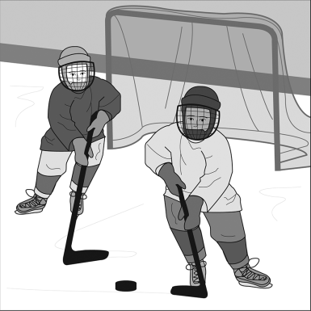
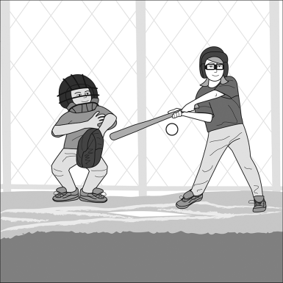
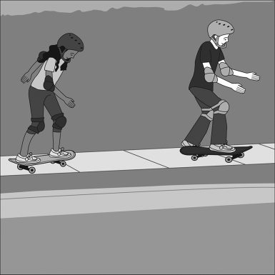
Emerging Level Items
1.
2.
3.
Always accompanied by a graphic
Examiner gives context
  People use things made of wood to play sports. These pictures show children using wooden equipment to play sports.
Examiner models a sample response
  [POINT to PICTURE 1] These children are using wooden hockey sticks to play hockey.
Examiner asks question
  Tell me other ways children can use wooden equipment.
Examiner rephrases if examinee does not respond
  Wood is used for some sports. [POINT to PICTURE 1] These children are playing hockey with wooden sticks.
  [POINT to PICTURES 2 AND 3] What are the other children doing with things made of wood?

Slide 18
Emerging Level Item Rubric
No response
Responds with “yes,” “no,” or “I don’t know”
Responds completely in a language other than English
Uses one word to respond
Does not express a complete thought or idea
Unintelligible
Score
0
Uses multiple words, short phrases, or sentences to respond
Partially expresses thoughts and ideas
Frequent errors may obscure meaning
Score
1
N/A
Score
2

Slide 19
Grades 1–2 Emerging Samples
1.
2.
3.
Context: People use things made of wood to play sports. These pictures show children using wooden
equipment to play sports.
Modeling: [POINT to PICTURE 1] These children are using wooden hockey sticks to play hockey.
Question: Tell me other ways children can use wooden equipment.
Rephrasing: Wood is used for some sports. [POINT to PICTURE 1] These children are playing hockey with
wooden sticks. [POINT to PICTURES 2 AND 3] What are the other children doing with things made of wood?
Score Point 0
Score Point 1
“Other children could use
. . . um . . . To play . . . um . . . baseball because it's a wood . . .”
“Skating . . .
I don’t know.”
Track 05
Track 06

Slide 20
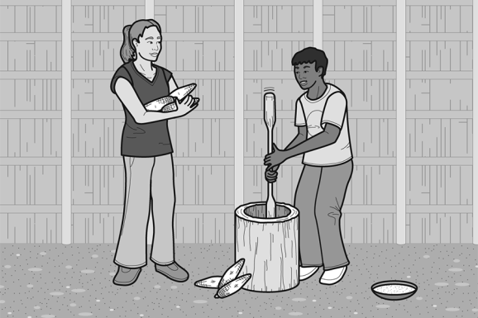
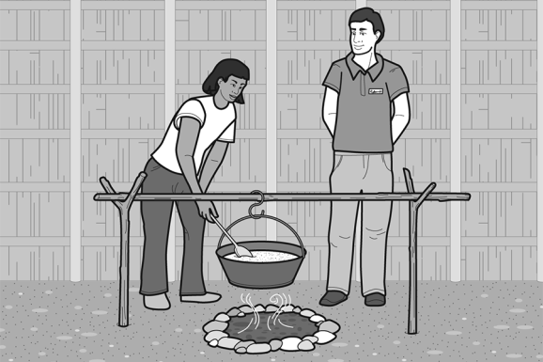
Transitioning Level Items
1.
2.
Always accompanied by a graphic
Examiner gives context
  Visitors to some historical sites can experience how people lived long ago. These students are preparing food the same way the Seneca people did long ago when they lived at this site.
Examiner does not model a sample response
Examiner asks question
  Tell me how they are preparing food.
Examiner does not rephrase or repeat if examinee does not respond
Examiner may use follow-up when more language is needed “Tell me more.”

Slide 21
Transitioning Level Item Rubric
No response
Responds with “yes,” “no,” or “I don’t know
Responds completely in a language other than English
Uses one word to respond
Does not express a complete thought or idea
Unintelligible
Errors may totally obscure meaning
Score
0
Uses multiple words to respond
Partially expresses thoughts and ideas
Frequent errors may obscure meaning
Score
1
Uses connected phrases or a simple sentence to respond
May use multiple sentences
Expresses complete thoughts and ideas relevant to the topic
Occasional errors in words and structures may obscure some meaning
Score
2

Slide 22
Grades 9–12 Transitioning Samples
1.
2.
Context: Visitors to some historical sites can experience how people lived long ago. These students are
preparing food the same way the Seneca people did long ago when they lived at this site.
Question: Tell me how they are preparing food.
Score Point 0
Score Point 1
Score Point 2
Track 07
Track 08
Track 09
“Can’t, sorry
I don’t know.”
“They prepare food like Seneca people did long…long ago when they lived in this . . . Mm . . . lived at this site.”
“It is student? . . . The students are preparing
soup, to the corn.”

Slide 23
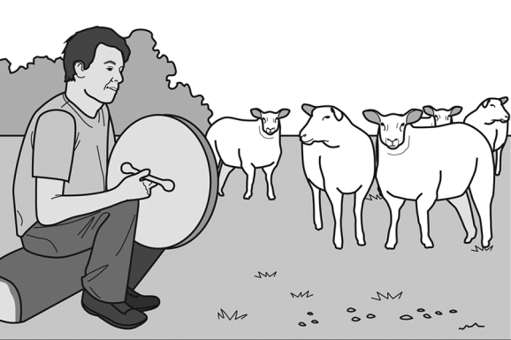
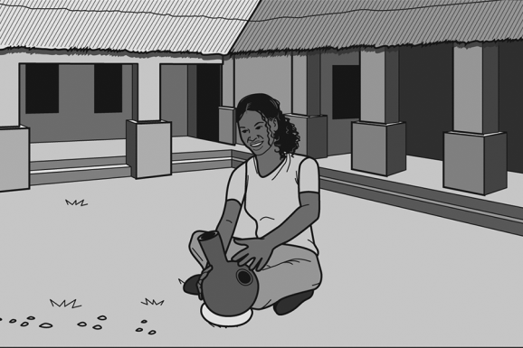
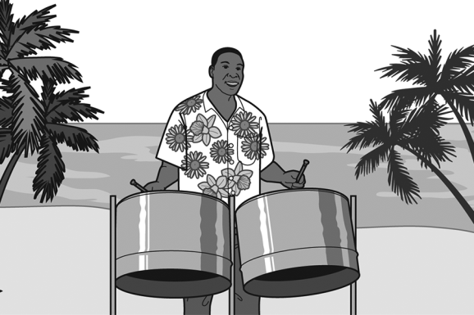
Expanding Level Items
1.
2.
3.
Accompanied by a graphic or by a passage and graphic
Examiner gives context
  Drum music is thousands of years old and is played all over the world. Almost every culture has its own kind of drum. [POINT to PICTURE 1] For example, in Ireland, people play a bodhrán [bau-rawn] drum, which is made of wood and animal skin.
  [POINT to PICTURE 2] In parts of West Africa, women play an udu drum, which is made of clay.
  [POINT to PICTURE 3] In the Caribbean, people play steel drums, which are made of metal.
Examiner asks question
  Tell me about how drums around the world are made of different things.
No modeling, rephrasing, or repeating

Slide 24
Expanding Level Item Rubric
Responds with “yes,” “no,” or “I don’t know”
Uses at most multiple words to respond
Does not express complete thoughts and ideas
Frequent errors may obscure meaning
Score
0
Uses connected phrases or a simple sentence to respond
Expresses complete thoughts and ideas relevant to the topic
Occasional errors in words and structures may obscure some meaning
Score
1
Uses connected simple sentences to respond
May use limited expanded sentences
Expresses connected and complete thoughts and ideas relevant to the topic
Infrequent errors in words and structure may obscure some meaning
Score
2

Slide 25
Grades 3–4 Expanding Samples
1.
2.
3.
Context: Drum music is thousands of years old and is played all over the world. Almost every culture has
its own kind of drum. [POINT to PICTURE 1] For example, in Ireland, people play a bodhrán [bau-rawn]
drum, which is made of wood and animal skin. [POINT to PICTURE 2] In parts of West Africa, women play
an udu drum, which is made of clay. [POINT to PICTURE 3] In the Caribbean, people play steel drums,
which are made of metal.
Question: Tell me about how drums around the world are made of different things.
Score Point 0
Score Point 1
Score Point 2
Track 10
Track 11
Track 12
“Em I eh... oh mm the drum eh and all the world is have like um some brr- mm mm mm bo- some br- bo- mm”
“They can be made it- build it fr- from the trees… earth, um and me- and metal”
“Um in in uh inland, I don’t know how to say this word, in this place you gotta get skin from animals, then put it in a wood, and then you make a drum. In West Africa, you g- you gotta get clay and then make it to a drum, and in Cariddean, you gotta get metal and built it with your hands.”

Slide 26
Special Focus: Text-Based Items
Text-based items (Grades 1–12) include both a graphic and text with the focus on the text.
Text is read out loud once by the Examiner
Consecutive Expanding and Commanding items use the same text, read once for the Expanding item only
Student can read along in test booklet

Slide 27
Tips for Scoring Text-Based Items
In some cases, students may read or repeat language directly from the text. It is important to listen for the student’s authentic language.
Sometimes students respond with only language from the text. If they do not create any new language on their own, the response is scored zero.
Some students respond with a combination of their own words and language from the text. Rate the students’ own language.

Slide 28
Expanding Level Text-Based Items
Accompanied by graphic or by a passage and graphic
Examiner gives context
  It is very difficult for many countries to produce all the goods their populations need. Therefore, trade between countries is
  extremely important.
  Trade is the exchange of one thing for another thing. Trade can include the following: exchanging goods, like salt, for other goods; exchanging goods for services, like engineering; or selling goods for money. Usually, countries trade goods that they have too much of in return for goods and services that they do not have enough of. For example, Saudi Arabia has a lot of oil. However, because Saudi Arabia is mostly desert, it does not have enough water to grow enough food for all its people. Therefore, Saudi Arabia sells oil to other countries and uses the money to buy food such as chicken, rice, and milk from other countries.
  Countries do well when they are able to trade goods with other countries in order to have enough goods for their people. In this way, countries also become interdependent, which means that they depend on each other for some of their needs.
Examiner asks question
  Tell me about how countries trade with other countries.
No modeling, rephrasing, or repeating

Slide 29
Expanding Level Item Rubric
Responds with “yes,” “no,” or “I don’t know”
Uses at most multiple words to respond
Does not express complete thoughts and ideas
Frequent errors may obscure meaning
Score
0
Uses connected phrases or a simple sentence to respond
Expresses complete thoughts and ideas relevant to the topic
Occasional errors in words and structures may obscure some meaning
Score
1
Uses connected simple sentences to respond
May use limited expanded sentences
Expresses connected and complete thoughts and ideas relevant to the topic
Infrequent errors in words and structure may obscure some meaning
Score
2

Slide 30
Grades 7–8 Expanding Text-Based Samples
Context: It is very difficult for many countries to produce all the goods their populations need. Therefore, trade between
countries is extremely important.
Trade is the exchange of one thing for another thing. Trade can include the following: exchanging goods, like salt, for other goods;
exchanging goods for services, like engineering; or selling goods for money. Usually, countries trade goods that they have too much of
in return for goods and services that they do not have enough of. For example, Saudi Arabia has a lot of oil. However, because Saudi
Arabia is mostly desert, it does not have enough water to grow enough food for all its people. Therefore, Saudi Arabia sells oil to other
countries and uses the money to buy food such as chicken, rice, and milk from other countries.
Countries do well when they are able to trade goods with other countries in order to have enough goods for their people.
In this way, countries also become interdependent, which means that they depend on each other for some of their needs.
Question: Tell me about how countries trade with other countries.
Score Point 0
Score Point 1
Score Point 2
Track 13
Track 14
Track 15
“Coun . . . The countries . . . In order to have a lot of the goods for their people. In this way, countries also became independent, which means they depend on for some of their needs.”
“They trade with other countries by changing one thing by another.”
“Mm they produce . . . Mm . . . food and they send to the other countries.”

Slide 31



Commanding Level Text-Based Items
Cirrus
Stratus
Fog
Accompanied by a graphic or by a passage and graphic
Examiner gives context
  You just learned about clouds. There are several different kinds of clouds. One kind of cloud is a cirrus cloud. These clouds are thin and long and look like white lines on a sunny day. Dark gray clouds in the sky are called stratus clouds. They cover the sky like a blanket. Other clouds aren’t in the sky at all! Fog is a special kind of cloud that floats close to the ground. Fog can be dangerous because it makes it hard for people to see.
Examiner asks question
  Tell me how fog is different from other clouds.
No modeling, rephrasing, or repeating

Slide 32
Commanding Level Item Rubric
Responds with “yes,” “no,” or “I don’t know”
Uses at most connected phrases or a simple sentence to respond
May express complete thoughts and ideas
Occasional or frequent errors in words and structures may obscure meaning
Score
0
Uses connected simple sentences to respond
Expresses connected and complete thoughts and ideas relevant to the topic
Infrequent errors in words and structure may obscure some meaning
Score
1
Uses connected expanded sentences
Generates a fluid response using linking words and phrases to sequence
complete thoughts and ideas relevant to the topic
No errors or infrequent errors that do not obscure meaning
Score
2

Slide 33



Grades 1–2 Commanding Text-Based Samples
1.
2.
3.
Cirrus
Stratus
Fog
Context: [You just learned about clouds. There are several different kinds of clouds. One kind of cloud is a
cirrus cloud. These clouds are thin and long and look like white lines on a sunny day. Dark gray clouds in
the sky are called stratus clouds. They cover the sky like a blanket. Other clouds aren’t in the sky at all!
Fog is a special kind of cloud that floats close to the ground. Fog can be dangerous because it makes it
hard for people to see.]
Question: Tell me how fog is different from other clouds.
Score Point 0
Score Point 1
Score Point 2
Track 16
Track 17
Track 18
“I think fog are different from other clouds because . . . I don't get it . . . I don't know it…”
“Because they're floating on the ground. They're dangerous.”
“Because they are close to ground and some people do not see it.”

Slide 34
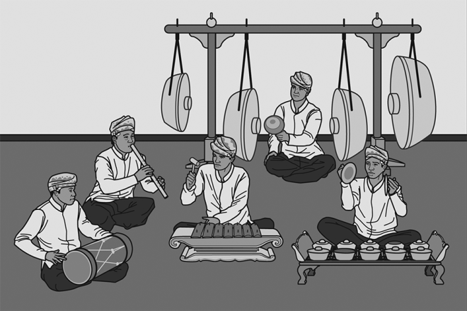
Commanding Level Items
Accompanied by a graphic or by a passage and graphic
Examiner gives context
  A Gamelan [gah-meh-lahn] music group is made up mostly of people who play drum instruments. These instruments are made out of wood, metal, or iron. Musicians play the instruments with their hands or with a stick called a mallet. [POINT to GONG] Some instruments, like the gong, only make one note. Larger instruments make lower notes. [POINT to SMALLER INSTRUMENTS] Smaller instruments make higher notes. Together, the group plays a melody using
  these different notes.
Examiner asks question
  Why does a Gamelan group use instruments that are different sizes?
No modeling, rephrasing, or repeating

Slide 35
Commanding Level Item Rubric
Responds with “yes,” “no,” or “I don’t know”
Uses at most connected phrases or a simple sentence to respond
May express complete thoughts and ideas
Occasional or frequent errors in words and structures may obscure meaning
Score
0
Uses connected simple sentences to respond
Expresses connected and complete thoughts and ideas relevant to the topic
Infrequent errors in words and structure may obscure some meaning
Score
1
Uses connected expanded sentences
Generates a fluid response using linking words and phrases to sequence
complete thoughts and ideas relevant to the topic
No errors or infrequent errors that do not obscure meaning
Score
2

Slide 36
Grades 3–4 Commanding Samples
Context: A Gamelan [gah-meh-lahn] music group is made up mostly of people who play drum instruments.
These instruments are made out of wood, metal, or iron. Musicians play the instruments with their hands
or with a stick called a mallet. [POINT to GONG] Some instruments, like the gong, only make one note.
Larger instruments make lower notes. [POINT to SMALLER INSTRUMENTS] Smaller instruments make
higher notes. Together, the group plays a melody using these different notes.
Question: Why does a Gamelan group use instruments that are different sizes?
Score Point 0
Score Point 1
Score Point 2
Track 19
Track 20
Track 21
“To make special sounds.”
“Because if if the big sizes make the low noise, and the little ones made loud noise”
“Because these Gamelan use eh different size of instrument because they make uh the more sound uh and they make like more notes. Like large instruments make lower notes, small instruments make higher notes, and together they make one song, good song.”

Slide 37
Scoring Recap
NYSESLAT is a language test, not a content test. Students may demonstrate language competence without content accuracy.
Emerging means that student fluency is still emerging. Only a “yes,” “no,” “I don’t know,” non-English, single word, or blank response is scored “0.”
Commanding reflects a high level of proficiency with grade-level language. Students can produce a full simple sentence with a complete thought and still be rated “0.”
Rubrics are tailored for the difficulty of specific items. Remember to adjust your expectations when evaluating responses.

Slide 38
Additional Practice Items
Additional Speaking practice items can be found in the Turnkey Training Practice Items PowerPoint.
The PowerPoint is designed to be a self-paced module.
Slides contain embedded audio of student responses.
Practice Items can be found starting on Page 4; Transcripts, Scores, and Justifications can be found starting on Page 16 in the Turnkey materials.
The Practice Items PowerPoint and scoring information can be found on the NYSESLAT web site:
http://www.p12.nysed.gov/assessment/nyseslat

Slide 39
2019 NYSESLAT Resources
For Information or Assistance | Contact
Questions regarding testing policies, accommodations, security breaches and sensitive student responses | Office of State Assessment Email: emscassessinfo@nysed.gov Call: 518-474-5902
Questions regarding the provisions of ELL/MLL services in Bilingual Education and English as a New Language programs | Office of Bilingual Education and World Languages Email: obewl@nysed.gov Phone: 518-474-8775 (Albany office) Phone: 718-722-2445 (NYC office)
Questions regarding scoring of Speaking and Writing constructed-response questions or shipment of materials | MetriTech, Inc. Customer Service Email: nyseslat@metritech.com Phone: 800-747-4868 Fax: 217-398-5798

Slide 40
2019 NYSESLAT Resources (Continued)
For Information or Assistance | Contact
For regulatory or training assistance: | Regional Bilingual Education Resource Networks http://www.nysed.gov/bilingual-ed/regional-supportrberns
Machine-scannable answer sheets and local scanning services | RIC or Large-City Scanning Center http://www.p12.nysed.gov/irs/sirs/ric-big5.html
Information about the NYSESLAT and regular updates including the turnkey training materials and School Administrators Manual (SAM) | NYSESLAT Homepage http://www.p12.nysed.gov/assessment/nyseslat

