Slide 1


State Performance Plan (SPP) 8/
Annual Performance Report (APR)
2020-2025
Individuals with Disabilities Education Act (IDEA)
General Overall Presentation – 2021; SPP Indicator 8: Parent Involvement
Notes:
Welcome to the State Performance Plan (SPP) 8/Annual Performance Report (APR) 2020-2025 presentation.

Slide 2
Agenda
Introduction to Indicator : How Do We Measure Parent Satisfaction?
Is Our Sampling Method Representative of Our Families and Fair to All Districts?
Should We Consider Additional Improvement Activities?
Are Parents Given Response Options that Are Accessible to All Families?
Are Our Targets Reasonable and Appropriate?
Notes:
This slide contains the agenda for our discussion on this topic, which will cover:
Introduction to Indicator : How Do We Measure Parent Satisfaction?
Is Our Sampling Method Representative of Our Families and Fair to All Districts?
Are Parents Given Response Options that Are Accessible to All Families?
Should We Consider Additional Improvement Activities?
Are Our Targets Reasonable and Appropriate?

Slide 3
Frequently Used Terms in the Presentation
Term | Description
State Performance Plan or SPP | Evaluates the state's efforts to implement the requirements and purposes of the IDEA and describes how the state will improve its implementation.
Sample | A subset of a population whose characteristics are studied to gain information about the entire population.
Survey | A data collection activity involving observation or questionnaires for a sample of a population.
Representativeness | Refers to the extent to which the demographics of the children and youth whose parents provided data are representative of the demographics of all children and youth receiving special education services in the state.
Notes:
Here are definitions for some terms commonly used throughout this presentation:
The State Performance Plan, or SPP, is a six-year plan that the US Department of Education requires states to develop to improve its implementation of the IDEA.
A sample is a subset of a population whose characteristics are studied to gain information about the entire population.
A survey is a data collection activity involving observation or questionnaires for a sample of a population.
For Indicator 8, representativeness refers to the extent to which the demographics of the children and youth whose parents provided data are representative of the demographics of all children and youth receiving special education services in the state.

Slide 4
Frequently Used Terms in the Presentation
Term | Description
Baseline | Data starting point to measure improvement over time.
Targets | Performance objectives set for each SPP indicator measurement.
Potsdam Institute of Applied Research (PIAR) | An independent research firm that is working with the New York State Education Department to survey parents of children who are receiving special education services.
Parent | A birth or adoptive parent, a legally appointed guardian generally authorized to act as the child’s parent or authorized to make educational decisions for the child.
Notes:
A baseline is a data starting point to measure improvement over time.
Targets are the performance objectives set for each SPP indicator measurement.
The Potsdam Institute of Applied Research (PIAR), housed within the State University of New York (SUNY) Potsdam Campus, is an independent research firm that is working with the New York State Education Department to survey parents of children who are receiving special education services.
A parent means a birth or adoptive parent, a legally appointed guardian generally authorized to act as the child’s parent or authorized to make educational decisions for the child.

Slide 5
Introduction to Indicator: How Do We Measure Parent Satisfaction?
Introduction to Indicator :
How Do We Measure Parent Satisfaction?
Notes:
In this section we will discuss how New York State measures parent involvement and parent satisfaction.

Slide 6

INDICATOR 8 PARENT INVOLVEMENT
Measures the percent of parents with a child receiving special education services who report that schools facilitated parent involvement as a means of improving services and results for children with disabilities.
Notes:
Ensuring parental involvement is extremely important to the New York State Education Department (NYSED). Indicator 8 measures the percent of parents with a child receiving special education services who report that schools facilitated parent involvement as a means of improving services and results for children with disabilities.
Indicator 8 collects data to measure parent involvement through parent surveys.
The following slides will describe the parent survey options allowed by the federal Office of Special Education Programs or OSEP and the parent survey New York State uses to measure parent involvement.

Slide 7
Parent Survey Options
Federal Office of Special Education Programs
Use state-developed survey or model survey
2. Survey all parents versus sample of
parents
Notes:
The federal Office of Special Education Programs or OSEP allows some flexibility to states in terms of:
Whether to use a state-developed survey or a model survey. Based on federal data, 68% of states used state-developed survey instruments as their data collection tool during Federal Fiscal Year or FFY 2018, 20% of states used a model survey, and 10%, including New York State, used a smaller set of questions from the model survey created by the National Center for Special Education Accountability Measures (NCSEAM) and
Whether to collect feedback from all parents in the state or to survey a smaller sample of preschool and school age parents. In the FFY2018 APRs, 51.7% of states identified mailing survey information to all parents of students with IEPs and including the survey as part of annual IEP meetings with parents as their methods for distributing surveys. The remaining 48.3% reported using sampling methods, including random samples, stratified random samples, cohorts, and other strategies.

Slide 8
New York State Education Department
Parent Survey
New York State Education Department
Parent Survey
1. Modified model survey developed
by the National Center for Special Education Accountability Measures (NCSEAM)
2. Sample Size
3. Random sampling of parents
4. Survey distribution
Notes:
New York State has chosen to use a modified, 25-question version of the survey developed by the National Center for Special Education Accountability Measures (NCSEAM).
Using this survey, New York State collects and reports data from a representative sample of school districts throughout the State. These school districts, based on the number of eligible children, uses the State provided calculator to determine minimum sample size.
After the minimum sample size is determined, districts randomly select a sample of parents of students with disabilities who are then contacted by their school district and asked to complete a paper copy of the 25-question survey. Each survey is coded with a unique identifier for the specific guardian.

Slide 9
Potsdam Institute of Applied Research (PIAR)
Potsdam Institute of Applied Research (PIAR)
PIAR receives, inputs and tracks the responses electronically.
Each fall, non-responders are contacted via email and again asked to submit the survey, which can now be made electronically.
Notes:
The Potsdam Institute of Applied Research (PIAR) is an independent research firm that is working with the New York State Education Department (NYSED) to survey parents of children who are receiving special education services. They are responsible for receiving and tracking survey responses.
Each fall, non-responders are contacted via email and again asked to submit the survey, which can now be made electronically.

Slide 10
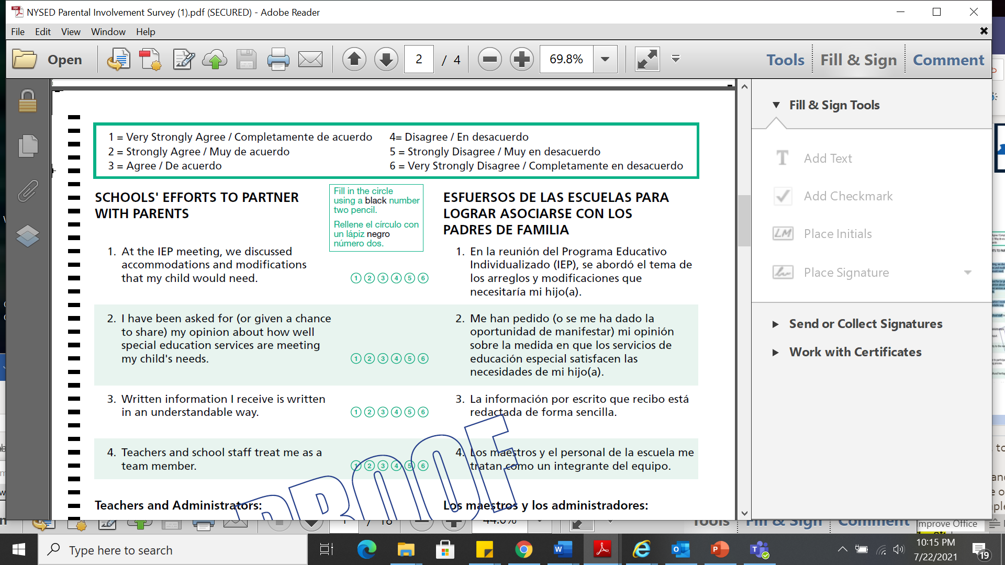
New York State Parent Survey-Sample
At the IEP meeting, we discussed accommodations and modifications that my child would need.
The School gives me the help I need to play an active role in my child's education.
I have been asked for (or given a chance to share) my opinion about how well special education services are meeting my child's needs.
Teachers and school staff treat me as a team member.
Response Selection
1= Agree
2=Strongly agree
3=Very strongly agree
4= Disagree
5=Strongly disagree
6=Very strongly disagree
Notes:
The slide shows a screen shot of the survey distributed to parents with sample questions that either apply to the school district or the school the child attends.
It also shows sample survey questions such as:
At the IEP meeting, we discussed accommodations and modifications that my child would need.
The school gives me the help I need to play an active role in my child's education.
Teachers and school staff treat me as a team member.
I have been asked for (or given a chance to share) my opinion about how well special education services are meeting my child's needs.
Parents are asked to rate each question with a response indicating that they “agree”, “strongly agree”, “very strongly agree”, “disagree”, “strongly disagree” or “very strongly disagree”.
In New York State, the surveys are available in English and in six predominant languages, namely Spanish, Russian, Simplified Chinese, Haitian Creole, Bengali, and Urdu. NYSED requires the school districts to provide translations to ensure that parents who do not read or understand one of these languages have an opportunity to participate in the survey.

Slide 11
Indicator 8 Data Measurement
The number of surveys with an overall positive parental involvement rating
Percent of respondent parents who report schools facilitated parent involvement as a means of improving services and results for children with disabilities
All surveys returned with at least 15 of the 25 questions answered
100 =
Notes:
Indicator 8 measurement is calculated based on results of the Parent Survey.
The measurement calculation is the number of respondent parents who reported positive parental involvement rating divided by the total number of returned surveys where at least 15 out of 25 questions were answered, times 100.
A positive parental involvement rating means that the parent indicated that they “agree”, “strongly agree” or “very strongly agree” for at least 51% of the questions they responded to on the survey.
Only surveys that are returned with at least 15 of the 25 questions answered are counted. All questions are weighted equally. Unlike some other states, New York State does not include an option of “no” or “I don’t know.”
In order to give each school district’s positive response rate a proportional weight relative to their sample size in the State’s average, the percent of positive responses is weighted by the sample size of each school district. This is necessary because many school districts received a response that was well above the minimum sample size required and, in other school districts, the minimum response required was not achieved.

Slide 12

Facilitator check for understanding on the SPP measurement or how the data is used to measure results or outcomes.
Virtual Meeting Question
Notes:
During the virtual meetings, we are now going to pause and have the facilitator check to ensure the information we presented regarding the measurement was clear and understandable. The questions in this section are designed to ask whether you have an understanding of how Indicator 8 is measured.

Slide 13
Is Our Sampling Method Representative of Our Families and Fair to All Districts?
Is Our Sampling Method Representative of Our Families and Fair
to All Districts?
Notes:
In this section we are going to discuss how all districts within New York State are represented in the Indicator 8 sample over the course of a six-year cycle of measurement and reporting.

Slide 14
Six-Year Rotational Calendar-SPP Indicator 8
NAME
NEW YORK CITY
SOUTH COLONIE
2011-2012
BETHLEHEM
ALBANY
ROCHESTER
2012-2013
SPP 8
SPP 8
2013-
2014
2014-2015
SPP 8
SPP 8
2015-2016
SPP 8
2016-2017
SPP 8
SPP 8
SPP 8
SPP 8
SPP 8
SPP 8
BUFFALO
(District sampling schedule can be found at: http://www.p12.nysed.gov/sedcar/sppschedule2017-2025.html.)
Notes:
Indicator 8 is one of the six indicators where New York State collects data for a student sample. In order to reduce the burden on most districts, so that they only need to gather data for one indicator sample per year, the New York State Education Department developed a six-year rotational calendar. Using this six-year rotational calendar, NYS collects data on Indicator 8 each year, but only from a subset of districts so that each district provides data once per cycle. The exception is New York City – due to NYC’s total enrollment of over 50,000 students, OSEP requires that this district be part of the sample each year.

Slide 15

New York State Minimum Sample
​ | # School Districts in the Sample​ | Minimum Sample Needed​
New York City​ | 1​ | 96​
Large Four Cities ​ | 1​ | 95​
Urban-Suburban High Need Districts​ | 8​ | 656​
Rural High Need Districts​ | 28​ | 1,700​
Average Need Districts​ | 52​ | 3,440​
Low Need Districts​ | 23​ | 1,578​
Notes:
The chart shows that in 2019:
New York City sampled a minimum of 96 parents, despite having a student with a disability population of over 50,000 in 32 community school districts including District 75 and 79 families who are counted under the community school district in which they live.
Each year, for four out of six years of the rotational calendar one of the Big Four Cities (namely Yonkers, Buffalo, Rochester and Syracuse) sampled a minimum of 95 parents.
As per the 2018 SPP/APR data, surveys were distributed to 47,389 parents across the state with an overall return rate of 20.47%.
Under the current sample method, a small district with approximately 100 students with a disability would be required to have a minimum sample of 49 parents, which is roughly 50% of their student with a disability population. Whereas, New York City is required to have a minimum sample of 96 parents each year, which is less than 0.2% of their student with a disability population.
Therefore, the parents in a small district have a greater likelihood of being sampled and affecting the demographic representation of the results reported.

Slide 16
Percentage of SWDs in NYC and Rest of State
Notes:
NYC and the other Big 4 cities comprise most of the ethnic, racial and linguistic diversity of the State, and their low overall contribution to the sample, as a result of the sample calculator, has had a significant contribution to lack of demographic representativeness on Indicator 8. The source of this data is the NYSED SPP/APR Part B Reporting on FFY2019.
One consideration to keep in mind about the way we currently sample districts is that NYC and the other Big Four account for 2.5% of the sample for 4 of the years in the 6-year cycle, and 1.3% of the sample in the years when the Big Four are not included. In 2019, NYC alone made up 49.5 % of students with disabilities Statewide but made up only 1.3 % of the returns from the Indicator 8 survey.

Slide 17
Reporting Parent Satisfaction
Among Different Demographics
The New York State 25-question survey contains questions that would enable reporting data on race, age, disability category, geographic location and data by question. Reporting on this data and disaggregating it would better inform and target improvement strategies.
Notes:
The New York State 25-question survey requests that parents provide data on race, age, disability category, and geographic location. However, we do not report parent satisfaction rates broken down by these different subcategories. Reporting on this data and disaggregating might better inform and target our improvement strategies.
In February 2021, the IDEA Data Center (IDC) published a guidance document entitled, Parent Involvement Data: How to Measure and Improve Representativeness for Indicator 8, which suggests that states consider comparing results in demographic categories (i.e., race/ethnicity, student gender, student age, disability category, and geographic location) and any additional categories they might wish to explore, such as income level, length of time child received services, or primary language.

Slide 18

SPP 8 Sample Feedback
Is our sampling method representative of our families and fair to all districts?
Notes:
NYSED is committed to increasing the voices of diverse parents, families, and communities across New York State. Your feedback is important to us. Now that we have discussed how a parent sample is determined and how the survey is distributed, we would like you to consider the following questions regarding whether our sampling method is representative of our families and fair to all districts.

Slide 19
Are Parents Given Response Options that Are Accessible to All Families?
Are Parents Given Response Options that Are Accessible to All Families?
Notes:
In this section we are going to discuss how districts follow up with parents who do not return the paper survey, and the varied ways in which parents can submit their responses.

Slide 20
Survey Distribution
Parents are also able to complete the survey at http://parentsurvey.potsdam.edu
Each fall, non-responders are contacted via email and again asked to submit the survey electronically.
School districts send a cover letter to parents selected to complete an enclosed paper survey.
Notes:
Indicator 8 surveys are disseminated by the selected districts between February and August annually. School districts first send a cover letter to parents selected to complete an enclosed paper survey, and parents are also informed that they can complete the survey at http://parentsurvey.potsdam.edu.
Surveys are made available to all parents in the sample in English and six predominant languages in NYS. NYSED requires the school districts to provide translations to ensure that parents who do not read or understand one of these languages have an opportunity to participate in the survey.
In addition to the paper survey and web portal, the school district may also use telephone surveys or have the surveys completed through interview. Each fall, non-responders are contacted via email and again asked to submit the survey electronically through an internet website made available by NYS.

Slide 21
Sample District Letter for SPP Indicator 8
http://www.p12.nysed.gov/specialed/spp/ltrsample-parent.htm
Dear Parent:
Our school district is working with the New York State Education Department (NYSED) to collect information on how we help you and other parents of students with disabilities to be involved in their children’s education. Parents from school districts throughout the State are completing the same survey. NYSED is working with the Potsdam Institute for Applied Research (PIAR) at SUNY Potsdam, an independent research firm, to collect the information.
Your answers to the survey are very important to us. They will help us identify how well we work with parents in order to improve services and results for all our students with disabilities. No one from our school district will see how you answered the questions. PIAR will compile the results of the surveys from all our parents and the results will be available to you in a public report issued by NYSED for our school district.
To complete the questionnaire on the Internet, go to http://parentsurvey.potsdam.edu or you may fill out the enclosed paper survey and mail it to PIAR in the postage-paid envelope. Please take the time to complete the survey as soon as you receive it.
Notes:
This slide shows the NYSED parent letter template provided to districts to be disseminated to parents in the sample. The letter is intended to explain to parents the reason for the confidential survey.
In September 2019, the Census Bureau released data from the 2018 American Community Survey (ACS), which indicated that 49% of the population of NYC reside in households where a language other than English is spoken. For New York State overall, 31% of the population live in households where a language other than English is spoken. As a result, NYS encourages districts to consider all reasonable methods, including face-to-face, telephone, and electronic response gathering.

Slide 22
Additional Feedback
Does the letter convey the importance
of the survey?
Is it understandable to families of varied cultural and linguistic backgrounds and literacy levels?
22
Notes:
These are questions where we would like to gather feedback now that you have reviewed the parent letter:
Does the letter convey the importance of the survey?
Is it understandable to families of varied cultural and linguistic backgrounds and literacy levels?

Slide 23
Are improvements needed in the content of the survey or the way it is given to parents?
Notes:
The parent survey contains terminology that may need to be defined for parents, such as: accommodation, modification, cultural heritage. We would like feedback from you as to whether we need to make improvements in the content of the survey or the way it is given to parents.

Slide 24
Do We Need Additional Improvement Activities?
Do We Need Additional Improvement Activities?
Notes:
In this section we will discuss current and potential improvement activities to increase parent satisfaction with their involvement in the special education process, and to increase the percentage of parents who are responding to the survey.

Slide 25

Office of Special Education Educational Partnership Tiered Support & Professional Development
12 Regional Partnership Centers
14 School-Age Family and Community Engagement Centers
14 Early Childhood Family and Community Engagement Centers
Systems Change Work Providing a Variety of Supports to Educational Organizations in New York State
Regional Learning
Targeted Skills/Support Groups
Support Plans
1
2
3
Notes:
The OSE Educational Partnership is a special education professional development network located in Regional Teams across the State. Regional Teams are comprised of:
a Regional Partnership Center that has specialists who provide professional development in a range of disciplines including behavior, transition, culturally responsive education, literacy and specially designed instruction,
a school aged Family and Community Engagement Center that has specialists with expertise supporting parents and families of school-aged students with disabilities and
an early childhood Family and Community Engagement Center that supports parents and families of preschool students with disabilities.
These Regional Teams provide professional development to stakeholders including parents and families as well as schools, including preschools that serve student with disabilities.
The Regional Teams offer three tiers of support:
Regional Learnings are offered to all educational organizations and/or parents and families of students with disabilities in a region. The trainings may be offered in-person and/or virtually and there are training topics in all areas of special education.
Targeted Skills Groups are provided to groups of schools that have a similar performance or compliance issue that requires more intensive professional development and targeted assistance.
Support Plans are the most intensive level of support that includes embedded support from one or more specialists from the Regional Team provided directly to the identified schools.
The FACE Centers are one element of the coordinated Partnership network providing technical assistance, professional development and troubleshooting to parents, districts, and schools Statewide.
In the next slide, we will take a look at trainings currently offered by the Educational Partnership related to our Indicator.

Slide 26
Trainings on Meaningful Parent Involvement
Partnership
Understanding the IEP Process for Parents of Preschoolers
Family Engagement: Communication & Culture
What Does it Mean to Be Culturally Responsive?
Student-Directed Individualized Education Program (IEP) for Families
Parent and Family Engagement within the Functional Behavioral Assessment (FBA) & Behavioral Intervention Plan (BIP) Process
Specially Designed Instruction (SDI) for Families
Positive Solutions for Families: The Pyramid Model for Supporting Social Emotional Competence in Infants and Young Children
Notes:
A major way in which New York State supports parent involvement is through offering both parents and educational staff a variety of focused trainings on meaningful parent involvement.
Some trainings are provided directly to families, while other trainings are provided to district and school staff to ensure that they consider ways to include and expand on meaningful parent participation
Local Partnership staff work with the Office of Special Education Quality Assurance and district leadership to determine where the trainings should be offered based on local need.

Slide 27
Current NYSED Improvement Activities
Workshops for families on early childhood or postsecondary transition
Dissemination of relevant NYSED materials and resources to
established community networks that can reach stakeholders, community
groups, developers, government workers (and the agencies they represent),
business owners, medical community, neighborhood leaders, etc.
Providing NYSED materials such as Procedural Safeguards in English and
the six identified high frequency languages.
Notes:
The following current NYSED improvement activities also impacts our performance by increasing opportunities for parent engagement:
1. Workshops for families on early childhood or postsecondary transition.
2. Providing NYSED materials such as Procedural Safeguards in English and the six identified high frequency languages.
Dissemination of relevant NYSED materials and resources to established community networks that can reach stakeholders, community groups, developers,
government workers (and the agencies they represent), business owners, medical community, neighborhood leaders, etc.

Slide 28
Potential NYSED Improvement Activities
Improving survey distribution methods
Improving district follow up with survey parents
Technical assistance to districts with low response rates or low satisfaction levels
Notes:
SED can also consider developing new improvement strategies to address:
Improving districts’ methods for distributing the survey.
Improving districts’ methods for following up with parents who have not yet responded, and
Technical assistance to districts with low response rates or low satisfaction levels.

Slide 29
Potential Improvement Activities For Consideration
Target large districts and outlier districts with the lowest response rates to provide technical assistance on the method of survey distribution and follow up, including discussion of what staff will be used for follow up
Follow up post-survey to evaluate nonresponse bias
Use a web portal or electronic submission as the initial/main responder submission method
Notes:
NYSED can additionally consider improvement activities to increase the survey response rate.
The IDC federal technical assistance group suggests that districts follow up post-survey to evaluate nonresponse bias. They recommend looking to see if there are differences between responders and non-responders by continuing outreach to a sample of parents who did not respond during the survey period. The goal would be to see if their responses differ from responses of parents who did participate and explore the reasons for this.
Examples of potential future follow up activities could include targeting large districts and outlier districts with the lowest response rates to provide technical assistance on the method of survey distribution and follow up, including discussion of what staff will be used for follow up (ex. CSE administrators, community coordinators, parent members, NYC School Survey office) and, in particular for non-English speaking parents. If the district’s efforts center around the annual IEP meeting, consideration should be given to outreach to parents who elect not to attend the meeting.
During Covid-19, many NYS districts switched to electronic communications as the main/default communication method with families. NYSED could consider using a web portal or electronic submission as the initial/main responder submission method. This has become a familiar method of communication for families and also might reassure families that their responses are kept confidential from district staff, and reduce the outreach needed by district staff who will only need to follow up with non-responders.

Slide 30
What are your thoughts about the current improvement activities?
Do you feel that new improvement activities are needed in any of these areas: survey distribution, monitoring of response rates, or improving the percent of positive response rates?
Notes:
What are your thoughts about the current improvement activities?
Do you feel that new improvement activities are needed in any of these areas: survey distribution, monitoring of response rates, or improving the percent of positive response rates?

Slide 31
Are Our Proposed Targets Reasonable and
Appropriate?
Are Our Proposed Targets Reasonable and
Appropriate?
Notes:
In this section we will discuss the targets that NYSED has proposed for the percent of parents who report satisfaction on this Indicator each year.

Slide 32
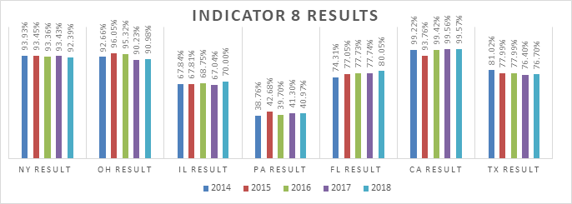
State-to-State Target Comparisons: PAK-7
Notes:
The bar graph demonstrates performance for New York, California, Florida, Pennsylvania, Illinois, Texas, and Ohio. These states are referred to as the PAK-7 States. The PAK-7 States group is a consortium of the seven largest states that the National Association of State Directors of Special Education, Inc. determined to have both similar demographics (e.g., general population, diversity, significant rural and inter-city populations) and issues in the delivery of special education programs to its students with disabilities. ​
Compared to some other states with similar populations and demographics, NYS has both generally higher targets and higher results. However, it’s hard to do direct comparisons as each state’s survey/interview tool is different, the way each state determines which parent responses are coded as 'satisfied' is different, and baselines are also different.
The graph on this slide shows that each of the PAK-7 states all reported a relatively flat parent satisfaction rate over the five-year period, meaning that there was not much change in the percent of satisfied parents from one year to the next within a state.
​

Slide 33
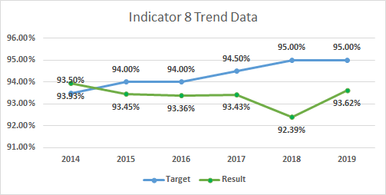
Current Data & Trend Data – Targets and Actual
(FFY 2015-2019)
Notes:
This chart shows New York State’s targets for percent of parents reporting satisfaction with parent involvement each year in blue. From 2014 through 2019 the target increased every other year, with a final target of 95% satisfaction rate in 2019.
The green line shows the actual percent of parents reporting satisfaction with parent involvement that was reported for each year. The satisfaction rate has remained very flat, or steady, from year to year with around 93.3% of parents reporting satisfaction with parent involvement annually.
If we change the survey in a future year for example, by changing the instrument, delivery methodology or district sample contribution, we will then need to reset the baseline and establish new targets and go back out for stakeholder input.

Slide 34
Proposed Targets for Indicator 8 for the 2020-2025 SPP/APR Reporting Period
Baseline 2005 | FFY | 2020 | 2021 | 2022 | 2023 | 2024 | 2025
87.80% | Target >= | 93.75% | 94.00% | 94.25% | 94.50% | 94.75% | 95.00%
The NYSED SPP 8 parent satisfaction rate is currently at 93.62%, a percentage that has stayed very flat over six years with only slight fluctuations (standard deviation of 0.47%, variance of only 0.22%, 93.36% mean, 93.40% median).
NYSED recommends continuing to use the 2005 baseline of 87.80%.
Notes:
Federal OSEP requires that the targets:
1. Must be rigorous yet achievable,
2. Must show improvement over baseline,
3. Must be set with advice of stakeholders.
Indicator 8 parent satisfaction rate is currently at 93.62%, a percentage that has stayed very flat over six years with only slight fluctuations (standard deviation of 0.47%, variance of only 0.22%, 93.36% mean, 93.40% median). NYSED recommends continuing to use the 2005 baseline of 87.80%.
The proposed targets for the period of 2020-2025 were developed by starting with an end goal of 95% satisfaction, recalibrating our annual targets by having one year 0.13% target growth factor from the current FFY2019 to next year’s FFY2020, and then working with a steady growth rate of 0.25% each year. The proposed targets are based on a slower, steady 0.25% growth factor, after aligning the baseline to our State’s current performance. We set targets by establishing an end goal of 95% (1.38% from the current FFY2019 to FFY2025) and working backwards with a .25% change each year.
*This recommended reduction in growth rate is particularly important given the lack of performance increase expected for FFY 2020 as service provision and school/parent interaction were both impacted by COVID-19.

Slide 35
Do you feel that the proposed targets for 2020-2025 are too high, too low or just right?
Notes:
NYSED is targeting a steady 0.25% growth factor each year from 2020 to 2025, with an end goal of 95%.
One question where NYSED would like to gather feedback from stakeholders is:
Do you feel that the proposed targets for 2020-2025 are too high, too low or just right?

Slide 36
Resources:
Parent Involvement Data: IDEA Data Center: https://ideadata.org/sites/default/files/media/documents/2021-03/RepresentativenessAndNonresponse.pdf
District sampling schedule:
http://www.p12.nysed.gov/sedcar/sppschedule2017-2025.html
NYSED SPP/APR Part B Reporting on FFY 2019:
https://sites.ed.gov/idea/files/NY-B-SPPAPR-FFY19.docx
NYSED parent letter template:
http://www.p12.nysed.gov/specialed/spp/indicators/8.htm
NYSED Parent survey:
http://parentsurvey.potsdam.edu
NYSED Internet Questionnaire:
http://parentsurvey.potsdam.edu
Public Reported NYS Educational Data:
Data.nysed.gov
Notes:
We hope you will continue to access information on Indicator 8. This slide provides links for many of the resources discussed in today’s presentation.

Slide 37
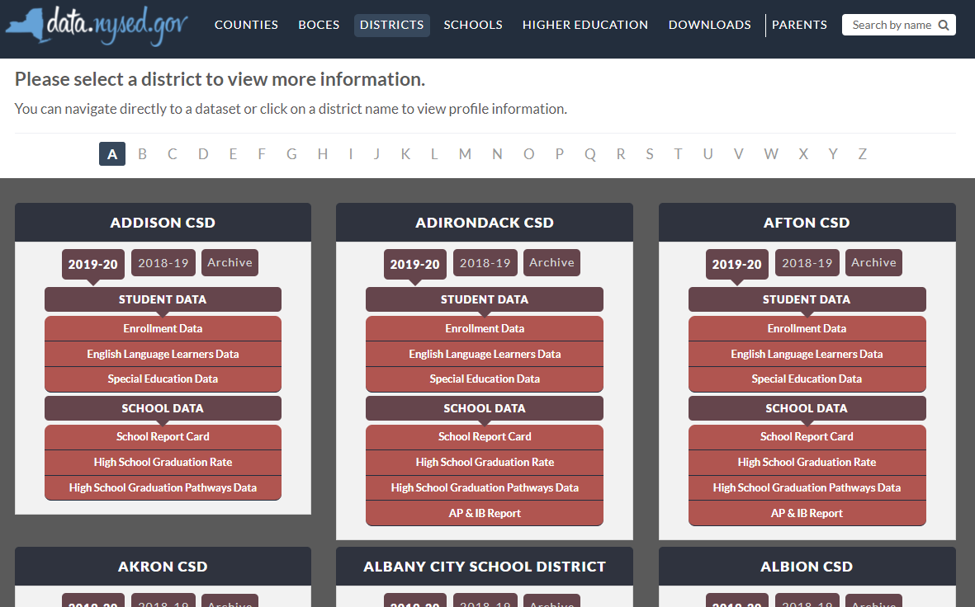

New York State School District SPP Data
Additional information on SPP Indicator data may be found in school district “Special Education Data” reports available at data.nysed.gov
Notes:
For additional information on how the SPP Indicator data impacts your school district, please visit data.nysed.gov.
In the “Districts” category on this webpage, you can view the Special Education Data reports under each school district. These reports are published annually for each individual school district and outline the district’s performance on the SPP Indicators.

Slide 38

Share Your Voice in our Online Survey
Each SPP Indicator has an online survey to collect input on NYS’s target-setting and/or improvement activities
The online surveys are intended to collect feedback from interested stakeholders. They are available for those who are not attending a virtual meeting or for those who have additional information to share beyond the virtual meetings
Please visit the SPP/APR webpage to submit your survey
Notes:
We greatly appreciate your feedback and ask that you visit our SPP/APR webpage (link provided in the slide).
We will use the survey information to collect input from those who have not attended a virtual meeting or for those who have additional information to share.
Each individual SPP Indicator will have its own survey and we encourage you to access all surveys that are of interest to you so that we can achieve our objective of meaningful stakeholder engagement. It is important to us to ensure that voices from diverse backgrounds are included in conversations about our students and we value multiple perspectives and viewpoints to inform our efforts.

Slide 39






THANK YOU for your contribution
Your Voice is Important to New York State’s Efforts to Improve Outcomes for our Students with Disabilities
Notes:
Thank you for your participation and contribution today. We greatly value your voice and input on our efforts to improve outcomes for students with disabilities in New York State.

