Slide 1

State Performance Plan (SPP)/
Annual Performance Report (APR)
2020-2025
Individuals with Disabilities Education Act (IDEA)
Indicator 5 – School-Age Least Restrictive Environment
Notes:
Today’s presentation will discuss State Performance Plan Indicator 5 which measures education in the Least Restrictive Environment for Students with Disabilities.

Slide 2
Agenda: School-Age Least Restrictive Environment
Frequently Used Terms for School-Age Least Restrictive Environment
Next Steps and Closing
Indicator 5 How the Measurement Works
Indicator 5 Data in New York State (Trends and Comparisons)
Indicator 5 Improvement Activities
Indicator 5 Proposed Targets
Notes:
Today we will first review the Frequently Used Terms that will be used throughout the presentation to describe the indicator and the data collected to measure outcomes.
We will then provide a description of “How the Indicator 5 School-Age Least Restrictive Environment Measurement Works” and illustrate data trends and comparisons in New York State.
Next we will provide an overview of existing activities and potential new activities aimed at improving school-age least restrictive environment outcomes.
We will then offer our proposed State Performance Plan targets for the 2020 through 2025 Annual Performance Reports to the federal government.
Finally, we will offer next steps for how to continue the discussion and obtain additional information and resources.

Slide 3
Frequently Used Terms in the Presentation
Term | Description
State Performance Plan or SPP | Evaluates the state’s efforts to implement the requirements and purposes of the IDEA and describes how the state will improve its implementation
Federal Fiscal Year or FFY | Federal Government Fiscal Year (October 1 – September 30)
Indicator 5 | SPP Indicator 5 measures School-Age Least Restrictive Environment
Indicator 5A | Indicator 5A measures services inside the regular class 80% or more of the day
Indicator 5B | Indicator 5B measures services the regular class less than 40% of the day
Indicator 5C | Indicator 5C measures services in separate schools, residential facilities, or homebound/hospital placements
Baseline | Data starting point to measure improvement overtime
Targets | Performance Objectives set for SPP Measurements
Annual Performance Report (APR) Reported Data | Data reported to the United States Department of Education Office of Special Education Programs (OSEP) against the state’s targets
Data Equated to New Measurement | Submitted Data recalculated using the components of a new measurement
Notes:
In this presentation we will use the term State Performance Plan or SPP to identify the plan used by the federal Department of Education to evaluate state’s efforts to implement the requirements and purposes of the Individuals with Disabilities Education Act (also referred to as the IDEA).
The term Federal Fiscal Year or FFY is the reporting period of time used for the Annual Performance Report which runs from October 1st through September 30th. When we present Annual Performance Report data, the year reflected in the presentation will be the data for the federal fiscal year.
Indicator 5 is the SPP Indicator that measures School-Age Least Restrictive Environment.
5A is a subcomponent of the Indicator 5 measurement which captures services inside the regular class 80% or more of the day; subcomponent 5B captures services in the regular class less than 40% of the day; and subcomponent 5C captures services in separate schools, residential facilities, or homebound/hospital placements.
We will use the term “Baseline” as a starting point in our New York State results used to measure our improvement over time. Targets reflect our desired annual outcomes for our measurement results and are required as part of our SPP in order to set performance objectives.
The Annual Performance Report or APR is data that is reported annually to the United States Department of Education Office of Special Education Programs. It contains our actual reported performance against our SPP Targets.
Finally, because our Indicator 5 measurement has changed, meaning prior to 2020 we measured progress in a different manner than we will for 2020 through 2025, some of the data we use in the presentation will be equated data. Equated data is our New York State historical data that we have “recalculated” to the best of our ability to apply the standards of the new measurement. We will use the terms “equated data” or “equated to new measurement” when this occurs in our presentation of data.

Slide 4
Students with disabilities have a fundamental right to receive their special education supports in a classroom and setting that, to the maximum extent appropriate, includes students without disabilities. Under federal law, the presumption is that students with disabilities will attend the same schools they would have attended if they did not have disabilities and that removal or restriction from their regular schools and classrooms can only occur for reasons related to the student’s disability when the student’s individualized education program (IEP) cannot be satisfactorily implemented in that setting, even with the use of supplementary aids and services.
Least Restrictive Environment (LRE)
Notes:
The IDEA Part B includes the right for a student with a disability to be educated in the least restrictive environment (also referred to as “LRE”).
Under federal law, the presumption is that students with disabilities would attend the same schools they would have attended if they did not have a disability and removal from regular schools and classrooms only occurs for reasons related to the student’s disability when the student’s individualized education program (also referred to as IEP) cannot be satisfactorily implemented in that setting, even with the use of supplementary aids and services.

Slide 5

The placement of an individual student with a disability in the least restrictive environment must:
provide the special education needed by the student;
provide for education of the student to the maximum extent appropriate with other students who do not have disabilities; and
be as close as possible to the student's home.
Notes:
A placement in the least restrictive environment must:
Provide the special education needed by the student
To the maximum extent appropriate with other students who do not have disabilities; and
Be as close to home as possible.

Slide 6
Indicator 5 – Old Measurement (SPP 2013 – 2019)
School Age Least Restrictive Environment
Percent of children aged 6 through 21 served:
A. Inside the regular class 80% or more of the day;
B. Inside the regular class less than 40% of the day;
C. In separate schools, residential facilities, or homebound/hospital placements.
For subcomponents A & B: Regular class is where students without disabilities also receive their education. The number of students without disabilities should be more than or equal to the number of students with disabilities.
For subcomponent C: Regular school facility is a school building attended by both students with and without disabilities. Separate Settings are outside of regular school facilities in buildings that are attended by students with disabilities only.
Improvement = Increase over Baseline
Improvement = Decrease over Baseline
Improvement = Decrease over Baseline
Notes:
State’s School-Age LRE performance is measured by SPP Indicator 5.
From 2013 through 2019, School-Age LRE Indicator 5 measurement considered the Percent of children aged 6 through 21 served:
Inside the regular class 80% or more of the day (where improvement occurs with an increase in the percentage or when more students receive services inside the regular class 80% or more of the day);
Inside the regular class less than 40% of the day (where improvement occurs with a decrease in the percentage or fewer students with disabilities receiving services in a regular class less than 40% of the day);
In separate schools, residential facilities, or homebound/hospital placements (where improvement occurs with a decrease in the percentage or fewer students with disabilities receiving services in separate schools, facilities, or home/hospital placements).
When reporting data in the SPP, a regular class is one where at least 50% of the students attending the class do not have individualized education programs (or IEPs). A regular school facility is a building attended by both students with and without disabilities and a separate setting includes buildings that are attended only by students with disabilities.
It is important to consider that Indicators 5A, 5B, and 5C do not add up to 100%. Meaning, not all students are served in a regular class 80% or more, or less than 40%, or are served in a separate school/facility. For example, a student may attend a regular class less than 80% but more than 40% of the day. While most students are represented in the reported data for Indicator 5A, 5B, or 5C, not all are. The 2020 reported data reflected 18.4% of students with disabilities are NOT included in the Indicator 5 measurement.

Slide 7
Indicator 5 – New Measurement FFY 2020
School Age Least Restrictive Environment
Percent of children with Individualized Education Programs (IEPs) aged 5 who are enrolled in kindergarten and aged 6 through 21 served:
A. Inside the regular class 80% or more of the day;
B. Inside the regular class less than 40% of the day;
C. In separate schools, residential facilities, or homebound/hospital placements.
For subcomponents A & B: Regular class is where students without disabilities also receive their education. The number of students without disabilities should be more than or equal to the number of students with disabilities.
For subcomponent C: Regular school facility is a school building attended by both students with and without disabilities. Separate Settings are outside of regular school facilities in buildings that are attended by students with disabilities only.
Improvement = Increase over Baseline
Improvement = Decrease over Baseline
Improvement = Decrease over Baseline
Notes:
For the SPP 2020 through 2025, the Indicator 5 measurement has changed. Indicator 5 now includes children aged 5 who are enrolled in kindergarten. Previously all 5 year old children were included in Indicator 6 (Preschool LRE) but starting in 2020, states are required to identify whether a child with a disability aged 5 attends a preschool program or a kindergarten program. If the child aged 5 attends a preschool program, they are reported in Indicator 6; if the child aged 5 attends a school-age program, then they are reported as part of Indicator 5 (School-Age LRE).
Improvement is still measured the same (increase in 80% or more and decrease in 40% or less and separate setting). And the interpretation of regular class and separate setting are also still the same under the new SPP measurement.

Slide 8
Data Collection Methodology for Indicator 5
School-Age LRE data is collected for all children with IEPs who meet the age requirements (children aged 5 who are enrolled in kindergarten and aged 6 through 21).
Sampling is not allowed.
Student environment data is reported for each school year annually as a “snapshot” or “point in time” as of the first Wednesday in October (BEDs Day).
Code | LRE Environment Description
SA01 | Inside the regular classroom 80% or more of the day.
SA02 | Inside the regular classroom 40% to 79% of the day.
SA03 | Inside the regular classroom less than 40% of the day.
SA04 | Separate School or Residential Facility
SA05 | Hospital Inpatient
SA06 | Home Instruction – Placed on Home Instruction by the CSE
SA07 | Incarcerated
SA08 | Parentally placed in a nonpublic school and receiving special education services
SA09 | Parentally placed in a nonpublic school and NOT receiving publicly funded special education services
SA10 | Home Schooled at parent’s choice
Notes:
Indicator 5 data is collected annually for all children who meet the age requirements (there is no data sampling allowed for this indicator).
Data reflecting students’ Least Restrictive Environment Code is collected annually via the Student Information Repository System (SIRS) and verified by school districts. The reported data is a “snapshot” or “point in time” reflecting students’ educational environment as of the first Wednesday in October (BEDs Day). The October 2020 BEDS Day data is reported in the 2020 annual performance report due to the United States Department of Education in February of 2022.

Slide 9

Facilitator check for understanding on the SPP measurement for Indicator 5 and how the data is used to measure results or outcomes in LRE.
Notes:
We are going to pause to check to ensure the information we presented regarding the measurement was clear and understandable.

Slide 10
Indicator 5 – Data Trends and Comparisons
State Performance Plan (SPP)/
Annual Performance Report (APR)
2020-2025
Individuals with Disabilities Education Act (IDEA)
Notes:
We will now present Indicator 5 data trends and comparisons. During the virtual meetings, we will pause throughout the data presentation to get stakeholder feedback. Specifically, we will ask stakeholders what does the State Performance Plan data tell us? And how should we use the data to inform our target-setting and improvement activities?

Slide 11
Explanation Indicator 5 FFY Data in the Annual Performance Report (APR)
Data years presented will reflect the data NYSED submits to the federal Office of Special Education Programs (OSEP) in the APR which covers the federal fiscal year (FFY) period
October 2020
The Indicator 5 data sample is
collected on a “point in time” basis
The FFY 2020 APR is
submitted to OSEP
FFY 2020 APR
The October 2020 LRE Data is
included in the FFY 2020 APR
February 2022
Notes:
The data that we present today will reflect the Annual Performance Report data that NYSED submits to the federal Office of Special Education Programs (or OSEP). The reporting period is based on the federal fiscal year (or FFY). For Indicator 5, least restrictive environment or LRE data is reported in the same year’s APR. For example, the October 2020 LRE data is reported in the FFY 2020 APR which is submitted to OSEP in February of 2022.

Slide 12
New York State SPP Targets and Actual Reported
Indicator 5A: Inside the Regular Class 80% or More
Increase = Improvement
Difference | +.16 | -0.6 | -0.82 | -.0.74 | -1.02 | -1.49 | -1.79
Indicator 5A: Reported APR Data
Notes:
We will now consider New York State’s past performance for Indicator 5 based on the actual reported data in our Annual Performance Report (which used the old measurement applicable during this time).
This graph and chart contains New York State historical data from 2013 through 2019 for the Percent of children aged 6 through 21 with IEPs served inside the regular class 80% or more of the day. For Indicator 5A, the greater the percent value the better the improvement for this outcome. In other words, more students served inside the regular class 80% or more of the day demonstrates improvement.
The red dotted line illustrates the New York State Indicator 5A Targets and the blue solid line reflects the New York State actual reported data results during the period. Each year on the line graph is marked with the percentage point increase or decrease from the prior year. For example, from 2013 to 2014, the New York State target increased by 0.4 percentage points and the reported data decreased by 0.36 percentage points from the prior year.
The chart below the line graph provides the reported percent values for each year with the difference between the New York State Target and Actual Reported Data in the bottom row labeled “difference.” A positive symbol is used to illustrate where results performed better than the target and a negative symbol is used to illustrate where results performed worse than the target. For example, in 2019 the New York State Actual Reported Data was 1.79 percentage points below our 60% target for students served inside the regular class for 80% or more of the day.
Although New York State did not meet most of its targets during the period, results slightly increased in most years with the 2019 results above the 2013 results to a small degree.

Slide 13
State-to-State Result Comparison
Indicator 5A: Inside the Regular Class 80% or More
Increase = Improvement
Notes:
The bar graph demonstrates performance for New York State against comparable states in Indicator 5A (served in a regular class for 80% or more of the day) for the years 2015 through 2018. As a reminder, for Indicator 5A, the greater the percentage, the better the outcome.
New York, California, Florida, Pennsylvania, Illinois, Texas, and Ohio are known as the 7-PAK States. 7-PAK States is a consortium of the seven largest states that the National Association of State Directors of Special Education, Inc. determined to have both similar demographics (e.g., general population, diversity, significant rural and inter-city populations) and issues in the delivery of special education programs to its students with disabilities.
The red dotted line reflects the 2018 National Mean for Indicator 5A performance at 66%. The bar graph values above the dotted line performed better than the 2018 National Mean and the bar graph values below the red dotted line performed worse.
Of the 7 represented states, New York State ranks 5 out of 7 for Indicator 5A performance and below the 2018 National Mean.

Slide 14
New York State SPP Targets and Actual Reported
Indicator 5B: Inside the Regular Class 40% or Less
Decrease = Improvement
Difference | +.03 | +1.2 | +0.68 | +0.44 | -0.04 | -0.96 | -1.01
Indicator 5B: Reported APR Data
Notes:
For the percent of children aged 6 through 21 with IEPs served inside the regular class less than 40% of the day, the reported APR data for New York State from 2013 through 2019 is reflected on the graph and chart. For Indicator 5B, the lower the percentage value (or fewer students with disabilities served inside the regular class less than 40% of the day) the greater the improvement on this measurement.
The red dotted line illustrates the New York State Indicator 5B Targets during the period and the blue solid line reflects the New York State actual reported results. Each year on the line graph is marked with the percentage point increase or decrease from the prior year to show change from year to year.
The chart below the graph contains the reported percent values for each year with the difference of how far above or below the results were from the target in the bottom row labeled “difference.” A positive symbol is used to illustrate where results performed better than the target and a negative symbol is used to illustrate where results performed worse than the target.
The data reflects that New York State Indicator 5B reported data results demonstrated improvement in most years from 2013 through 2019 with a total decreased by approximately 2.46 percentage points during that period. Indicator 5B targets were met in the first 4 years from 2013 through 2016 but not in the final three years from 2017 through 2019 where New York State ended approximately 1 percentage point off Target.

Slide 15
State-to-State Result Comparison
Indicator 5B: Inside the Regular Class 40% or Less
Decrease = Improvement
Notes:
The bar graph demonstrates performance for New York, California, Florida, Pennsylvania, Illinois, Texas, and Ohio in Indicator 5B (inside the regular class 40% or less) for the years 2015 through 2018. As a reminder, for Indicator 5B, the lower the percentage, the better the outcome on this measurement.
The red dotted line reflects the 2018 National Mean for Indicator 5B performance (at 10.38%). Bar graph values below the dotted line performed better than the 2018 National Mean and the bar graph values above the red dotted line performed worse.
Of the 7 represented states, New York State ranks 6th for performance in Indicator 5B compared to other states and worse than the 2018 National Mean.

Slide 16
New York State SPP Targets and Actual
Indicator 5C: In Separate Schools, Residential Facilities, or Homebound/Hospital Placements
Decrease = Improvement
Difference | +0.12 | -0.13 | +0.36 | -0.44 | -0.15 | -0.43 | -0.11
Indicator 5C: Reported APR Data
Notes:
For the percent of students aged 6 through 21 with IEPs served in separate schools, facilities, and homebound or hospital placements, the reported APR data for New York State is reflected on the graph and chart. For Indicator 5C, the lower the percentage value (or fewer students with disabilities in a separate schools, facilities, or home/hospital placements) the greater the improvement on this measurement.
The red dotted line illustrates the New York State Indicator 5C Targets during the period. The blue solid line reflects the New York State actual reported results. Each year on the line graph is marked with the percentage point increase or decrease from the prior year to show change from year to year. The chart below the line graph contains the reported percent values for each year with the difference between the New York State Target and Actual Reported Data in the bottom row labeled “difference.” A positive symbol is used to illustrate where results performed better than the target and a negative symbol is used to illustrate where results performed worse than the target.
The data reflects that New York State Indicator 5C Targets decreased by approximately 1.1 percentage points, and the actual reported data varied year to year but ultimately decreased by 0.87 percentage points.

Slide 17
State-to-State Result Comparison
Indicator 5C: In Separate Schools, Residential Facilities, or Homebound/Hospital Placements
Decrease = Improvement
Notes:
The state and national data comparison demonstrates that New York performs worse than the 2018 National Mean of 2.78% and among the lowest of the represented states.

Slide 18

Data Trends and State/National Comparisons
1) What did the Indicator 5 SPP data tell us?
2) How should we use the data to inform our target-setting and improvement activities?
Stakeholder
Discussion
Notes:
During the virtual meetings, we will pause to have discussion and feedback from stakeholders. We will be asking: What did the State Performance Plan data tell us? And how should we use the data to inform our target-setting and improvement activities?

Slide 19
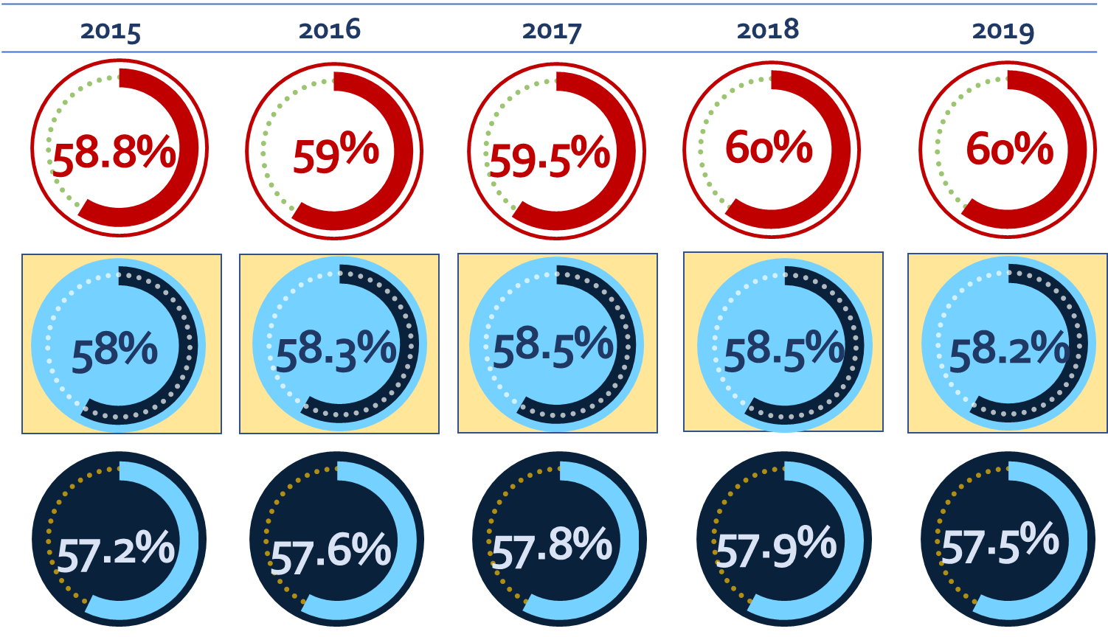
Indicator 5A Inside the Regular Class 80% or More of the Day
Old vs New Measurement: Old Performs Better
Increase = Improvement
Target
Old Measurement (excludes 5-year-olds in Kindergarten)
New Measurement (includes 5-year-olds in Kindergarten)
Notes:
In order to compare the impact of the new Indicator 5 measurement, we recalculated the historic data equated to the new measurement standards. In other words, to see the impact of the new measurement, we considered the historic reported data but added children aged 5 attending kindergarten to equate the historic data to the new standards for 2020.
For example, in 2015, the New York State target for students with disabilities served in a regular class 80% or more of the day was 58.8%. The reported data (using the old measurement) was 58% but when the 5 year olds in kindergarten were added to equate the data to the new measurement, New York State performed slightly worse at 57.2%. The old measurement performed better in all 5 of the last 5 years but the new measurement was within 1 percentage point of the old measurement each year.

Slide 20
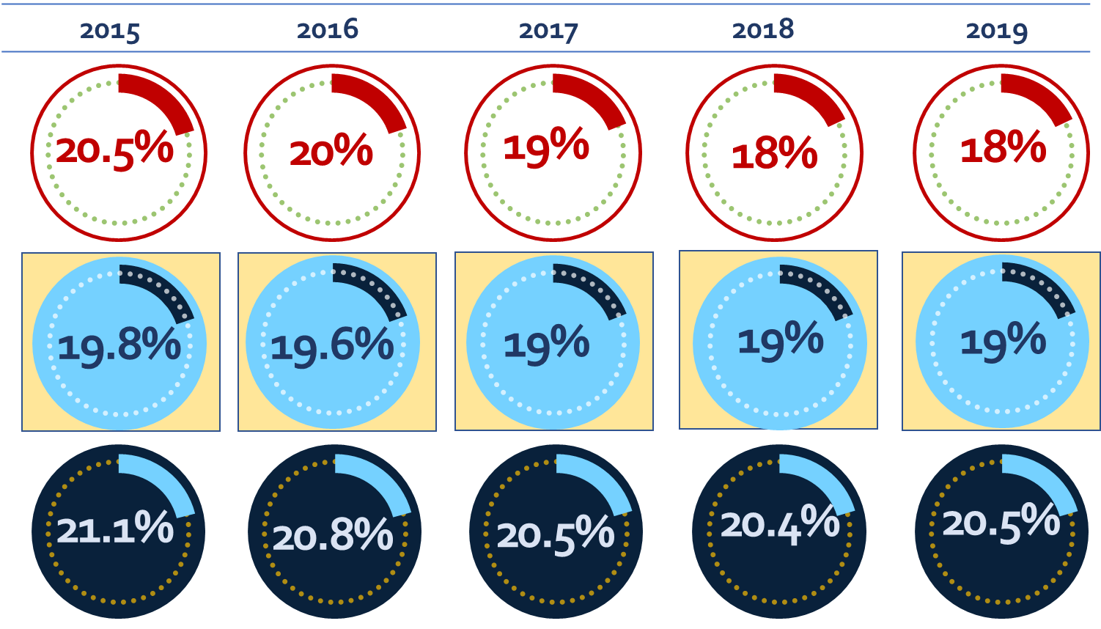
Indicator 5B Inside the Regular Class 40% or Less of the Day
Old vs New Measurement: Old Performs Better
Decrease = Improvement
Target
Old Measurement (excludes 5-year-olds in Kindergarten)
New Measurement (includes 5-year-olds in Kindergarten)
Notes:
When comparing Indicator 5B, inside the regular class 40% or less of the day, the old measurement which excluded 5 year old students with disabilities in kindergarten performed better in all years 2015 through 2019. In other words, including 5 year olds in kindergarten worsened Indicator 5B results in the equated data comparison.

Slide 21
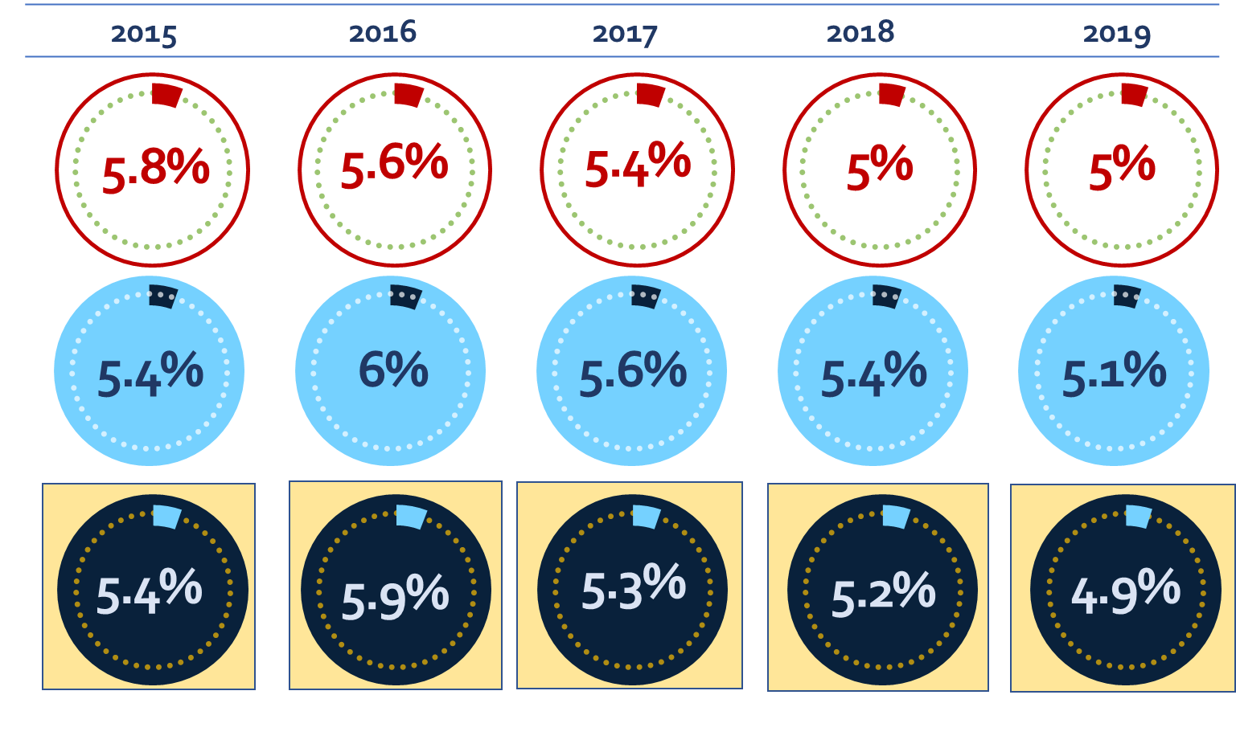
Indicator 5C In Separate Schools:
Old vs New Measurement: New Performs Better
Decrease = Improvement
Target
Old Measurement (excludes 5-year-olds in Kindergarten)
New Measurement (includes 5-year-olds in Kindergarten)
Notes:
For the Indicator 5C old and new measurement comparison, the new measurement demonstrated better performance. For example in 2019, once kindergarten children were included in the measurement, the percent of students in separate settings decreased to 4.9% which meets the 5% target for that year.

Slide 22
Old vs New Measurement
1) What did the Indicator 5 SPP data tell us?
2) How should we use the data to inform our target-setting and improvement activities?
Stakeholder
Discussion
Notes:
During the virtual meetings, we will pause to have discussion and feedback from stakeholders. We will be asking: What did the State Performance Plan data tell us? And how should we use the data to inform our target-setting and improvement activities?

Slide 23
Indicator 5 – Disaggregate Data
State Performance Plan (SPP)/
Annual Performance Report (APR)
2020-2025
Individuals with Disabilities Education Act (IDEA)
Notes:
We will now present Indicator 5 disaggregate data. During the virtual meetings, we will pause throughout the data presentation to get stakeholder feedback. Specifically, we will ask what does the State Performance Plan data tell us? And how should we use the data to inform our target-setting and improvement activities?

Slide 24
Indicator 5A: NYS in a Regular Class 80% or More
Student Data by Race and Ethnicity (FFY 2019)
Increase = Improvement
60%
Notes:
The bar graph illustrates Indicator 5A data (inside a regular class 80% or more) by race and ethnicity.
The data is from October 2019 (we chose this point in time because it is pre-COVID). The 2019 data is equated to the new Indicator 5 measurement so that 5 year old children attending kindergarten are included in the data.
The New York State 2019 target of 60% is reflected as the red dotted vertical line. Bar values to the right of the line met the target and bar values to the left did not.
Each bar on the graph represents a student cohort by race or ethnicity and each student count belonging to that cohort is also labeled. The highest percent served inside a regular class 80% or more is reflected at 60.93% by Hispanic or Latino cohort which has a student count of 96,426. The lowest percentage of 45.46% is reflected by the Multiracial cohort with a student count of 6,836.
The other cohorts reflect approximately a 5.75 percentage point range from 54.25% (for the Native Hawaiian/Other Pacific Islander cohort) to 60.06% (for the Asian cohort).
Indicator 5 Race and Ethnicity data is made available to each district in its annual Verification Report where each school district is required to review its data to verify the report accurately represents LRE data for all students with disabilities for whom the district has CSE responsibility and who were receiving special education services on the October snapshot date. The Verification Report specifically directs each district to verify that all students’ race/ethnicity information are accurate. This information can be used as an identifier for how school district decision-making results in equity in educational opportunities and this will be discussed further in the improvement strategy conversation.

Slide 25
Indicator 5A: NYS in a Regular Class 80% or More
Student Data by District Needs/Resource Capacity (FFY 2019)
Increase = Improvement
Notes:
Next we considered disaggregate data by school district need/resource capacity. Again, we used FFY 2019 data.
The need/resource capacity index is a measure of a school district's ability to meet the needs of its students with local resources. Districts are evaluated based on an estimated poverty percentage (which considers free-and-reduced-price-lunch and poverty factors) and a Combined Wealth Ratio (which is a ratio of district wealth per pupil compared to the State average). On the needs/resource capacity index, low need districts have more local resources and high need districts have fewer local resources.
New York City represents the New York City Department of Education and the Large City represents the Big 4 school districts of Buffalo, Rochester, Syracuse, and Yonkers. Rural High Need Districts have fewer than 50 students per square mile; or fewer than 100 students per square mile and an enrollment of less than 2,500.
For Indicator 5A (inside the regular class 80% or more of the day), the reported results range from the lowest performance of 45.81% for urban/suburban high needs districts and highest performance of 61.44% for low needs districts which was the only category that met the 2019 target, with the New York City Department of Education within a percentage point of meeting the 60% target in 2019.

Slide 26
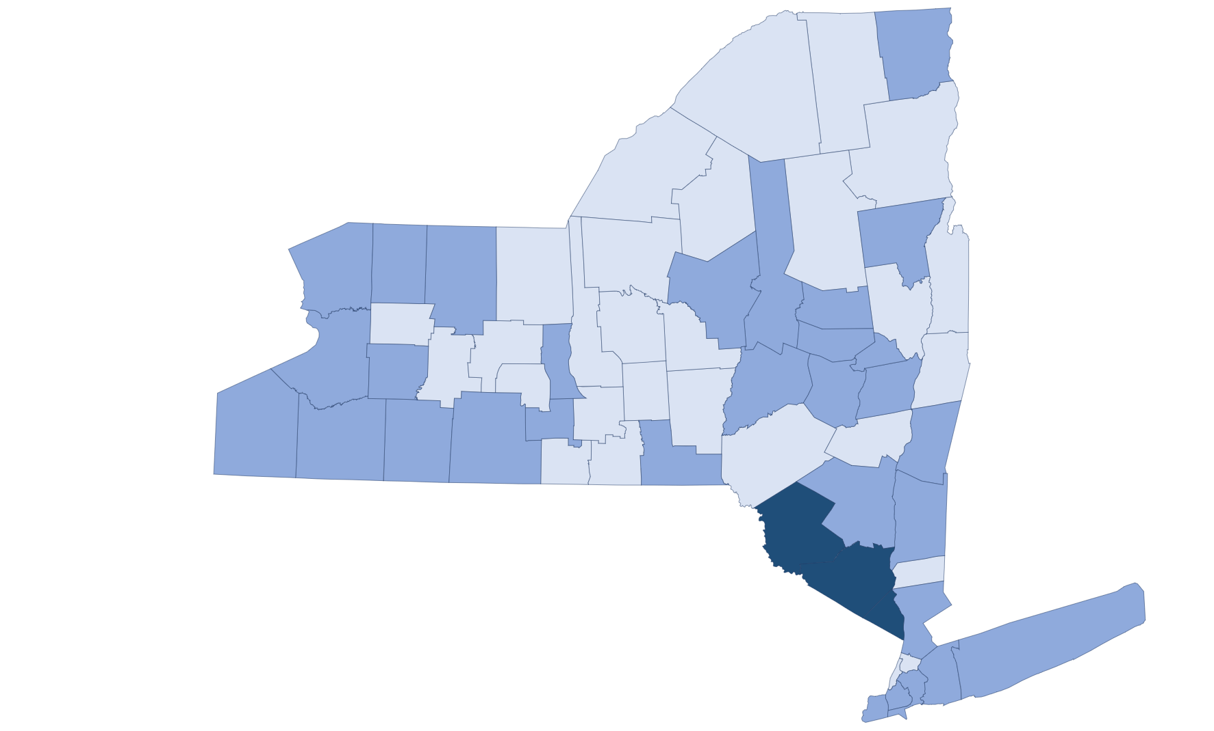
Regional 5A Data
Inside the regular class 80% or more of the day
Increase = Improvement
County Level Data | Minimum Value | Maximum Value
Met Target | 60.0% | 100.0%
Did not Meet Target (Within 25%) | 45.0% | 59.9%
Did not Meet Target (Over 25%) | 0.0% | 44.9%
Notes:
When looking at Indicator 5 data on a regional County level, there is a variety in performance. The light blue Counties reflect where the school districts in aggregate met the 2019 Target of 60% or more school-age students with disabilities served in a regular class 80% or more of the day.
Medium blue Counties did not meet the 60% Target but were within 25% of the Target - meaning those school districts in aggregate had between 45% and 59.9% of their students served in a regular class 80% or more of the day.
School districts in dark blue Counties did not meet the 2019 target and were more than 25% from the target (they had less than 44.9% of their students inside the regular class 80% or more of the day).

Slide 27
Indicator 5A Disaggregate Data
1) What did the Indicator 5A SPP data tell us?
2) How should we use the data to inform our target-setting and improvement activities?
Stakeholder
Discussion
Notes:
During the virtual meetings, we will pause to have discussion and feedback from stakeholders. We will be asking: What did the State Performance Plan data tell us? And how should we use the data to inform our target-setting and improvement activities? What questions do you have about the data?

Slide 28
Indicator 5B: NYS in a Regular Class 40% or Less
Student Data by Race and Ethnicity (FFY 2019)
Decrease = Improvement
Notes:
The Indicator 5B by race and ethnicity is reflected in the bar graph with the 2019 target of 18% represented by the red dotted vertical line. Because a decrease in percentage demonstrates improvement, bar graph values to the left of the red dotted line met the 5B target and bar graph values to the right of the red dotted line did not.
The data demonstrates that the White and Multiracial student cohorts (at 15.89% and 16.21% respectively) met the New York State 2019 target. The remaining student cohorts did not and ranged from 23.57% for the Hispanic or Latino cohort and 26.45% for the Native Hawaiian/Other Pacific Islander cohort of students inside the regular classroom for 40% or less of the school day.

Slide 29
Indicator 5B: NYS in a Regular Class 40% or Less
Student Data by District Needs/Resource Capacity (FFY 2019)
Decrease = Improvement
Notes:
When viewing Indicator 5B by school district needs/resource data, as with Indicator 5A, only the low needs school districts category met the target. Average needs districts were slightly over the target at 18.34% with the remaining district categories performing between approximately 3.5 percentage points and 8 percentage points worse than the 2019 target of 18% or under for students inside a regular class 40% or less of the day.

Slide 30
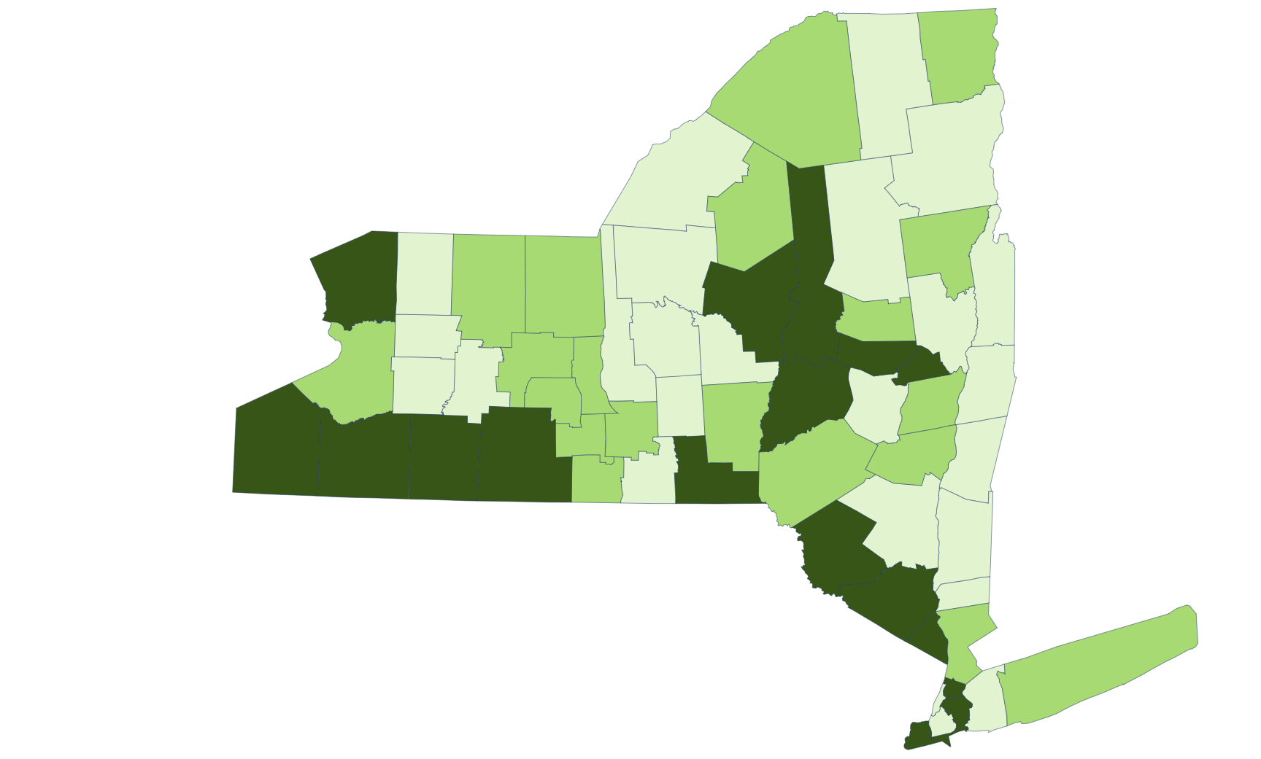
Regional 5B Data
Inside the regular class less than 40% of the day
Decrease = Improvement
County Level Data | Minimum Value | Maximum Value
Met Target | 0% | 18.0%
Did not Meet Target (Within 25%) | 18.1% | 22.5%
Did not Meet Target (Over 25%) | 22.6% | 100.0%
Notes:
School District aggregate data by County for Indicator 5B also demonstrates regional disparities in the percent of school-age students inside a regular class for 40% or less of the day.
The light green Counties are those where school district data in aggregate met the New York State 2019 target of 18% or less.
The medium green shade reflects aggregate school district data where the 18% target was not met but reported performance was within 25% of the target. In other words, the school districts in the medium green Counties had aggregate data demonstrating the percent of school-age students in a regular class 40% or less of the day was between 18.1% and 22.5%.
The dark green shade on the map reflects those Counties where over 22.5% of school-age students with disabilities are served in a regular class 40% or less of the day based on aggregate data from the districts.

Slide 31
Indicator 5B Disaggregate Data
1) What did the Indicator 5B SPP data tell us?
2) How should we use the data to inform our target-setting and improvement activities?
Stakeholder
Discussion
Notes:
During the virtual meetings, we will pause to have discussion and feedback from stakeholders. We will be asking: What did the State Performance Plan data tell us? And how should we use the data to inform our target-setting and improvement activities? What questions do you have about the data?

Slide 32
Indicator 5C: NYS Separate Setting
Student Data by Race and Ethnicity (FFY 2019)
Decrease = Improvement
Notes:
The race and ethnicity data for Indicator 5C in 2019 illustrates that the Hispanic or Latino, Multiracial, and White student cohorts met the target of below 5% of students in separate schools, residential facilities, or homebound/hospital placements.
The American Indian or Alaska Native, Asian, Black or African American, and Native Hawaiian/Other Pacific Islander student cohort data reported more than 5% of students in separate schools, residential facilities, or homebound/hospital placements.

Slide 33
Indicator 5C: NYS Separate Setting
Student Data by District Needs/Resource Capacity (FFY 2019)
Decrease = Improvement
Notes:
The Indicator 5C by school district needs/resource data illustrates that most school district categories met the 5C target and had 5% or below for the percent of school-age students served in separate schools, residential facilities, or homebound/hospital placements.
The Large City School Districts, and the Urban/Suburban High Needs districts did not meet the 2019 target by almost 2 percentage points or more.

Slide 34
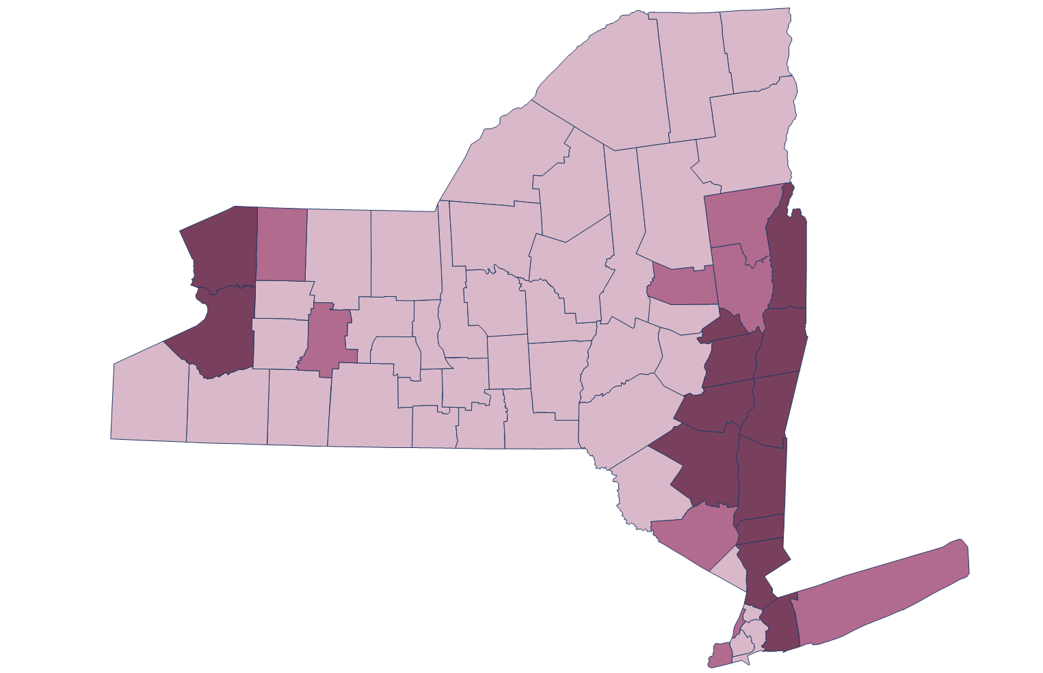
Regional 5C Data
In separate schools, residential facilities, or homebound/hospital placements
Decrease = Improvement
County Level Data | Minimum Value | Maximum Value
Met Target | 0% | 5.00%
Did Not Meet Target (Within 25%) | 5.1% | 6.25%
Did Not Meet Target (Over 25%) | 6.26% | 100%
Notes:
School District aggregate data by County for Indicator 5C also demonstrates some regional differences in the percent of school-age students served in separate schools, residential facilities, or homebound/hospital placements.
The pale pink Counties are those where school district data in aggregate met the New York State 2019 target of 5% or less served in separate schools, residential facilities, or homebound/hospital placements.
The medium pink shade reflects aggregate school district data where the 5% target was not met but reported performance was within 25% of the target. In other words, the school districts in the medium pink Counties had aggregate data demonstrating the percent of students served in separate schools, residential facilities, or homebound/hospital placements was between 5.1% and 6.25%.
The dark plum shade on the map reflects those Counties where over 6.25% of school-age students with disabilities were served in separate schools, residential facilities, or homebound/hospital placements in 2019.

Slide 35
Indicator 5C Disaggregate Data
1) What did the Indicator 5C SPP data tell us?
2) How should we use the data to inform our target-setting and improvement activities?
Stakeholder
Discussion
Notes:
During the virtual meetings, we will pause to have discussion and feedback from stakeholders. We will be asking: What did the State Performance Plan data tell us? And how should we use the data to inform our target-setting and improvement activities? What questions do you have about the data?

Slide 36
Indicator 5 – Improvement Activities
State Performance Plan (SPP)/
Annual Performance Report (APR)
2020-2025
Individuals with Disabilities Education Act (IDEA)
Notes:
We will now look at Improvement Strategies aimed at improving New York State’s School-Age Least Restrictive Environment performance.

Slide 37
Focused Intervention LRE Monitoring Review
District Survey
Identifies the special education service options in the district and potential barriers to LRE
Parent Interview
Describes the child’s needs and the services received
Student Record Review
Review of the student’s IEP and Prior Written Notice (for the notice of placement)
CSE Observation
Observing the IEP meeting and CSE recommendation to provide a free appropriate public education in the LRE
Notes:
School Districts not meeting IDEA targets may receive an LRE monitoring review as a focused intervention. The LRE review module is comprised of a district survey, parent interview, student record review, and CSE observation.
The district survey identifies student’s access to the continuum of special education programs and services including the supports available to include students in the general education classroom and participation of students with disabilities in in extracurricular and nonacademic activities. The district is also asked to identify “what barriers might prevent a student with a disability in the district from being successfully included in the general education classroom.”
The parent interview asks parents to describe the programs and services their child receives and any other special education programs and services that were recommended.
Student record review evaluates the student’s IEP and extent to which the student is involved in and progressing in the general education curriculum. The Prior Written Notice for the notification of placement is also reviewed to ensure it includes a description of other options that the CSE considered and the reasons why those options were rejected.
The CSE Observation provides an opportunity to see IEP meetings in progress and listen to the discussion of the student’s present levels of performance, annual goals, and recommended programs and services following consideration of the various options from the continuum of services that might meet the needs of the student and also promote access to the general education curriculum in the least restrictive environment.

Slide 38
Significant Disproportionality: Placement
IDEA requires state to collect and examine data to determine if significant disproportionality based on race and ethnicity is occurring with respect to identification, placement, and discipline.
In order to identify significant disproportionality in placement, school district’s school-age LRE data is evaluated for those students inside a regular class 40 percent or less and also for those students educated in separate schools and residential facilities.
Significant disproportionality in placement generally occurs when students of one racial or ethnic group are more likely to be placed in a more restrictive setting compared to all other students.
To identify significant disproportionality in placement, New York State uses a relative risk ratio of 2.5 or higher or, if there are not enough students in a subgroup to meet the minimum cell size, an alternate risk ratio to compare district data to the State average.
Notes:
Indicator 5 School-Age LRE data is used to determine significant disproportionality in placement. Significant disproportionality is identified with respect to identification, placement, and discipline.
Significant disproportionality in placement considers a school district’s data for students inside a regular class 40% or less of the day and students in separate settings. Significant disproportionality in placement generally occurs when students of one race or ethnicity are more likely to be placed in a more restrictive setting compared to other students.
New York State identifies significant disproportionality in placement when students of a particular race or ethnicity are two and a half times more likely to be inside a regular class 40% or less or be placed in a separate setting. If there are not enough students in a subgroup to meet the minimum cell size, an alternate risk ratio is used to compare district data against a State average.

Slide 39
Significant Disproportionality
At Risk for Significant Disproportionality
When a district shows disproportionality for one or two years, they are notified as being At Risk for Significant Disproportionality.
Having Significant Disproportionality
When a district shows disproportionality in placement for three years in a row for the same race and ethnicity subgroup, the district is identified as having Significant Disproportionality.
The district is subject to a monitoring review; and
The district is required to reserve 15 percent of its IDEA funds (Sections 611 and 619) to provide Comprehensive Coordinated Early Intervening Services (CCEIS) for students in grades K-12.
Notes:
School districts are notified if their data demonstrates a significant disproportionately in placement. A school district is “At Risk” for Significant Disproportionality when the district data shows disproportionality for one or two years (13 districts were “at risk” in the 2020-21 school year). A district with data showing disproportionality in placement for three consecutive years for the same race and ethnicity subgroup, is identified as having Significant Disproportionality. Those districts undergo a monitoring review and are required to reserve 15% of its IDEA funds to provide Comprehensive Coordinated Early Intervening Services (also known as Comprehensive CEIS).
Comprehensive CEIS are services provided to students age 3 through grade 12 who are either:
Not currently identified as a student with a disability, but who need additional academic and/or behavioral support to succeed in the general education environment; or
Currently identified as a student with a disability (funds can be used primarily, but not exclusively, for this group).

Slide 40

Special Education Space Requirements
Section 200.2(g) of the Regulations of the Commissioner of Education requires boards of cooperative educational services (BOCES) district superintendents to determine the adequacy and appropriateness of special education programs facilities space to ensure:
  the allocation of instructional space is sufficient and appropriate to meet current and future special education space needs of all students with disabilities in their BOCES region;
  any change to the allocation of space in the BOCES region is consistent with the needs for placement in the LRE and for the stability and continuity of program placements for participating students with disabilities;
  special education programs and services located in appropriate facilities are relocated only with adequate consideration of the needs of participating students with disabilities; and
  any changes to allocate, lease, renovate or construct space in the BOCES region that include special education programs are structured to ensure that students with disabilities have appropriate access to the general education curriculum.
Notes:
Each BOCES district superintendent must determine the adequacy and appropriateness of facilities space that houses special education programs in their geographic area. District Superintendents and local school districts must ensure the stability and continuity of their program placements for students with disabilities which requires consideration of the allocation of instructional space with respect to students with disabilities and their appropriate access to the general education curriculum.
In addition, under section 155 of the Regulations of the Commissioner of Education, each school district’s long-range plan pertaining to educational facilities must include an appraisal of the allocation of instructional space to meet the current and future special education program and service needs, and to serve students with disabilities in settings with nondisabled peers.

Slide 41
School District Placement Certifications Required for 10-Month Private Excess Cost Aid (DCERT)
In order to qualify for State Aid reimbursement, the DCERT screen is used by school district personnel to submit information to NYSED for providing “Assurance of Required Certifications for 10-Month Private School Reimbursement”
Placement certification is required for four types of separate school 10-month programs:
Day In-State
Day Out-of-State
Residential In-State
Residential Out-of-State
Placement certification is also required upon:
Change from day to residential or residential to day placement
Change from in-state to out-of-state placement
Change in Committee on Special Education (CSE) school district
Change from preschool to school age
Notes:
Before state aid can be provided to a school district for a separate school placement, there are assurances that the school district must complete. This is commonly referred to as the DCERT online screen. The DCERT Private Certification Placement process is part of NYSED’s online state aid reimbursement system (also known as STAC). On an annual basis, school district personnel must submit information to NYSED providing “Assurance of Required Certifications for 10-Month Private School Reimbursement.” This assurance is also required if a student changes from a day to residential placement (or vice versa); if a student moves from an in-state placement to an out-of-state placement; if there is a change in school district, or if a preschool student has transitioned to school-age.

Slide 42

School-Age LRE DCERT Certifications
 | School District Certification For Placements in a Private Separate School or Special Act School District
 | The student is of school-age and has a disability or combination of disabilities such that appropriate public facilities for instruction are not available.
 | The CSE has documentation of its efforts to place the student in a public facility and the outcomes of those efforts, and/or the CSE findings regarding the lack of suitability of each currently available and geographically assessable public placement.
 | The CSE has documentation of all efforts to enable the student to benefit from instruction in less restrictive settings using support services and supplementary aids and special education services, and/or for those services not used, a statement of reasons why such services were not recommended.
 | The CSE has detailed evidence of the student’s lack of progress in previous less restrictive programs and placements or a statement of reasons that such evidence is not available.
 | If the CSE recommends a residential program it must assure that documentation is on record that includes a proposed plan and timetable for enabling the student to return to a less restrictive environment or statement of reasons why such a plan is not currently appropriate.
Notes:
The DCERT is a series of questions that school districts must complete. The DCERT questions ensure that a school district has considered all appropriate lesser restrictive options for the student by asking the district to certify:
That appropriate public facilities are not available to meet the student’s needs
The CSE has documented its efforts to place the student in a public facility
The CSE has documented its efforts to place in a less restrictive setting using support services and supplementary aids and, if those services were not used, the reason.
The CSE has evidence of the student’s lack of progress in less restrictive programs; and
For a residential placement, the CSE had documented a proposed plan for enabling the student to return to a less restrictive environment.
State Aid reimbursement for a separate school will not be paid to a school district for a student without a current DCERT on file.

Slide 43
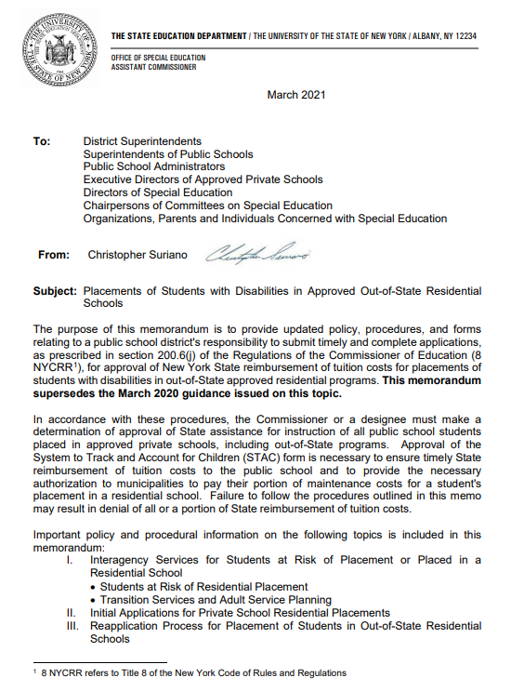
Application Process for Placement in
Out-of-State Residential Schools
School district must annually apply to receive State Reimbursement for student’s placed in a New York State approved out-of-state residential school.
The decision that a student needs an educational placement in a residential school, either in or out of State, must be based on the CSE determination that there is no appropriate nonresidential school available to meet the educational needs of the student.
State law and regulations require the school district to identify needed support services that may help families maintain children in their own homes and communities, and avoid placement in residential care, for as long as possible.
Notes:
The Office of Special Education also oversees a robust application process for school district placements in New York State approved out-of-state residential schools.
In order to receive State reimbursement for any residential placement (including an out-of-state school), the school district must demonstrate that there is no appropriate nonresidential school available to meet the educational needs of the student. Appropriate in-state school options must be exhausted prior to reimbursement for an out-of-state CSE placement.
To support families to maintain children in their own homes, school districts are required to identify needed support services that would avoid placement in residential care for as long as possible.

Slide 44

Office of Special Education Educational Partnership Tiered Support & Professional Development
12 Regional Partnership Centers
14 School-Age Family and Community Engagement Centers
14 Early Childhood Family and Community Engagement Centers
Systems Change Work Providing a Variety of Supports to Educational Organizations in New York State
Regional Learning
Targeted Skills/Support Groups
Support Plans
1
2
3
Notes:
The OSE Educational Partnership is a special education professional development network located in Regional Teams across the State. Regional Teams are comprised of a Regional Partnership Center that has specialists who provide professional development in a range of disciplines including behavior, transition, culturally responsive education, literacy and specially designed instruction, a school aged Family and Community Engagement Center and an early childhood Family and Community Engagement Center who provide direct support for parents and families.
These Regional Teams offer three tiers of support:
Regional Learnings are offered to all educational organizations and/or parents and families of students with disabilities in a region. The training may be offered in-person and/or virtually and there are training topics in all areas of special education.
Targeted Skills Groups are provided to groups of schools that have a similar performance or compliance issue that requires more intensive professional development and targeted assistance.
Support Plans are the most intensive level of support that includes embedded support from one or more specialists from the Regional Team provided directly into the identified schools.
In the next slide, we will take a look at trainings currently offered by the Educational Partnership related to our Indicator.

Slide 45
Educational Partnership Resources
Targeted Professional Development Improvement Strategies
Training relevant to School-Age Least Restrictive Environment include:
CPSE/CSE Chairperson Training
Positive Behavioral Intervention and Supports Training (all tiers)
Identifying and Intensifying Intervention
Fundamentals of Equity: Exploring Equity and Cultural Responsiveness
Introduction to the Behavior Pathway
Using the Behavior Pathway to Identify Interventions
Specially Designed Instruction/Explicit Direct Instruction
Disproportionality
Functional Behavioral Assessment/Behavioral Intervention Plan Training
Developing Behavior Systems that Work
Dimensions of Equity in Education
Notes:
The Office of Special Education’s Educational Partnership provides a variety of regional learning opportunities to Committees on Special Education, and to educators and leaders representing educational organizations serving students with disabilities.
These professional development offerings contain effective practices to assist Committees and Educators in effective methods of supporting students in the general education classroom and understanding the requirements for placements in the Least Restrictive Environment.

Slide 46
Potential New Improvement Activity #1
Require School Districts to develop and implement a five-year plan for high-quality inclusive programs for students with disabilities
District inclusion plans would be required for districts whose data shows:
District inclusion plans would provide a five-year projection to increase the number of students with disabilities in inclusive settings and describe the steps the district will take to improve the availability and quality of inclusive programs in the district.
(1) high percentage of school age students with disabilities placed in special classes for 40 percent or more of the school day and/or in separate schools; and/or
(2) low percentage of students participating in regular education classes for 80 percent or more of the school day.
District inclusion plans would describe the district’s data analysis on the number and percentage of time students with disabilities spend in special classes, regular education classes and separate schools, disaggregated by race and ethnicity, age, and disability categories.
Notes:
A potential new improvement activity to increase school-age LRE performance would be to require school districts to develop and implement comprehensive plans to expand high-quality inclusive programs for students with disabilities.
These plans could be required for districts that have low performance based on:
a high percentage of students served in special classes for 40% or more of the day
a high percentage of students served in a separate setting; or
a low percentage of students served in a regular class for 80% or more of the day.
The district plans for inclusion would describe the district's analysis of its Indicator 5 data both in aggregate and by race and ethnicity, age, and disability category. This would include both an overview of the district-wide LRE data and also a record review of student specific information, including but not limited to the LRE decision-path and considerations made prior to a special class or school placement for the student.
The school district inclusion plan would focus on improving the availability and quality of inclusive programs in the district to increase the number of students with disabilities served in a regular class over a five-year period. Additionally, if the district data demonstrates a disparity in the data by race or ethnicity, measures taken to address this disparity must also be included in the district’s inclusion plan.

Slide 47
Potential New Improvement Activity #2
Develop a CSE training module for Indicator 5 and placement in the LRE
Training Modules would be available remotely and/or via webinar and emphasize:
reporting Indicator 5 LRE data accurately;
connection of Indicator 5 and significant disproportionality placement data on LRE; and
LRE decision making tools.
Identified school districts would be required to participate in the training modules in order to improve Indicator 5 results.
Notes:
A second potential improvement activity to improve school-age LRE would be to develop a CSE training module for Indicator 5 and placement in the least restrictive environment. An LRE training module would serve as a proactive and preventative measure by providing professional development to CSE chairpersons in making optimal LRE decisions for individual students with disabilities, as well as to assist districts in accurately reporting their Indicator 5 School-Age LRE data to NYSED.

Slide 48
What activities could be considered, maintained, or strengthened to address improvements in School-Age Least Restrictive Environment?
Stakeholder Discussion
Notes:
We will now pause the presentation to discuss our improvement activities.
Specifically, we will ask: What activities could be considered, maintained, or strengthened to address improvement in School-age LRE Outcomes?

Slide 49
Indicator 5 – School-Age Least Restrictive Environment Target Setting
State Performance Plan (SPP)/
Annual Performance Report (APR)
2020-2025
Individuals with Disabilities Education Act (IDEA)
Notes:
Indicator 5, School-Age Least Restrictive Environments, requires each state to establish targets for performance. We will now provide an overview of the Office of Special Education’s proposed targets for Indicator 5 and request stakeholder feedback on each target.

Slide 50
New Baseline for Indicator 5: School-Age LRE
A. Inside the regular class 80% or more of the day
2020 Reported Data Serves as New FFY 2020-25 Baseline
58.28%
B. Inside the regular class less than 40% of the day
2020 Reported Data Serves as New FFY 2020-25 Baseline
18.16%
C. In separate schools, residential facilities, or homebound/hospital placements
2020 Reported Data Serves as New FFY 2020-25 Baseline
5.14%
New Baseline performs 3.78 percentage points better than old baseline (2005 54.50%)
New Baseline performs 7.34 percentage points better than old baseline (2005 25.50%)
New Baseline performs 1.76 percentage points better than old baseline (2005 6.90%)
Notes:
Because the Indicator 5 measurement changed in 2020 to include children aged 5 with IEPs in kindergarten, New York State will establish a new baseline for our SPP targets.
A baseline is a starting point used to evaluate improvement over the SPP period. Each 2025 target must demonstrate improvement over the applicable baseline.
The new baseline for Indicator 5A, 5B, and 5C is the data that was reported for these subcomponents by school districts in October 2020.
For Indicator 5A (inside the regular class 80% or more of the day) the 2020 baseline is 58.28% . This performs 3.78 percentage points better than the prior New York State baseline of 54.50% from 2005 - demonstrating that New York State’s performance on Indicator 5A has improved from the last time we established our baseline.
For Indicator 5B (inside the regular class for 40% or less of the day) the 2020 baseline is 18.16% which performs 7.34 percentage points better than the New York State 2005 baseline of 25.50% - demonstrating that New York State’s performance on Indicator 5B has improved from the last time we established our baseline.
Indicator 5C’s new baseline is 5.14% which again performs better than the prior baseline of 6.9% from 2005.

Slide 51
Proposed Targets: Indicator 5A
Percent of children with IEPs aged 5 who are enrolled in kindergarten and aged 6 through 21 served inside the regular class 80% or more of the day
Proposed Targets
Increase = Improvement
2015-2019 Equated Average was 57.6%
Baseline 2020 | 2021 | 2022 | 2023 | 2024 | 2025
58.28% | -0.03 | +0.50 | +0.25 | +0.50 | +0.50
Student Impact 8,474 additional students would be included (2020 baseline vs 2025 proposed target)
Target Setting
Methodology
Consideration that 2020 Baseline Outperforms Prior 5-year Average
Improvement Over Baseline & Increase over Average Past Trend Data
Consideration of Student Impact associated with each Proposed Target
  Stakeholder Question: Targets must show improvement over baseline and be rigorous but achievable. Do you feel that the proposed targets are too high, too low, or just right?
Notes:
The Office of Special Education’s proposed targets for Indicator 5A (inside the regular class 80% or more of the day) are reflected in the circles on the line graph.
2020 would start with the baseline of 58.28% and we propose to increase over baseline by 1.72 percentage points by 2025 with a proposed target of 60%.
Our rationale and methodology used to establish the proposed targets include:
The baseline establishes a rigorous starting point at 58.28% which performs better than the prior 5 year average which was 57.6%
Our proposed targets maintain our 2020 performance in 2021 (with a very slight decrease of .o3 percentage points in consideration of a potential COVID-19 impact) and then add mostly incremental growth in each following year (0.5 percentage point increase for 2022, 2024, and 2025 with a .25 percentage point increase in 2023).
We have identified a statewide student impact that 8,474 additional students with disabilities would be educated in a regular class 80% or more of the day if 2025 targets are met.
We will now pause to have stakeholder discussion on the proposed Indicator 5A targets for students served in a regular class for 80% or more of the day. Targets must show improvement over baseline and be rigorous but achievable. Do you feel the proposed targets are too high, too low, or just right?

Slide 52
Proposed Targets: Indicator 5B
Percent of children with IEPs aged 5 who are enrolled in kindergarten and aged 6 through 21 served inside the regular class less than 40% of the day
Decrease = Improvement
Proposed Targets
2015-2019 Equated Average was 20.67%
Baseline 2020 | 2021 | 2022 | 2023 | 2024 | 2025
18.16% | -0.16 | -0.20 | -0.30 | -0.25 | -0.25
Student Impact 5,690 fewer students would be included (2020 baseline vs 2025 proposed target)
Target Setting
Methodology
Consideration that 2020 Baseline Outperforms Prior 5-year Average
Improvement Over Baseline & Increase over Average Past Trend Data
Consideration of Student Impact associated with each Proposed Target
  Stakeholder Question: Targets must show improvement over baseline and be rigorous but achievable. Do you feel that the proposed targets are too high, too low, or just right?
Notes:
The Office of Special Education’s proposed targets for Indicator 5B (inside the regular class 40% or less of the day) are reflected in the circles on the line graph.
2020 would start with the baseline of 18.16% and we propose to decrease below baseline by 1.16 percentage points by 2025 with a proposed target of 17%.
Our rationale and methodology used to establish the proposed targets include:
The baseline sets a rigorous starting point at 18.16% which performs better than the prior 5 year average of 20.67%.
Our proposed targets propose the smallest improvement in 2021 to account for a potential COVID-19 impact. The following years targets propose to improve between 0.2 percentage points and 0.3 percentage points.
We have identified the statewide student impact of 5,690 fewer students with disabilities would be educated in a regular class 40% or less of the day if 2025 targets are met.
We will now pause to have stakeholder discussion on the proposed Indicator 5B targets for students served in a regular class for 40% or less of the day. Targets must show improvement over baseline and be rigorous but achievable. Do you feel the proposed targets are too high, too low, or just right?

Slide 53
Proposed Targets: Indicator 5C
Percent of children with IEPs aged 5 who are enrolled in kindergarten and aged 6 through 21 served in separate schools, residential facilities, or homebound/hospital placements
Proposed Targets
Decrease = Improvement
2015-2019 Equated Average was 5.32%
Baseline 2020 | 2021 | 2022 | 2023 | 2024 | 2025
5.14% | -0.04 | -0.10 | -0.10 | -0.10 | -0.05
Student Impact 1,911 fewer students would be excluded (2020 baseline vs 2025 proposed target)
Target Setting
Methodology
Consideration that 2020 Baseline Outperforms Prior 5-year Average
Improvement Over Baseline & Increase over Average Past Trend Data
Consideration of Student Impact associated with each Proposed Target
  Stakeholder Question: Targets must show improvement over baseline and be rigorous but achievable. Do you feel that the proposed targets are too high, too low, or just right?
Notes:
The Office of Special Education’s proposed targets for Indicator 5C (served in separate schools, residential facilities, or homebound/hospital placements) are reflected in the circles on the line graph.
2020 would start with the baseline of 5.14% and we propose to decrease below baseline by 0.39 percentage points by 2025 with a proposed target of 4.75%.
Our rationale and methodology used to establish the proposed targets include:
The baseline sets a rigorous starting point at 5.14% as it performs better than the prior 5 year average of 5.32%.
Our proposed targets maintain our 2020 performance in 2021 (with a very slight improvement of 0.04 percentage points in consideration of a potential COVID-19 impact) and then add mostly incremental improvement in each following year (0.1 percentage points for 2022, 2023, and 2024 with a 0.05 percentage point improvement in 2025).
We have identified a statewide student impact that 1,911 fewer students with disabilities would be educated in separate schools, residential facilities, or homebound/hospital placements if 2025 targets are met.
We will now pause to have stakeholder discussion on the proposed Indicator 5C targets for students served in separate schools, residential facilities, or homebound/hospital placements. Targets must show improvement over baseline and be rigorous but achievable. Do you feel the proposed targets are too high, too low, or just right?

Slide 54
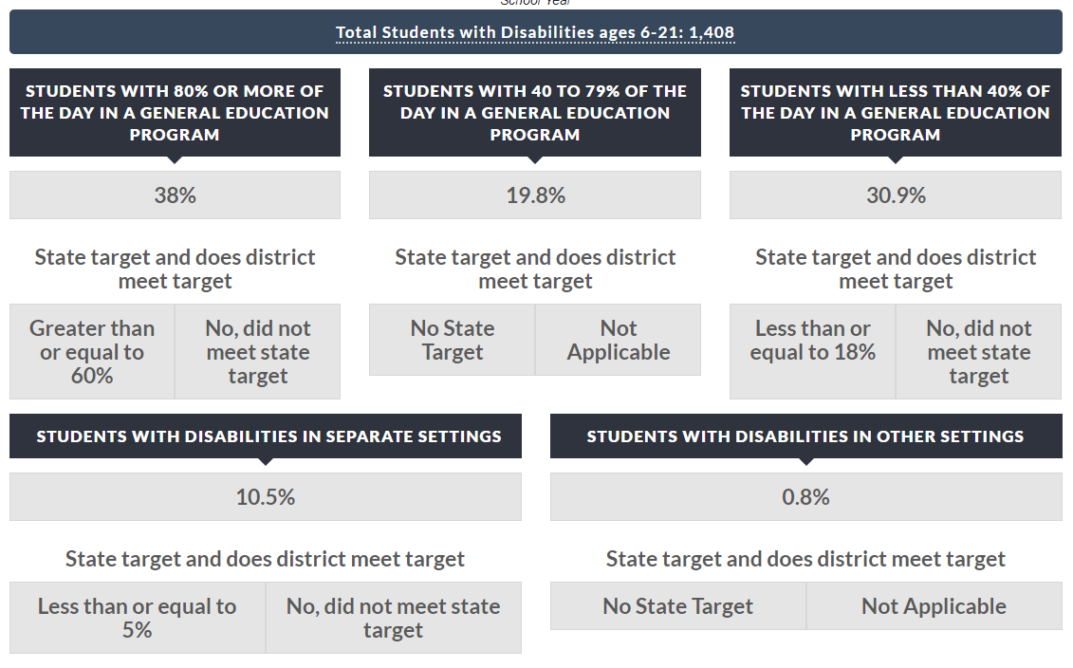
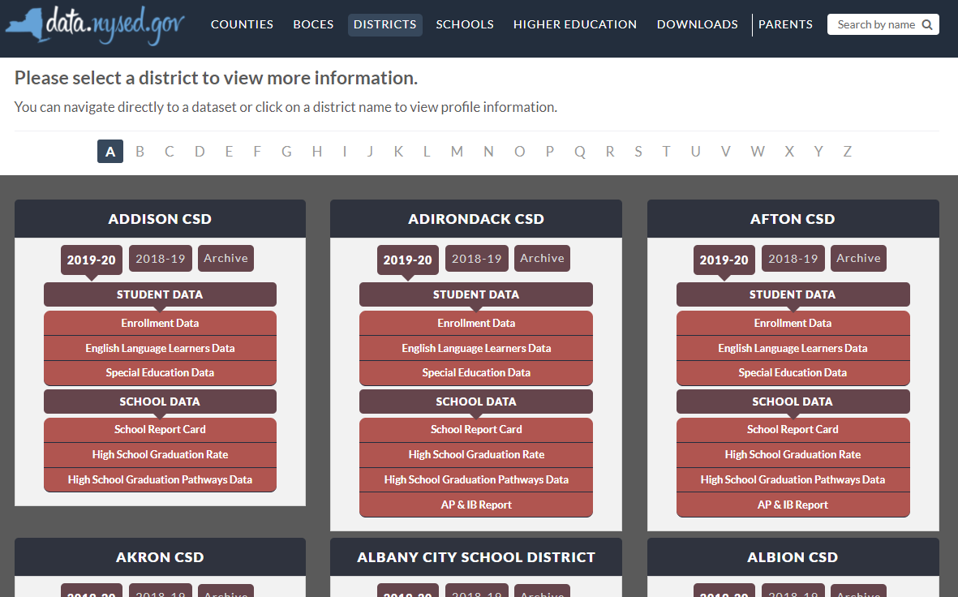

New York State School District SPP Data
Additional information on SPP Indicator data may be found in school district “Special Education Data” reports available at data.nysed.gov
Notes:
For additional information on how the SPP Indicator data impacts your school district, please visit data.nysed.gov.
In the “Districts” category on this webpage, you can view the Special Education Data reports under each school district. These reports are published annually for each individual school district and outline the district’s performance on the SPP Indicators.

Slide 55

Share Your Voice in our Online Survey
Each SPP Indicator has an online survey to collect input on NYS’s target-setting and/or improvement activities
The online surveys are intended to collect feedback from interested stakeholders. They are available for those who are not attending a virtual meeting or for those who have additional information to share beyond the virtual meetings
Please visit the SPP/APR webpage to submit your survey http://www.nysed.gov/special-education/ffy-2020-2025-spp-apr
Notes:
We greatly appreciate your feedback and ask that you visit our SPP/APR webpage (link provided in the slide).
We will use the survey information to collect input from those who have not attended a virtual meeting or for those who have additional information to share.
Each individual SPP Indicator will have its own survey and we encourage you to access all surveys that are of interest to you so that we can achieve our objective of meaningful stakeholder engagement. It is important to us to ensure that voices from diverse backgrounds are included in conversations about our students and we value multiple perspectives and viewpoints to inform our efforts.

Slide 56






THANK YOU for your contribution
Your Voice is Important to New York State’s Efforts to Improve Outcomes for our Students with Disabilities
Notes:
Thank you for your participation and contribution today. We greatly value your voice and input on our efforts to improve outcomes for students with disabilities in New York State.

