Slide 1
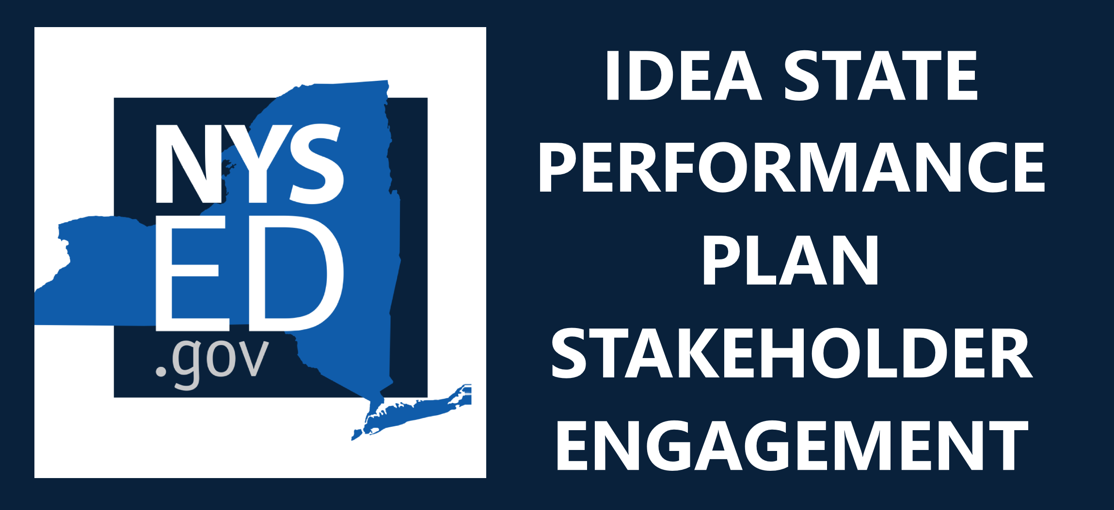

General Overall Presentation – 2021; Indicator 14: Post-School Outcomes–2021
State Performance Plan (SPP) 14/
Annual Performance Report (APR)
2020-2025
Individuals with Disabilities Education Act (IDEA)
Notes:
Welcome to the New York State Performance Plan (SPP) 14 / Annual Performance Report (APR) 2020-2025 presentation.

Slide 2
Agenda
Introduction
Target Setting
Measurement
Data Collection
Improvement Activities
Notes:
As we advance through the slides, we will review measurement of post-school outcomes, present trend and comparative data, consider improvement strategies, and propose new targets. The agenda is a road map for collaboration, providing opportunities to pose questions and determine future direction.

Slide 3
Frequently Used Terms
Term | Description
State Performance Plan (SPP) | Evaluates the state’s efforts to implement the requirements and purposes of the Individuals with Disabilities Education Act (IDEA) and describes how the state will improve its implementation.
Annual Performance Report (APR) | The IDEA requires each state to develop a state performance plan/annual performance report (SPP/APR) that evaluates the state’s efforts to implement the requirements and purposes of the IDEA and describes how the state will improve its implementation.
Federal Fiscal Year (FFY) | October 1 – September 30
SPP Indicator 14 | SPP Indicator 14 measures Post-School Outcomes. There are three components: 14A, 14B, 14C
SPP Indicator 14A | SPP Indicator 14A measures students with a disability enrolled in higher education within one year of leaving high school.
SPP Indicator 14B | Indicator 14B measures students with a disability enrolled in higher education or competitively employed within one year of leaving high school.
SPP Indicator 14C | Indicator 14C measures students with a disability enrolled in higher education or in some other postsecondary education or training program; or competitively employed or in some other employment within one year of leaving high school.
7-PAK | 7-PAK States is a consortium of the seven largest states that the National Association of State Directors of Special Education, Inc. determined to have both similar demographics (e.g., general population, diversity, significant rural and inter-city populations) and issues in the delivery of special education programs to its students with disabilities.
Baseline | Data starting point to measure improvement over time.
Notes:
This slide is a list of key terms and definitions that appear in the presentation. Please take a moment to read the description to familiarize yourself with each term.

Slide 4
Today participants will….
Gain a deeper understanding of SPP/APR Indicators 14A, 14B, and 14C, and how New York State measures and collects data.
Gain a deeper understanding of current information and trend data regarding New York State’s progress in meeting SPP Indicator 14 targets as well as state and national comparisons.
Gain a deeper understanding of current improvement strategies to help improve postsecondary outcomes for students with disabilities.
Review proposed targets for the Federal Fiscal Year (FFY) 2020-2025 SPP/APR.
Notes:
The goals of this presentation are to:
Gain a deeper understanding of SPP/APR Indicators 14A, 14B, and 14C, and how New York State measures and collects data.
Gain a deeper understanding of the current information and trend data regarding New York State’s progress in meeting SPP Indicator 14 targets as well as State and national comparisons;​
Gain a deeper understanding of current improvement strategies to help improve postsecondary outcomes for students with disabilities, and to
Review proposed targets for the Federal Fiscal Year 2020-2025 SPP/APR.

Slide 5
Understanding SPP Indicator 14A, 14B, 14C
SPP Indicator 14 measures the percent of youth who are no longer in high school, had IEPs in effect at the time they left school, and:
SPP 14A
Enrolled in higher education within one year of leaving high school.
SPP 14B
Enrolled in higher education or competitively employed within one year of leaving high school.
SPP 14C
Enrolled in higher education or in some other postsecondary education or training program; or competitively employed or in some other employment within one year of leaving high school.
14C
14B
14A
Notes:
This slide provides an overview of SPP Indicator 14. Indicator 14 measures the percent of youth who are no longer in high school, had IEPs in effect at the time they left school, and:
SPP 14A measures the percentage of former students enrolled in higher education within one year of leaving high school.
SPP 14B measures the percentage of former students enrolled in higher education or competitively employed within one year of leaving high school.
SPP 14C measures the percentage of former students enrolled in higher education or in some other postsecondary education or training program; or competitively employed or in some other employment within one year of leaving high school.

Slide 6
Data Collection:
NYSED has contracted with the Potsdam Institute for Applied Research (PIAR), located at the State University of New York (SUNY) at Potsdam, to survey a sample of students who had an IEP at the time they left high school.
This includes all students who had an IEP in effect at the time they left school, including those who graduated with a regular diploma or some other credential, dropped out, or aged out.
Data are collected by September 2020 on students who left school during the 2018-2019 school year, timing the data collection so that at least one year has passed since the students left school.
NYSED must ensure that the data collected are representative of the racial and ethnic groups that make up all NYS former high school students with disabilities.
Notes:
We will now discuss how data are collected for Indicator 14.
Students included in the Indicator 14 data are former students with disabilities who had individualized education programs (IEPs) at the time they left high school and participated in New York State’s SPP Indicator 14 post-school outcomes survey one year after exiting school.
NYSED has contracted with the Potsdam Institute for Applied Research at the State University of New York to survey a sample of former students with IEPs one year after exiting school.
When possible, interviews are conducted by telephone, but the survey is also made available in both online and paper formats. New York State must ensure that the data collected are representative of the racial and ethnic groups that make up all New York State former high school students with disabilities.
New York State collects and reports data for Indicator 14 using a sampling method. This means that, rather than collecting data from all districts every year, different districts report the information needed for this indicator once every six years. At the end of the six-year cycle, all districts will have reported data for SPP Indicator 14. New York City is the only district that reports data every year.

Slide 7
Explanation of Indicator 14 FFY Data in the Annual Performance Report (APR)
Data years presented will reflect the data NYSED submits to the federal Office of Special Education Programs (OSEP) in the APR which covers the federal fiscal year (FFY) period
2020-21 School Year
The data sample is
collected from students who exited in the 2019-20 school year.
The FFY 2020 APR is
submitted to OSEP
FFY 2020 APR
Data from students who exited in the 2019-20 School Year Data is
included in the FFY 2020 APR
February 2022
Notes:
The Indicator 14 data that we present today reflects the Annual Performance Report (APR) data that NYSED submits to the federal Office of Special Education Programs (OSEP). The submission period is based on the federal fiscal year (FFY).
For example, the survey data for students who exited in June of 2020 is collected after June of 2021 which is one year after the students have exited. The results of the survey are reported in the FFY 2020 APR. The 2020 APR is submitted to OSEP in February of 2022.

Slide 8
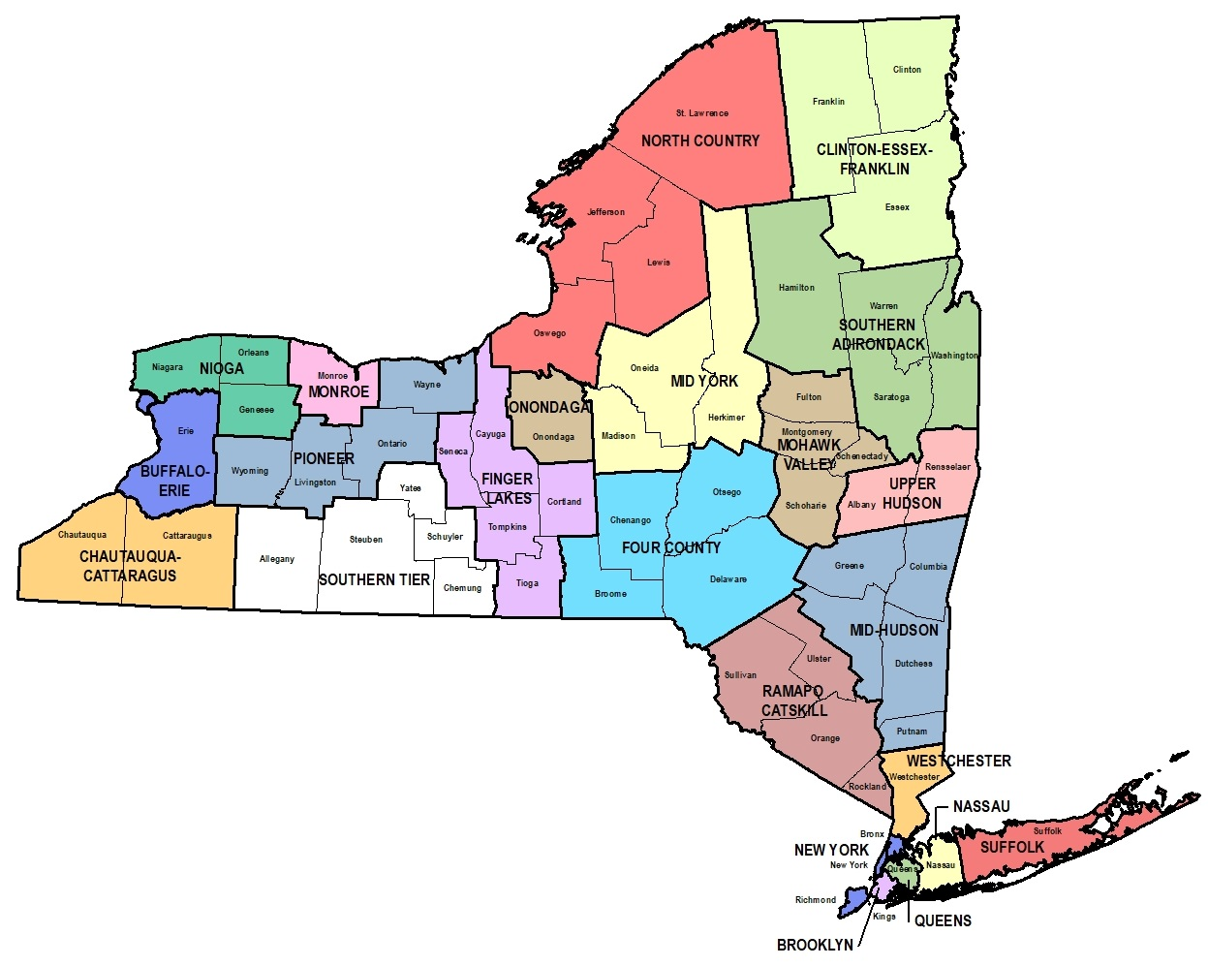
Representativeness of Data
Beginning with FFY 2021, states must report the extent to which the demographics of respondents are representative.
NYSED collects and reports data that is representative of race/ethnicity, gender and disability.
Representativeness means the extent to which demographics of the respondents are similar to the demographics of the target population.
States must include race and ethnicity in this analysis and must also choose another category. Some additional categories to consider include geographic location, economic status, and/or another demographic category.
If data are representative, conclusions may be drawn about the target population.
Notes:
Beginning with FFY 2021, which contains data from students who exited in 2019-20, states must report the extent to which the demographics of respondents are representative.
NYSED collects and reports data that is representative of race/ethnicity, gender and disability.
Representativeness means the extent to which demographics of the respondents are similar to the demographics of the target population.
States must include race and ethnicity in this analysis but must also choose another category. The other options include geographic location, economic status, and/or another demographic category.
If data are representative, conclusions may be drawn about the target population.
To summarize, data that are representative should be reflective, relevant, and provide an unbiased estimate of the target population.

Slide 9

Stakeholder Feedback Representative Sample
In an effort to develop a representative sample, which of the proposed additional categories would you add for further analysis?
A. Gender
B. Geographic Location
C. Economic Status
D. Other ___________
Notes:
We are now to going to pause to seek your input on the following:
In an effort to develop a representative sample, which of the proposed additional categories would you add for further analysis?
A. Gender
B. Geographic Location
C. Economic Status
D. Other ___________

Slide 10
Data Measurement - Indicator 14A
14A = Students with IEPs enrolled in higher education
within one year of leaving high school.
Percent enrolled in higher education = [(# of youth who are no longer in secondary school, had IEPs in effect at the time they left school and were enrolled in higher education within one year of leaving high school) for at least one term, divided by the (# of respondent youth who are no longer in secondary school and had IEPs in effect at the time they left school)] times 100.
Respondents enrolled in
higher education
Percent =
X 100
[total respondents]
Notes:
In the next three slides we are going to discuss the measurements of Indicators14A, 14B and 14C:
Indicator 14A is defined as Students with IEPs enrolled in higher education within one year of leaving high school. An institution of higher education is an educational organization where students may generate academic credit leading to a postsecondary credential or degree.
The percent of students enrolled in higher education equals the number of youth who are no longer in secondary school, had IEPs in effect at the time they left school and were enrolled in higher education within one year of leaving high school, for at least one term, divided by the number of respondent youth who are no longer in secondary school and had IEPs in effect at the time they left school, times 100.

Slide 11
Data Measurement - Indicator 14B
14B = Enrolled in higher education or competitively employed
within one year of leaving high school.
Percent enrolled in higher education or competitively employed within one year of leaving high school = [(# of youth who are no longer in secondary school, had IEPs in effect at the time they left school and were enrolled in higher education or competitively employed within one year of leaving high school) for a period of 20 hours per week for at least 90 days divided by the (# of respondent youth who are no longer in secondary school and had IEPs in effect at the time they left school)] times 100.
Respondents enrolled in
higher education or competitively employed
Respondents enrolled in higher education or competitively employed
[total respondents]
Percent =
X 100
Percent =
X 100
[total respondents]
Notes:
Indicator 14B is defined as students enrolled in higher education or competitively employed within one year of leaving high school.
The percent of students enrolled in higher education or competitively employed within one year of leaving high school equals the number of youth who are no longer in secondary school, had IEPs in effect at the time they left school and were enrolled in higher education or competitively employed within one year of leaving high school for a period of 20 hours per week for at least 90 days, divided by the number of respondent youth who are no longer in secondary school and had IEPs in effect at the time they left school, times 100.
Competitive employment is defined as work in the competitive labor market that is performed on a full-time or part-time basis in an integrated setting and for which a person with a disability is compensated at or above the minimum wage, but not less than the customary wage and level of benefits paid by the employer for the same or similar work performed by persons without disabilities.

Slide 12
Data Measurement - Indicator 14C
14C = Enrolled in higher education or in some other postsecondary education or training program; or competitively employed or in some other employment within one year of leaving high school.
Percent enrolled in higher education, or in some other postsecondary education or training program; or competitively employed or in some other employment = [(# of youth who are no longer in secondary school, had IEPs in effect at the time they left school and were enrolled in higher education, or in some other postsecondary education or training program; or competitively employed or in some other employment) for at least one complete term in the year since leaving high school in an education or training program divided by the (# of respondent youth who are no longer in secondary school and had IEPs in effect at the time they left school)] times 100.
Respondents enrolled in higher education; some other postsecondary education or training program; or competitively employed or in some other employment
[total respondents]
Percent =
X 100
Percent =
X 100
[total respondents]
Notes:
Indicator 14C is defined as students enrolled in higher education or in some other postsecondary education or training program; or competitively employed or in some other employment within one year of leaving high school.
The percent of students enrolled in higher education, or in some other postsecondary education or training program; or competitively employed or in some other employment, equals the number of youth who are no longer in secondary school, had IEPs in effect at the time they left school and were enrolled in higher education, or in some other postsecondary education or training program; or competitively employed or in some other employment, for at least one complete term in the year since leaving high school, in an education or training program, divided by the number of respondent youth who are no longer in secondary school and had IEPs in effect at the time they left school, times 100.
“Some other employment,” as used in measure 14C, means youth who have worked for pay or been self-employed for a period of at least 90 days at any time in the year since leaving high school. This includes working in a family business such as a farm, store, fishing, ranching, catering services, etc.

Slide 13

SPP Indicator 14A,14B,14C
Measurement of Data
Facilitator check for understanding or how the data are used to measure results or outcomes.
Notes:
We will now pause and ask you to discuss the following:
In the past few slides we have explained how data are measured for Indicator 14.
Indicator 14 consists of three parts: 14A, 14B and 14C. Each has its own target and performance score.
We measure performance by surveying a sample of students every year – these are students who had an IEP when they left high school.
Based on the survey responses, we determine what percentage of students went on to enroll in higher education or were employed or were involved in some other training program.
What questions do you have about the Indicator 14 measurement or how the data are used to measure results or outcomes?

Slide 14
Understand current information and trend data
New York State 14A
Measure | Baseline 2009
A | 43.00%
FFY | 2014 | 2015 | 2016 | 2017 | 2018 | 2019
Target >= | 42.20% | 42.70% | 43.00% | 43.50% | 44.00% | 44.00%
Data | 48.12% | 40.77% | 44.02% | 43.39% | 44.37% | 35.30%
14
Notes:
This chart illustrates New York State’s trend data for Indicator 14A over the past six years. The graph under the data shows the trend data for each year. The blue line indicates the target which is defined as performance objectives set for SPP measurements. The red line indicates New York State’s performance.
In 2009, New York State established a baseline of 43% of students with IEPs who went on to enroll in higher education.
In 2014, 2016 and 2018, New York State exceeded its targets.
In 2015 and 2017, New York State did not meet its targets.
In 2019, New York State did not meet the target, which may be attributed to the impact of COVID-19 on the ability of students with disabilities to enroll and/or receive supports during their college experience.

Slide 15
Results: NYS and National Trends 14A
14A Results | 2014 | 2015 | 2016 | 2017 | 2018
NY Result | 48.12% | 40.77% | 44.02% | 43.39% | 44.37%
OH Result | 29.37% | 36.45% | 28.81% | 27.53% | 27.57%
IL Result | 39.74% | 27.54% | 32.07% | 29.59% | 29.58%
PA Result | 25.76% | 28.84% | 33.08% | 29.53% | 27.55%
FL Result | 28.63% | 28.48% | 27.84% | 24.30% | 25.58%
CA Result | 50.41% | 52.26% | 48.87% | 53.97% | 54.78%
TX Result | 24.97 | 24.39% | 21.41% | 18.31% | 16.36%
Notes:
The bar graph and table demonstrates performance for New York, California, Florida, Pennsylvania, Illinois, Texas, and Ohio. These states are referred to as the 7-PAK States. 7-PAK States is a consortium of the seven largest states that the National Association of State Directors of Special Education, Inc. determined to have both similar demographics (e.g., general population, diversity, significant rural and inter-city populations) and issues in the delivery of special education programs to students with disabilities.
As previously noted, New York State, which is bolded in the top row, exceeded its target in 2014, 2016, and 2018.

Slide 16
National Mean: NYS and National Trends 14A
2018 National Mean = 28%
Notes:
This graph shows the results for Indicator 14A in comparison to the national mean. The national mean, indicated by the horizontal black dash line, was derived from all the Indicator 14A data collected across the country for 2018.
New York State exceeded the national mean of 28% in 2018 by 16.37 percentage points.

Slide 17

Stakeholder Discussion 14A
What did the SPP data tell us?
How should we use the data to inform our target-setting and improvement activities?
17
Notes:
We will now pause and ask you to discuss the following:
What did the SPP data tell us?
How should we use the data to inform our target-setting and improvement activities?

Slide 18
Understand current information and trend data
New York State 14B
Measure | Baseline 2009
B | 64.00%
FFY | 2014 | 2015 | 2016 | 2017 | 2018 | 2019
Target >= | 66.00% | 67.00% | 68.00% | 69.00% | 70.00% | 70.00%
Data | 71.71% | 67.25% | 69.43% | 70.34% | 69.10% | 65.56%
18
Notes:
This chart shows New York State’s targets and performance on Indicator 14B over the past six years. The graph under the data shows the trend data for each year.
The blue line indicates the target and the red line indicates New York State’s performance.
In 2009, New York State established a baseline of 64% of students with IEPs who went on to enroll in higher education plus the youth who are competitively employed.
In 2014, 2015, 2016 and 2017, New York State exceeded its targets.
In 2018, New York State did not meet its target.
In 2019, New York State did not meet its target, which may be attributed to the impact of COVID-19, which dramatically impacted the number of respondent youth enrolling in higher education and competitively employed and obtaining and retaining employment.

Slide 19
Results: NYS and National Trends 14B
14B Results | 2014 | 2015 | 2016 | 2017 | 2018
NY Result | 71.71% | 67.25% | 69.43% | 70.34% | 69.10%
OH Result | 66.55% | 76.61% | 67.49% | 70.86% | 64.52%
IL Result | 69.60% | 63.19% | 64.22% | 63.46% | 60.88%
PA Result | 60.60% | 67.32% | 70.78% | 69.14% | 71.66%
FL Result | 43.67% | 43.18% | 43.84% | 50.55% | 55.03%
CA Result | 72.38% | 75.46% | 72.65% | 77.60% | 70.65%
TX Result | 54.21% | 57.38% | 53.69% | 50.88% | 51.10%
Notes:
The bar graph and table demonstrates performance for New York, California, Florida, Pennsylvania, Illinois, Texas, and Ohio. These states are referred to as the 7-PAK States. 7-PAK States is a consortium of the seven largest states that the National Association of State Directors of Special Education, Inc. determined to have both similar demographics (e.g., general population, diversity, significant rural and inter-city populations) and issues in the delivery of special education programs to its students with disabilities.
The results for New York State are in bold in the top row.
As indicated before, New York State exceeded its targets in 2014, 2015, 2016 and 2017.

Slide 20
National Mean: NYS and National Trends 14B
2018 National Mean = 61%
Notes:
This graph shows the results for Indicator 14B in comparison to the national mean.
The national mean, indicated by the horizontal black dash line, was derived from all the Indicator 14B data collected across the country for 2018.
New York State exceeded the national mean of 61% in 2018 by 8.1 percentage points.

Slide 21
Stakeholder Discussion 14B
What did the SPP data tell us?
How should we use the data to inform our target-setting and improvement activities?
21
Notes:
We will now pause and ask you to discuss the following:
What did the SPP data tell us?
How should we use the data to inform our target-setting and improvement activities?

Slide 22
Understand current information and trend data
New York State 14C
Measure | Baseline 2009
C | 77.00%
FFY | 2014 | 2015 | 2016 | 2017 | 2018 | 2019
Target >= | 75.00% | 76.00% | 77.50% | 78.50% | 80.00% | 80.00%
Data | 80.85% | 77.75% | 80.66% | 82.84% | 80.65% | 75.05%
22
Notes:
This chart shows New York State goals and performance on Indicator 14C over the past six years. The graph under the data shows the trend data for each year.
The blue line indicates the targets and the red line indicates New York State performance.
In 2009, New York State established a baseline of 77% of students with IEPs who went on to enroll in higher education.
In 2014, 2015, 2016, 2017 and 2018 New York State exceeded its targets.
In 2019, New York State did not meet its target, which may be attributed to the impact of COVID-19. This would result in significant challenges students encountered enrolling and/or receiving supports during their college experience, and obtaining and retaining employment for many individuals, including students with disabilities.

Slide 23
Results: NYS and National Trends 14C
14C Results | 2014 | 2015 | 2016 | 2017 | 2018
NY Result | 80.85% | 77.75% | 80.66% | 82.84% | 80.65%
OH Result | 81.87% | 83.95% | 83.44% | 79.49% | 84.74%
IL Result | 79.69% | 73.33% | 76.09% | 75.74% | 71.79%
PA Result | 69.23% | 73.34% | 76.90% | 75.33% | 77.58%
FL Result | 55.74% | 54.91% | 56.16% | 58.76% | 62.97%
CA Result | 82.17% | 83.16% | 81.72% | 85.56% | 89.33%
TX Result | 67.36% | 68.52% | 66.67% | 64.78% | 93.31%
Notes:
The bar graph and table demonstrates performance for New York, California, Florida, Pennsylvania, Illinois, Texas, and Ohio. These states are referred to as the 7-PAK States. 7-PAK States is a consortium of the seven largest states that the National Association of State Directors of Special Education, Inc. determined to have both similar demographics (e.g., general population, diversity, significant rural and inter-city populations) and issues in the delivery of special education programs to its students with disabilities.
The results for New York State are in bold in the top row. As indicated, New York State exceeded its targets from 2014-2018.

Slide 24
National Mean: NYS and National Trends 14C
2018 National Mean = 78%
Notes:
This graph shows the results for Indicator 14C in comparison to the national mean.
The national mean, indicated by the horizontal black dash line, was derived from all the Indicator 14C data collected across the country for 2018.
New York State exceeded the national mean of 78% in 2018 by 2.65 percentage points.

Slide 25
Stakeholder Discussion 14C
What did the SPP data tell us?
How should we use the data to inform our target-setting and improvement activities?
25
Notes:
We will now pause and ask you to discuss the following:
What did the SPP data tell us?
How should we use the data to inform our target-setting and improvement activities?

Slide 26

Post-School Outcomes Improvement Activities
Appropriate transition planning and services that lead to meaningful post-school outcomes, including career and technical education, is a priority area of the Office of Special Education (OSE).
Notes:
In this next section, we will discuss current improvement activities aligned with Indicator 14 and seek your input.
A priority area of the Office of Special Education (OSE) is for students with disabilities to have meaningful post-school outcomes, as measured by 14A, 14B and 14C, including appropriate transition planning and services.
OSE has taken several actions to impact this priority area and improve outcomes for students with disabilities.

Slide 27
Improvement Activities
  Adult Career and Continuing Education Services-Vocational Rehabilitation (ACCES-VR)
  Independent Living Centers (ILCs)
  Office for People with Developmental Disabilities (OPWDD)
  Youth Advisory Panel (YAP)
  Commissioner's Advisory Panel for Special Education Services (CAP)
Notes:
The New York State Education Department has seven branches, each under the direction of the Commissioner of Education. Two of these branches are Adult Career and Continuing Education Services-Vocational Rehabilitation (ACCES-VR) and P-12 Instructional Support, which includes the Office of Special Education (OSE). These branches have programs which benefit students’ secondary transition and post-school outcomes.​
Independent Living Centers (ILCs) provide an array of services that assist New Yorkers with all disabilities to live fully integrated and self-directed lives. ILCs assist with all aspects of living, learning and earning. Individuals who are eligible for ILCs include those with: physical and mental disabilities; disabilities of all ages (including those living in their own homes, supported living arrangements, institutional settings, and elsewhere); and parents, spouses, siblings, and significant others of people with disabilities.
OPWDD works with the New York State Education Department, local school districts and special education staff to assist students to transition from school and to help plan for the supports that will be needed in adult life. The agency is responsible for coordinating services for New Yorkers with developmental disabilities, including intellectual disabilities, cerebral palsy, Down syndrome, autism spectrum disorders, Prader-Willi syndrome and other neurological impairments.
The Youth Advisory Panel was established to advise the Office of Special Education on proposed policies related to the education of students with disabilities. Panel members engage in facilitated discussions with NYSED staff on policy issues relating to the education of students with disabilities. In addition to commenting on and providing their recommendations regarding proposed policies, panel members share their concerns and recommendations for future policy consideration. Their participation serves to advise NYSED from a first-hand perspective on ways to improve the quality of special education services and student outcomes. Participation on the panel also provides students with the opportunity to sharpen their self-advocacy and leadership skills and network with other youth.
The Commissioner's Advisory Panel for Special Education Services was established in an advisory capacity to the Office of Special Education and advises the Governor, Legislature and Commissioner on unmet needs in the education of children with disabilities.

Slide 28

Office of Special Education Educational Partnership Tiered Support & Professional Development
12 Regional Partnership Centers
14 School-Age Family and Community Engagement Centers
14 Early Childhood Family and Community Engagement Centers
Systems Change Work Providing a Variety of Supports to Educational Organizations in New York State
Regional Learning
Targeted Skills/Support Groups
Support Plans
1
2
3
Notes:
The OSE Educational Partnership is a special education professional development network located in Regional Teams across the State. Regional Teams are comprised of a Regional Partnership Center that has specialists who provide professional development in a range of disciplines including behavior, transition, culturally responsive education, literacy and specially designed instruction, a school aged Family and Community Engagement Center that has specialists with expertise supporting parents and families of school-aged students with disabilities and an early childhood Family and Community Engagement Center that supports parents and families of preschool students with disabilities.
These Regional Teams provide professional development to stakeholders including parents and families as well as schools, including preschools, that serve student with disabilities.
The Regional Teams offer three tiers of support:
Regional Learnings are offered to all educational organizations and/or parents and families of students with disabilities in a region. The training may be offered in-person and/or virtually and there are training topics in all areas of special education.
Targeted Skills Groups are provided to groups of schools that have a similar performance or compliance issue that requires more intensive professional development and targeted assistance.
Support Plans are the most intensive level of support that includes embedded support from one or more specialists from the Regional Team provided directly into the identified schools.
In the next slide, we will take a look at trainings currently offered by the Educational Partnership related to our Indicator.

Slide 29
OSE Educational Partnership
Available Professional Development, Trainings and Tools
Self-Determination Training
What Does it Mean to Be Culturally Responsive
Virtual Overview of the Indicator 13 Self-Review Process
Agency 101 (formerly Navigating Adult Services)*
Transition Assessment Training
Fundamentals in Equity: Exploring Equity and Cultural Responsiveness
CDOS Modules 1,2,3: Work-Based Learning
Diploma and Credential Options*
Notes:
Since its inception, the OSE Educational Partnership has provided various trainings and tools to educational organizations and families to prepare students for post-secondary life. This slide includes a sample of many offered trainings. Those that are marked with an asterisk have been translated into Spanish.

Slide 30
OSE Educational Partnership
Available Professional Development, Trainings and Tools
National Technical Assistance Center on Transition (NTACT) Taxonomy for Transition Programming 2.0, Predictor Self-Assessment, Self-Assessment instructions, and NTACT Capacity Building Tool
“Graduation” Pathways Exam Tool
NYS Diploma Requirements Tracking Tool
I’m Determined Toolbox for Self-Determination
CDOS Graduation Tracker
Notes:
The OSE Educational Partnership also provides various trainings and tools to educational organizations, such as school districts and individual schools, for successful student support with post-secondary transition. This slide references some of those tools that are currently available.

Slide 31

SPP Indicator 14:
Improvement Activities
What activities could be considered, maintained, or strengthened to address improvements in this area?
31
Notes:
We will now pause the presentation to get your thoughts on the proposed improvement activities.
What activities could be considered, maintained, or strengthened to address improvements in this area?

Slide 32

Target Setting: Effects of COVID-19
The COVID-19 pandemic has significantly impacted students with disabilities enrolled in IHEs or in some other postsecondary education or training program; or competitively employed or in some other employment within one year of leaving high school. Several survey respondents cited the impact of COVID-19 on the household as a reason for not enrolling on a full- or part-time basis in an IHE or in an education or training program for at least one complete term.
COVID-19 has impacted the ability of students with disabilities to receive supports during their college experience.
Additionally, many businesses in communities statewide have been financially impacted or closed indefinitely due to COVID-19 which has resulted in significant challenges in obtaining and retaining employment for many individuals, including students with disabilities.
32
Notes:
Our next slide discusses the impact of COVID-19 on target setting.
The COVID-19 pandemic has significantly impacted the number of students with disabilities enrolled in IHEs or in some other postsecondary education or training program; or competitively employed or in some other employment within one year of leaving high school. COVID-19 severely disrupted operations at New York’s IHEs during the Spring 2020 semester and continues to have profound impact on campuses during the 2020-21 academic year. Many respondents also reported that COVID-19 made it difficult to obtain and maintain competitive employment or some other employment.
COVID-19 also effected the ability of students with disabilities to receive the supports and resources necessary for a successful college experience. As colleges shifted to off-campus learning models, many students with disabilities did not have access to the internet, technology, or the accommodations or supports they needed to meaningfully participate in remote learning.
Additionally, many businesses in communities statewide have been financially impacted or closed indefinitely due to COVID-19 which has resulted in significant challenges in obtaining and retaining employment for many individuals, including students with disabilities.

Slide 33
Review proposed SPP Indicator 14 targets
New targets for FFY 2020-2025 SPP/APR cycle must be:
  Measurable
  Rigorous (but attainable)
  Indicative of improvement over the baseline data
  Inclusive of stakeholder input
Final target for FFY 2025‐2026 must demonstrate improved performance compared to the baseline.
33
Notes:
The U.S. Department of Education requires states to establish baselines and set targets for the SPP/APR.
Baseline is the starting point or initial level of data on the indicator against which future targets and actual performance data will be compared.
New targets are needed for the six-year cycle of the FFY 2020-2025 SPP/APR. These targets must be measurable and rigorous but also achievable. States are required to set targets that show improvement over their baseline data. Final target for FFY 2025‐2026 must demonstrate improved performance compared to the baseline. However, the targets for the years between the baseline and the final target do not have to be higher than the baseline.
In the next few slides, you will learn about the targets NYSED is proposing and what information was considered in determining these targets.
Your input on whether you think the proposed targets are rigorous enough, yet still achievable over the next six years is extremely important. At the end of this presentation, you will learn more about the way you can provide your input.

Slide 34
34
Notes:
The information on this slide is specific to Indicator 14A. There are three types of information presented in this slide:
The baseline established in FFY 2009 is indicated on the left in orange. The New York State baseline for Indicator 14A is 43.00%. New York State is not changing the baseline for FFY 2020-2025.
The red boxes indicate New York State’s performance data reported in FFY 2018 and 2019.
In FFY 2018 the target was 44.00% and the performance data reported was 44.37%.
In FFY 2019 the target was again 44.00% but the performance data reported was 35.30% indicating a slippage of 8.7% primarily due to the impact of COVID 19.
The purple boxes indicate proposed targets for SPP Indicator 14A for the years 2020 through 2025.
The proposed target for FFY 2020 is 35.30%, mirroring the performance data of FFY 2019, keeping in mind the impact of COVID-19 as previously discussed.
A review of the results from FFY 2014 through 2018 indicates that with the exception of FFY 2014, New York State was scoring in the range of 45.00%. So, New York State decided to set an end target of 45.00%, which is higher than the baseline of 43.00% and a rigorous and achievable target.
New York State proposes incremental increases of 2.00% for all targets with the exception of FFY 2021 with the anticipation that the impact of COVID 19 will lessen and the performance data will improve as the years progress.
The proposed target for FFY 2021 is 37.00%.
The proposed target for FFY 2022 is 39.00%.
The proposed target for FFY 2023 is 41.00%.
The proposed target for FFY 2024 is 43.00%.
The proposed target for FFY 2025 is 45.00%.

Slide 35

Targets must show improvement over baseline and be rigorous but achievable.
Do you believe that the proposed targets are:
too high
too low
just right
35
Notes:
We will now pause to discuss the proposed targets for Indicator 14A. Targets must show improvement over baseline and be rigorous but achievable.
Do you feel that the proposed targets are too high, too low, or just right?

Slide 36
36
Notes:
The information on this slide is specific to SPP Indicator 14B. There are three types of information presented in this slide:
The baseline established in FFY 2009 is indicated on the left in orange. The New York State baseline for Indicator 14B is 64.00%. New York State is not changing the baseline for FFY 2020-2025.
The red boxes indicate New York State’s performance data reported for FFY 2018 and FFY 2019.
In FFY 2018 the target was 70.00% and the performance data reported was 69.10%.
In FFY 2019 the target was again 70.00% and the performance data reported was 65.56% indicating a slippage of 4.44% primarily due to the impact of COVID 19.
The purple boxes indicate the proposed targets for Indicator 14B for the years FFY 2020 - 2025.
The proposed target for FFY 2020 is 65.00%, mirroring the performance data of FFY 2019, keeping in mind the impact of COVID-19 as previously discussed.
A review of the results from FFY 2014-19 indicates that, with the exception of FFYs 2018 and FFY 2019, New York State was scoring in the range of 70.00%. So, New York State decided to set an end target of 71.00% which is higher than the baseline of 64.00% and a rigorous and achievable target.
New York State proposes incremental increases of 1.00% for all targets with the exception of the target for FFY 2025 which increases 2% with the anticipation that the impact of COVID 19 will lessen and the performance will improve as the years progress.
The proposed target for FFY 2021 is 66.00%.
The proposed target for FFY 2022 is 67.00%.
The proposed target for FFY 2023 is 68.00%.
The proposed target for FFY 2024 is 69.00%.
The proposed target for FFY 2025 is 71.00%.

Slide 37
Targets must show improvement over baseline and be rigorous and achievable.
Do you believe that the proposed targets are:
too high
too low
just right
37
Notes:
Let’s pause again to now discuss the proposed targets for Indicator 14B.
Do you feel that the proposed targets are too high, too low, or just right?

Slide 38
38
Notes:
The information on this slide is specific to SPP Indicator 14C.
The 2009 baseline is indicated on the left in orange. The New York State baseline for Indicator 14C is 77.00%.
The red boxes indicate New York State’s performance data reported for FFY 2018 and 2019.
For FFY 2018, the New York State target was 77.00% and the performance data reported was 80.65%.
For FFY 2019, the New York State target was 77.00% but the performance data reported was 75.05% indicating a slippage of 1.95%, primarily due to the impact of COVID 19.
The purple boxes indicate proposed targets for Indicator 14C for the years FFY 2020-2025.
A review of the results from FFY 2014-18 indicates that, with the exception of FFY 2015, New York State scored in the range of 80.00%. New York State decided to set a target of 81.00%, which is higher than the baseline of 77.00% and a rigorous and achievable target.
NYS proposes incremental increases of 1.00% for all targets with the exception of the target for FFY 2025 which increases 2% with the anticipation that the impact of COVID 19 will lessen and the performance data will improve as the years progress.
The proposed target for FFY 2020 is 75.00%, mirroring the performance of FFY 2019, keeping in mind the impact of COVID-19 as previously discussed.
The proposed target for FFY 2021is 76.00%.
The proposed target for FFY 2022 is 77.00%.
The proposed target for FFY 2023 is 78.00%.
The proposed target for FFY 2024 is 79.00%.
The proposed target for FFY 2025 is 81.00%.

Slide 39
Targets must show improvement over baseline and be rigorous but be achievable.
Do you believe that the proposed targets are:
too high
too low
just right
39
Notes:
Finally, we will pause to discuss the proposed targets for Indicator 14C.
Do you feel that the proposed targets are too high, too low, or just right?

Slide 40
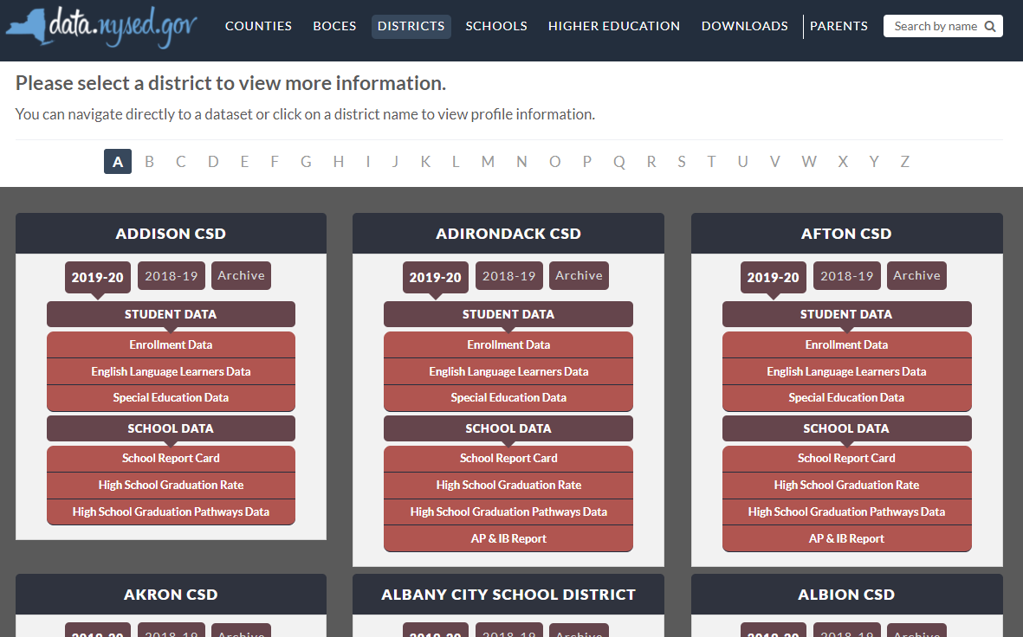

New York State School District SPP Data
Additional information on SPP Indicator data may be found in school district “Special Education Data” reports available at data.nysed.gov
Notes:
For additional information on how the SPP Indicator data impacts your school district, please visit data.nysed.gov.
In the “Districts” category on this webpage, you can view the Special Education Data reports under each school district. These reports are published annually for each individual school district and outline the district’s performance on the SPP Indicators.

Slide 41

Share Your Voice in our Online Survey
Each SPP Indicator has an online survey to collect input on NYS’s target-setting and/or improvement activities
The online surveys are intended to collect feedback from interested stakeholders. They are available for those who are not attending a virtual meeting or for those who have additional information to share beyond the virtual meetings
Please visit the SPP/APR webpage to submit your survey
Notes:
We greatly appreciate your feedback and ask that you visit our SPP/APR webpage (link provided in the slide).
We will use the survey information to collect input from those who have not attended a virtual meeting or for those who have additional information to share.
Each individual SPP Indicator will have its own survey and we encourage you to access all surveys that are of interest to you so that we can achieve our objective of meaningful stakeholder engagement. It is important to us to ensure that voices from diverse backgrounds are included in conversations about our students and we value multiple perspectives and viewpoints to inform our efforts.

Slide 42






THANK YOU for your contribution
Your Voice is Important to New York State’s Efforts to Improve Outcomes for our Students with Disabilities
Notes:
Thank you for your participation and contribution today. We greatly value your voice and input on our efforts to improve outcomes for students with disabilities in New York State.

