Slide 1

State Performance Plan (SPP)/
Annual Performance Report (APR)
2020-2025
Individuals with Disabilities Education Act (IDEA)
Indicator 11 Child Find and Indicator 12 Early Childhood Transition
Notes:
Today’s presentation and discussion on the New York State Performance Plan is focused on Child Find and Early Childhood Transition. Both these indicators are pivotal as an entry pathway to special education programs and services.
The timeline requirements of both these compliance indicators demonstrate the importance of ensuring a timely determination of eligibility and access to the rights and protections of the Individuals with Disabilities Education Act (also referred to as the IDEA) for a Free Appropriate Public Education in the Least Restrictive Environment.

Slide 2
Agenda: Child Find and Early Childhood Transition
Frequently Used Terms for Child Find (Indicators 11 & 12)
Indicator 11 & 12 Improvement Activities
Next Steps and Closing
Indicator 11 How the Measurement Works
Indicator 11 Data in New York State (Trends and Comparisons)
Indicator 12 How the Measurement Works
Indicator 12 Data in New York State (Trends and Comparisons)
Notes:
Today we will first discuss the frequently used terms we will use in the presentation to provide more familiarity with the topics we will cover.
We will spend some time reviewing Indicator 11 (the Child Find Indicator) to provide an overview of “How the State Performance Plan Measurement Works” and the associated data trends and comparisons for this Indicator.
We will provide the same information for Indicator 12 (the Early Childhood Transition Indicator).
After reviewing the measurement requirements and data, we will offer a description of our existing improvement activities aimed at improving results for Indicator 11 and 12 and will include potential new improvement strategies for discussion.
We will close today’s meeting with an overview of next steps for this work in New York State.

Slide 3
Frequently Used Terms
Term | Description
State Performance Plan or SPP | Evaluates the state’s efforts to implement the requirements and purposes of the Individuals with Disabilities Education Act (IDEA) and describes how the state will improve its implementation
Federal Fiscal Year or FFY | Federal Government Fiscal Year (October 1 – September 30)
Annual Performance Report (APR) Data | Data reported to the United States Department of Education Office of Special Education Programs (OSEP) against the state’s targets
Indicator 11 | SPP Indicator 11 measures Child Find Evaluation Timelines
Indicator 12 | SPP Indicator 12 measures Early Childhood Transition
Compliant Reason | Reasons for a delay in evaluation/transition that are considered to be in compliance with New York State requirements for timely evaluations or early childhood transition
Noncompliant Reason | Reasons for a delay in evaluation/transition that are considered NOT to be in compliance with New York State requirements for timely evaluations or early childhood transition.
CSE | Committee on Special Education responsible for conducting timely evaluations for school-aged students suspected of having a disability.
CPSE | Committee on Preschool Special Education responsible for conducting timely evaluations for preschool aged students suspected of having a disability.
Part B of IDEA | Special Education services for preschool and school-aged children (3 through 21 years of age)
Part C of IDEA | Early intervention services (birth through 36 months of age)
Notes:
We will refer to the State Performance Plan or SPP as the plan each state is required to develop pursuant to the IDEA. It covers a six-year period and includes state’s data, efforts to implement the IDEA, and improvement activities.
A lot of the data we will discuss is pulled from our federal reports which we submit on a federal fiscal year schedule. You will see the term FFY to reflect the federal fiscal year period of October 1 – September 30th. For the Child Find Indicator and Early Childhood Transition Indicator, we submit school year data in the same annual report year. For example, 2020-21 school year data is reported in the 2021 annual performance report.
The annual performance report is a report we submit to the U.S. Department of Education containing our most recent data which is compared to our targets.
We will use the term Indicator 11 to refer to the Child Find Indicator and the term Indicator 12 to refer to the Early Childhood Transition Indicator.
For both Indicators, we will use the terms compliant reason and noncompliant reason for a delay in meeting the requirements of the Indicator. Compliant reasons are reasons for a delay in evaluation or transition that are considered to be in compliance with New York State requirements; and noncompliant reasons are not in compliance with requirements.
CSE refers to the Committee on Special Education and CPSE refers to the Committee on Preschool Special Education – these are the entities responsible for performing many of the functions associated with Indicators 11 and 12.
Finally, when we use the term Part B or Part C of the IDEA, we are referring to the Act’s legal structure where Part B covers special education for children ages 3-21 and Part C covers early intervention services for children at birth to 36 months of age.

Slide 4
Indicator 11 – Measurement Description
State Performance Plan (SPP)/
Annual Performance Report (APR)
2020-2025
Individuals with Disabilities Education Act (IDEA)
Notes:
We will start with an overview of the Indicator 11 measurement description.

Slide 5

Child Find
  Must consist of procedures to determine if the child is a child with a disability; and to determine the educational needs of the child.
  Must be conducted within 60 days of receiving parental consent for the evaluation; or within a State established timeframe.
Notes:
The Individuals with Disabilities Education Act (IDEA) requires each state to ensure that all children with disabilities residing in the state, and who are in need of special education and related services, are identified, located, and evaluated.
Per the IDEA, the initial evaluation:
Must be conducted within 60 days of receiving parental consent for the evaluation; or within a State established timeframe; AND
Must consist of procedures –
To determine if the child is a child with a disability; and
To determine the educational needs of the child.

Slide 6
Indicator 11 – Child Find
State Performance Plan Targets Set at 100%
Indicator 11 measures the percent of children who were evaluated within 60 days of receiving parental consent for initial evaluation or, if the State establishes a timeframe within which the evaluation must be conducted, within that timeframe.
For those students whose evaluations were not completed within 60 days (or State-established timeline), Indicator 11 reporting includes the range of days beyond the timeline when the evaluation was completed and any reasons for the delays.
The timeframe set for initial evaluation does not apply if:
the parent of a child repeatedly fails or refuses to produce the child for the evaluation; or
a child enrolls in another school district after the timeframe for initial evaluations has begun, but prior to a determination being made.
in New York State, the student’s parent and Committee on Special Education (CSE) mutually agree to extend the timeline when the student is suspected of having a learning disability.
Notes:
The SPP Indicator 11 measures the percent of children who were evaluated within 60 days of receiving parental consent for initial evaluation or, if the State establishes a timeframe within which the evaluation must be conducted, within that timeframe.
There are factors where this measurement does not apply. In New York State these include, when the parent fails to produce the child for evaluation; if the child enrolls in a new school district after the timeline started but prior to the first district making a determination of eligibility; and for a child suspected of having a learning disability, if the parent and CSE agree to an extension.
If the timeline is not met, data is required to identify the range of days beyond the timeline when the evaluation was completed and any reasons for the delays.

Slide 7
Indicator 11 Data Collection in New York State
Committee on Preschool Special Education (CPSE) and Committee on Special Education (CSE) Events
Annually, a statewide representative sample of one-sixth of New York State school districts plus the New York City Department of Education report when certain special education events occur:
New York State does not have a reporting code for the date the evaluation is completed. Instead, for purposes of monitoring Indicator 11, districts report the date the CPSE or CSE meeting is held to discuss the evaluation results.
All school districts have a choice of reporting data on all eligible students or they may submit data on a randomly selected sample of a minimum number of students using prescribed sampling guidelines.
CPSE Code | CSE Code | Special Education Event Name
CPSE01 | CSE01 | Initial referral to CPSE/CSE
CPSE02 | CSE02 | Parental consent to evaluate
CPSE03 | CSE03 | CPSE/CSE meeting at which evaluation results are discussed (all evaluations are completed)
Notes:
To collect the data needed for Indicator 11, New York State has arranged school districts into a representative sample of one-sixth that report data each year. The New York City school district, due to the size of the number of students, reports every year.
NYSED collects individual student data through the Student Information Repository System (SIRS). Using codes, school districts report specific dates when special education events occur, such as the date of referral, date of written parent consent for an initial individual evaluation and the date of the committee on preschool special education (CPSE) or committee on special education (CSE) meeting to discuss evaluation results.
NYSED does not have an event for the date the evaluation is completed. Therefore, for purposes of monitoring for this indicator, districts report the date the CPSE or CSE meeting is held to discuss the evaluation results. If the district has documentation that shows that the evaluation was completed within 60 calendar days from parental consent, but the meeting to discuss the evaluation results was delayed, the district is determined to have evaluated such students in a timely manner. However, absent such documentation, the district is reported as having untimely evaluations.
School districts may report data for all eligible students or they may select a sample of a minimum number of students using prescribed sampling guidelines.

Slide 8
Indicator 11 Evaluation Delay
Compliant Reasons and Noncompliant Reasons
Compliant CSE & CPSE Reasons for Delay
Mutually agreed upon extended evaluation timeline met for transfer or suspected learning disability classification
Evaluation completed on time, postponed due to parents documented request or emergency school closing
Parents withdrew referral or consent to evaluate
Documented delays in making contact with parents to schedule the evaluation
Parents cancelled the scheduled evaluation and/or selected another approved evaluator
Parents refused or repeatedly did not make the child available for the evaluation
Student moved out of the district
Compliant CPSE-only Reasons for Delay
Parents cancelled the scheduled evaluation and/or selected another approved evaluator
Noncompliant CSE & CPSE Reasons for Delay
Delays in finding an approved evaluator
Evaluator delays in completing the evaluation
An approved multilingual evaluator was not available to provide a timely evaluation
Notes:
If the number of days reported by the school districts exceeds the state-established timelines, reasons for delays are collected.
Some reasons are considered to be in compliance with New York State requirements and other reasons are not in compliance. The compliant reasons align with the exclusions noted in the measurement: when the parent fails to produce the child for evaluation; if the child enrolls in a new school district after the timeline started but prior to the first district making a determination of eligibility; and for a child suspected of having a learning disability, if the parent and CSE agree to an extension.
The noncompliant reasons for a delay in evaluation include:
Delays in finding an approved evaluator
Evaluator delays in completing the evaluation; and
Approved multilingual evaluator was not available.

Slide 9

Facilitator check for understanding on the SPP measurement for Indicator 11 and how the data is used to measure results or outcomes.
Notes:
We are going to pause to check to ensure the information we presented regarding the measurement was clear and understandable.

Slide 10
Indicator 11 Data Trends
State Performance Plan (SPP)/
Annual Performance Report (APR)
2020-2025
Individuals with Disabilities Education Act (IDEA)
Notes:
We will now present some data trends to describe New York State’s performance on Indicator 11. At the end of the presentation of the data, during the virtual meetings we will be asking for stakeholders to share their thoughts about the data. Specifically, we will ask what does the data tell us? This will help to inform our improvement strategy discussion.

Slide 11
Explanation Indicator 11 FFY Data in the Annual Performance Report (APR)
Data years presented will reflect the data NYSED submits to the federal Office of Special Education Programs (OSEP) in the APR which covers the federal fiscal year (FFY) period
2020-21 School Year
The Indicator 11 data sample is
collected on a school-year basis
The FFY 2020 APR is
submitted to OSEP
FFY 2020 APR
The October 2020 Preschool LRE Data is included in the FFY 2020 APR
February 2022
Notes:
The data that we present today will reflect the Annual Performance Report data that NYSED submits to the federal Office of Special Education Programs (or OSEP). The reporting period is based on the federal fiscal year (or FFY).
The Statewide data sample for Indicator 11 for the 2020-21 school year is based on parent consent to evaluate the child received between July 1, 2020 and June 30, 2021, and status of the eligibility determination process as of August 31, 2021. This data is reported by New York State in the 2020 annual performance report due to the United States Department of Education in February of 2022.

Slide 12
Indicator 11 – Child Find New York State Trend Data & Results
Percent of children whose evaluations were completed within 60 days (or State-established timeline) & Year over Year Change
Increase = Improvement
Difference | -11.93 | -16.16 | -16.70% | -14.90% | -16% | -12.33% | -11.81
Notes:
We now will present data trends relevant to Indicator 11.
The red dotted line on the graph demonstrates the federal Office of Special Education Programs’ (otherwise referred to as OSEP) established target of 100% compliance with Child Find requirements or the percent of children whose evaluations were completed within 60 days or State-established timeline. The blue solid line reflects the actual reported data for New York State where the 2013 to 2019 average was 85.74%.
The values on the solid blue line represent the change from the prior year. For example, from 2013 to 2014, the percent of children whose evaluations were completed within 60 days or State established timeline decreased by 4.23 percentage points. Progress was made from 2017 to 2018 where Indicator 11 results in New York State increased by 3.67 percentage points and from 2018 to 2019 where results increased by 0.52 percentage points.
The chart below the graph reflect the APR data reported each year from the representative sample and the difference between the New York State results and 100% OSEP target.
The highest New York State result is represented in 2019 at 88.19% and lowest is represented in 2015 at 83.30%.

Slide 13
State-to-State and National Result Comparison​
Indicator 11: Child Find
Notes:
We compared the New York State trend data to the reported data results of other states of comparable size and demographics and to the 2018 National Mean.
New York, California, Florida, Pennsylvania, Illinois, Texas, and Ohio are known as the 7-PAK States. 7-PAK States is a consortium of the seven largest states that the National Association of State Directors of Special Education, Inc. determined to have both similar demographics (e.g., general population, diversity, significant rural and inter-city populations) and issues in the delivery of special education programs to its students with disabilities.
When the New York State data is compared to other states, New York performs the lowest in recent years with the 2018 National Mean at 97%.

Slide 14
Indicator 11 National & Regional Data Comparison
50 states and 10 other administrative units National Comparison: Percent Evaluated within 60 Days
 | 2013 | 2014 | 2015 | 2016 | 2017 | 2018
90% to 100% | 56 | 57 | 57 | 58 | 59 | 57
80% to <90% | 4 | 3 | 3 | 2 | 1 | 3
0% to <80% | 0 | 0 | 0 | 0 | 0 | 0
3-Year Average New York State District Data (2017-18 through 2019-20)
 | All districts on sampling schedule | NYC sample | Rest of State districts on sampling schedule
on time | 38,516 | 15,022 | 23,494
compliant reason | 4,819 | 1,451 | 3,368
noncompliant reason | 5,272 | 4,281 | 991
Total referrals | 50,059 | 21,159 | 28,900
Annual Performance Report rate: | 89.15% | 79.37% | 96.44%
Notes:
When data from all states is considered, New York State performs among the lowest each year. The top chart reflects that almost all states and territories report between 90%-100% compliance each year during 2012 through 2018. New York State reports between 80% to 90% during the same period.
When New York State data is compared at a regional level, a discrepancy between the New York City school district and districts located in the rest of the State is found.
The three year average Indicator 11 performance from 2017-18 to 2019-20 for the New York City school district is at 79.37% with rest of State districts reporting 96.44%.

Slide 15
2019 New York State Indicator 11 Data
Compliant Delay Reasons Reported
CSE
CPSE
Notes:
The circle graph illustrates how frequently each compliant reason was reported in 2019. The outer circle reflects CSE data and the inner circle reflects CPSE data.
The most common compliant reason in 2019, accounting for a little less than half of the delays, was that the evaluation was completed on time, was postponed due to parent request, or emergency school closing. This is the code used when the evaluation is timely but there was a delay in holding the CSE or CPSE meeting.
The next frequently reported compliant reason for the CSE is a mutual agreement between the CSE and parent to extend the timeline for a student who transferred or is suspected of having a learning disability (reflecting 25%). For the CPSE this would only apply to a preschool student who transferred to the new CPSE (because preschool children do not receive a disability classification) and therefore this compliant reason is less frequent at CPSE at only 2.6%.
The next three compliant reasons relate to lack of parent refusal to make the child available, lack of parent consent, or documented delays reaching the parent. At CPSE, these compliant reasons account for almost 45% while at the CSE they represent approximately 24%.
The most infrequent compliant reason at CPSE and CSE is that the student moved.
For the CPSE, there is also a possibility that the parent cancels the evaluation and/or selects a new evaluator, and this was reported as a compliant reason 4% in 2019.

Slide 16
2019 New York State Indicator 11 Data
Noncompliant Reasons Reported
CSE
CPSE
Notes:
For the noncompliant reasons reported for a delay in evaluation in 2019:
Evaluator delays accounts for the majority for both CSE and CPSE (the vast majority at CPSE at 88.5%)
Delays in finding an approved evaluator was reported at 27.1% for CSE and 11.2% for CPSE.
Multilingual evaluator not available was reported more frequently at CSE at 14.1% and almost not a factor for CPSE (reported only .3% in 2019).

Slide 17
What did the Indicator 11 SPP data tell us?
Stakeholder
Discussion
Notes:
We will pause now to have discussion and feedback from stakeholders. We will be asking: What did the State Performance Plan data tell us?
As a reminder, Indicator 11 does not require states to establish targets as OSEP has set targets at 100%. Stakeholder feedback is intended to identify strategies for improvement so that New York State achieves the Indicator 11 100% target.

Slide 18
Indicators 11 & 12 – Improvement Strategies
State Performance Plan (SPP)/
Annual Performance Report (APR)
2020-2025
Individuals with Disabilities Education Act (IDEA)
Notes:
We will now look at Improvement Strategies aimed at improving New York State’s Child Find and/or Early Childhood Transition performance.

Slide 19
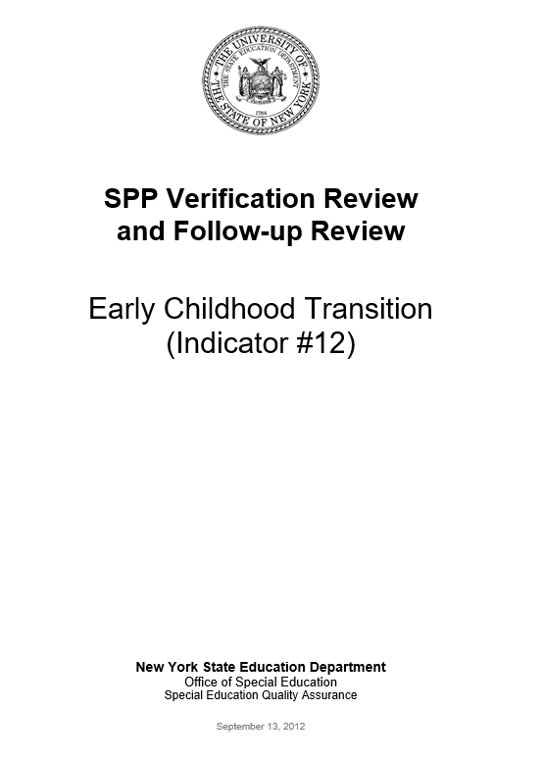
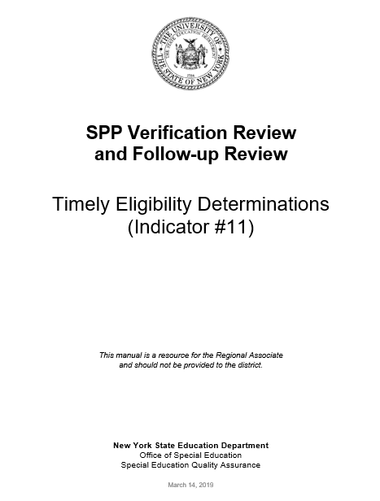
Office of Special Education Monitoring: Verification and Follow-Up Reviews
For both Indicators 11 and 12, states must report detailed information about the timely correction of noncompliance, information regarding the nature of any continuing noncompliance, improvement activities completed, and enforcement actions that were taken.
The Special Education Quality Assurance Offices conducts Indicator 11 and Indicator 12 verification and follow-up reviews, selecting districts on a 6-year cycle.
Targeted monitoring of Indicators 11 and 12 are included in the New York City School District compliance assurance plan (CAP).
Notes:
Both Indicator 11 and 12 APR submissions require states to provide detailed information about the timely correction of noncompliance. In addition, states must report information regarding the nature of any continuing noncompliance, improvement activities completed, and any enforcement actions that were taken.
The Special Education Quality Assurance (or SEQA) Offices, within the NYSED Office of Special Education, conduct verification and follow-up reviews for both Indicators 11 and 12 for those districts on the sample reporting cycle. As part of its oversight, SEQA will monitor district’s data reporting to identify noncompliance with Indicator 11 and/or 12 that must be addressed and contact districts at 3, 6, and 9 months to ensure the district is working to resolve the noncompliance.
In addition, as part of a comprehensive compliance assurance plan, the New York City SEQA Office has been verifying actions the New York City Department of Education (DOE) has been taking to address systemic issues with timely evaluations and early childhood transition including additional resources for the CSEs and CPSEs, increasing the number of evaluations performed by the DOE, enhancing data sharing and communication with the early intervention system, and revising its policies and procedures for the CPSE evaluation process.

Slide 20
Continued Description – Indicator 11 & Indicator 12
Monitoring: Verification and Follow-Up Reviews
School districts not reporting 100% compliance rates with Indicators 11 or 12 must verify that:
  All student-specific noncompliance has been resolved; and
  The district has addressed the reasons for its noncompliance and met compliance standards for all students tracked during a three-month period.
These school districts submit assurances that noncompliance has been addressed.
SEQA follows up on the district assurances, confirm that the student-specific noncompliance was resolved, and review a sample from the three-month period to confirm compliance was achieved.
Indicator 11 Statement of Assurances
In the first assurance (Part 1), the district will assure that for each identified student, if any, whose initial evaluation was not completed in compliance with State time lines, and for whom data was not already available in SIRS, has since had his or her initial evaluation completed and if not, there is a reason that is in compliance with State requirements. In the second assurance (Part 2), the district will assure that it has addressed the reasons why the students did not receive their initial evaluations on time and provide data to verify that students for whom parent consent to evaluate was received during a three-month period determined by the district have received their initial individual evaluations within the State required timelines.
Notes:
If a school district does not report 100% compliance with Indicator 11 or 12 requirements, the district must resolve student specific noncompliance, address the reasons for its noncompliance, and submit written assurances to NYSED.
For the student-specific noncompliance, the school district must assure that those students who did not receive their individual evaluations or did not successfully transition within required timelines have subsequently had their evaluations completed and/or successfully transitioned in compliance with State requirements.
To ensure the district has addressed its reasons for noncompliance, the district must conduct a review of all students during a three-month period. The district must provide data and submit an assurance to verify that Indicator 11 and/or 12 requirements were met in the district during its review period.
SEQA will conduct a monitoring review to follow-up on the school district’s assurances by reviewing the student-specific compliance actions taken by the district and monitoring a sample from the district’s three month review period to address the reasons for its noncompliance.

Slide 21
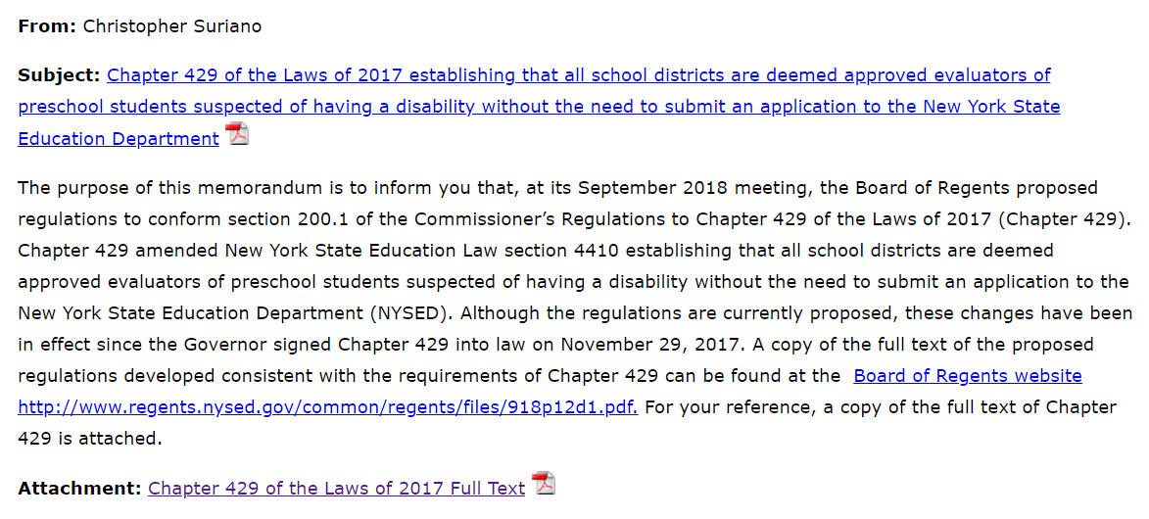
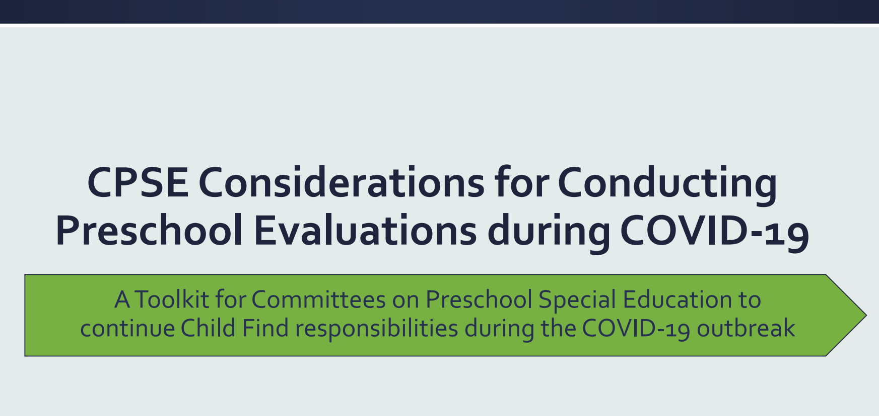
Indicator 11 Child Find Guidance
In October 2018, the Office of Special Education issued field guidance that an amendment to Education Law 4410 (Chapter 429 of the Laws of 2017) has made school districts approved preschool evaluators without needing to submit an application to NYSED.
On June 22, 2020, Office of Special Education posted a toolkit for CPSE’s to continue child find responsibilities during the COVID-19 outbreak
Notes:
New York State Education Law section 4410 was amended in 2017 making all school districts approved preschool evaluators. This means that school districts may be added to the list of approved evaluators for parents to select to conduct the evaluations in accordance with State timelines.
Also, during the COVID pandemic, the Office of Special Education issued a toolkit regarding the responsibility for conducting preschool evaluations with considerations for remote evaluations and use of previous assessments to determine eligibility. The objective of these resources was to assist Committees on Preschool Special Education in completing timely preschool evaluations, either in-person or remotely, for all preschool aged children (including those transitioning from Early Intervention).

Slide 22

Indicator 12 Early Childhood Transition Materials
The Office of Special Education Preschool Policy Unit partnered with the Office of Early Learning and the New York State Council on Children and Families to issue A Resource to Special Education Support Services.
  This resource includes important information for families to help navigate the early childhood transition process.
NYSED and the New York State Department of Health (DOH) are developing a Memorandum of Understanding (MOU) regarding the Early Intervention Program and Preschool Special Education Programs.
  The MOU contains agency roles, relevant timelines, data sharing agreements, and process requirements according to the laws and regulations governing both agencies.
Notes:
A Resource to Special Education Support Services includes information on the Early Intervention program, the transition process to CPSE, and how to navigate the special education system for children with disabilities. It is a good source of information for parents and families outlining the steps in the process and the timelines for early childhood transition.
The State Education Department maintains a memorandum of understanding with the New York State Department of Health that outlines each agency’s roles, the process, and timelines for transition according to laws and regulations governing both agencies.

Slide 23
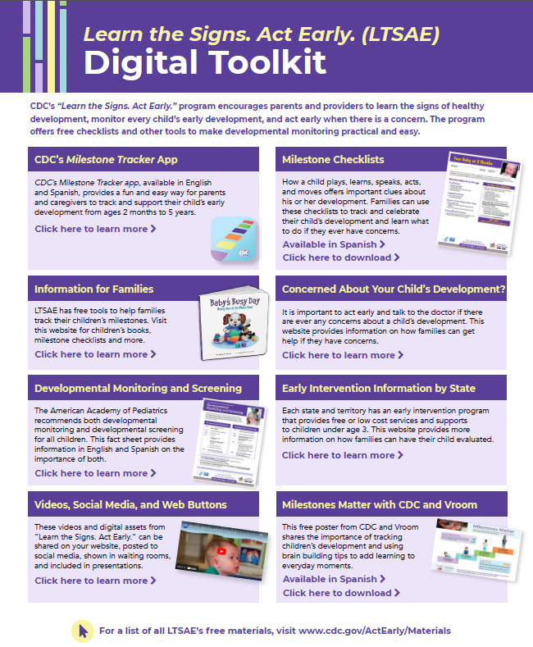
Learn the Signs. Act Early.
The Office of Special Education is a member of the New York State Act Early Team to assist in promoting the Centers for Disease Control’s “Learn the Signs. Act Early” Campaign.
The “Learn the Signs. Act Early” Campaign includes tools, resources and videos, in multiple languages, and is available at www.cdc.gov/ActEarly.
Notes:
The Office of Special Education is a member of the New York State Act Early Team to assist in promoting the Centers for Disease Control’s “Learn the Signs. Act Early” Campaign. This Campaign encourages parents and providers to learn the signs of healthy development, monitor every child’s early development, and take action when there is a concern.
The “Learn the Signs. Act Early” Campaign includes tools, resources and videos, in multiple languages, that were shared through the Office of Special Education listserv and through our regional Early Childhood Family and Community Engagement Centers.

Slide 24

Office of Special Education Educational Partnership Tiered Support & Professional Development
12 Regional Partnership Centers
14 School-Age Family and Community Engagement Centers
14 Early Childhood Family and Community Engagement Centers
Systems Change Work Providing a Variety of Supports to Educational Organizations in New York State
Regional Learning
Targeted Skills/Support Groups
Support Plans
1
2
3
Notes:
The OSE Educational Partnership is a special education professional development network located in Regional Teams across the State. Regional Teams are comprised of a Regional Partnership Center that has specialists who provide professional development in a range of disciplines including behavior, transition, culturally responsive education, literacy and specially designed instruction, a school aged Family and Community Engagement Center that has specialists with expertise supporting parents and families of school-aged students with disabilities and an early childhood Family and Community Engagement Center that supports parents and families of preschool students with disabilities.
These Regional Teams provide professional development to stakeholders including parents and families as well as schools, including preschools, that serve students with disabilities.
The Regional Teams offer three tiers of support:
Regional Learnings are offered to all educational organizations and/or parents and families of students with disabilities in a region. The training may be offered in-person and/or virtually and there are training topics in all areas of special education.
Targeted Skills Groups are provided to groups of schools that have a similar performance or compliance issue that requires more intensive professional development and targeted assistance.
Support Plans are the most intensive level of support that includes embedded support from one or more specialists from the Regional Team provided directly into the identified schools.
In the next slide, we will take a look at trainings currently offered by the Educational Partnership related to our Indicator.

Slide 25
Educational Partnership Resources
Targeted Professional Development Improvement Strategies
The following professional development trainings are offered relating to Timely Evaluations and/or Early Childhood Transition:
CPSE/CSE Chairperson Training​
Preschool Special Education Process ​
CPSE to CSE for Parents​
EI to CPSE for Parents​
EI to CPSE for Professionals​
Identifying and Intensifying Intervention ​
Universal Screening: Best Practices in Screening for Academic Deficits​
Understanding the IEP Process for Parents of Preschoolers
Early Childhood Benchmarks of Quality
Notes:
The Office of Special Education’s Educational Partnership provides several regional learning opportunities to approved preschool programs and to Committees on Preschool Special Education and to Committees on Special Education. Approved preschool evaluators are also eligible to participate and access these resources.
These professional development offerings contain effective practices to assist Committees and approved evaluators in their timely evaluation and early childhood transition responsibilities.

Slide 26
Potential New Improvement Strategies
1
2
3
4
Leverage OSE Partnership resources for additional planning for identified school districts based on preschool and school-age data, with a special emphasis on those districts with the lowest performance. Identified districts would be required to conduct root cause analysis and develop steps to take to improve evaluation timelines.
Develop a CSE/CPSE Chairperson Training module on guidance on reporting and building systems to support Indicator 11 data, including the importance of providing timely evaluations and effective processes used by districts that report high numbers of timely evaluations. Discuss OSEP’s expected target of 100 percent compliance.
Issue additional guidance on the following:
- Multidisciplinary Evaluator (MDE) Program Responsibilities for Timely Evaluations
- CPSE Early Childhood Transition Responsibilities
Issue updated guidance relating to initial evaluations.
Notes:
To improve New York State’s performance on timely evaluations and early childhood transition, potential improvement activities 1 through 4 would focus on additional professional development, training, and guidance.
For potential Improvement Activity #1, the Office of Special Education could leverage its Educational Partnership resources to provide embedded support to districts reporting low performance in Indicator 11. This work would include a root cause analysis reflecting recent performance and action steps to improve evaluation timelines. This support would be targeted to those districts reporting the lowest Indicator 11 results.
For potential Improvement Strategy #2, the Office of Special Education Educational Partnership could expand on its existing CSE/CPSE training by developing a targeted module on Indicator 11 specifically (including reporting and compliance assurance requirements). This work would be targeted for districts with lowest Indicator 11 results, but available for any district as a proactive measure to improve data statewide.
The 3rd Potential Improvement Activity would be to issue additional guidance on Indicator 12 requirements to MDE Programs and to CPSEs on timely evaluation requirements. For this guidance, the Office of Special Education would evaluate survey results from approved evaluators to identify areas of concern or challenges with conducting preschool evaluations. CPSE guidance could include more information about data reporting to improve data accuracy and consistency.
For potential Improvement Strategy #4, the Office of Special Education could update existing guidance relating to initial evaluations. Since there is frequent turnover in CPSE and CSE Chairpersons statewide, this guidance would be available to the field in general.

Slide 27
Potential New Improvement Strategies - Continued
5
6
7
Expand Indicators 11 and 12 Sample Size for low performing districts
- Increase frequency of district reporting
- Increase the sample of students for reporting districts
Partner with the New York State Department of Health to update early childhood transition resources for parents and families last issued in 2005 titled: The Transition of Children from The New York State Department of Health Early Intervention Program to The State Education Department Preschool Special Education Program or Other Early Childhood Services (nysed.gov)
Repeal the requirement that the parent(s) selects the preschool evaluator and replace it with the requirement that the school district, after providing the parent(s) with a list of approved evaluators, must consult with the parent(s) regarding the selection of an evaluator that can provide a timely evaluation of the preschool child.
Notes:
A 5th Potential Improvement Strategy would be to expand the amount of data the State collects for Indicators 11 and 12. This could be to expand the total pool of data (the frequency of district reporting or increasing the student sample size) and could be targeted only to those districts with low compliance rates in order to perform increased oversight and accountability for these districts.
For a 6th Potential Improvement Strategy, the Office of Special Education could partner with the New York State Department of Health to update and reissue transition guide to parents and families to ensure the most recent information and best practices are reflected.
For a 7th Potential Improvement Activity, we would propose to amend State law to repeal the requirement that the parent select the preschool evaluator. The requirement has contributed to significant noncompliance in New York State for timely evaluations of preschool students, as parents may not be able to select an approved evaluator who is able to complete the individual evaluation within the State’s required timeline. Districts would select an approved evaluator (which could be the district) in consultation with the parent and in consideration of the availability of the approved evaluator to complete the evaluation within the time period required by State law. Parents would be provided a list of approved evaluators and informed of their right to request an independent educational evaluation if they disagree with the evaluation that is completed or contracted for by the school district.

Slide 28
What activities could be considered, maintained, or strengthened to address improvements in Child Find?
What activities could be considered, maintained, or strengthened to address improvements in Early Childhood Transition?
Stakeholder Discussion
Notes:
We will now pause the presentation to discuss our improvement activities.
Specifically, we will ask: What activities could be considered, maintained, or strengthened to address improvement in Child Find or Early Childhood Transition.

Slide 29
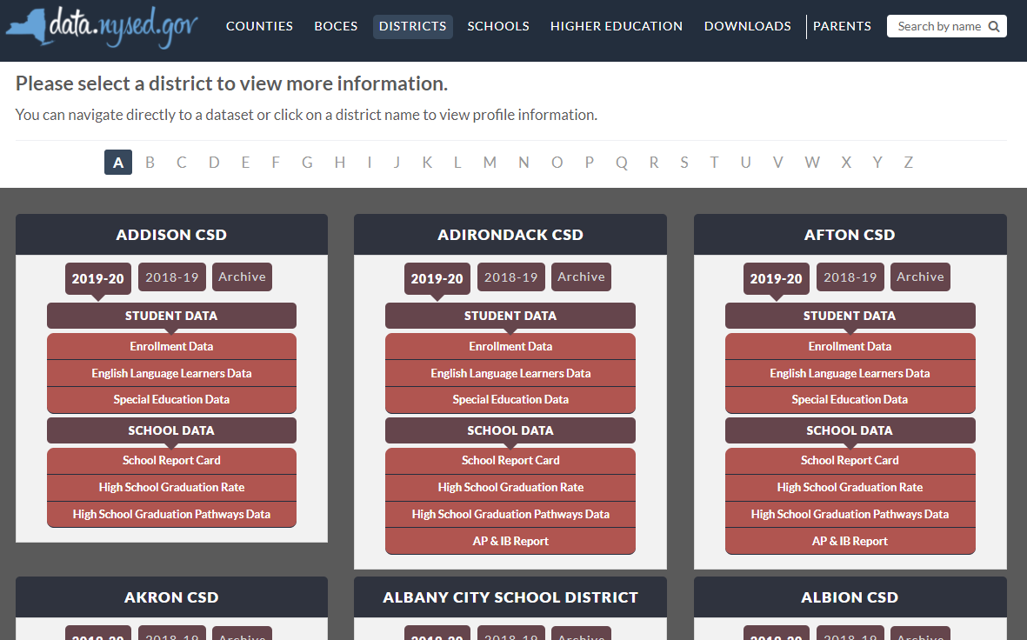

New York State School District SPP Data
Additional information on SPP Indicator data may be found in school district “Special Education Data” reports available at data.nysed.gov
Because Indicator 11 and 12 data is reported on a sampling schedule, data will appear in the Special Education Data Reports only in the school year the district reports data
Notes:
For additional information on how the SPP Indicator data impacts your school district, please visit data.nysed.gov.
In the “Districts” category on this webpage, you can view the Special Education Data reports under each school district. These reports are published annually for each individual school district and outline the district’s performance on the SPP Indicators.

Slide 30

Share Your Voice in our Online Survey
Each SPP Indicator has an online survey to collect input on NYS’s target-setting and/or improvement activities
The online surveys are intended to collect feedback from interested stakeholders. They are available for those who are not attending a virtual meeting or for those who have additional information to share beyond the virtual meetings
Please visit the SPP/APR webpage to submit your survey http://www.nysed.gov/special-education/ffy-2020-2025-spp-apr
Notes:
We greatly appreciate your feedback and ask that you visit our SPP/APR webpage (link provided in the slide).
We will use the survey information to collect input from those who have not attended a virtual meeting or for those who have additional information to share.
Each individual SPP Indicator will have its own survey and we encourage you to access all surveys that are of interest to you so that we can achieve our objective of meaningful stakeholder engagement. It is important to us to ensure that voices from diverse backgrounds are included in conversations about our students and we value multiple perspectives and viewpoints to inform our efforts.

Slide 31






THANK YOU for your contribution
Your Voice is Important to New York State’s Efforts to Improve Outcomes for our Students with Disabilities
Notes:
Thank you for your participation and contribution today. We greatly value your voice and input on our efforts to improve outcomes for students with disabilities in New York State.

