Slide 1



Financial Reporting Requirements for School Districts and BOCES
  Presented by Maria Stamoulis
  Office of Audit Services
  August 2022

Slide 2
Agenda
Financial Surveys 1-7
  Background,
    Who must submit each survey,
    Regulation/Law behind requirements,
    Due dates,
    Required documentation,
    Screenshots of NYSED Application Business Portal, and
    Common errors and helpful tips.
Contact Information and Useful Links

Slide 3
Access to the NYSED Application Business Portal
  User ID and password required.
  CEO must assign rights and roles depending on responsibilities.
  To access the portal and for troubleshooting, refer to the step-by-step instructions posted on website in the SEDDAS User Guide:
    SEDDAS User Guide

Slide 4
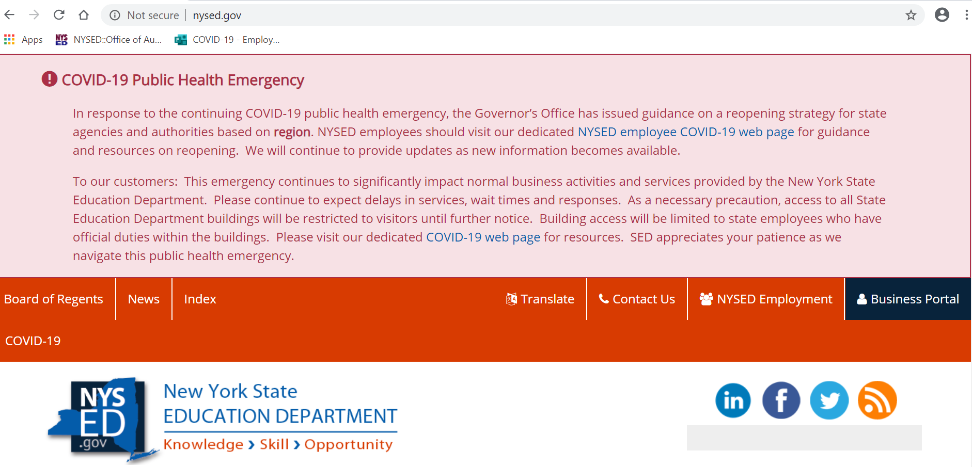
NYSED Application Business Portal
          Login to NYSED Application Business Portal

Slide 5
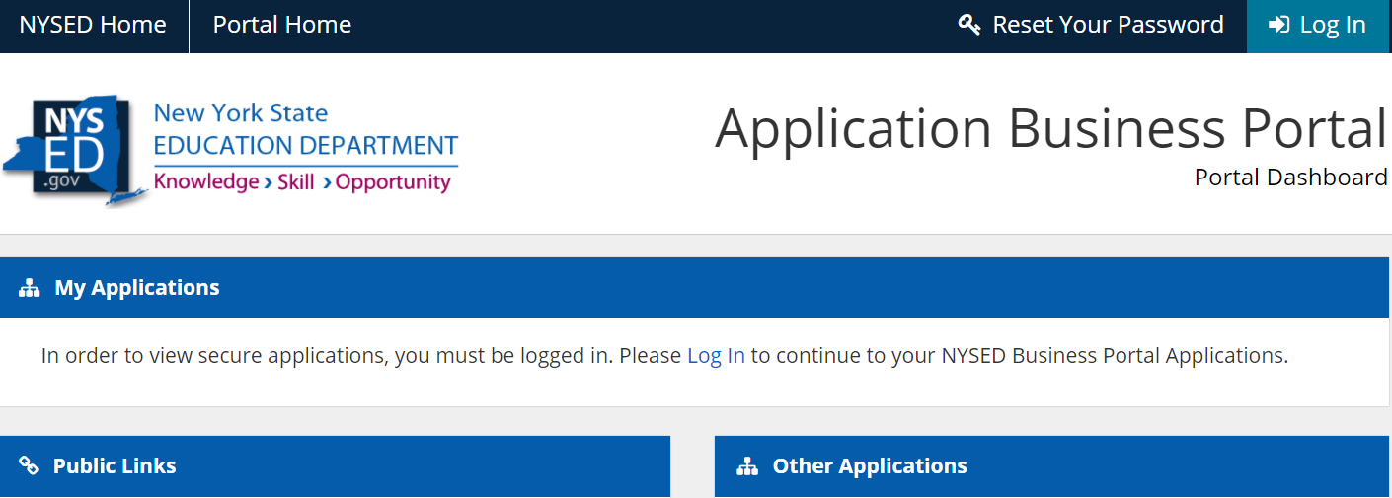
NYSED Application Business Portal

Slide 6
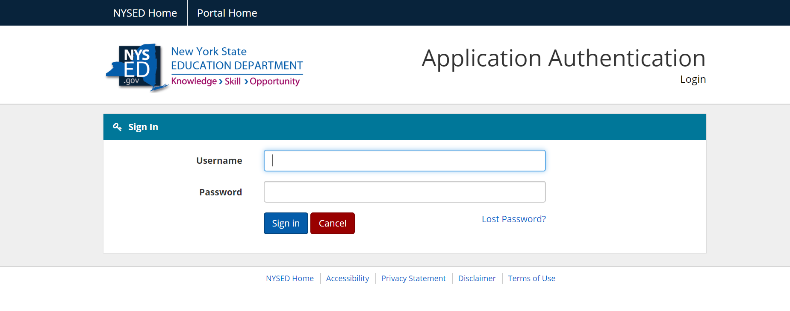
NYSED Application Business Portal

Slide 7
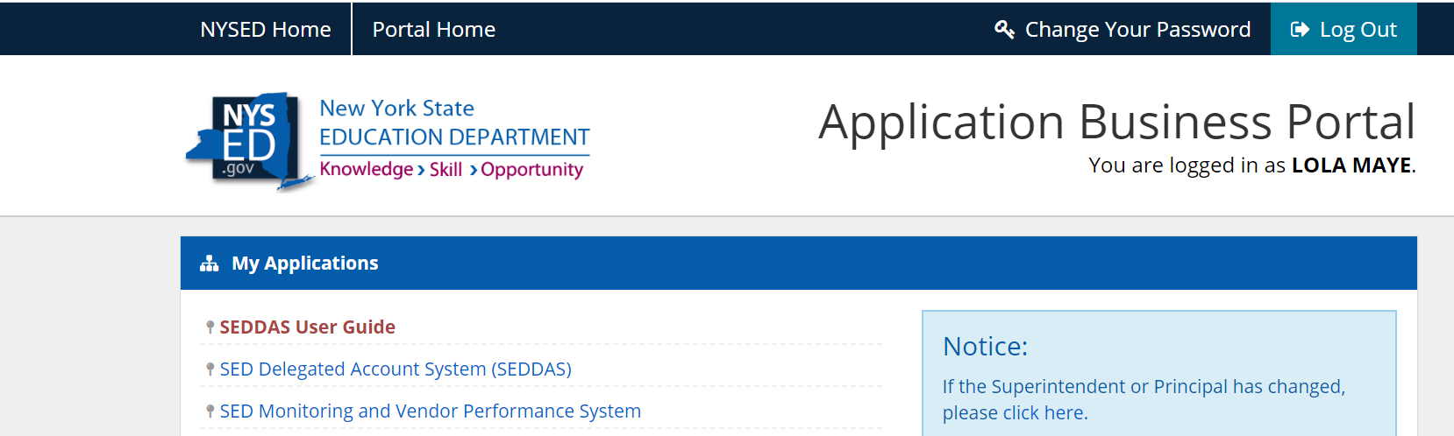
NYSED Application Business Portal

Slide 8
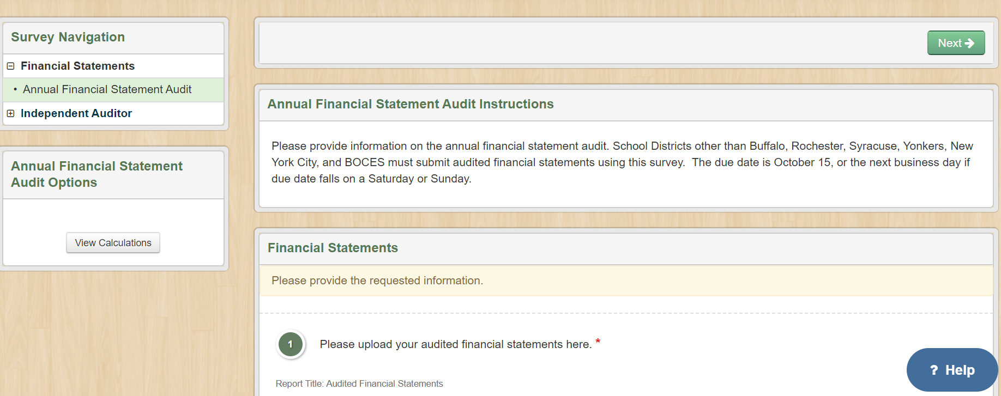
NYSED Application Business Portal

Slide 9
Background
Status
  Submitted – not able to edit submission, unless it is un-submitted by OAS staff,
  Approved – submission was reviewed and approved by OAS staff, or
  Un-submitted – survey has yet to be submitted or survey was returned because at least one item was not addressed appropriately. Notes within that survey detail deficiencies that must be corrected prior to re-submission.
Due Date
  If the due date falls on a weekend or Federal Holiday, the deadline becomes next business day.

Slide 10
Financial Survey 1: Audited Financial Statements
Regulation/Education Law
  Section §2116-a(3) of NYS Education Law and Section §170.12(e)(1) of the Regulations of the Commissioner of Education require all BOCES and each school district employing eight or more teachers to obtain an annual audit of its records.
Due Date
  October 15 (January 1 for “Big 5”).
Required Documentation
  Independent Auditor's Report; Management’s Discussion and Analysis; Eight Basic Financial Statements; Notes to the Financial Statements; Four Supplemental Schedules.

Slide 11
Financial Survey 1 Requirements
  Basic Financial Statements
Statement of Net Position | Statement of Activities | Balance Sheet – Governmental Funds | Reconciliation of Governmental Funds Balance Sheet to the Statement of Net Position
Reconciliation of Governmental Funds Statement of Revenues, Expenditures, and Changes in Fund Balances to the Statement of Activities | Statement of Fiduciary Net Position | Statement of Changes in Fiduciary Net Position | Statement of Revenues, Expenditures, and Changes in Fund Balance - Governmental Funds

Slide 12
  Financial Survey 1 Requirements
  Required Supplementary Information
  Schedule of Changes in the District’s Total OPEB Liability and Related Ratios,
  Schedule of Revenues, Expenditures, and Changes in Fund Balance ‐ Budget (Non‐GAAP Basis) and Actual – General Fund,
  Schedule of District Contributions, and
  Schedule of District’s Proportionate Share of the Net Pension Liability.

Slide 13
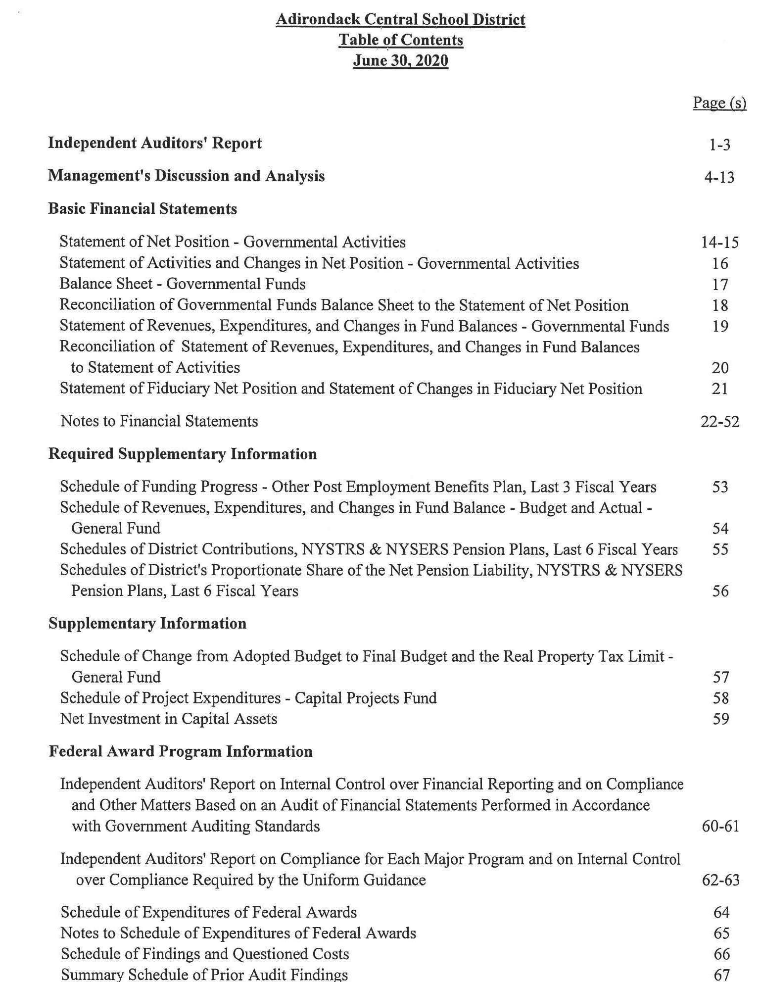
  Financial Survey 1 Requirements
Notes:
.

Slide 14
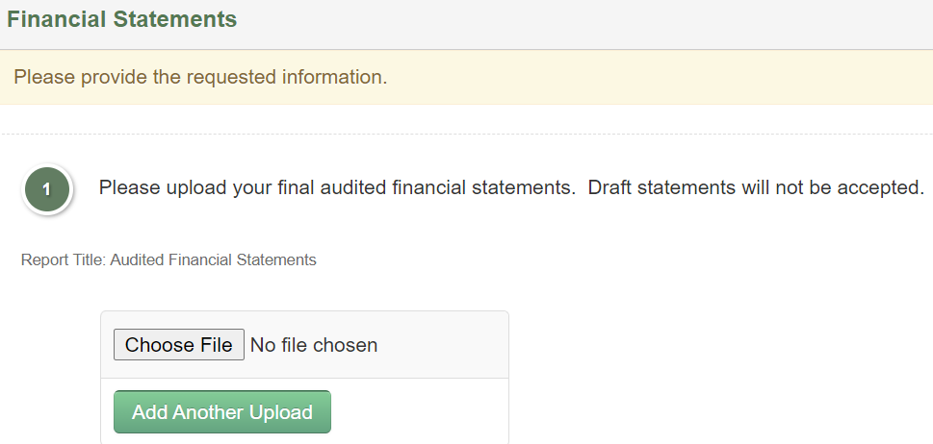
  Financial Survey 1 Questions

Slide 15
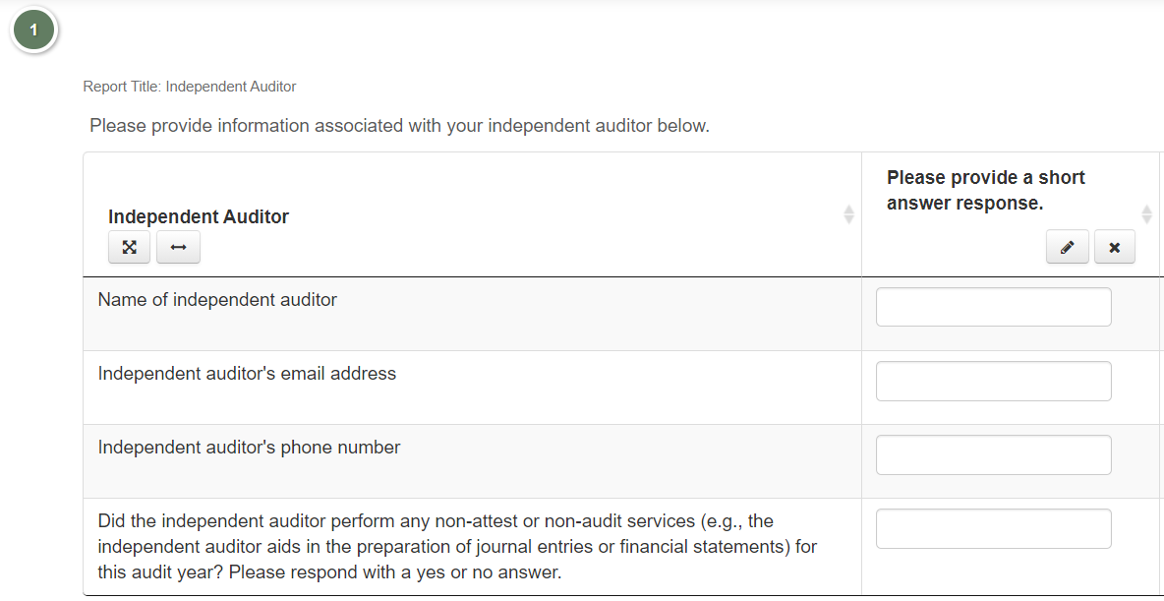
  Financial Survey 1 Questions

Slide 16
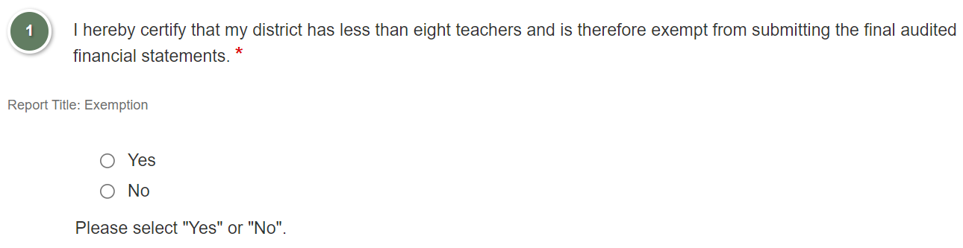
  Financial Survey 1 Questions

Slide 17
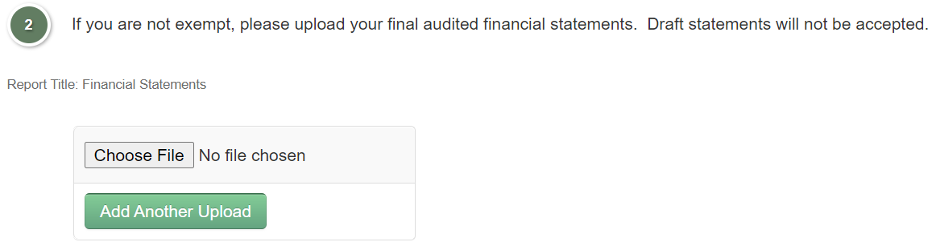
  Financial Survey 1 Questions

Slide 18
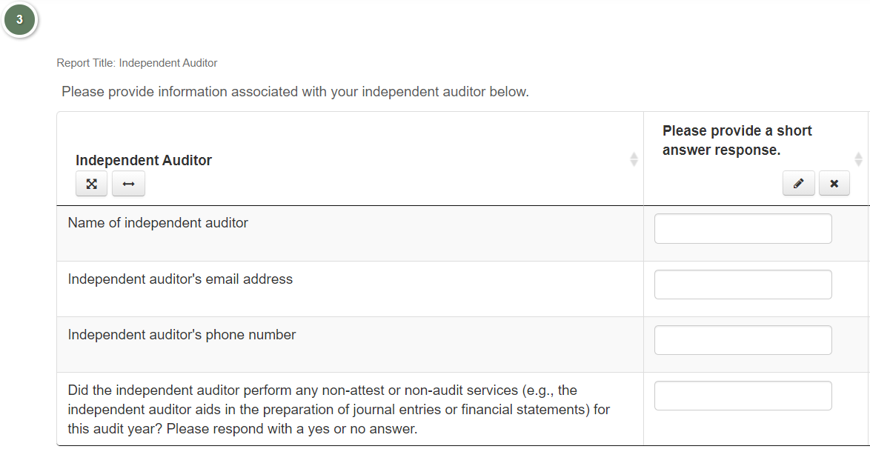
  Financial Survey 1 Questions

Slide 19
  Financial Survey 1 Helpful Tips
Ensure audit report contains correct year for the survey cycle.
  For example – due October 15, 2021, financial statements with year-end June 30, 2021, must be submitted.
Ensure audit report is in final format.
  “Draft” is not on the heading of the financial statements.
Submit on time.
  Aid is withheld for school districts post mid-November and January 30 for the “Big 5”.

Slide 20
Financial Survey 2/3:
Financial Statement Board Approval, Management Letter(s), Extraclassroom Audit, and CAP(s)
Regulation/Education Law –Management Letter
  Education Law §2116-a(3) and Commissioner’s Regulation §170.12(e)(2) - the annual audit report must be submitted to and approved by the trustees or Board, then filed with NYSED.
  Education Law §2116-a(3) and Commissioner’s Regulation §170.12(e)(4) - Board approved corrective action plans (CAP(s)) must be submitted to NYSED within ninety days of receipt of audit report or management letter for ANY findings.

Slide 21
Financial Survey 2/3
Regulation/Education Law – Extraclassroom Audit
  Commissioner’s Regulation §172.3(d) requires the Extraclassroom Activity Fund to be audited.
  Education Law §2116-a(3) and Commissioner’s Regulation §170.12(e)(4) - Board approved CAP(s) must be submitted to NYSED within ninety days of receipt of audit report or management letter for ANY findings. The CAP(s) shall include expected date(s) of implementation.
Due Date
  January 15 (February 1 for “Big 5”).

Slide 22
Financial Survey 2/3 Requirements
  Minutes showing Board approval of the independent auditor’s report.
  Management letter and extraclassroom audit, if applicable.
  CAP(s) must be final.
  CAP(s) in response to management letter findings and extraclassroom audit findings must contain:
    detailed action taken or planned to correct deficiencies in audit findings, or statement which describes reason(s) that corrective action is unnecessary, and
    expected date(s) of implementation.
  Meeting Minutes/Board Resolution showing the Board approval of CAP(s).

Slide 23
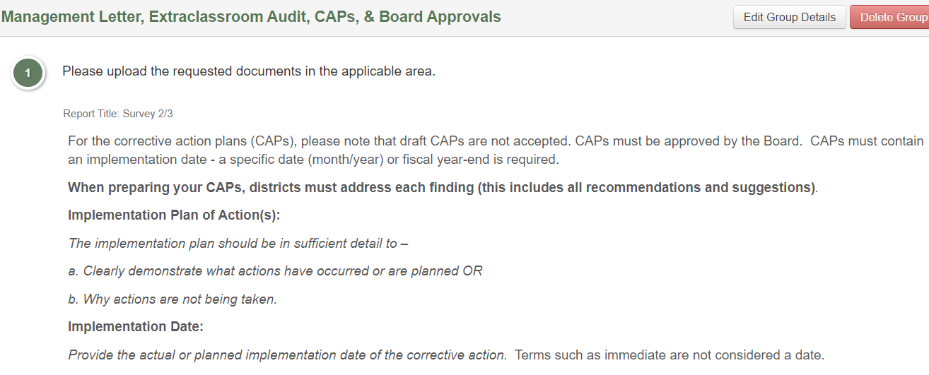
Financial Survey 2/3 Questions

Slide 24
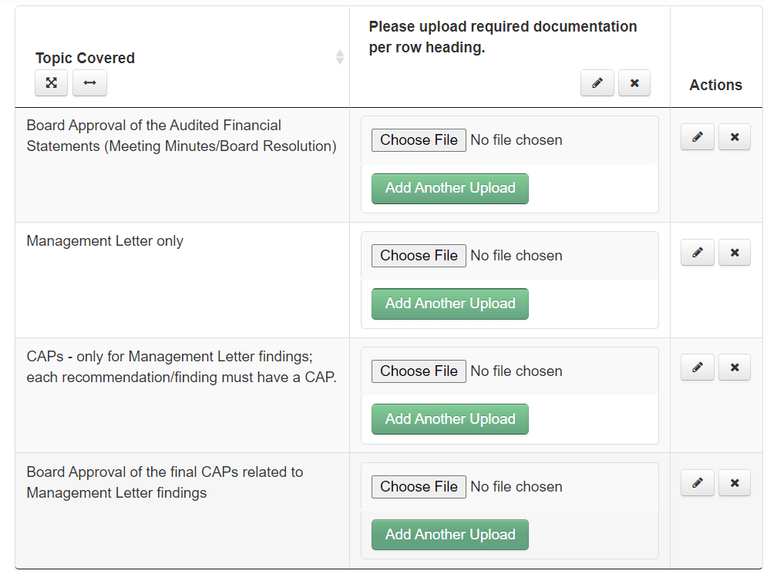
Financial Survey 2/3 Questions

Slide 25
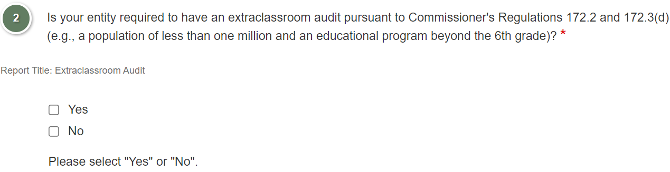
Financial Survey 2/3 Questions

Slide 26
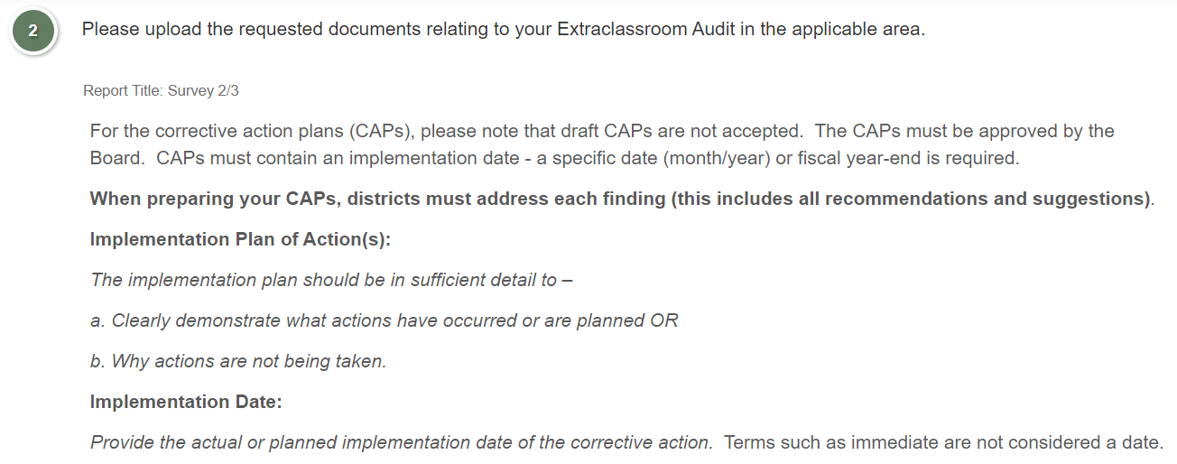
Financial Survey 2/3 Questions

Slide 27
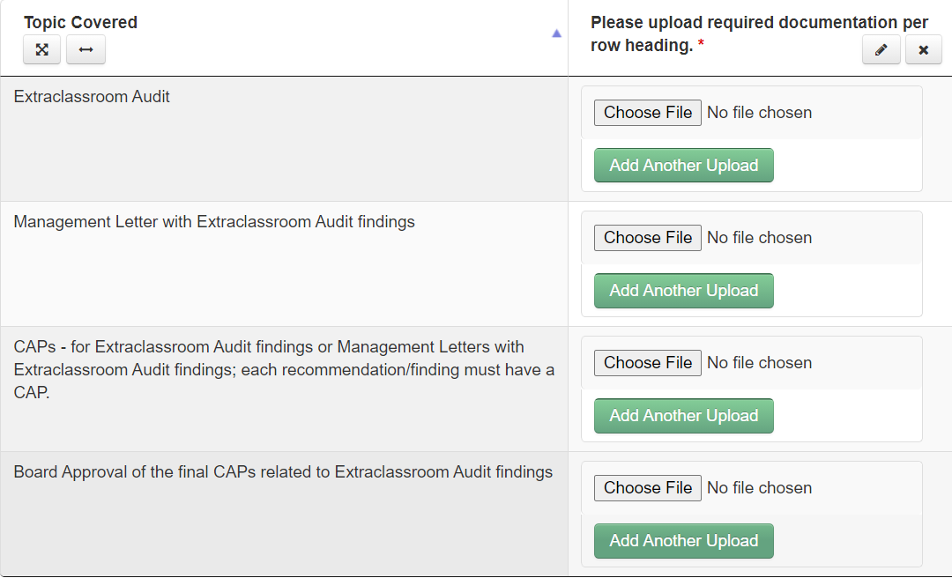
Financial Survey 2/3 Questions

Slide 28
Financial Survey 2/3 Helpful Tips
Ensure CAP(s) are submitted for every management letter and extraclassroom audit finding.
Ensure anticipated implementation date is included in the CAP(s) for any management letter and extraclassroom audit findings.
Ensure CAP(s) adequately addresses each finding.
Ensure updated Board minutes are submitted for revised CAP(s).

Slide 29
Financial Survey 4
Single Audit Threshold and/or Single Audit Exemption Form
Federal Regulations
  Office of Management and Budget's Uniform Grant Guidance 2 CFR §200.501(a) states that a non-federal entity that expends $750,000 or more in federal awards during the non-federal entity’s fiscal year must have a Single Audit or Program-Specific Audit conducted for that year.
  The Office of Management and Budget's Uniform Grant Guidance 2 CFR §200.512(a)(1), (b)(1), and (d) indicates that the data collection form and reporting package must be submitted to the Federal Audit Clearinghouse within the earlier of 30 calendar days after receipt of the auditor's report or nine months after the end of the audit period.

Slide 30
Financial Survey 4
Federal Regulations
  The Office of Management and Budget's Uniform Grant Guidance 2 CFR §200.501(d) states that a non-federal entity that expends less than $750,000 during the fiscal year in federal awards is exempt from federal audit requirements for that year, but records must be available for review or audit by appropriate officials of the pass-through entity.
  If entity expends less than $750,000, they may elect to have Single Audit or Program-Specific Audit.
Due Date
  June 30

Slide 31
Financial Survey 4 Requirements
Question 1 must be answered correctly.
If total federal award expenditures is less than $750,000, the district must submit the appropriate signed and dated Exemption Form for the applicable fiscal year, and
If total federal award expenditures is $750,000 or more, the district must have uploaded the Single Audit or Program-Specific Audit to the Federal Audit Clearinghouse for the correct fiscal year.

Slide 32
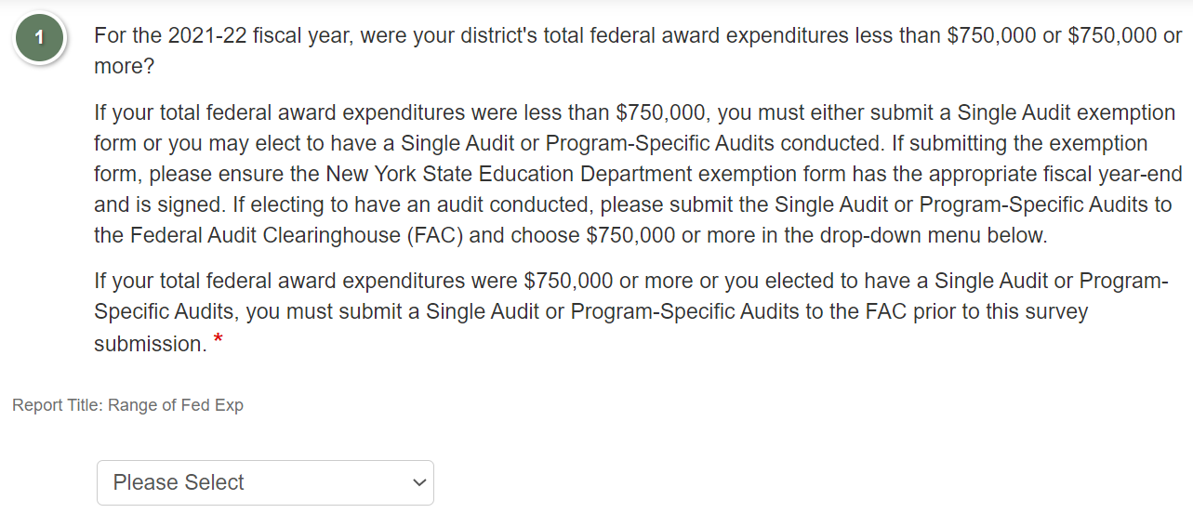
Financial Survey 4 Questions

Slide 33
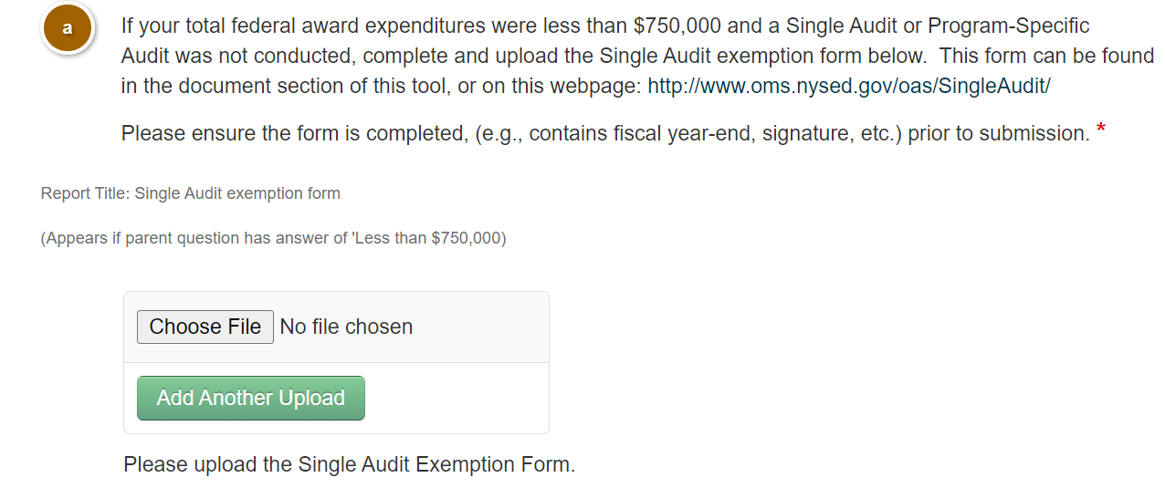
Financial Survey 4 Questions

Slide 34
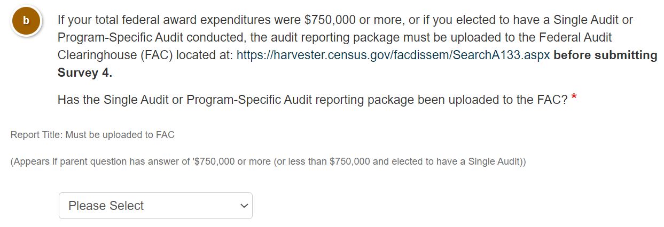
Financial Survey 4 Questions

Slide 35
Financial Survey 4 Helpful Tips
Selection of appropriate threshold.
If total federal award expenditures are under $750,000 and a Single Audit or Program-Specific Audit was not conducted:
  Upload the sign and dated Exemption Form,
  Submit NYSED’s Exemption Form rather than another entity’s, and
  Submit the correct fiscal year-end.
If subject to the Single Audit or Program-Specific Audit, submission must be made to the Federal Audit Clearinghouse prior to submitting this survey.
Please ensure that you receive an email from the FAC prior to submitting your survey as $750,000 or more.

Slide 36
Financial Survey 5:
Single Audit CAP(s) for Financial Statement Findings (Section II) and/or Major Federal Program Findings (Section III)
Federal Regulations
  Office of Management and Budget’s Uniform Grants Guidance 2 CFR §200.511(c) states the auditee must prepare, in a document separate from the auditor’s findings described in 2 CFR §200.516 audit findings, a CAP to address each audit finding included in the current year auditor’s reports.
  The CAP(s) must provide the name(s) of the contact person(s) responsible for corrective action, the corrective action planned, and the anticipated completion date.
Due Date
  July 31

Slide 37
Financial Survey 5 Requirements
  Question 1 must be answered correctly based on our review of the Single Audit or Program-Specific Audit in the Federal Audit Clearinghouse (FAC). We check whether the audit had findings.
  Board approved CAP(s) are submitted in response to any Section II and/or Section III findings.
  Board approved CAP(s) are final - not in draft format.
  CAP(s) in response to Section II and/or Section III findings must include:
    Name(s) of contact person(s) responsible for corrective action,
    Corrective action planned, and
    Anticipated completion date.
  If auditee does not agree with the audit findings or believes corrective action is not required, the CAP(s) must include an explanation and specific reasons.

Slide 38
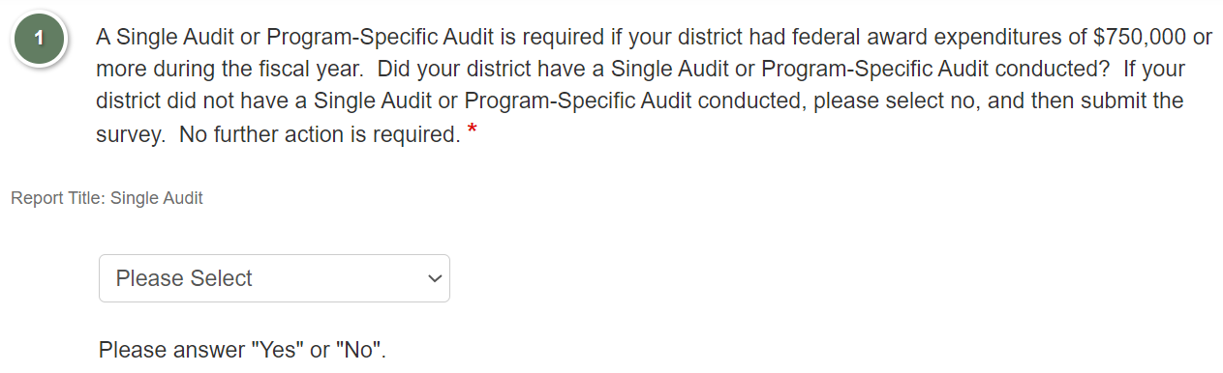
Financial Survey 5 Questions

Slide 39
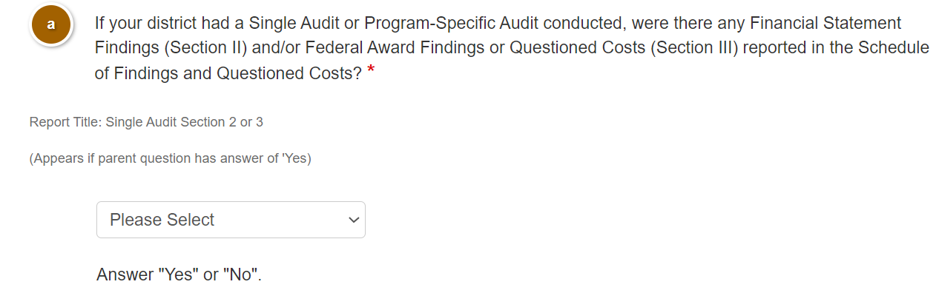
Financial Survey 5 Questions

Slide 40
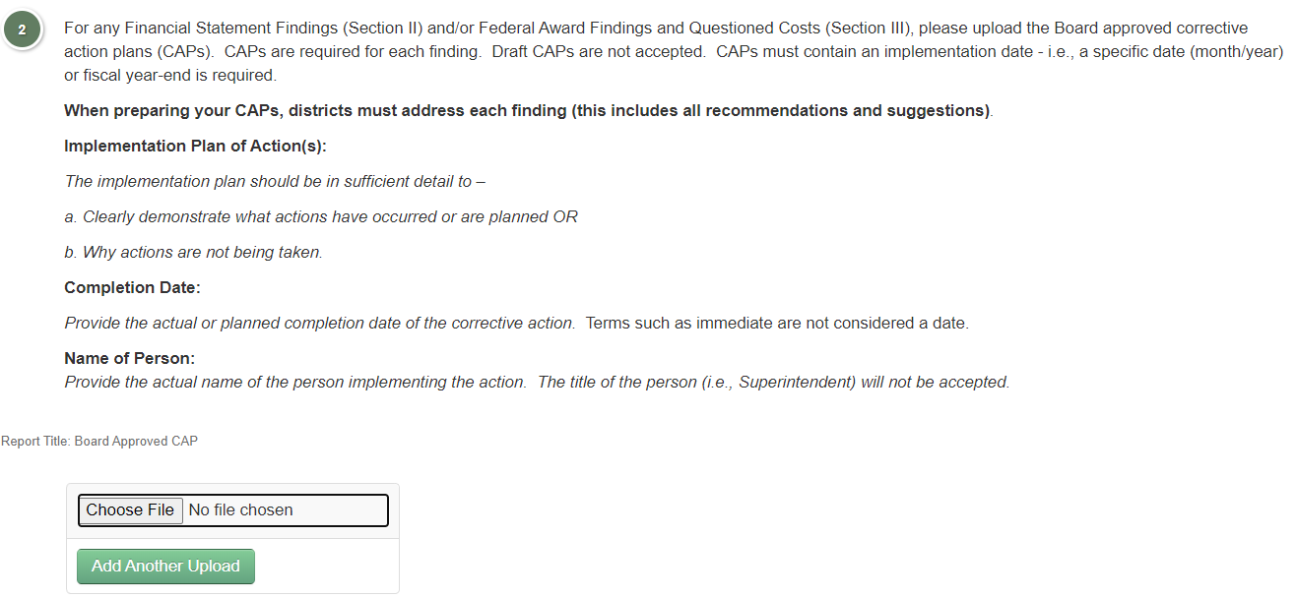
Financial Survey 5 Questions

Slide 41
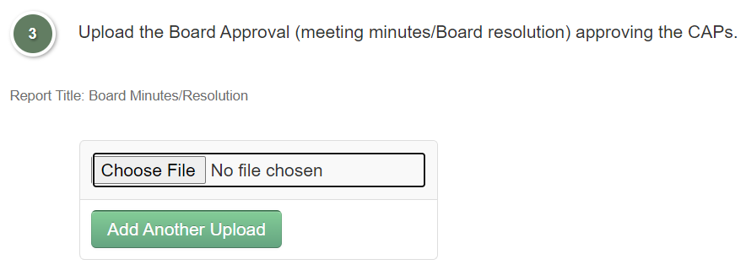
Financial Survey 5 Questions

Slide 42
Financial Survey 5 Helpful Tips
Submission of CAP(s) for each Financial Statement Finding (Section II) and/or Federal Award and Questioned Costs Findings (Section III).
Submission of name of contact person responsible for corrective action.
Submission of anticipated completion date for each finding.
Submission of updated Board minutes for any revised CAP(s).
CAP(s) must adequately address each finding.

Slide 43
Financial Survey 6: Internal Audit Report and Related CAP(s)
Regulation/Education Law
  Education Law §2116-b(1) and 1950(4)(k) – requires each school district and BOCES to establish an internal audit function.
  Education Law §2116-b(1) – the following school districts are exempt from this requirement:
    School districts with less than eight teachers,
    School districts with actual general fund expenditures less than $5,000,000 in previous school year, or
    School districts with actual enrollment of less than 1,500 students in previous school year.
  Commissioner’s Regulation §170.12(e)(4)(i)(b) – Superintendents must prepare a CAP with an implementation date for any findings issued by the entity’s internal auditor; must be Board approved and submitted within 90 days.
Due Date
  April 30

Slide 44
Financial Survey 6 Requirements
Exemption status must be certified, e.g., Exemption Certification submitted in Survey 6B.
Board approved CAP(s) that address all findings/recommendations mentioned in the Internal Control Report.
Internal Control Report and CAP(s) must be final – not in draft format.
CAP(s) in response to Internal Control Report must contain:
  Detailed action taken or planned to correct deficiencies in audit findings, or statement which describes reason(s) that corrective action is unnecessary and
  Expected date(s) of implementation.
Meeting Minutes/Board Resolution showing the Board approval of CAP(s).
BOCES that have not established an Internal Audit Function must enter the date the Internal Audit Function is expected to be fully implemented.

Slide 45
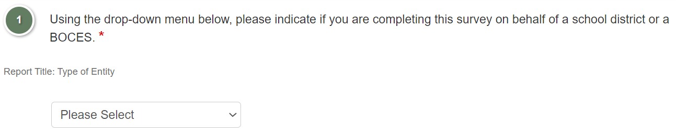
Financial Survey 6 Questions

Slide 46
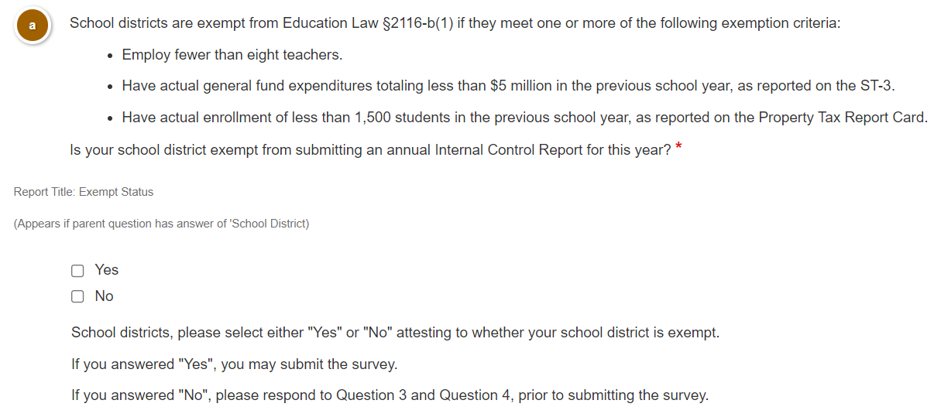
Financial Survey 6 Questions

Slide 47
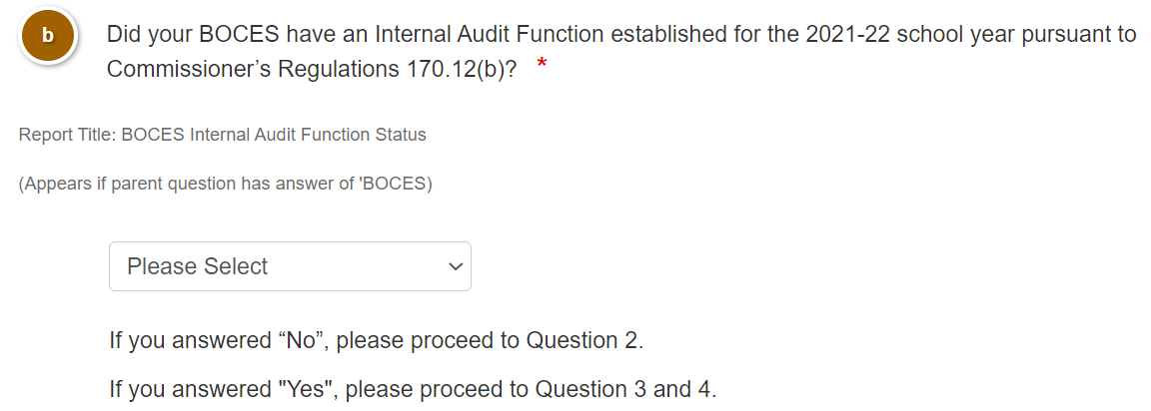
Financial Survey 6 Questions

Slide 48
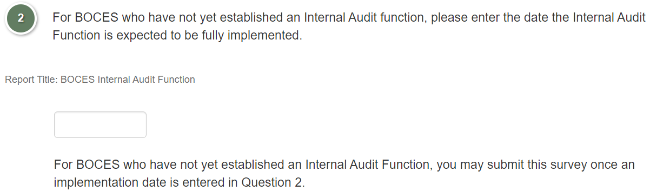
Financial Survey 6 Questions

Slide 49
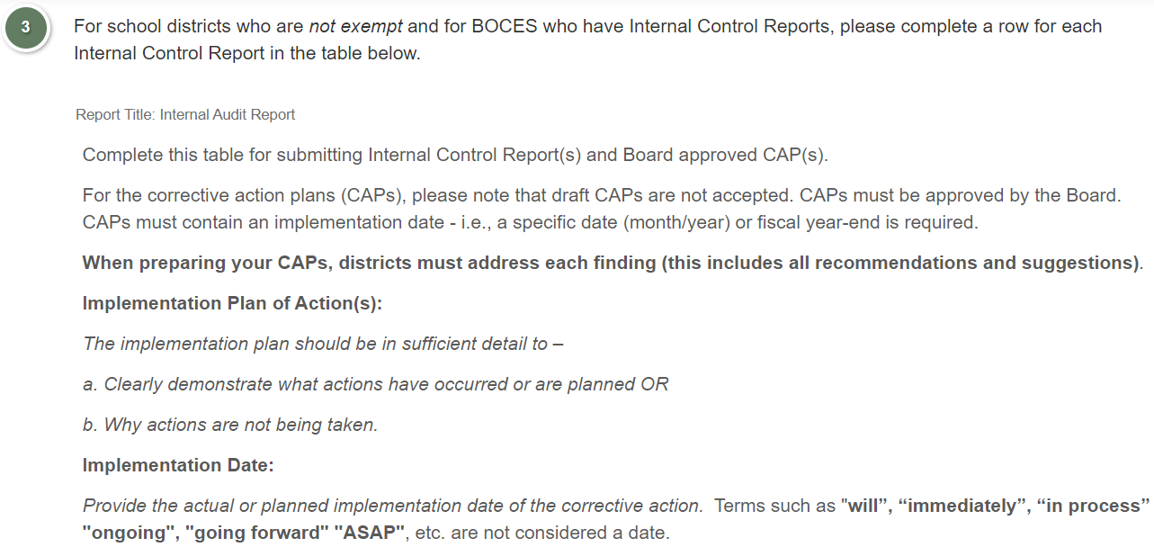
Financial Survey 6 Questions
Notes:
i

Slide 50
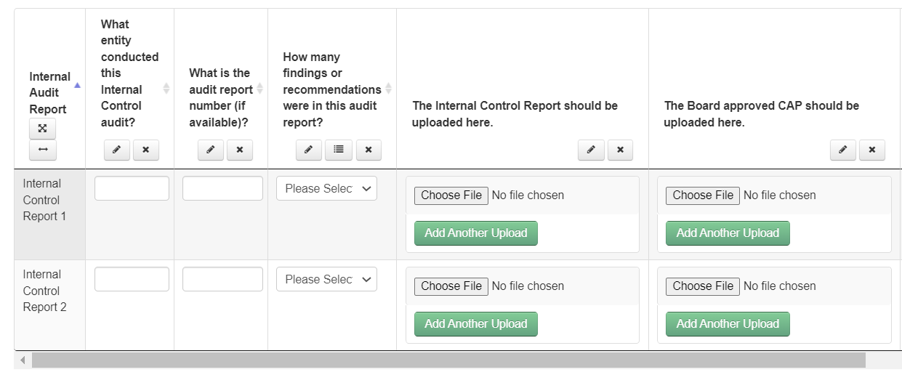
Financial Survey 6 Questions

Slide 51
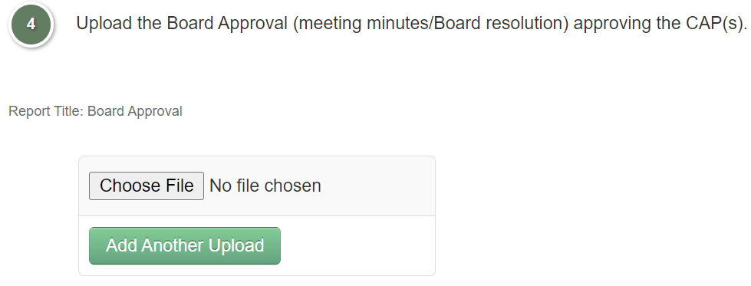
Financial Survey 6 Questions

Slide 52
Financial Survey 6 Helpful Tips
Internal Control Report is not in draft copy.
Internal Control Report is for correct fiscal year-end.
Submission of CAP(s) for each finding.
Submission of anticipated implementation date for each finding.
CAP(s) adequately addresses each finding.
Submission of updated Board minutes for any revised CAP(s).
BOCES that have not established an Internal Audit Function must enter the date the Internal Audit Function is expected to be fully implemented.

Slide 53
Financial Survey 6B: Internal Control Exemption Certification
Regulation/Education Law
  Education Law §2116-b(2) states the following school districts are exempt from submitting an Internal Control Report:
    School districts employing fewer than eight teachers in previous school year, or
    School districts with actual general fund expenditures totaling less than $5 million in previous school year, or
    School districts with actual enrollment of less than 1,500 students in previous school year.

Slide 54
Financial Survey 6B
Due Date
  June 30.
Requirements
  School districts must select the appropriate checkbox(es).
Helpful Tips
  Ensure the appropriate checkbox(es) are marked prior to submitting the survey.
  To obtain the previous year’s general fund expenditures, refer to the ST-3.
  To obtain the actual enrollment of students in the previous school year, refer to the Property Tax Report Card.

Slide 55
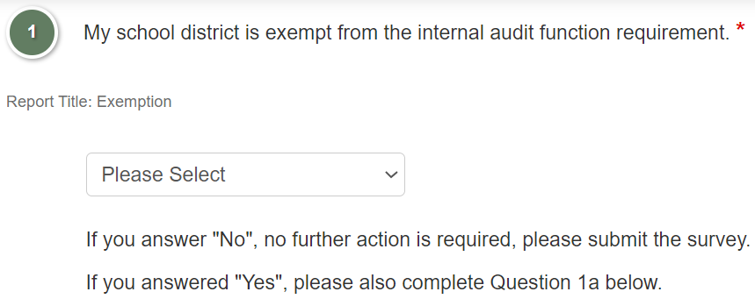
Financial Survey 6B Question

Slide 56
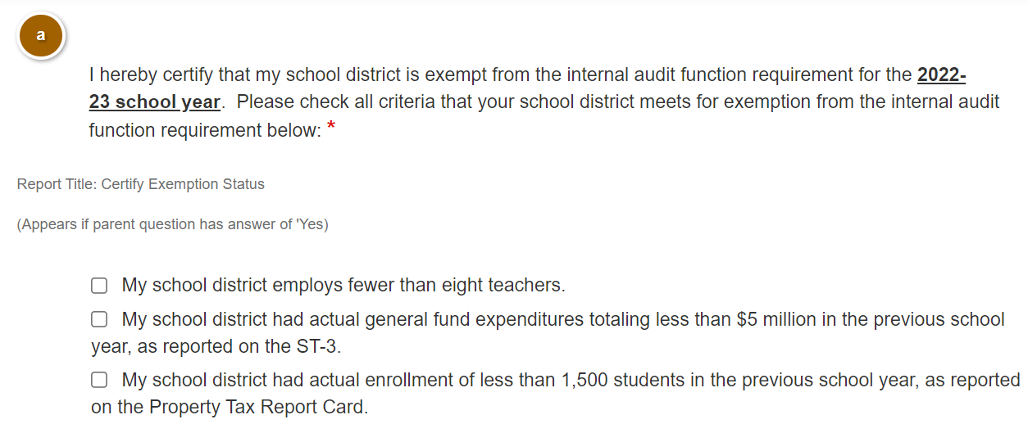
Financial Survey 6B Question

Slide 57
Financial Survey 7:
Regulatory Audit and Related CAP(s)
Regulation/Education Law
  Education Law §2116-a(3)(c) and Commissioner’s Regulation §170.12(e)(4) – CAP(s) must be submitted to SED within ninety days of receipt of Regulatory Audits - OSC, NYSED, etc.
  CAP(s) must be Board approved.
Due Date
  Regulatory Audits and CAP(s) are due within 90 days of receipt of Regulatory Audit Reports, unless otherwise identified in the Audit Report.

Slide 58
Financial Survey 7 Requirements
Board approved CAP(s) in response to any Regulatory Audit findings.
Regulatory Audit Report and CAP(s) must be final – not in draft format.
CAP(s) in response to Regulatory Audits contain:
  Detailed action taken or planned to correct deficiencies in audit findings, or a statement which describes reason(s) corrective action is unnecessary, and the
  Expected date(s) of implementation.
Meeting Minutes/Board Resolution showing the Board approval of CAP(s).

Slide 59
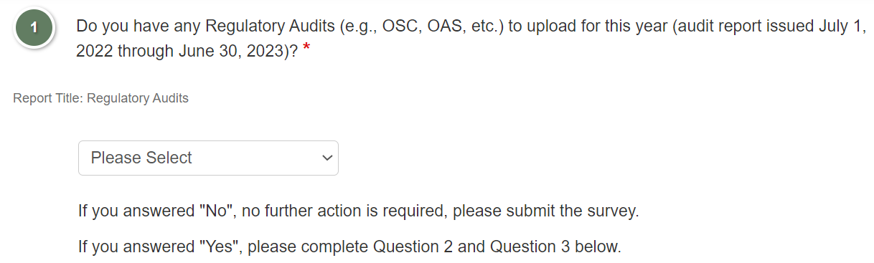
Financial Survey 7 Questions

Slide 60
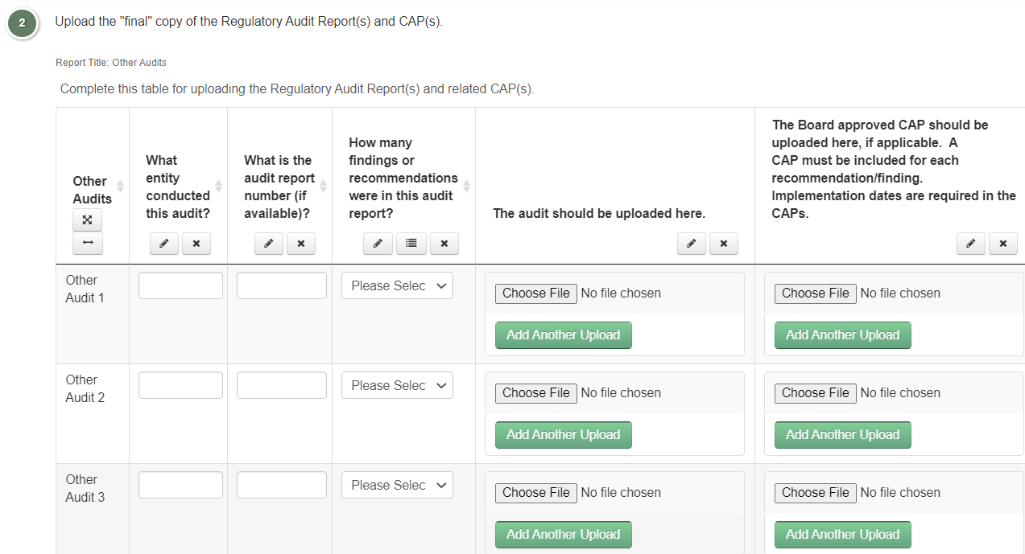
Financial Survey 7 Questions

Slide 61
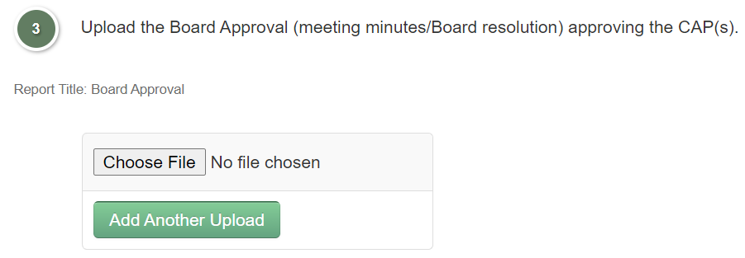
Financial Survey 7 Questions

Slide 62
Financial Survey 7 Helpful Tips
Submission of all Regulatory Audits (i.e., OSC, NYSED).
Regulatory Audit is in final copy – not draft.
The issuance date of the Regulatory Audit is for the correct fiscal year-end.
Submission of CAP(s) for each Regulatory Audit finding.
Submission of anticipated implementation date for each Regulatory Audit finding.
CAP(s) adequately address each finding.
Submission of updated Board minutes for any revised CAP(s).

Slide 63
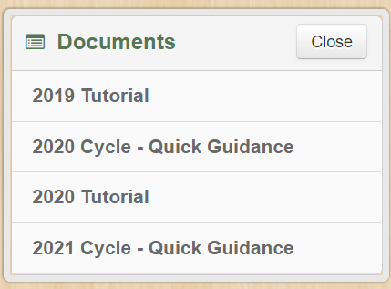
Documents

Slide 64
Useful Links
Complete Guide to Submissions
  Portal Tutorial
Technical NYSED Application Business Portal Assistance
  SEDDAS Complete User Guide
Audit Reference Manual
  Audit Reference Manual

Slide 65
Contact Information
Office of Audit Services
  NYSED OAS Website
  Email: FSandSingleAudit@nysed.gov

Slide 66
Thank You

