Slide 1
Nonpublic School Aid
Mandated Services Aid (MSA) & Comprehensive Attendance Policy (CAP)
Guidance for Preparing the 2020-21 Claim
& Utilizing the MSA Online System
New York State Education Department
Office of Grants Management

Slide 2
Presentation Overview
General Information
What’s New
Comprehensive Attendance Policy (CAP) Overview
Completing MSA Forms
General Information About Mandated Services Aid
General Information About Mandated Services Aid Online System
Demonstration of the MSA Online System
Recordkeeping
*Documentation must be maintained for all MSA related expenditures.*

Slide 3
General Information

Slide 4
Mandated Services Aid
Mandated Services Aid (MSA) is a New York State funded reimbursement program for nonpublic schools. The schools receive reimbursement for the state mandates that they have met in the prior school year (July 1 to June 30). In order to receive reimbursement, the school must have met the requirements of the mandate and have documentation to support it. The reimbursement request, or claim, must be processed via our online system. A full listing of the mandates and a brief explanation of each one follows this introduction.
Many of the mandates are met by reporting information in a timely fashion to the Department itself. For example, the Basic Educational Data Systems (BEDS) report, which is due every October, has a twofold purpose for nonpublic schools: it fulfills the requirement of mandate number three and enables a school’s claim to be entered into the processing system for Mandated Services. Other mandates, such as Pupil Attendance Reporting (PAR) rely on the school providing the state information relative to the time and effort attributed to complying with the regulation.

Slide 5
Mandated Services Aid (continued)
Reimbursement of mandated services to nonpublic schools may be made for the actual costs related to complying with certain State mandates, if eligibility requirements are met. To be eligible for reimbursement, the school must:
Provide instruction in all required subjects according to §3204 of the Education Law.
Require pupils to attend full-time instruction according to §3205 of the Education Law.
No students for which the school receives direct tuition payments from the state or local government may be included in the MSA calculations (e.g., tuition payments for a disabled student).
Be a not-for-profit institution.

Slide 6
Mandated Services Aid (continued)
Expenses incurred in fulfilling mandates are reimbursable. These include, but are not limited to the following activities:
BEDS forms
Pupil attendance records
Elementary school tests
Regents Exams
Regents Competency Tests
Regents Scholarship applications
Registration of high schools
Graduation reports
Documentation of incorporation of home and career skills, technology education and library and information skills into other courses
Comprehensive School Improvement Plan (for schools identified by the Commissioner as having to develop a Plan)

Slide 7
Contact Information
Grants Management
518: 474-3936
emscmsa@mail.nysed.gov
The MSA Web-based System is accessible via the Department’s web portal (http://portal.nysed.gov)
NYSED Business Portal Username & Password Help: 518-473-8832
Mandated Services Aid (MSA): http://www.p12.nysed.gov/nonpub/mandatedservices/
Comprehensive Attendance Policy (CAP):http://www.p12.nysed.gov/nonpub/mandatedservices/cap/
Information and Reporting Services: www.emsc.nysed.gov/irts/
518-474-7965
Office of State Assessment: http://www.p12.nysed.gov/assessment/contact-osa.html
518-486-5765

Slide 8
Electronic Payments
“Electronic Payments” are the Office of the State Comptroller’s program to maximize efficiency in making State payments to local governments, school districts, vendors, contractors, not-for-profits, payroll deduction agents and other eligible payees.
Payments will be sent to the payees from the Office of the State Comptroller (OSC) utilizing the payee chosen method of payment. The Office of the State Comptrollers Guide to Financial Operations listed Automated Clearing House (ACH) as the preferred payment method and is now requiring vendors currently enrolled in ACH to be paid utilizing the ACH payment method only.
Vendors not enrolled in the ACH system are highly encouraged to enroll.
For more information about this fast and convenient way to receive your nonpublic school aid, go to http://www.osc.state.ny.us/epay/index.htm

Slide 9
Check SEDREF
The Department’s authoritative source for institutional information
To see your institution’s information, go to http://portal.nysed.gov
Click on SEDREF Query which appears under “Public Links” column

Slide 10
School Year 2020-21
MSA Claims
The 20-21 claims must be received by April 1, 2022. Amendments will be accepted through 12/31/2022.
An e-mail message will be sent to school administrators when the MSA online system is ready to enter claims.

Slide 11
Mandated Services Aid Guidance
The Mandated Services Aid Guidance document highlighting the MSA system is available on the Non-public Schools Mandated Services Aid page @ http://www.p12.nysed.gov/nonpub/mandatedservices/forms

Slide 12
Payee Information
If any Payee Information is missing or inaccurate, you will need to complete and submit a Payee Information form. http://www.oms.nysed.gov/cafe/forms/documents/PIformBronze.pdf
Vendor changes other than Payee Information http://www.p12.nysed.gov/nonpub/mandatedservices/osc.html

Slide 13
Payee Information Screen
The payee information screen includes the Chief Executive Officer’s or Chief Financial Officer’s e-mail address. It is very important that this address be up-to-date because all communications regarding the Mandated Services Aid claim will be sent to that e-mail address. User will get error message if no email address is on file.

Slide 14
What’s New

Slide 15
Changes to the Mandated Services Aid Forms/Online System
School Year 2020-21
Please refer to the Special COVID-19 document for guidance pertaining to calculating the Average Hourly Rates [(Annual Gross Salary + Fringe Benefits)/ Total Annual Hours Worked] Claiming Parameters, and Hold-Harmless for Regents Exam Cancellations.
Schools with claims on hold can now upload documents to the MSA system. The claims in hold status will be reviewed and the reviewer will send request to schools to provide documentation. The schools will be able to access their claims in the MSA system and upload requested document/s.

Slide 16
Changes to the Mandated Services Aid Forms/Online System (continued)
School Year 2020-21
During the 2020-21 school year, field tests were not administered for the following MSA related exams:
  Grades 3 through 8 Math and English Language Arts (Mandate 2)
  Regents Examinations (Mandate 4)
  Grade 4 Science (Mandate 11)
  Travel to Storage Sites (TSS) (Mandate 12)
  Grade 8 Science (Mandate 14)

Slide 17
Changes to the Mandated Services Aid Forms/Online System (continued)
School Year 2020-21
The following exams were given in 2020-21:
  3-8 ELA
  3-8 Math
  4 & 8 Science
  K-12 NYSESLAT/NYSITELL
The following Regents exams were granted exemption status in 2020-21:
  August 2020 Regents (Mandate 4)
  January 2021 Regents (Mandate 4)
  June 2021 Regents (Mandate 4)

Slide 18
Changes to the Mandated Services Aid Forms/Online System (continued)
School Year 2020-21
NYSED administered only the following optional Regents Examinations in 2020-21:
  Algebra I
  Earth Science (written test only)
  English Language Arts (ELA)
  Living Environment
Mandate 8 – The SSIP, State School Immunization Program, rate has been set at $3.90. The new appropriation limits participation in this program to New York City, Rochester, Buffalo schools that have immunization records on file with the New York State Department of Health.

Slide 19
Comprehensive Attendance Policy (CAP) Overview

Slide 20
Comprehensive Attendance Policy (CAP)
CAP was promulgated by the Board of Regents for all schools in June 2002. The attendance policy must encompass the nine points outlined in Commissioner’s Regulations 104.(i), All non-public schools must have such a policy on file and may be asked to produce the policy during a site visit or claim review.
The purpose of the policy shall be to ensure the maintenance of an adequate record verifying the attendance of all children at instruction in accordance with Education Law sections 3205 and 3210 and establish a mechanism by which the patterns of pupil absence can be examined to develop effective intervention strategies to improve school attendance.

Slide 21
CAP (continued)
Nine elements to be included in the CAP
1. A statement of the objectives to be accomplished;
2. A description of the specific strategies to accomplish each objective;
3. A determination of which pupil absences, tardiness and early departures will be excused, and which will not be excused and an illustrative list of excused and unexcused pupil absences and tardiness;
4. A description of the coding system used to identify the reason for a pupil’s absence, tardiness or early departure recorded in the register of attendance;
5. A description of the school’s policy regarding pupil attendance and a pupil’s ability to receive course credit;
6. A description of the incentives to be employed to encourage pupil attendance and any disciplinary sanctions to be used to discourage unexcused pupil absences, tardiness and early departures;

Slide 22
CAP (continued)
7. A description of the notice to be provided to the parents of a pupil who is absent, tardy or leaves school early without an acceptable excuse;
8. A description of the process to develop specific intervention strategies to be employed by teachers and other school employees to address identified patterns of unexcused pupil absence, tardiness or early departure;
9. Identification of the person(s) designated in each school building who will be responsible for reviewing pupil attendance records and initiating appropriate action to address unexcused pupil absence, tardiness and early departure consistent with the comprehensive attendance policy.

Slide 23
CAP (continued)
The reimbursement amount is generated using the average hourly rates reported for staff in Mandate 1 Pupil Attendance Reporting (PAR) and the enrollment reported for a given school year.
The formula used to calculate CAP reimbursement is as follows:
  Teachers K-6 expenses = ([Teachers hourly salaries] x [K-6 enrollment]) x (0.17)
  Administrative K-6 expenses = ([Administrative hourly salaries] x [K-6 enrollment]) x (.125)
  Support staff K-6 expenses = ([Support staff hourly salaries] x [K-6 enrollment]) x (.125)
  Teachers 7-12 expenses = ([Teachers hourly salaries] x [7-12 enrollment]) x (4.13)
  Administrative 7-12 expenses = ([Administrative hourly salaries] x [7-12 enrollment]) x (.35)
  Support staff 7-12 expenses = ([Support staff hourly salaries] x [7-12 enrollment]) x (.50)

Slide 24
Completing MSA Forms

Slide 25
Completing the Forms
Getting Started
Please read the accompanying Guidelines for the 2020-21 school year before completing the Mandated Services Aid forms.
In addition to other information, the Guidelines describe requirements for each mandate and recordkeeping, and provide important information about calculating hourly rates and expenditures.

Slide 26
Completing the Forms
(continued)
Assemble testing records, the Graduation and Dropout Report, BEDS Report, attendance records, invoices for test kits, teacher workshop fees, calculators, scoring center costs, etc. and any other documentation that supports the mandated services aid claim for each mandate.
Gather employee records showing gross salary, hours worked and allowable fringe benefits.
You need to know how many employees provided the service—line 1.
Enter the total hours the employees worked—line 2.
Enter the total salaries for the employees—line 3.
Enter the total employee benefits—line 4.
The system calculates the total salaries and benefits-line 5.
The system calculates the Average Hourly Rate-line 6.

Slide 27
MSA GENERAL INFORMATION

Slide 28
Mandated Services Aid Online System - Statuses
Auto Approved
Hold – Program Reviewer may request further clarification or documentation before approval is granted
Withdrawn-Claims inactive in the MSA for 6 months will be withdrawn with the option to do an amendment.
Post Review Pending/Post Review- Program Reviewer may request further clarification or documentation before approval is granted.
Approve-Payment will be received in 7-10 business days
Overpayment- ALL subsequent Mandated Services Aid or Comprehensive Attendance Policy (CAP) payments will be held until the overpayment has been remitted
Paid/Closed

Slide 29
Examples of Approved Claim Explanations
Be clear, concise and specific
Enrollment increased by 17 students. Last year 12 teachers took attendance; this year we had 11 teachers taking attendance. This changed the time and effort standard from 20 to 30 which increased the Pupil Attendance Reporting (PAR) expenditure.
The increase in PAR is due to the fact that there was a new administrator hired two years ago who had a graduated salary increase. This meant that the average hourly wage for the administrator increased significantly. In addition, there was a small increase of $1.22 over last year’s teachers’ average hourly wage. Despite the fact that it is a minimal increase, it significantly increases the reimbursement due to the fact that there are 5,000 teacher parameter hours for PAR.
A nearby school closed so we picked up 25 students and had to add a new grade 4 class. Added two teachers; one for the 4th grade class and ½ day kindergarten.
We began offering more Regent exams which meant we had to add more proctors which increased the average hourly rate $8.00. It also increased the total combined hours for the exams.
Our administrator retired. We had to increase the salary 25% in order to find a replacement.

Slide 30
Common MSA Mistakes
Not multiplying the number of days in the work year X the number of hours in the workday to arrive at the total hours of work for all assigned tasks (line 2 in the calculation of the hourly rate) if you have full time staff.
Using salaries for staff that did not perform the services for the mandate.
Including stipends in the staff salaries.
Including substitute teachers.
Including pre-school students in the BEDS enrollment.
Using different # of teachers for PAR and BEDS.
Not entering an explanation for the increase in PAR, BEDS and/or Total Aid.
Including students from another school in the count of tests administered. If you reported 8 graders in your Oct. BEDS Report, you are sent a Secondary School Examination Report in June.
Not including Regents Exams for August, January and June in the Secondary Examination Report.
Using W-2’s for staff gross salaries; school year not calendar year.
Not paying attention to exam data discrepancies.
Not having documentation to support the claim.

Slide 31
MSA ONLINE SYSTEM GENERAL INFORMATION

Slide 32
Mandated Services Aid Online System – General Information
The Mandated Services Aid Online System links to information that has been submitted to the Office of Information Reporting Services. BEDS data, elementary and secondary examination data, and Regents examination data will be displayed for the applicable mandates. Applicable data entry field is also populated with the same value.
The MSA user has the option of entering the same populated data or something different for applicable mandates. If the tolerance level that we established is exceeded, a warning message will appear at the top of the screen. The claim will be set to a “hold” or “post review” status.
When you complete entering data for a mandate, the Section I – Summary expenditure data will automatically be populated.
Warning signs appear next to the problem field for the mandate and on the Section I – Summary expenditure screen.
If you see a warning message & sign, prior to submitting the claim, please double-check that you have entered the correct data and that you have the supporting documentation.
Many schools had to refund the State money because of entry errors and lack of documentation.
The buttons for mandates 7, High School Registration, and 8, SSIP, will be disabled for some schools. You will not be able to enter claim data for that mandate .
If a school has been previously reimbursed for mandate 7, it cannot receive reimbursement again. For SSIP, a school must be located in New York City, Rochester or Buffalo.

Slide 33
Mandated Services Aid Online System – General Information (continued)
The school administrator will receive an e-mail message when the claim is “auto approved”, set to “hold” “paid” “post review” and “overpayment”.
Claims can be amended after the payment is made “closed”.
Do not use commas when entering salaries and benefits
Not a valid number Mandate 1. (do not use any special characters)
You must select “standard workday” or “actual hours are varied”.
If “standard workday” is selected, you must enter the # of hours in the workday.
You must click on the <Save Form>button after completing entry for each mandate.
Explanations are required when PAR exceeds last year’s PAR by 25%, when BEDS enrollment exceeds what was submitted on the BEDS Report by 20% and the Total Aid Expenditure exceeds the previous year by 25%.
You must enter the number of graduation candidates for High School Graduation Report, Mandate 10.
Schools with claims on hold can now upload documents to the MSA system.

Slide 34
DEMONSTRATION of MSA ONLINE SYSTEM

Slide 35
Entering the MSA Claim
After you click on the <All the information is correct> button, the following information will appear:
School year <2017-18> <2018-19> and <2020-21 buttons>
Institution ID
Beds Code
Claim Number – includes year and inst. ID
Amendment Number
Claim Status
Received date
Entry Type
<Edit>, <Print>, and <Withdraw Claim> buttons

Slide 36
Entering the MSA Claim
BEDS Enrollment
Click on the “Enrollment” button.
The BEDS Enrollment Screen will be displayed.
Enrollment data is displayed and populated in the data entry field. Drop down defaults to BEDS on File; change to Opening or Closing if you are entering different values.
Click on the <Save Form>button at the top of the screen.
Note: If the BEDS enrollment figure you entered exceeds what was submitted on the BEDS Report by 20%, an explanation will be required.
A box will appear on the screen for entry of the explanation. The claim cannot be submitted until something is entered in the explanation box.

Slide 37
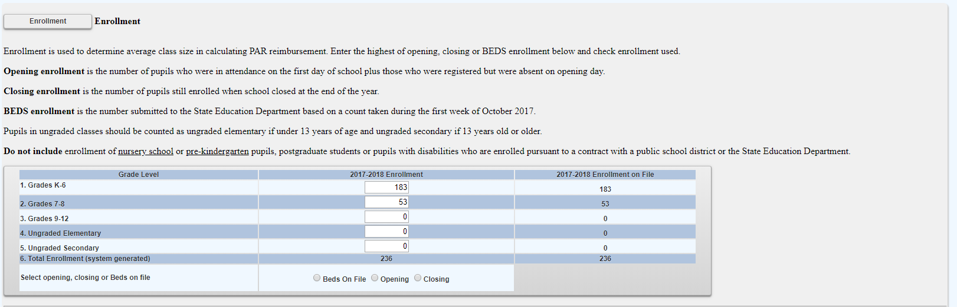
BEDS Enrollment Screen

Slide 38
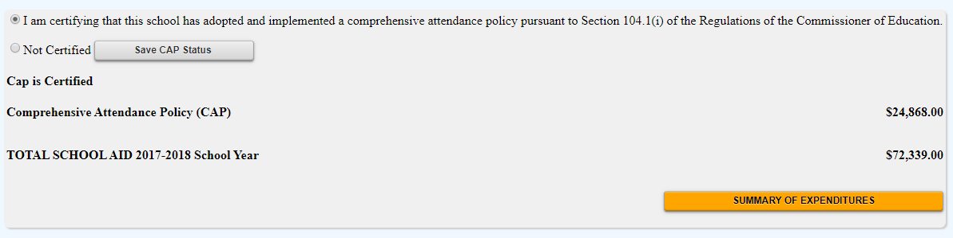
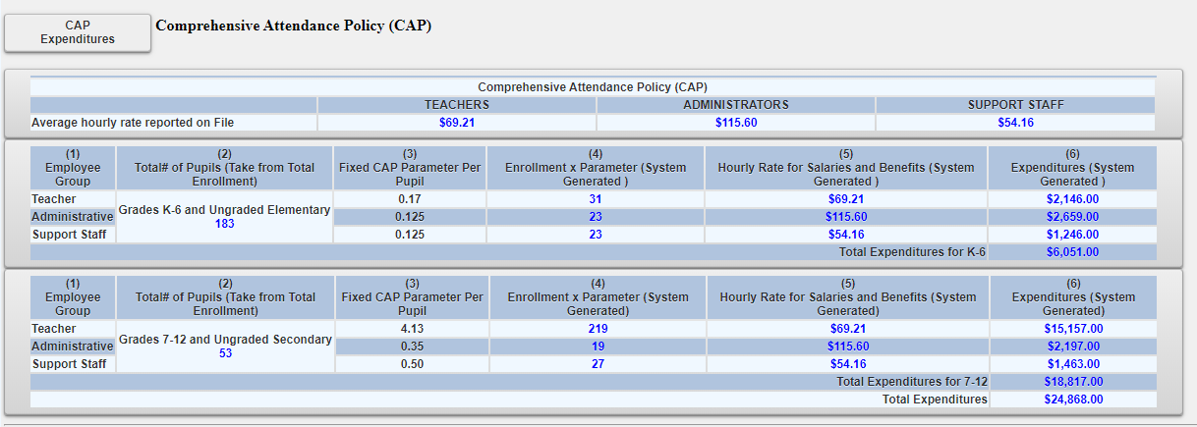
Comprehensive Attendance Policy (CAP) Certification

Slide 39
Entering the MSA Claim
Pupil Attendance Reporting (PAR)
Click on the button for “standard workday” or “actual hours of employees are varied”.
If “standard workday ” is selected, enter the # of days in the school year and # of hours in the workday for teachers, administrators and support staff.
The # of days in the school year and at least one entry for # of hours in the workday are required fields.

Slide 40
Mandate 1: Pupil Attendance Reporting (PAR)
Calculation of Hourly Rate & Calculation of Expenditures
Enter data for line #1. Use the “tab” key to move to the next data entry field.
Continue entering data for lines 2-4. When you get to the end of line 4, tab again. If you enter a comma in the number, you will receive an error message after you click on the <Save Form> button.
Enter the total # of teachers taking daily attendance.
Click on the <Save Form> button.
The system calculates the information for lines 5-6 for the calculation of hourly rates and columns 3, 4, 5 & 6 for the calculation of expenditures.
Note: If the PAR total exceeds last year’s PAR by a 25%, an explanation will be required. A warning message will appear at the top of the screen.
A box will appear on the screen for entry of the explanation. The claim cannot be submitted until something is entered in the explanation box.

Slide 41
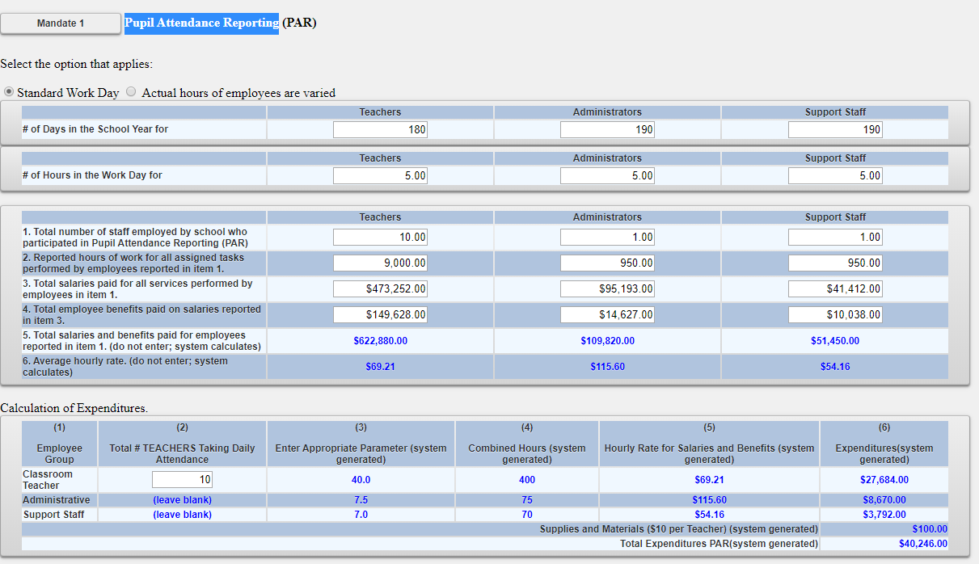
Mandate 1: PAR Screen

Slide 42
Mandate 2: Elementary and Intermediate Assessment in English Language Arts and Math (EIA)
Calculations of Hourly Rate,
Combined Hours, &
Expenditures
Calculation of Hourly Rate
Enter data for line #1. Use the “tab” key to move to the next data entry field.
Continue entering data for lines 2-4. When you get to the end of line 4, tab again.
If you enter a comma in the number or if you enter a character instead of a number in any of the fields, you will receive an error message saying “not a valid number” after you click on the <Save Form> button. A caution sign will appear next to the field that caused the problem.

Slide 43
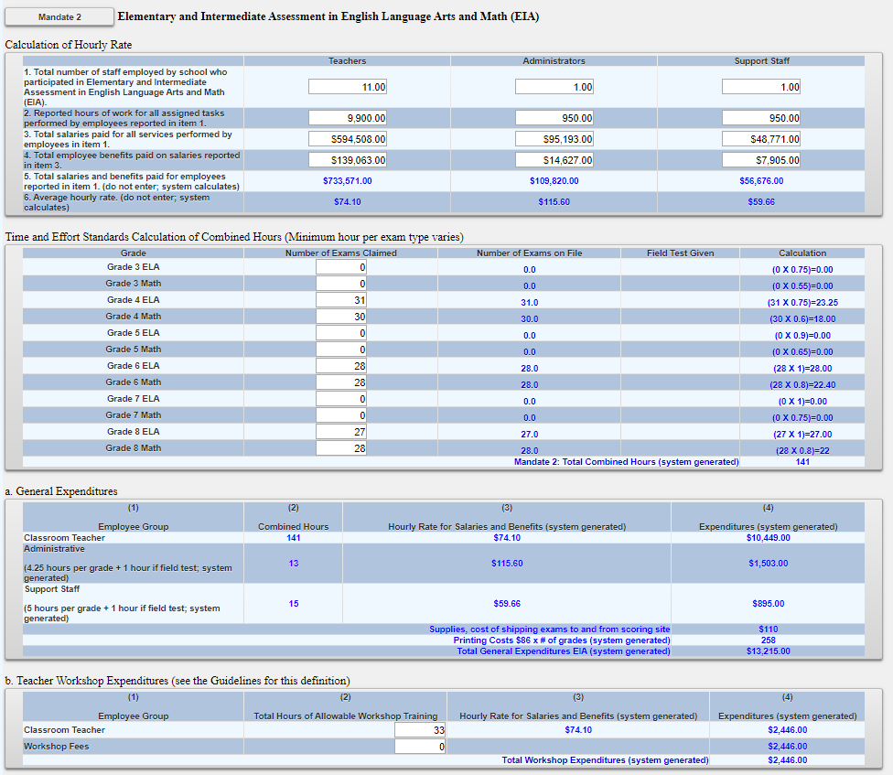
Mandate 2: EIA Screen

Slide 44
Mandate 3: Basic Educational Data System Reporting (BEDS) Enrollment
Click on the <Mandate 3> button.
Enter data for line #1. Use the “tab” key to move to the next data entry field.
Continue entering data for lines 2-4.
Enter the total # of teachers taking daily attendance in the calculation of expenditure area.
Click on the <Save Form>button.
The system generates the information for lines 5 and 6 and completes the fields for Calculation of Expenditures.

Slide 45
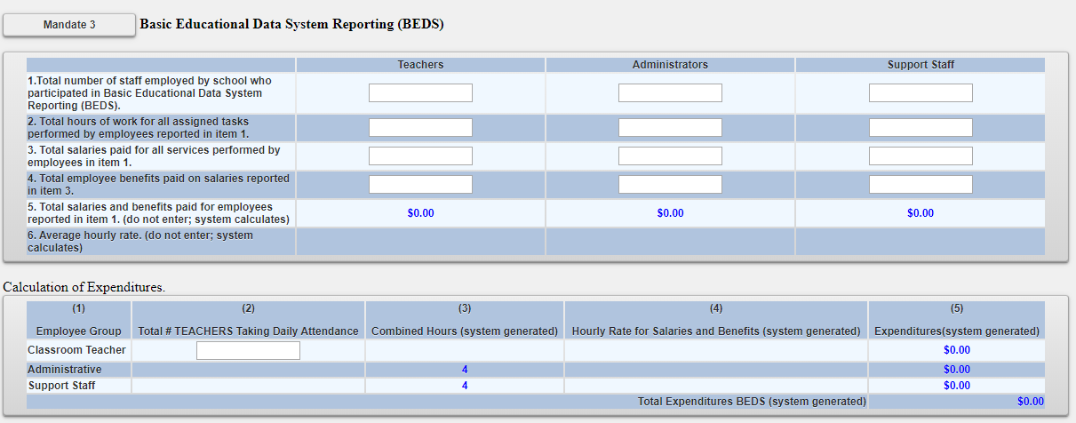
Mandate 3: BEDS Enrollment Screen

Slide 46
Mandate 4: Regents Examinations
Calculation of Hourly Rate
Click on the <Mandate 4> button.
Enter data for line #1. Use the “tab” key to move to the next data entry field.
Continue entering data for lines 2-4.
The system generates the information for lines 5 and 6 and completes the fields for Calculation of Expenditures.

Slide 47
Mandate 4: Regents Examinations (continued)
Calculation of Combined Hours
The system shows the number of Regents exams that were reported to the Office of Information Reporting Services.
Enter the number of exams that were administered. Use the “tab” key to move to the next field.
You must make an entry for each exam you want to receive reimbursement for.
When you have completed entering the exam data, click the <Save Form> button. The system generates the Total General Expenditures.

Slide 48
Mandate 4: Regents Exams (continued)
Teacher Workshop Expenditures
Enter the total hours of allowable workshop training.
Enter the dollar amount of the workshop fee.
Test Kits
Enter the number of students taking Regents Earth Science.

Slide 49
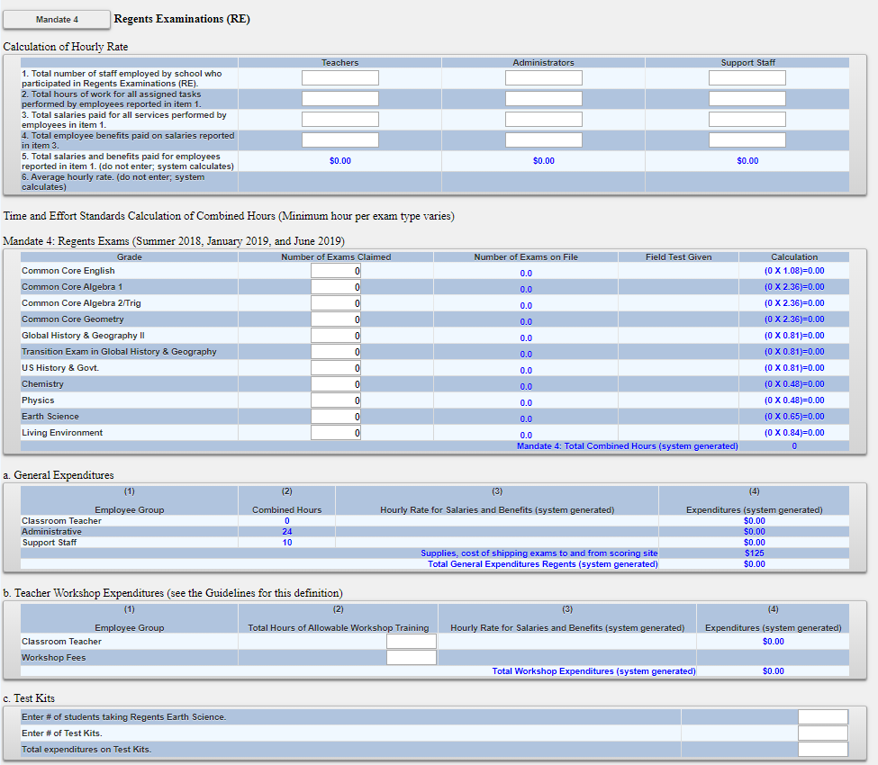
Mandate 4:Regents Exam Screen

Slide 50
Mandate 6: Calculator Expenses
Enter the number of scientific calculators that were purchased.
Use the “tab” key to move to the next data entry field.
Enter the number of graphing calculators that were purchased.
Click on the <Save Form> button.
The system calculates the Total Expenditures and populates the Section I – Summary page.

Slide 51
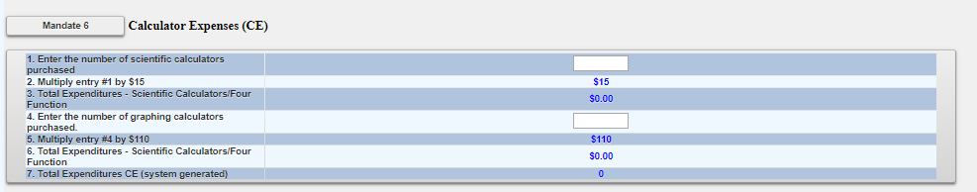
Mandate 6: Calculator Screen

Slide 52
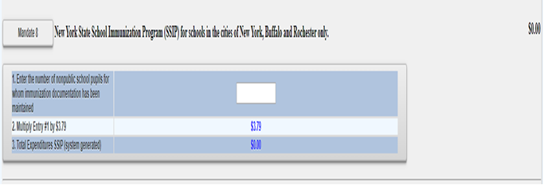
Mandate 8: New York State School Immunization Program (SSIP)
Only non-public schools in New York City, Buffalo or Rochester that filed their immunization data with NYSDOH are eligible for Mandate 8. The Mandate 8 button will be disabled for the other non-public schools.
Enter the number of non-public school pupils for whom immunization documentation has been maintained.
The system generates the Total Expenditures for SSIP.

Slide 53
Mandate 9: Documentation of Integration of Required Instruction in 7th and 8th Grade (DIRI)
Calculation of Hourly Rate
Click on the <Mandate 9> button.
Enter data for line #1. Use the “tab” key to move to the next data entry field.
Continue entering data for lines 2-4.
Calculation of Expenditures
Use the “tab” key to move to the combined hours field.
Enter Total #of 7th & 8th grade teachers that participated in the mandate.
Click on the <Save Form> button.
The system generates the Total General Expenditures for DIRI and populates the Section I – Summary of Expenditures screen.

Slide 54
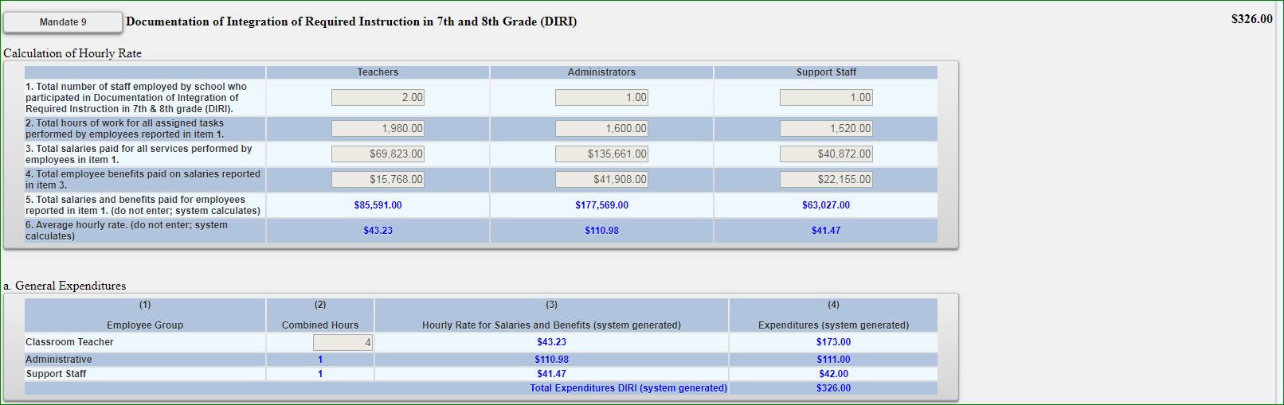
Mandate 9:DIRI Screen

Slide 55
Mandate 10:
High School Graduation Report (HSGR)
Calculation of Hourly Rate
Click on the <Mandate 10> button.
Enter data for line #1. Use the “tab” key to move to the next data entry field.
Continue entering data for lines 2-4.
Calculation of Expenditures
Use the “tab” key to move to the next field.
Enter the number of graduation candidates.
Click on the <save> button.
The system generates the Total Expenditures for HSGR.

Slide 56
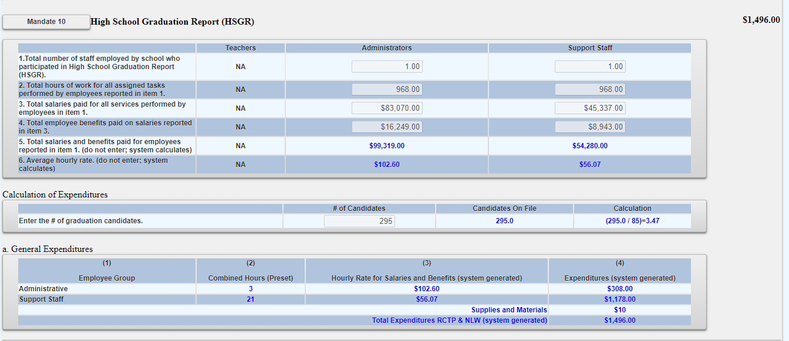
Mandate 10: HSGR SCREEN

Slide 57
Mandate 11: Grade Four Science Test (GFST)
Calculation of Hourly Rate
Enter data for line #1. Use the “tab” key to move to the next data entry field.
Continue entering data for lines 2-4. Do not use commas. When you get to the end of line 4, tab again.
If you enter a comma in the number or if you enter a character instead of a number in any of the fields, you will receive an error message saying “not a valid number” after you click on the “save” button. A caution sign will appear next to the field that caused the problem.

Slide 58
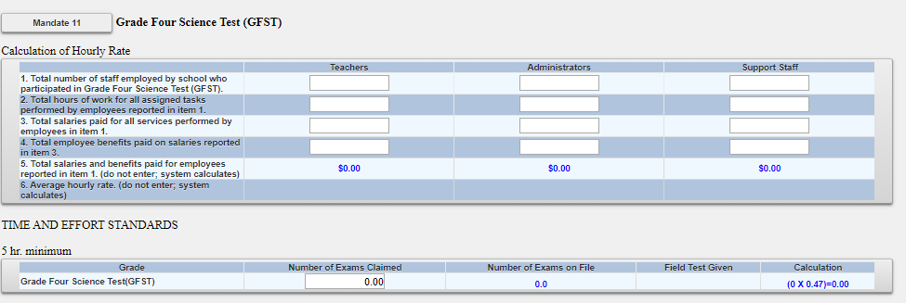
Mandate 11: Grade Four Science Test Screen

Slide 59
Mandate 11: GFST – Teacher Workshop Expenditures & Test Kits
Teacher Workshop Expenditures
Enter the total hours of allowable workshop training (the time that the teacher is out of the classroom). Use the “tab” key to move to the next field.
Enter the dollar amount of workshop fees. Use the “tab” key to move to the next field.
Test Kits
Enter number of students taking Grade Four Science Test
Enter number of test kits purchased (Note: each kit serves 30 pupils)
Click on the <Save Form> button.
The system generates the Total Expenditures and Total Workshop Expenditures and populates the Section I – Summary of Expenditures Screen.
Documentation must be maintained for all these expenditures.

Slide 60
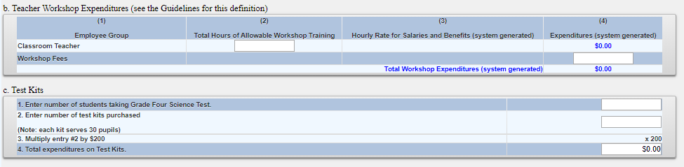
Mandate 11: GFST – Teacher Workshop Expenditures & Test Kits Screen

Slide 61
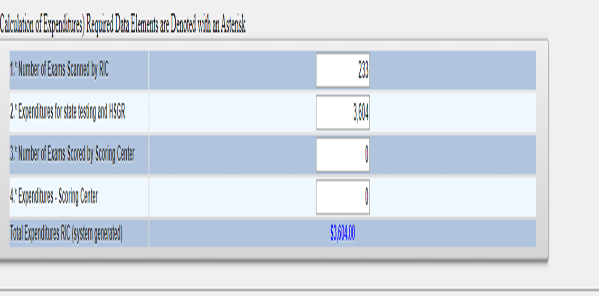
Mandate 19-RIC & Scoring Center Expenditures
An entry must be made in each field. If you only have the total expenditures for the scanning and scoring, enter zeroes in the other fields. If you leave the fields blank, a warning message will appear at the top of the screen.

Slide 62
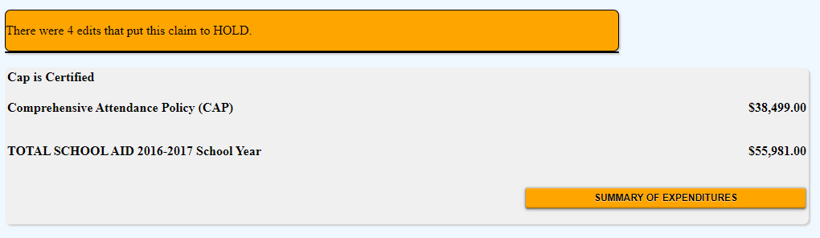
Hold Messages
Expanding summary of expenditures will show the user the reasons for the claim being in hold status.

Slide 63
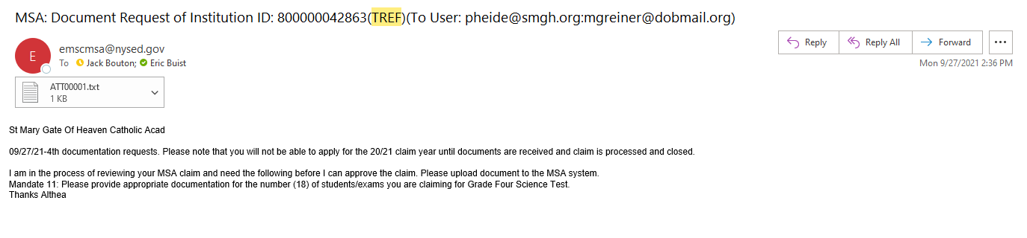
HOLD CLAIMS: UPLOAD DOCUMENT REQUEST
Schools with claims on hold can upload documents to the MSA system. The claims in hold status will be reviewed and the reviewer will send request to schools to provide documentation. The schools will be able to access their claims in the MSA system and upload requested document/s.
School will receive an e-mail for the request. The document request text will be in the e-mail.

Slide 64
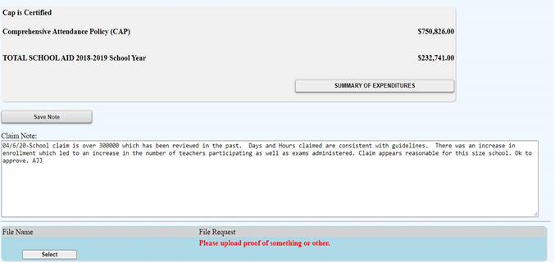
HOLD CLAIMS: UPLOAD DOCUMENT REQUEST (continued)
Schools can upload a file by selecting the SELECT button.

Slide 65
HOLD CLAIMS: UPLOAD DOCUMENT REQUEST (continued)
Select the CHOOSE FILE button to choose the file to upload, then hit the UPLOAD File button.

Slide 66
HOLD CLAIMS: UPLOAD DOCUMENT REQUEST (continued)
After the file is uploaded, there will be a link that both the schools and the reviewer can view and download.

Slide 67
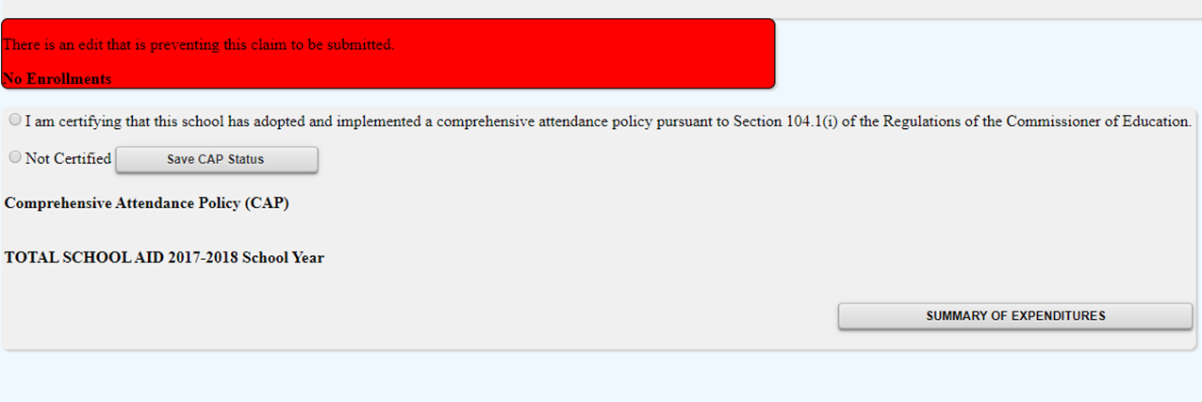
Submitting Claims:Warning Messages
Expanding summary of expenditures will show the user the warnings associated with the claim.

Slide 68
Submitting the MSA Claim
When all errors have been corrected, an <I agree> button will appear at the top of the Section I - Summary of Expenditures screen.
Read the certification statement--
I certify that the expenditures reported have been incurred and calculated in accordance with all applicable statutes, regulations and guidelines; that the claim is just and correct; and that the balance is due and owing.
Click on the <I agree> button.
Click on the <submit claim> button.
The system returns you to the “home” screen and displays the status of the claim.

Slide 69
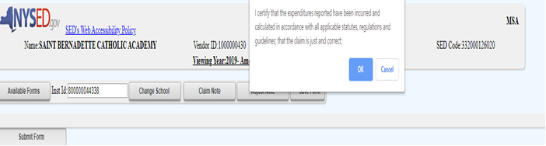
MSA Screen
Submitting the MSA Claim

Slide 70
Recordkeeping

Slide 71
Recordkeeping
It is very important that accurate documentation be kept by every school that claims mandated services. Even if your mandated services forms are completed by an independent contractor or diocesan office, the school is responsible for maintaining complete records.
Documentation must be maintained for a minimum of 7 years. Records must be available for inspection, monitoring and/or audit by the New York State Education Department and the Office of the State Comptroller.
It is recommended that each school create and maintain a mandated services documentation file for each school year that a claim is submitted. The following list identifies types of records that would be recommended documentation to include in the file or otherwise have readily available:

Slide 72
Recordkeeping (continued)
  Payroll records, for only those employees providing the mandated service, including allowable fringe benefits. If you use a payroll service, you will need to put copies of the applicable payroll records in the mandated services aid documentation file.
  Salary agreements and/or contracts for those employees providing mandated services.
  Time distribution records. You are required to maintain documentation to show that the employee actually provided services such as taking attendance or proctoring exams.

Slide 73
Recordkeeping (continued)
  Student enrollment records, class schedules or Attendance rosters.
  Invoices/cancelled checks or credit card receipts/statements for purchases made to perform mandated services.
  Any documentation that supports the information and calculations used to prepare any claim for nonpublic school aid.
  Schools must maintain inventory records for calculators and science test kits. Calculators are not a consumable product. The inventory control procedure should include a replenishment cycle to replace aging and broken calculators. Calculators may not be given permanently to students.
  Documentation of calculator purchase must be retained for monitoring and/or audit.

Slide 74
Recordkeeping (continued)
Documentation of the hours that form the basis for a standard workday must be maintained by the school.
Information gathering per Comptroller’s Audit.
Documentation must be maintained to show the basis of the calculation for the average hourly rates.
Schools must maintain inventory records of the science test kits and earth science test kits.
Evidence of number of students who graduated from high school such as student transcripts.
Records of student scores on State examinations such as the Individual Student Score Reports, Nonpublic Secondary Examination Report, Comprehensive Information Report.
Failure to maintain adequate supporting documentation may result in a disallowance or partial disallowance.
NOTE: This is not an all-inclusive list

Slide 75
SAVE/PRINT CLAIM AS PDF

Slide 76
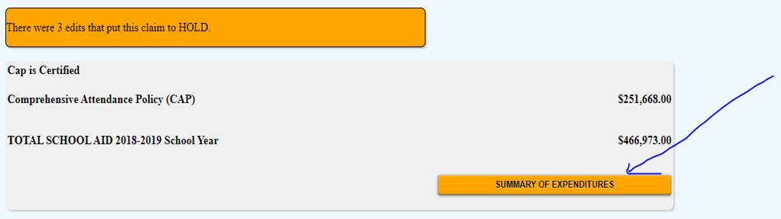
Select Summary of Expenditures at the top of the MSA claim form.

Slide 77
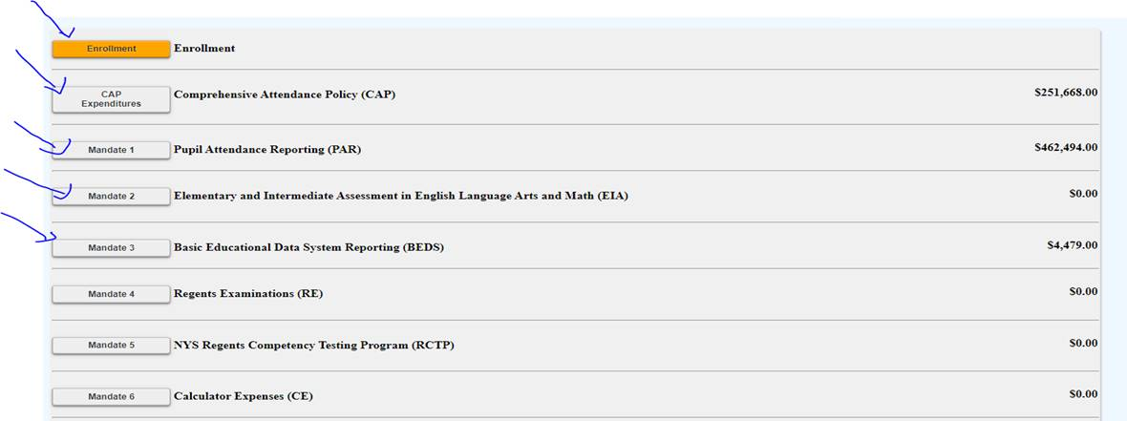
Select each mandate to expand and view detail explanation of each mandate.

Slide 78
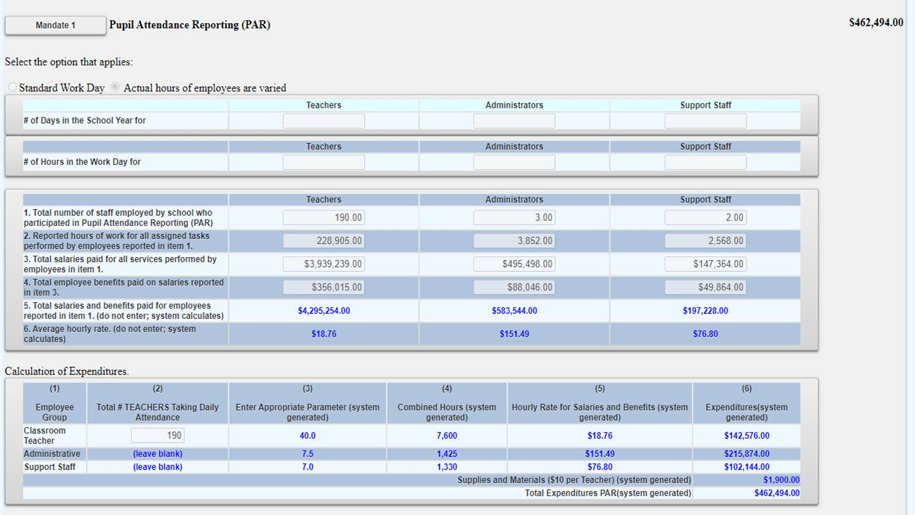
Sample of expanded mandate.

Slide 79
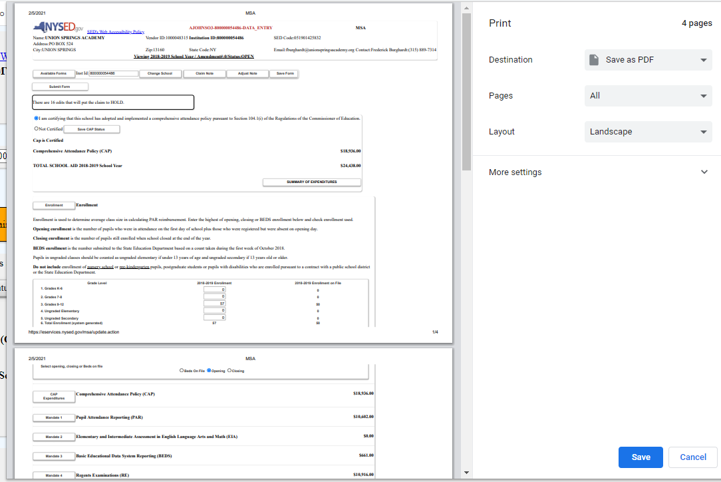
Select print feature and print or save document as PDF and print.

