Slide 1
GRADUATION MEASURES IN NEW YORK STATE
BREAKOUT ROOM SESSION
WINTER 2022
REGIONAL INFORMATION MEETING

Slide 2

INTRODUCTIONS
Your name and role
The group(s) and/or organization(s) you represent

Slide 3
NEW YORK STATE DIPLOMA REQUIREMENTS:
CREDIT DISTRIBUTION
 | Minimum number of credits
English | 4
Social Studies Distributed as follows: U.S. History (1) Global History and Geography (2) Participation in Government (½) Economics (½) | 4
Science Distributed as follows: Life Science (1) Physical Science (1) Life Science or Physical Science (1) | 3
Mathematics | 3
World Languages | 1
Visual Art, Music, Dance, and/or Theater | 1
Physical Education (participation each semester) | 2
Health | ½
Electives | 3 ½
Total | 22
Student Choice in Course Selection
In most disciplines, students choose the courses they want to take.
Required Courses
Health (½ credit required)
Global Studies and Geography (2 credits required)
United States History (1 credit required)
Participation in Government (½ credit required)
Economics (½ credit required)

Slide 4

MULTIPLE (+1) PATHWAYS
STEM
If students are not able to earn a passing score of 65 on Regents Exams, they may be eligible for:
Appeals
Safety Nets
Superintendent Determination
STEM: Science, Technology, Engineering, Math
CTE: Career & Technical Education
CDOS: Career Development and Occupational Studies
4
Humanities
All students must pass 4 required assessments (one in each discipline)
Arts
+1
World Languages
CTE
CDOS
Civic Readiness*
*In PILOT program now

Slide 5
TYPES OF DIPLOMAS
Local
Regents
Regents with Advanced Designation
22 units of credit
Used appeals, safety nets to meet assessment requirements
  OR Superintendent Determination of a Local Diploma
22 units of credit
Earned passing scores (65+)* on all required assessments (4 +1)
22 units of credit
Earned passing score (65+) on all required assessments (7 + 1)
  Additional exams required
    +2 math
    +1 science
Completed a sequence
* A student can appeal one Regents Exam score within 5 points of passing and still receive a Regents Diploma

Slide 6






Seal & Endorsement Options
Local Diploma
Regents Diploma
Regents with
Advanced Designation
Technical Endorsement
Technical Endorsement
Technical Endorsement
Seal of Civic Readiness
Seal of Civic Readiness
Seal of Civic Readiness
Seal of Biliteracy
Seal of Biliteracy
Honors Endorsement
Honors Endorsement
Mastery in Mathematics and/or Science

Slide 7


Exiting Credentials that are not diplomas
Skills and Achievement Commencement Credential
Career Development and Occupational Studies (CDOS) Commencement Credential

Slide 8
Phase 1: information gathering & learning regional meeting guiding questions
What do we want all students to know and to be able to do before they graduate?
How do we want all students to demonstrate such knowledge and skills, while capitalizing on their cultures, languages, and experiences?
How do you measure learning and achievement (as it pertains to the answers to #2 above) to ensure they are indicators of high school completion while enabling opportunities for all students to succeed?
How can measures of achievement accurately reflect the skills and knowledge of our special populations, such as students with disabilities and English language learners?
What course requirements or examinations will ensure that all students are prepared for college, careers, and civic engagement?

Slide 9
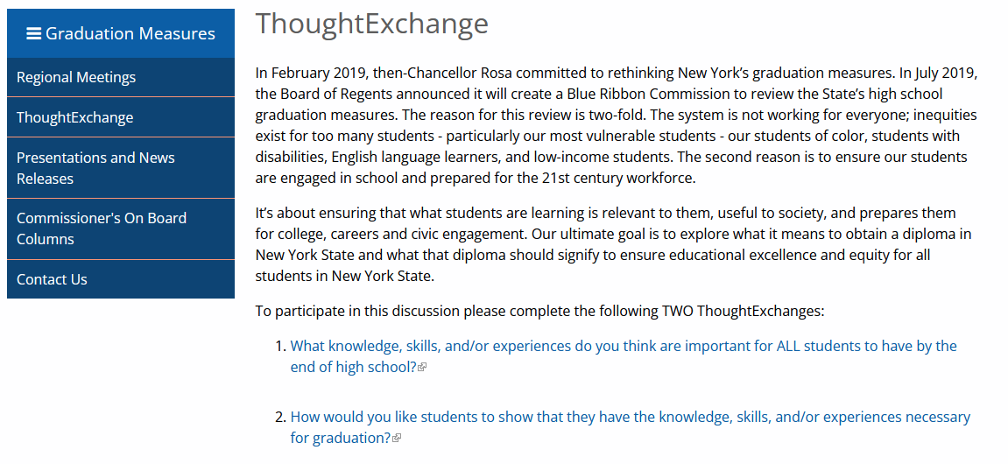
Share Your Thoughts
Continue the conversation on ThoughtExchange.

Slide 10

Our Key Takeaway

Slide 11
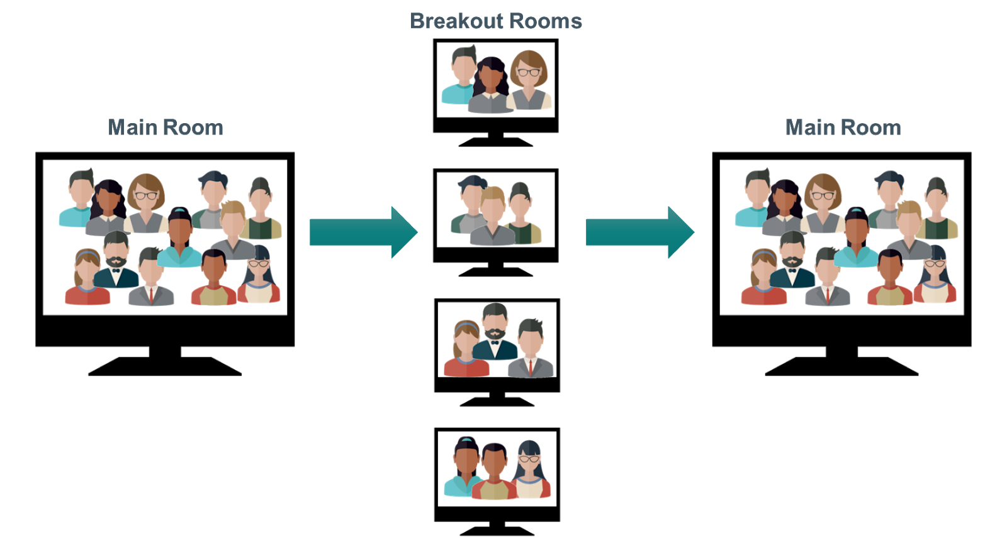
THANK YOU

