Slide 1
NYS Next Generation Mathematics Learning Standards
NYSED and S/CDN – Mathematics team
March 28, 2018
Notes:
WELCOME and INTRODUCTIONS

Slide 2
www.nysed.gov/next-generation-learning-standards
https://www.engageny.org/next-generation-learning-standards
Notes:
Before we begin, we would like you to access your pre-downloaded or pre-printed copy of the New York State Next Generation Mathematics Learning Standards.
If you have not yet downloaded or printed a copy, you can attempt to access it online, at either of these two web addresses, which are hyperlinked on this slide.
There is limited Wi-Fi access.

Slide 3
Notes:
We would like to draw attention to the NYSED.GOV page for a moment. The drop down menu on the left provides access to the Next Generation Mathematics Learning Standards and their supporting documents, and also provides access to the latest guidance document that has been released which is the New York State Next Generation ELA and Mathematics Learning Standards Implementation Timeline and Roadmap.

Slide 4
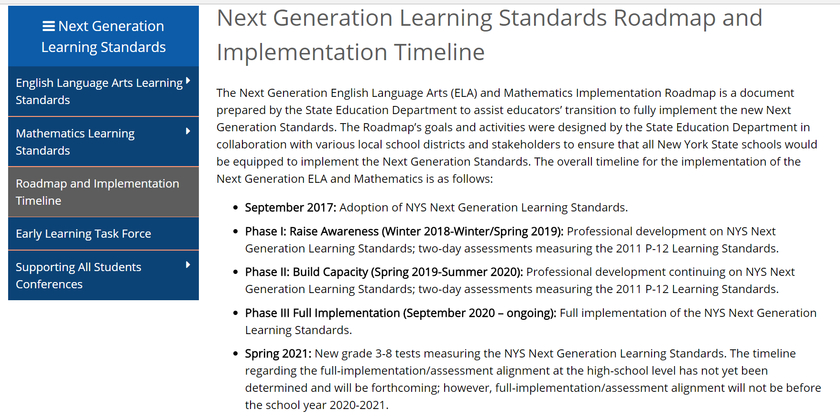
Notes:
The timeline highlights where we started with respect to the adoption of the NYS Next Generation Learning Standards this past September, and when full-implementation of these standards will take place, which is the 2020-2021 school year for grades PK-8 with state assessments for grades 3-8 aligned to the NYS Next Generation Learning Standards . Information regarding full-implementation/state assessment alignment at the high school level with be forthcoming, however will not take place prior to the school year 2020-2021.
As you can see, the transition period to full-implementation has been broken down into three phases (Raising awareness, building capacity and full-implementation) which are further detailed in the roadmap document.

Slide 5
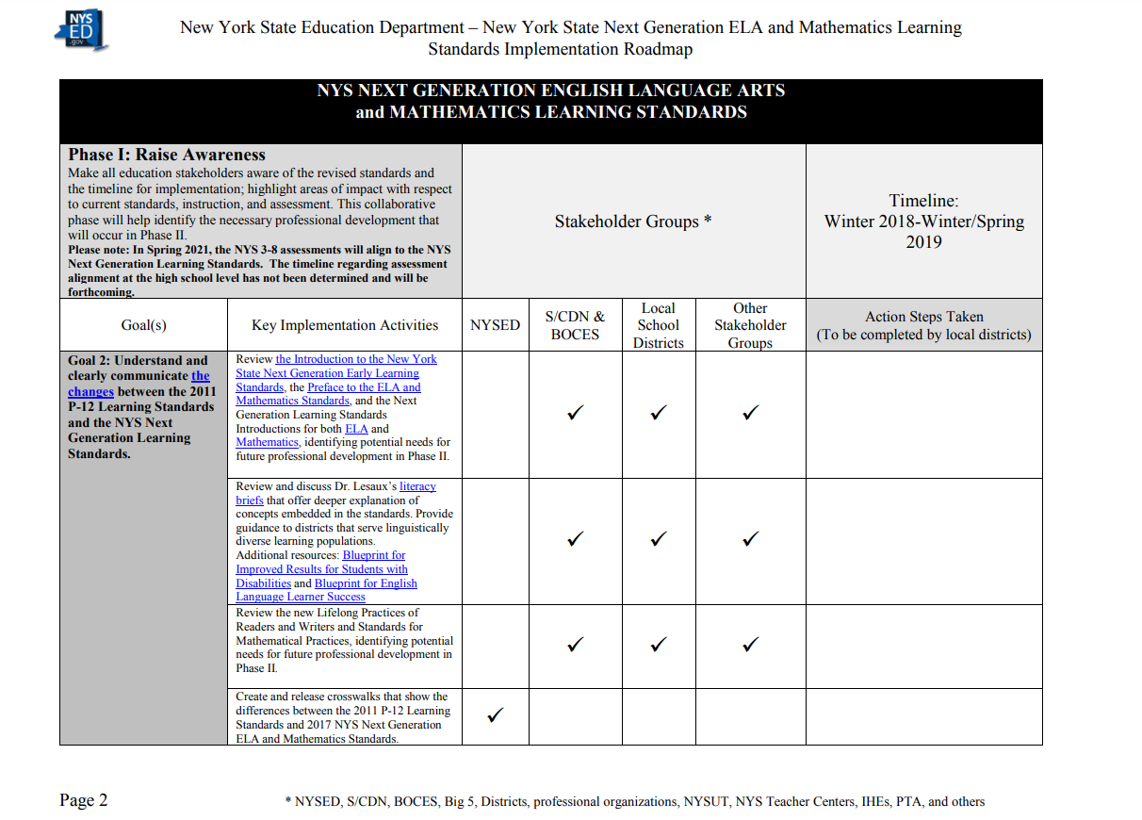
Notes:
The Implementation Roadmap is a document that has been prepared by the New York State Education Department and other educational stakeholders that provides a recommended plan containing shared goals and implementation activities spread out over the three phases that support the transition process to the NYS Next Generation Learning Standards for the New York State Education Department (NYSED), local school districts, and other key stakeholders. Districts are encouraged to tailor the suggested implementation activities to meet their specific district level needs during the transition process.
These three phases of this transition plan as stated earlier are: Raise Awareness, Capacity Building and Implementation.
The main purpose of Phase I : Raise Awareness is to ensure that all education stakeholders are aware of the revised standards, the timeline, and areas of impact with respect to current curriculum, instruction and assessment.
The main purpose of Phase II : Capacity Building is to identify and provide the professional development and guidance support necessary for districts based on needs coming off of Phase I to ensure successful full-implementation in Phase III.
Our focus for this session is to partake in one of the highlighted implementation activities for Phase I that involves reviewing the Introduction to our Next Generation Mathematics Learning Standards. The afternoon sessions will focus on other implementation activities such as how to best utilize the standards documents, the crosswalks and …

Slide 6
Notes:
What work needs to be done with respect to the role the standards play in the design and implementation of state assessments.

Slide 7
Notes:
The graphic design on the cover of the New York State Next Generation Mathematics Learning Standards is a visual representation of the domains of the Content Standards, highlighted to the left (pause and advance animation), as well as the Standards for Mathematical Practice, we see infused throughout P-12 continuum (pause and advance animation).
While the domains coherently build by grade level, we can see that students engage with each of the 8 Standards for Mathematical Practice throughout their mathematics learning experiences.

Slide 8
The Introduction: Why Start Here ?
Why is there a need for change ?
What is the relationship between standards, curriculum, instruction and assessment with regards to student learning ?
How do we make the standards accessible to our diverse learner populations ?
What is the importance of connecting the Content Standards to the Standards for Mathematical Practice, and what does this look like ?
Notes:
As we take a look at the table of contents, we may be eager to get into the various grade-level standards, but we would like to first invite you to reflect on the introduction.
The introductory material is essential as it provides us with key understandings about the new standards as well as the context for the revision.
The introduction can be used as a tool to generate discussion for districts as they begin to implement the Next Generation Mathematics Learning Standards into their mathematics programs.
Why is there a need for change?
What is the relationship between standards, curriculum, instruction and assessment with regards to student learning?
How do we make the standards accessible to our diverse learner populations?
How do we connect content to practice?
We will be walking through these pieces together.

Slide 9
The Opening Paragraph…
In 2015, New York State (NYS) began a process of review and revision of its current mathematics standards adopted in January of 2011. Through numerous phases of public comment, virtual and face-to-face meetings with committees consisting of NYS educators (Special Education, Bilingual Education and English as a New Language teachers), parents, curriculum specialists, school administrators, college professors, and experts in cognitive research, the New York State Next Generation Mathematics Learning Standards (2017) were developed. These revised standards reflect the collaborative efforts and expertise of all constituents involved.
Notes:
Let’s first look at the opening paragraph of the Introduction.
Key understanding: this was a collaborative effort.

Slide 10
2015 Legislative Requirement:
Standards re-evaluated with stakeholder input
NYSED conducted a survey (AIMHighNY) of teachers, parents and other stakeholders about the current standards. More than 10,500 people responded to the survey and provided over 750,000 pieces of feedback
Fall
2015
Notes:
If we take a closer look at the revision timeline, we gain a better understanding of how the revised standards meet the 2015 legislation requiring that standards be reevaluated with stakeholder input.
(advance animation)
Begining just over two years ago, in the Fall of 2015, NYSED began by conducting a survey of teachers, parents, and other stakeholders about the current standards. There were more than 10,500 respondents providing over 750,000 pieces of feedback.

Slide 11
2015 Legislative Requirement:
Standards re-evaluated with stakeholder input
NYSED conducted a survey (AIMHighNY) of teachers, parents and other stakeholders about the current standards. More than 10,500 people responded to the survey and provided over 750,000 pieces of feedback
NYSED formed the Mathematics Learning Standards Review committee comprised of more than 68 educators and key stakeholders across the state that met for a week in Albany during July
Fall
2015
April 2016
Notes:
The following spring, April of 2016, the New York State Education Department formed a committee which included more than 68 educators and key stakeholders. This committee came together to meet for a full week in July to begin the Mathematics Learning Standards Review process.

Slide 12
Standards Review Committee
BOCES/SCDN
NYC DOE
The Math and ELA Leadership Teams plan the logistics for the standards review process including developing materials and providing guidance for the Standards Review Committees.
Standards Review Leadership Team
NYSUT
NYSED
Grade Band Committees
Facilitator: Content Advisory Member
Both Math and ELA Committees are split into grade band subcommittees; and into course subcommittees for high school math.
Teachers: P-12, ENL, Special Education
Administrators: Building level, District level, Instructional Coaches
College Professors: SUNY, CUNY, Community Colleges
Parents: Urban, Suburban, rural, ENL, SWD
Notes:
For mathematics, the 68 member committee was broken up into seven subcommittee groups (Prekindergarten-Grade 2, Grades 3-5, Grades 6-8, Algebra I, Algebra II, Geometry and Plus Standards) that were comprised of NYS teachers, parents, curriculum specialists, school administrators and college professors.
At the elementary/middle level there were 2 grade level teachers for each grade level within the band, as well as a special education teacher, bilingual teacher, and 2 administrators . There was parent representation in each band as well. At the high school level, there were 3 or 4 classroom teachers in each band. A special education teacher was in the Algebra I group, and parent representation was in Algebra I, II and Geometry. We had an additional math coach, bilingual teacher, administrator, special education teacher and a higher education professor float amongst high school groups to aid accordingly.
For English Language Arts, the grade band committees were broken up into grades P-2, 3-5, 6-8, 9-12, and Literacy 6-12. P-12 classroom teachers, parents, curriculum specialists, school librarians, and college professors were all involved in the review and revisions. Each grade-band room was facilitated by a New York State educator, including a superintendent, two middle school teachers, and two high school teachers.

Slide 13
2015 Legislative Requirement:
Standards re-evaluated with stakeholder input
NYSED formed the Mathematics Learning Standards Review committee comprised of more than 70 educators and key stakeholders across the state that met for a week in Albany during July
NYSED released the new draft learning standards for public comment and received more than 4,100 comments
Fall
2015
April 2016
Sept. 2016
Notes:
By September, the Education Department released a new draft of the mathematics learning standards, and once again sought public comment, resulting in an additional 4,100 comments.

Slide 14
2015 Legislative Requirement:
Standards re-evaluated with stakeholder input
NYSED released the new draft learning standards for public comment and received more than 4,100 comments
The Mathematics Content Advisory Panel and other committees reviewed every learning standard, making any necessary modifications based on professional expertise as well as input gathered from public comment and child development experts
Fall
2015
April 2016
Sept. 2016
Dec. 2016 – April 2017
Notes:
The Mathematics Content Advisory Panel and other committees reviewed each standard, and made additional necessary modifications based upon professional expertise as well as input generated from public comment and various child development experts.
*You will be able to hear more from the New York State Early Learning Task force if you choose to attend the afternoon breakout session (Early Learning and the Standards).

Slide 15
2015 Legislative Requirement:
Standards re-evaluated with stakeholder input
The Mathematics Content Advisory Panel and other committees reviewed every learning standard, making any necessary modifications based on professional expertise as well as input gathered from public comment and child development experts
Revised learning standards presented to the Board of Regents
Fall
2015
April 2016
Sept. 2016
Dec. 2016 – April 2017
May 2017
Notes:
In May of 2017, the revised learning standards were presented to the New York State Board of Regents.

Slide 16
2015 Legislative Requirement:
Standards re-evaluated with stakeholder input
Next Generation Mathematics Learning Standards approved by the Board of Regents
Revised learning standards presented to the Board of Regents
Fall
2015
April 2016
Sept. 2016
Dec. 2016 – April 2017
May 2017
Sept. 2017
Notes:
In September 2017, the Next Generation Mathematics Learning Standards were approved by the New York State Board of Regents.

Slide 17
The New York State Next Generation Mathematics Learning Standards (2017) reflect revisions, additions, vertical movement, and clarifications to the current mathematics standards. The Standards are defined as the knowledge, skills and understanding that individuals can and do habitually demonstrate over time because of instruction and learning experiences.
Standards
Notes:
In the second paragraph of the Introduction, we come across four terms: Standards, Curriculum, Instruction, and Assessment.
How do they relate?
How are they different?
Let’s dive in.
The NYS Next Generation Mathematics Learning Standards were built from the revisions, additions, vertical movement of, and clarification to the NYS P-12 CCLS for mathematics which will be in effect through the school year 2019-2020.
We can agree that standards are the knowledge, skills, and understanding that we want our learners to be able to do so that they are successful in their post-secondary path of their choosing. (advance animation)

Slide 18
These mathematics standards, collectively, are focused and cohesive—designed to support student access to the knowledge and understanding of the mathematical concepts that are necessary to function in a world very dependent upon the application of mathematics, while providing educators the opportunity to devise innovative programs to support this endeavor..
Instruction
Curriculum
Notes:
These standards, which are both focused and cohesive, are intended to support student access to that knowledge and understanding, which we refer to as instruction (advance animation). The standards also inform educators as they devise innovative programs in the development of curriculum (advance animation).

Slide 19
As with any set of standards, they need to be rigorous; they need to demand a balance of conceptual understanding, procedural fluency and application and represent a significant level of achievement in mathematics that will enable students to successfully transition to post-secondary education and the workforce.
Assessment
Notes:
We find that the standards are both rigorous and balanced in conceptual understanding, procedural fluency and application.
They represent the level of achievement in mathematics that will allow students to successfully transition to either post-secondary education or workforce opportunities.
We determine student’s level of achievement through various assessments (advance animation).

Slide 20
Instruction
Assessment
Curriculum
Standards
How do these four components work together to support student learning?
Notes:
These four components: standards, curriculum, instruction, and assessment, cannot stand alone.
Collaboratively consider how these four components work together to support student learning.
Using one piece of blank paper provided at each table, develop a visual that represents the relationship between standards, curriculum, instruction, and assessment AND THE IMPACT ON STUDENT LEARNING.
[Set the timer for 10 minutes.]
[Facilitators circulate the room. With three minutes remaining, begin to identify 3-5 teams to share at the document camera – have teams who are presenting come to the front to share their visual.]

Slide 21
Context for Revision of the NYS Next Generation Mathematics Learning Standards (2017)
Changing expectations for mathematics achievement
Increasingly Diverse Learner Populations
Students with Disabilities and the Standards
Understanding the NYS Next Generation Mathematics Learning Standards (2017)
Notes:
Let's go back to the introduction of the standards document, where we are provided with some insight into the context for the revision of the New York State Next Generation Mathematics Learning Standards.
We are reminded of the ever changing expectations for mathematics achievement, the increasing diversity of learner populations in our classrooms, and the necessity of including our students with disabilities.
REVISIT THIS STATEMENT: There is also additional information providing a deeper understanding of the NYS Next Generation Mathematics Learning Standards.

Slide 22
Round Robin
Each team of 4 will be provided a set of task cards to read
While reading your assigned task card, answer the following:
What is the most important takeaway?
How do you relate your takeaway to standards, curriculum, instruction, and/or assessment?
Notes:
To deepen the understanding of the first 4 sections of the Introduction, we will engage in a round robin jigsaw task.
Teams of 4 will be provided a set of task cards.
[2 sets of cards per table. If there are more than 8 at a table, they can share cards.]
As you read your task card, consider what the biggest take away is, and how you envision the main message will impact future planning of standards, curriculum, instruction, and assessment.
[Set the timer for 5 minutes]
[After timer]
Share out within your team of 4.
Each person gets 30 seconds for a total of 2 minutes.

Slide 23
HIGH CEILING
What types of learning experiences support these changing expectations?
LOW FLOOR
Notes:
What types of learning experiences support these changing expectations?
To make the content standards more accessible to ALL STUDENTS, we can use tasks that have a low floor and a high ceiling (advance animation).
Today you will engage in a task that comes from Jo Boaler and YouCubed.org.(advance animation)

Slide 24
Describe how the shapes are growing.
Case 1
Case 2
Case 3
Notes:
Ask the participants to look at the cases and think about how the shapes are growing. Each participant should be provided with a “squares upon squares” activity sheet. Each participant should write down the description of how they think the shapes are growing on their sheet (3-5 minutes).

Slide 25
Continuous Round Table
Pass your paper clockwise
Read your teammates description
Write at least 1 comment reflecting on their description
Repeat process until you receive your paper back
Notes:
Format for Continuous Round Table
30 seconds per paper, for a total length of time, 2 minutes.
Last 30 seconds will be used for each individual to read the groups’ comments about their description.
Each table will then have 2 minutes for a table talk to discuss how this continuous round table structure is a powerful tool that can be used in the classroom.

Slide 26
That’s Me!
Which method do you identify with?
We’ll share some common strategies. If you hear one of yours, stand up and say, “That’s me!”
Notes:
How did you engage in this task?
We will share with you some common ways students see this pattern grow.
If you hear one that you used, stand up and say "that's me!"

Slide 27
Raindrop Method
Notes:
One common way to visualize this pattern is the raindrop method.
The learner sees the square tiles falling down from above like raindrops.
If you used the raindrop method, stand up and say, "That's me."

Slide 28
Bowling Alley Method
Notes:
Another way to visualize this pattern growing is the bowling alley method.
The learner sees the rows coming up from the bottom like bowling pins.
If you used the bowling alley method, stand up and say, That's me!"

Slide 29
Wayne’s World
Notes:
Here's a throwback to 1992.
In the Wayne's World method, the learner sees the squares going up like the stairway to heaven.....access denied.
If you used the Wayne's World staircase method, stand up and say, "That's me."

Slide 30
Red Sea Method
Notes:
Others might see the pattern grow like the parting of the Red Sea.
The shape splits itself and fills in the middle.
If you used the red sea method, stand up and say, "That's me!"

Slide 31
Square Method
Notes:
Another way to see the pattern grow is the square method.
The learner moves the tiles to create a square.
If you used the square method, stand up and say, "That's me!"
(2 minutes total).

Slide 32
Team Collaboration
What would the 6th case look like? How many total blocks would it have? How do you know?
How many blocks would there be in the n^{th} case? How do you know?
Notes:
Allow 10 minutes for collaboration (may need more time) to close out task.
Have 1-2 teams share out their solutions.

Slide 33
How Do The NYS Next Generation Mathematics Learning Standards Support These Changing Expectations?
Connecting Content to Practice
Standards for Mathematical Content
NY-3.OA.9
NY-4.OA.5
NY-5.OA.3
NY-6.EE.1
NY-6.EE.2
NY-6.G.5
AI-F.BF.1a
Notes:
After completion of this task, let’s reflect again on the cover page and introduction which speaks to the content standards as they build procedural and conceptual understanding.
In the shapes task we engaged in:
Low Floor – High Ceiling tasks are intended to provide access to appropriate grade level tasks with entry points for students who are not on grade level. While the end goal of this task is an Algebra I standard, working with sequences, several other standards are embedded.
Time will be provided in one of the afternoon segments to dig into the grade-level content standards.

Slide 34
How Do The NYS Next Generation Mathematics Learning Standards Support These Changing Expectations?
Connecting Content to Practice
Standards for Mathematical
Content
Standards for Mathematical
Standards for Mathematical
Practice
Content & Practice
What are the Standards for Mathematical Practice?
Notes:
True understanding of the content standards does not occur until there is a merging of the content standards and the Standards for Mathematical Practice.
Let’s take some time to familiarize ourselves or review the Standards for Mathematical Practice.

Slide 35
Standards for Mathematical Practice
Make sense of problems and persevere in solving them
Reason abstractly and quantitatively
Construct viable arguments and critique the reasoning of others
Model with mathematics
Use appropriate tools strategically
Attend to precision
Look for and make use of structure
Look for and express regularity in repeated reasoning
Notes:
The Standards for Mathematical Practice were developed prior to the adoption of the Common Core Learning Standards.
They were based upon the NCTM math strands.
The Standards for Mathematical Practice can be thought of as “habits of mind”, or what we should see students doing as part of their natural routine in math classroom.
[Hand out Standard for Mathematical Practices sheet.]
The Standards for Mathematical Practice are outlined in more detail on pages 7 and 8 in the Next Generation Mathematics Learning Standards document.

Slide 36
Table Talk
Each table has been assigned a number
At your table fill in the following sentence frame:
SMP ________ Looked like _________ and Sounded like ____________ during this activity.
Notes:
You’ve experienced an open-ended task and utilized the Standards for Mathematical Practice while engaging in the task.
Each table has been assigned a number that corresponds to one of the eight Standards for Mathematical Practice.
Using that number, at your table, fill in the following sentence frame:

Slide 37
Work as an impactful and motivated data scientist developing technical solutions to complex problems. Analyze data to identify trends and support the development of mission-related analyses, using techniques such as econometrics regression analysis, cluster analysis, Bayesian analysis, discriminant analysis, sentiment analysis, support vector machines, survival analysis, and other modes of machine learning. Contribute to the development of new concepts and experiments, translate these ideas into executable action plans, and communicate these plans to a diverse client base. Create mathematical models and programs used to test solutions to complex systems. Work within cross-functional teams to engage the client, comprehend the client's problems, develop strategic analytical products, support requirements analysis, including process and systems analyses, support the development of business and system architectures, and define actionable system requirements.
Source: https://www.clearancejobs.com/jobs/2618108/data-scientist-junior-in-washington-dc-at-booz-allen-hamilton
Notes:
This is a job description. Notice what is highlighted, is there a common theme with what we have been able to discuss today?
Perspective employers want their employees to have the total package; not only content, but the ability to put that content into practice as well.

Slide 38
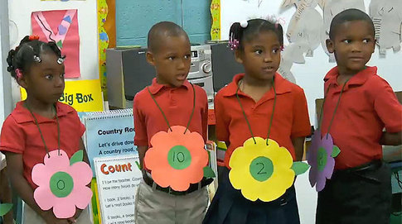
What do the Standards for Mathematical Practice Look and Sound Like in Kindergarten?
https://www.teachingchannel.org/videos/pre-k-math-lesson

Slide 39
NYSED Office of Curriculum and Instruction
518-474-5922
John Svendsen (NYSED Math Associate) John.Svendsen@nysed.gov
Sue Brockley (NYSED Math Associate) Susan.Brockley@nysed.gov
Boards of Cooperative Educational Services (BOCES)
Staff and Curriculum Development Network
(S/CDN)
NYSCDN.COM Whose mission is to strengthen the capacity of school districts to promote successful attainment of the New York State Standards by all students.
Notes:
NYSED Contact Information

Slide 40
Standards Review Committee
BOCES/SCDN
NYC DOE
The Math and ELA Leadership Teams plan the logistics for the standards review process including developing materials and providing guidance for the Standards Review Committees.
Standards Review Leadership Team
NYSUT
NYSED
Grade Band Committees
Facilitator: Content Advisory Member
Both Math and ELA Committees are split into grade band subcommittees; and into course subcommittees for high school math.
Teachers: P-12, ENL, Special Education
Administrators: Building level, District level, Instructional Coaches
College Professors: SUNY, CUNY, Community Colleges
Back
Parents: Urban, Suburban, rural, ENL, SWD
Notes:
For mathematics, the 68 member committee was broken up into seven subcommittee groups (Prekindergarten-Grade 2, Grades 3-5, Grades 6-8, Algebra I, Algebra II, Geometry and Plus Standards) that were comprised of NYS teachers, parents, curriculum specialists, school administrators and college professors.
At the elementary/middle level there were 2 grade level teachers for each grade level within the band, as well as a special education teacher, bilingual teacher, and 2 administrators . There was parent representation in each band as well. At the high school level, there were 3 or 4 classroom teachers in each band. A special education teacher was in the Algebra I group, and parent representation was in Algebra I, II and Geometry. We had an additional math coach, bilingual teacher, administrator, special education teacher and a higher education professor float amongst high school groups to aid accordingly.
For English Language Arts, the grade band committees were broken up into grades P-2, 3-5, 6-8, 9-12, and Literacy 6-12. P-12 classroom teachers, parents, curriculum specialists, school librarians, and college professors were all involved in the review and revisions. Each grade-band room was facilitated by a New York State educator, including a superintendent, two middle school teachers, and two high school teachers.

